Slide 1
THE CORES & CO
THINGS TO DISMOUNT DURING THE CIVIL ENGINEERING WORK OF CORES
POSSIBLE IMPROVEMENT (TO AVOID DISMONTING OR REDUCED COST IMPACT)

Slide 2
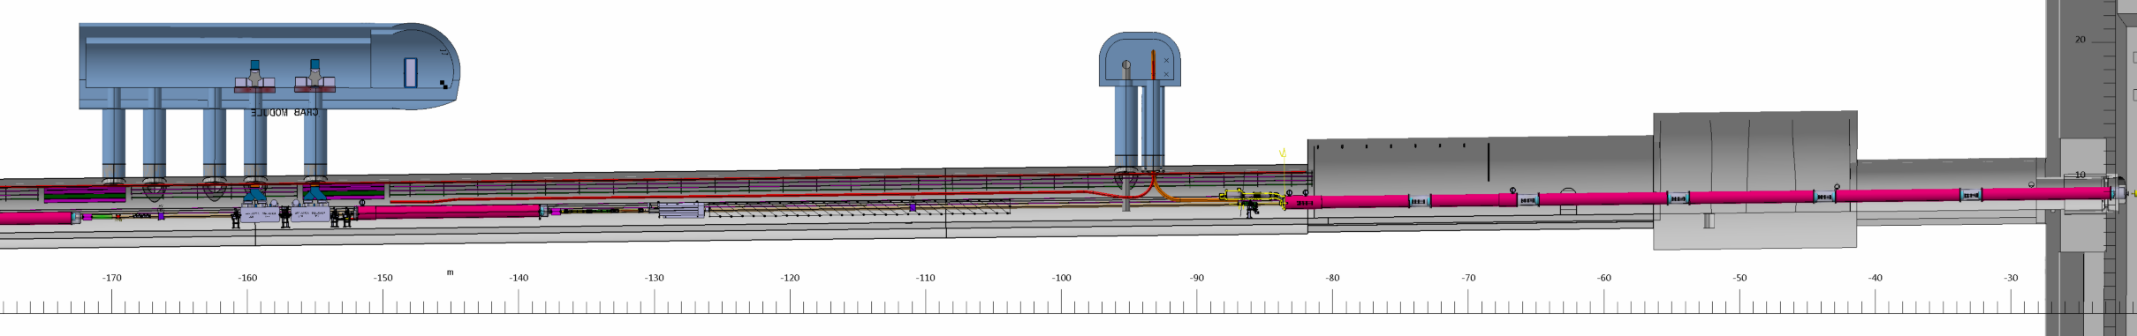
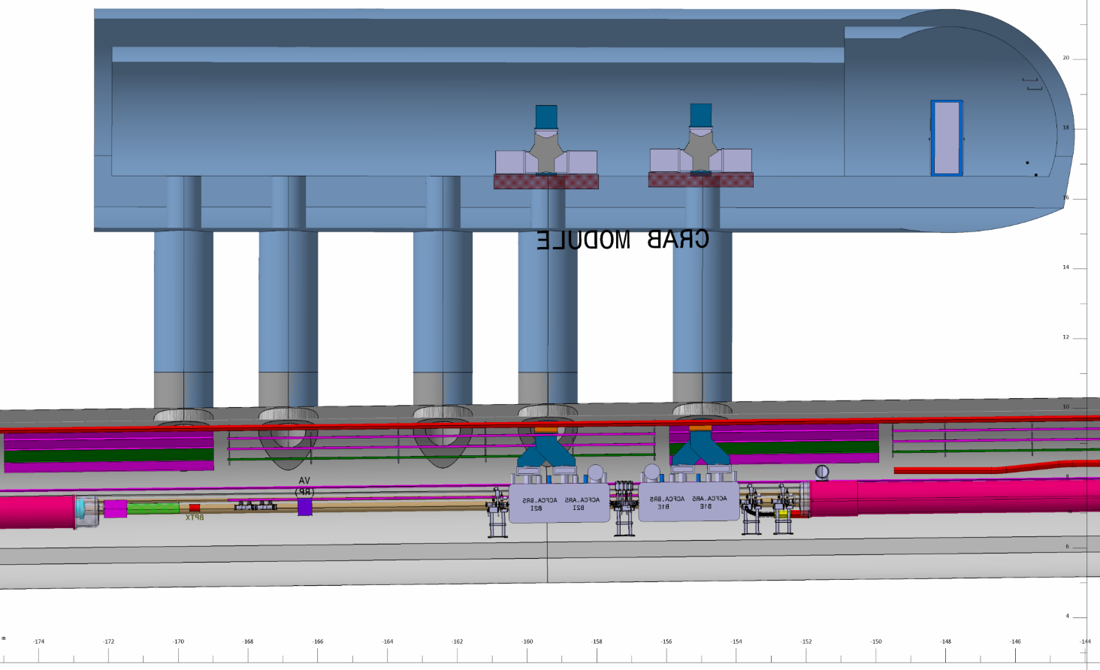
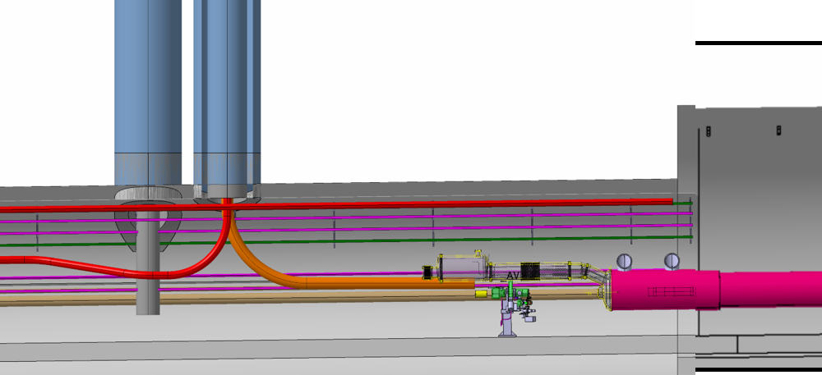
P1L
UL CORES ZONE
2 DISMONTING ZONE RI132 TUNNEL
UA CORES ZONE
UA13
UL13
6
55.5
10
UJ13
RI132
93,25 /IP 1
154.95 /IP 1
UL CORES ZONE
UA CORES ZONE
11.9
81.4 (IP1)
55.5
10
6
10
UJ13

Slide 3
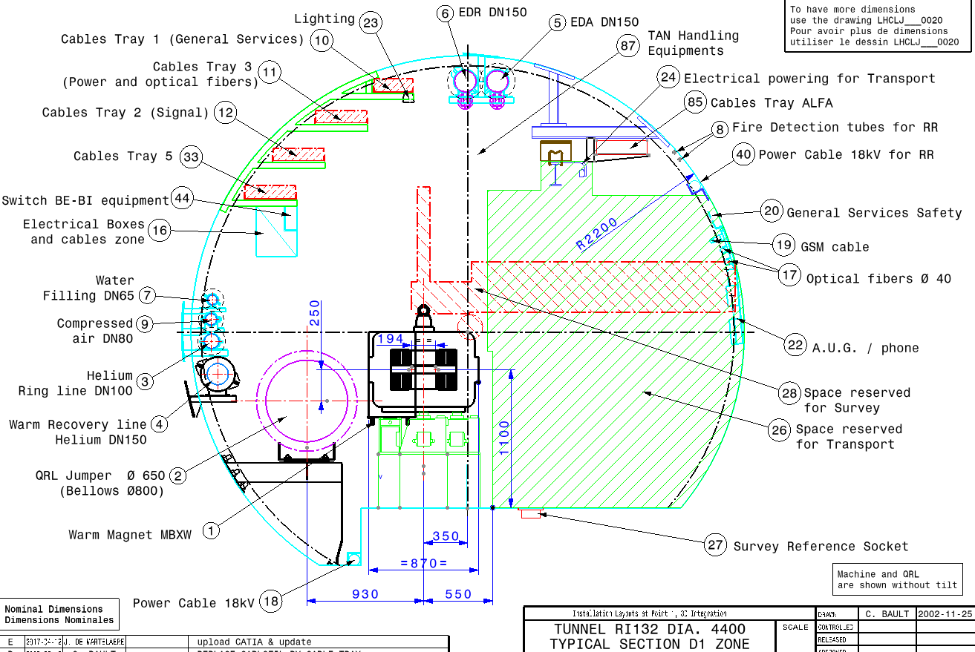
SERVICES IMPACTED BY DRILLING CORES

Slide 4
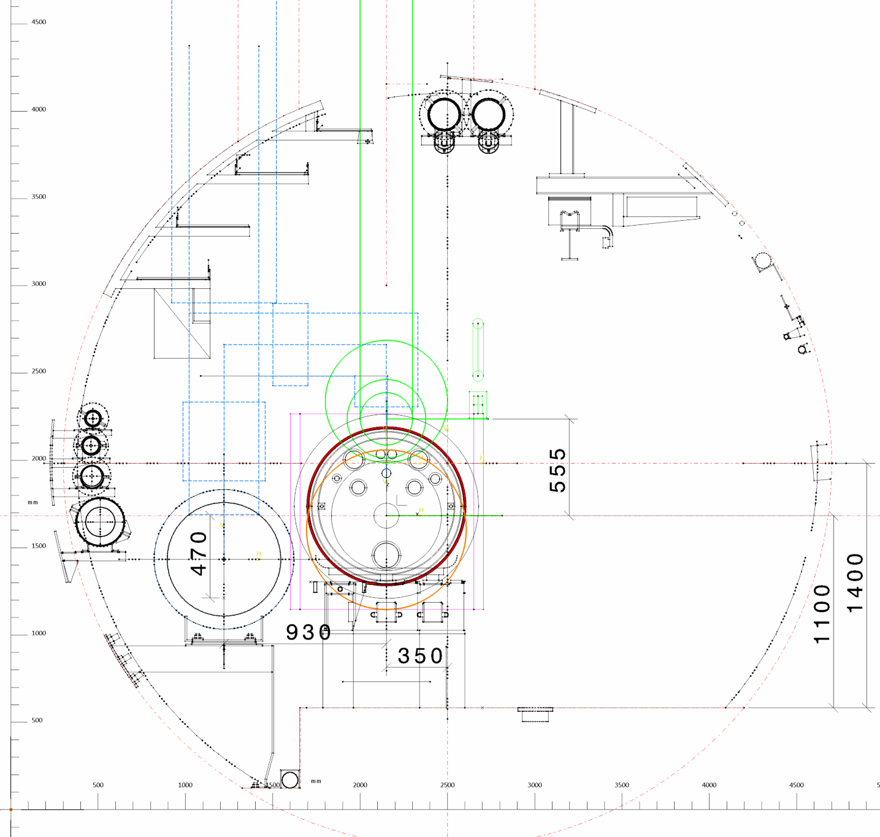
Ø1.7
IMPACTED ZONE RI132 TUNNEL
Pipes to cut locally
sclink
CUT ≈ 5 m : start at 91 m end at 96 m
Question :
peut-on laisser la tuyauterie?
peut-on laisser la qrl ?
Limite de la zone de travaux souhaité
SCLINK CORE ( -93.25 )

Slide 5

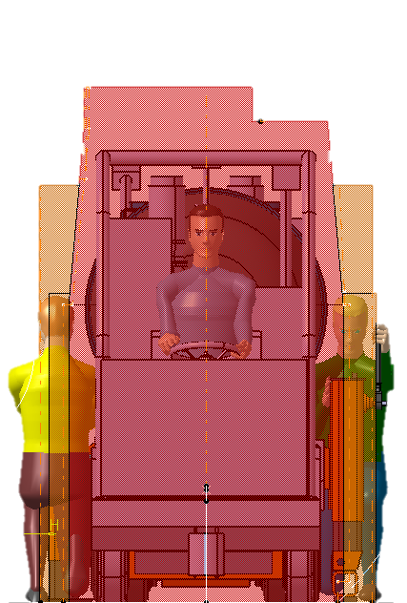
IMPACTED ZONE RI132 TUNNEL
Ø1.7
QRL
Question :
peut-on laisser la tuyauterie?
peut-on laisser la qrl ?
Limite de la zone de travaux souhaité
Systeme de protection a prevoir ?
QRL CORE ( -95.25 )

Slide 6
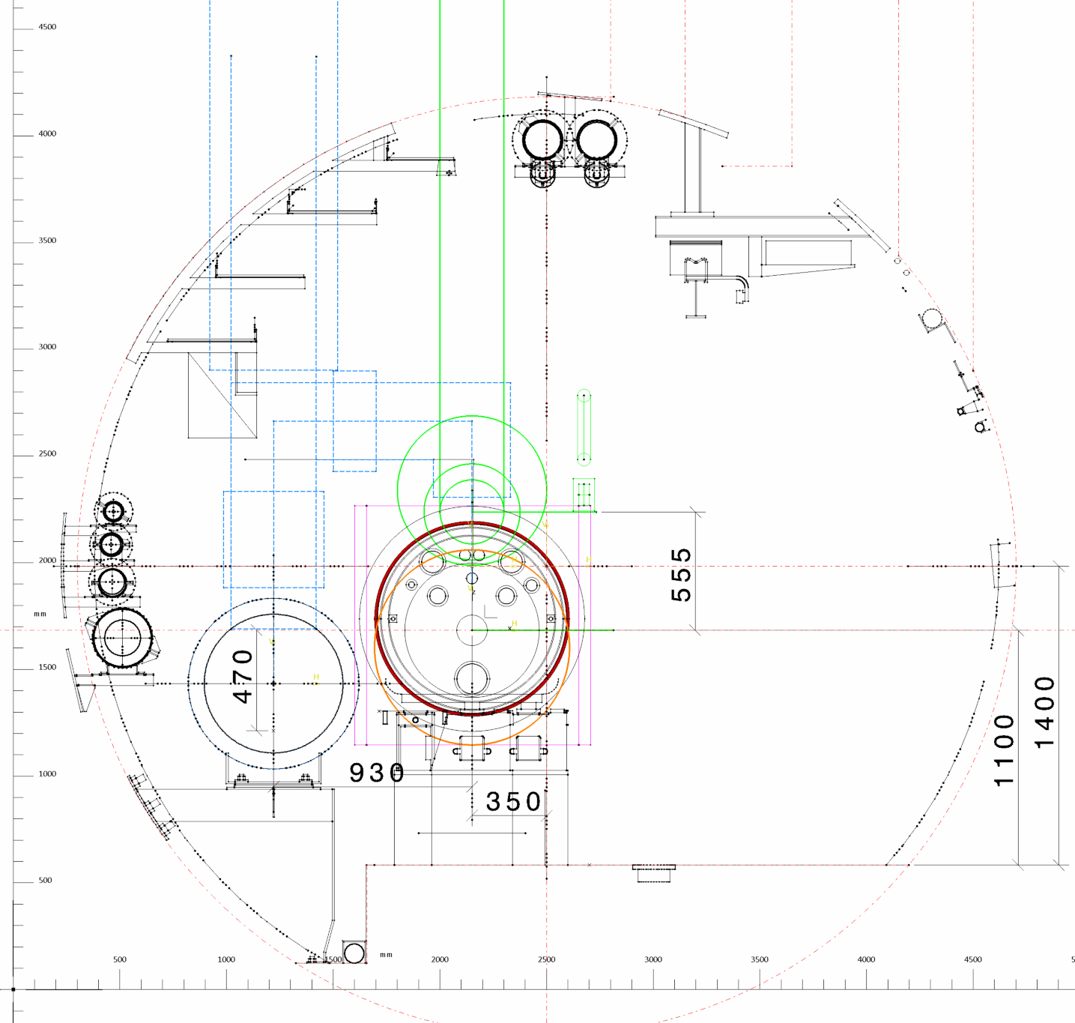
IMPACTED ZONE RI132 TUNNEL
Ø1.7
Limite de la zone de travaux souhaité
2000
1.7
SERVICE CORE (-94.95)

Slide 7
THINGS TO DISMOUNT DURING THE CIVIL ENGEENIRING WORK OF CORE
TO DISMOUNT (OR CUT) :
Machine side (left)
All cables
ALL cables trays (CT) +
Support structure of CT
Helium ring line
Warm recovery line
Quench line
Compressed air pipe
EDR & EDA
QRL !
Transport side (right)
Transport rail (≈ 3m) &
Rail Support
Power 18kva cable
Safety cables & support (if present)
GSM cable
Optic fibber
Fire detection tube
Cables trays of experiment ALFA
Cables trays attached to support rail

Slide 8
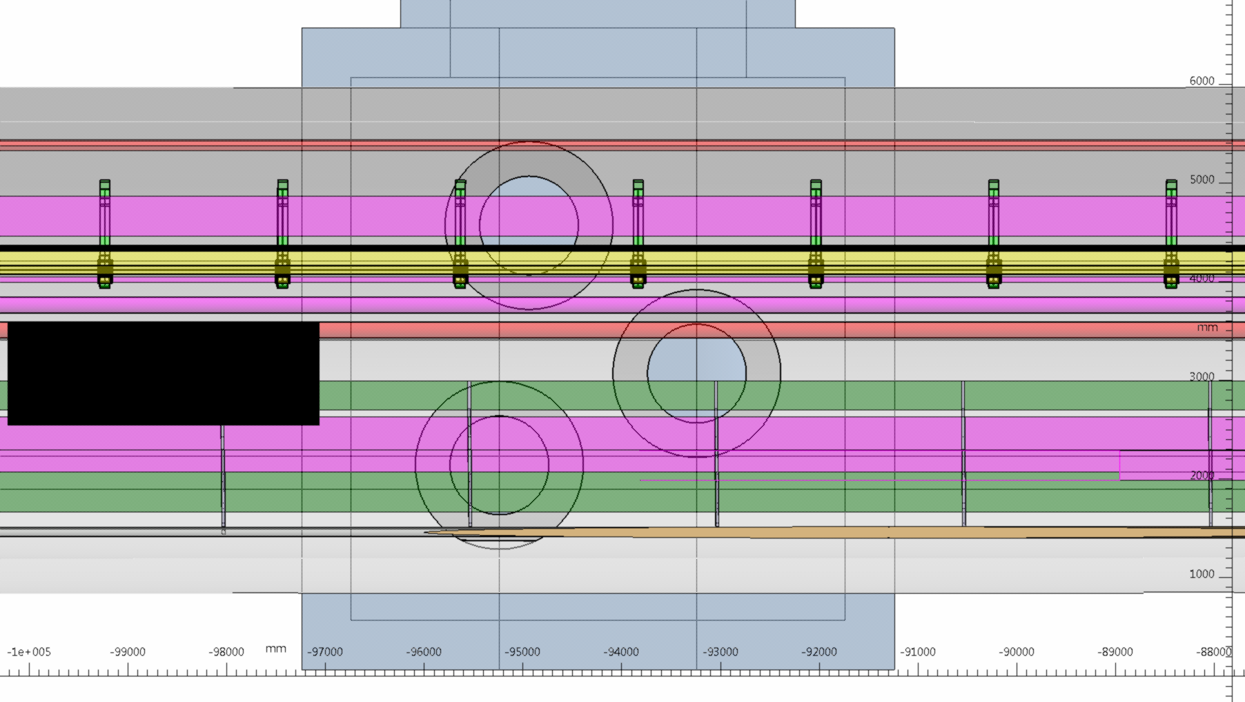
1.7
1
2
CUT rail
Ø 1 M
Ø 1.7 M
8
CUT PIPES
ADD VALVES?
93,25 M TO IP
2

Slide 9
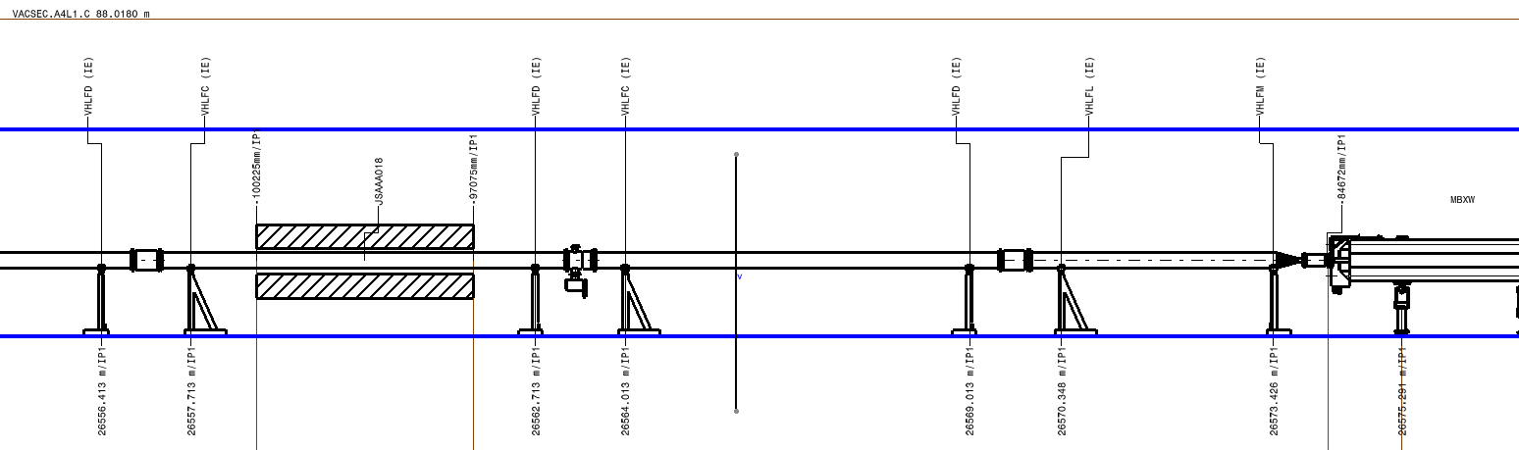
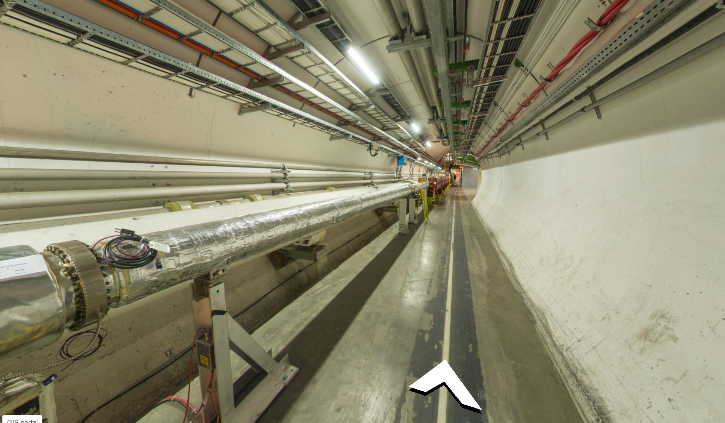
LHC LAYOUT
QXL
CABLES
SCLINK

Slide 10
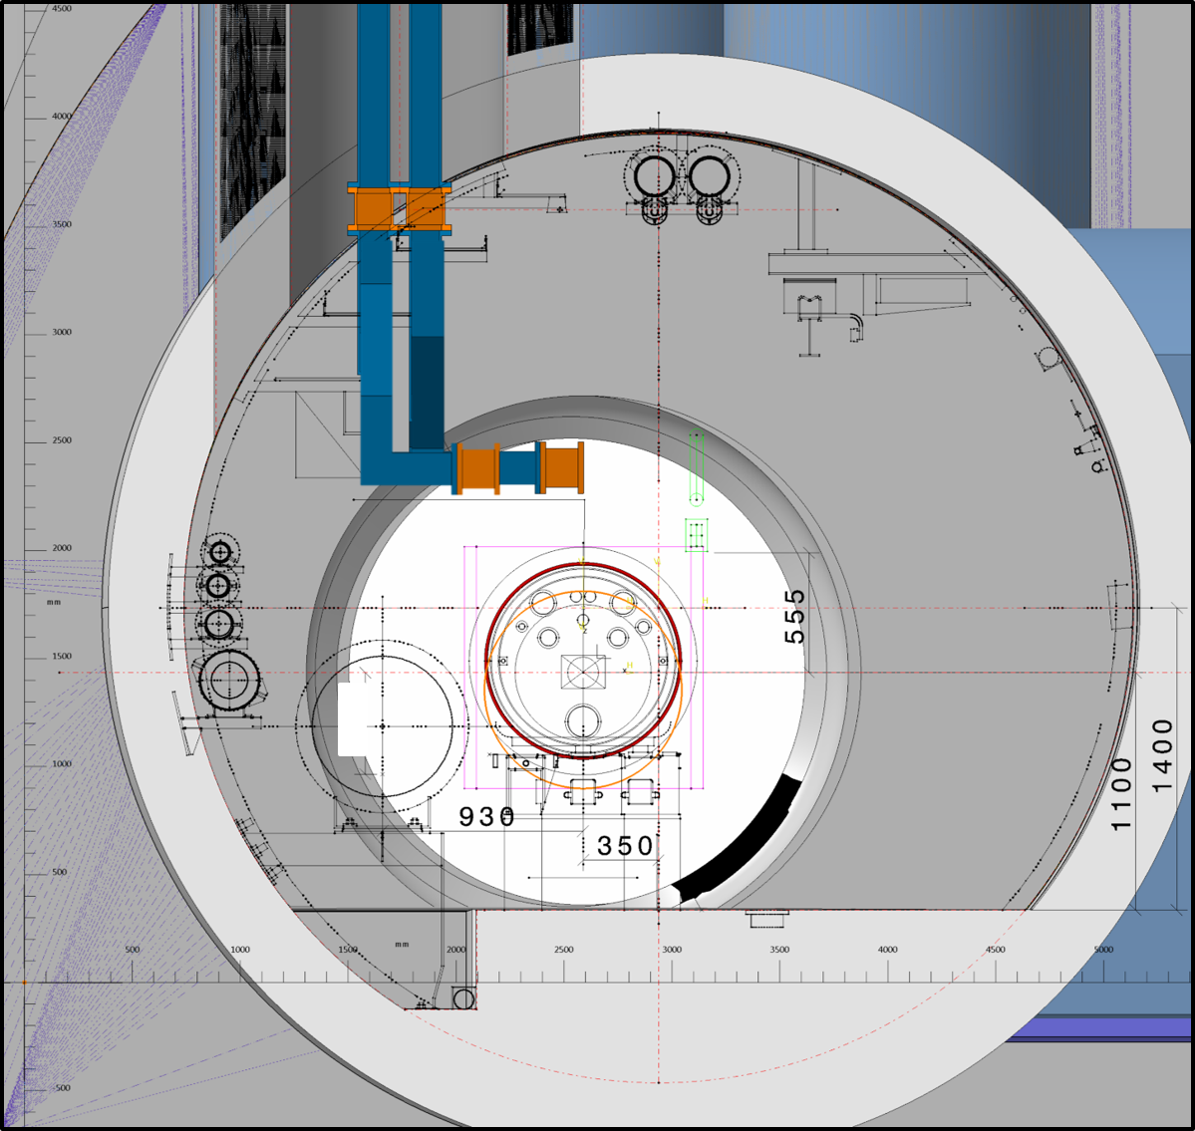
IMPACTED ZONE RI132 TUNNEL

Slide 11
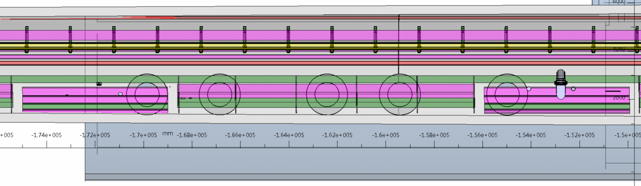
BOTTOM VIEW TUNNEL RI132
14.9 M
154,95 M TO IP

Slide 12
TO DISMOUNT :
Machine side (left)
All cables
ALL cables trays (CT) +
Support structure of CT
Helium ring line
Warm recovery line
Compressed air pipe
QRL !
Transport side
Not necessary!

Slide 13
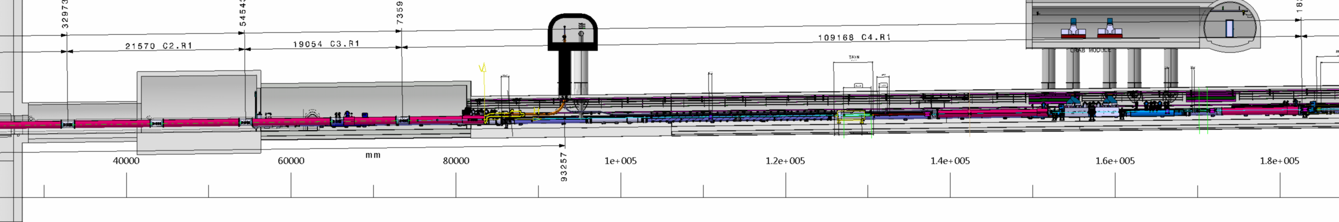
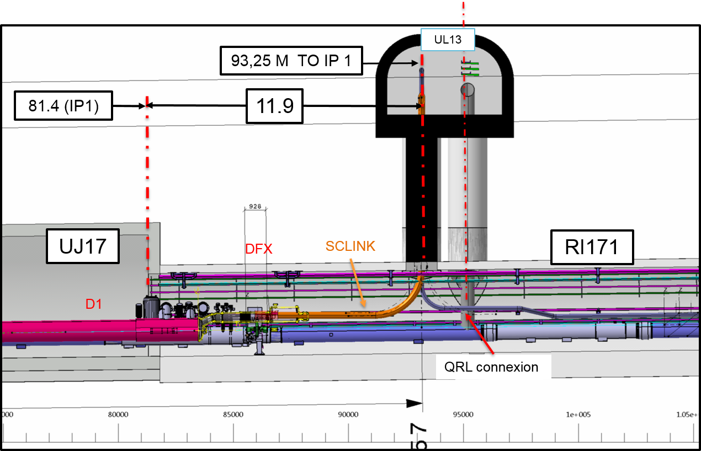
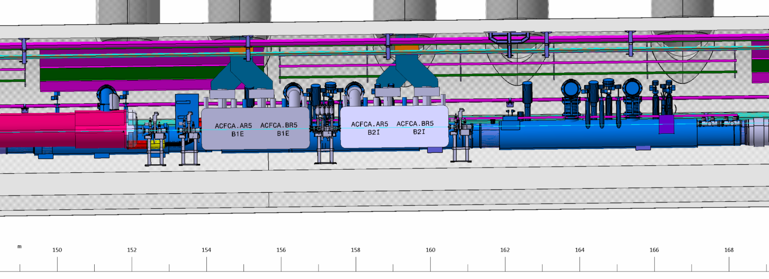
P1R
UL CORES ZONE
2 DISMONTING ZONE RI132 TUNNEL
UA CORES ZONE
6
55.5
10
RI171
UA17
UL CORES ZONE
154,957 TO IP 1
UA CORES ZONE
6
55.5
10
RI171
10

Slide 14
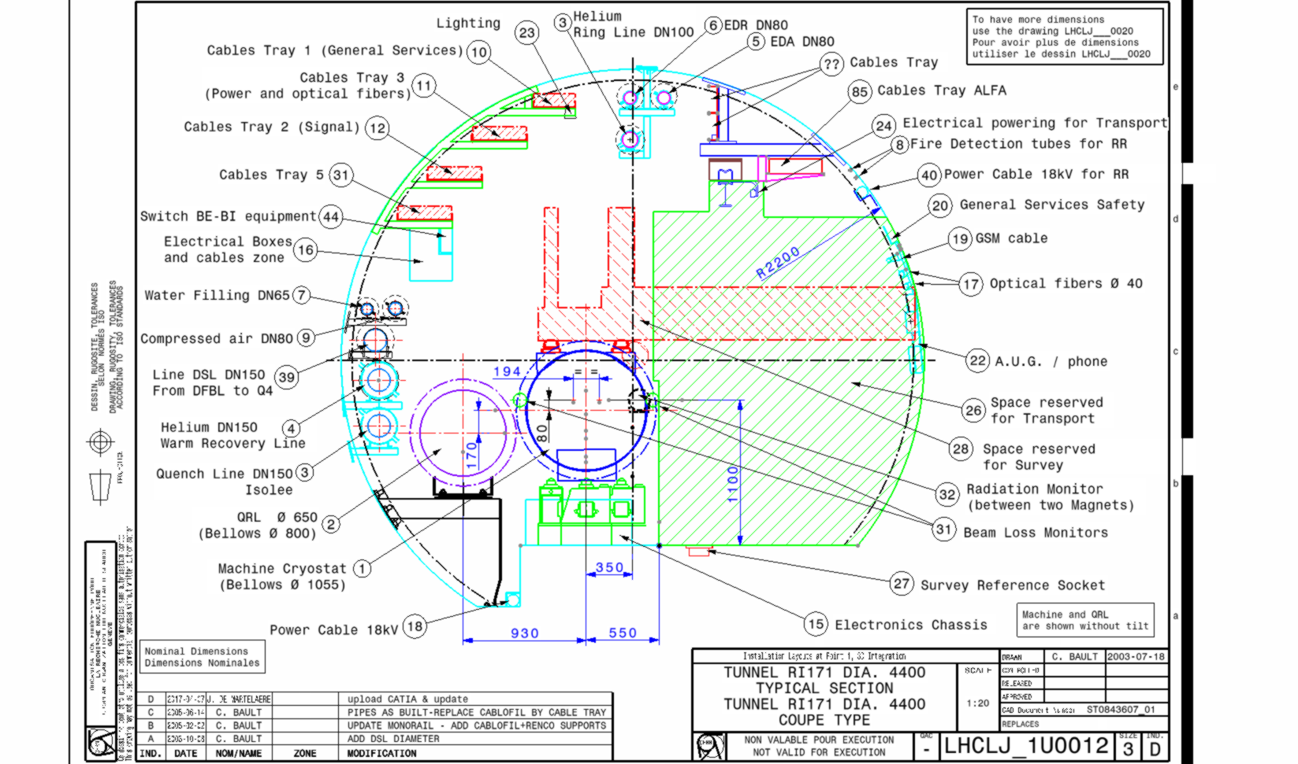
SERVICES IMPACTED BY DRILLING CORES

Slide 15
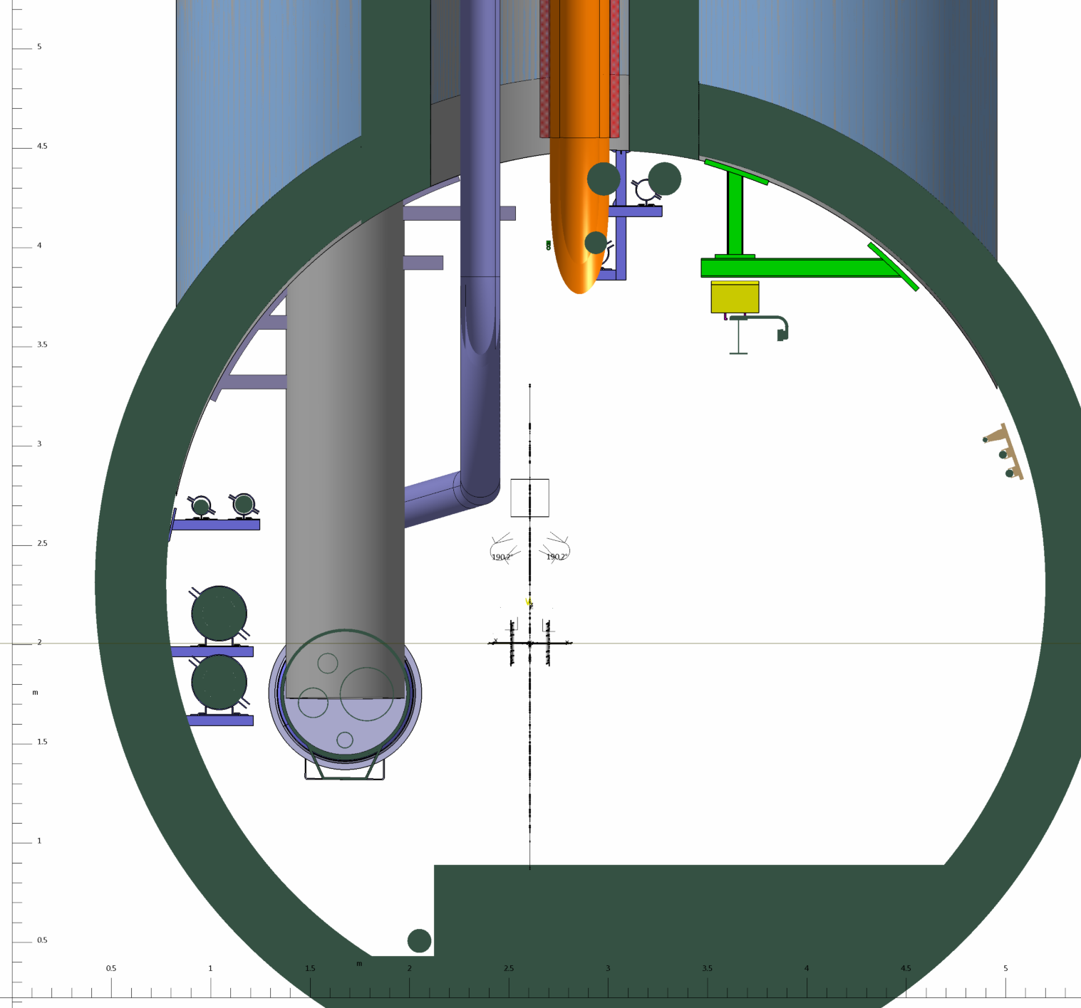
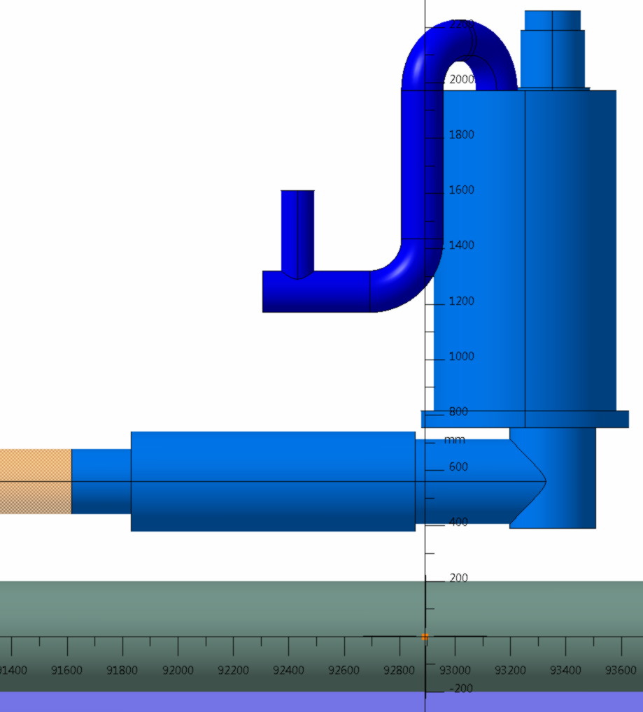
Ø1.7
IMPACTED ZONE RI132 TUNNEL
Ø 660
sclink
1400
560
SCLINK CORE ( -93.25 )

Slide 16
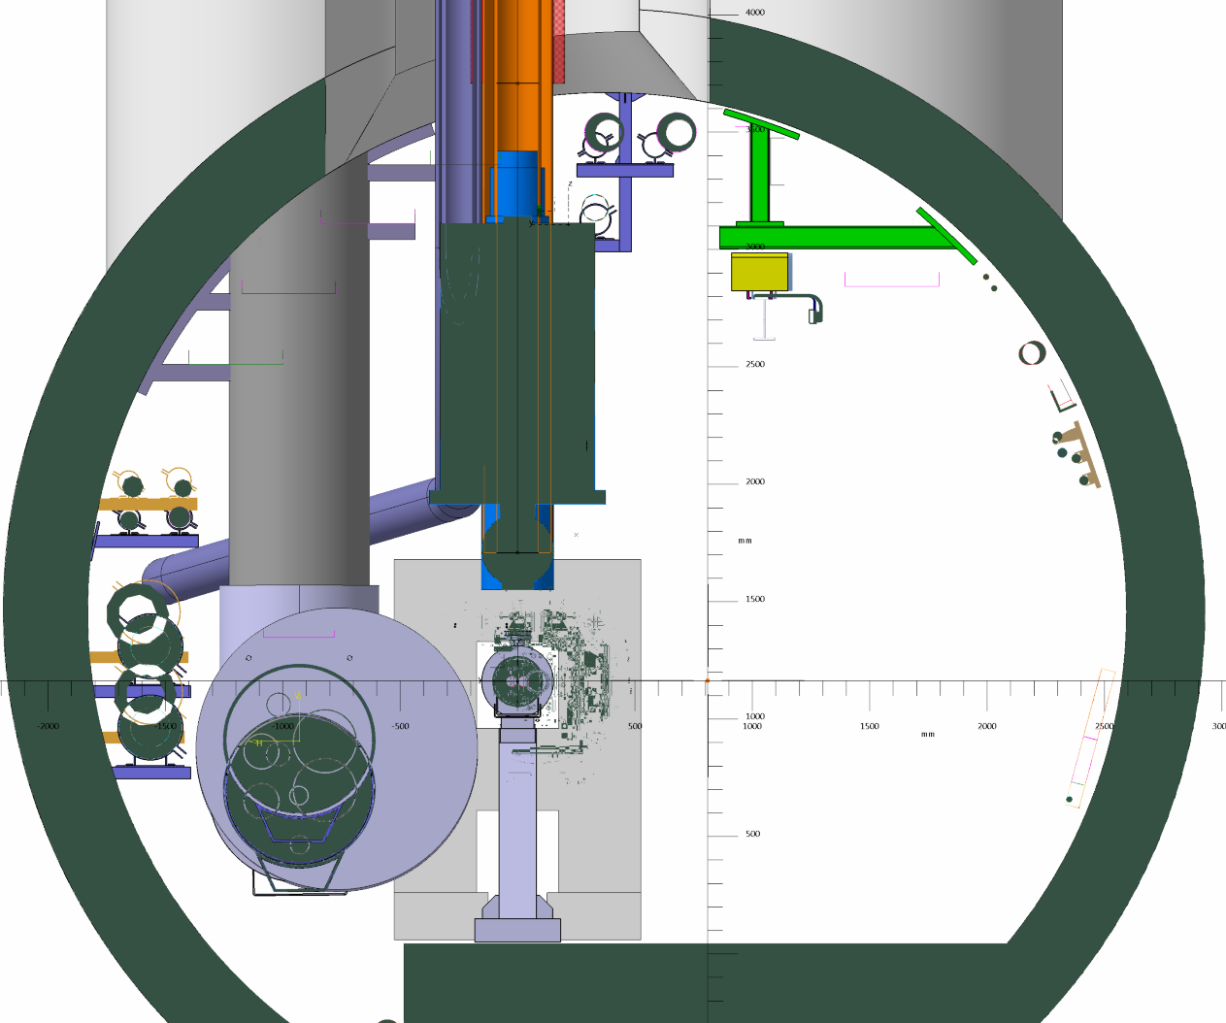
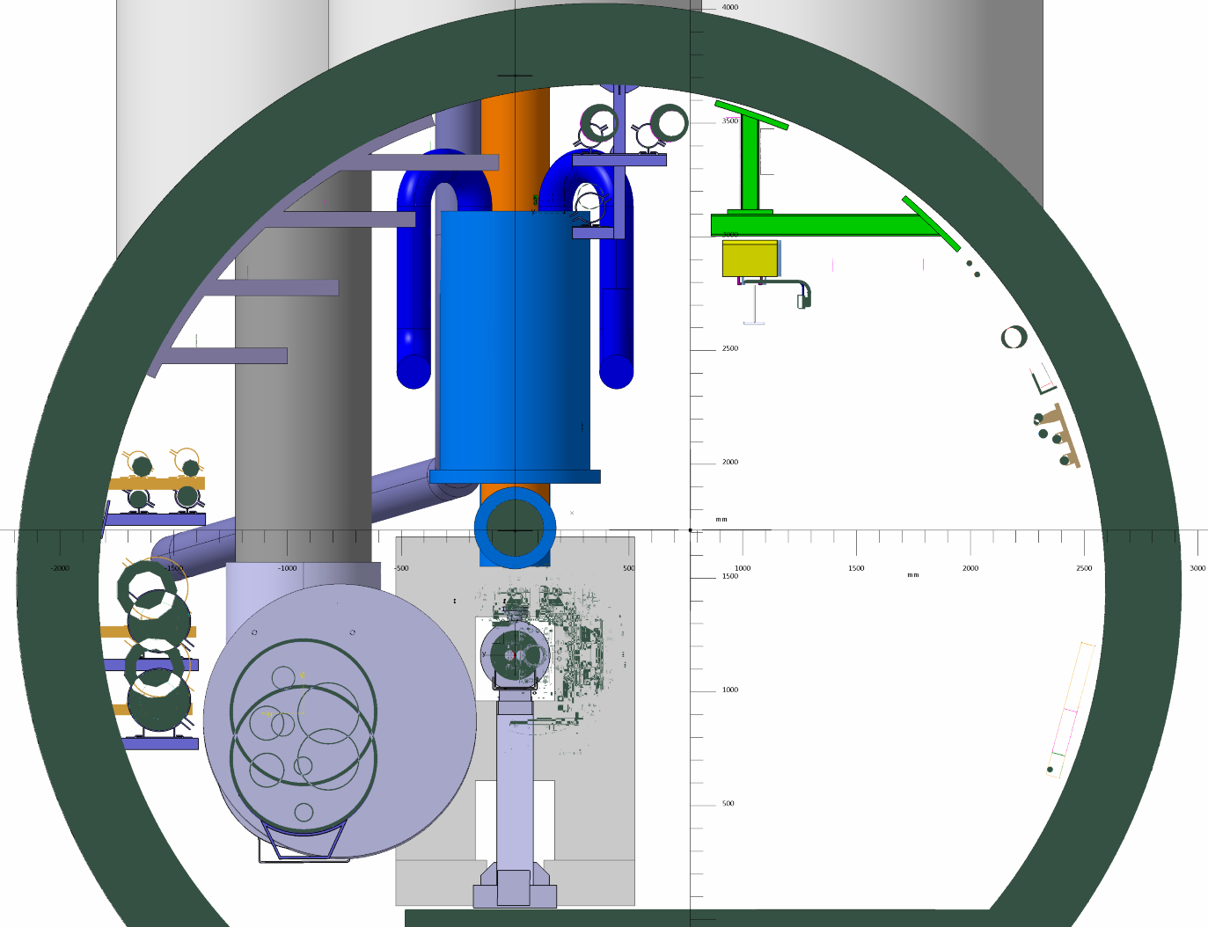
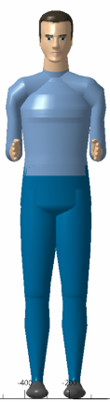
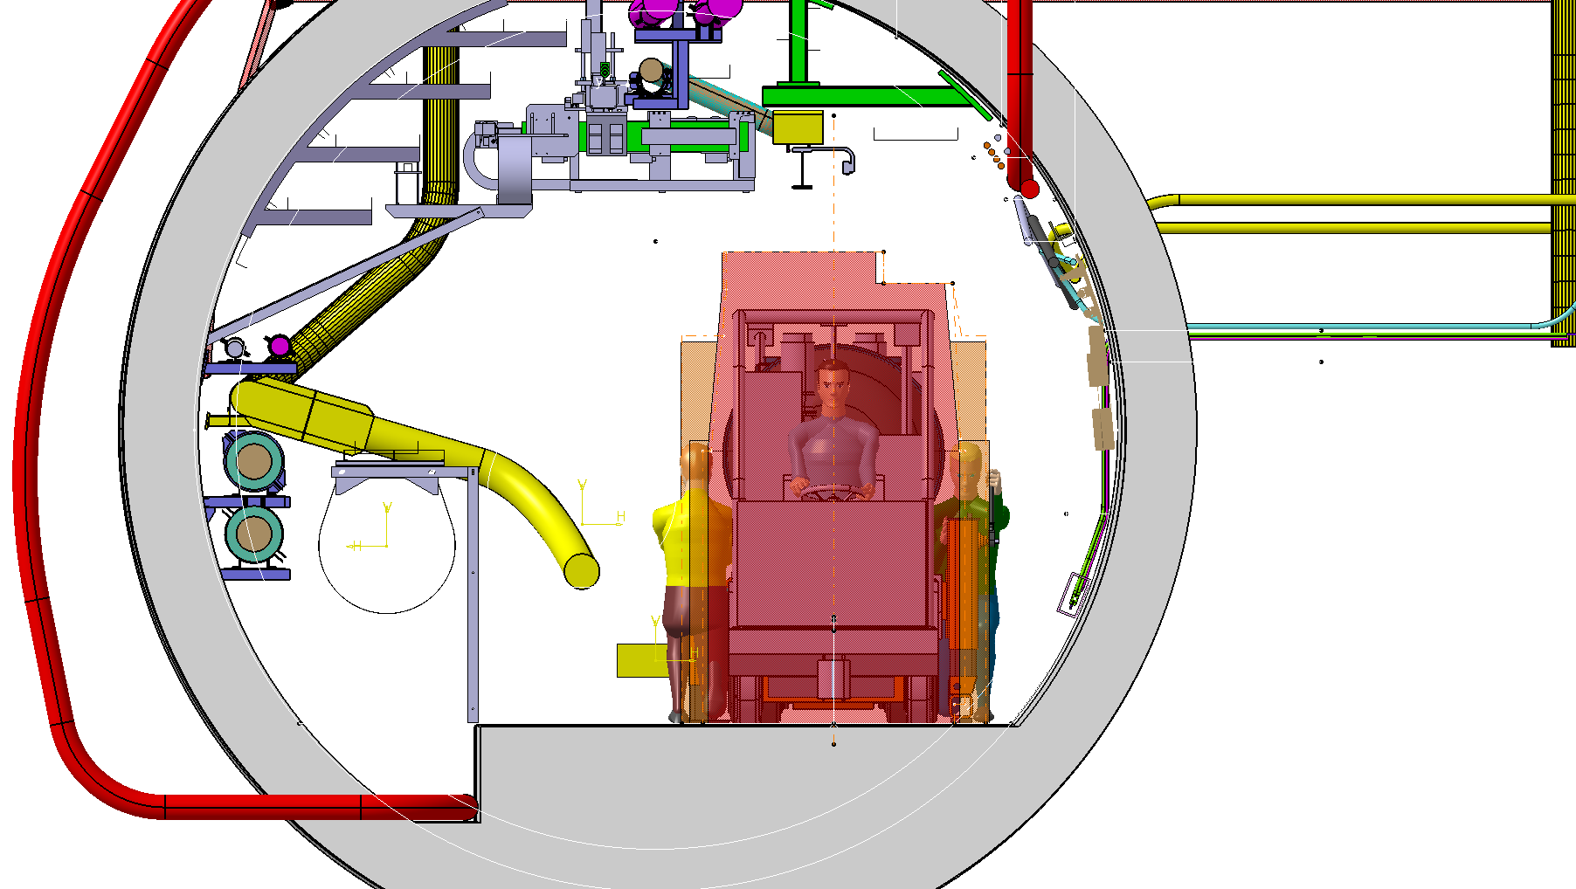
NEW CONCEPT OF DFX (VERTICAL POSITION/ CORE)

Slide 17

≈450
1960/IP
Ø 660

Slide 18
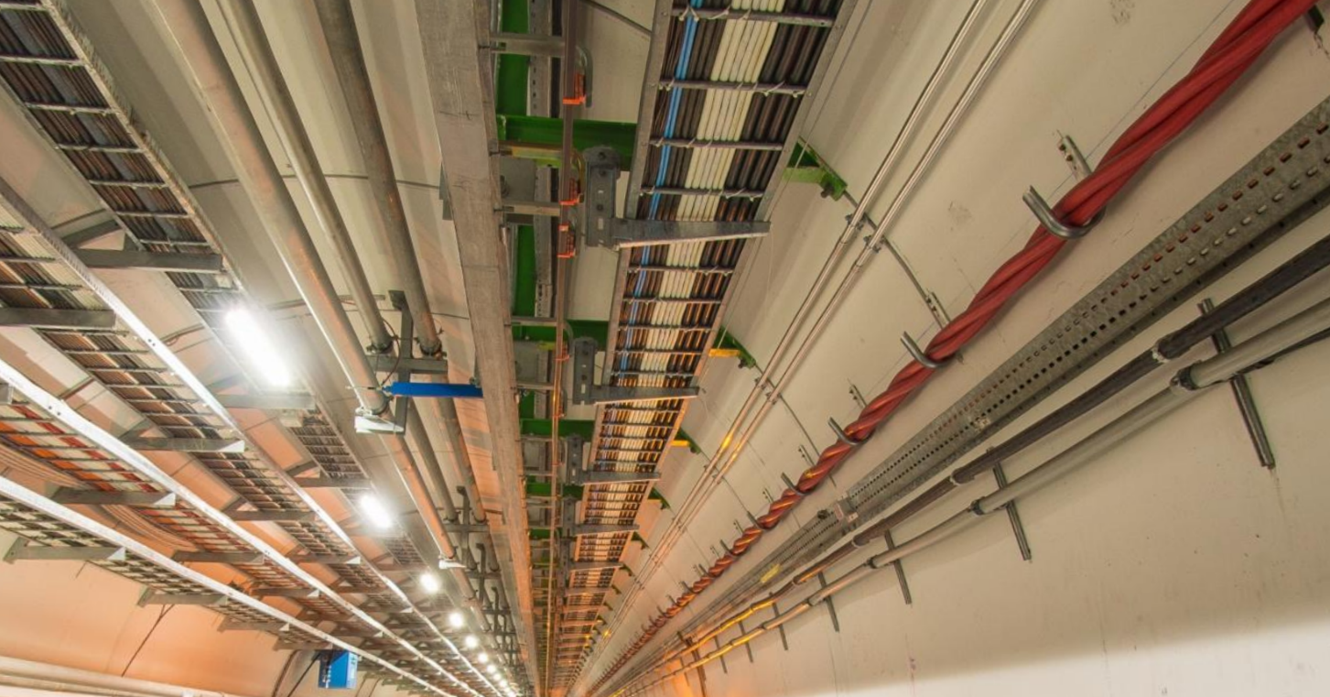

Slide 19
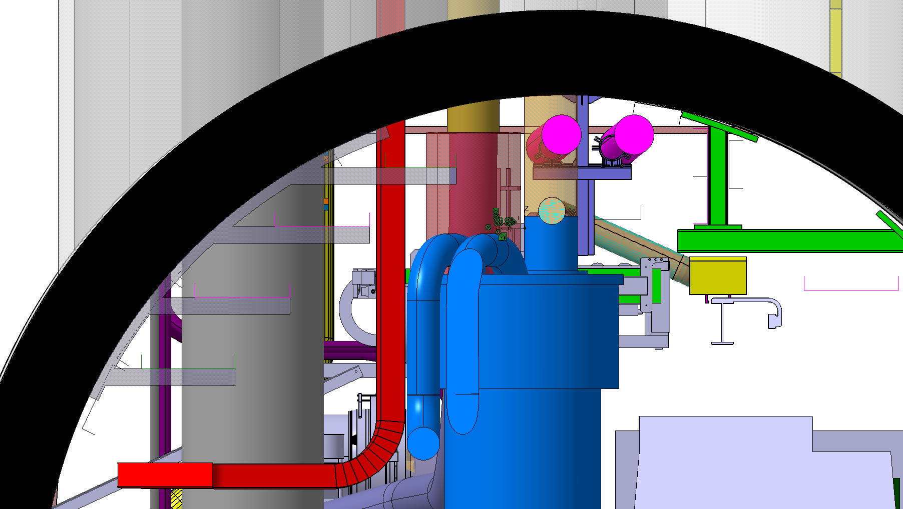

Slide 20
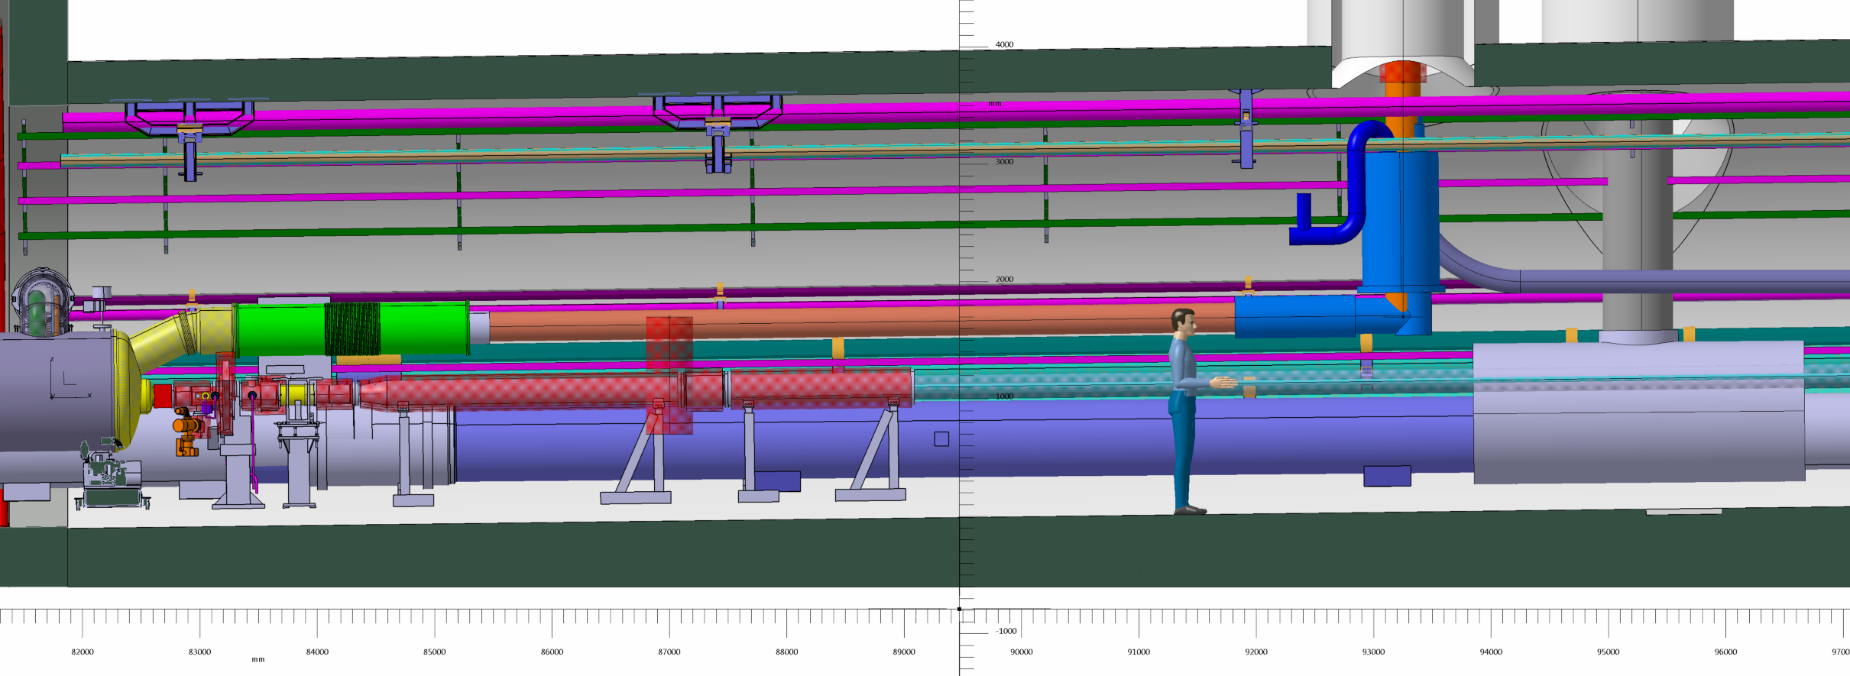
NEW CONCEPT OF DFX (VERTICAL POSITION/ CORE)

Slide 21
IMPACTED ZONE RI132 TUNNEL
Ø1.7
QRL CORE ( 95.25 )

Slide 22
IMPACTED ZONE RI132 TUNNEL
Ø1.7
2000
1.7
SERVICE CORE (94.95)

Slide 23
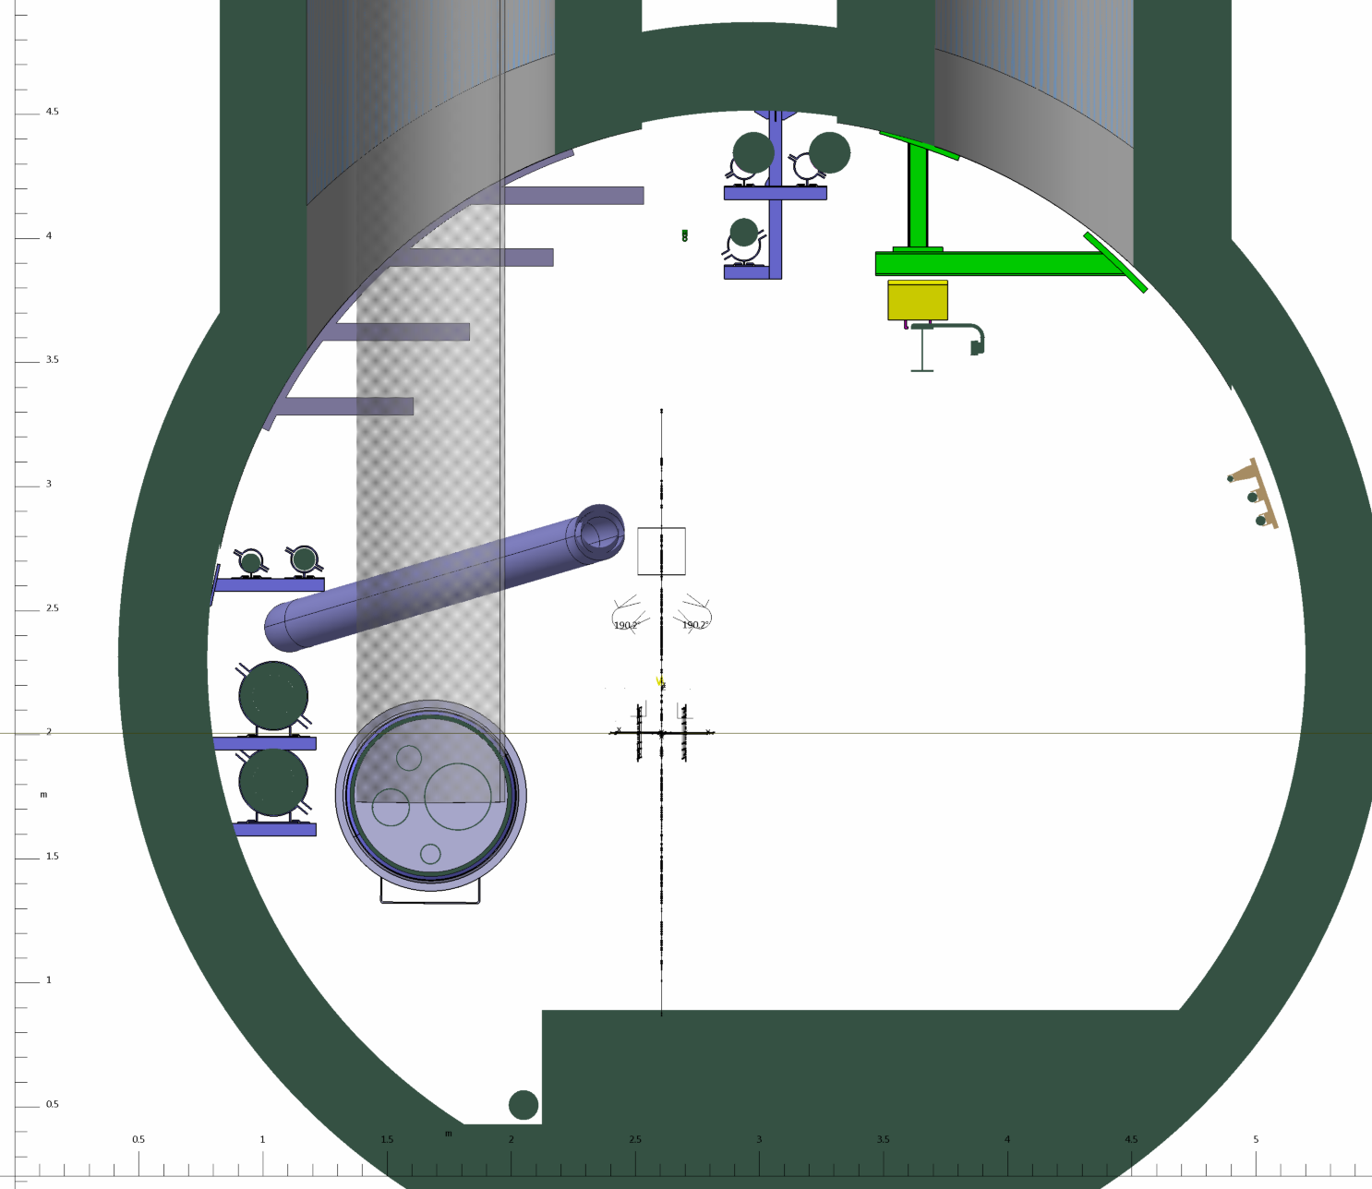
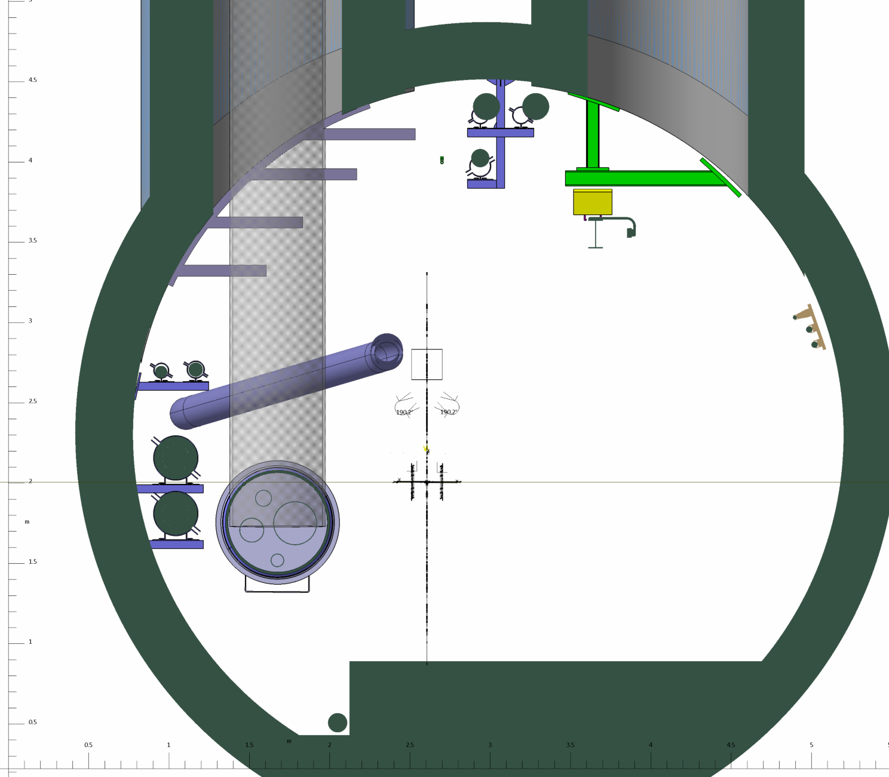
Ø1.7
Ø1.7
2000
1.7
QRL CORE ( 95.25 )
SERVICE CORE (94.95)

Slide 24
TO DISMOUNT :
Machine side (left)
All cables
ALL cables trays (CT) +
Support structure of CT
Helium ring line
Warm recovery line
Compressed air pipe
QRL !
Transport side
Not necessary!

Slide 25
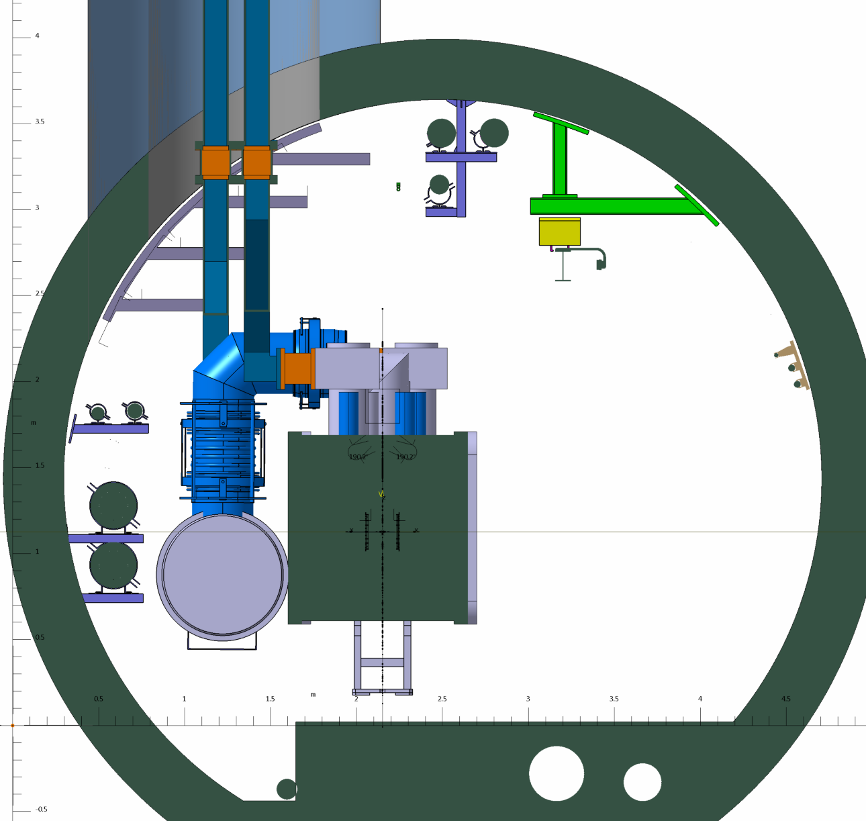
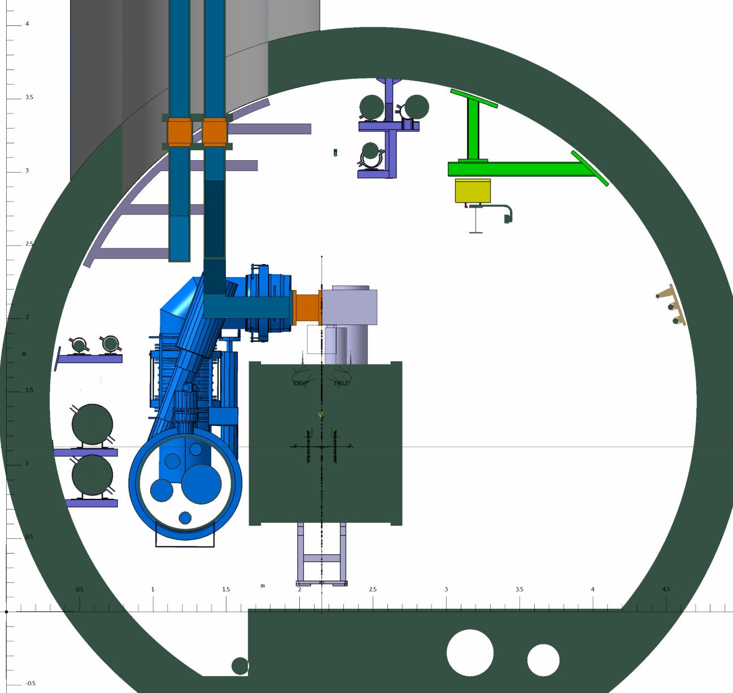
IMPACTED ZONE RI132 TUNNEL
Ø1.7

Slide 26
TO DISMOUNT :
Machine side (left)
Ventilation duct Ø 300
All cables
ALL cables trays (CT) +
Support structure of CT
Helium ring line
Warm recovery line
EDR & EDA
Compressed air pipe
QRL !
Transport side
Ventilation duct Ø 300
Transport rail & Support (if present)
Safety cables & support (if present)
GSM CABLE
OPTIC FIBER CABLE

Slide 27
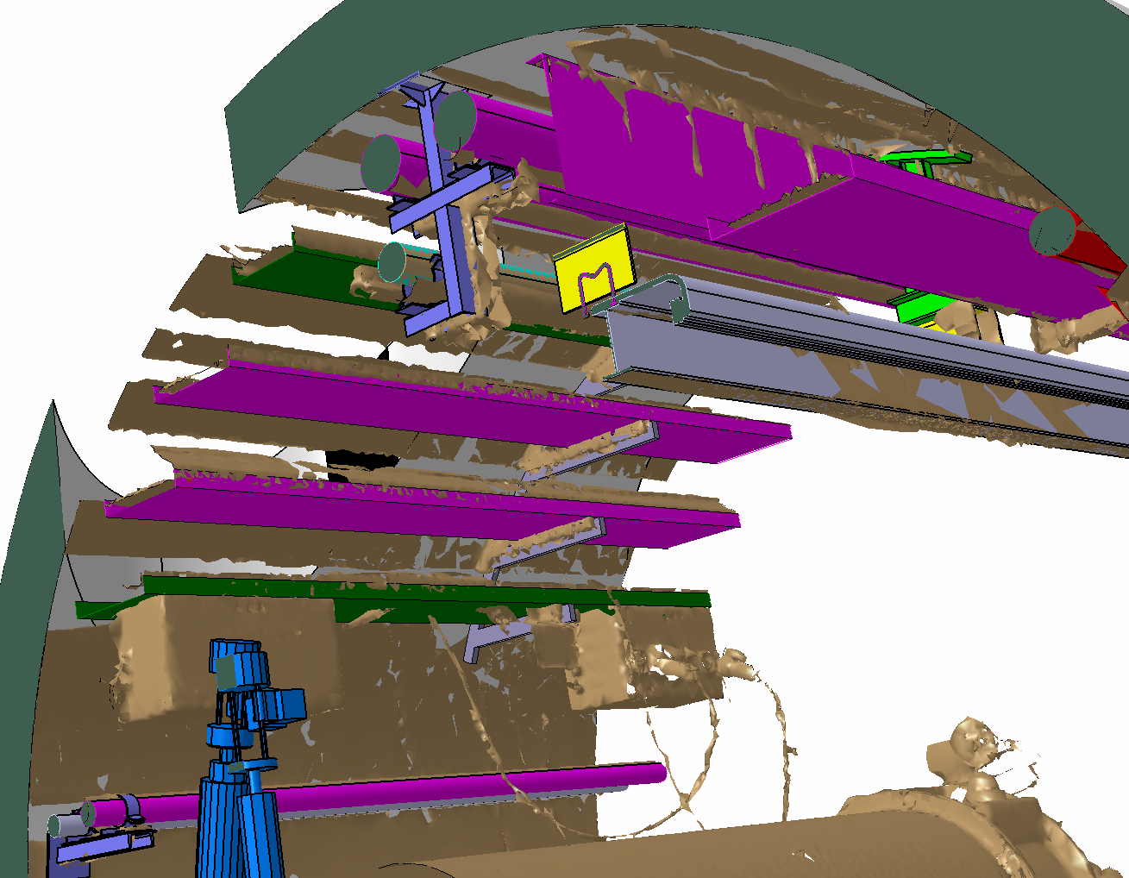
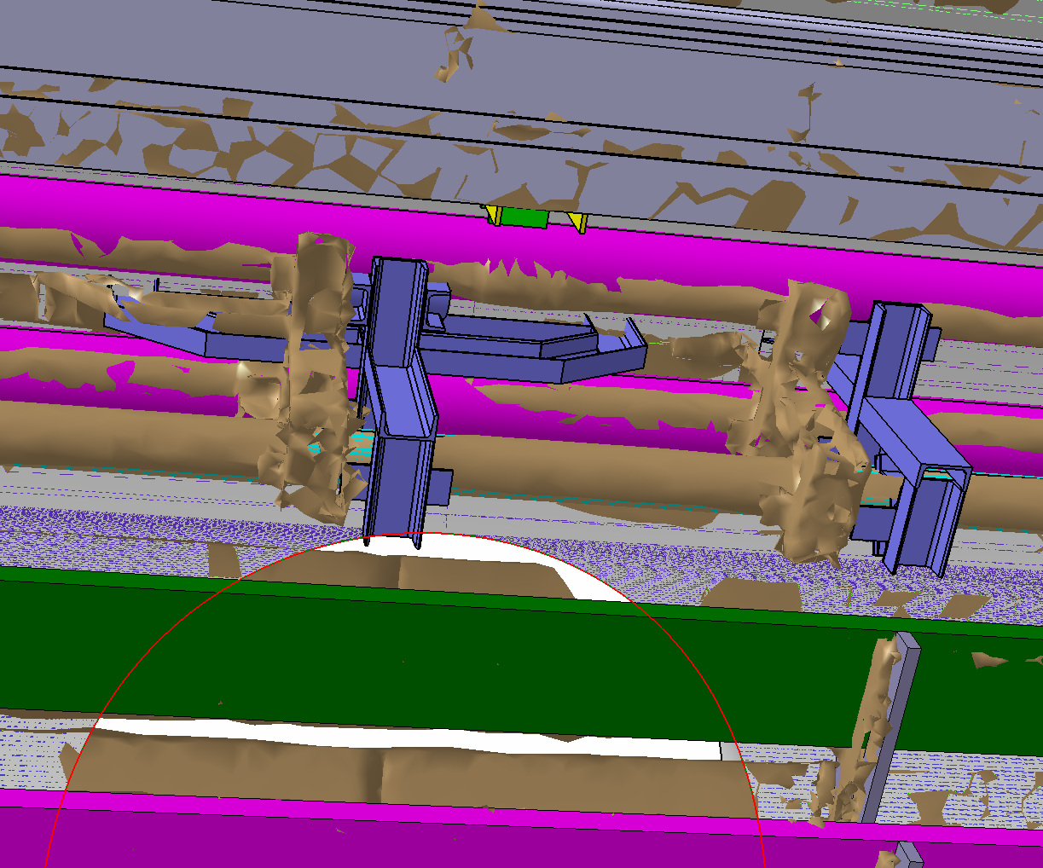
COMPARAISON AVEC LE SCAN

Slide 28
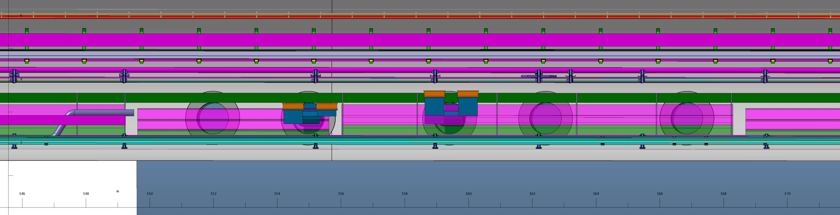
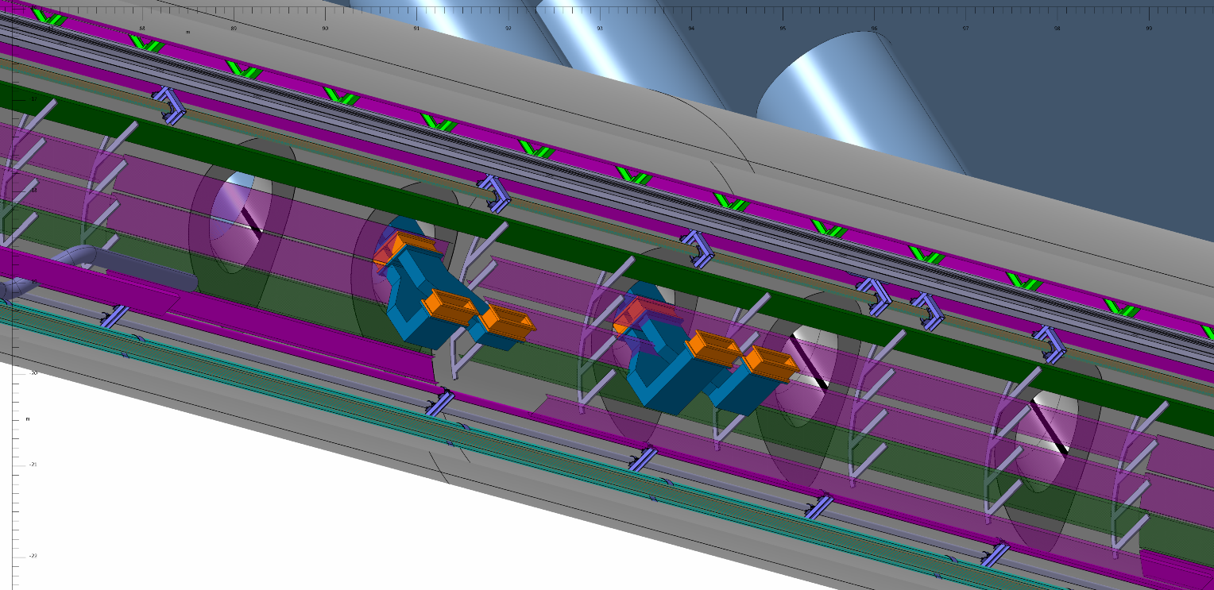
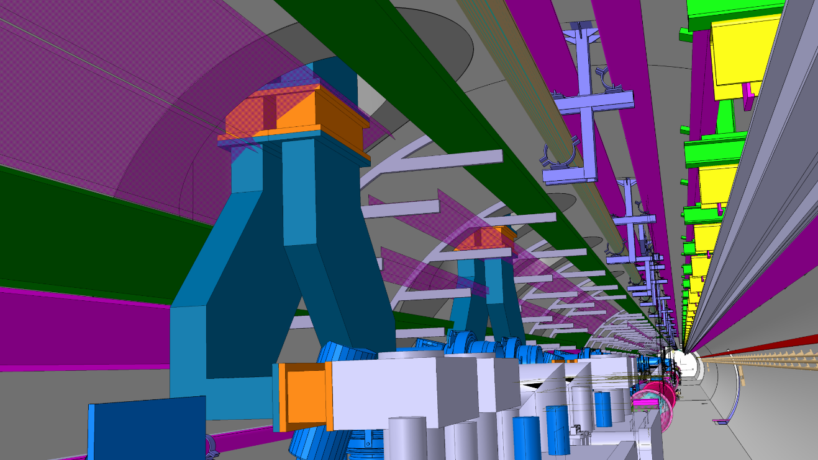
BOTTOM VIEW ZONE CRAB. CAV. TUNNEL RI171
154,95 M TO IP
≈ 14.9 M

Slide 29
LHC LAYOUT
QXL
CABLES
SCLINK

Slide 30
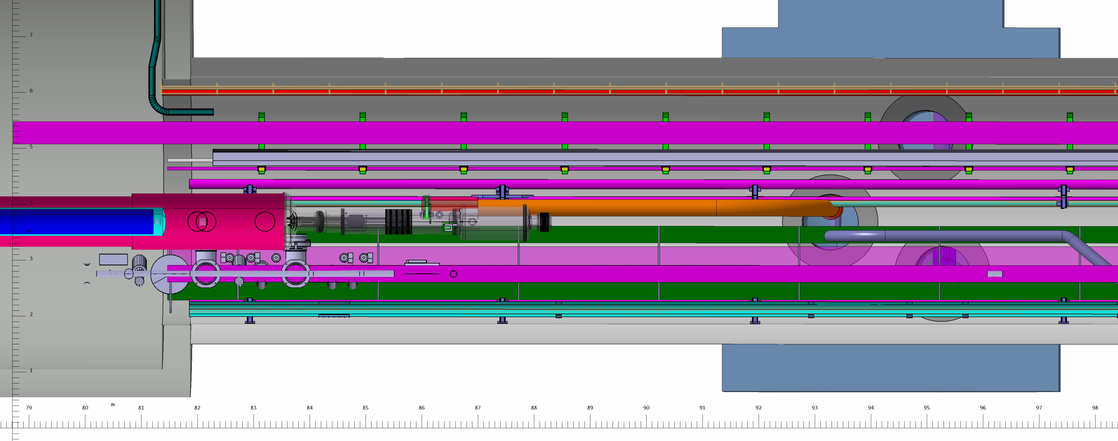
Ø 1 M
Ø 1.7 M
11.9
1.7
UJ17
RI171
93,25 M TO IP 5
2

Slide 31
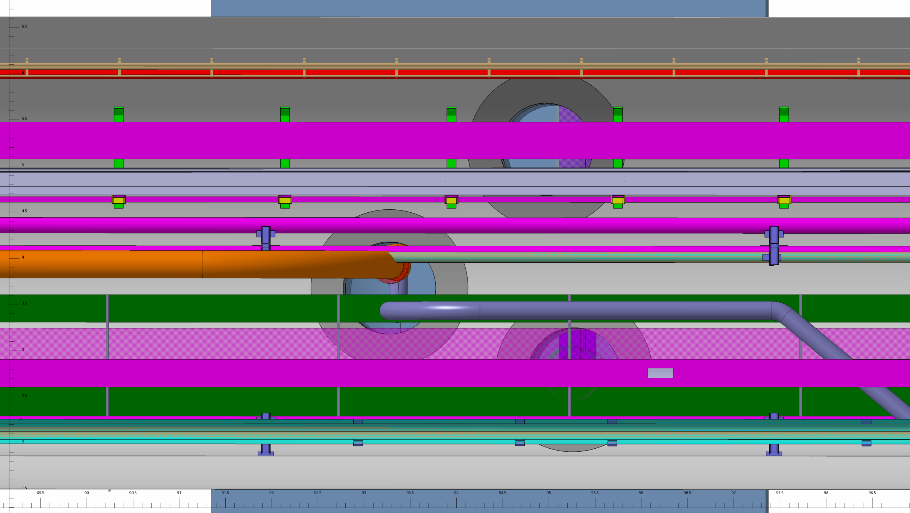

Slide 32
p5

Slide 33
P5R

Slide 34
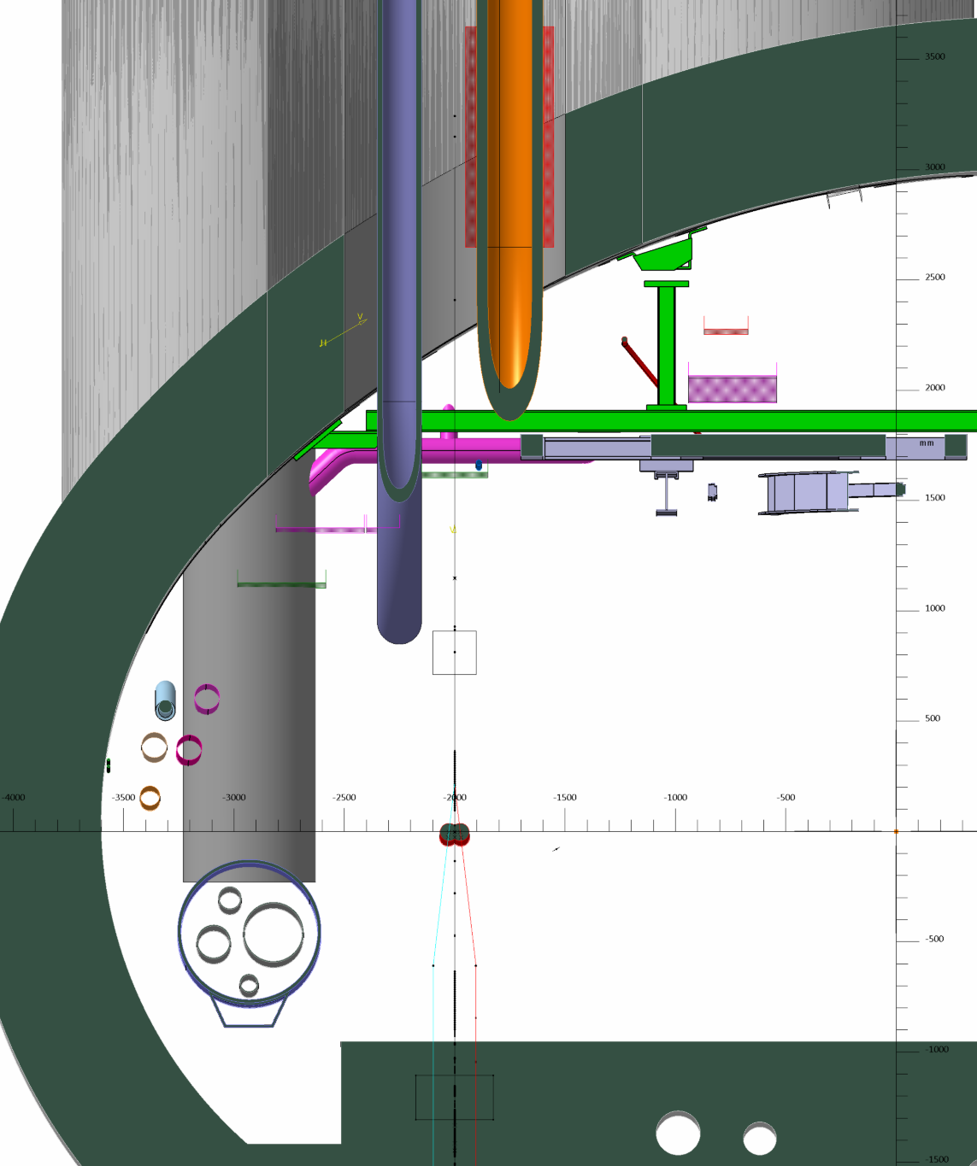
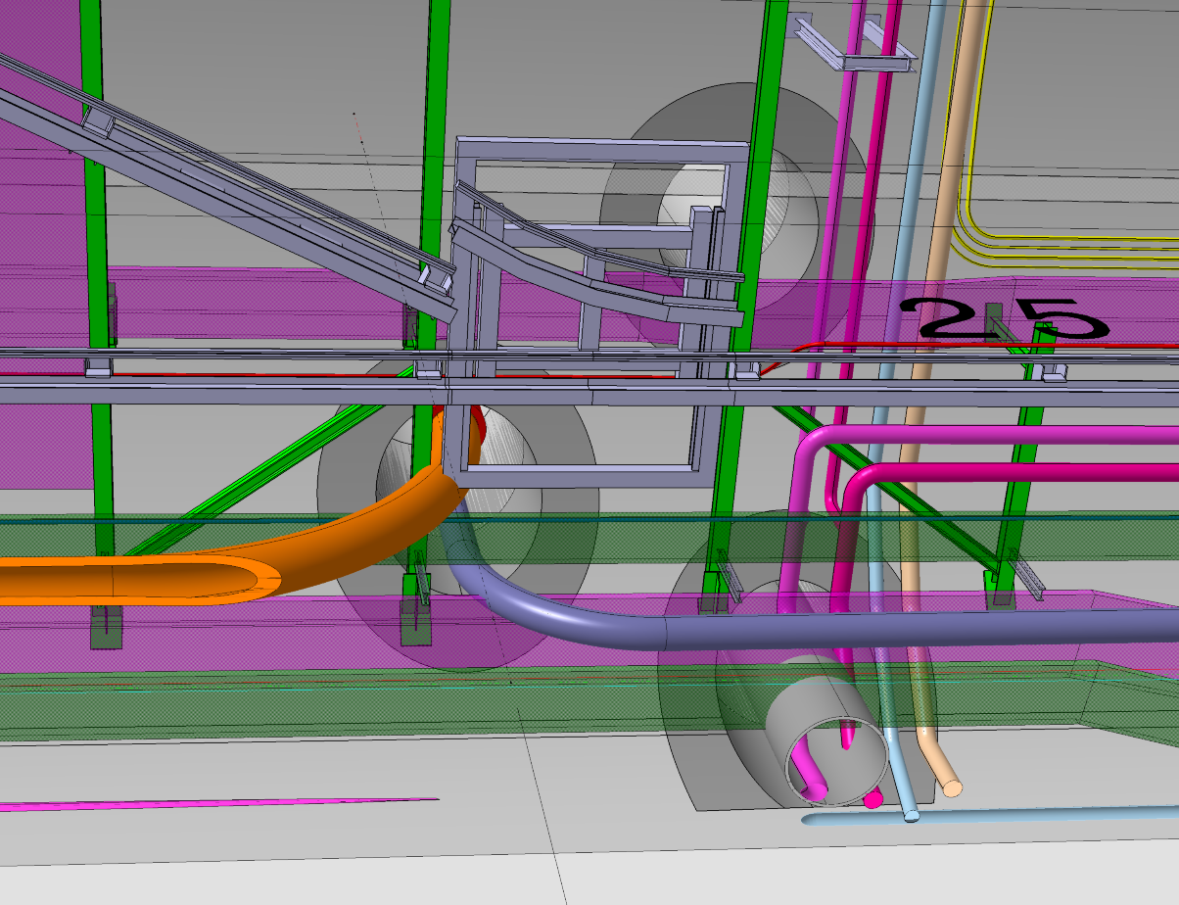
Ø 1.7 M
IMPACTED ZONE UJ57
SCLINK CORE ( -93.25 )

Slide 35
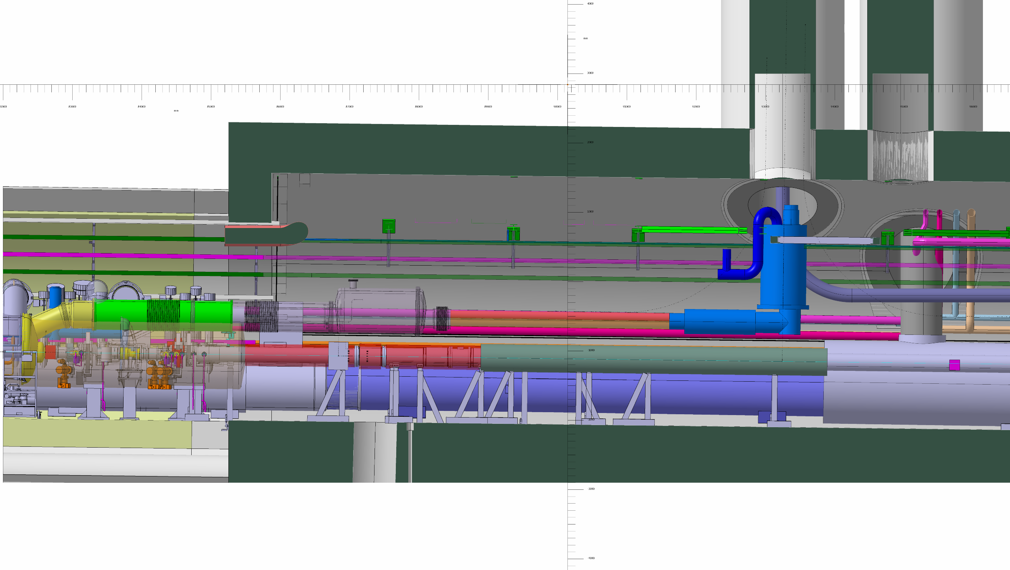
NEW CONCEPT OF DFX (VERTICAL POSITION/ CORE)

Slide 36
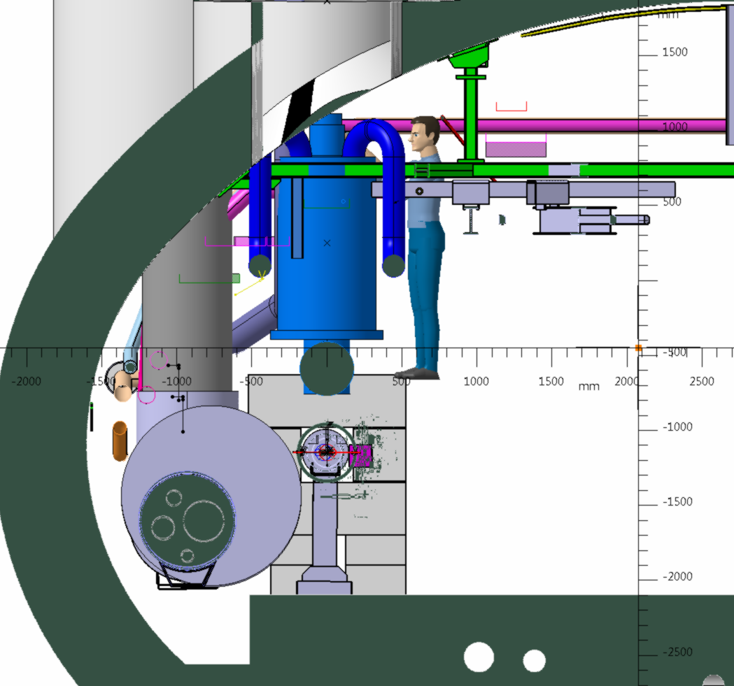
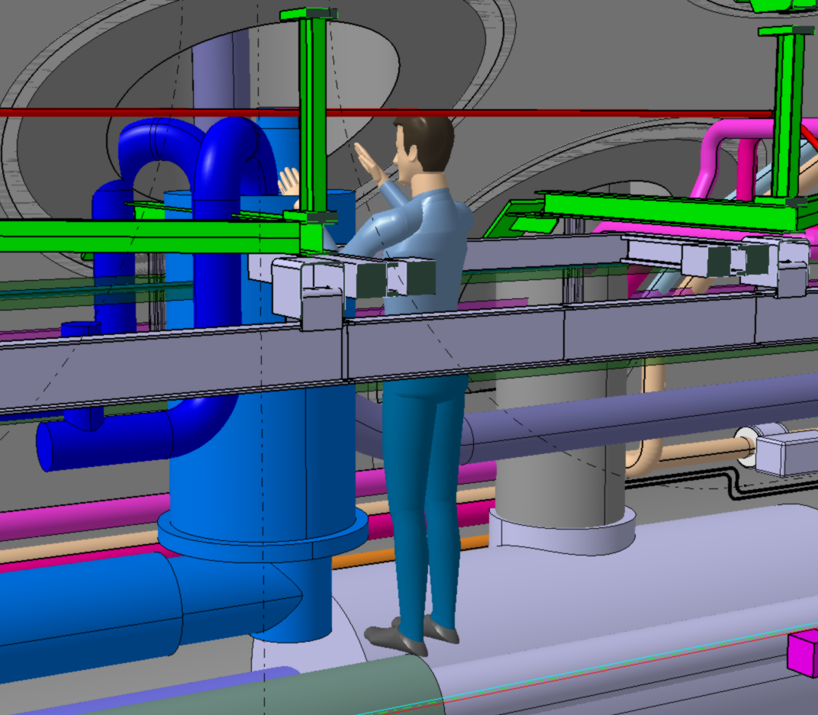
NEW CONCEPT OF DFX (VERTICAL POSITION/ CORE)

Slide 37
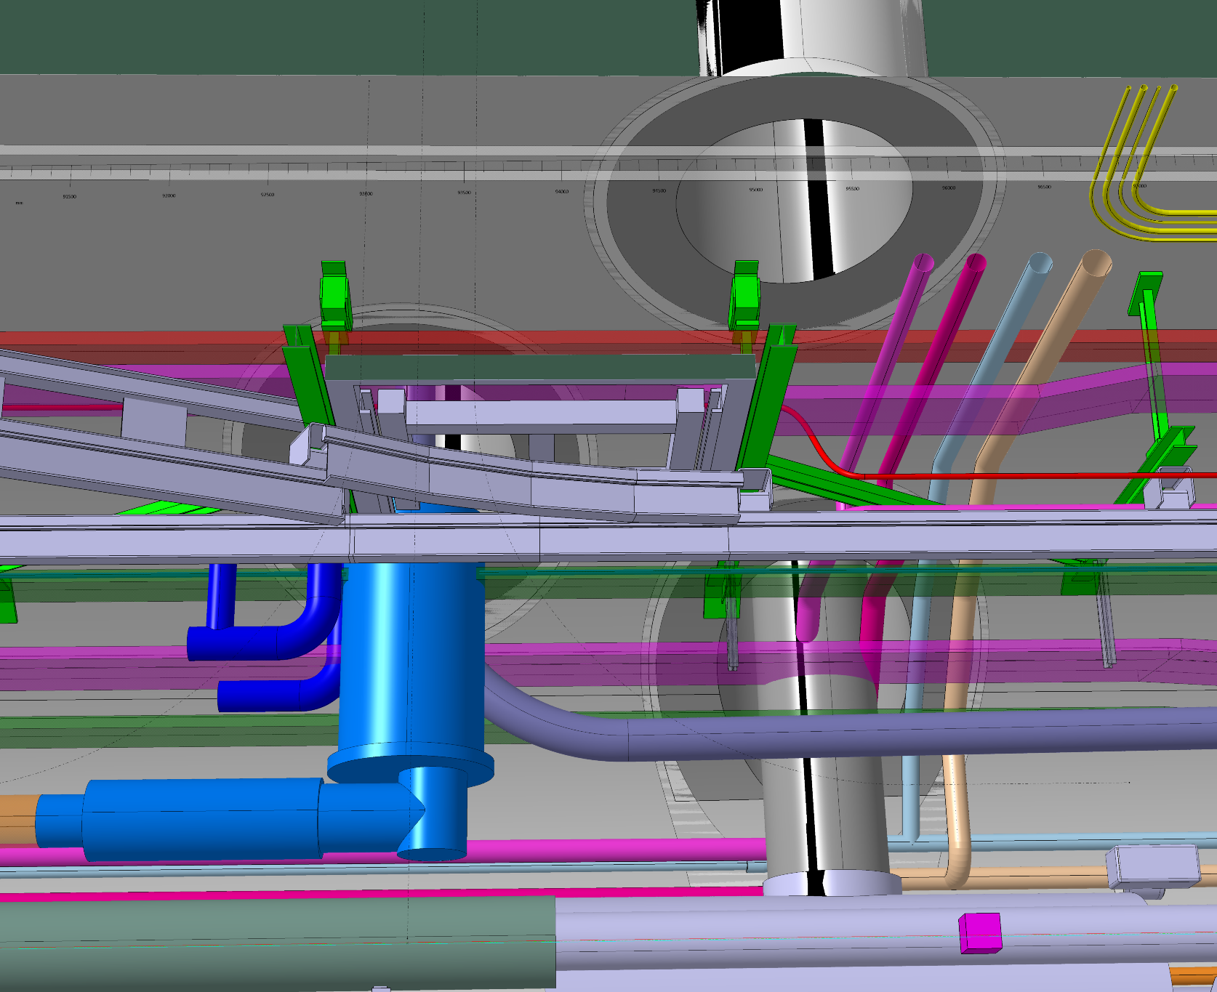
NEW CONCEPT OF DFX (VERTICAL POSITION/ CORE)

Slide 38
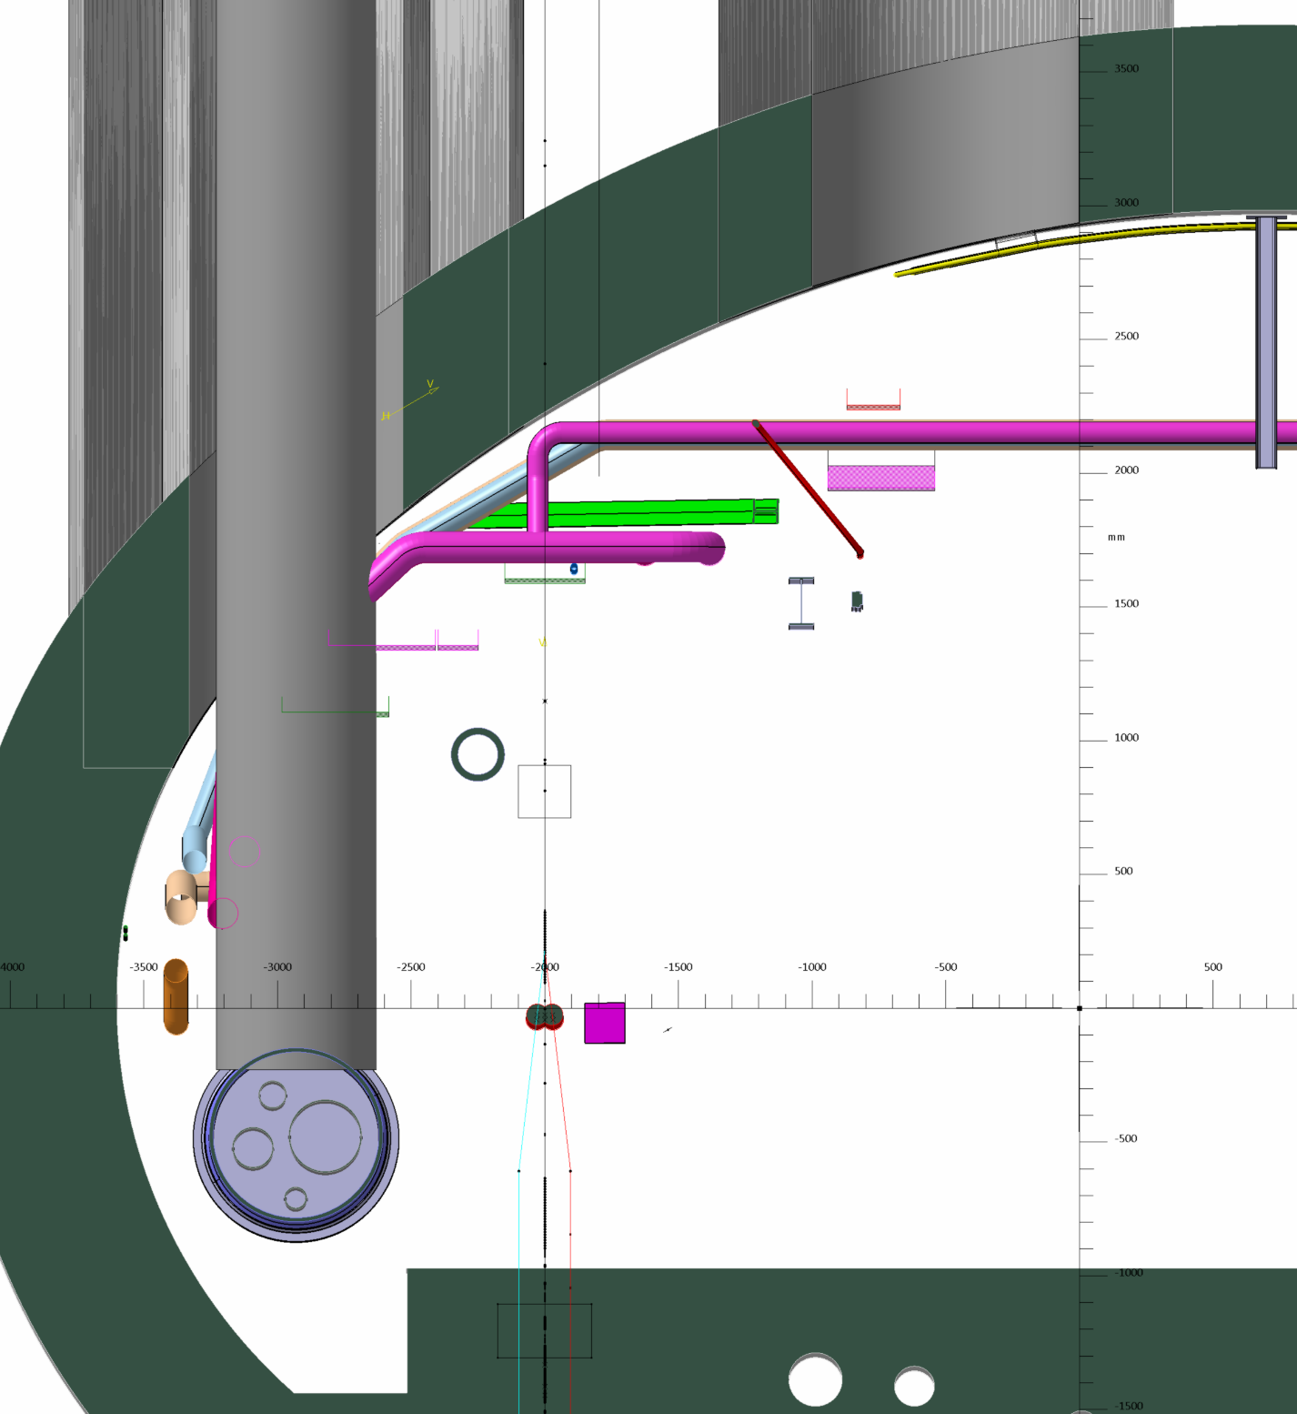
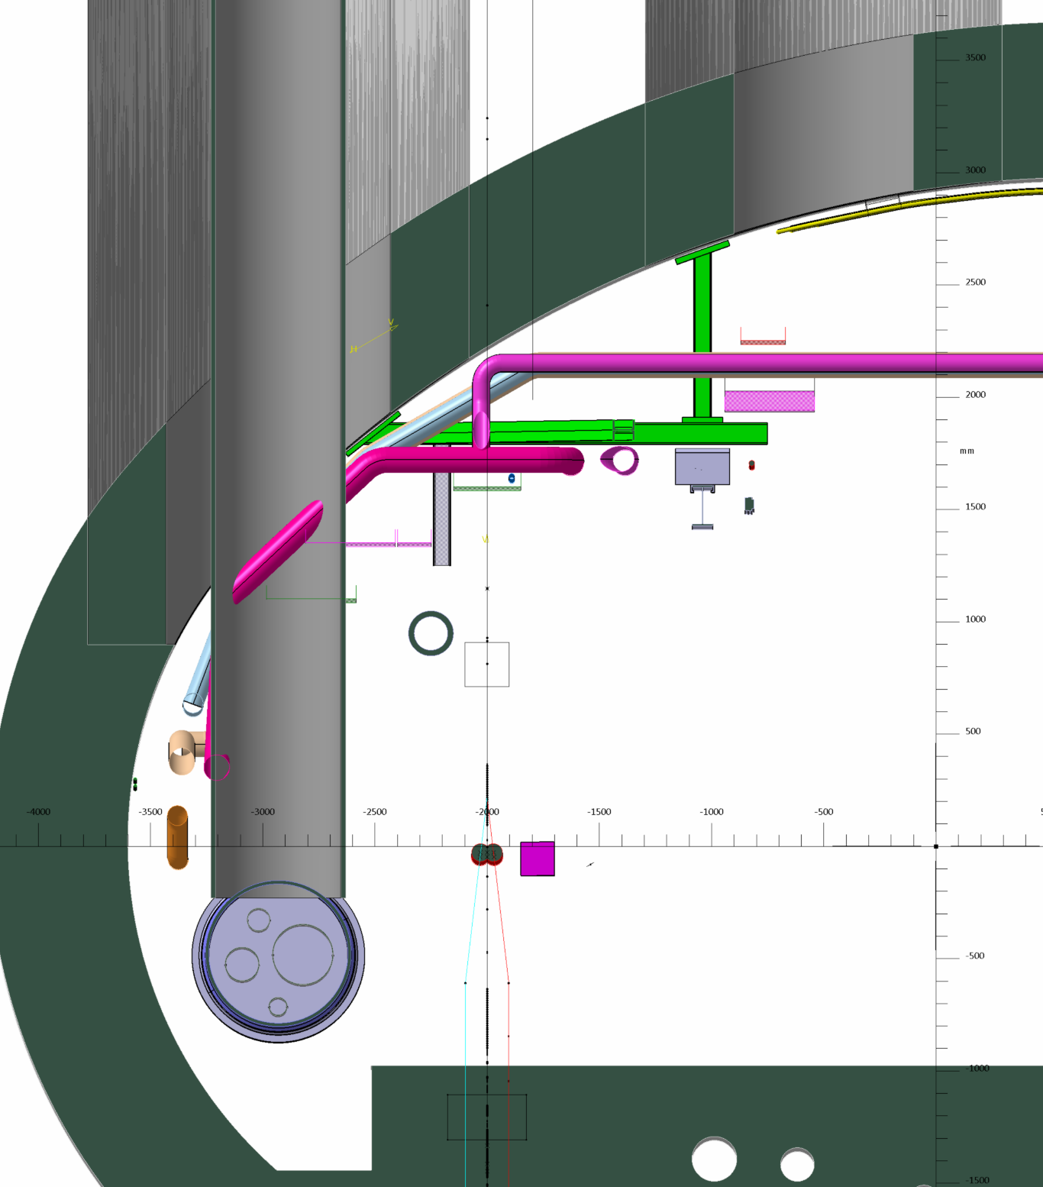
IMPACTED ZONE UJ57
Ø 1.7 M
Ø 1.7 M
SERVICE CORE (-94.95)
QRL CORE ( -95.25 )

Slide 39
TO DISMOUNT :
Machine side (left)
All cables
ALL cables trays (CT) +
Support structure of CT
Helium ring line
Warm recovery line
Compressed air pipe
QRL !
Part of metallic structure
Transport side
Not necessary!

Slide 40
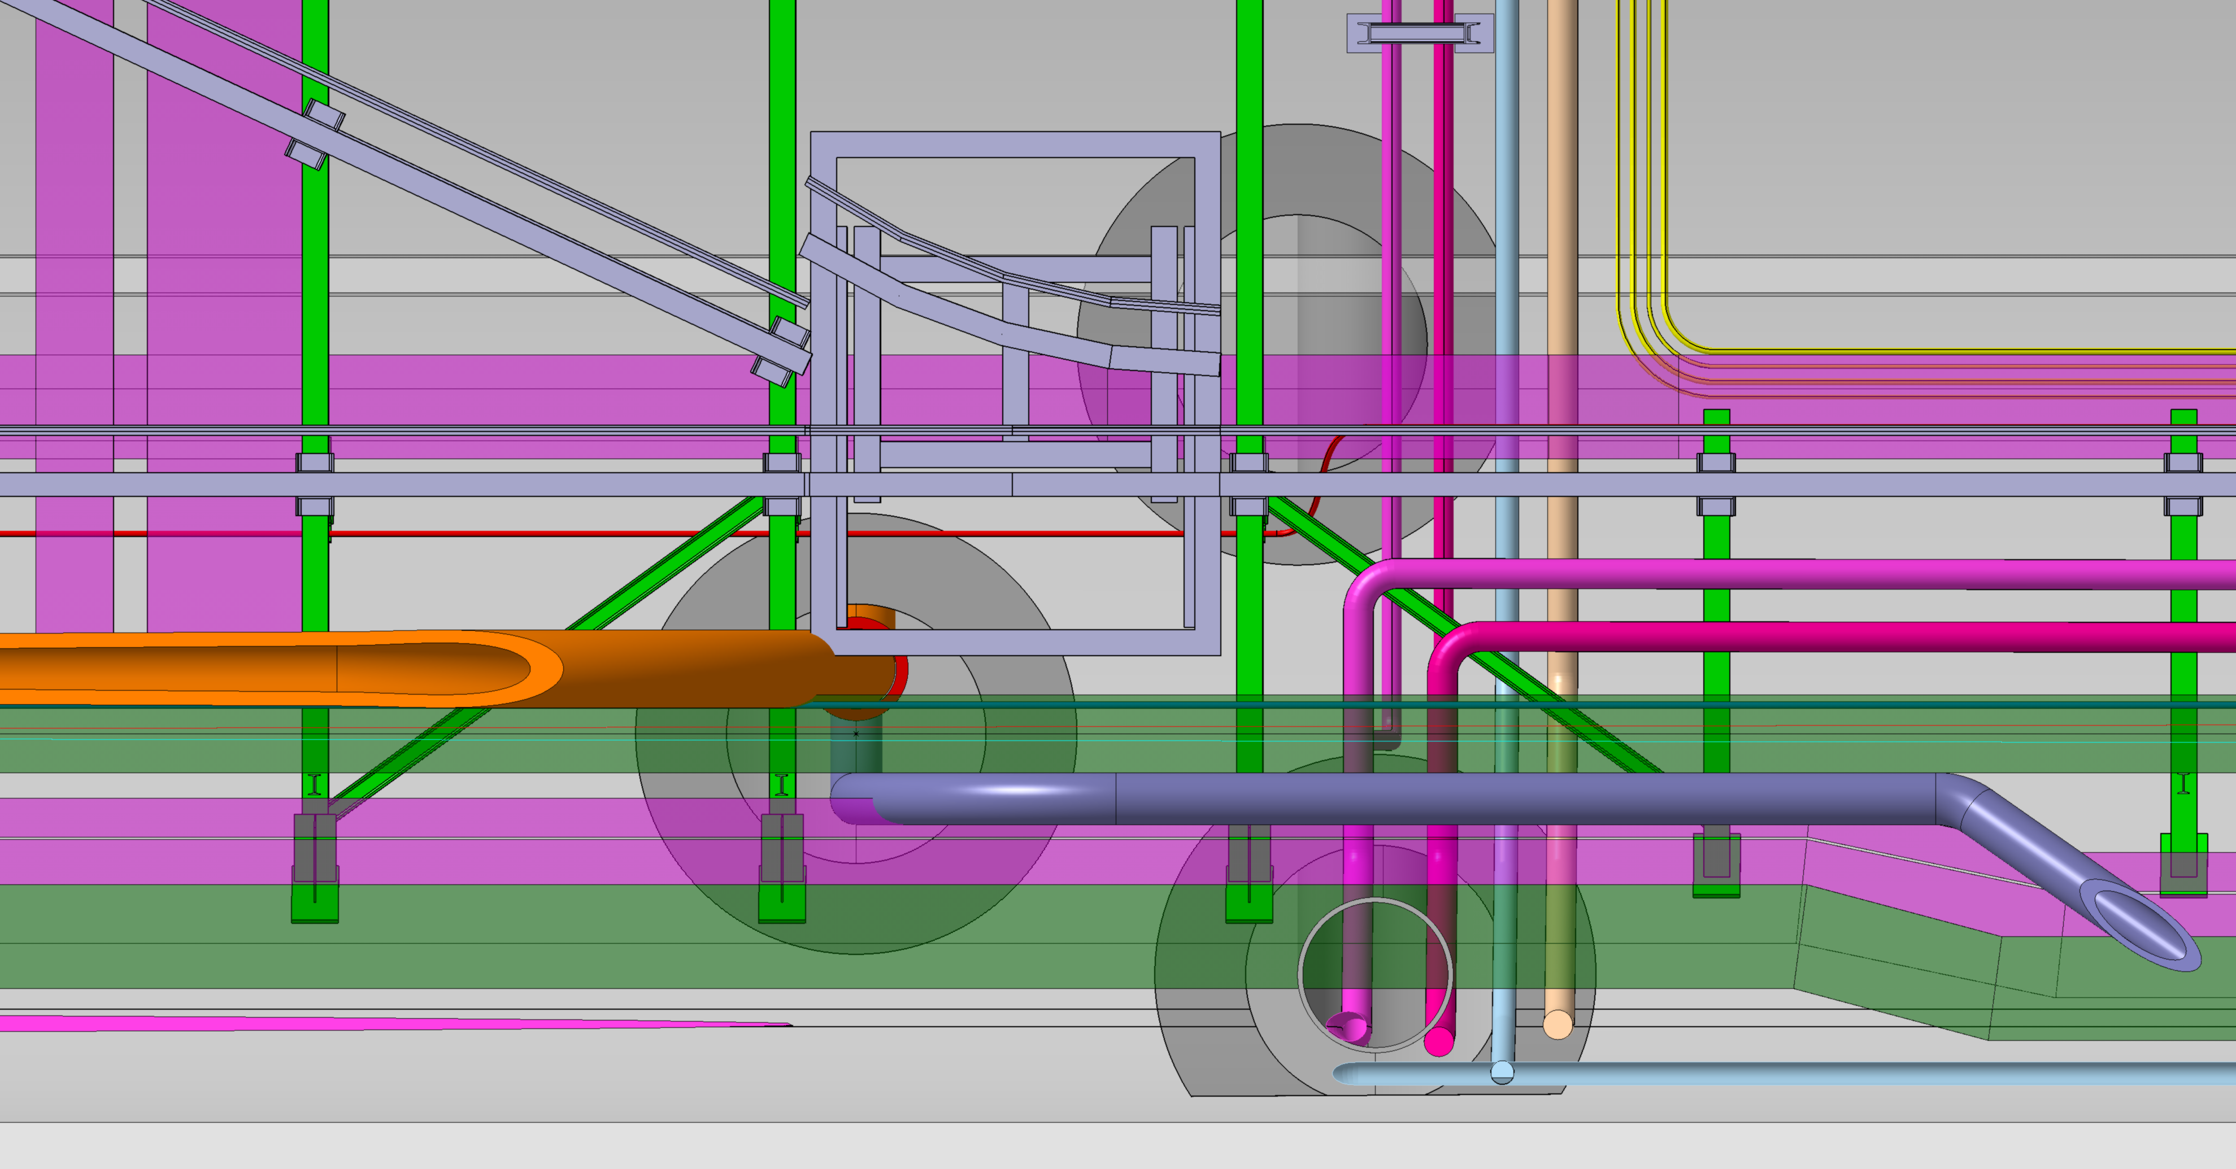
Ø 1.7 M
1.7
Ø 1 M
93,25 M TO IP 5
2

Slide 41
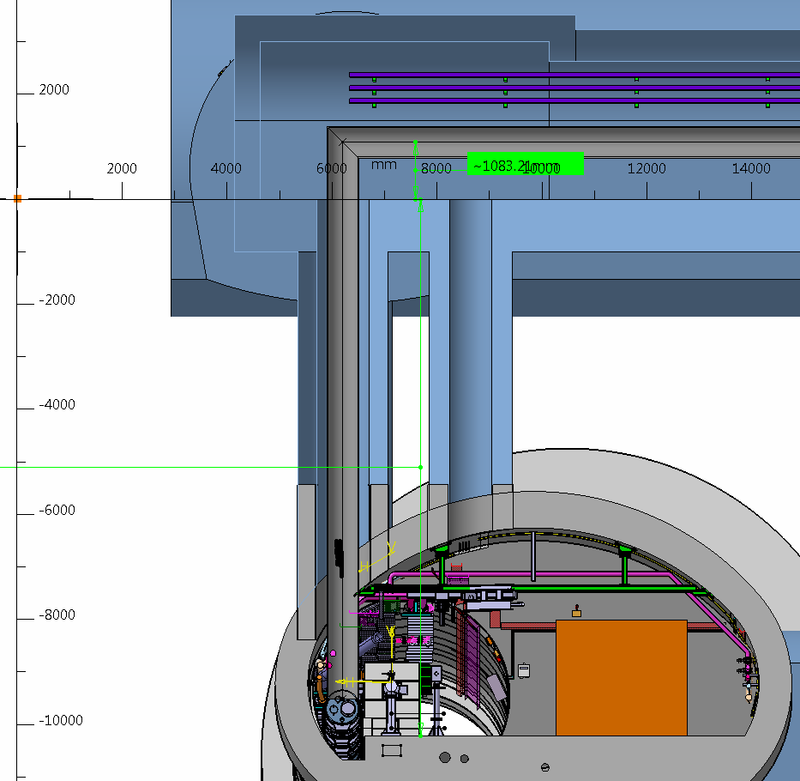
95.25 m
UL57
QXL
10.2 m
UJ57

Slide 42
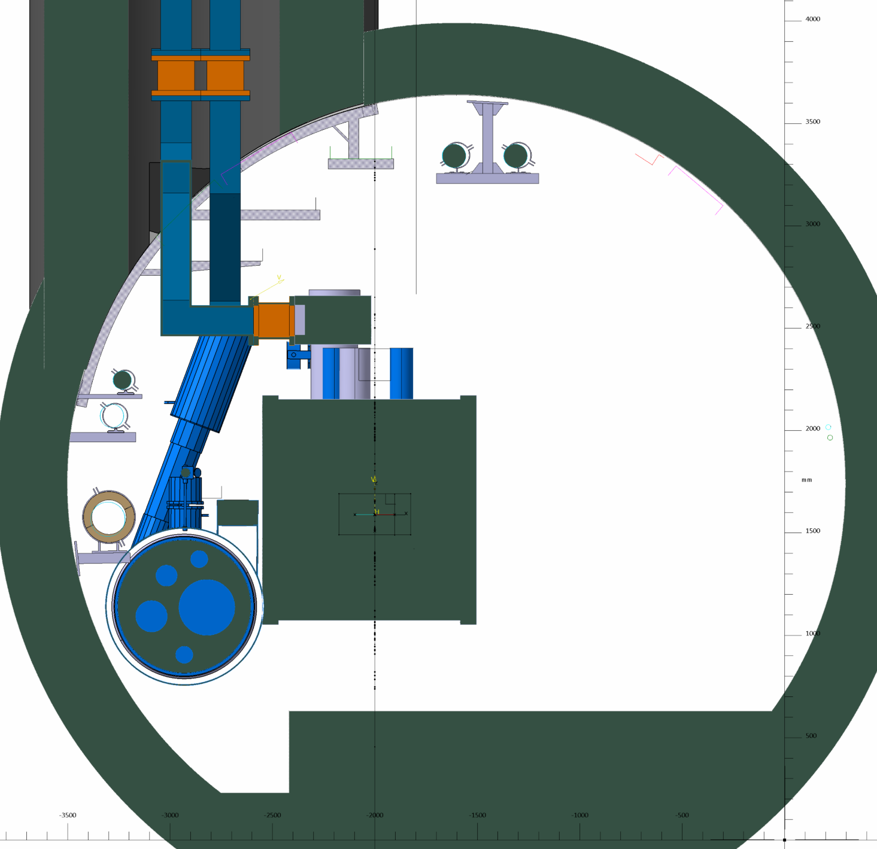
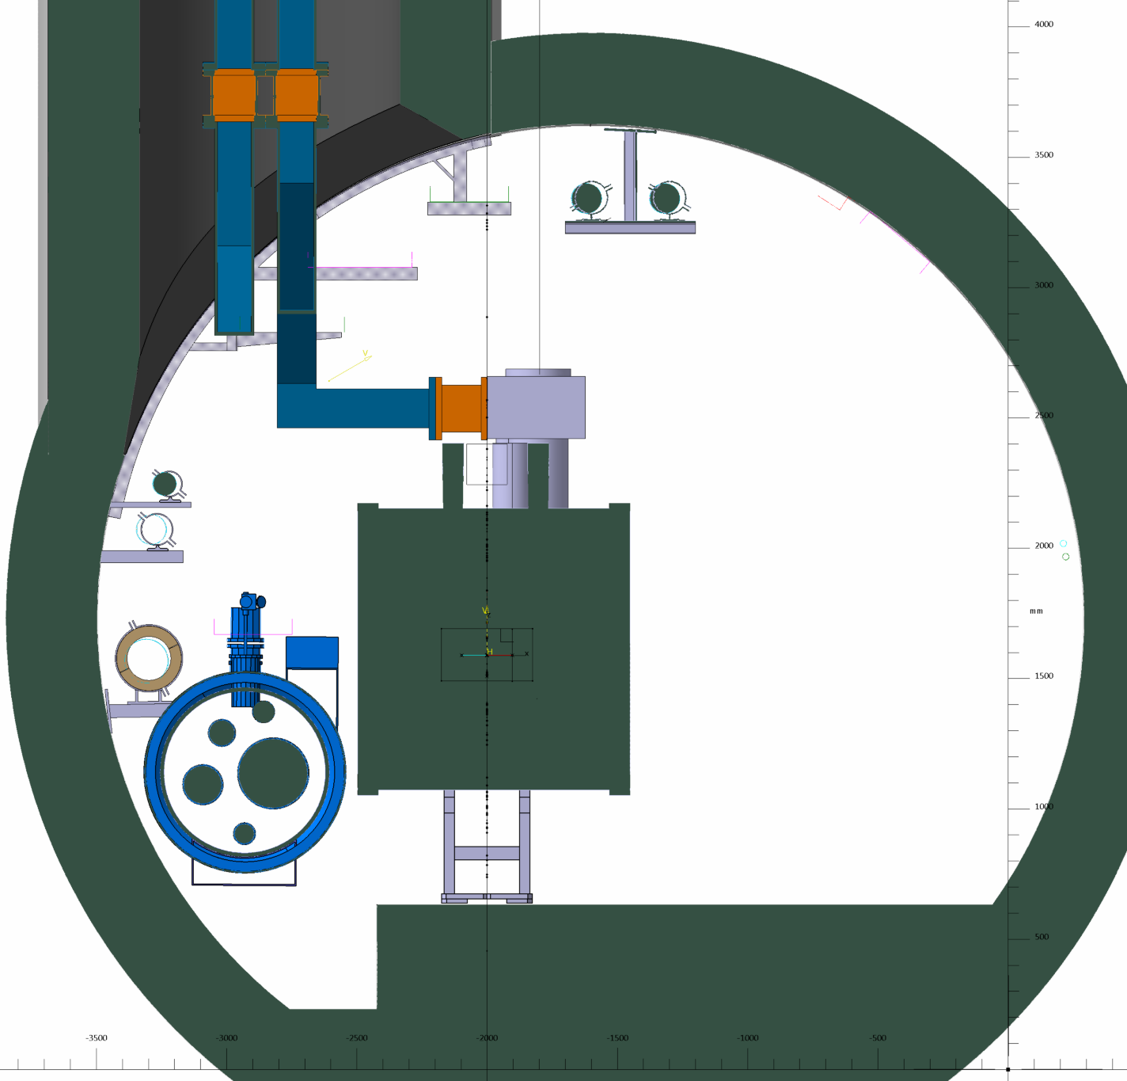
IMPACTED ZONE R571 TUNNEL

Slide 43
TO DISMOUNT :
Machine side (left)
All cables
ALL cables trays (CT) +
Support structure of CT
Helium ring line
Warm recovery line
Compressed air pipe
QRL !
Transport side
Not necessary!

Slide 44
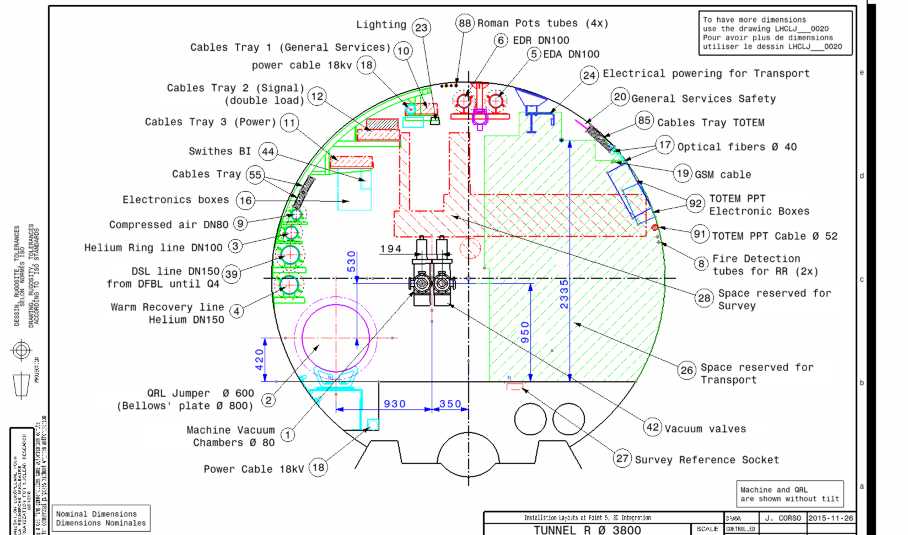
SERVICES IMPACTED BY DRILLING CORES

Slide 45
p5L

Slide 46
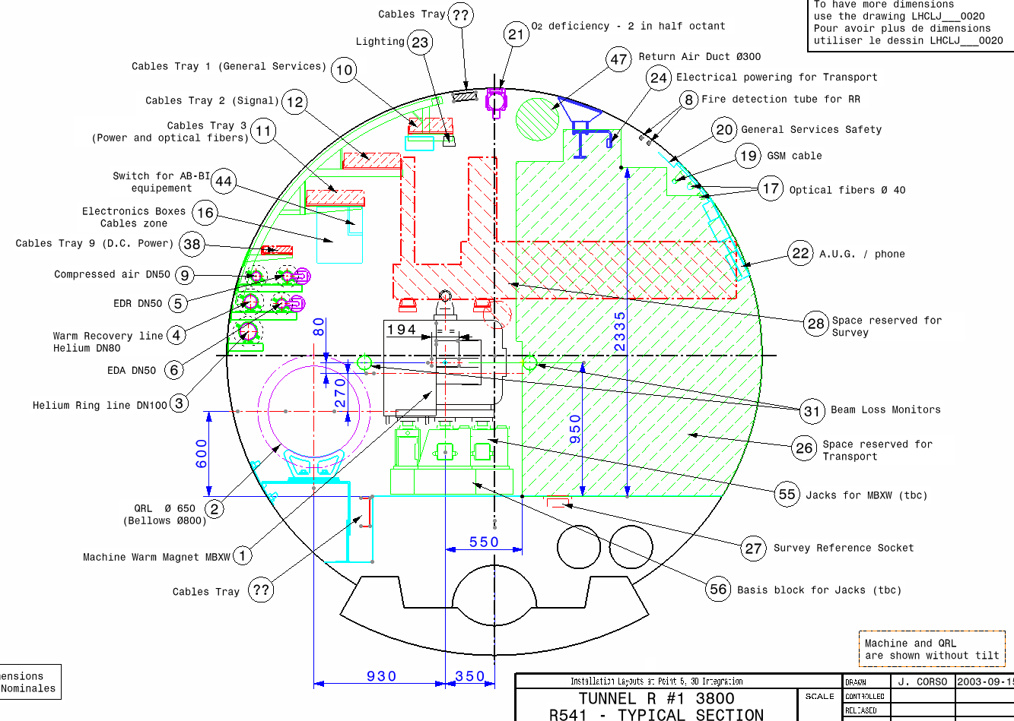
SERVICES IMPACTED BY DRILLING CORES

Slide 47

Ø 1.7 M
IMPACTED ZONE R541 TUNNEL
SCLINK CORE ( -93.25 )

Slide 48

NEW CONCEPT OF DFX (VERTICAL POSITION/ CORE)

Slide 49

NEW CONCEPT OF DFX (VERTICAL POSITION/ CORE)

Slide 50


Slide 51

IMPACTED ZONE R541 TUNNEL
Ø 1.7 M
SERVICE CORE (-94.95)

Slide 52

IMPACTED ZONE R541 TUNNEL
Ø 1.7 M
QRL CORE ( -95.25 )

Slide 53
TO DISMOUNT :
Machine side (left)
Ventilation duct Ø 300
All cables
ALL cables trays (CT) +
Support structure of CT
Helium ring line
Warm recovery line
EDR & EDA
Compressed air pipe
QRL !
Transport side
Ventilation duct Ø 300
Transport rail & Support (if present)
Safety cables & support (if present)
GSM CABLE
OPTIC FIBER CABLE

Slide 54

Ø 1 M
Ø 1.7 M
1.7
93,25 M TO IP 5
2

Slide 55




Ø 1.7 M
2.3 M

Slide 56


R532
D2
C.C.
C.C.
R532
D2
C.C.
C.C.

Slide 57

BOTTOM VIEW TUNNEL R532
UJ53
≈ 14.9 M
≈ 10.4 M
154,95 M TO IP 5

