Slide 1
LIU Commissioning Coordination Committee
Schedules of ISTs
Julie Coupard, Verena Kain
Friday 29th March 2019

Slide 2
Past Experiences
LHC-PM-QA-0010: “Prior to the commissioning phase, every equipment will undergo the so-called individual system tests (IST) which validate its proper functioning”
Existing procedure in EDMS
  Individual System Tests: LHC-%-TP-% (LHC procedures), L4-%-TP-% (Linac4 procedures)
  Hardware Commissioning: LHC-%-HCP-% (LHC procedures), PSB-%-HCP-% (PSB procedures)
  If additional procedures exists, they must be linked to the Hardware Baseline managed by EN-ACE

Slide 3
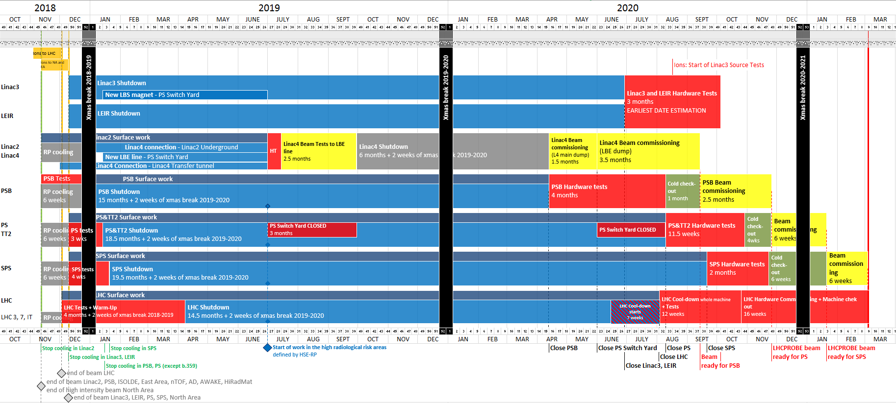
Master schedule - the phases
IEFC 12th October 2018
Magnet tests
Shutdown
Hardware
commissioning
Beam
commissioning
Additional activities (not indicated in master schedule):
Individual System Tests (IST)
Dry runs

Slide 4
Organization
IEFC 12th October 2018
Magnet tests→ BE-OP
  Carried out by equipment experts in collaboration with OP
  Machine closed. No other activity in machine
  No powering network separation
Shutdown→ EN-ACE
  Machine in access and partially not powered
  Coordination of activities through facility coordinators
  Individual system tests
  Dry runs
Hardware commissioning→ BE-OP
  Machine closed
  Individual system tests
  Final qualification of all equipment and controls for beam according to operational scenarios and with operational tools

Slide 5
Dry runs and Individual System Tests - definition
IEFC 12th October 2018
Individual system tests
  Need to be carried out before dry runs and hardware commissioning tests
  Not executed in operational environment, not relying on operational tools nor (necessarily) scenario → defined by equipment experts
  Example: conditioning of kickers
Dry runs
  Organized by OP in collaboration with equipment experts and facility coordinators (shutdown period)
  Philosophy of staged deployment
  Vertical slice testing of equipment with operational tools and according to operational scenarios
  All interfaces required

Slide 6
Dry runs and Individual System Tests - LS2
IEFC 12th October 2018
Ideally IST and dry runs during Shutdown, but:
Co-activity and safety ←→ separation of powering network
Main issue with: RF, kickers, septa and magnets
Therefore:
IST of systems impacted by separation of powering network to be carried out during hardware commissioning period
  If time insufficient: 6 weeks IST period at the end of shutdown foreseen for each machine
    Joint coordination between EN-ACE & BE-OP (needs and resources under discussion)
  If even longer time is required or period in the middle of LS2: organisation/safety to be discussed in LS2C with compensatory measures

Slide 7
Summary
IEFC 12th October 2018
IST for equipment impacted by the network separation during Hardware Commissioning or dedicated IST at end of shutdown
  IST can only be local and not affect entire machine at the same time.
All "other" IST: to be carried out during shutdown coordinated by facility coordinators in collaboration with equipment owners.
Essential:
  Groups to provide the list of all required IST
  Facility coordinators to compile list of required tests and include in the LS2 schedule

Slide 8
From Shutdown Activities to Hardware Commissioning
Objectives
  Schedule all activities of tests from individual system to multiple systems
    Get the information for scheduling, including safety aspects
    Schedule the tests in the shutdown or hardware commissioning time window
  Identify any conflicts between activities of tests and activities of installation across facilities to define priorities
    Extract activities per group (installation and tests) through the overall accelerators’ chain (injectors and LHC)
    Identify resource over allocations
    Define priorities
The follow-up of objective (1) will be done in the Hardware and Beam Commissioning working groups
The final results of objective (2) will be presented at the LIU Commissioning Coordination Committee
To reach the objectives, we need a collaborative approach between the Experts of system, EN-ACE and BE-OP

Slide 9
From Shutdown Activities to Hardware Commissioning
1. Schedule all activities of tests from individual system to multiple systems
Get the information for scheduling, including safety aspects
  The Experts of system in each groups must provide the information to EN-ACE and BE-OP
    The information about the tests must include the sequence of tasks, duration
    Each task (or group of tasks) must include prerequisites (General Services, Controls, Ethernet, Vacuum, HV Circuits locked-out by the network separation procedures*, etc…)
    The risks generated by the tests must be defined with compensatory measures (Ex. HV all around the machine → machine closed)
  Deadline: end of June 2019
    *PSB-E-PRD-0001, PS-E-PRD-0001, SPS-E-PRD-0001
Schedule the tests in the shutdown or hardware commissioning time window
  The tests will be scheduled by EN-ACE and BE-OP according to the information provided as defined above
    For each machine, the persons in charge to schedule the tests are the Facility Coordinator(s) and the Re-commissioning Coordinator(s), working together
    Dedicated meeting could be organized with Experts of systems if necessary
    The schedule(s) of tests to be performed in the Shutdown time window will be stored in MS Project Online and managed by EN-ACE
    The schedule(s) of tests to be performed in the Hardware Commissioning time window must be stored in MS Project Online to reach the objective 2 and managed by BE-OP (support from EN-ACE can be provided if necessary)
  Any tests that require to close access of the overall machine will be scheduled during the Hardware Commissioning
  Deadline: end of July 2019

Slide 10
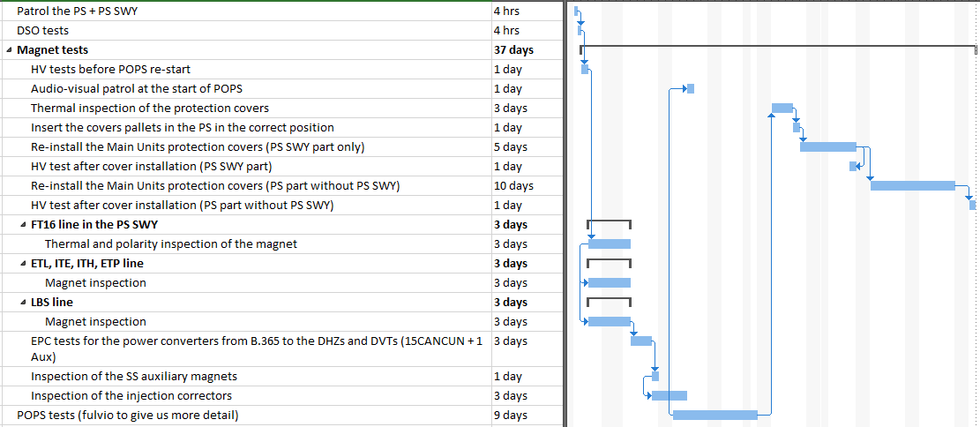
From Shutdown Activities to Hardware Commissioning
1. Schedule all activities of tests from individual system to multiple systems
Example of scheduling work ongoing in the PS

Slide 11
From Shutdown Activities to Hardware Commissioning
2. Identify any conflicts between activities of tests and activities of installation to define priorities
Extract activities per group (installation and tests) through the overall accelerators’ chain (injectors and LHC)
  The extraction will be done in MS Project Online by EN-ACE and sent to the group
    The extraction of data must contain name of the activity, duration, dates, group, responsible
  Deadline: mid-August 2019
Identify resource over allocations
  The group must identify any conflicts according to resource allocations and inform EN-ACE and BE-OP
  Mitigations of scheduling must be proposed by EN-ACE and BE-OP
    The schedule options/proposals must not impact on the LS2 Master Schedule
  Deadline: end of September 2019
Define priorities
  Priorities can be defined at the level of the LIU machine coordination (LIU Tech. meeting and/or LIU HBC meeting) if impact on single machine
  Priorities can be defined at the level of the LIU commissioning coordination committee if impact on several machines
  Priorities can be defined at the level of the LS2 Committee if impact on the LS2 Master Schedule

Slide 12
Summary
List of tests
End of June
Extraction for the groups
Identification of conflicts
Schedule of tests
End of July
Mid-August
End of September
Contacts | Facility Coordinators | Re-commissioning Coordinators
Linac3 | Christian Mastrostefano | Reyes Alemany Fernandez
LEIR | Dom Nicosia Chris Wetton | Reyes Alemany Fernandez
Linac4 | Luca Timeo (Julie Coupard) | Bettina Mikulec
PS Booster | David Hay | Fabrice Chapuis Abdel Akroh
PS&TT2 | Fernando Pedrosa | Oliver Hans Marc Delrieux (Denis Cotte)
SPS | David Mcfarlane Jonathan Meignan Antonio Grande | James Ridewood Stephane Cettour Cave

