Slide 1
Possibility to suppress the installation of MS in Q10 in IR1 & 5
F. Plassard, R. De Maria
Thanks to: X. Buffat, S. Fartoukh, M. Giovannozzi,
S. Kostoglou, E. Maclean, T. Persson, F. Van der Veken
WP2 Meeting 19/03/2019

Slide 2

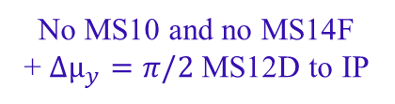
Introduction
The HL-LHC foreseen the installation of an additional sextupole at Q10, named MS10 on each side of the IP 1 & 5 in order to preserve the DA (Baseline optics).
Alternative optics have been optimized without MS10 and their performances were addressed.
Baseline
No MS10
No MS14F
No MS14F MS14D
Additional MS10 in IR1&5
LHC configuration
No MS10 and no MS14F
+ ${Δµ}_{y}=π/2$ MS12D to IP
No MS10, no MS14F and no MS14D
Disp. Corr. Bumps
Option 1
Disp. Corr. Bumps
Option 2
Same ATS factor
Larger ATS factor
New Δ$µ_{y}$ IP1-5
All the simulations performed on the HL-LHCv1.4 optics, $β_{x,y}^{IP1\&5}$ = 15 cm without Beam-beam and on Beam 1

Slide 3
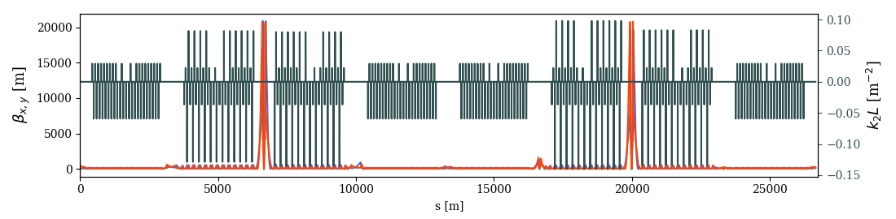
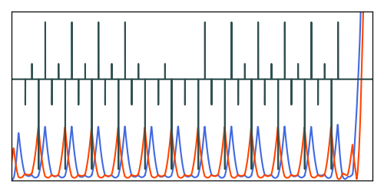
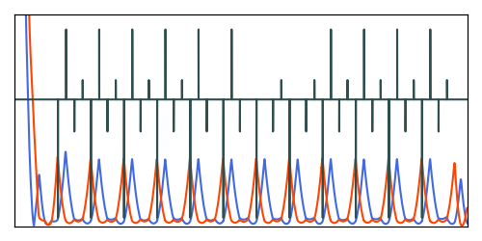
Baseline optics
IP5
IP1
MS10F
MS10D
Arcs | Circuit (strong)
B1: 81, 45 | SF1 (10), SD2 (12)
B2: 81, 45 | SF1 (10), SD2 (12)
B1: 12, 56 | SF1 (10), SD2 (12)
B2: 12, 56 | SF1 (10), SD2 (12)
The additional MS10 in each side of IP1&5 restore an even number of sextupoles allowing the cancellation of geometrical aberrations

Slide 4
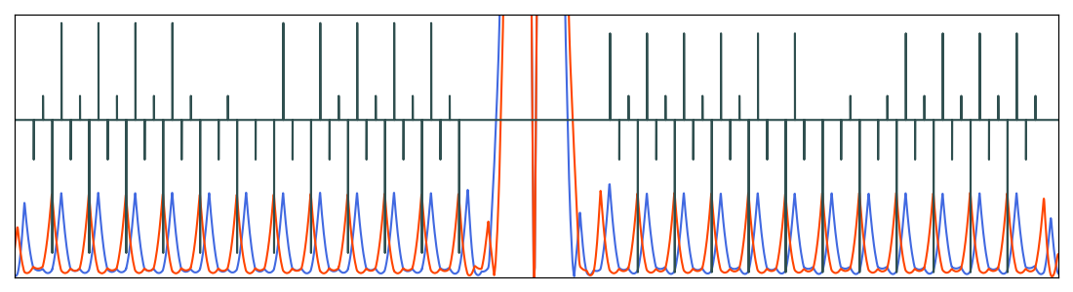
Observations: No MS10 optics
No MS10: Same sextupole configuration as in LHC
9 SF
IP1-5 (B1)
11 SD
Odd number of sextupoles on each side of IP1&5
Less compensation of the sextupole geometrical aberrations
Arcs | Circuit (strong)
B1: 81, 45 | SF1 (9), SD2 (12)
B2: 81, 45 | SF1 (10), SD2 (11)
B1: 12, 56 | SF1 (10), SD2 (11)
B2: 12, 56 | SF1 (9), SD2 (12)

Slide 5
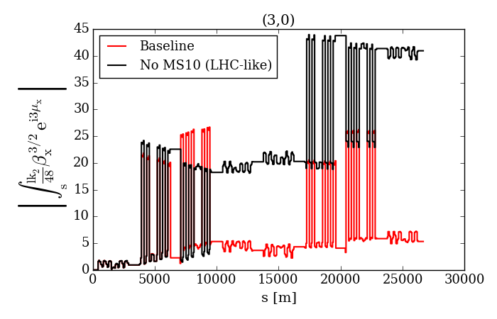
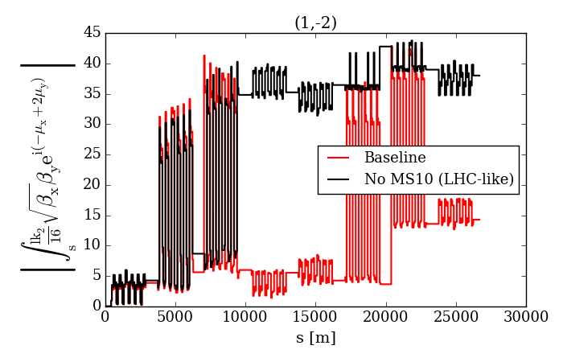
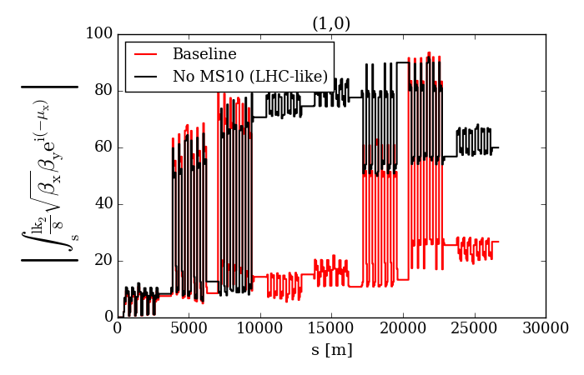
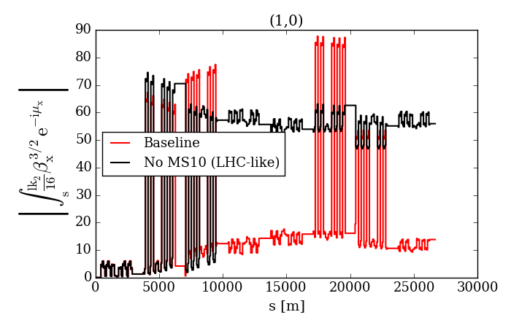
Observations: No MS10 optics
Very large geometric aberrations from MS scaling with ATS factors:

Slide 6
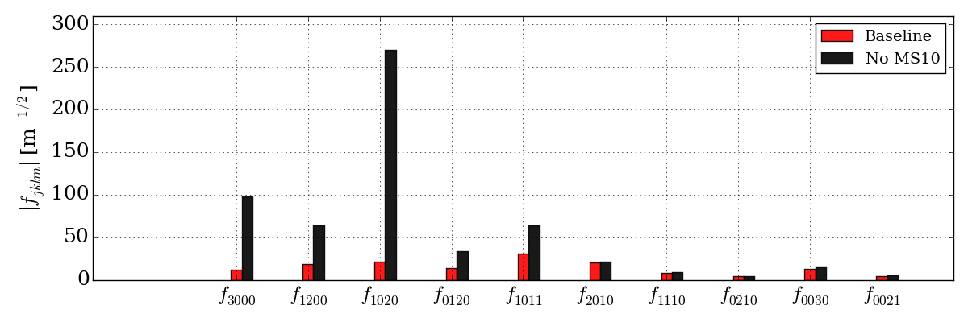
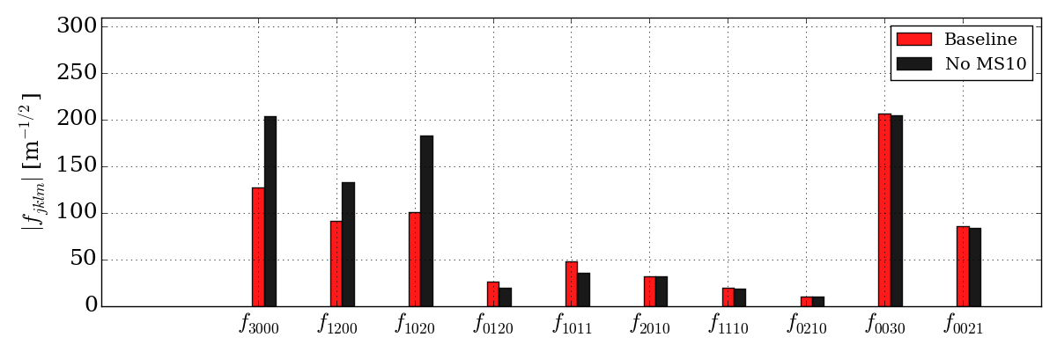
Observations: No MS10 optics
Very large geometric aberrations from MS scaling with ATS factors:
MO = 0 A
MO = -570 A
RDTs computed from PTC, with orbit bumps

Slide 7
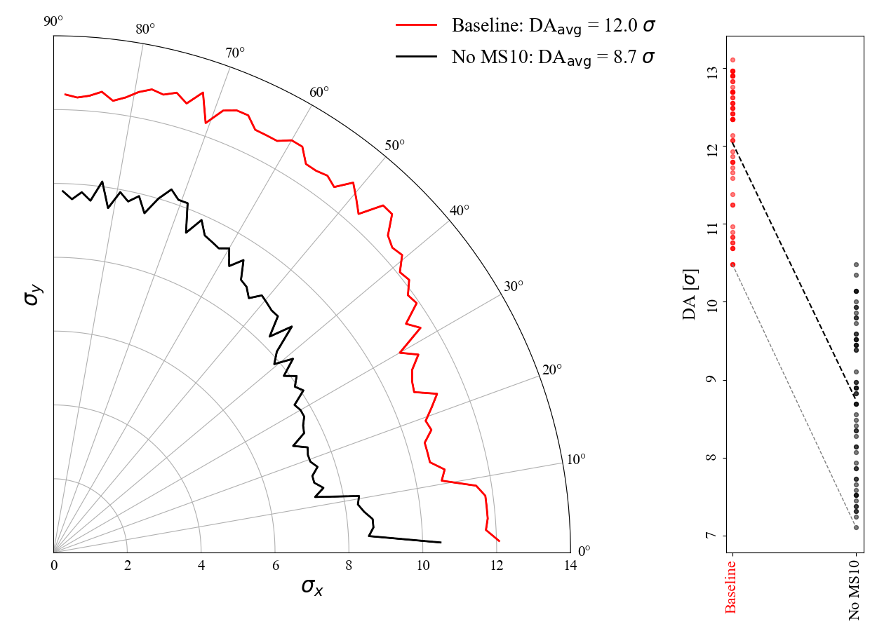
Observations: No MS10 optics
Lower DA than Baseline:
xing = 295 $µ$rad, $Q_{x}$= 62.31 / $Q_{y}$= 60.32, $δ_{p}$= 2.7$×{10}^{−4}$, without imperfections,
with dispersion correction, Q’=15, Laudau octupoles MO = -570 A, ${10}^{6}$ turns, 60 angles

Slide 8
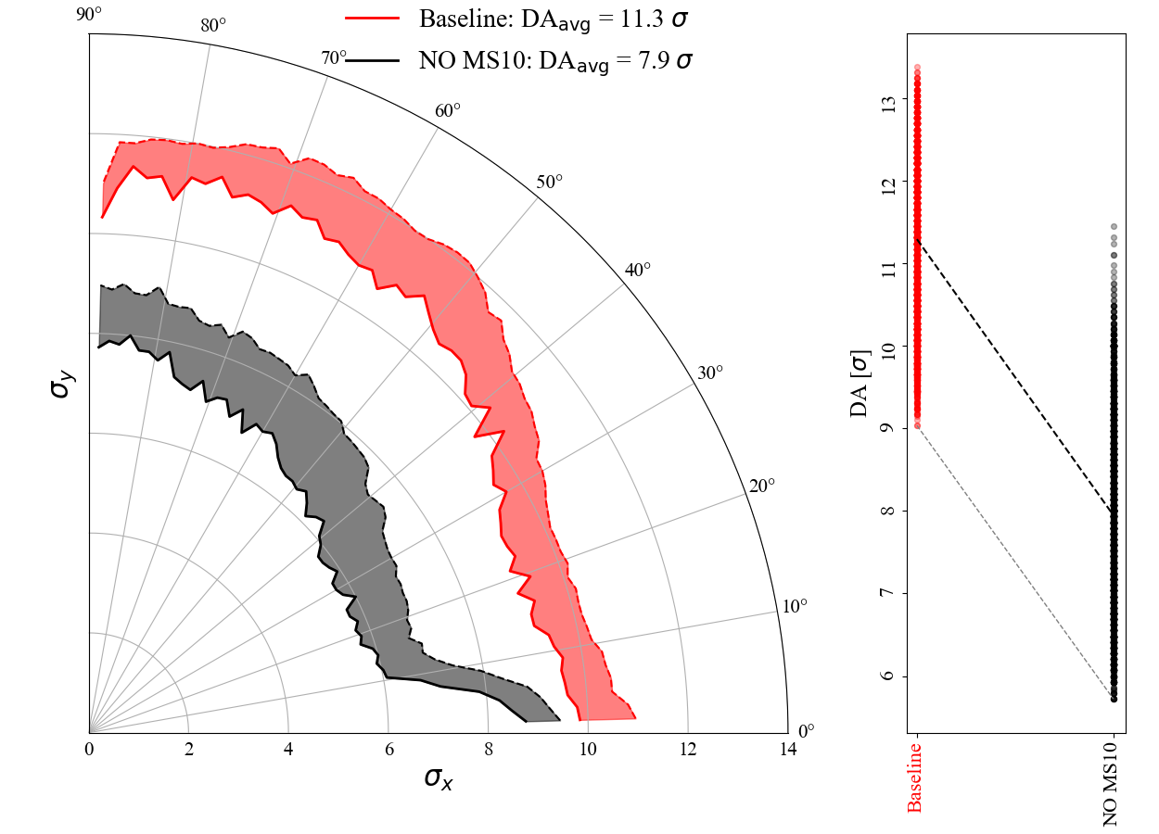
Observations: No MS10 optics
Lower DA than Baseline:
xing = 295 $µ$rad, $Q_{x}$= 62.31 / $Q_{y}$= 60.32, $δ_{p}$= 2.7$×{10}^{−4}$, with imperfections,
with dispersion correction, Q’=15, Laudau octupoles MO = -570 A, ${10}^{6}$ turns, 60 angles

Slide 9
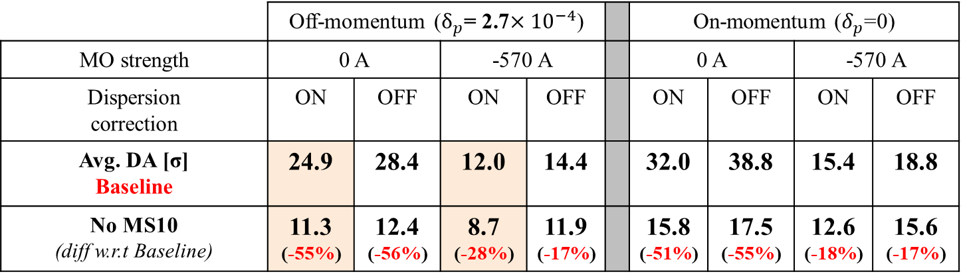
Observations: No MS10 optics
Lower DA than Baseline in all possible cases:
 | Off-momentum ($δ_{p}$= 2.7$×{10}^{−4}$) |  |  |  |  | On-momentum ($δ_{p}$=0)
MO strength | 0 A |  | -570 A |  |  | 0 A |  | -570 A
Dispersion correction | ON | OFF | ON | OFF |  | ON | OFF | ON | OFF
Avg. DA [σ] Baseline | 24.9 | 28.4 | 12.0 | 14.4 |  | 32.0 | 38.8 | 15.4 | 18.8
No MS10 (diff w.r.t Baseline) | 11.3 (-55%) | 12.4 (-56%) | 8.7 (-28%) | 11.9 (-17%) |  | 15.8 (-51%) | 17.5 (-55%) | 12.6 (-18%) | 15.6 (-17%)
DA simulations performed without imperfections, on/off momentum, with/without octupoles and orbit bumps for the dispersion correction.
Large decrease of DA for on-momentum beam showing a clear impact of the geometrical aberrations

Slide 10
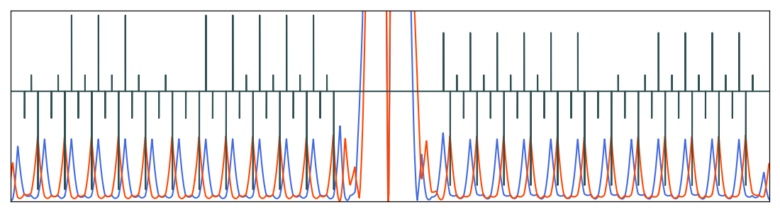

Observations: No MS14F optics
No MS14F
No MS10F
No MS10D
New phases in IR1 & 5 : ${∆µ}_{y}^{IR1\&5}$ = -$\frac{π}{2}$
12 strong defocusing & 11 local defocusing sextupoles
No additional sextupole and MS14F disconnected (in 81 & 45)
Change of phase and optics rematch (in 12 & 56)
Even number of strong sextupoles on each side of IP1&5 → geom. aberr. Cancellation
Orbit and dispersion correction knobs have been modified accordingly
(see backup slides)
Arcs | Circuit (strong)
B1: 81, 45 | SF1 (8), SD2 (12)
B2: 81, 45 | SF1 (10), SD2 (12)
B1: 12, 56 | SF1 (10), SD2 (12)
B2: 12, 56 | SF1 (8), SD2 (12)

Slide 11
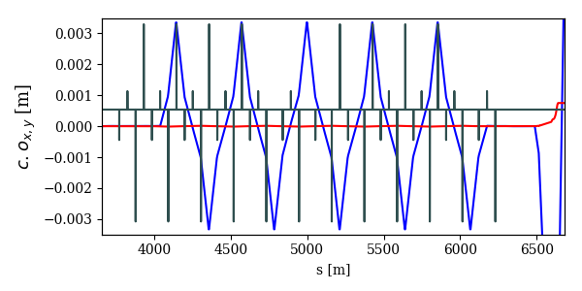
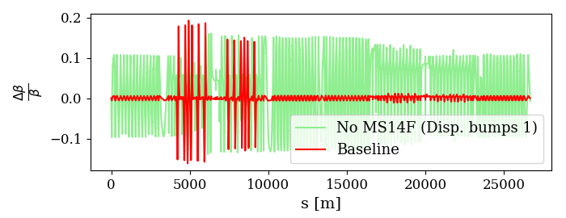
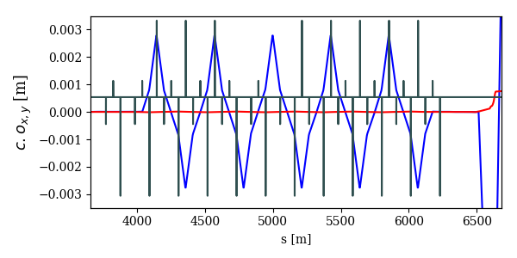
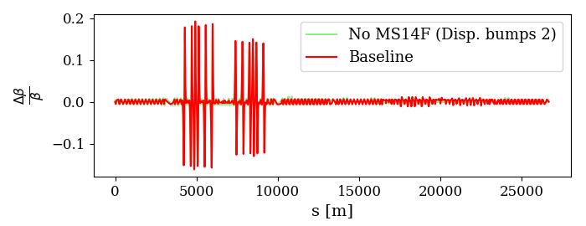
Observations: No MS14F optics
Disp. Corr. Bumps Option 1
Larger β-beating than Baseline due to the orbit bumps
No MS14F
Disp. Corr. Bumps Option 2
Same β-beating than Baseline
No MS14F
Only option 2 optics is considered in the following simulations

Slide 12
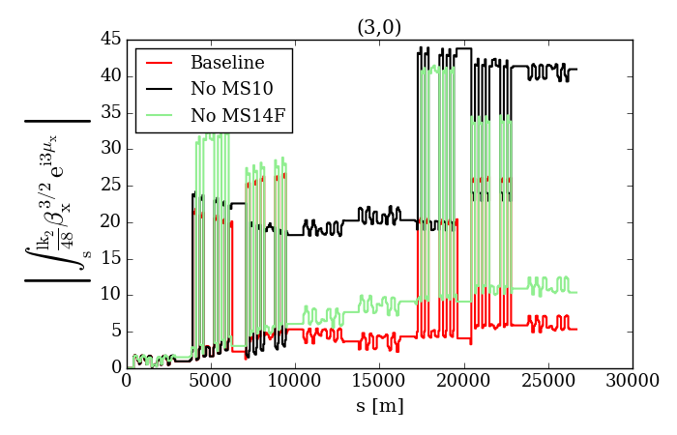
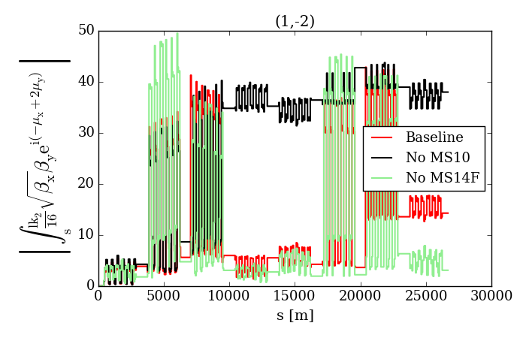
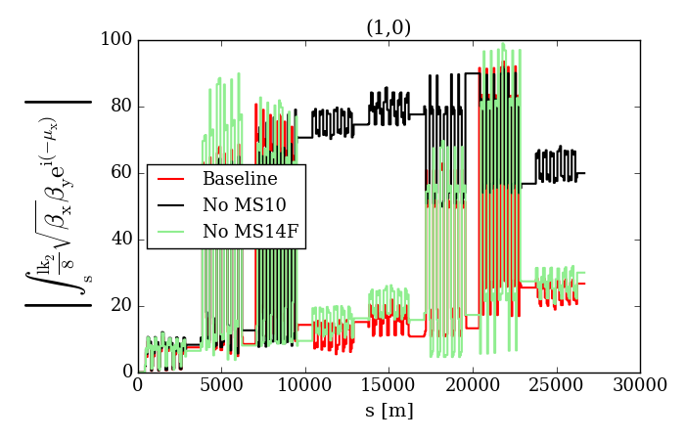
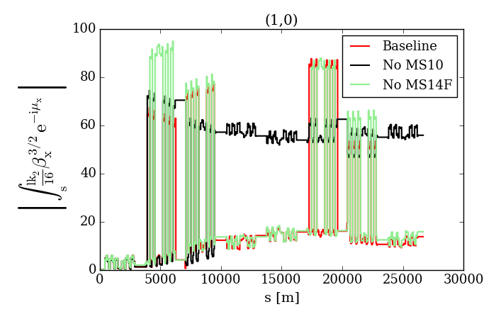
Observations: No MS14F optics
Good cancellation of geometric aberrations (comparable to Baseline)

Slide 13
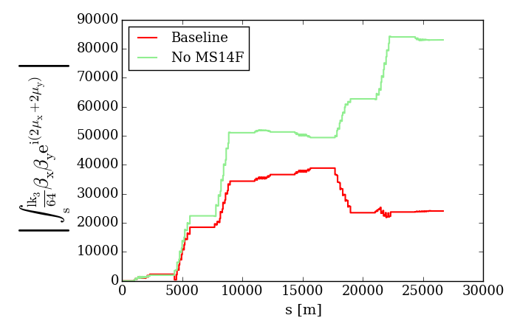
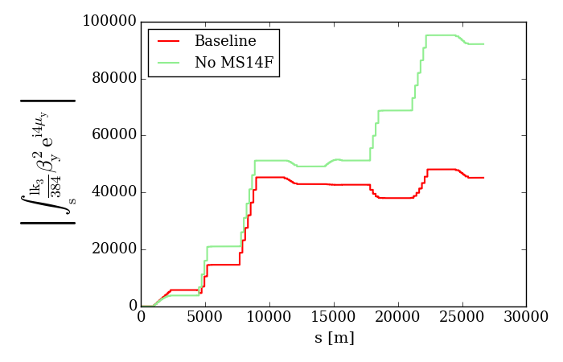
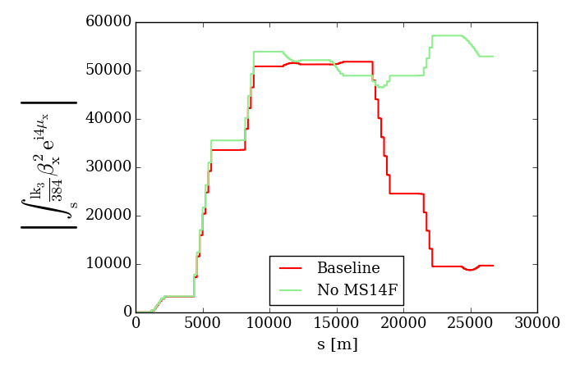
Observations: No MS14F optics
Some octupolar RDTs were not properly compensated (No MS14F optics)

Slide 14
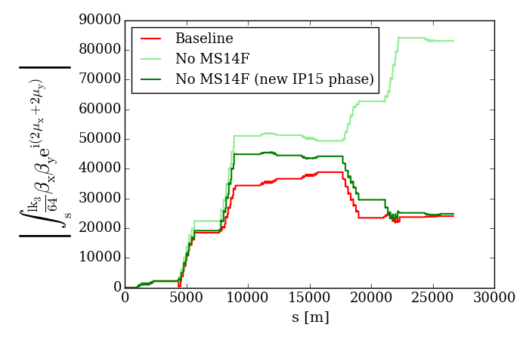
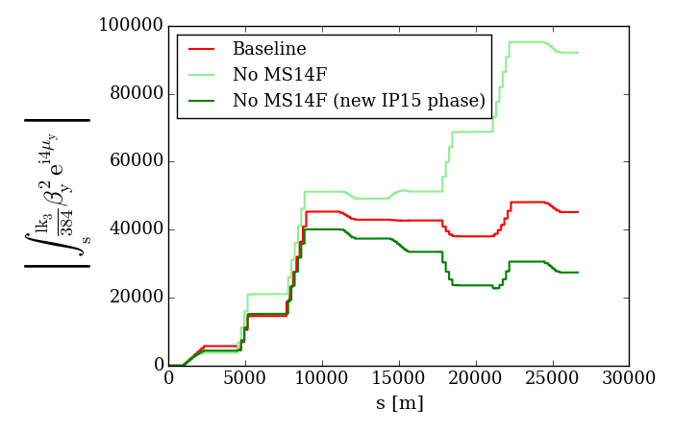
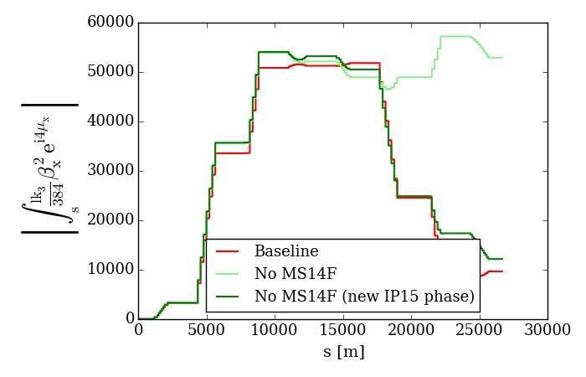
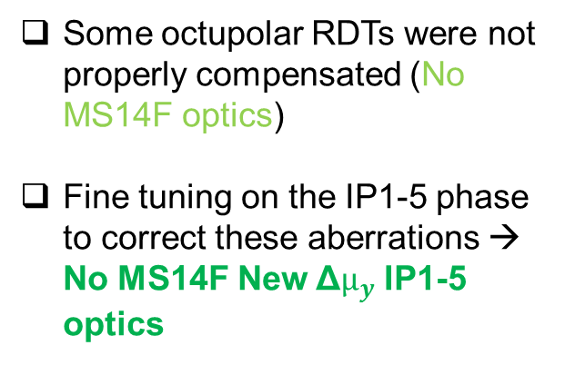
Observations: No MS14F optics
Some octupolar RDTs were not properly compensated (No MS14F optics)
Fine tuning on the IP1-5 phase to correct these aberrations → No MS14F New Δ$µ_{y}$ IP1-5 optics

Slide 15
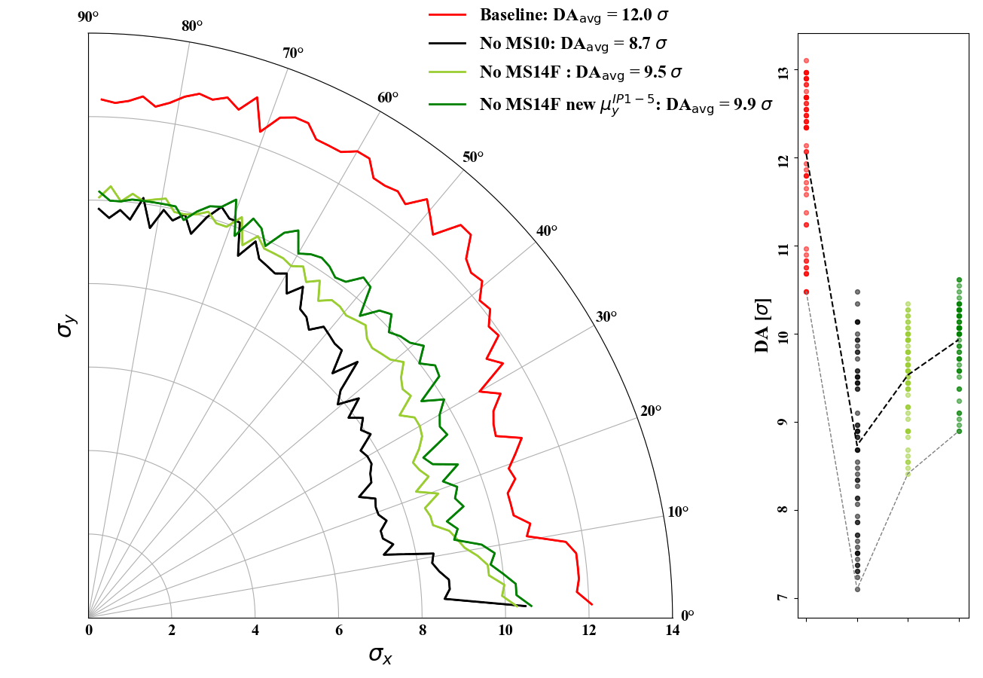
Observations: No MS14F optics
Optimizing the IP1-5 phase for the no MS14F optics increase DA by 0.4 σ but there still 2.1 σ DA reduction w.r.t Baseline
xing = 295 $µ$rad, $Q_{x}$= 62.31 / $Q_{y}$= 60.32, $δ_{p}$= 2.7$×{10}^{−4}$, without imperfections,
with dispersion correction, Q’=15, Laudau octupoles MO = -570 A, ${10}^{6}$ turns, 60 angles

Slide 16
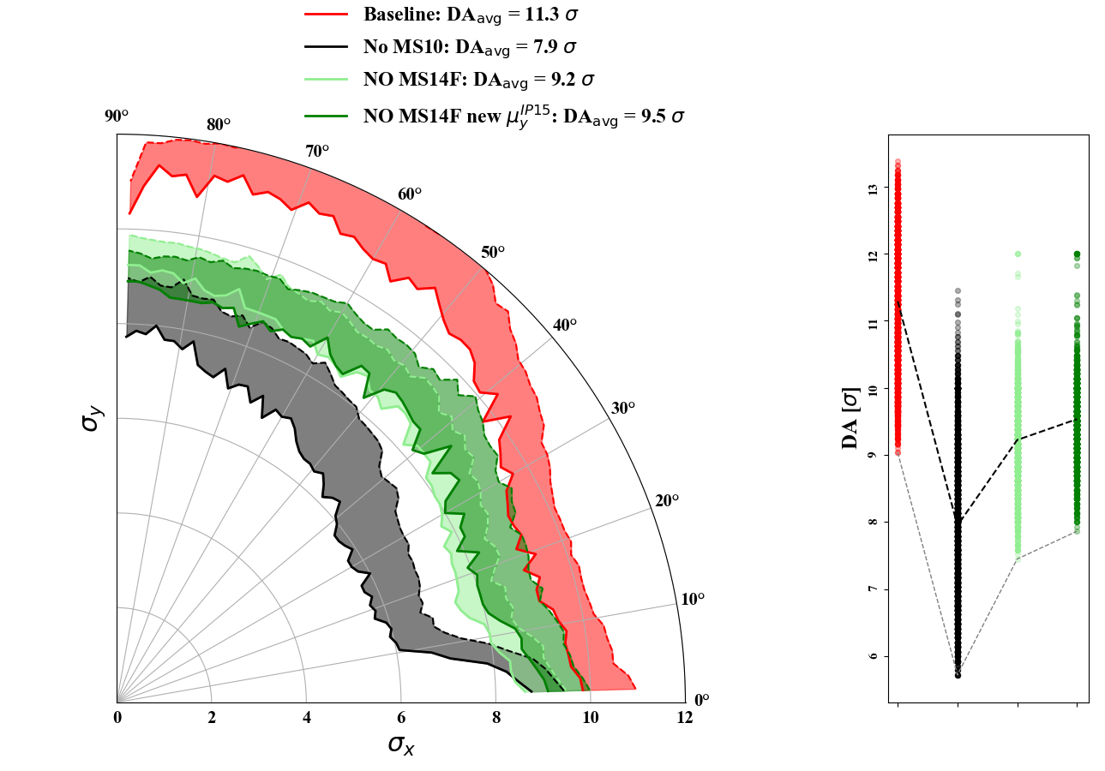
Observations: No MS14F optics
Optimizing the IP1-5 phase for the no MS14F optics increase DA by 0.3 σ but there still 1.8 σ DA reduction w.r.t Baseline
xing = 295 $µ$rad, $Q_{x}$= 62.31 / $Q_{y}$= 60.32, $δ_{p}$= 2.7$×{10}^{−4}$, without imperfections,
with dispersion correction, Q’=15, Laudau octupoles MO = -570 A, ${10}^{6}$ turns, 60 angles

Slide 17
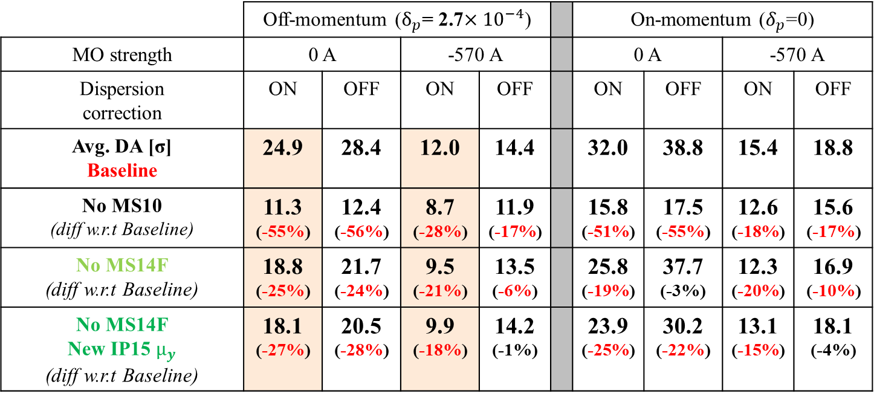
Observations: No MS14F optics
 | Off-momentum ($δ_{p}$= 2.7$×{10}^{−4}$) |  |  |  |  | On-momentum ($δ_{p}$=0)
MO strength | 0 A |  | -570 A |  |  | 0 A |  | -570 A
Dispersion correction | ON | OFF | ON | OFF |  | ON | OFF | ON | OFF
Avg. DA [σ] Baseline | 24.9 | 28.4 | 12.0 | 14.4 |  | 32.0 | 38.8 | 15.4 | 18.8
No MS10 (diff w.r.t Baseline) | 11.3 (-55%) | 12.4 (-56%) | 8.7 (-28%) | 11.9 (-17%) |  | 15.8 (-51%) | 17.5 (-55%) | 12.6 (-18%) | 15.6 (-17%)
No MS14F (diff w.r.t Baseline) | 18.8 (-25%) | 21.7 (-24%) | 9.5 (-21%) | 13.5 (-6%) |  | 25.8 (-19%) | 37.7 (-3%) | 12.3 (-20%) | 16.9 (-10%)
No MS14F New IP15 $µ_{y}$ (diff w.r.t Baseline) | 18.1 (-27%) | 20.5 (-28%) | 9.9 (-18%) | 14.2 (-1%) |  | 23.9 (-25%) | 30.2 (-22%) | 13.1 (-15%) | 18.1 (-4%)
Decrease of DA w.r.t Baseline for off and on-momentum beams when the orbit bumps are ON
With octupoles ON and disp. corr OFF → similar DA for ON/OFF momentum
With octupoles ON and disp. corr ON → DA reduction for ON/OFF momentum
Stronger feed-down at the octupoles for the No MS14F optics?

Slide 18
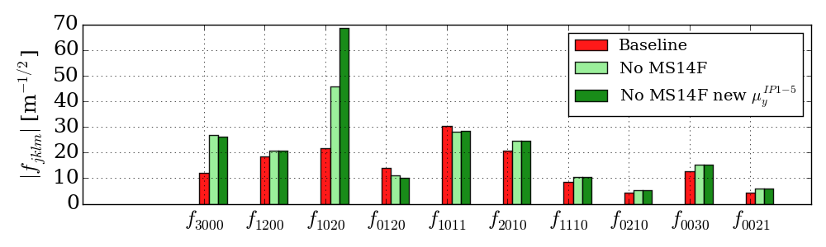
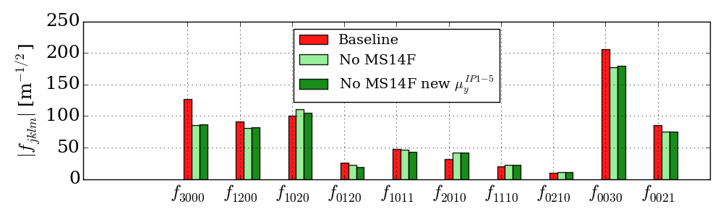
Observations: No MS14F optics
No larger RDTs feed-down from octupoles and dispersion correction compared to the Baseline
MO = 0 A
MO = -570 A

Slide 19
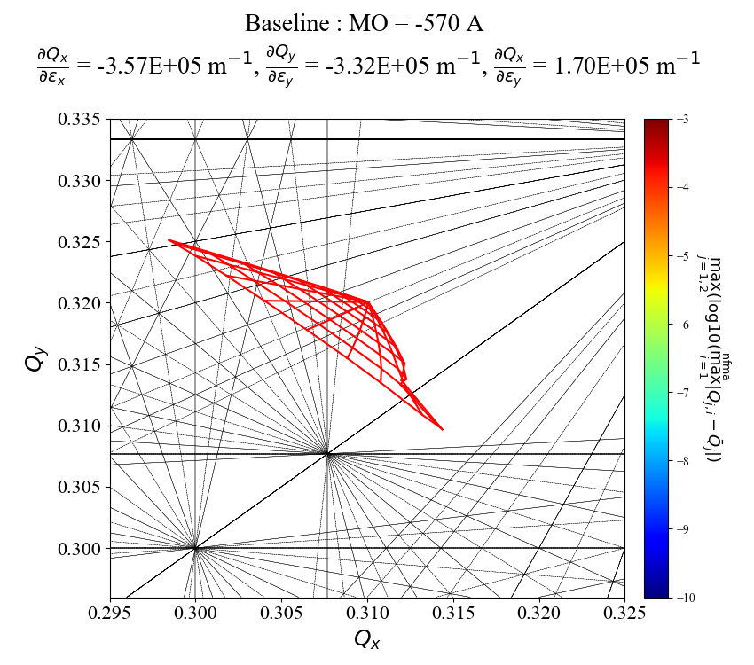
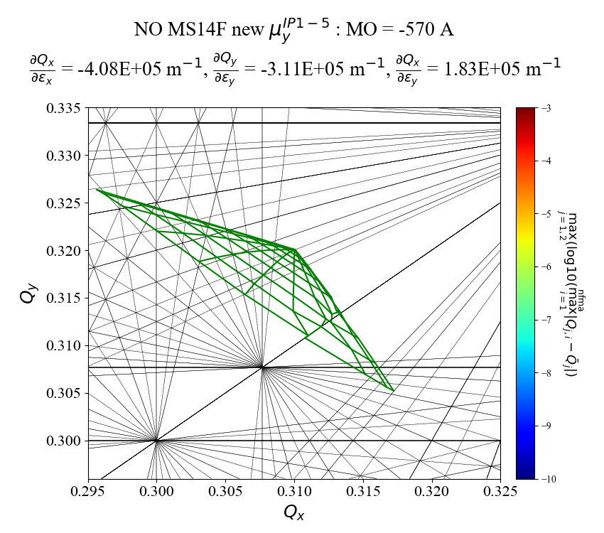
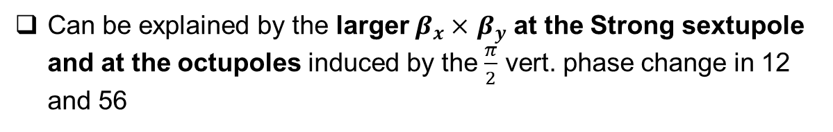
Observations: No MS14F optics
Larger amplitude detuning at same octupole current (10 σ, disp. corr ON)
(On-momentum footprints)
Can be explained by the larger $β_{x}×$ $β_{y}$ at the Strong sextupole and at the octupoles induced by the $\frac{π}{2}$ vert. phase change in 12 and 56

Slide 20
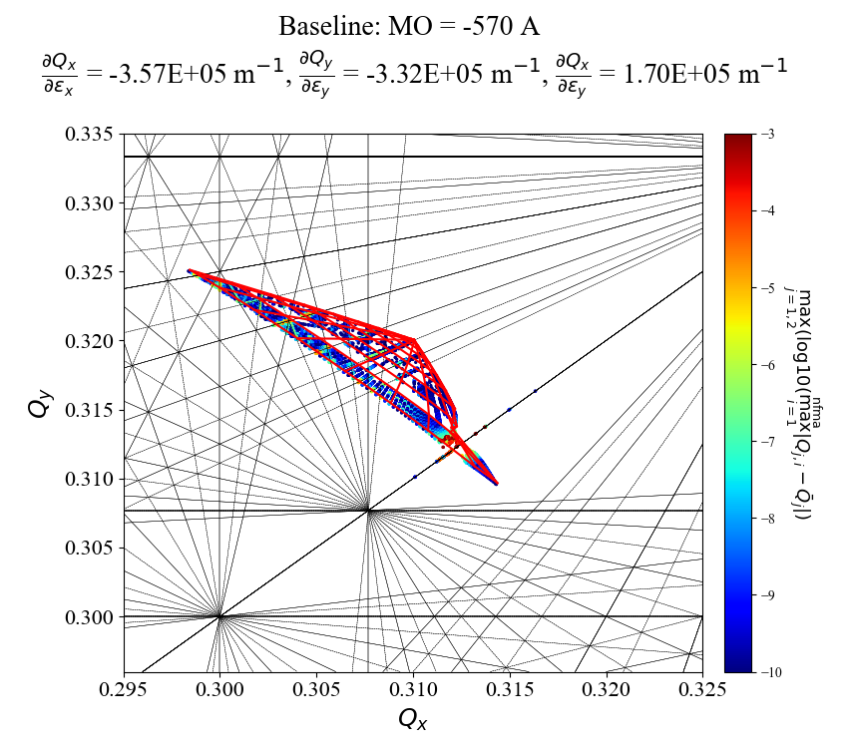
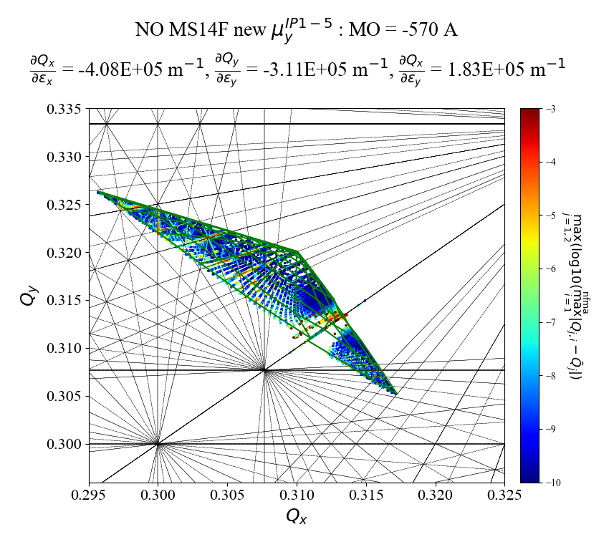
Observations: No MS14F optics
Larger amplitude detuning at same octupole current (10 σ, disp. corr ON)
(On-momentum footprints)
Can be explained by the larger $β_{x}×$ $β_{y}$ at the Strong sextupole and at the octupoles induced by the $\frac{π}{2}$ vert. phase change in 12 and 56

Slide 21
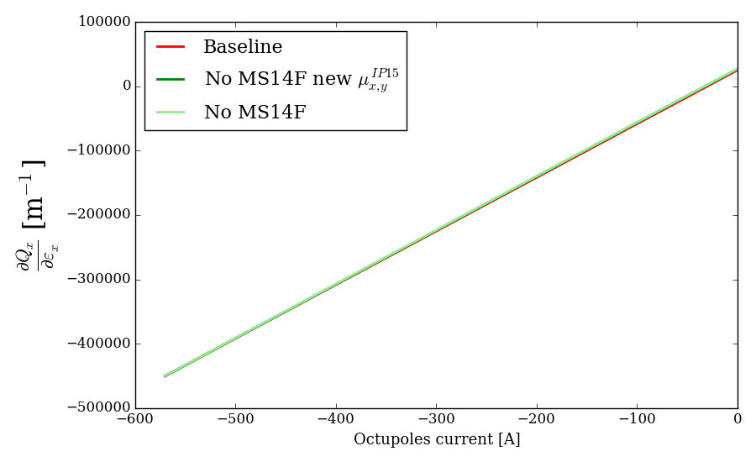
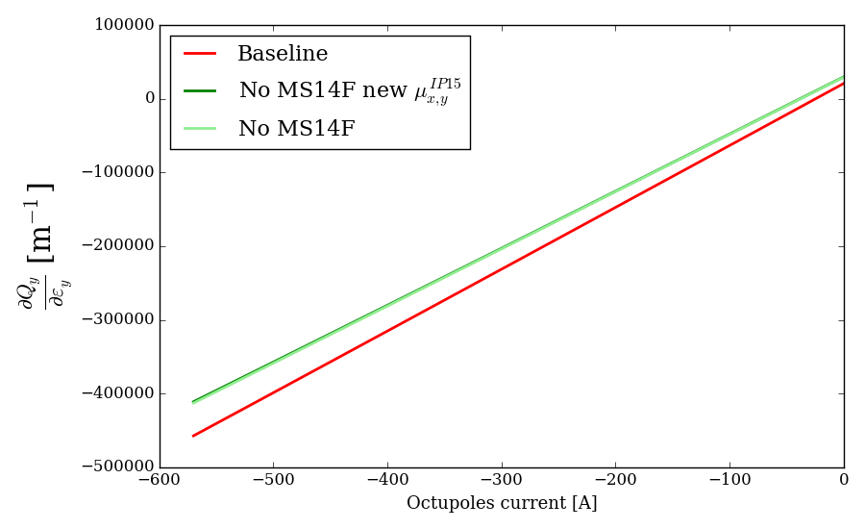
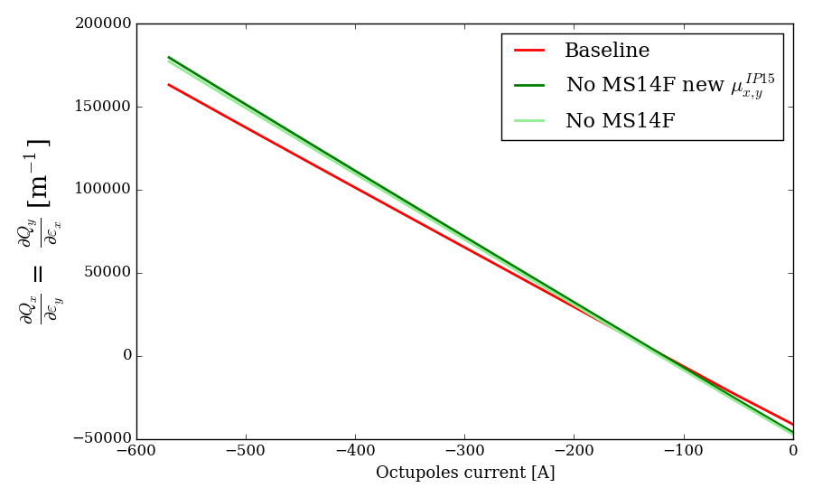
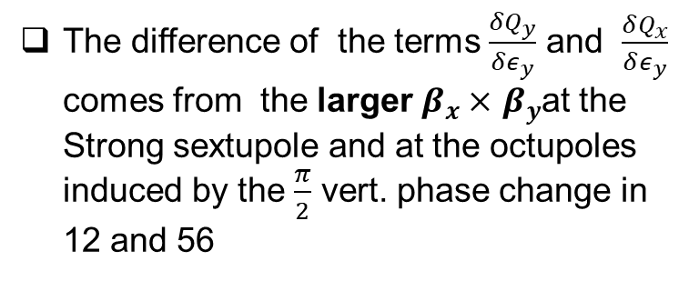
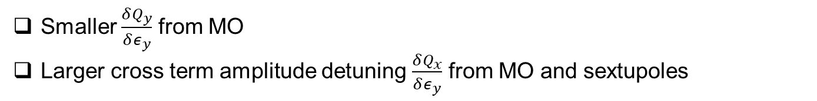
Observations: No MS14F optics
Without orbit bumps for dispersion correction
Smaller $\frac{δQ_{y}}{δε_{y}}$ from MO
Larger cross term amplitude detuning $\frac{δQ_{x}}{δε_{y}}$ from MO and sextupoles
The difference of the terms $\frac{δQ_{y}}{δε_{y}}$ and $\frac{δQ_{x}}{δε_{y}}$ comes from the larger $β_{x}×$ $β_{y}$at the Strong sextupole and at the octupoles induced by the $\frac{π}{2}$ vert. phase change in 12 and 56

Slide 22
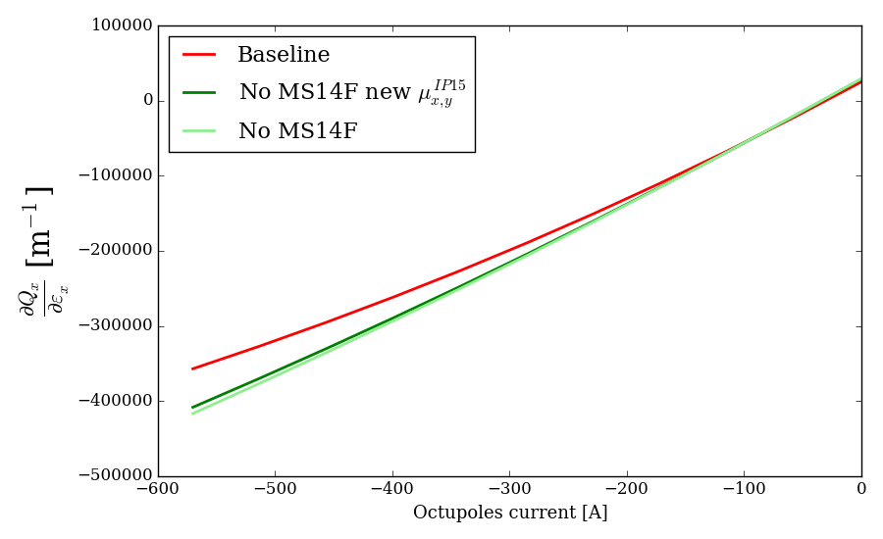
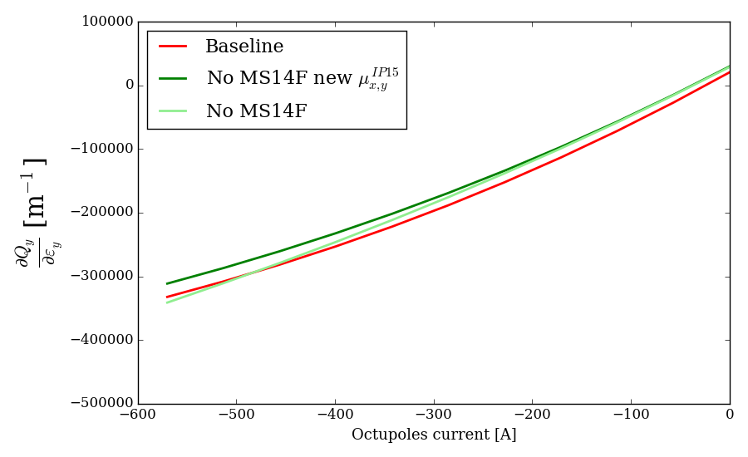
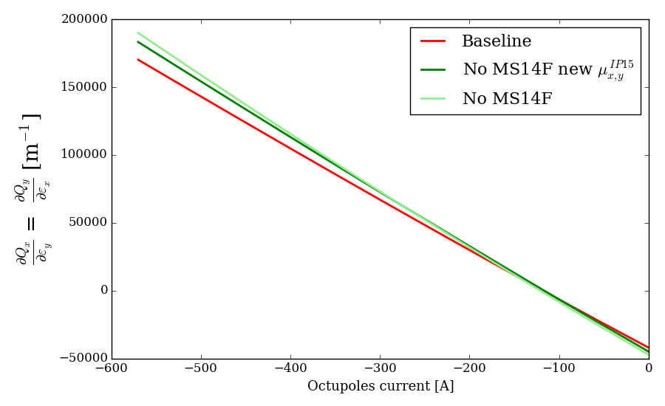
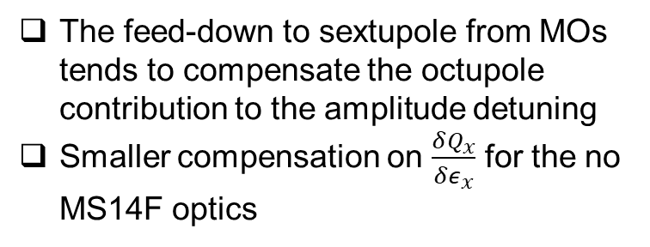
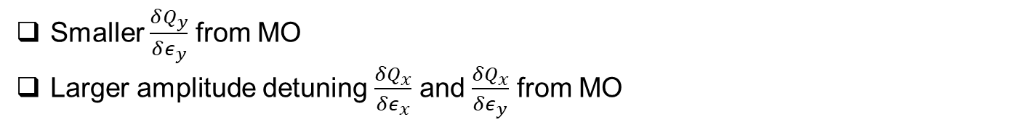
Observations: No MS14F optics
With orbit bumps for dispersion correction
Smaller $\frac{δQ_{y}}{δε_{y}}$ from MO
Larger amplitude detuning $\frac{δQ_{x}}{δε_{x}}$ and $\frac{δQ_{x}}{δε_{y}}$ from MO
The feed-down to sextupole from MOs tends to compensate the octupole contribution to the amplitude detuning
Smaller compensation on $\frac{δQ_{x}}{δε_{x}}$ for the no MS14F optics

Slide 23

Past MS14F optics DA simulations (HL-LHCv1.3)
Courtesy of R. De Maria and D. Pellegrini
    Previous DA studies show that the No MS14F optics (HLLHCv1.3 optics) miss the DA target of 6σ by about 0.5 σ

Slide 24

Observations: No MS14F MS14D optics
Option 1: Same ATS factor
No MS14F
IP1-5
No MS14D
No change in phases & even number of sextupoles
Requires an increase of ~20% of the sextupole strength for chromaticity correction
Strong family strength in IR15 kept constant and weak sextupoles family strength increased in 23, 34, 67, 78
Arcs | Circuit (strong)
B1: 81, 45 | SF1 (8), SD2 (12)
B2: 81, 45 | SF1 (10), SD2 (12)
B1: 12, 56 | SF1 (10), SD2 (10)
B2: 12, 56 | SF1 (8), SD2 (10)

Slide 25




Observations: No MS14F MS14D optics
Option 2: Larger ATS factor
ATS squeeze starts at $β^{∗}$ = 60 cm (instead of 50 cm for option 1)
Peak $β_{x,y}$at SD increased by 20% from option 1 to 2
IP1-5
IP3
IP5
IP7
IP1
Same sextupole strength as for the Baseline for chromaticity correction
Option 2 allows to restore minimization of off-momentum beta-beating
IP3
IP5
IP7
IP1
IP3
IP5
IP7
IP1

Slide 26


Observations: No MS14F MS14D optics
Good correction of the sextupole RDTs for both options without MS14F&D w.r.t the Baseline
MO = 0 A
MO = -570 A

Slide 27

Observations: No MS14F optics
Similar footprint w.r.t the Baseline with Octupoles (with same ATS factor)
(On-momentum footprints)

Slide 28

Observations: No MS14F optics
Similar footprint w.r.t the Baseline with Octupoles (with same ATS factor)
(On-momentum footprints)

Slide 29

Observations: No MS14F optics
Larger footprint w.r.t the Baseline with Octupoles (with same octupole current)
(On-momentum footprints)

Slide 30


Observations: No MS14F MS14D optics
For the No MS14F & MS14D optics with larger ATS factor, the DA has been computed for similar amplitude detuning by reducing the octupole strengths by 20% (MO = -456 A)

Slide 31

Observations: No MS14F optics
Similar footprints (with MO=-456 A for the larger ATS factor optics)
(On-momentum footprints)

Slide 32


Observations: No MS14F MS14D optics
Difference of -0.4σ for Option 1 and -0.5σ for Option 2 (with same amplitude detuning) w.r.t to Baseline
xing = 295 $µ$rad, $Q_{x}$= 62.31 / $Q_{y}$= 60.32, $δ_{p}$= 2.7$×{10}^{−4}$, without imperfections,
with dispersion correction, Q’=15, Laudau octupoles MO = -570/-456 A, ${10}^{6}$ turns, 60 angles

Slide 33


Observations: No MS14F MS14D optics
Difference of -0.7σ for Option 1 and -0.5σ for Option 2 (with same amplitude detuning) w.r.t to Baseline
xing = 295 $µ$rad, $Q_{x}$= 62.31 / $Q_{y}$= 60.32, $δ_{p}$= 2.7$×{10}^{−4}$, with imperfections,
with dispersion correction, Q’=15, Laudau octupoles MO = -570/-456 A, ${10}^{6}$ turns, 60 angles

Slide 34

Observations: No MS14F MS14D optics
xing = 295 $µ$rad, $Q_{x}$= 62.31 / $Q_{y}$= 60.32, $δ_{p}$= 2.7$×{10}^{−4}$, without imperfections,
with dispersion correction, Q’=15, Laudau octupoles MO = -570 A, ${10}^{6}$ turns, 60 angles

Slide 35

Observations: No MS14F MS14D optics
xing = 295 $µ$rad, $Q_{x}$= 62.31 / $Q_{y}$= 60.32, $δ_{p}$= 2.7$×{10}^{−4}$, with imperfections,
with dispersion correction, Q’=15, Laudau octupoles MO = -570 A, ${10}^{6}$ turns, 60 angles

Slide 36

Conclusions
No MS10 optics results in strong DA degradation due to the large sextupolar geometrical aberrations → difference of -3.4σ w.r.t Baseline → not advisable
Baseline optics (+MS10) gives in overall the best performances
No MS14F optics :
  Good correction of the geometrical aberrations
  Larger $β_{x}×β_{y}$ at octupoles and strong sextupoles due to the change of phase Δ$μ_{y}$ in IR1-5
  Larger footprint with and without octupoles (larger $\frac{δQ_{x}}{δε_{x}}$ and $\frac{δQ_{x}}{δε_{y}}$)
  Smaller DA w.r.t Baseline for ON & OFF momentum beams → geometrical effect
  Difference of -1.8 σ w.r.t Baseline
No MS14F & MS14D optics :
  No change of vertical phase advance → same linear optics as Baseline
  Good correction of the geometrical aberrations
  20% increase of the sextupole strength if same ATS factor and larger off-momentum beta-beating
  Same sextupole strengths with 1.2 larger ATS factor and same off-momentum beta-beating as Baseline; implications on IR6 optics, collimation performance and machine protection that are yet to be quantified
  For same ATS factor as Baseline: difference of -0.7 σ w.r.t Baseline
  For Larger ATS factor and similar amplitude detuning: difference of -0.5 σ
The No MS14F&MS14D optics is the best alternative to the MS10 at this stage of the study but beam-beam needs to be included to conclude on the best option

Slide 37
Further studies
Include beam-beam effects in the DA simulations: crucial to evaluate the best design
    Previous DA studies show that the No MS14F optics (HLLHCv1.3 optics) miss the DA target of 6σ by about 0.5 σ
    Should be better for the No MS14F&MS14D optics → to be checked
Does the DA behavior similar among the different optics for Beam 2?
    First DA results shows a quiet important difference between B1 & B2 → needs to be understood
Does the DA behavior similar among the different optics for Flat optics?
    Simulations ongoing

Slide 38
BACKUP

Slide 39

DA summary table (no imperfections)
 | Off-momentum ($δ_{p}$= 2.7$×{10}^{−4}$) |  |  |  |  | On-momentum ($δ_{p}$=0)
MO strength | 0 A |  | -570 A |  |  | 0 A |  | -570 A
Dispersion correction | ON | OFF | ON | OFF |  | ON | OFF | ON | OFF
Avg. DA [σ] Baseline | 24.9 | 28.4 | 12.0 | 14.4 |  | 32.0 | 38.8 | 15.4 | 18.8
No MS10 (diff w.r.t Baseline) | 11.3 (-55%) | 12.4 (-56%) | 8.7 (-28%) | 11.9 (-17%) |  | 15.8 (-51%) | 17.5 (-55%) | 12.6 (-18%) | 15.6 (-17%)
No MS14F (diff w.r.t Baseline) | 18.8 (-25%) | 21.7 (-24%) | 9.5 (-21%) | 13.5 (-6%) |  | 25.8 (-19%) | 37.7 (-3%) | 12.3 (-20%) | 16.9 (-10%)
No MS14F New IP15 $µ_{y}$ (diff w.r.t Baseline) | 18.1 (-27%) | 20.5 (-28%) | 9.9 (-18%) | 14.2 (-1%) |  | 23.9 (-25%) | 30.2 (-22%) | 13.1 (-15%) | 18.1 (-4%)
No MS14F&MS14D (diff w.r.t Baseline) | 22.6 (-9%) | 29.5 (+4%) | 11.6 (-3%) | 14.8 (+3%) |  | 29.8 (-7%) | 41.6 (+7%) | 15.1 (-2%) | 18.9 (0.5%)
No MS14F&MS14D Larger ATS factor (diff w.r.t Baseline) | 20.0 (-20%) | 25.7 (-10%) | 10.2 (-15%) | 12.6 (-12%) |  | 27.2 (-15%) | 38.1 (-2%) | 13.1 (-15%) | 16.0 (-15%)
xing = 295 $µ$rad, $Q_{x}$= 62.31 / $Q_{y}$= 60.32, without imperfections,
Q’=15, ${10}^{6}$ turns, 60 angles

Slide 40

DA summary table (with imperfections)
 | Off-momentum ($δ_{p}$= 2.7$×{10}^{−4}$)
MO strength | 0 A | -570 A
Avg. DA [σ] Baseline | 11.2 | 11.3
No MS10 (diff w.r.t Baseline) | 8.9 (-21%) | 7.9 (-30%)
No MS14F (diff w.r.t Baseline) | 11.1 (-1%) | 9.2 (-19%)
No MS14F New IP15 $µ_{y}$ (diff w.r.t Baseline) | 10.6 (-5%) | 9.5 (-16%)
No MS14F&MS14D (diff w.r.t Baseline) | 10.9 (-3%) | 10.6 (-6%)
No MS14F&MS14D Larger ATS factor (diff w.r.t Baseline) | - | 9.4 (-17%)
xing = 295 $µ$rad, $Q_{x}$= 62.31 / $Q_{y}$= 60.32, $δ_{p}$= 2.7$×{10}^{−4}$, with imperfections,
with dispersion correction, Q’=15, ${10}^{6}$ turns, 60 angles

Slide 41

Tunes vs $δ_{p}$ (MO = 0 A)

Slide 42

Tunes vs $δ_{p}$ (MO = -570 A)

Slide 43


dispersion correction before DA calculation
Baseline
No MS14F
For both optics configurations the orbit and dispersion are well corrected in the mask files before sixtrack DA calculations

Slide 44




Orbit correction before DA calculation
Baseline
No MS14F

Slide 45


Observations: Baseline optics
(OFF-momentum FMA)

Slide 46


Observations: No MS10 optics
(OFF-momentum FMA)

Slide 47


Observations: No MS14F optics
(OFF-momentum FMA)

Slide 48


Observations: No MS14F MS14D optics
(OFF-momentum FMA)

Slide 49


Observations: No MS14F MS14D optics
(Larger ATS factor)
(OFF-momentum FMA)

Slide 50





FMA (no imperfections, MO=-570 A, disp. corr., 6σ)
(OFF-momentum FMA)

Slide 51





FMA (no imperfections, MO=-570 A, disp. corr., 10σ)
(OFF-momentum FMA)

Slide 52






Footprint (no imperfections, MO= 0A, disp. corr., 10σ)
(ON-momentum footprints)

Slide 53






Footprint (no imperfections, MO= -570A, disp. corr., 10σ)
(ON-momentum footprints)

Slide 54






Amplitude detuning from octupoles
No change of $∆μ_{x}$ in IR1&5:
Same $\frac{δQ_{x}}{δε_{x}}$ term
Change of $∆μ_{y}$ in IR1&5:
Smaller $\frac{δQ_{y}}{δε_{y}}$ term
Due to the change of $∆μ_{y}$ in IR1&5 there is larger product of $β_{x}×$ $β_{y}$ at the octupoles:
Larger $\frac{δQ_{x}}{δε_{y}} (=\frac{δQ_{y}}{δε_{x}})$ cross term

Slide 55



Larger $β_{x}×β_{y}$ at Sextupoles and Octupoles
for No MS14F

Slide 56
Amplitude detuning vs DA (no imperfections)
MO = 0 A
 | δQx/δεx (diff. w.r.t Baseline) (w/o disp. corr.) (w. disp. corr) [m-1] | δQy/δεy (diff. w.r.t Baseline) (w/o disp. corr.) (w. disp. corr) [m-1] | δQx/δεy (diff. w.r.t Baseline) (w/o disp. corr.) (w. disp. corr) [m-1] | DA (dp/p≠0) (diff. w.r.t Baseline) (w/o disp. corr.) (w. disp. corr) | DA (dp/p=0) (diff. w.r.t Baseline) (w/o disp. corr.) (w. disp. corr)
Baseline | 2.50e4 2.49e4 | 2.08e4 2.05e4 | -4.12e4 -4.19e4 | 28.4 24.9 | 38.8 32.0
No MS14F (new phase) | 2.68e4 (+7.2%) 2.87e4 (+15.3%) | 2.97e4 (+42.8%) 2.97e4 (+44.9%) | -4.60e4 (+11.7%) -4.48e4 (+7%) | 20.5 (-38.5%) 18.1 (-37.6%) | 30.2 (-28.5%) 23.9 (-33.4%)
No MS14F & MS14D | 2.15e4 (-16.3%) 2.23e4 (-11.7%) | 1.98e4 (-5%) 1.99e4 (-3%) | -3.88e4 (-6.2%) -3.71e4 (-12.9%) | 29.5 (+3.9%) 22.6 (-10.2%) | 41.6 (+7.2%) 29.8 (-7.4%)
MO = -570 A
 | δQx/δεx (diff. w.r.t Baseline) (w/o CA) (w. CA) [m-1] | δQy/δεy (diff. w.r.t Baseline) (w/o CA) (w. CA) [m-1] | δQx/δεy (diff. w.r.t Baseline) (w/o CA) (w. CA) [m-1] | DA (dp/p≠0) (diff. w.r.t Baseline) (w/o CA) (w. CA) | DA (dp/p=0) (diff. w.r.t Baseline) (w/o CA) (w. CA)
Baseline | -4.50e5 -3.57e5 | -4.57e5 -3.32e5 | 1.63e5 1.70e5 | 14.4 12.0 | 18.8 15.4
No MS14F (new phase) | -4.51e5 (+0.22%) -4.08e5 (+14.3%) | -4.11e5 (-11.2%) -3.11e5 (-6.8%) | 1.80e5 (+10.43%) 1.83e5 (+7.6%) | 14.2 (-1.41%) 9.9 (-21.2%) | 18.1 (-3.9%) 13.1 (-17.6%)
No MS14F & MS14D | -4.54e5 (+0.9%) -3.92e5 (+9.8%) | -4.58e5 (+0.22%) -3.40e5 (+2.4%) | 1.65e5 (+1.23%) 1.62e5 (-4.94%) | 14.8 (+2.8%) 11.6 (-3.5%) | 18.9 (+0.5%) 15.1 (-2.0%)

Slide 57




Second order Amplitude detuning
No dispersion correction
With dispersion correction

Slide 58




Second order Amplitude detuning
No dispersion correction
With dispersion correction

Slide 59

DA vs MO strength
xing = 295 $µ$rad, $Q_{x}$= 62.31 / $Q_{y}$= 60.32, $δ_{p}$= 2.7$×{10}^{−4}$, without imperfections,
with dispersion correction, Q’=15, ${10}^{6}$ turns, 60 angles
DA vs MO strength computed with steps of 100 A
All optics shows a significant increase of DA for MO strength of around -100 A

Slide 60

DA vs MO strength
xing = 295 $µ$rad, $Q_{x}$= 62.31 / $Q_{y}$= 60.32, $δ_{p}$= 2.7$×{10}^{−4}$, without imperfections,
with dispersion correction, Q’=15, ${10}^{6}$ turns, 60 angles
DA vs MO strength computed with steps of 100 A
All optics shows a significant increase of DA for MO strength of around -100 A

Slide 61




Second Order Chromaticity
No dispersion correction
With dispersion correction

Slide 62




Off-momentum detuning with amplitude
No dispersion correction
With dispersion correction

Slide 63


Off-momentum detuning with amplitude
No dispersion correction
With dispersion correction

Slide 64


Chromatic sextupole RDTs (MO = 0 A)
No dispersion correction
With dispersion correction

Slide 65


Chromatic sextupole RDTs (MO = -570 A)
No dispersion correction
With dispersion correction

Slide 66




Chromatic coupling
Larger chromatic coupling ($\frac{∆|f_{1001}|}{Δp}$) contribution for both options of the no MS14F optics compared to all other optics
The contribution arises with the dispersion correction bumps, with and without octupoles
Lower average linear coupling amplitude $|f_{1001}|$ for both No MS14F optics

Slide 67


Chromatic octupole RDTs (MO = 0 A)
No dispersion correction
With dispersion correction

Slide 68


Chromatic octupole RDTs (MO = -570 A)
No dispersion correction
With dispersion correction

Slide 69

DA on B2
xing = 295 $µ$rad, $Q_{x}$= 62.31 / $Q_{y}$= 60.32, $δ_{p}$= 2.7$×{10}^{−4}$, without imperfections,
with dispersion correction, Q’=15, Laudau octupoles MO = -570 A, ${10}^{6}$ turns, 60 angles

Slide 70

DA on B2
xing = 295 $µ$rad, $Q_{x}$= 62.31 / $Q_{y}$= 60.32, $δ_{p}$= 2.7$×{10}^{−4}$, without imperfections,
with dispersion correction, Q’=15, Laudau octupoles MO = -570 A, ${10}^{6}$ turns, 60 angles

Slide 71

DA on B2
xing = 295 $µ$rad, $Q_{x}$= 62.31 / $Q_{y}$= 60.32, $δ_{p}$= 2.7$×{10}^{−4}$, without imperfections,
with dispersion correction, Q’=15, Laudau octupoles MO = -570 A, ${10}^{6}$ turns, 60 angles

Slide 72

DA on B2
For B2 the Baseline does no longer show the best DA
Need to understand the DA difference between B1 & B2

Slide 73




Observations: No MS14F MS14D optics
For the Larger ATS factor option the larger $β_{x,y}$ at the octupoles increases the amplitude detuning terms

Slide 74

Observations: No MS14F MS14D optics
Difference of -0.4σ for Option 1 and -1.8 σ for Option 2 (with same octupole strength) w.r.t to Baseline
xing = 295 $µ$rad, $Q_{x}$= 62.31 / $Q_{y}$= 60.32, $δ_{p}$= 2.7$×{10}^{−4}$, without imperfections,
with dispersion correction, Q’=15, Laudau octupoles MO = -570 A, ${10}^{6}$ turns, 60 angles

Slide 75

Observations: No MS14F MS14D optics
Difference of -0.6σ for Option 1 and -1.9 σ for Option 2 (with same octupole strength) w.r.t to Baseline
xing = 295 $µ$rad, $Q_{x}$= 62.31 / $Q_{y}$= 60.32, $δ_{p}$= 2.7$×{10}^{−4}$, without imperfections,
with dispersion correction, Q’=15, Laudau octupoles MO = -570 A, ${10}^{6}$ turns, 60 angles

Slide 76


Observations: No MS14F MS14D optics
Good correction of the octupole RDTs for both options without MS14F&D w.r.t the Baseline
MO = 0 A
MO = -570 A

