Slide 1
Next Generation (Particle) Therapy Accelerators
September 4 2019
Yves Jongen, Founder and Chief Research Officer, IBA sa

Slide 2
Outline of this presentation
The situation today
One old myth to debunk: the expensive PT accelerator
Main specifications (including Flash therapy)
Superconducting synchrotrons
FFAG’s
The DWA
The linac for PT
Laser acceleration of protons
Isocentric gantries

Slide 3
The situation today in particle therapy
A majority of the accelerators treating patients today in proton therapy are cyclotrons (isochronous cyclotrons or synchrocyclotrons)
Today, a slight majority of these cyclotrons are superconducting. All new cyclotrons designed for PT are SC.
The rest of the accelerators treating patients today in proton therapy are compact, resistive synchrotrons
All the accelerators treating patients today with heavier ions (essentially carbon ions) are resistive synchrotrons
Interestingly, despite a very significant amount of research invested in other accelerators for particle therapy, today, no other accelerator technology has reached the point where it is used routinely to treat patients

Slide 4
The myth of the expensive proton therapy accelerators
If your accelerator, built, assembled, tuned and factory tested costs you more than 2 M€, you are not competitive in the PT market.

Slide 5
Main Specifications of proton therapy

Slide 6
Main specifications
To be accepted by the market, a medical accelerator technology has to meet a set of minimum specifications detailed in the following slides.
Improvements over these minimum specifications can offer interesting additional possibilities (example: higher range allowing to do proton radiography of the whole body, faster dose delivery allowing a 10 seconds lung treatment, higher efficiency allowing thinner shielding walls), but these added specifications will be accepted by the market only if the price penalty is not too severe.
An exception to this could be the possibility to do Flash therapy which, if successful, could become a basic specification
When the basic specifications are met, the experience of the last 20 years in proton therapy suggests that the life-cycle cost of the accelerator remains the first criterium of choice for prospective customers

Slide 7
The Range in patient
For protons, 32 g/cm² is the current accepted standard. For Carbon, there is not yet a firm standard
Higher ranges could be useful for proton radiography in the whole body, and are frequently discussed, but have never been sold even by manufacturers proposing synchrotrons where higher energies are not too costly.
Conversely, even if it has been demonstrated that a lower range, like 20 g/cm², could treat a majority of patients, it is unlikely that an hospital will select a technology offering a lower range that would oblige him to reject a significant fraction of the prospective patients

Slide 8
The dose rate
The dose rate is related to the particle current delivered by the accelerator
But the time to treat a given tumor is much more significant that the dose rate. In addition to the dose rate, this time depends on the number of Bragg peaks needed to deliver a uniform dose, on the time needed to change energy (including the time needed to re-stabilize the beam line optics), on the time needed to move the spot and to perform the needed quality checks… etc.
Being able to deliver a dose of 2 Grays in a one liter target in one minute is seen as a minimum standard
But being able to treat a lung tumor in 10 seconds allows to get rid of respiratory gating, and to use breath hold.
The big new challenge on dose rate or irradiation time will come from the possibility to do Flash irradiation (more on that later)

Slide 9
Flash Therapy
Preliminary experiments indicate that, at very high dose rates (between 40 Gy/sec and 100 Gy/sec), the effects of radiation on heathy tissues are significantly reduced, while the radiation effect on the tumor is not reduced
This is not new, but in the last year, the number of experiments has significantly increased, and the accuracy and reproducibility of the experiments as well
This effect is observed with electron and with proton beams
The effects of the time structure of the beam are currently investigated.
The whole treatment dose can be delivered in a single fraction lasting less than one second, resolving the moving targets issues
The reduction of the number of fractions increases the number of patients treated in one treatment room, reducing strongly the cost of the therapy
This changes radically the dose rate requirements!!!

Slide 10
Superconducting Synchrotrons for Carbon Therapy

Slide 11
NIRS conceptual SC Carbon Synchrotron and Gantry
This concept uses a laser acceleration Carbon injector at 4 MeV/u and 4 T dipoles
For protons a SC synchrotron is less justified because the straight sections are not reduced like the magnets radius

Slide 12
Adjusting the RBE of carbon ions with a longitudinal magnetic field

Slide 13
FFAG’s (Fixed Field Alternating Gradient Accelerators)

Slide 14
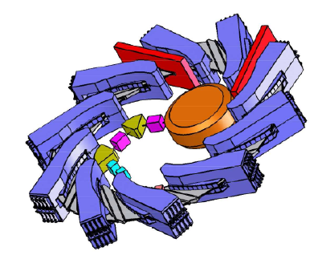
The RACCAM spiral scaling FFAG project (France 2006-2009)

Slide 15
Carol Johnstone 30 MeV to 230 Mev non scaling isochronous FFAG

Slide 16
FFAG’s in proton or carbon therapy
Despite many studies (and even construction and testing of a prototype magnet for RACCAM), FFAG’s have never been built for proton or carbon therapy.
Compared to compact accelerators of the same energy, FFAG’s are much more expensive to build (in part because they need a high energy injector) and do not offer significant advantages excepting, perhaps fast energy variation using extraction by fast (and large) kicker magnets
But this fast extraction has never been the subject of a detailed design (to my knowledge)
Most of the studies on FFAG’s have concentrated on magnetic structure design and optics calculations. Other critical issues like the variable frequency RF system have been much less studied.

Slide 17
The Dielectric Wall Accelerator

Slide 18
The Dielectric Wall Accelerator
The DWA was a concept invented by the group of George Caporaso at LLNL
The License to the DWA technology was given to the US Company Tomotherapy
Later, the company CPAC was created as a subsidiary of Tomotherapy to develop the DWA
The development of the DWA by CPAC was long and painful. The prototype failed. The development was abandoned when Tomotherapy was acquired by Accuray

Slide 19
The DWA as presented by Tomotherapy

Slide 20
The main elements of the DWA

Slide 21
Linear accelerators for proton therapy

Slide 22
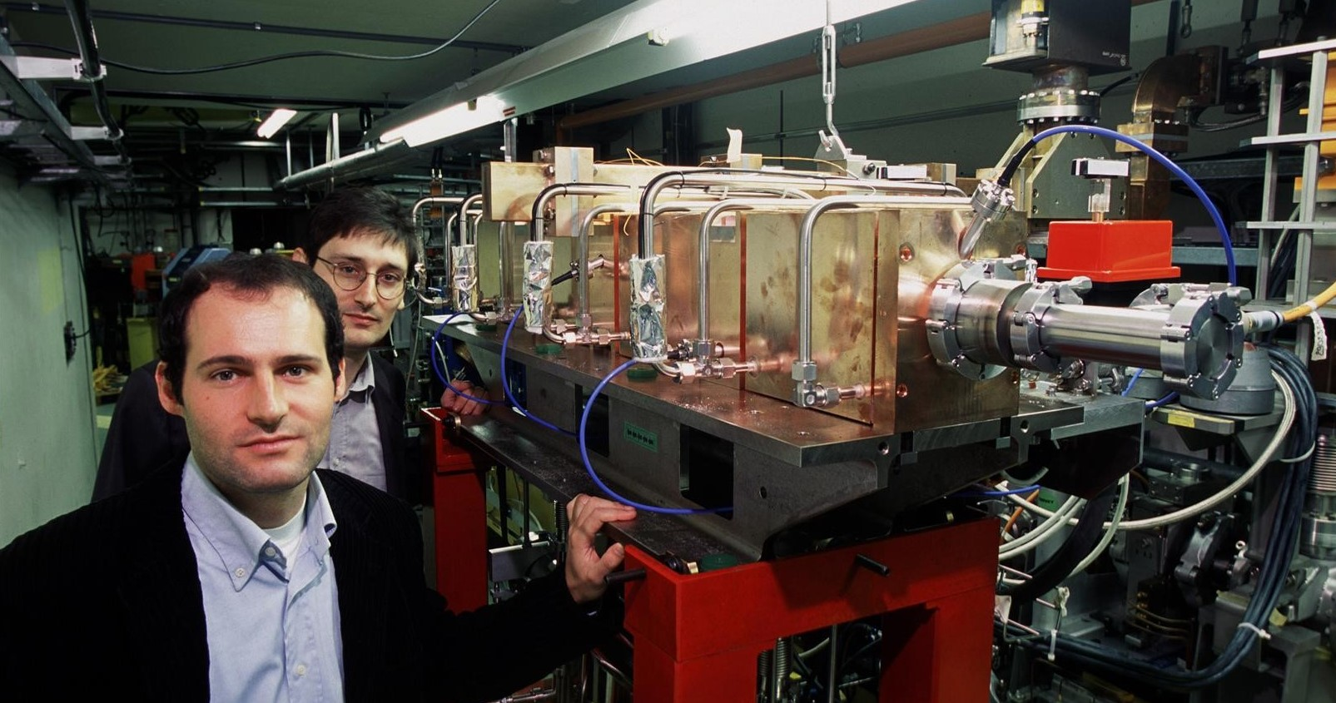
The origin: the LIBO project (1993-2002)

Slide 23
A 3 GHz linac for proton therapy
The idea to use the 3 GHz hardware to design and build a linear accelerator for proton therapy was initially proposed by Ugo Amaldi in the TERA-CERN collaboration. The concept development started in 1993
The prototype section, accelerating protons by 11 MeV, was successfully tested on the SC cyclotron at the LNS in Catania. The RF for this test was provided by IBA.
In 2006, the company ADAM (Application of Detectors and Accelerators to Medicine) was founded to develop the LIBO toward a commercial system.
In 2013, AVO (Advanced Oncotherapy) acquired ADAM, to further develop and commercialize the PT Linac technology.

Slide 24
AVO-ADAM LIGHT Linac for PT

Slide 25
Main data of LIGHT Linac

Slide 26
Main Linac Sections

Slide 27
Treatment Room setup: no gantry

Slide 28
The AVO proton therapy system
Today, in 2019, the prototype is being assembled and tested at Daresbury laboratory, before being moved to its final location in Harley Street in London
Since the start in 1993, the development of the 3 GHz proton linac has been long and the beam has not yet been accelerated to full energy.
So far, AVO has invested 93 M£ (102 M€) in the development of the new system.
For this first system, AVO has elected to skip the gantry, and to do the treatment in an horizontal beam line
While it is very likely that the AVO system will perform very well according to its specifications, it remains to be seen if such a linac system without a gantry will be seen as cost-competitive on the proton therapy equipment market

Slide 29
Laser Acceleration of Protons

Slide 30

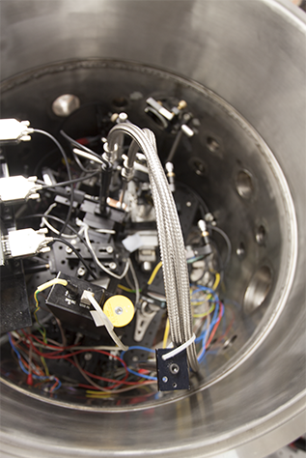
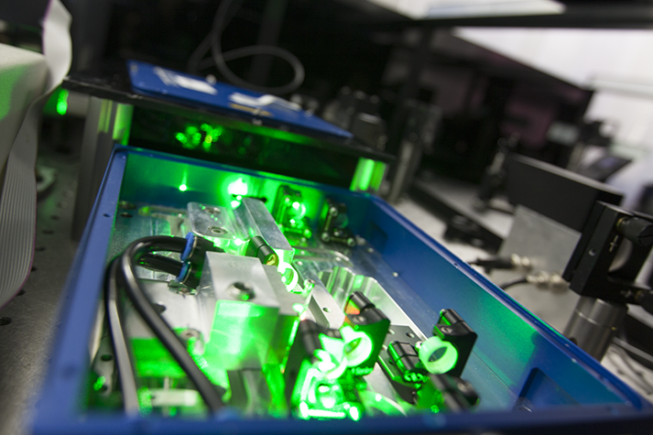
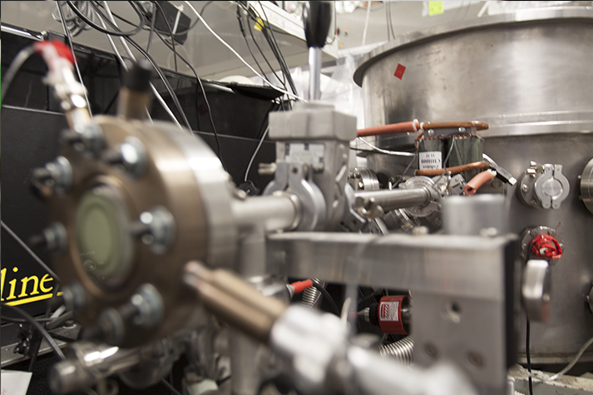
Next-Generation Proton-Beam Cancer Therapy
Notes:
Early-stage medical-technology company.
Spin out of the Hebrew University in Jerusalem, Israel.
Addressing a major unmet need in proton therapy, which is the fastest-growing segment within radiation oncology.
Seed-funded by $1MM from the HU, the Israeli government, and private investors.
Raising a $6.5M A-round.
Eitan’s comments 2012-05-29:
- Add IP status and money
Eliminate holy grail (religious sensitivity)
Add legend to graph 8
remove 1/10 PoC with “early”, or something else… it smells like way-to-early stuff.
Get a land-line number with company voicemail system.

Slide 31
Basic Beam Parameters
Compared to State-of-the-Art Competing Laser acceleration Groups
Acceleration – Max. Energy
HIL’s Data
PIC Simulation
Others
Commercially Available Lasers

Slide 32
Basic Beam Parameters – Cont’d
Near-Clinical Proton Flux
Clinical proton flux
S
S
S
High-Energy Protons per Laser Shot
D
D

Slide 33
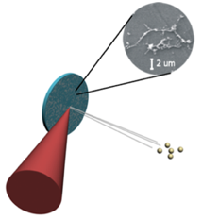


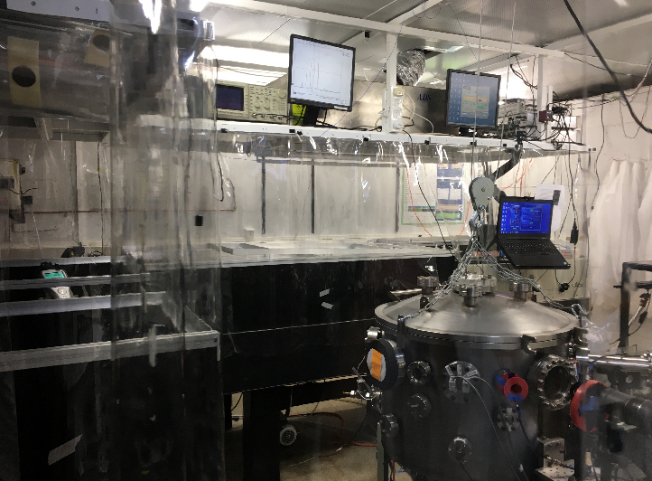
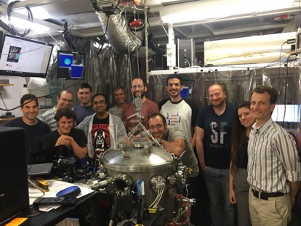
Laser based proton accelerator cont’d:
Nano-engineered
Target
Bringing 21st-century tech to proton therapy
The accelerator:
+
    Nano – engineered target supported by a vacuum chamber
    Small dimensions (60 cm diameter, 200kG).
    Optional machine shielding against radiation.
=
High-Intensity
Laser
High Energy
Protons
    Laser system & Accelerator vacuum chamber
    HILs proton accelerator and the team.

Slide 34
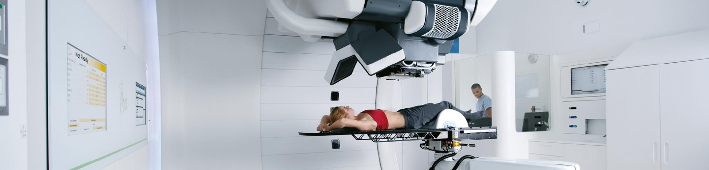
Patient-Beam interaction: isocentric gantries

Slide 35
Isocentric gantries (1)
In the human body, and especially in the abdomen region, the relative position of the organs changes when the body orientation is changed.
Therefore, the treatment planning will be valid only if the TPS imaging is made with the same body orientation as the treatment.
To optimize the treatment plan, any position in the patient body should be reachable from any direction. Generally, several directions are selected in a treatment plan.
In classical radiotherapy, this is done by imaging the patient in a supine position, and treating the supine patient with an isocentric gantry.
In photon radiotherapy, in the technique named “Intensity Modulated Radio Therapy” (IMRT), the number of beam incidences becomes very large, and now arc therapy is commonly used
Arc therapy in proton therapy is also under development and has been tested on IBA systems.

Slide 36
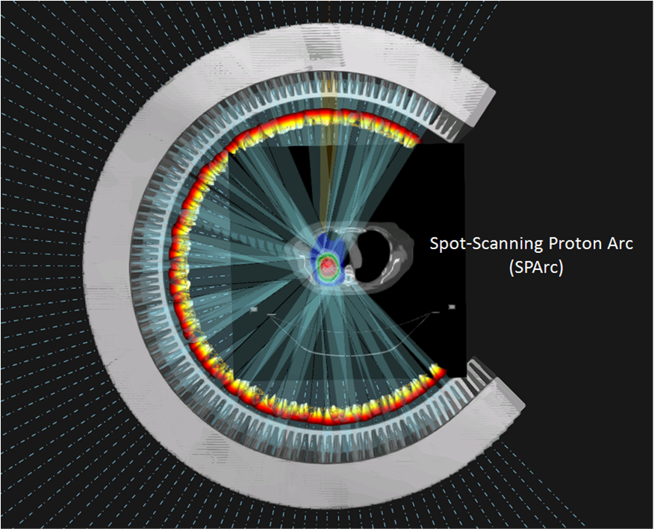

Proton arc therapy
A robust and efficient delivery technique with potential for continuous arc delivery
An advanced IMPT optimization algorithm
  First technical paper (IJROBP 2016)
  Advanced stage lung cancer (NA-PTCOG 2016)
  Prostate (PTCOG 2017)
  Brain Hippocampus sparing (AAPM 2017)
  Cranial SRS (ASTRO 2017)
  Spine SRS (ASTRO 2017)
  Bilateral Head & Neck (AAPM 2017)
  Mobile tumor – interplay (AAPM 2017)
  Dosimetric comparison study with Iowa
  More to come...
Ding X & Li X IJROBP 2016
Feature not currently available for sale
Notes:
robust optimized intensity modulated proton therapy (RO-IMPT)

Slide 37
Isocentric gantries (2)
Compared to 6 to 12 MeV electron beams, 230 MeV protons have 110 times larger magnetic rigidity, and therapeutic carbon ions beams 300 times.
Gantries for proton therapy are therefore large, heavy and expensive. Carbon gantries using resistive magnets are just impractical.
For our one treatment room proton system, the cost of the gantry and of the patient positioning and alignment system exceeds the cost of the accelerator.
For this reason, many designers have looked for solutions where the patient would be rotated in front of a fixed horizontal beam. Although some of these solutions do work technically (P-Cure), they have never been popular with medical doctors. Example of Protom.

Slide 38
Open gantries or 360° gantries ?
With a modern robotic patient positioner, all positions in a patient can be reached from any direction with a gantry rotating 180°, or a bit more. This solution offers to the therapist a much better access to the patient, and this design is therefore named the “open gantry”
The choice between “open gantries” and “360° gantries” is hotly debated by sales people. Companies offering both alternatives, like IBA, see the open gantry selected by a slight majority of customers

Slide 39
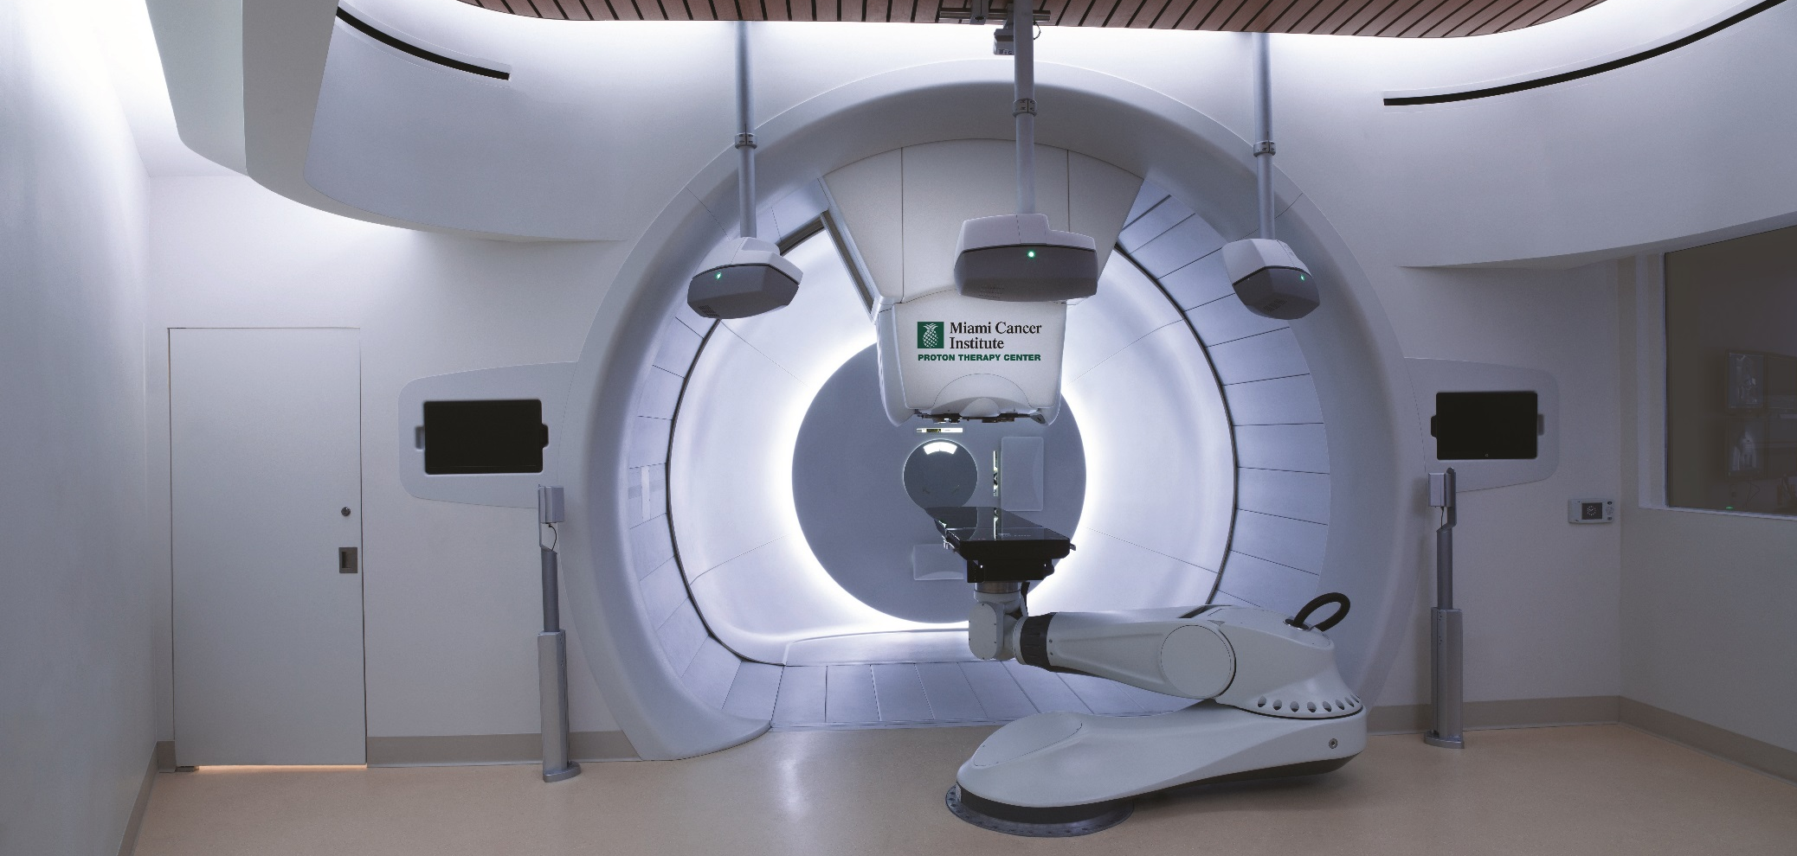
Image-Guided proton therapy
Imaging
systems
Fisheye picture from the Miami Cancer Institute

Slide 40
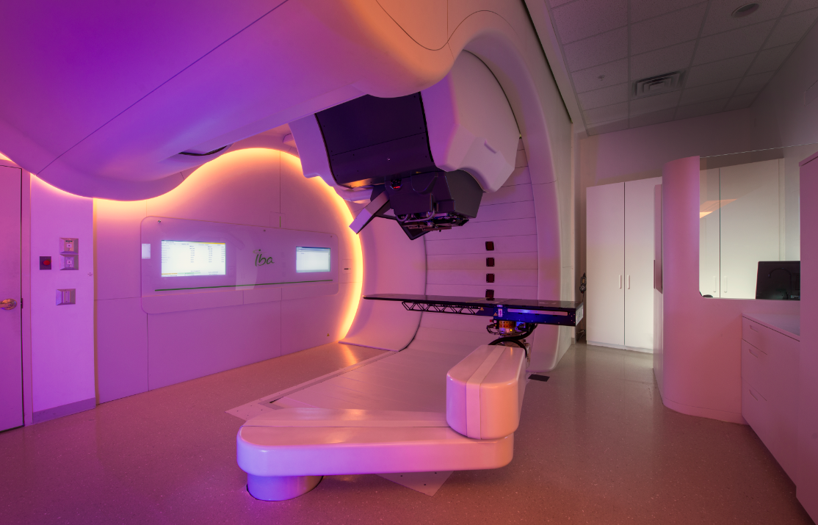
Notes:
40

Slide 41
Thank you

