Slide 1




Slide 2

Digital LLRF system:
Concepts and requirements for proton therapy based on linear accelerator
Borut Baričević
WWW.I-TECH.SI
ICMAPT Seville, September 2019

Slide 3
Presentation outline
Brief cancer therapy introduction
Linear accelerators advantages
Basic LLRF system principles
LLRF implementation overview
Proton therapy LLRF critical aspects
Status of the AVO-ADAM project

Slide 4
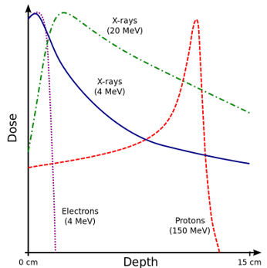
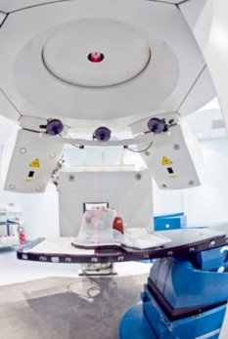
Radiation therapy
Cancer treatment through ionizing radiation is acting on cancer cells DNA.
Radiation therapy methods:
Electrons:
Limited effects on surface
Photons (x-rays):
Spread among different depths
Protons (or heavy ions, e.g. carbon)
  Very focused with depth (Bragg peak)
  Penetrate deeply (depth depends on beam energy)

Slide 5
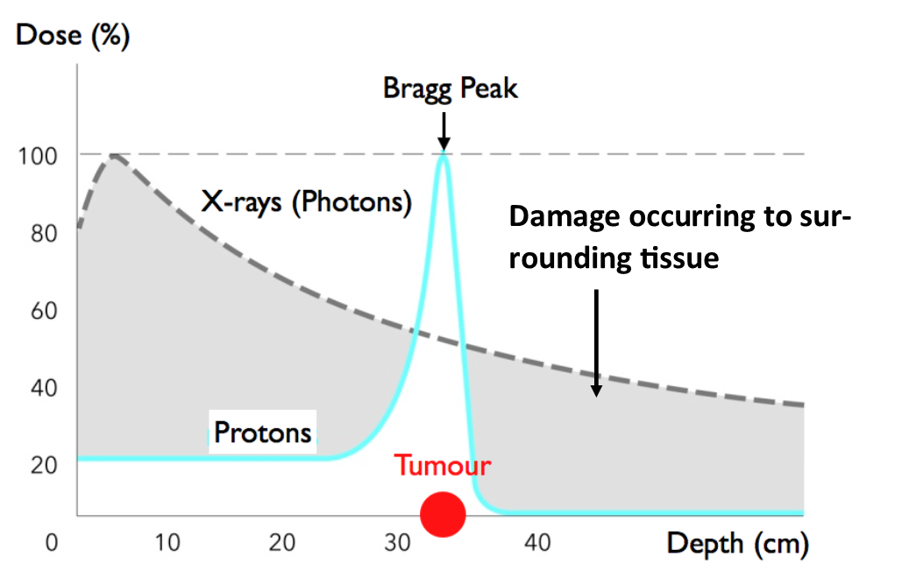
Proton therapy advantages
High energy protons are applied to tumor tissue.
Proton energy is increased through particle accelerators.
Proton therapy advantages:
Radiation dose selectively deposited at beam energy dependent depth (70 MeV to 250 MeV)
Beam transversally more focused, less scattering (protons are heavy)
Protons reach tumors deeply in the body
Minimized side-effects on surrounding tissue

Slide 6
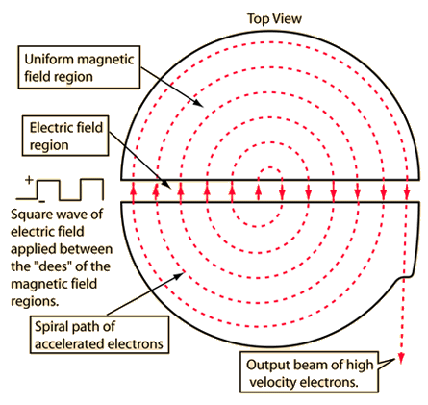
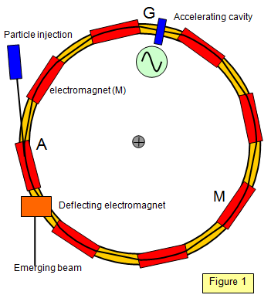
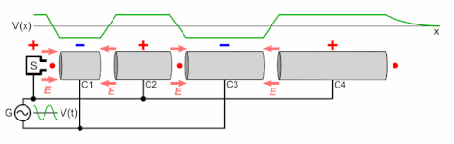
Proton accelerators
Protons are accelerated by applying electro-magnetic field within RF cavities or dees.
Circular machines: cyclotrons and synchrotrons
  beam energy is increased over many cycles and require accelerating RF frequency and deflecting magnetic field to be corrected accordingly. Cyclotron extract at full energy; degrader are used to reduce it. (radiation issues)
  RF frequency ramping process may have implication on cavity tuning and transverse beam position control
Linear machines: LINACs
  More flexible in controlling beam energy and less complex to control
  Dynamic control of beam energy (tracking patient movement)
  More efficient as protons are accelerated to the required energy
LINAC
Cyclotron
Synchrotron

Slide 7
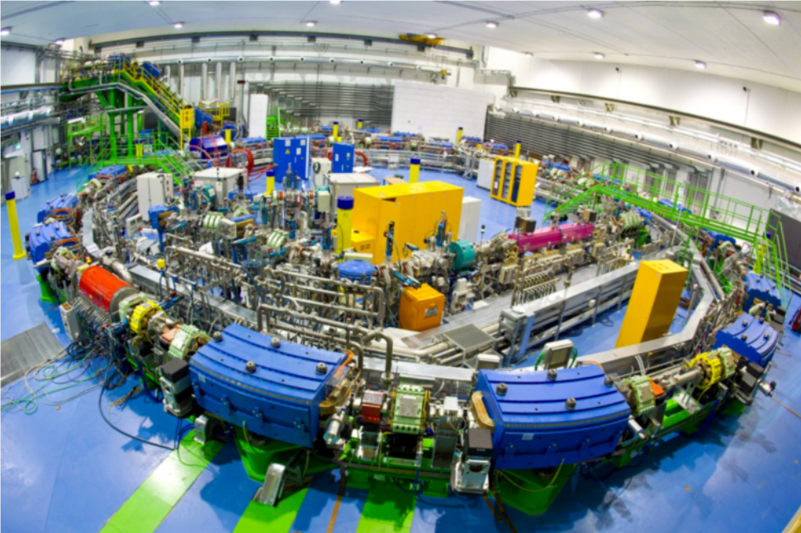
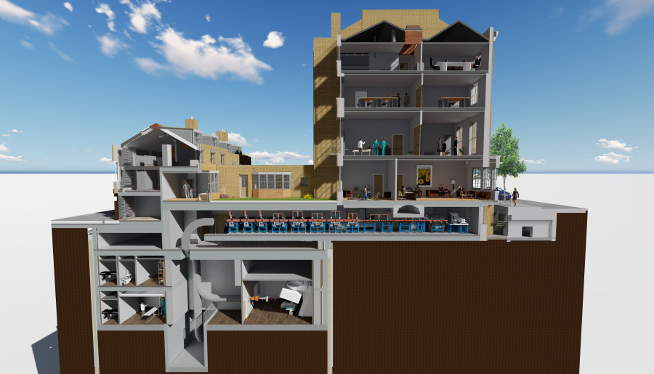
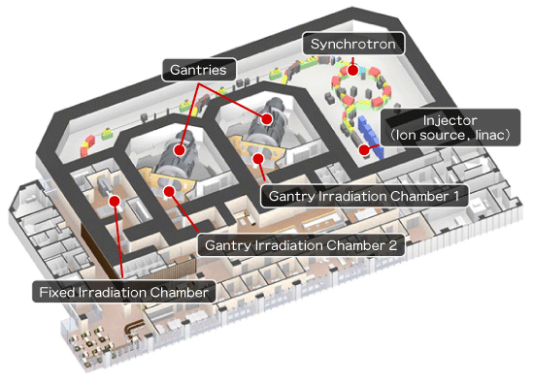

Circular vs. Linear
Circular machines:
  Less flexibility in beam energy control
  Large machines with demanding shielding requirements
  Expensive*
Linear machines: (AVO-ADAM LIGHT)
  Precise 3D treatment dose control
  Compact solutions to be installed in preexisting buildings, less shielding required
  Cheaper than circular*
Synchrotron proton therapy
AVO-ADAM LIGHT, Harley Street, London (installation plan)
* https://bit.ly/2jVBdRR

Slide 8
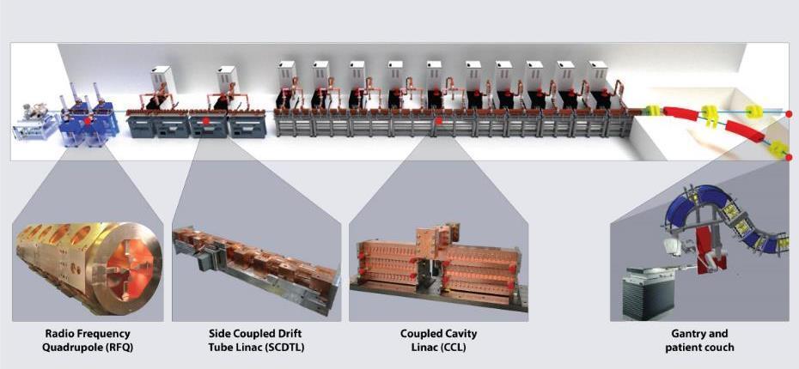
AVO-ADAM LIGHT parameters
Linac Image Guided Hadron Therapy
13 RF stations (a 750 MHz RFQ and 12x 3GHz SCDTL and CCL)
RF pulses 5 us at 200 Hz rep. rate
Beam energy and charge modulation at 200 Hz
Total peak RF power over 50 MW
Proton source up to 300 uA, 20 us

Slide 9
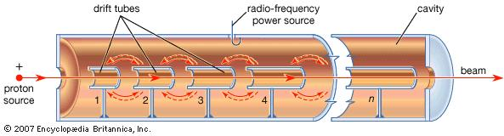
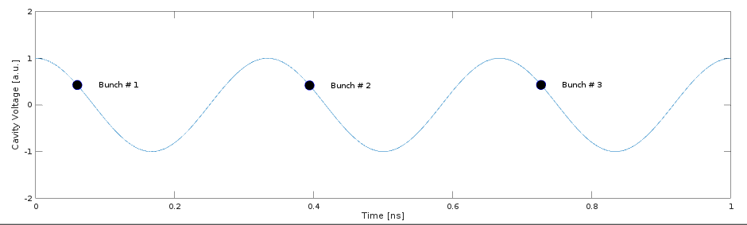
Proton acceleration
Precise synchronization RF cavity field vs. Beam
Cascaded RF stations: beam dynamics effects may spoil beam quality
Sources of errors:
  High power amplifier response
  Cavity resonant frequency drifts (thermal expansion)
  Amplifier working point (beam energy modulation)
  There is the need to actively control cavity field amplitude and phase!

Slide 10
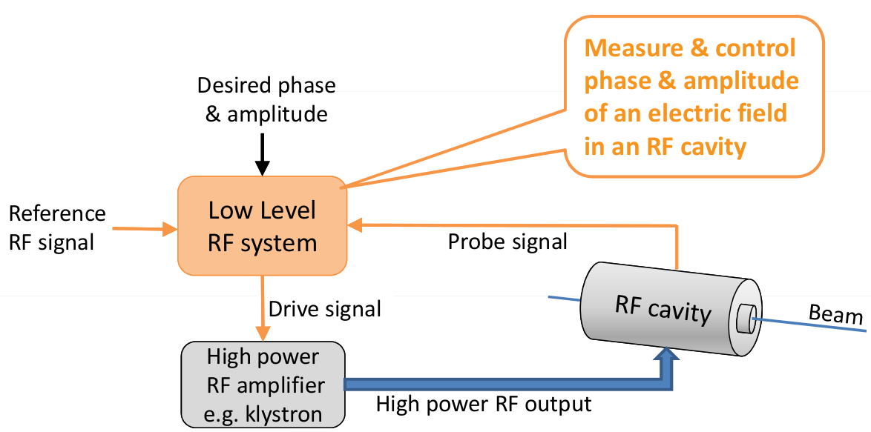
Digital LLRF control
LLRF systems:
  continuously measure RF cavity field amplitude and phase
  control high power RF to keep cavity field stable
LLRF control for each RF station (cavity)

Slide 11
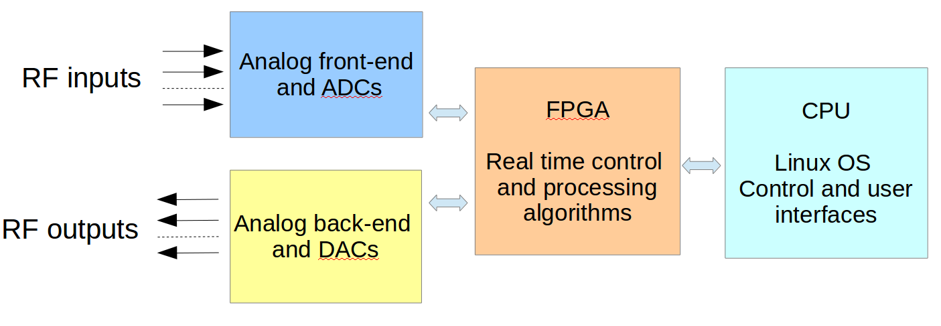
Digital LLRF block scheme
LLRF control systems are developed at two processing layers:
FPGA layer applies deterministic (real-time) feedback on cavity voltage
SW (CPU) layer for slower control functions (e.g. cavity tuning) and interfacing accelerator Control System and user
Analog front-end and back-end interface Digital Signals Processing with the RF signals.
Analog front-end stability: normally provided in a separate temperature stabilized chassis.

Slide 12
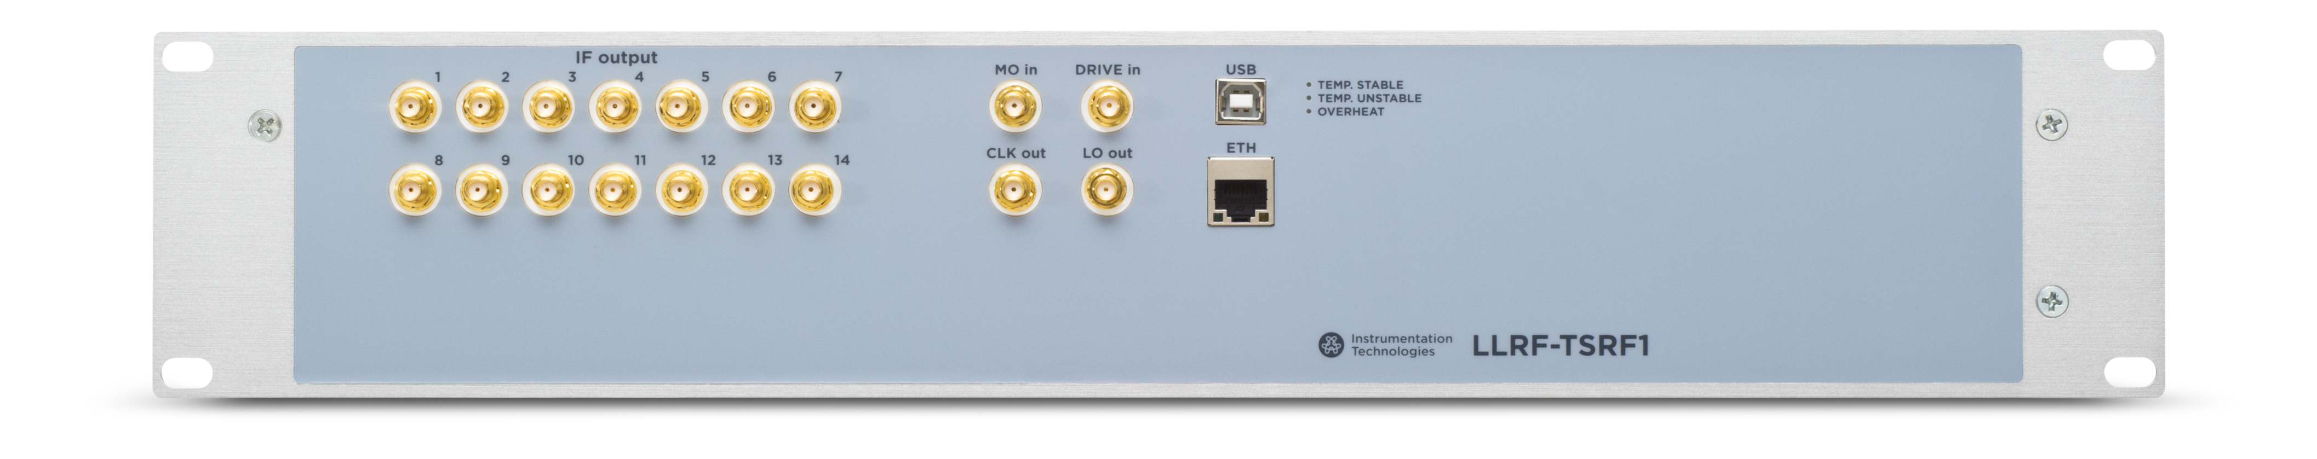
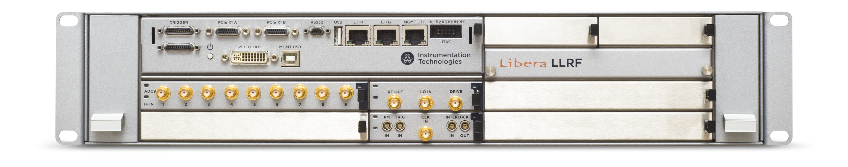
Libera LLRF
LLRF temperature stabilized RF front-end unit (19" 2U, up to 14 RF channels)
Libera LLRF processing unit (19" 2U, MTCA based modular platform)
Experience of more than 500 platforms continuously running for years (different BPM applications and LLRF)
Very high reliability (MTBF over 100 years)

Slide 13
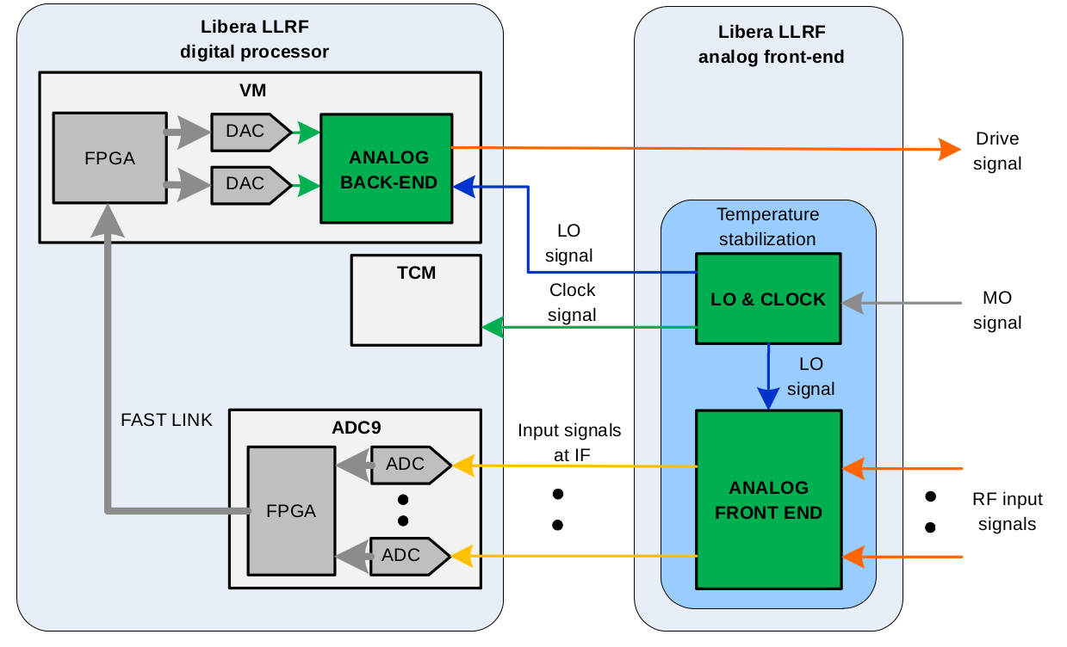
Libera LLRF block diagram
ADC9 module

Slide 14
Libera LLRF block diagram
VM module

Slide 15
Libera LLRF block diagram
TCM module

Slide 16
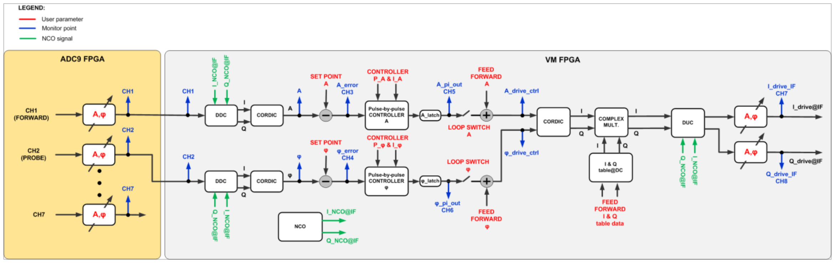
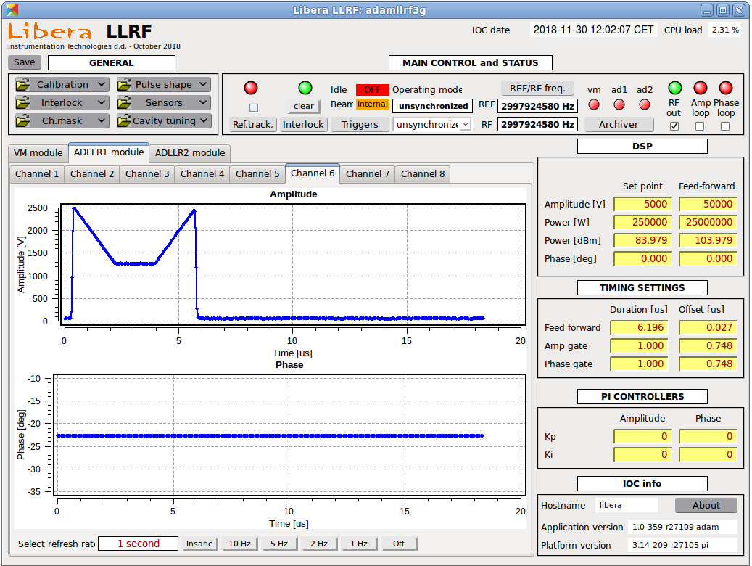
Signal processing scheme
LLRF control is implemented separately for amplitude and phase (two independent controllers)
RF pulse amplitude and phase shape can be arbitrarily configured by the user
Arbitrary amplitude pulse shape profile example

Slide 17
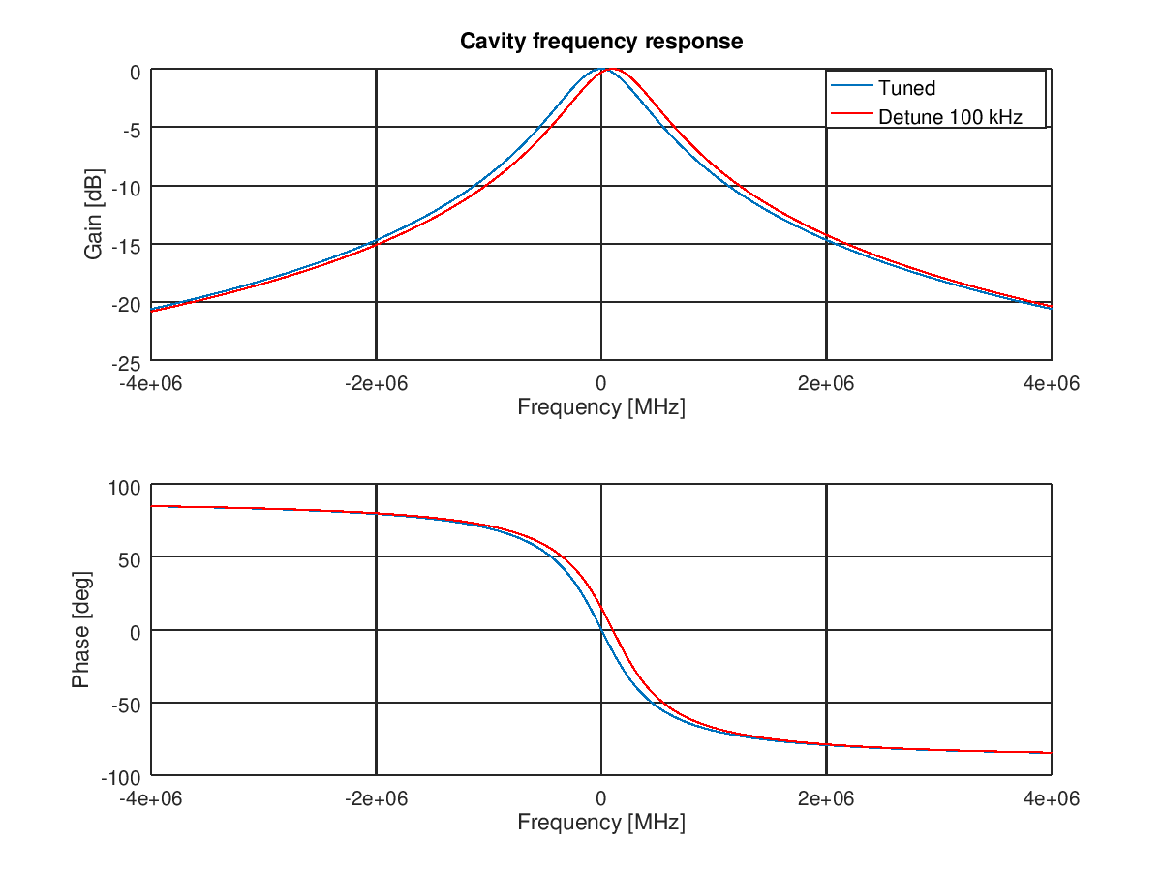
LIGHT cavity tuning system
In addition to LLRF amplitude and phase loops a dedicated cavity tuning is required to keep cavities at resonance.
Drive
Cavity Probe

Slide 18
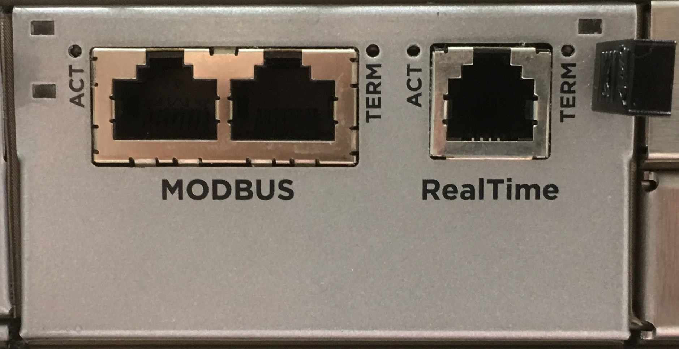
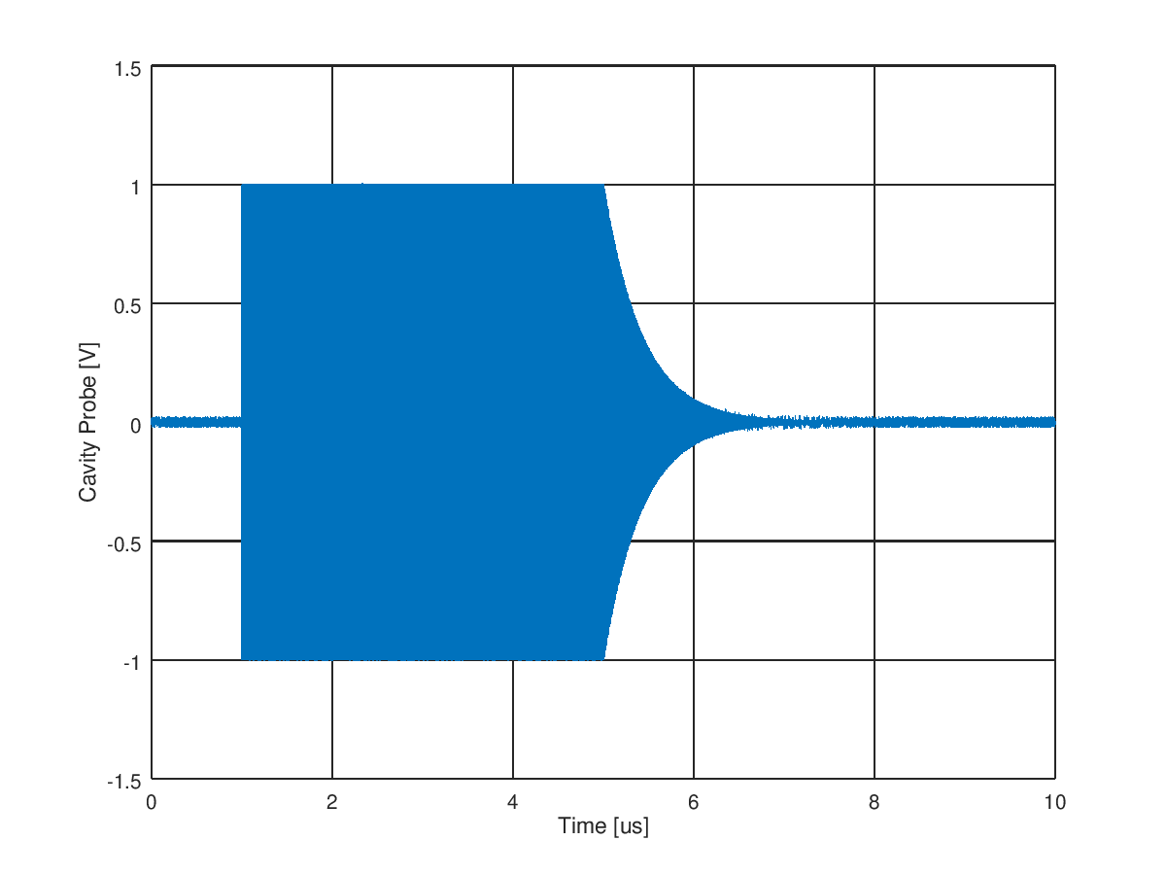
LIGHT cavity tuning loop
Libera LLRF calculates the cavity resonant frequency from the exponentially free decaying field.
The detune information is provided over Modbus interface to the cavity cooling system controller, that use it to keep cavities at resonance.
Modbus
Cavity
cooling
controller
Drive
Cavity Probe

Slide 19
LIGHT real time control
Typically LLRF systems are integrated in accelerator network and accessed remotely to manually configure RF system parameters.
To modulate proton energy a realtime control over all the RF pulse parameters is required (e.g. at 200 Hz rate).
Remote user
(Control System
or GUI)
Network
Cavity Probe
Drive

Slide 20
LIGHT real time control
Typically LLRF systems are integrated in accelerator network and accessed remotely to manually configure RF system parameters.
To modulate proton energy a realtime control over all the RF pulse parameters is required (e.g. at 200 Hz rate).
A real-time Control System (CS) protocol interface based on RS-485 has been developed to apply on time all the pulse parameters according to the treatment plan. (amplitude & phase shape, pulse timing)
  CS talks directly to LLRF FPGAs
  Communication is bidirectional (CS is tracking in real time RF system response on previous pulses)
  Libera LLRF has instructions how to proceed in cases of communication failures.
Remote user
(Control System
or GUI)
Real-time Control System
(treatment plan)
Network
Cavity Probe
Drive

Slide 21

LIGHT RF data archiving system
The proton therapy application requires that all the RF pulses traces of a treatment are recorded and archived.
A dedicated Ethernet network is used to stream all the data generated to an external archiving server.
Each LLRF system generates 512 samples, for 13 channels at 200 Hz rate.
Remote user
(Control System
or GUI)
Treatment data archiving server
Network
Cavity Probe
Drive

Slide 22
Performance
Amplitude and phase stability requirements are specified in a 20 dB dynamic range required for proton energy modulation.
Parameter |  | Required | Measured
RMS amplitude stability | (at full scale) | <0.05% RMS | 0.004% RMS
RMS phase stability | (at full scale) | <0.05° RMS | 0.002° RMS
RMS amplitude stability | (at –20 dB FS) | <0.1% RMS | 0.013% RMS
RMS phase stability | (at –20 dB FS) | <0.1° RMS | 0.007° RMS
Cavity Probe
Drive

Slide 23
Other LLRF features
Interlock system:
  Normally LLRF systems stop operation in case an RF system failure it's detected (Interlock).
  Failures are detected when signal exceeds predefined absolute threshold.
  Beam energy modulation requires that relative thresholds are used for failure detection.
  To increase beam availability LIGHT LLRF interlock system has been upgraded to tolerate a certain number of failures before stopping operation. Faulty RF stations are operated at low power and compensated by other stations.
Cavity conditioning:
  Before operation, each RF cavity needs to be conditioned in laboratory by applying power to it.
  Special cavity conditioning mode has been developed to simplify cavity conditioning process: LLRF drive frequency is adjusted to track cavity resonance over the conditioning period.
Cavity Probe
Drive

Slide 24
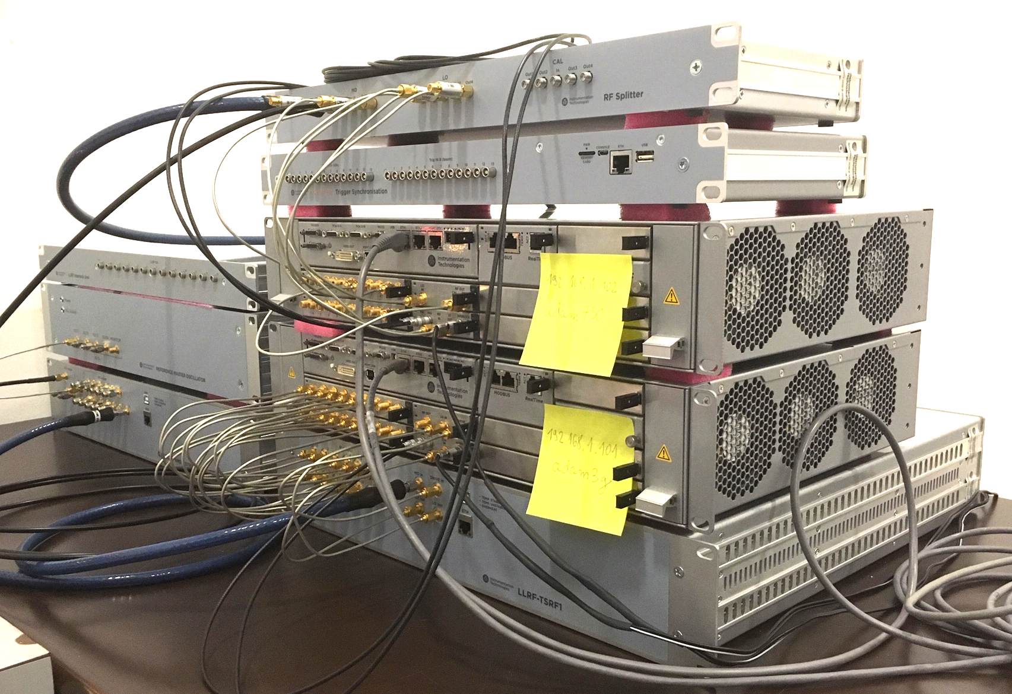
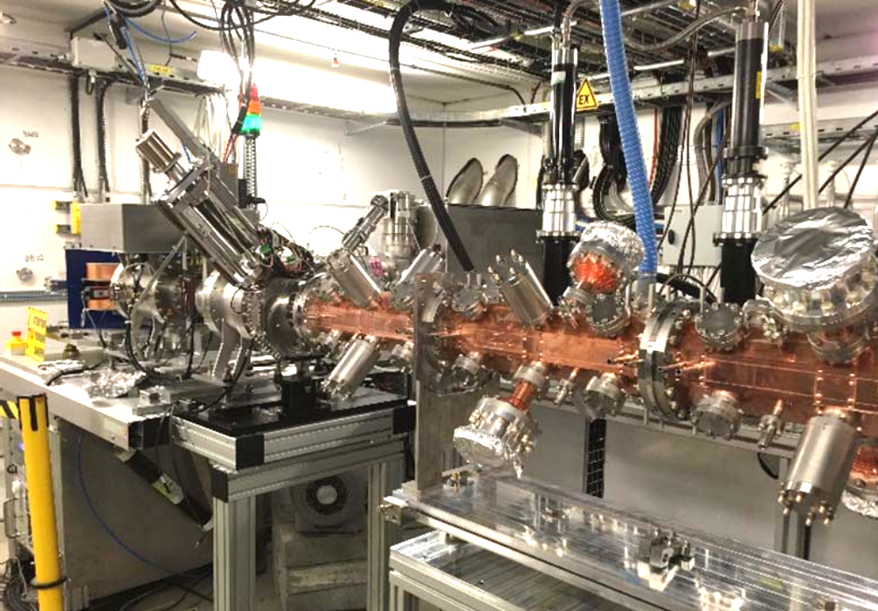
Status of the project
First LIGHT machine prototype has been assembled and tested at ADAM (Geneva)
13 Libera LLRF systems have been delivered to AVO-ADAM (including Master Oscillator, distribution system, trigger synchronization unit, external drive signal amplifiers and interlock isolation system.
Libera LLRF in all sub-systems successfully passed the SAT
Further testing will be performed on LIGHT machine that is being built at STFC (Daresbury).

Slide 25
Thank you!
WWW.I-TECH.SI

