Slide 1
Treatment facility optimization
Andrea De Franco
MedAustron
International Conference on Medical Accelerator and Particle Therapy
CNA Seville, 4th - 6th Sep 2019

Slide 2
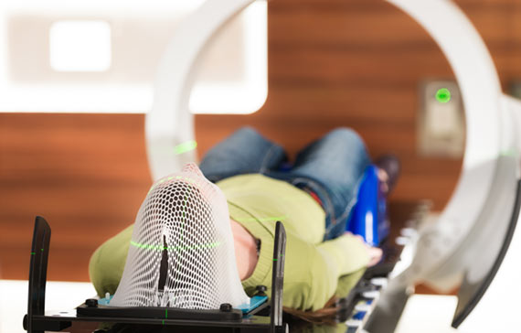
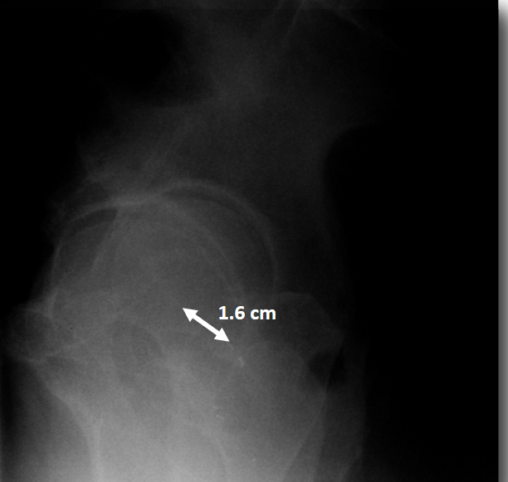
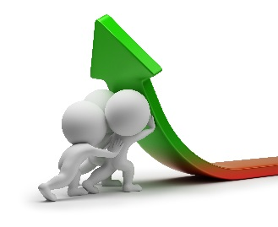
Treatment Time Reduction
Patient comfort
Intra-fractional movement
Patient throughput
M. Stock, OMA school Vienna, 2019

Slide 3
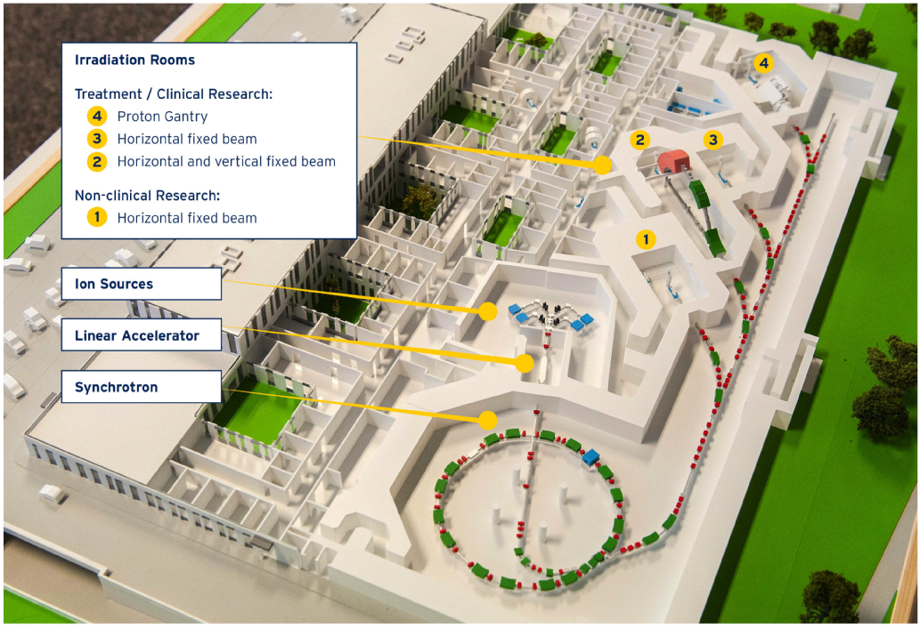
MedAustron
Irradiation Rooms
Treatment/Clinical Research:
Research Room:
Ion Sources
LINAC
Synchrotron
Proton treatment from Dec 2016
Carbon treatment from July 2019

Slide 4
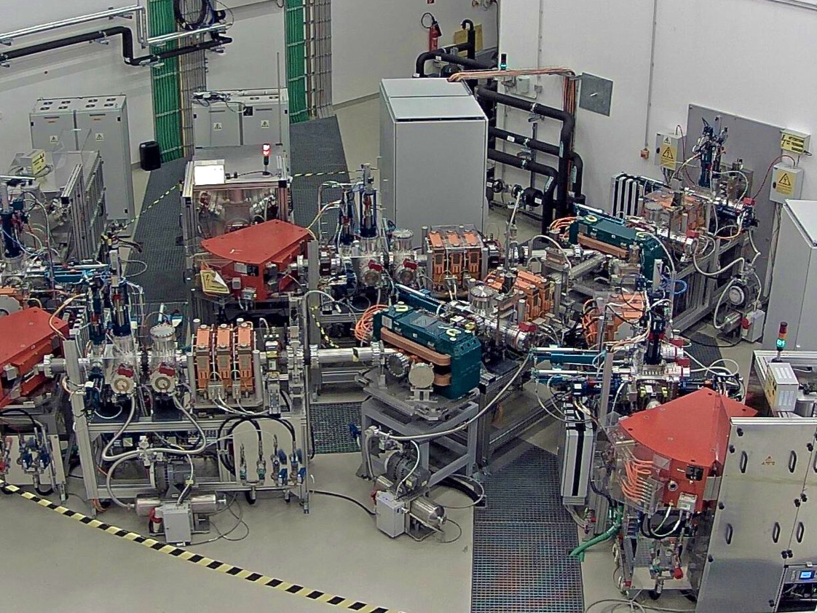
Injector Hall - LEBT
3 Ion Sources and particle type switching area

Slide 5
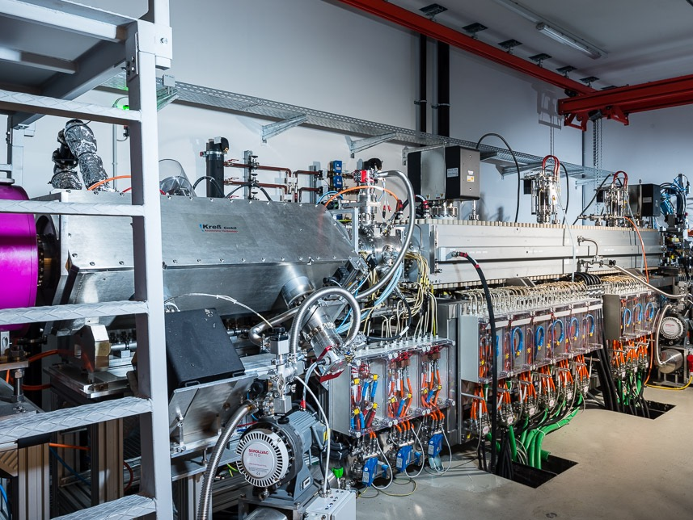
LINEAR ACCELERATOR - LI
Solenoid, RFQ, IH tank, acceleration to 7 MeV/n

Slide 6
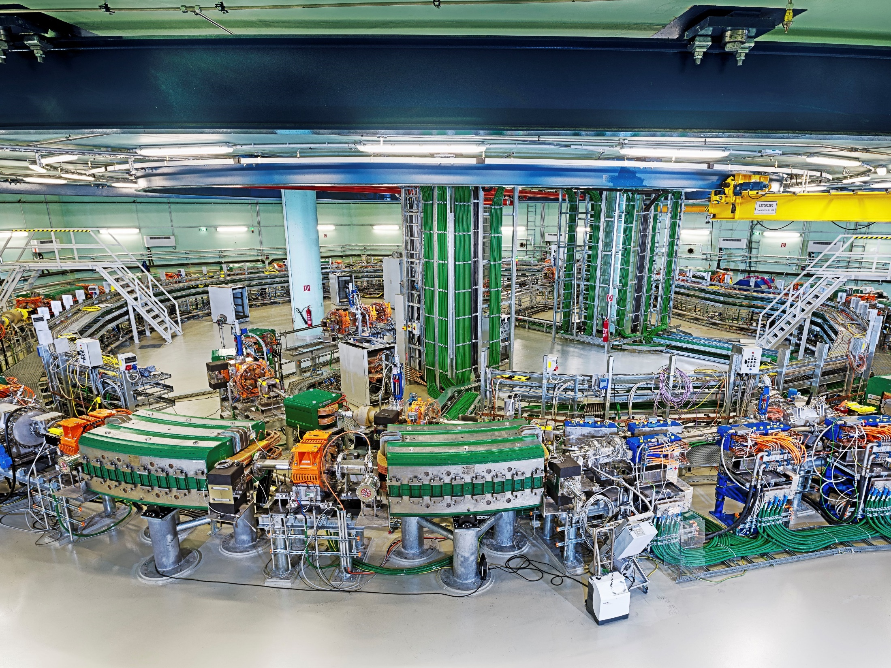
SYNCHROTRON - MR
Proton 60-250 (800) MeV, carbon 120-400 MeV/n

Slide 7
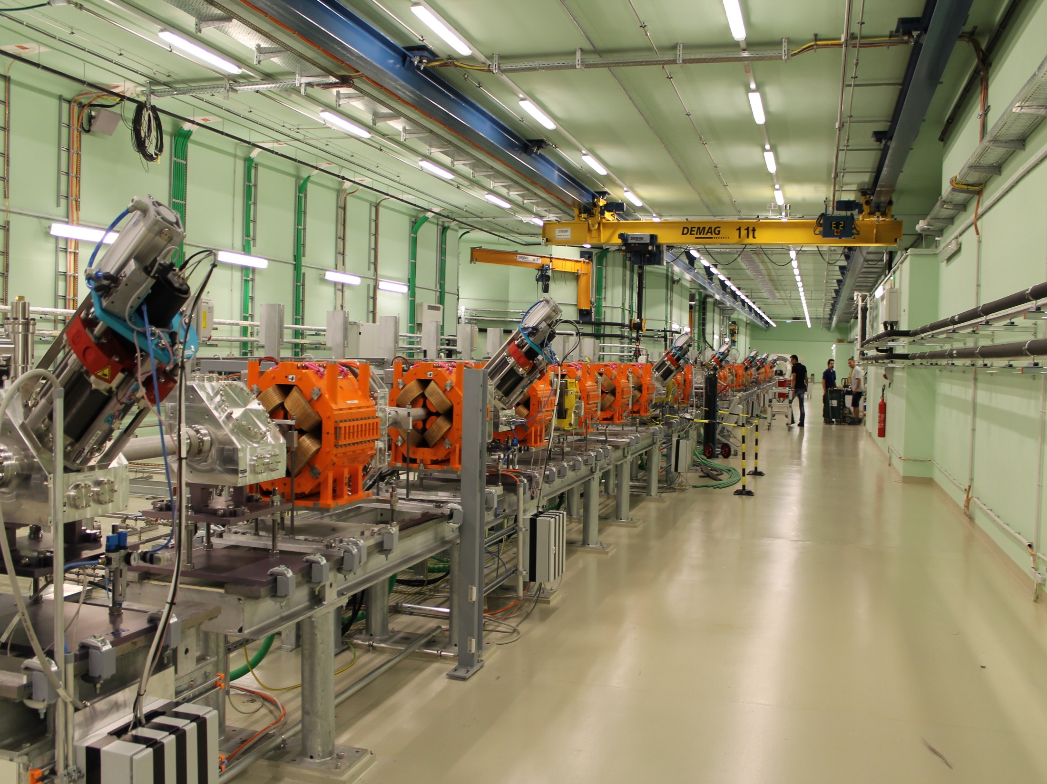
HEBT
HIGH ENERGY TRANSFER LINE - HEBT
Beam to 3 treatment & 1 research rooms

Slide 8
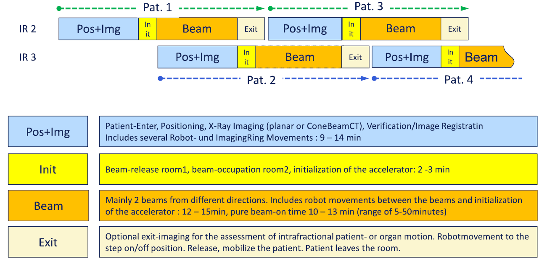
Workflow & Statistics
(H. Hentschel)

Slide 9
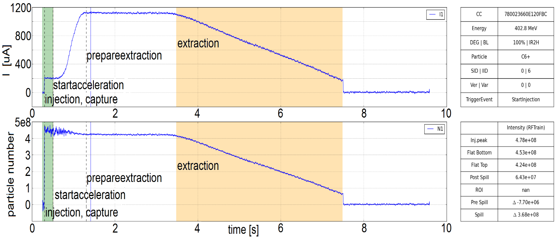
Irradiation
New spill requested when:
No more particles stored in synchrotron
New energy required
Statistics* ( Dec 16 – May 19)
Avg. Slices per portal: 41.43
Avg. Spills per portal: 44.65
Avg. Spills per Slice: 1.072
Sync. B-Field
*Patient selection biased by machine performance!

Slide 10
Irradiation time red. Options
Flux [p/s]
T between
spills
Time [s]
Flux [p/s]
Flux
Time [s]
Flux [p/s]
nr. of spills
Time [s]

Slide 11
Irradiation time red. Options
Flux [p/s]
T between
spills
Time [s]
Flux [p/s]
Flux
Time [s]
Flux [p/s]
nr. of spills
Time [s]

Slide 12
Time between spills - 1
Unused beam
Flux [p/s]
T between
spills
Time [s]
Dynamic timings for accelerator phases control
Sync. B-Field
Implemented at MedAustron in 2018
Project Leader: C. Schmitzer
Deputy: A. De Franco
Up to -40% treatment time

Slide 13
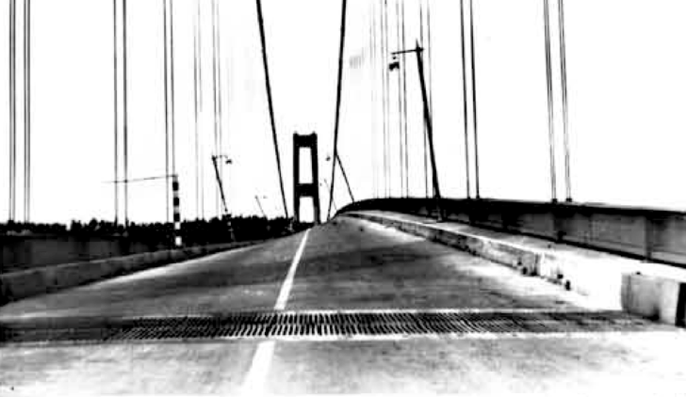
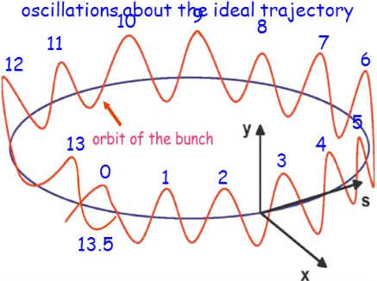
Resonant Slow Extraction
Wrong way to use resonances:
Tacoma Narrows Bridge example
Condition of Resonance
Condition for resonance
Amplitude
Unstable beam
Stable beam
Momentum or Tune
Notes:
Prior to extraction: Acceleration

Slide 14
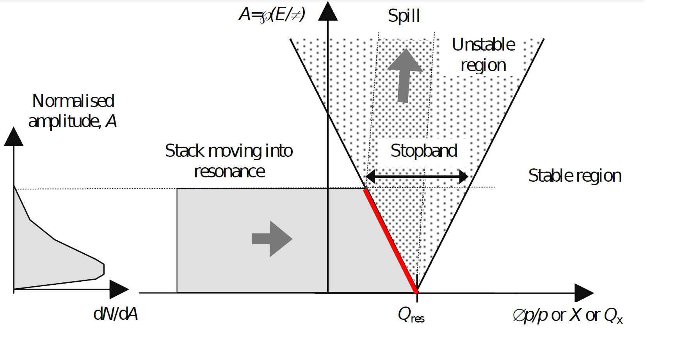
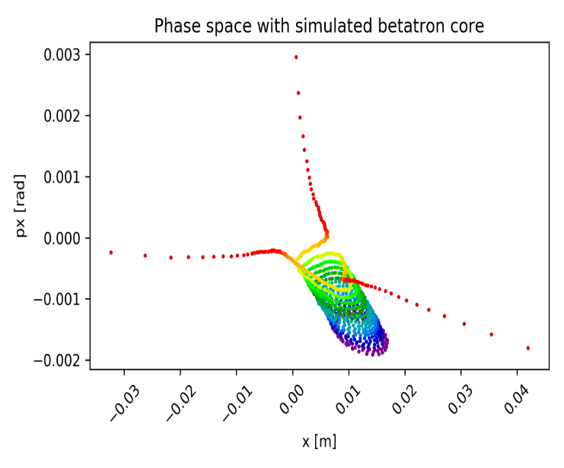
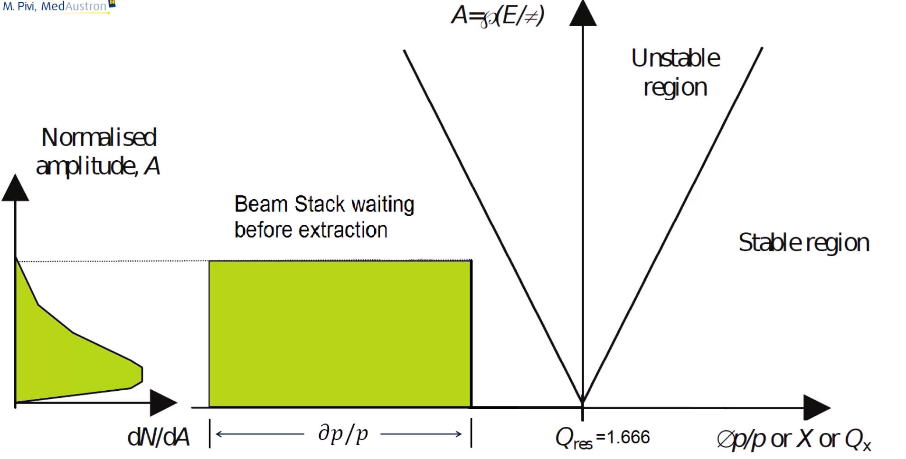

Resonant Slow Extraction
(F. Kühteubl Master thesis)
Electrostatic septum wire
Hor. phase space of one particle during the extraction
    Slowly increase momentum spread to move beam into resonance Qx=1.6666
histogram dp/p
Protons measured Schottky monitor
(A. Goetz bachelor thesis)
Notes:
Prior to extraction: Acceleration

Slide 15
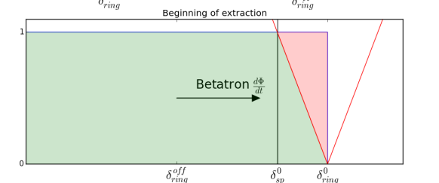
Time between spills - 2
Non-adiabatic capture
Dual phase Betatron Core settings
Parallel beam preparation (Longitudinal and Transverse)
Avoid dipole ‘washing’
(B-Field active reg.)
Sync. B-Field
Combined
~2 sec per spill
Up to -30% treatment time

Slide 16
Irradiation time red. Options
Flux [p/s]
T between
spills
Time [s]
Flux [p/s]
Flux
Time [s]
Flux [p/s]
nr. of spills
Time [s]

Slide 17
Higher Intensities
We use slow extraction to stretch the pulse. Doing the opposite is ‘easy’, but…
Flux [p/s]
Safety (Standards & Risk Management)
Functional
MinP
Time [s]
Intensity ripples (<ms)
Machine failure
MinP:= ~lowest spot weight in the slice(~10⁶p) < -- > minimum beam dwell time (~1ms)
Need to:
Model beam dynamics during failures
Reduce termination times
Reduce intensity ripples
Speed up scanning system
…Voxel based flux
Expected implementation Q1 2020
Project Leader: A. De Franco
> x2 Flux
(x4 stored intensity in synchrotron)
Up to -35% treatment time

Slide 18
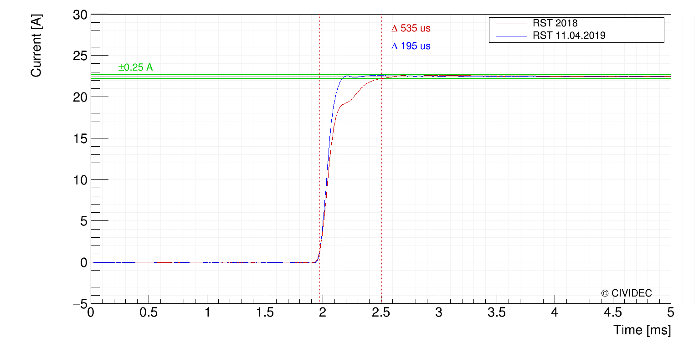
Scanning Speed

Slide 19
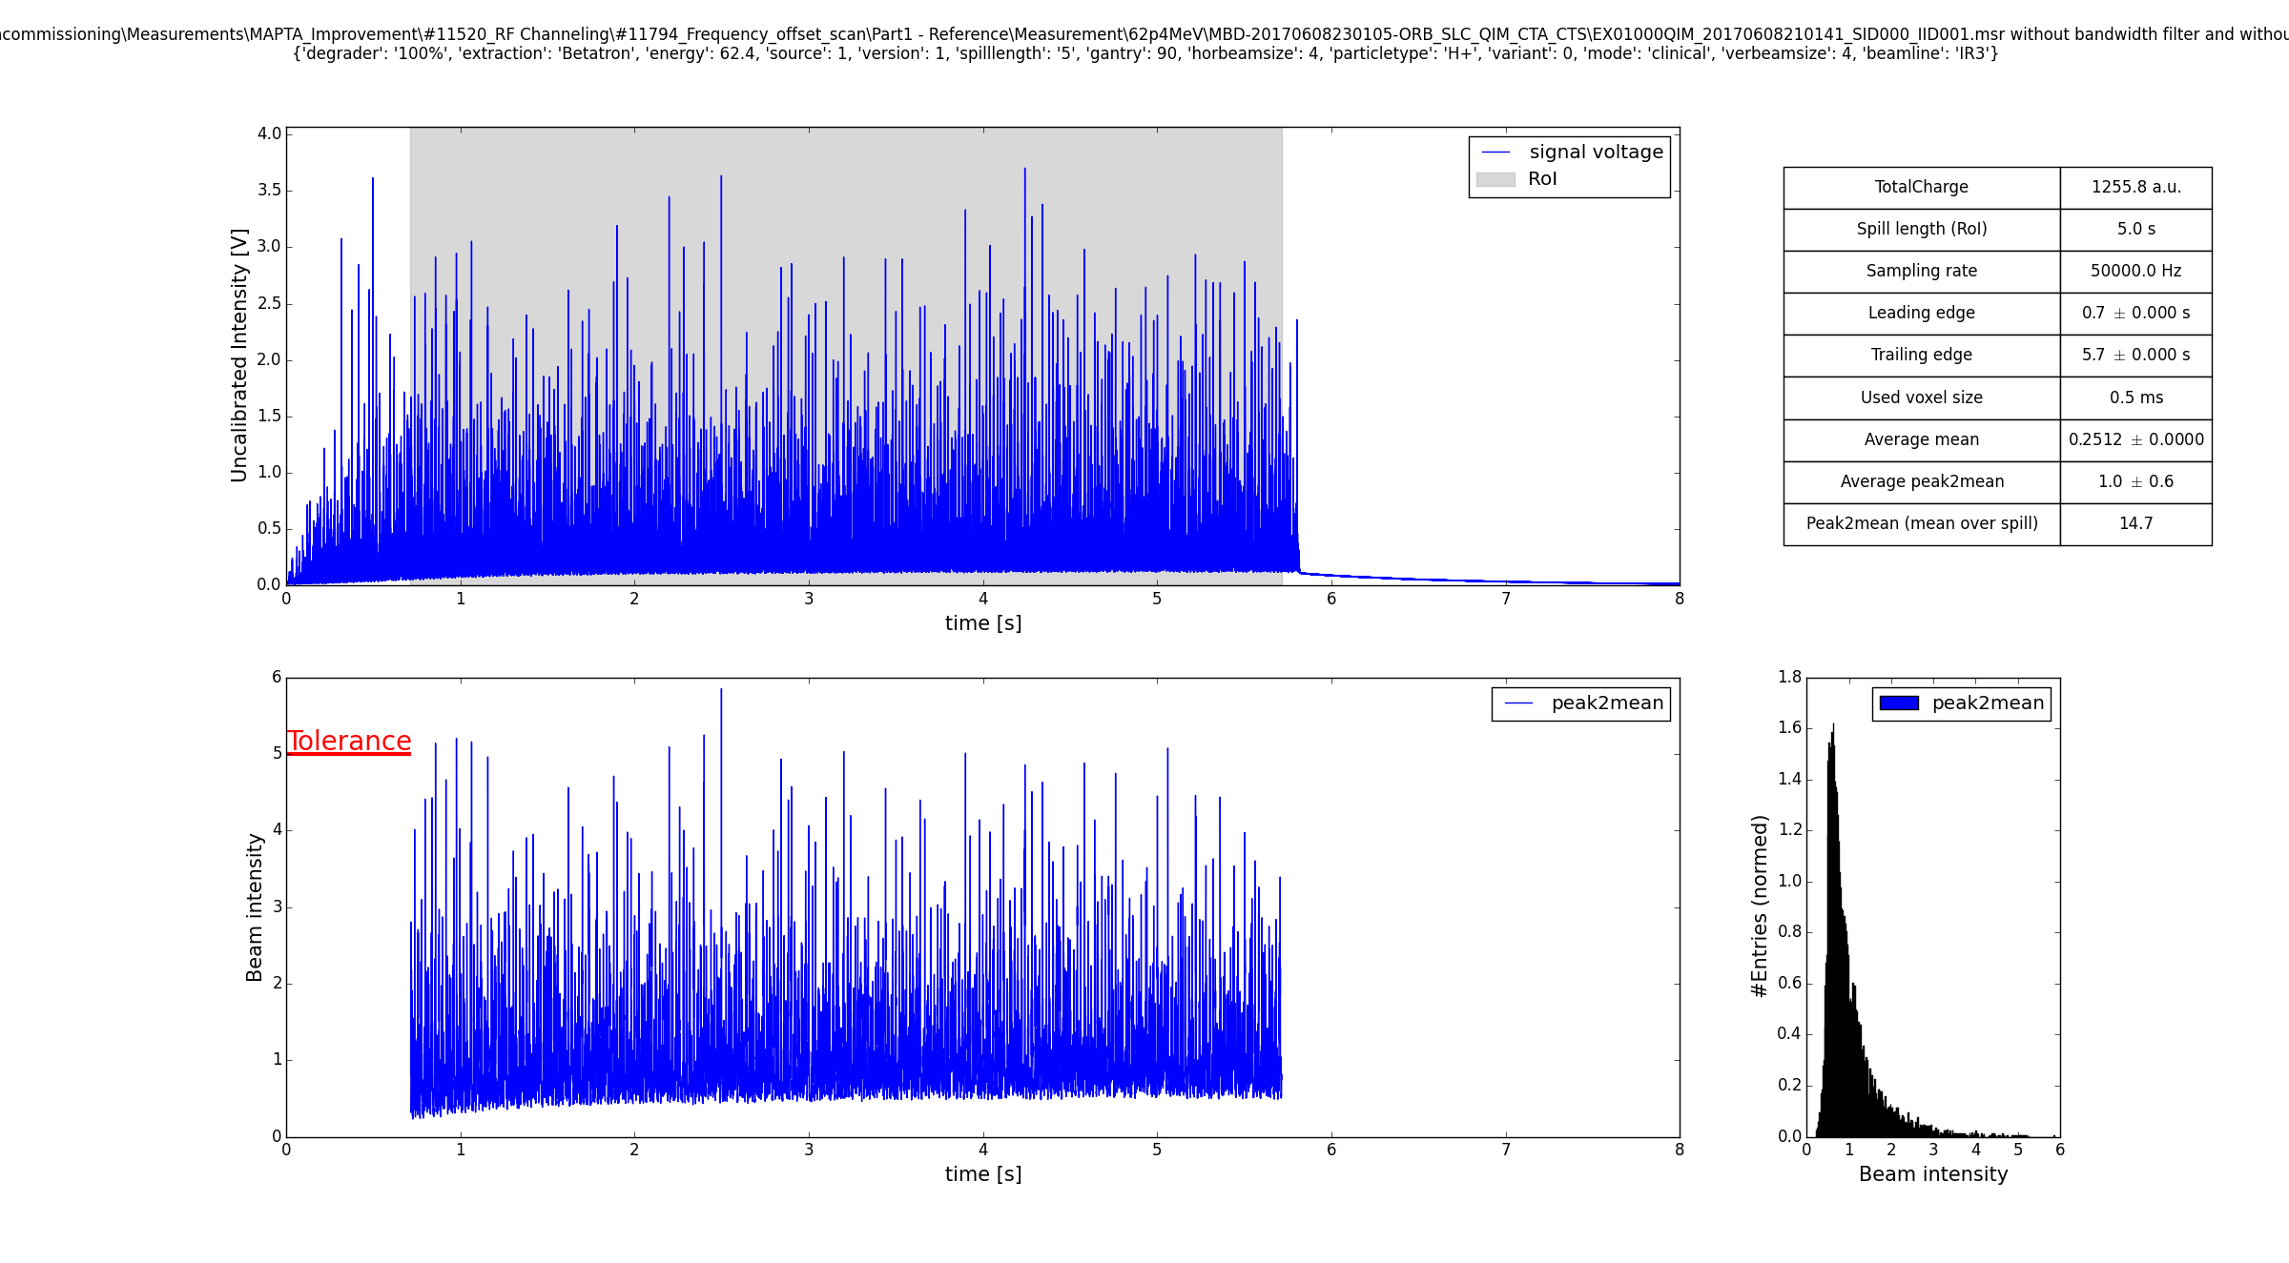
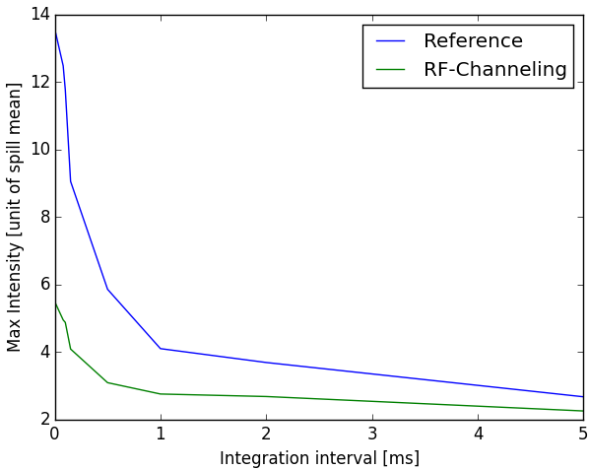
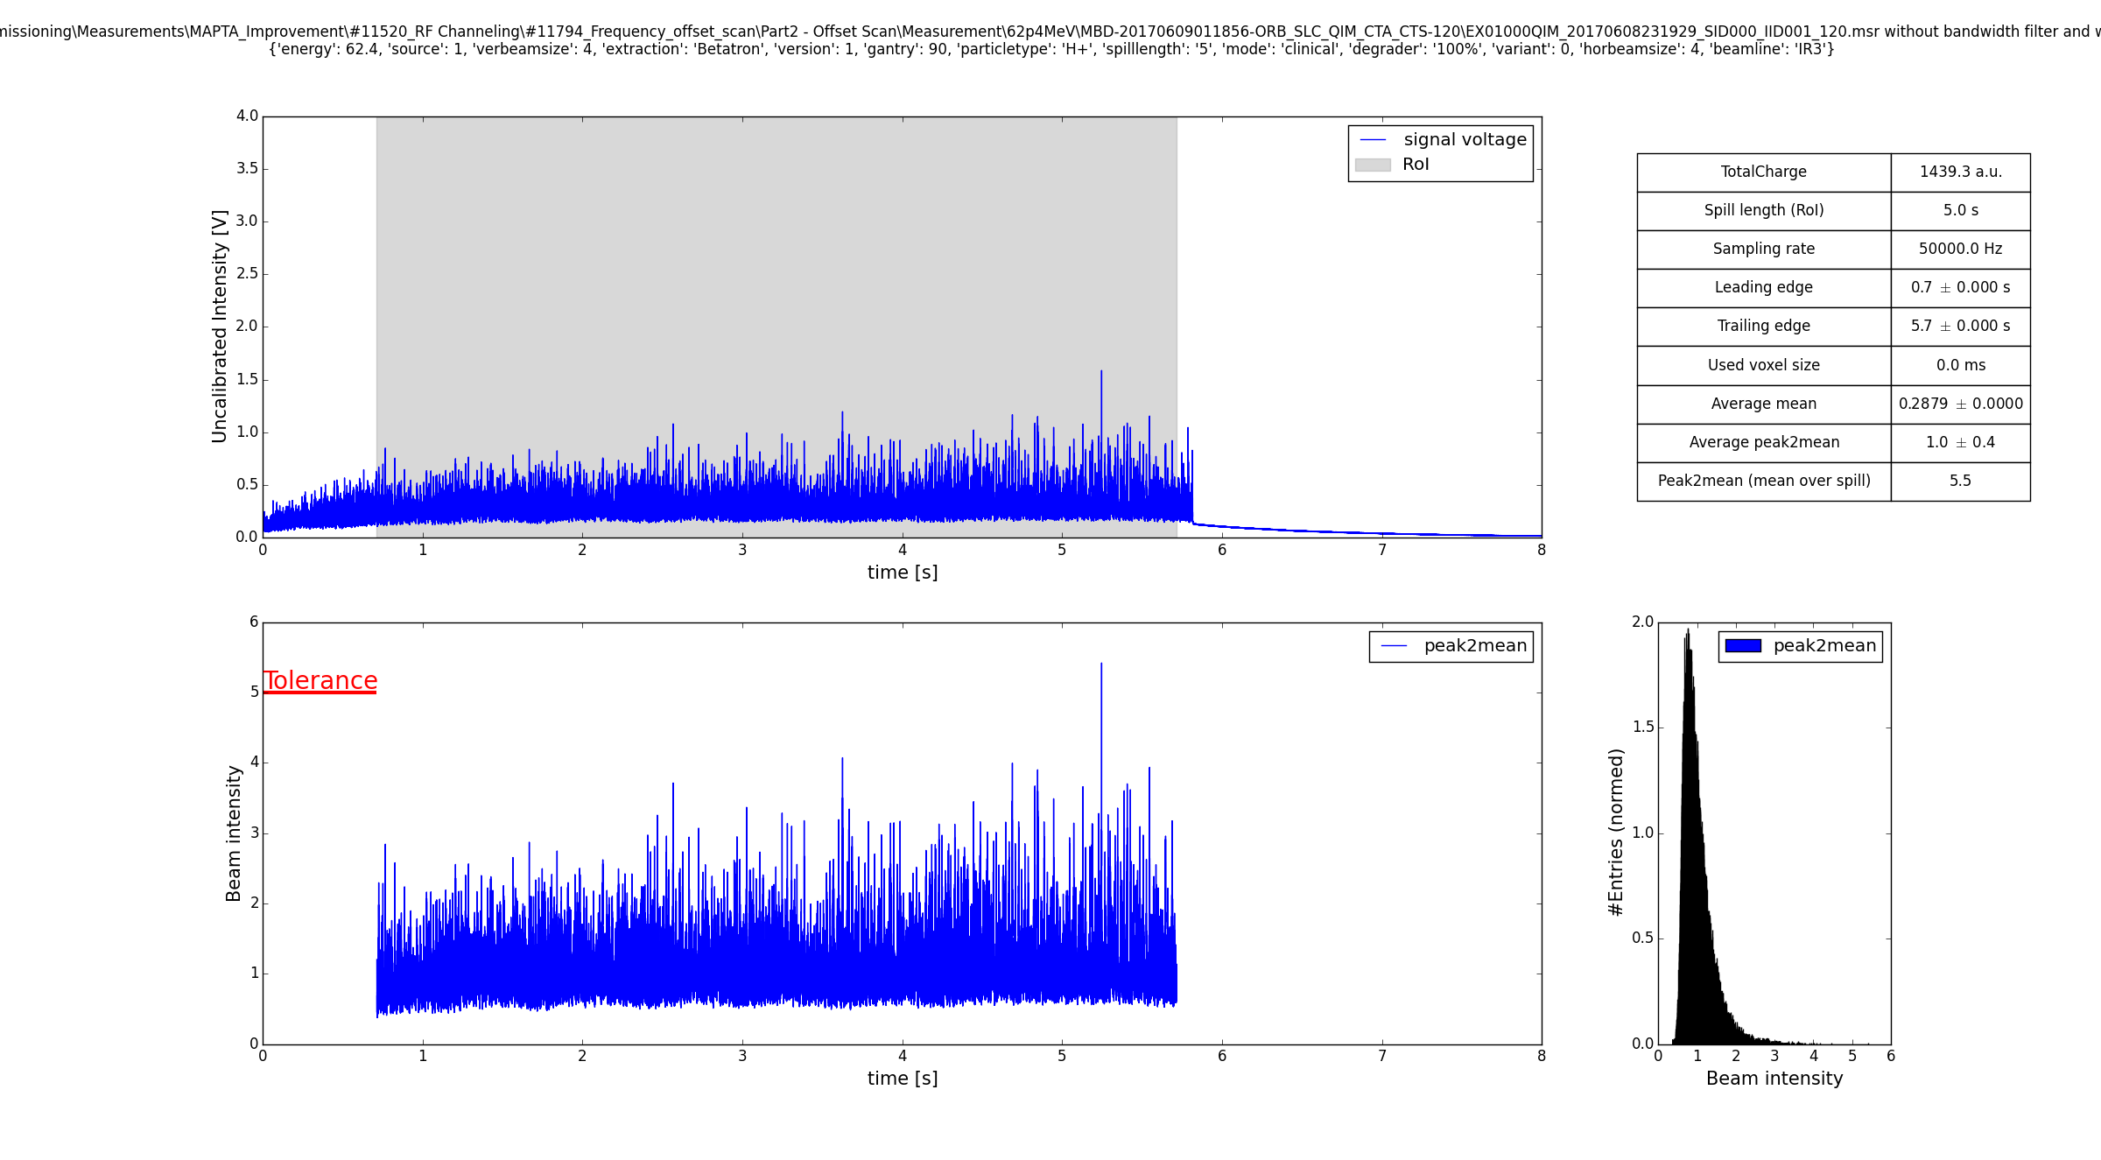
Ripples suppression
Change Spot Sizes, Range !!!
→ Re-commissioning
With RF channeling
En:62.4 MeV - F_{rev}: 1.33 MHz.
∆F_{ch}:15kHz – 1500V
Spill time structure (50kHz)

Slide 20
Irradiation time red. Options
Flux [p/s]
T between
spills
Time [s]
Flux [p/s]
Flux
Time [s]
Flux [p/s]
nr. of spills
Time [s]

Slide 21
Nr. Spills Reduction
New spill requested when:
No more particles stored in synchrotron
New energy required
Statistics* ( Dec 16 – May 19)
Avg. Slices per portal: 41.43
Avg. Spills per portal: 44.65
Avg. Spills per Slice: 1.072
Sync. B-Field
*Patient selection biased by machine performance!

Slide 22
Nr. Spills Reduction
New spill requested when:
No more particles stored in synchrotron
New energy required
Higher stored intensities in the synchrotron
Ripple filters
Multi energy extraction
Spread Bragg peak to reduce the number of energy layers necessary
Change the energy of the beam stored in the synchrotron
Need to:
Model beam dynamics during failures
Reduce termination times
Might have to:
Upgrade Ion source
Use higher harmonics capture

Slide 23
Multi Energy Extraction
Sync. B-Field
Flux [p/s]
En1
En2
En4
En5
Time [s]

Slide 24
Resonant Slow Extraction
(F. Kühteubl Master thesis)
Electrostatic septum wire
Hor. phase space of one particle during the extraction
    Slowly increase momentum spread to move beam into resonance Qx=1.6666
histogram dp/p
Protons measured Schottky monitor
(A. Goetz bachelor thesis)
Notes:
Prior to extraction: Acceleration

Slide 25
Resonant Slow Extraction
(F. Kühteubl Master thesis)
Electrostatic septum wire
De-bunched! Not easy to re-accelerate
Need bunched extraction!!!
Hor. phase space of one particle during the extraction
    Slowly increase momentum spread to move beam into resonance Qx=1.6666
histogram dp/p
Protons measured Schottky monitor
(A. Goetz bachelor thesis)
Notes:
Prior to extraction: Acceleration

Slide 26
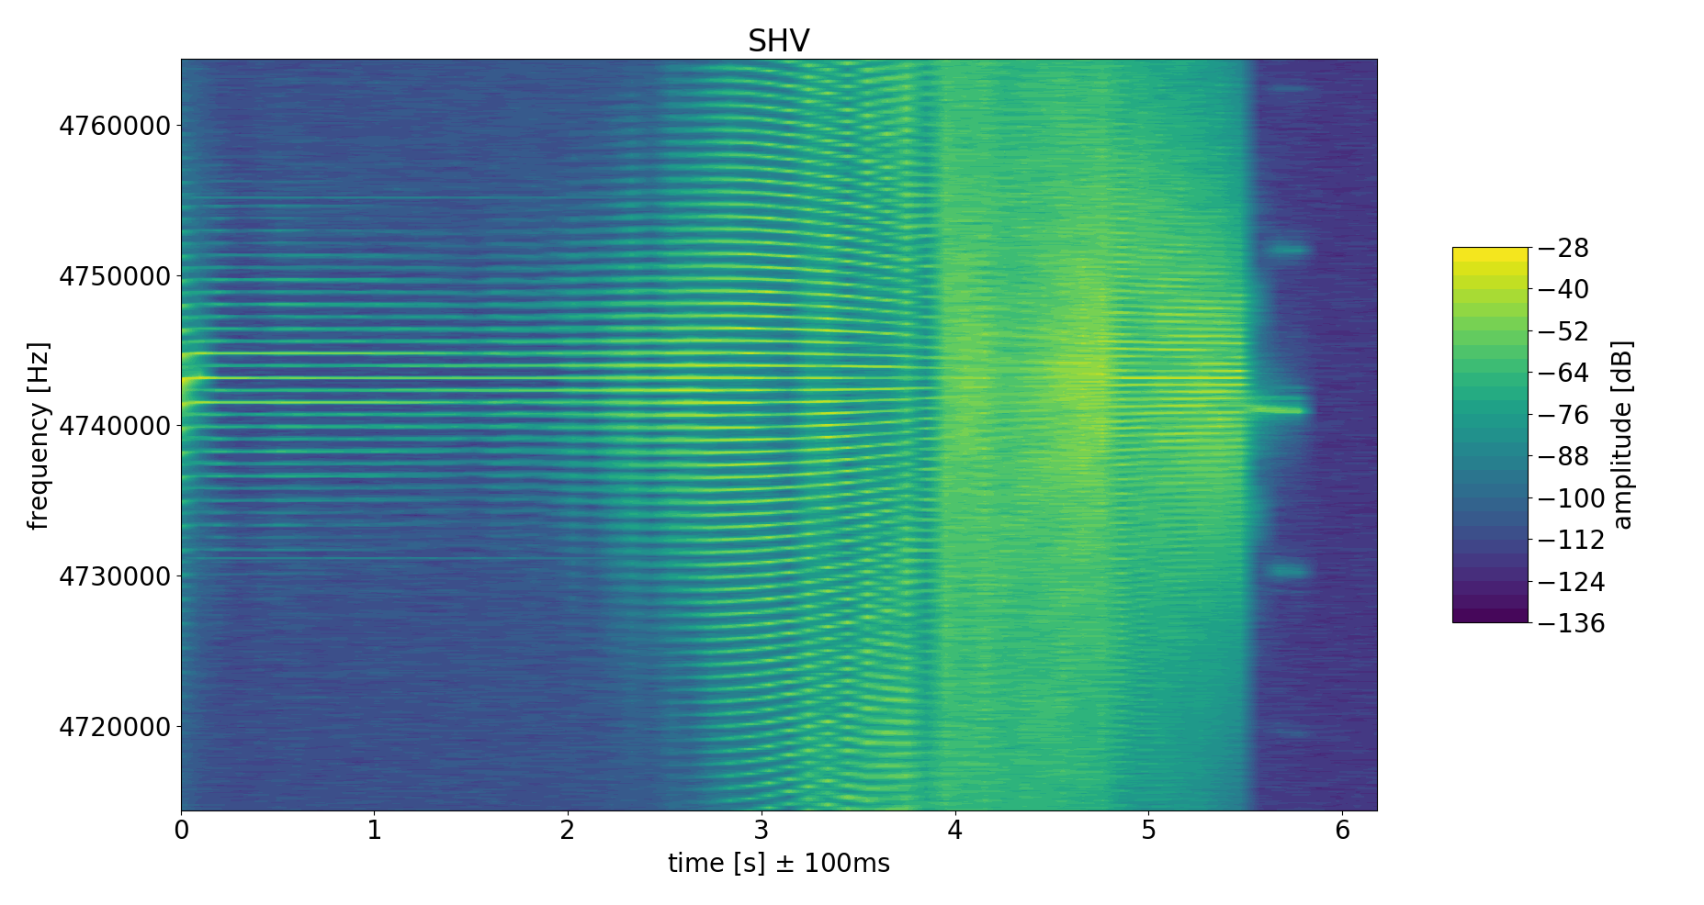
RF-KO extraction
Amplitude
P, Q
(A. Goetz bachelor thesis)
Amplitude
P, Q
(A. Goetz bachelor thesis)

Slide 27
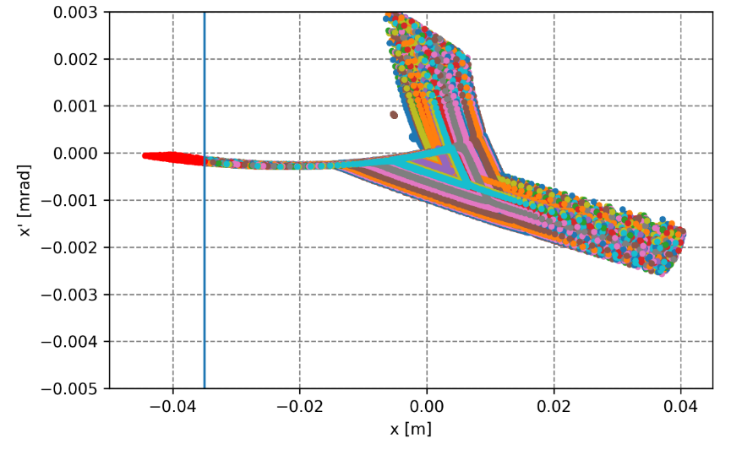
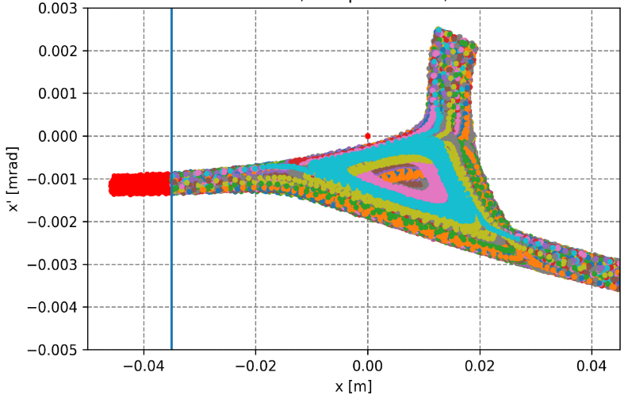
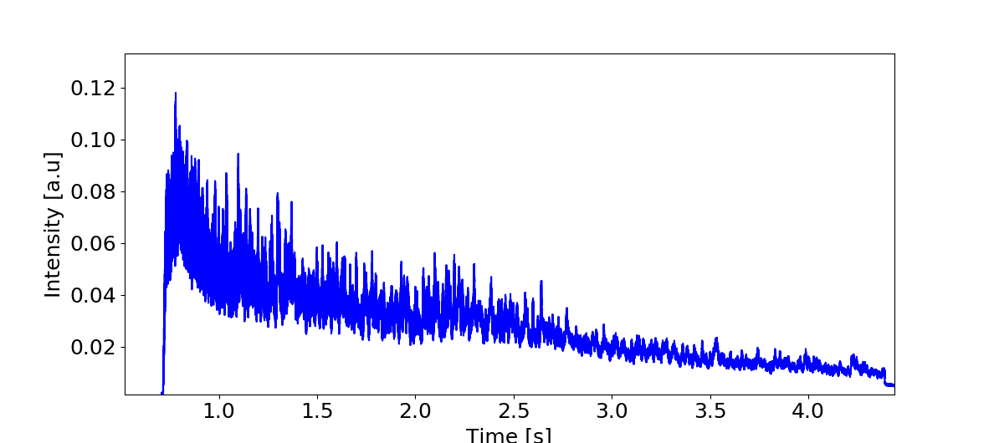
RF-KO extraction
Betatron Core
RF-KO
Preliminary optics
re-design fro RF-KO
(F. Kühteubl Master thesis)
Measured intensity time profile of extracted beam with RF-KO

Slide 28
THANK YOU
Andrea De Franco
andrea.de.franco@medaustron.at
This project has received funding from the European Union’s Horizon 2020 research and innovation programme under the Marie Skłodowska-Curie grant agreement No 675265.

Slide 29
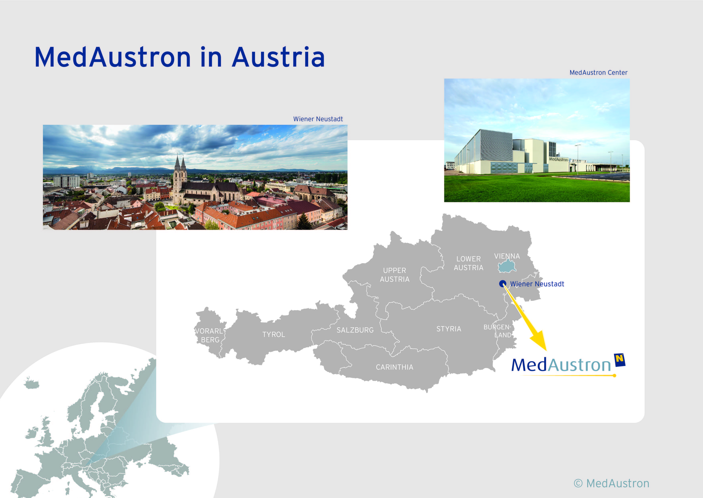
Proton treatment from Dec 2016
Carbon treatment from July 2019

Slide 30
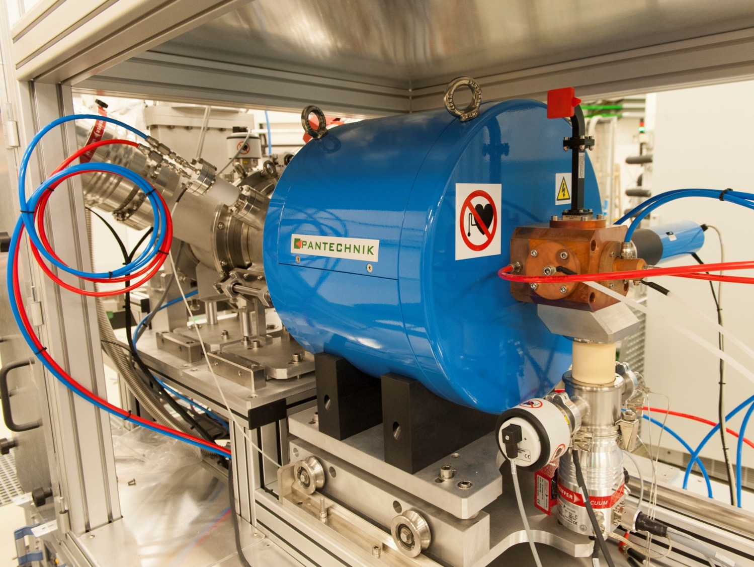
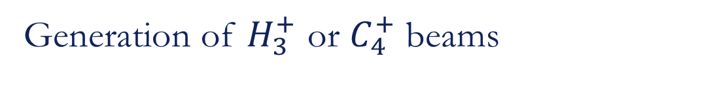
ION SOURCES S1 – S3
Generation of $H_{3}^{+}$ or $C_{4}^{+}$ beams

Slide 31
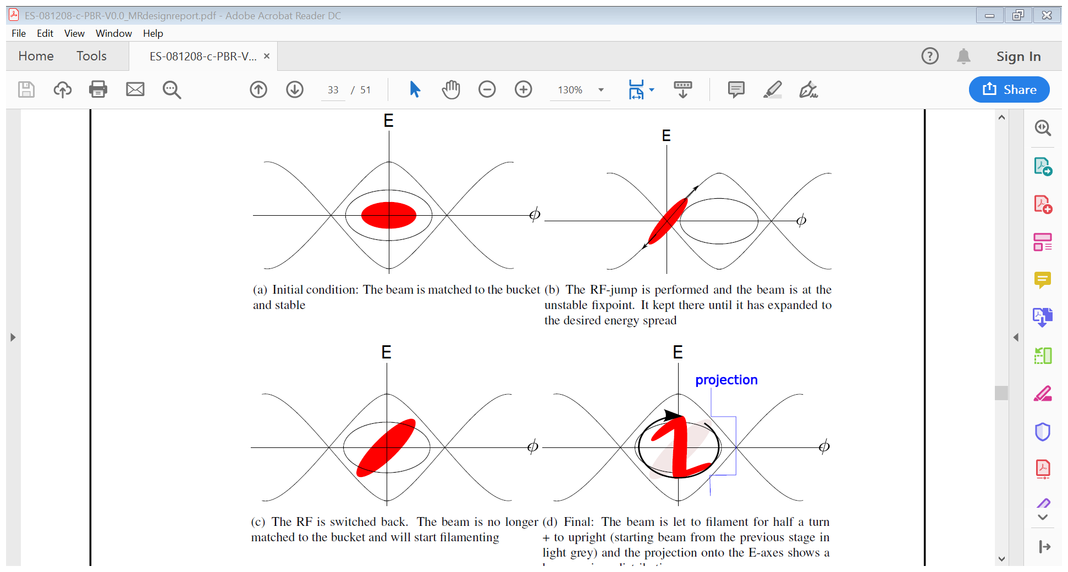
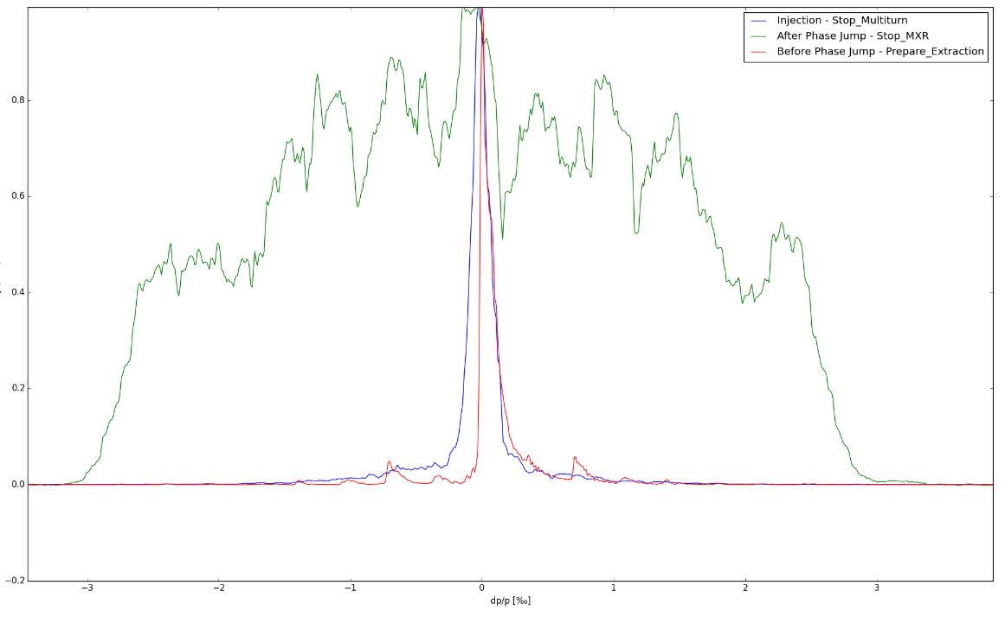
Phase Jump – Enlarge dp/p
Momentum Distribution (Schottky mon.)
Blue: Injection (± 0.3 ‰)
Red: Flat Top (± 0.3 ‰)
Green: After Phase Jump (± 3 ‰)
± 0.3 ‰
Intensity (a.u.)
± 3 ‰
Momentum (‰)
Notes:
Prior to extraction: Acceleration

Slide 32
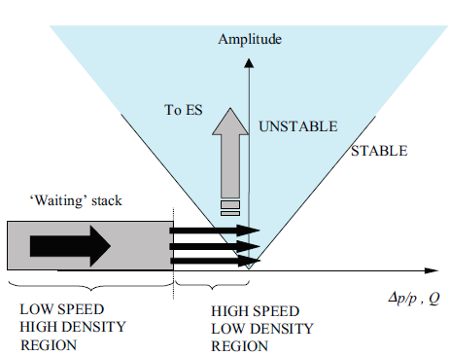
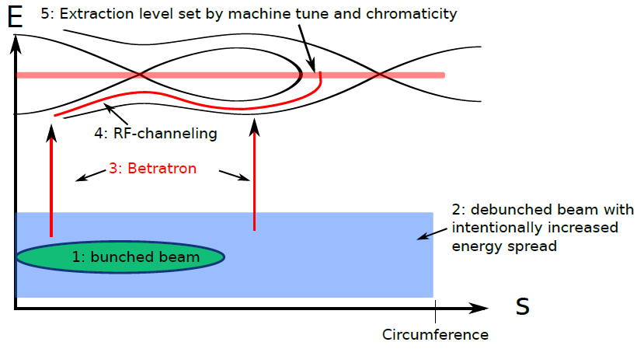
Ripples suppression

