Slide 1

Beamline measurement of a non-invasive BCM: its advantages and limits
Sudharsan Srinivasan

Slide 2
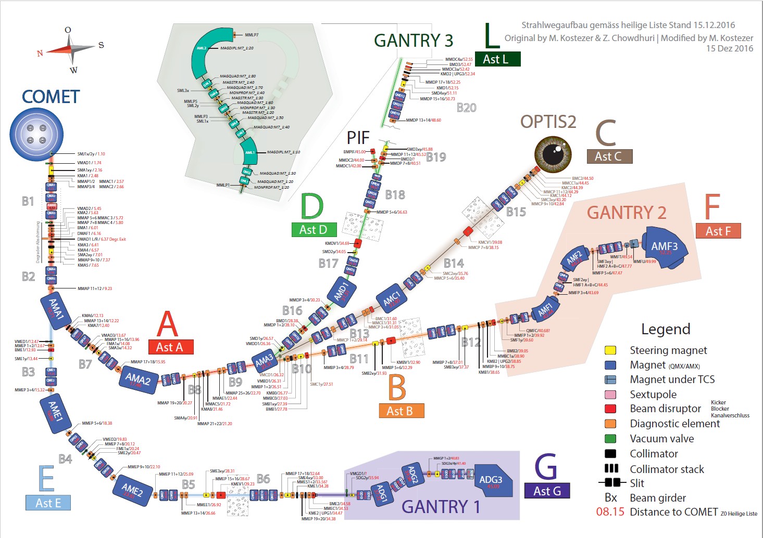
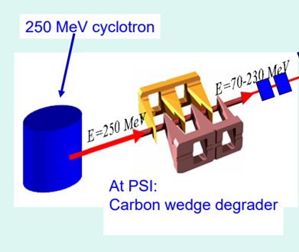
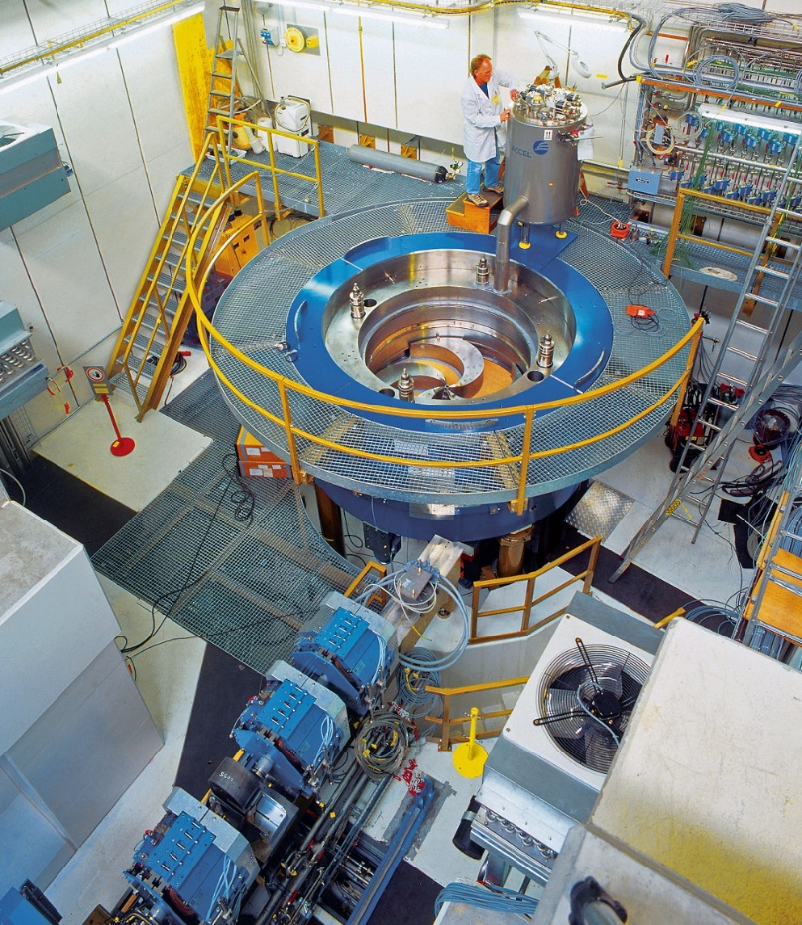
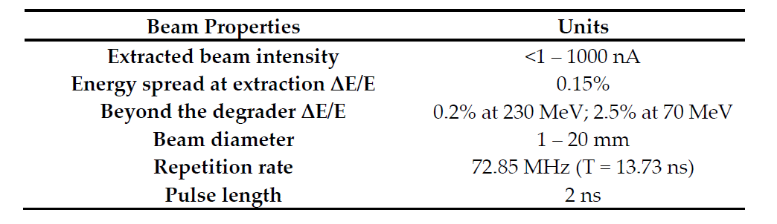

COMET
Superconducting cyclotron
250MeV proton beam
Compact cyclotron
Relevant Beam Parameters

Slide 3
Specific Diagnostic needs
Beam parameter of interest: Beam intensity (Most Important)
Two different modes of operation: Diagnostics for commissioning/Diagnostics for Standard operation
Diagnostics for Standard Operation [1]:
  To control and improve accelerator operation (precise)
  Diagnosis of unwanted errors and to trigger interlocks
  High demands for accuracy
  Minimum beam disturbing schemes
Repetitive and stable beam: CW system (Closed loop system)
Signals are treated typically in Frequency domain
Beam current is a non- or slowly varying parameter
High precision by averaging

Slide 4
Review of the BCM
Standard Beam Current Measurements:
ionization chambers are the most commonly used detector type
caveat: intercept beam → decrease the beam’s quality by scattering
An alternative:
a sensitive RF-based current monitor
fully non-interceptive beam current measurement
simple and robust system (KISS), good for safety purpose/applications
Challenge:
For very low charge beams (bunch charge ~ 1.36e-17 C)
Trade-off between bandwidth and sensitivity
Potential benefit:
design a new beam position monitor system using the same technics
IC
NOTE: Slide provided by Pierre André Duperrex

Slide 5
[2,3,4]
BPM types | Bunch/Beam size | Signal strength & quality | Mechanical realization
Linear-cut | Longer | smaller & deformations | complex
Button | comparable | smaller & deformations | simple
Stripline | short | larger & minor deformations | complex
Pill-box | very short | larger ; minuscule deformations | simple
Reentrant | very short | larger; minuscule deformations | simple
Resistive WCM | short | large with thermal noise | complex
Inductive WCM | short | better than linear-cut | complex
BPM types | Advantages | Bandwidth | PROSCAN
Linear-cut | highly linear and good position sensitivity | Broadband | No
Button | non-linear and good position sensitivity | Broadband | No
Stripline | directivity and better position sensitivity | Broadband | Yes (3)
Pill-box | extermely linear and highly position sensitive | Narrowband | Yes (2)
Reentrant | extermely linear and highly position sensitive | Narrowband | Yes (1)
Resistive WCM | linear and average position sensitivity | Broadband | No
Inductive WCM | linear and position sensitivity better than linear-cut | Broadband | No

Slide 6
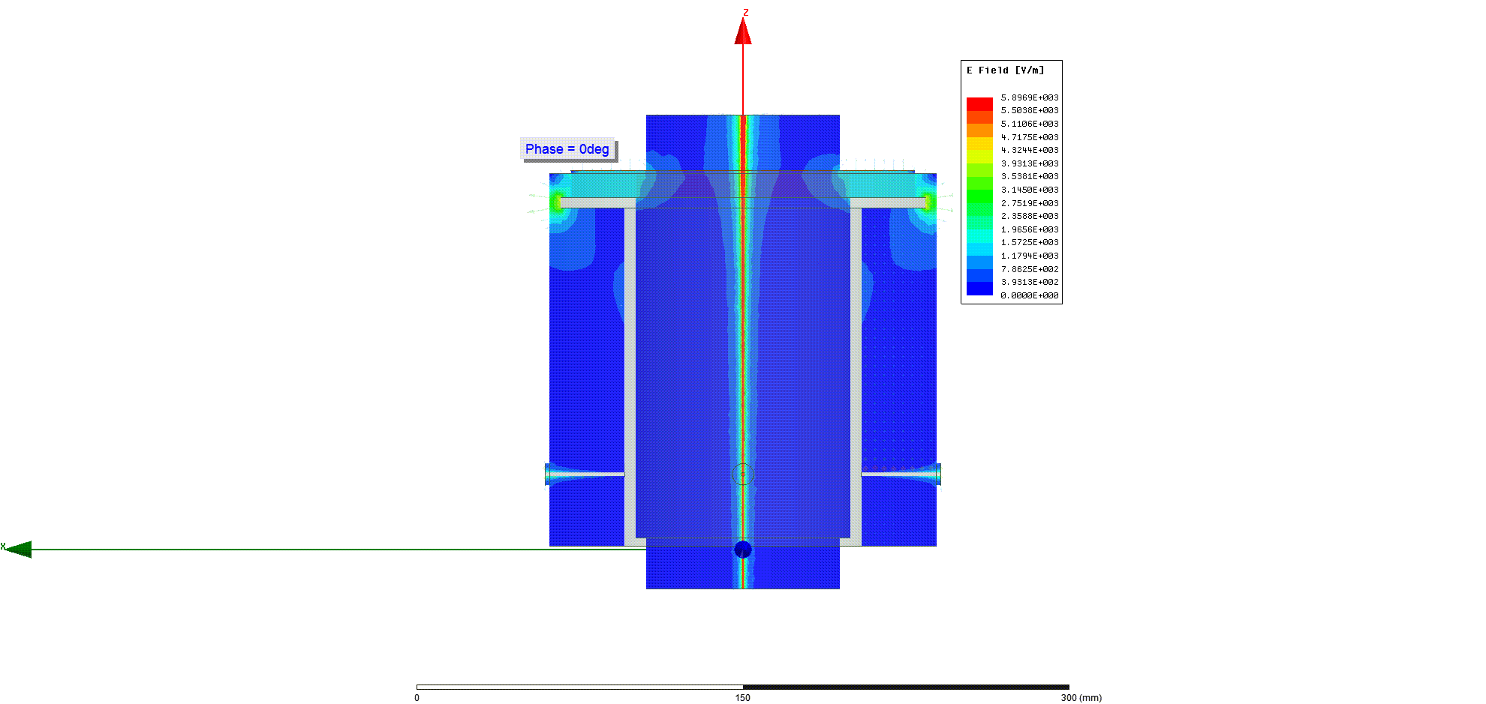
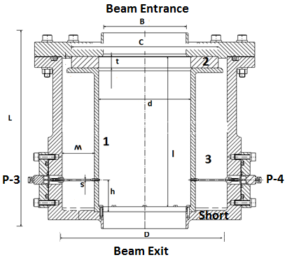
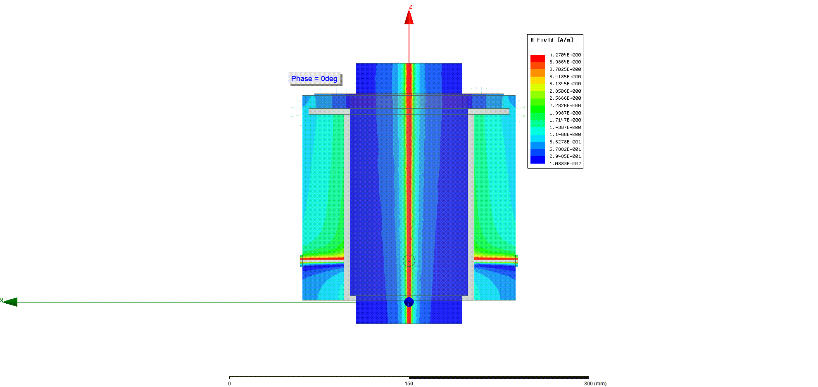
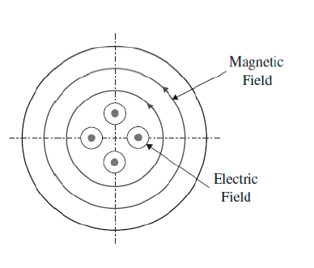
Review of the BCM
Induced E field
Matched to 2nd harmonic of the pulse repetition rate=72.85MHz
TM010
Induced B field
For 1nA at 145.7MHz
Dielectric-Filled Reentrant Cavity Resonator as a Low-Intensity Proton Beam Diagnostic, Instruments 2018, 2,24

Slide 7
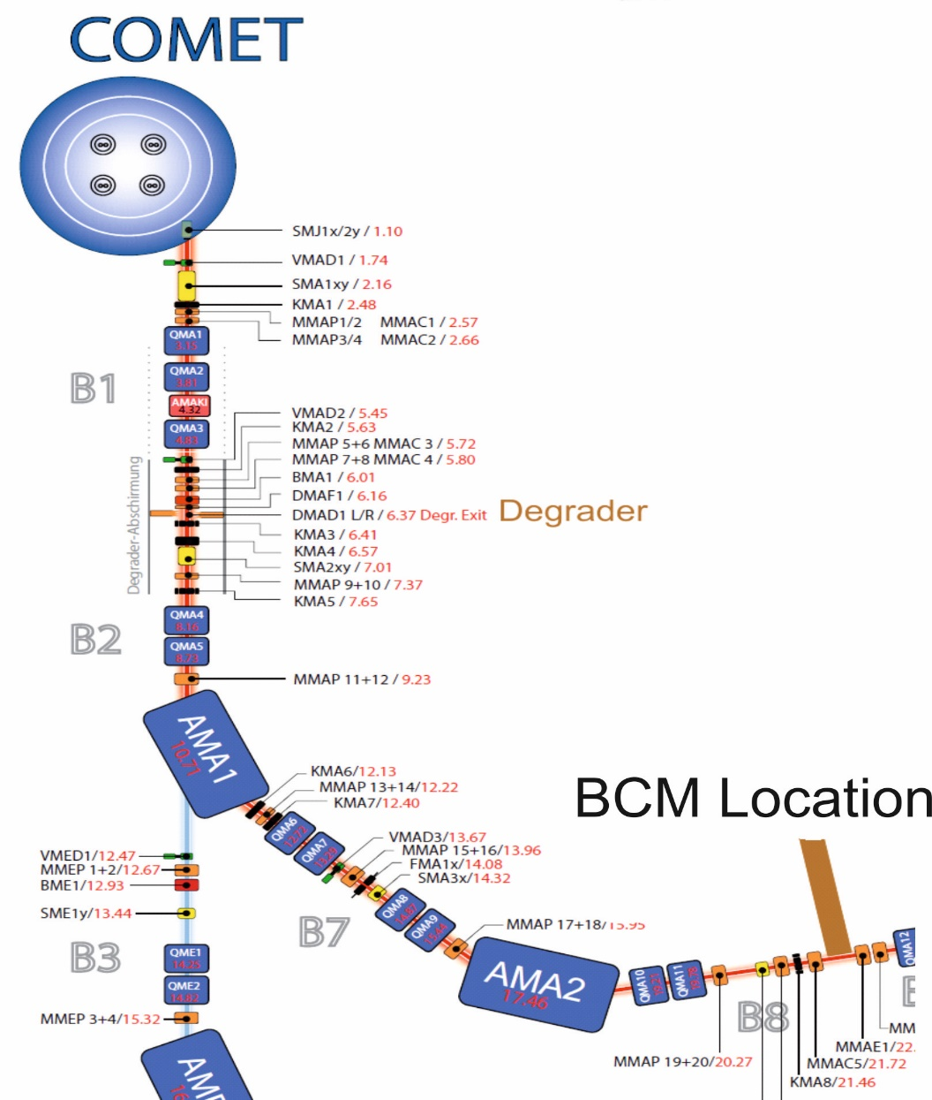
PROSCAN Beamline
BCM located at 22m from the cyclotron exit
Placed behind an Ioniozation Chamber Ionization Chamber used as reference for measurements

Slide 8
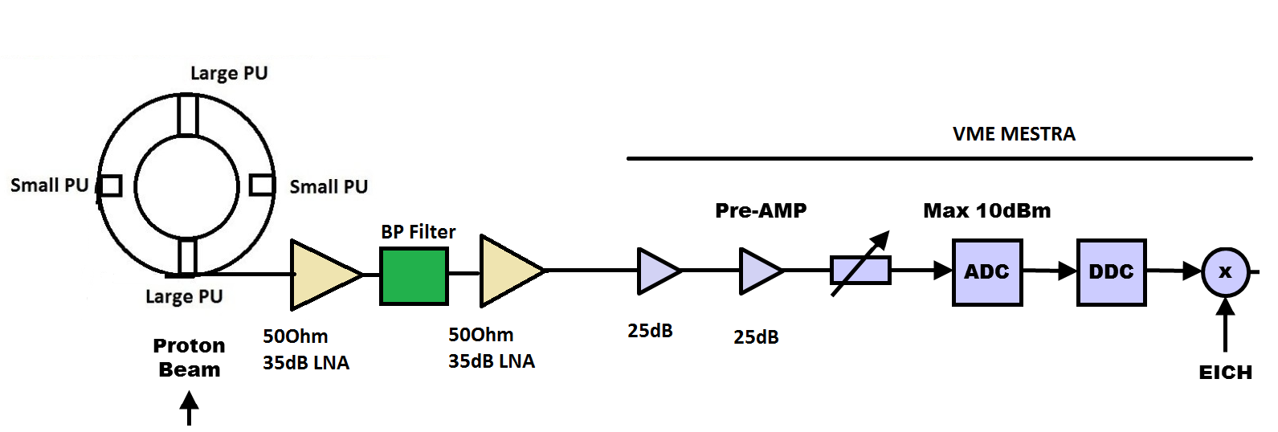
Measurement Chain
2*50Ohm LNA with a BP filter inbetween (center freq: 145.7MHz ; span=10MHz)
Subsystems of VME MESTRA (PSI developed)
  Preamplifier
  Digitizer (ADC); ADC3110 : max. input power of 10dBm (2V peak-peak) 16bit resolution (0.0001V)
  Digital Down Converter (DDC)
  Current Calculations
VME MESTRA converts RF signals to digital signals proportional to absolute beam current
Friss Formula

Slide 9
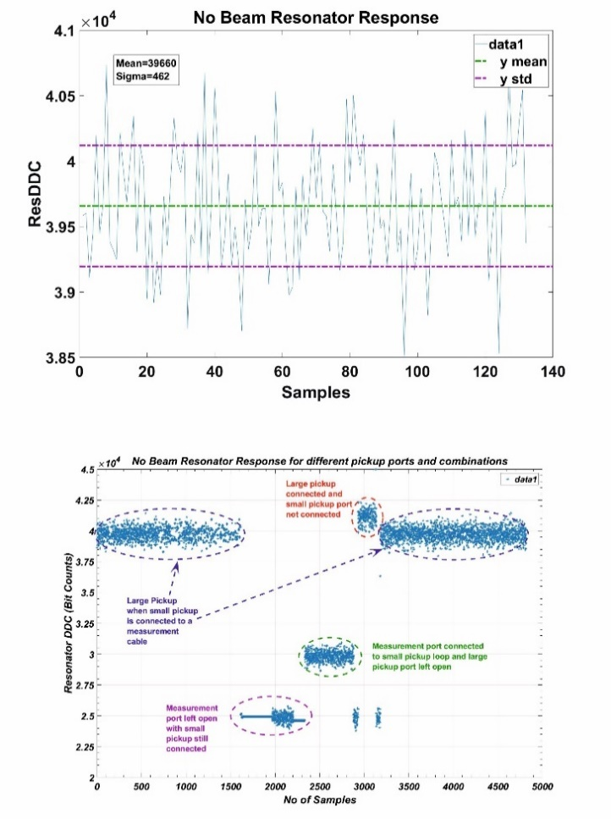
Measurement Chain: Power Budget
Noise Level
The typical power budget for the measurement system is:
Resonator at 1nA: -134dBm
Local amplifiers: +70dB -64dBm
Cellflex cable 150m: -3dB -67dBm
1st Amplifier: +25dB -42dBm
2nd Amplifier: +25dB -17dBm (0.089V peak to peak)

Slide 10
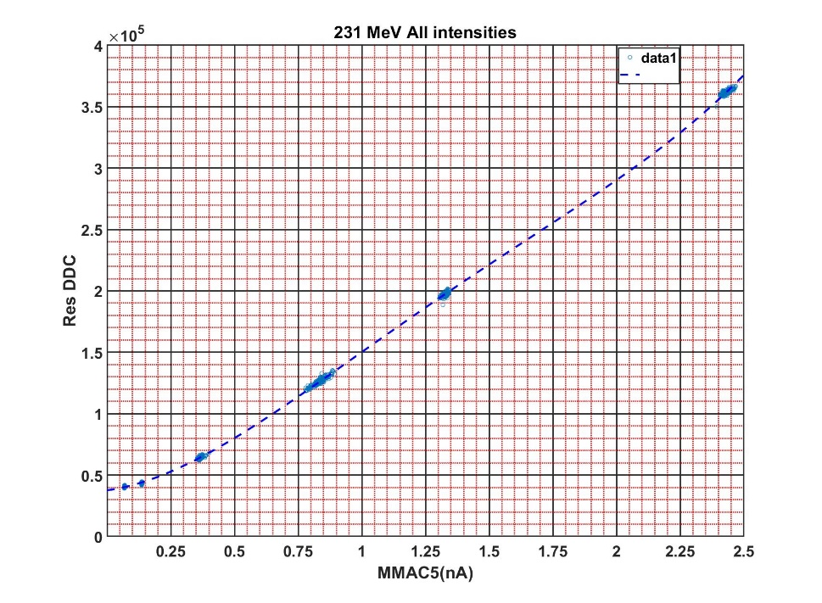
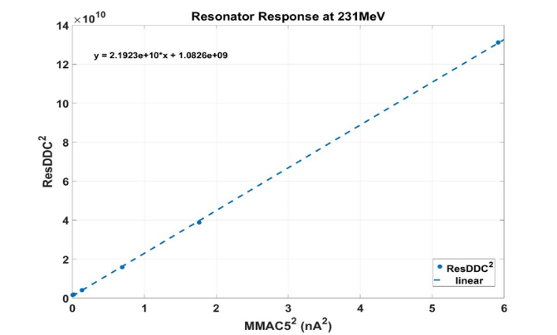
Resonator Vs MMAC5
Uncertainty in noise arises from uncertainty of MMAC5 (15-20% measurement uncertainty )

Slide 11
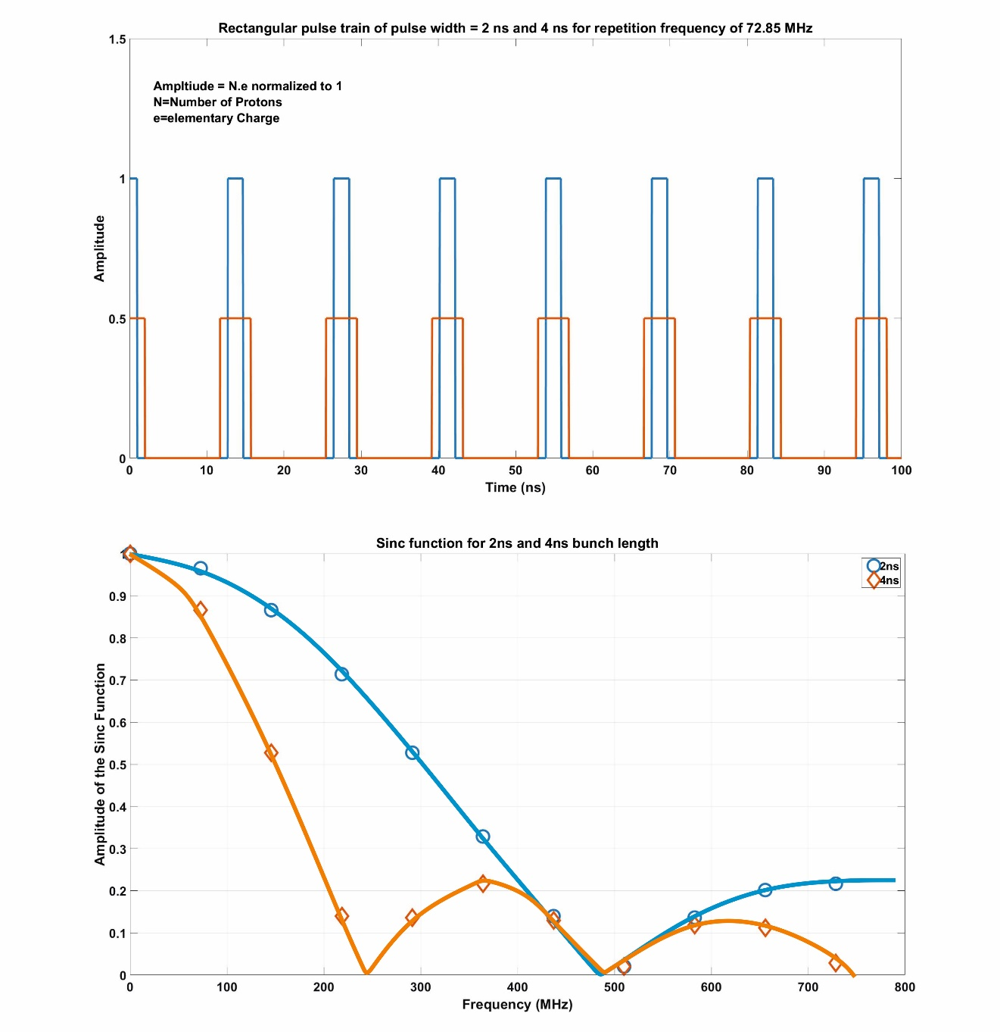
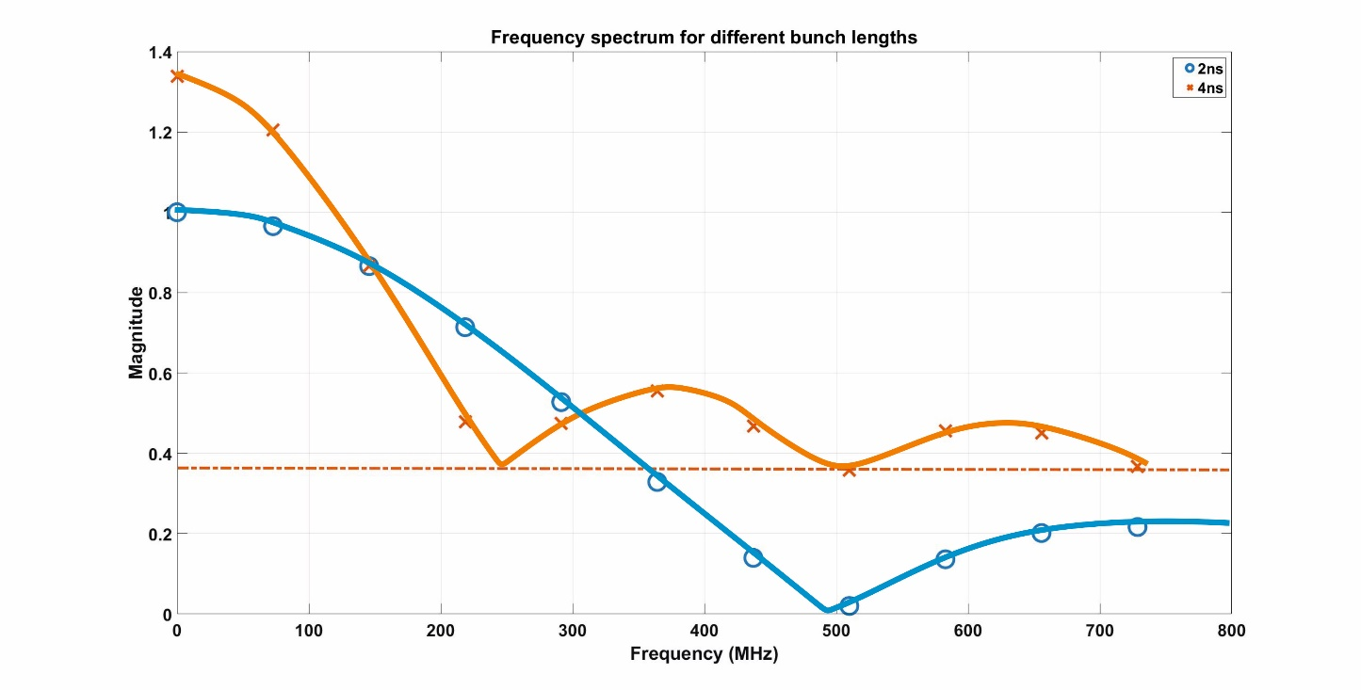
For lower beam energies, energy spread is higher beyond degrader. Hence, pulse length increases thus decreasing the 2nd harmonic component of the beam current.

Slide 12
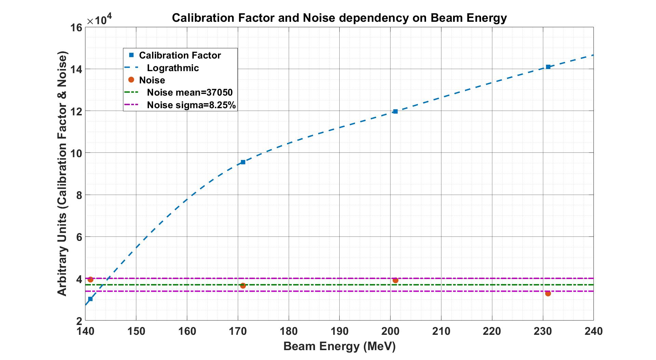

Slide 13
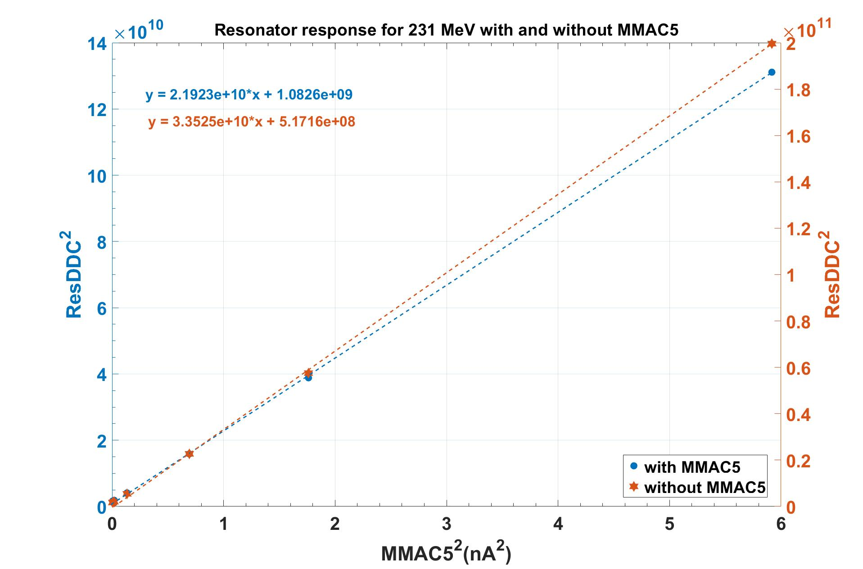
Influence of MMAC5

Slide 14
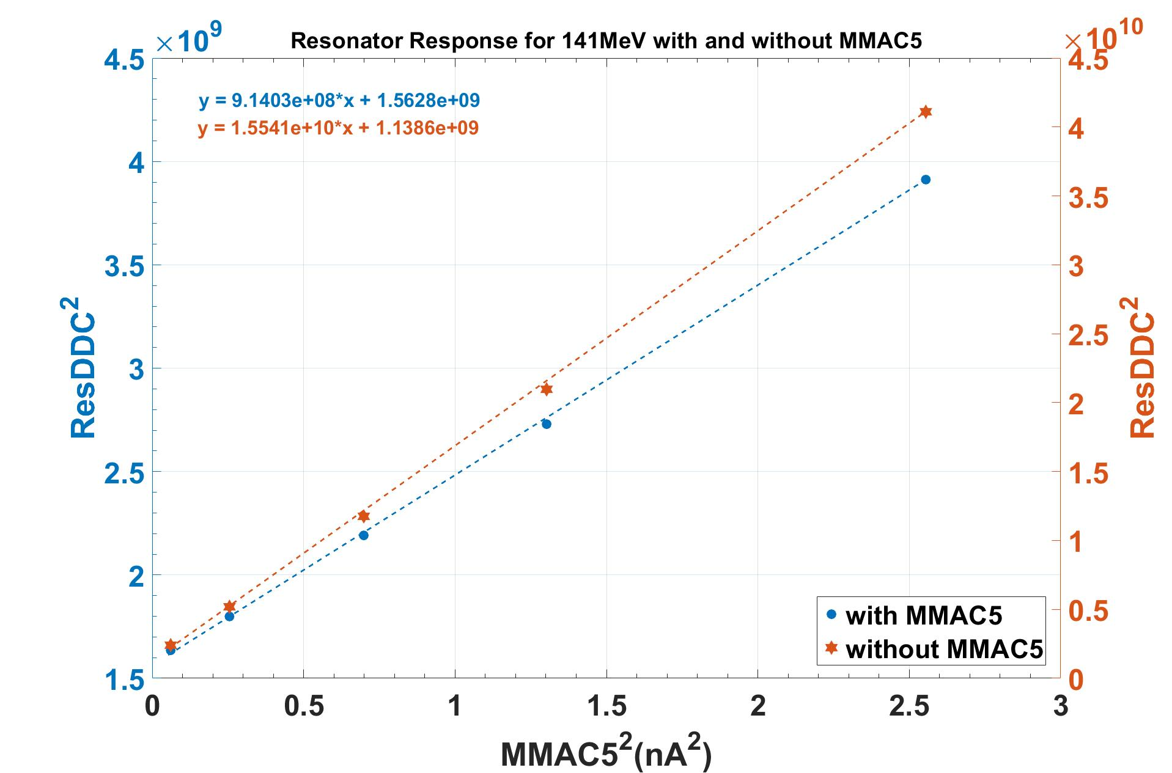
Influence of MMAC5
For higher beam energy (200-230MeV), the influence of IC is minor
As for lower beam energies, IC influence is detrimental affecting signal sensitivity
IC has a huge measurement uncertainty (15-20%)
Beam measurements without IC in beamline recommended

Slide 15
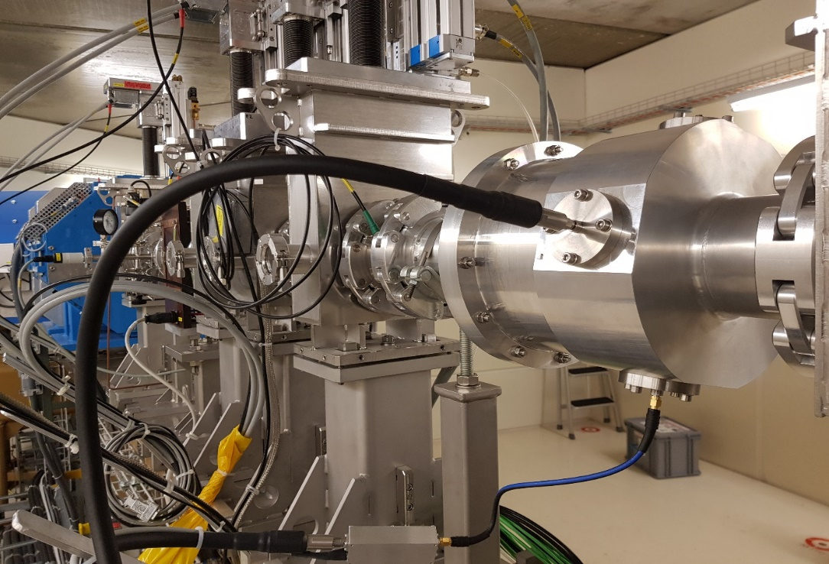
Summary
TM010 resonance
Energy spread affects signal level
60pA at 230MeV; 500pA at 140MeV
Few 100ms integration time
No activation unlike in IC
NO IC in Beamline

Slide 16
References
G.Kube, CAS on Beam Diagnostics, ``Specific diagnostic needs for different machines``, 2008.
J.C. Denard, CAS on Beam Diagnostics, ``Beam Current Monitors``, 2008
P.Forck, P.Kowina; D. Liakin, CAS on Beam Diagnostics, ``Beam Position Monitors``, 2008
Q. Luo; B.G. Sun; Z.R. Zhou; Q.K. Jia, ``Design and Cold test of Reentrant Cavity for HIs``, Proceedings of PAC2011

Slide 17
Thank You
This project has received funding from the European Union’s Horizon 2020 research and innovation programme under the Marie Skłodowska-Curie grant agreement No 675265.
Questions???

Slide 18
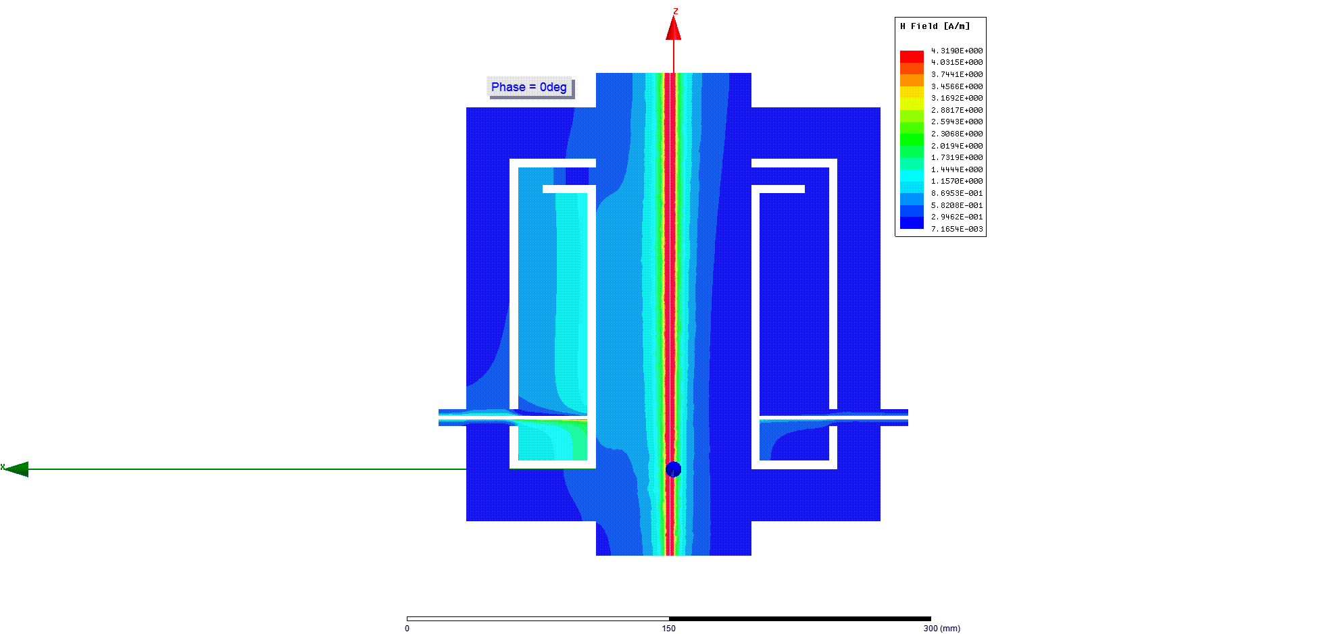
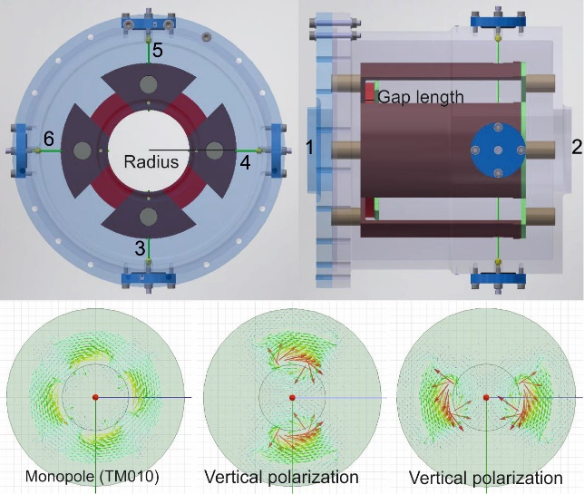
Potential Benefits
TM110

