Slide 1
A Modular Control System for Treating Moving Targets with Scanned Ion Beams: Design, Development, and Preliminary Test Results
M. Lis^{1,2}, W. Newhauser², M. Donetti³, U. Weber¹, M. Wolf¹, C. Graeff¹
¹GSI Helmholtzzentrum für Schwerionenforschung GmbH, Darmstadt Germany
²Louisiana State University, Baton Rouge, LA, USA
³CNAO Centro Nazionale di Adroterapia Oncologica, Pavia, Italy
Notes:
“presenting my work in designing and testing a modular control system for treating moving targets with scanned ion beams”

Slide 2

Disclosures
This project has received funding from the European Union’s Horizon 2020 research and innovation programme under the Marie Skłodowska-Curie grant agreement No 675265.

Slide 3

Motivation
Notes:
The motivation for my work begins with the persistence of low lung cancer survival rates. Lung cancer has the lowest 5 year survival rates for the most commonly occurring cancers in the USA.

Slide 4
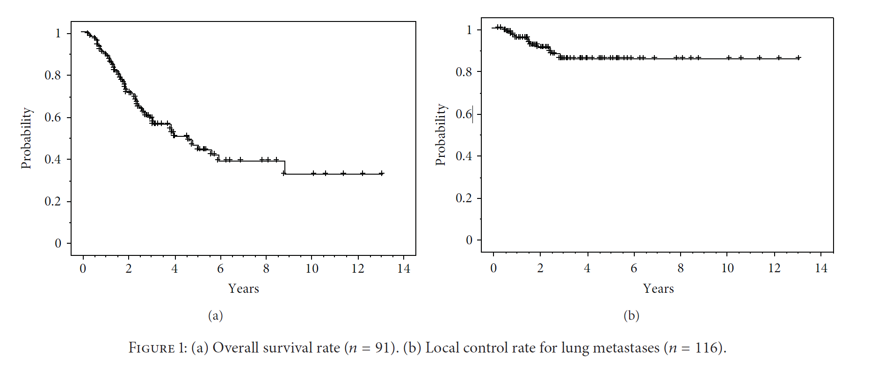
Motivation
Overall Survival Rates
Local Control Rates
(Nakajima M et al 2013)
Notes:
If we look deeper, we see that lung cancer survival rates (seen here on the left) have shown limited improvements despite generally more effective local control rates (seen here on the right). This implies that we are killing the tumor, but causing complications to the patient which result in patient death.

Slide 5
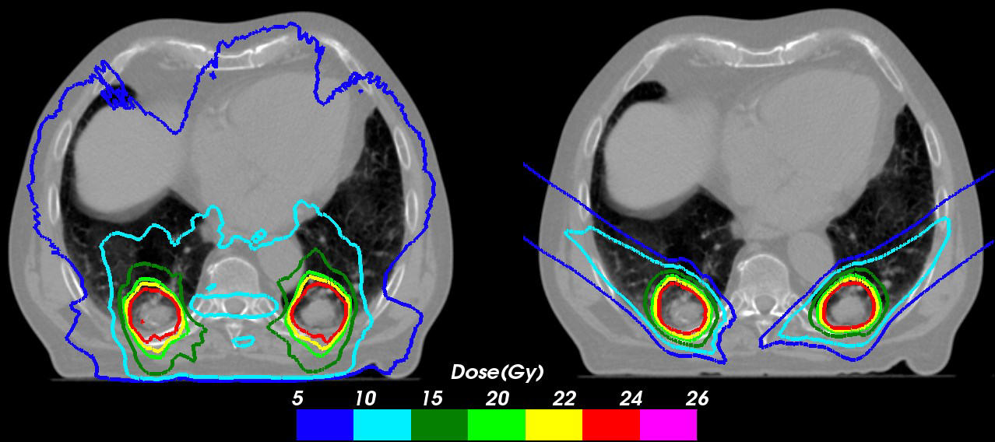
Ion therapy
Scanned particle therapy has potential for dose escalation while sparing healthy tissue
But it requires a practicable solution to the longstanding problem of the adverse effects from the interplay of moving ion beams and moving tumors.
IMRT
carbon therapy
(courtesy of Anderle K)
Notes:
Dose escalation is still necessary to achieve the tumor control, however, healthy tissue sparing must be maintained.
Compared to photon therapy (here seen on the left), ion therapy provides a potential solution for this problem, provided that tumor motion can be compensated for.
In fact, we can see that conformal treatment plans can be created for ions (right) for lung tumors, as seen in the photo here.

Slide 6
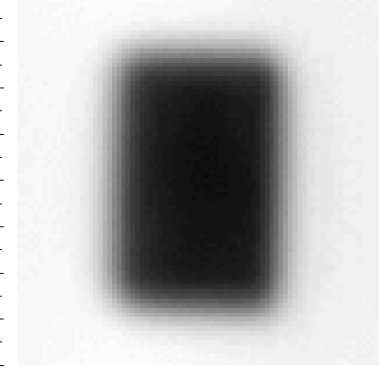
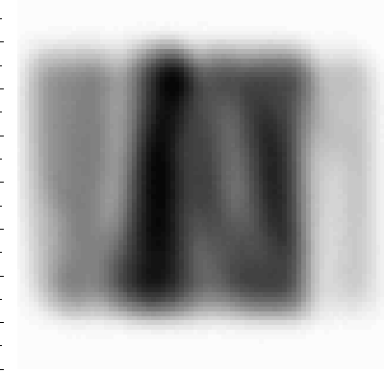
Ion therapy
Scanned particle beam therapy has the potential for dose escalation while sparing healthy tissue
But requires a practicable solution to adverse effects from interplay between moving ion beams and moving tumors.
Static
Interplay
Notes:
When actively scanned ion beams are delivered to moving tumors, the scanning movement interferes with the tumor movement, resulting in the so-called ‘interplay effect, seen here.
This rectangular distribution, when niavely delivered to a moving target, becomes distorted, as seen here.
We can also see the effect of interplay in the dose distribution results

Slide 7
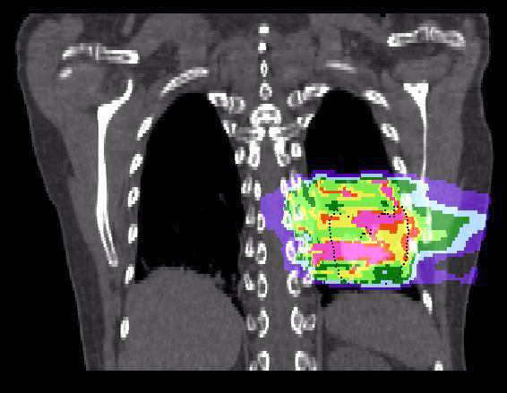
Ion therapy
Scanned particle beam therapy has the potential for dose escalation while sparing healthy tissue
But requires a practicable solution to adverse effects from interplay between moving ion beams and moving tumors.
% of target dose
Static
Interplay
Notes:
We can also see the effect of interplay in the dose distribution results

Slide 8
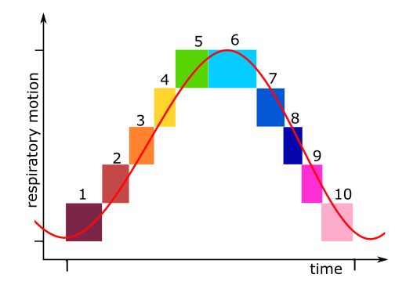
State of knowledge
Many motion compensation methods
Designed conformal treatment plans and dose delivery method
TPS already available (TRiP4D)
Notes:
There are a variety of strategies to handle tumor motion, however, to fully exploit the potential dose distribution conformity that scanned carbon ion therapy offers, we chose a strategy which begins by creating a set of treatment plans which are EACH conformal to the initially measured tumor motion by using the robust 4D optimization approach. We then use live tumor motion information to guide the sequence of delivery and make modifications when there are deviations. We call this the motion-synchronized, conformal dose delivery approach.
The robust 4D optimization strategy has been already implemented into the treatment planning system portion, through GSI TRiP4D, but the dose delivery portion had not.

Slide 9
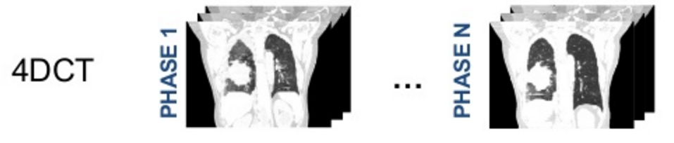
4D-optimization
Library of plans
Notes:
The aforementioned treatment planning method uses the discrete tumor location image sets of a 4DCT to create a series of optimized treatment plans. Each plan corresponds to when a tumor is in a specific motion phase. A series of separate, conformal to the tumor volume, plans are created, one for each motion phase. The plans are each made to the prescription dose. The particle numbers of each individual beam spot in the treatment plans are then scaled down so that the total dose of all the plans combined is the prescribed dose. This constitutes what we call the LIBRARY OF PLANS.

Slide 10
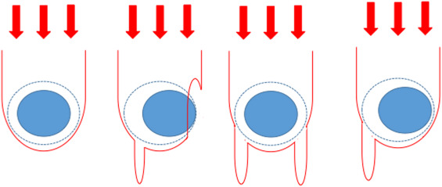
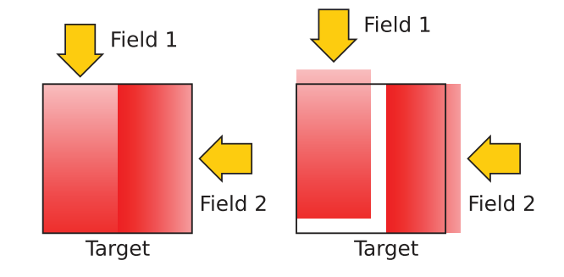
4D-optimization
robust 4D-optimization
  worst case cost function to minimize the dose distribution degradation from patient positioning shifts and tumour depth uncertainties
  minimize effect of uncertainties
(Wolf M, 2018)
Notes:
Several strategies to minimize the dose to surrounding organs while maintaining a high level of tumor conformity. Our group has developed a “Worst case optimization” method. This method involves using a worst case cost function…
The effects of uncertainties are depicted here, where…

Slide 11
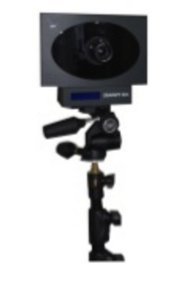
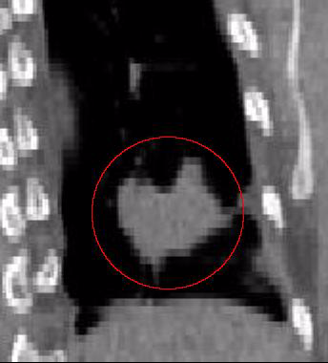

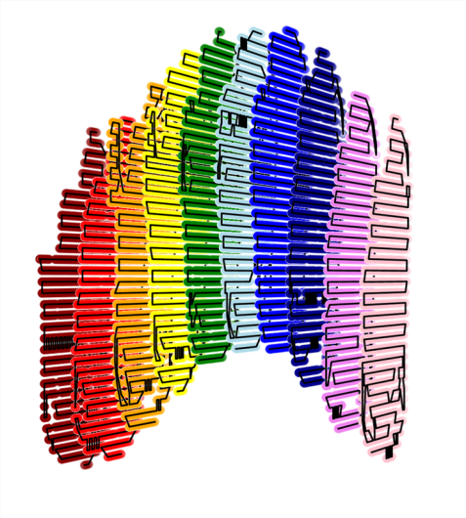
Delivery process
treatment delivery:
  library is sent to motion-synchronized DDS
  MMS detects motion, directs sub-plan switching
4D-optimized conformal irradiation
synchronize
Motion Phase
single slice, E=224.8 MeV/u
Notes:
During treatment delivery, this treatment plan library is sent to our motion-synchronized dose delivery system. As treatment progresses, a motion monitoring device measures the tumor motion and directs switching from sub-plan to sub-plan, depending on the calculated motion phase. Once all the sub-slices of a given energy are delivered, the delivery progresses to the next energy layer.
When the detected tumor location deviated from the path detected during 4DCT creation, a correction vector can be applied to the scan path.

Slide 12


The M-DDS
A motion-synchronized dose delivery system (M-DDS) was designed, developed and tested at GSI and CNAO.
Notes:
As the motion mitigation capabilities did not exist, we adapted the clinical DDS from CNAO for development of the motion mitigation capabilities at GSI. After developing the system, we performed validation tests at both centers.

Slide 13
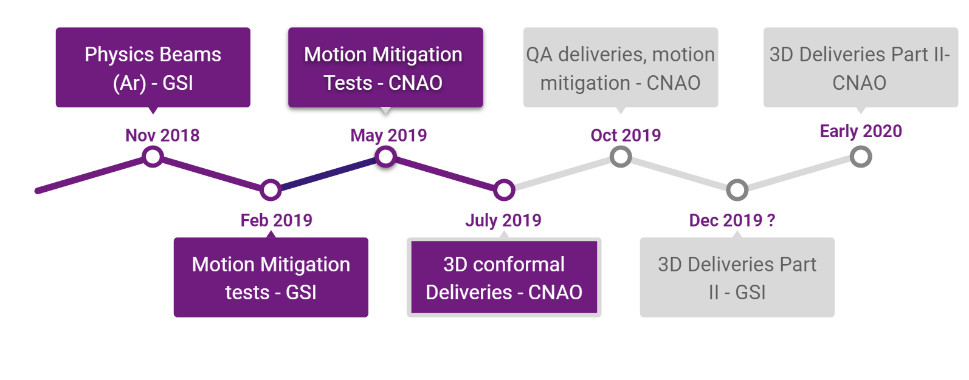
Experiment timeline
Notes:
The validation tests were performed last November, during physics beams at GSI. Argon ions where used for these tests. So far, we’ve developed version 1 of our system, performed a series of validation experiments, and done part I of our performance tests.

Slide 14
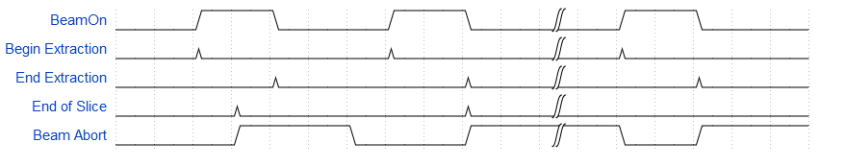
Validation tests - GSI
transmission, reception, timing, and synchronization of signals used by each subsystem
Integration testing: delivering test plans
time
Notes:
The validation was done by testing the transmission, reception, timing, and synchronization of signals used by each subsystem. The subsystems include the scanning system, integral and position detection systems, timing systems, etc. Here we see a schematic of the synchrotron spills synchronized with the timing events which progress treatment delivery.

Slide 15
Validation tests - GSI
transmission, reception, timing, and synchronization of signals used by each subsystem
Integration testing: delivering test plans
time
Notes:
And here we see the real signals visualized on an oscilloscope.
The integration tests which we performed last November were done by delivering test-case plans. With these tests, we confirmed that the DDS worked according to clinical standard at GSI.

Slide 16
Objective
Confirm that the implemented dose delivery system, which synchronizes the motion of tumors and scanned ion beams can irradiate tumors safely and with dosimetric accuracy, while sparing surrounding healthy tissues.
Notes:
Following the validation, we began to study whether the implemented dose delivery system, which synchronizes the motion of tumors and scanned ion beams, can irradiate tumors safely and conformally, while sparing surrounding healthy tissues.

Slide 17
Experiment timeline
Notes:
These tests were performed with carbon beams last February at GSI and then again at CNAO in May.

Slide 18
Safety
Continued safety for clinical prototype
Gating tests
CNAO: Complete beam disruption with chopper magnet
GSI: Residual intensities ~10 % of full intensity
Notes:
The continued safety of the system was an important aspect of our study as our system is a prototype of a potential new clinical product.
The most important safety feature was the gating system. Gating response time was tested at GSI and CNAO to determine if rapid gating was possible.
Complete beam disruption was possible with the chopper magnet at CNAO, while residual intensities on the order of 10 % of full intensity compromised experimental results at GSI.
At both facilities, rapid gating was verified, which is an essential function of switching between plan libraries

Slide 19

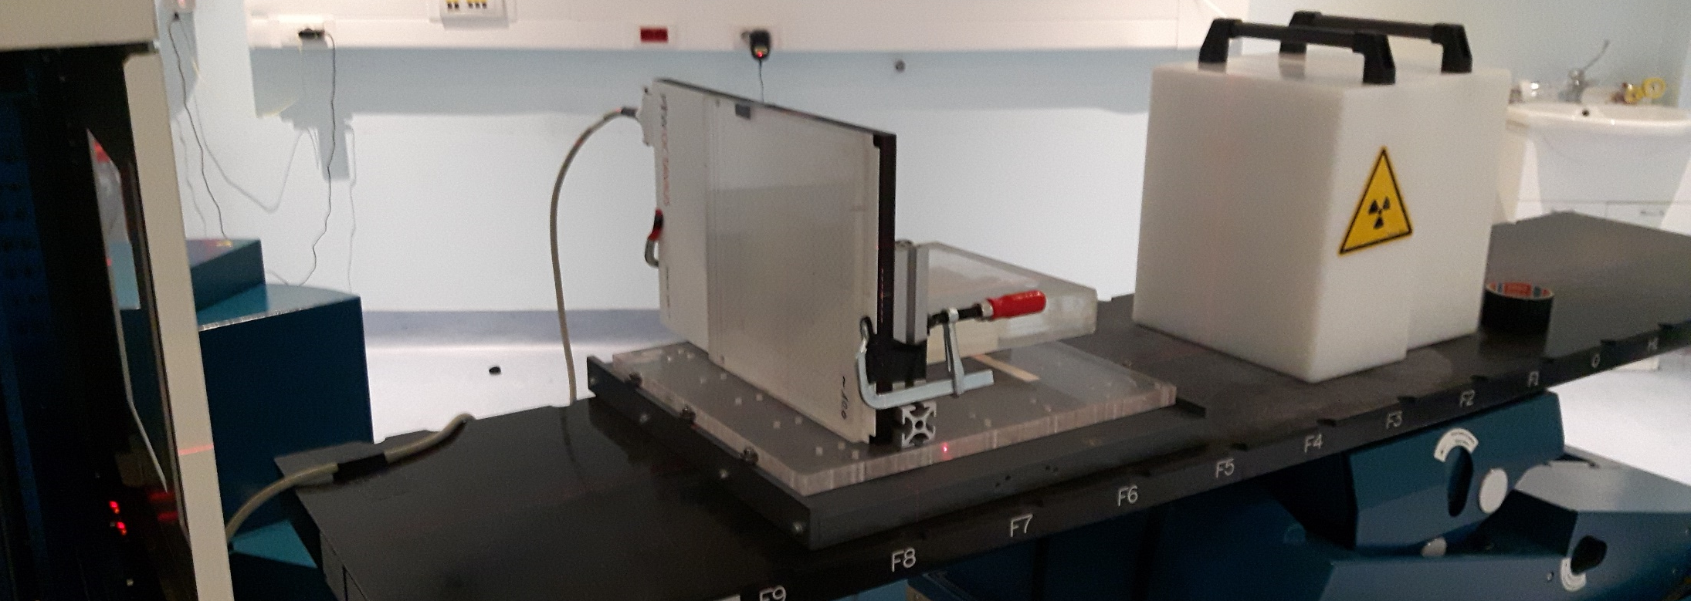
Delivery set-up
2D and 3D geometries – squares, outlines, lines, cubes, ellipses
20 mm and 40 mm horizontal motion
uncompensated, 3, 6, 10 motion phases
2D ionization chamber array detector
optical distance sensor
carbon ion beams
sinusoidally sliding platform
Notes:
Investigation of the degree of motion compensation of the M-DDS
Simple geometries were delivered to a 2-dimensional ionization chamber array detector and radiochromic films mounted on a sinusoidal moving platform.
Various plans designed for uncompensated, 3, 6, and 10 respiratory states (motion phases) were delivered to investigate 1) the degree of motion compensation and 2) the extent of residual motion within a single motion state.

Slide 20
Discussion
Preliminary results have validated the basic functionality and feasibility of the implemented motion mitigation strategy.
3D conformal irradiations successfully delivered
Notes:
Data Analysis is ongoing.

Slide 21



Thank you!
Christian Graeff
Moritz Wolf
Christoph Sauter
Chrsitoph Schuy
Uli Weber
Berdt Voss
Timo Steinsberger
Marco Donetti
Medical physics staff
The results presented here are based on the experiment SBIO, which was performed at the GSI Helmholtzzentrum für Schwerionenforschung, Darmstadt (Germany) in the frame of FAIR Phase-0.
This project has received funding from the European Union’s Horizon 2020 research and innovation programme under the Marie Skłodowska-Curie grant agreement No 675265.

