Slide 1





EXPLORING OF ADVANCES IN HIGH GRADIENT TECHNOLOGIES FOR USE IN HADRON THERAPY ACCELERATORS
Anna Vnuchenko
CSIC / IFIC – Instituto de Fisica Corpuscular (CSIC-UV)
Under supervision: Angeles Faus Golfe
(LAL, CNRS/IN2P3, Orsay, France)
Juan Fuster Verdu (IFIC - CSIC)
International Conference on Medical Accelerators and Particle Therapy 4 September, 2019

Slide 2


Outline
Introduction:
Applications of High-Gradient technology,
High-Gradient limiting quantities.
3 GHz structure for protontherapy:
Conditioning of the structure,
Breakdown position analysis.
352 MHz and 750 MHz RFQs:
Technical specification of the RFQs,
Breakdown study.
Conclusions

Slide 3
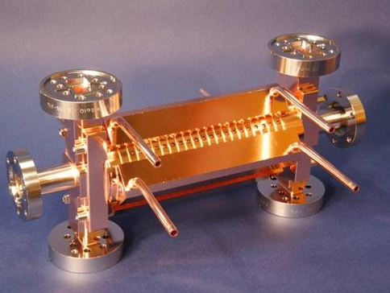
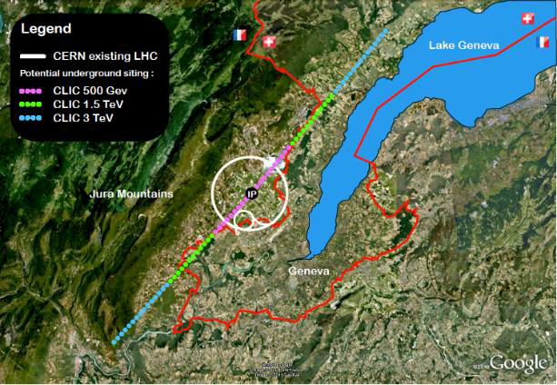
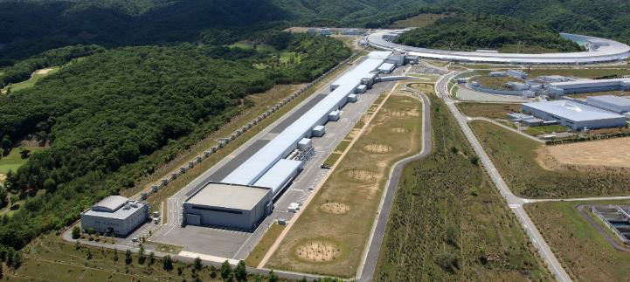
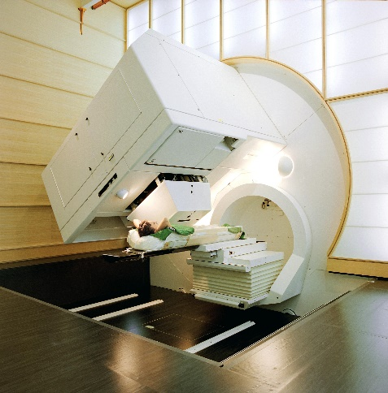
Introduction
The High-Gradient (HG) technology is being developed with the purpose of building feasible, compact and efficient accelerators: increasing HG from 20-30 MV/m up to 100-120 MV/m.
The main idea of the study: Transfer Knowledge from High-Energy Physics to other applications:
CLIC structure
Future Linear Colliders
X-band (12GHz)
Free Electron Lasers
(FEL) C-band (5.7GHz)
Hadron therapy
S-band(3GHz)/C-band
CLIC
SACLA
Linear collider - TeV XFEL – 1 to 10 GeV 350 MeV

Slide 4
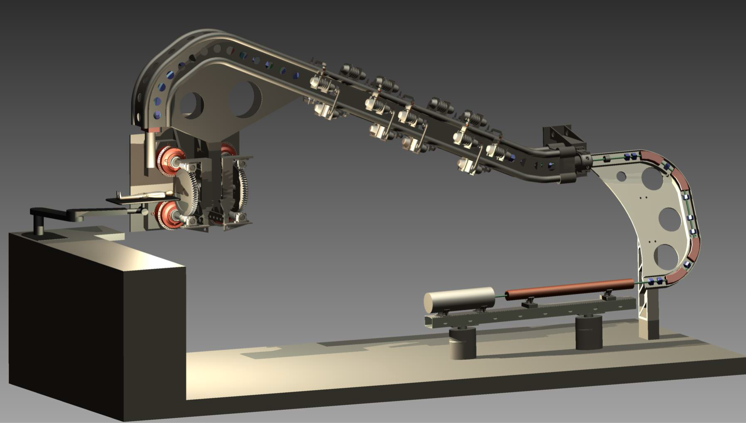
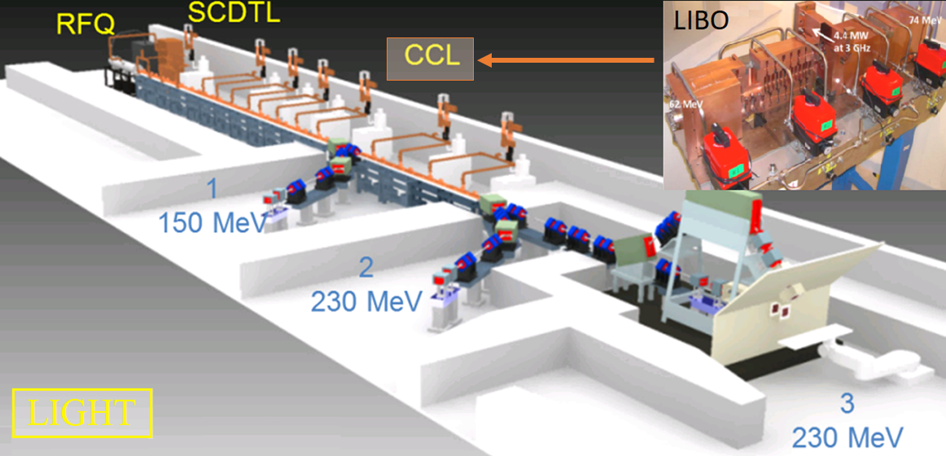
Why Linear Accelerator?
The linear accelerator (Linac) looks as the most promising option on terms of size, complexity and efficiency.
Advantages:
active energy variation (pulse to pulse),
treatment time (a high repetition rate).
230 MeV
3 GHz BTW structure
HEBT
70 MeV
MEBT
Beam source
5 MeV
IH SCDTL
750 MHz RFQ
TULIP
22 m
TULIP: Single-room proton therapy
Advantages: footprint (200 m², 70 ton), shielding
LIGHT: Linac for Image Guided Hadron Therapy
Advantages: beam current, power consumption
BTW (Backward Travelling Wave) structure with a design gradient of 50 MV/m.
CCL (Coupled Cavity Linac) based on the TERA design of LIBO with a gradient of 15.7 MV/m.

Slide 5
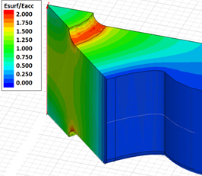
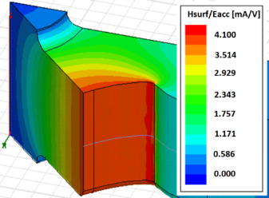
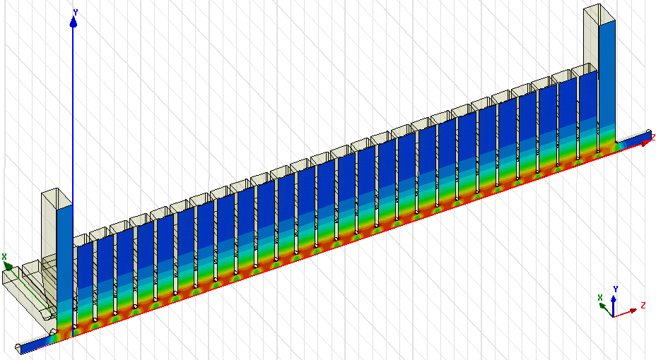



High-Gradient limiting quantities
The accelerating efficiency is strongly dependent on the type of structure used and on the beam energy.
E
Iris
The criteria which limit accelerating gradient:
$E surf=200$ $MV/m$
Surface electric field
Surface magnetic field/pulsed surface heating
Power flow:
H
Cell wall
modified Poynting vector, $S_{c}=5 MW/mm^{2}$
$ΔT∝H_{s}^{2}\sqrt{t_{p}, }$ $T_{max}=50^{o}C$
  Efficiency reduction;
  Erosion of surface;
  Material fatigue, cracks;
  Detector backgrounds;
  Breakdowns (vacuum arcs).
New CLIC 3 TeV baseline H.Zha, A Grudiev
Well developed RF design can predict the gradient of pulsed HG structures.

Slide 6
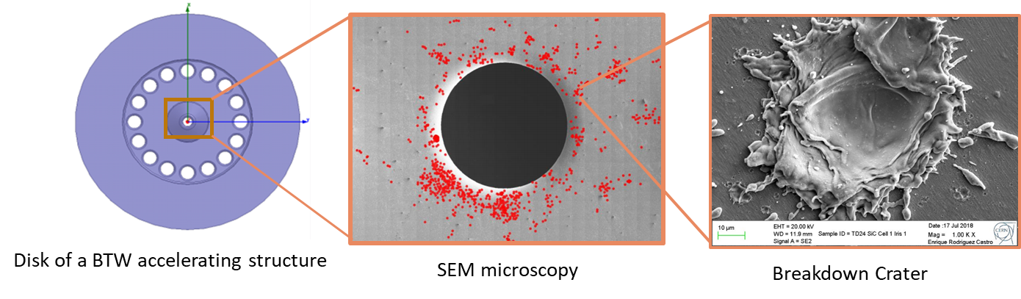
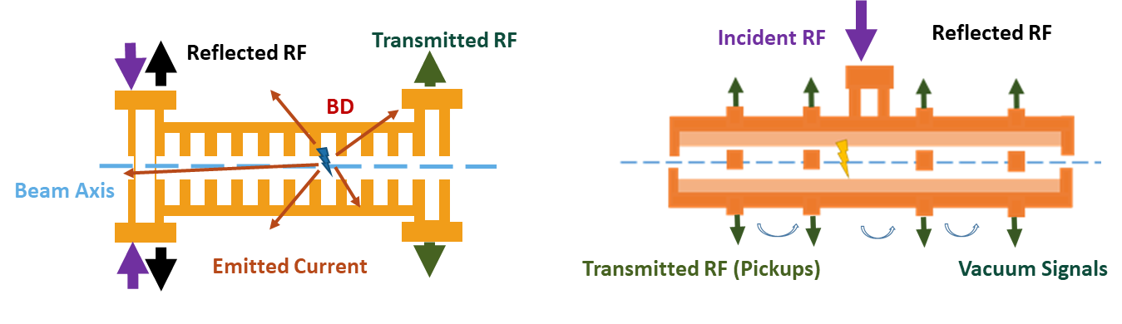
Breakdowns in accelerating structures
BDs can damage the surface and induce instabilities into the beam.
Objective: studying of the HG performance of various accelerating structure, definition of limiting factors to further optimize the structure design.
Traveling-wave structure
Standing-wave structure

Slide 7
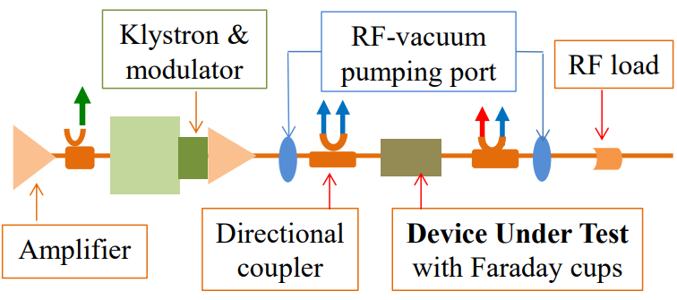
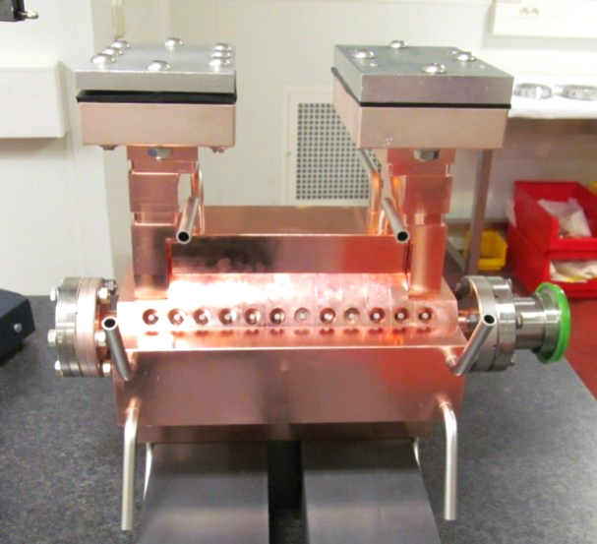
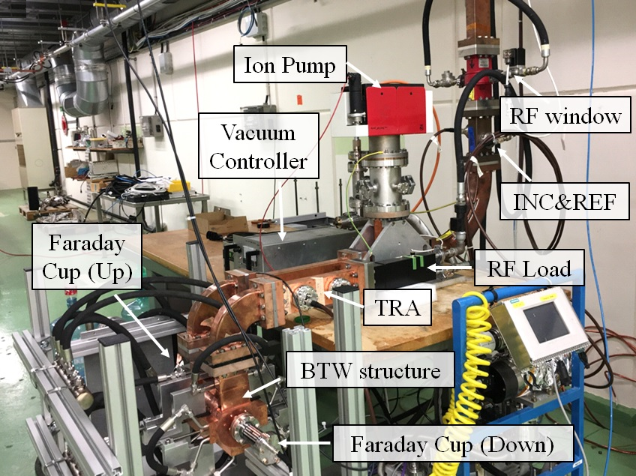
l. S-band medical linac structure (BTW)
Functional diagram of S-band test facility
BTW structure (TULIP), 3 GHz
2.5 μs, 50 MV/m
S-box at CERN
Number of RF cells | 12
β – RF Ph. adv. | 0.38 - 150 deg
Total length | 189.84 mm
Max Sc/Ea² | 0.29 mA/V
Max Es/Ea | 3.9
Filling time | 220 ns
Group velocity (1st/last) | 0.39 / 0.21 %c
10 MeV energy gain from this structure
Dec 2017 – May 2018

Slide 8
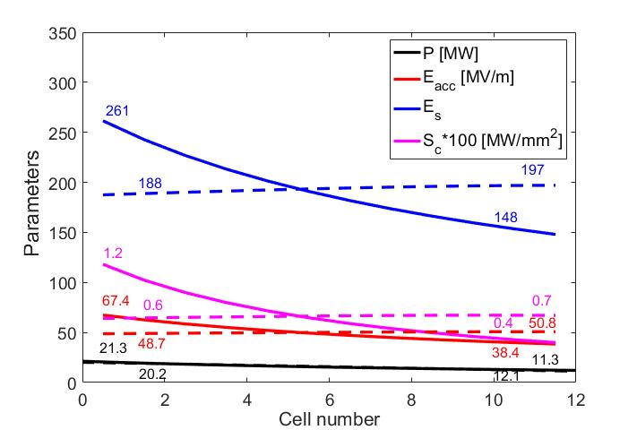
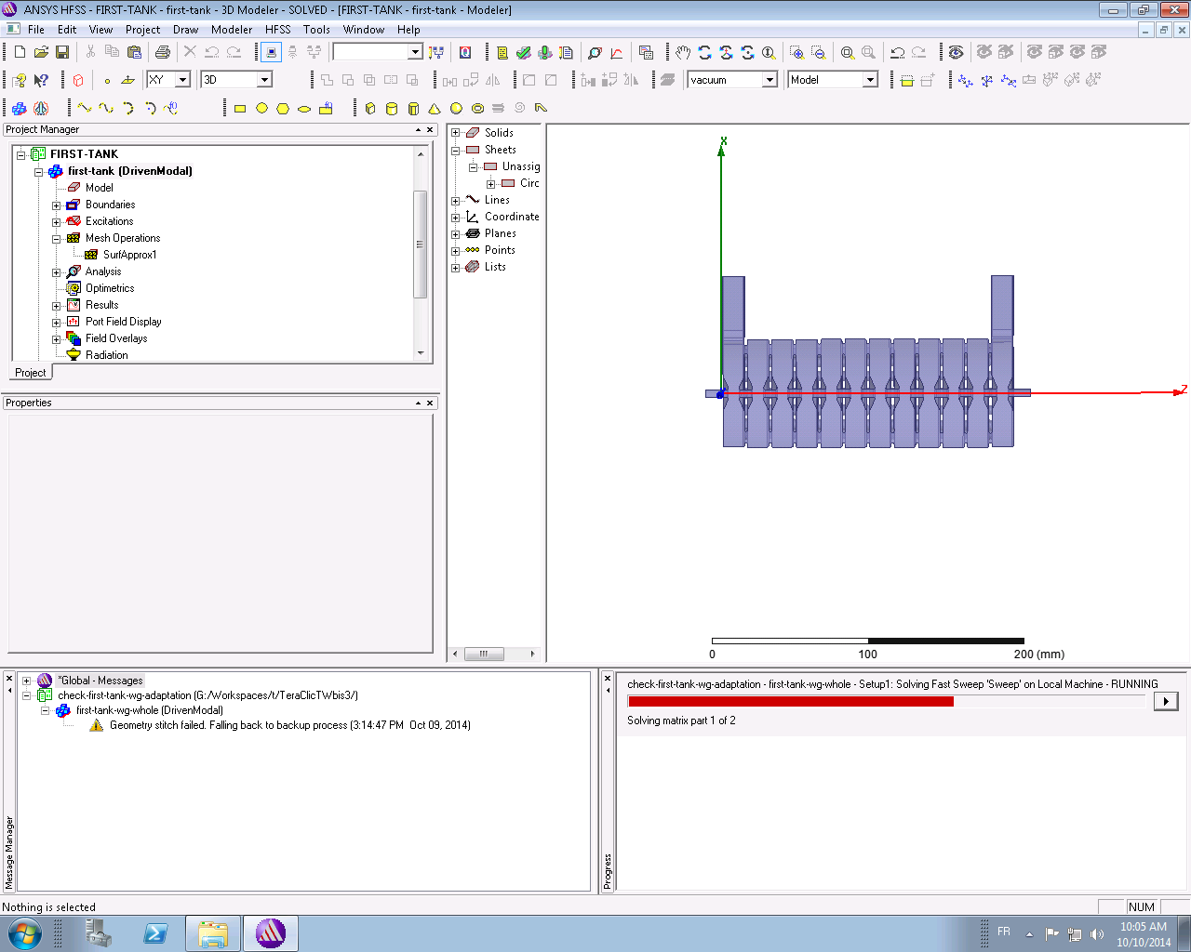
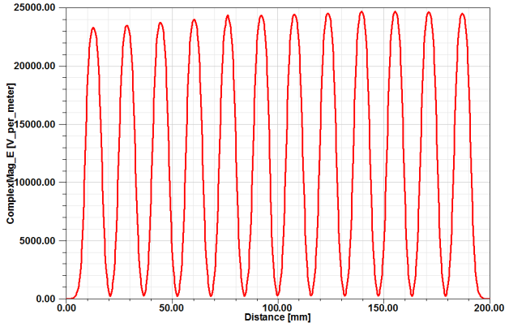
RF parameters of BTW structure
RF
REF RF
TRA RF
INC RF
DC
DC
Electric field profile in the structure.
Distribution of the RF parameters along the structure for normal (dashed) and backward (solid) filled at average gradient of 50 MV/m with a pulse width of 1.6 μs.

Slide 9
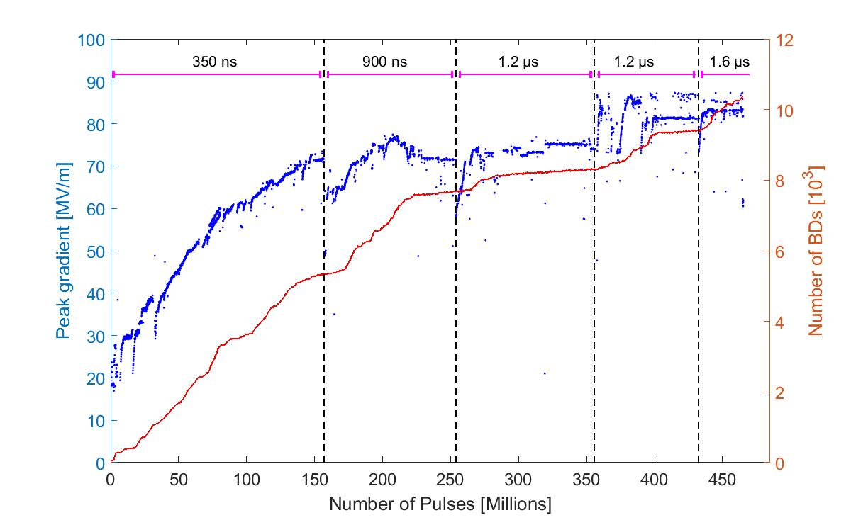
Conditioning history of BTW prototype
*
* In the first cell
Accelerating gradient above 80 MV/m:
BDR = 4x10⁻⁶ 1/pulse at 1.6 μs.
Surface electric field: 320 MV/m

Slide 10
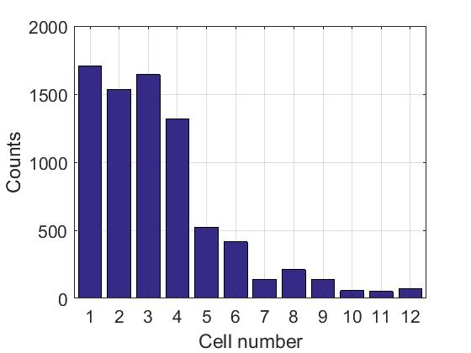
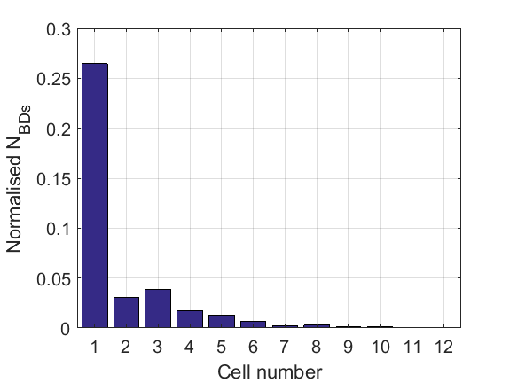
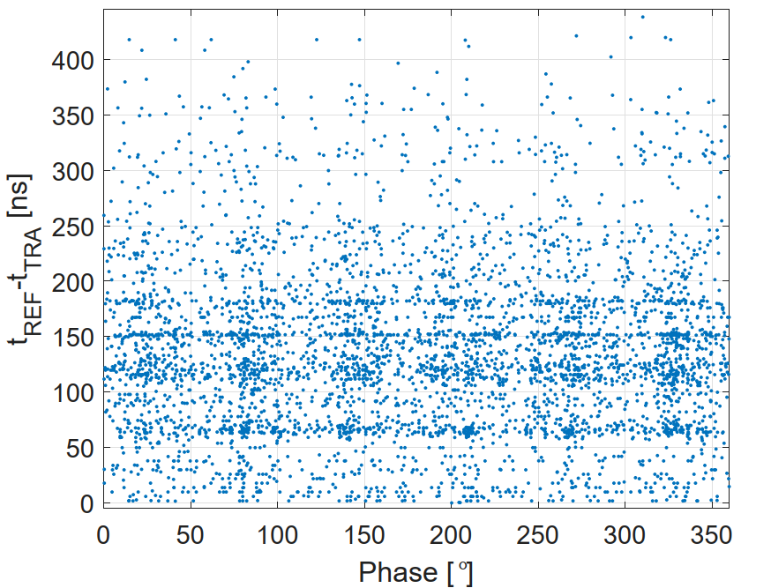
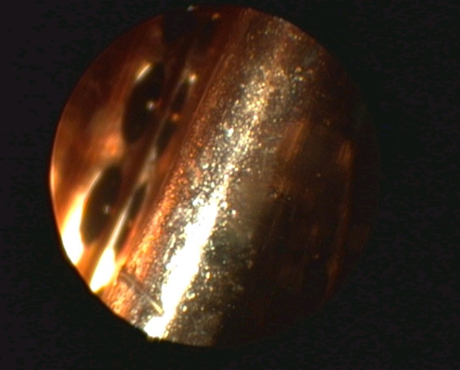
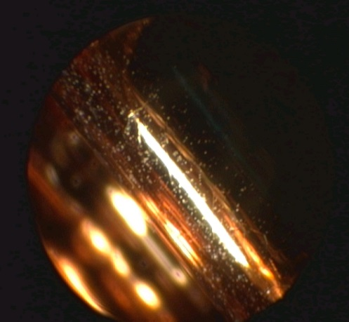
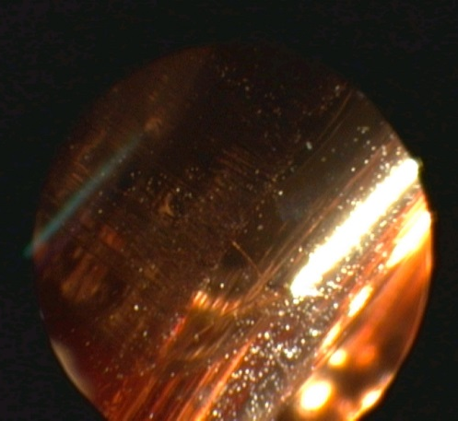
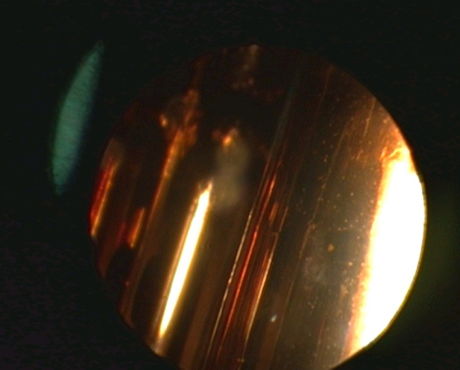
Position analysis of BTW structure
Full history (edge and phase method)
History at end of run
Borescope measurement
1st
2st
3rd
12th
Courtesy of Serge Lebet

Slide 11
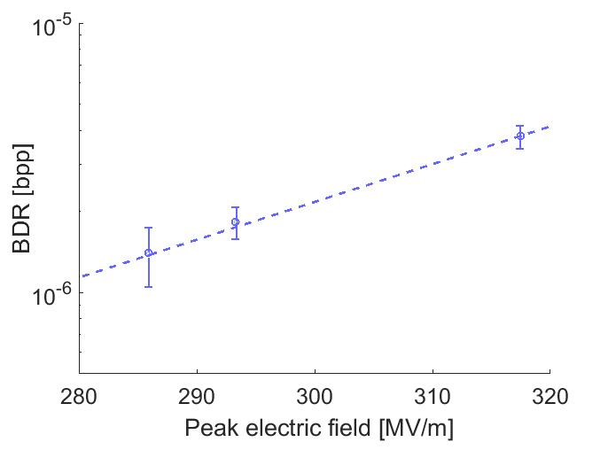
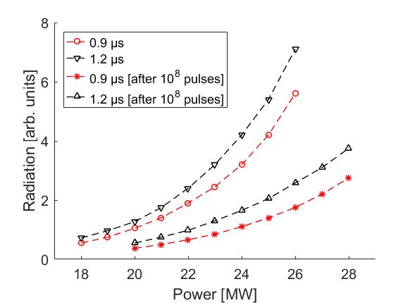
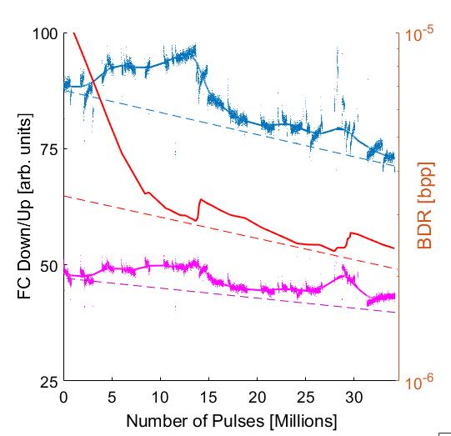
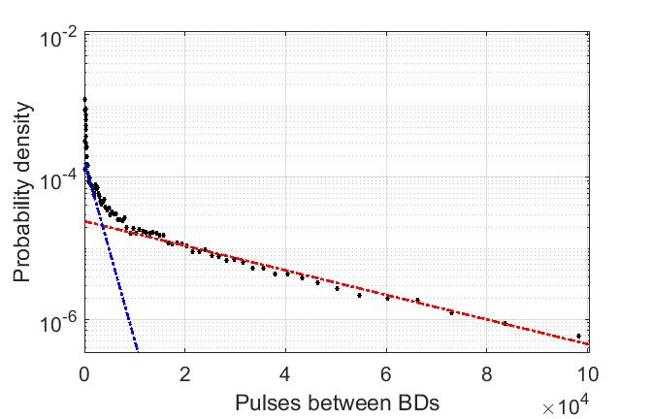
Conclusions of BD study in BTW structure
𝑬_{𝟎} ∝ 𝑩𝑫𝑹 ^{𝟏/1𝟎}
Long term conditioning estimation of BDR:
for 12 GHz: 𝑬_{𝟎} ∝ 𝑩𝑫𝑹 ^{𝟏/𝟑𝟎} * 𝝉 ^{−𝟏/6}
for 3 GHz: 𝑬_{𝟎} ∝ 𝑩𝑫𝑹 ^{𝟏/1𝟎}
Dark current measurements: radiation depends on pulse length and BD activity of the structure.
Statistic of BD event: the number of primary BDs is predominant when conditioning of the structure, but this ratio changes for a well-conditioned structure.
𝑬_{𝟎} =const
1st
2st
3rd
12th

Slide 12
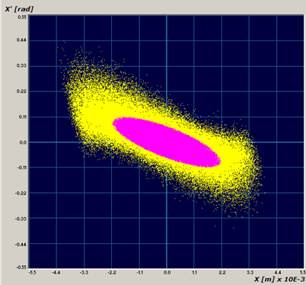
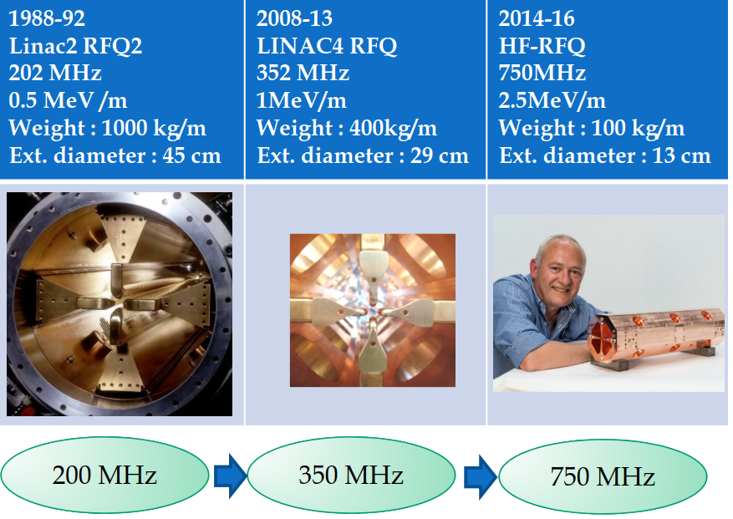
Surface field limitations of RFQ
The RFQ is a linear accelerator which
Focuses,
Bunches,
Accelerates.
High peak fields increase the RFQ performance in areas of:
Higher acceptance (larger emittance beams);
Greater space charge capability;
Accept heavy ions with lower charge state;
Shorter RFQ;
All-Linac (RFQ+DTL “injector”) medical facility.
PARMTEQ + TOUTATIS
The main problem:
the expected transmission through the RFQ.
(measured emittance (yellow) and RFQ acceptance (pink))
but also have the effect of:
Increased probability of sparking;
More RF power required;
Tighter machining and alignment tolerances.

Slide 13
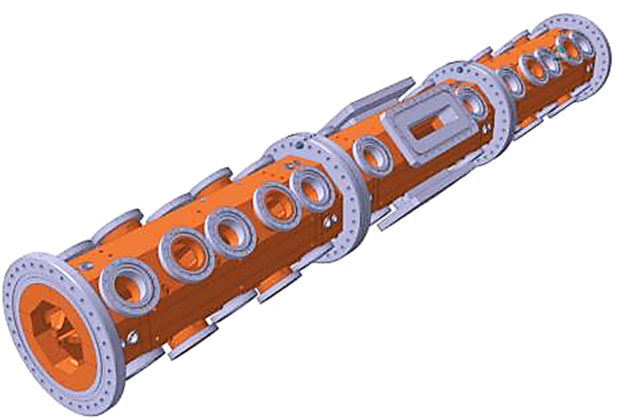
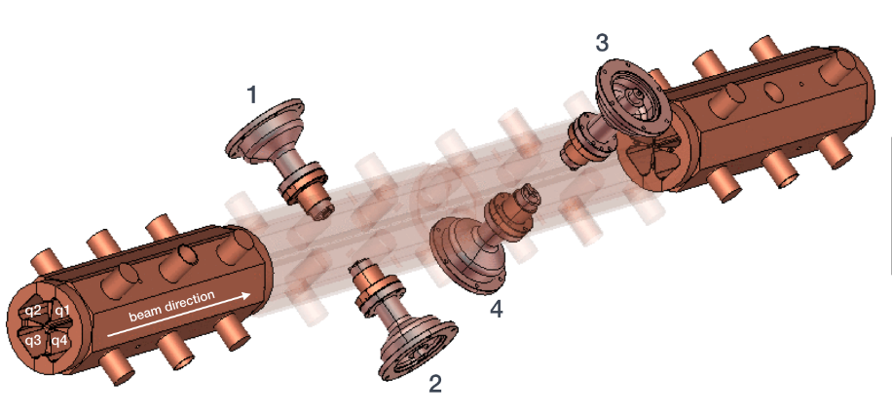
II. Technical specification of the RFQs
RFQ at ADAM
RFQ at Linac4
4-vane structure with 2 brazing steps
Operation: 480 kW, 750 us, 1.2 Hz
4-vane structure with 3 brazing steps
Operation: IOT 4*100 kW, 10 us, 200 Hz
Source and RFQ parameters
Frequency | 352.2 MHz
Length | 3.06 m
Vane voltage | 78.27 kV
Max field on pole tip | 34 MV/m
RF total peak power | 600 kW
Beam Input Energy | 45 keV
Beam Output Energy | 3.0 MeV
Source and RFQ parameters
Frequency | 750 MHz
Length | 2 m
Vane voltage | 65 kV
Max field on pole tip | 50 MV/m
RF total peak power | 400 kW
Beam Input Energy | 40 keV
Beam Output Energy | 5 MeV

Slide 14
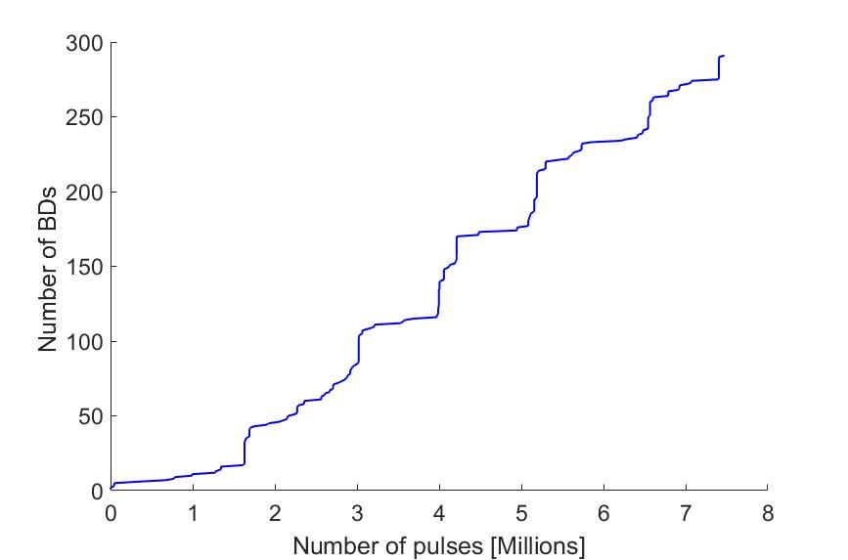
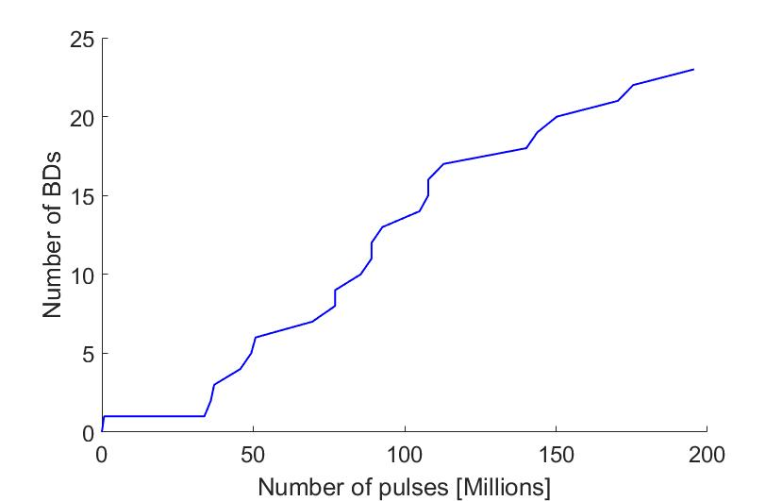
Operation history of RFQs at ADAM and Linac4
RFQ at Linac4
RFQ at ADAM
Forward power = 440 kW
Pulse length = 750 us
Forward power = 400 kW
Pulse length = 10 us
BDR = 3.85 e-05 [1/pulse]
BDR = 1.28 e-07 [1/pulse]
Measurement of BDs without impact on normal operation of the RFQs.

Slide 15
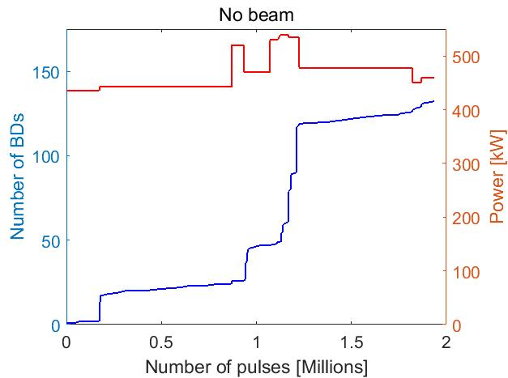
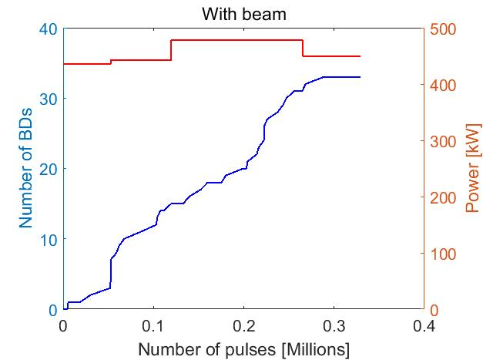
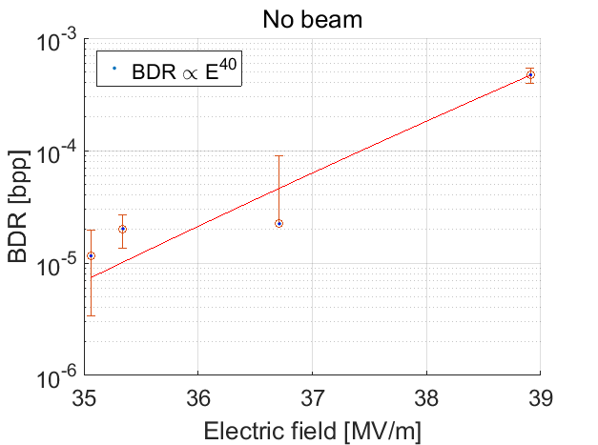
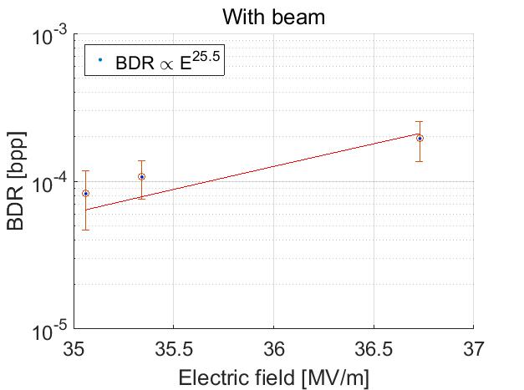
BDR vs Electric field measurement
RFQ at Linac4 (1 month test during shutdown of LHC): 900 μs, power up to 540 kW.
*
*
For unloaded forward power 440 kW => BDR = 1.1E-05 1/pulse; loaded => BDR = 8.2E-05 1/pulse.
A high BDR can be explained that the structure has not been tested with such high power before.

Slide 16
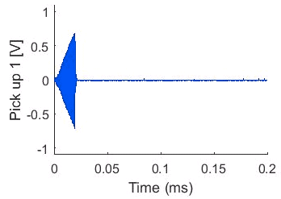
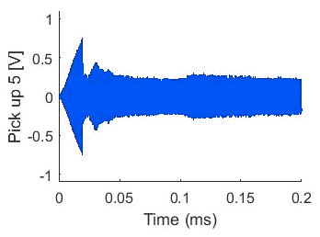
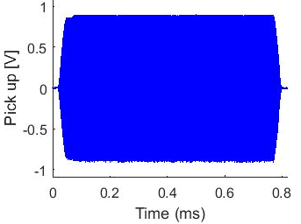
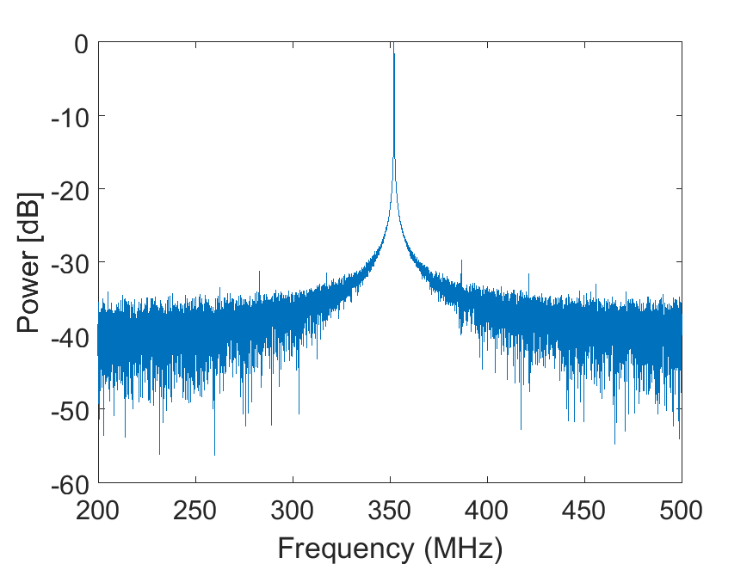
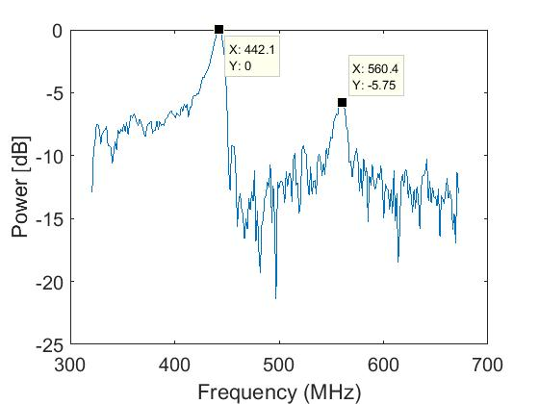
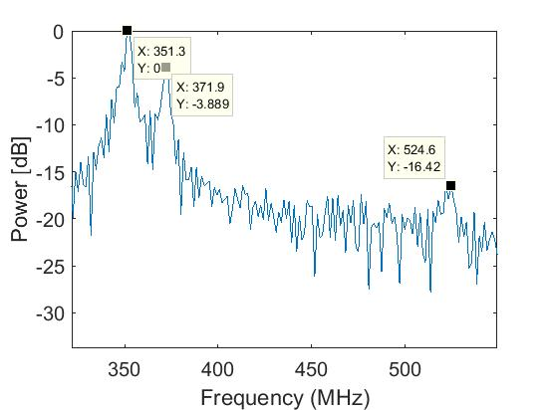
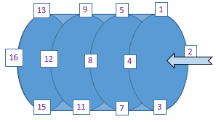
RF parameters measurement
Normal: Pick up
BD: Pick up 1
BD: Pick up 5
352.2 MHz
When RF BDs occur, the cavity divided to 2 sections: power continue to flow into section with coupler and radiative value is driving with BD present.
Non Resonant frequencies appear during BD, that depends on how far the BD event occur.
Beam
RF
16

Slide 17
Conclusions of BD study in RFQ structure
The first time measurements of the BD behaviour in the RFQs have been carry out in a systematic way.
Measurements of two structures with different frequencies have been performed.
Developed a primary technique for determining the location BD along the structure.
Quality factor of the structure at BD is twice smaller compare to normal operating regime. The stored energy varied from event to event, require additional study with higher signal resolution:
Q-factor at Linac4/ADAM ≈ 6772/6500, during BD = 2850 - 5700/1800 - 4500.
BD location in the RFQ at Linac4:
1st module: 10% , 2nd module: 20%, 3rd module: 60%, Unclear: 10%.
BD location in the RFQ at ADAM test bench:
Dominant BDs in the 2st and 3rd module (RF directional coupler): not enough available signals.

Slide 18
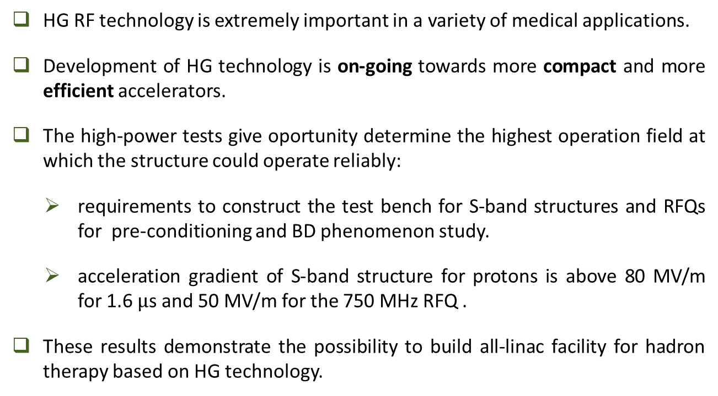
Conclusions
HG RF technology is extremely important in a variety of medical applications.
Development of HG technology is on-going towards more compact and more efficient accelerators.
The high-power tests give oportunity determine the highest operation field at which the structure could operate reliably:
requirements to construct the test bench for S-band structures and RFQs for pre-conditioning and BD phenomenon study.
acceleration gradient of S-band structure for protons is above 80 MV/m for 1.6 $μ$s and 50 MV/m for the 750 MHz RFQ .
These results demonstrate the possibility to build all-linac facility for hadron therapy based on HG technology.

Slide 19
Thank you for your attention!
This project has received funding from the European Union's Horizon 2020 research and innovation programme under the Marie Skłodowska-Curie grant agreement No 675265.

Slide 20
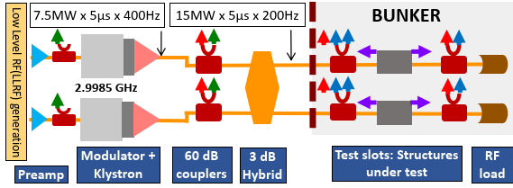
Backup slide: The IFIC – HGRF Laboratory
S-Band (2.9985 GHz)
Pulsed High Power RF (HPRF):
2 x pulsed power klystron: to 7.5 MW, 5 us pulse, 400 Hz
High power waveguide RF network that allows power combining: enables to test 2 structures at a time at up to 15 MW, 5 us pulse, 200 Hz repetition rate.
Low level RF (LLRF): real-time control system with fast system interlock based on Ni-PXI acquisition system.
Running on Ultra-High vacuum (10⁻⁹ mbar).

Slide 21
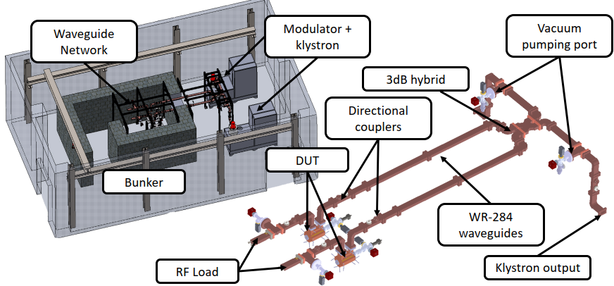
Backup slide: The IFIC – HGRF Laboratory

