Slide 2
Study of SC thin films on substrate
Dorothea Fonnesu TE/CRG-CI

Slide 3
Contents
EASITrain
SRF cavities at CERN
Thin films for SRF
PhD goals
T_{c} test stand @Cryolab
Next steps
Conclusions

Slide 4
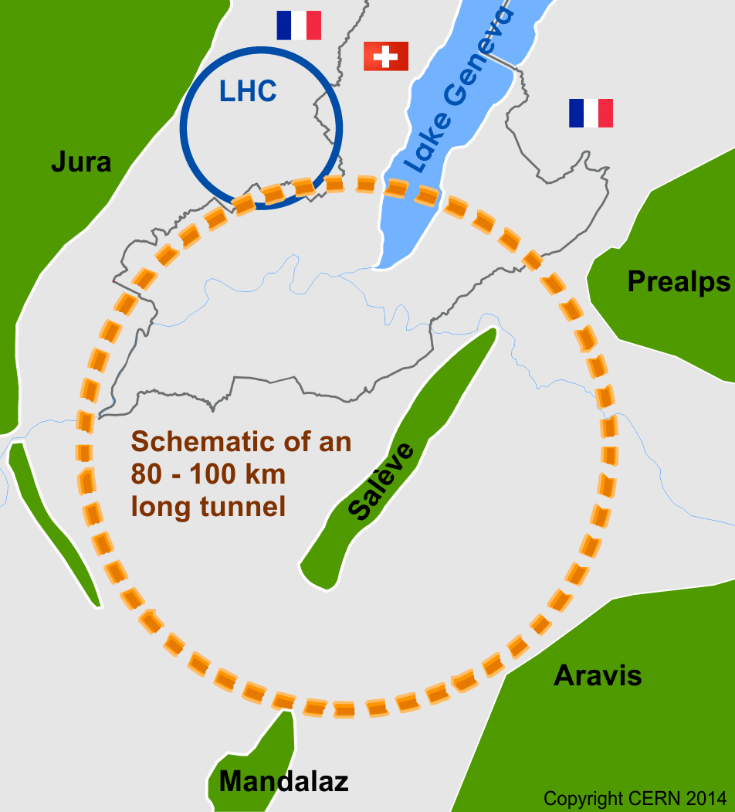

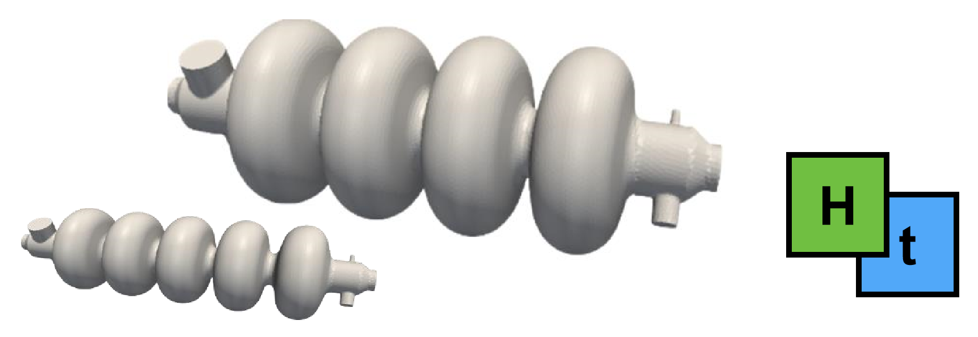
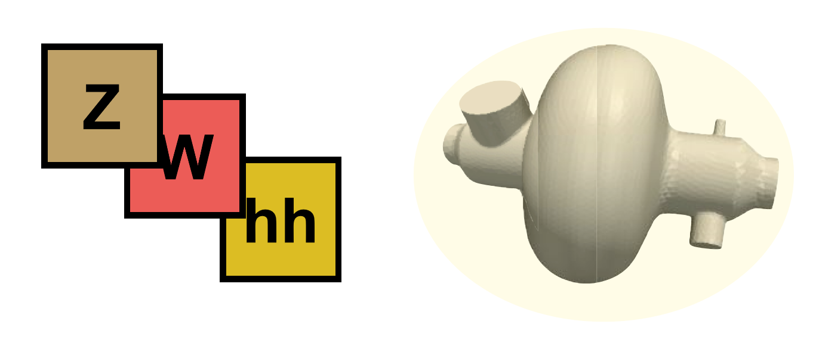

EASITrain programme
Pushing the limits of particle colliders
International FCC collaboration
with CERN as host lab to study:
FCC-hh
FCC-ee
HE-LHC
FCC-he
Challenges:
Civil engineering
Stronger magnets
New detectors
Cryocooling power
Higher fields from SRF cavities
Work supported by the European Commission under the Horizon2020 projects EuroCirCol, grant agreement 654305

Slide 5
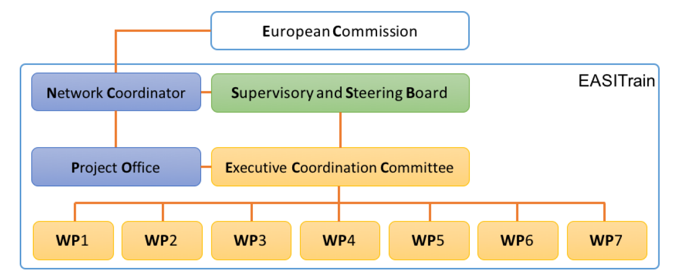
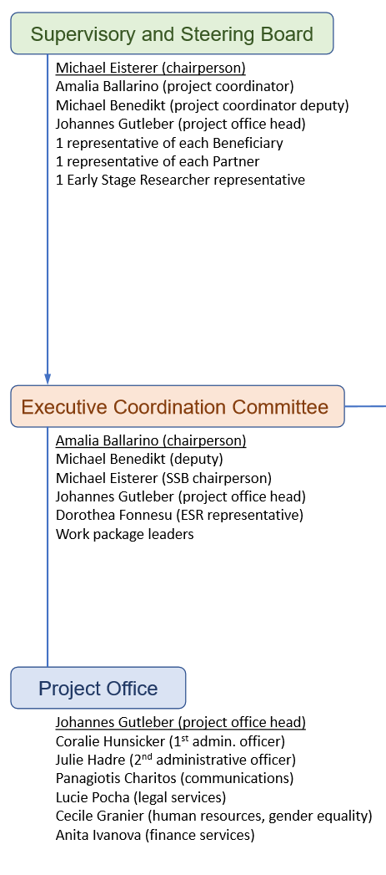

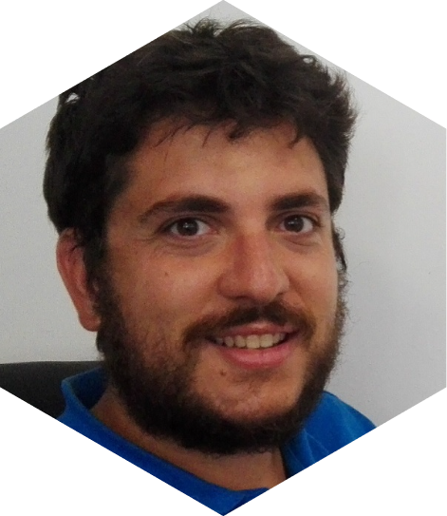
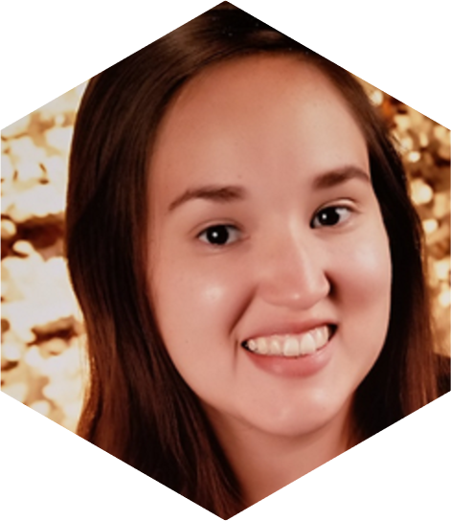
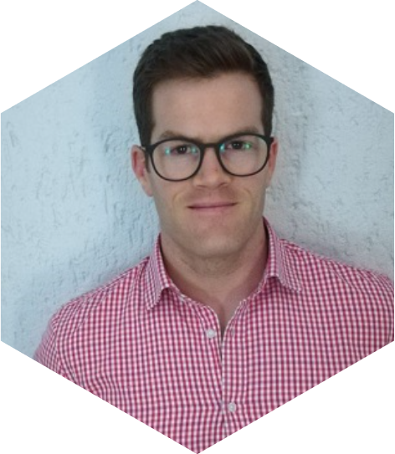
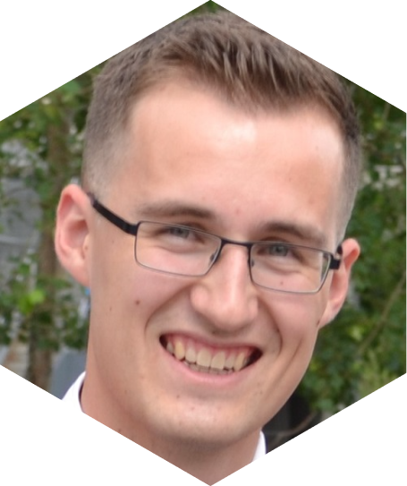


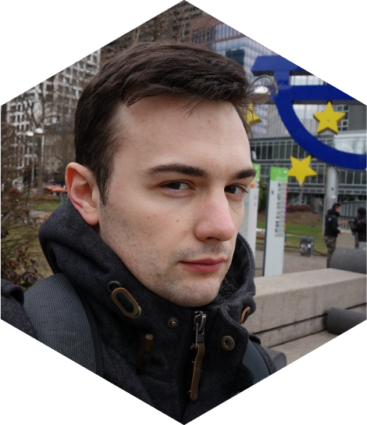
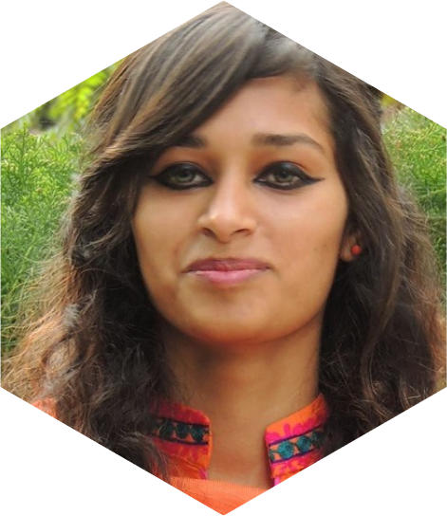
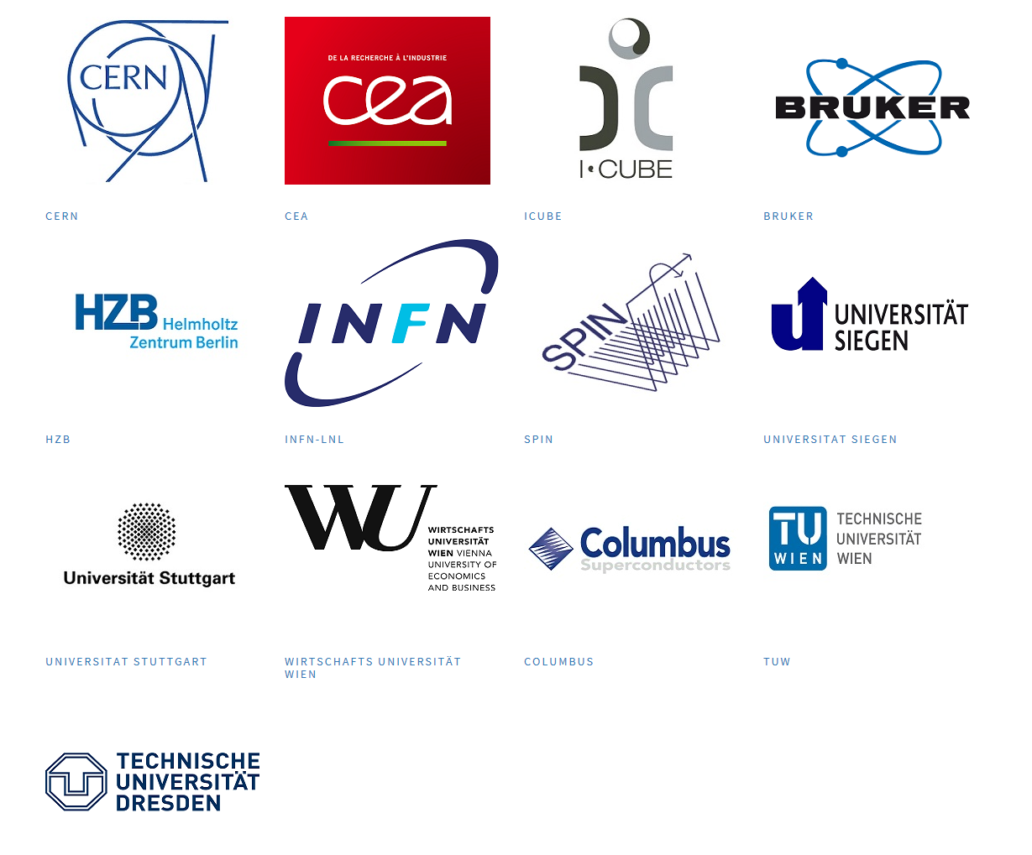
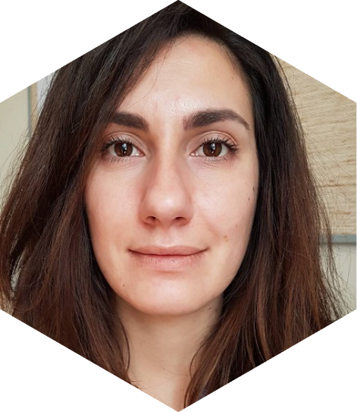
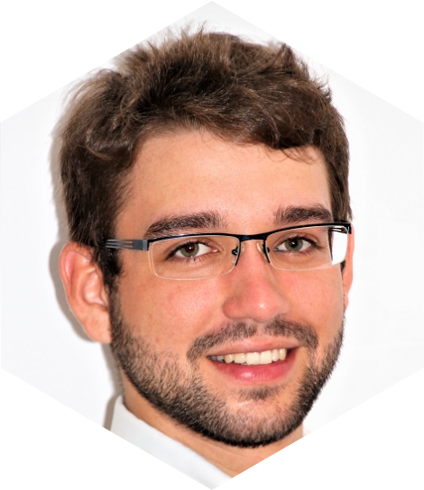
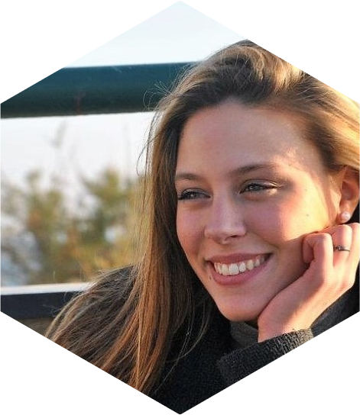
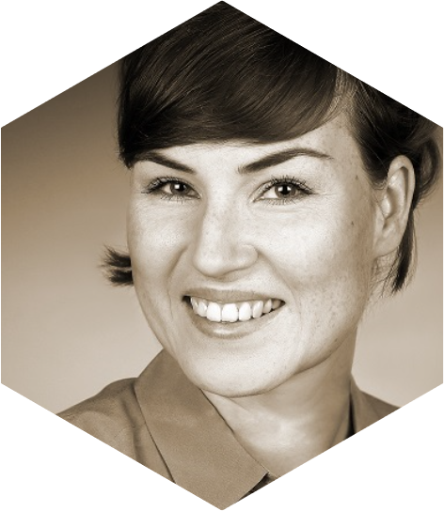
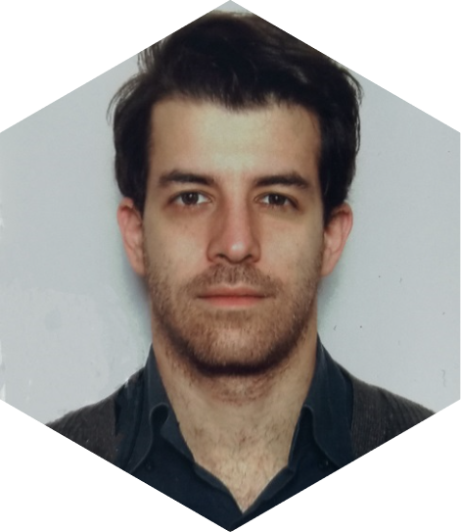
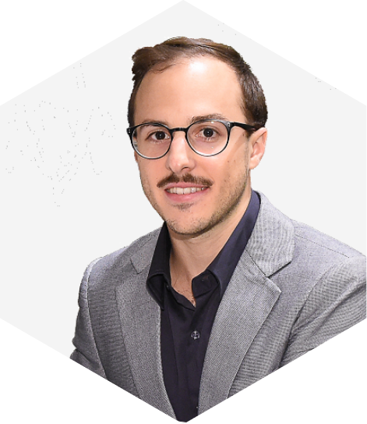
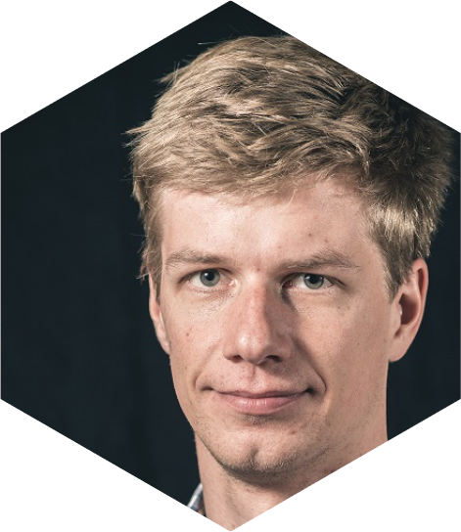
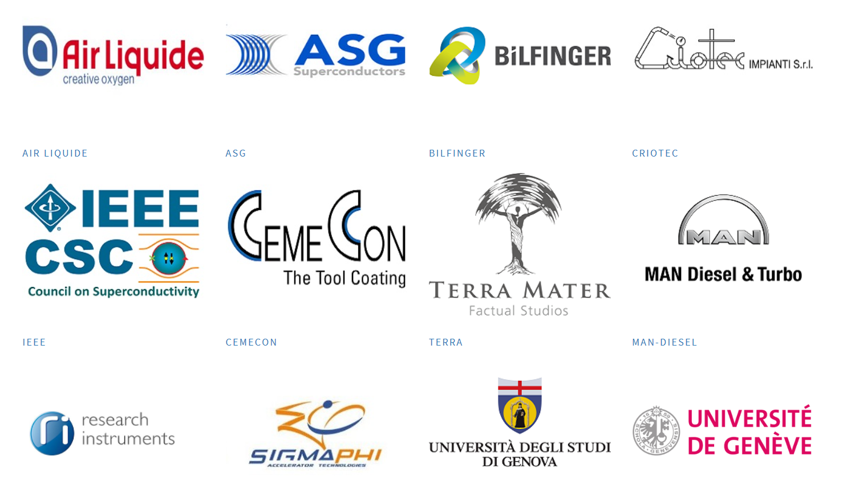
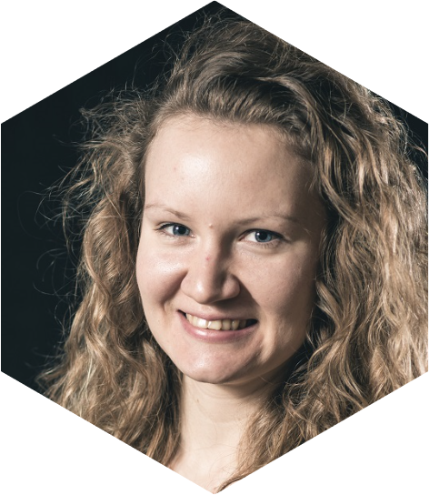
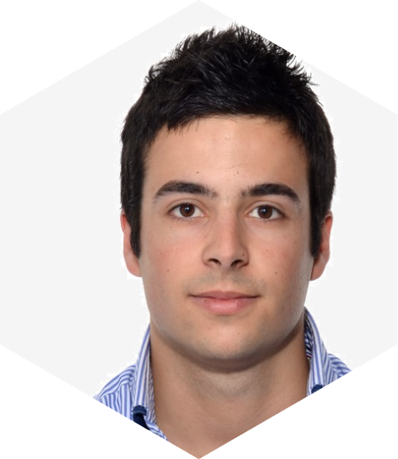
EASITrain programme
3
15 ESRs
Manufacturing
2
5
Materials
Consortium:
13 beneficiaries
12 partners
4
Valorization
Cryogenics

Slide 6
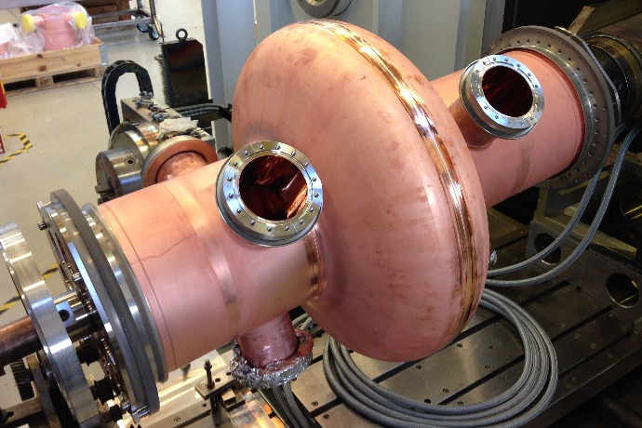
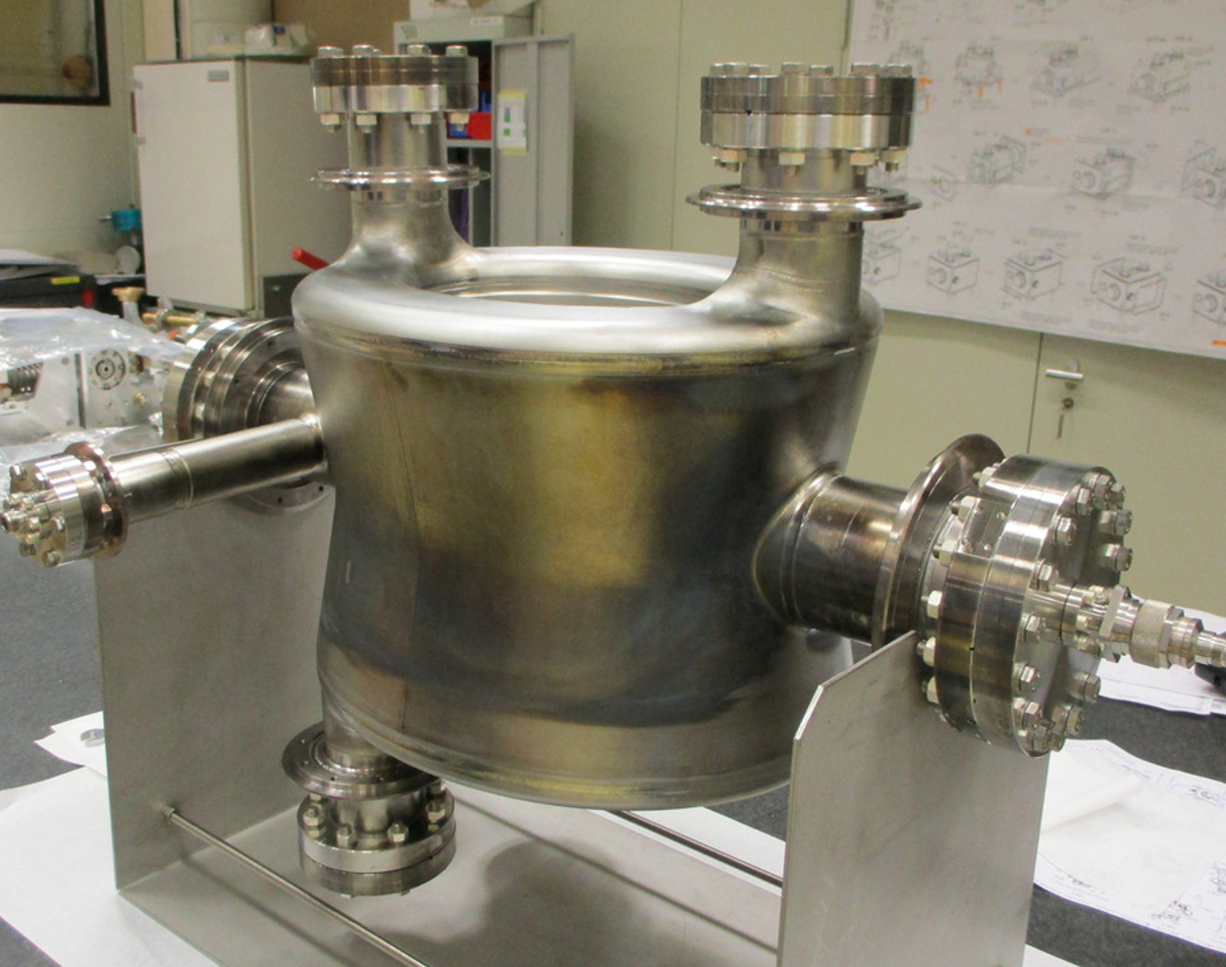
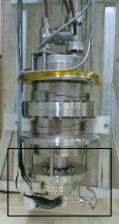
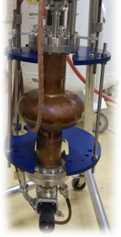
SRF cavities at CERN
LHC
4x RF cryomodules (4x elliptical cavities each)
Nb/Cu operated at 4.5 K
8-16 MV/beam
400 MHz
HiLumi
16 crab cavities (2/beam/IP side)
bulk Nb operated at 2 K
3.4 MV/cavity
400 MHz
M. Karppinen, CERN SRF Workshop 2016
C. Zanoni, Proceedings IPAC 2017
Cryolab
HIE-ISOLDE
For R&D purposes (1.8 K):
QPR, bulk Nb, 400-800-1200 MHz
Elliptical, bulk Nb or Nb/Cu, 1.3 GHz
2x RF cryomodules (5x QWR each)
Nb/Cu
6 MV/m
100 MHz
M. Arzeo, FCC week 2018
J. A. Rodriguez, CERN SRF Workshop 2016

Slide 7
Thin films for SRF
From bulk Nb to Nb/Cu (since LEP):
Cu is cheaper
Cu has higher thermal conductivity
Q-slope not fully understood
Nb₃Sn (A15 compound) on Cu:
Higher T_{c}
Lower surface resistance
Synthetize A15 crystalline phase
Achieve theoretical T_{c} on Cu substrate
Manage material stress and treatment
Investigate intermediate layer (Nb, Ta, Al₂O₃…)
Toward real cavity coatings for future leptonic machine compatible cavities

Slide 8
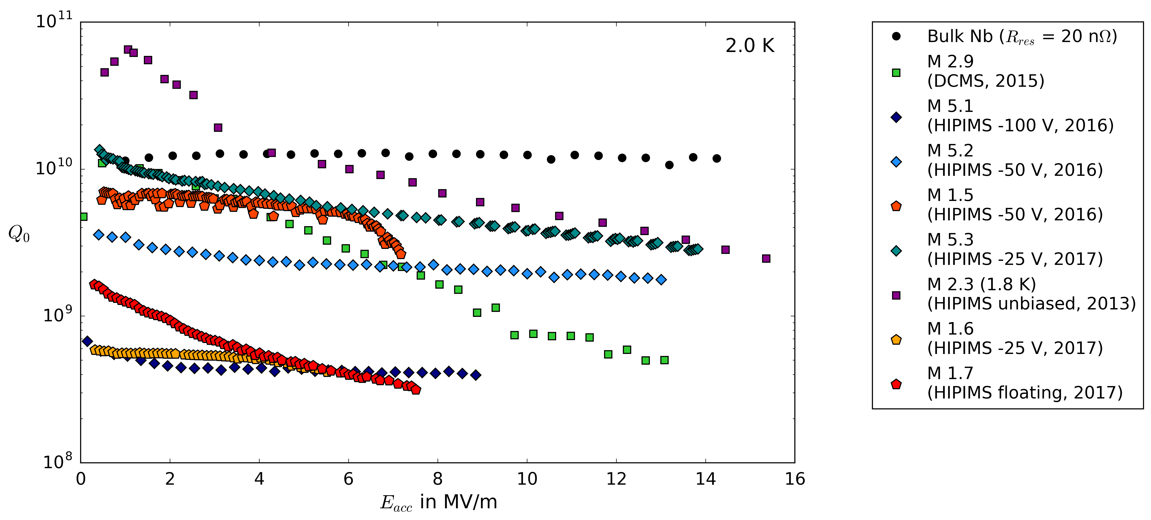
Thin films for SRF
From bulk Nb to Nb/Cu (since LEP):
Cu is cheaper
Cu has higher thermal conductivity
Q-slope not fully understood
Nb₃Sn (A15 compound) on Cu:
Higher T_{c}
Lower surface resistance
Synthetize A15 crystalline phase
Achieve theoretical T_{c} on Cu substrate
Manage material stress and treatment
Investigate intermediate layer (Nb, Ta, Al₂O₃…)
Toward real cavity coatings for future leptonic machine compatible cavities
G. Rosaz, FCC 2018

Slide 9
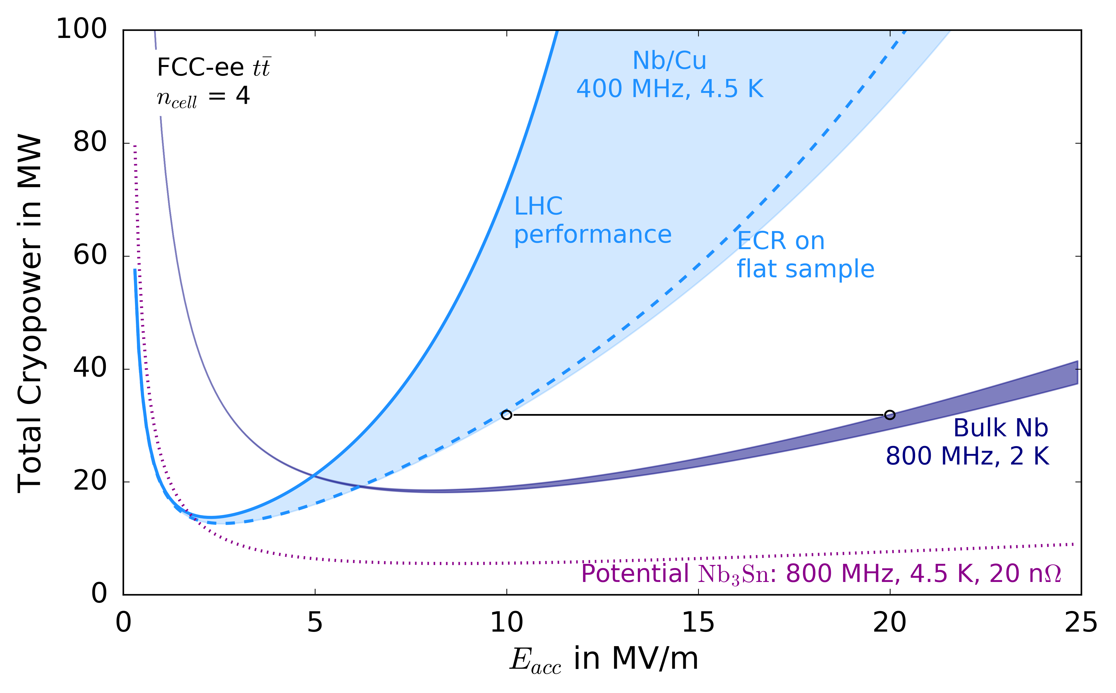
Thin films for SRF
From bulk Nb to Nb/Cu (since LEP):
Cu is cheaper
Cu has higher thermal conductivity
Q-slope not fully understood
Nb₃Sn (A15 compound) on Cu:
Higher T_{c}
Lower surface resistance
Synthetize A15 crystalline phase
Achieve theoretical T_{c} on Cu substrate
Manage material stress and treatment
Investigate intermediate layer (Nb, Ta, Al₂O₃…)
Toward real cavity coatings for future leptonic machine compatible cavities
S. Aull
A. M. Valente-Feliciano, FCC 2018

Slide 10
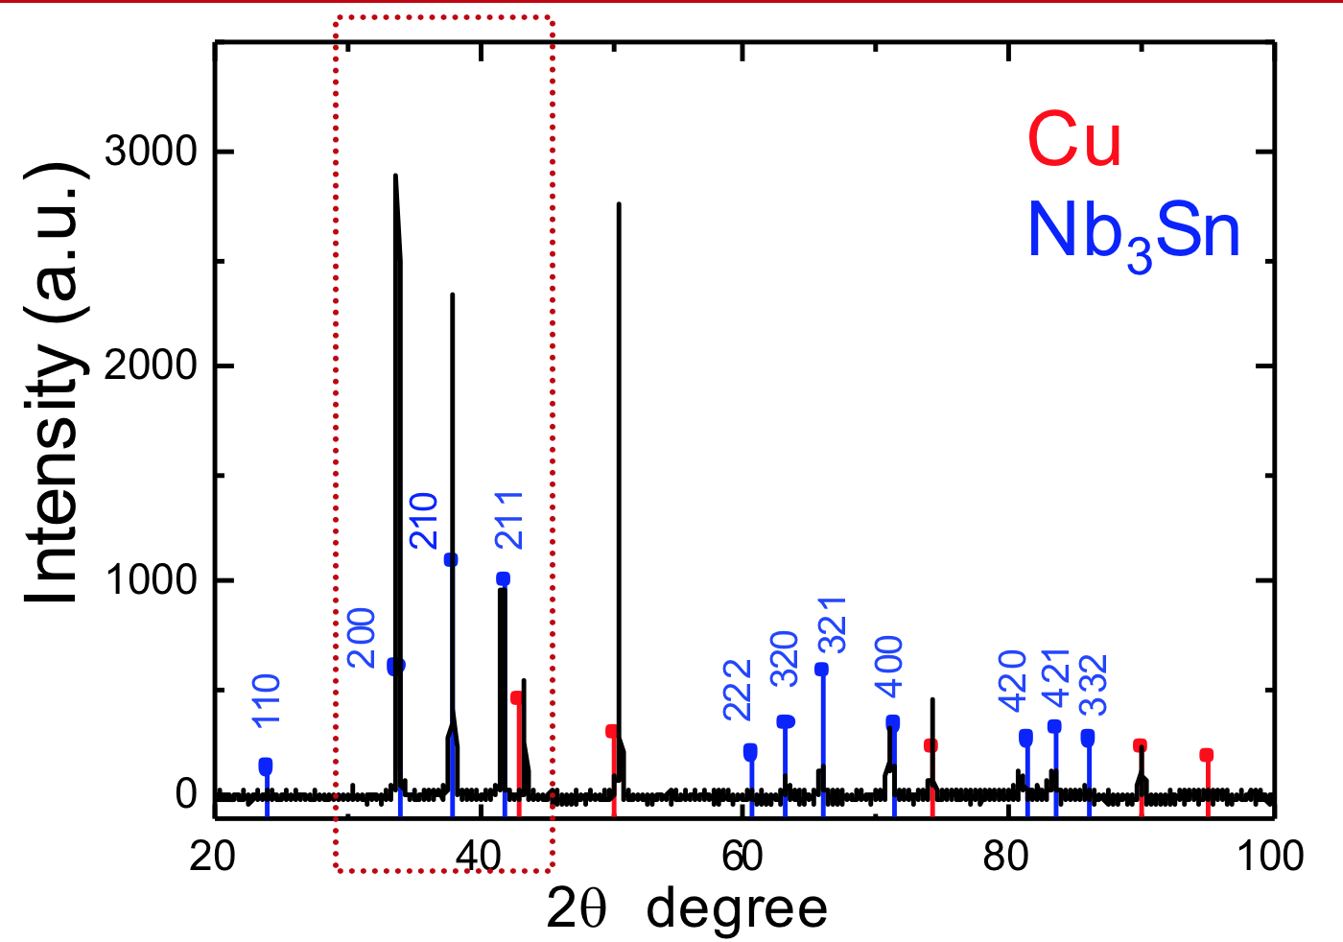
Thin films for SRF
From bulk Nb to Nb/Cu (since LEP):
Cu is cheaper
Cu has higher thermal conductivity
Q-slope not fully understood
Nb₃Sn (A15 compound) on Cu:
Higher T_{c}
Lower surface resistance
Synthetize A15 crystalline phase
Achieve theoretical T_{c} on Cu substrate
Manage material stress and treatment
Investigate intermediate layer (Nb, Ta, Al₂O₃…)
Toward real cavity coatings for future leptonic machine compatible cavities
K. Iliyna-Brunner, FCC 2018

Slide 11
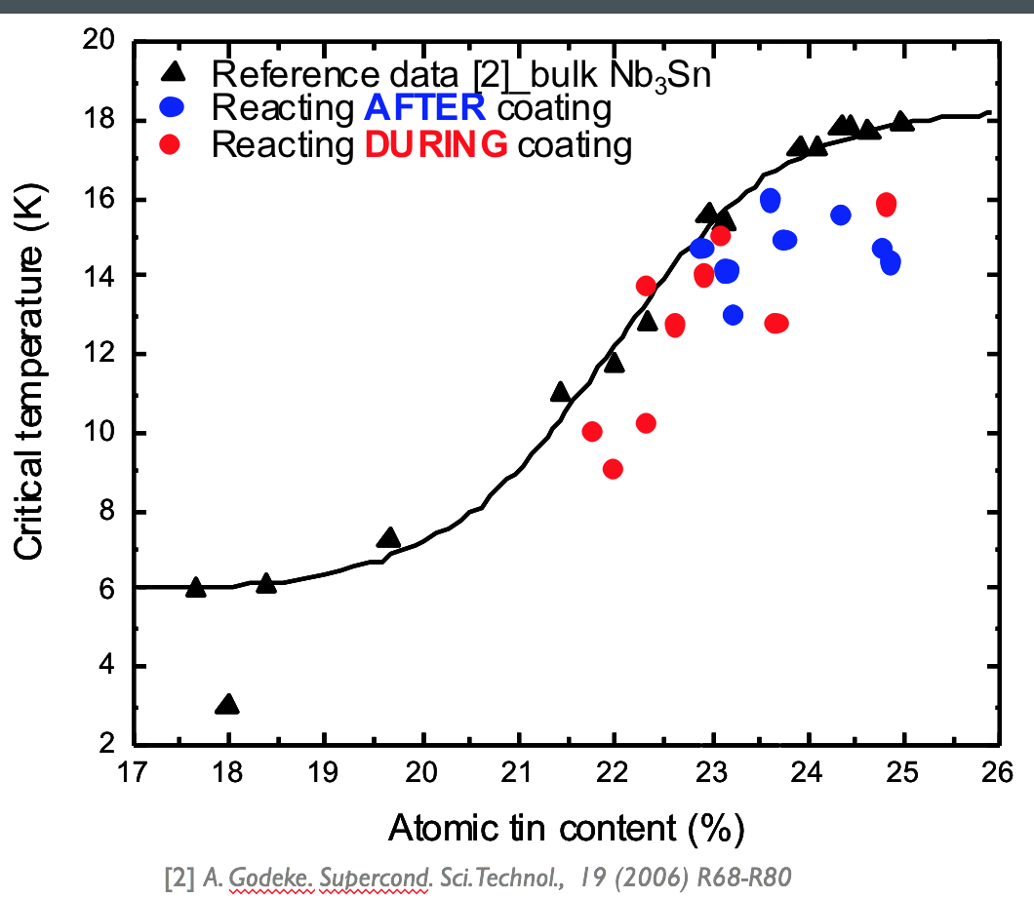
Thin films for SRF
From bulk Nb to Nb/Cu (since LEP):
Cu is cheaper
Cu has higher thermal conductivity
Q-slope not fully understood
Nb₃Sn (A15 compound) on Cu:
Higher T_{c}
Lower surface resistance
Synthetize A15 crystalline phase
Achieve theoretical T_{c} on Cu substrate
Manage material stress and treatment
Investigate intermediate layer (Nb, Ta, Al₂O₃…)
Toward real cavity coatings for future leptonic machine compatible cavities
K. Iliyna-Brunner, FCC 2018

Slide 12
Thin films for SRF
From bulk Nb to Nb/Cu (since LEP):
Cu is cheaper
Cu has higher thermal conductivity
Q-slope not fully understood
Nb₃Sn (A15 compound) on Cu:
Higher T_{c}
Lower surface resistance
Synthetize A15 crystalline phase
Achieve theoretical T_{c} on Cu substrate
Manage material stress and treatment (microstructural features)
Investigate intermediate layer (Nb, Ta, Al₂O₃…)
Toward real cavity coatings for future leptonic machine compatible cavities
K. Iliyna-Brunner, FCC 2018

Slide 13
Thin films for SRF
From bulk Nb to Nb/Cu (since LEP):
Cu is cheaper
Cu has higher thermal conductivity
Q-slope not fully understood
Nb₃Sn (A15 compound) on Cu:
Higher T_{c}
Lower surface resistance
Synthetize A15 crystalline phase
Achieve theoretical T_{c} on Cu substrate
Manage material stress and treatment
Investigate intermediate layer (Nb, Ta, Al₂O₃…)
Toward real cavity coatings for future leptonic machine compatible cavities
K. Iliyna-Brunner, FCC 2018

Slide 14
PhD goals
Study of SC thin films on substrate
Investigate thermodynamic parameters of SC thin films on their substrate
Measurement of critical temperature T_{c} on small samples
Measurement of thermal diffusivity on medium size samples at QPR, i.e. in RF environment
Test of coated real size 1.3 GHz cavity
Numerical simulation of thermal behaviour of SC film on substrate in RF environment, focus on:
QPR
film/substrate interface
D. Fonnesu – CRG FPT Seminar – CERN 13.03.2019

Slide 15
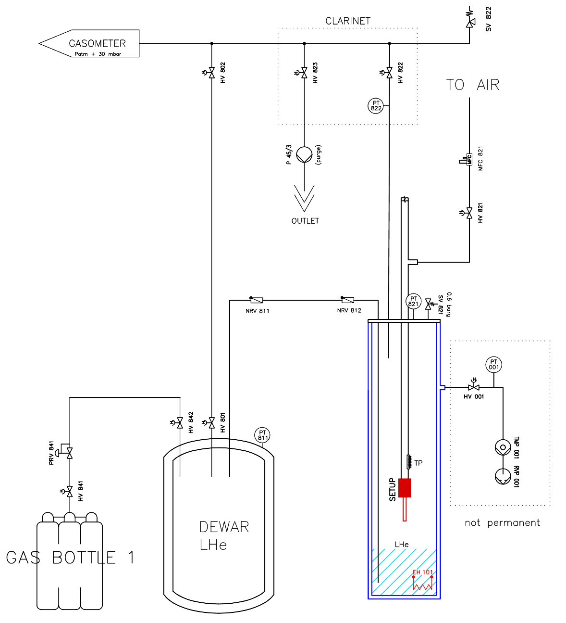
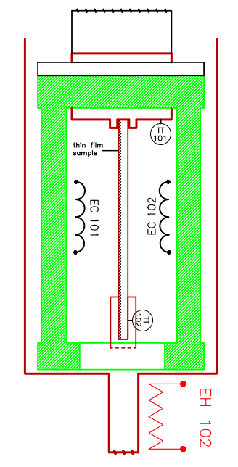
T_{c} test stand @Cryolab
Contactless, inductive measurement of the critical temperature of SC thin films on Cu

Slide 16
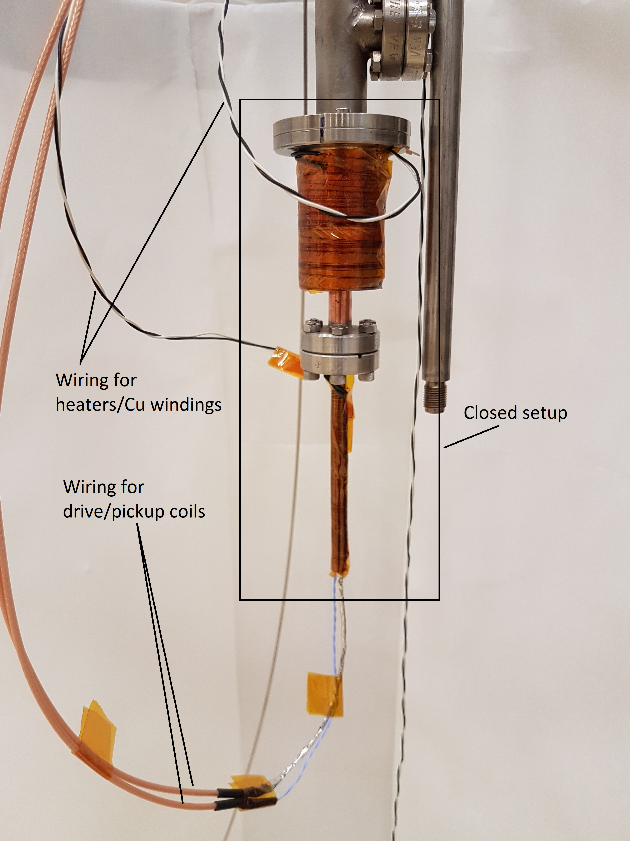
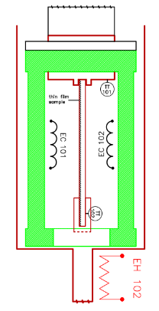
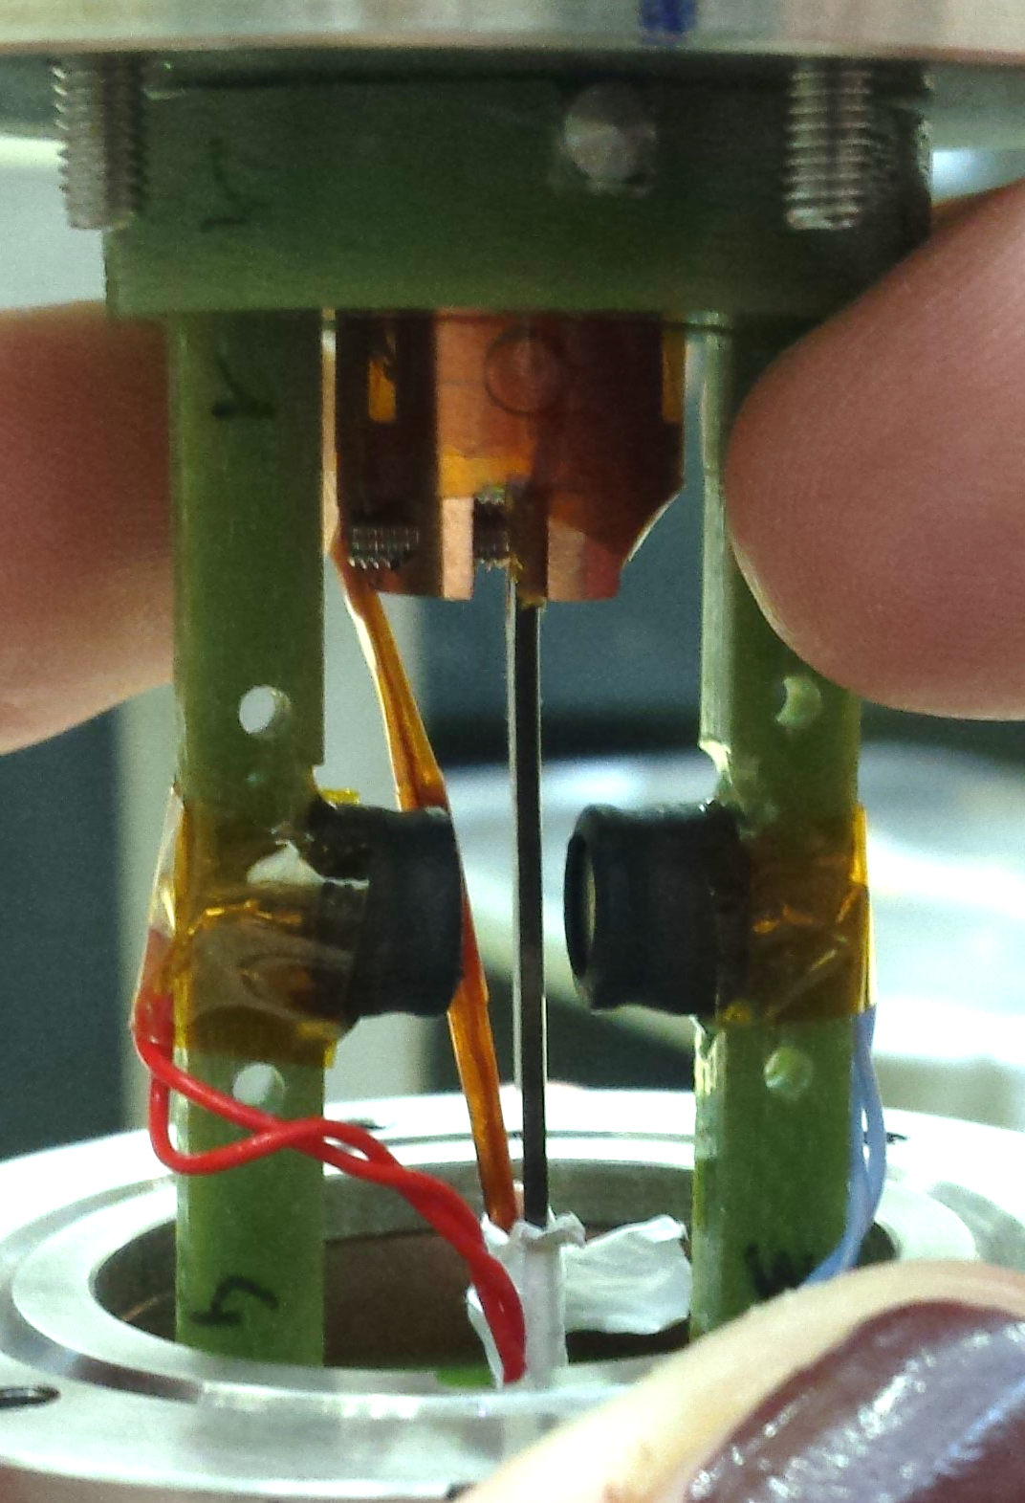
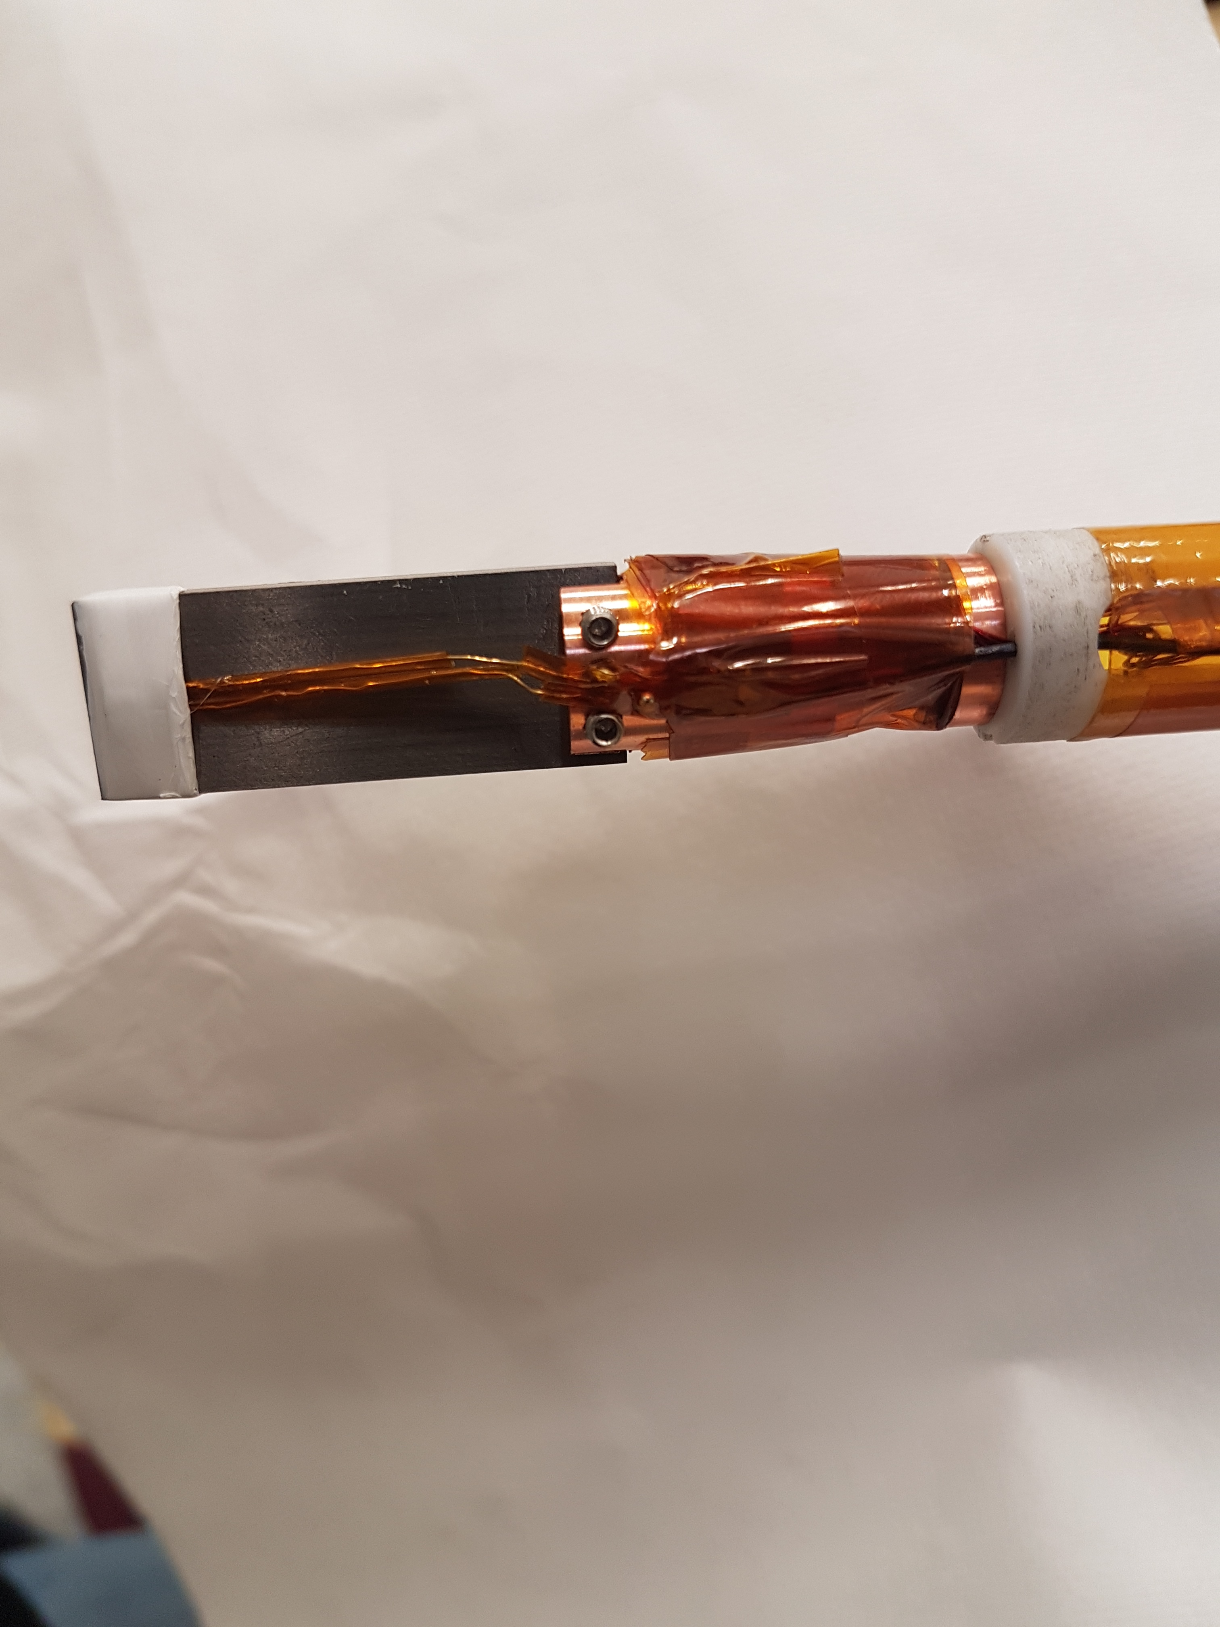
T_{c} test stand @Cryolab

Slide 17
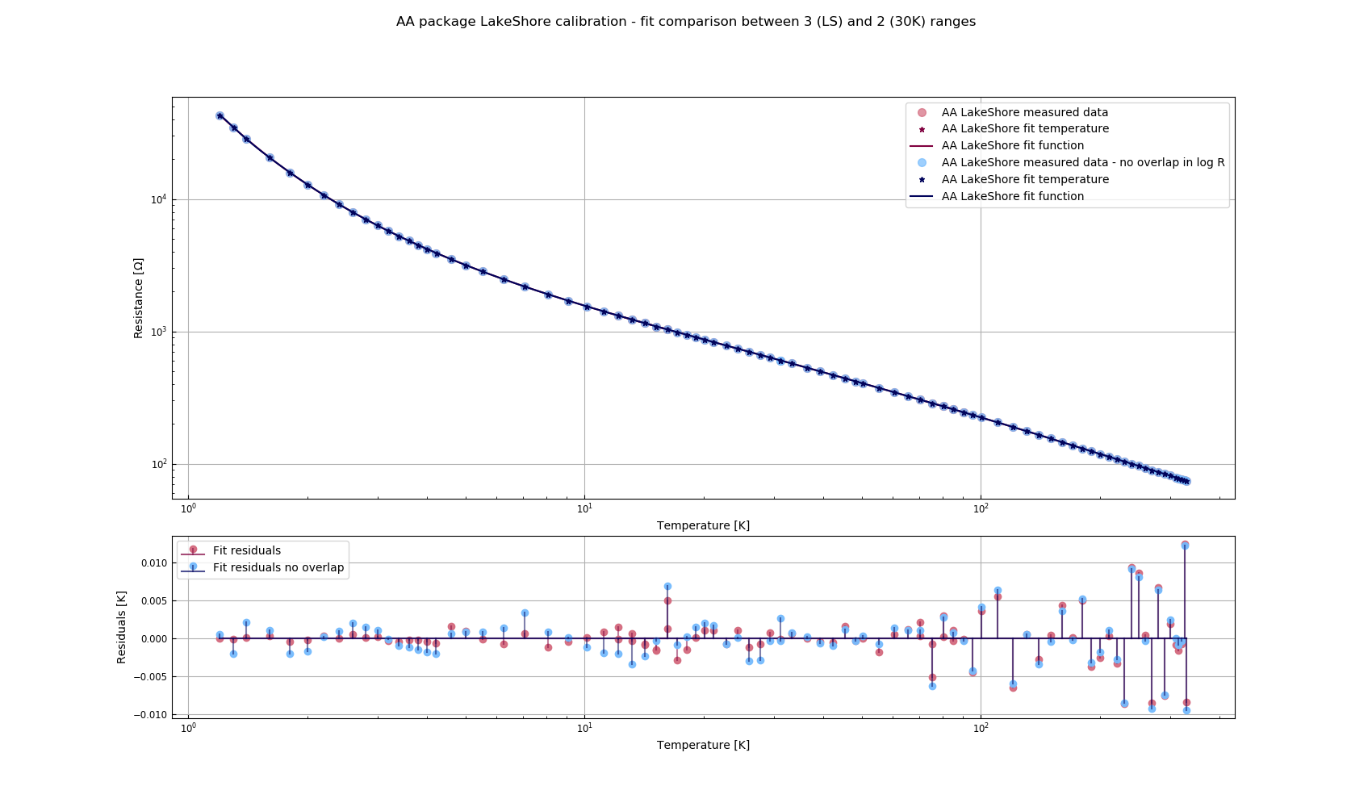
T_{c} test stand @Cryolab
Sensors (re-) calibration
T-range of interest: 8 – 30 K

Slide 18
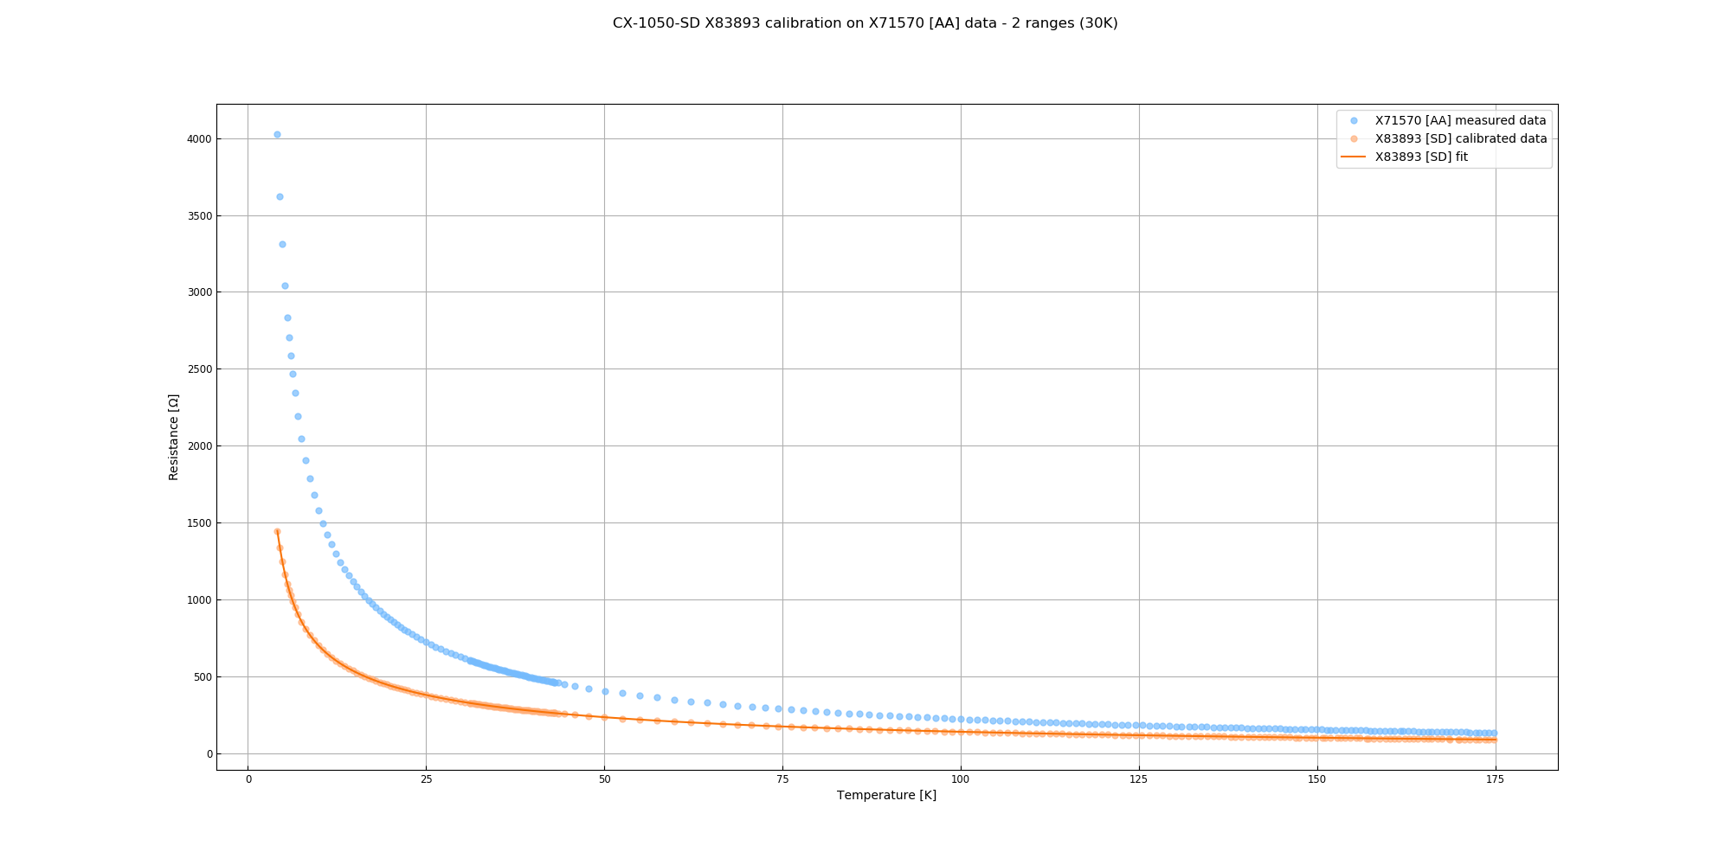
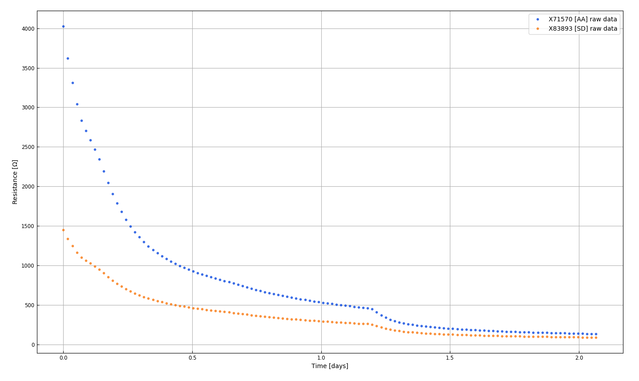
T_{c} test stand @Cryolab
Sensors (re-) calibration
T-range of interest: 8 – 30 K

Slide 19
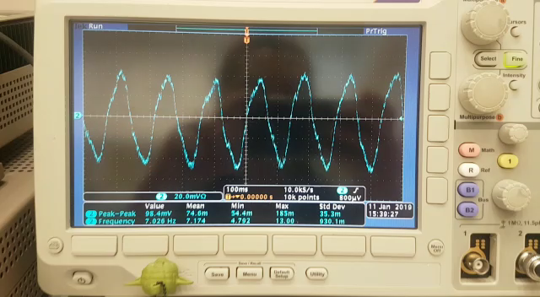
T_{c} test stand @Cryolab
Observation of first transitions

Slide 20
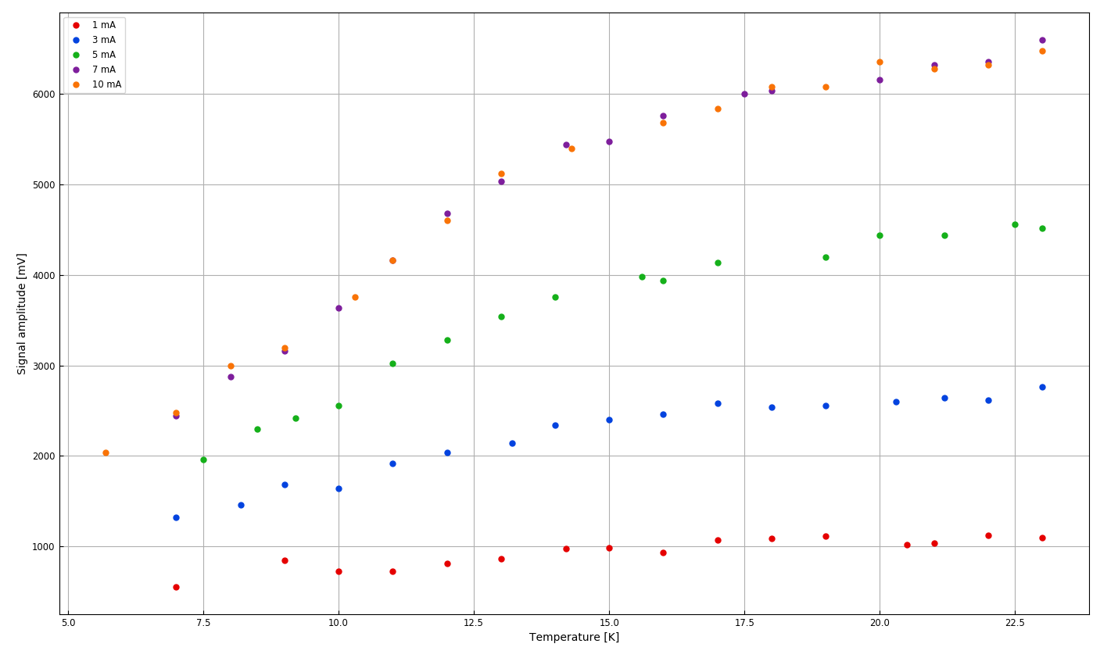
T_{c} test stand @Cryolab
Pickup coil response to temperature... ...for no/different samples and drive coil currents
Coils only

Slide 21
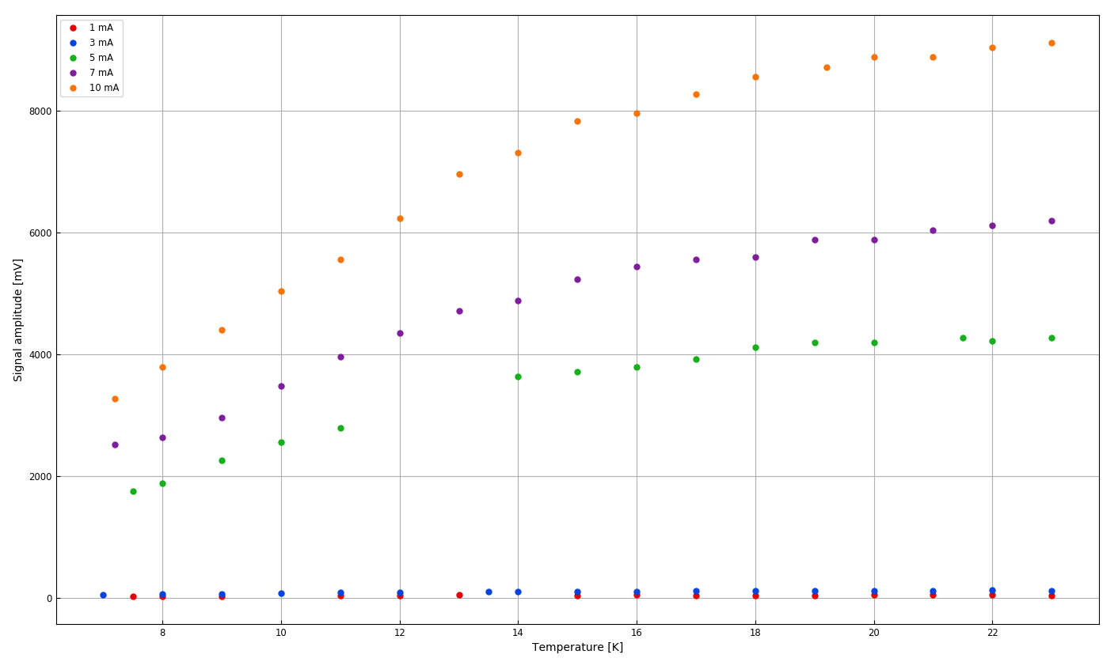
T_{c} test stand @Cryolab
Pickup coil response to temperature... ...for no/different samples and drive coil currents
Cu substrate

Slide 22
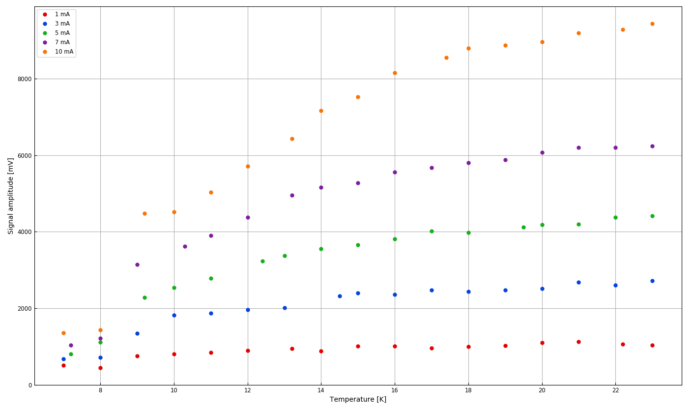
T_{c} test stand @Cryolab
Pickup coil response to temperature... ...for no/different samples and drive coil currents
Nb/Cu DCMS 1A
F. Avino TE/VSC-SCC

Slide 23
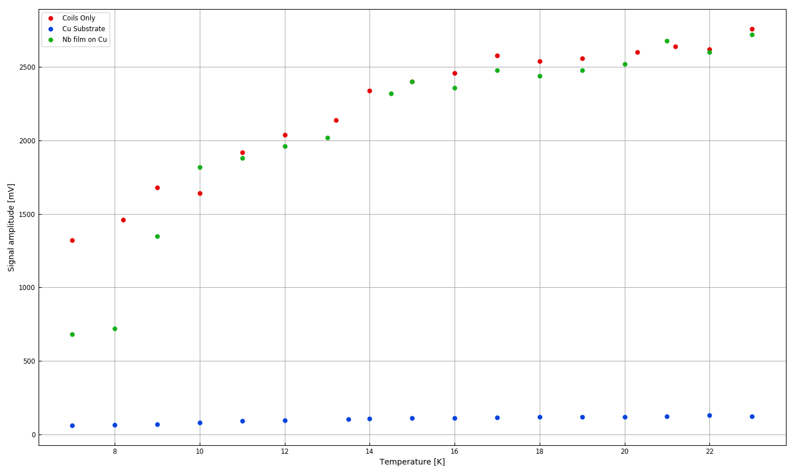
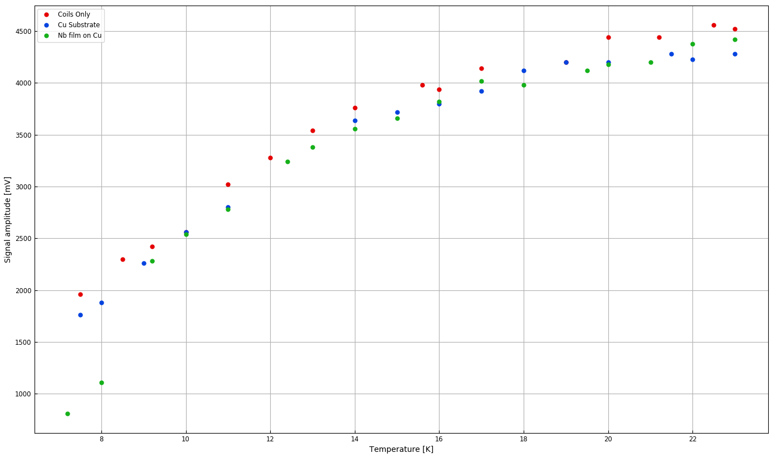
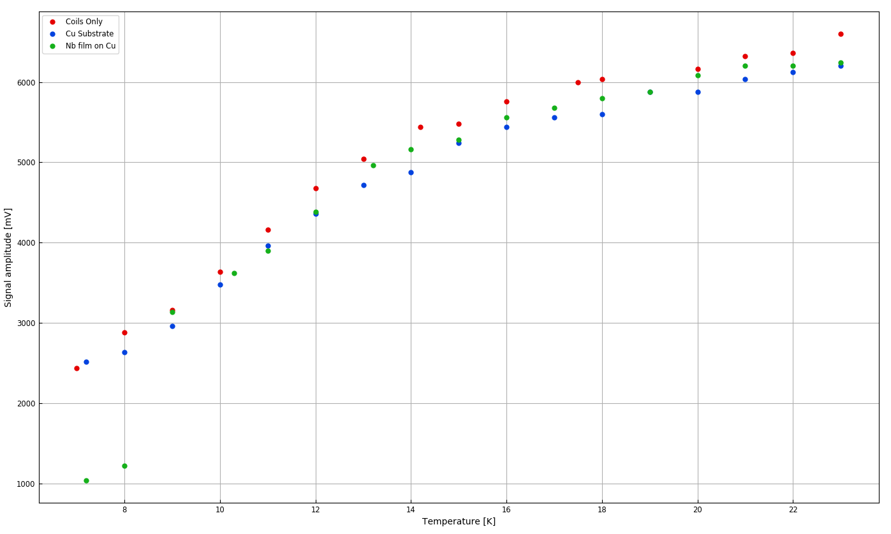
T_{c} test stand @Cryolab
Pickup coil response to temperature... ...for no/different samples and drive coil currents: 3, 5 and 7 mA
3 mA
5 mA
7 mA
D. Fonnesu – CRG FPT Seminar – CERN 13.03.2019

Slide 24
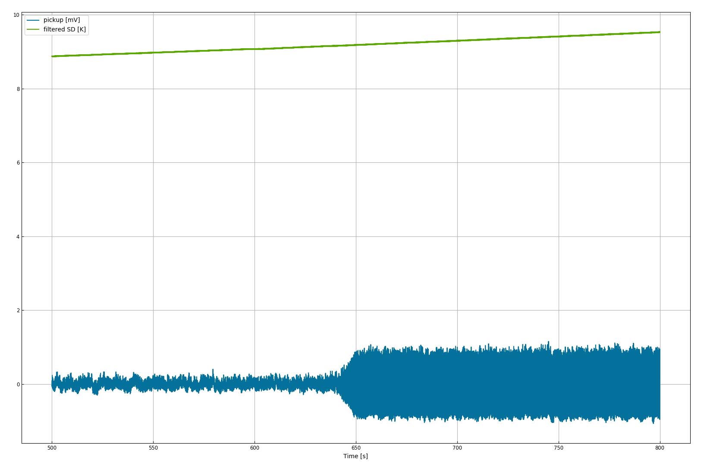
T_{c} test stand @Cryolab
Measurement of T_{c} - bulk Nb, EH 0.15 A, I_{D} = 5 mA, f_{D} = 7 Hz I – acquire signal amplitude transition and temperature
D. Fonnesu – CRG FPT Seminar – CERN 13.03.2019

Slide 25
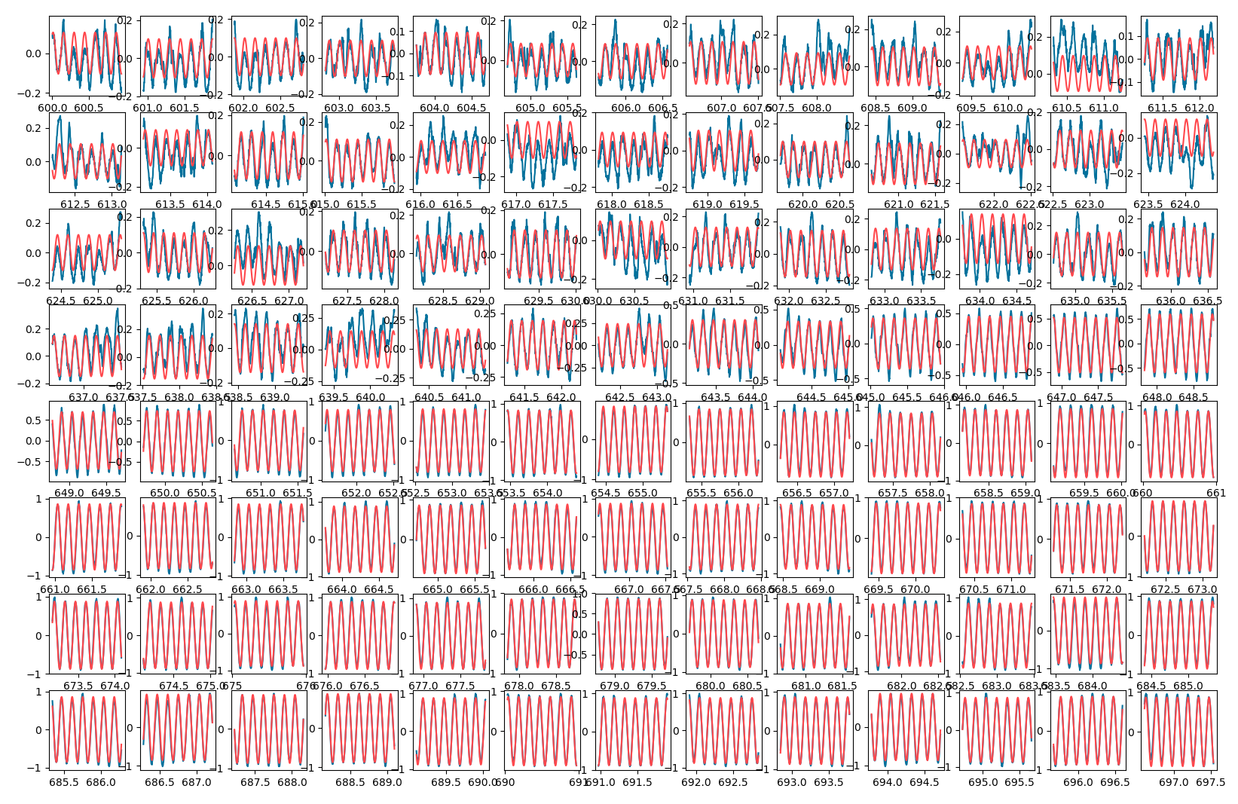
T_{c} test stand @Cryolab
Measurement of T_{c} - bulk Nb, EH 0.15 A, I_{D} = 5 mA, f_{D} = 7 Hz II.a – fit signal for regular intervals to get amplitude
D. Fonnesu – CRG FPT Seminar – CERN 13.03.2019

Slide 26
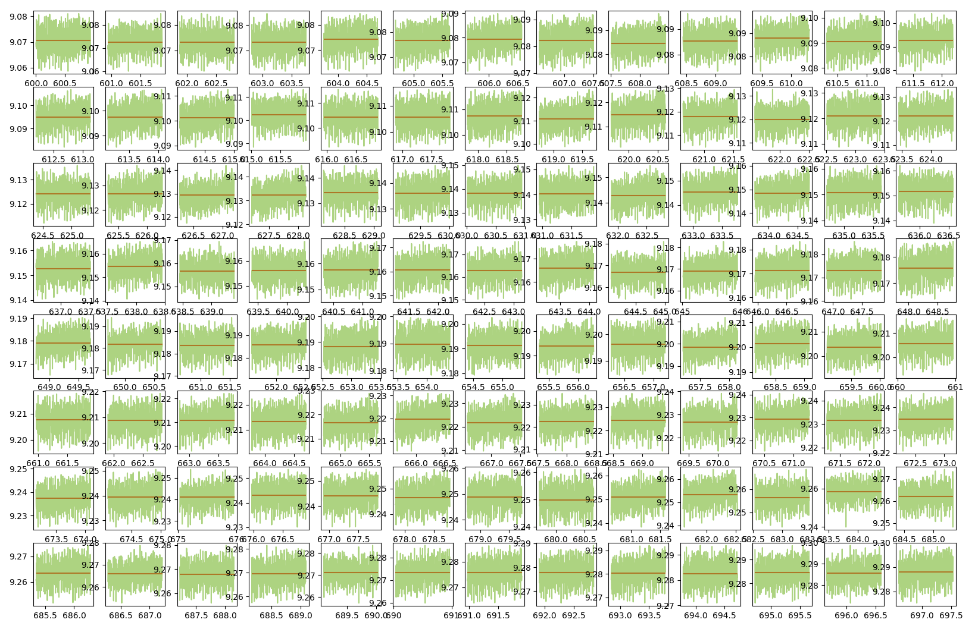
T_{c} test stand @Cryolab
Measurement of T_{c} - bulk Nb, EH 0.15 A, I_{D} = 5 mA, f_{D} = 7 Hz II.b – get average temperature for same intervals
D. Fonnesu – CRG FPT Seminar – CERN 13.03.2019

Slide 27
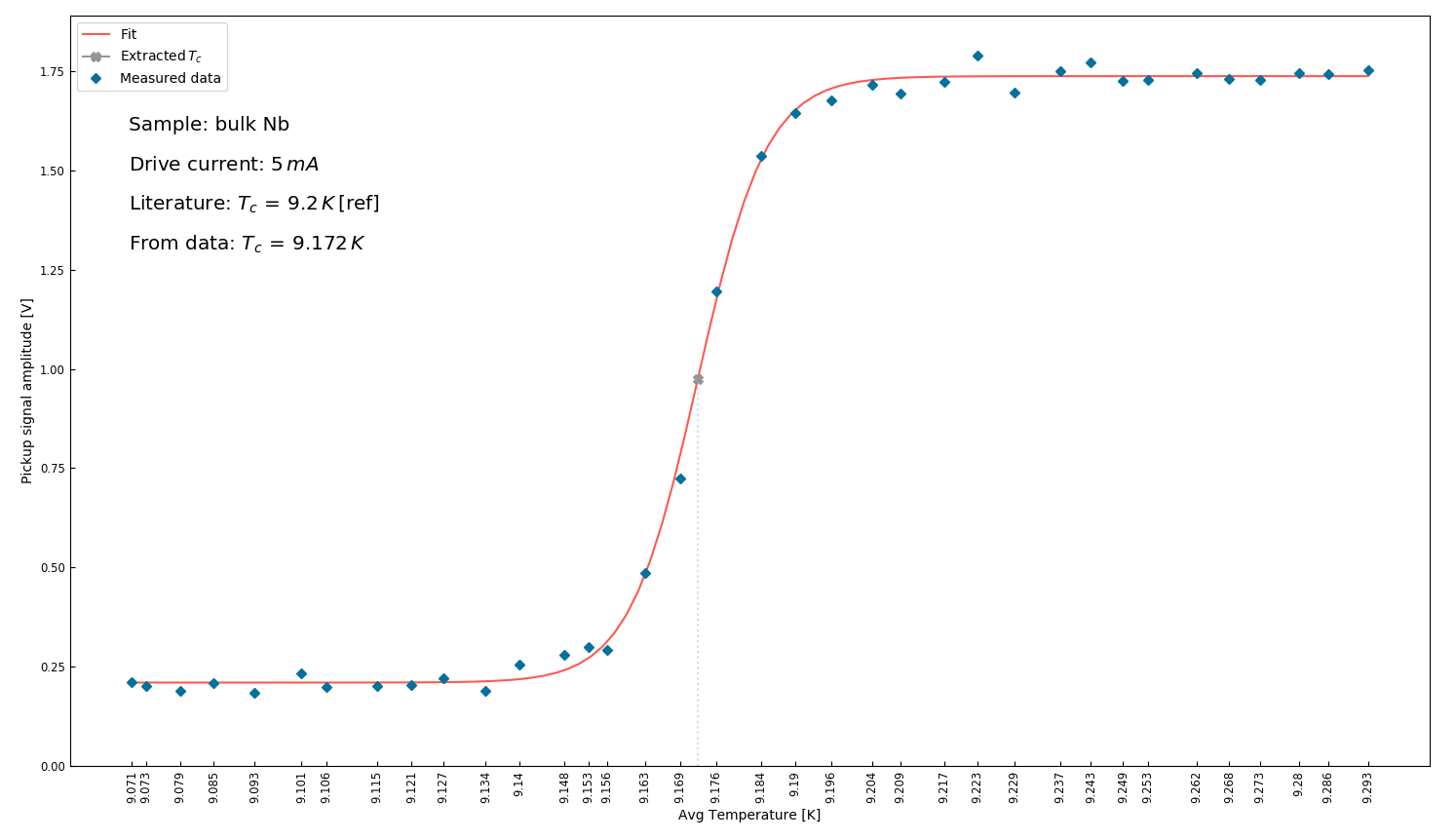
T_{c} test stand @Cryolab
Measurement of T_{c} - bulk Nb, EH 0.15 A, I_{D} = 5 mA, f_{D} = 7 Hz III – plot extracted A against <T> and fit
D. Fonnesu – CRG FPT Seminar – CERN 13.03.2019

Slide 28
T_{c} test stand @Cryolab
Measurement of T_{c} - bulk Nb, EH 0.15 A, I_{D} = 5 mA, f_{D} = 7 Hz III – plot extracted A against <T> and fit
D. Fonnesu – CRG FPT Seminar – CERN 13.03.2019

Slide 29
T_{c} test stand @Cryolab – next steps
Measurements:
HiPIMS Nb3Sn/Cu, DCMS Nb/Cu samples ready and available from TE/VSC-SCC (G. Rosaz, F. Avino)
Analysis:
Fit of temperature data
Evaluation of uncertainties
DAQ setup:
Noise reduction (cabling, filtering at amplifier, etc.)
Experimental setup:
Temperature stabilization (G10 chamber, mesh at vapour inlet, etc.)
Automatised system:
PID controller, DAQ GUI
D. Fonnesu – CRG FPT Seminar – CERN 13.03.2019

Slide 30
PhD – next to next steps
Study of SC thin films on substrate
Investigate thermodynamic parameters of SC thin films on their substrate
Measurement of critical temperature T_{c} on small samples
Measurement of thermal diffusivity on medium size samples at QPR, i.e. in RF environment
Test of coated real size 1.3 GHz cavity
Numerical simulation of thermal behaviour of SC film on substrate in RF environment, focus on:
QPR
film/substrate interface
D. Fonnesu – CRG FPT Seminar – CERN 13.03.2019

Slide 31
PhD – next to next steps
Study of SC thin films on substrate
Investigate thermodynamic parameters of SC thin films on their substrate
Measurement of critical temperature T_{c} on small samples
Measurement of thermal diffusivity on medium size samples at QPR, i.e. in RF environment
Test of coated real size 1.3 GHz cavity
Numerical simulation of thermal behaviour of SC film on substrate in RF environment, focus on:
QPR
film/substrate interface
D. Fonnesu – CRG FPT Seminar – CERN 13.03.2019

Slide 32
PhD – next to next steps
Study of SC thin films on substrate
Investigate thermodynamic parameters of SC thin films on their substrate
Measurement of critical temperature T_{c} on small samples
Measurement of thermal diffusivity on medium size samples at QPR, i.e. in RF environment
Test of coated real size 1.3 GHz cavity
Numerical simulation of thermal behaviour of SC film on substrate in RF environment, focus on:
QPR
film/substrate interface
D. Fonnesu – CRG FPT Seminar – CERN 13.03.2019

Slide 33
Conclusions
EASITrain: familiarised myself with the EU standards and procedures
Requirements for measurement of T_{c} analysed
Measurement system established and commissioned
DAQ defined – to be now implemented
First diffusivity measurements done at QPR
Data analysis to be done
EASITrain – European Advanced Superconductivity Innovation and Training. This Marie Sklodowska-Curie Action (MSCA) Innovative Training Networks (ITN) has received funding from the European Union’s H2020 Framework Programme under Grant Agreement no. 764879

Slide 35

Backup
O. Brunner, CERN SRF Workshop 2016

Slide 36
SRF cavities at CERN - II
FCC study: two phases
High-gradient machine – FCC-ee
High-current machine – FCC-ee/hh
Acceleration efficiency
400-800 MHz
Bulk Nb? Nb/Cu? N cells?
Cavity shape optimization
400 MHz
Nb/Cu? A15/Cu?
Long term R&D programs
Nb3Sn and other A15 materials
EHF
Seamless fabrication
Pictures from: O. Brunner, CERN SRF Workshop 2016

