Slide 1

Data analytics for LHC cryo operation
Oskar Martensson
Benjamin Bradu
TE-CRG-OP

Slide 2
Content
Motivations
Infrastructure
Automatic ronde
Estimation of BS heat load distribution at beam dump
Webpage overview

Slide 3
Motivations
Why perform data analytics on LHC cryogenics ?
  Detect problems not seen by conventional alarms
  Anticipate a potential failure or loss of availability
  Detect unoptimized processes and malfunctioning sensors
  Prolong the life span of equipment
  Improve the cryo availability and performance
How to perform such analysis ?
  Analyze archived data daily on virtual machines
  Create reports for experts/operators
  Publish the reports on the web

Slide 4
Infrastructure - Analysis process
EOS
Result storage
Input storage
Homepage storage
CERN-Network
Result presentation
3. Check latest results
(and read input)
6. Save output
Local PC
Openstack VM
1. Start job (automatic through cron)
Editing
Configuration
Computations
5. Perform calculations
2. Read python environment
and the program
4. Fetch signal data (PyTimber)
AFS
LDB
Code
Python environment
Signal data

Slide 5
Infrastructure - Virtual machines
AFS+EOS
CDA-1
CDA-2
CDA-3
CDA-4
CDA-5
CDA-6
CDA-7
CDA-8
CDA-9
CDA-10
Ronde
S12
Ronde
S23
Ronde
S34
Ronde
S45
Ronde
S56
Ronde
S67
Ronde
S78
Ronde S81
BS
heat load
estimation at beam dump
Non-regular computations
cron:
00:15*
+
Read queue every 10 minutes
cron:
00:30*
+
Read queue every 10 minutes
cron:
00:45*
+
Read queue every 10 minutes
cron:
01:00*
+
Read queue every 10 minutes
cron:
01:15*
+
Read queue every 10 minutes
cron:
01:30*
+
Read queue every 10 minutes
cron:
01:45 *
+
Read queue every 10 minutes
cron:
02:00*
+
Read queue every 10 minutes
cron:
Look for new dump every 10 minutes
Not started simultaneously because of EOS interferences.
Approximately 1h is required to compute one sector for one day.
* Will run every 2 hours as long as the report for the previous day is missing.

Slide 6
Automatic ronde - Introduction
Purpose:
Avoid the repetitive manual operator checking (“ronde”).
Have a coherent check across similar installations.
Detect problems not seen by conventional alarms and difficult to catch by “human eyes”.
This is NOT replacing the daily operator surveillance !
Who can do what?
Operators can view job specifications and the daily results.
Experts can edit the job specifications and view the daily results.

Slide 7
Automatic ronde - Algorithms
11 algorithms have been developed until now…
1. Amplitude difference
3. Offset
  Function:
  Check if average (opt. median) amplitude of a signals is significantly larger than others in a group.
  Applications:
  Magnets TTmin/TTmax/TTavg
  DFB CL valves
  DFB CL Cold-end temperatures
  Function:
  Check if a signal is significantly distanced from other signals in a group. (2 modes)
  Applications:
  QRL line sensors
  Magnet pressures and temperatures
  DFB pressures
2. Integral
4. PID performance
  Function:
  Check if a signal is significantly above or below its most frequent value.
  Applications:
  Magnet Filling valves
  Bayonet levels
  Function:
  Check if PID loop is correctly tuned
  (by checking measured value and actuator).
  Applications:
  All PID

Slide 8
Automatic ronde - Algorithms
5. Average
7. Slow deviation
  Function:
  Check if the average of a signal is above or below given limits.
  Applications:
  Thermal shield valves
  Thermal shield temperatures
  Function:
  Check if the signals have a slow accumulation over time.
  Applications:
  Filters
  vacuum gauges
6. Count
8. Span
  Function:
  Check if the span of a signal is significantly larger than the average span of other signals in a group.
  Applications:
  CV910
  Magnets (TTmax and Ttavg)
  Function:
  Check if the number of On/Off switch for a Boolean is above a given limit.
  Applications:
  He guards
  Cryo start / Cryo maintain

Slide 9
Automatic ronde - Algorithms
9. Correlation
10. Daily average
11. Oscillation
  Function:
  Check if local derivatives of signals is different from others in a group for a significant time.
  Applications:
  CV910
  Function:
  Check if the ratio between the daily average of a signal and the average of the previous day is above a given limit.
  Applications:
  Vacuum gauges
  Function:
  Find a cyclic behaviour in a signal.
  Applications:
  Supercritical helium pressure stability

Slide 10
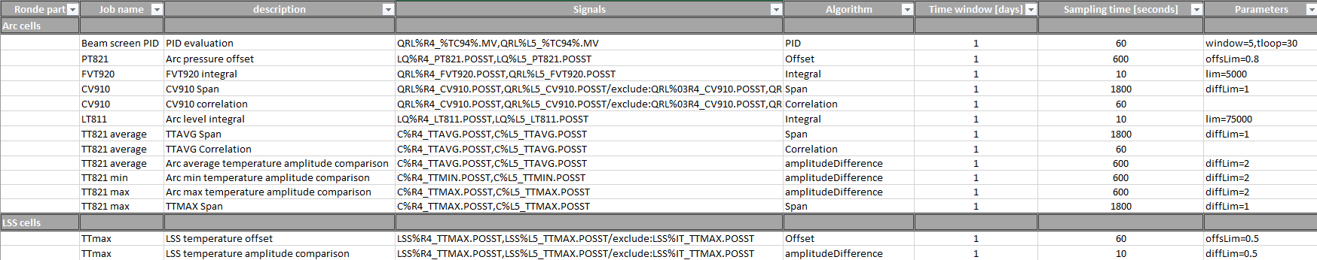
Automatic ronde - Job specification
One xml file is defined per sector
  Can be edited by experts and transferred on EOS (via CERN Box)
  About 40 jobs are defined per sector
  About 1000 signals are analysed per sector

Slide 11
Automatic ronde - Concrete examples
A series of real examples
  Problems detected using the different algorithms described before
  2018 – January 2019 were analysed
  8 out of 11 active algorithms triggered warnings
Typical day for one sector:
  Total number of warnings: ~ 20 warnings
  Total number of new warning: ~ 1 warning

Slide 12
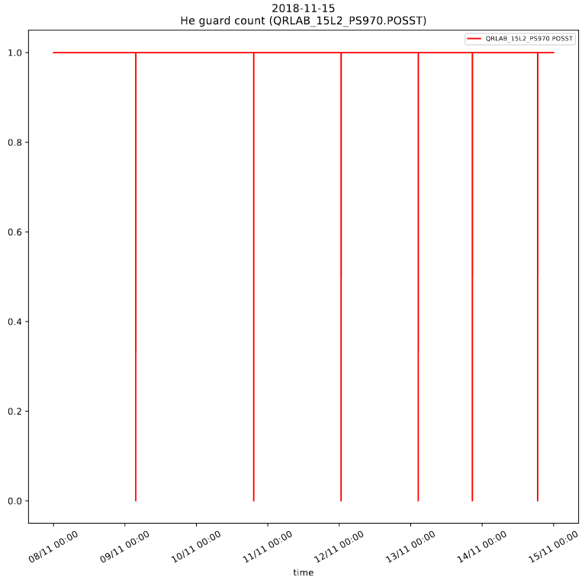
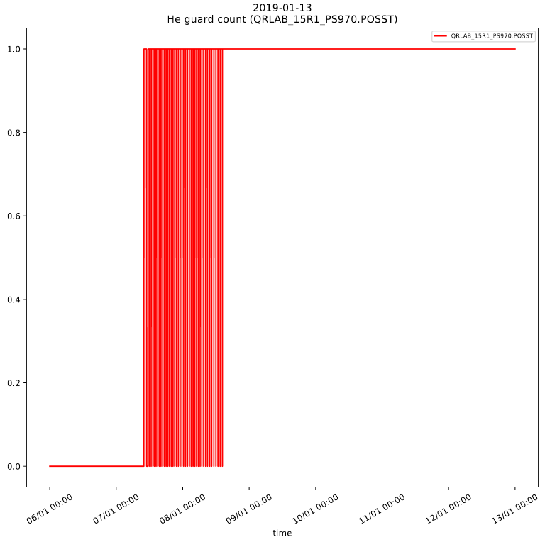
Concrete examples - He guard leak
  Algorithm = Count
  15L2 He guard regularly open: leak ? (15/11/2018)
  15R1 specific He guard issue: ? (13/01/2019)

Slide 13
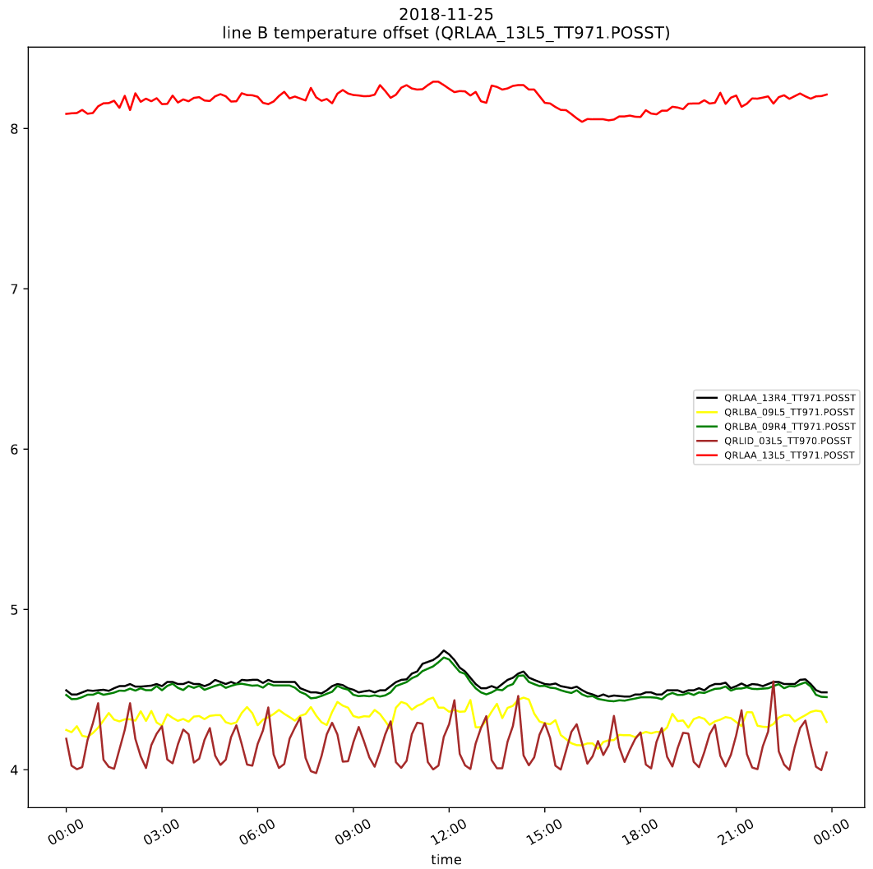
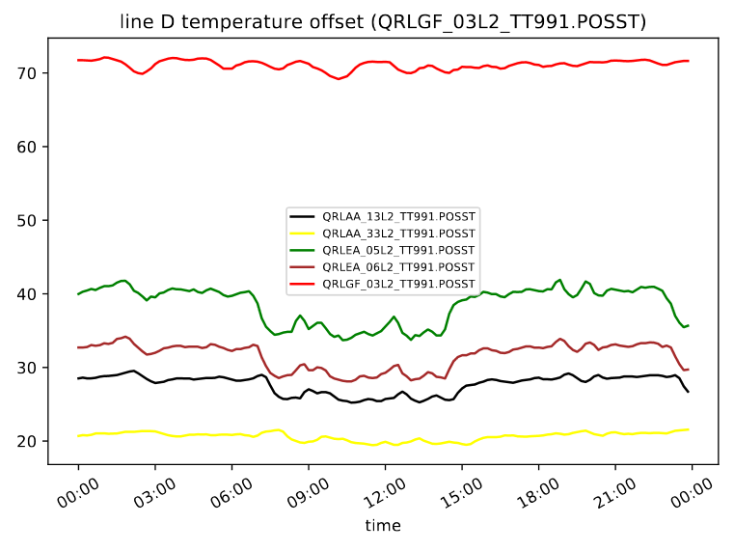
Concrete examples - QRL sensors offset
(sensor issue)
  Algorithm = Offset
(process issue)
  QRLGF_03L2_TT991: Line D starts at 75 K due to shield reconfiguration in S12 (26/11/2018)
  QRLAA_13L5_TT971: sensor offset (25/11/2018)

Slide 14
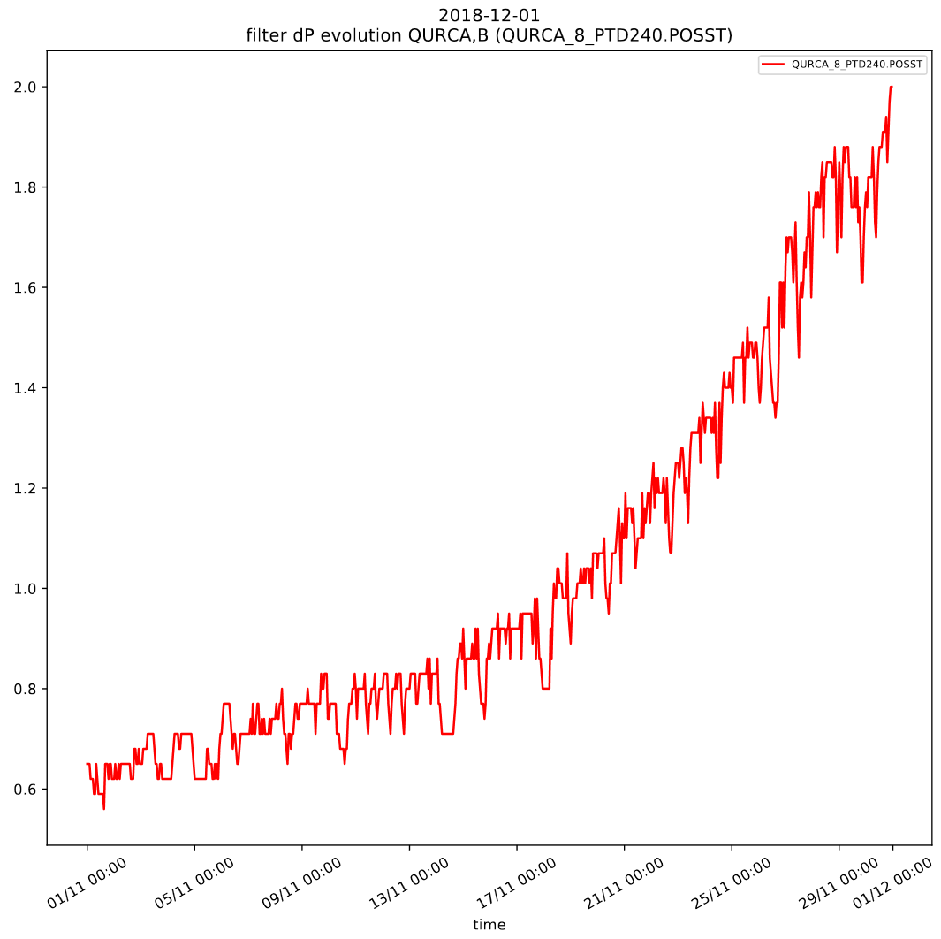
Concrete examples - Clogging filter
  Algorithm = Slow deviation
  QURCA-8 filter in November 2018: clogging (01/12/2018)

Slide 15
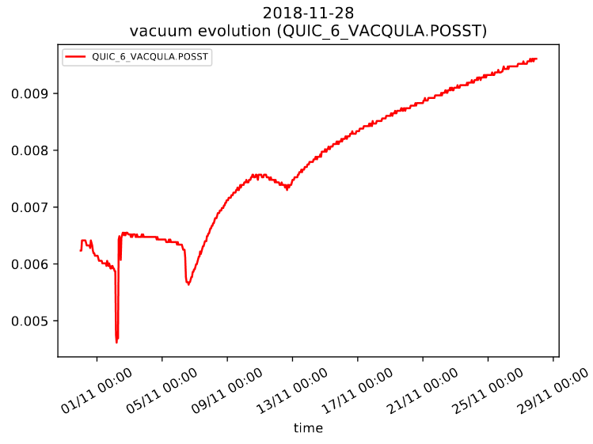
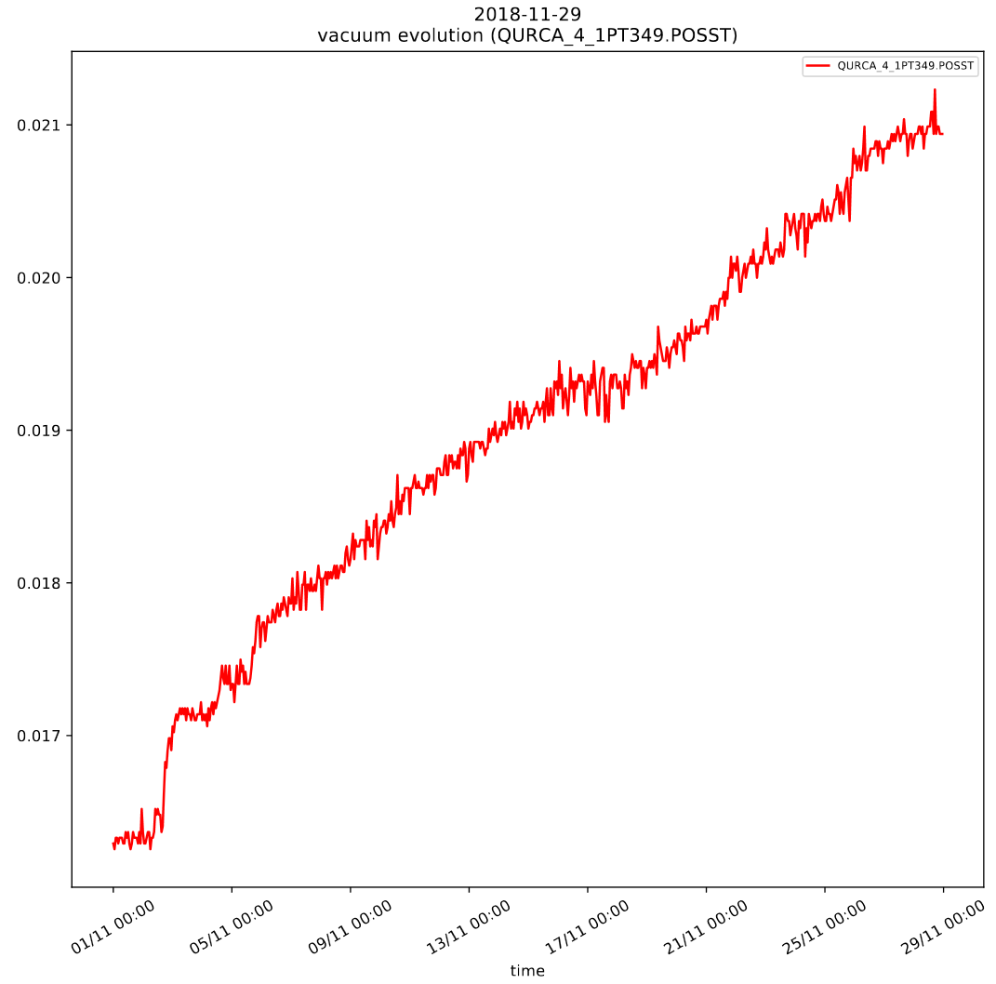
Concrete examples - Vacuum degradation
  Algorithm = Slow deviation
  QUIC_6_VACQULA (28/11/2018): Degassing after QURA stop
  QURCA_4_1PT349 (29/11/2018): Degradation of primary vacuum

Slide 16
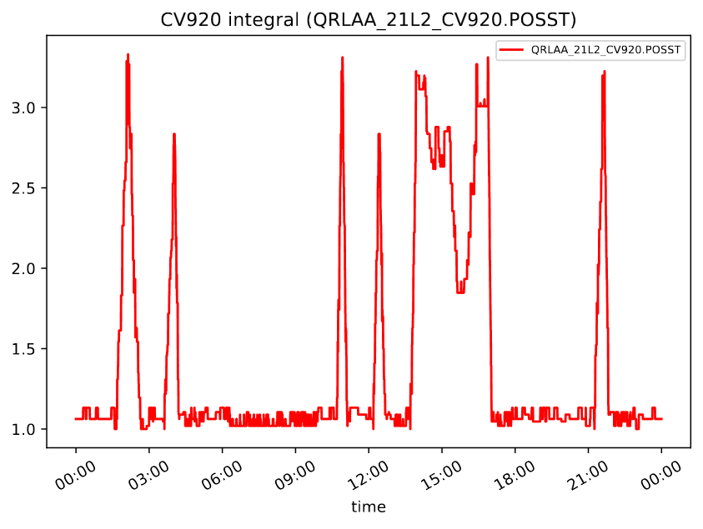
Concrete examples - Leak on magnet bath
  Algorithm = Integral
  QRLAA_21L2_CV920 opens regularly (25/11/2018)

Slide 17
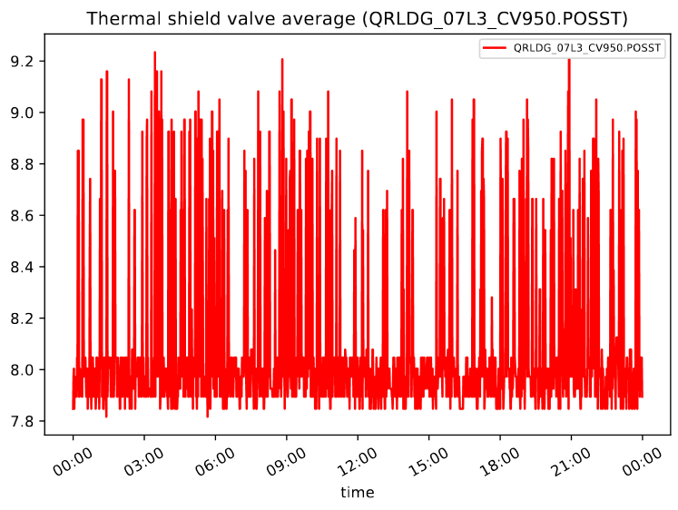
Concrete examples - Thermal shield valve not regulating
  Algorithm = Average
  Thermal shield in 07L3 (18/11/2018): after S12 shield reconfiguration on QSRB

Slide 18
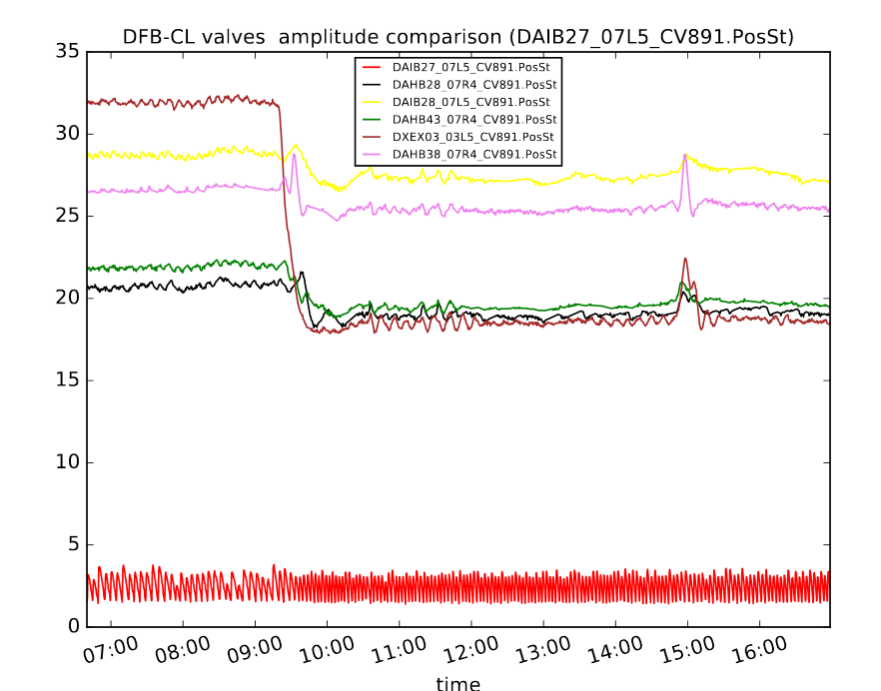
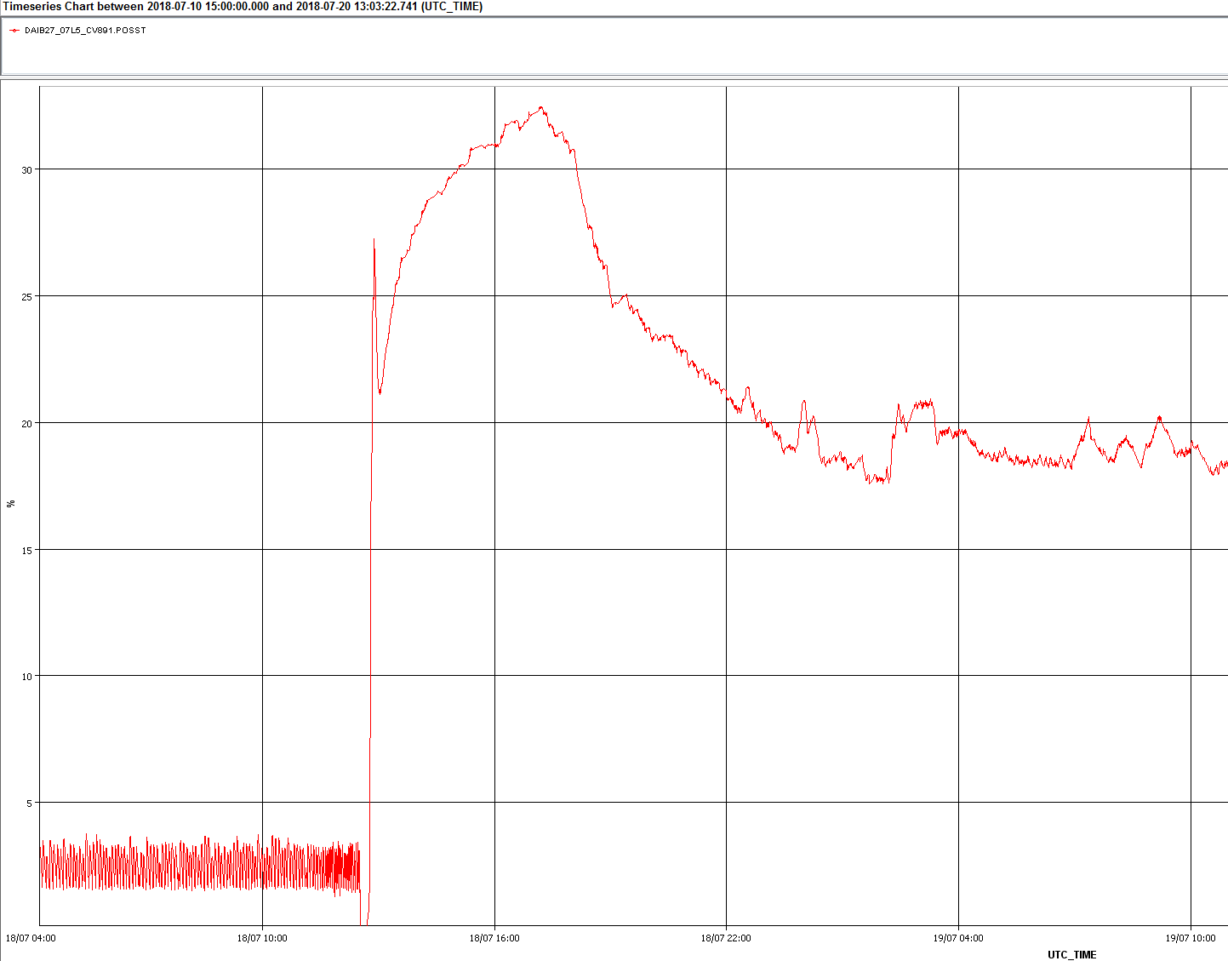
Concrete examples - Faulty DFB current lead valve
  Algorithm = Amplitude difference
  DAIB27_07L5_CV891: valve electronic problem (15/07/2018)
  DAOC05_07L8_CV891: valve electronic problem (17/10/2018)
  DADB34_06R2_CV891: valve electronic problem (29/11/2018)
Before/after valve electronic replacement

Slide 19
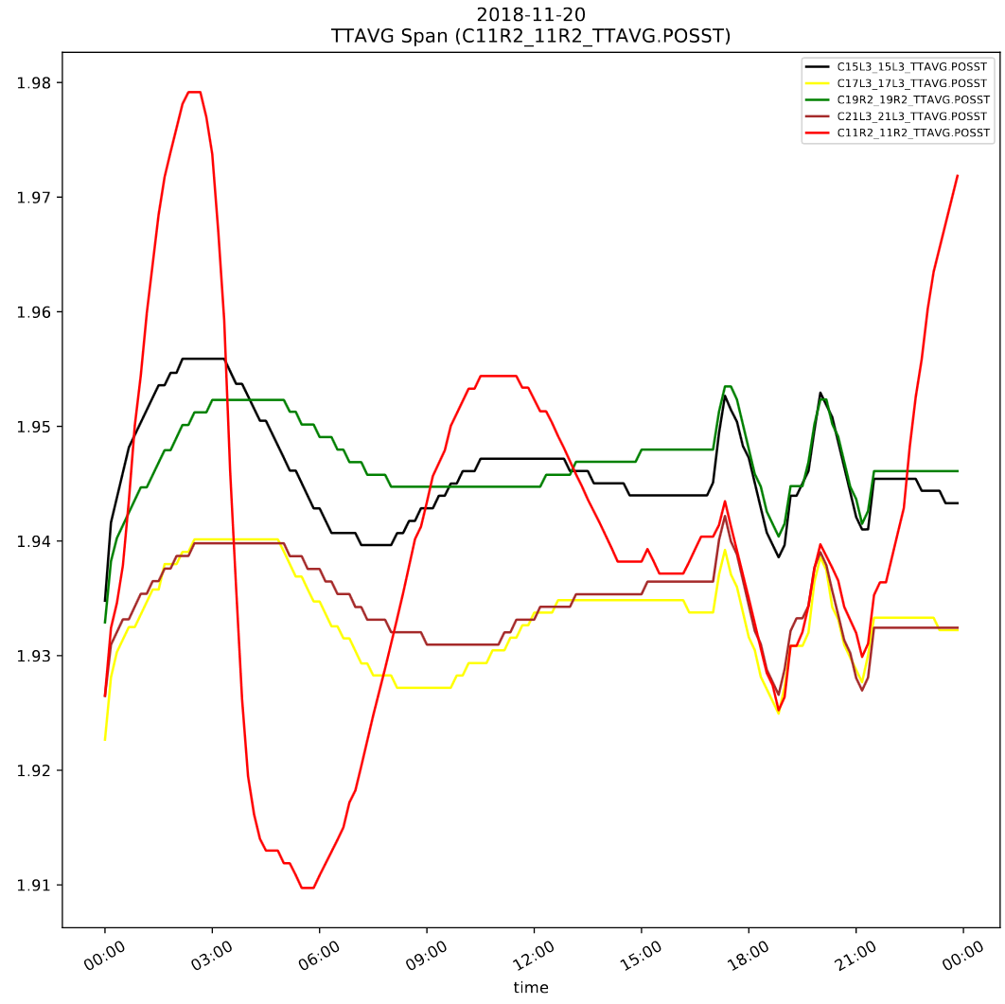
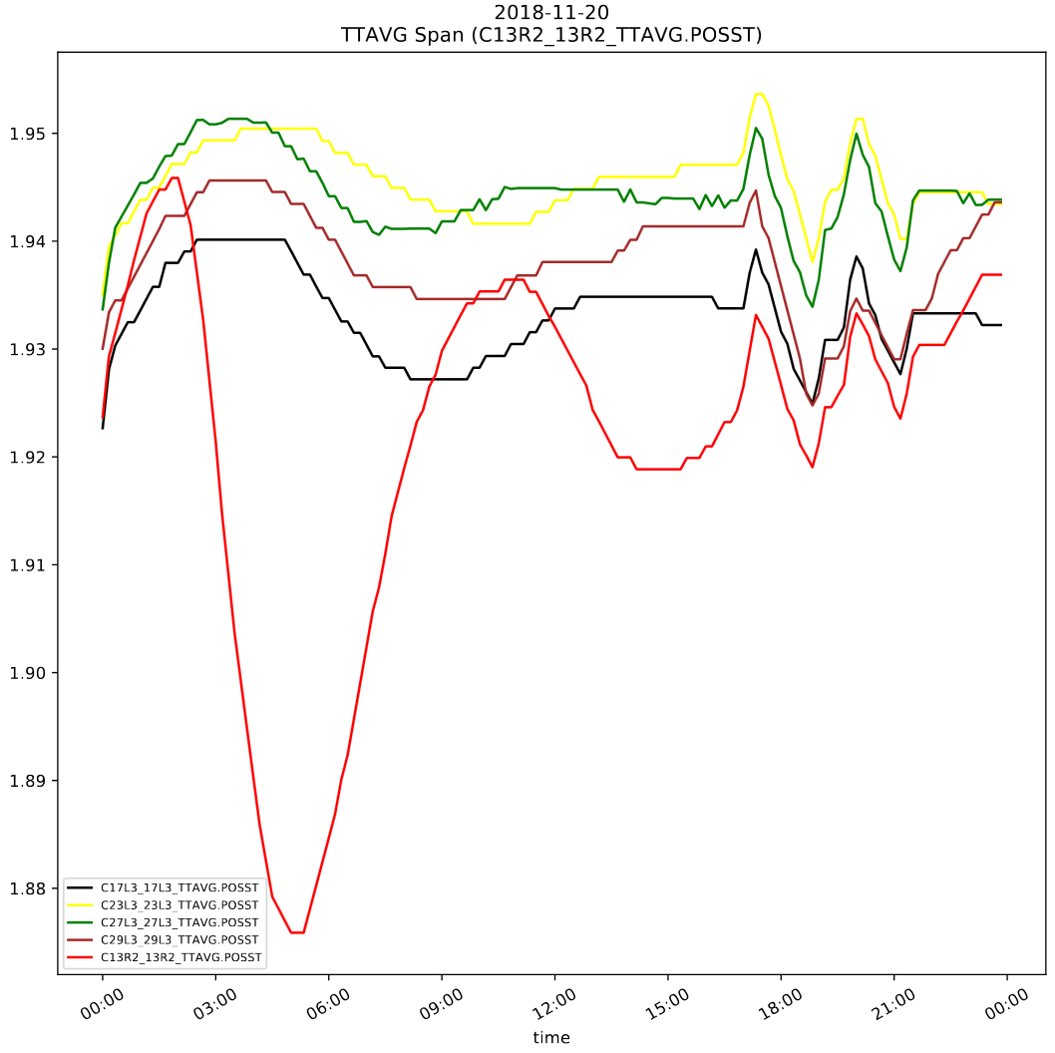
Concrete examples - Extra heat load on magnets
  Algorithm = Span
  11R2/13R2 TTAVG: Pb ion losses in 12R2 (20/11/2018)

Slide 20
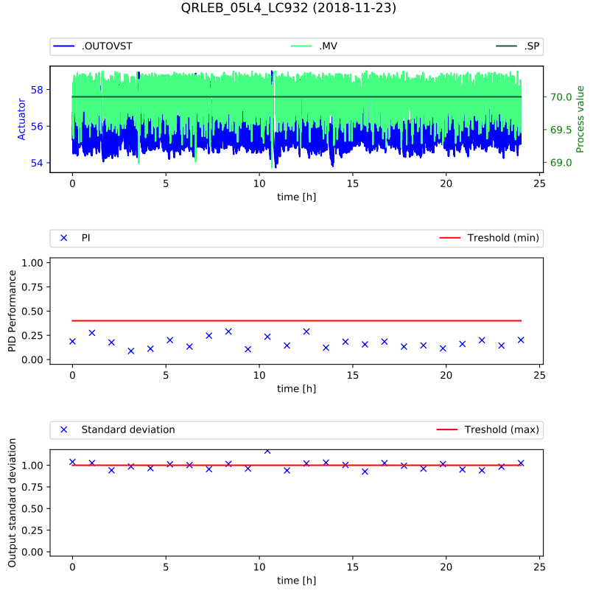
Concrete examples - Bad PID controller tuning
  Algorithm = PID performance
  QRLEB_05L4_LC932: Bad level regulation in D3 magnet.
  (23/11/2018)

Slide 21
Ronde automation – Perspectives
Implement e-mail/sms notifications of new warnings.
  In the coming year
Implement a login function (for permission management) and enable access from outside of CERN.
  In the coming year
Further tuning of parameters to avoid false positives.
  Along the years of usage
Start to use it.
  Run 3

Slide 22
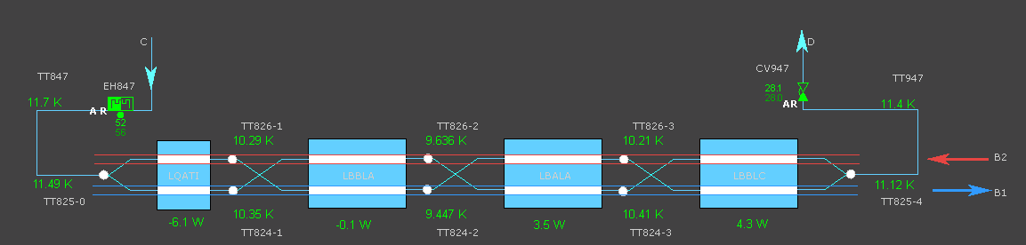
BS heat load distribution - Introduction
Purpose:
Make an estimation of the heat load distribution in instrumented half-cells at beam dump. This information is then used in the trouble shooting process regarding the unexpected heat load present in the LHC (e-cloud).
➔ Objective is to be able to locate heat loads with a resolution ~1 meter
4 half-cells have 8 extra thermometers between magnets to estimate heat load on each magnets beam screen (13R4, 33L5,13L5, 31L2)

Slide 23
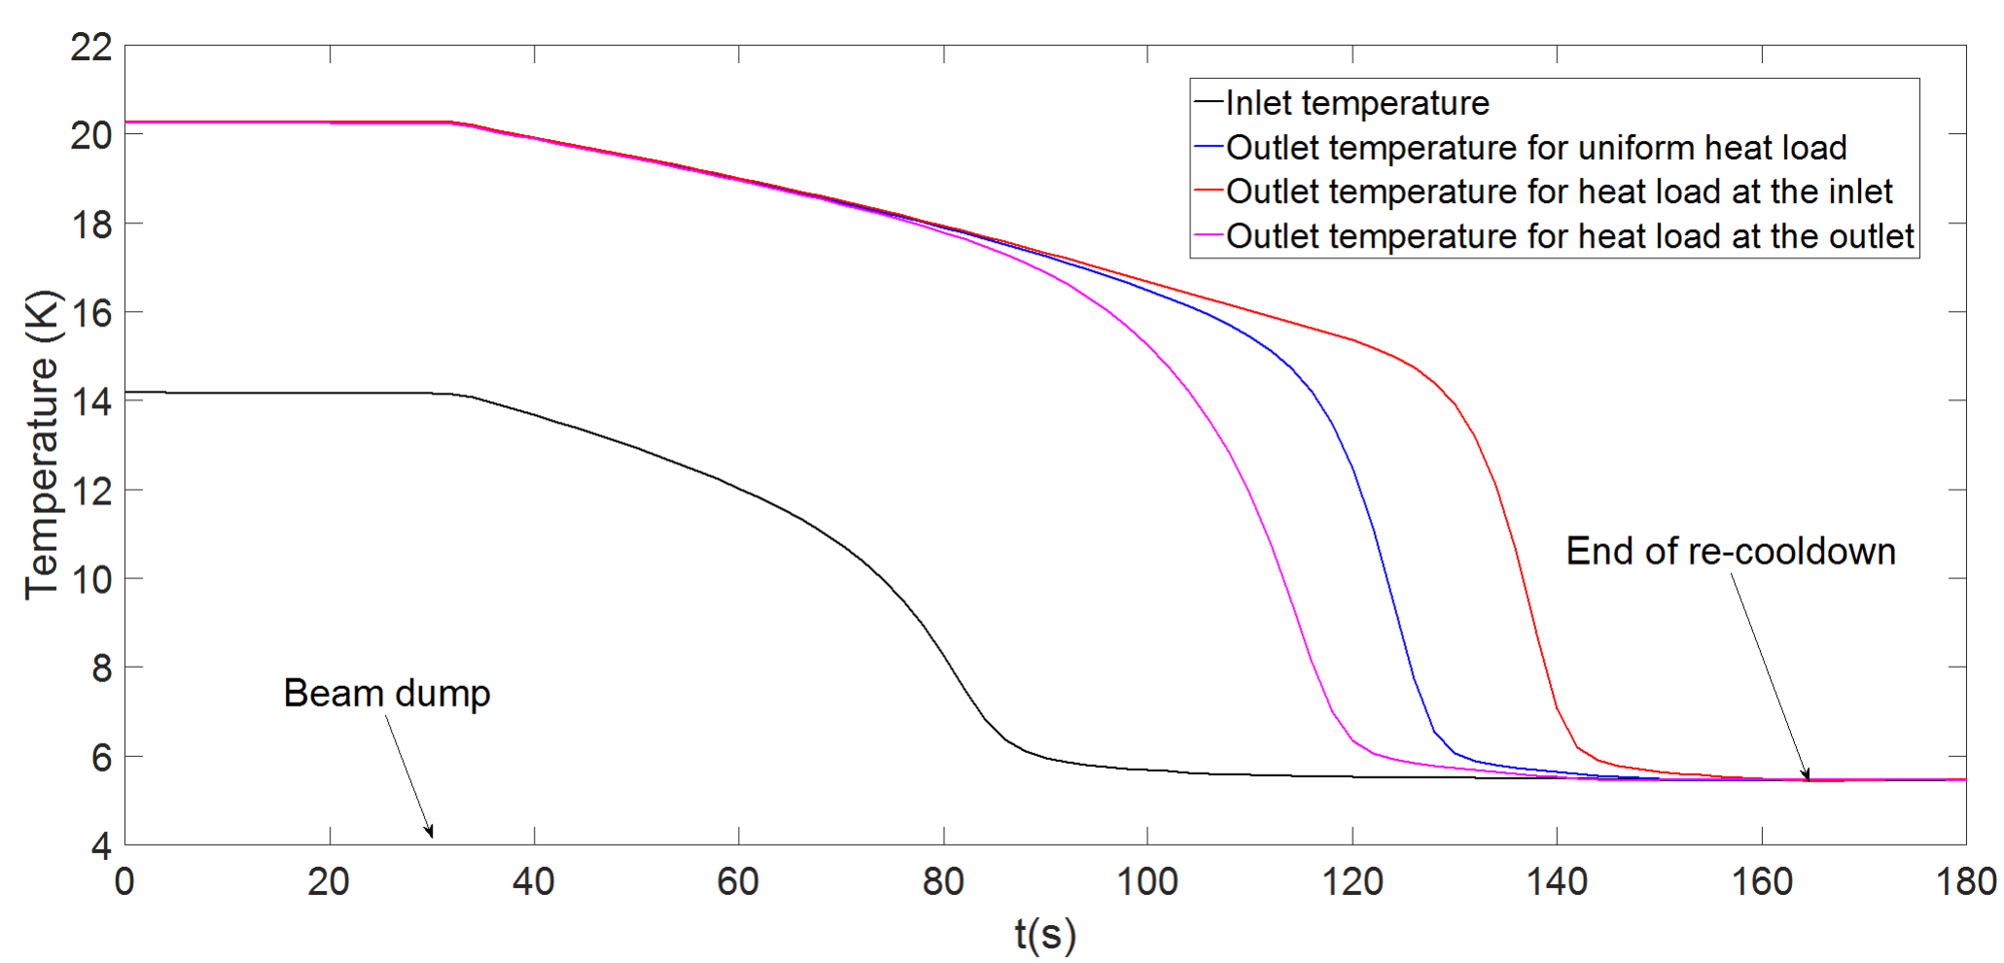
BS heat load distribution – Analysis principle
At beam dump, BS heat loads suddenly disappear.
If the helium supply is kept at constant temperature (EH84x off), the beam screen is cooled down uniformly at ~ 6 K.
Analysis of the re-cooldown transient allows us to estimate the heat load distribution along the beam screen.
This estimate can be quite accurate in the instrumented half-cells.

Slide 24
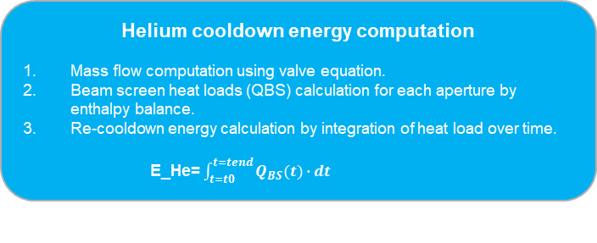
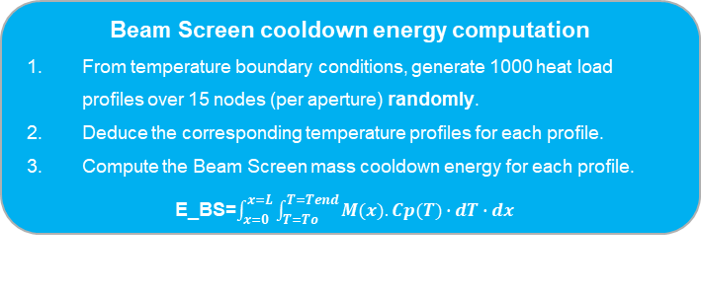
BS heat load distribution - Method
Data fetching
Fetch all necessary data (TT, PT, CV, EH, beam…)
around beam dump time, from LDB.
Re-cooldown time identification
Start of re-cooldown: Beam dump time (# of bunches == 0)
End of re-cooldown: When temperatures are at minimum
Helium cooldown energy computation
Mass flow computation using valve equation.
Beam screen heat loads (QBS) calculation for each aperture by enthalpy balance.
Re-cooldown energy calculation by integration of heat load over time.
E_He= $\int_{t=t0}^{t=tend}{Q_{BS}(t)∙dt}$
Beam Screen cooldown energy computation
From temperature boundary conditions, generate 1000 heat load profiles over 15 nodes (per aperture) randomly.
Deduce the corresponding temperature profiles for each profile.
Compute the Beam Screen mass cooldown energy for each profile. E_BS=$\int_{x=0}^{x=L}{\int_{T=To}^{T=Tend}{M(x).Cp(T)∙dT∙dx}}$
Select all the possible heat load profiles where E_BS = E_He at +/- 5 %.

Slide 25
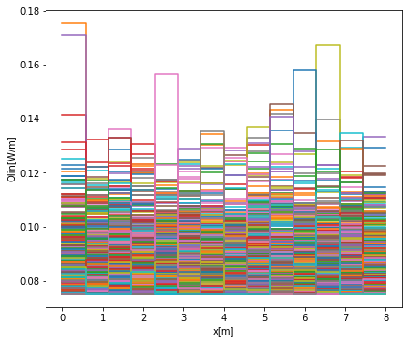
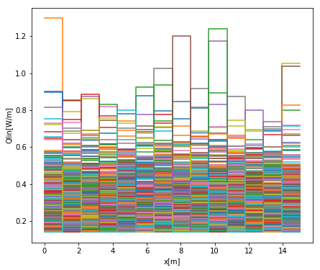
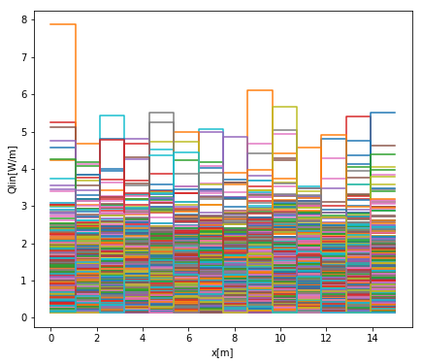
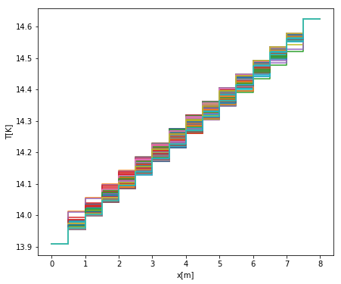
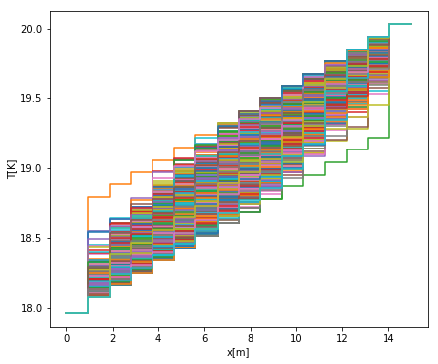
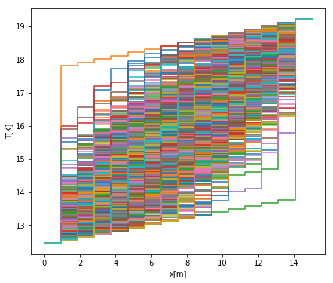
BS heat load distribution – Random profile generation
13R4-Q1-B1
13R4-D4-B1
33L5-D3-B2
(Fill #7245)
Small Heat load (~0.15 W/m)
sync rad + image current only
➔ Very few possibilities
Medium Heat load (~1 W/m)
sync rad + image current + e-cloud
➔ Some possibilities
Large Heat loads (~5 W/m)
sync rad + image current + large e-cloud
➔ Many possibilities

Slide 26
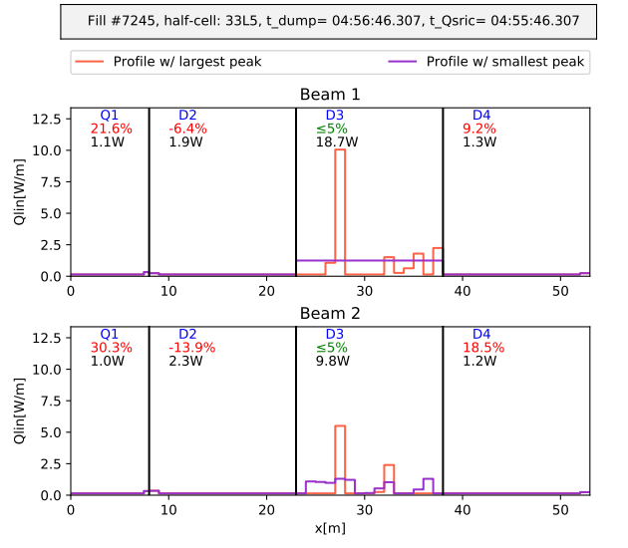
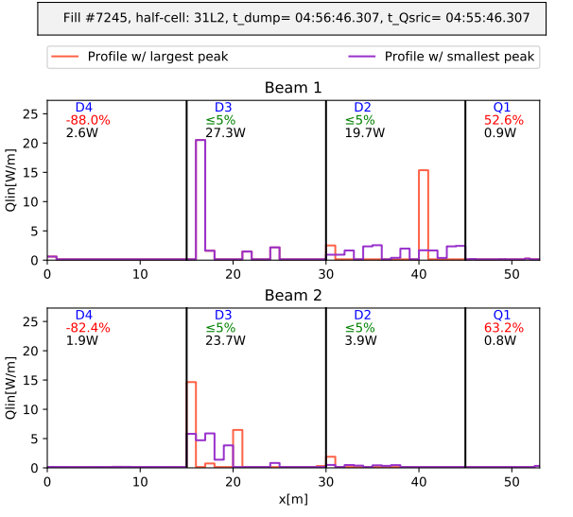
BS heat load distribution - Results
NB: Only profiles with smallest peak (optimistic) and highest peak (pessimistic) are represented
For details, see : B. Bradu et al, Heat load profile estimated on LHC beam screens by thermal transient analysis, ICEC27, Oxford, 2018

Slide 27
Webpage overview
http://CryoDataAnalytics.web.cern.ch
(Accessible from CERN network only)

Slide 28
Conclusions
CRG-OP started to perform some online data analytics on LHC cryogenics.
Two main tasks have been implemented
  Ronde: Daily analysis of LHC cryo installations to detect abnormal behaviours.
  BS Heat load profile estimation: heat load profile estimation performed at each beam dump on the 4 instrumented half-cells for e-cloud studies.
Some tuning is still needed to put these tools in use for Run 3.
Some additional features to be implemented on homepage.
Model based diagnostics to anticipate potential failures or malfunctioning processes will be added to the homepage (EcosimPro).

Slide 30
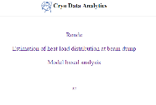
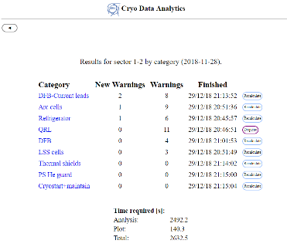
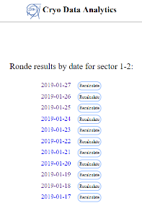
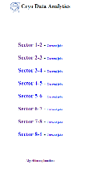
Webpage overview - Ronde
Select main task
Select day
Select sector

Slide 31
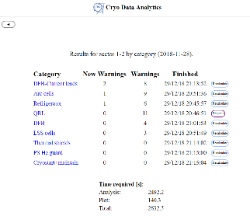
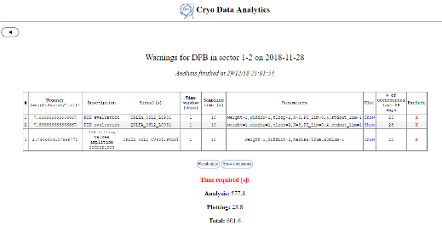
Webpage overview - Ronde
Select
installation

Slide 32
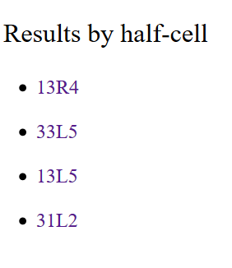
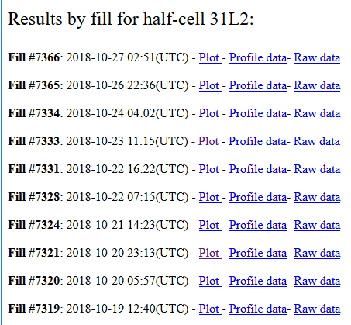
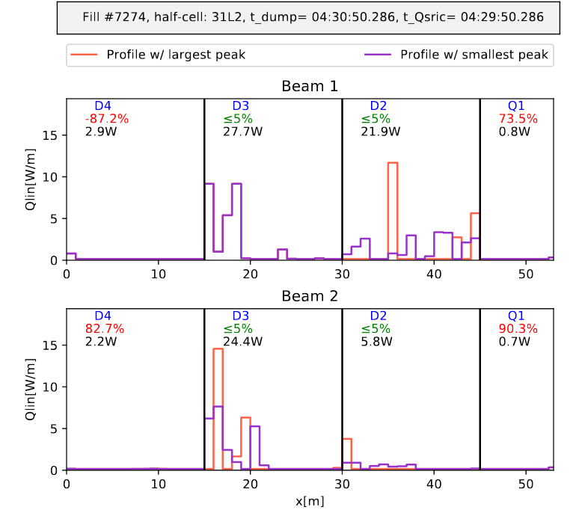
Webpage overview - BS heat load at beam dumps
Select Dump to view plot of BS heat load profiles over magnets
Select
half-cell

Slide 33
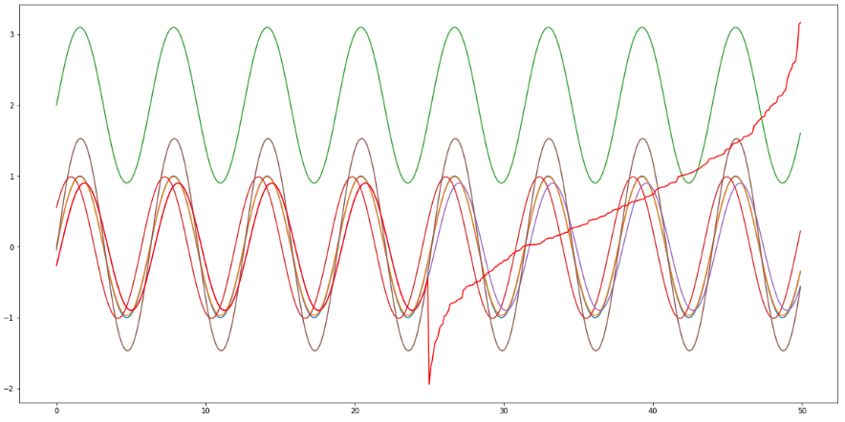
Extras
Example of signal to trigger correlation warning

Slide 34
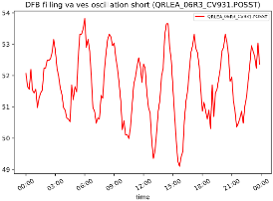
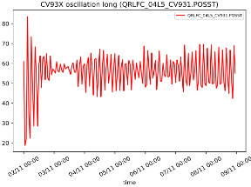
Concrete examples – Oscillating valves
  Algorithm = Oscillation

Slide 35

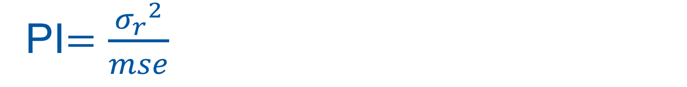

PI$=\frac{{σ_{r}}^{2}}{mse}$
${σ_{r}}^{2}$=error residue variance
$$mse=mean square error$$

