Slide 1
ELENA beam commissioning
Planning and Results

Slide 2
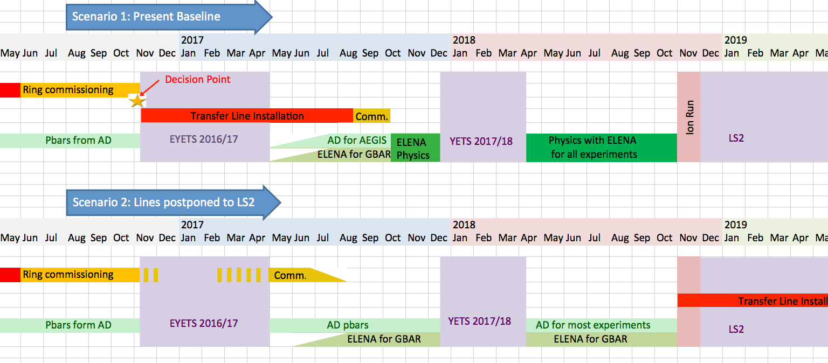
ELENA initial planning…

Slide 3
The Commissioning Plan, Scenario 2
1. 14:th November – 20:th December 2016, midFebruary – March 2017, (possibly also part of January 2017)
100 keV H- @ 1 Hz, ring in normal polarity & normal direction:
  Finalise set up of xfer line from source: need BTV:s, BPM
  First injections & circulating beam: need ring BPM:s, tune msmnt, Schottky system
  Orbit/coupling: validation of systems, corrections, need RF
  Tunes: validation of system, corrections
  Chromaticity: validation of system, RF needed
  Acceptance check/studies: need scraper & beam blow-up systems
  Lifetime/blow-up rates, need intensity measurement (Schottky analysis)
  (Lattice validation with orbit response msmnts)
  (check alignment of e-cooler solenoids with orbit correction program, study effects of e-cooler solenoids on optics)
  Acceleration: tests & ramp corrections: further RF setup needed incl. B-train
  Repeat validations and corrections at intermediate & top plateau
  100 keV protons @ 1 Hz, ring in normal or reversed polarity (both beam directions) could be used if needed

Slide 4
The Plan
2. May 2017 (timing also depends on commissioning progress)
Installation & tests of e-cooler
Vacuum bakeout of sector 40
Installation of LNE50 (Gbar) line ? (readiness of SEM:s & magnetic pick-up?)
LNI/LNE SEM & magnetic pick-up installation
3. From June 2017
100 keV H- @ 1 Hz, ring in normal polarity & normal direction:
  Set-up e-cooler
  If H- lifetime is too short: use protons, ring in reverse polarity & normal direction, additional corrections might be necessary later for pbar operation due to remanence effects
  Recombination detection (protons), additional tool for alignment/tuning
  Extensive use of scraper system for profile and emittance msmnts
  Schottky analysis for long. Emittances
  Check solenoid alignment with orbit correction program, cooling time studies
  Lifetime/blow-up rates

Slide 5
The Plan
4. From June 2017
100 keV protons or H- @ 1 Hz, ring in reverse or normal polarity & normal direction:
  Initial setting-up of the extraction and ejection lines (only short sections installed at this stage for main and GBAR lines)
  Need u-wire monitors + high sensitivity intensity msmnt pickup in lines
5. From June 2017
5.3 MeV pbars @ .01 Hz, ring in normal polarity & normal direction:
  Set-up transfer line from AD: need BTV, GEM, TFA7049, BPM. (optics validation)
  RF synchro s-u for bunch to bucket transfer
  Deceleration (mirror acceleration cycle):
    Ramp studies: orbits, tunes, slope
    Further e-cooler set-up & optimisation
    Set-up of nominal cycle; obtain nominal emittances
  Bunched beam cooling @ extraction
  Set up extraction for Gbar operation

Slide 6
The Plan
6. From July 2017 until end of 2018
Pbar operation for Gbar
Further studies with Ions & Pbars
Space charge studies on higher intensity bunches (extraction on lower harmonics); compatibility with ejection lines
Deceleration efficiency > 60% ?
Synthetic B-train, validation for use in regular operation
7. LS2 – first half? (assuming ELENA performance is satisfactory)
Installation of low-energy beam lines to experiments
Commissioning with 100 keV Ions (Pbar set-up when available in 2021)

Slide 7
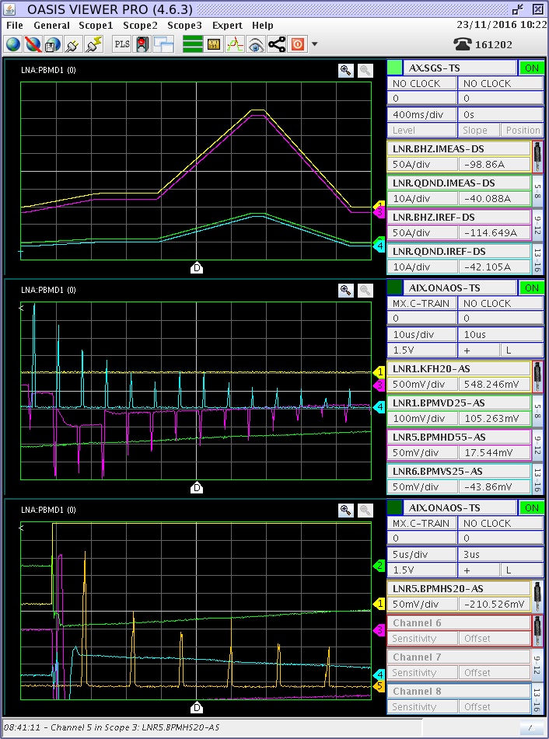
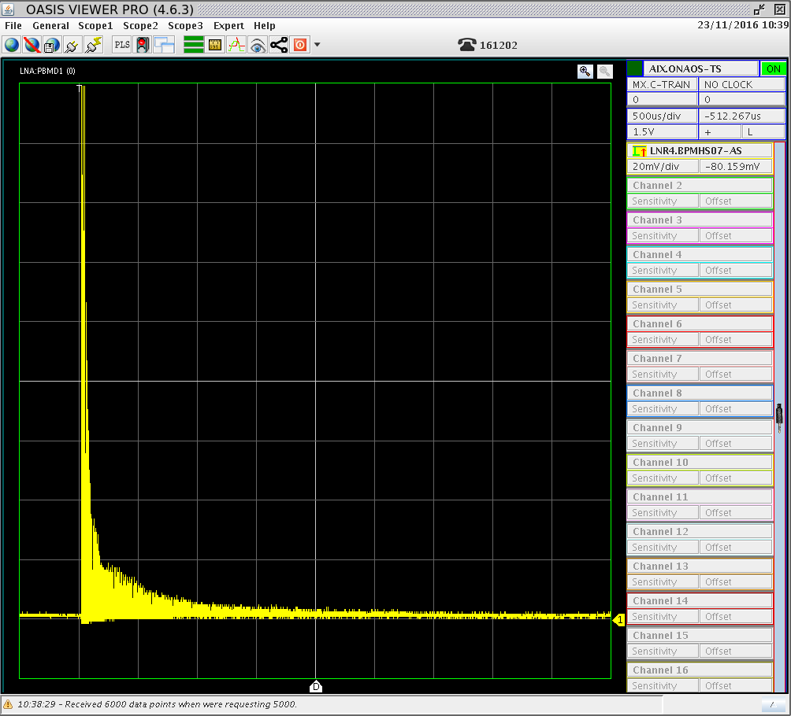
The Reality…..
Nov. 2016: H- source operating at 100 keV, ELENA ready for first tests
First H- injected 16/11 and “threaded” around ELENA, circulating beam (a few hundred turns) a few days later
Only LNR.BTV118 (between septum and kicker) and ring BPM:s via OASIS used
25/11 H- source isolation transformer breakdown => end of run 2016

Slide 8
The Reality…..
H- source back up in March 2017. It was decided to run at 85 keV to minimise the risks of further breakdowns.
Some main activities/milestones in 2017:
  March: 1:st SEM tests using 16 OASIS channels = 2 monitors for H- => improved xfer and H- lifetime (0.5s)
  As of March, sometimes temporary instrumentation solutions while getting systems ready:
    1:st tune measurements using bpm delta signal and OASIS FFT (strong coherent oscillations at injection)
    Synchrotron frequency measurements using radial position and OASIS FFT
    Work on Scraper beam profile measurements
    Orbit system: first measured YASP orbits 30/5
    Set-up and tuning of many systems, RF, B-train, BBQ,…,
    Trying to improve/better understand Source stability problems, H- transfer line, lifetime etc. etc.
  3 Pbar shifts/week interleaved with Ion commissioning as of June 2017
  7 June: 1:st 5.3 MeV Pbar tests, 2 BTV:s available for AD-ELENA xfer
  23/6: Pbars seen on LNR.BTV118
  2/8 First Pbars circulating in ELENA
  Faster progress towards the end of the year – see following slides

Slide 9
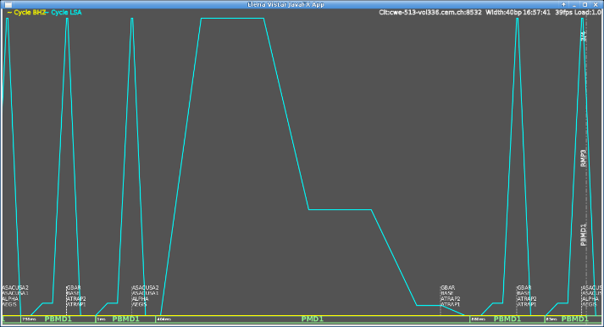
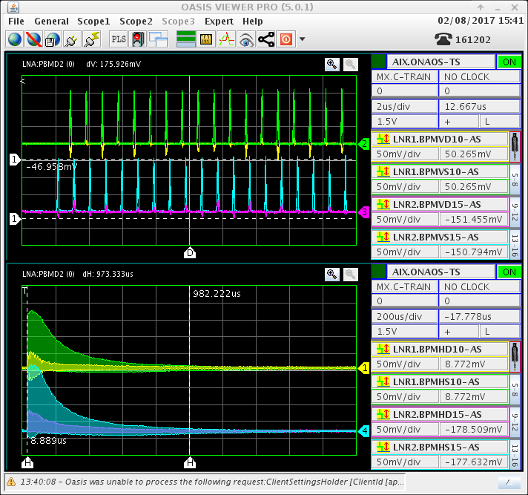
First Pbars in ELENA
ELENA supercycle with Pbar and Ion cycles
- Pbars transferred through beam line and seen on BTV118 23 June….with missing bpm:s, only the 2 BTV:s available.
2 August 2017:
AD – ELENA cycle synchro and handshake debugged & operational
RF/timing clocktrains installed & debugged
After minimal correction of H/V trajectories in transfer line
Small correction of ELENA main B field
=> first Pbars circulating in ELENA!
First few turns observed on bpm:s
Envelope over 2 ms

Slide 10
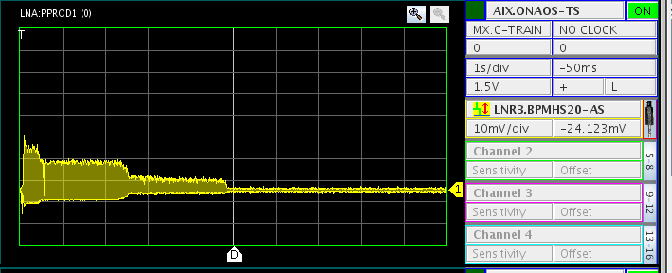
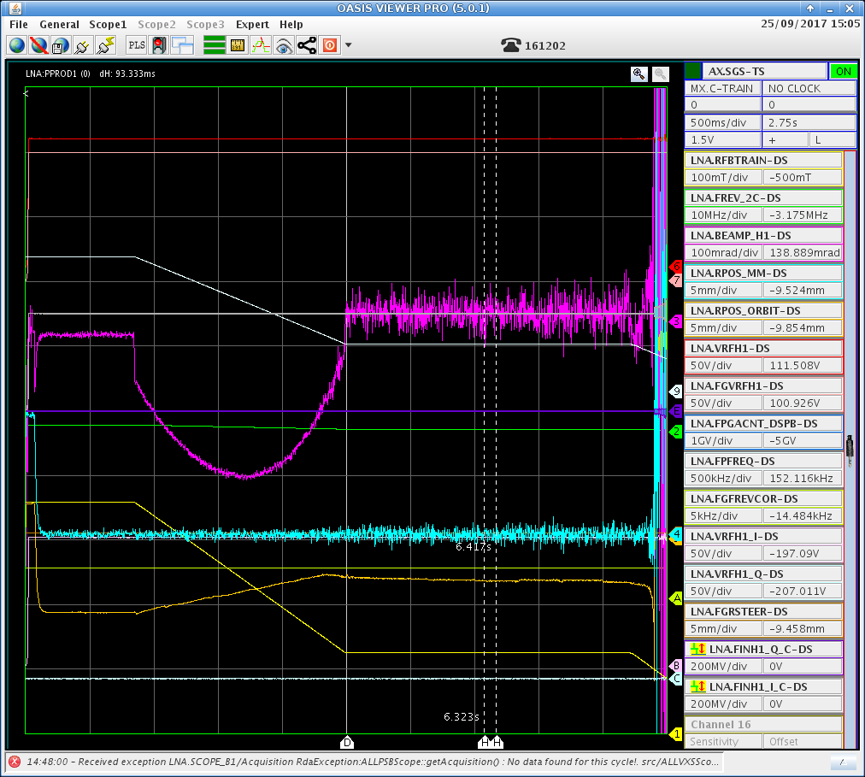
Pbar progress Sept.-17
25/9: Significant RF progress with Pbars; beam decelerated with good efficiency down to the 35 MeV/c plateau and well into the following ramp using both radial and phase loops after optimisation of the phase loop correction. Aperture was also measured at 100 MeV/c using radial steering, beam survives to +20 and to -5 mm offsets.

Slide 11
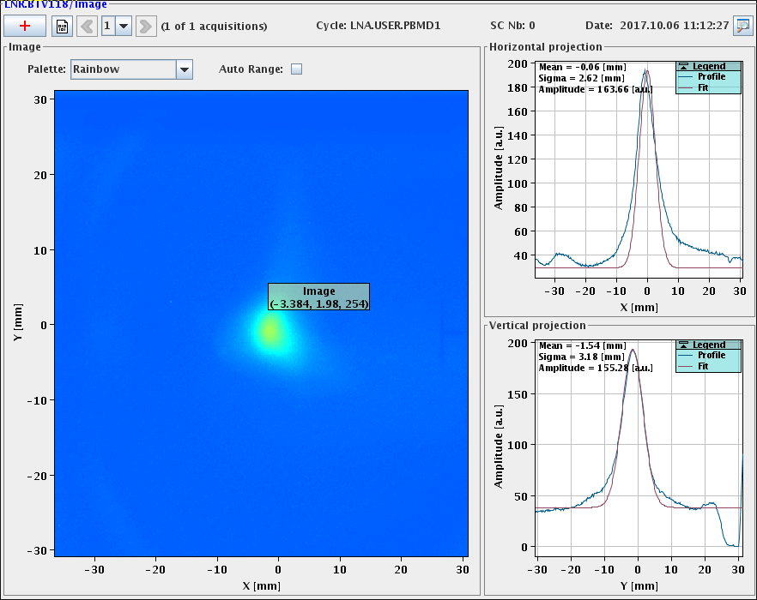
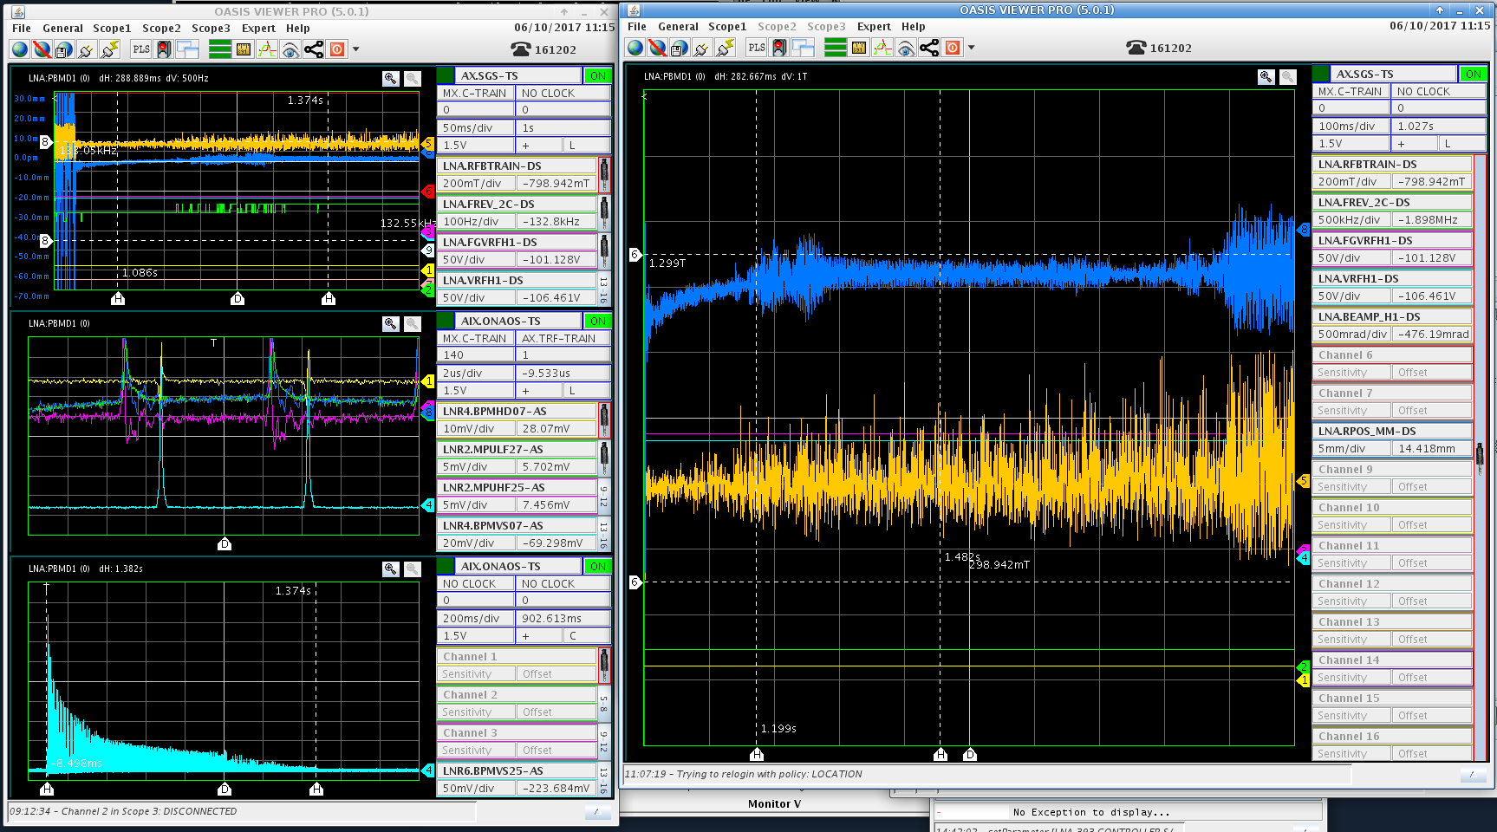
H- progress Sept./Oct. -17
Good intensity and well-focused beam on BTV118.
Much shorter and intense circulating bunches could be observed after bunch to bucket transfer of H- was established.
The radial and beam phase loops could not be closed as both the LPU and bpm signals seemed too weak/noisy. A different bpm is now connected (as LPU) which should see less “pollution” of the H-beam.

Slide 12
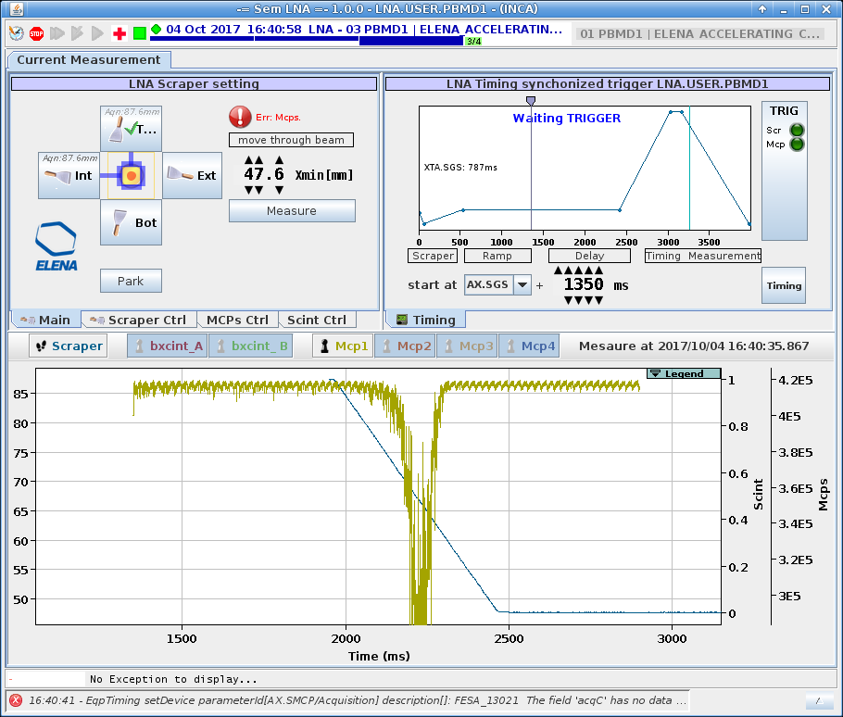
H- circulating beam profiles Sept./Oct. -17
First nice H- beam profiles have now been observed but there are still timing issues to be sorted out before we can see position (and emittance estimation) instead of time on the x-axis.

Slide 13
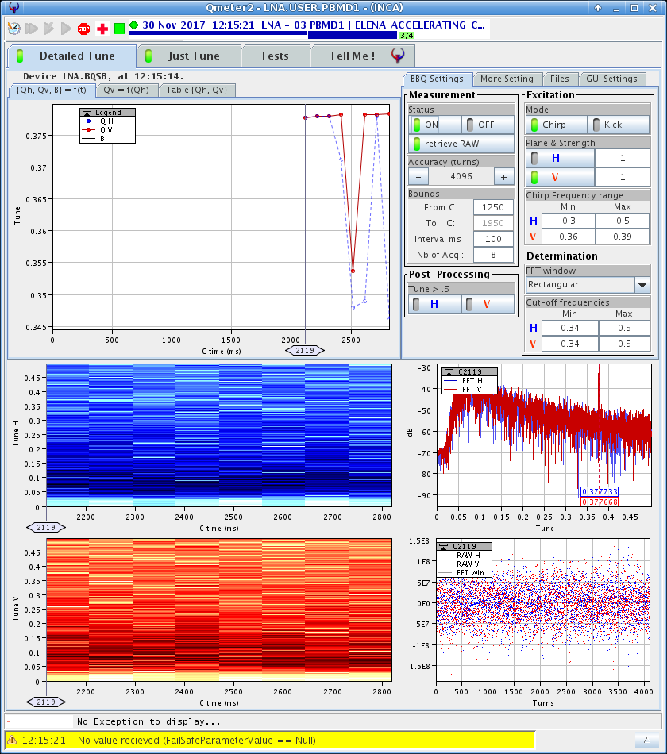
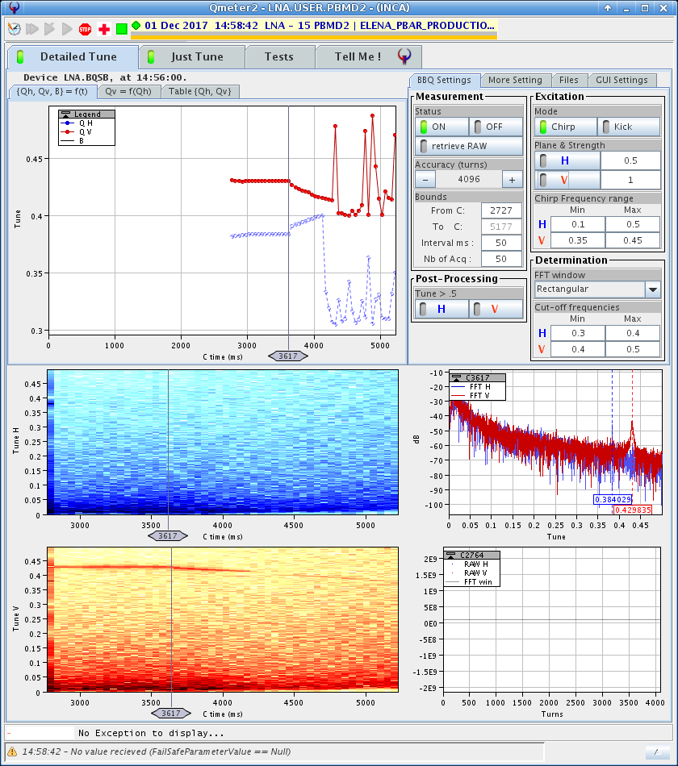
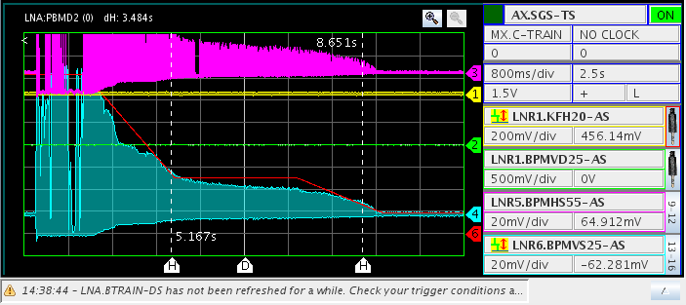
End of 2017:
H-
  Ion source stability/reliability improved – often simple start-up and circulating beam
  Orbit corrections and kick response measurements work with only 2E6 H- but still not understood polarity/sign convention issue
  Influence on beam position on BTV118 by overhead crane observed
  BBQ tune measurements tested with beam excitation, looks promising! =>
  Gbar extraction tested, fast deflectors commissioned, beam seen on first SEM. Issues with readout not understood…
  Lifetime estimations => in the second(s) range
  RF: phase and radial loop set-up &
  Source clocked with RF-train => cleaner transfer, better lifetime !
Pbars
  Bunch to bucket RF LL set-up and operational
  BBQ tunes, clean H and V signals (with excitation) at injection plateau + part of ramp
  After initial QFND scan (some) beam makes it down to (almost) 100 keV !

Slide 14
The Reality…..continued in 2018
ELENA start-up end April – now equipped with electron cooler!
3 Pbar shifts/week planned until 27/7, this was later extended to the end of the run with Gbar often taking beam in parallel
2018: a bad year for AD, only 65% machine availability, affected physics as well as ELENA…
H- source at 100 keV until end of May, then at 85 keV after breakdown, down again 21/9 =>…
More debugging/set-up of:
  YASP orbits and corrections, LSA incorporation rules etc.
  Kick response measurements to identify bpm or polarity issues
  BBQ tune measurements throughout the cycle
  Transverse beam profiles from scraper measurements
  Injection coherent oscillations correction program – extensive use throughout the run
Setting up of Pbar (and H-) cycles - Much work on:
  Tune settings throughout the cycle, many working points tested to try to reduce losses
  Further set-up of RF - additional features, tuning, debugging etc.
  Injection line quad scans (only 2 monitors)

Slide 15
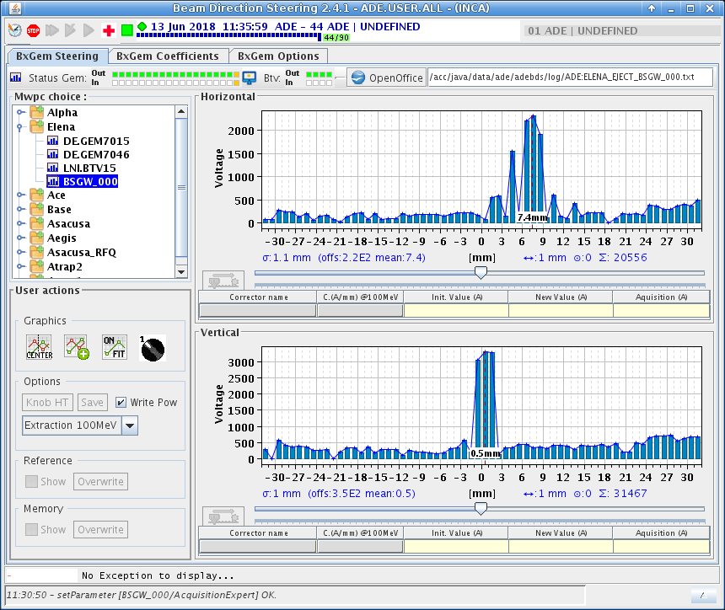
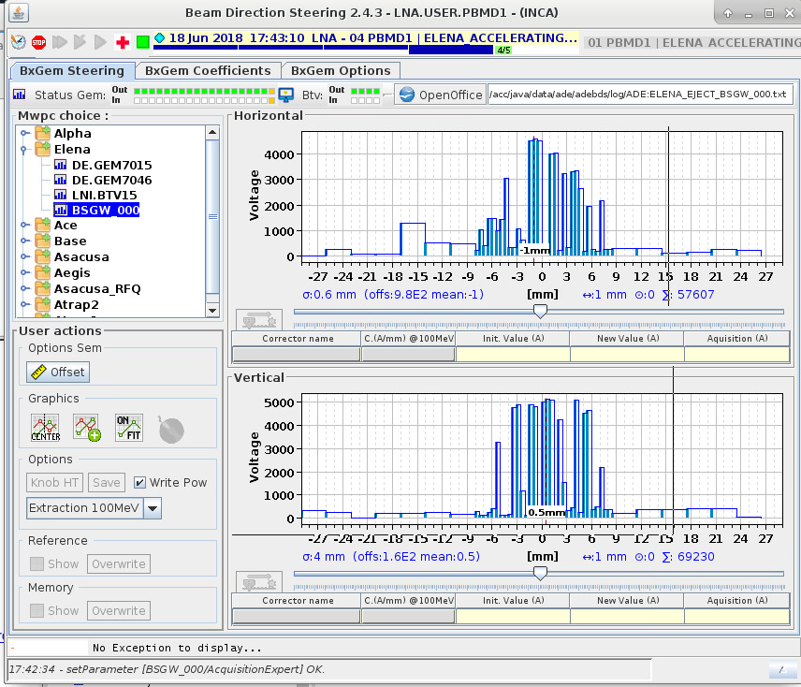
Injection line SEM, first beam profiles observed!
13/6/2018: Pbars
18/6/2018: H-

Slide 16
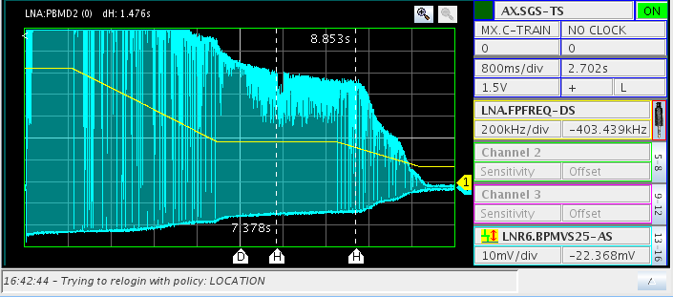
Pbars: 22/5/18 - First beam observed at 100 keV !
After tune corrections throughout the cycle a small amount of Pbars remain at 100 keV
This without beam cooling…

Slide 17
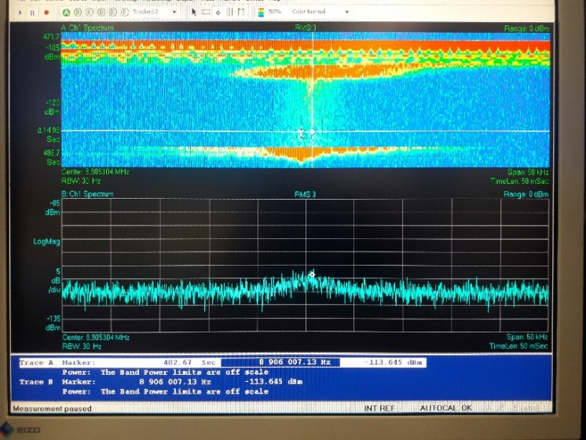
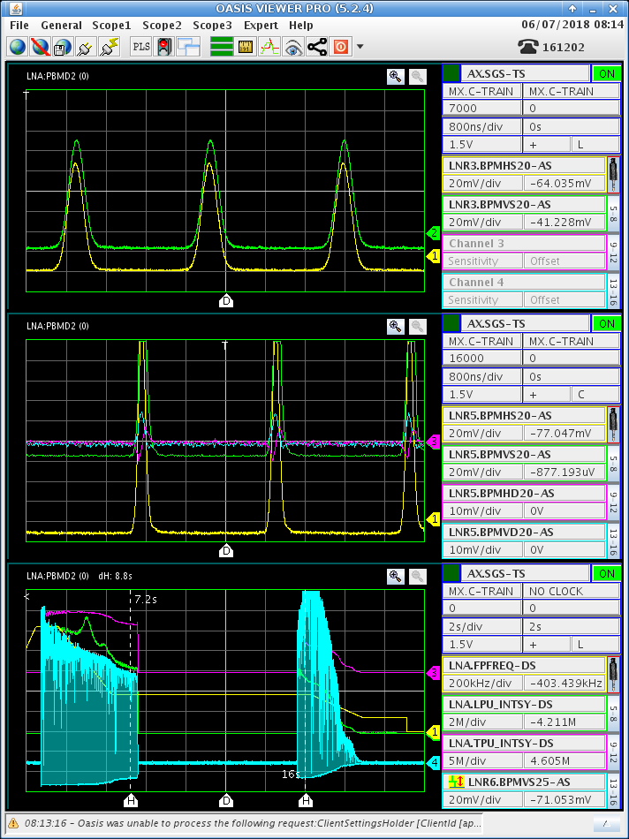
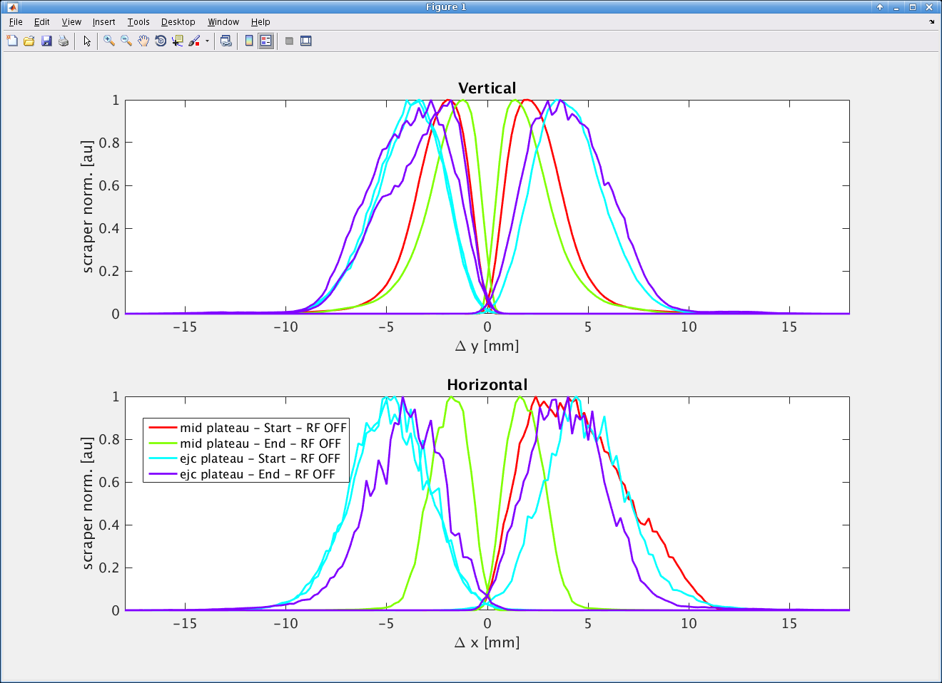
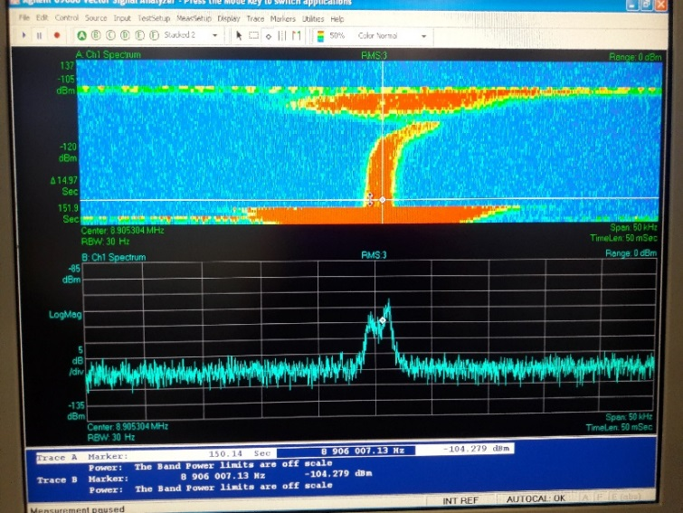
2/7/2018: First signs of effect of e-cooler
Set-up & conditioning with electrons started 29/5 (interleaved with H- operation in ELENA)
Set-up and compensation of ring orbit & coupling due to solenoid, toroid and fringe fields
Set-up of cooler parameters & orbit bumps
Clear signs of dp/p cooling seen on 4/7
…and later on, transverse cooling at both energies
can be seen with scraper measurements

Slide 18
H- cycle set-up Sept.18
Set-up of a complete cycle with:
  Injection at 85 keV
  Acceleration to 100 keV
  Acceleration to 5.3 MeV
  Deceleration to 100 keV
H- operation compromised due to periods with unstable beam position and several breakdowns of the Ion source (Mainly HV isolation transformer)

Slide 19
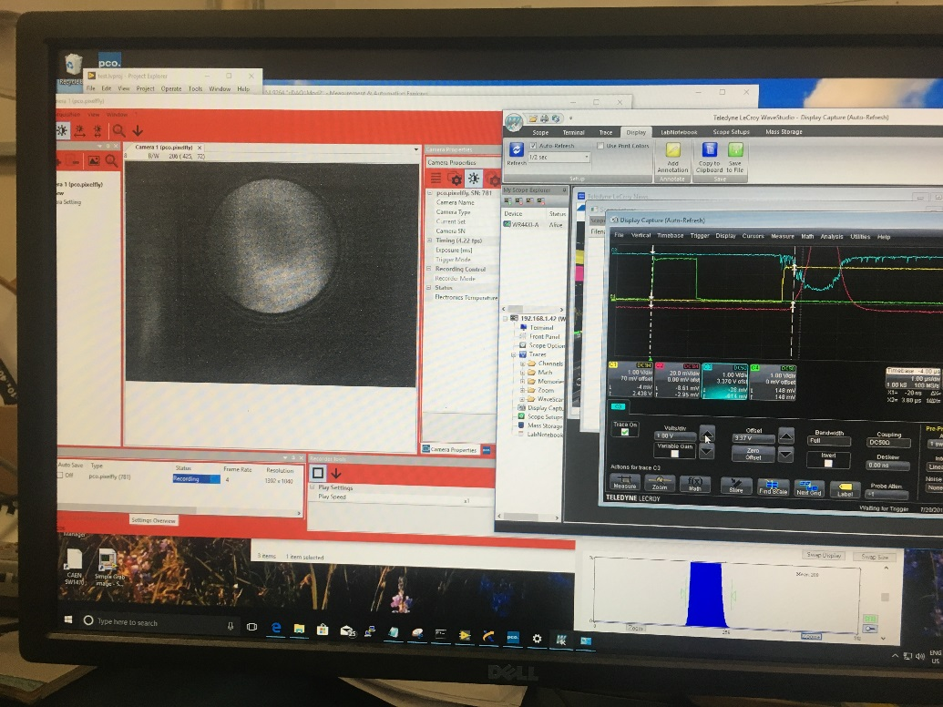
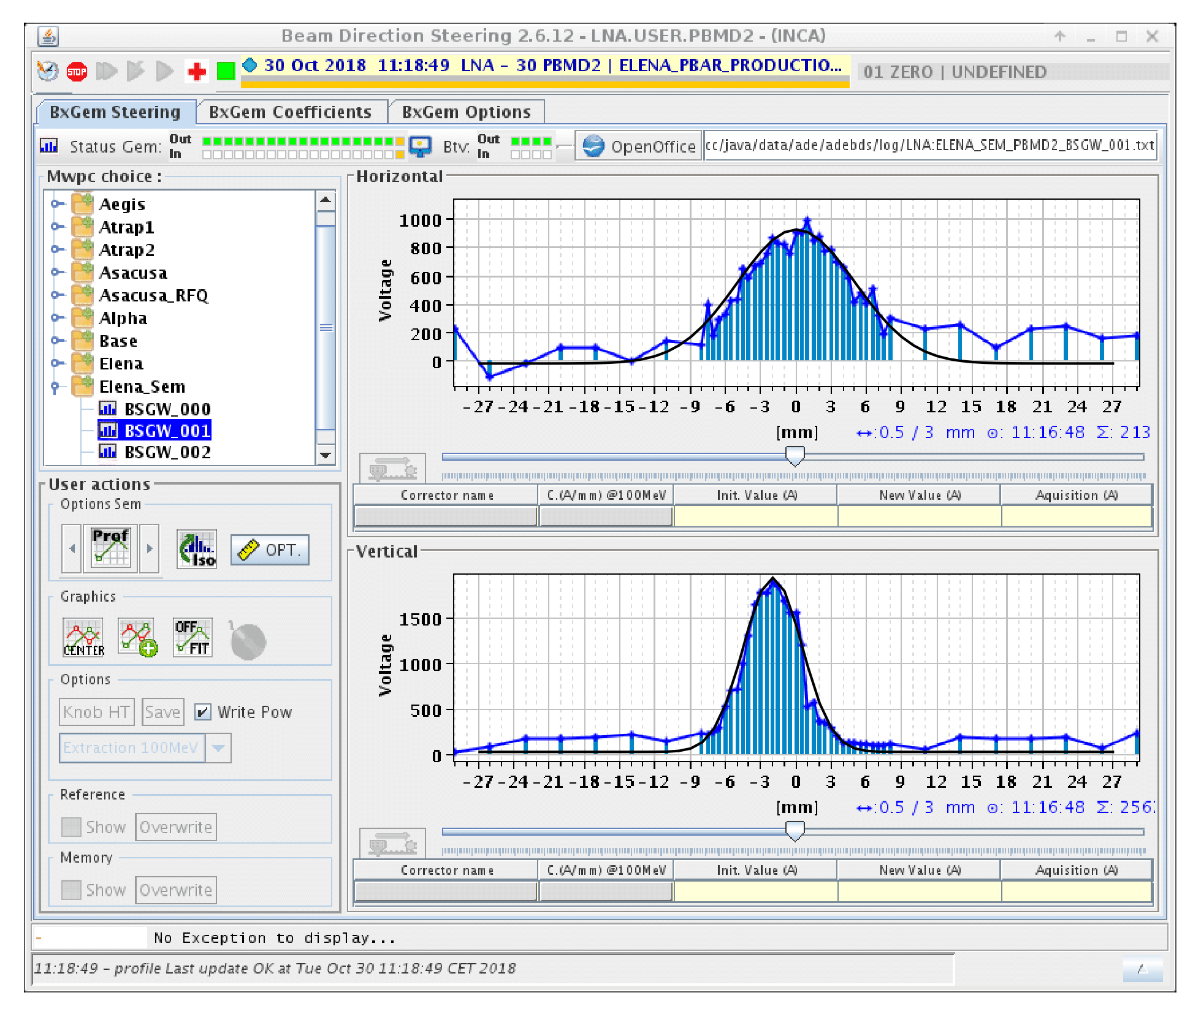
Gbar beam transfer, on the rota as of 30/7
H- extracted as of June/July
1:st Pbars extracted on 20/7 after set-up of ejection synchro.
Some “Normal” Gbar shifts with Pbars starting in August with low intensity (no cooling at 100)
Gbar staff often present in ACR towards the end of the run to profit from any beam extracted…
Transverse profiles measured with SEM detectors in the GBAR line
1:st Pbar beam observed at entrance of Gbar decelerator 20/7

Slide 20
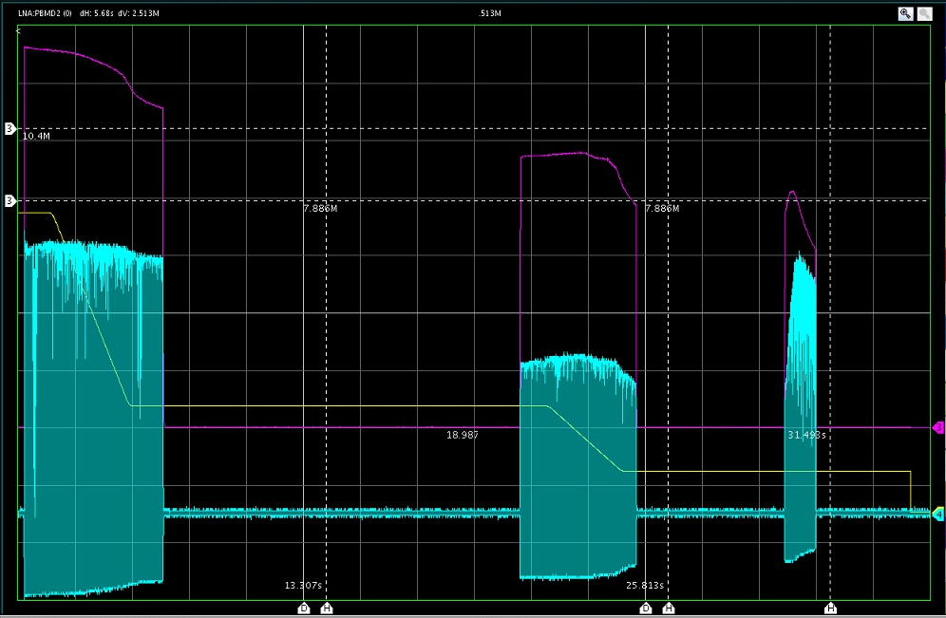
Pbar cycle at end of run – towards a nominal deceleration cycle
Good deceleration efficiency, beam survival at 100keV and transfer to Gbar was finally obtained during the last week of operation in 2018 after:
  Further tuning of working point(s)
  Further optimisation of RF parameters
  Deceleration on lowest ramp on h=4 instead of h=1
  Bunched beam cooling at 100 keV
  Bunch rotation before extraction
  Etc. etc. etc.
Deceleration cycle:
  Pbars from AD injected at 100 MeV/c
  Deceleration to 35 MeV/c on h=1
  Electron cooling at 35 MeV/c
  Deceleration to 13,7 MeV/c on h=4
  Electron cooling at 13,7 MeV/c
  Re-bunching for extraction on h=4
  ~45% of injected beam extracted
  (transfer efficiency AD to ELENA unknown)

Slide 21
Goals & Achievements
Obtained 1/11/2018:
  Decent deceleration efficiency (60% in design report) ☹☺
  Good enough lifetime at 13.7 MeV/c ☺
  Efficient cooling at both plateaus ☺
  Acceptable emittances, lifetime & blow-up ☺
  with bunched beam prior to extraction
  Beam transfers to Gbar ☺
  Stability & reproducibility ☺

Slide 22
Conclusion
For beam commissioning, the Ion source was used less than expected while Pbars were used much more
Progress was very slow at the beginning and quite fast towards end of 2017 and 2018
Beam was sent to Gbar experiment more or less as planned – good progress on their side
ELENA design specs almost achieved
But…..much work remains on tuning/improving ELENA performance and installation & commissioning of the new transfer lines

