Slide 1
Chromaticity measurement in ELENA and
Cycle Editor changes
Elena commissioning review meeting
Lajos Bojtar 7.03.2019

Slide 2

Linear chromaticity
$ξ =\frac{∆Q}{∆p/p}$
Tune dependence on momentum deviation
The procedure for chromaticity measurement :
- Measure the tunes at a given time in the cycle
Introduce a known momentum deviation of the beam
Measure again the tunes with the modified momentum
Calculate the chromaticity with the formula above

Slide 3


Momentum deviation from radial position change
Changed the radial position of the beam by +5.75 mm at the end of the injection flattop to avoid
dynamical effects.
Frequency offset can’t be introduced directly, because the redial loop will compensate
the change.
The revolution frequency change was measured on OASIS by the FFT tool.
From the frequency change we can calculate the momentum deviation:
$$\frac{∆p}{p}=\frac{1}{η}\frac{∆f}{f}$$
$$η =\frac{1}{ϓ}− \frac{1}{{ϓtr}^{2}}$$
Where
is the momentum compaction

Slide 4
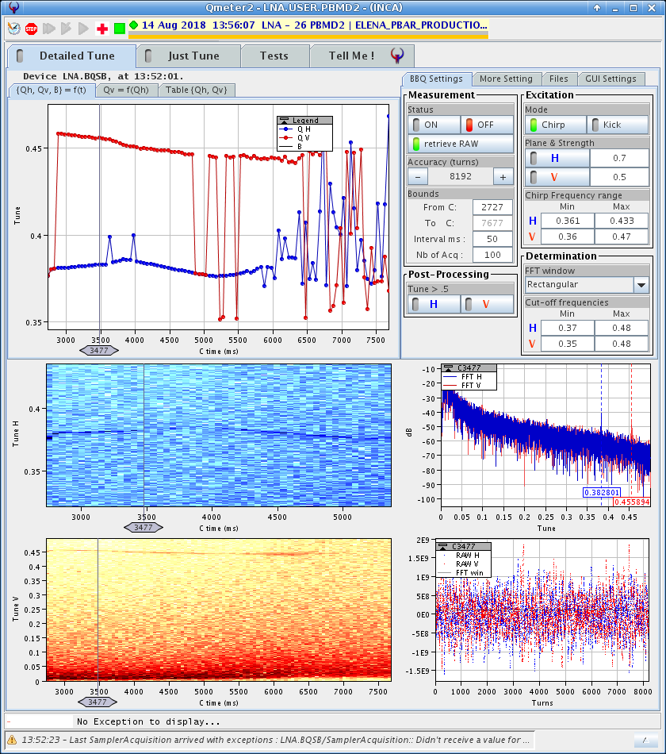
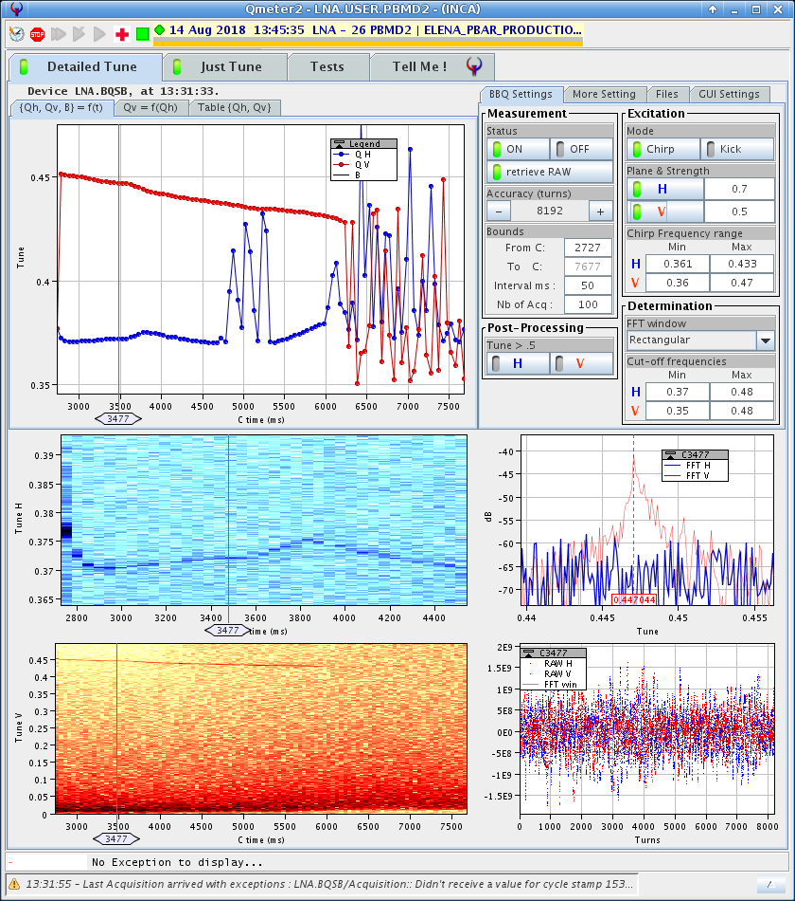
Nominal radial position
+5.75 mm radial position

Slide 5
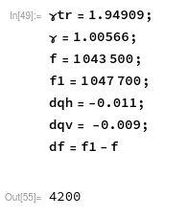
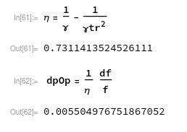
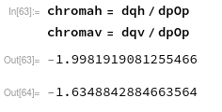
The results
Measured values , only gamma transition calculated by Mad-x

Slide 6
Comparison with models
 | Measured | Mad-x | Symplectic tracking with realistic field map (e-cooler included)
Hor. chromaticity | -2 | -2.8 | -1.8 … -2.2
Vert. chromaticity | -1.63 | -1.7 | -1.4 … -1.55
The symplectic tracking with realistic field maps showed a
dependence of both chromaticity's on the actual orbit.
The perturbation due to the vacuum gauges makes them vary from
-1.8 -> -2.2 in the H plane and
-1.4 -> -1.55 in the V plane.
CONCLUSION: No big surprise, the machine is not too far what is expected.

Slide 7
side note on FFT
The frequency resolution of FFT is quite low. Using the maximum number of sample points (65536 ) the error in the revolution frequency is about 100 Hz.
There are far more precise algorithms available, some of them developed at CERN.
The freq. error of FFT is ~ 1/N , but for example the NAFF algorithm is ~1/N^3
It could be quite useful to have it in OASIS. It would take about 1-3 man week to integrate it. Source code for NAFF is available in Python.

Slide 8
Elena Cycle Editor
Similar concept as the AD Cycle Editor. In both machines we want to have an easy way to change the structure of the cycle.
The length of flattops and ramps can be changed with a few clicks and also adding and removing flattops is easy.
During the early years of the AD these features were essential, mostly because of the instrumentation. No orbit and tune measurement were available on the ramps.
Still there are good reasons to have this flexibility of the cycle structure.
- Change the electron cooling duration
- Can not do scraper measurements on ramps. This might be important to find where the emittance growth happens during the deceleration.

Slide 9
look back to the commissioning
Problems were noticed with the machine model. The calculated tune fitted reasonably at injection energy, but deviated significantly from the measured tunes at low energy. This problem is not yet understood. The required hysteresis to explain this phenomena is about 5 times bigger than the measured one (according to Christian)
The interpolation table which translates quad K values to tunes was updated several times, but still it was limiting the operation. At the lowest part of the cycle we could not send corrections.
We circumvent the problem by working directly with the currents, but this was inconvenient, because the tune parameters overwrote the current changes each time a new cycle was sent.
Finally decided to remove the absolute tune parameters and worked only with currents for the quads.

Slide 10
The relative tune parameters I.
Calculating the required tune changes during operation by hand is not convenient.
The plan to improve the situation by introducing two RELATIVE tune change functions dQh and dQv.
Should be much less dependent on the accuracy of the machine model than the absolute tunes.
The relative tune parameters will be implemented as LSA make rules.

Slide 11
The relative tune parameters II.
There are 3 quadrupole families. This gives one additional degree of freedom we can use to set another parameter.
The dispersion in the e-cooler is important. This was the constraint used to calculate the interpolation table for the absolute tune parameters.
We can have a fixed dispersion or we can create a new dispersion parameter. To be discussed.
The quadrupole gradients can be approximated well with a 2 order polynomial.
Trimming of tunes will be performed with the standard LSA tools, function editor + incorporation rules, not inside the Cycle Editor .

Slide 12
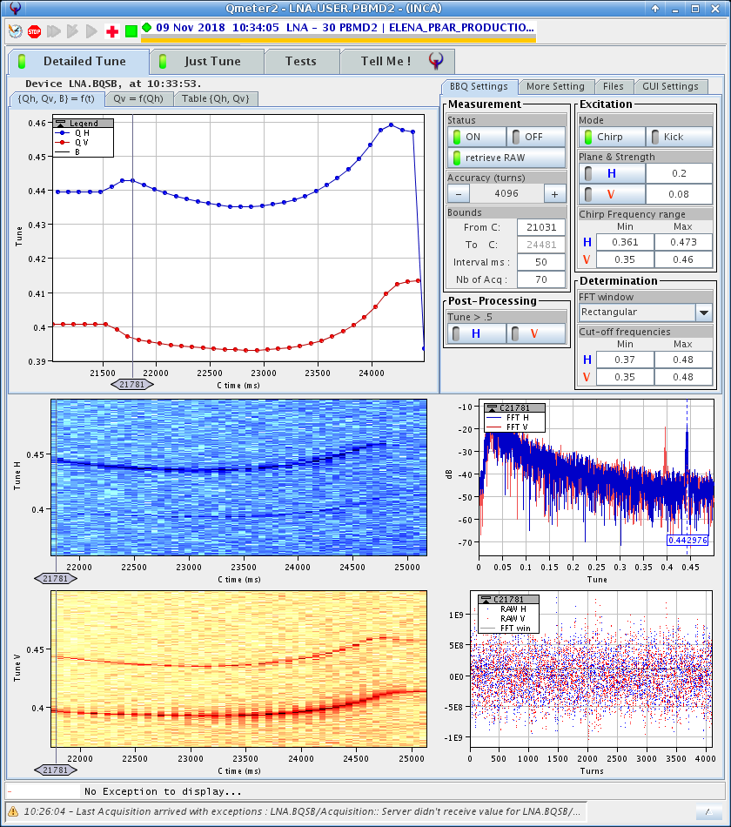
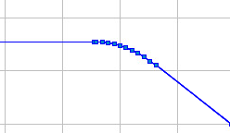
rounding
In tune measurements the effects of the roundings are visible.
It would be better to have more control over the roundings.
Roundings in the functions are calculated by a mathematical expression using a fixed number of points .
At the moment if a function is modified at the rounding the modification will be lost after a write operation by the Cycle Editor.
Worse, if the number of points in a rounding is modified by some application it can mess up things for the Cycle Editor.

Slide 13
Flexible rounding
The handling of rounding will be modified to make the Cycle Editor work better with YASP and other LSA tools and to give flexibility at the rounding.
The calculation of the rounding will be available as an option, but not used by default.
The Cycle Editor will not touch the roundings unless it is asked for it.
More flexibility, but can result strange looking rounding when the duration of a ramp is changed. In any case the old way of calculating the rounding will be available.

Slide 14
More flexibility on the flattops
At the moment flattops are truly flat functions, a straight horizontal line with two points. Any modification by another tool is rewritten when writing a function or a cycle with the Cycle Editor.
The only reason for this is heritage from the AD.
This behavior will be changed in ELENA. The Cycle Editor will leave the whatever function is on the flattop unchanged. It will only shift the level with the requested offset .
There is one restriction which will be checked by the editor: The start and end level of the flattop must be the same.

Slide 15
Thank you !
Questions ?

