Slide 1
Electron Cooling in ELENA
- observations and plans
Lars V. Jørgensen, BE-BI-EA

Slide 2
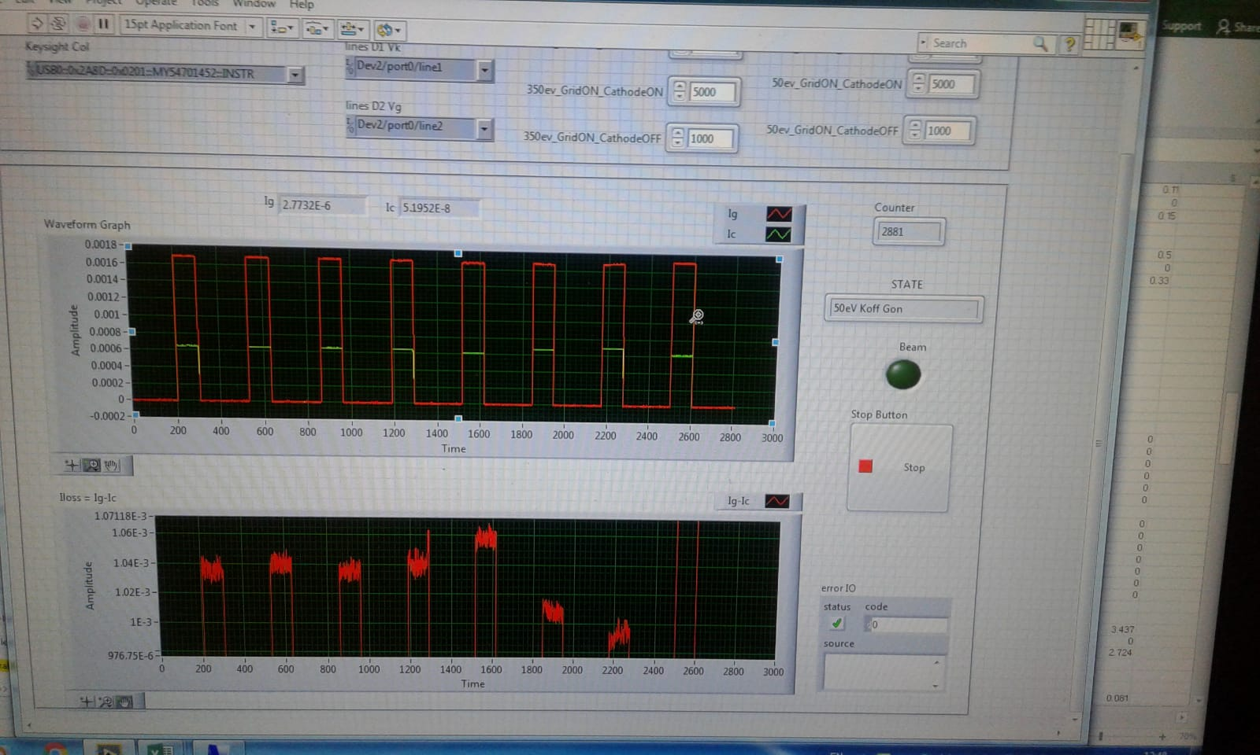
First beam! 29 May 2018
E-beam reaches collector, but losses still rather big.
Magnets nominal!

Slide 3
31 May 2018 ecooler filament heat test.
12 A for a while
Switched off by simulated power cut.

Slide 4
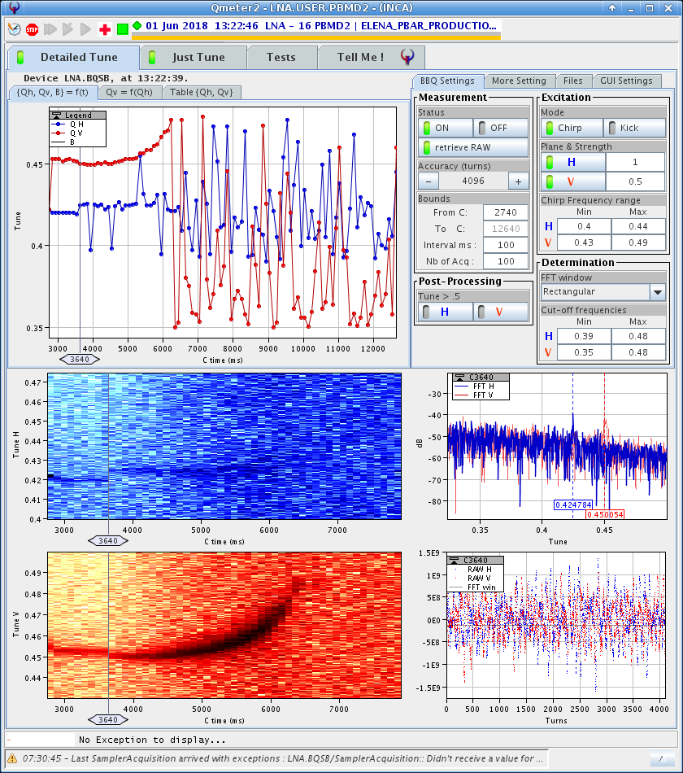
1 June 2018
Fields on in ecooler – trying orbit correction
Kyoto correctors at 6 A to correct the orbit back to what it was before.

Slide 5
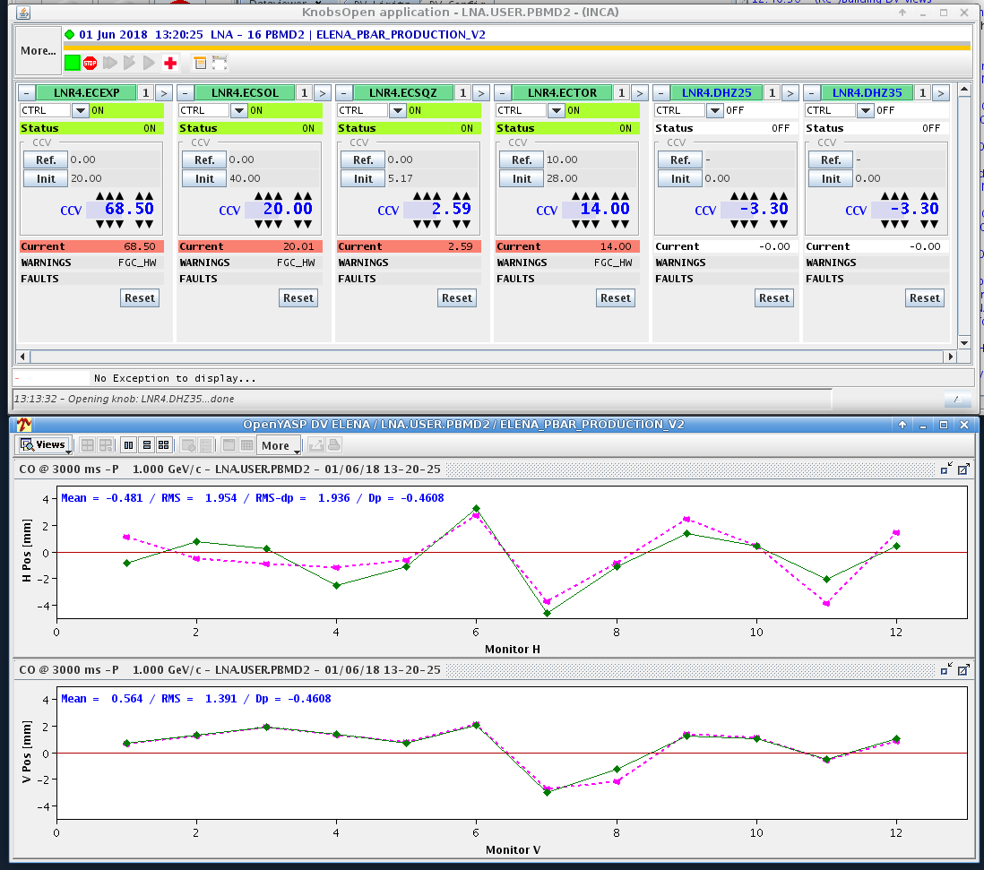

Slide 7
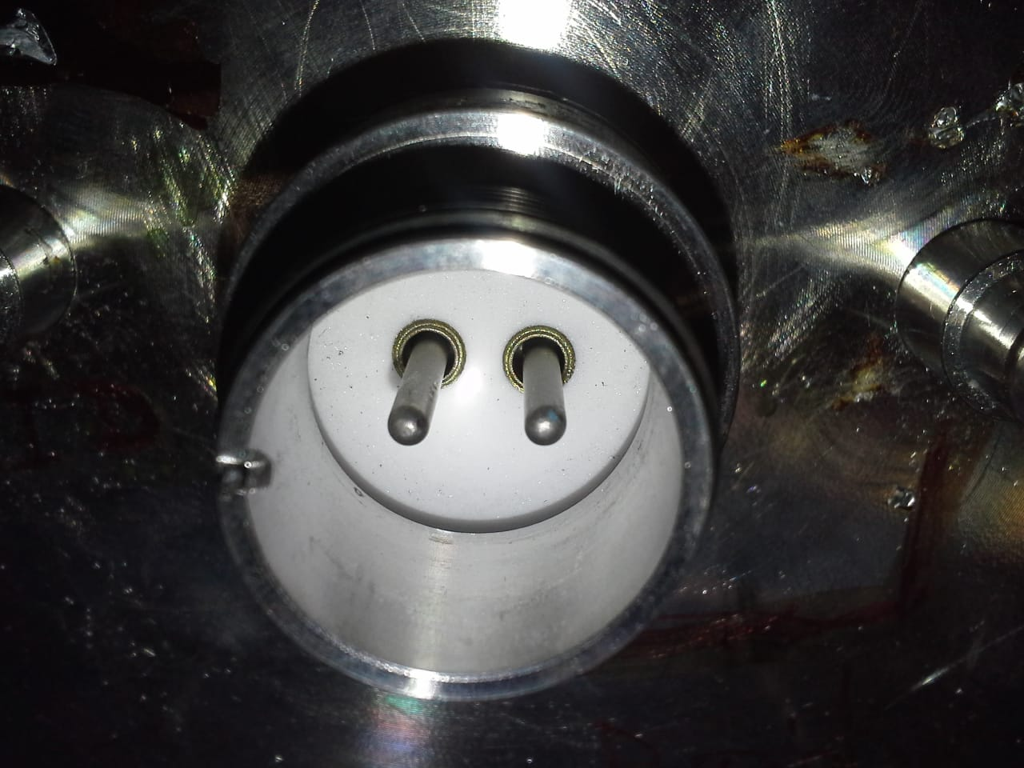
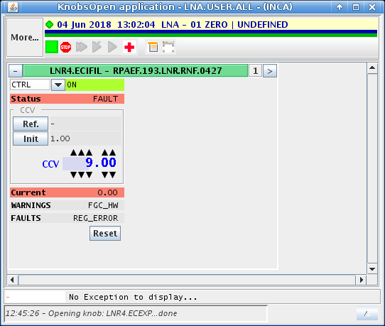
4 June 2018
EC filament fault

Slide 8
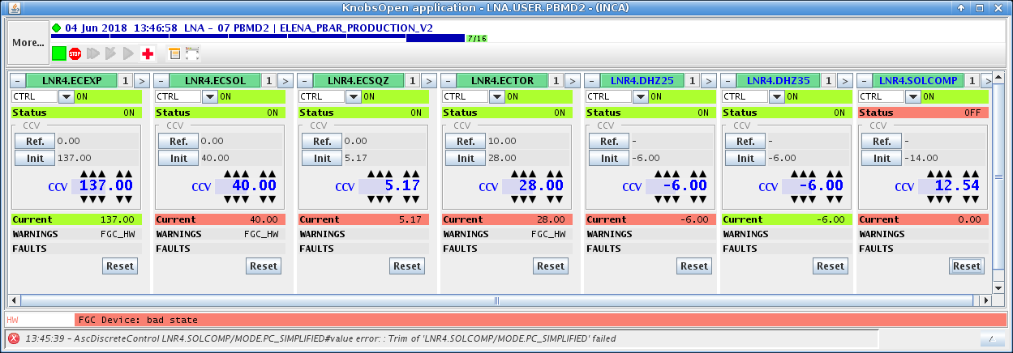
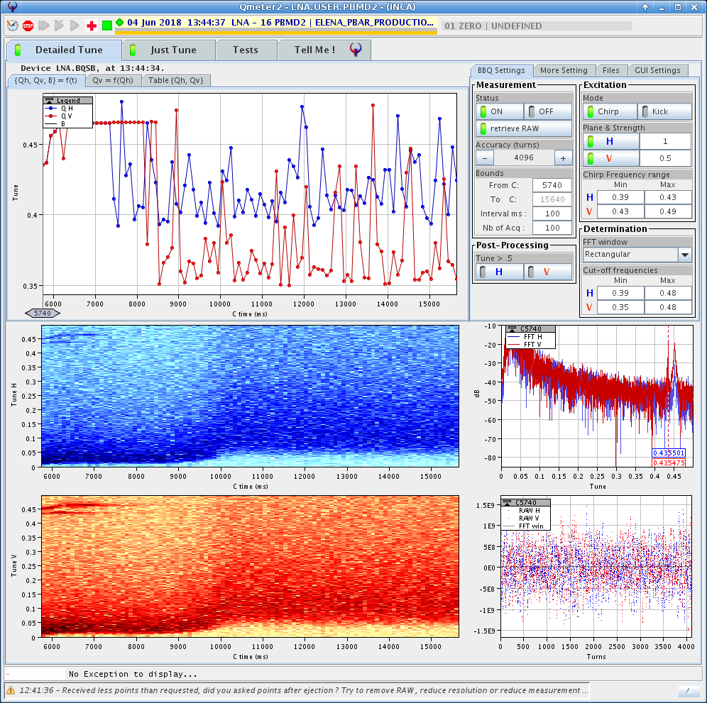
More 4 June

Slide 9
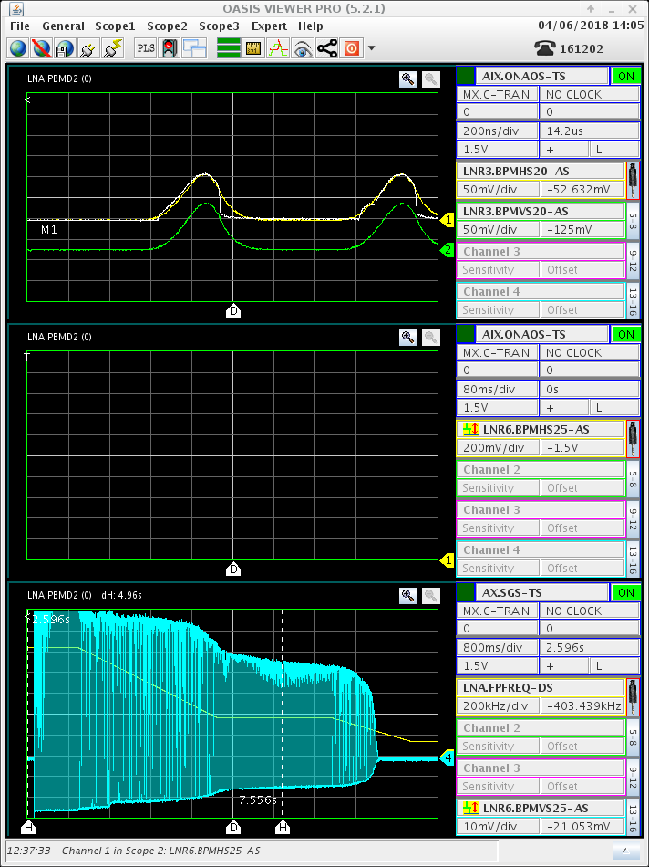
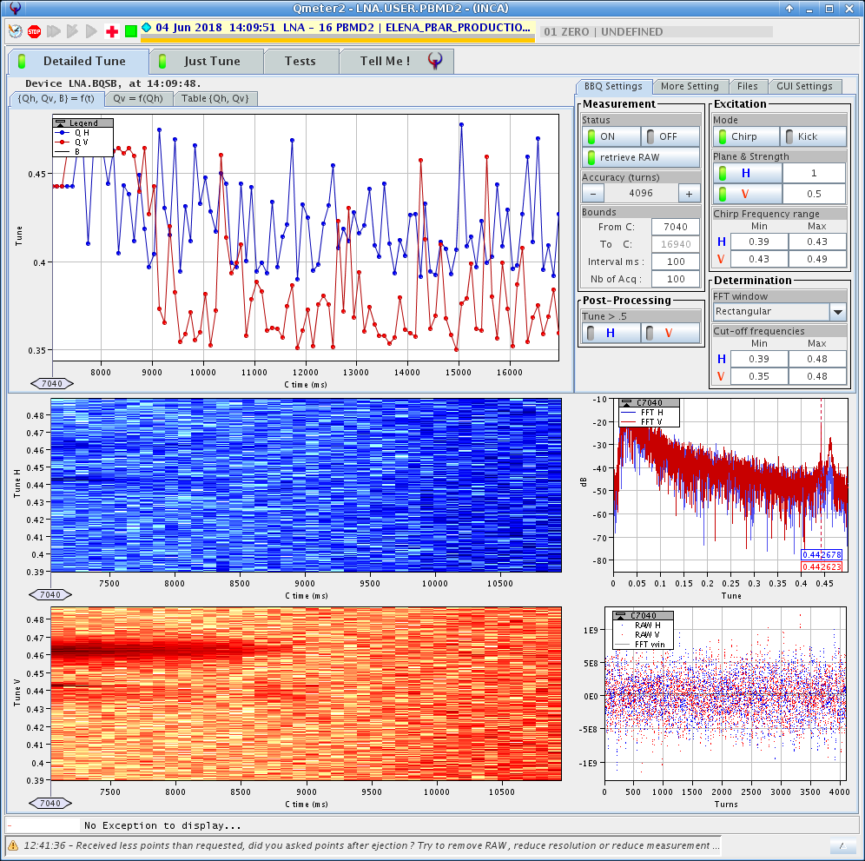
Also work on tuning out coupling using the compensation solenoids

Slide 10
7 June 2018
Short circuit on the filament traced to aluminium shavings around the flange connector.
Cathode heating left on local power supply at 9 A.
Electron beam generated at 55 eV and settings optimised. Optimisation is not complete as many power supplies have current limitations and/or cannot switch polarity. ECT1V magnet needs to be investigated as an open circuit is detected by the power supply.
At 55 eV we have 1 mA of electrons with a loss current at about 5 uA.
The electron beam energy has been sucessfully increased to 100 eV with 2.25 mA of current and losses below 10 uA.
The vacuum level is quite high but should get better with time.

Slide 11
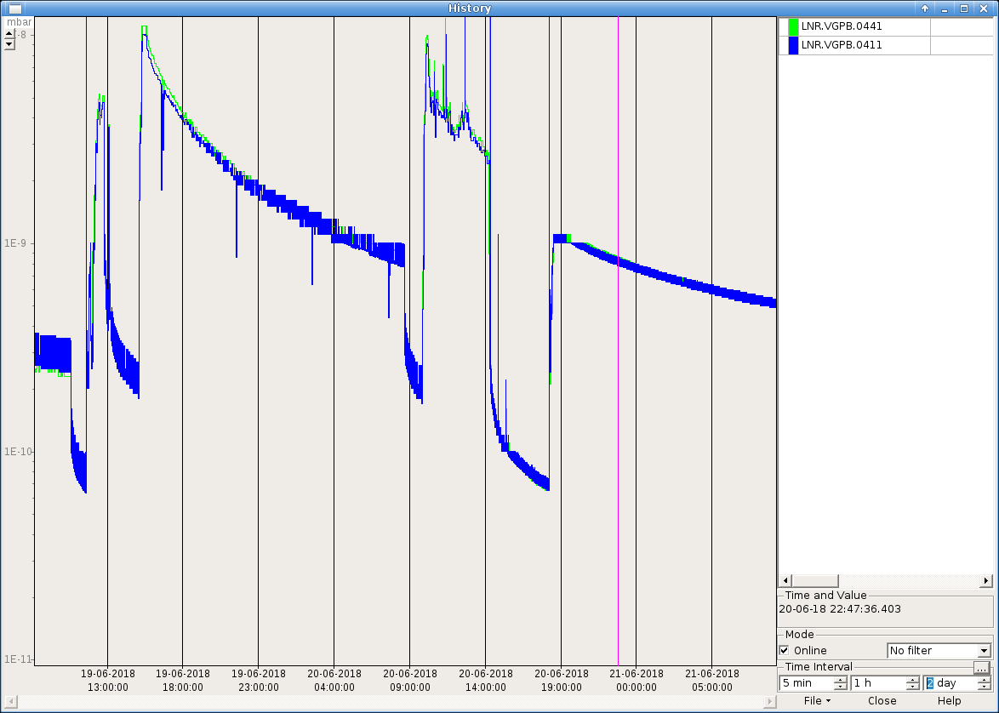

Slide 12
Very little time to test electron cooling in 2018 due to about 2 months of no antiproton beam caused by the collector problems on the AD ecooler.
Priority was on demonstrating that there was no show-stoppers, i.e. that electron cooling worked on both flat tops.
Second priority was to deliver pbars to GBAR.
Very little (practically none) time for optimizing the electron cooling and do systematic measurements
However, some rough electron energy and pbar bump optimization done.
Also some bunched beam cooling at extraction

Slide 13
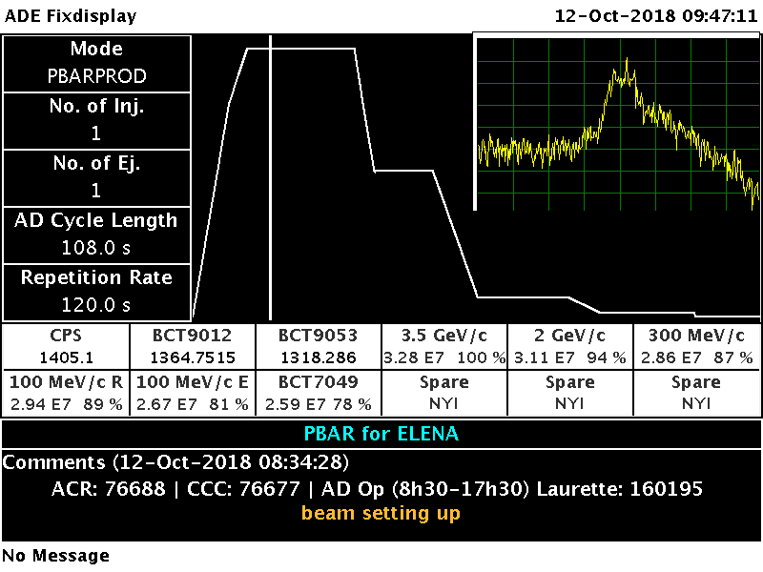
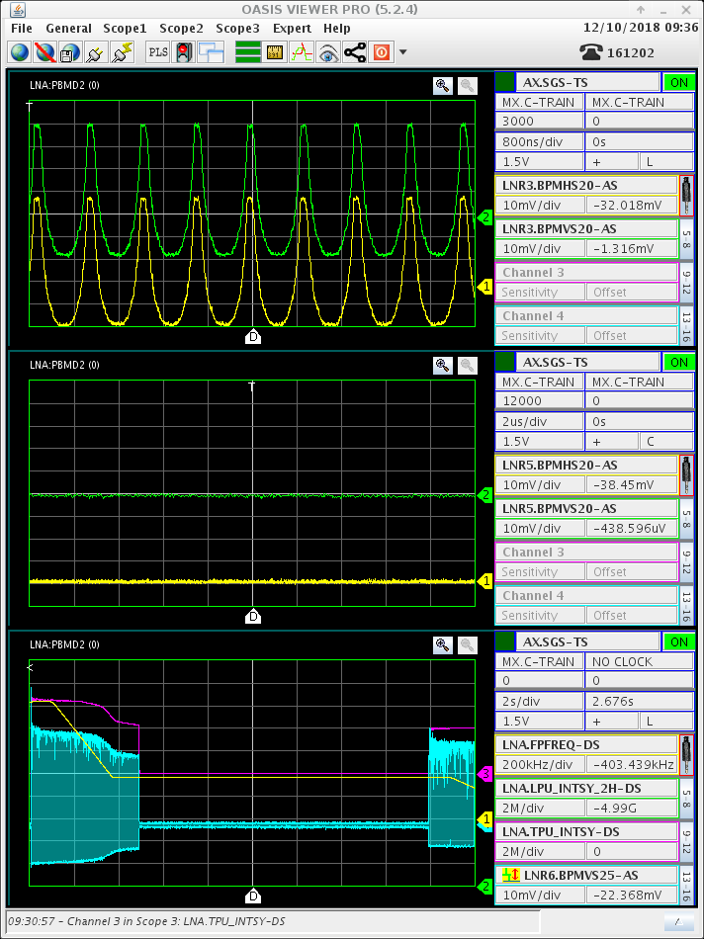
Beam finally back in AD Oct. 12!
…and the same day beam in back in ELENA!

Slide 14
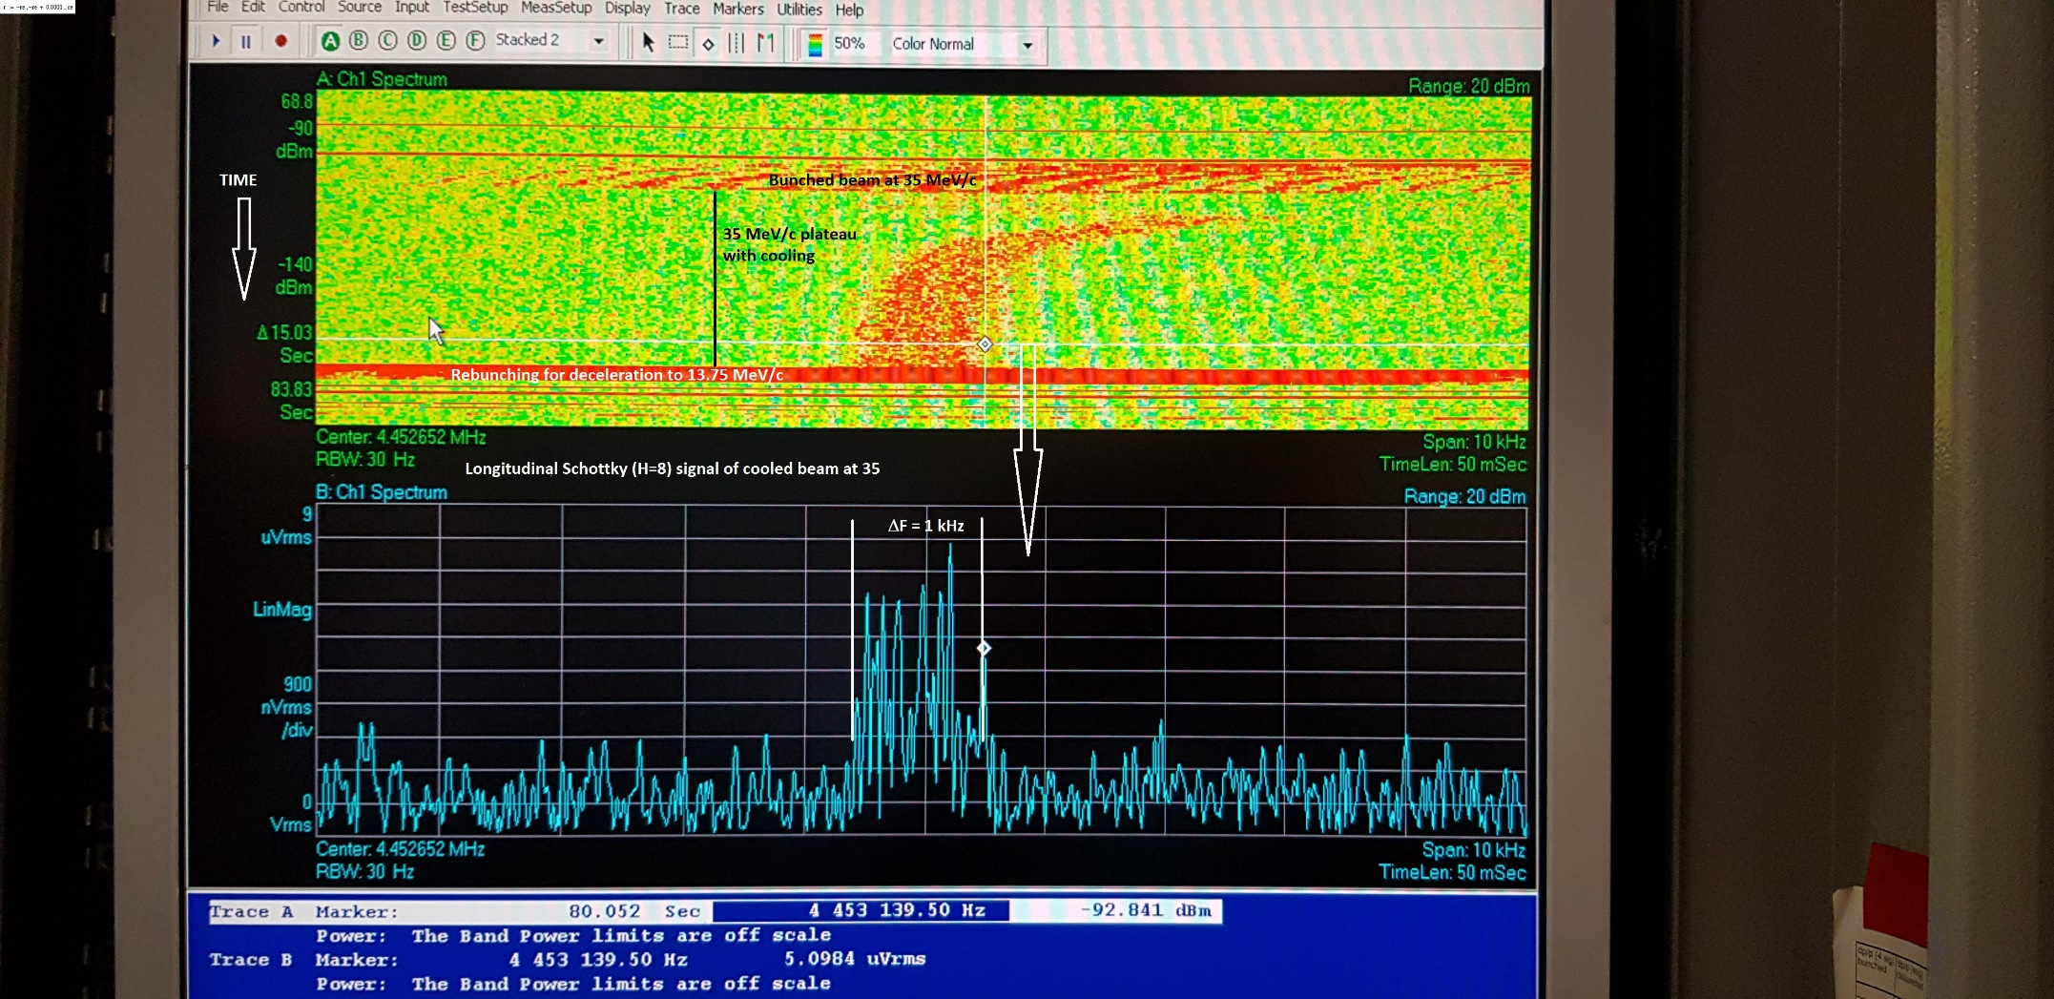
Electron cooling at intermediate plateau

Slide 15
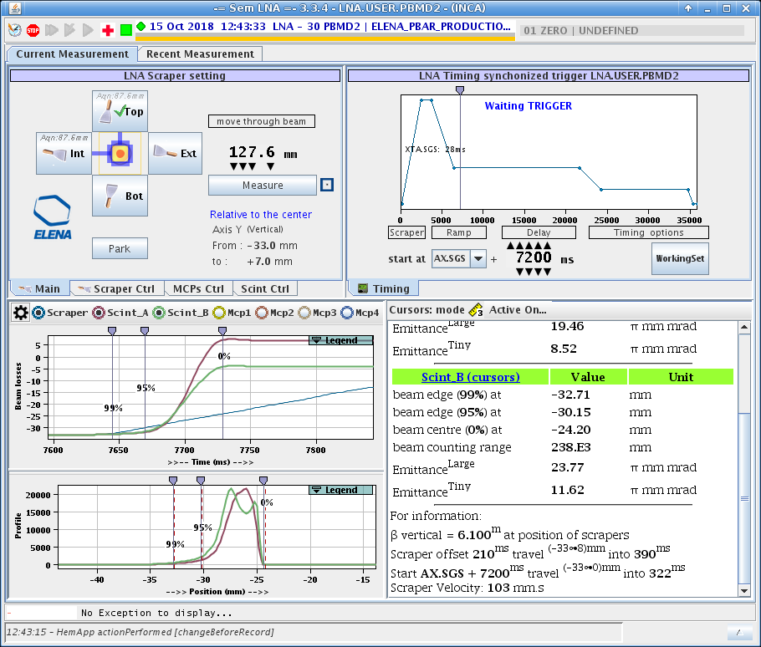
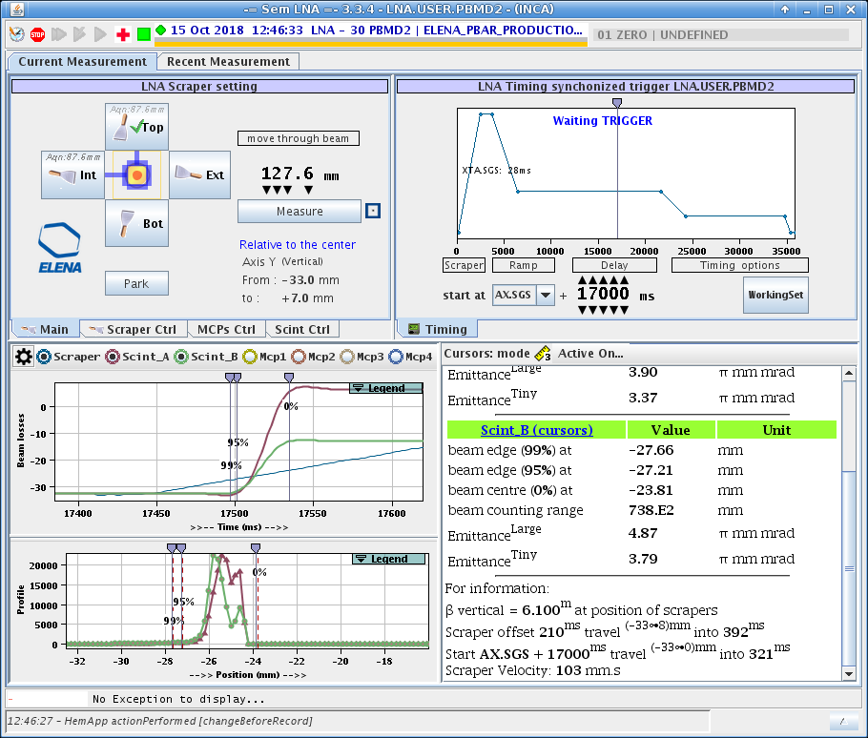
Vertical emittance – intermediate plateau

Slide 16
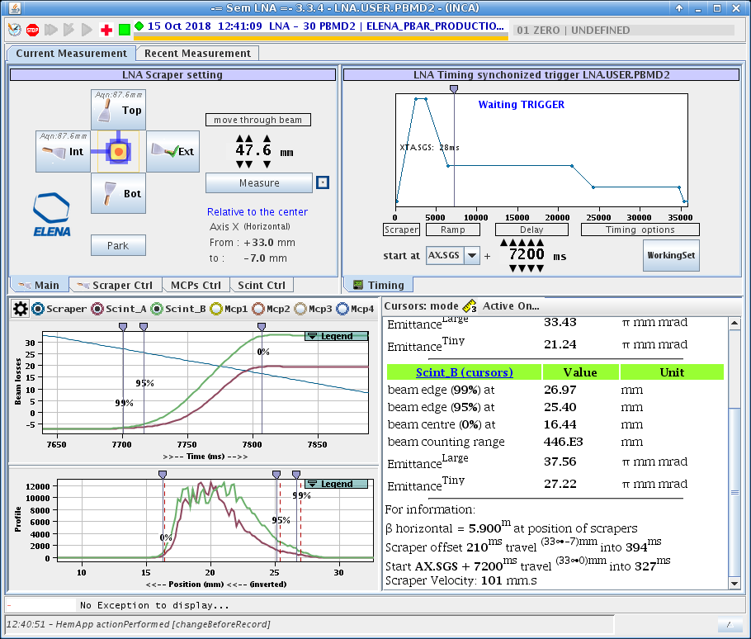
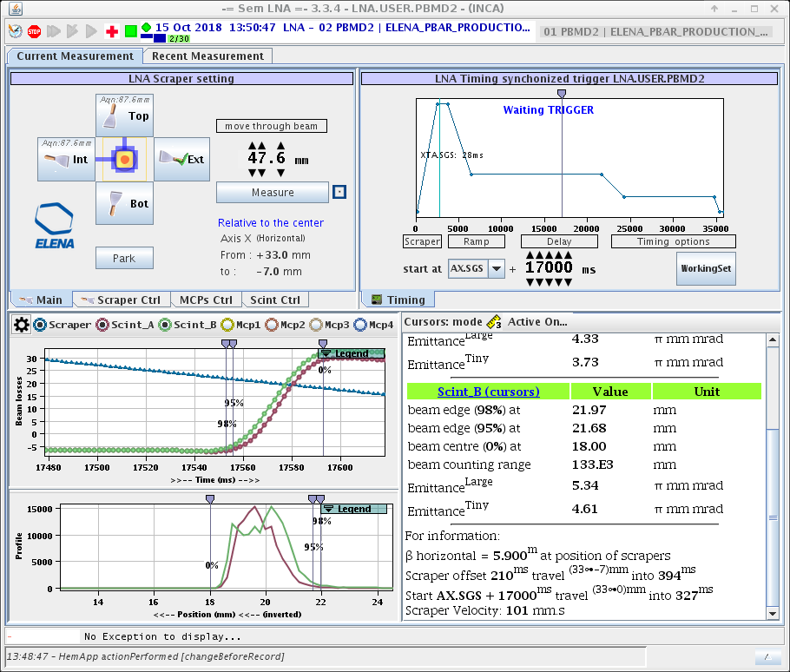
Horizontal emittance – intermediate plateau

Slide 17
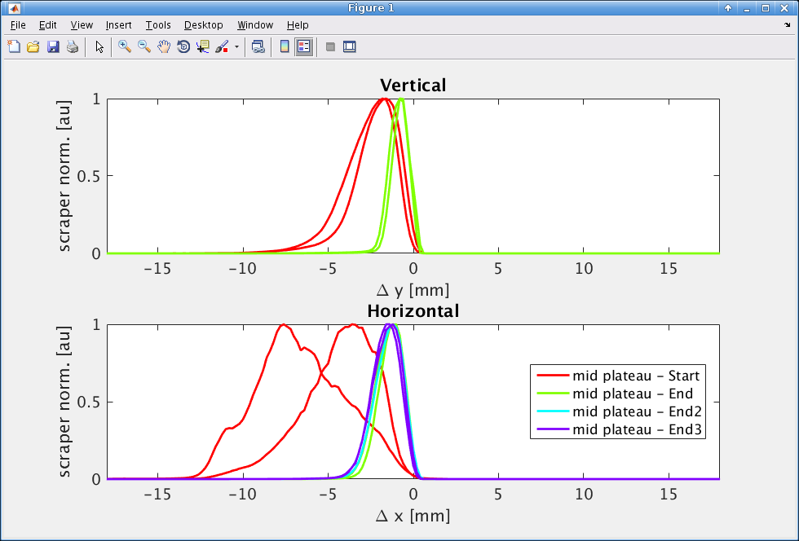
Beam profiles

Slide 18
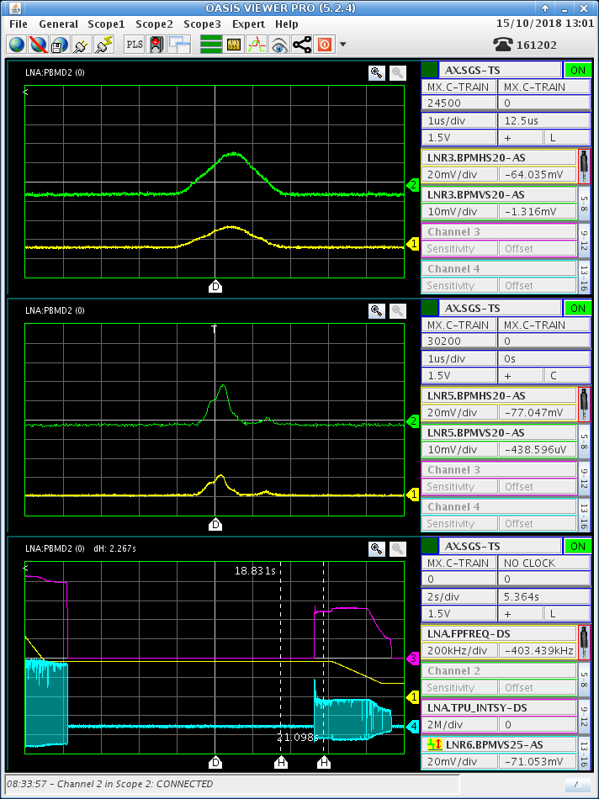
Longitudinal cooling

Slide 19
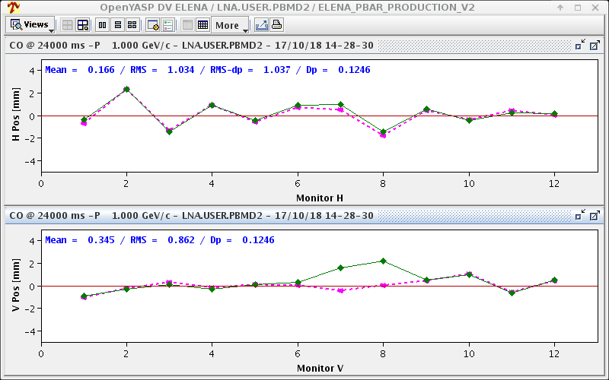
Bumping pbars in electron cooler

Slide 20
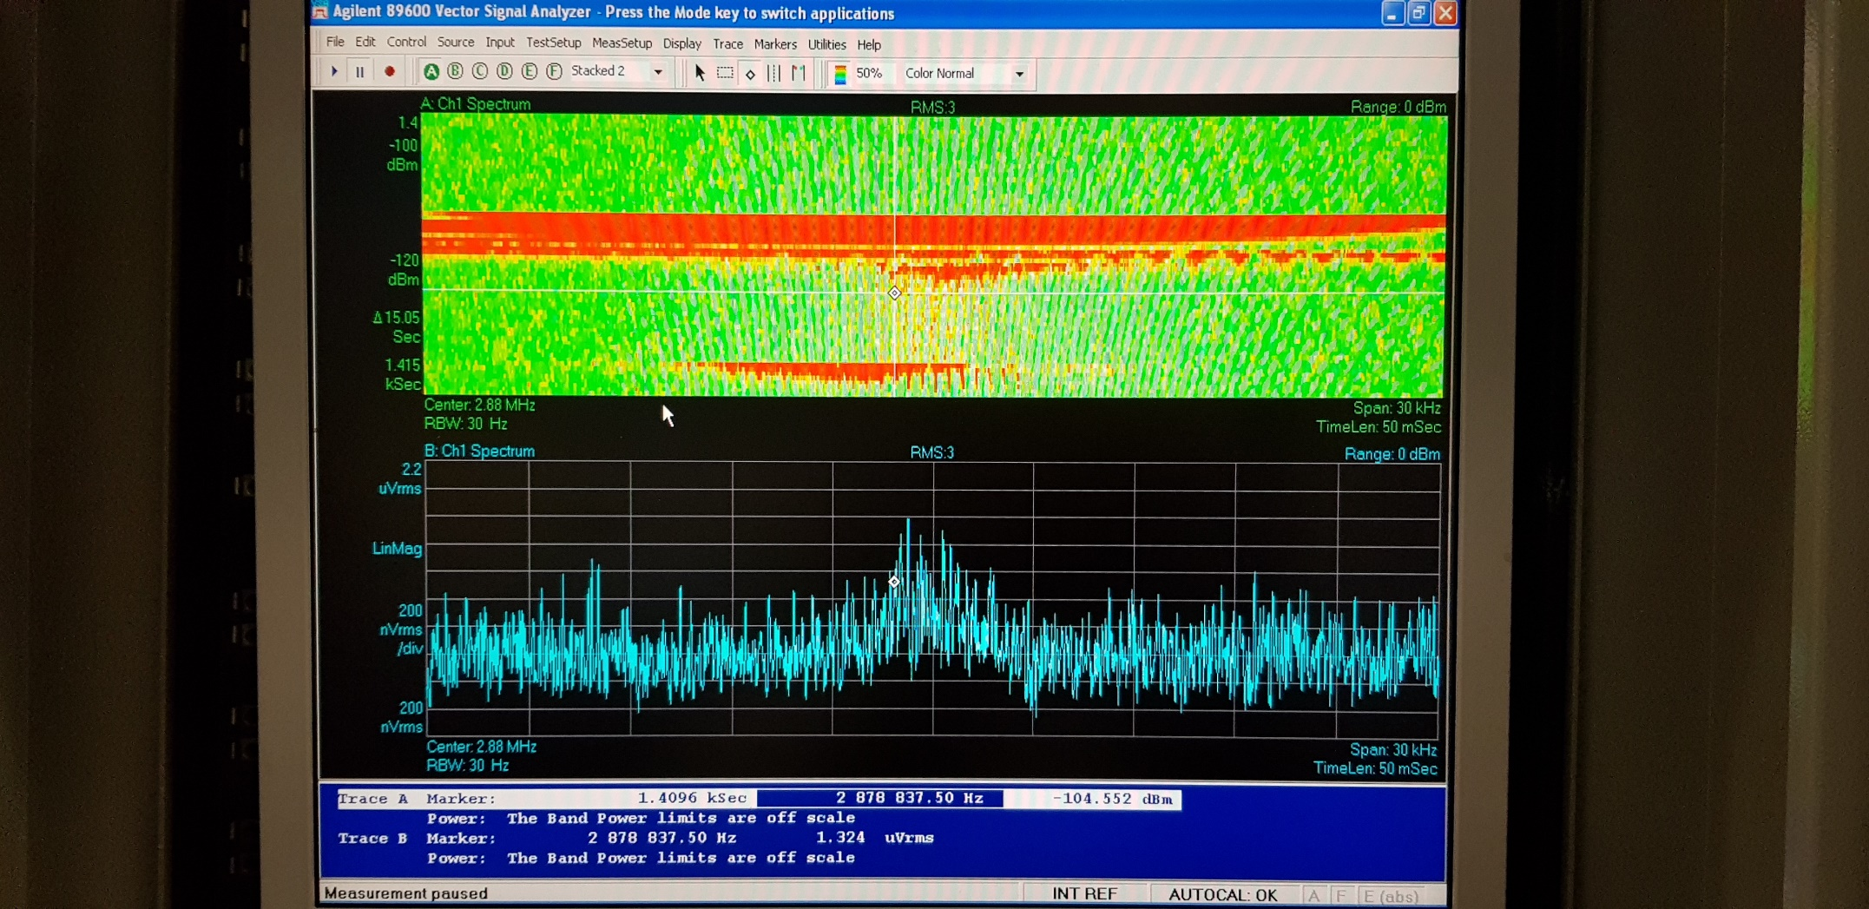
No electron cooling 100 keV

Slide 21
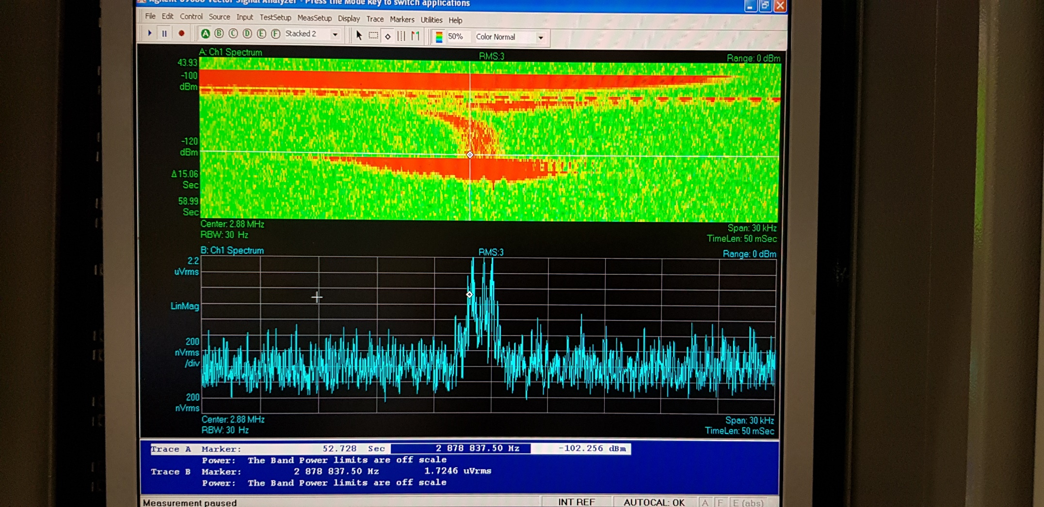
Electron cooling at 100 keV

Slide 22
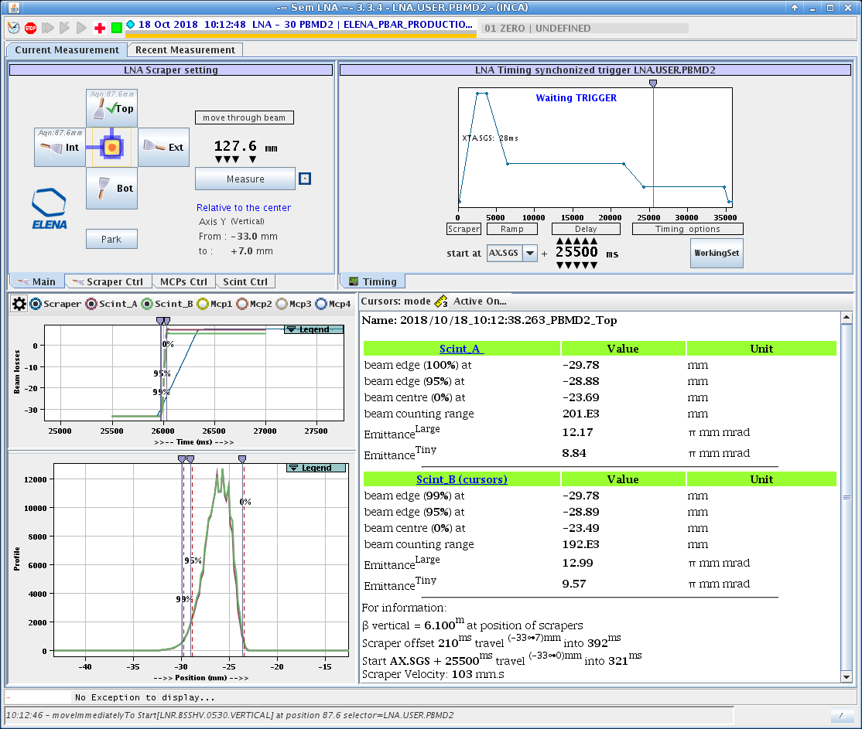
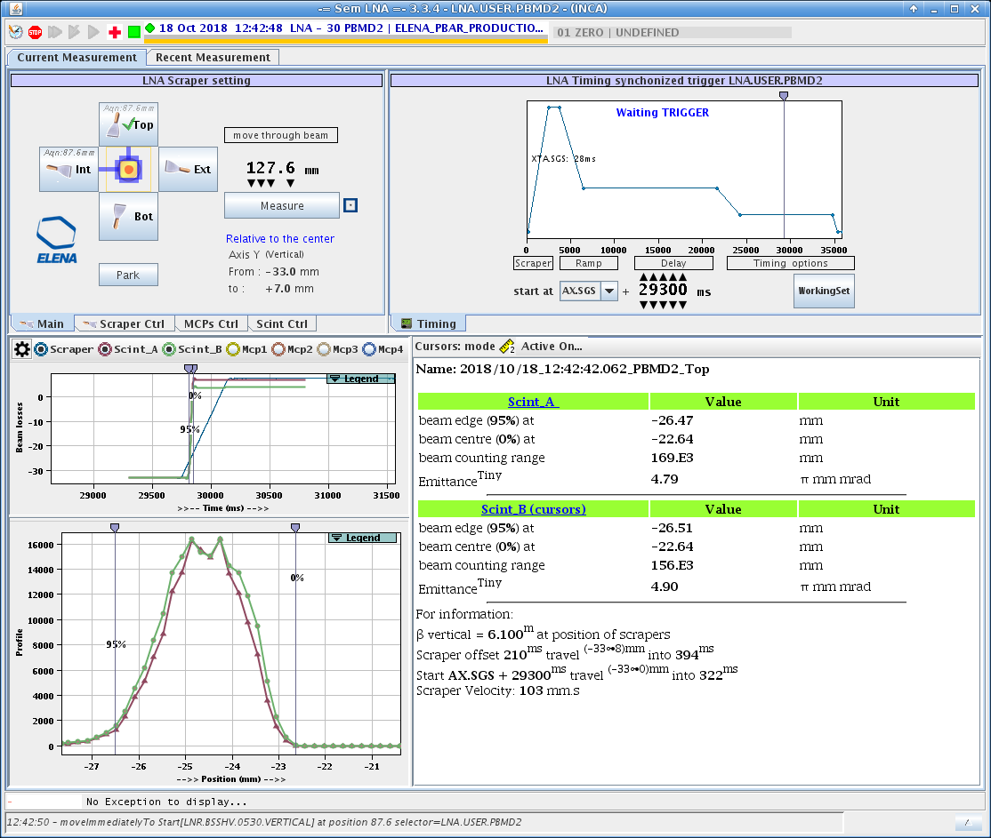
Vertical – ejection plateau

Slide 23
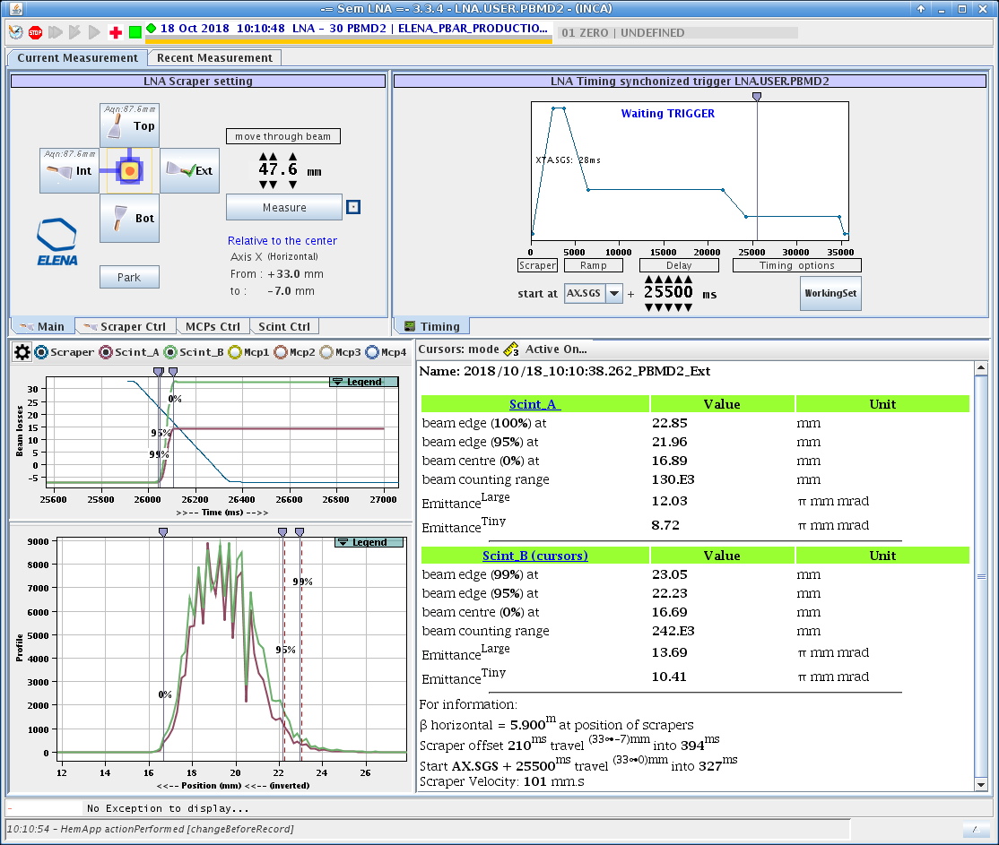
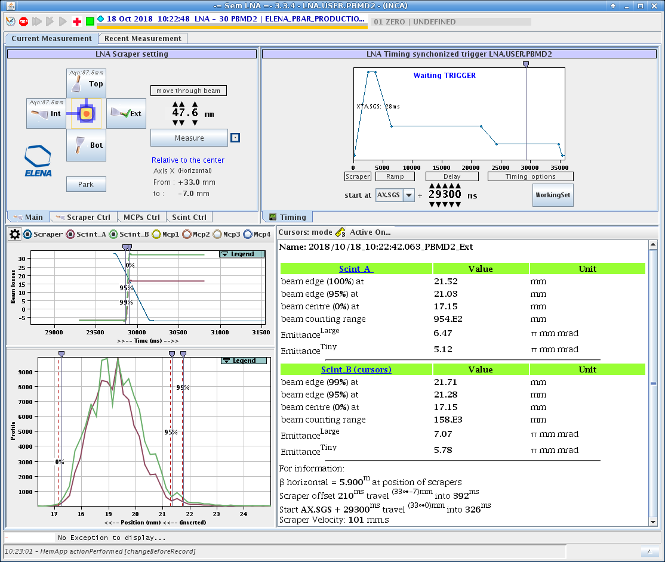
Horizontal – Ejection plateau

Slide 24
Plans for 2019 run
Modulate electron beam and verify that we can measure the position of the beam.
Ascertain that H- can survive the electron beam on – and for how long.
If lifetime is too short -> switch to protons
An enormous amount of systematic measurement to be done:
Overlap between the electrons and protons
Systematic measurements of bumps and steering for electrons and antiprotons– incl. in the toroids
Electron energy
Systematic measurements of influence of the correction and fine tune coils.
Measurement of the influence of the electrostatic plates in the toroids.
Adiabatic expansion measurements

