Slide 1


BI@ELENA
Gerard Tranquille BE-BI-EA
on behalf of the BI colleagues involved in the ELENA project

Slide 2
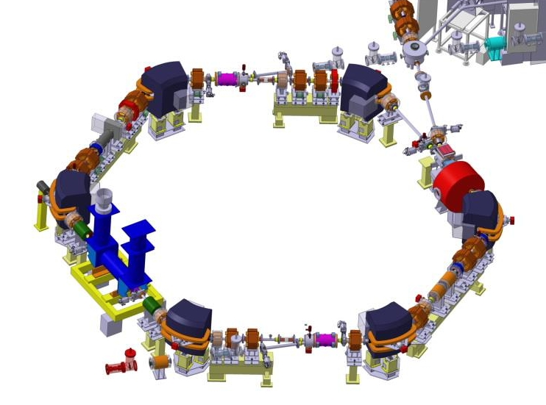
Scraper
Secondary emission monitors
Recombination monitor
BTV systems
Beam position monitors (10+2)
Tune measurement (PU+kicker)
Electron cooler

Slide 3
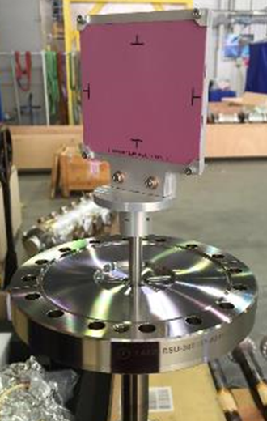
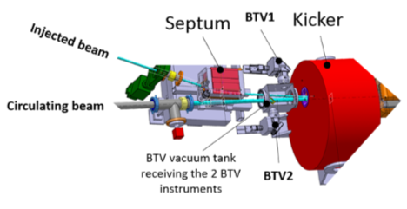
BTV
Three monitors installed – one in pbar line, two in common tank at injection
1mm thick chromox screen
No grid to better optimize S/N with image digitalization
Magnetic coupled actuator
Resolution of 190um/px and 215um/px

Slide 4
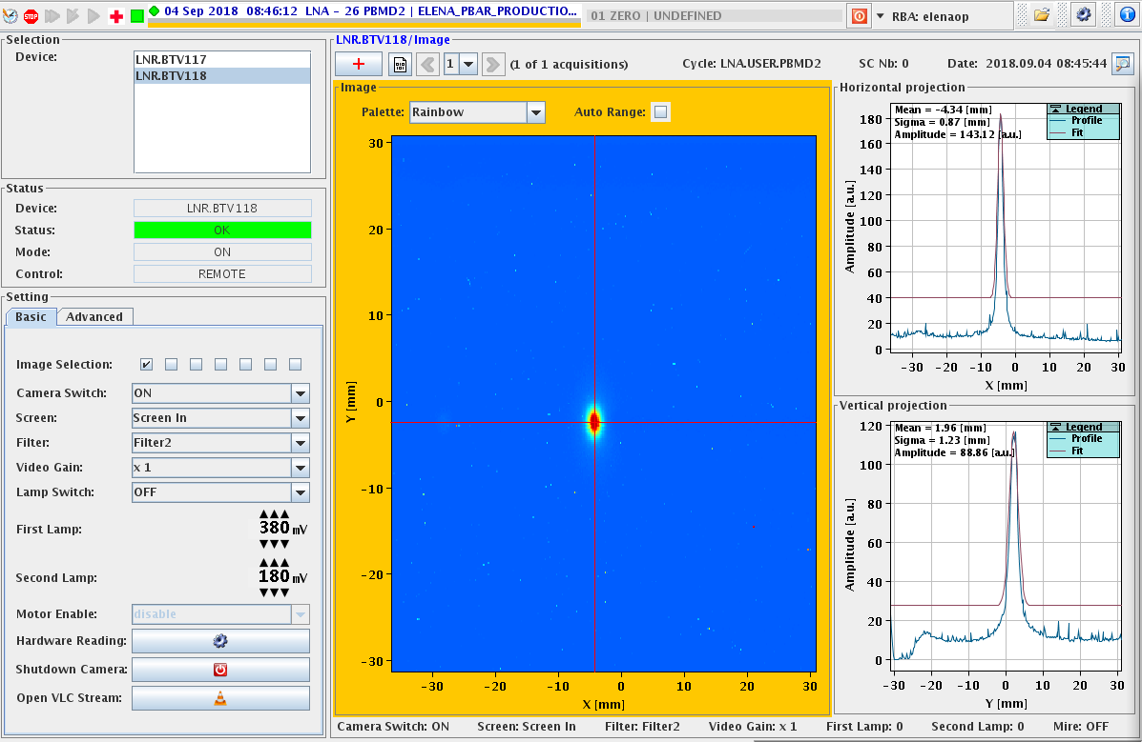
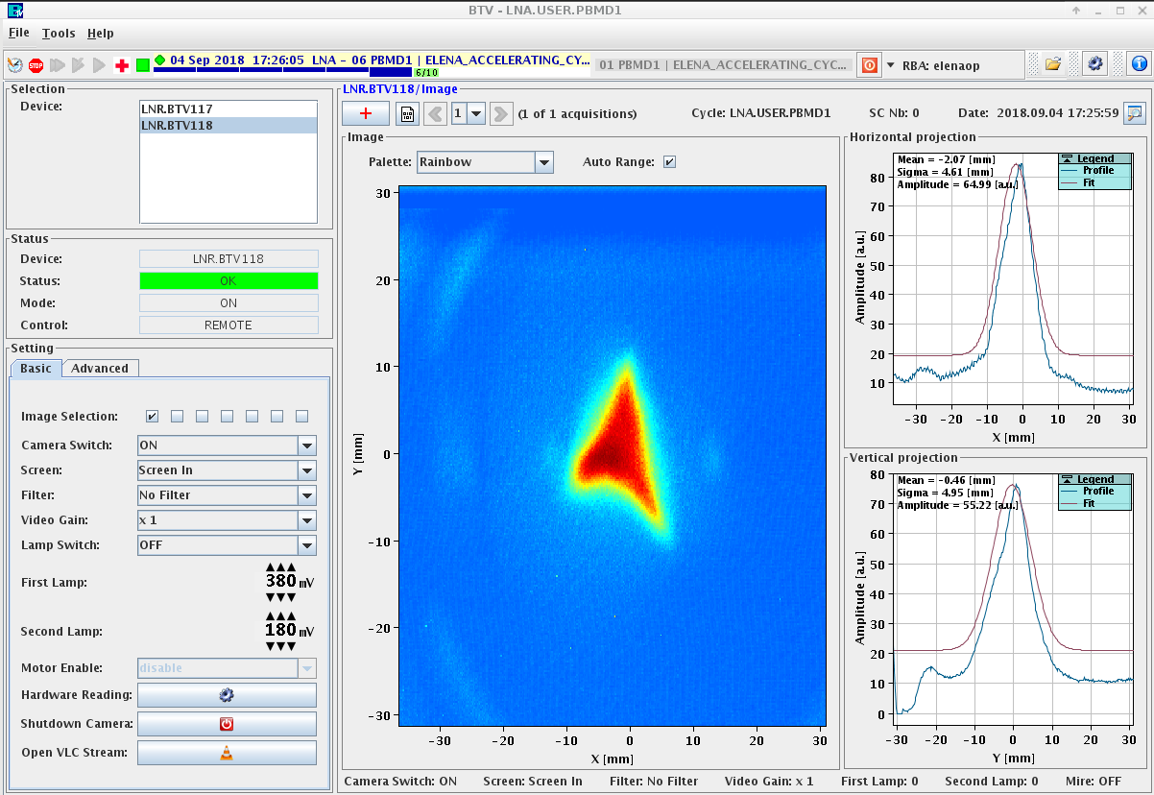
BTV signal of pbar beam at 5.3 MeV
BTV signal H⁻ ions at 85 keV
Standard check/maintenance will be done before the startup

Slide 5
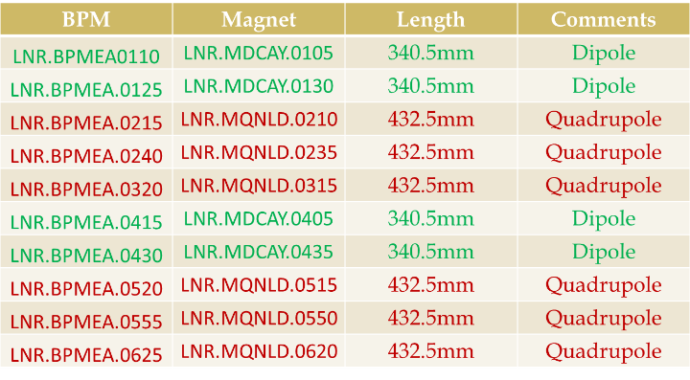
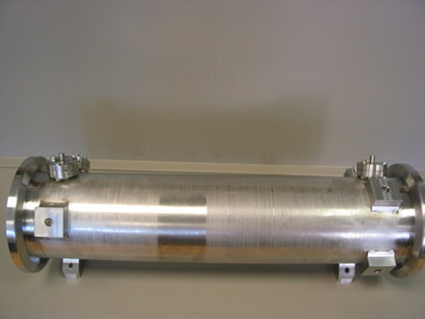
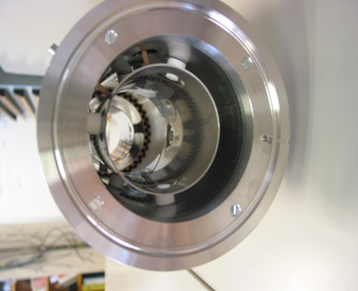
BPM
Stainless steel body containing 2 diagonal cut BPMs.
Two such elements inserted in to a vacuum tank, 100mm diameter, in order to have a position measurement in both planes.
10 (+2 in electron cooler) installed.

Slide 6
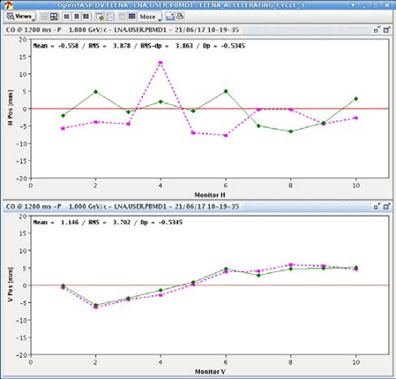
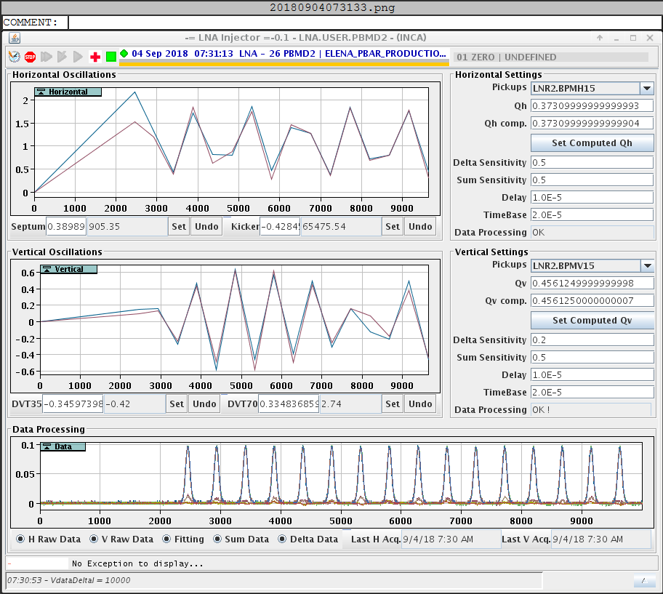
Horizontal orbit correction measured with the BPMs
Injection oscillations correction using the BPM system

Slide 7
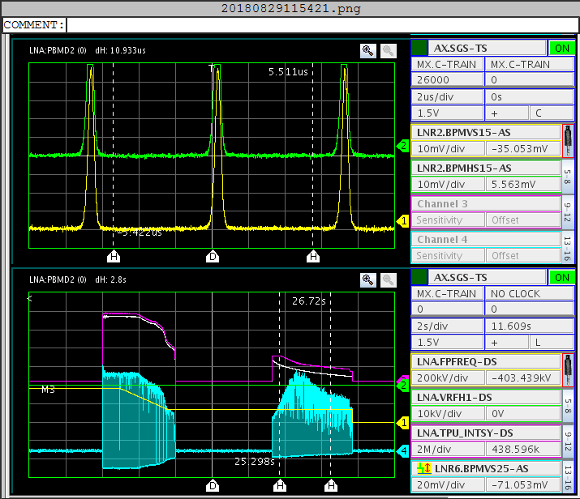
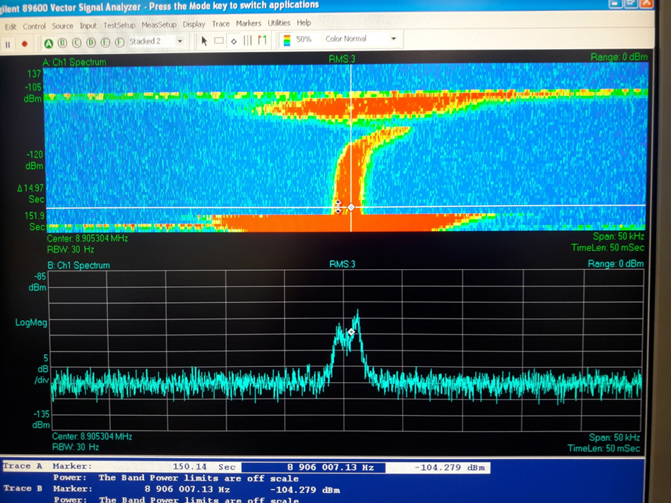
Frequency spread measurement using the BPM system
Peak-hold measurement on an Oasis scope

Slide 8
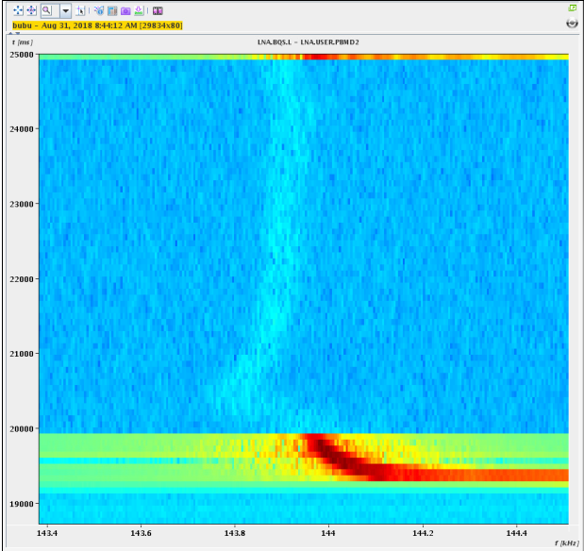
Plan to implement the multi-PU longitudinal Schottky
Long read out time
New architecture required to speed up the system (PCI express based)
First longitundinal Schottky measurements using the BPM system

Slide 9
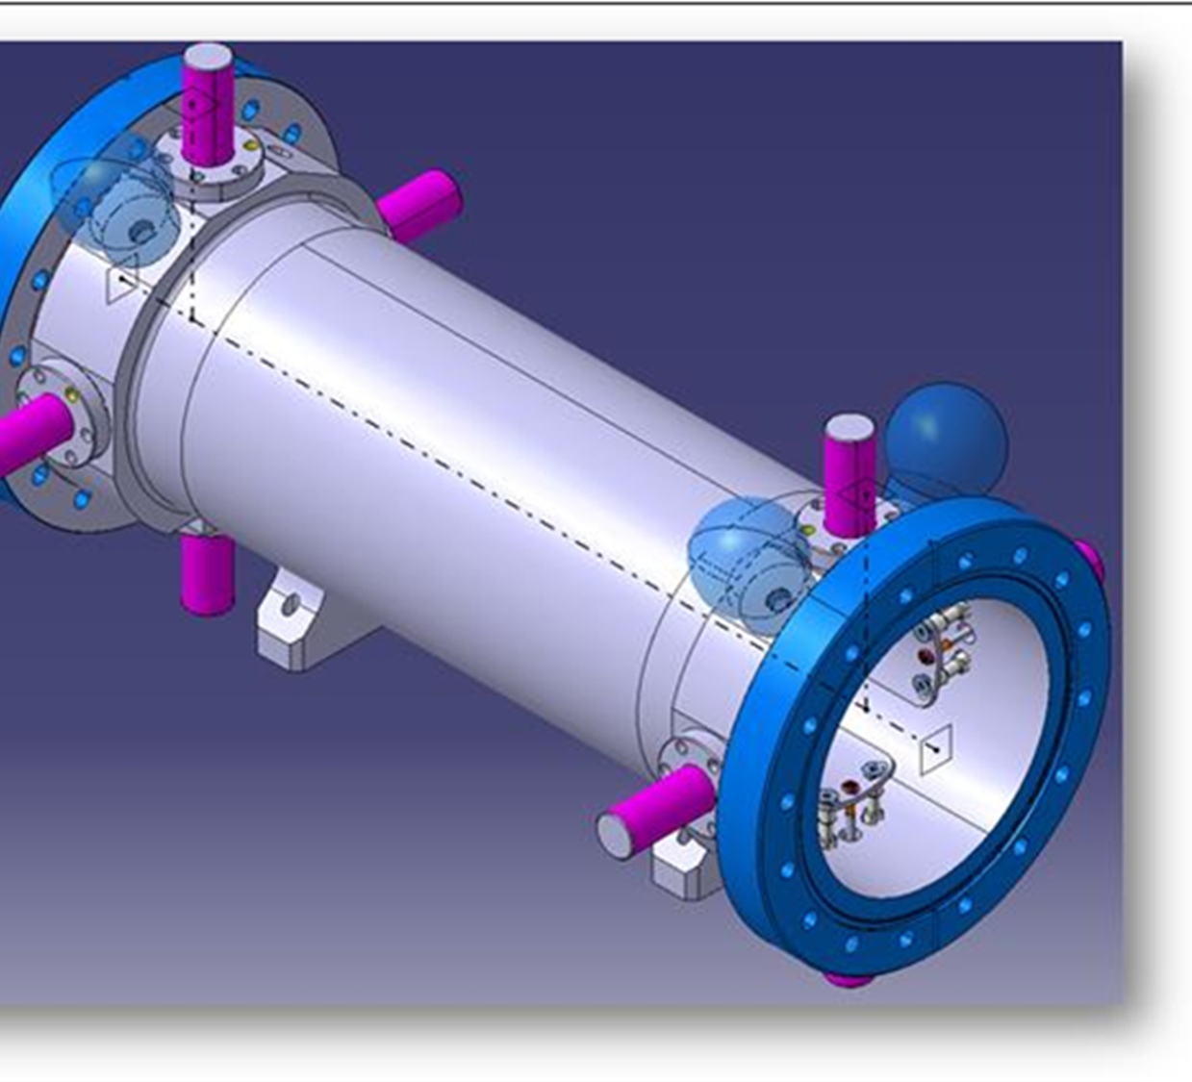
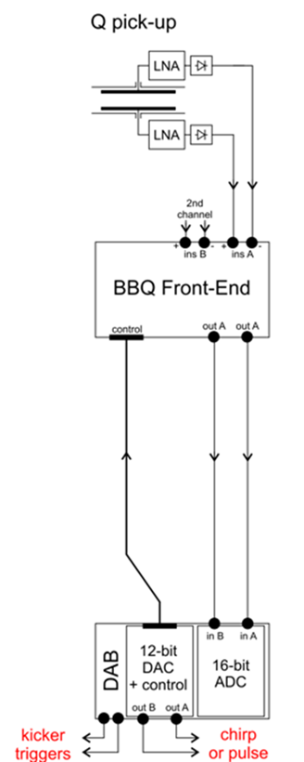
BBQ
The tune measurement system uses two identical pick-ups (PUs) with four 340 mm electrodes. One PU is used to capture beam signals and the second for beam harmonic excitation.
Beam signals from the four electrodes of the capture PU are amplified with four low noise amplifiers installed directly on the PU ports. The amplified signals are sent to the tune signal processing electronics based on diode detectors, a so called Base Band Tune (BBQ) front-end.
Chirped beam excitation signals are produced by two 12-bit DACs clocked with the same 8th harmonic of the revolution frequency. The DAC output signals are amplified to provide currents in the order of 100 mA passing through the electrodes of the excitation PU.

Slide 10
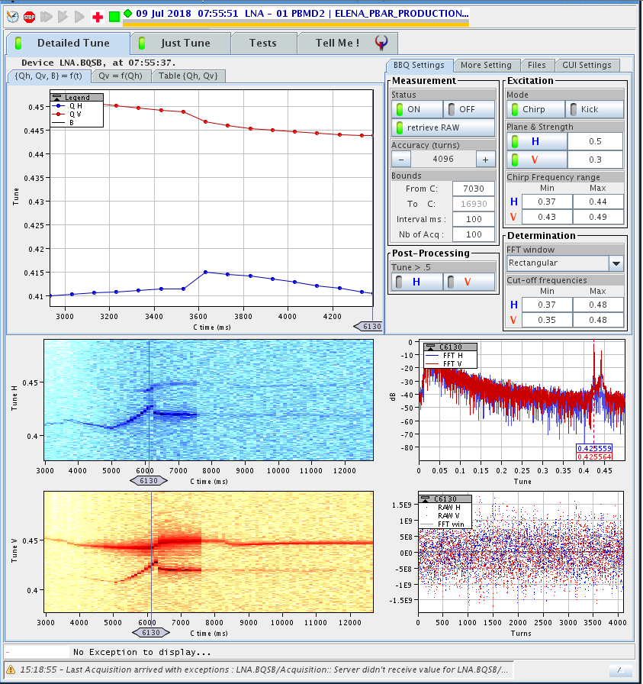
Typical BBQ acquisition

Slide 11
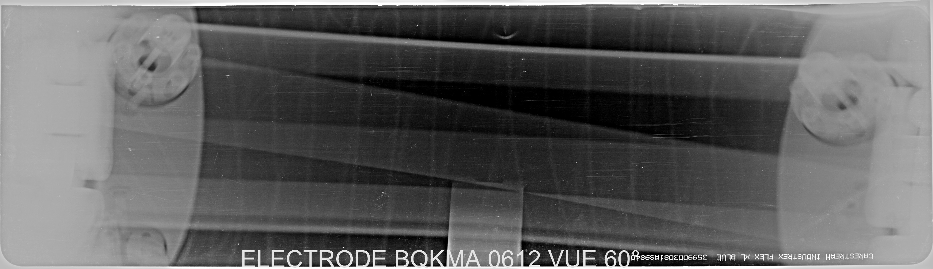
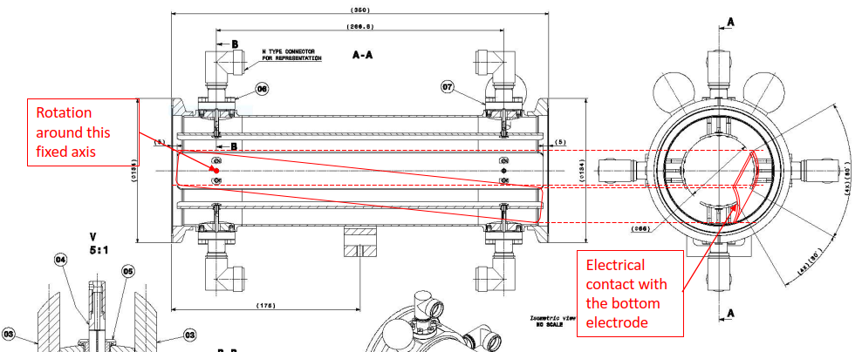
Detached kicker electrode

Slide 13
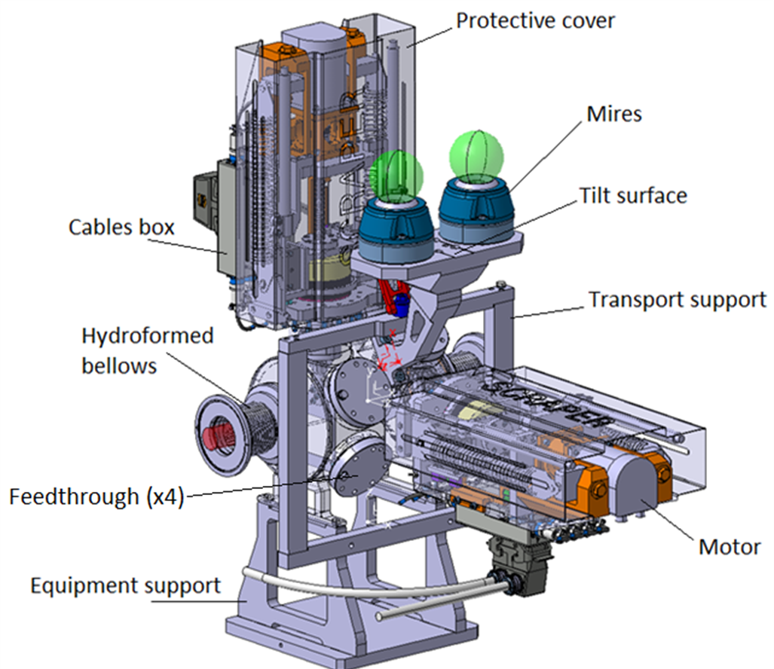
Scraper
The scraper device is a destructive diagnostic device using a motorised blade as a scraping tool which is moved into the circulating beam at constant speed. Secondary particles are emitted by the interaction of the beam with the blade. The flux of secondary particles detected is proportional to the beam density, and one can reconstruct the beam profile by plotting the flux as a function of the blade position.
Two detection systems have been implemented to cover the different particle types that are available in ELENA. For antiprotons two scintillator paddles outside the vacuum chamber capture the pions created by the annihilation of the particles with the blade. For protons and H- ions, secondary electrons are measured on four micro-channel plates (MCP) installed inside the vacuum tank.

Slide 14
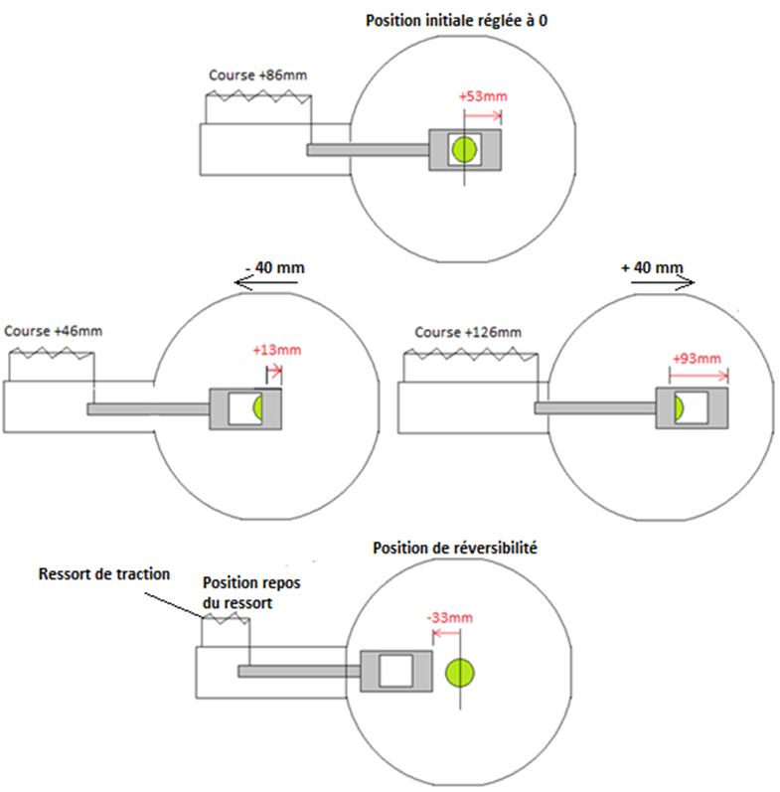
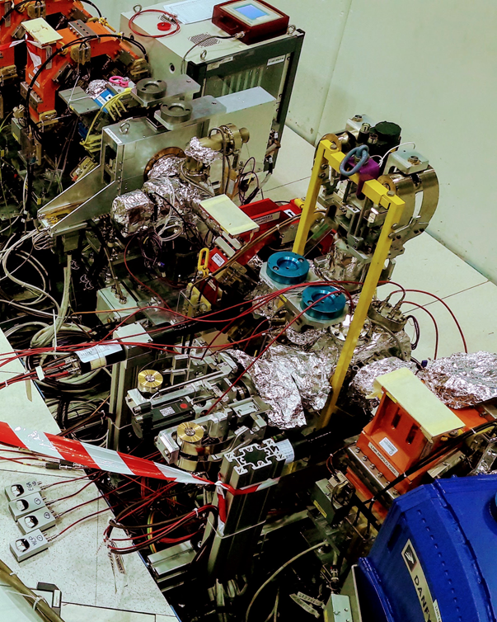
Scraper blade positions
Maximum speed of blade: 4cm/s
400 Hz acquisition of position and signal
Scraper in the ELENA ring

Slide 15
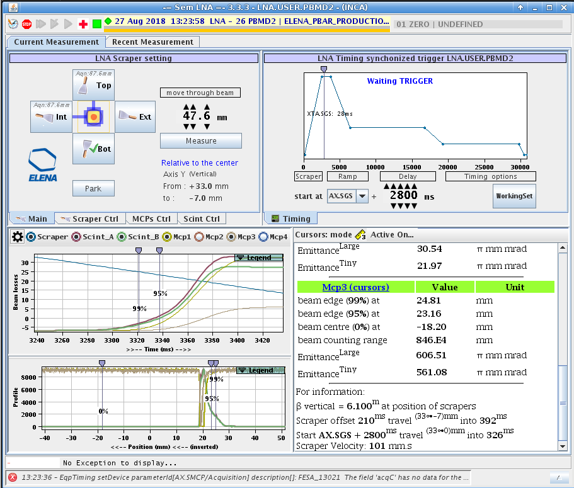
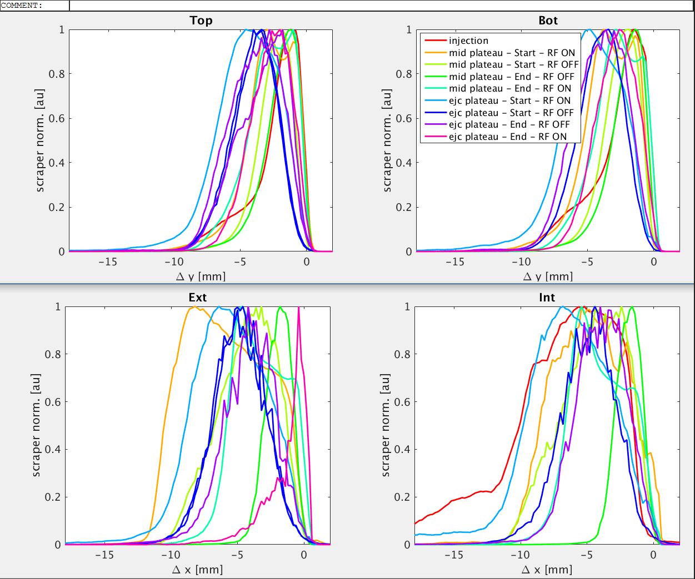
Scraper controls and acquisition
Scraper profiles during the ELENA deceleration cycle

Slide 16
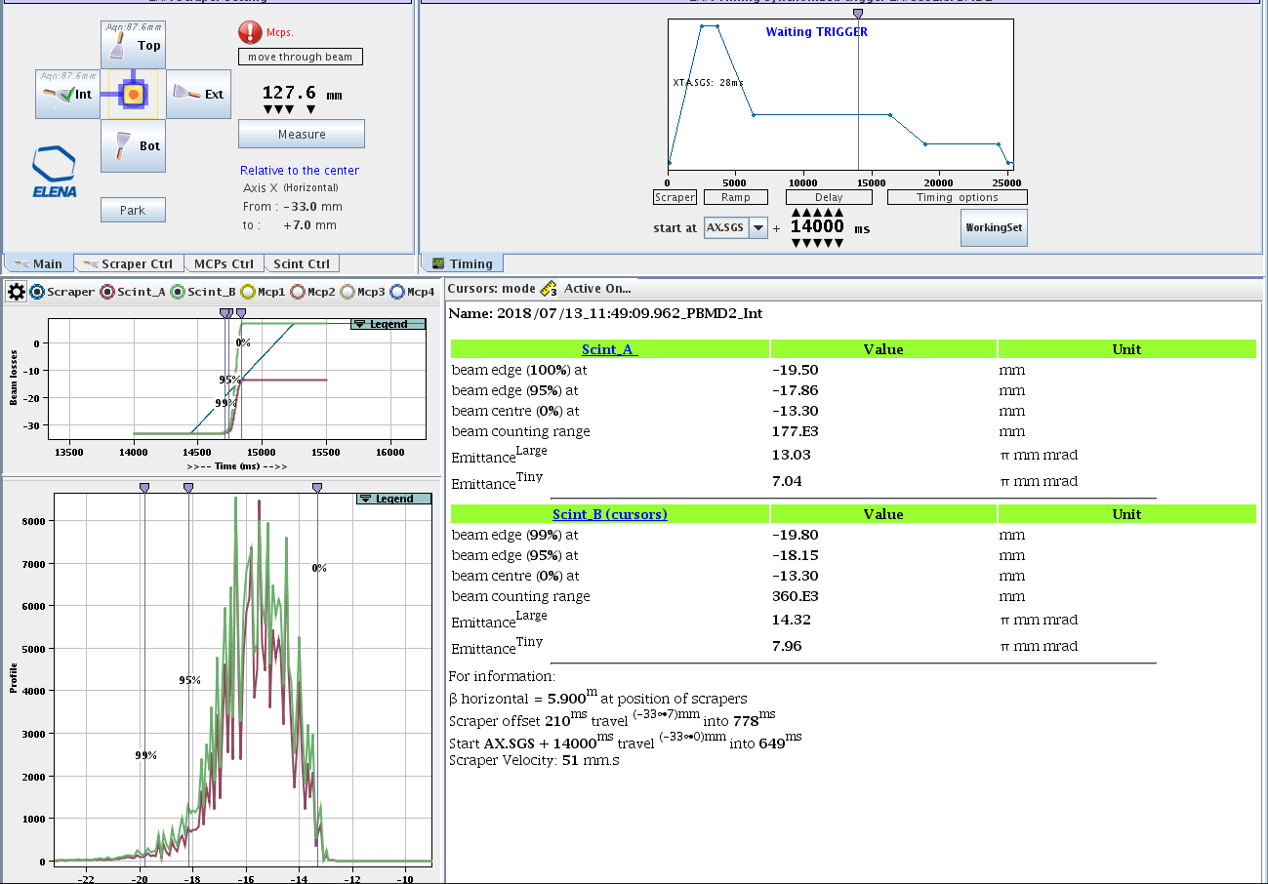
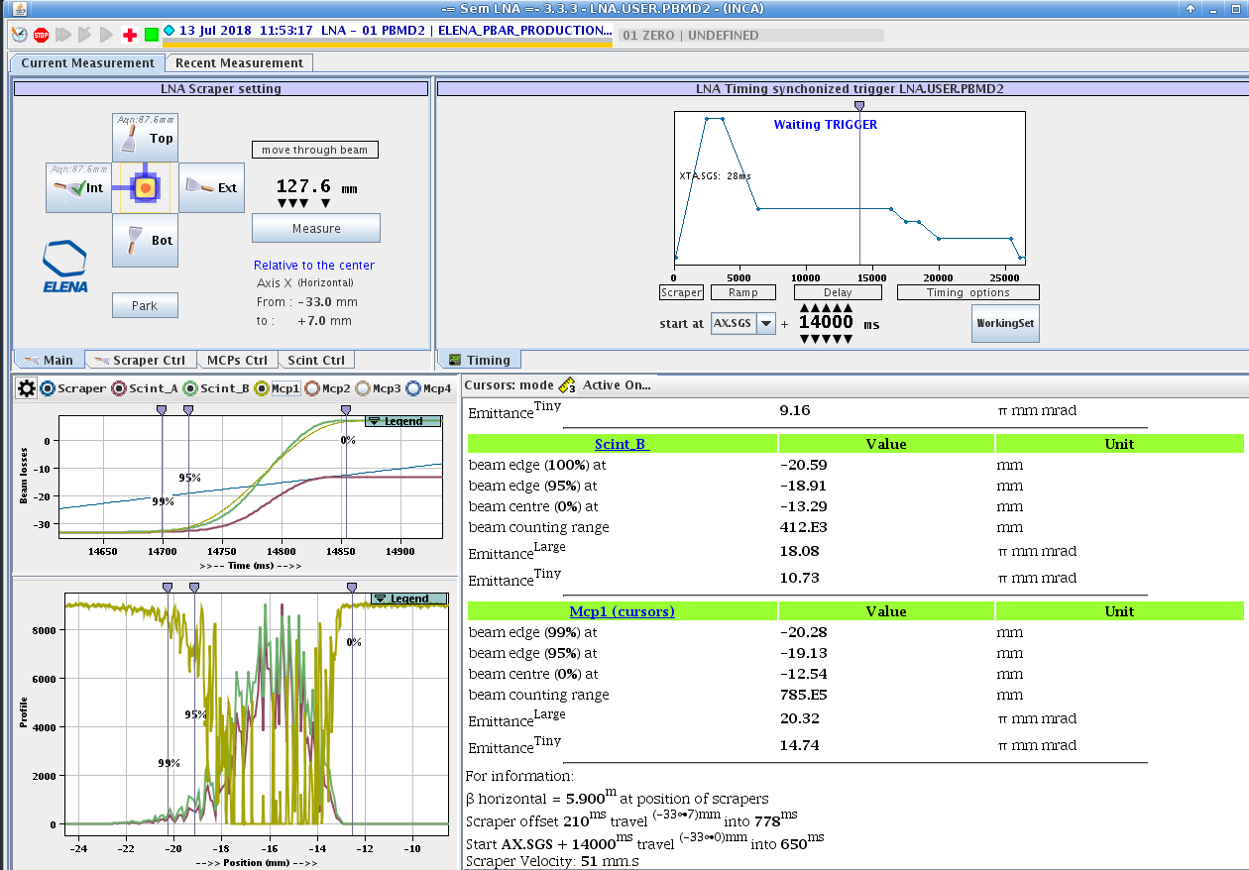
MCP “off” MCP “on”

Slide 17

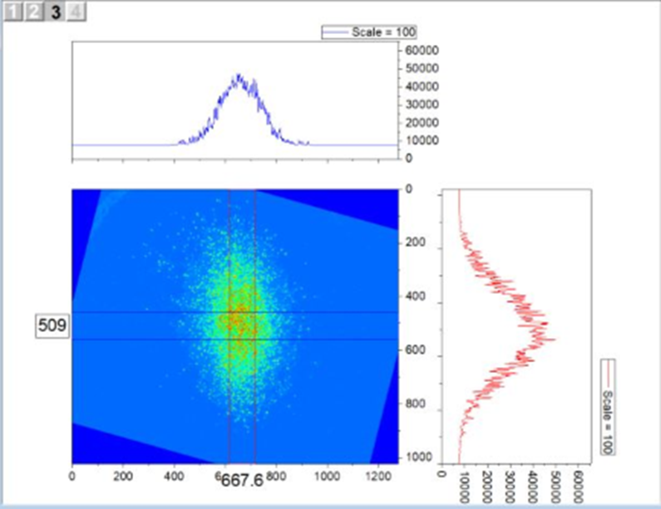
Recombination Monitor
Neutral hydrogen atoms, created either by the striping of the loosely bound electron of the H⁻ ion by the residual gas molecules or the recombination of protons with the electrons of the cooler device, can be detected in the extension of the downstream bending magnet.
The monitor consists of a chevron mounted MgO coated MCP coupled to a P43 phosphor screen. The image, acquired by a CMOS camera connected to a PC, is a direct image of the circulating beam from which the transverse profiles can be inferred.
CCD camera acquisition

Slide 18
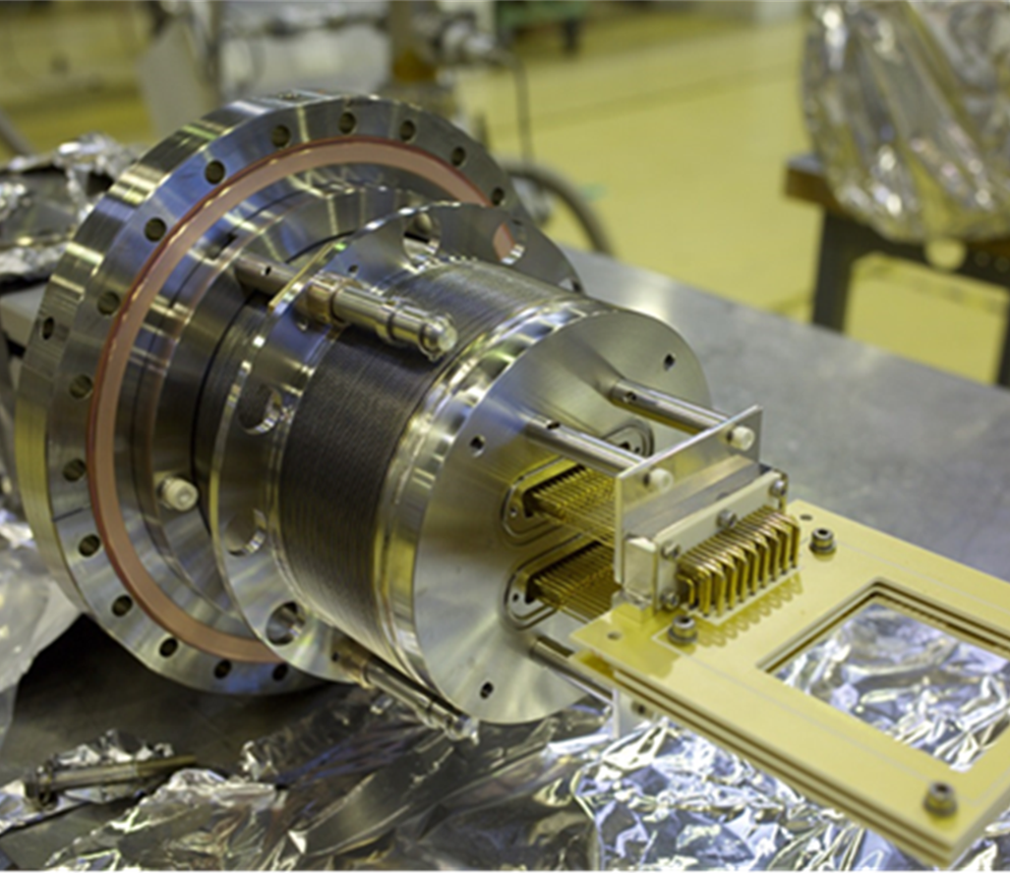
SEM
Semi-non-destructive monitor allows most of the particles to pass through without any degradation, while the small portion (1-3%) intercepted by the wires produces the signal.
The device is sensitive to antiproton, proton, and H- beams of energies between E =10 keV and 5.3 MeV.
It consists of two position-sensitive grids providing the X- and Y- projections of the beam, separated by anode grids.
Each grid consists of 45 gold-coated tungsten wires of diameter of 10 um stretched over a ceramic frame, with a pitch of 0.5 mm between neighbouring wires (in the centre) and 3.0 mm on the edge.
The cathode grids at ground potential are irradiated by the beam, and the secondary electrons emitted from them are accelerated toward the anode grids biased at 50 V.
The beam profile is obtained by using charge-sensitive preamplifiers to measure the charge Q_{i} ejected from the cathode wires on the X- and Y-grids with high sensitivity.

Slide 19
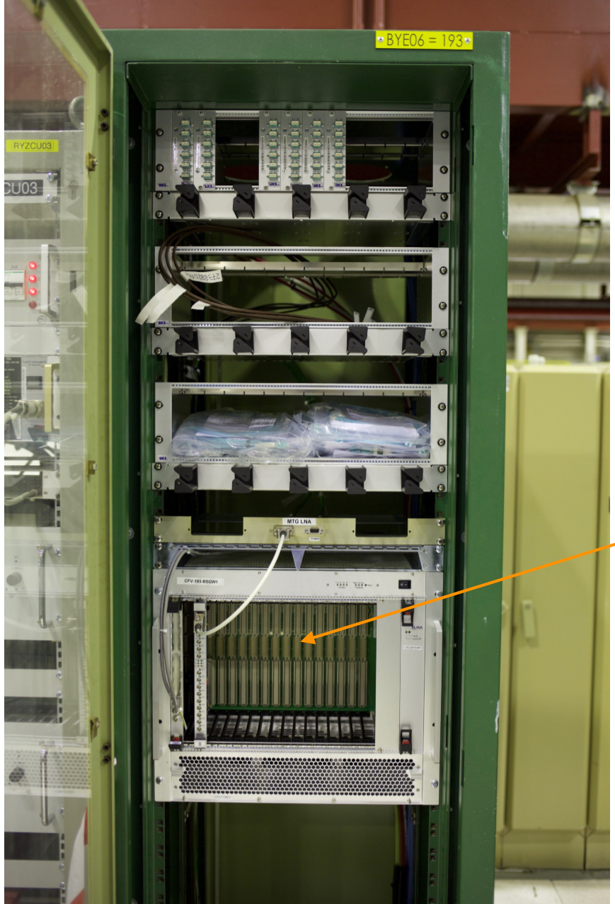
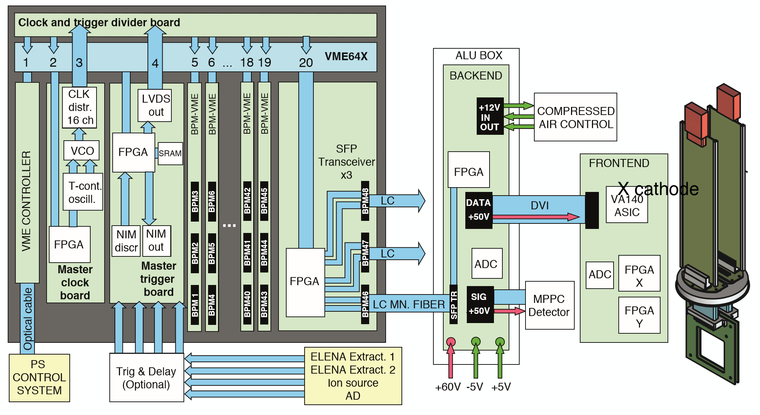
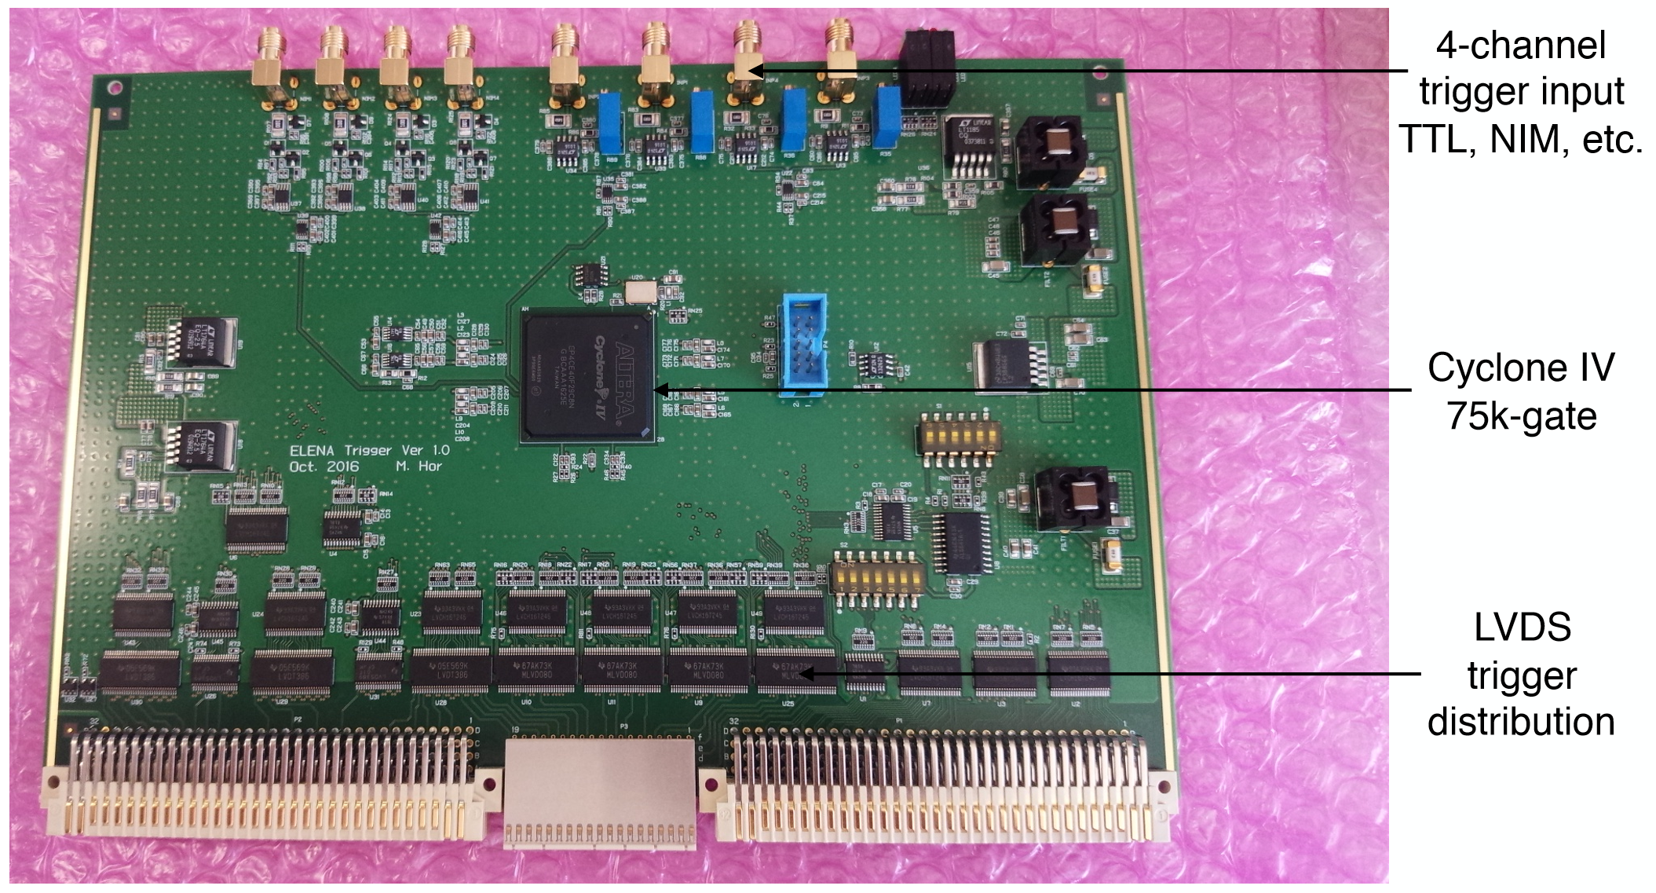
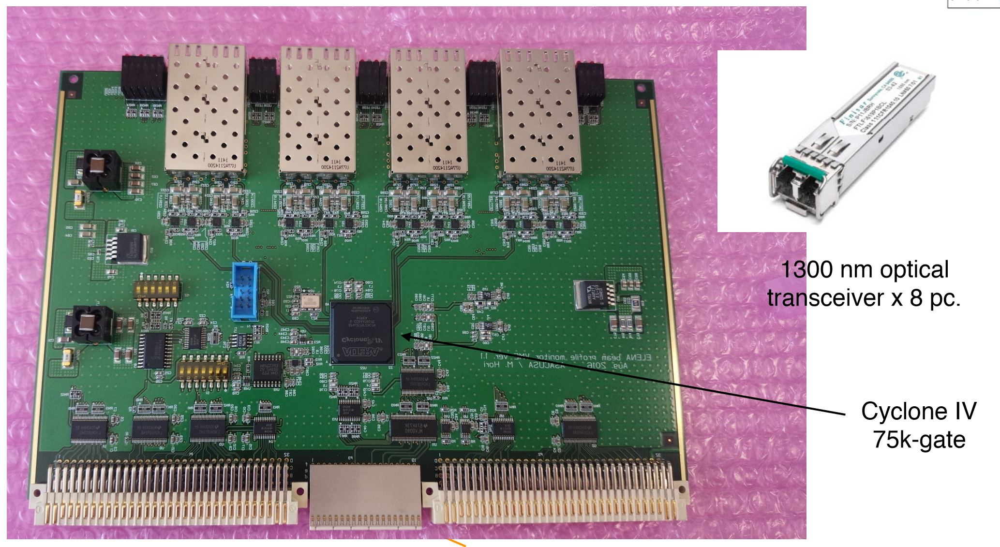

Slide 20
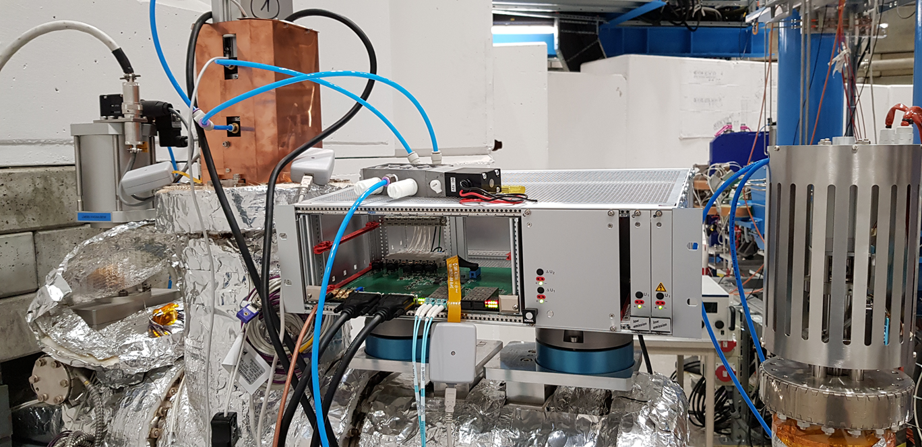
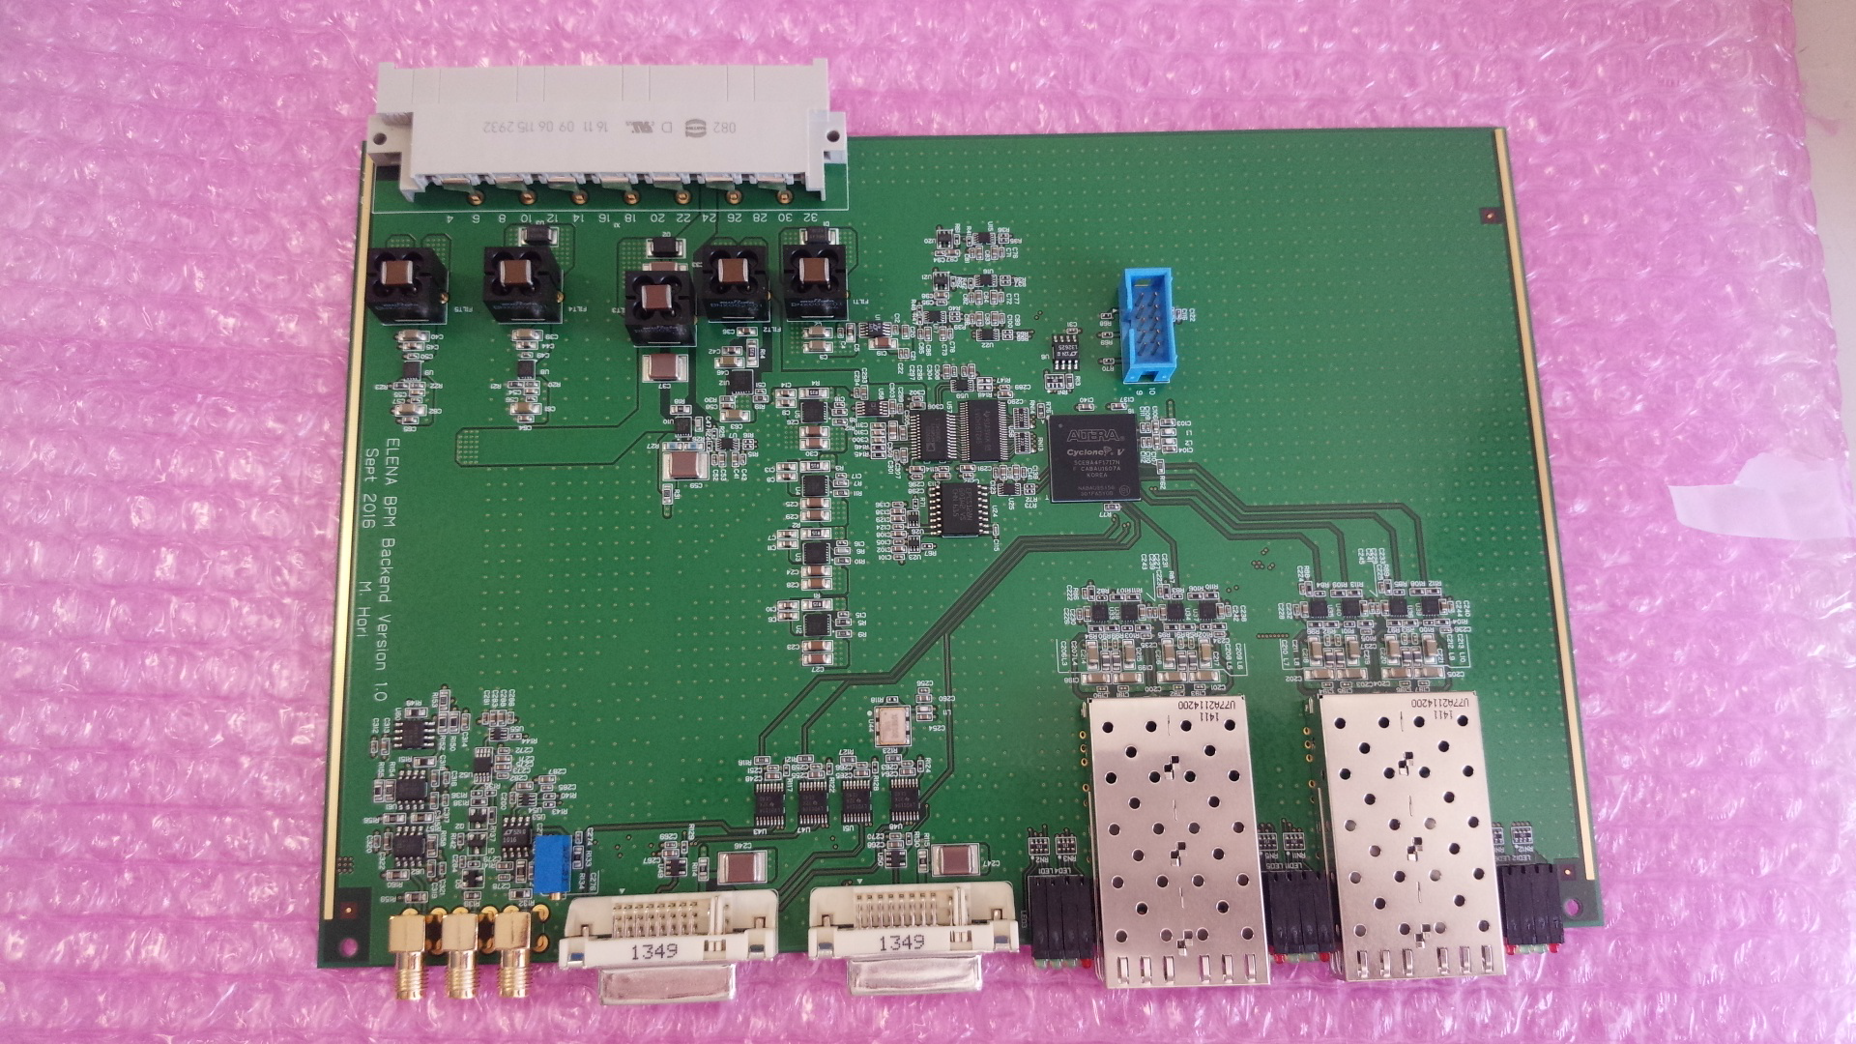
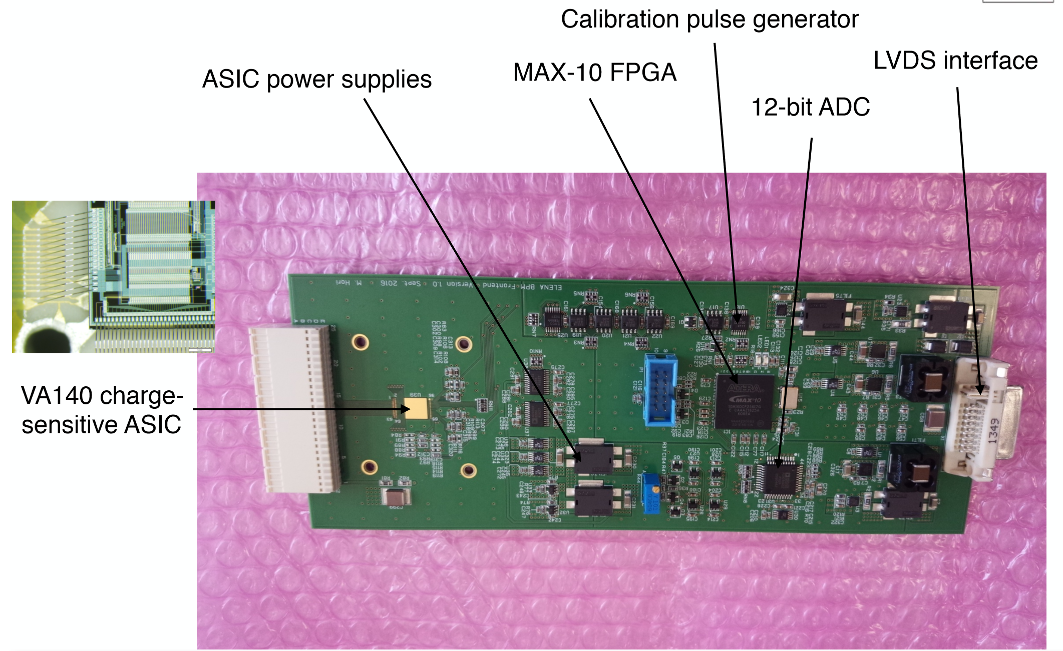

Slide 21
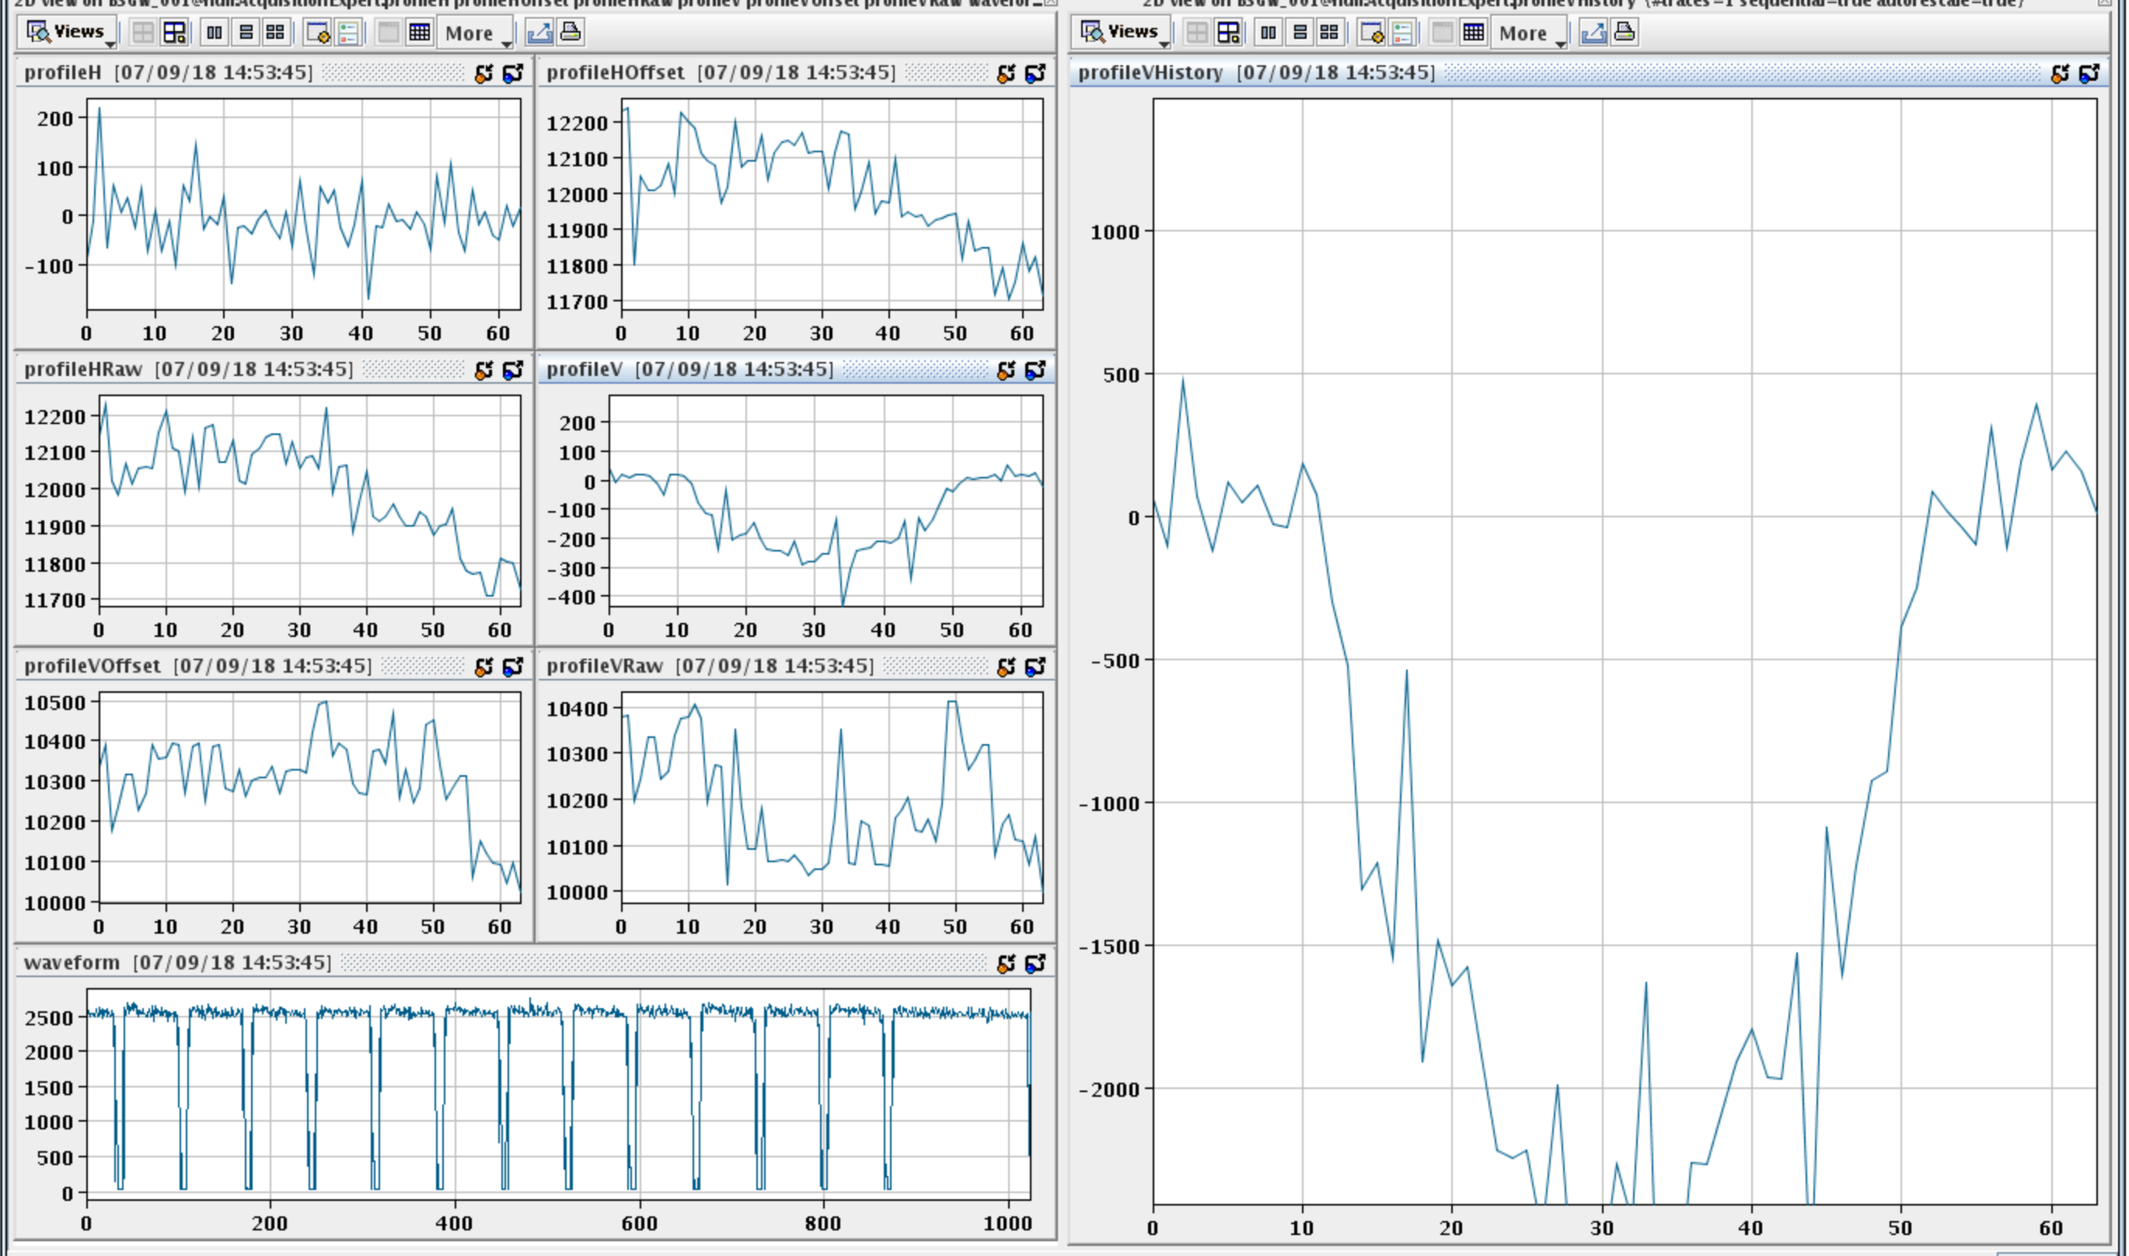
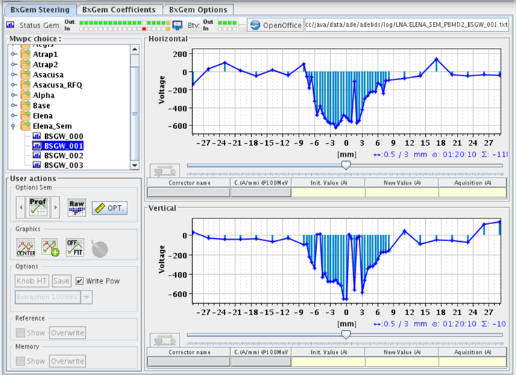
Profile obtained after ten averages and background subtraction

Slide 22
8 monitors have been installed for beam commissioning with H⁻/protons/pbars:
One in LNS
Two in LNI
Two in LNE00
Two in LNE50
One for the GBAR experiment (taken from LNE00)
Electronics not fully debugged. Only one functional chain was available during 2018.

Slide 23
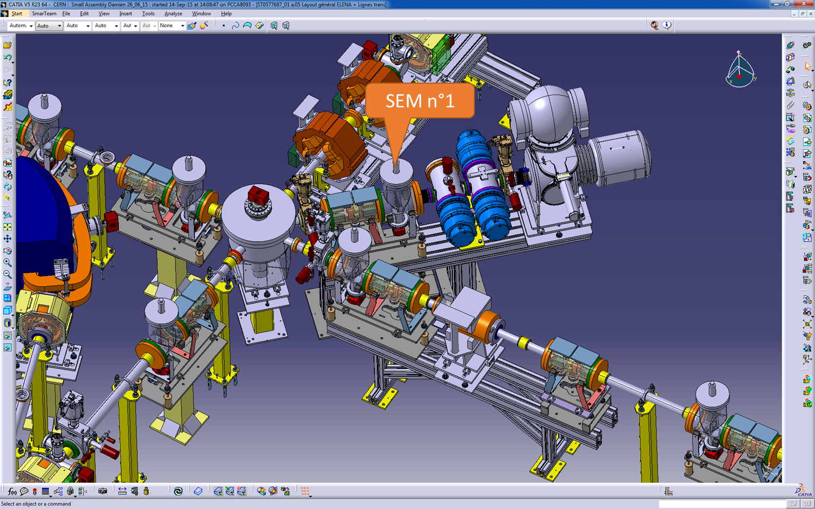
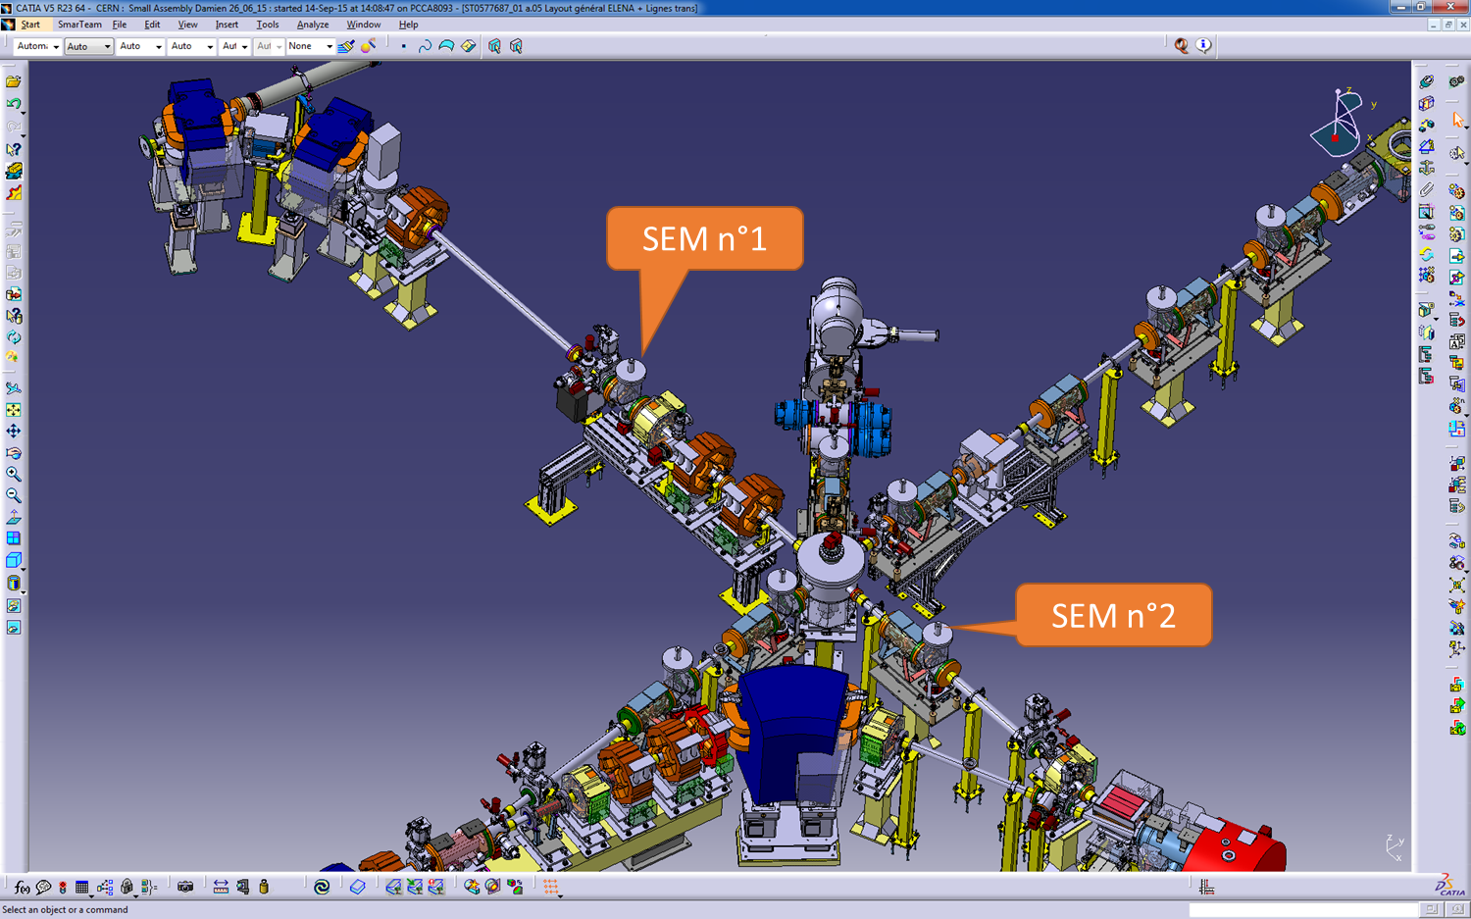
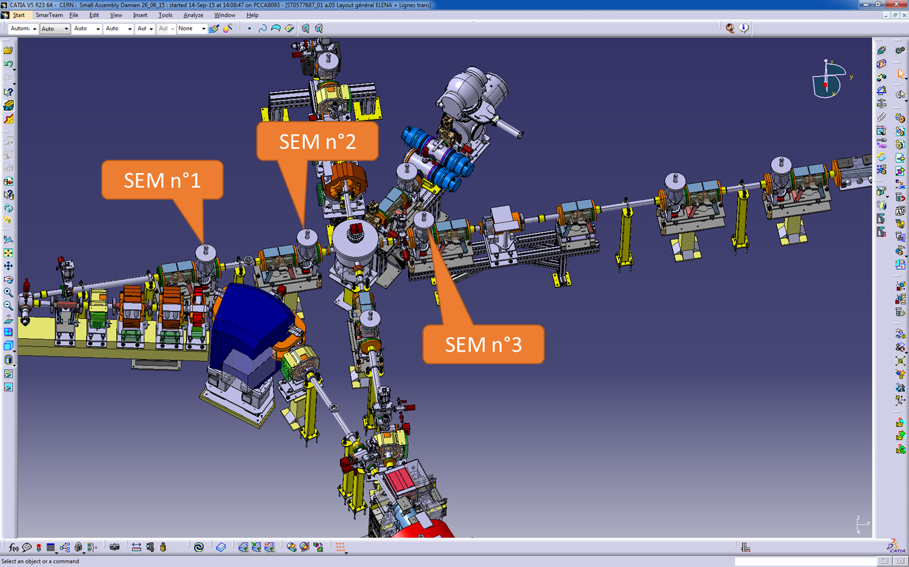
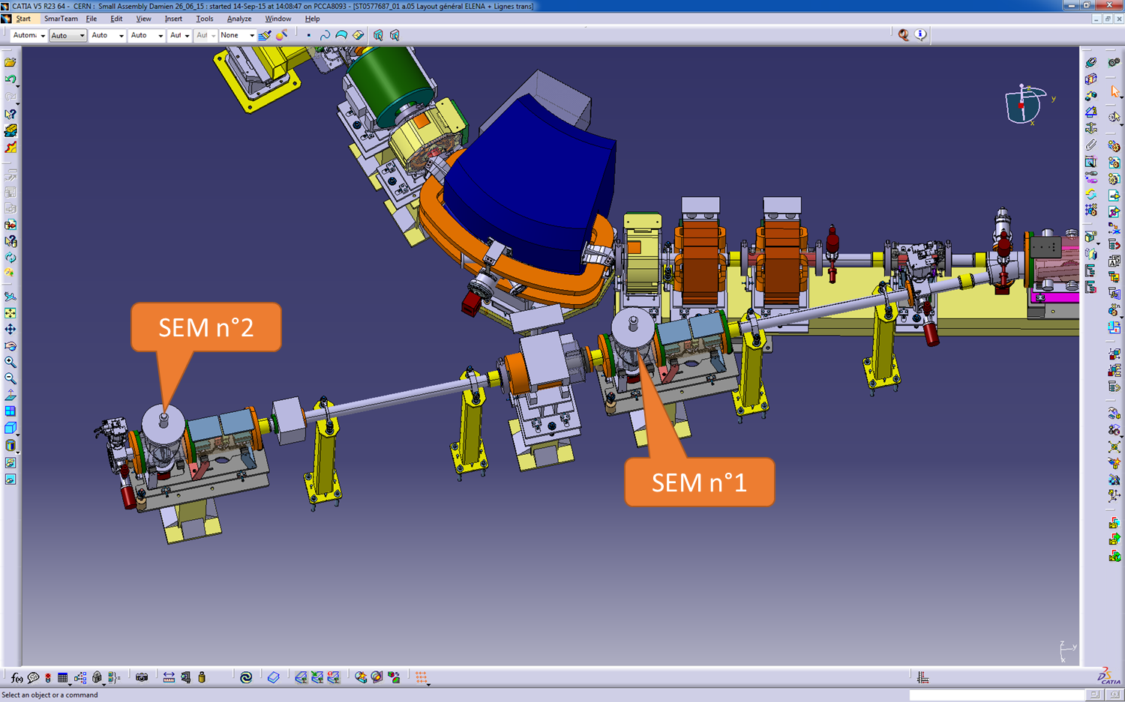
Additional SEM in GBAR zone

Slide 24
During LS2 we have to build and install another 36 complete monitors:
LNE00: 3
LNE01: 8*
LNE02: 2
LNE03: 5*
LNE04: 4
LNE05: 6
LNE06: 5
LNE07: 3
LNE01 and 03 will have 4 special SEMs (no IN/OUT, compact design) for ATRAP.
And install the electronics (2nd VME crate, local electronics chassis, boards, fibre-optics…..)
3 monitors delivered, another 5 are being prepared, recently received parts to mount 5 more monitors. (21/42(44) monitors so far).
Delivery schedule still holds: 3 monitors every 3-4 weeks.

Slide 25
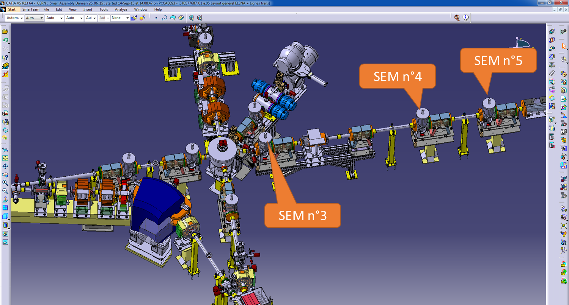
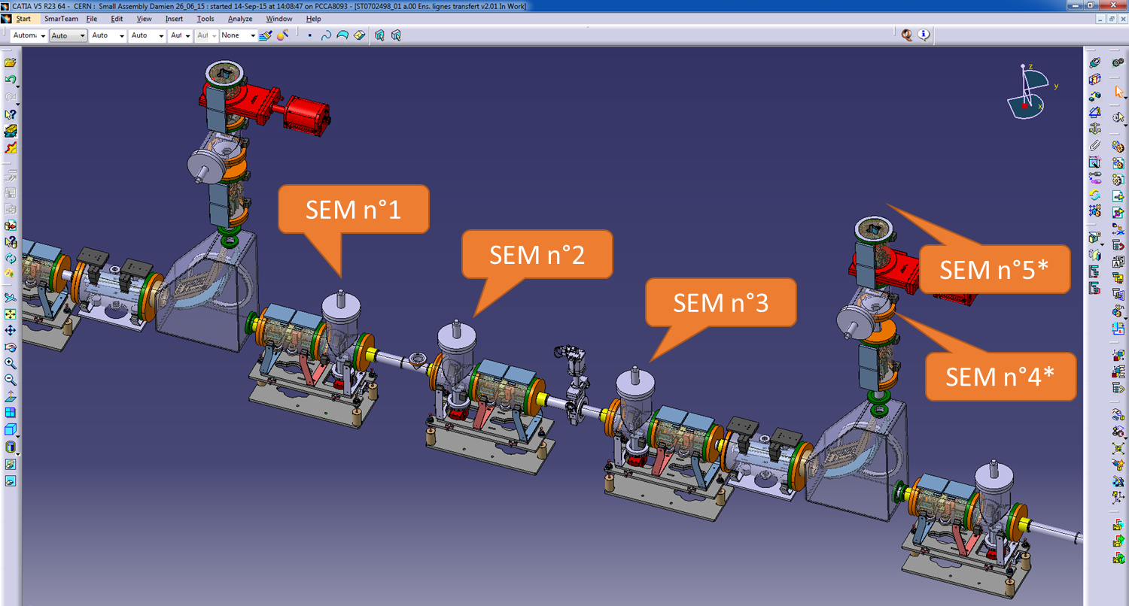


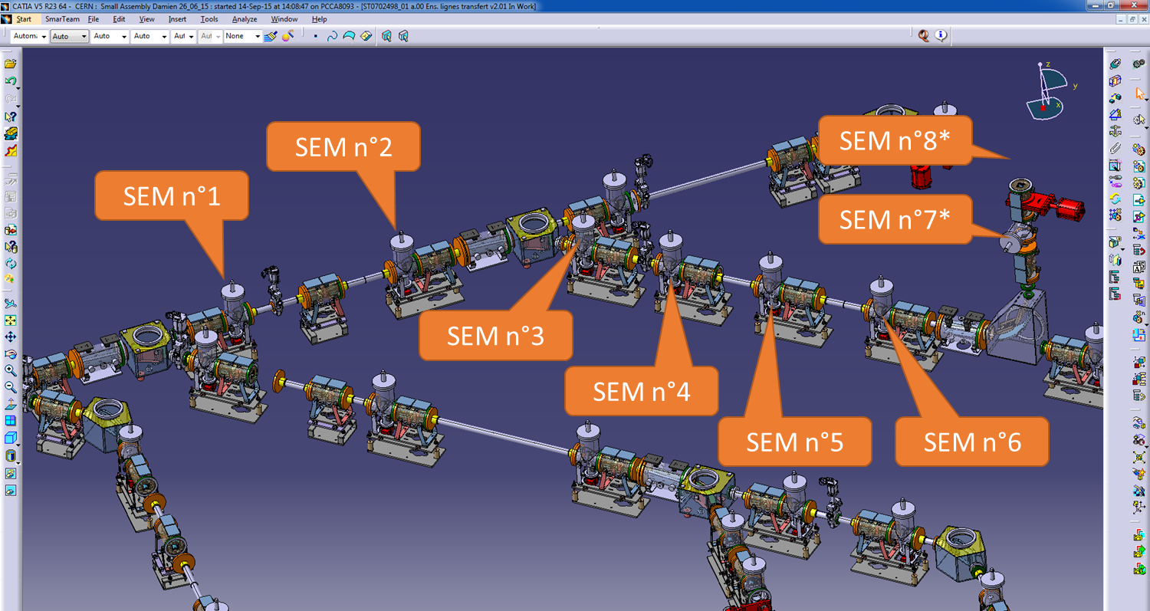
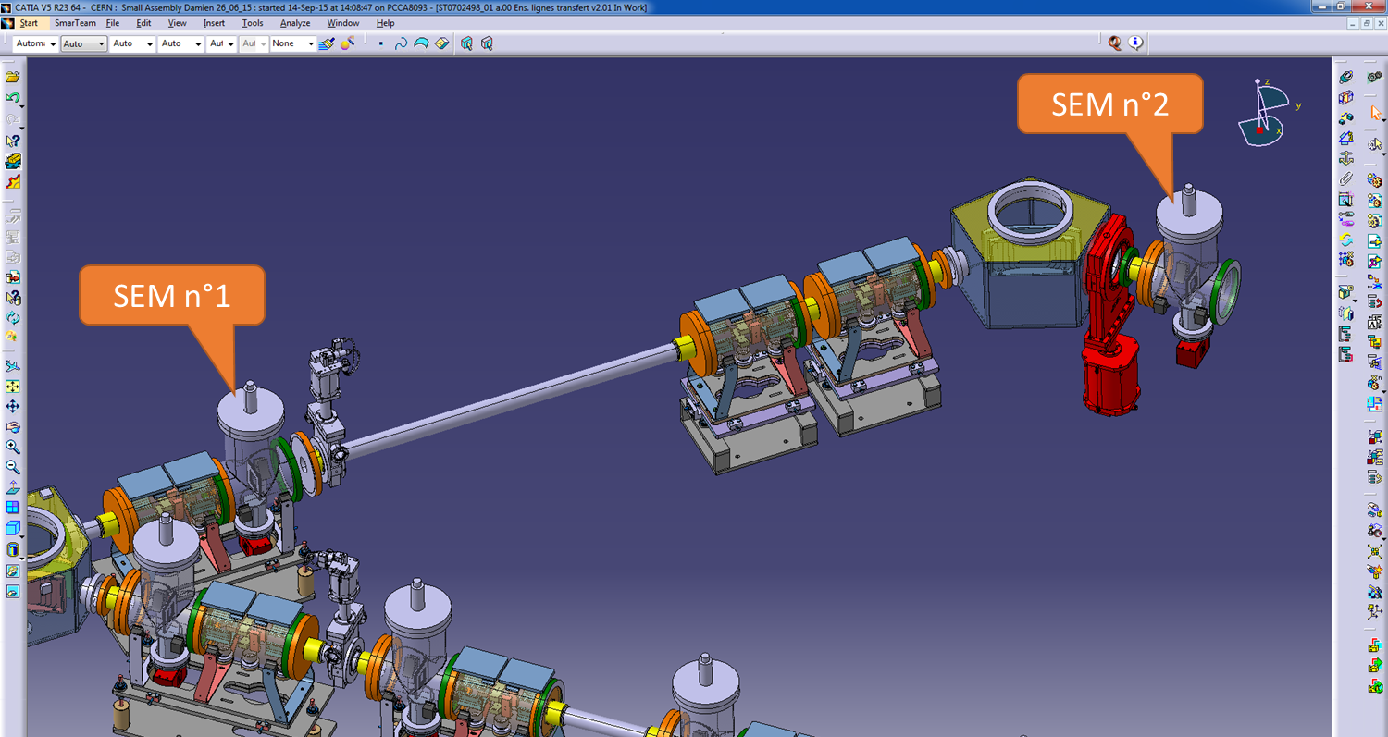



Slide 26
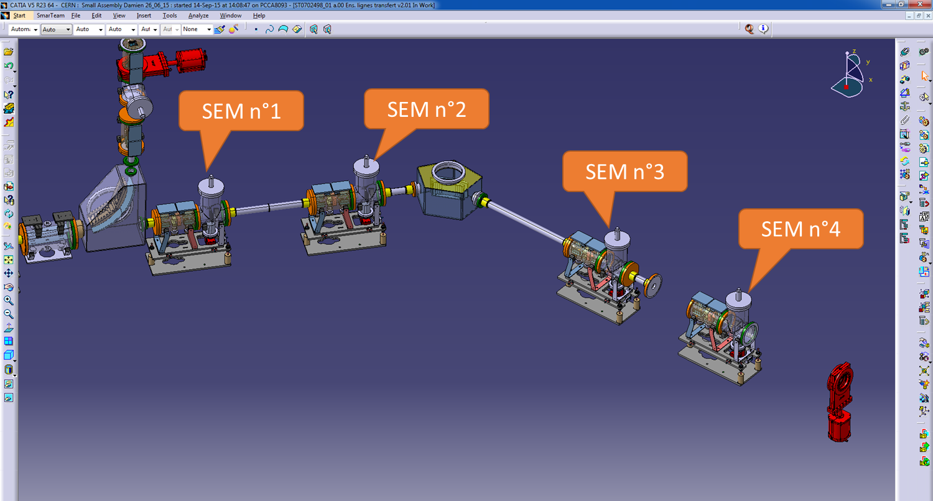
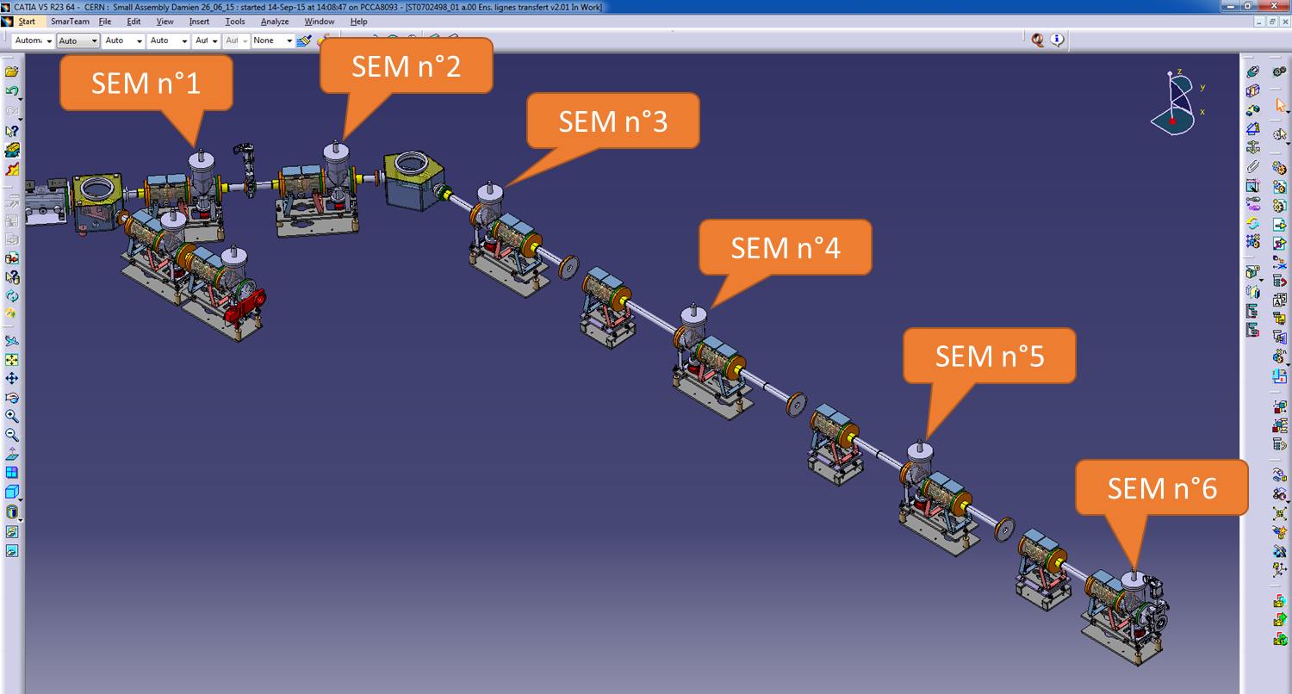


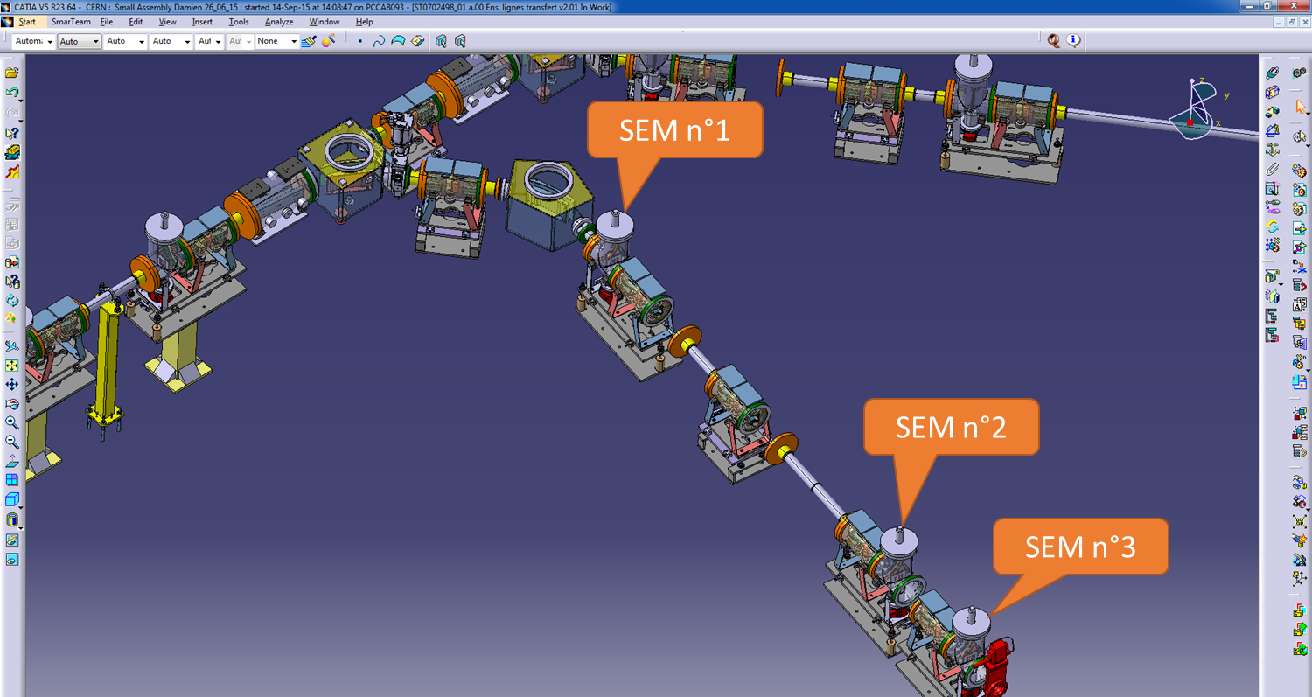
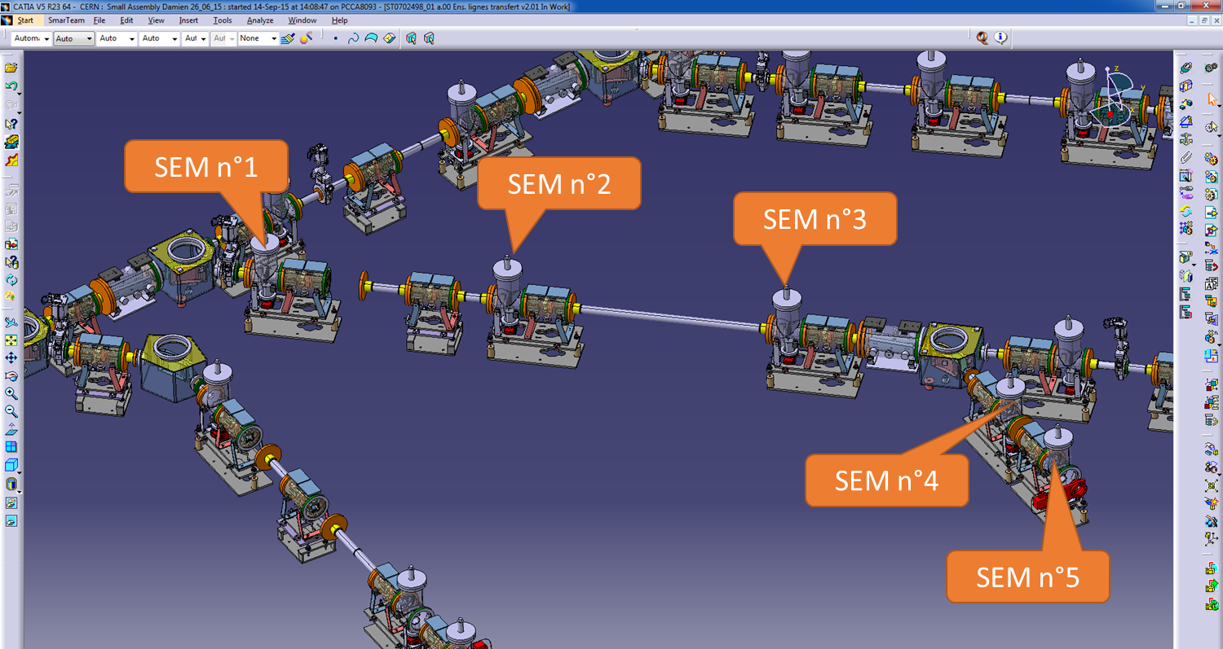



Slide 27
BI@ELENA status
BTV: All systems working well.
BPM: Ok. Use as longitudinal Schottky PU looks promising.
BBQ: Ok. Intervention to repair detached electrode.
Scraper: In general works well. Sometimes difficult to interpret the data. MCP perturbs the scintillator readings.
Recombination monitor: Ok. Faster CCD camera would be useful. Application program to be written.
SEMs: Situation improving. Mechanical issues addressed. Still waiting for parts for mounting. Electronics arriving slowly.

Slide 28

FUTURE DEVELOPMENTS
Non(Semi)-destructive profile monitoring.
Intensity measurement.

Slide 29
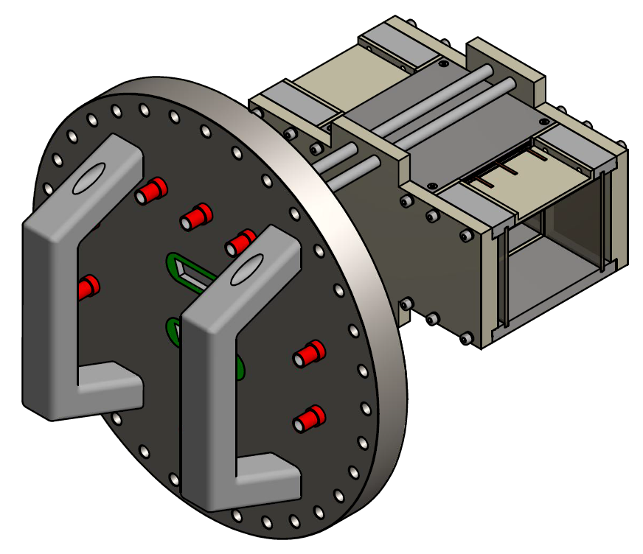
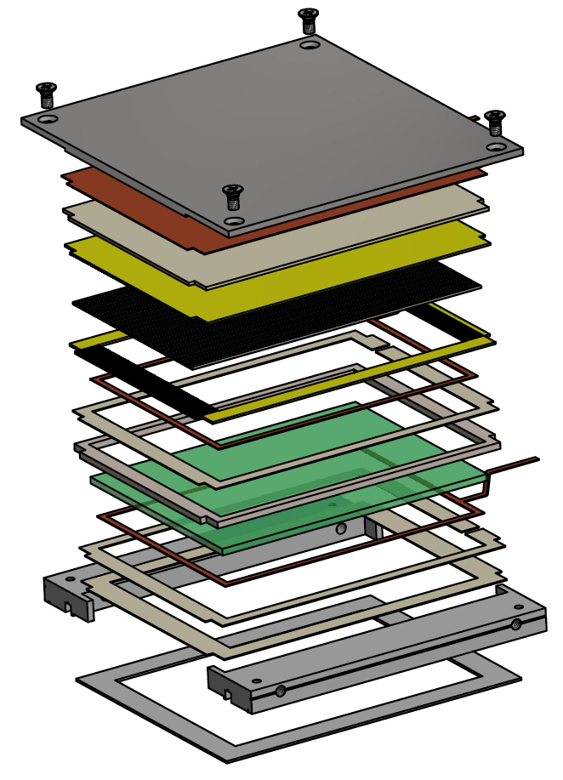

IPM
Design based on AD and LEIR IPM
Double MCP
Read-out : stainless steel tubes
XHV material compatible only
Two orbit correction electrodes
Long detection length : 80mm
External dimensions: 206 x 140 x 128 mm
Beam aperture: 82 x 70 mm

Slide 30

integration in ELENA
Bellow
Gas injection
Bellow
Horizontal BIPM +
NEXTorr D 1000-10
Vertical BIPM +
NEXTorr D 1000-10
Turbo-molecular
pump

Slide 31


Cryogenic Current Comparator
The CCC works by measuring the magnetic ﬁeld induced by the particle beam current. This ﬁeld is concentrated in a high-permeability ferromagnetic pickup core, from which it is coupled into a Superconducting Quantum Interference Device(SQUID). These are highly sensitive magnetic ﬂux sensors that permit sensing the weak ﬁelds created by the beam. A superconducting magnetic shield structure around the pickup-core renders the coupled magnetic ﬁeld nearly independent of the beam position and makes the system practically immune to external magnetic ﬁeld perturbations.

Slide 32


Slide 33

IPM
CCC

Slide 34

QUESTION TIME

