Slide 2
Quench Protection Systems
Jelena Spasic
TE-MPE-EP

Slide 3
Outline
Introduction to Quench Protection Systems
Planned changes in QPS for LS2
Upgraded QPS – closer look
  QPS for main quadrupoles (MQ)
  QPS for 11T dipole
  QPS for individually powered magnets (IPx)
Conclusions

Slide 4
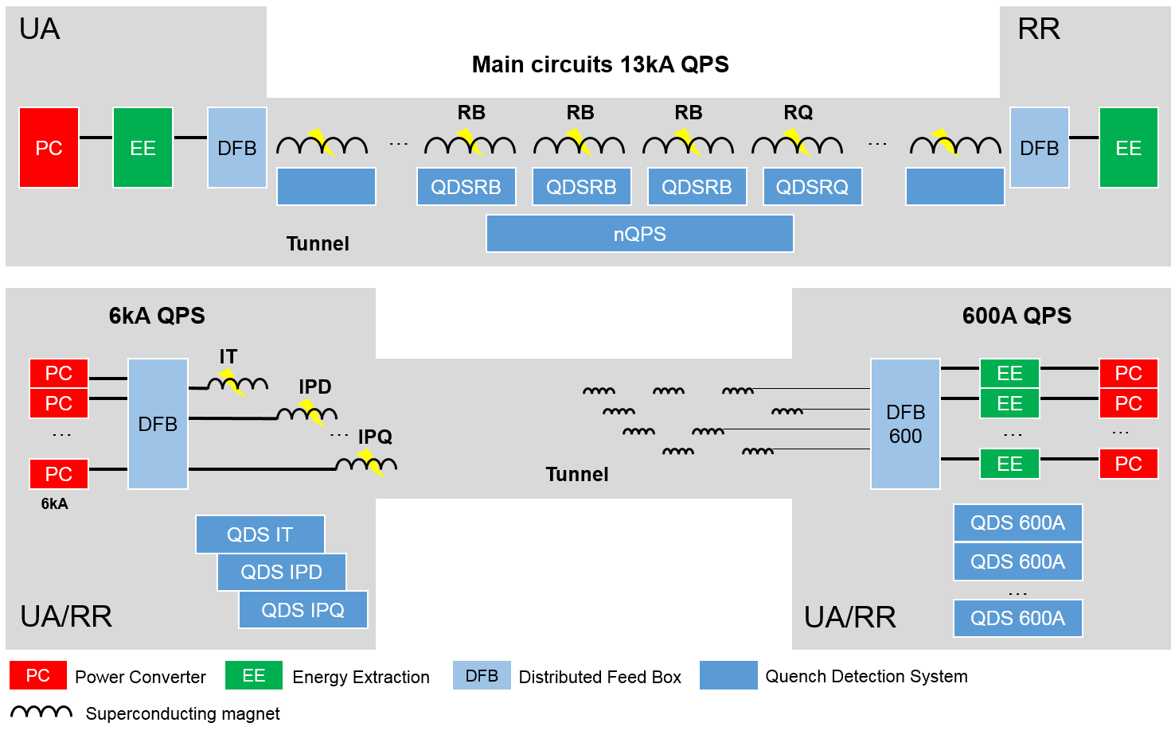
Introduction to Quench Protection Systems 1/2
Item | Count
EE13kA | 32
EE600 | 202
HDS | 6084
QDSRB | 1232
Magnet detector | 2464
QDSRQ | 392
Magnet detector | 1568
nQPS | 436
Magnet detector | 1632
Bus-bar detector | 4096
QDSIPX | 76
IP magnet detector | 360
IT magnet detector | 48
Current lead detector | 1124
QDS600 | 114
Magnet detector | 624
Rad-tol magnet det. | 212
Current lead detector | 1672
Total | 8568
Interlocking | 13800
4

Slide 5
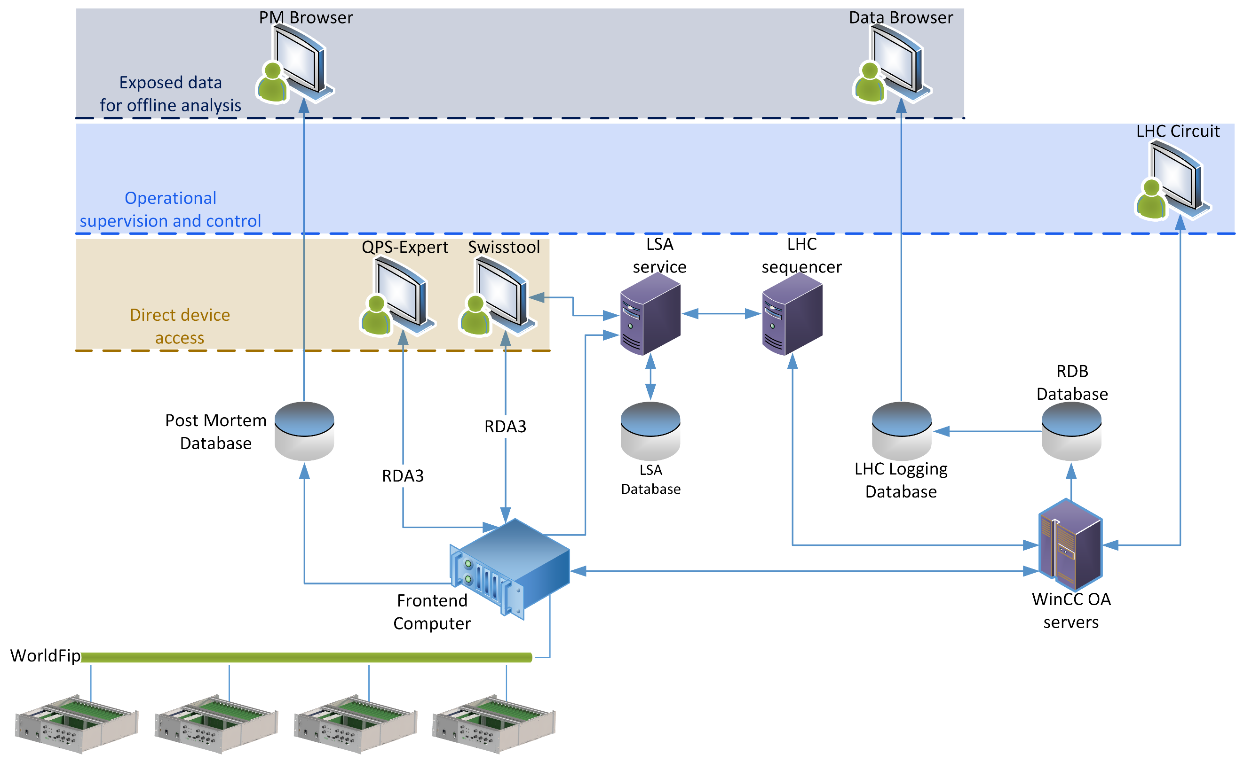
Introduction to Quench Protection Systems 2/2

Slide 6
Planned Changes in QPS for LS2
QPS for MQ (DYPQ)
  Lifecycle management driven
  Enhance diagnostics and remote maintenance
  Improve reliability and radiation tolerance
QPS for 11T
  New quench protection system needed
QPS for IPx (IPQ, 600A)
  Reduce susceptibility to thunderstorms – IPQ
  Improve detection of symmetric quenches – IPQ
  Improve EMC of current sensors – 600A
  Maintenance, test and reduction of units – EE 600A

Slide 7
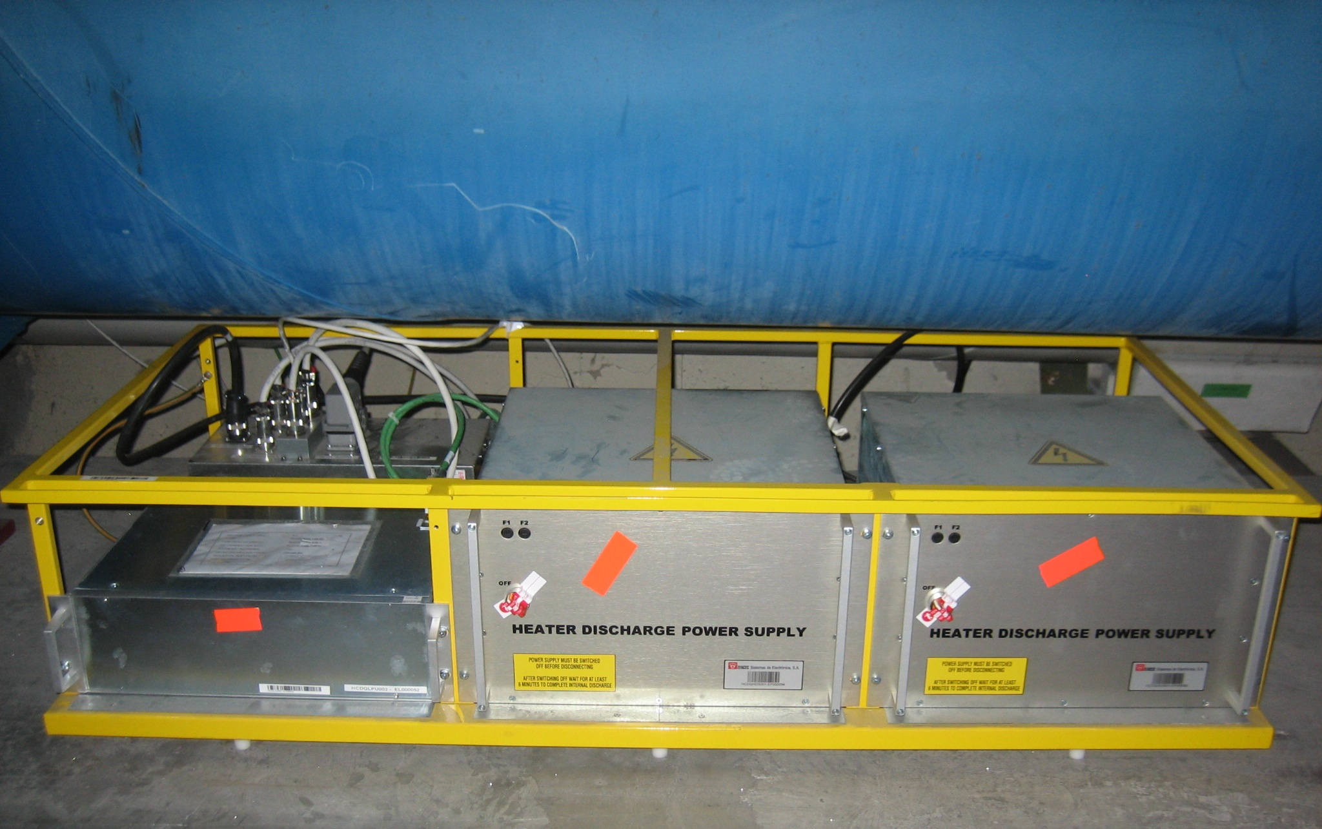
Old DYPQ
392 racks in the LHC tunnel
HDS trigger coupling
UPS 1
HDS 1
HDS 2
Power supply 1
Quench detector MQF A
Power supply 2
Quench detector MQF B
Quench detector MQF B
Quench detector MQD B
Data acquisition controller
Notes:
Replacement is part of the general QPS maintenance plan. While there are no new requirements for the quench detection functionality, the new DQLPU type B units will offer enhanced capabilities in terms of data acquisition, diagnostics and remote maintenance.
Current units run reliably since 2008, but lack extended functionalities of the renovated DQLPUA for the dipoles.
The lifetime of the DQLPUBv1 electronics will not extend much passed LS3 • For planning reasons LS2 is regarded as more suitable for the upgrade than LS3 where the workload of the section is rather high due to the HiLumi project

Slide 8
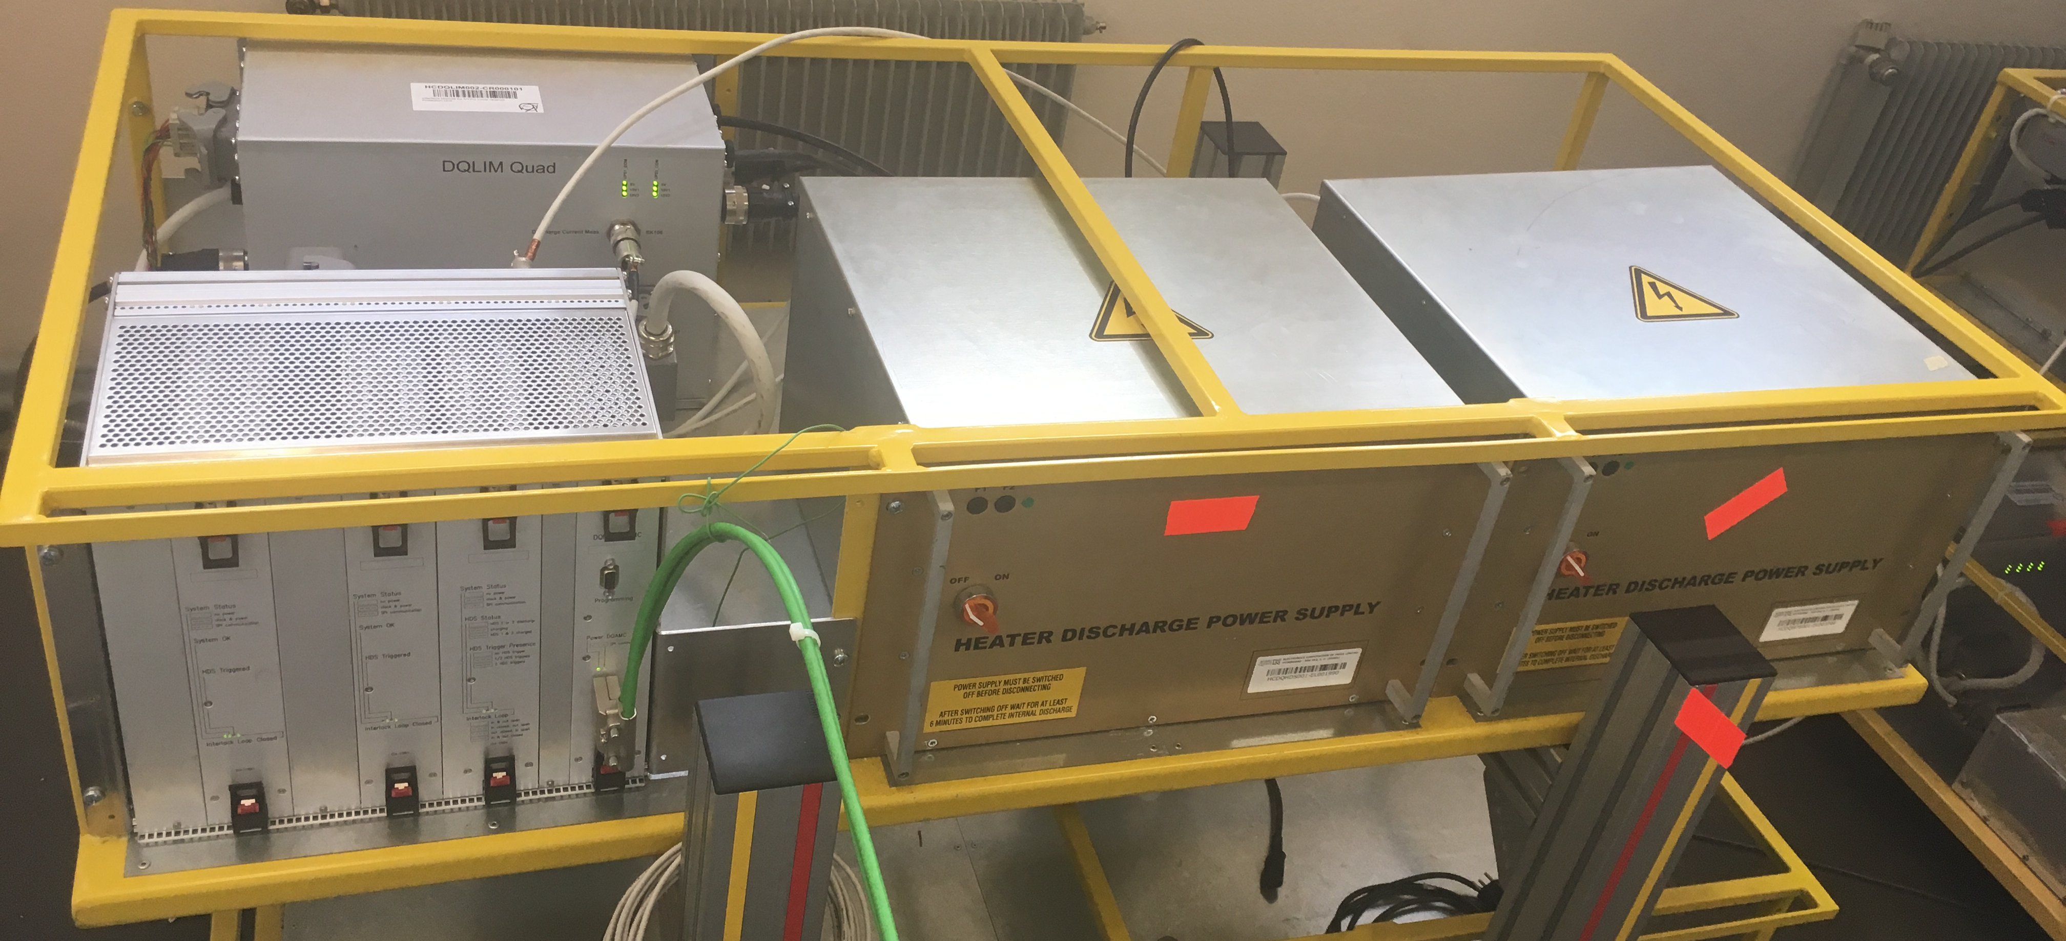
New DYPQ
Power supply 1
Power supply 2
UPS 1
UPS 2
Trigger coupling HDS2
Trigger coupling
HDS1
HDS 2
HDS 1
Data acquisition controller
Quench detector MQF+D A
Quench detector RQF+D B
Supervision &
Synchronization

Slide 9
DYPQ Upgrade
Core Functions
Redundant powering on the UPS level
Quench detection logic and signal filtering in digital domain
Enhanced quench heater supervision
Qualified in radiation
    Components in PSI, device in CHARM – radiation tolerant up to 300 Gy
    (with an exchange of data acquisition controller)
Enhanced Diagnostics
Quench heater trigger monitoring
Interlock loop monitoring
Power supply monitoring
Enhanced PM timing precision
Continuous configuration transmission
Enhanced
Maintenance
Remote power cycle
Boards in metallic enclosures (cassettes)
Tool-less exchange of the cassettes
Dedicated LED indicators on the front panel allowing quick status assessment by Piquet

Slide 10
DYPQ Upgrade – Operational View
Signals from redundant quench detectors sent
at the same time
System configuration continuously transmitted
Larger number of signals transferred to the LHC controls
  All power supplies provided by DQLIM are monitored
  HDS trigger links are monitored for the first time in the LHC
  HDS voltage and current are monitored
  Interlock loop state is monitored
Improved PM data timing
Selectable PM analysis resolution
Remote power cycle

Slide 11
QPS for 11T
RR77 (RR73)
4 x I, 2x4U
Trim Lead Protection
Interlock to PIC
RB Interlock loop
4 physical cables,
2 per IFS
MB.B9L7
MBA.B8L7
Beam
4
RR73
RR77
MBB.B8R7
MB.A9R7
11T UQDS B
11T cryo-assembly
11T cryo-assembly
Tunnel
IP 7
IFS x2
IFS x2
…
…
…
…
11T
11T
MQ.8R7
MB.A9R7
11T UQDS A
…
…
…
8 x HDS
8 x HDS
HDS trigger links 2x16
11T HDS Controller
8xNE8
U_HDS, I_HDS, HDS trigger
8xNE8
Connection to Controls
via WorldFIP
~100m

Slide 12
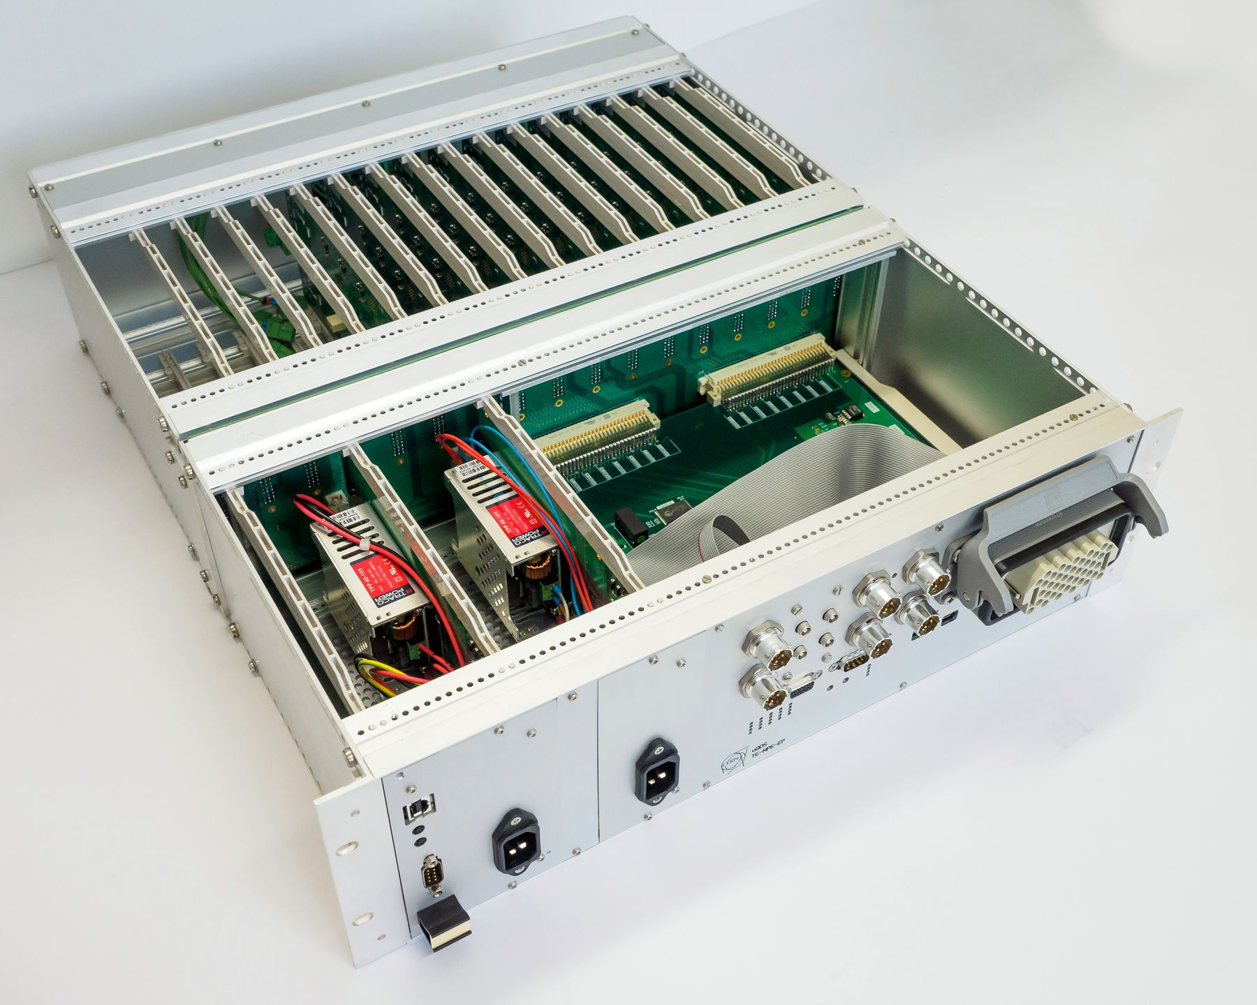
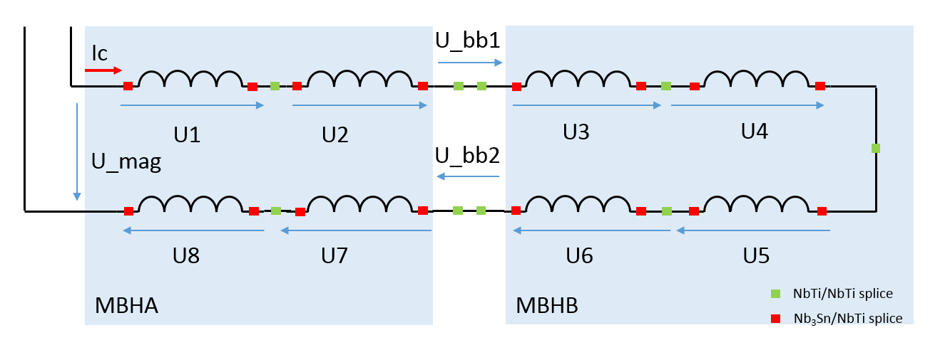
Universal Quench Detection
Front-end channels
(up to 16)
Backplane with signal connector(s)
Galvanic insulation
2.5kV
Digital mid-plane
Redundant power supplies
(monitored)
Detect asymmetric and symmetric quenches
  8x pole voltages for quench detection
Detect quenches of the interconnection bus-bar
  2x interconnection bus-bar voltage for bus-bar protection
Cover all bus-bars in the magnet assembly
  pole voltages include adjacent short bus-bars
Interlocks &
communication
Field
Bus
Redundancy on the level of crate
    Enhanced availability of supervision
Qualified in radiation
    Components in PSI, device in CHARM – radiation tolerant up to 100 Gy

Slide 13
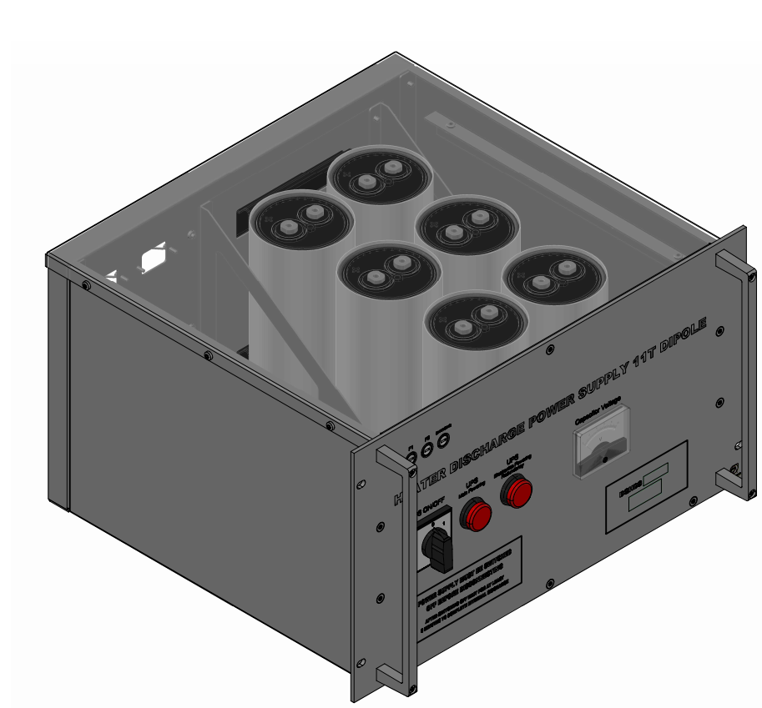
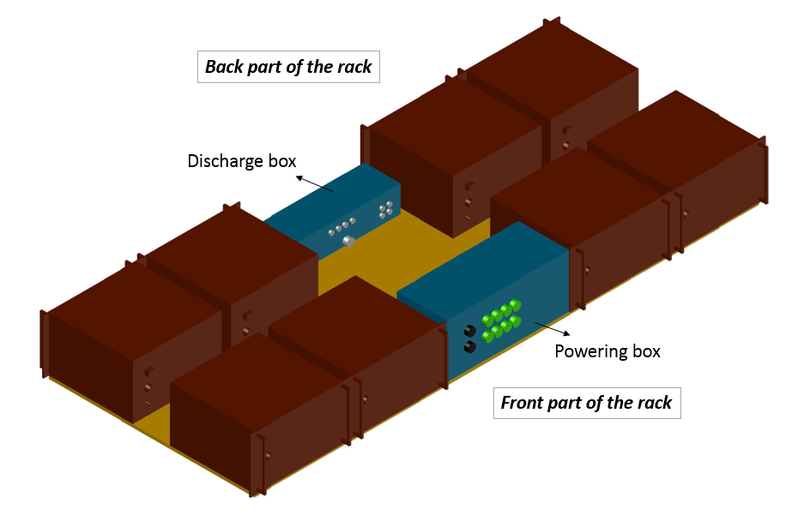
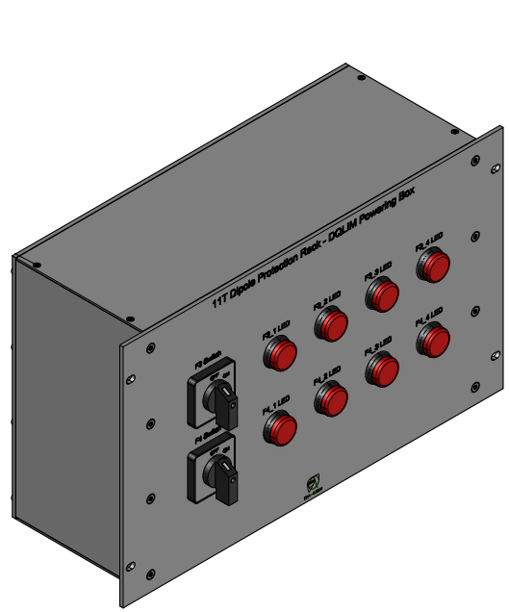
HDS Rack
DQHDS supplied by both F3 (UPS1) and F4 (UPS2)
Switches on the front side to turn on/off the eight DQHDS
For maintenance purposes, the current transformers installed inside the DQHDS
New DQHDS has relays in the internal discharge circuit for safety
New DQHDS has a voltage indicator
Qualified in radiation (components in PSI, device in CHARM – radiation tolerant up to 420 Gy)
Courtesy of D. Carillo

Slide 14
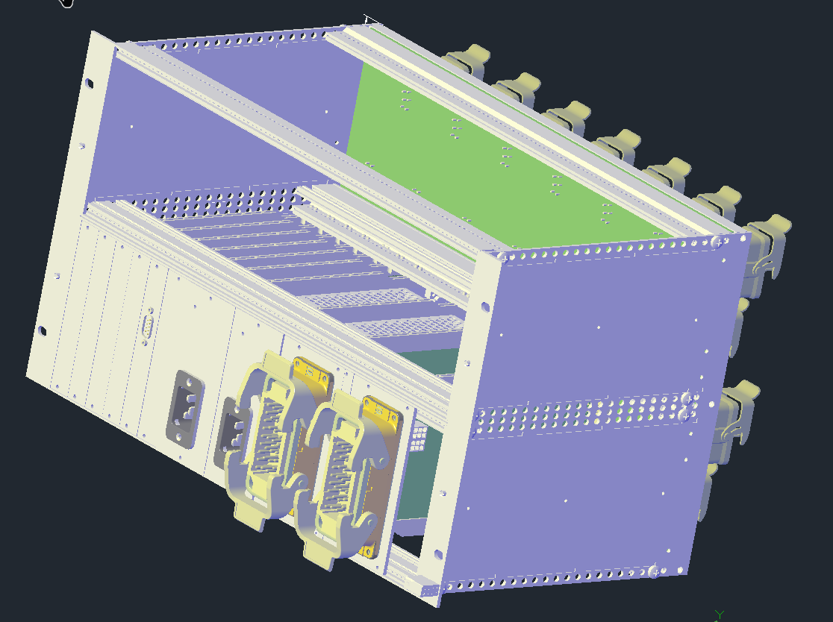
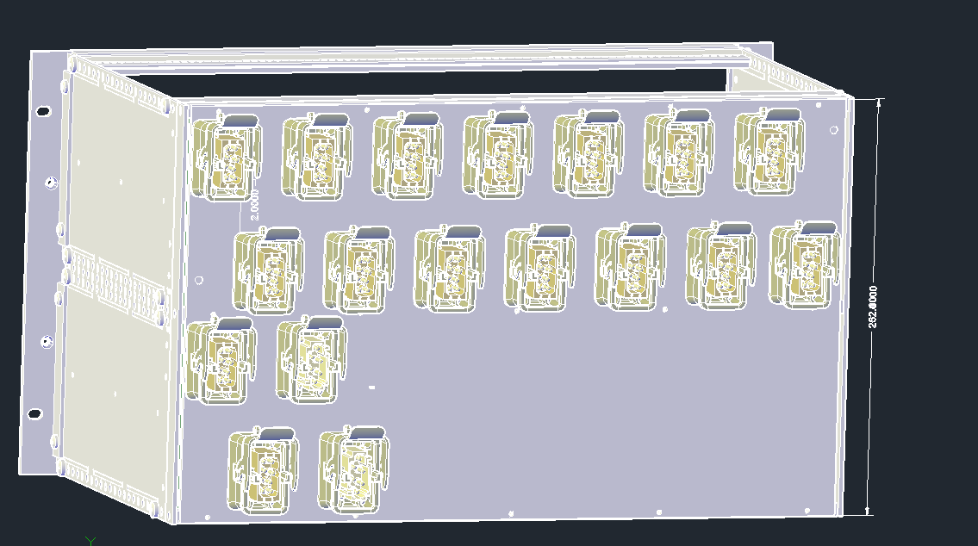
11T HDS Controller
Monitoring 16 quench heater voltages and 16 currents
Trigger coupling of 2x16 HDS trigger lines from UQDS (fully passive, no fan-out required)
HDS trigger monitoring
Supervision of Heater-to-IFS box cable connection

Slide 15
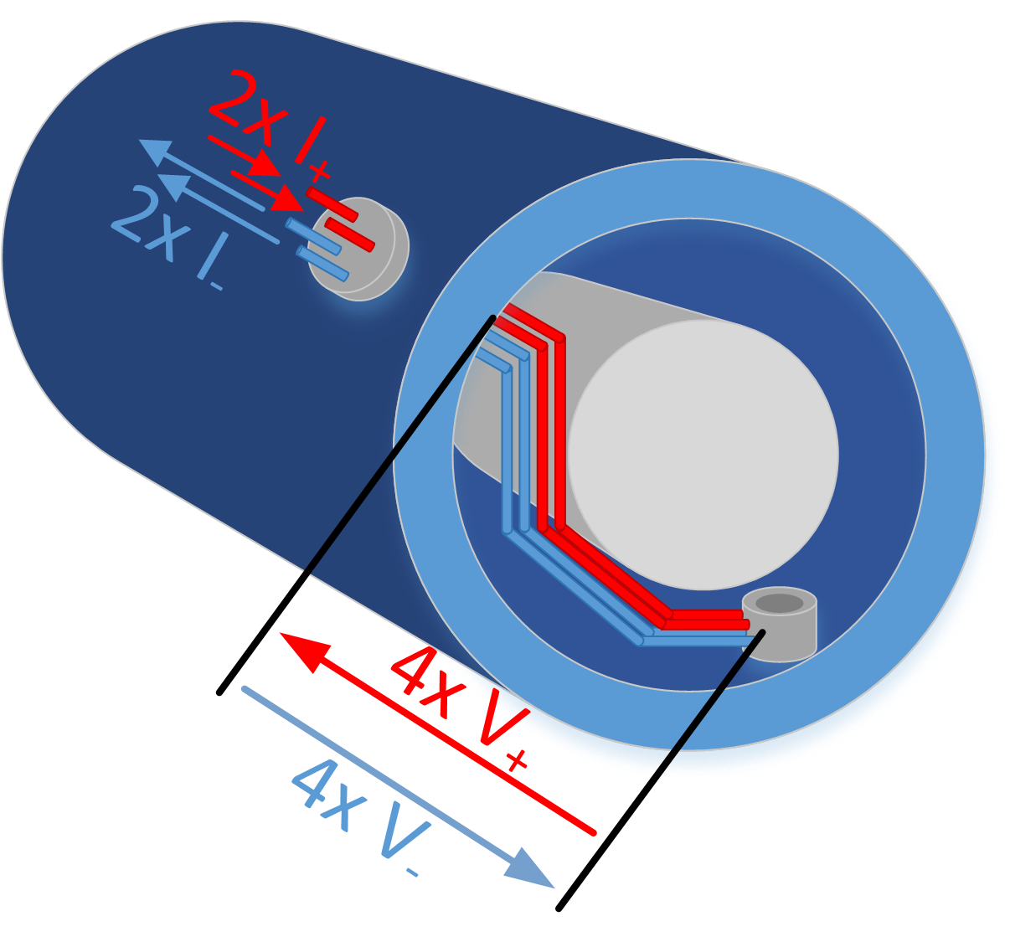
Trim Lead Protection Unit
The resistive leads of the 11T trim circuit require active protection
Lead voltage will be measured redundantly (2x4 voltages)
Short bas-bars connecting circuit to the magnet will be included in measurements
Current sharing will be monitored and optionally interlocked
(1x4 currents)
Unit will be composed of existing quench detection boards (DQQDC & DQAMG) or UQDS will be used

Slide 16
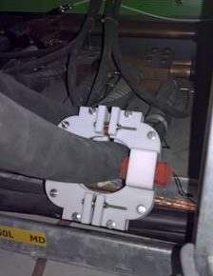
Consolidation of QPS for IPQ
Reduce susceptibility to thunderstorms
  Separation of magnet and bus-bar protection
Enhance detection of symmetric quenches
  Use of current derivative sensors
  New quench detection unit to interface
  current derivative sensors
Improve quench heater supervision
  Use existing DQHSU units (used for main dipoles)
Improve remote maintenance
Partial upgrade planned for LS2
  According to priority list that is in preparation by MP3

Slide 17
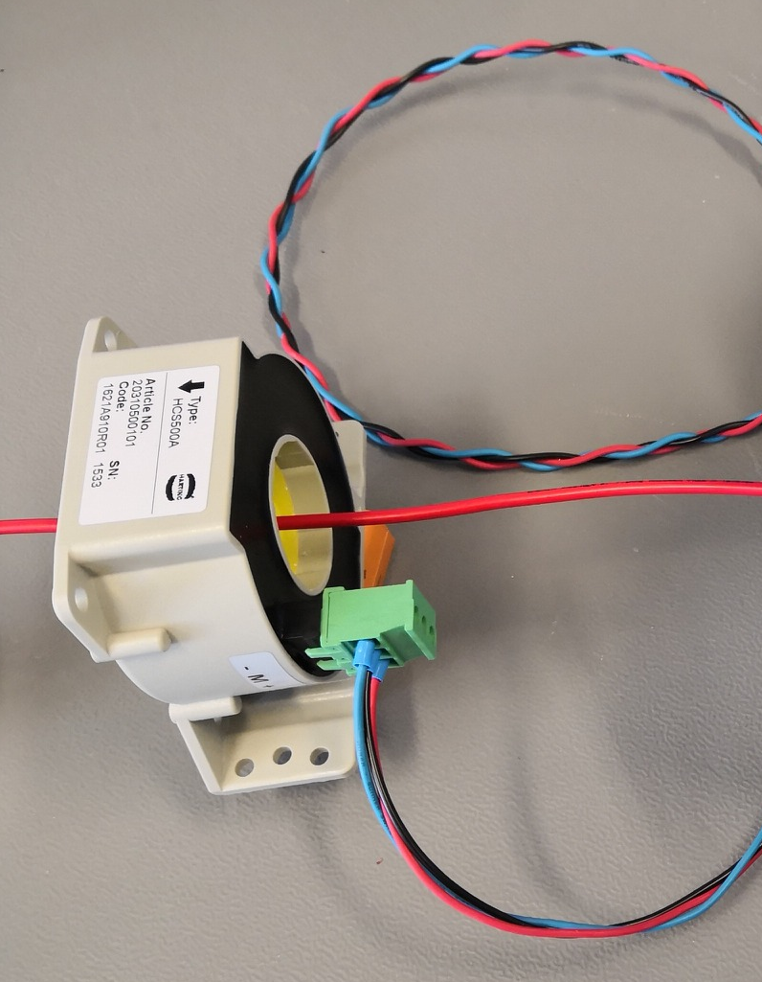
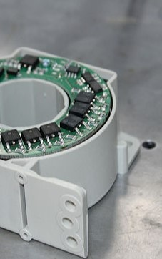
Consolidation of QDS for 600A
Improve EMC of current sensors
  Exchange of current sensors in sensitive areas (RR)
  Installation of redundant sensors to switch in case of faults
  New sensor candidate showed very good noise performance and was qualified in irradiation testing campaign in PSI up to 420 Gy
Improve ramp rate limits
  Use of current derivative sensors for high-inductance circuits – planned but not confirmed for beginning of Run 3
General maintenance
  Improve PM timing
  Improve remote maintenance
  Improve current sensor cabling (RR)

Slide 18
Consolidation of EE 600A
General maintenance of 600A EE systems
  Systems targeted according to closing failure rate
Reduction of 600 A EE units in operation
  Circuits with operational currents below 300 A to be by-passed
  Changes in firmware required
  Interlock configuration affected
Four vacuum breaker-based systems will replace four electromechanical ones
  Exact circuits to be decided
Transparent for operation

Slide 19
Upgrade of QPS: Miscellaneous
Partial replacement of obsolete detection boards by new generation QDS for ITs
Fast quench loop controllers for S67 and S78
  Fast (<1 ms) transmission of circuit abort signal to PIC – required to dump the beam prior to heater firing in 11 T dipoles
Reconfiguration of the nQPS layer in S67 and S78 after 11 T dipole installation
  11 T dipoles cannot serve as reference magnets for aperture symmetric quenches
13 kA EE systems
  Consolidation and maintenance of 256 circuit breakers
  Inspection and maintenance of dump resistors
  Consolidation of controls

Slide 20
Upgrade of QPS Supervision & Control
MasterFIP replaces WorldFip (test successful so far)
Major software stack update
NXCALS logging – in cooperation with BE-ICS
Refactoring of real time application
  Data processing optimization
  State machine controller
  Automatic fault recovery
Automatic analysis of state of health of the system
Swisstool extension
Supervision must be fully operational before QPS IST and LHC HWC!

Slide 21
Conclusions
QPS for MQ will be upgraded due to approaching the end of the system lifetime, and as well to enhance diagnostics and remote maintenance
QPS for 11T will be deployed to protect 11T magnet
Partial consolidation of QPS for IPx circuits will be performed
We do not expect any surprises in QPS due to operation at 7 TeV

Slide 22
Thank you for your attention!

