Slide 1
Interlock Systems
I. Romera Ramírez on behalf of TE-MPE-MI
7-8 May 2019 - MPP Workshop 2019

Slide 2
LHC MPS layout
Beam Interlocks
Powering Interlocks

Slide 3
Beam Interlock System
BIS

Slide 4
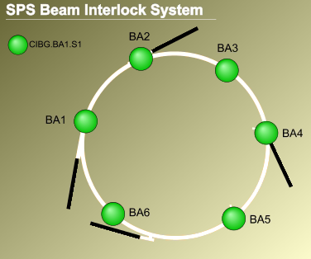
SPS-ring BIS: Reconfiguration
Reconfiguration required following SBDS relocation:
  New CIBU connection from SBDS in ECA5 to BIC in BA5
  New fibre optics from SBDS in ECA5 to BIC in BA5
  Frequency generator board (CIBG) to be relocated in BA5
  TSU integration as client of the Beam Permit Loop
  Reference DB and software tools to be updated
  Dry run in collaboration with TE-ABT to test arming
  procedures, frequency detection, etc
SBDS
SBDS
Beam Interlock System

Slide 5
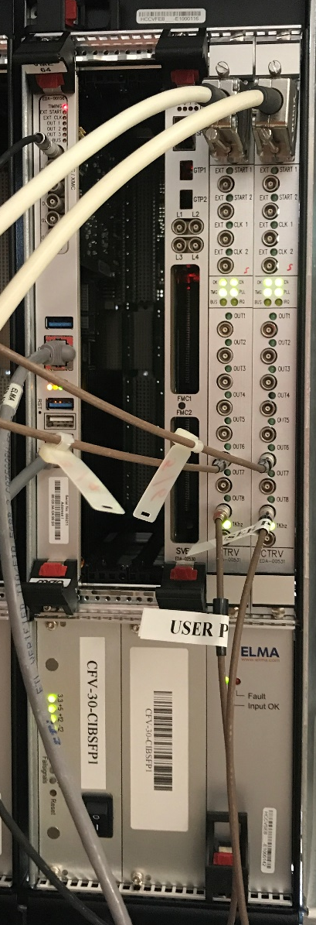
SPS-ring BIS: New connections
GMT monitoring: aiming at detecting failures on timing distribution
Standard Dump: “SX.KIKDMPTG-CT” timing event will trigger a beam dump request through the BIS (see G. Kruk’s talk)
Beam dump event: beam dump trigger from BIS to GMT
CTRV_0/CH_1: PPS
CTRV_0/CH_2: START_OF_CYCLE
CTRV_0/CH_6: STANDARD_DUMP_A
CTRV_1/CH_6: STANDARD_DUMP_B
CTRV_0/CH_8: GMT_MONITOR_A
CTRV_1/CH_8: GMT_MONITOR_B
redundant GMT reception
redundant processing
redundant triggering
fail-safe logic
Beam Interlock System

Slide 6
SPS Injection Interlocking - Motivation
the SPS Beam Dump System (SBDS) will be relocated from LSS1 to LSS5 and the existing ABT link between the SBDS and the Injection kicker (MKP) will be removed => injection inhibit through the SPS-Injection-BIS
after the LIU consolidation, beam brightness will increase and beam energy/intensity can reach damage thresholds at the TBSJ (see Thermo-mechanical studies of the TBSJ for LIU beams) => a highly dependable interlocking solution has to be provided
Beam Interlock System

Slide 7
SPS Injection Interlocking - From PS to SPS
TT2-TT10 switching magnet
SPS injection kicker
corrector dipole to
center beam on TBSJ
Beam Interlock System

Slide 8
SPS Injection Interlocking - Strategy (1/3)
IF (TT2-TT10 beam permit)
AND
(SPS-INJ beam permit) THEN
SPS injection allowed
Beam Interlock System

Slide 9
SPS Injection Interlocking - Strategy (2/3)
IF (TT2-TT10 beam permit)
AND NOT
(SPS-INJ beam permit) THEN
SPS injection not allowed AND beam to TBSJ
Beam Interlock System

Slide 10
SPS Injection Interlocking - Strategy (3/3)
IF NOT (TT2-TT10 beam permit) THEN
SPS injection not allowed AND beam to D3
Beam Interlock System

Slide 11
SPS Injection Interlocking - Architecture
Beam Interlock System

Slide 12
SPS Injection Interlocking - New failure modes
Impact of injecting a new beam when a beam dump has just been triggered
  Risk of injecting a new beam with no possibility to dump it
  Consequence of increased length between SBDS and MKP
  Mitigation: Proposal to implement a delay (2 turns) between the dump request and the dump trigger
Impact of injecting a new beam just after MKDV erratic
  Risk of injecting and accelerating a new beam with no possibility to dump it
  Consequence of additional delay required to inhibit injection (i.e. delay from ECA5 to BA1)
  Mitigation: Proposal to use the MDSH magnet to dissipate the beam in the ring
More details by V. Kain tomorrow
Beam Interlock System

Slide 13
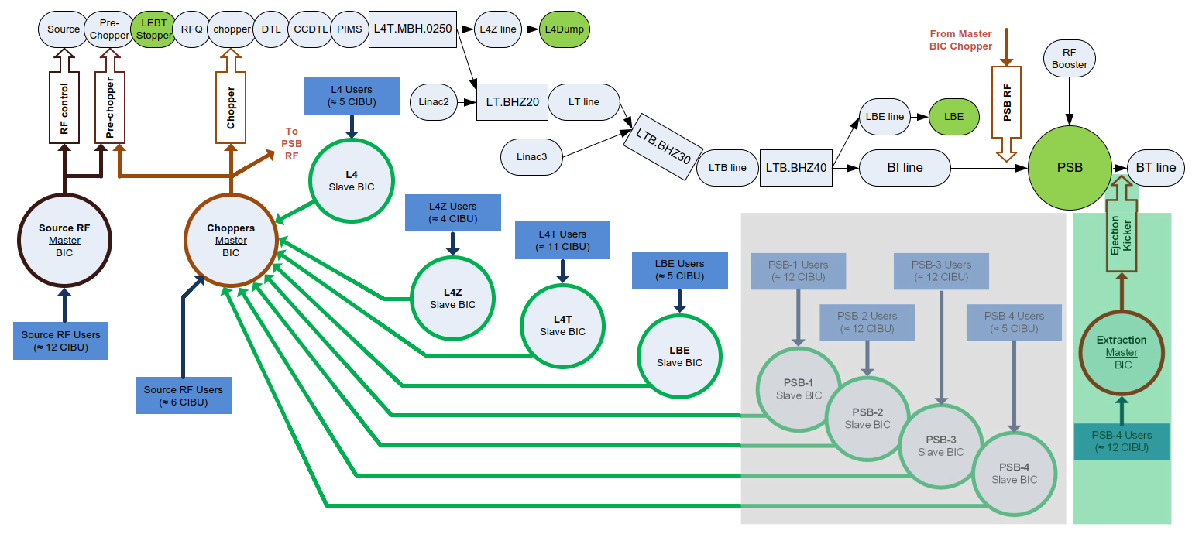
New BIS architecture in LINAC4 and PSB
New interlock architecture in Linac4, TLs and PSB
5 new slave BICs connected to Chopper Master BIC (PSB-1, PSB-2, PSB-3, PSB-4 and LBE)
BIC Master equations re-configured
More details by B. Mikulec
and D. Nisbet tomorrow
Beam Interlock System

Slide 14
Beam-beam kick effects in LHC
Extraction of one beam causes a missing beam-beam kick in the other beam, i.e. ultra fast orbit offset, leading to beam losses in IR7 (see D. Wollmann at BIS 2v0 workshop)
For HL-LHC, the beam-beam kick is reaching critical levels, risking to cause damage in the collimation system if beams are not dump swiftly after each other
Reliable linking of the two beams required for high intensity operation
Clarify asap the consequences for Run 3!
Beam Interlock System

Slide 15
Safe Machine Parameters
SMP

Slide 16
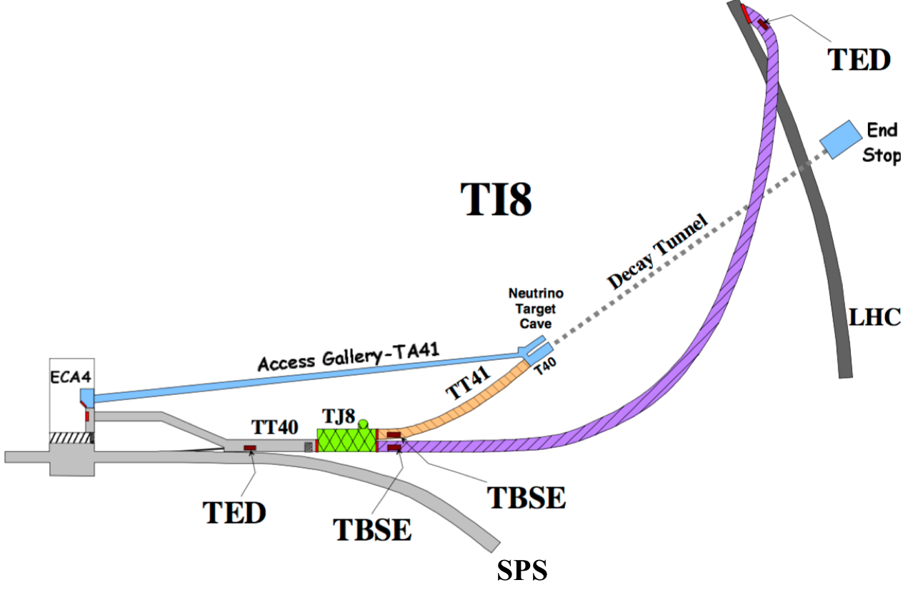
SMP flag for SPS-LHC TL TED stoppers
TEDs will not be able to withstand a full 25 ns LIU batch consisting of 288b
New machine protection strategy with LHC beams after LS2 (SPS-OTH-ES-0001)
The maximum intensity to be extracted with TED in beam ≤ 3.34 x 10¹³ protons
New SMP flag => SPS TED Beam Flag (SPS_TBF)
Logic:
  SPS_TBF = true when (SPS_INTENSITY ≤ 3.5 x 10¹³)
  else SPS_TBF = false
SPS_TBF transmitted over the GMT and received via a standard timing board (CTR)
4 ELMA 3U VME chassis to be installed
SPS-LHC transfer line for beam 2
Safe Machine Parameters

Slide 17
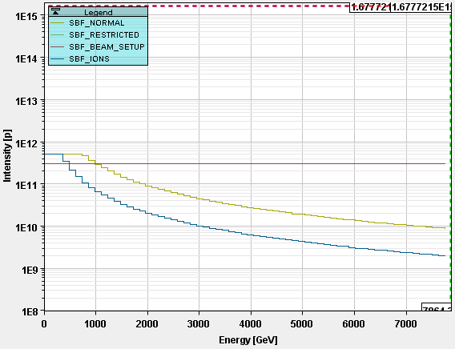
SMP flags in LHC
Review Setup Beam Flag equations?
  SBF_BEAM_SETUP (3x10¹¹p) is used for almost any MD.
  Is that good in terms of safety?
Suppression of UNSTABLE_BEAMS mode?
  UNSTABLE BEAMS used for the calculation of the Moveable Devices In (MDI) flag
if (PHYSICS_ENERGY = TRUE)
AND
(BEAM_MODE = “STABLE BEAMS” OR BEAM_MODE = “UNSTABLE BEAMS” OR BEAM_MODE = “BEAM DUMP”)
AND
(BEAM_SQUEEZED = TRUE) then
MDI = TRUE
else MDI = FALSE
  Removing the UNSTABLE_BEAMS mode does not have an impact on the flag calculations, provided the beam mode enumeration is maintained as it is.
Safe Machine Parameters

Slide 18
Other requests
Reliable transmission of bunch intensity in HL-LHC:
  For TCDQ levelling: due to the TCDQ damage limit, allowed TCDQ position depends on bunch intensity
  For beam-beam kick effect: kick scales with bunch intensity
Transmission of SPS energy and intensity:
  For beam instrumentation equipment
SMP v2.0 Workshop - 21 June 2019 at CERN
Safe Machine Parameters

Slide 19
Powering Interlock System
PIC

Slide 20
Energy dependent masking of GPM
Experience showed that 75% of the 600A EE openings in Run 2 were due to the activation of the GPM and only 25% due to individual openings
In 30 % of the cases the activation was not necessary for protection due to the low energy stored in the magnets (i.e. at injection energy)
In order to reduce the number of openings of the 600A EE and ultimately to reduce the maintenance cost, preserve and extend the life of the 600A EE systems, the GPM will be automatically disabled as a function of the current level in the main circuits
Implementation options:
  a) FESA class: get main circuit currents from PC gateway, calculate and communicate with PIC PLCs
  b) SIS: get main circuits currents from PC gateway, calculate and communicate with PIC WinCC OA

Slide 21
Review criticality of electrical circuits
ESSENTIAL or UNMASKABLE (if such a circuit fails, the beams will be dumped under any condition, also for safe beams): RB, RQD/F, RQX, RD1-4, RQ4-RQ10
AUXILIARY or MASKABLE (if such a circuit fails, the beams will be dumped only if beams are unsafe. So for unsafe beams, an auxiliary circuit will do the same as an essential): RCS, RQT%, RSD%, RSF%, RQSX3, ROD, ROF, RCBXH/V and RCB%
NO IMPACT (if such a circuit fails, the interlock will only stop powering but will not dump the beam): RCD, RCO, RQS.%, RSS
In Run 1: RQSX3 family was included in the Maskable configuration after trip provoking fast orbit changes and beam losses in IP7 (EDMS 1203408)
In Run 2: 2 trips of RQS.A81B1 @ 16.06.2017 that led to increasing losses and dumped on BLMs. This was presented at the MPP and no action was finally taken on the RQS family.
For Run 3: Configuration reviewed by BE/ABP and proposed to keep as it is

Slide 22
New interlock for 11T dipole
11T trim circuit to be added as an independent circuit on the PIC (B1 type)
FPA on the RB circuit will be propagated to 11T trim PC via GPM
Quench detection for 11T current leads connected to PIC quench loop
New trim Power Converter interfaces to be connected to PICs in RR73/77
Main dipole circuit RB.A67 configuration for the HL-LHC with the 11T trim power converter.

Slide 23
Warm Magnet Interlock System
WIC

Slide 24
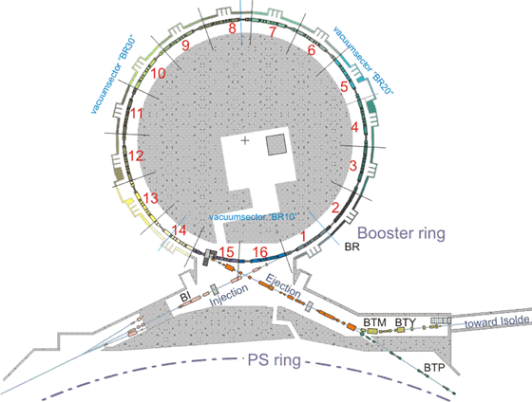
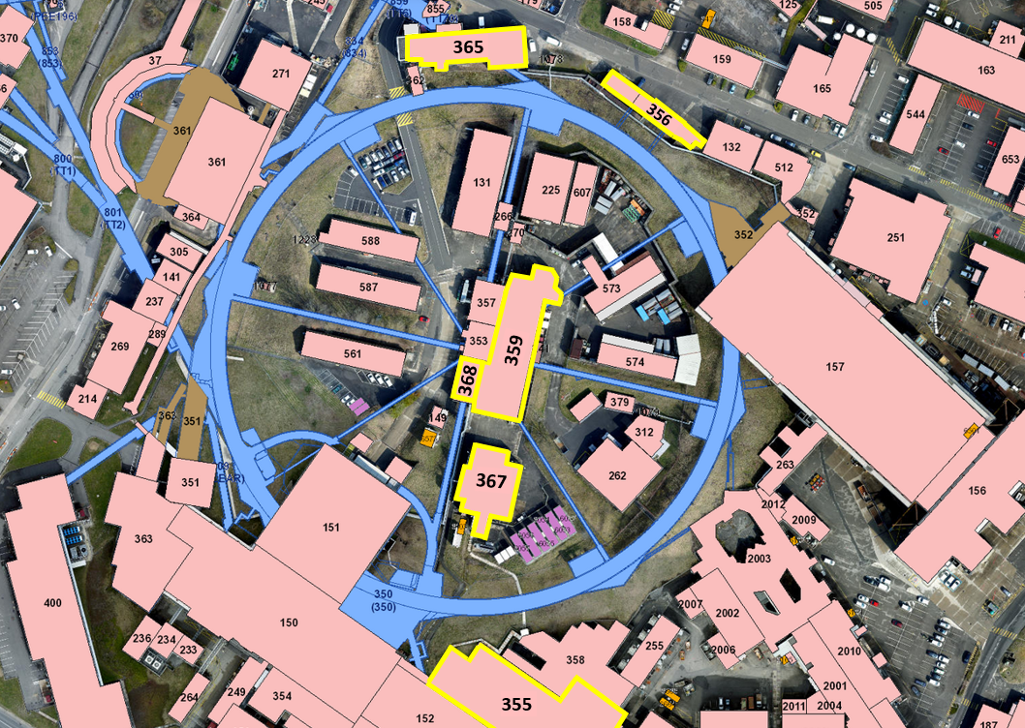
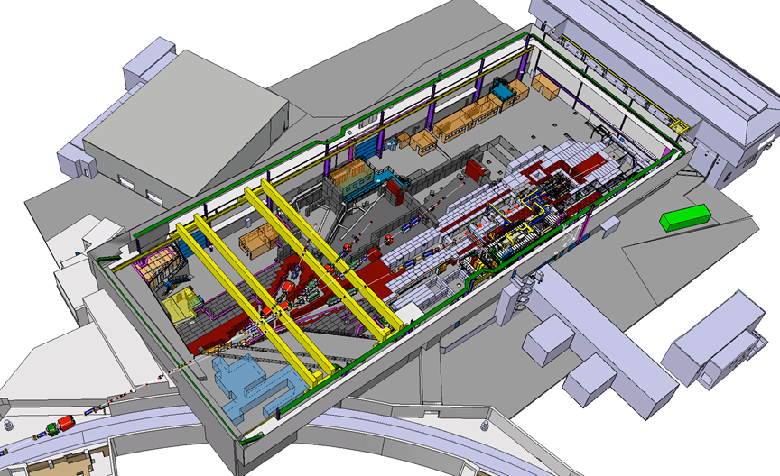
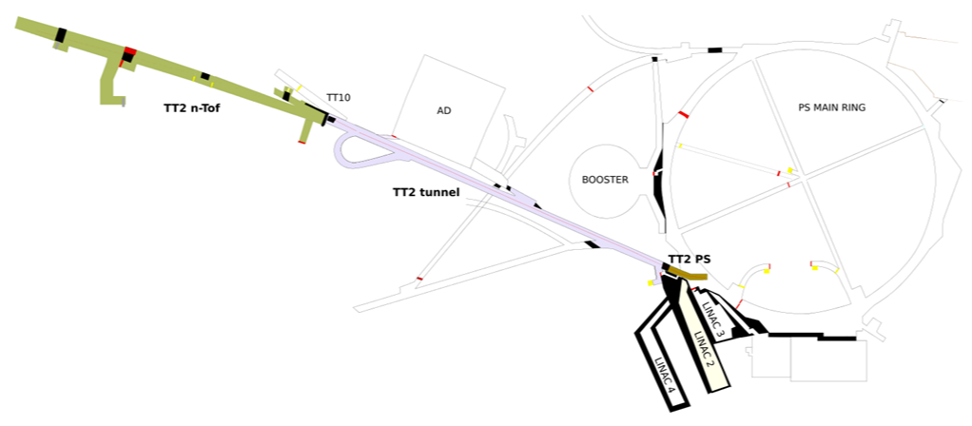
New installations for LS2
PS machine (PS-CIW-ES-001)
LT- LTB- LBE- BI transfer lines (CPS-CIW-ES-002)
East Area (EA-CIW-ES-0001)
BT- BTM- BTP transfer lines (CPS-CIW-ES-003)
TT2- nTOF transfer lines (CPS-CIW-ES-001)

Slide 25
Connection to BIS of BBCW in LHC
Wire collimators for BBLR compensation (LHC-TC-EC-0019): Wire power converter added to the WIC Fast Boolean Processor to trigger a beam dump in case of internal PC failure
Due to low inductance of the wire, the current decay and effect on the beam in case of powering failures is in the order of ∼30 ms
The WIC also protects the wire from overheating, by switching off the PC and dumping the beam
SCADA-WinCC OA and PLC configuration need to be updated
FGC3-BIS propagation time measured (∼ 1.2 ms) is fast enough

Slide 26
New interface between SPS main PCs and BIS
Upgrade of the obsolete interface between the main power converters of the SPS and the BIS (SPS-CIW-EC-0001)
At present, in case of internal failures of the main power converters, the Hardware Interlock Loop (HIL) is responsible for switching off all other power converters of a given circuit and triggering a beam dump
After LS2, the HIL will request the beam dump via the WIC – Fast Boolean Processors (response time <10 ms faster than present implementation)
New FM352 modules to be added in BA3 and BB3 WICs

Slide 27
Fast Magnet Current Change Monitor
FMCM

Slide 28
Activities in LS2
No changes are foreseen on the FMCMs, beyond controls upgrades (i.e. FESA classes)
For operation at 7 TeV, review circuit currents and re-adjust voltage dividers at the input stage of all FMCMs in the LHC
Potential availability gain if improving electrical glitch rejection on sensitive power converters (i.e. RQ4.LR3/7 and RQ5.LR3/7) - see S. Uznanski at Evian ‘19

Slide 29
Conclusions
All interlock related protection systems worked very reliably during Run 2
For Run3, deployment of new interlock installations in LHC and injectors
  Linac4 BIS/WIC, PSB WIC, SPS injection BIS, 11 T dipole, BBCW…
Consolidation of BIS and SMP systems foreseen for LS3
Future interlocking requirements for HL-LHC need to be clarified: SMP bunch intensity, linking of Beam Permit Loops…

Slide 30
Thank you for your attention!

Slide 31
Spares

Slide 32
WIC beam dump matrix in Linac4 and TLs
3 WIC systems are installed to protect the resistive magnets in Linac4 and TLs up to PSB
WICs connected to the Linac4 BIS to interrupt the beam in case of magnet overheating or power converter failures
Proposed to exclude the status of certain power converters in the calculation of the “User Permit” signal sent to the BIS (CPS-CIW-EC-0001)
Non-working corrector power converters should be possible to compensate with other correctors in order to restore an acceptable beam trajectory and help to maintain availability

Slide 33
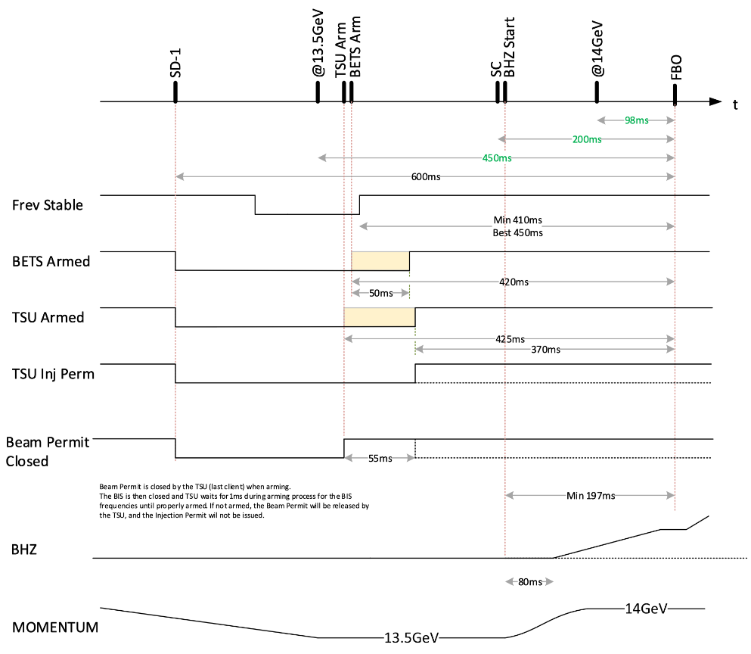
SPS Injection Interlocking - Arming sequence
TSU is the last client to rearm
Only when TSU is armed, the SPS Beam Permit becomes TRUE
  Frev stable
  BETS armed
  TSU armed
SPS Injection Permit has to be given early enough for the Power Converters to play the required function (~350ms before beam)
  Worst case will be SFTPro p+ (14 GeV)
Beam Interlock System

