Slide 1
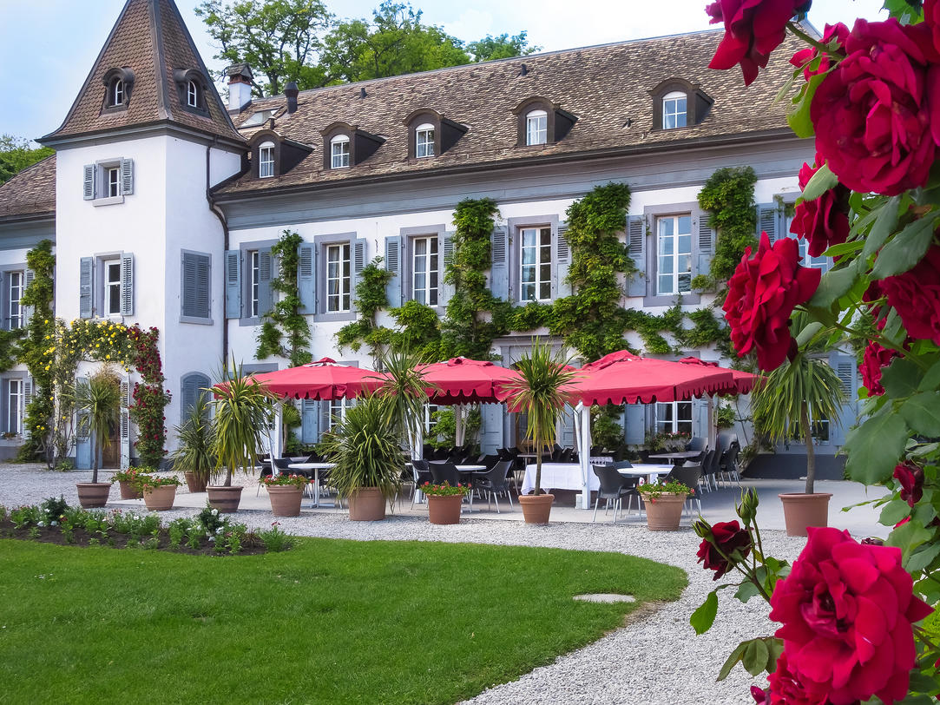
PS and Machine Protection
MPP Workshop 8 May 2019
K Hanke, D Cotte

Slide 2

Outline
Present situation
Features of the present system and experience with (pre-LS2) protection
Mid-term strategy
LS2 changes and run 3
Long-term strategy
LS3 and beyond
2
MPP Workshop 8 May 2019
KH

Slide 3
Interlocks in the PS: Present Situation
External Conditions EC:
Presently main system
Hw system
Reaction time up to 4 cycles (in the worst case)
Software Interlock System SIS:
Additional monitoring
Not fail safe
Reaction time 2-3 pulses
BLMs
Cutting Linac2 timing
3
MPP Workshop 8 May 2019
KH

Slide 4
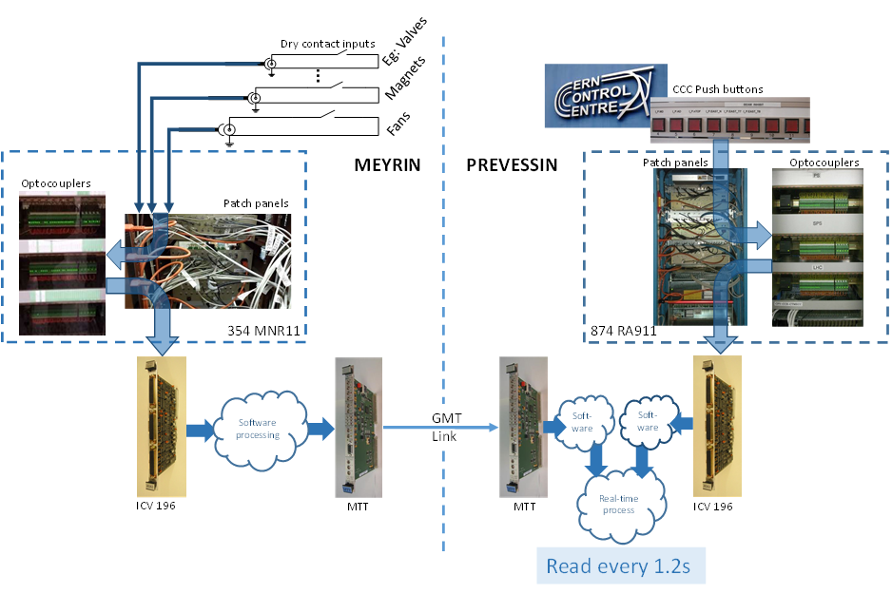
External Conditions
4
MPP Workshop 8 May 2019
KH

Slide 5
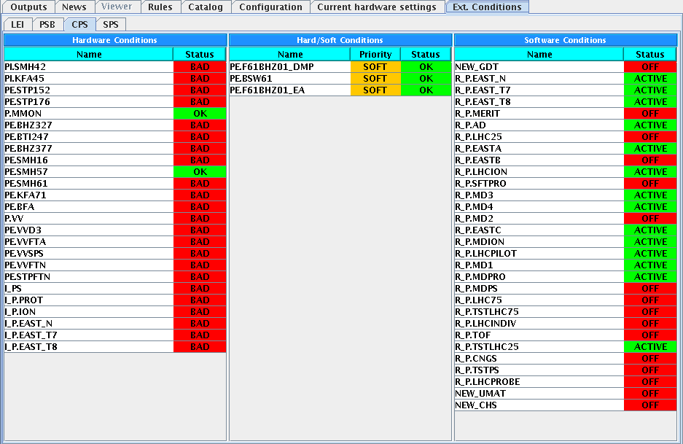
External Conditions
5
MPP Workshop 8 May 2019
KH

Slide 6
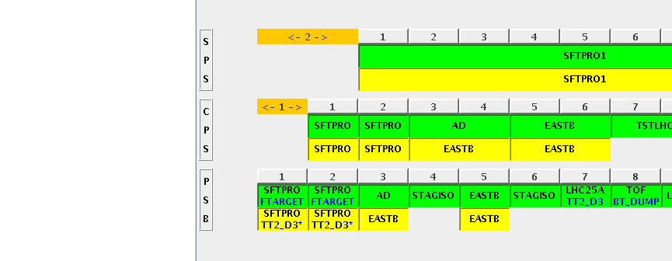
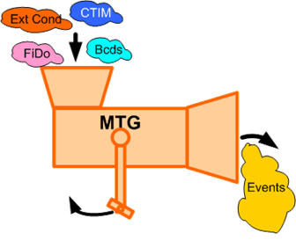
External Conditions
The EC give us the flexibility to select nominal and spare cycles depending on the ECs
6
MPP Workshop 8 May 2019
KH

Slide 7
External Conditions
Equipment | Details | Comments
TE-EPC - power supplies | hardware EC mixed solution SOFT-EC + SIS | POPS (hw) FGCs (mixed)
TE-STI - beam stoppers, internal dump, “ralentisseur” | hardware EC | internal dump with (BIC + SIS + EC)
TE-VSC - valves | hardware EC | possible candidate for future BIS
TE-ABT - kickers, BFA | hardware EC
7
MPP Workshop 8 May 2019
KH

Slide 8
External Conditions: EPC
Equipment | Details | Comments
P.MMON (EIS) | main power supply ON only FGC with hardware EC | POPS - FGC53
PE.SMH16 (EIS) | extraction septum with HW EC renovation post-LS2 | POWM1553
PI.SMH42, PE.SMH57(EIS), PE.SMH61 TT2: PE.BTI247(EIS), PE.BHZ377/8(EIS), FTN.BHZ403 (EIS) | renovation foreseen during LS2 with FGC control type; agreement of a mixed solution SOFT-EC + SIS | EC in TT2 to be renamed with correct prefix F16 BHZ377/8 will be powered with two separate circuits
2 new external conditions for EAST Area | agreement of a mixed solution SOFT-EC + SIS | F61.MBXHD025 F63.MBXHD001 (name tbc)
8
MPP Workshop 8 May 2019
KH

Slide 9
External Conditions: STI
Equipment | Details | Comments
PE.STP152 (EIS) PE.STP176 (EIS) | renovation during LS2, keep hardware EC | prefix to be renamed (F16) 2+1 Stoppers
FTN.TARGET | renovation during LS2, keep hardware EC
PE.STPFTN (EIS) | renovation foreseen post-LS2, hardware EC | Prefix to be renamed (FTN)
PE.STPFTA (EIS) | renovation foreseen post-LS2, hardware EC | Prefix to be renamed (FTA)
PE.STPF61 (EIS) PE.STPZT8 (EIS) | renovation during LS2, keep hardware EC | Sum of 5 Stoppers in F61 (1 EC) Sum of 5 Stoppers in T8 (1 EC) 1 in T9, 1 in T10, 1 in T11 (no EC)
PR.TDI47 PR.TDI48 | new equipment | 1 (or 2) EC in parallel with BIC + SIS EDMS 1977845
PR.RAL12 | new equipment interlock with SEMGrid position | 1 EC for maximum threshold for beam impact (could be software or SIS) to be defined
9
MPP Workshop 8 May 2019
KH

Slide 10
External Conditions: VSC
Equipment | Details | Comments
P.VV | keep hardware EC vacuum valves in PS Ring | possible client for future BIC (LS3)
PE.VVD3 | keep hardware EC FT16.VVS10 + FT16VVS20 + FT16VVS30 | possible client for future BIC (LS3)
PE.VVFTA | keep hardware EC vacuum valves in FTA | possible client for future BIC (LS3)
PE.VVFTN | keep hardware EC vacuum valves in FTN | possible client for future BIC(LS3) in PS
PE.VVSPS | keep hardware EC FTS.VVS10 | possible client for future BIC(LS3) in PS or to be linked to SPS BIC -> BHZ377/378 to 0A
10
MPP Workshop 8 May 2019
KH

Slide 11
External Conditions: ABT
Equipment | Details | Comment
PI.KFA45 | switch to sw solution
PE.BFA_CT | to be removed (pedestal + staircase)
PE.KFA13-21 | renovation during LS2 keep existing hardware EC | act only on MTE type beam
PE.KFA4 | renovation during LS2 keep existing hardware EC | act only on MTE type beam
PE.BFA_MTE | keep existing hardware EC (pedestal 9 only) | could be remove in case we allow MTE beam in degraded mode
PE.KFA71-79 | switch to sw solution | successful test performed in order to replace EC with a PPM interlock + SIS in 2018
11
MPP Workshop 8 May 2019
KH

Slide 12
SIS: Existing Situation (until 2018)
Monitor power converter status for critical circuits (PFWs)
Monitor power converter status of 8 Low Energy Quadrupoles equipped with thermal switches in order to switch off all power supplies powering the same quadrupole family
Stop TOF beam in case the maximum proton flux to nTOF target is exceeded
Dump beams with destination SPS in case of absence of TFID
Cut predefined users in case the KFA71 ppm interlock is present
Protect EAST Area from a bad setting of F61 switching magnet
Handle beam request and beam stopper position for EAST users
12
MPP Workshop 8 May 2019
KH

Slide 13
LS2 Modifications
External Conditions
Need to be modified (“software” ECs)
Beam Interlock System BIS:
not used in the PS for the moment (two devices will be connected to the BIS of other machines)
acts shot to shot
hw system
Warm Interlock System WIC
new in PS
Timings:
BLMs cut beam in Linac4
13
MPP Workshop 8 May 2019
KH

Slide 14
EC: Post-LS2 Situation
External conditions cannot be included as before with the new power converters
For the FGCs a pure hw solution for the ECs is not possible any more after LS2
As a compromise we will need to implement ECs as “sw” ECs
Note: already before LS2, ECs were not “fully” hw; there was always sw involved
14
MPP Workshop 8 May 2019
KH

Slide 15
BIS: Post-LS2 Situation
There will be no BIS in the PS after LS2 (no risk of damage of equipment)
In two cases PS equipment will be linked to the BIS of other machines (where shot-to-shot reaction and fail safety is mandatory):
Interlocks from both PS internal dumps in case of bad position of the dump core → will act on the Booster extraction BIS + EC
Interlock from SPS BIS in case of wrong condition in TT10 → will act on switching magnet F16.BHZ377/378 at the end of TT2 in order to send the beam to D3
15
MPP Workshop 8 May 2019
KH

Slide 16
WIC: Post-LS2 Situation
New system being implemented during LS2 dedicated to the protection of the auxiliary magnets from overheating by switching off the power converter
Concerns all auxiliary magnets in the PS Ring except the Low Energy Quads (EDMS1701483)
Concerns extraction lines F16 & FTN (EDMS1701477); not FTA
Concerns all magnets in the EAST AREA extraction lines F61, F62, F63, T8, T9, T10, T11 (EDMS 2037701, under approval)
16
MPP Workshop 8 May 2019
KH

Slide 17
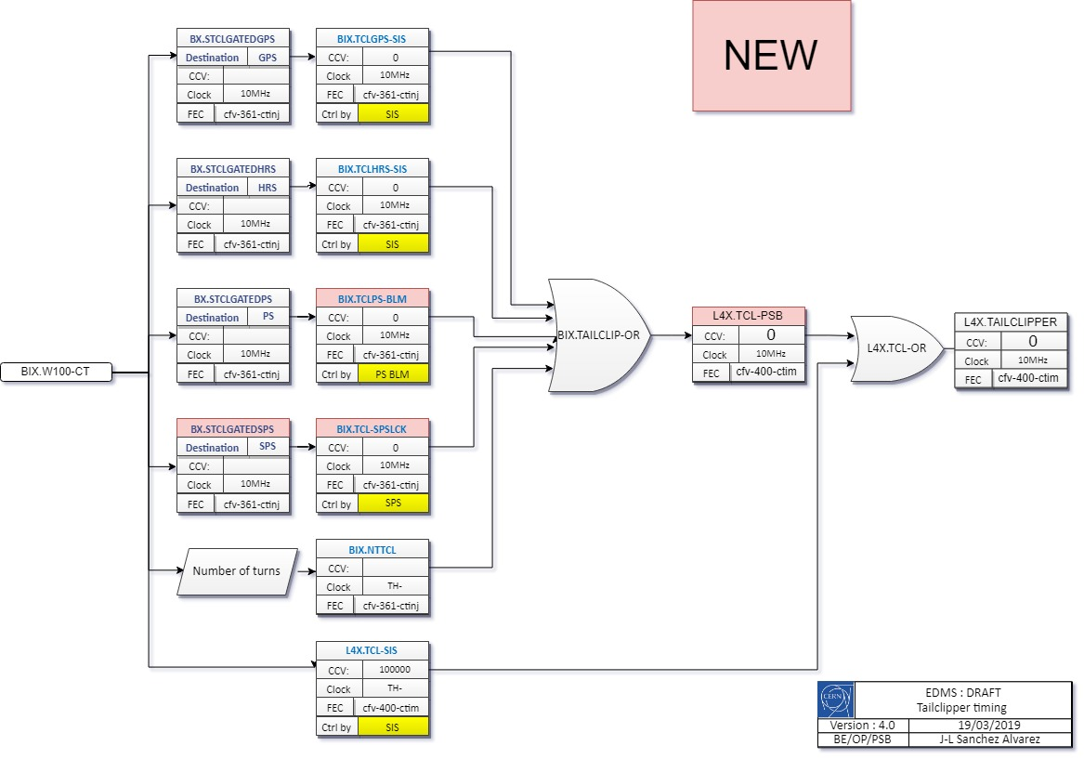
Timings for BLMs: Post-LS2 Situation
Stop the beam in case of beam loss in the PS Ring or TT2
Act on Linac4 Pre-Chopper timing L4X.TAILCLIPPER
Triggered by the new BE-BI FESA class for BLM
BLMs in EAST AREA (F61,F62, F63 and T8) will not be interlocked
17
MPP Workshop 8 May 2019
KH

Slide 18
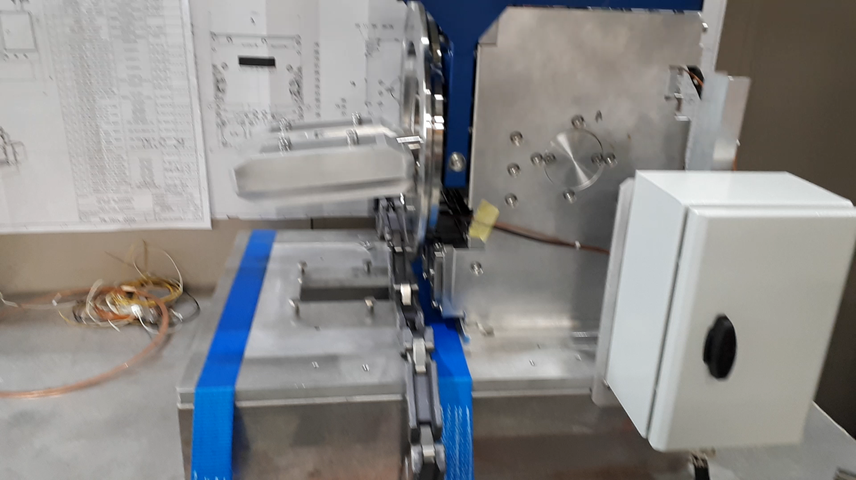
Internal Dump TDI47/48
Condition to trigger the internal dump
Protection against possible high intensity beam:
Protect EAST Area from erratic extraction of parasitic TOF bunch
Equipment protection
Dump satellite bunches a few milliseconds after extraction (LHC type beams)
Dump the full beam just before extraction in case of absence of TFID
On purpose for Machine Development or setting-up
18
MPP Workshop 8 May 2019
KH

Slide 19
Post-LS2 Modifications
WIC further implementation (EDMS1836387)
Main magnets during YETS22-23
Low Energy Quads to be equipped during LS3
PFW? Today only B8L is equipped with a thermal switch on the reference magnet
BIC
Implementation of a BIC for the PS under discussion; could replace external conditions
Could be envisaged for LS3 to ensure same strategy across the machines and would coincide with new BIS version
19
MPP Workshop 8 May 2019
KH

Slide 20
Overview of the three Main Protection Systems
System | Reaction time | Main feature | Up to LS2 | Post LS2 | Post LS3
External Conditions | max 4 pulses (typically 2-3) |  | hw; main system | “soft” ECs will remain main system
SIS | 2 – 3 pulses | high flexibility! | used to complement ECs | continue to use | continue to use
BIC | pulse to pulse | fail safe | no BIC | no BIC but use of PSB and SPS BICs in two cases | could be envisaged
20
MPP Workshop 8 May 2019
KH

Slide 21
Summary
The present machine protection in the PS is widely based on External Conditions complemented by SIS
The external conditions will be modified during LS2 (“soft-ECs”)
Post LS2 we will have additional machine protection systems: WIC, BLMs acting on Linac4; there will be no BIS for the time being
In the long term one could think of a BIS for the PS, in order to harmonise with the other machines and in order to have a fast and fail safe system
There are very few (if any) cases where equipment can be damaged in the PS, even with LIU beams
The goal of machine protection is therefore to avoid long term activation
We must preserve the flexibility and efficiency of the PS
21
MPP Workshop 8 May 2019
KH

