Slide 1
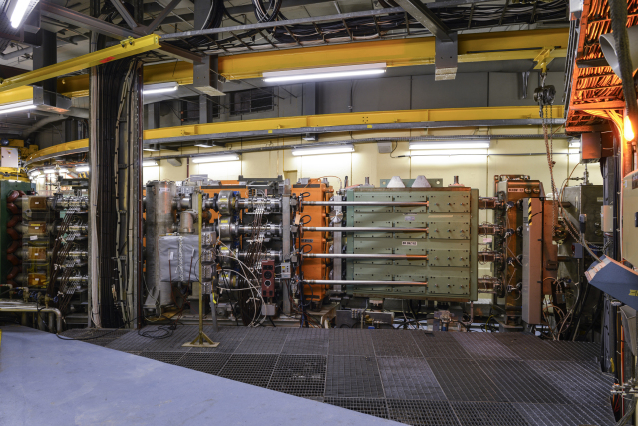
PSB Interlocking after LS2
Thanks to everybody who was patient to answer my open questions and who provided input!
B. Mikulec

Slide 2
Outline
PSB post-LS2 interlock design
  Design principle
  BIS, SIS, WIC, EC
The four rings of the PSB
  Available flexibility
  Open issues
Special considerations
  BT.BHZ10 switching magnet
  POPS-B / MPS switching
Fault diagnostics, masking of interlocks, settings management
Summary

Slide 3
Pre-LS2 PSB Interlock Situation
Pre-LS2: interlock based on External Conditions, timing and SIS
  External Conditions (EC): served as HW interlock, but also to optimize beam availability (usually spare cycles programmed and useful e.g. during periods when ISOLDE was not continuously requesting beam)
    Main EC, e.g. MPS, extraction septum/bumpers, recombination kickers, beam stoppers, ring vacuum valves, PSB inhibit…
    Destination-dependent EC: ISOLDE, GPS, HRS, PS, Bdump
    Linac2 test and MDs
  Tailclipper: reducing the Linac2 pulse length with the ‘tailclipper’ timing
    e.g. for zero turns in one or several rings, PS BLMs, as possible SIS action etc.
  SIS: when the above could not be used, e.g. for
    PS stray field compensation (injection trajectory), average current or pulse current limitation for ISOLDE targets or EAST/TOF cycles
Should remember that the PSB has no internal dump and no fast kicker magnet to the external dump → once the beam is in the machine, either cut RF (spread out losses in rings) or extract…

Slide 4
Outline
PSB post-LS2 interlock design
  Design principle
  BIS, SIS, WIC, EC
The four rings of the PSB
  Available flexibility
  Open issues
Special considerations
  BT.BHZ10 switching magnet
  POPS-B / MPS switching
Fault diagnostics, masking of interlocks, settings management
Summary

Slide 5
Post-LS2 Design Considerations
With Linac4 new options to cut the beam → decided to deploy an integrated Linac4 and PSB BIS design for post-LS2, still maintaining:
EC: mainly for user requests / inhibits, equipment affecting individual rings / destinations or certain equipment in the extraction lines (see later…)
  Still needed due to PSB individual rings (BIS action always means cutting the entire Linac4 pulse…) and to maximize proton delivery
Tailclipper: will be maintained, but different action → advance pre-chopper and chopper timings to remove the beam at low energy
SIS: similar to pre-LS2, additional equipment survey (mainly in extraction lines) or e.g. degradation of stripping efficiency in ppm
WIC: will cover now full machine with transfer lines* (before LS2 only PSB rings); input into BIS
* Remark: the BTY line (transfer line to ISOLDE) will be added after LS2.

Slide 6
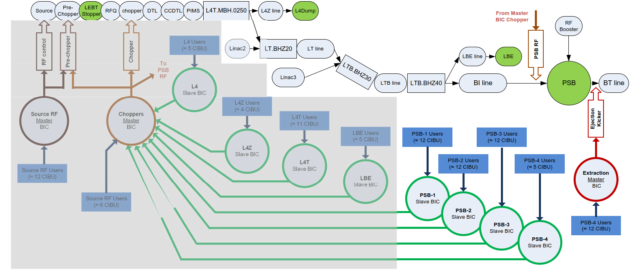
PSB BIS Layout
https://edms.cern.ch/document/1016233/
4 slave BICs; action → cut Linac4 beam with pre-chopper & chopper and disable PSB RF
1 extraction master BIC; action → disable PSB extraction kickers

Slide 7
Outline
PSB post-LS2 interlock design
  Design principle
  BIS, SIS, WIC, EC
The four rings of the PSB
  Available flexibility
  Open issues
Special considerations
  BT.BHZ10 switching magnet
  POPS-B / MPS switching
Fault diagnostics, masking of interlocks, settings management
Summary

Slide 8
The PSB and it’s 4 Rings…
In 2017 an analysis was done based on some past experience with ‘degraded’ (<4 ring) operation and a downtime analysis of individual ring equipment
  Operation with <4 rings can be attractive for certain physics users, also production of standard LHC25 beam with 3+3 instead of 4+2 rings
Decision to modify the BIS architecture to allow for degraded mode mainly for the following cases:
  Failure of the stripping foil holder (intervention time including cool-down and pump-down times up to 20h)
  Degraded vacuum in the new PSB injection section (leak or time for intervention/pump-down)
Procedure for OP:
  Set the number of turns to zero in affected ring and force it to zero (min/max) in the controls DB (~1h intervention by BE-CO)
  Person with appropriate RBAC role can then mask the corresponding BIC input
https://edms.cern.ch/document/1715266/

Slide 9
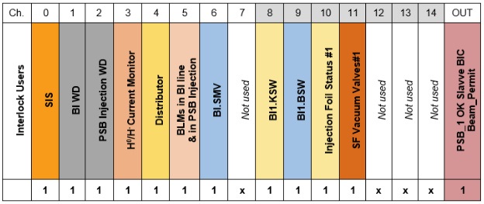
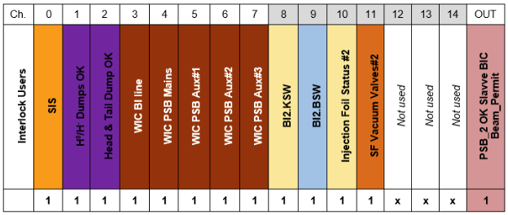
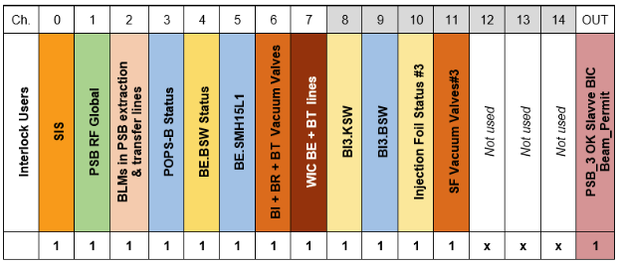
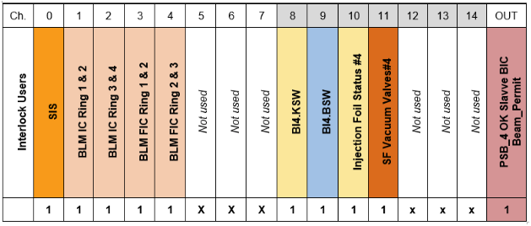
BIS PSB Injection (+ Rings) Layout
Allows operation with <4 rings for limited failure modes
  Stripping foil system status, injection painting kickers and chicane bumpers and SF vacuum valves → protection through procedure and BLMs at valve location
Other ring-dependent failure modes will cut beam for all rings (e.g. RF, distributor, extraction bumpers + septa…)

Slide 10
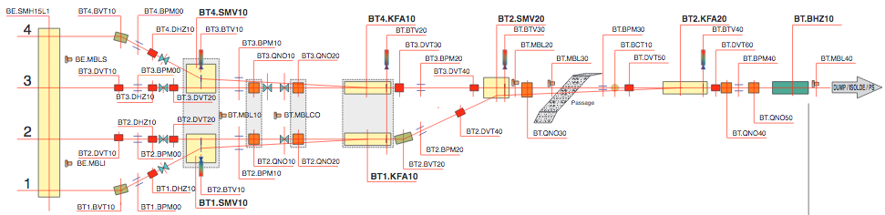
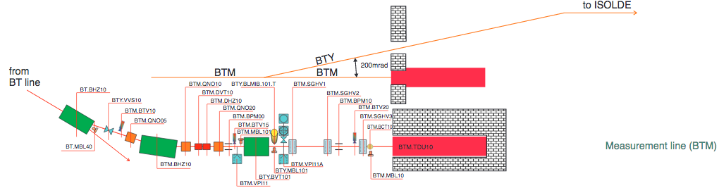
PSB Extraction, Recombination + Transfer
Recombination with help of septa and kicker magnets + bends/correctors
Vertical deflection to ISOLDE GPS or HRS through BTY.BVT101
to PS

Slide 11
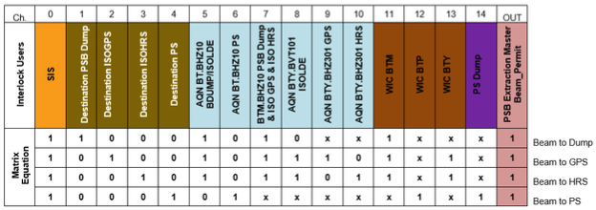
The PSB Extraction BIC and Open Issues
The 4 PSB destinations are provided by timing receiver cards
Only bending magnets and WIC connected (+ PS dump)
No distinction between the 4 PSB rings
Action: do not pulse PSB extraction kickers → loose beam in rings
  Acquisition of power converter currents within the interlock window only once beam is already in the PSB → cannot be safely dumped
  Reproduce BIC matrix with SIS and remove beam permit (latched) of Choppers master BIC for the corresponding destination

Slide 12
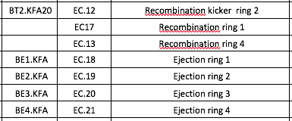
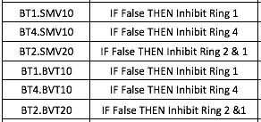


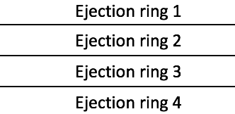
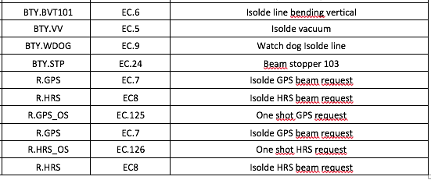

PSB Extraction Interlocks with EC
Affecting individual rings (extraction/recombination kickers/septa)
Destination-dependent equipment in extraction (sometimes only for proton delivery optimisation; for other cases it would have required adding another BIC, CIBUs etc. → budget considerations at the time; in addition the destination inputs always block several channels…); BIS not ‘destination-aware’
To be added: quadrupoles in BTP line (dest. PS)
and quadrupoles in BTY line (dest. ISOLDE)

Slide 13
PSB SIS
A not yet exhaustive list of SIS-based interlocks (or other…) for the PSB:
  PS stray field compensation at PSB injection
  Survey of H⁰/H⁻ monitor (ppm threshold) for stripping efficiency degradation
  Set number of turns to 0 in the corresponding ring if one of the stripping foil vacuum valves is closed (additional security when the BIC input is masked as explained earlier)
  Survey of power converters that are not covered by WIC (e.g. shavers)
  Survey of extraction and recombination elements (ring-specific)
  Reproduce Extraction BIC and cut the beam at the low energy
  Survey status of BTP quads (inhibit BTP destination) and BTY quads (inhibit ISOLDE destination) → input for EC
  ISOLDE SIS interlocks (ppp and pps, max. average current to targets)
  Limit intensity for TOF/EAST cycles
  Elogbook and/or LASER notifications in case of masked interlocks

Slide 14
Outline
PSB post-LS2 interlock design
  Design principle
  BIS, SIS, WIC, EC
The four rings of the PSB
  Available flexibility
  Open issues
Special considerations
  BT.BHZ10 switching magnet
  POPS-B / MPS switching
Fault diagnostics, masking of interlocks, settings management
Summary

Slide 15
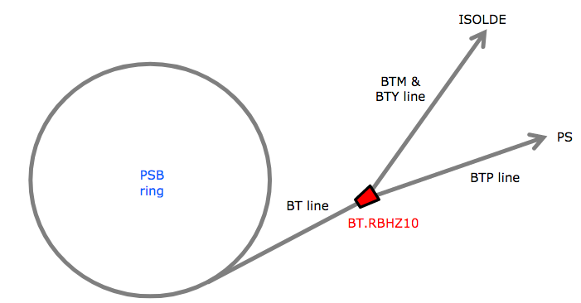
The Special Case of BT.BHZ10
Switching magnet between PS and BDUMP/ISOLDE
  Normal operation: bipolar current for the different destinations
  If PS is in access mode: EIS applies VETO → BT.BHZ10 must only provide a negative current
Before LS2, only one power supply was available (+ it’s spare), and the operators had to manually switch off / reset / switch to unipolar mode / restart in case of a PS access

Slide 16
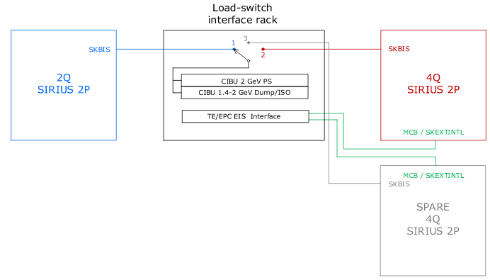
The Special Case of BT.BHZ10 after LS2
During LS2, 3 power supplies will be installed for BT.BHZ10, one 2-quadrant and one 4-quadrant SIRIUS 2P (+ a 4Q spare)
  Normal operation: 4Q supply in use
  VETO from PS access system: the main circuit breakers of the power supplies will trip and a switch will start moving towards the 2Q supply when the current is zero and both power supplies are off → operators can restart the 2Q supply
4 CIBUs installed in load-switch interface rack
  2 for destination PS and 2 for destination BDUMP/ISOLDE (small and larger current window, respectively)
  User_inputs 6+5 of PSB extraction BIC
The CIBUs are always connected to the currently operational BT.BHZ10 power supply
https://edms.cern.ch/document/1829269/

Slide 17
POPS-B / MPS Switching
POPS-B will be the new PSB main power supply and replace the old MPS after LS2
  Nevertheless maintain MPS to be used in case of POPS-B breakdown
    Different magnetic cycles; old MPS can only provide 1.4 GeV cycles (no 2 GeV operation)
    Different powering layout and configuration of trim power supplies (with POPS-B separate powering of inner and outer PSB rings etc.)
    Different interlocking → procedure will be prepared in case of a swap
POPS-B interlocks:
  BIC user_input (PSB-3 BIC)
  EC (software-based)
MPS interlocks:
  EC (hardware)

Slide 18
POPS-B / MPS Switching Procedure for Interlock
OP propose to have a common EC for either POPS-B and MPS
  ‘Soft’ is only checking POPS-B, ‘hard’ only the MPS status
  Other option: 2 EC (hard for MPS and soft for POPS-B) and possibility of masking one
Changes in case of switchover from POPS-B to MPS:
  MPE to add a ‘bouchon’ instead of the POPS-B BIC user_input for PSB-3 BIC
  EC: OP needs to switch from ‘soft’ condition (will be BAD during a POPS-B failure) to ‘hard’ condition in the Sequence Manager GUI

Slide 19
Outline
PSB post-LS2 interlock design
  Design principle
  BIS, SIS, WIC, EC
The four rings of the PSB
  Available flexibility
  Open issues
Special considerations
  BT.BHZ10 switching magnet
  POPS-B / MPS switching
Fault diagnostics, masking of interlocks, settings management
Summary

Slide 20
Fault Diagnostics
For BIS:
  BIS GUIs provided by TE-MPE
  For better ppm diagnostics plan to use Joerg’s BIS Monitor application
    Experience from Linac4 that a debugging of the BIS interlocks at 1.2s cycle repetition is otherwise practically unfeasible; also the OP application might require some adaptation from the SPS to Linac4/PSB
For WIC:
  WIC GUIs provided by TE-MPE well adapted to OP needs
For EC:
  EC tab of Sequence Manager GUI (BE-CO)
  In the new LIC Central Timing online information on used (destination-dependent) and bad conditions
For SIS:
  Sometimes SIS fault diagnostics is not straight-forward → hope for some improvements along the SIS upgrade

Slide 21
Masking of Interlocks
Masking of BIS and SIS interlocks will happen more frequently during the beam commissioning phase (need certain flexibility) compared to standard operation
Procedures will be written for more complex masks, e.g. for beam without stripping foil (H⁰/H⁻ monitor calibration etc.) or for stripping foil vacuum valves
Regular reminders (elogbook/LASER) for OP team (SIS)
For interlock masking we still need to define and create the corresponding RBAC roles

Slide 22
Settings Management
Deducing from Linac4 experience this is a challenge
Will have to define most interlock thresholds etc. during beam commissioning when there is a lot of pressure and not yet stable operation
  Contrary to the SPS and LHC we will soon have to face tens of operational cycles with ppm settings and in total several hundreds of cycles at the end of the year including MD cycles
  List of critical settings still to be compiled
    Examples: power converter acquisition windows, BLM and watchdog thresholds, H⁰/H⁻ monitor thresholds…
Would be useful to discuss with OP and MPE colleagues what could be the best method for the PSB

Slide 23
Conclusions
With Linac4 connection in LS2 the BIS will cover most of the hardware interlocks for the PSB with the aim to cut the beam at lowest possible energy (still keeping the Linac4 source pulsing…)
Nevertheless a mixed design including External Conditions, tailclipper and SIS to allow for the required flexibility, including optimisation of proton delivery to the numerous physics users
Minimising machine activation is another desired ‘side-effect’ of the interlock system
Only very few cases where we require fail-safeness; the challenge for the PSB lies more in maintaining operational flexibility and adapted interlock settings with hundreds of cycles covering 4 orders of magnitude of intensity

Slide 24
Summary
Specific PSB issues:
  4 rings (beam distribution at injection and beam recombination at extraction) being served by one Linac4 pulse
  No internal dump or fast kickers separating the different destinations
  Complication: no BIS per destination at extraction
‘Rapid’ cycling poses issues for interlock monitoring in ppm
Will need to work on procedures for masking, settings management, definition of machine critical settings etc.
  The PSB OP team still needs to gain experience with the new interlock system
A regular discussion/consultancy forum with TE-MPE and a core BE-OP team with a special eye on settings management / improvements for the injectors would be very useful!

