Slide 1
Joint master study programmes
Kaunas University of Technology
Department of Academic Affairs
22/03/2019

Slide 2
JOINT STUDY PROGRAMMES
Joint study programme – an integrated curriculum coordinated and offered jointly by different higher education institutions and leading to a (double/multiple or joint) degree.
The joint programme shall be implemented by ensuring the integrity of the content and study results of the university-partner programmes, the academic mobility of students and teachers and the management of the partnership. A significant part of the joint programme must be carried out on the basis of academic physical mobility, and student physical mobility is compulsory.

Slide 3
DEGREES
Joint degree – a single document awarded by higher education institutions offering the joint programme and nationally acknowledged as the recognised award of the joint programmme (3 programmes like this at KTU, executed with Lithuanian universities: Health Informatics, Medical Chemistry, Master of Business Administration).
Double/multiple degree – two degrees/separate degrees awarded by higher education institutions offering the joint programme attesting the successful completion of this programme (6 programmes at KTU).
Dual degree – two degrees awarded individually, attesting the successful completion of two separate curriculum, with potential overlap and efficiencies in course-taking, and, if more than one institution is involved, each institution is primarily responsible for its own degree (1 programme at KTU).
Students who graduate from:
one-field study programme are granted a qualification degree of the field and issued a Master’s diploma with a supplement;
interdisciplinary study programme are granted a qualification degree of the main field and issued a Master’s diploma with a supplement;
joint study programme are granted a joint qualification degree and issued one joint Master’s diploma of partner universities with a supplement.

Slide 4
THE SCOPE OF THE STUDY PROGRAMME
The scope of the master study programme is no less than 90 and no more than 120 study credits:
at least 60 study credits shall consist of field study subjects (modules);
maximum 30 study credits may include the establishment of a university and the subjects chosen by the student, depending on the nature of the study programme to prepare for doctoral studies, practical activities or other subjects in the course of a study programme for which the objectives relate to interdisciplinary studies, as well as general subjects of university studies and optional items of a student to achieve the necessary objectives of the study programme. This item does not apply to study programmes with a scope of 90 study credits;
at least 30 study credits are devoted to the preparation and defence of the final work, or to the finishing and final examinations;
in the interdisciplinary Master programme, 40% of the study subjects must be allocated to the dominant field.

Slide 5
ACCREDITATION
Study programmes must be accredited by:
any agency that is included in EQAR Register or
centre for Quality Assessment in Higher Education (Lithuania). In this case – the same procedure as for all Lithuanian study programmes.
No specific requirements for the accreditation are placed irrespective of the degree awarded.

Slide 6
INCLUSION OF STUDY RESULTS
In double degree case
Inclusion of study modules taken at another university
maximum of 75% of the study programme can be included (max 90 out of 120 ECTS);
final degree project (30 ECTS) is not included, it must be prepared at KTU to be granted a KTU qualification degree;
optional modules are included without limitations.
Documents issued after completion of partial studies
academic transcript of the completed modules, their scope in ECTS and marks;
description of the KTU grading scale.

Slide 7
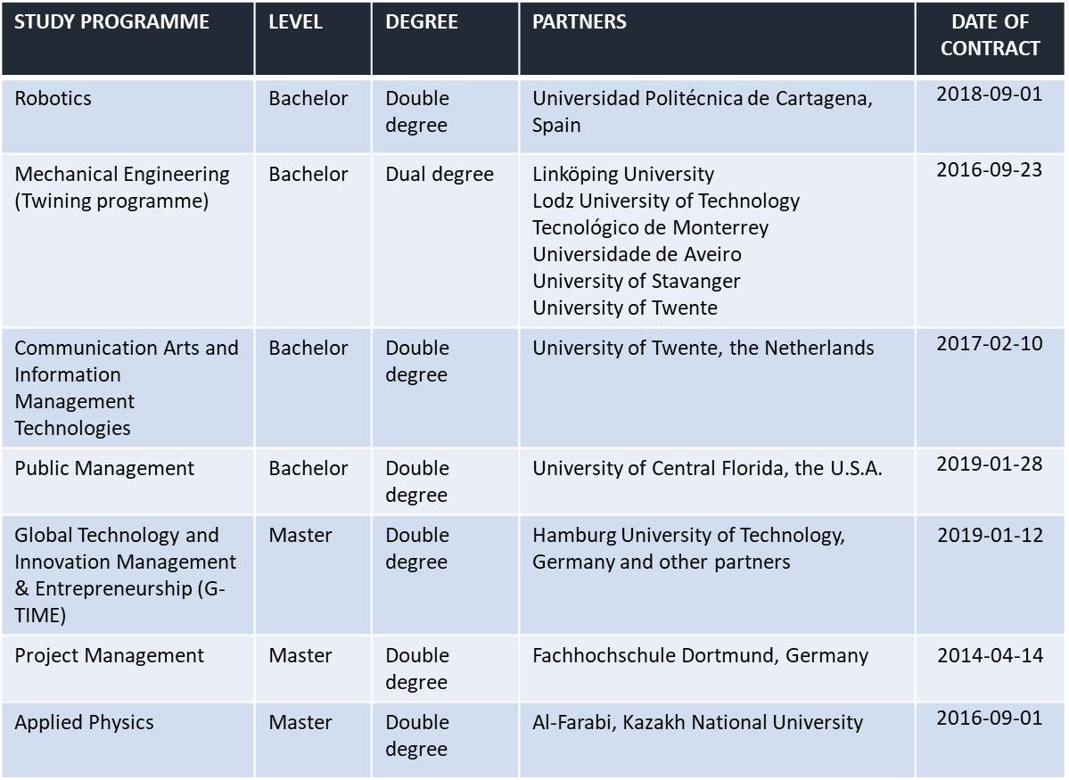
INTERNATIONAL COLLABORATION IN STUDY PROGRAMMES

