Slide 1

RF STUDIES FOR
HL-LHC INTENSITIES
Authors
H. Timko, T. Argyropoulos,
P. Baudrenghien, O. Brunner,
R. Calaga, I. Karpov,
L. E. Medina Medrano, F. Peauger,
E. Shaposhnikova, K. Turaj
Acknowledgements:
J. Wenninger
HL-LHC WP2 meeting, 2nd April 2019

Slide 2
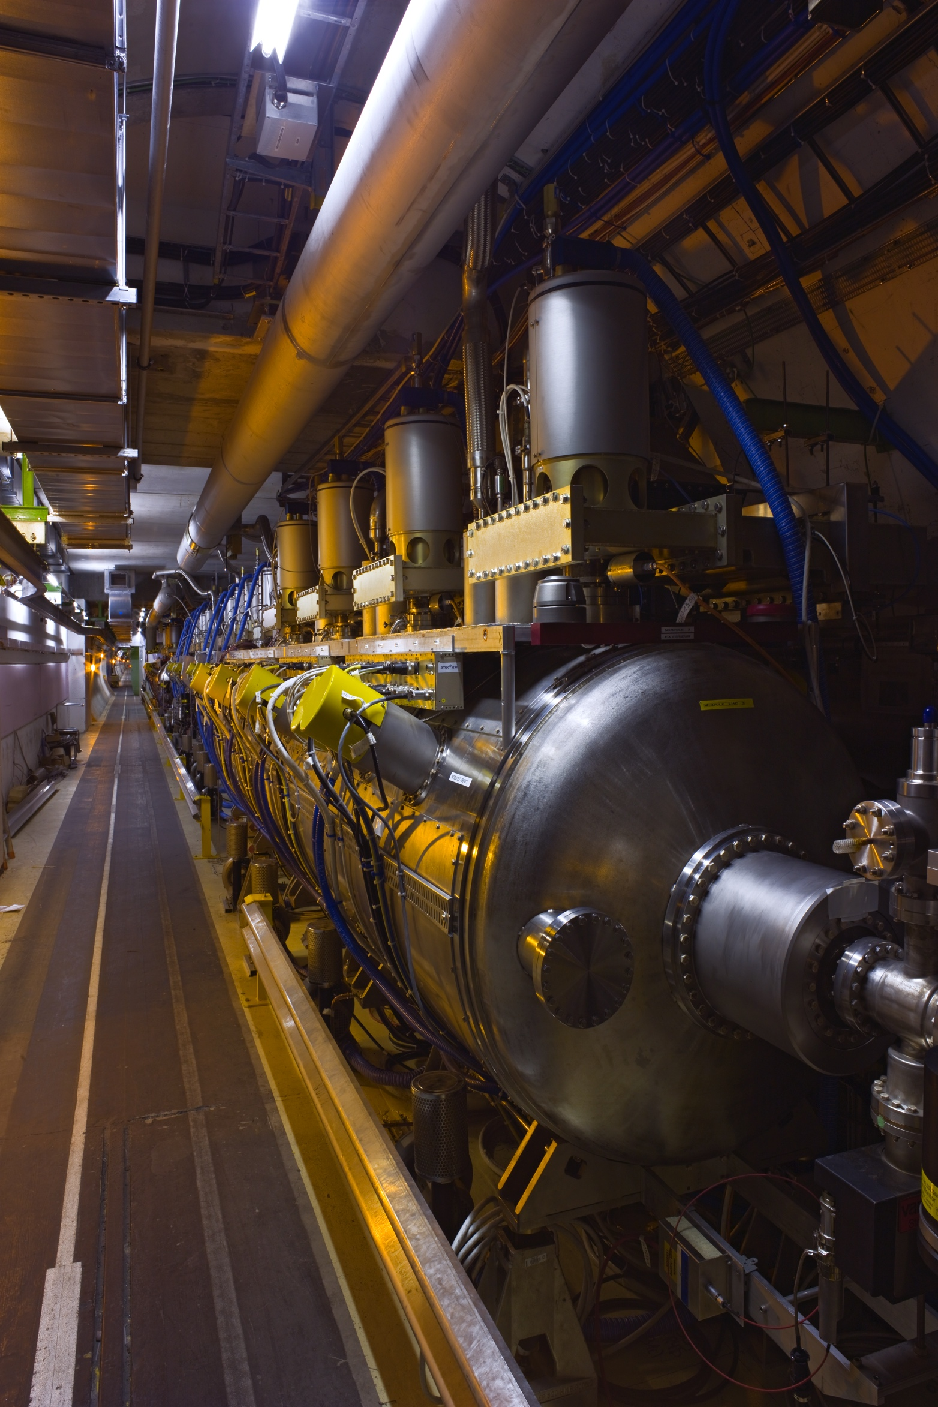
Outline
Full detuning
Required voltage and power consumption at injection
SPS-LHC energy matching
Controlled emittance blow-up
Ongoing studies
Conclusions

Slide 3
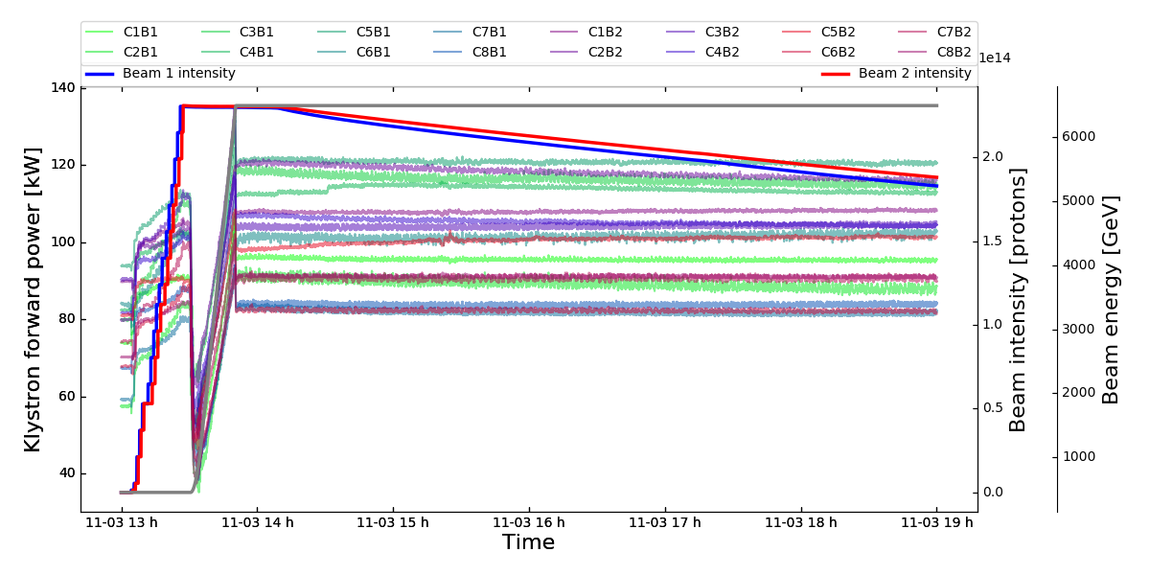

Full-Detuning Beam-Loading Compensation
Operational since mid-2017, reduces the RF power consumption
  Used during the ramp and at flat top, where higher voltage is needed
  The power required becomes independent of the beam current
$$P=\frac{V_{0}^{2}}{8\frac{R}{Q}Q_{L}}$$
With 2017 beam parameters, the power consumption at top energy (N.B. ±20 % spread)
is reduced from 190 kW in half-detuning mode to 100 kW in full-detuning mode

Slide 4
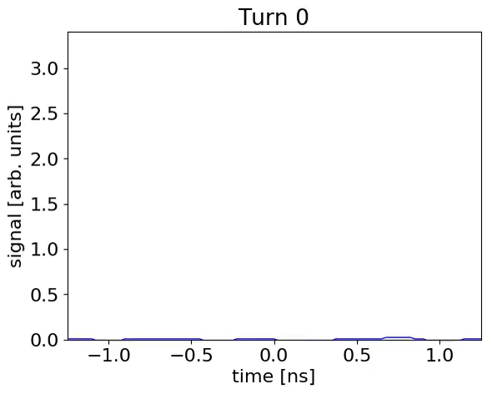
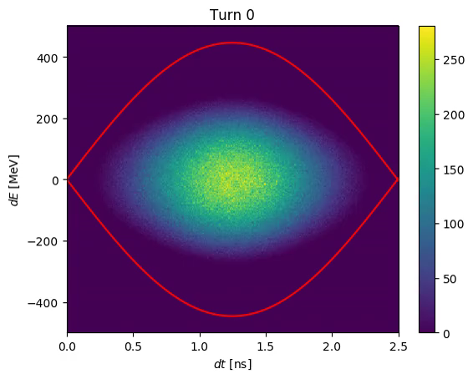
Beam Stability at Injection
Persistent injection oscillations
  Observed since first start-up with beam
  Damping time ~1 h, can survive the ramp and potentially impact stability
  Peak-to-peak oscillation amplitude up to 50°
  Flat bottom losses with 1.9×10¹¹ ppb
Is due to a large mismatch between the LHC bucket height and the momentum spread of the arriving bunch [7]
  Intensity effects and injection errors have an impact, too
Non-rigid dipole oscillations,
MD 2017, 2.0×10¹¹ ppb in 6 MV
Simulations, 2.3×10¹¹ ppb in 8.5 MV

Slide 5
Optimum Injection Voltage
‘Matched’ voltage w.r.t. dp/p of arriving SPS bunch: ~2 MV
  Not possible to use, too much injection losses (3 MV were tried at LHC start-up)
Higher voltage preferable to reduce capture losses
Lower voltage preferable for beam stability & reduced RF power consumption
Optimum LHC capture voltage depends on the SPS beam arriving
  For SPS Q26 optics, V_{SPS} = 7 MV, 1.65 ns at transfer: V_{LHC} = 6 MV
  For SPS Q20 optics, V_{SPS} = 7 MV, 1.40 ns at transfer: V_{LHC} = 4 MV

Slide 6

Voltage Limitations at Injection
$$P=\frac{V_{0}I_{b,pk}}{8}$$
Half-detuning scheme at injection is limiting for Run III
Two MDs were preformed with beam
  First MD (as operational): all lines set to the same voltage, cavities are pre-detuned with 12b only → strong transient when 144b are injected
    Maximum voltage maintainable: 9 MV for 50 kV klystron HV & 1.15×10¹¹ ppb.
  Second MD (as operational): asking for less voltage in “weak” lines, cavities are pre-detuned for 144b → no transient when 144b are injected
    Maximum voltage maintainable: 10 MV for 58 kV klystron HV & 1.3×10¹¹ ppb.
Klystron HV | Cathode current | DC power | RF power | Measured saturation
50 kV | 7.8 A | 390 kW | 230 kW | 190-220 kW
58 kV | 8.6 A | 500 kW | 300 kW | 250-280 kW
  Operational settings of present LHC klystrons: 30 % more power available with 58 kV w.r.t. 50 kV

Slide 7
Power Limitations at Injection
Klystron saturation in CW measurements: 250-280 kW/line
  In theory, ~8 MV/beam should be doable with HL-LHC beam current
  In operation with beam, the lines seem to saturate at lower levels, thus providing less voltage
Source of this discrepancy currently under investigation
  Is it due to the pulsed behaviour of the system?
  Can we still gain in voltage by optimising the system or are we fundamentally limited?
    E.g. circulator adjustment, and clamping mechanism currently under investigation
    Detailed analysis of MD results concerning transient behaviour is currently ongoing

Slide 8
Can we do 1.8×10¹¹ ppb in Run III?
Conservative estimate based on first MD with operational margin
  Available voltage: 6.6 MV for 1.8×10¹¹ ppb
  Available voltage: 5.2 MV for 2.3×10¹¹ ppb
LHC capture voltage required, depending on SPS optics:
  Min. 6.4 MV with Q20 (+26.6 % dp/p), i.e. at the limit
  Min. 7.9 MV with Q22 (+40.7 % dp/p), i.e. potentially out of reach
Bunch intensity | Extraction voltage |  | Rel. momentum spread |  | Emittance
 | Q20 | Q22 | Q20 | Q22 | Q20 | Q22
1.8×10¹¹ ppb | 10 MV * | 10 MV * | 4.95×10⁻⁴ | 5.50×10⁻⁴ | 0.570 eVs | 0.633 eVs
2.3×10¹¹ ppb | 10 MV | 10 MV | 4.95×10⁻⁴ | 5.50×10⁻⁴ | 0.570 eVs | 0.633 eVs
  SPS extraction parameters depending on intensity and optics
* Will likely use the maximum voltage, even if not strictly needed from stability point of view

Slide 9
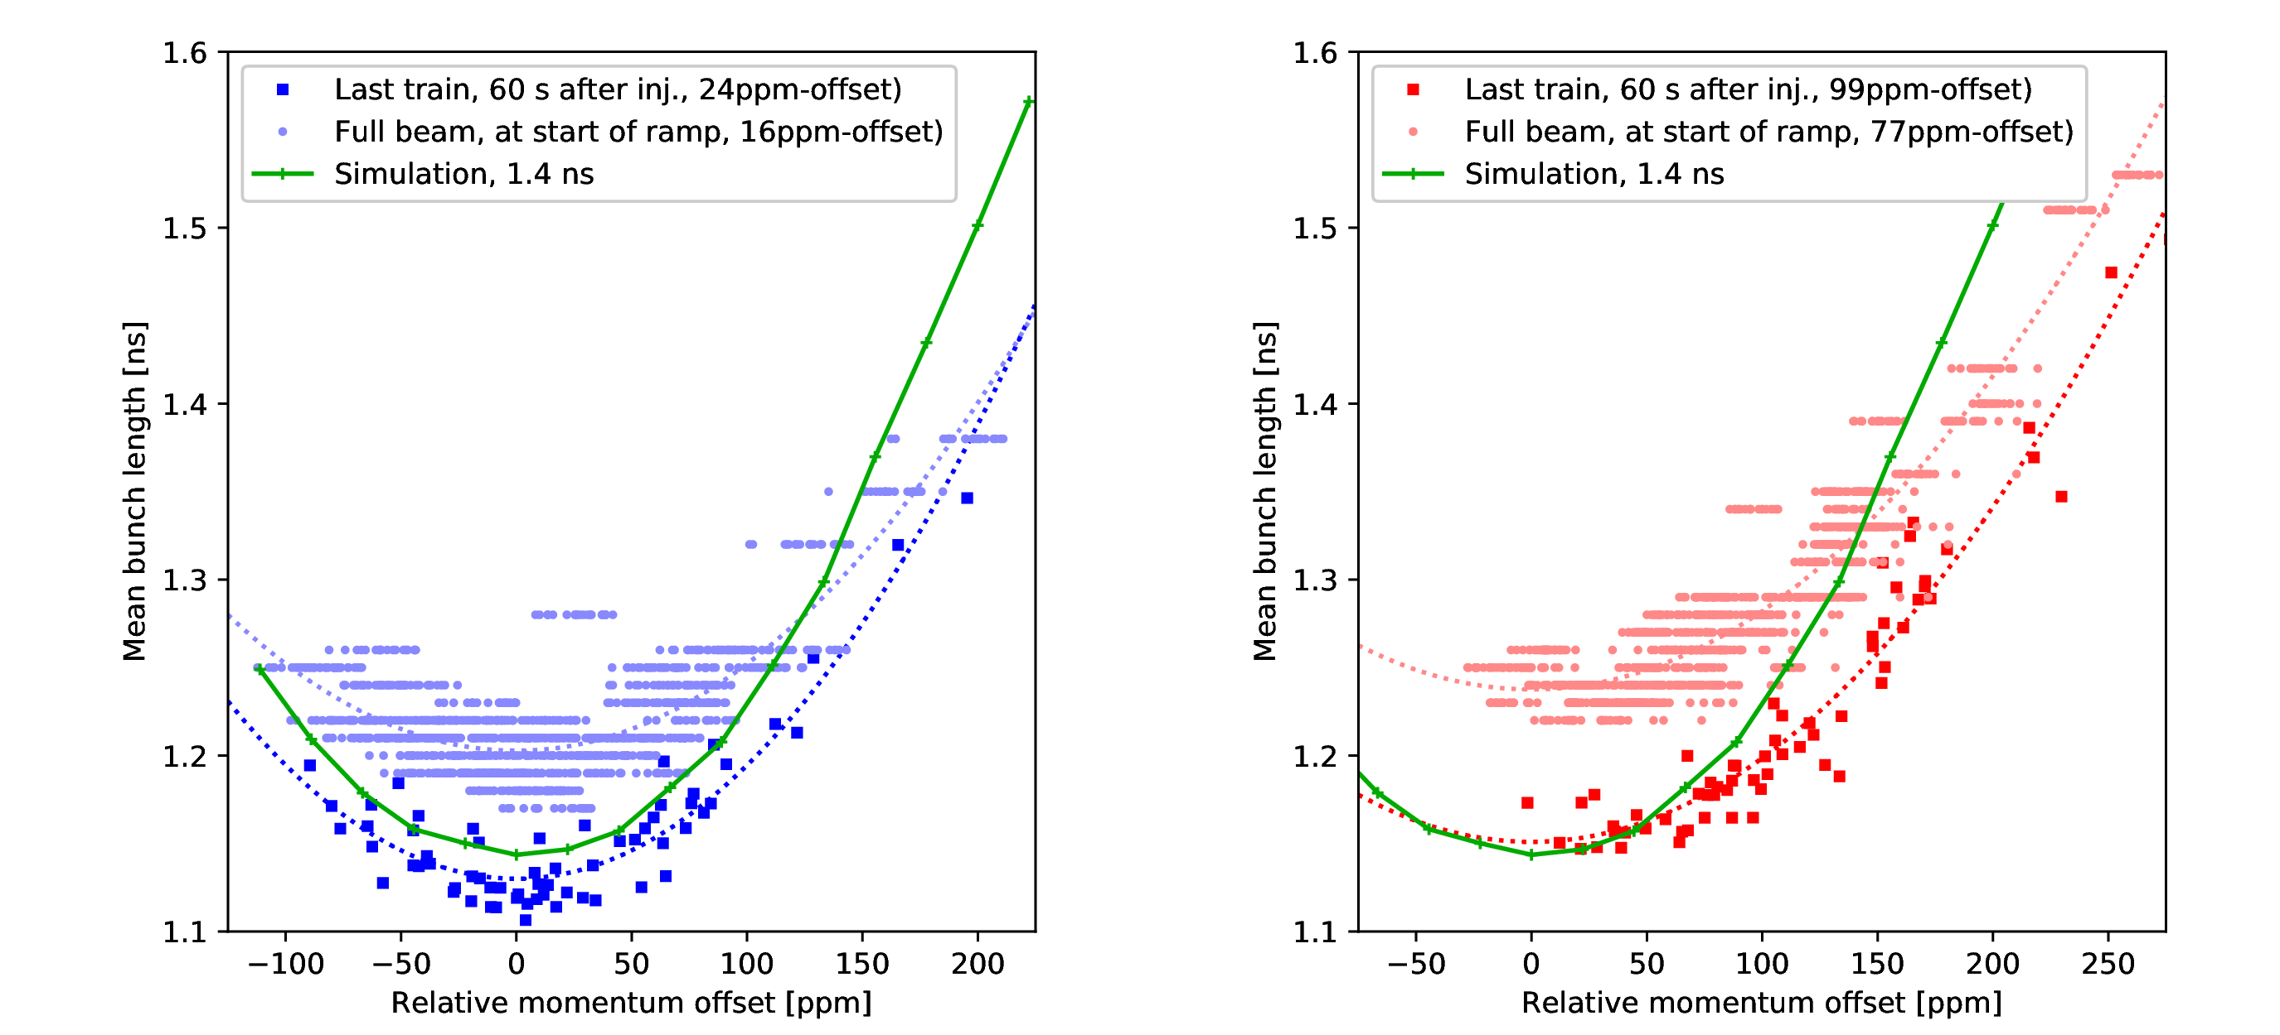
Energy Errors at Injection
Energy matching between SPS and LHC varies over time
  In some fills, a large blow-up due to filamentation is observed
  B2 slightly longer; measurement error or blow-up on flat bottom?
Correlation of energy errors and bunch length

Slide 10
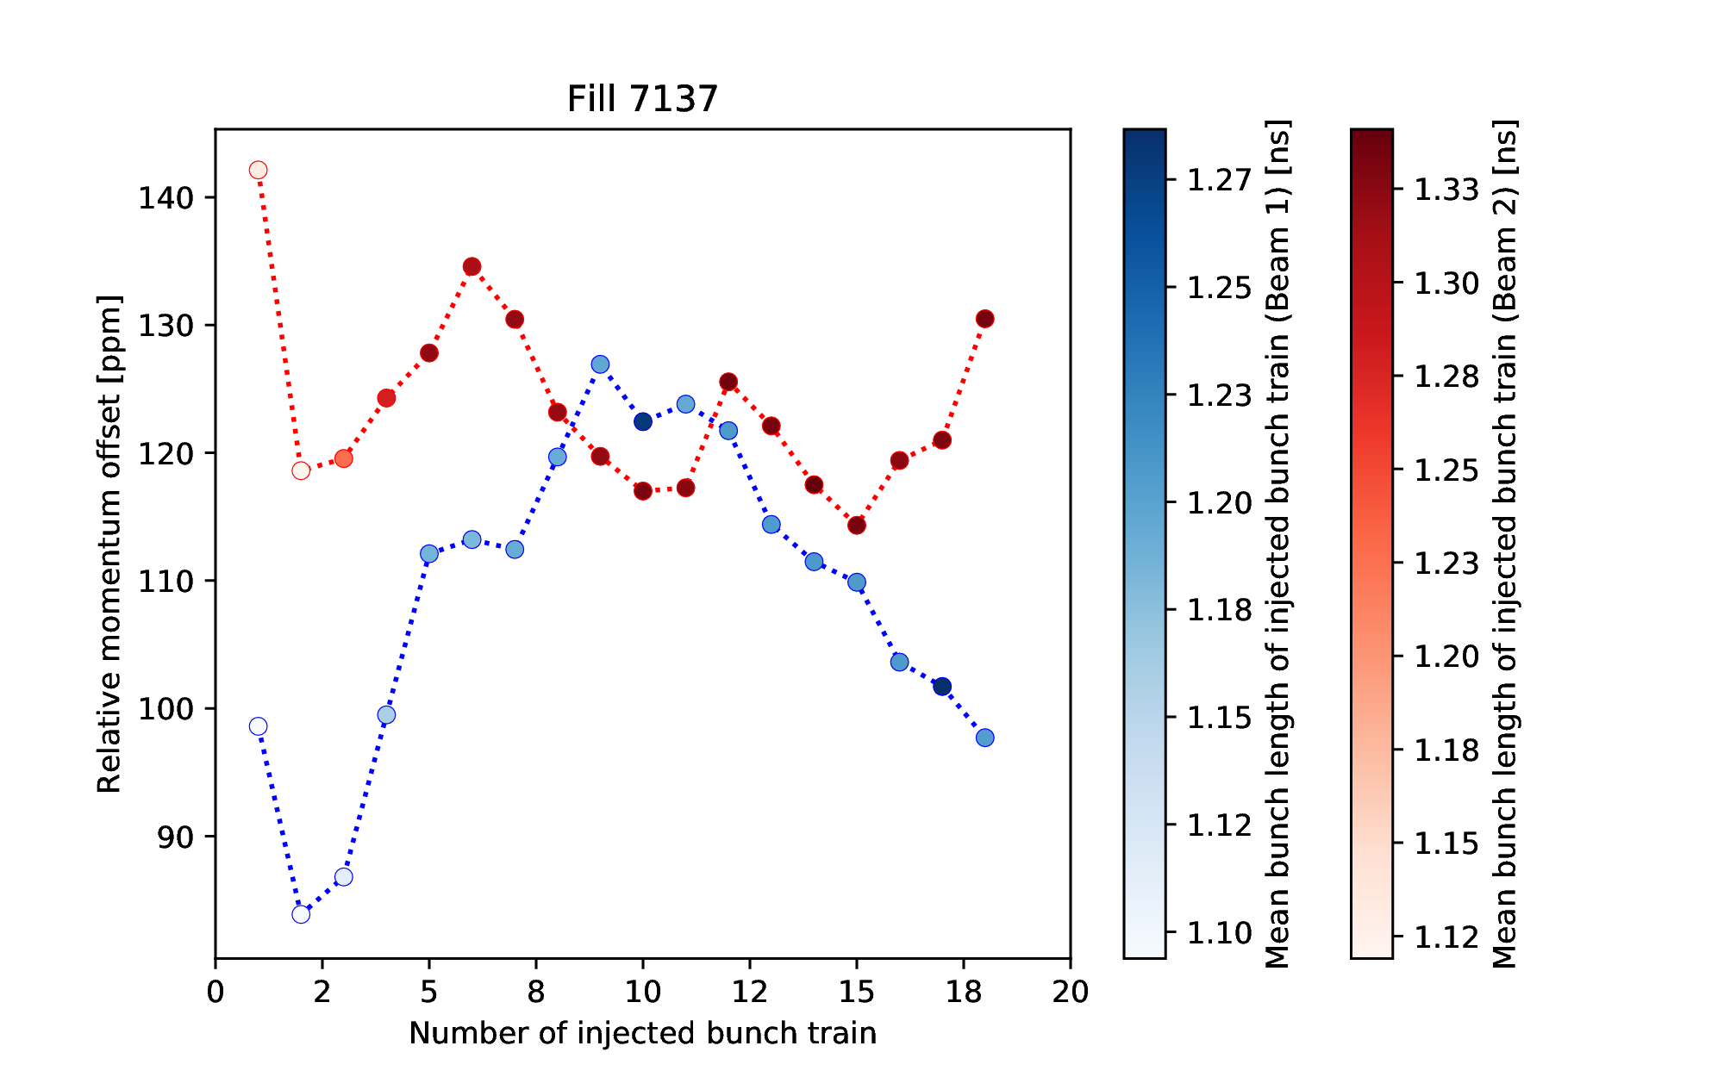
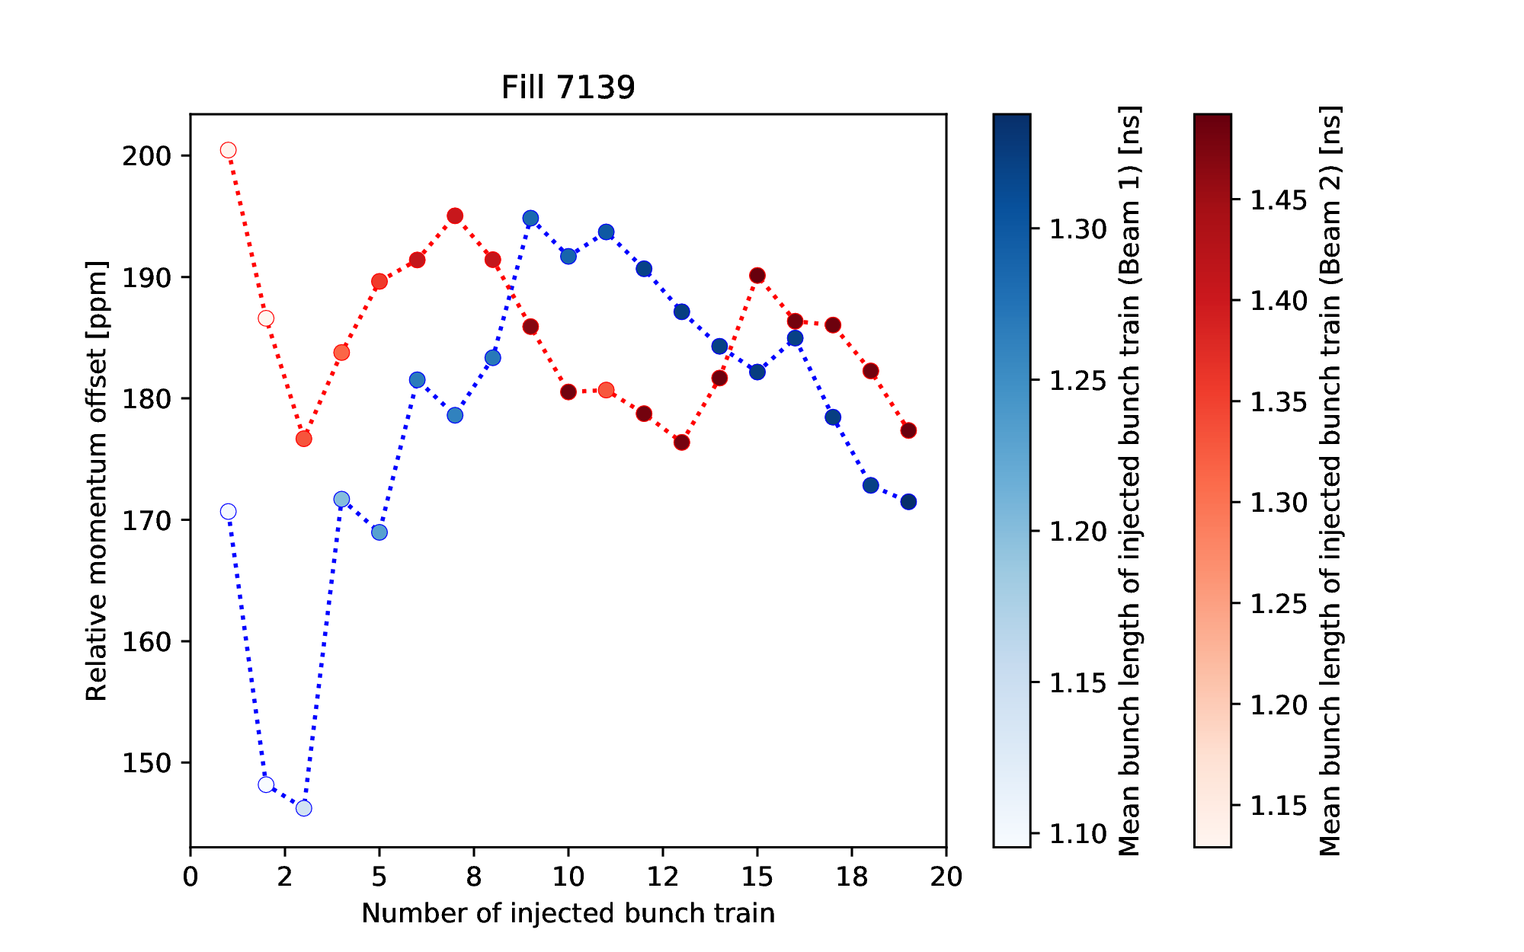
Energy Errors at Injection
Energy matching between SPS and LHC varies over time
  In some fills, a large blow-up due to filamentation is observed
  The beam phase loop only damps the injection errors of the first batches
Fills with large energy errors: first batches remain short, while subsequent batches blow up

Slide 11
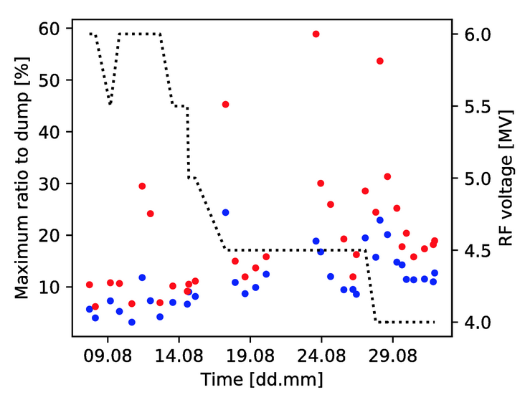
Voltage Reduction Campaign 2018
Reduction from 6 MV to 4 MV improves beam stability
  With large energy errors, start-of-ramp losses are close to dump threshold
  With better energy matching, could we further decrease the voltage and thus save power?
Increasing start-of-ramp losses with decreasing capture voltage

Slide 12
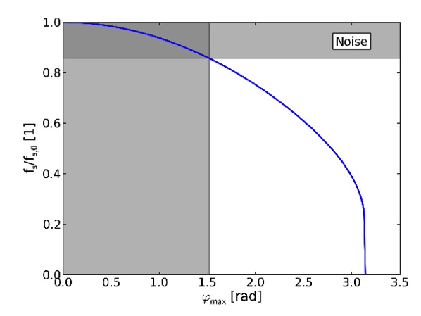
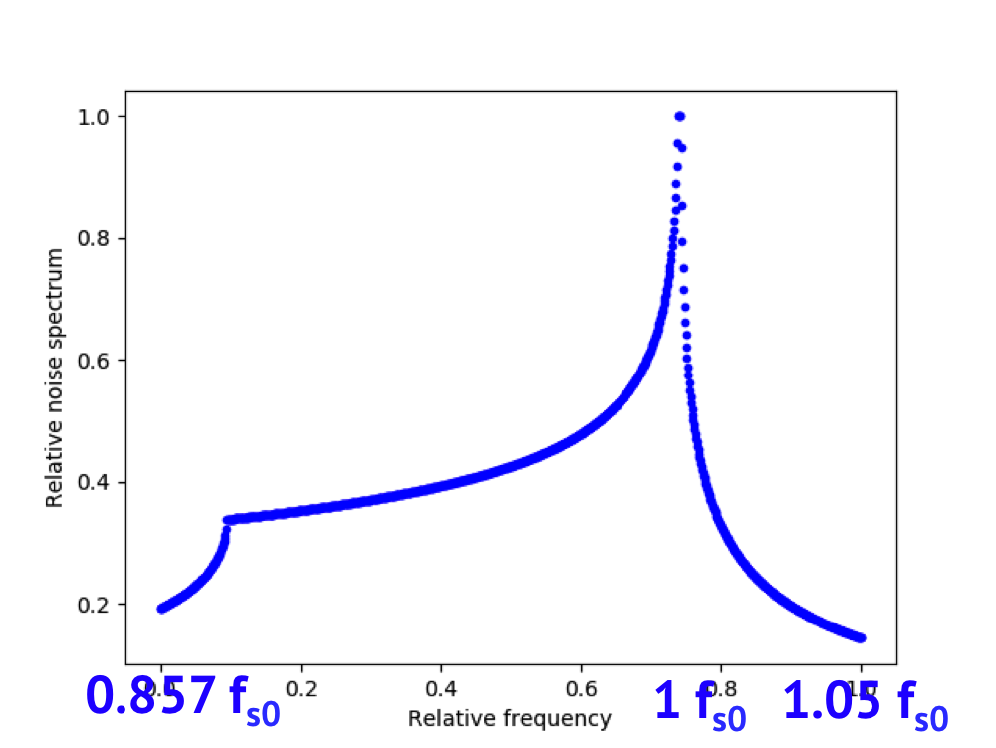
Controlled Emittance Blow-up
Indispensable for the acceleration ramp to counteract single-bunch loss of Landau damping
  The operational method generates a band-limited noise spectrum that targets the core of the bunch up to the target bunch length
  Compensating also for the action of the beam phase loop
Blow-up spectrum w.r.t. to the synchrotron frequency distribution
Pre-distorted noise spectrum used since 2015

Slide 13
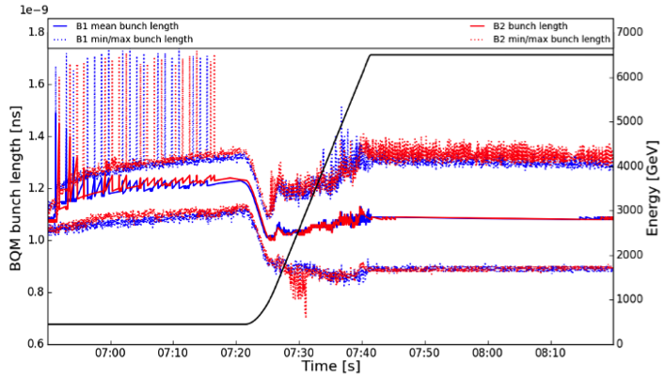
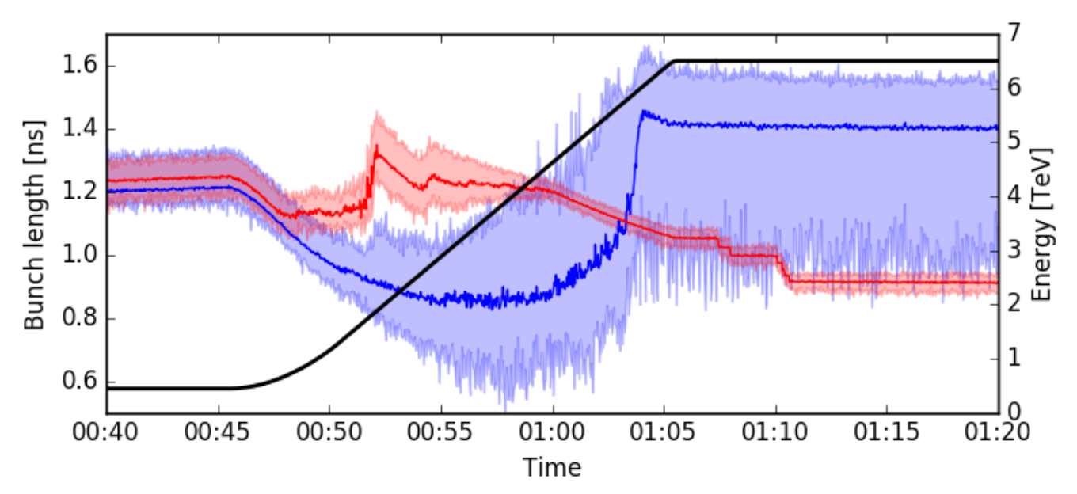
Divergence of Bunch Lengths
Observed for reduced target length
  If due to intensity effects, the effect will be amplified in Run III & Run IV
  In 2016, when the target bunch length was decreased from 1.25 ns to 1.1 ns
  In MDs, when the target bunch length was 0.9-1.0 ns
Increasing bunch length spread in operation
Divergence of bunch lengths in MD, 2016

Slide 14
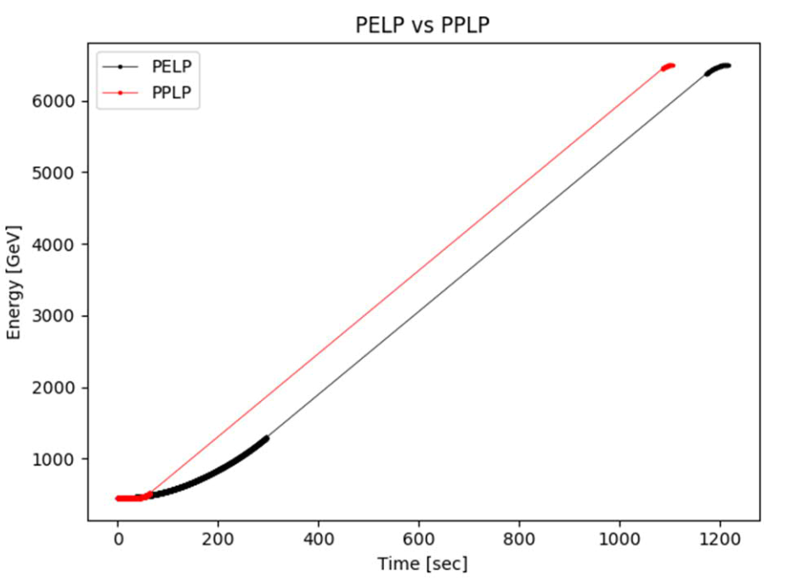
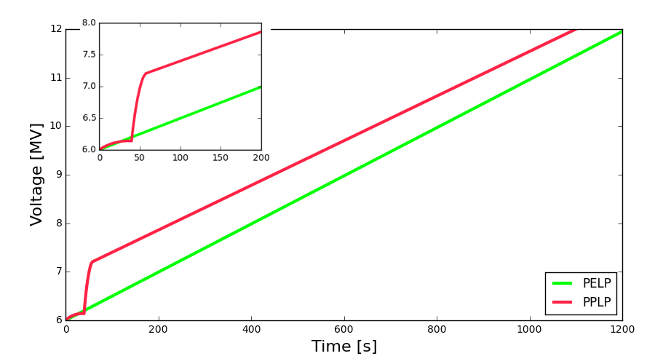
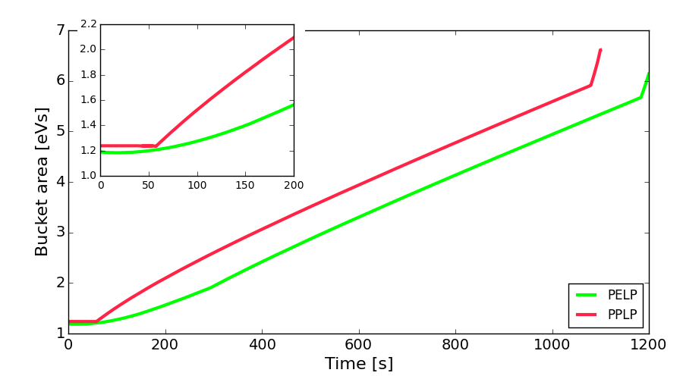
Blow-up during PPLP Ramp
The regulation of the blow-up is more challenging in the PPLP ramp (1100 s) than the operational PELP ramp (1210 s)
  First 50 s: no bucket area for blow-up, next 150 s: need to blow up a factor 2
Momentum programmes of the PELP and PPLP ramps
PELP = parabolic-exponential-linear-parabolic
PPLP = parabolic-parabolic-linear-parabolic
Fast rise of RF voltage ramp to keep a constant bucket area

Slide 15
Studies in LS2
RF power limitations at injection
  Transient power limitations and system behaviour
  Dynamic circulator adjustment, improved calibration schemes
  Alternative beam-loading compensation schemes
  Understand line-by-line differences and define appropriate operational margins
SPS-LHC energy mismatch
  Longitudinal damper using ACS
  Correction on SPS and/or LHC side
Controlled longitudinal emittance blow-up
  Divergence
  PPLP ramp
  Alternative noise-generation methods

Slide 16
Conclusions
Some challenges for the RF system at HL-LHC intensities have been identified
  RF power consumption in the half-detuning scheme limits the capture voltage
  Regulation of the controlled longitudinal emittance blow-up
Studies ongoing to understand and overcome the limitations
  Measurement and simulation studies to understand the source of the limitations and quantify the potential gain with different improvements (LHC/HL-LHC Beam Dynamics WG, E. Shaposhnikova)
  Hardware options for improvements, such as high-efficiency or additional RF cavities (HL-LHC WP4, R. Calaga)

Slide 17
References
P. Baudrenghien, T. Mastoridis, ‘Proposal for an RF roadmap towards ultimate intensity in the LHC’, Proc. IPAC’12, New Orleans, USA, 2012.
D. Boussard, ‘RF power requirements for a high intensity proton collider - Part I’, Proc. PAC’91, San Francisco, USA, 1991.
I. Karpov, S. Albright, T. Argyropoulos P. Baudrenghien, E. Shaposhnikova, H. Timko, ‘LHC MD 2042: Persistent Injection Oscillations‘, CERN-ACC-NOTE-2018-0018, (2018).
H. Timko, E. Shaposhnikova, K. Turaj, ‘Estimated LHC RF system performance reach at injection during Run III and beyond’, Rep. CERN-ACC-NOTE-2019-0005, CERN, Geneva, Switzerland, 2019.
H. Timko, T. Argyropoulos, I. Karpov, E. Shaposhinkova, ‘Beam Instabilities after Injection to the LHC’, Proc. HB2018, TUP1WA03, Daejeon, Korea, (2018).
H. Timko , T. Argyropoulos, I. Karpov, L. Medina Medrano, M. Palm, B. Salvachua, J. Wenninger, ‘Optimal Injection Voltage in the LHC’, to be submitted, (2019).
H. Timko, P. Baudrenghien, J. Esteban Müller, M. Jaussi, A. Lasheen, E. Shaposhnikova, ‘LHC MD 1087: Controlled Longitudinal Emittance Blow-up with Short Bunches‘, CERN-ACC-NOTE-2017-0018, (2017).

