Slide 1

A proposal for a very compact injector using an S-band gun and x-band acceleration
Simulation parameters
Results
Conclusion
Mohsen Dayyani Kelisani (IPM/CERN) and Steffen Doebert (CERN)
CompactLight , Mid term review, Helsinki 3-5 July

Slide 2
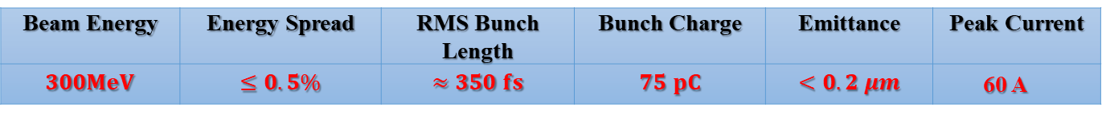
CompactLight requirements
CompactLight target parameters
Beam Energy | Energy Spread | RMS Bunch Length | Bunch Charge | Emittance | Peak Current
$$300MeV$$ | $$≤0.5\%$$ | $$≈350 fs$$ | $$75 pC$$ | $$<0.2 μm$$ | 60 A
- High repetition rate needed 100 - 1000 Hz

Slide 3
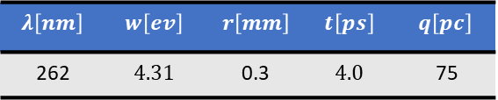
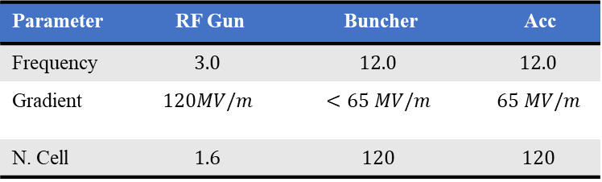
Injector Design
Philosophy: Use S-band rf-gun because of its well established performance (cathode, laser, magnets)
Use X-band for velocity bunching and acceleration
CERN has experience and hardware for those frequencies
RF- parameters
Parameter | RF Gun | Buncher | Acc
Frequency | $$3.0$$ | $$12.0$$ | $$12.0$$
Gradient | $$120MV/m$$ | $$<65 MV/m$$ | $$65 MV/m$$
N. Cell | $$1.6$$ | $$120$$ | $$120$$
INFN-type RF gun , CompactLight x-band structure used
Using ASTRA for simulations
Laser parameters, uniform distributions
$$λ\left[nm\right]$$ | $$w\left[ev\right]$$ | $$r\left[mm\right]$$ | $$t\left[ps\right]$$ | $$q\left[pc\right]$$
262 | $$4.31$$ | 0.3 | $$4.0$$ | 75
Thermal emittance 0.08 um (copper)

Slide 4
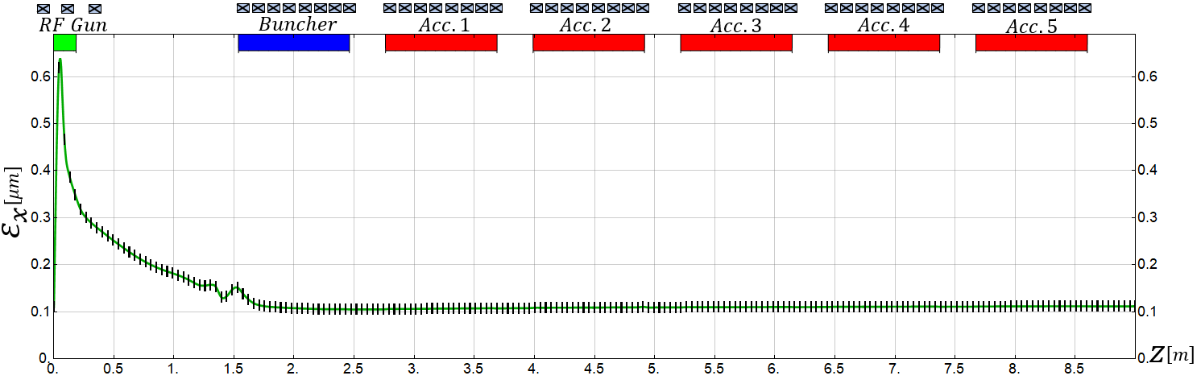
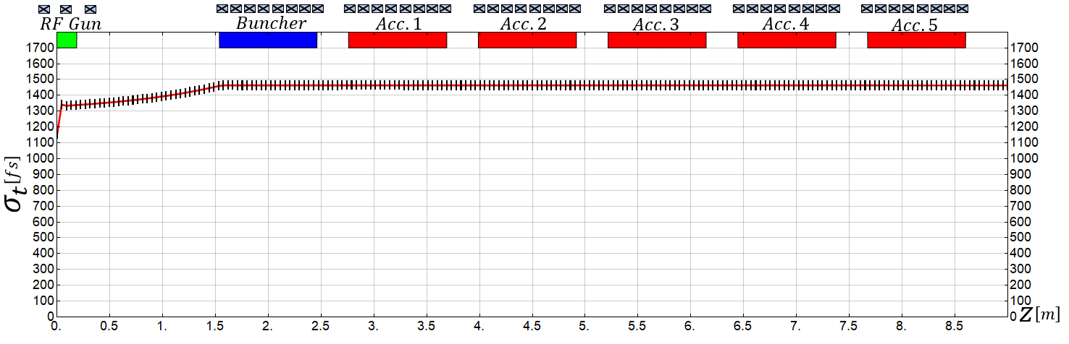
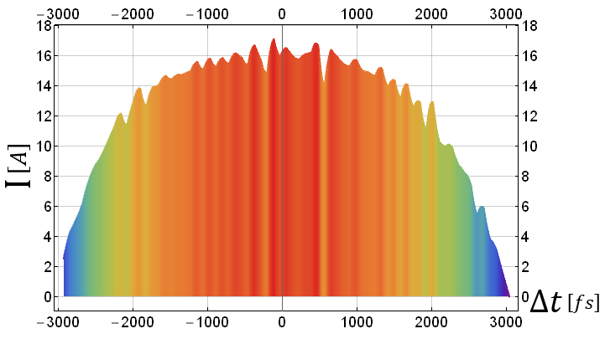
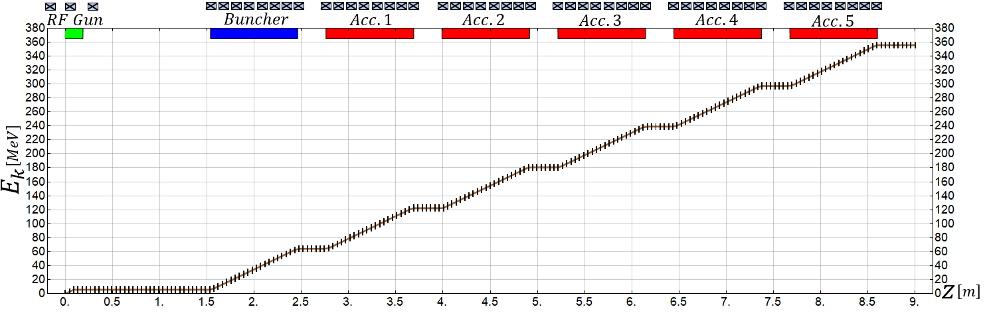
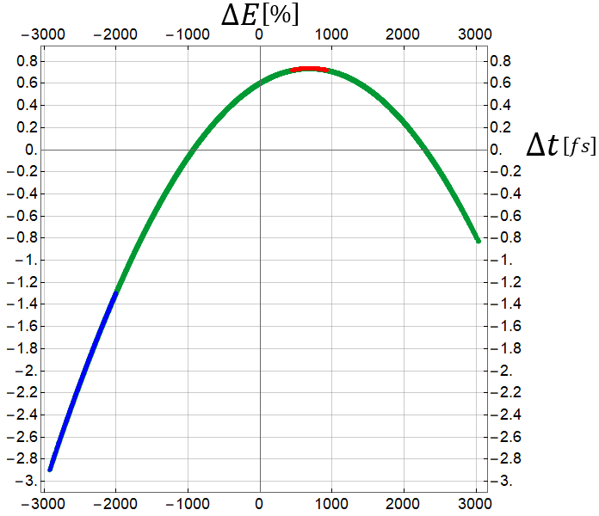
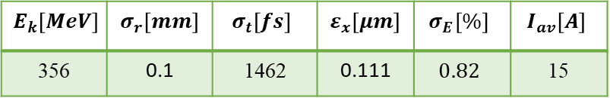
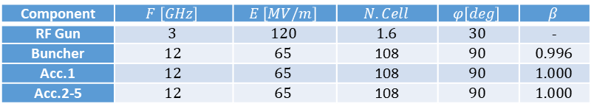
Case 1 : simply acceleration no bunching
Component | $$F \left[GHz\right]$$ | $$E \left[MV/m\right]$$ | $$N.Cell$$ | $$φ\left[deg\right]$$ | $$β$$
RF Gun | $$3$$ | $$120$$ | $$1.6$$ | $$30$$ | -
Buncher | $$12$$ | $$65$$ | 108 | $$90$$ | $$0.996$$
Acc.1 | $$12$$ | $$65$$ | 108 | $$90$$ | $$1.000$$
Acc.2-5 | $$12$$ | $$65$$ | 108 | $$90$$ | $$1.000$$
$$E_{k}\left[MeV\right]$$ | $$σ_{r}\left[mm\right]$$ | $$σ_{t}\left[fs\right]$$ | $$ε_{x}\left[μm\right]$$ | $$σ_{E}\left[\%\right]$$ | $$I_{av}\left[A\right]$$
356 | 0.1 | 1462 | 0.111 | $$0.82$$ | 15

Slide 5
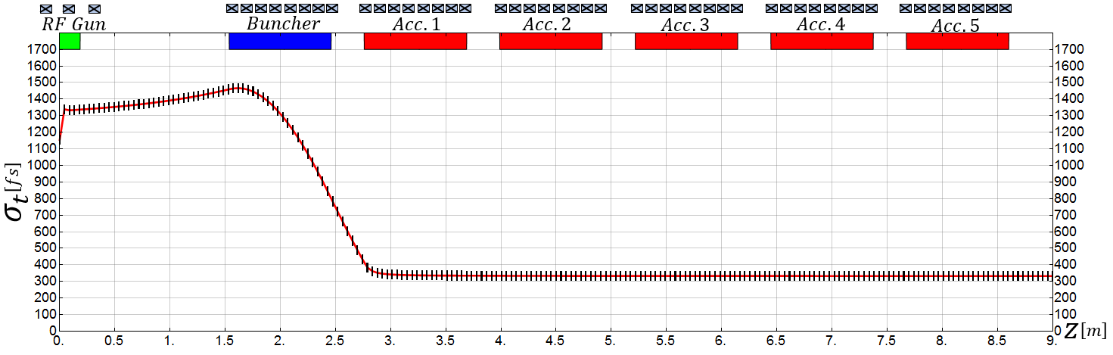
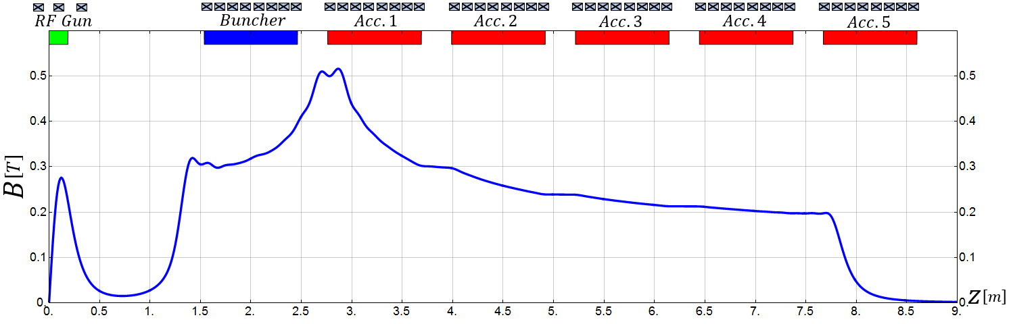
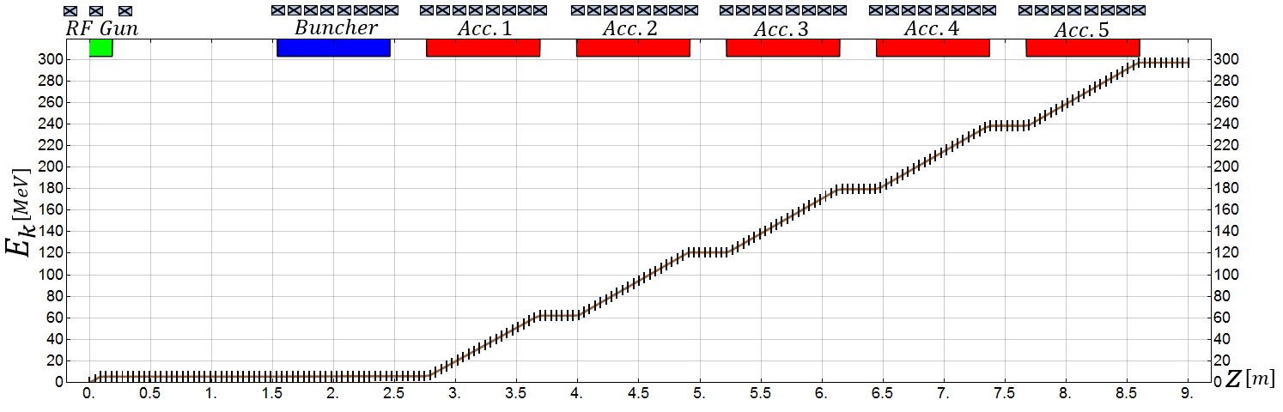
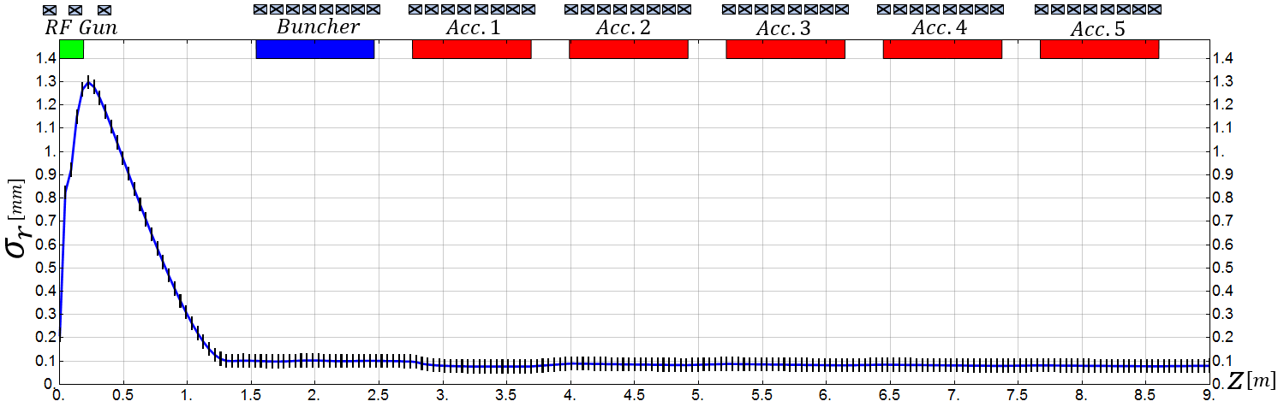
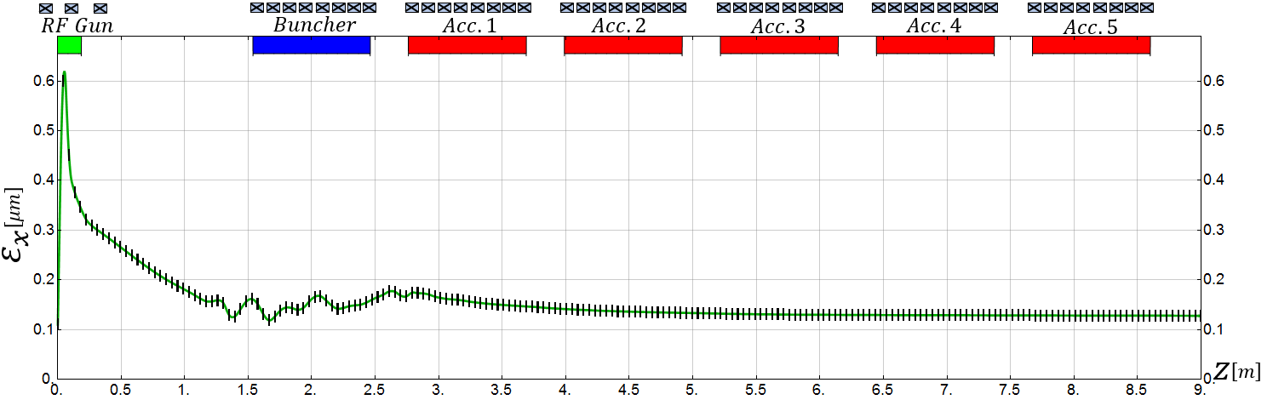
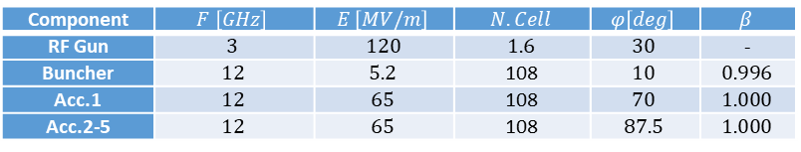
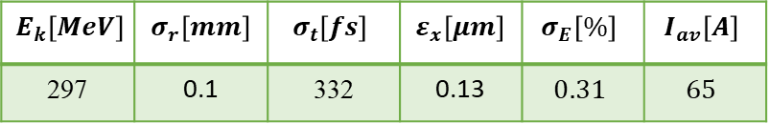
Case 2 : velocity bunching to 332 fs
Component | $$F \left[GHz\right]$$ | $$E \left[MV/m\right]$$ | $$N.Cell$$ | $$φ\left[deg\right]$$ | $$β$$
RF Gun | $$3$$ | $$120$$ | $$1.6$$ | $$30$$ | -
Buncher | $$12$$ | $$5.2$$ | 108 | $$10$$ | $$0.996$$
Acc.1 | $$12$$ | $$65$$ | 108 | $$70$$ | $$1.000$$
Acc.2-5 | $$12$$ | $$65$$ | 108 | $$87.5$$ | $$1.000$$
$$E_{k}\left[MeV\right]$$ | $$σ_{r}\left[mm\right]$$ | $$σ_{t}\left[fs\right]$$ | $$ε_{x}\left[μm\right]$$ | $$σ_{E}\left[\%\right]$$ | $$I_{av}\left[A\right]$$
297 | 0.1 | 332 | 0.13 | $$0.31$$ | $$65$$

Slide 6
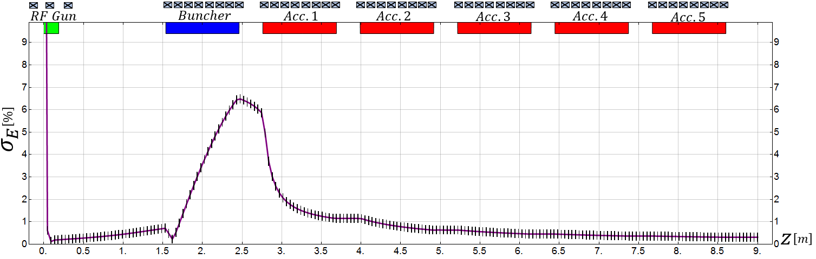
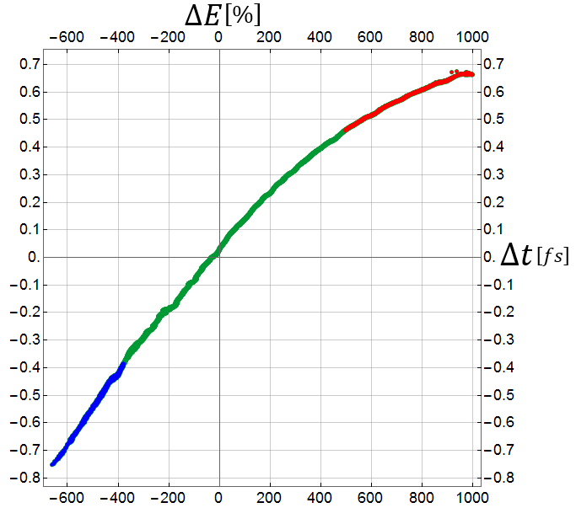
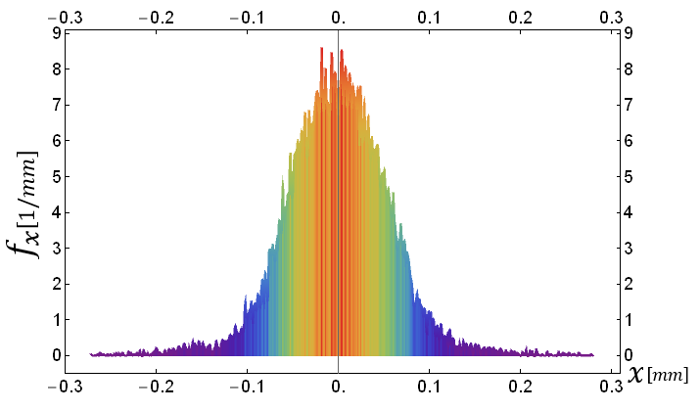
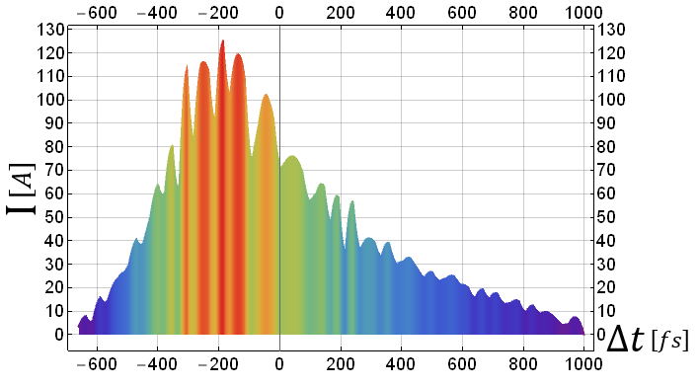
Case 2 : velocity bunching to 350 fs
This case has been used for subsequent Linac simulations
(see WP 6 presentations by Xingguang Liu)

Slide 7
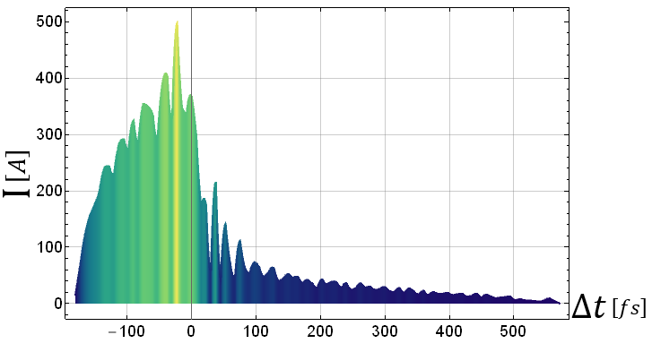
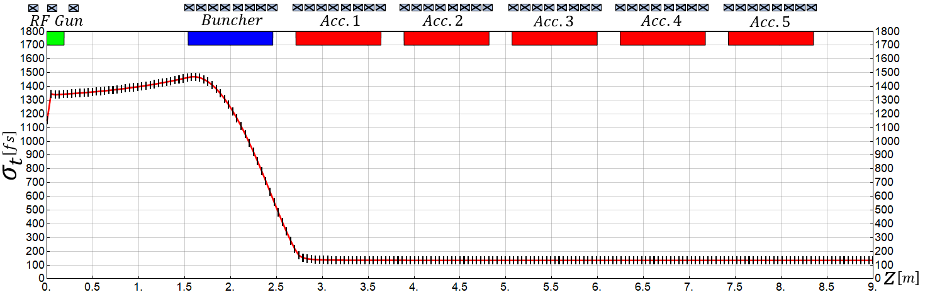
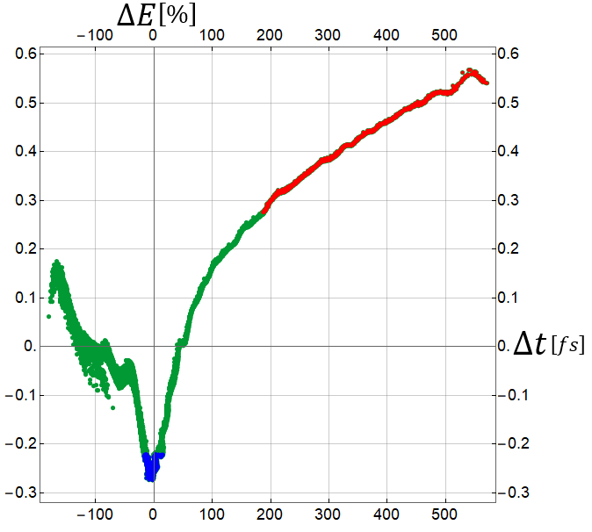
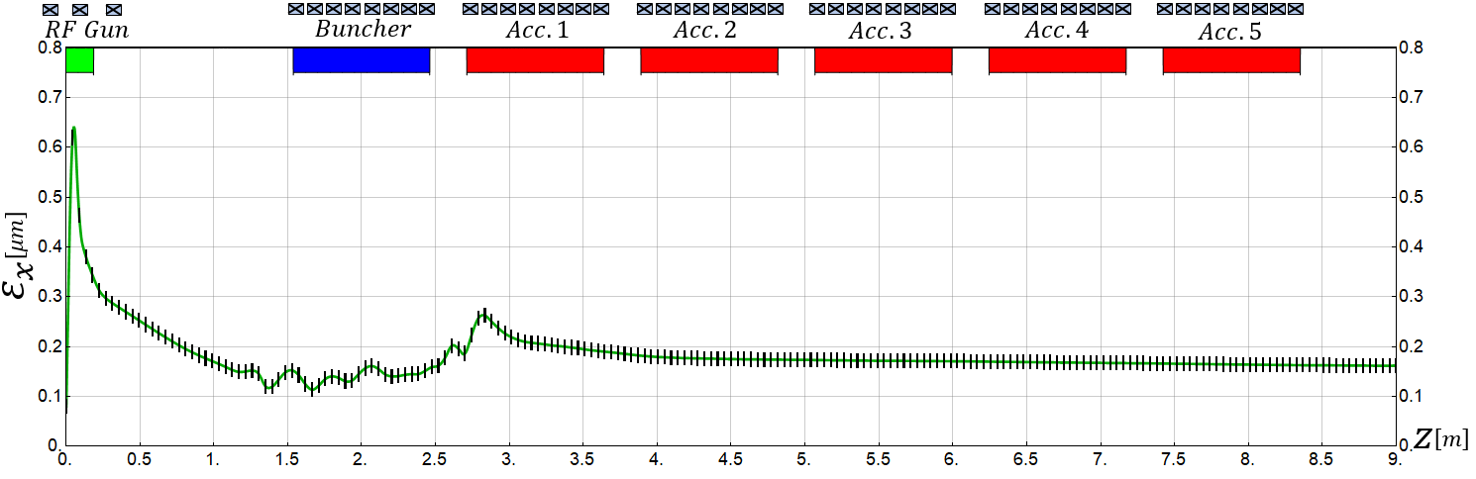
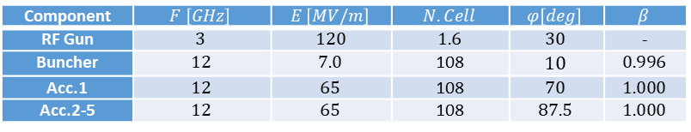
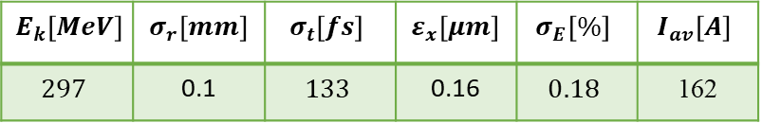
Case 3 : velocity bunching to avoid first bunch compressor
Component | $$F \left[GHz\right]$$ | $$E \left[MV/m\right]$$ | $$N.Cell$$ | $$φ\left[deg\right]$$ | $$β$$
RF Gun | $$3$$ | $$120$$ | $$1.6$$ | $$30$$ | -
Buncher | $$12$$ | $$7.0$$ | 108 | $$10$$ | $$0.996$$
Acc.1 | $$12$$ | $$65$$ | 108 | $$70$$ | $$1.000$$
Acc.2-5 | $$12$$ | $$65$$ | 108 | $$87.5$$ | $$1.000$$
$$E_{k}\left[MeV\right]$$ | $$σ_{r}\left[mm\right]$$ | $$σ_{t}\left[fs\right]$$ | $$ε_{x}\left[μm\right]$$ | $$σ_{E}\left[\%\right]$$ | $$I_{av}\left[A\right]$$
$$297$$ | 0.1 | $$133$$ | 0.16 | $$0.18$$ | 162

Slide 8
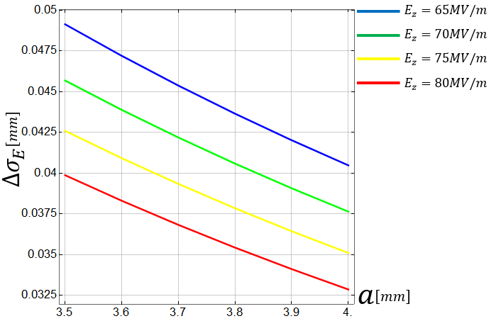
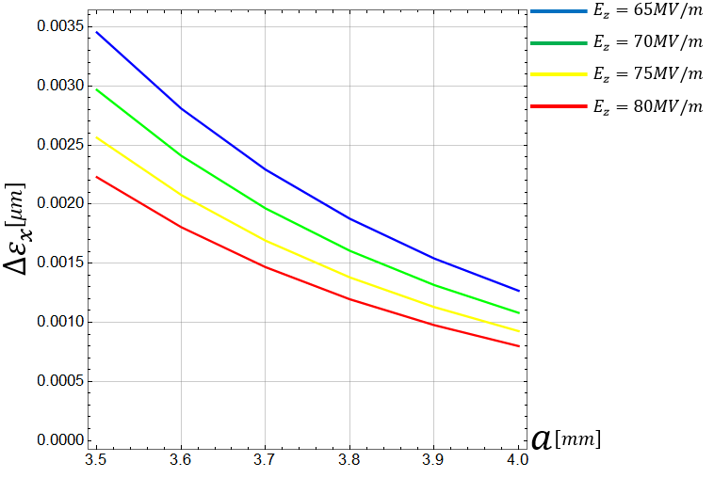
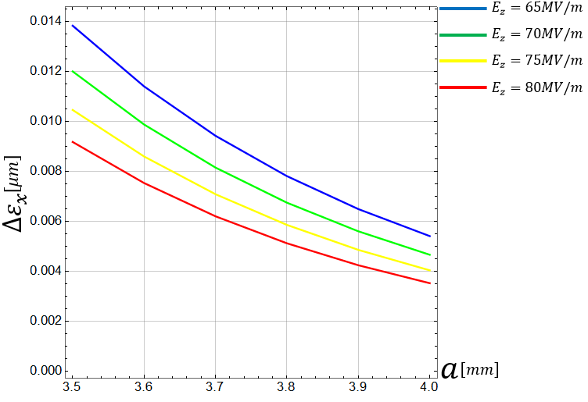
Wake field considerations
We don’t have the full 3D field map of the CompactLight x-band structure yet
First analytical (worst case) look into longitudinal and transverse wake fields (350 fs case)
Longitudinal wakes
Transverse wakes, 50 μm (0.5 sigma) and 100 μm (1 sigma) offset
Wake field effect within the injector seems quite small

Slide 9
Conclusion and Outlook
Proposal of a very compact injector with proven gun technology
x-band modules could be used from the beginning providing a very compact and flexible design, no need for other frequency module
scheme might work with different gun-types
S-band gun allows for flexibility in cathode material and laser set-up
Further transport of the beam and its suitability for FEL needs study
(see WP 6 presentations by Xingguang Liu)
Scheme makes most sense with moderate – strong velocity bunching and if it is possible to work without linearizer
We will continue looking into wake fields and tolerances for this type of injector

