Slide 1
Company Presentation
XLS Midterm Review
3.07.2019
Daniel Ganuza

Slide 2

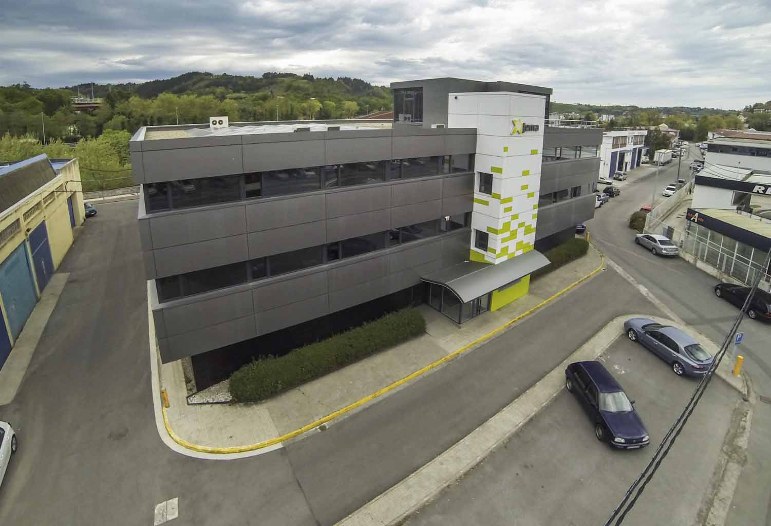
Company information
Founded in 1953
Since 2009 part of Irizar Group (>700 M€ turnover, 3500 employees)
Headquarters in Lasarte-Oria, Spain
160 employees (50% engineers)

Slide 3
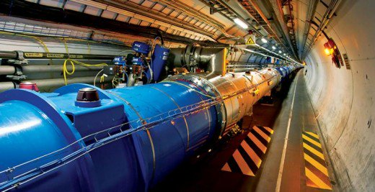


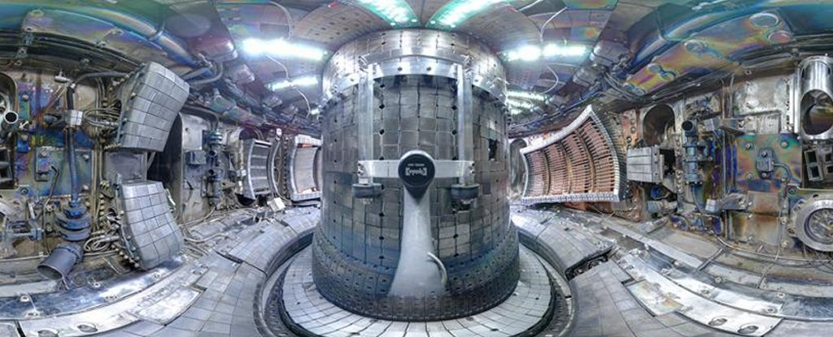
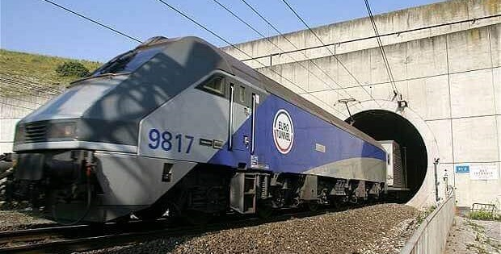

Markets - Electronic power conversion systems
Big Science
Transport
Energy

Slide 4
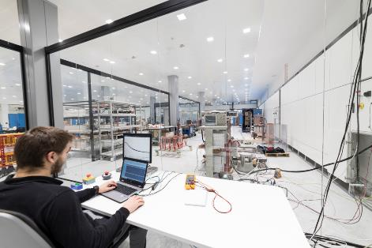
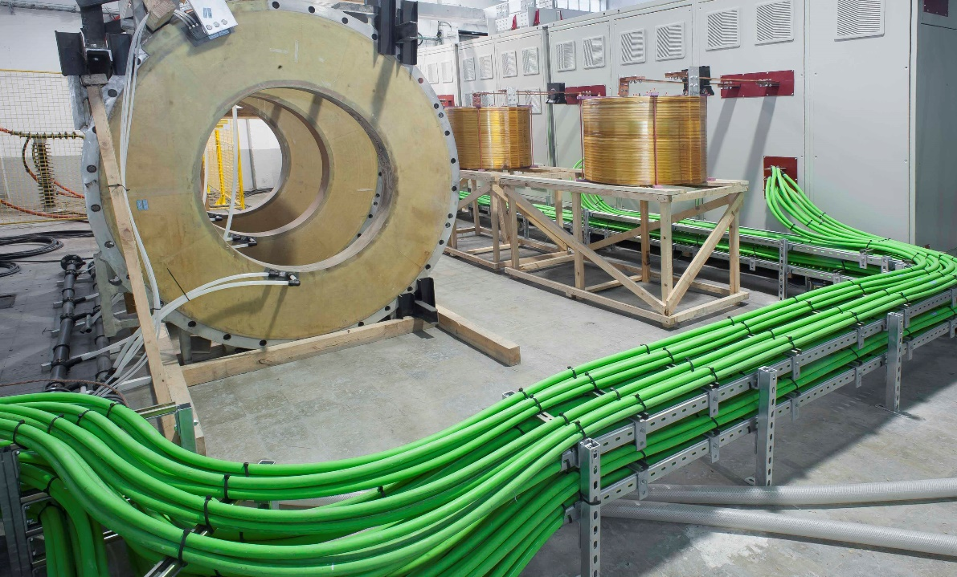
Facilities
Total area 4800 m² and production area of 2000 m²
Test facility with 30 kV - 22 MVA connection
High power test facility with 17 MW resistive load

Slide 5
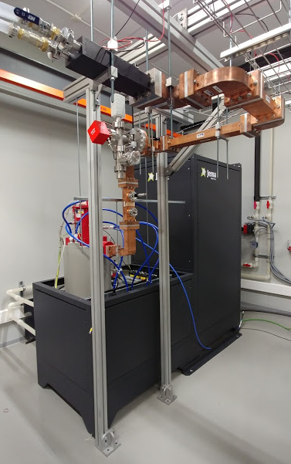
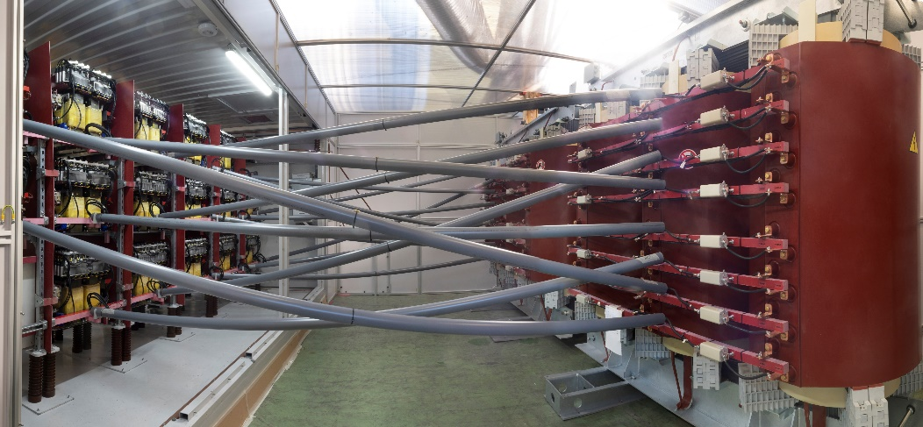
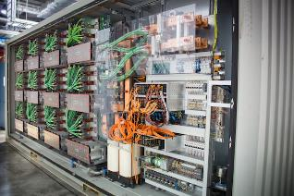
Big Science (Nuclear Fusion + Particle accelerators)
High Voltage DC power supplies:
  for plasma heating devices (Neutral Beam Injectors)
  for RF tubes (i.e. klystrons, tetrodes, IOT’s and gyrotrons)
Electro magnet DC power supplies:
  high current magnet coils for nuclear fusion
  high precision magnets

Slide 6
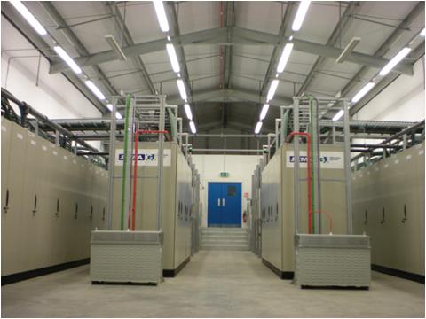
Neutral Beam Injector HVPS
Main characteristics:
Voltage : 80-130kV
Current : 70-130A
Power : up to 17MW
Pulse length : 0-10s
Duty cycle : 2-3%
Client : JET, MAST ,TJ-II, Budker, TAE

Slide 7

Gyrotron HVPS
Main characteristics:
Voltage : 60-100kV
Current : 30-110A
Power : up to 6,6MW
Pulse length : 100s
Duty cycle : 6-10%
Client : TJ-II and JT60-SA

Slide 8
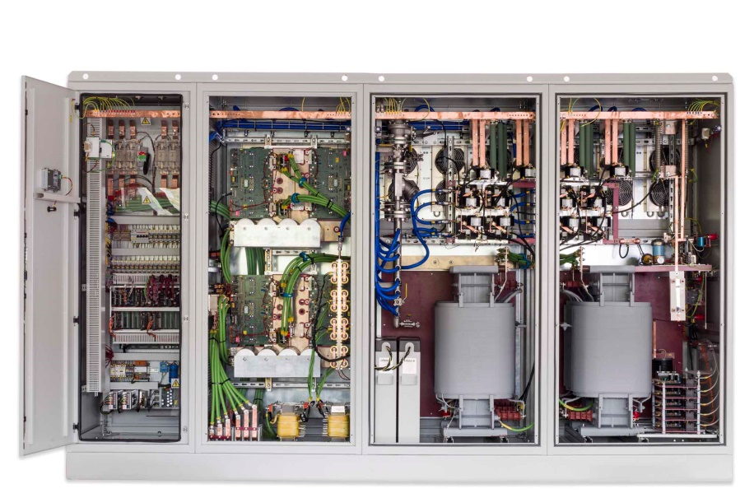
Tetrode HVPS
Main characteristics:
Voltage : 11-20kV
Power : 400kW
Pulse length : continuous
Client : RAL ISIS & IFMIF

Slide 9
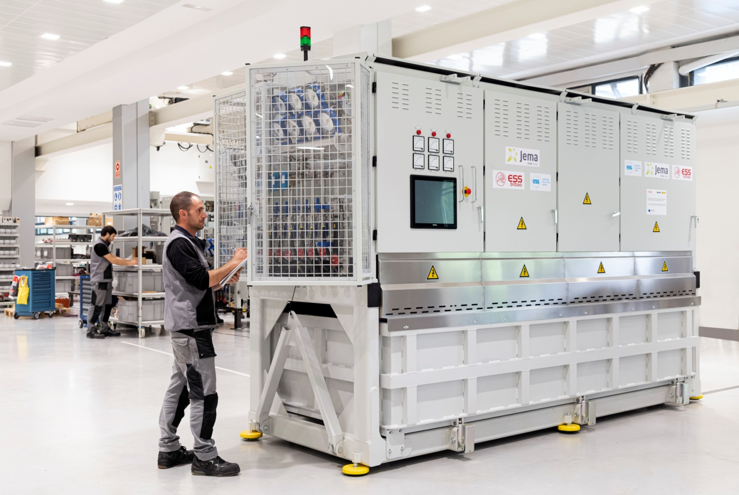
Solid State Klystron Modulator (medium – long pulse)
Main characteristics:
Voltage : 85-120kV
Current : 60-160A
Peak power : 7-14MW
Pulse length : 3.5ms
Average power : 660 kVA
HVHF transformers in oil or air
Client : ESS Bilbao, ESS Lund and ORNL

Slide 10
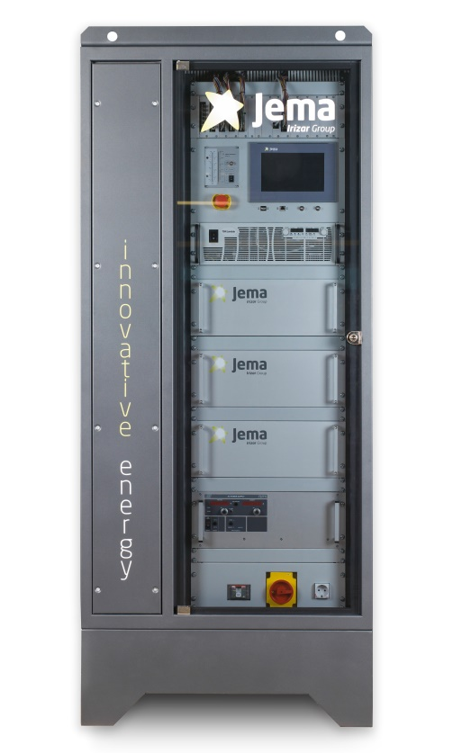
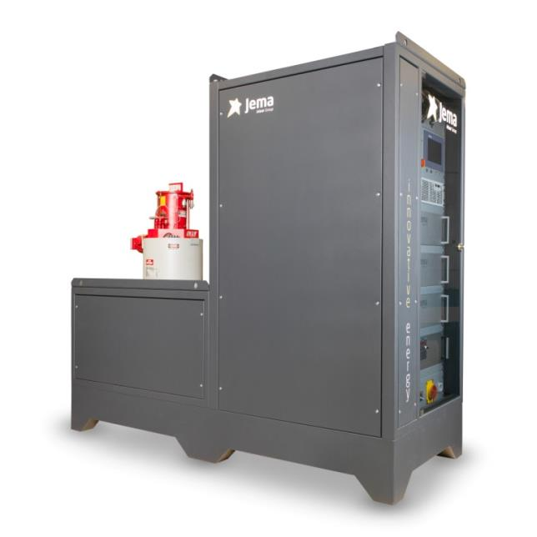
Solid State Klystron Modulator (short pulse)
Main characteristics:
Voltage : 45-150kV
Current : 105A
Peak power : 16,5MW
Repetition rate : 400Hz
Pulse length : 5μs
Pulse to pulse stability : <0,025%
Voltage ripple : <0.8% @ 130kV
Pulse transformer in oil
Solid state switching
Integrated active bouncer
Client : IFIC Valencia

Slide 11
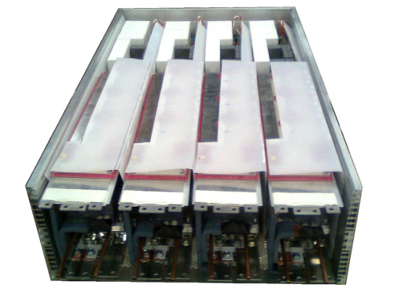
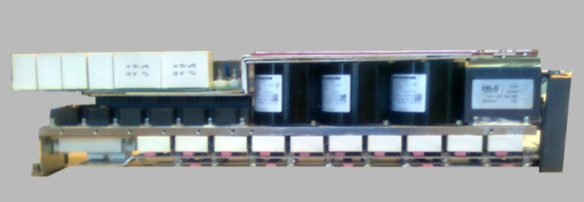
Solid State Klystron Modulator (short pulse)
- Modular and scalable solution
- Every individual module includes:
  Storage capacitors
  Main switch
  Bouncer
  Core reset

Slide 12
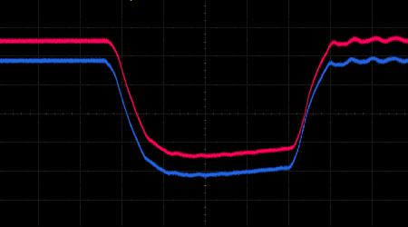
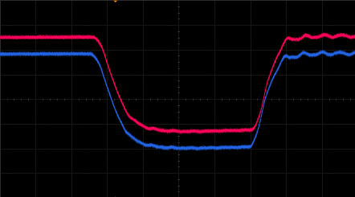
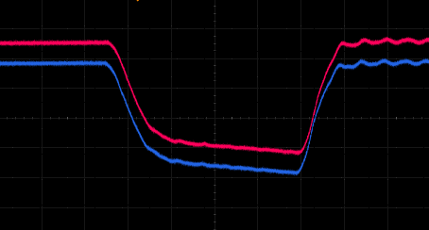
Solid State Klystron Modulator (short pulse)
-Bouncer allows for easy flatness correction from the control panel
Corrected flatness – IFIC – Valencia

Slide 13


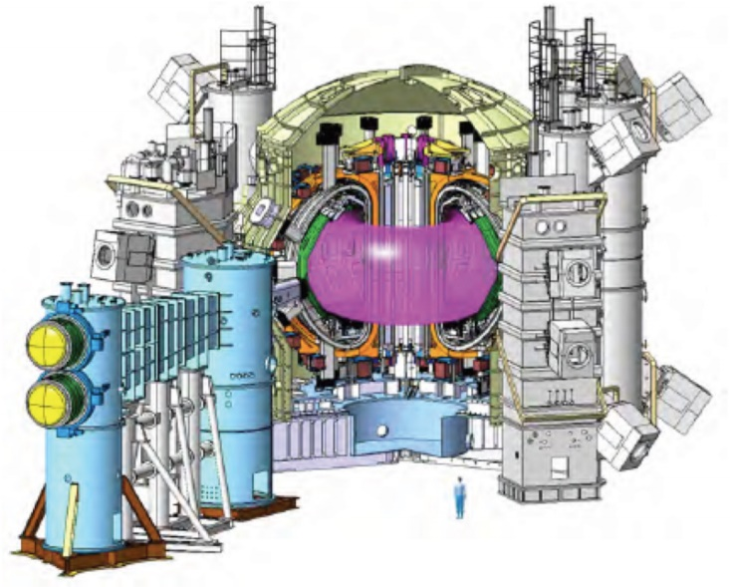








Nuclear Fusion references
JT-60SA (Japan)
JET (UK)
MAST (UK)
SST-1 (India)
TJ-II (Spain)
SPC (Switzerland)
W7X (Germany)
ST-40 (UK)
C2W (USA)

Slide 14








Particle Accelerators references
ESS (Sweden)
ESS (Spain)
LHC (Switzerland)
ISIS (UK)
IFMIF (Japan)
IFIMED (Spain)
DESY-II (Germany)

