Slide 1



Coordination Committee
CERN
07 March 2019

Slide 2

Outline
Milestones and deliverables
FCC Week 2019
Next ECC meetings
Co-funded by the
​The European Circular Energy-Frontier Collider Study (EuroCirCol) project has received funding from the European Union's Horizon 2020 research and innovation programme under grant No 654305. The information herein only reflects the views of its authors and the European Commission is not responsible for any use that may be made of the information.

Slide 3
Milestones & deliverables
Recently submitted on the H2020 portal
D2.6 Preliminary collimation system design concept and performance estimate (PDF)
M4.5 Preliminary cryogenic-beam-vacuum system design (PDF)

Slide 4
Milestones & deliverables
6 months sliding window
WP | Product | Due Date | Title
1 | Milestone | 01 APR 19 | Cost baseline
1 | Milestone | 01 APR 19 | Industry and outreach event (UNILIV)
5 | Deliverable | 01 APR 19 | Manufacturing folder for reference design dipole short model
5 | Milestone | 01 APR 19 | High-field accelerator dipole conceptual design report
2 3 4 5 | Milestone | 01 MAY 19 | Report on recommended follow-up R&D
1 | Milestone | 01 JUN 19 | EuroCirCol closing event
1 | Deliverable | 01 JUN 19 | Periodic report 3
1 | Deliverable | 01 AUG 19 | Final report
Further information on the EuroCirCol dashboard

Slide 5
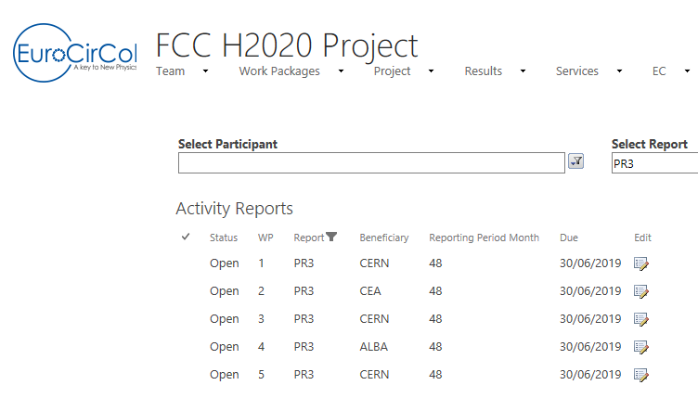
Preparation of the final reports
Most of the information needed for the final report will be taken from the periodic report 3.
First requests to WP leaders to be sent in the coming days to anticipate the preparation of these reports:
Name, gender, role of people in their team
List of publications
List of meetings
Next step will be the submission of activity reports for the period M37 – M48 (June 2018- May 2019).

Slide 6
FCC Week 24-28 June 2019
Website: http://fccweek2019.web.cern.ch/
Venue:
Hotel Crowne Plaza Brussels – Le Palace, Rue Gineste 3, Sint-Joost-ten-Node, 1210 Brussels, Belgium
The presentation slides shall be prepared in 4:3 landscape format.
Registrations by WP
WP | Name
1 | Michael Benedikt
2 | David Boutin
2 | Antoine Chance
3 | Manuela Boscolo
3 | Roman Martin
3 | Tatiana Pieloni
4 | Vincent Baglin
4 | Ignasi Bellafont
4 | Sara Casalbuoni
4 | Roberto Cimino
4 | Luis Antonio Gonzalez Gomez
4 | Patrick Krkotic
5 | Tiina Salmi
5 | Davide Tommasini

Slide 7
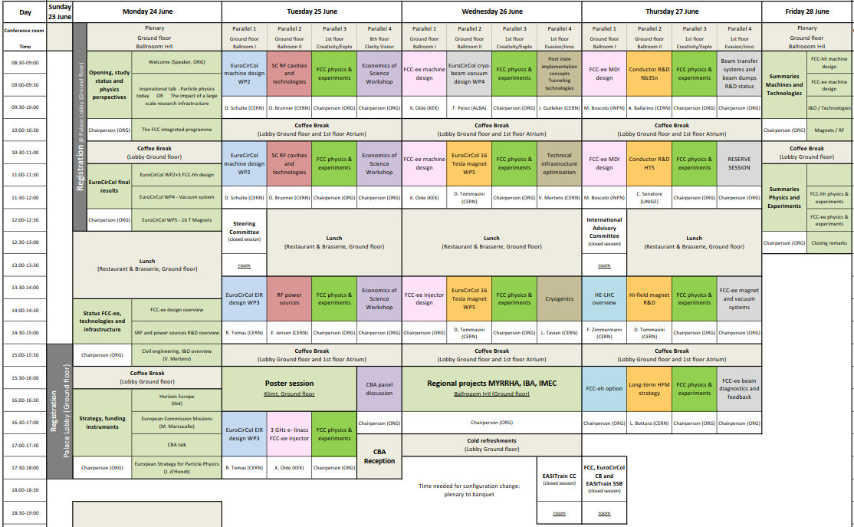
Draft programme
A second session will be added for WP4

Slide 8
WP4 draft programme
Study of the beam induced vacuum effects in the FCC-hh beam vacuum chamber (Ignasi Bellafont)
Material properties of relevance to cryogenic vacuum (Luisa Spallino)
R and PY from candidate materials for the FCC-hh Vacuum system (Roberto Cimino)
Photo desorption studies at the WINDY set-up at LNF (Marco Angelucci)
Progress on LASE surface treatment for the FCC-hh vacuum beam screen (Reza Valizadeh)
Recent results on NEG coating characterization (Ruta Sirvinskaite)
Photodesorption Studies on FCC-hh Beam Screen Prototypes at KARA (Luis A. Gonzalez)

Slide 9
Next ECC meetings
Date | Title | Location
Thu. 04 APR 19 | ECC 30 | 6-R-012 (CERN)
Thu. 02 MAY 19 | ECC 31 | 6-R-012 (CERN)
Thu. 23 MAY 19 | ECC 32 | 6-R-012 (CERN)

