Slide 1



NEG studies update
Ruta Sirvinskaite

Slide 2
Outline
Cryogenic test set up
NEG system upgrade
New samples
Experimental procedure
ESD at cryogenic temperatures
Alpha at cryogenic temperatures
Next steps

Slide 3
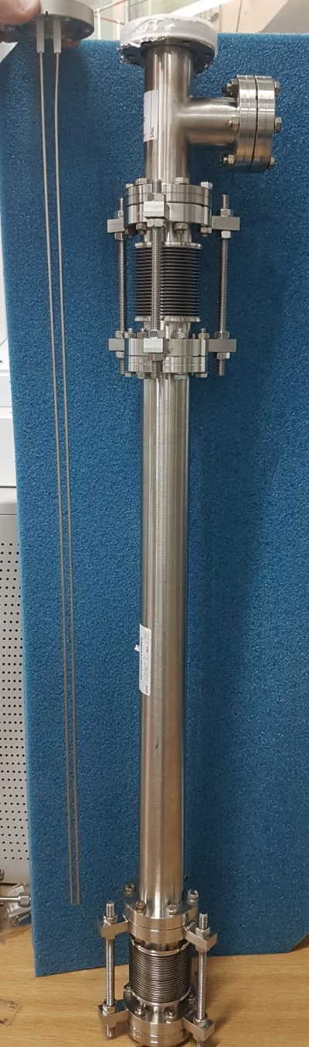
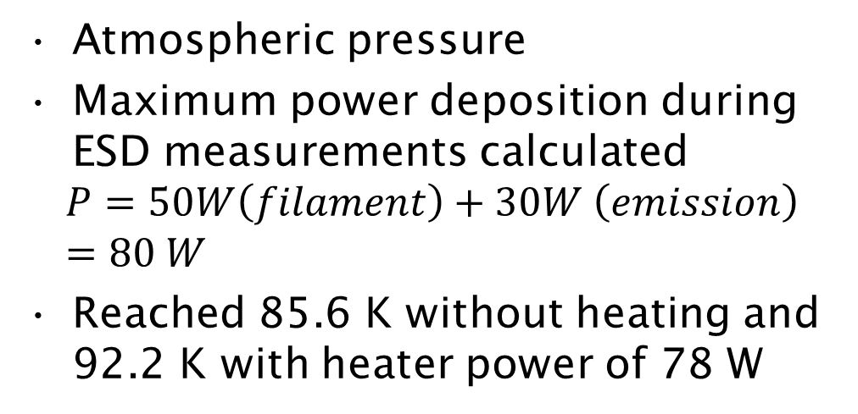
Cooling efficiency test
Atmospheric pressure
Maximum power deposition during ESD measurements calculated
$$P=50W\left(filament\right)+30W \left(emission\right)=80 W$$
Reached 85.6 K without heating and 92.2 K with heater power of 78 W
Silicone heater mat
Thermocouples (K-type and PT100s
Copper chiller
Heat insulation

Slide 4
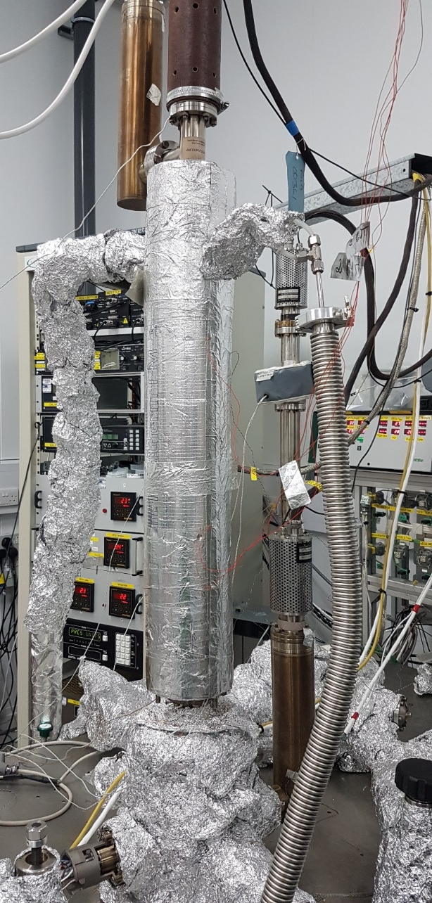
NEG system upgrade for cryogenics
Installation of the new sample, bellows and filament on a vacuum system
Sample not activated after bake out
Conditioning of the filament (from 1e-6 mbar at 3 A and 2 V after bake out to 5.1e-10 mbar at 6 V and 7 A after activation at 180 °C and subsequent experiments)

Slide 5
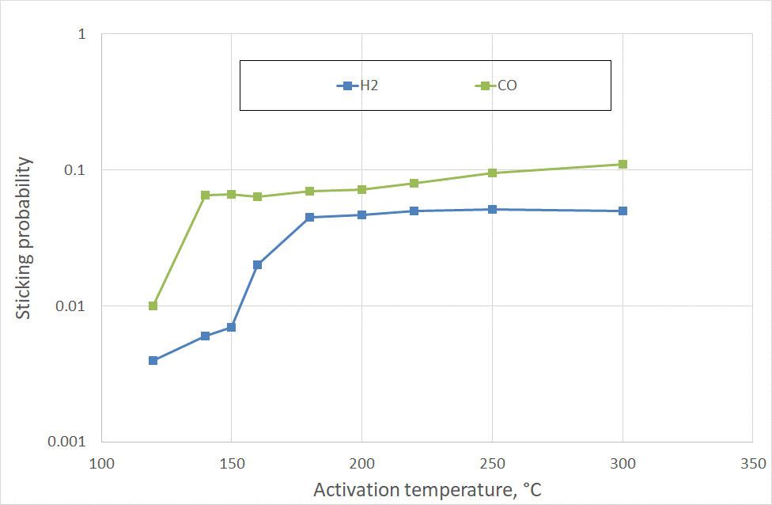
New samples
Two columnar TiZrV tubes deposited
One sample used for α measurements at RT
Another sample used for experiments at CT
  First test (after bake-out and activation to 180 °C)

Slide 6
Experimental procedure
Bake out of non-coated parts
Cooling down with ESD
Cooling down with hot filament without ESD
NEG coating activation
ESD at RT for 1-2 hours
ESD as a function of temperature
Start ESD -> start cooling ->bombard as long as possible -> warm up -> turn off ESD
Short H₂+CO injection to measure α at RT
Measurements of α at CT
Increase outgassing rate of the filament -> cool down while heating up the filament -> then warm up again (should be done with and without ion pump)

Slide 7
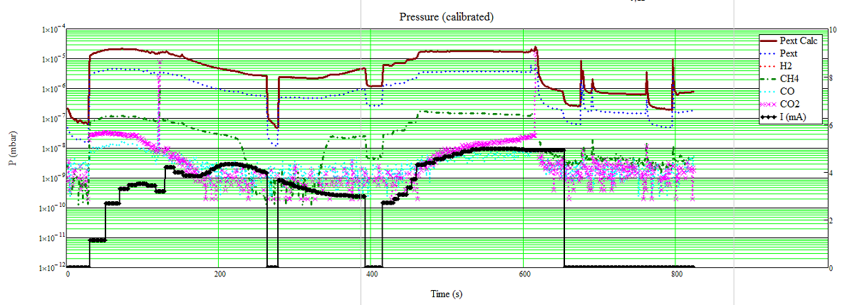
ESD after bake out
ESD with cooling
Filament was off during bake out (degassing started at 150 °C) and still outgassing a lot after it

Slide 8
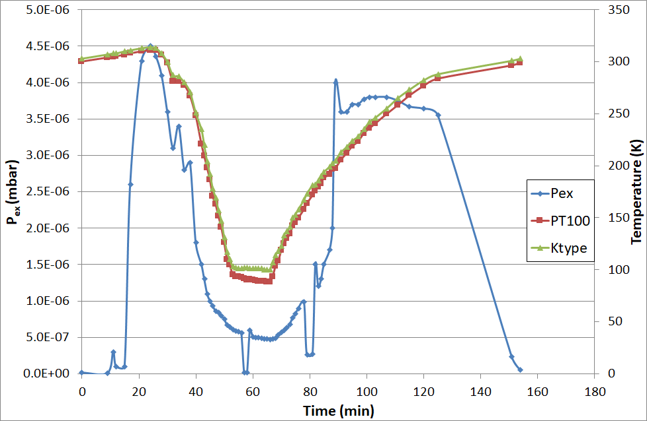
Tests after bake out - ESD

Slide 9
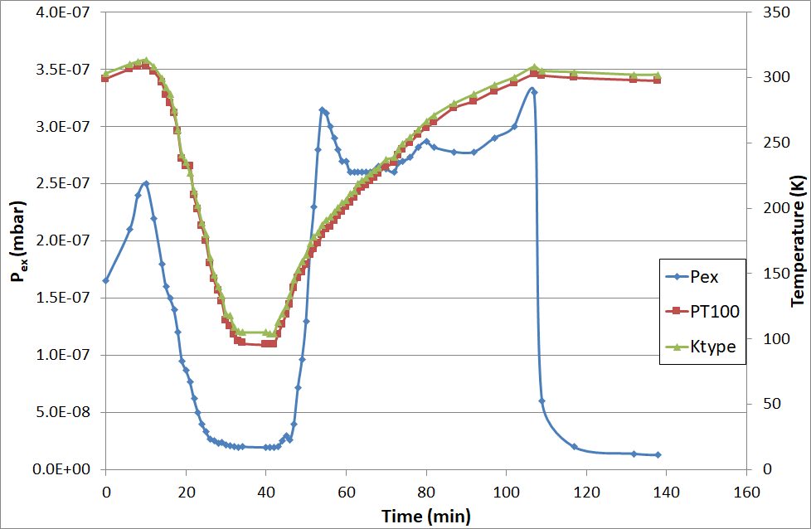
Sticking probability measurements with a hot filament - CT

Slide 10
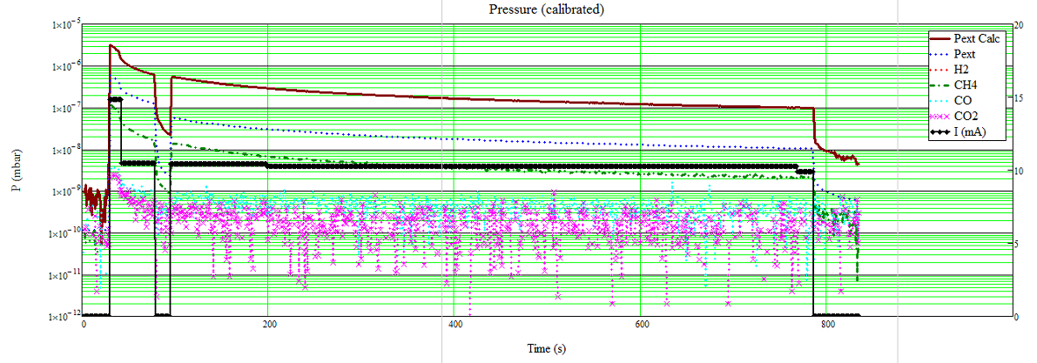
ESD after activation - RT
ESD at RT for 2 hours
Filament switched on during activation
The background was 2 times lower – slight pressure decrease after switching off the filament

Slide 11
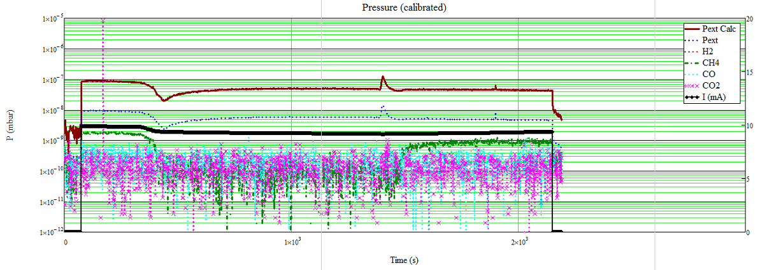
ESD after activation – CT
Bombardment at 89K for about 3 hours
The pressure started going up after and the became stable at 92 K

Slide 12
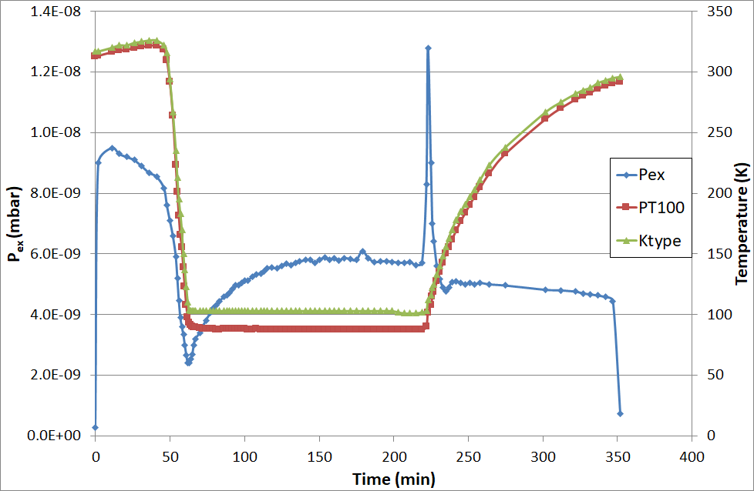
ESD after activation

Slide 13
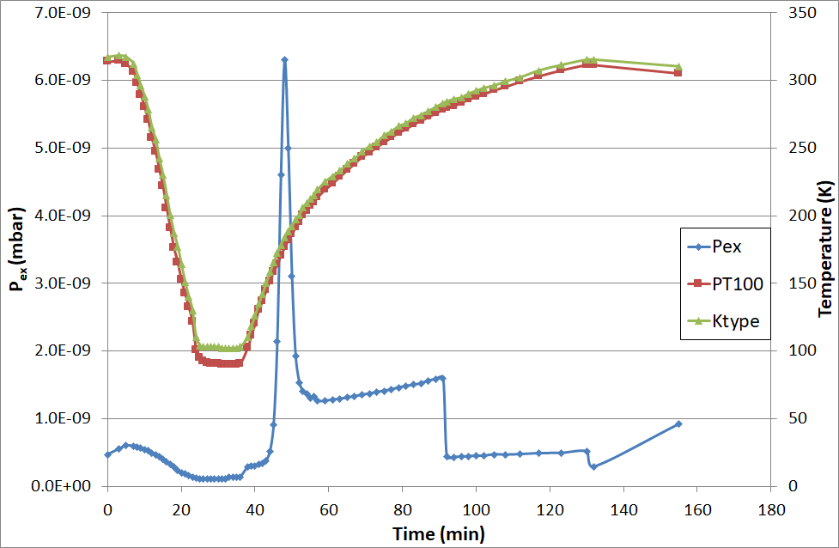
Sticking probability measurements with hot filament -CT

Slide 14
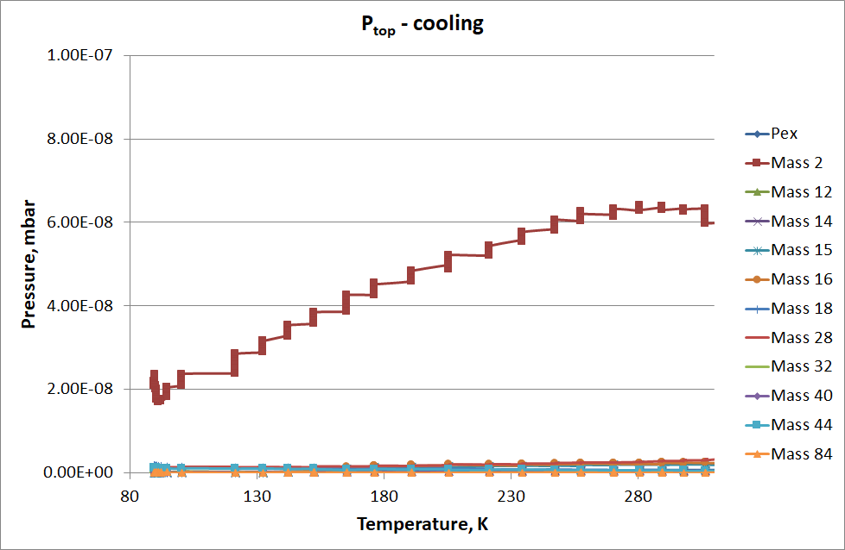
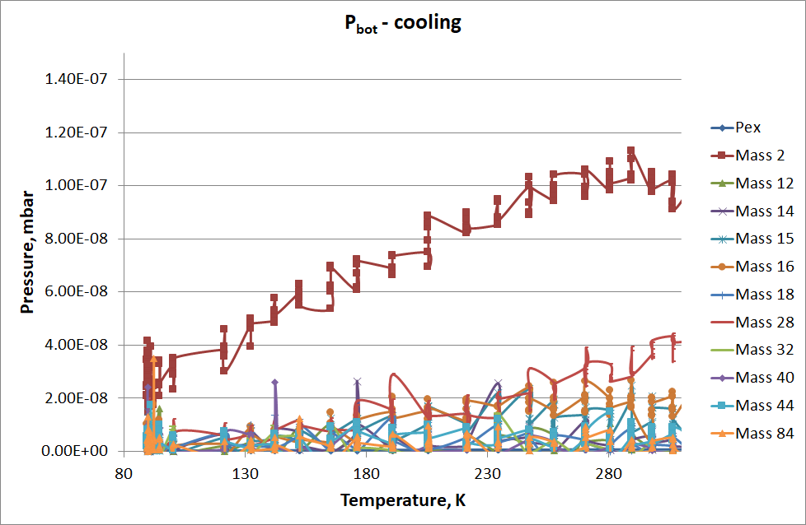
Cooling
SIP ON during the cooling

Slide 15
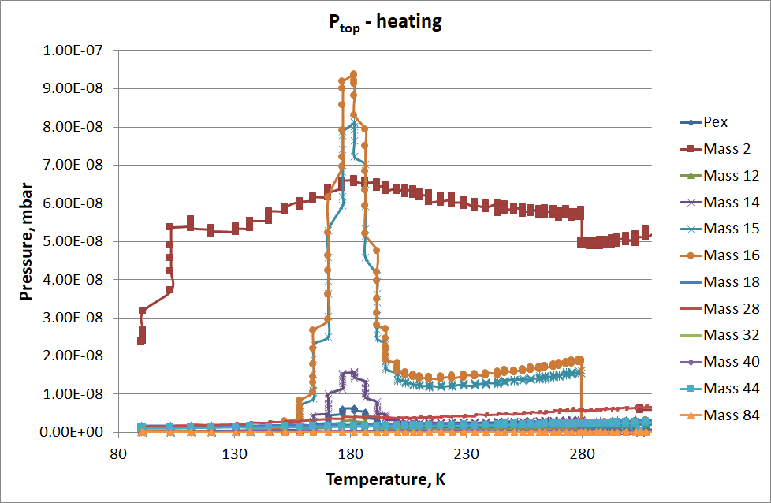
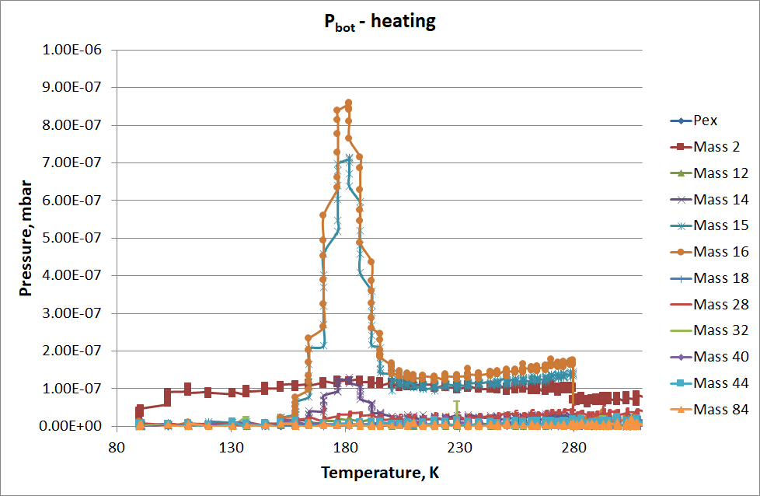
Warming up
SIP OFF during warming up
Can see methane being released from the surface

Slide 16
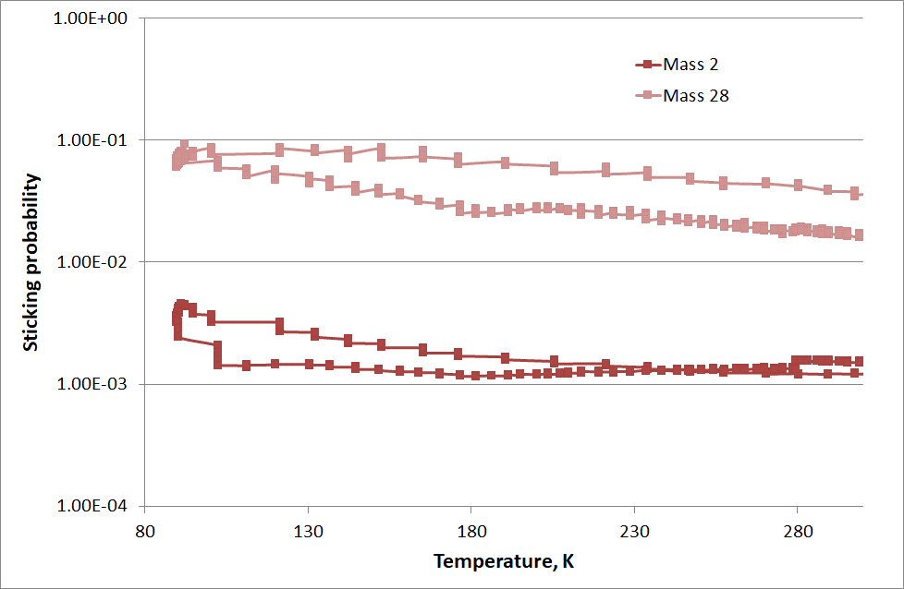


Calculating alpha at CT
If pump is closed,
$$Ptop ≈ Pbot$$
$$P=\frac{Q}{αS_{idt}}$$
$$P_{CT}=P_{RT}\sqrt{\frac{T_{CT}}{T_{RT}}}$$
$$α_{CT}=α_{RT}\frac{P_{RT}}{P_{CT}}$$

Slide 17
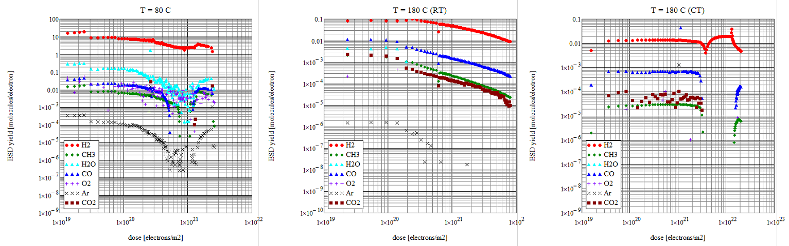
ESD results
Desorption yield as a function of electron dose decreased after activation and filament conditioning

Slide 18
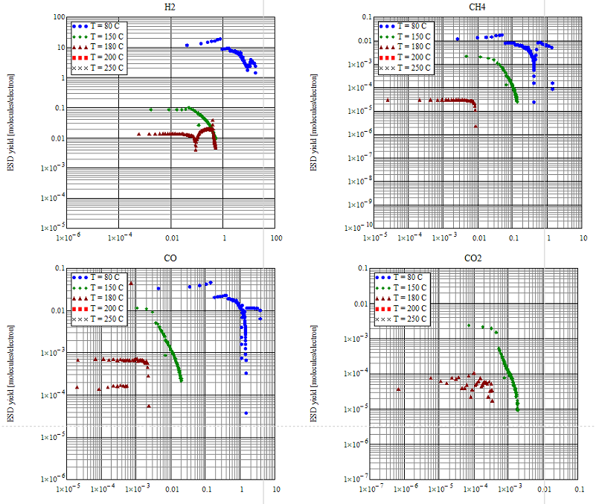
ESD results
Desorption yield as a function of desorbed gas reduced after sample activation and filament conditioning

Slide 19
Next steps
Detailed data analysis of the results before and after activation to 180 °C
Cryogenics
Activation to 250 °C
Measurements of dense TiZrV sample possible
Zr coating
Completed surface characterisation (cross-section SEM and XPS)

Slide 20
Thank you for your attention

