Slide 2



FCC-hh beam vacuum line interconnections
C. Garion

Slide 3
Outline
Interconnection layout
Requirements:
  End absorber
  Compensation system
Preliminary “conceptual” design

Slide 4
Layout principle
Cold mass
Beam screen bellows
Cold bore
Cryostat vacuum vessel
Shielded interconnection bellows
Beam screen
RF fingers
Beam
Connection beam screen/cold bore
Interconnection absorber
Fixed point Cold mass/ vacuum vessel
Cooling tubes
Interconnection absorber

Slide 5
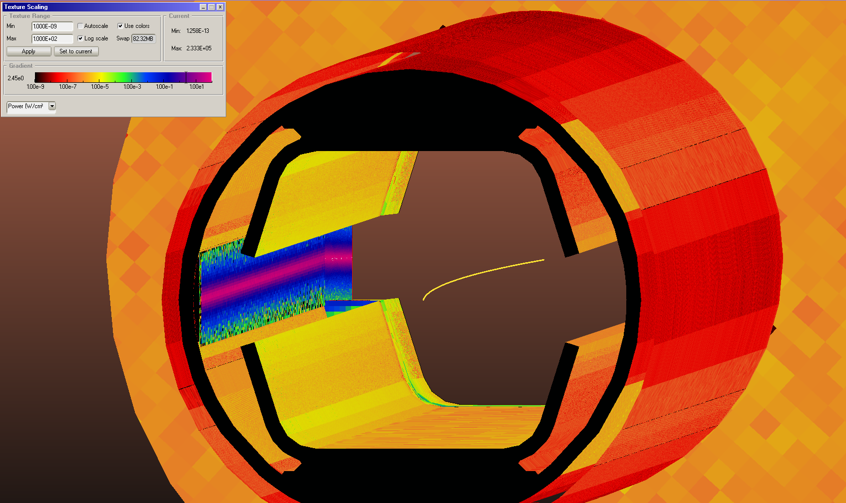
End absorber requirements
The absorbers are located on the downstream side of the magnet (upstream of the interconnection).
→ The two beam vacuum lines are different.
→ Shorter free space in the interconnections for the magnet installation.
Beam
Beam
Synchrotron radiation power intercepted by the end absorber is around 41 W.

Slide 6
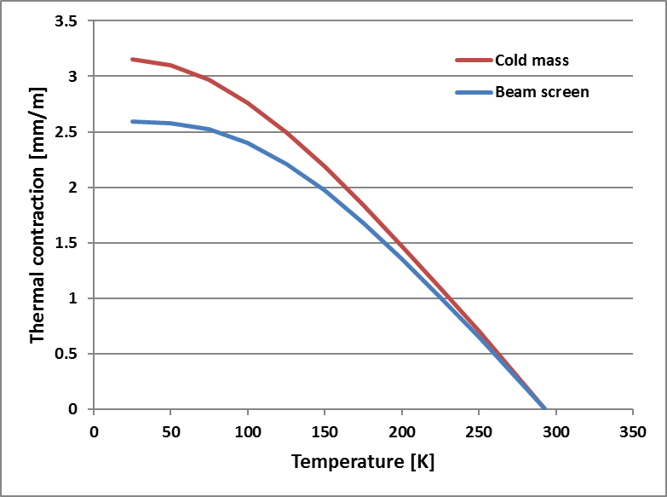
Compensation system requirements
The thermal expansion coefficients of the cold masses and the beam screen tube have been assumed equal to those measured in LHC.
15m long cold masses are assumed.
The stroke, in mm, of the compensation system has been evaluated for different cooling/warm-up scenarii, validated on LHC string II:
Thermal contractions
 | Beam screen | Cold mass
Nominal | 40-60 | 1.9
Coold down | 293 | 150
Warm up | 150 | 293
Exceptional 1 | 293 | 70
Exceptional 2 | 150 | 293
 | Beam screen bellows | PIM
Nominal conditions | 8 | 40
Cool down | 32 | -16
Warm-up | -30 | 46
Exceptional 1 | 45 | ~0
Exceptional 2 | -30 | 30
Design value for the bellows | -30/32 | -16/46
Temperature conditions
Bellows stroke

Slide 7
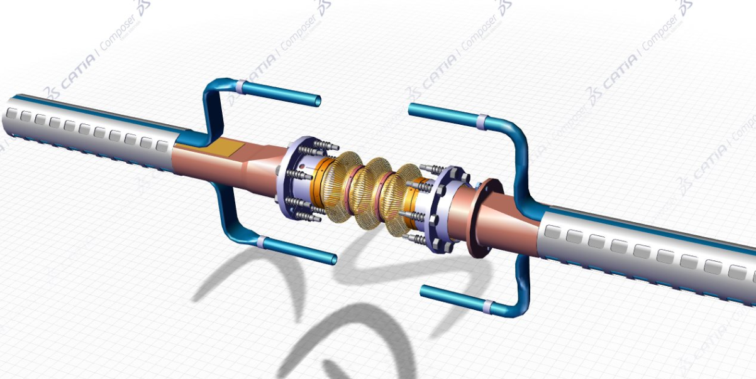
Preliminary conceptual design
Very first design. Alternatives have to be studied:
Transition and exit of cooling tubes.
RF bridge (deformable or sliding).
RF bridge
Beam screen
Absorber
Transition

Slide 8
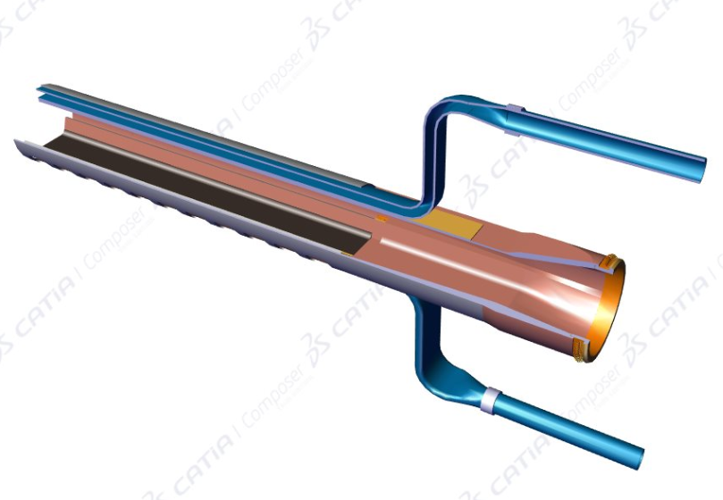
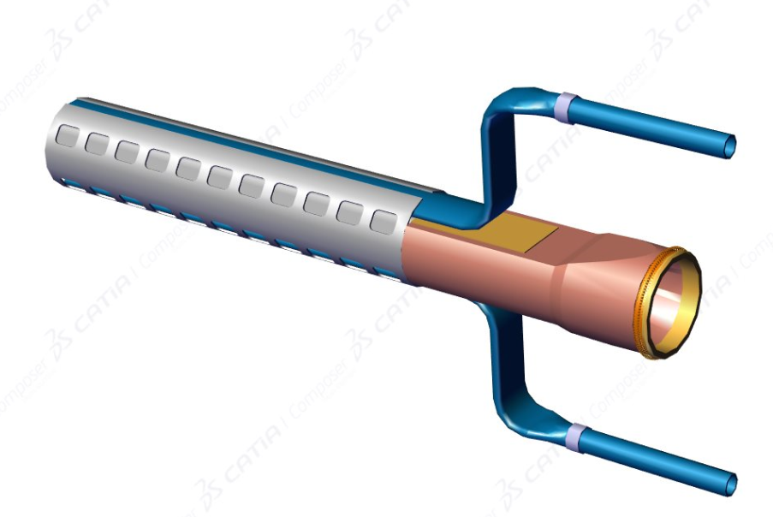
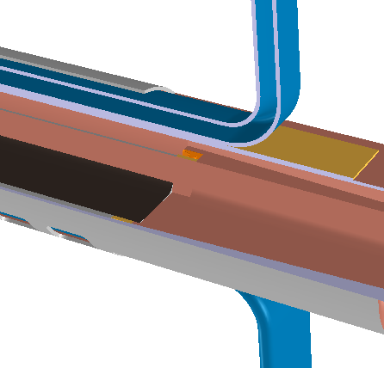
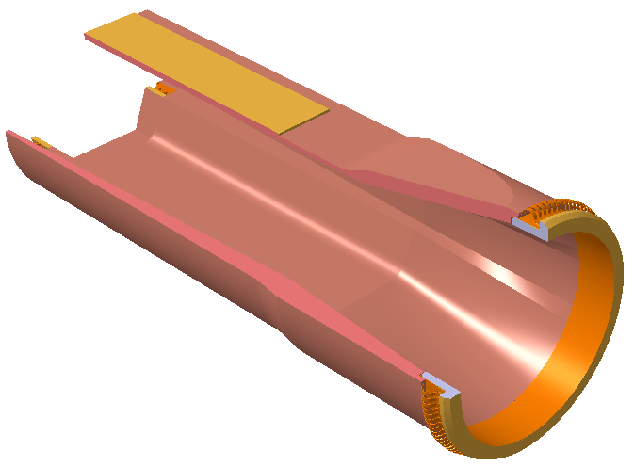
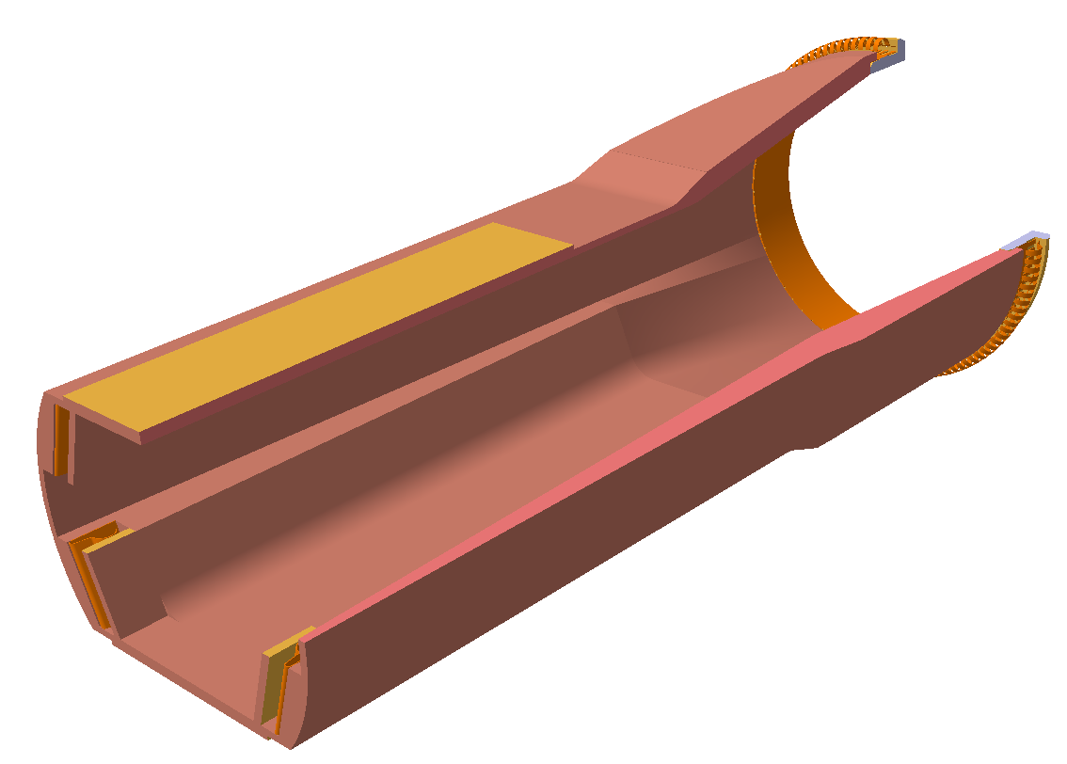
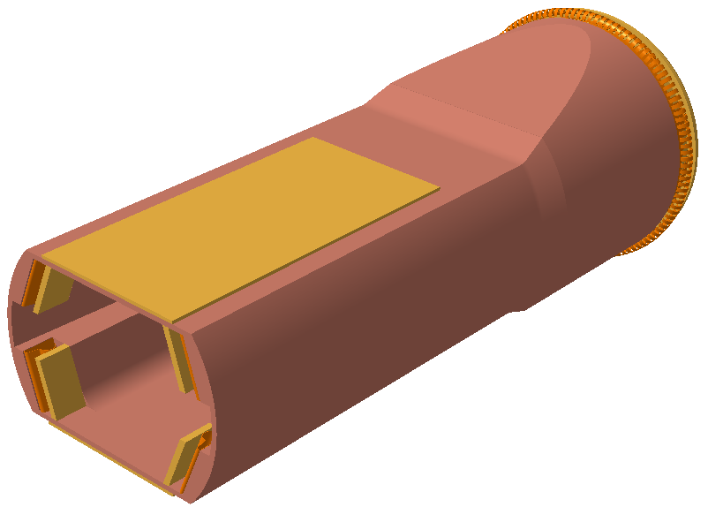
Absorber integration
Weld cooling tube/absorber
Contact “ring”
Interface plate
RF contact

Slide 9
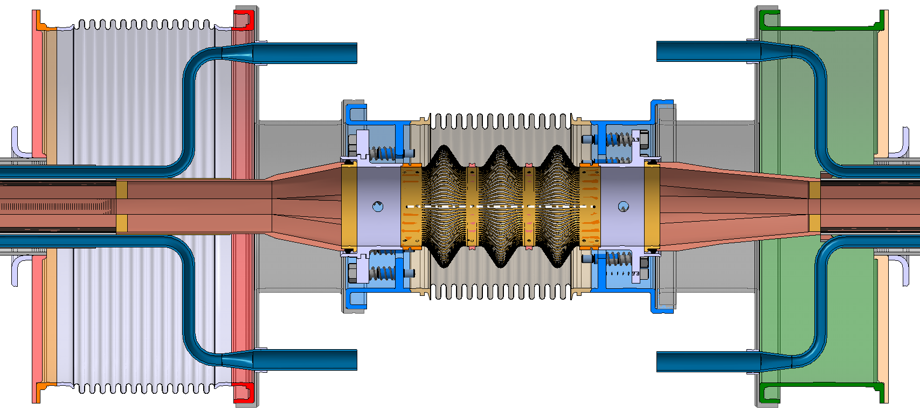
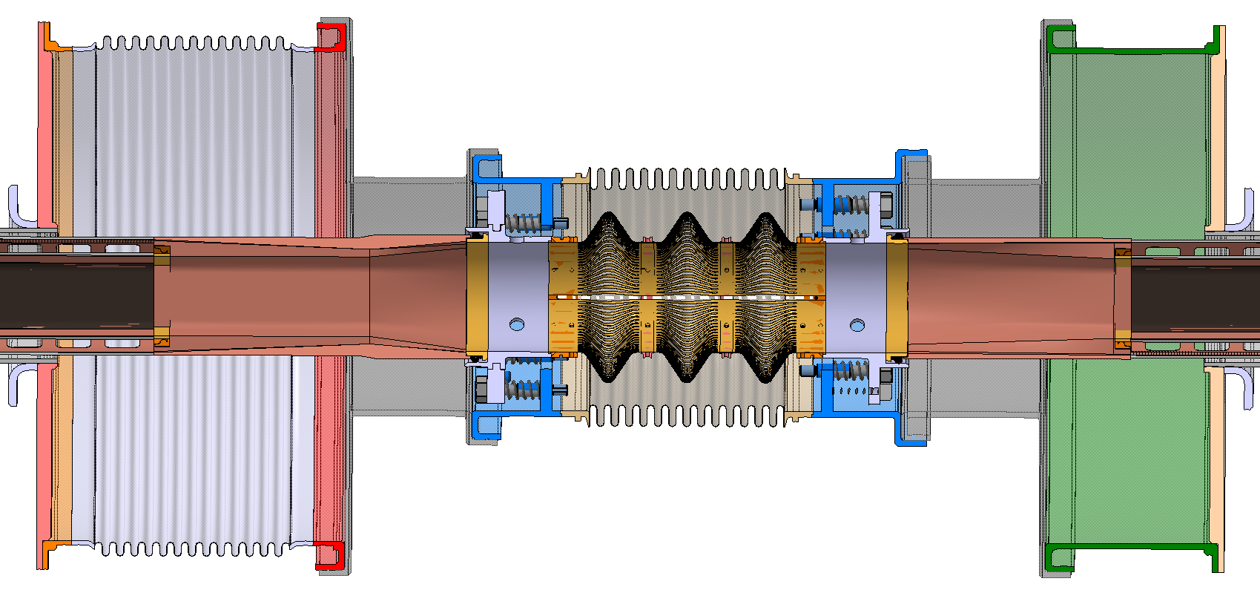
Preliminary conceptual design
Continuous cooling circuit (no weld in beam vacuum)
Beam screen bellows
Interconnection bellows
Absorber profile to optimize?
?

Slide 10
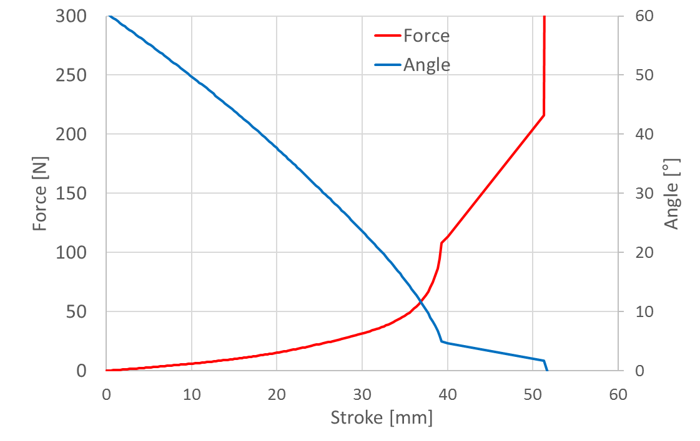
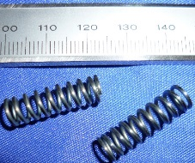
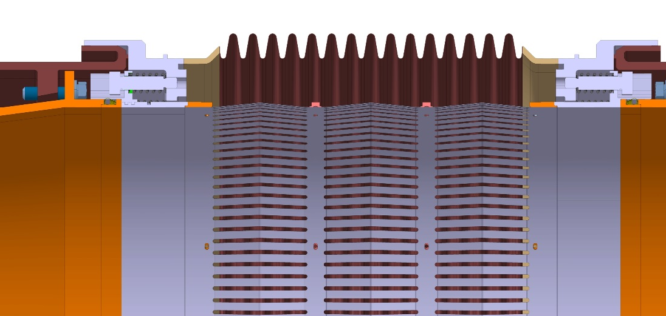
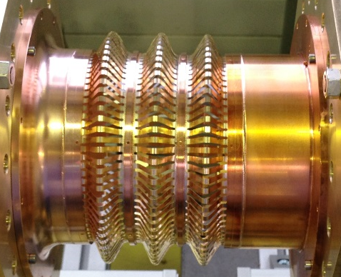
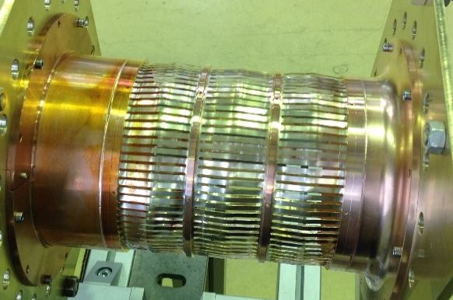
RF bridge
Copper Beryllium deformable RF bridge (based on HL-LHC design):
Circular aperture
C17410
0.1 mm thick, 3 mm width, gap: 1.4 mm
3 convolutions
Warm up
Spring compression
6 titanium G5 springs (total prestress: ~110 N)
Operation
Static RF fingers
Installation
Expected behaviour and working conditions of the RF bridge
Longitudinal constraint, due to the finger extension limitation, is reduced thanks to the static RF fingers and the springs.
as installed
in operation
Deformable RF fingers

Slide 11
Conclusions
A preliminary design of the beam screen extremities and interconnections is proposed.
An end absorber, connected to the cooling tubes, is integrated.
Alternatives and detailed design have to be studied, as well as the thermal heat transfer from the absorber.

Slide 13
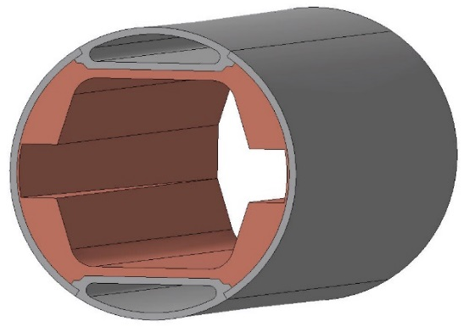
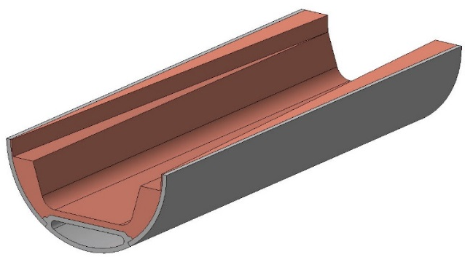
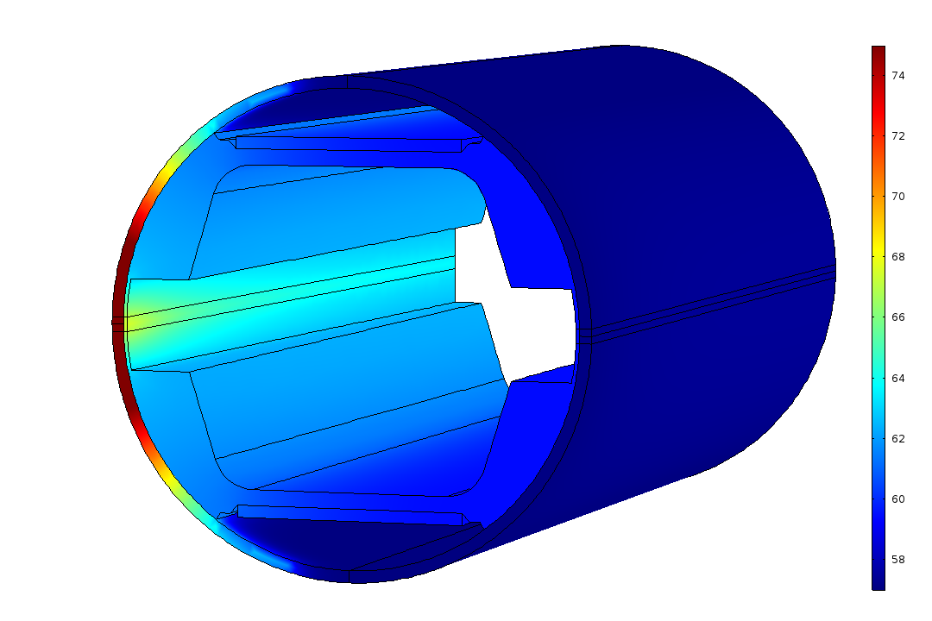
Thermal analysis
End dipole absorber
Preliminary end absorber design
100 mm
Beam direction
75
42 W (Points with about 200 W/cm²)
Due to the high SR density at the end of the dipole, an absorber has been designed in order to reduce as much as possible power density in this area.
Temperatures in the main absorber below 100 K
57
Temperature (K)

