Slide 2
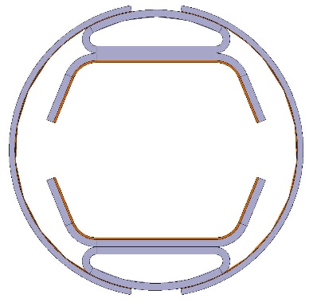
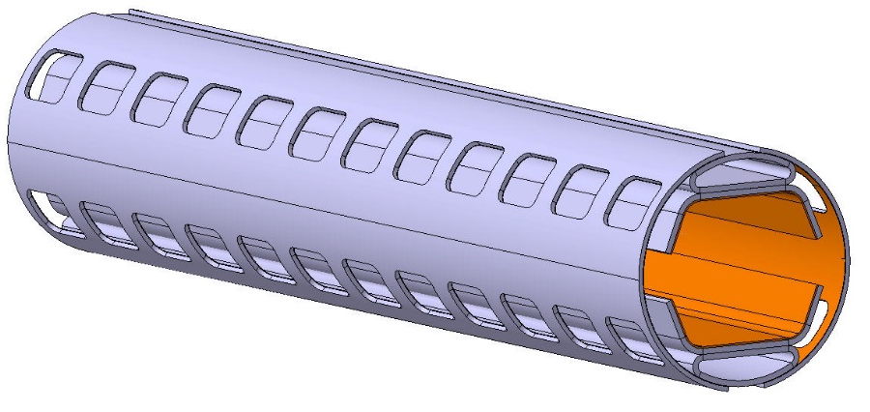


FCC-hh beam screen design
Marco Morrone
Cedric Garion
EuroCirCol WP4 meeting 12
18-19 March 2019
(ALBA Synchrotron)

Slide 3
Outline
Beam screen design
  Recent design evolution at a glance
Mechanical behaviour
  Quench analysis
  Beam screen supports
Thermal behaviour
  Temperature profile due to S.R.
  Heat load to the cold bore by S.R. and the supporting system
Conclusions
NEW

Slide 4
Outline
Beam screen design
  Recent design evolution at a glance
Mechanical behaviour
  Quench analysis
  Beam screen supports
Thermal behaviour
  Temperature profile due to SR
  Heat load to the cold bore by SR and the supporting system
Conclusions

Slide 5
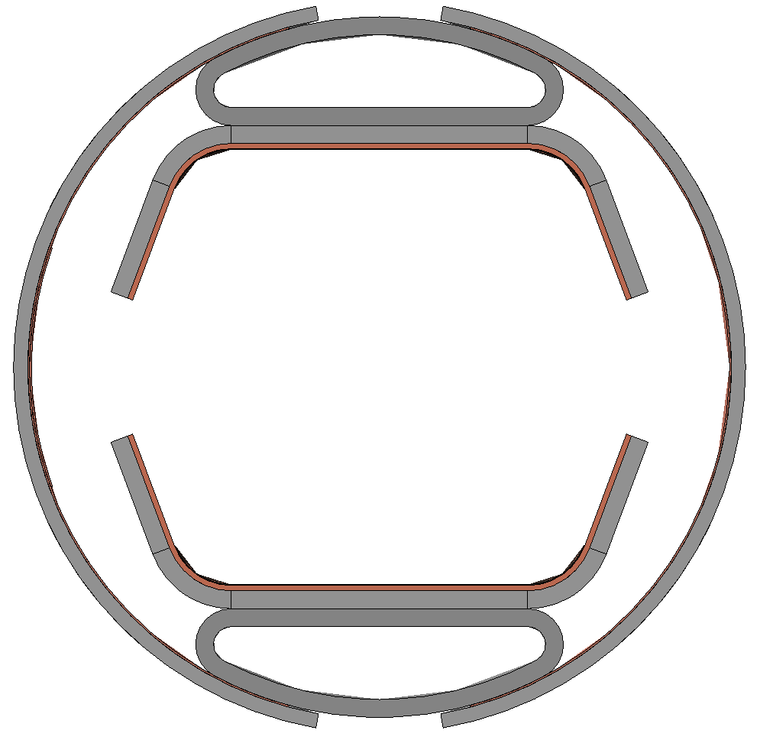
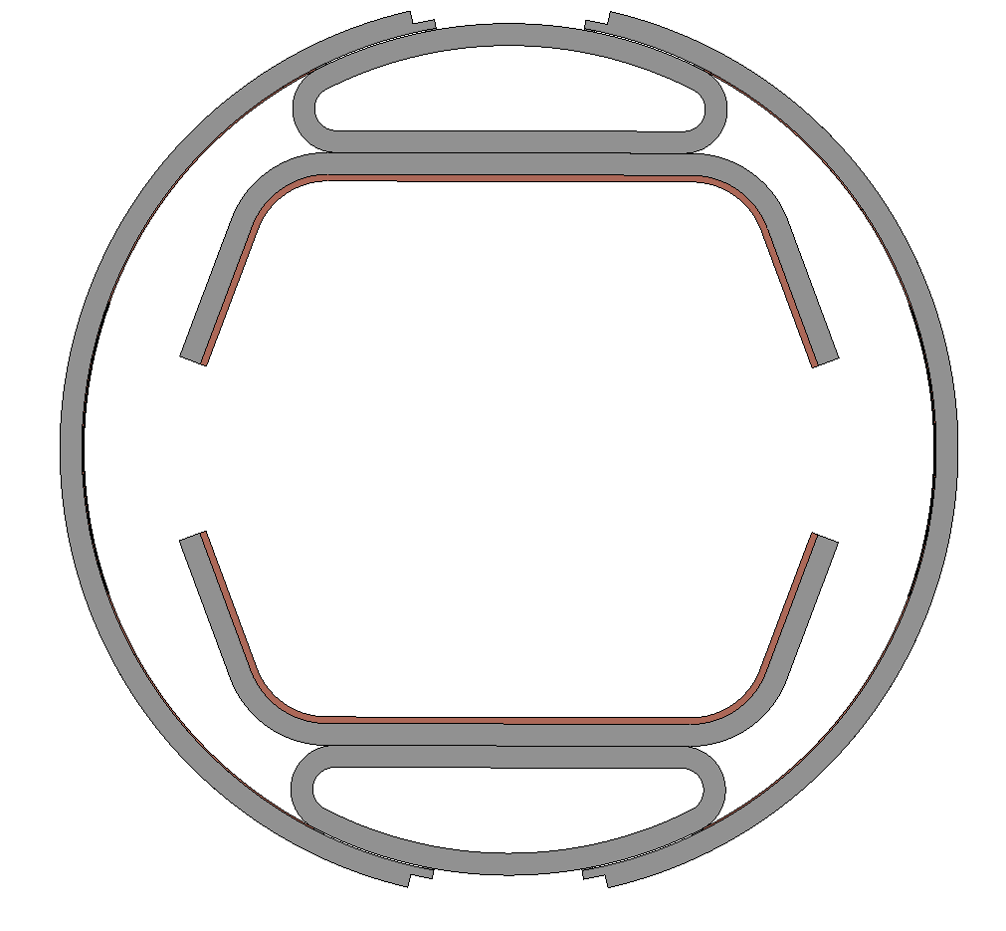
Beam Screen Design
Recent design evolution at a glance
Former version
Updated version
Edges reduced
(thickness 0.4 mm)
P506 outer shell
(thickness 0.8 mm)
P506 outer shell
(thickness 1 mm)
Co-laminated Cu
(thickness 100 μm )
Co-laminated Cu
(thickness 75 μm )
Edges reduced
(thickness 0.4 mm)
Welding points (0.5 mm wide)
Welding points (0.5 mm wide)
New welding points (0.5 mm wide)

Slide 6
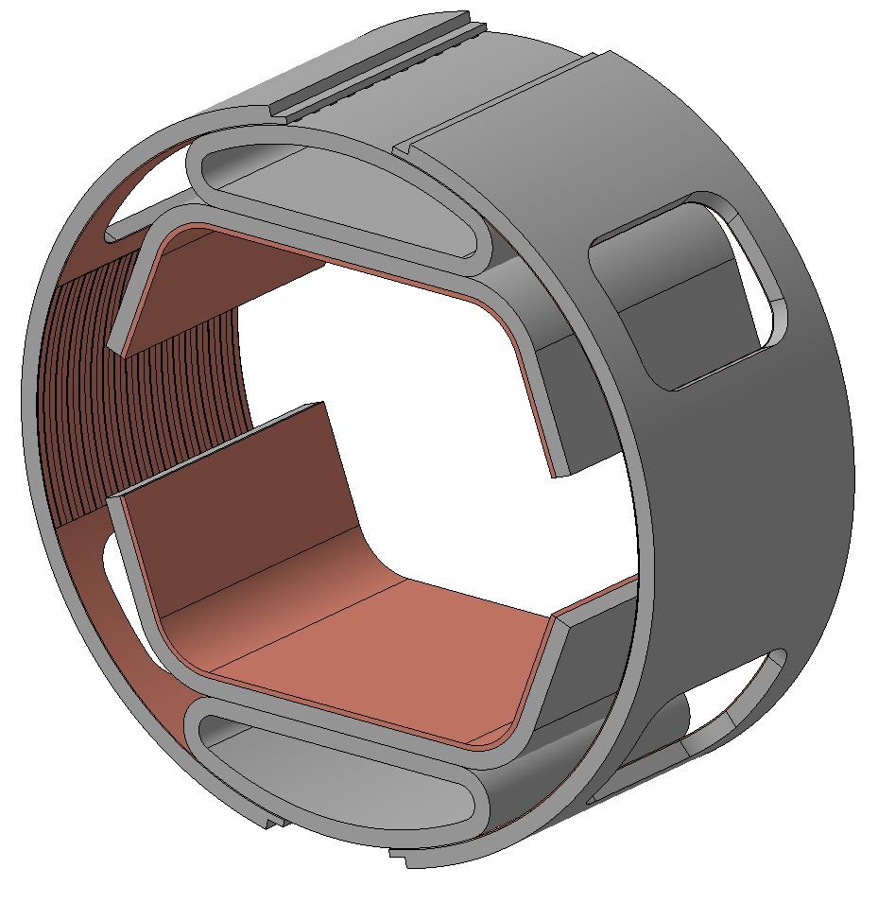
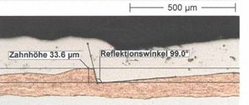
Beam Screen Design
Recent design evolution at a glance
Updated version
P506
(thickness 1mm) -everywhere-
Cooling channel (He at 40K, 50 bar)
Cu OFE
(thickness 0.3 mm)
12 mm
28.37 mm
R 20.5 mm
Saw-tooth profile
Cu OFE
(thickness 75 μm)
17 mm
Periodic unit

Slide 7
Outline
Beam screen design
  Recent design evolution at a glance
Mechanical behaviour
  Quench analysis
  Beam screen supports
Thermal behaviour
  Temperature profile due to SR
  Heat load to the cold bore by SR and the supporting system
Conclusions

Slide 8

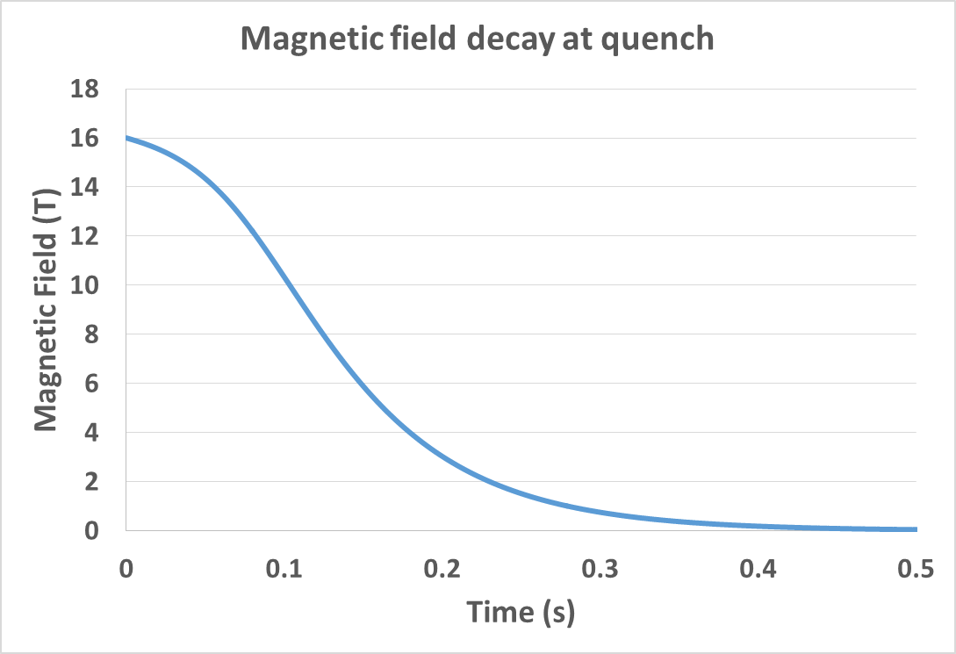
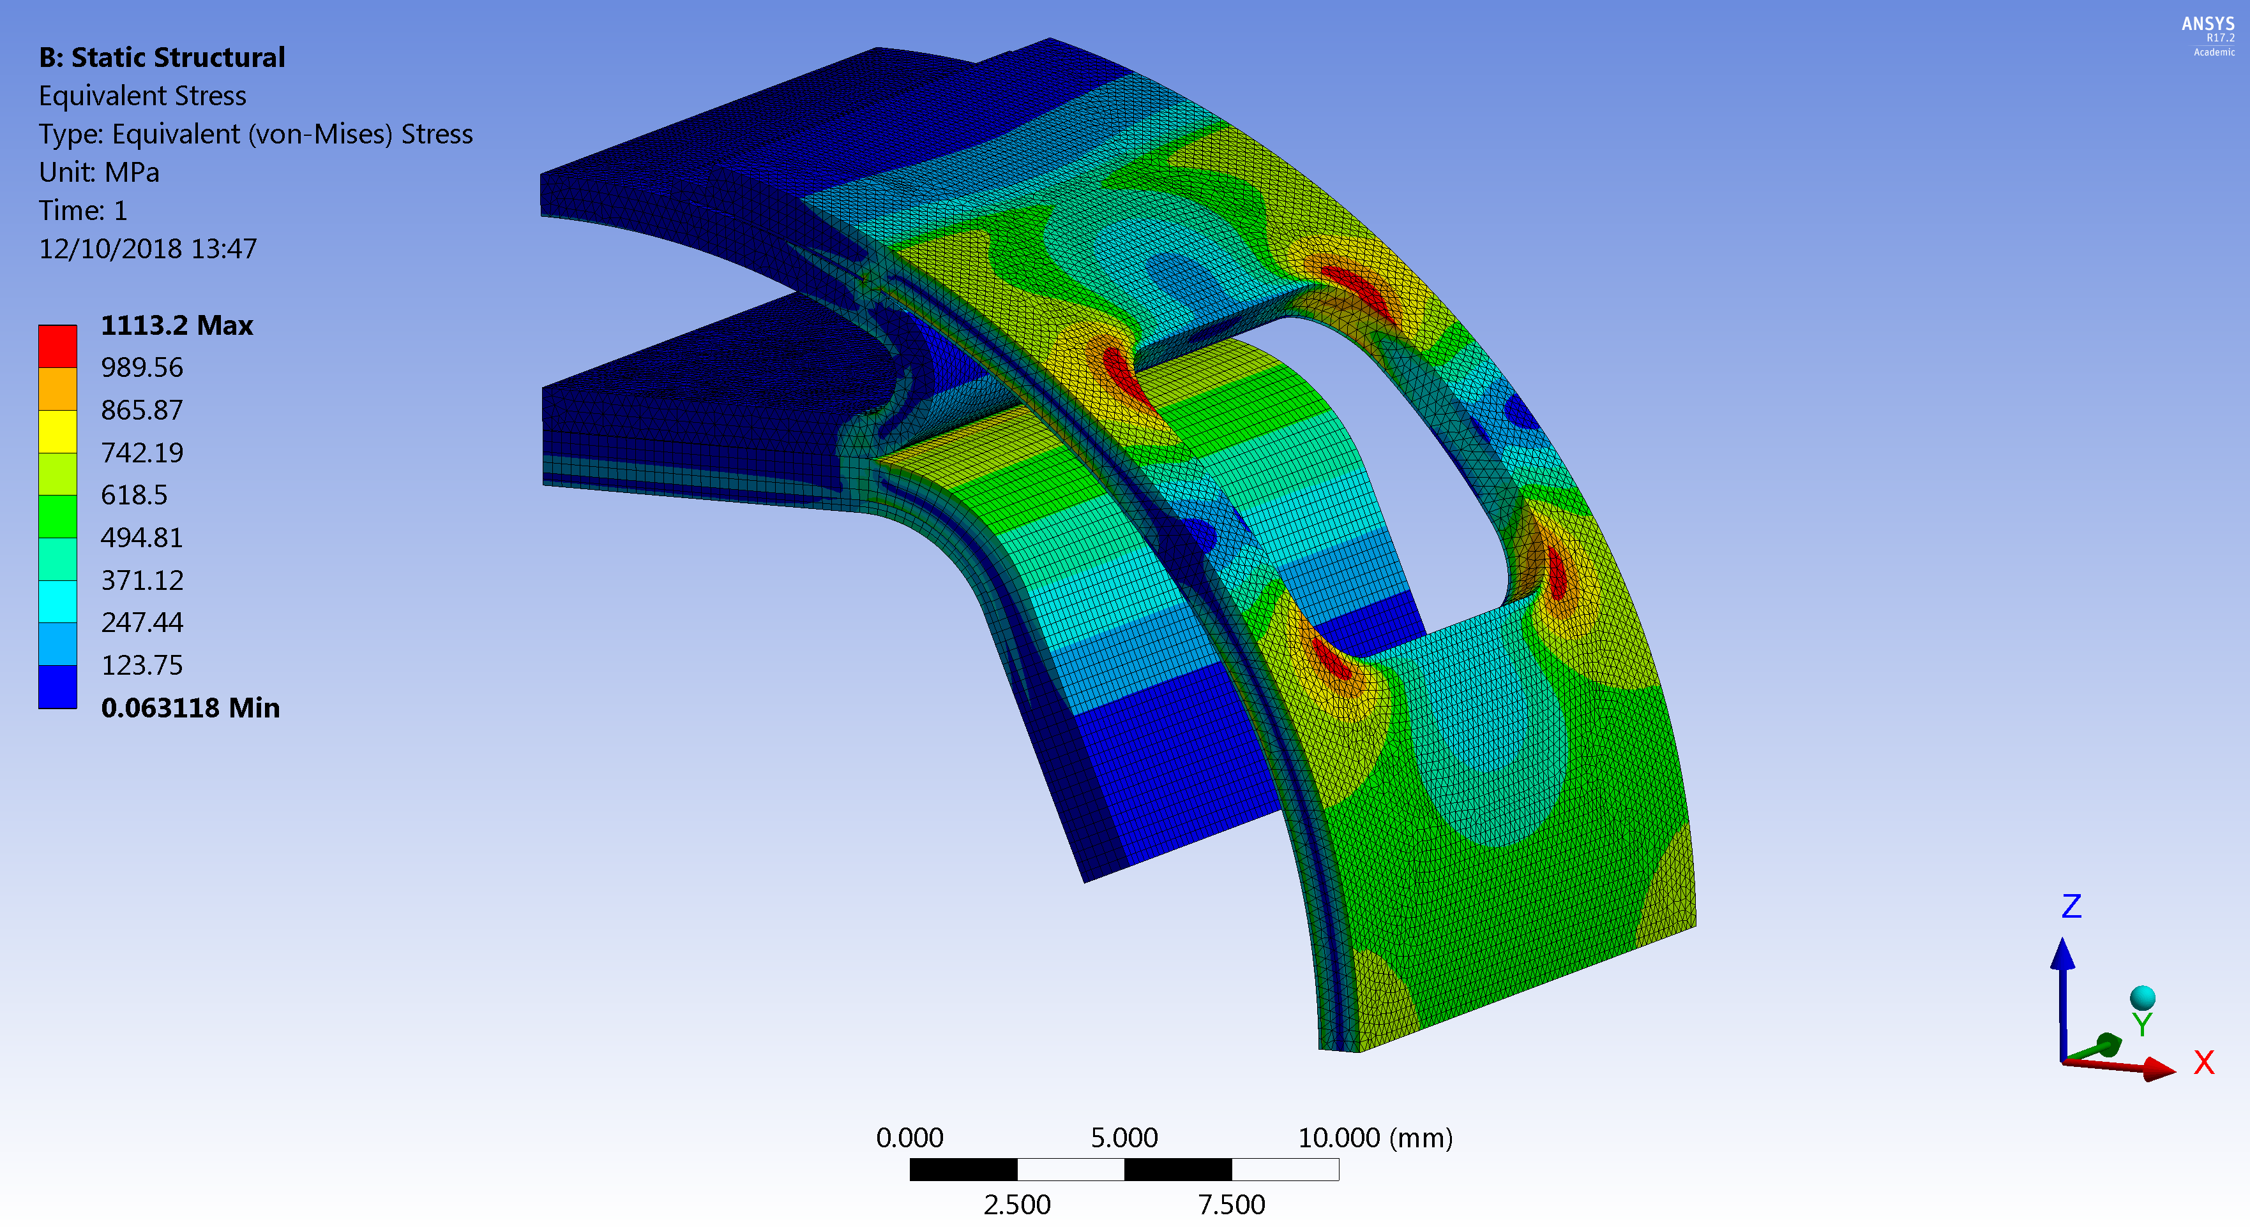




Mechanical behaviour
Quench analysis
$Fx$(𝑡)
Variation of magnetic field at quench produces currents along the beam screen.
These currents generate Lorentz forces that might endanger the mechanical integrity of the beam screen.
$j_{y}$(𝑡)
3D simulations have been carried out taking into account the Joule effect coupling with the magnetic field ($ρC_{p}\frac{∂T}{∂t}−∇\left(k∇T\right)=Q_{e}=JE$).
z
y
x
$$B_{z}(t)$$
σ_{y} = 1350 MPa @ 40 K
σ_{MAX} = 1130 MPa
Courtesy of Daniel Schoerling

Slide 9
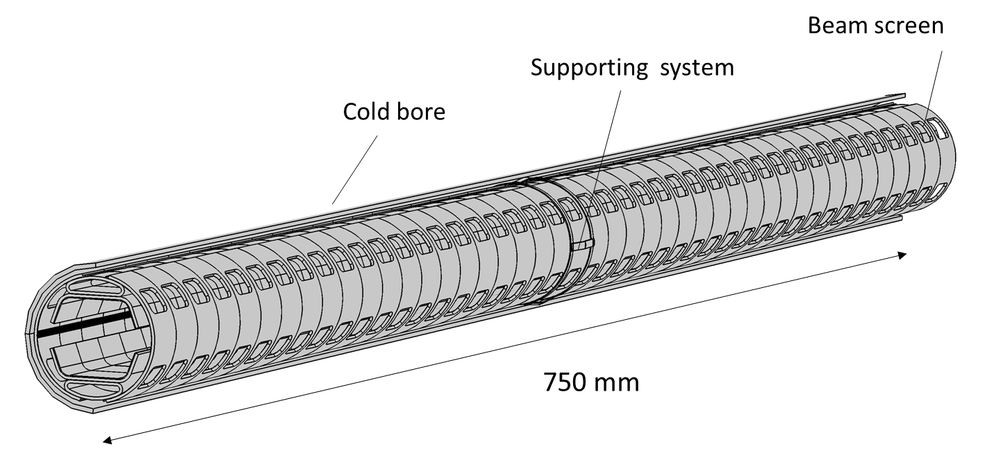
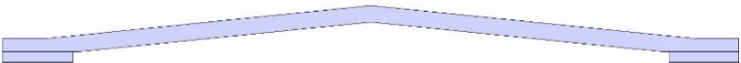
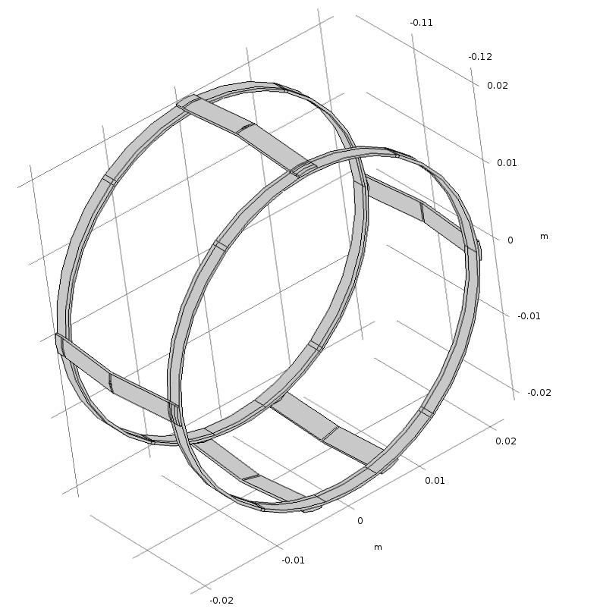
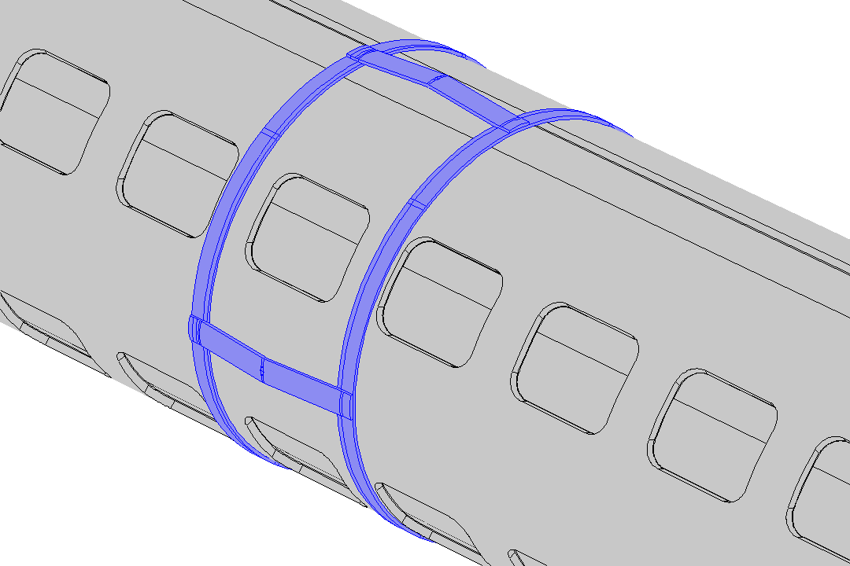
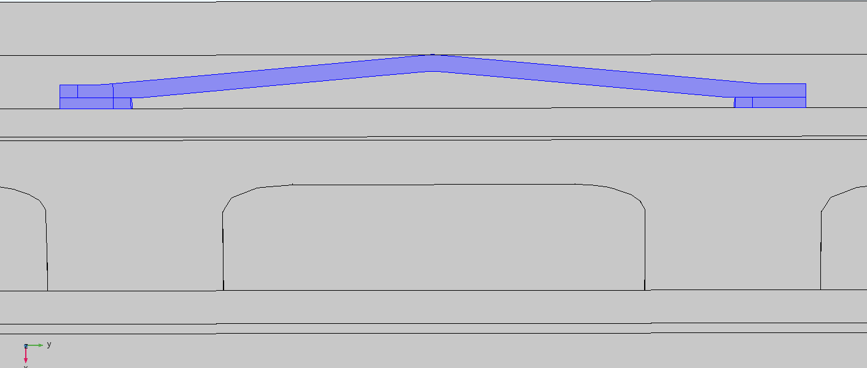
Beam Screen Design
Beam screen supports
Beam screen supports
1.6 mm
supports
welded on the rings
21 mm
Welded ring
→ pre-stress insertion 0.1 mm
cold bore
sliding
ring
1.5 mm
beam screen
Rings welded as two half shells on the BS

Slide 10
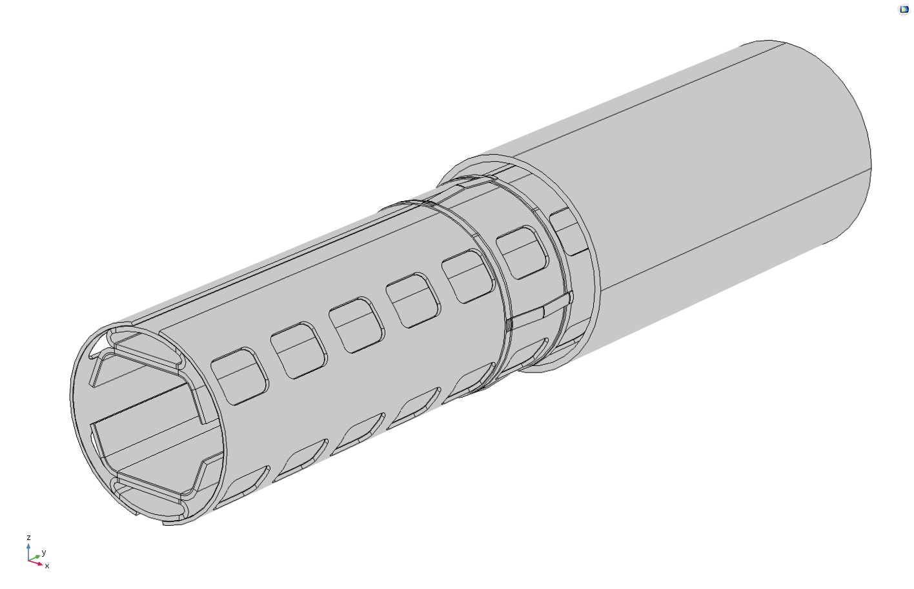
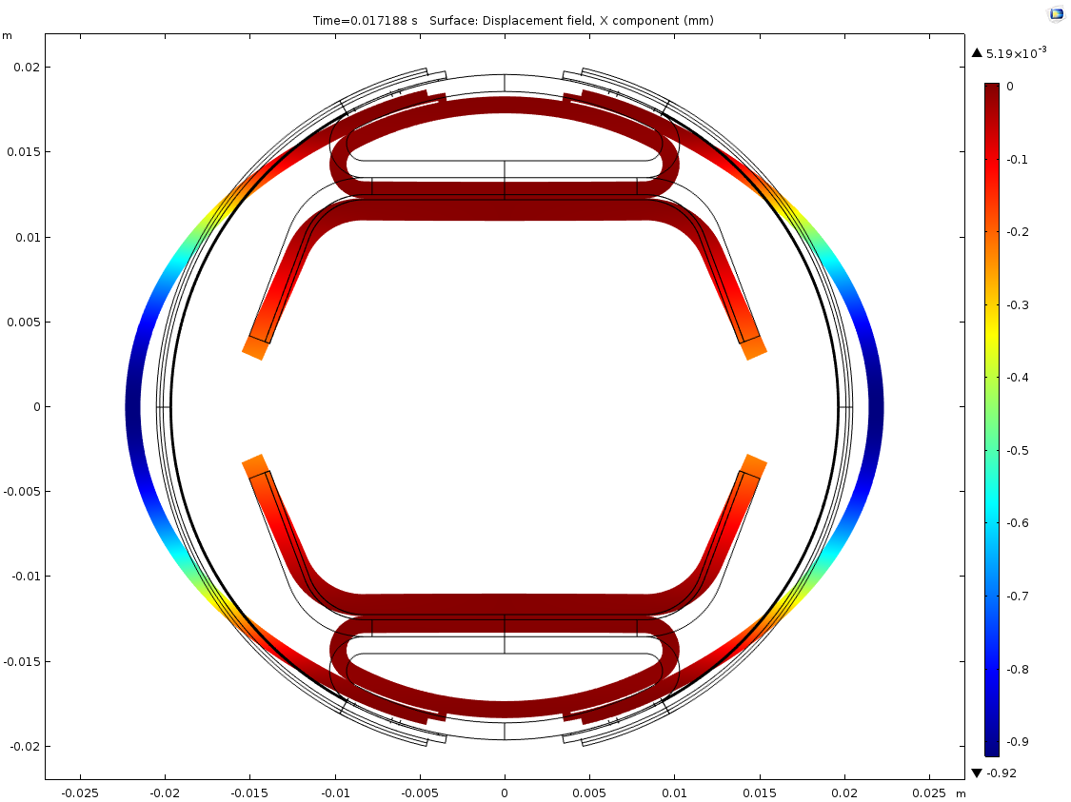
Beam Screen Design
Beam screen supports
Deformation of the BS during a magnet quench
Cold bore
Side supports
highly loaded during quench
5 x magnfication
Maximum displacement and force along the horizontal plane during a quench:
Former version:Δx=2.7 mm, not 0.9 mm F_{x} = 61 kN/m (per half_outer shell)
Updated version: Δx=0.65 mm F_{x} = 43 kN/m (per half_outer shell)
Revision of the boundary conditions used to elaborate the results
of the former BS version

Slide 11
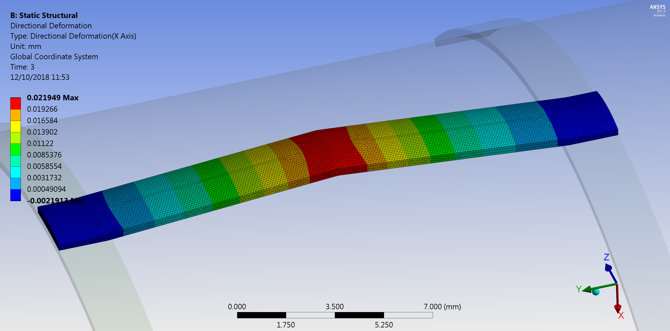
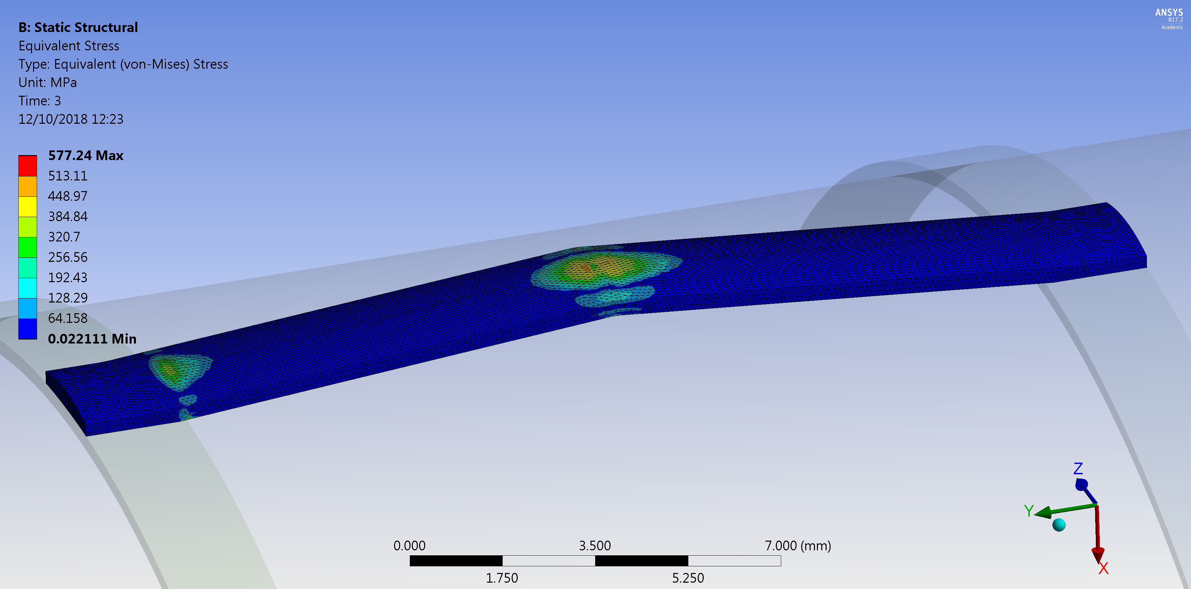
Mechanical behaviour
Beam screen supports
Maximum BS displacement Δx=0.65 mm
Residual deformation 20 μm < 100 μm of pre stress
Support on the horizontal plane
Residual max stress 400 MPa
Optimisation of the beam screen supports
to withstand a magnet quench with reduced plastic deformation

Slide 12
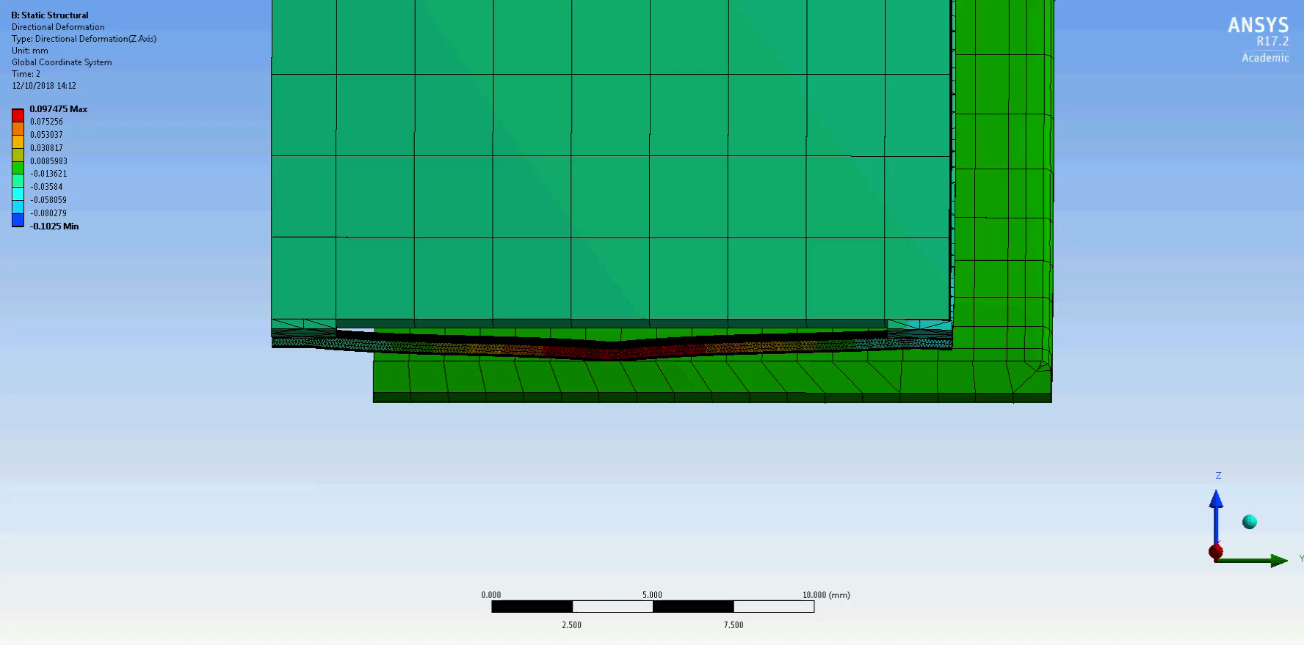
Mechanical behaviour
Beam screen supports
Weight: 2.16 Kg/m
Vertical displacement: -32 μm

Slide 13
Outline
Beam screen design
  Recent design evolution at a glance
Mechanical behaviour
  Quench analysis
  Beam screen supports
Thermal behaviour
  Temperature profile due to SR
  Heat load to the cold bore by SR and the supporting system
Conclusions

Slide 14
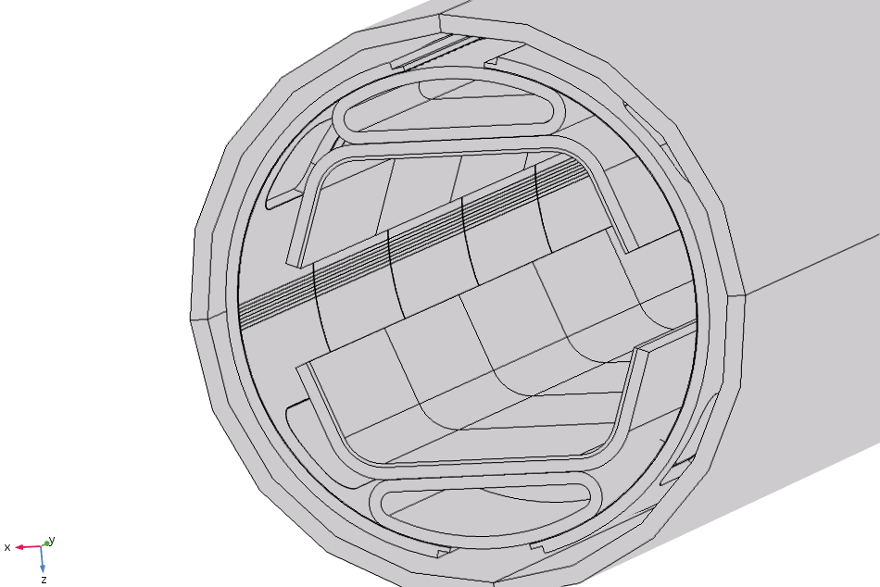
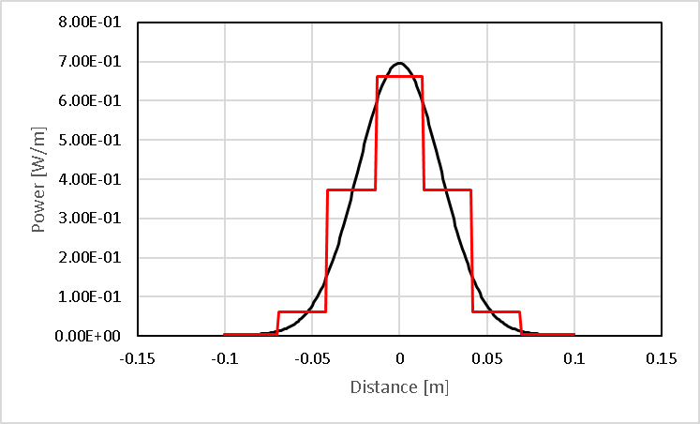
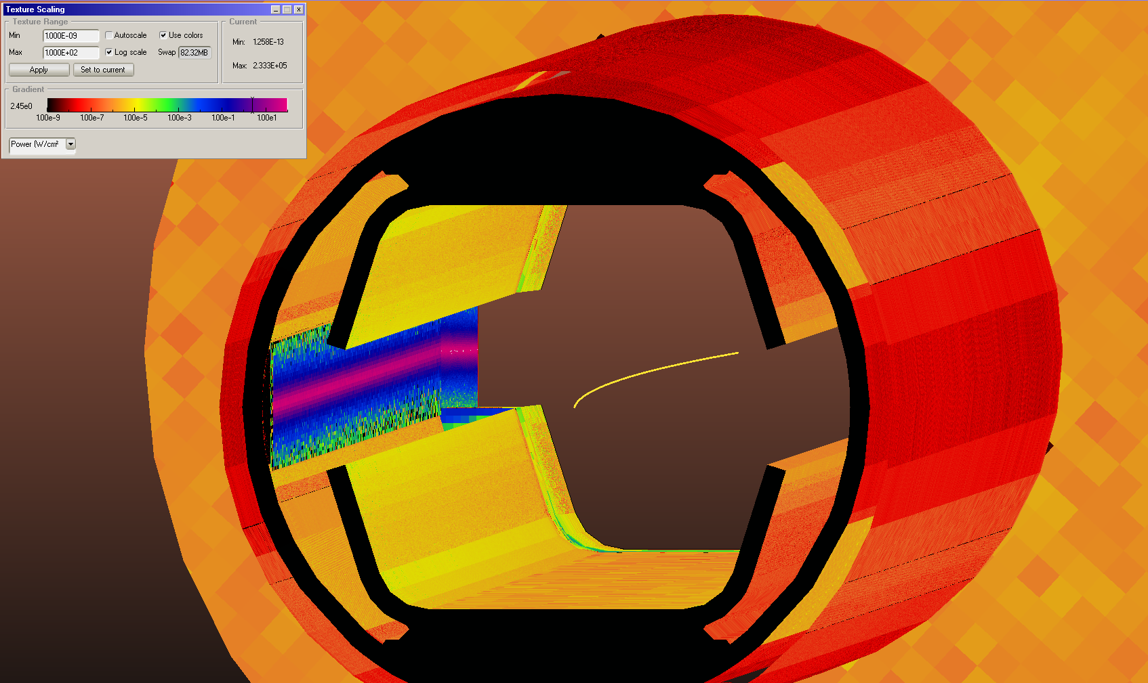
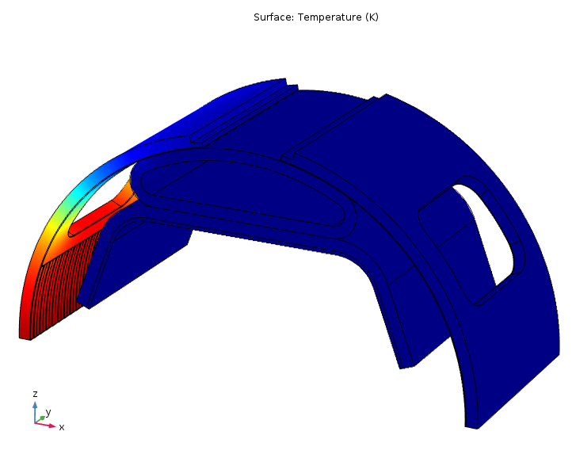
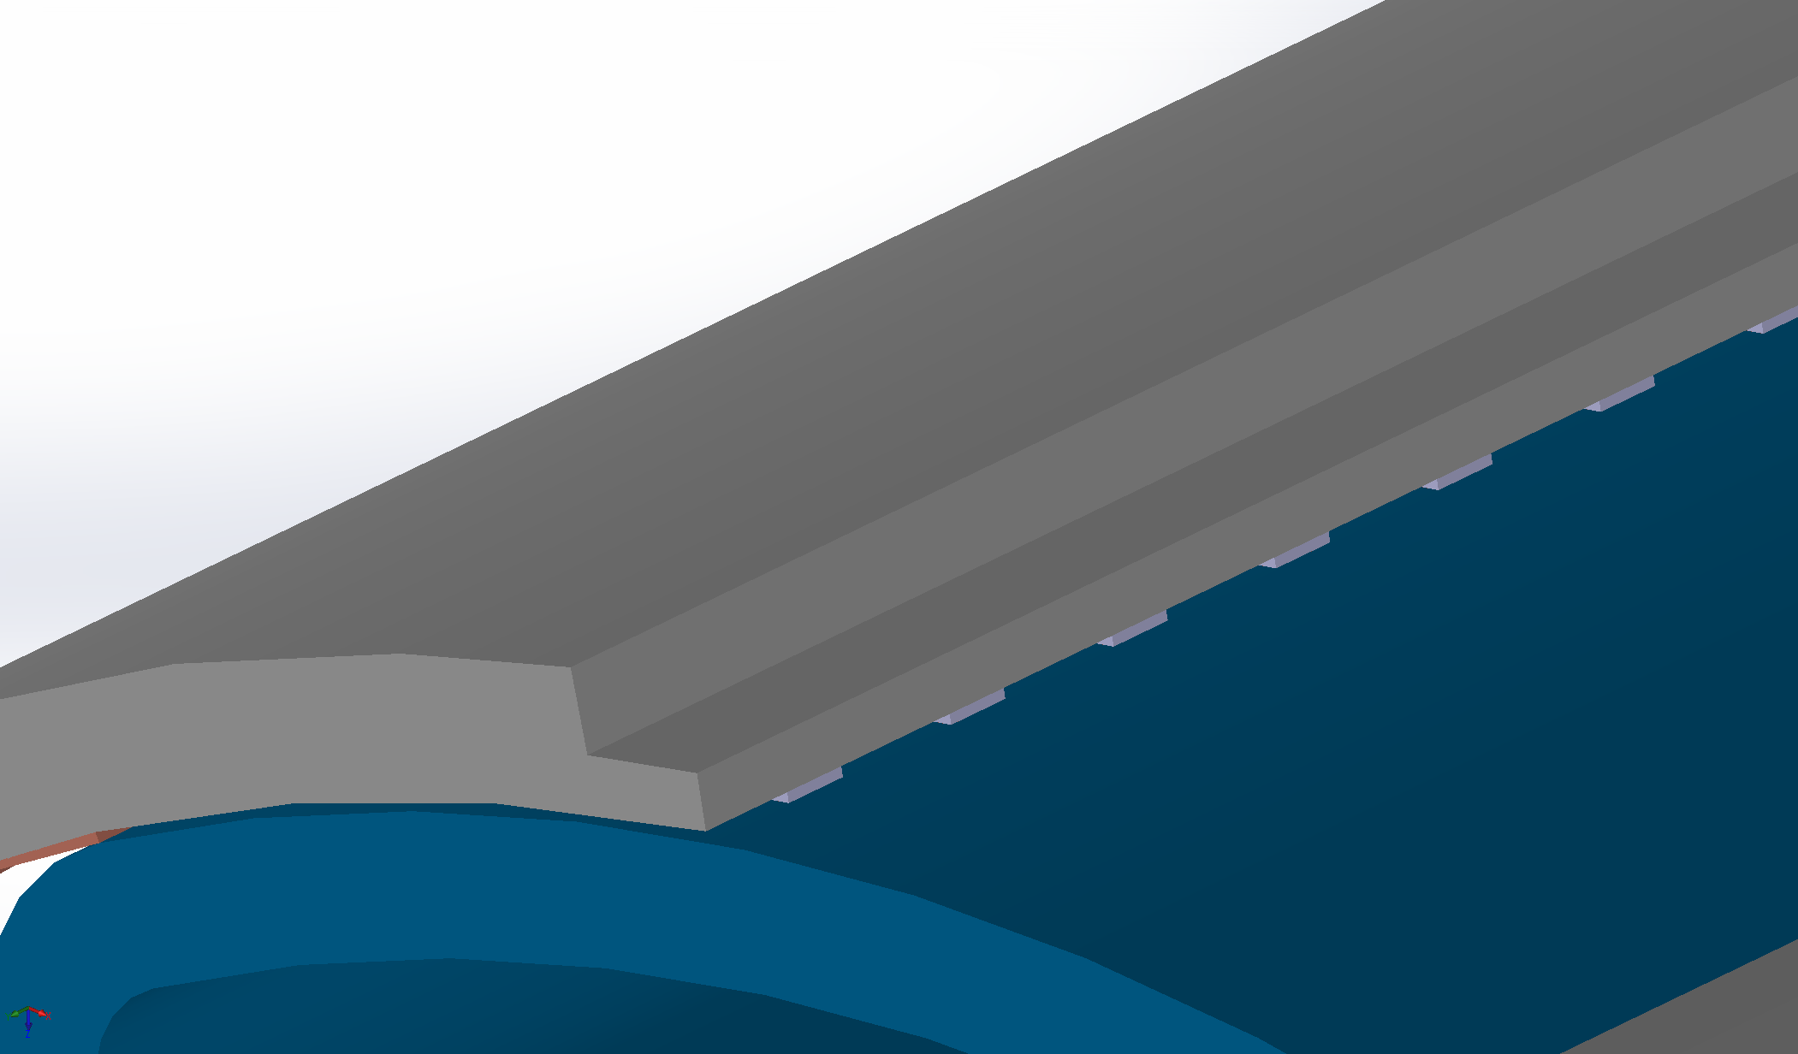
Thermal behaviour
Temperature profile due to S.R.
Heat load deposited according to a Gaussian distribution on the saw-teeth
Max synchrotron radiation power ~ 42 W/m
Beam intensity: 0.5 A, 50 TeV
Thermal contacts according to the spot weld pattern
Half beam screen has been modelled due to symmetry

Slide 15
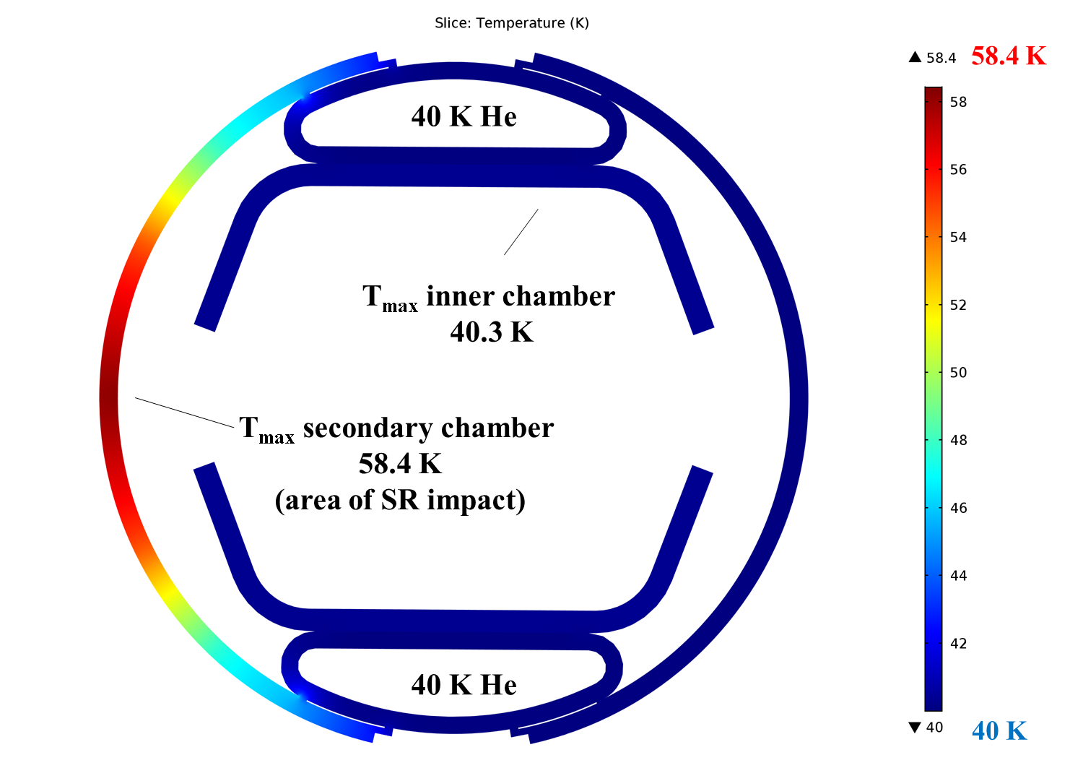
Thermal behaviour
Temperature profile due to S.R.
Base temperature 40 K

Slide 16
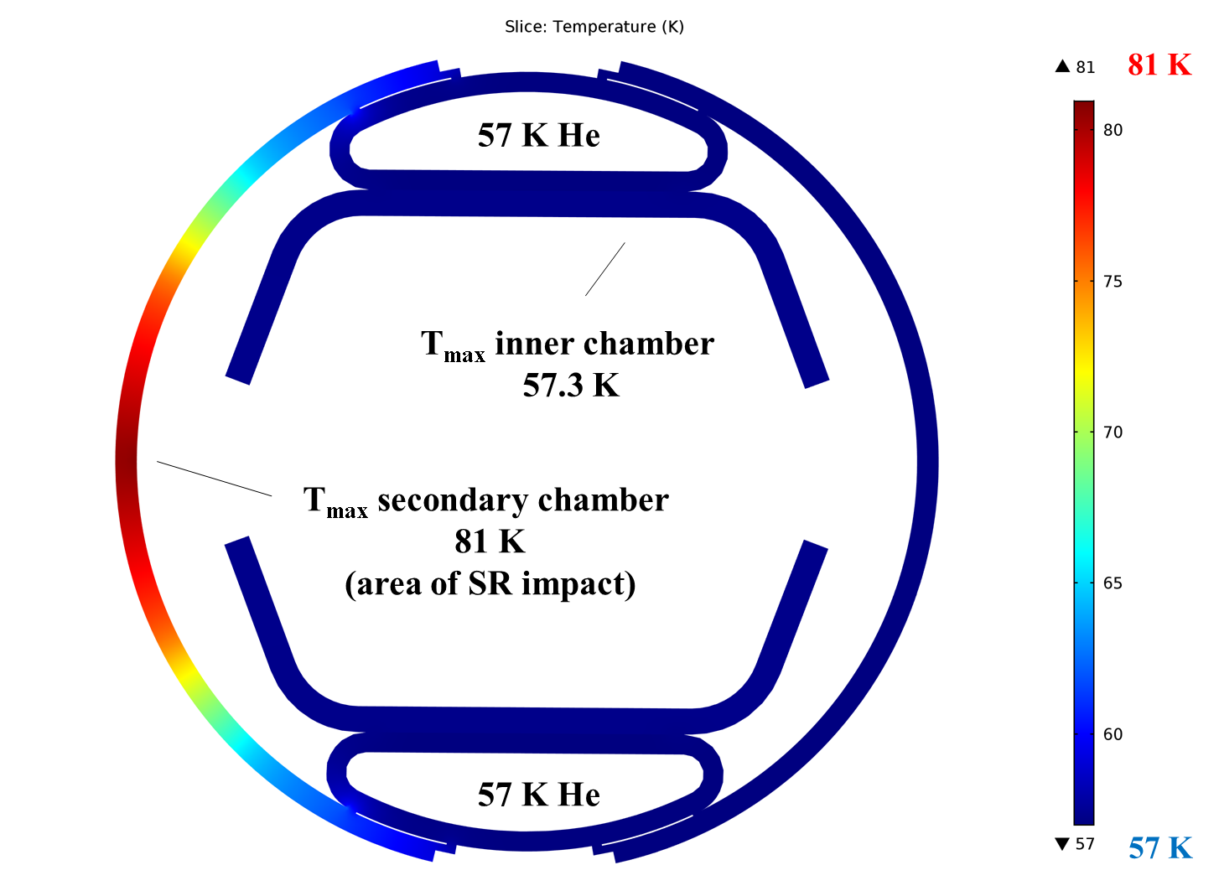
Thermal behaviour
Temperature profile due to S.R.
Base temperature 57 K

Slide 17
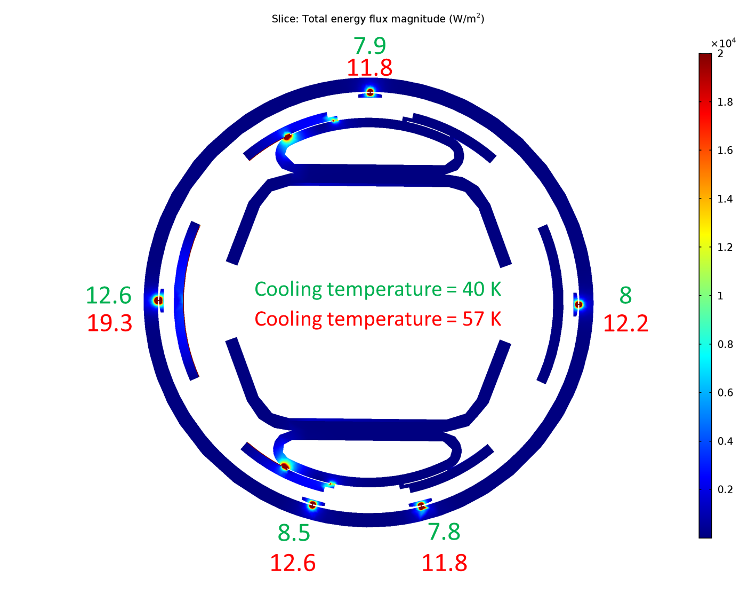
Thermal behaviour
Heat load to the cold bore [mW/m]
Heat
The contact area (0.01 mm² ) according to the Hertzian theory.

Slide 18
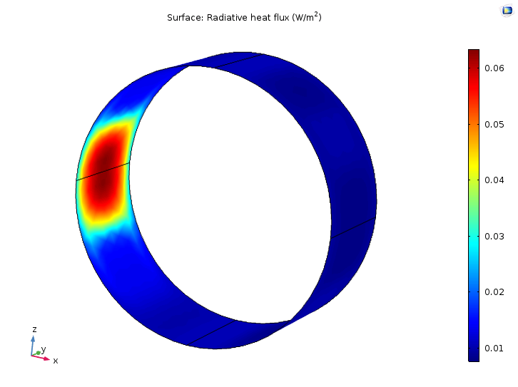
Thermal behaviour
Heat load to the cold bore by S.R.
Heat to the cold bore:
2.95 mW/m
@ base temperature of 40 K
Heat to the cold bore:
8.84 mW/m
@ base temperature of 57 K

Slide 19
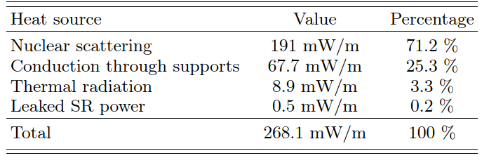
Summary of the heat loads @ 57 K
(worst case scenario)
< of the threshold of 300 mW/m!

Slide 20
Outline
Beam screen design
  Recent design evolution at a glance
Mechanical behaviour
  Quench analysis
  Beam screen supports
Thermal behaviour
  Temperature profile due to SR
  Heat load to the cold bore by SR and the supporting system
Conclusions

Slide 21
Conclusions
Beam screen design
The thickness of the P506 outer shell has been increased to 1 mm (from 0.8 mm) while its copper thickness has been reduced to 75 μm (from 100 μm). Two welding points have been added on the outer shell. The outer diameter of the beam screen remains unchanged, i.e. 41 mm.
Mechanical behaviour
During a magnet quench, the mechanical behaviour of the beam screen remains elastic, the maximum deformation along the horizontal plane is 0.65 mm.
Supports have been designed by to ensure a good alignment of the beam screen while minimizing the permanent deformation due to a quench.
Thermal behaviour
The synchrotron radiation heat load leads to a maximum temperature of 81 K.
The highest heat load to the cold bore due to SR is 8.9 mW/m.
The highest heat load to the cold bore through the supporting system is 67.7 mW/m.

Slide 22
Future plans
Magnet quench test at 1.9 K.

Slide 23
Thank you for your attention

Slide 24
Spare slides

Slide 25
Mechanical Design
Material properties
Copper
P506 (high-Mn high-N austenitic stainless steel)
Mechanical properties
Density, ρ = 8700 (Kg/m³)
Young’s modulus, E = 110 (GPa)
Poisson’s ratio, ν = 0.35
Mechanical properties
Density, ρ = 7850 (Kg/m³)
Young’s modulus, E = 205 (GPa)
Poisson’s ratio, ν = 0.28
Magnetic properties
Relative permittivity, ε = 1
Relative permeability, μ = 1
Resistivity changes with temperature
Magnetic properties
Relative permittivity, ε = 1
Relative permeability, μ = 1
Resistivity, ρ = 5E-7 (Ω·m)*
Thermal properties
Thermal conductivity, k = 700 (W/(m·K))
Heat capacity changes with temperature
Coefficient thermal expansion, α = 17E-6 (1/K)
Thermal properties
Thermal conductivity, k = 5 (W/(m·K))
Heat capacity changes with temperature
Coefficient thermal expansion, α = 12.3E-6 (1/K)
* Due to the high value of stainless steel resistivity, and its small variation with temperature, it has been considered constant with temperature.

Slide 26
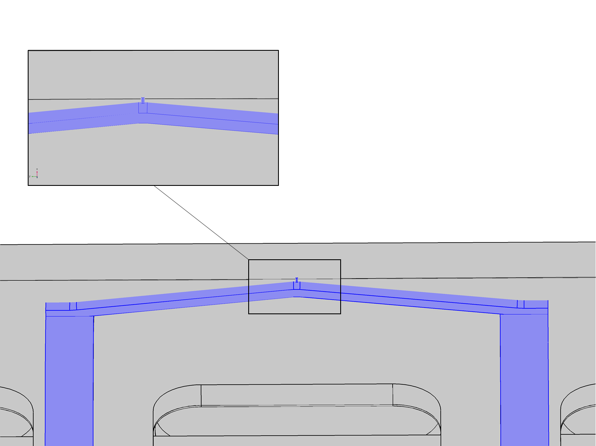
Thermal behaviour
Temperature profile due to S.R.
The contact area between the elastic ﬁnger and the cold bore has been calculated according to the Hertzian theory of
non-adhesive elastic contact [32]. Such area turns out to
be 0.01 mm2 and it has been used to dimension a cylin-
drical element 0.1 µm

