Slide 1





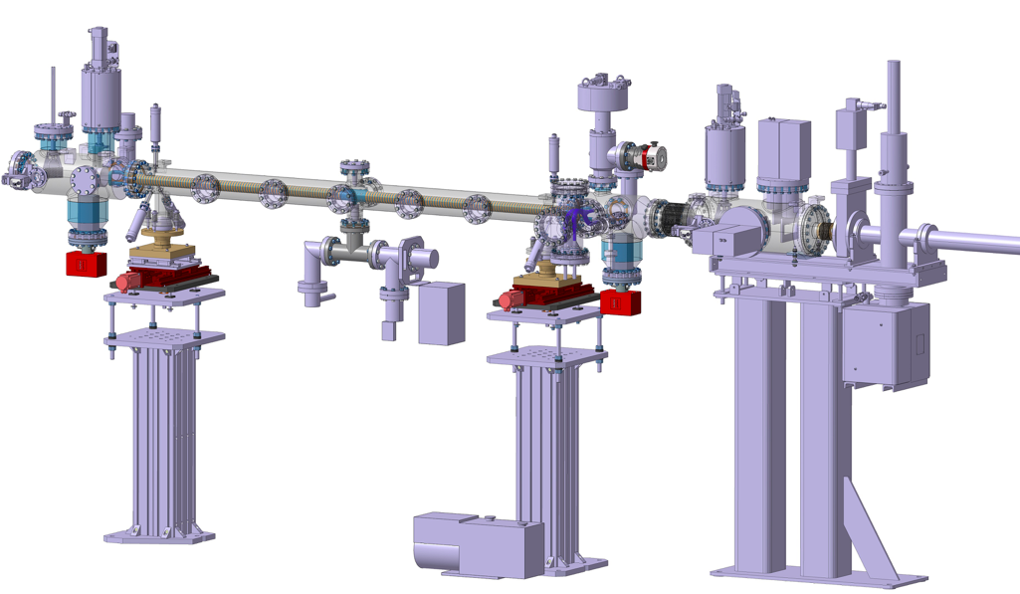
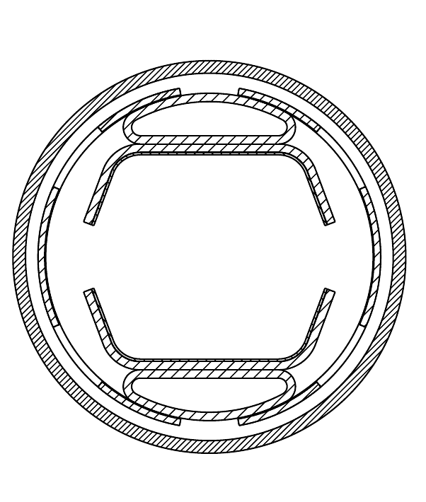


Test set-up at KARA:
Status report & next steps
L. A. Gonzalez,¹
1
2
3
4
5
Task4.6: Measurements on cryogenic
beam vacuum system prototype
Test set-up at KARA: Status report & next steps
Luis Gonzalez
CERN TE-VSC
ALBA. March 19th 2018

Slide 2
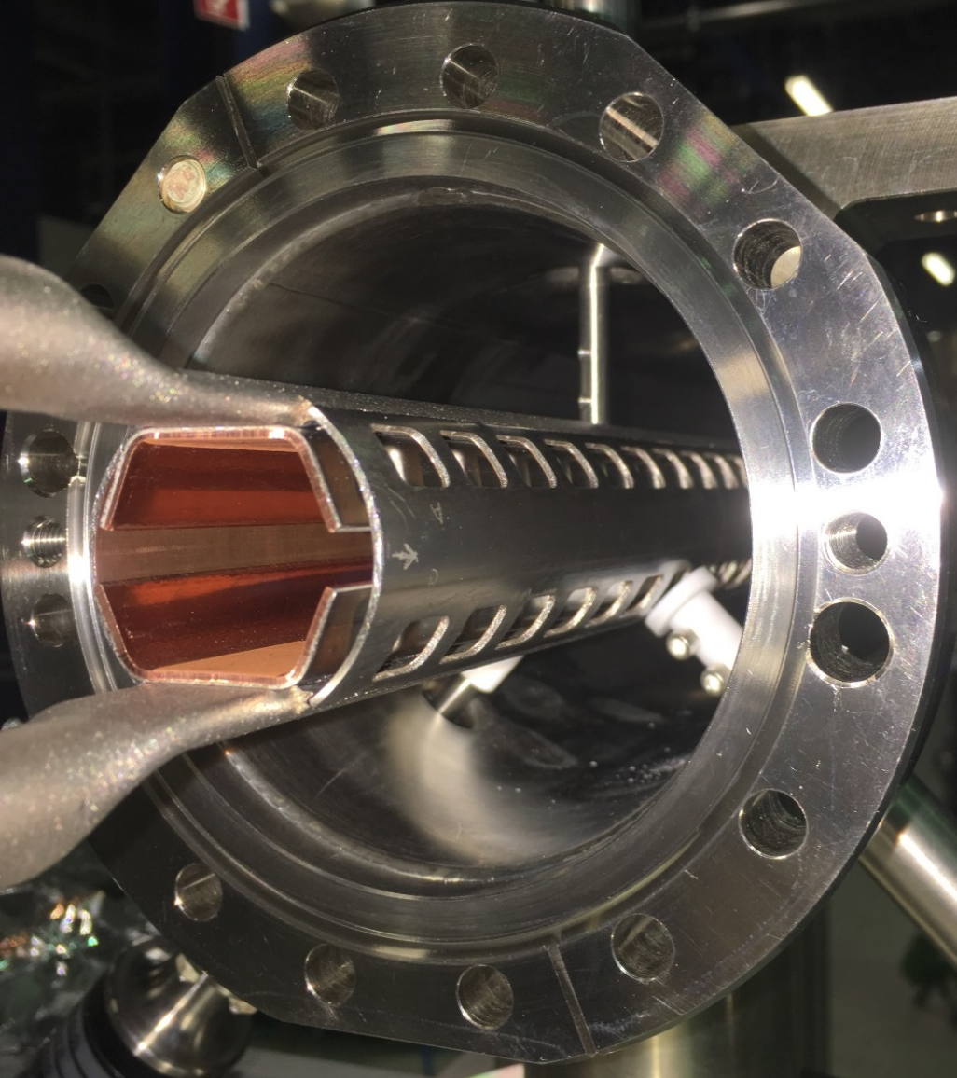
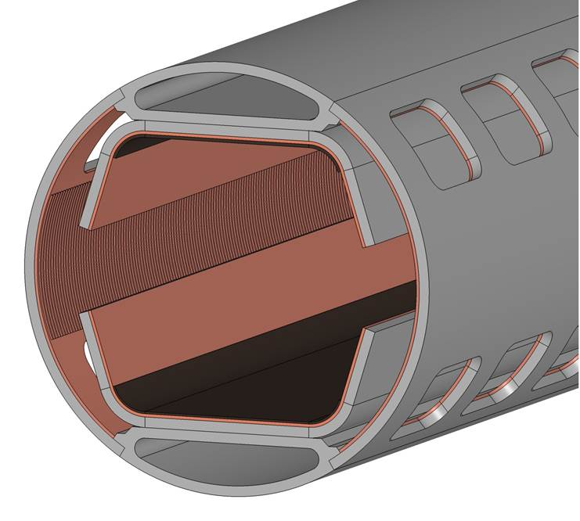
3rd Prototype at KARA
Irradiation Sawtooth
PSD
Reflectivity
Heat loads
Irradiation LASE
PSD
Reflectivity
Heat loads
Test set-up at KARA: Status report & next steps
1
Luis Gonzalez
CERN TE-VSC
ALBA. March 19th 2018

Slide 3
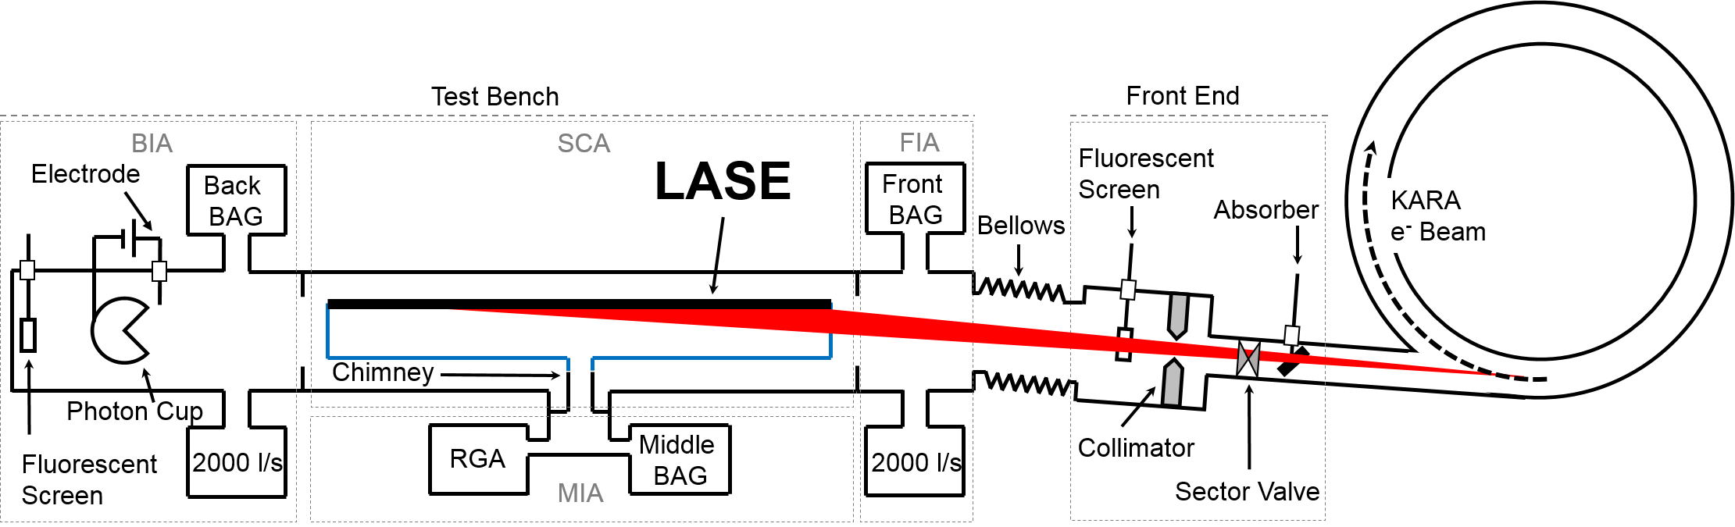
3rd Prototype at KARA Irradiation of LASE - Reflectivity
Re-Position of setup
Test set-up at KARA: Status report & next steps
2
Luis Gonzalez
CERN TE-VSC
ALBA. March 19th 2018

Slide 4
3rd Prototype at KARA Irradiation of LASE
New irradiation conditions:
Reduction angle of incidence:
On sawtooth Θ = 18 mrad
On LASE Θ < 1 mrad
Reduction of the horizontal slits opening:
Slits aperture @ Sawtooth = 3.44 x Slits Apperture @Lase
Θ < 1 mrad
LASE
Irradiated
Region
Test set-up at KARA: Status report & next steps
3
Luis Gonzalez
CERN TE-VSC
ALBA. March 19th 2018

Slide 5
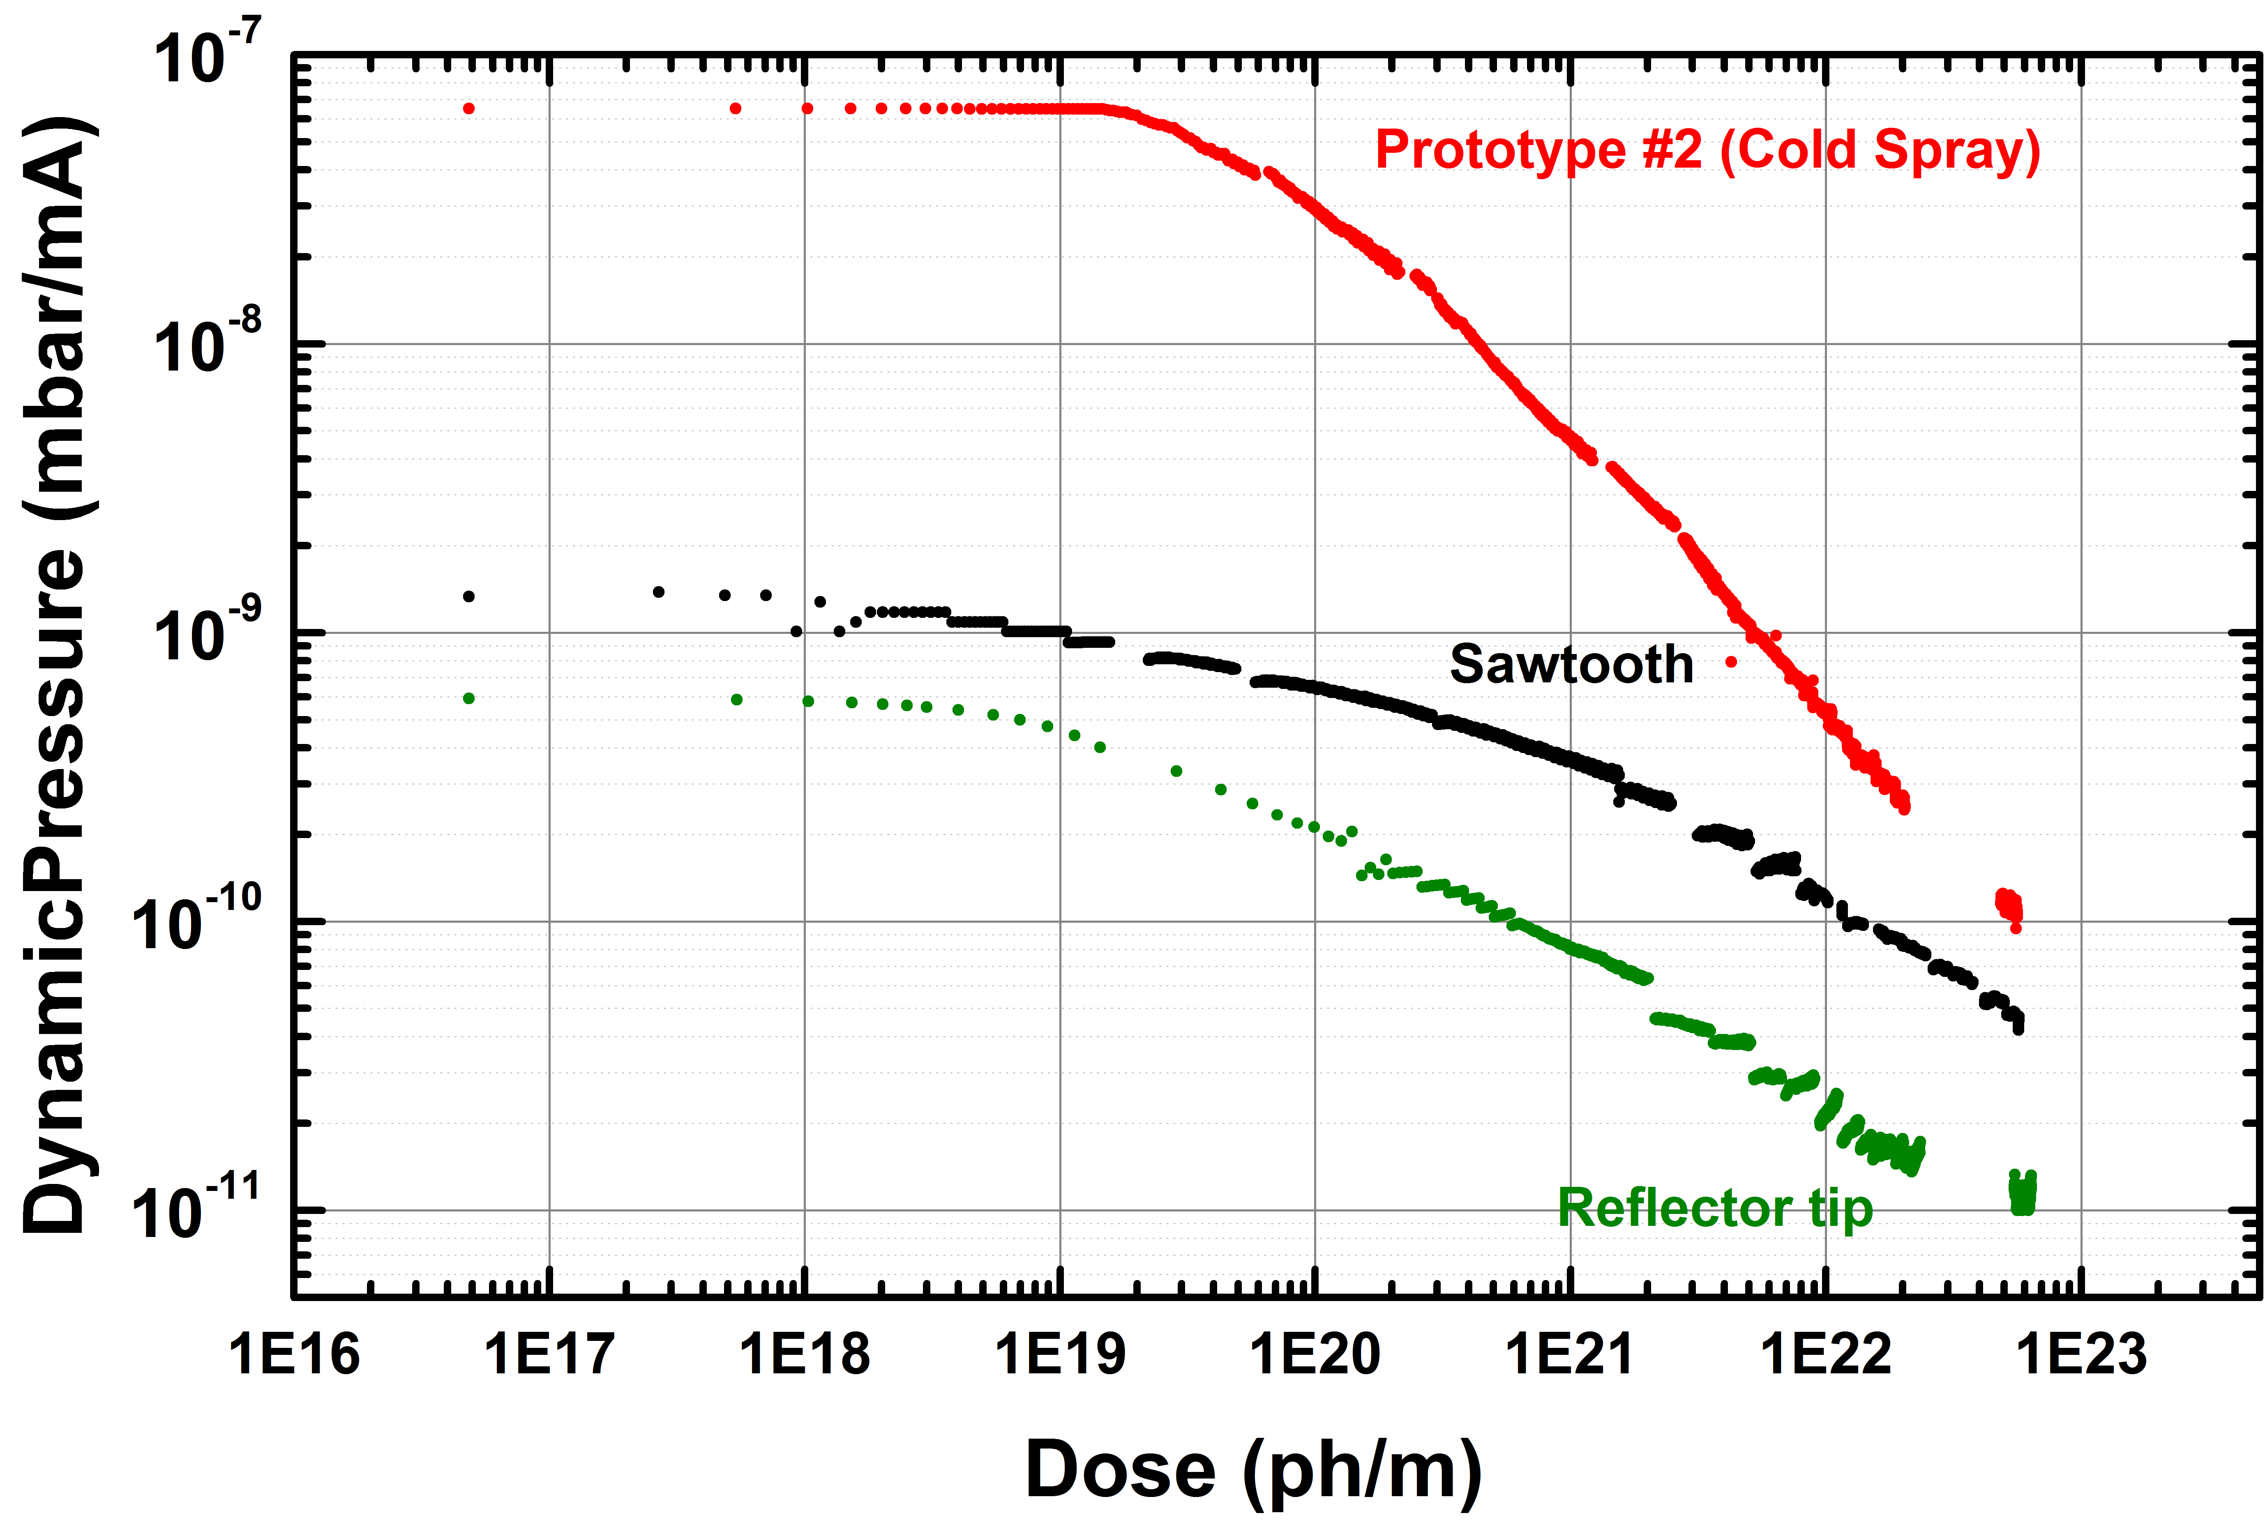
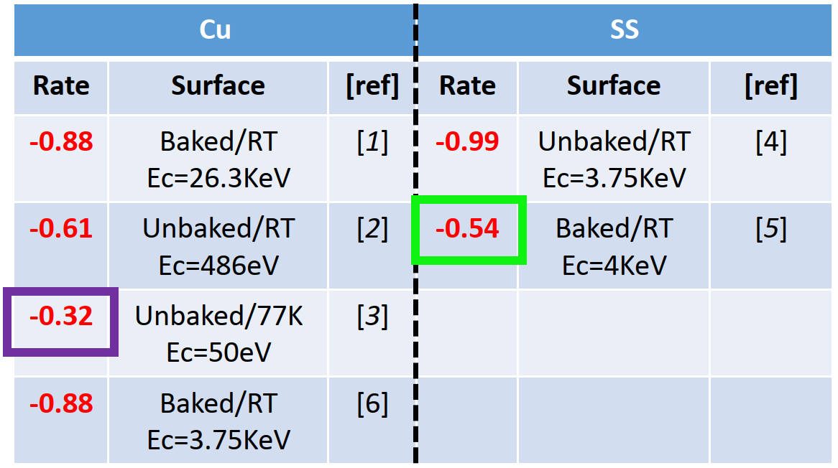
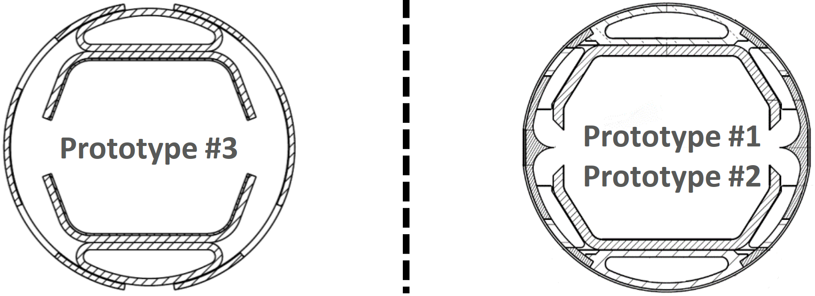
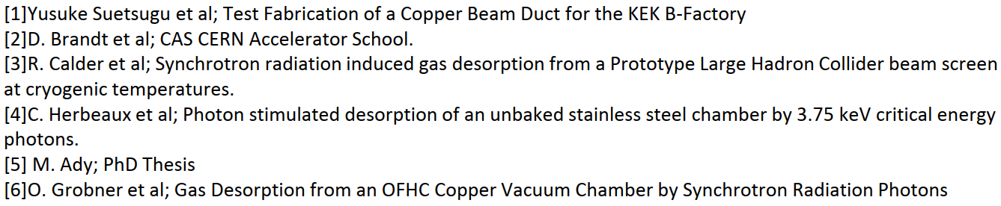
3rd Prototype at KARA Irradiation of LASE - PSD
α = -0.98
α = -0.34
α = -0.54
α = -0.16
Test set-up at KARA: Status report & next steps
4
Luis Gonzalez
CERN TE-VSC
ALBA. March 19th 2018

Slide 6
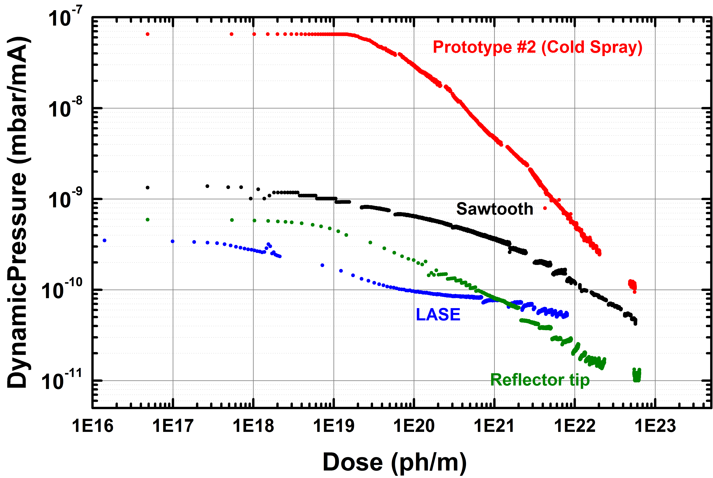
3rd Prototype at KARA Irradiation of LASE - PSD
PSD of LASE is considerably lower than for sawtooth, as expected due to the photoelectron yield of LASE being considerably lower than for sawtooth.
Plateau at very low doses indicates that LASE surface was not preconditioned during previous sawtooth irradiation. Such observation satisfactorily confirms the very low reflectivity of sawtooth profile.
PSD of Reflector is suspiciously low. Specially taking into account highly reflective rounded tip.
However, cleaning procedures of Proto#1 might have been more efficient than #3
α = -0.98
α = -0.34
α = -0.54
α = -0.16
Test set-up at KARA: Status report & next steps
5
Luis Gonzalez
CERN TE-VSC
ALBA. March 19th 2018

Slide 7
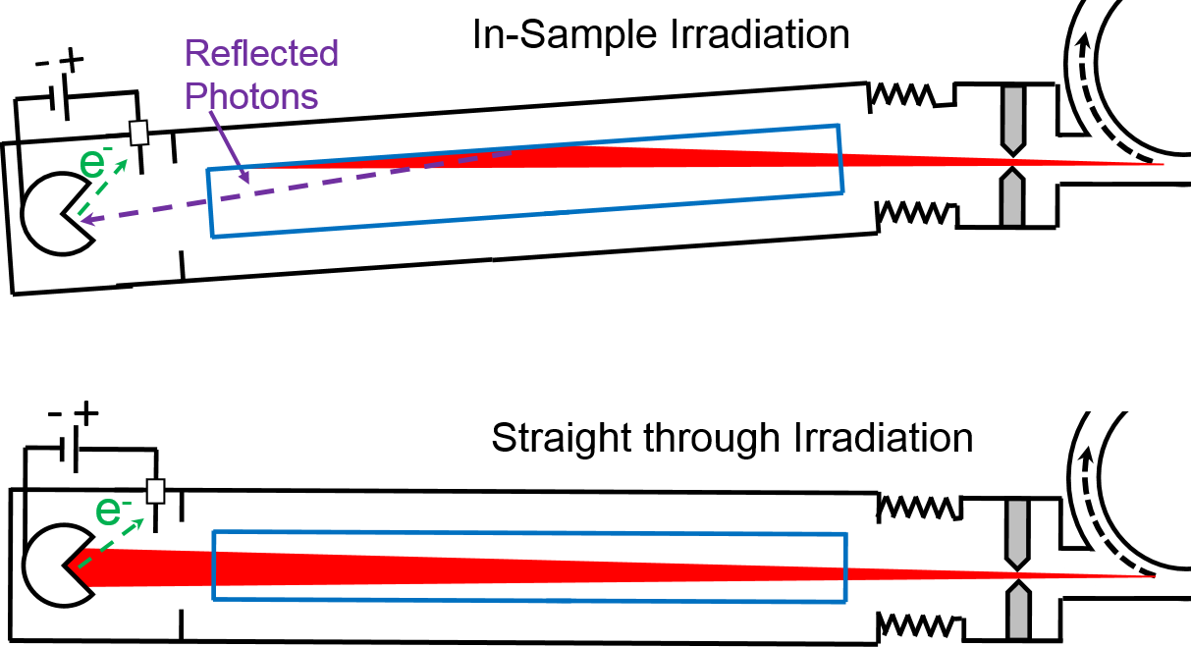

3rd Prototype at KARA Irradiation of LASE - Reflectivity
$$R=100∙\frac{I_{In−Sample}}{I_{Straight−Through}}$$
Test set-up at KARA: Status report & next steps
6
Luis Gonzalez
CERN TE-VSC
ALBA. March 19th 2018

Slide 8
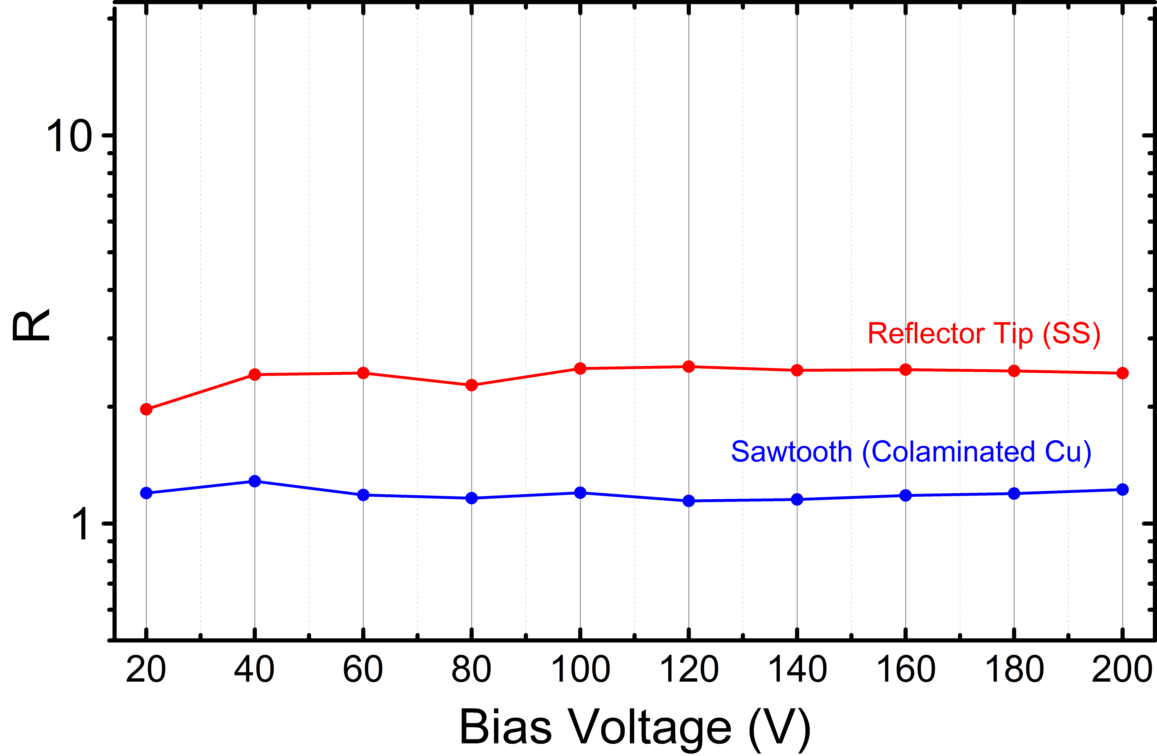
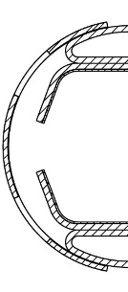
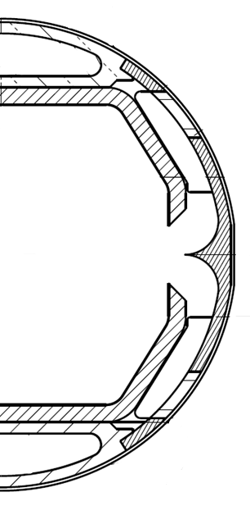
3rd Prototype at KARA Irradiation of LASE - Reflectivity
First
Prototype
Base Line
1
2
1
2
Test set-up at KARA: Status report & next steps
7
Luis Gonzalez
CERN TE-VSC
ALBA. March 19th 2018

Slide 9
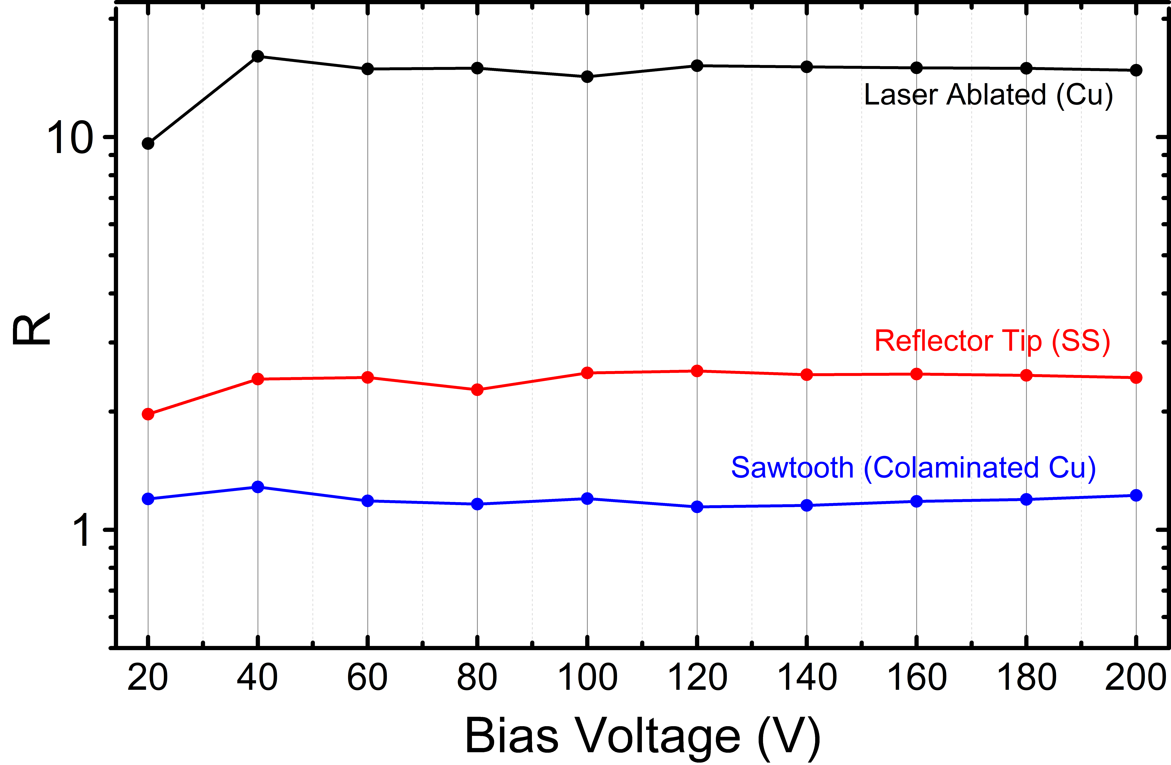
3rd Prototype at KARA Irradiation of LASE - Reflectivity
First
Prototype
Base Line
3
3
1
2
1
2
Reflectivity of the laser ablated surface SEEMS to be higher than the rest.
A few considerations to be taken into account…
Test set-up at KARA: Status report & next steps
8
Luis Gonzalez
CERN TE-VSC
ALBA. March 19th 2018

Slide 10
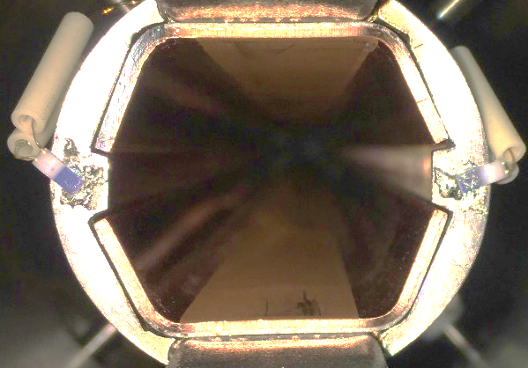
3rd Prototype at KARA Irradiation of LASE - Reflectivity
Difference between experiments
Irradiation Sawtooth and Tip
Irradiation LASE
Angle of Incidence
Θ = 18 mrad
Angle of Incidence
Θ < 1 mrad
LID
NO LID
Test set-up at KARA: Status report & next steps
9
Luis Gonzalez
CERN TE-VSC
ALBA. March 19th 2018

Slide 11
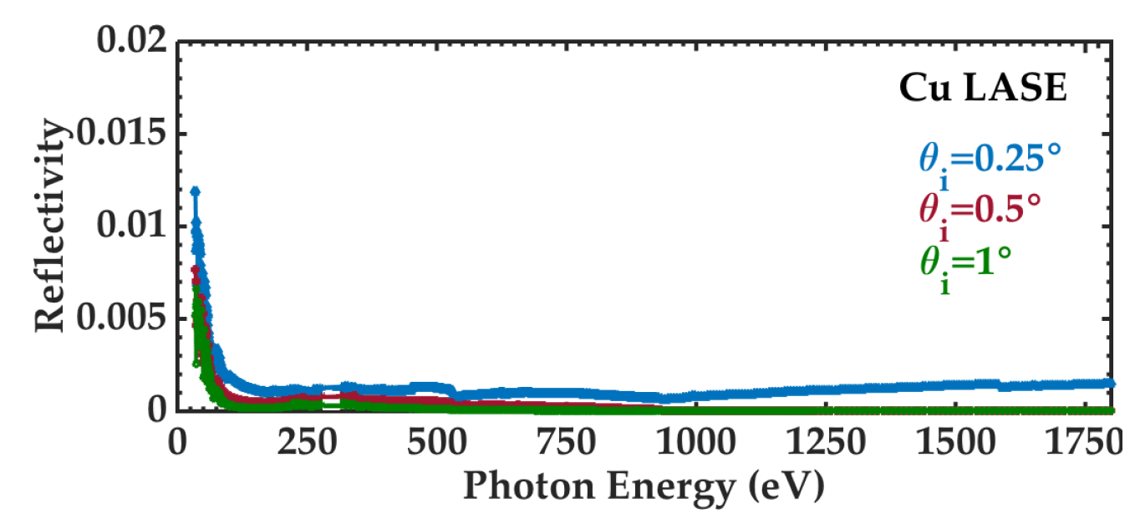
3rd Prototype at KARA Irradiation of LASE - Reflectivity
Experiment at BESSY
3
1
2
Still need to explain the disagreement with the experiments carried out at BESSY
A few considerations to be taken into account…
Test set-up at KARA: Status report & next steps
10
Luis Gonzalez
CERN TE-VSC
ALBA. March 19th 2018

Slide 12
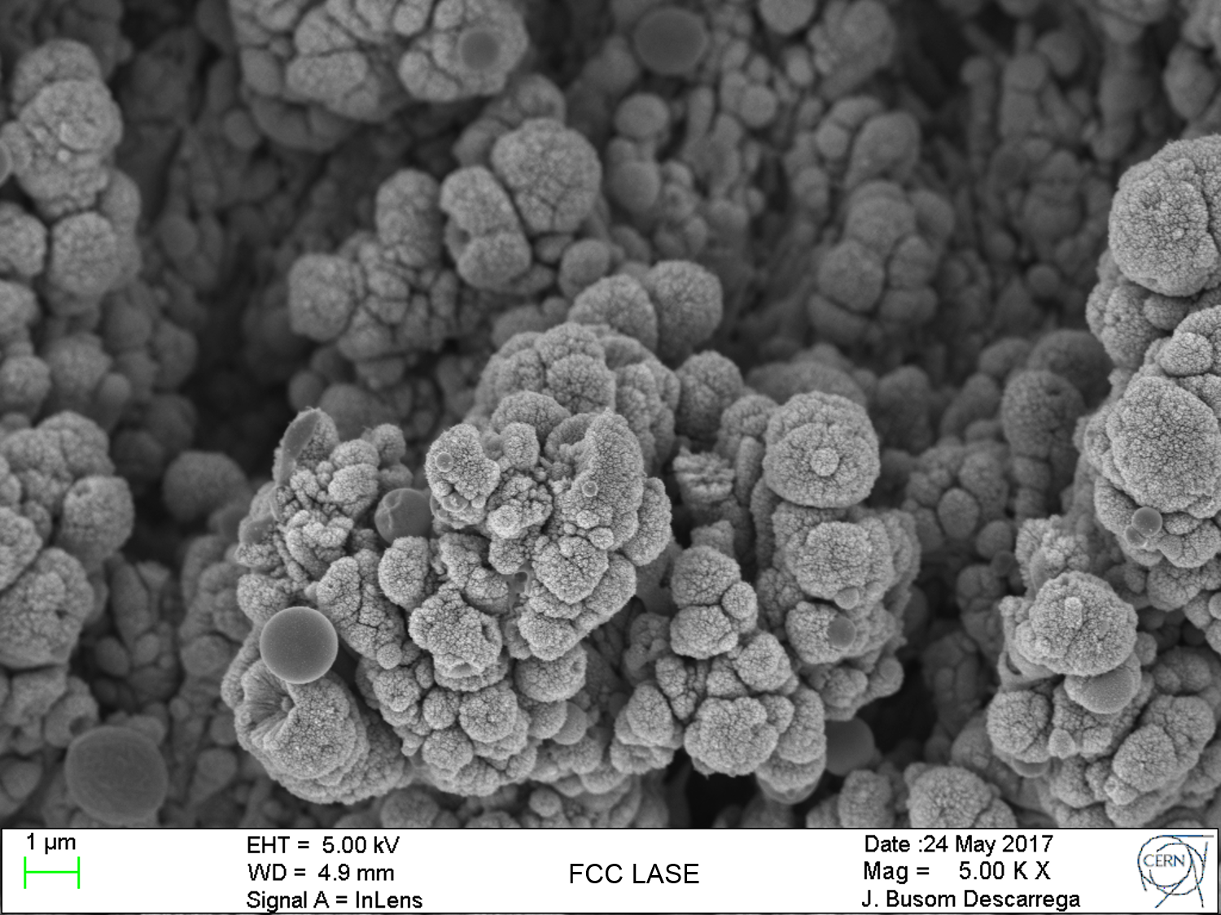
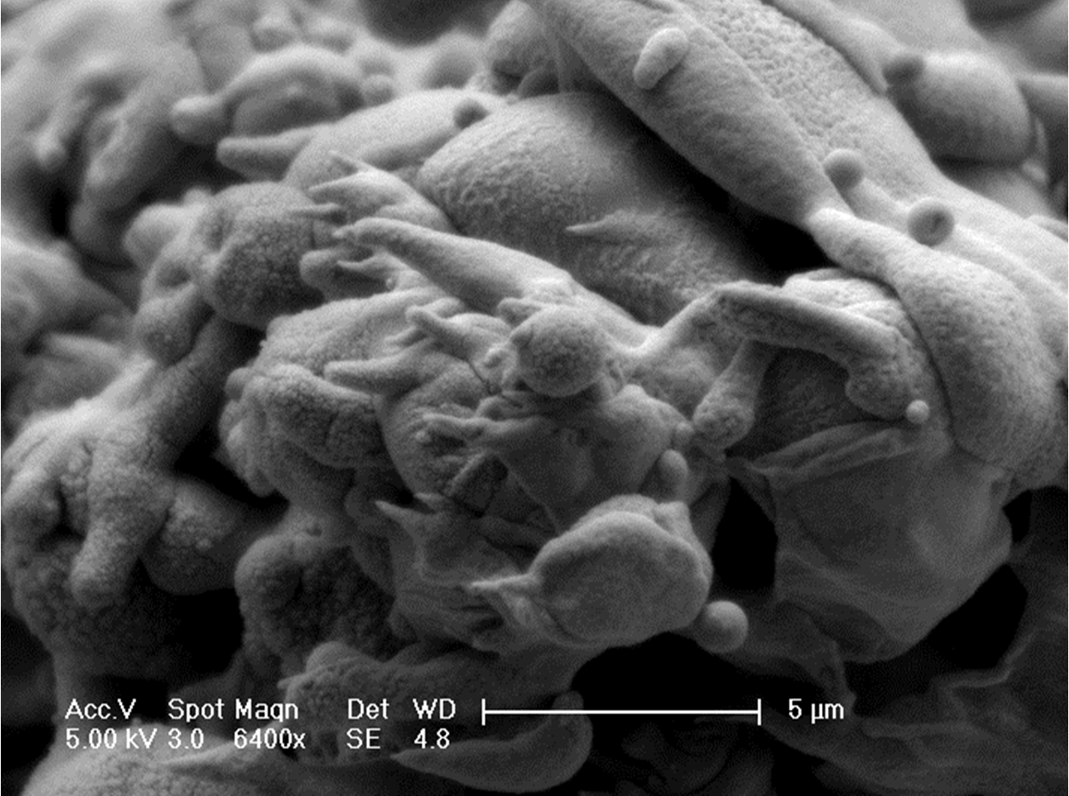
3rd Prototype at KARA Irradiation of LASE - Reflectivity
Surface morphology of different samples
LASE Measured in BESSY
LASE Measured in BESTEX
Test set-up at KARA: Status report & next steps
11
Luis Gonzalez
CERN TE-VSC
ALBA. March 19th 2018

Slide 13
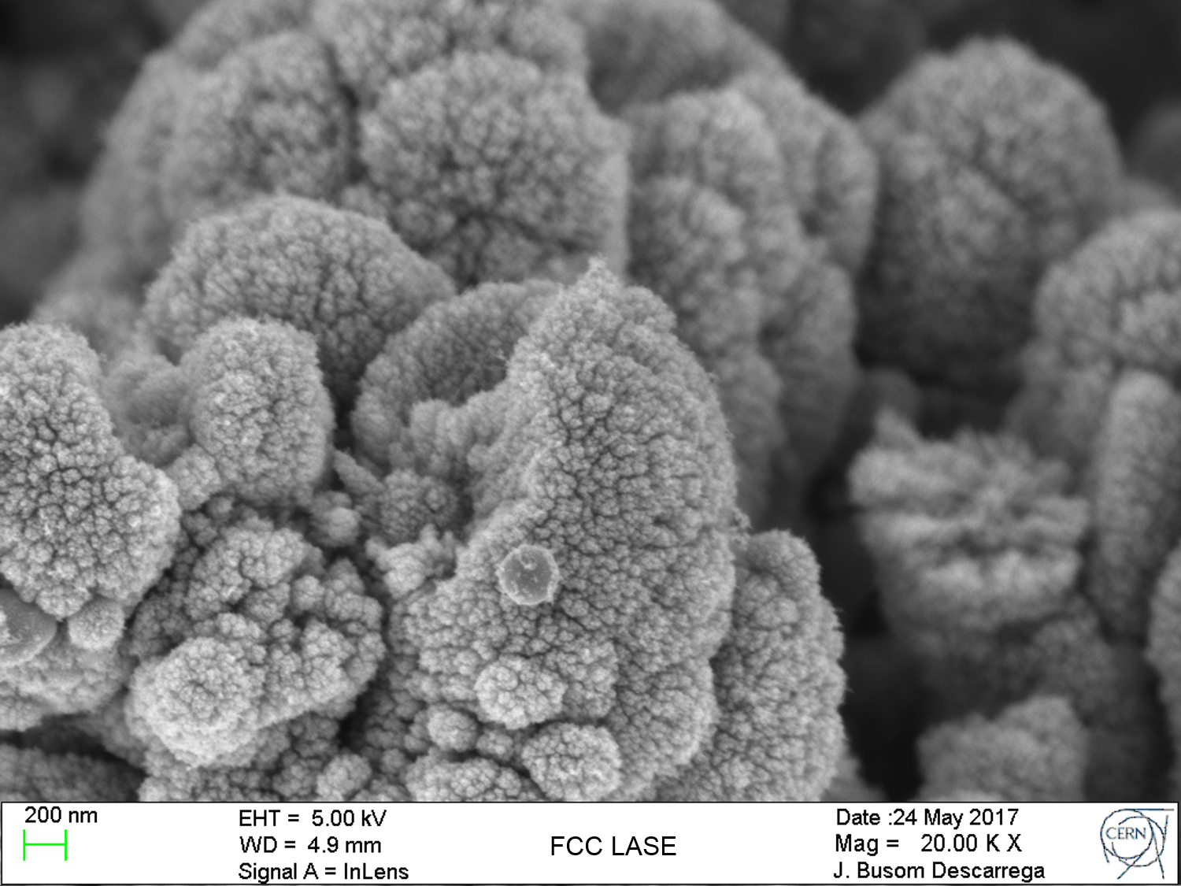
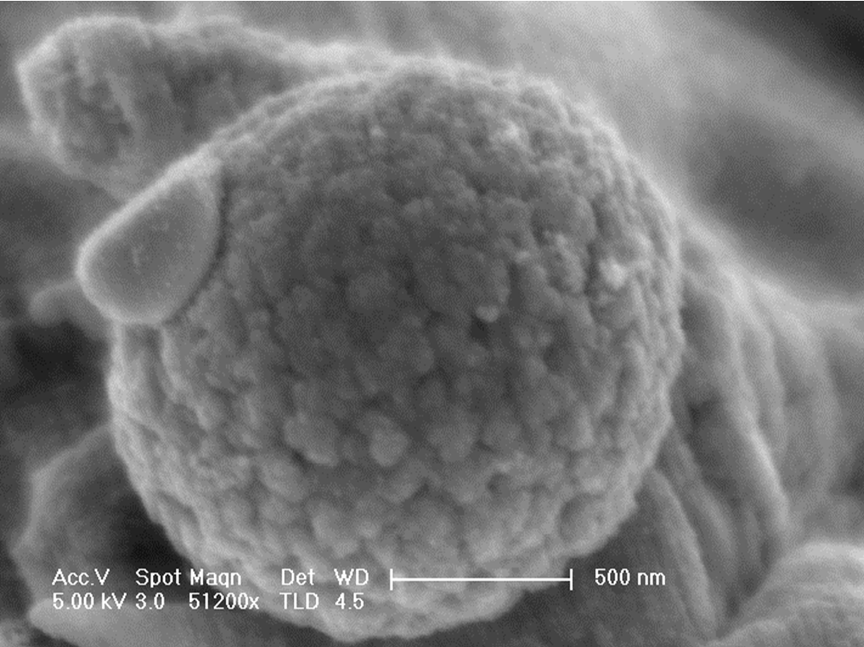
3rd Prototype at KARA Irradiation of LASE - Reflectivity
LASE Measured in BESSY
The microstructure of LASE is extremely dependent on the laser parameters
The reflectivity is extremely dependent on the microstructure of the surface
LASE Measured in BESTEX
Test set-up at KARA: Status report & next steps
12
Luis Gonzalez
CERN TE-VSC
ALBA. March 19th 2018

Slide 14
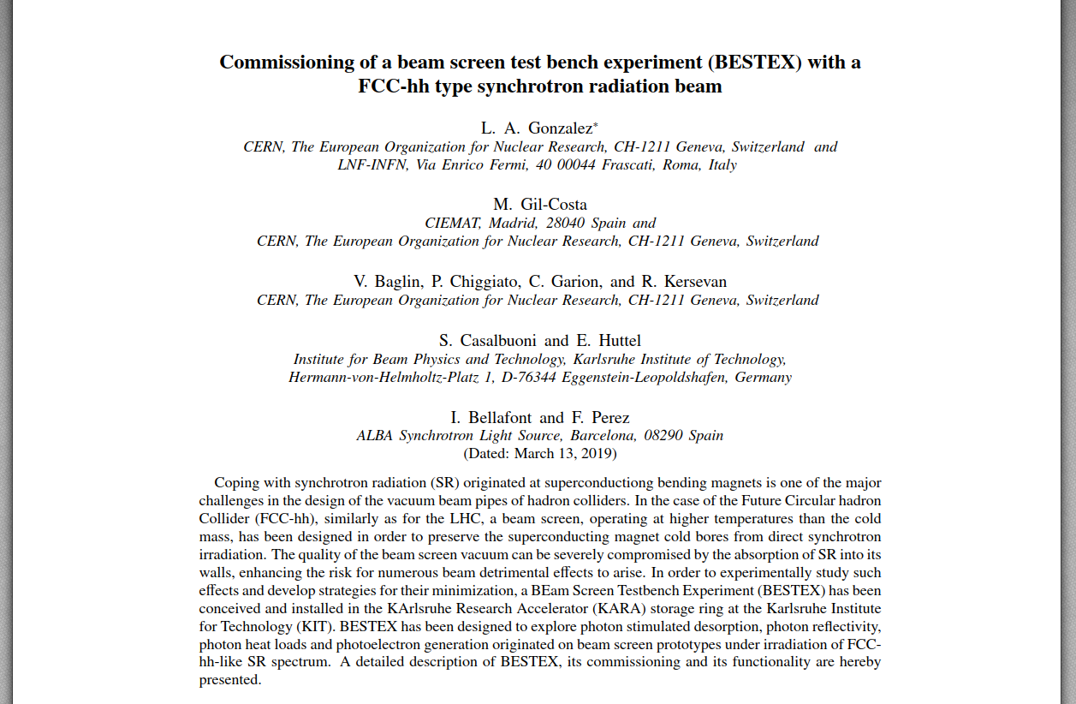
Submission of PRAB
Test set-up at KARA: Status report & next steps
13
Luis Gonzalez
CERN TE-VSC
ALBA. March 19th 2018

Slide 15
Future Steps – R&D Proposals
Scientific
Continue acquiring dose in current sample at 77K OR Vent the system and repeat the experiment from low doses at 77K
Perform measurements on new samples
-SS with internal coating
Colaminated Cu
Sawtooth profile (Cu)
LASE structure (Cu) – Different LASE’s?
…
-RT and 77K
PSD – Unpublished for T=77K; Ec=4.5KeV
Reflectivity – Manufacturing new samples with a geometry favorable for reflectivity studies (Repeatibility).
Unpublished - Very small gracing angles available.
Photoelectron generation – New electrode design (not cold sprayed) –
Unpublished - Evolution with Dose
Heat loads
Test set-up at KARA: Status report & next steps
14
8
Luis Gonzalez
CERN TE-VSC
ALBA. March 19th 2018

Slide 16
Future Steps – R&D Proposals
Technological
Cryogenic Upgrade
-Construction of a LN2 line at KARA for permanent LN2 access at BESTEX. Currently finalizing details to start the purchasing and construction – Implies PLC software upgrade
-Perform measurements at 77 K using a Dewar
Cryogenic test of FCC-hh BS at CERN by using a Dewar
Construction of new samples for BESTEX (Two different options)
Calibration of RGA at CERN
Upgrade of the setup for irradiation without bake out of sample.
  Add Valves and pumps - Implies PLC software upgrade
  Shrink collimator-testbench connector
Documentation of BESTEX
Test set-up at KARA: Status report & next steps
15
8
Luis Gonzalez
CERN TE-VSC
ALBA. March 19th 2018

Slide 17
Future Steps – R&D Proposals
Technological
Cryogenic Upgrade
-Construction of a LN2 line at KARA for permanent LN2 access at BESTEX. Currently finalizing details to start the purchasing and construction – Implies PLC software upgrade
-Perform measurements at 77 K using a Dewar
Cryogenic test of FCC-hh BS at CERN by using a Dewar
Construction of new samples for BESTEX (Two different options)
Calibration of RGA at CERN
Upgrade of the setup for irradiation without bake out of sample.
  Add Valves and pumps - Implies PLC software upgrade
  Shrink collimator-testbench connector
Documentation of BESTEX
Test set-up at KARA: Status report & next steps
16
8
Luis Gonzalez
CERN TE-VSC
ALBA. March 19th 2018

Slide 18
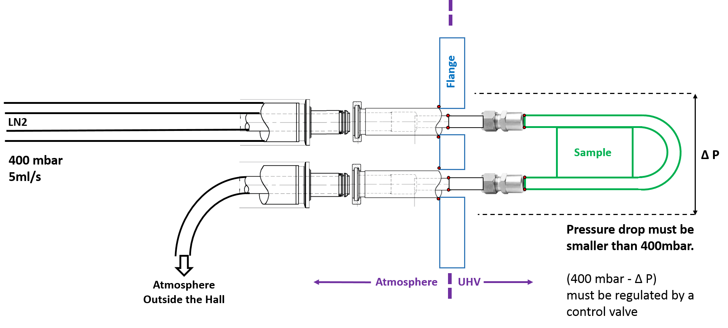
Fututre steps BESTEX Cryogenic Upgrade
KARA’s LN2 line
The flux required for the experiment is
Calculated and KARA can provide it
The pressure of the LN2 is 400 mbar, we
must ensure that the pressure drop in our
system is lower than 400mbar
CryoLab and valve providers claim that
valve must be implemented (welded, same
insulation vacuum) in the line, not flanged.
The valve should be implemented as part of
the LN2 order. (CERN will give detailed
description)
To be discussed with technicians at KARA
Test set-up at KARA: Status report & next steps
17
Luis Gonzalez
CERN TE-VSC
ALBA. March 19th 2018

Slide 19
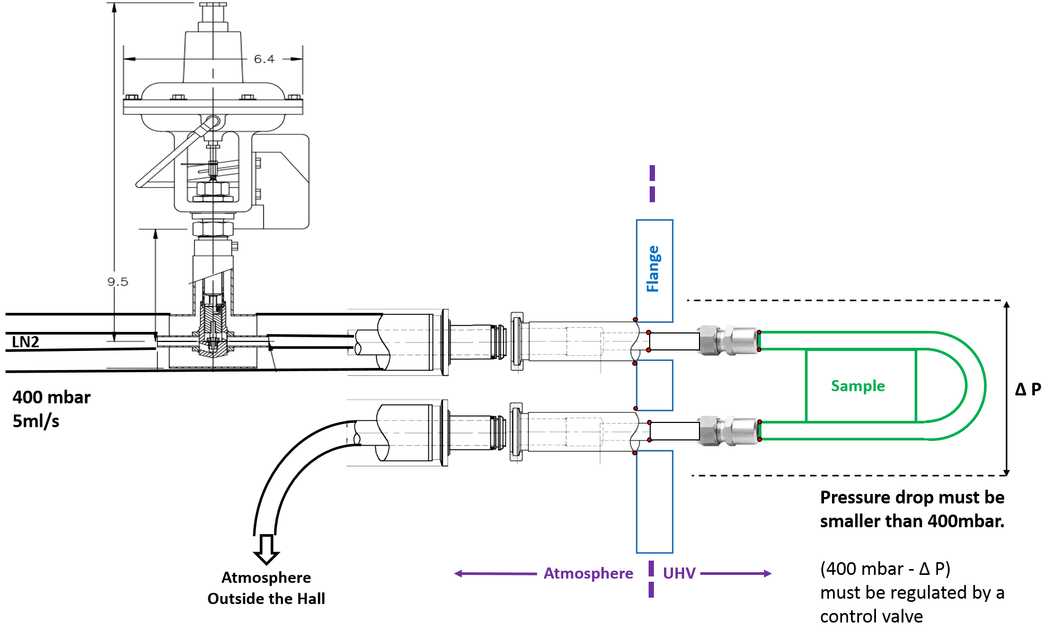
Fututre steps BESTEX Cryogenic Upgrade
KARA’s LN2 line
The flux required for the experiment is
Calculated and KARA can provide it
The pressure of the LN2 is 400 mbar, we
must ensure that the pressure drop in our
system is lower than 400mbar
CryoLab and valve providers claim that
valve must be implemented (welded, same
insulation vacuum) in the line, not flanged.
The valve should be implemented as part of
the LN2 order. (CERN will give detailed
description)
To be discussed with technicians at KARA
Test set-up at KARA: Status report & next steps
18
Luis Gonzalez
CERN TE-VSC
ALBA. March 19th 2018

Slide 20
Fututre steps BESTEX Cryogenic Upgrade
LN2 permanently from Dewar
KARA’s wall
Holes drilled
at KARA’s wall
Possibility of drilling holes at KARA’s wall to pass LN2 pipes from Dewar through
It is still to be reviewed how long a Dewar lasts
This option simplifies system and fastens up the cryogenic upgrade
LN2
Dewar
Test set-up at KARA: Status report & next steps
19
Luis Gonzalez
CERN TE-VSC
ALBA. March 19th 2018

Slide 21
Future Steps
Technological
Cryogenic Upgrade
-Construction of a LN2 line at KARA for permanent LN2 access at BESTEX. Currently finalizing details to start the purchasing and construction – Implies PLC software upgrade
-Perform measurements at 77 K using a Dewar
Cryogenic test of FCC-hh BS at CERN by using a Dewar
Construction of new samples for BESTEX (Two different options)
Calibration of RGA at CERN
Upgrade of the setup for irradiation without bake out of sample.
  Add Valves and pumps - Implies PLC software upgrade
  Shrink collimator-testbench connector
Documentation of BESTEX
Test set-up at KARA: Status report & next steps
20
8
Luis Gonzalez
CERN TE-VSC
ALBA. March 19th 2018

Slide 22
Future steps Construction of new samples
Option 1
Three Samples:
Tubular SS with coating of inner wall
Sample#1 Co-laminated copper
Sample#2 Co-laminated copper ST
Sample#3 Co-laminated copper LASE
Inner wall coating
Out
In
LN2
40-45mm
SR
LN2
8 mm
Test set-up at KARA: Status report & next steps
21
8
Luis Gonzalez
CERN TE-VSC
ALBA. March 19th 2018

Slide 23
Future steps Construction of new samples
Option 1
2 m
Three Samples:
Tubular SS with coating of inner wall
Sample#1 Co-laminated copper
Sample#2 Co-laminated copper ST
Sample#3 Co-laminated copper LASE
2 m long
Inner wall coating
Out
In
LN2
40-45mm
SR
LN2
8 mm
Test set-up at KARA: Status report & next steps
22
8
Luis Gonzalez
CERN TE-VSC
ALBA. March 19th 2018

Slide 24
Future steps Construction of new samples
Option 1
2 m
Three Samples:
Tubular SS with coating of inner wall
Sample#1 Co-laminated copper
Sample#2 Co-laminated copper ST
Sample#3 Co-laminated copper LASE
2 m long
Discontinuos welding
No pumping holes
Inner wall coating
Out
In
LN2
40-45mm
SR
LN2
8 mm
Test set-up at KARA: Status report & next steps
23
8
Luis Gonzalez
CERN TE-VSC
ALBA. March 19th 2018

Slide 25
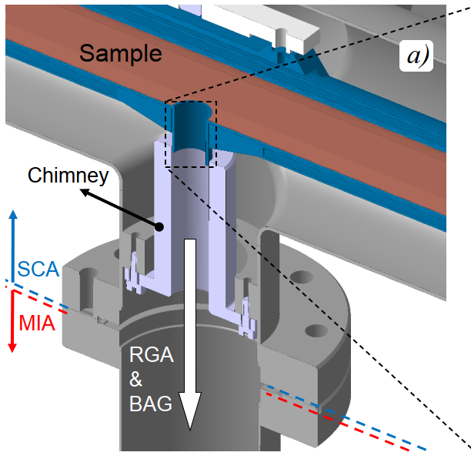
Future steps Construction of new samples
Option 1
2 m
Three Samples:
Tubular SS with coating of inner wall
Sample#1 Co-laminated copper
Sample#2 Co-laminated copper ST
Sample#3 Co-laminated copper LASE
2 m long
Discontinuos welding
No pumping holes
Chimney connection
-Fixed point
-We plan to modify the geometry to improve
leak tightness while keeping free of thermal
contact
Chimney
Test set-up at KARA: Status report & next steps
24
8
Luis Gonzalez
CERN TE-VSC
ALBA. March 19th 2018

Slide 26
Future steps Construction of new samples
Option 1
2 m
Three Samples:
Tubular SS with coating of inner wall
Sample#1 Co-laminated copper
Sample#2 Co-laminated copper ST
Sample#3 Co-laminated copper LASE
2 m long
Discontinuos welding
No pumping holes
Chimney connection
-Fixed point
-We plan to modify the geometry to improve
leak tightness while keeping free of thermal
contact
Chimney
Test set-up at KARA: Status report & next steps
25
8
Luis Gonzalez
CERN TE-VSC
ALBA. March 19th 2018

Slide 27
Future steps Construction of new samples
Option 1
+
-
Three Samples:
Tubular SS with coating of inner wall
Sample#1 Co-laminated copper
Sample#2 Co-laminated copper ST
Sample#3 Co-laminated copper LASE
2 m long
Discontinuos welding
No pumping holes
Chimney connection
-Fixed point
-We plan to modify the geometry to improve
leak tightness while keeping free of thermal
contact
Photoelectron electrode
UHV
~ 5 mm
~ 50 mm
Test set-up at KARA: Status report & next steps
26
8
Luis Gonzalez
CERN TE-VSC
ALBA. March 19th 2018

Slide 28
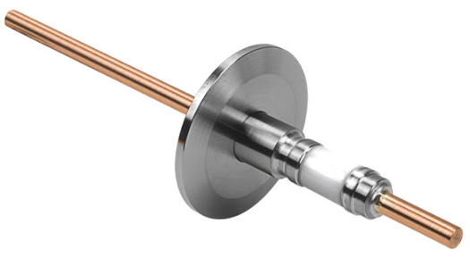
Future steps Construction of new samples
Option 1
+
-
Three Samples:
Tubular SS with coating of inner wall
Sample#1 Co-laminated copper
Sample#2 Co-laminated copper ST
Sample#3 Co-laminated copper LASE
2 m long
Discontinuos welding
No pumping holes
Chimney connection
-Fixed point
-We plan to modify the geometry to improve
leak tightness while keeping free of thermal
contact
Photoelectron electrode
UHV
~ 5 mm
~ 50 mm
Test set-up at KARA: Status report & next steps
27
8
Luis Gonzalez
CERN TE-VSC
ALBA. March 19th 2018

Slide 29
Future steps Construction of new samples
Option 2
+
-
Three Samples:
HALF PIPE SS with coating of inner wall
Sample#1 Co-laminated copper
Sample#2 Co-laminated copper ST
Sample#3 Co-laminated copper LASE
2 m long
Fix Sample mechanically (use of Ceramics)
Electrically isolate cooling pipes
Bias the sample and measure Photoelectron Yield
UHV
Test set-up at KARA: Status report & next steps
28
8
Luis Gonzalez
CERN TE-VSC
ALBA. March 19th 2018

Slide 30
Future Steps
*Shut Down
March | April | May | June | July | Aug | Sept | Oct | Nov | Dec
Cryogenic Test
CERN-Check availability of cooling sample with Dewar.
1st Cool Down KARA
1 month
error
margin
RGA Calibration and Setup upgrades
Manufacturing 1st new sample, test and assembly
Installation
and
Experiment
Installation LN2 line
Test set-up at KARA: Status report & next steps
29
9
Luis Gonzalez
CERN TE-VSC
ALBA. March 19th 2018

Slide 31
Future Steps
*Shut Down
March | April | May | June | July | Aug | Sept | Oct | Nov | Dec
Cryogenic Test
CERN-Check availability of cooling sample with Dewar.
1st Cool Down KARA
1 month
error
margin
RGA Calibration and Setup upgrades
Manufacturing 1st new sample, test and assembly
Installation
and
Experiment
Installation LN2 line
If permanent cool down with Dewar is possible, from this moment we would be able to start the experiments as soon as samples are manufactured
Test set-up at KARA: Status report & next steps
30
9
Luis Gonzalez
CERN TE-VSC
ALBA. March 19th 2018

Slide 32
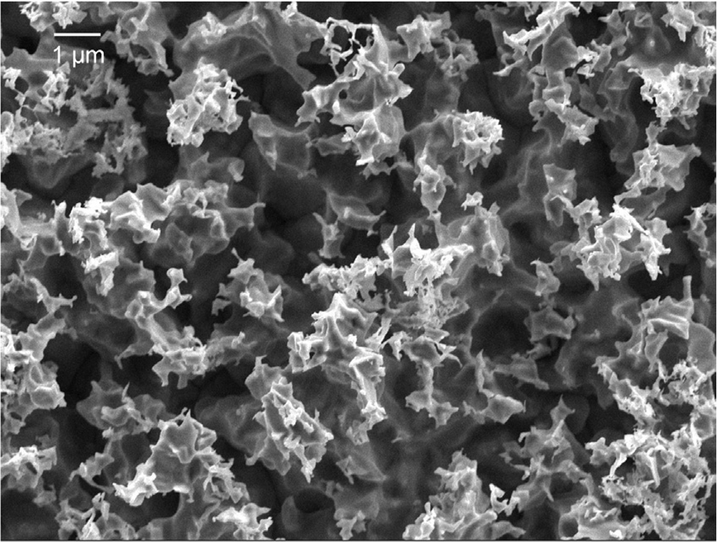
More R&D Follow Up Proposals
LASE on Cu
Chemical etching on Ag
Valentin Nistor, et al Applied Surface Science, Volume 315, 2014, Pages 445-453, https://doi.org/10.1016/j.apsusc.2014.05.049.
Test set-up at KARA: Status report & next steps
31
9
Luis Gonzalez
CERN TE-VSC
ALBA. March 19th 2018

Slide 33
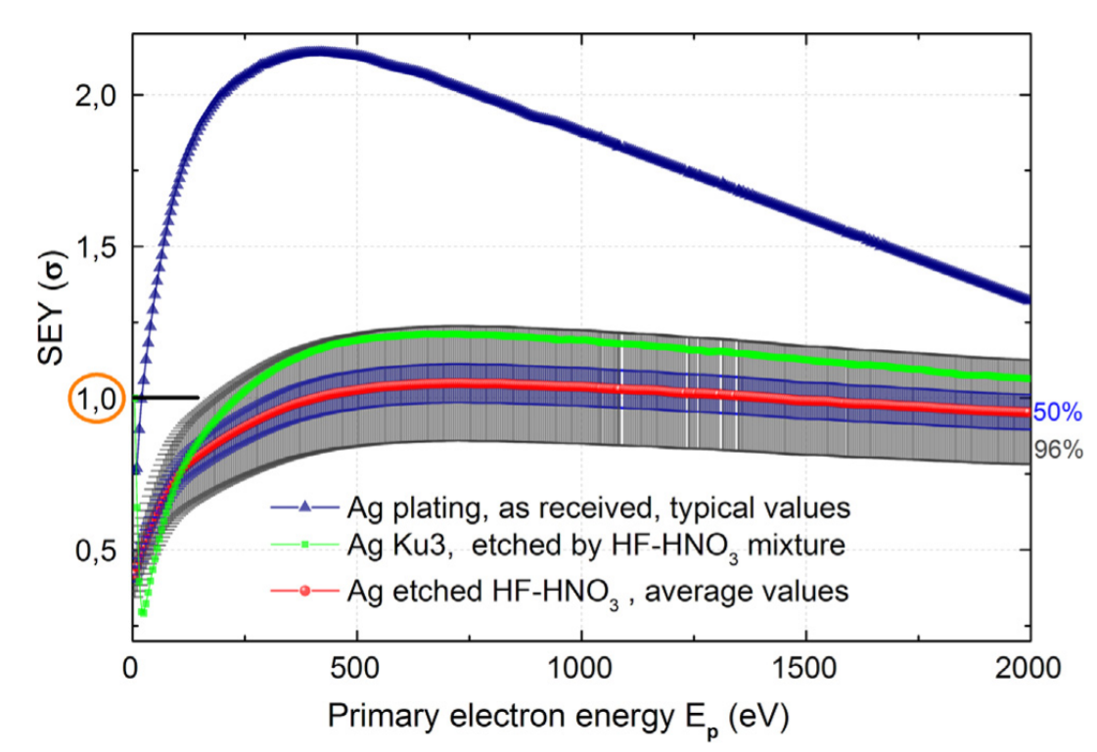
More R&D Follow Up Proposals
Chemical etching on Ag
Valentin Nistor, et al Applied Surface Science, Volume 315, 2014, Pages 445-453, https://doi.org/10.1016/j.apsusc.2014.05.049.
Test set-up at KARA: Status report & next steps
32
9
Luis Gonzalez
CERN TE-VSC
ALBA. March 19th 2018

Slide 34
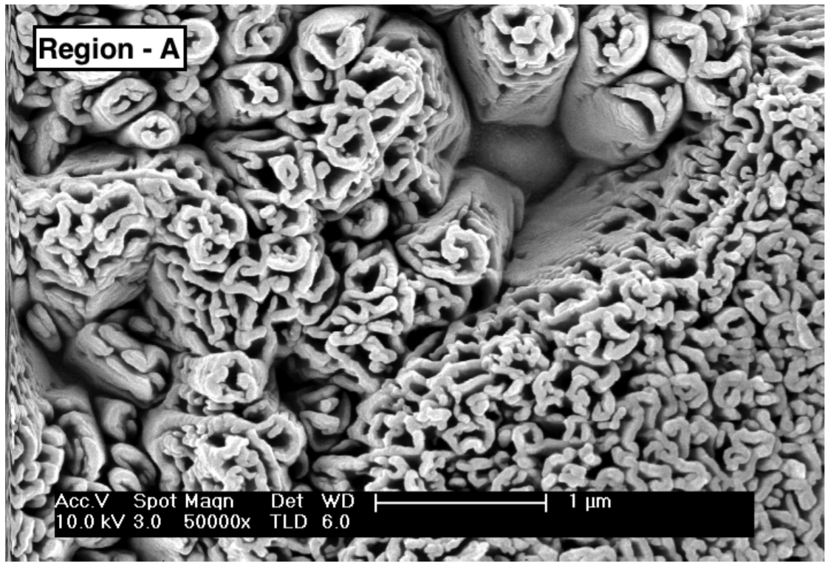
More R&D Follow Up Proposals
Magnetron sputteting on Ag
LASE on Cu
Magnetron sputteting on Ag - Luis Gonzalez PhD Thesis
Test set-up at KARA: Status report & next steps
31
9
Luis Gonzalez
CERN TE-VSC
ALBA. March 19th 2018

Slide 35
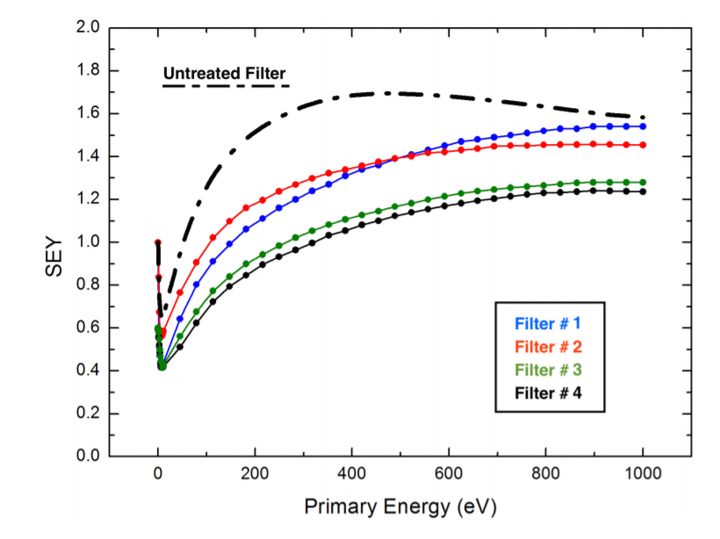
More R&D Follow Up Proposals
Magnetron sputteting on Ag
Filter #4
LASE on Cu
Magnetron sputteting on Ag - Luis Gonzalez PhD Thesis
Test set-up at KARA: Status report & next steps
31
9
Luis Gonzalez
CERN TE-VSC
ALBA. March 19th 2018

Slide 36
Conclusions
BESTEX was reoriented to irradiate the LASE surface.
PSD was found to be lower than for Sawtooth, I agreement with a lower photoelectron yield
Reflectivity measurements in LASE can not be compared with Sawtooth or Reflector
However it was confirmed that in terms of reflectivity, each LASE can behave differently depending on the manufacturing
parameters
PRAB is ready for submission
Two options for the new samples have been presented
Necessary Setup upgrades to be carried out have been presented
  Permanent LN2 line at KARA
  Cool down with Dewar
New scientific plan has been presented
Pros, contras and availabilities must still be reviewed to decide the most convenient strategy
Test set-up at KARA: Status report & next steps
33
Luis Gonzalez
CERN TE-VSC
ALBA. March 19th 2018

Slide 37
Acknowledgments
Thank You
Test set-up at KARA: Status report & next steps
34
Luis Gonzalez
CERN TE-VSC
ALBA. March 19th 2018

Slide 38
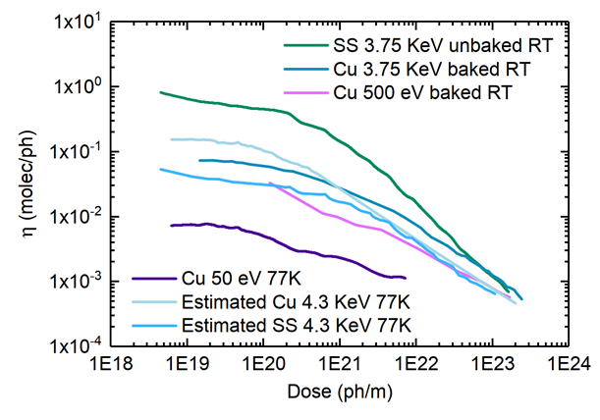
Test set-up at KARA: Status report & next steps
Luis Gonzalez
CERN TE-VSC
ALBA. March 19th 2018

