Slide 1
REPORT ON TURKEY
ASSOCIATE MEMBERSHIP AT
CERN
2015-2019 prepared by the Turkey-CERN Joint Liaison Committee of Turkey
15 March 2019

Slide 2
Contents
About Turkey
Organization of Research in Turkey
Turkish Atomic Energy Authority
History of Turkey-CERN Relations
Financial Contribution to CERN
Recent Activities
Goals

Slide 3

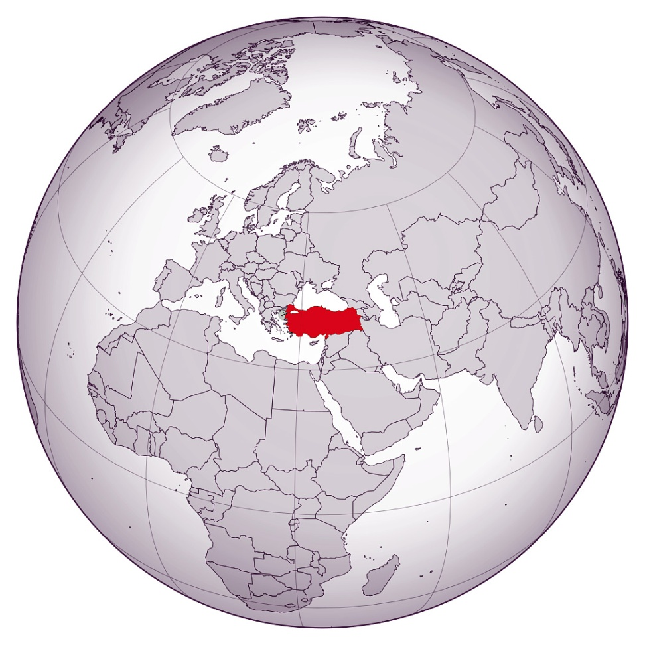
About TURKEY
Area: 783,562 km²
Currency: Turkish Lira (TRY)
1 TRY = 0.19 $ = 0.16 €
Capital City: Ankara
Time Zone: UTC+3
7 geographical regions with a total of 81 cities
Population:
  82 M (2018)
    Age distribution: “0-14” 23,4%, “15-64” 67,8%, “65+”8,8%
  Most populated cities:
    İstanbul 15.1M
    Ankara 5.5M
    İzmir 4.3M
    Bursa 3,0M
    Antalya 2.4M
3

Slide 4
Organization of Research in Turkey
The main institutions involved in R&D activities in Turkey are:
Supreme Council for Science and Technology,
Turkish Atomic Energy Authority,
Scientific and Technological Research Council of Turkey,
Turkish Academy of Sciences,
Universities,
Turkish President’s Office of Budget and Strategy

Slide 5
Turkish Atomic Energy Authority
The Turkish Atomic Energy Authority (TAEK) was first established with the name of Atomic Energy Commission in 1956 as a governmental organization directly under the supervision of the Prime Minister and became a founding member of the International Atomic Energy Agency in 1957.
The Turkish Atomic Energy Authority has been reformed on 15.07.2018 by the Presidential Decree No:4 to conduct, support, and coordinate scientific and technical studies for the use of nuclear energy, ionizing radiation and accelerator technologies for the benefit of the country for peaceful purposes.
TAEK has been in charge of coordination of the activities related to CERN in Turkey, and representing Turkey in CERN since 2006.

Slide 6
Turkish Atomic Energy Authority
Turkish Atomic Energy Authority;
Makes Associate Membership contribution of Turkey
Makes M&O Category A-B payments of Turkish researchers (in CMS, ATLAS, ALICE and AMS experiments)
Supports the travels of researchers to CERN

Slide 7
History of Turkey-CERN Relations
Turkey has established first relations with CERN in 1960’s by the involvement of some of our physicists in experiments by their own efforts and then has turned into institutional level by the support of the Turkish Atomic Energy Authority (TAEK) and Scientific and Technological Research Council of Turkey (TÜBİTAK).

Slide 8
History of Turkey-CERN Relations
1961-Observer status granted.
2006-TAEK appointed as responsible authority for activities at CERN by the prime minister.
2008-TAEK-CERN Collaboration Agreement signed.
2014-Associate Membership agreement signed at CERN.
2015 Associate membership officialized (6 May 2015).

Slide 9
History of Turkey-CERN Relations
Turkish physicists started participating at CERN experiments as groups in 1980s, CHARM-II, SMC and CHORUS, where they made several important contributions to data analysis.
Today, Turkish physicists are active in the ATLAS, CMS, ALICE and LHCb experiments at the Large Hadron Collider, and are also involved in the AMS-02, CAST, NA63 and OPERA experiments as well as experiments at the ISOLDE facility.
Turkey operates a Tier-2 centre of the Worldwide LHC Computing Grid.

Slide 10
Financial Contribution to CERN
The contribution of Turkey to the CERN budget
Year | Contribution (CHF)
2015 | 3,618,750
2016 | 4,751,750
2017 | 4,769,750
2018 | 5,619,000
2019 | 5,692,000 (50% payment was made)

Slide 11
Recent Activities
we organized «1st National CERN-Related Activities Workshop» in October 2018, about 130 people attended from various universities and industry representatives.
in 2018 we organized several meetings in order to prepare a «National Strategy/Roadmap for Particle Physics and Accelerator Technologies»
  a draft document has been prepared.
  the final document is expected to be ready in the middle of 2019.

Slide 12
Goals
Our mains goals related to Associate Membership of Turkey;
to increase the number of qualified researchers working in the field of high energy physics,
to have laboratories, equipment and facilities capable of contributing to research conducted in CERN,
to increase the return rate of country contribution by providing participation of Turkish industrialists to the CERN tenders,
to increase the number of Turkish citizens employed at CERN.

Slide 13
Thank you…

