Slide 1

Magnetorotational supernovae
A nucleosynthetic analysis of sophisticated 3D models
M. Reichert, M. Obergaulinger, M. Á. Aloy, M. Gabler, A. Arcones

Slide 2
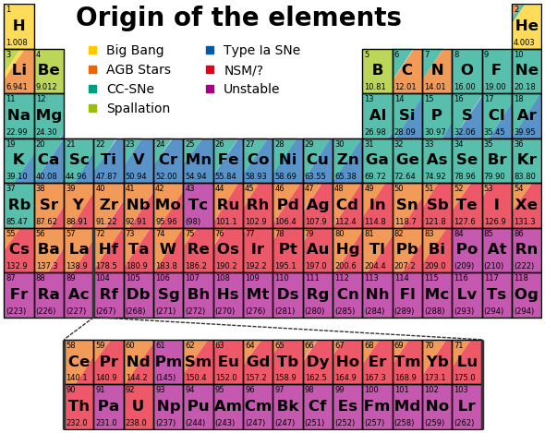
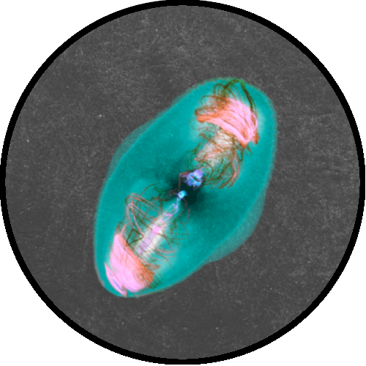

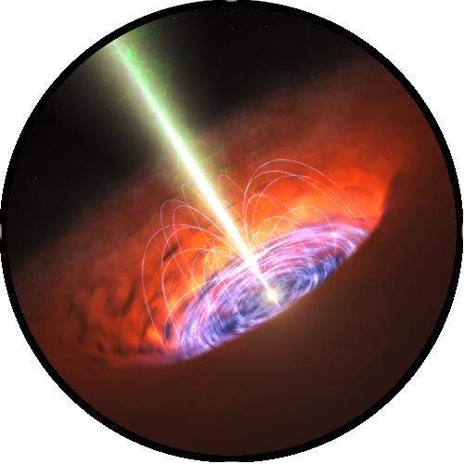
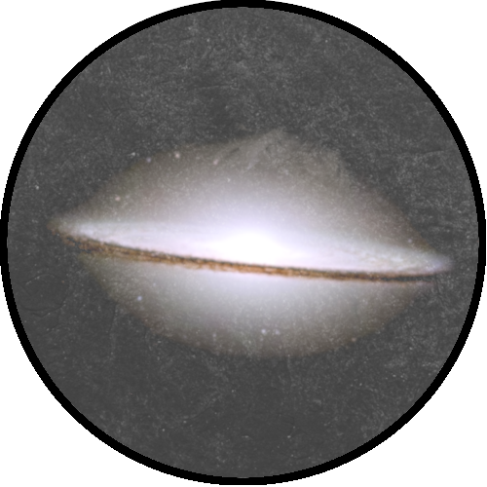

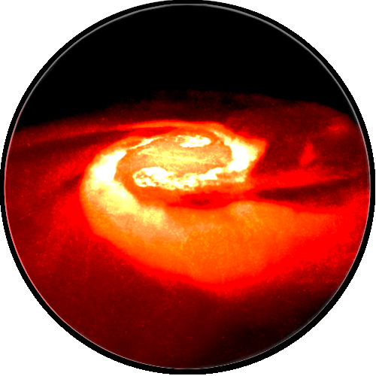
Magnetorotational
supernovae
Nucleosynthesis calculations
Collapsars
r-process?
Stellar
observations
Neutronstar
merger

Slide 3
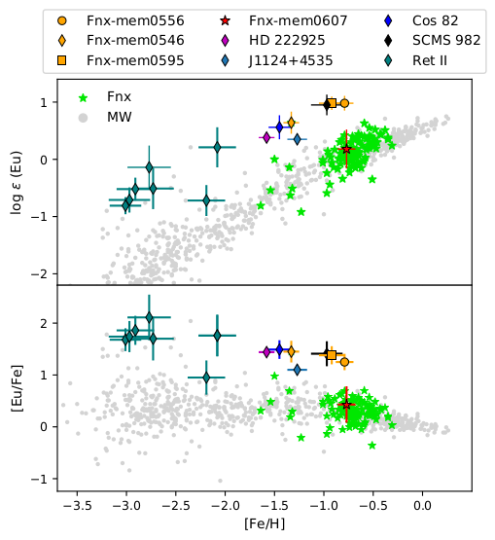
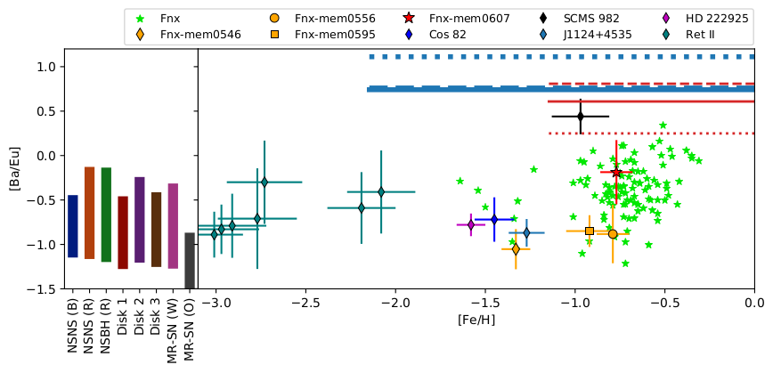
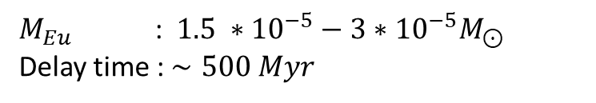
The dwarf spheroidal galaxy Fornax
$M_{Eu}$ : $1.5 ∗{10}^{−5}−3∗{10}^{−5}M_{⊙}$
Delay time : $∼500 Myr$
Reichert, Hansen & Arcones (2021), Reichert et al. (2020)

Slide 4
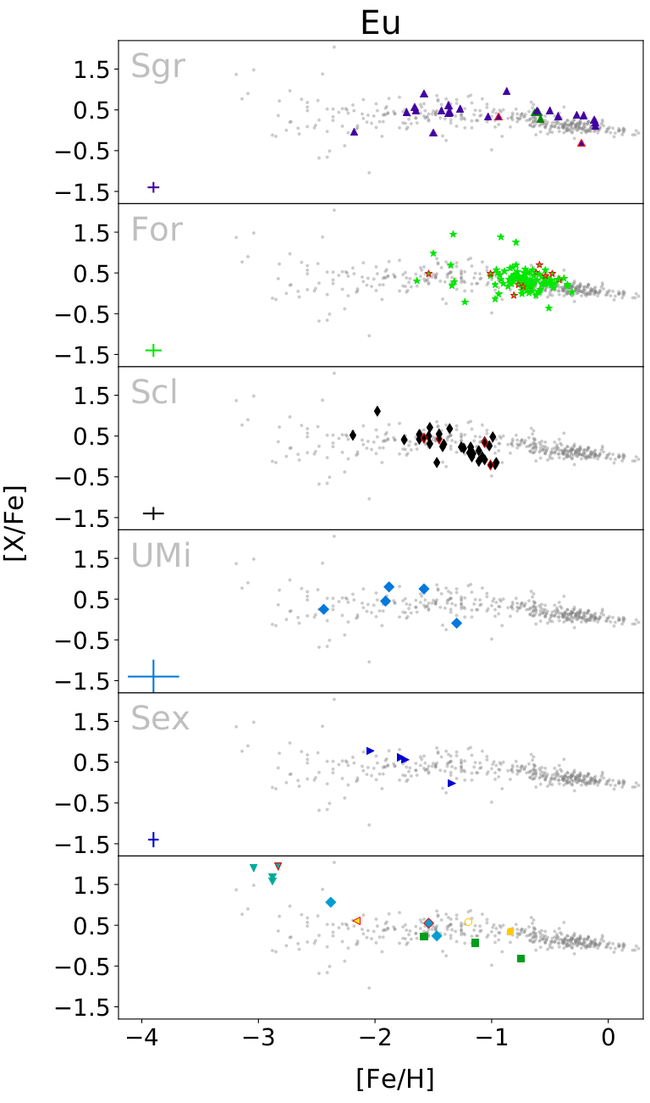
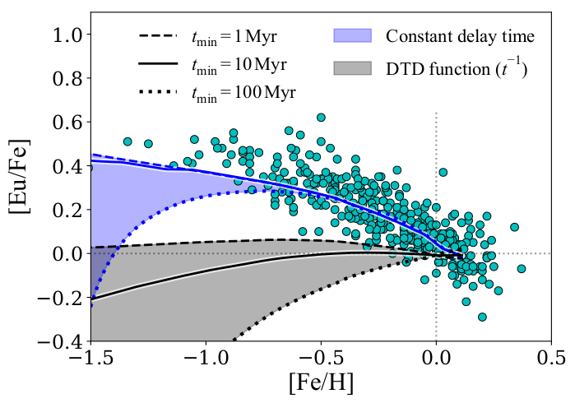
A decreasing Eu trend at high metallicities
Magnetorotational
supernovae
Event contributing at early time?
Collapsars
Côté et al. (2019)
Reichert et al. (2020)
See also Molero et al. (2021)

Slide 5
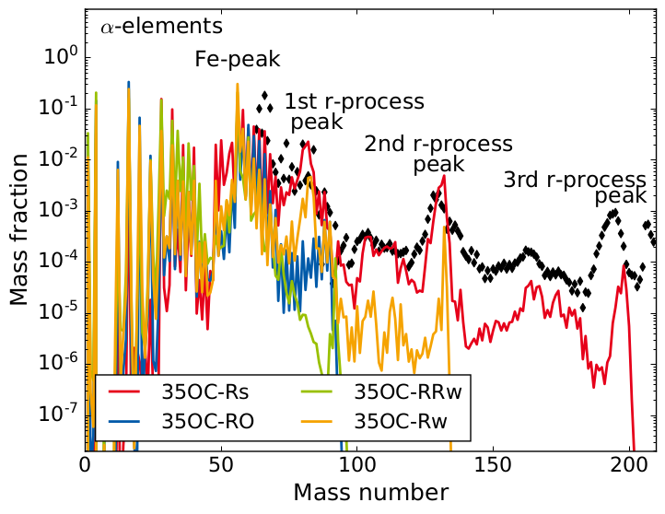
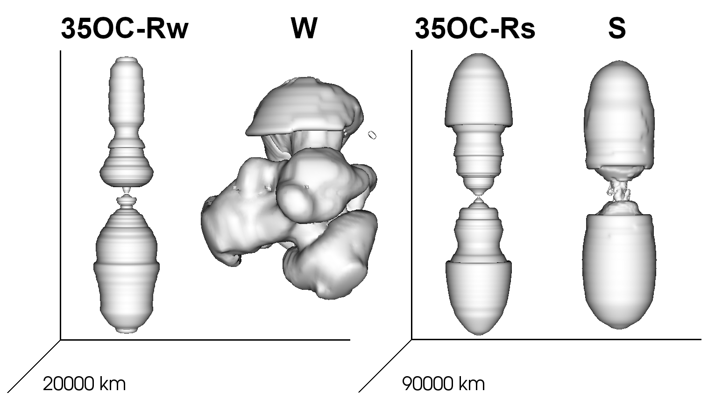
Nucleosynthesis of magnetorotational supernovae
Models
2D models
Ordinary magnetic field
Weak magnetic field
Strong magnetic field
2D
3D​
2D
3D​
Reichert et al. (2021b)
Reichert et al. (2022, submitted,
arXiv:2206.11914v1)
See also e.g., Obergaulinger & Aloy 2017, 2020, 2021; Aloy & Obergaulinger 2021

Slide 6
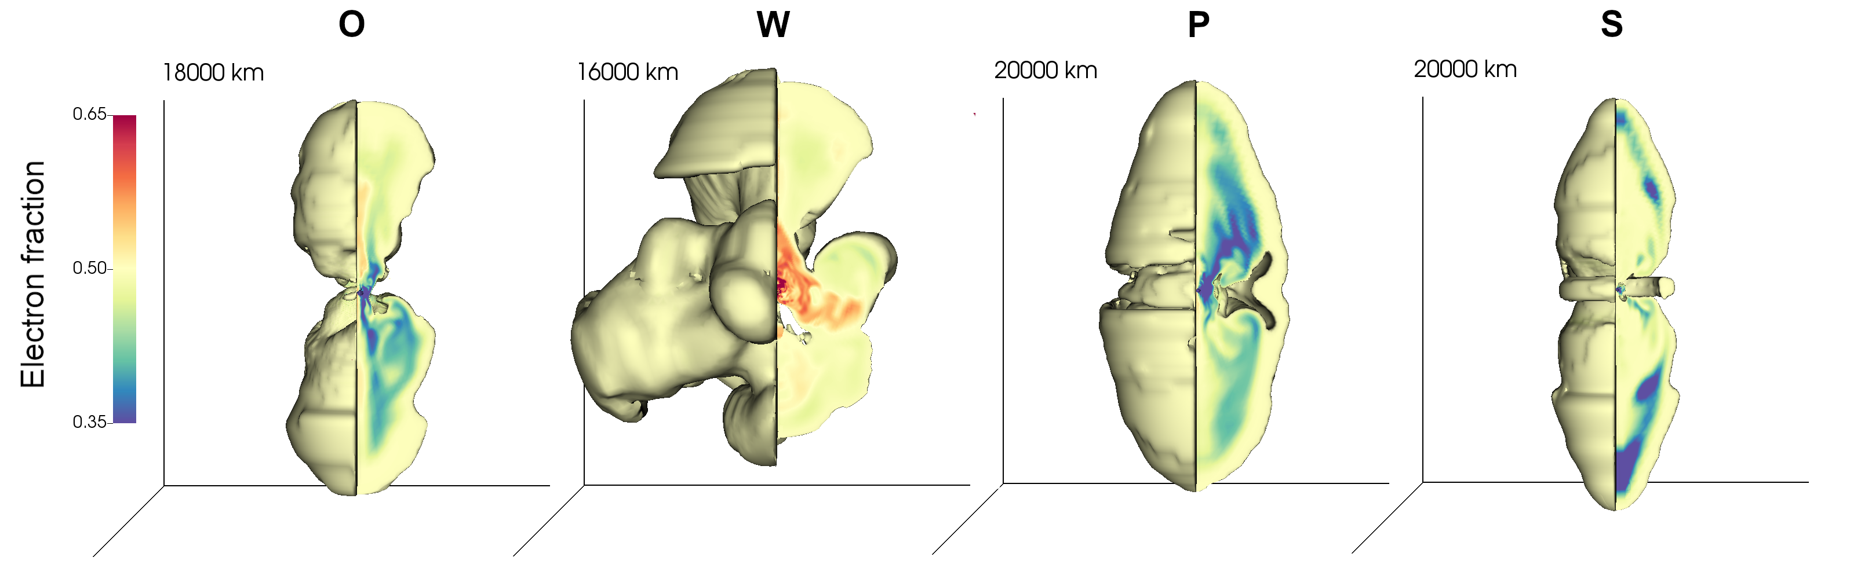
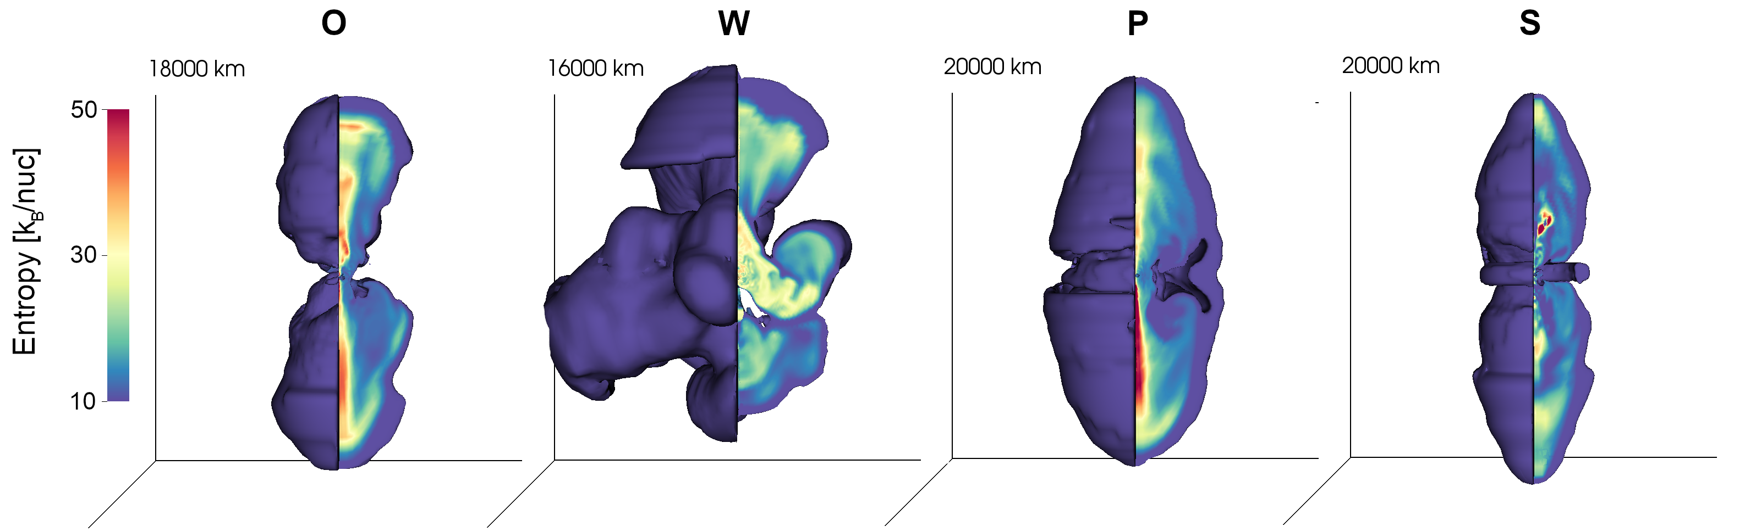
Nucleosynthesis of magnetorotational supernovae
Models
Ordinary magnetic field
Weak magnetic field
Poloidal field x3
Strong magnetic field
Reichert et al. (2022, submitted, arXiv:2206.11914v1), Hydrodynamic simulations of Obergaulinger & Aloy 2021

Slide 7
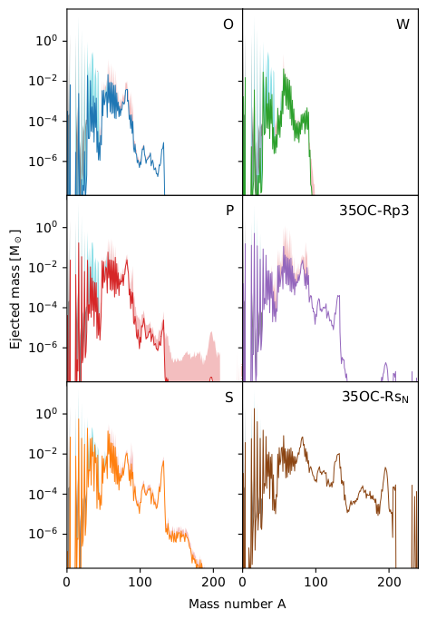
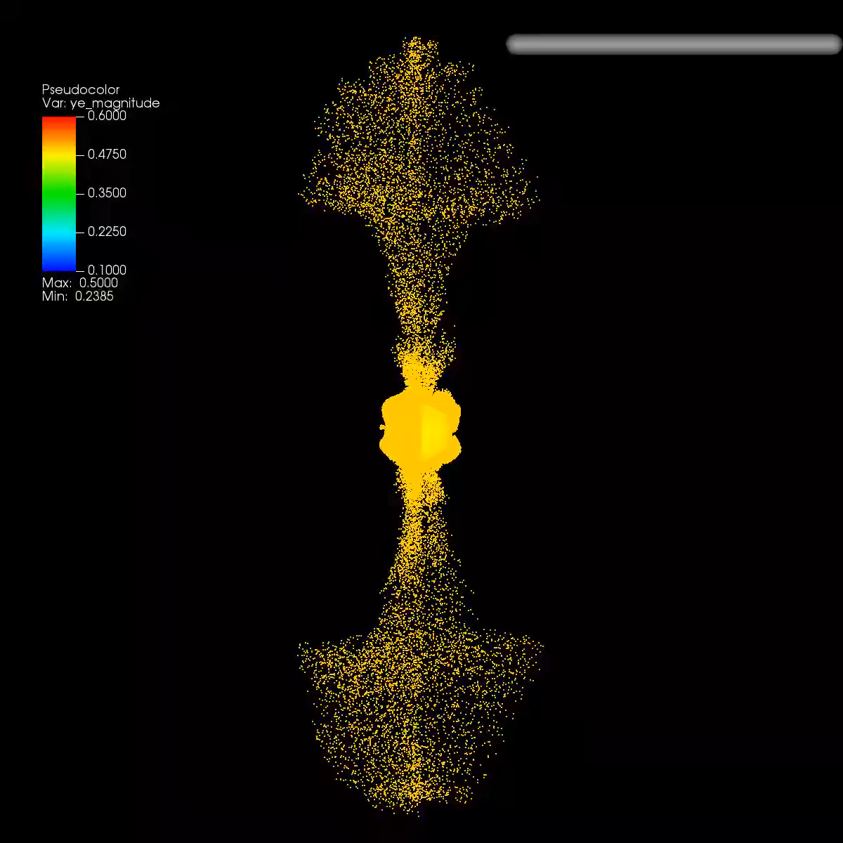
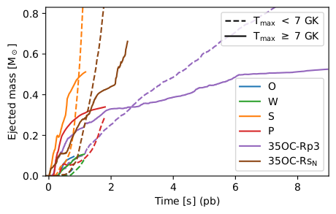
Nucleosynthesis of magnetorotational supernovae
Models
Ordinary magnetic field
Weak magnetic field
Poloidal field x3
Strong magnetic field
Abundances
Reichert et al. (2022, submitted, arXiv:2206.11914v1)
Hydrodynamic simulation of Obergaulinger & Aloy 2021

Slide 8
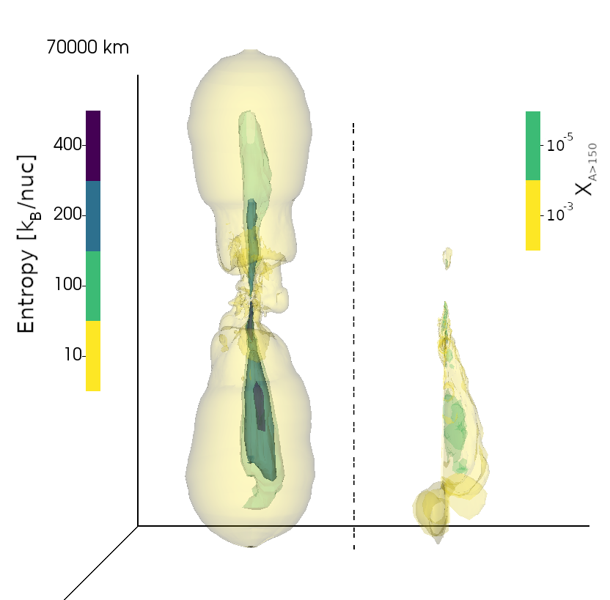
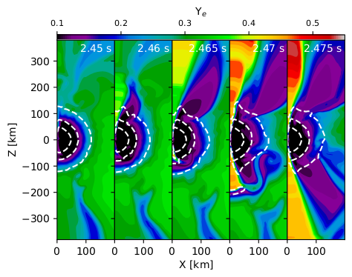
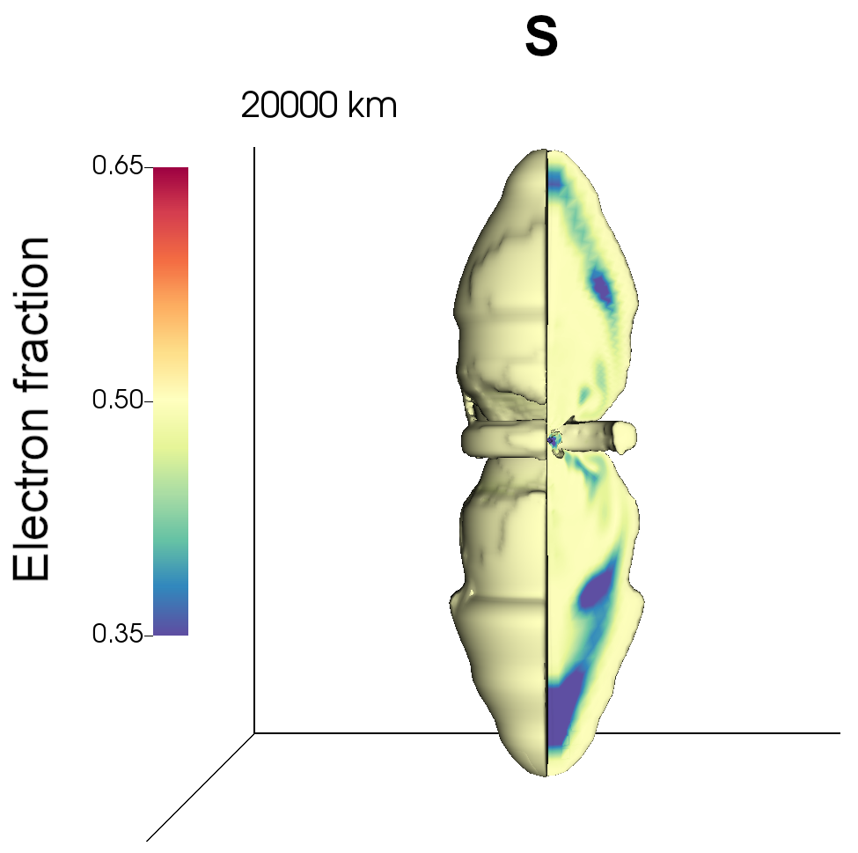
Nucleosynthesis of magnetorotational supernovae, r-process
Prompt ejection
(2D)
High entropies
(2D and 3D)
PNS shape reconfiguration
(2D)
Reichert et al. (2022, submitted, arXiv:2206.11914v1)

Slide 9
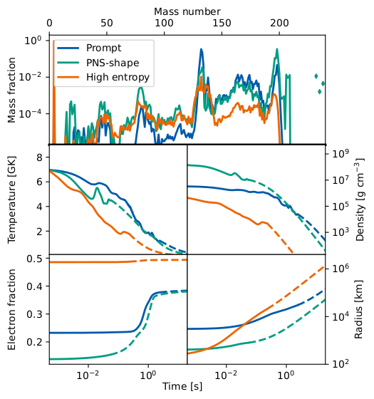

Nucleosynthesis of magnetorotational supernovae, r-process
Prompt
e.g.,
Nishimura et al. 2006; Winteler et al. 2012;
Nishimura et al. 2015,2017; Mösta et al. 2018;
Halevi & Mösta 2018; Reichert et al. 2021, 2022
PNS-Shape
e.g.,
Reichert et al. 2021, 2022
High entropy
e.g.,
Meyer 1994; Woosley et al 1994;
Wheeler et al. 1998; Freiburghaus et al. 1999;
Meyer 2002, Reichert et al. 2022
Reichert et al. (2022, submitted, arXiv:2206.11914v1)

Slide 10
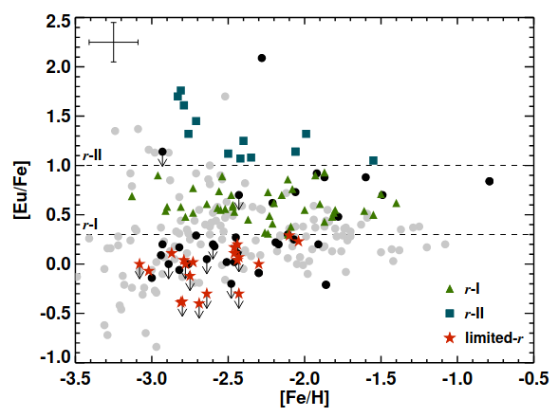
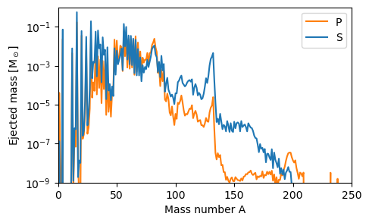
Heavy element production in the light of observations
S
P
Cowan et al. 2021, Hansen et al. 2018
Reichert et al. (2022, submitted, arXiv:2206.11914v1)

Slide 11
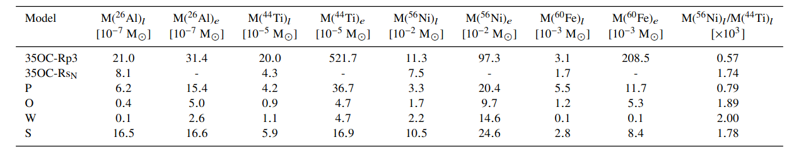
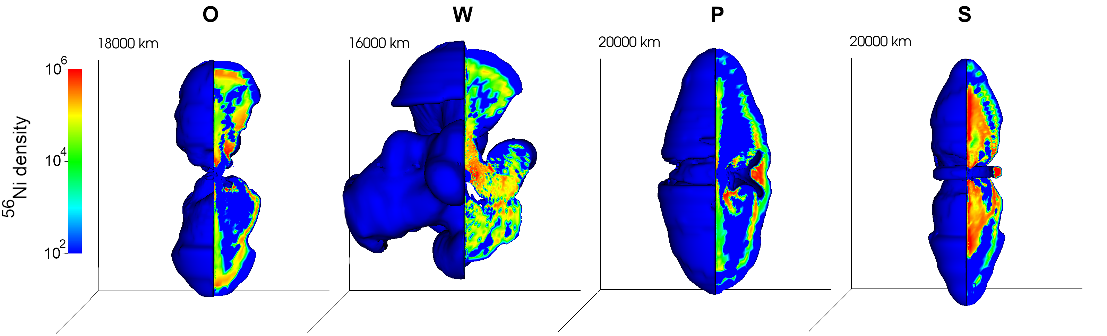
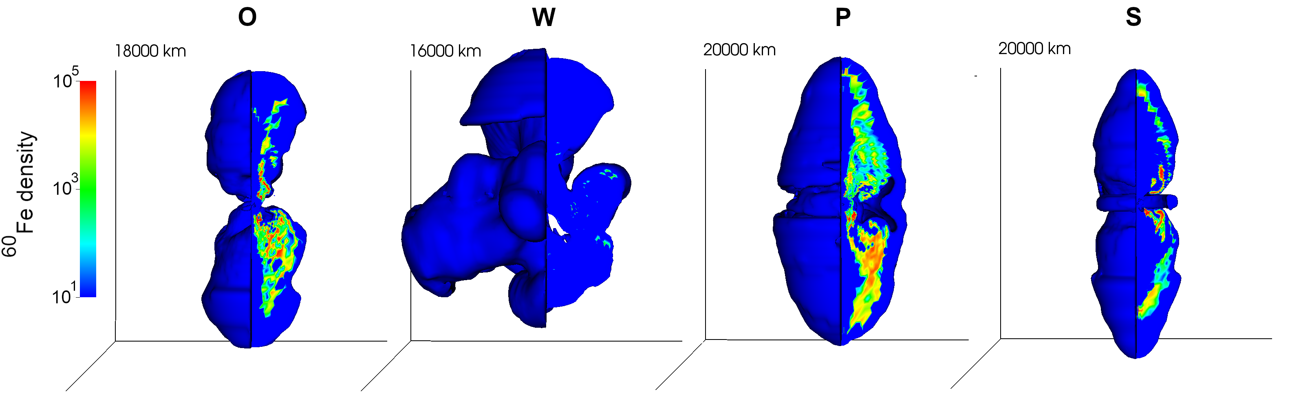
Nucleosynthesis of magnetorotational supernovae, radioactive elements
Reichert et al. (2022, submitted, arXiv:2206.11914v1)

Slide 12
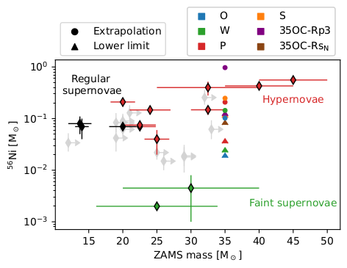
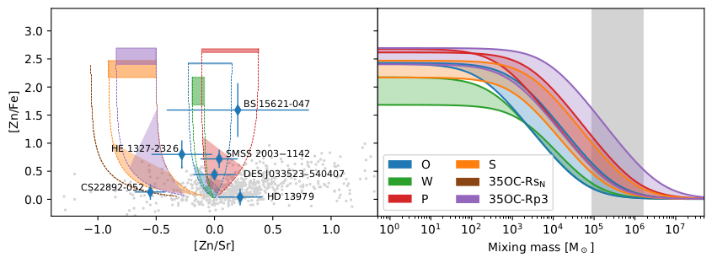
Nucleosynthesis of magnetorotational supernovae, hypernovae connection?
Reichert et al. (2022, submitted, arXiv:2206.11914v1)

Slide 13
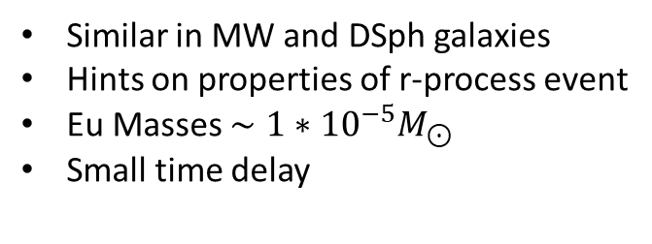
Nucleosynthesis calculations
Observational constraints
Reduced r-process yields in early ejecta when moving to 3D
High entropies could also provide conditions for r-process.
Actinides rather unstable produced. Variations expected. Actinide boost/deficient stars?
[Eu/Fe] only compatible with r-I stars due to high Fe ejecta, or pattern not compatible with solar pattern
Similar in MW and DSph galaxies
Hints on properties of r-process event
Eu Masses $∼1∗{10}^{−5}M_{⊙}$
Small time delay
e.g., Côte et al. 2019, Reichert et al. 2020,
Molero et al. 2021, Reichert et al. 2021b
Reichert et al. 2021a
Reichert et al. (2022, submitted, arXiv:2206.11914v1)
Thank you for your attention!
R-process host event candidates:
Magnetorotational
supernovae
Collapsars
Neutronstar
merger

