Slide 1
A novel method for constraining experimental neutron capture rates in unstable nuclei
Dennis Mücher
Insittute for Nuclear Physics, University of Cologne
University of Guelph + TRIUMF

Slide 2
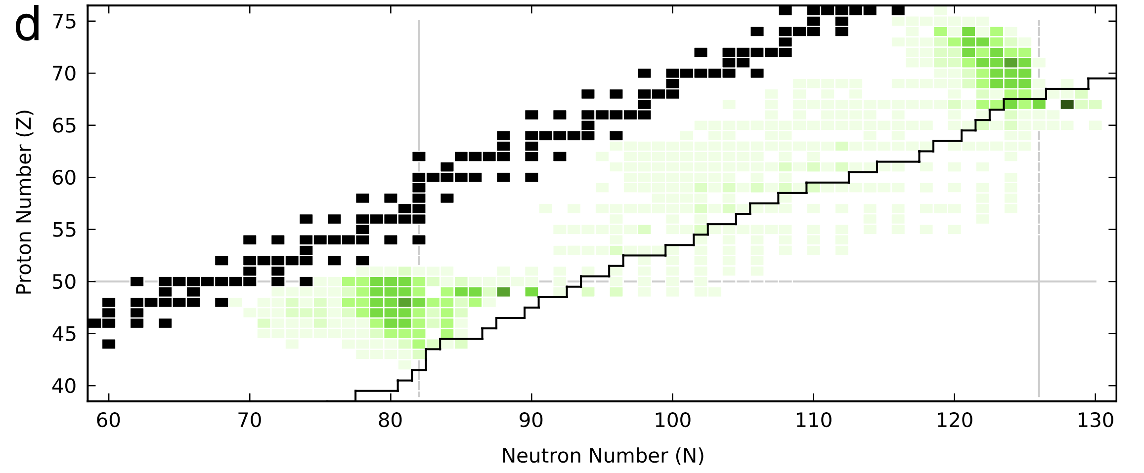
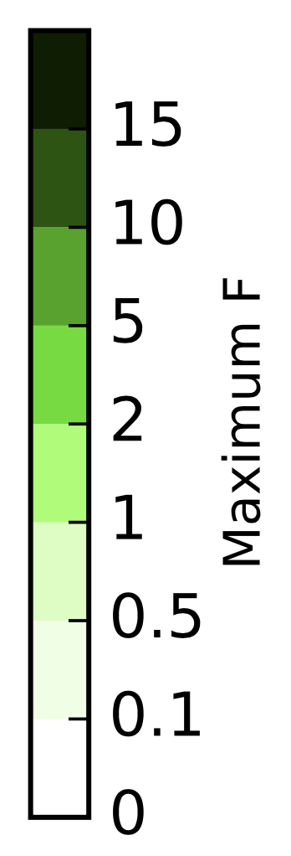
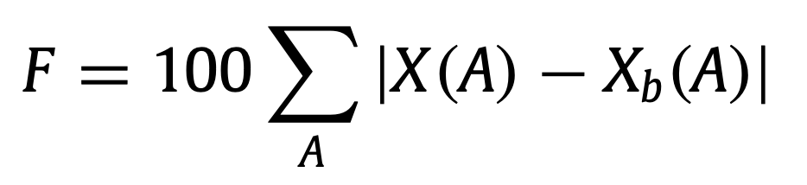
Neutron capture rates far from stability
direct measurements of n-capture rates for high-impact r-process nuclei not feasible in the next “X” years
Neutron Star Merger
rates at FRIB: a few pps
→ Too low beam intensity for reaction-based techniques, inverse Oslo, surrogate, …
Mumpower et al., Progress in Particle and Nuclear Physics 86 (2016) 86–126
Dennis Mücher, Univ. of Cologne muecher@ikp.uni-koeln.de NPA-X Sep 7th 2022
Notes:
With this proposal we would like to contribute understanding the r-process in more detail. For example, although heavy element formation has now been observed, doppler shifts prevent to disentangle the exact abundance distribution in this event.
As we all know, different properties of r-process nuclei directly impact the abundance distribution, like….

Slide 3
Neutron Capture Rates within the Statistical Model
(n,γ)
Hauser – Feshbach
Nuclear Level Density (NLD)
γ-ray strength function (γSF)
Optical model potential
(A-1, Z)
γ
(A, Z)
Dennis Mücher, Univ. of Cologne muecher@ikp.uni-koeln.de NPA-X Sep 7th 2022

Slide 4
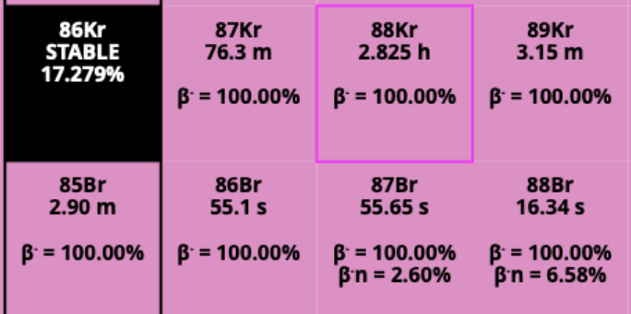
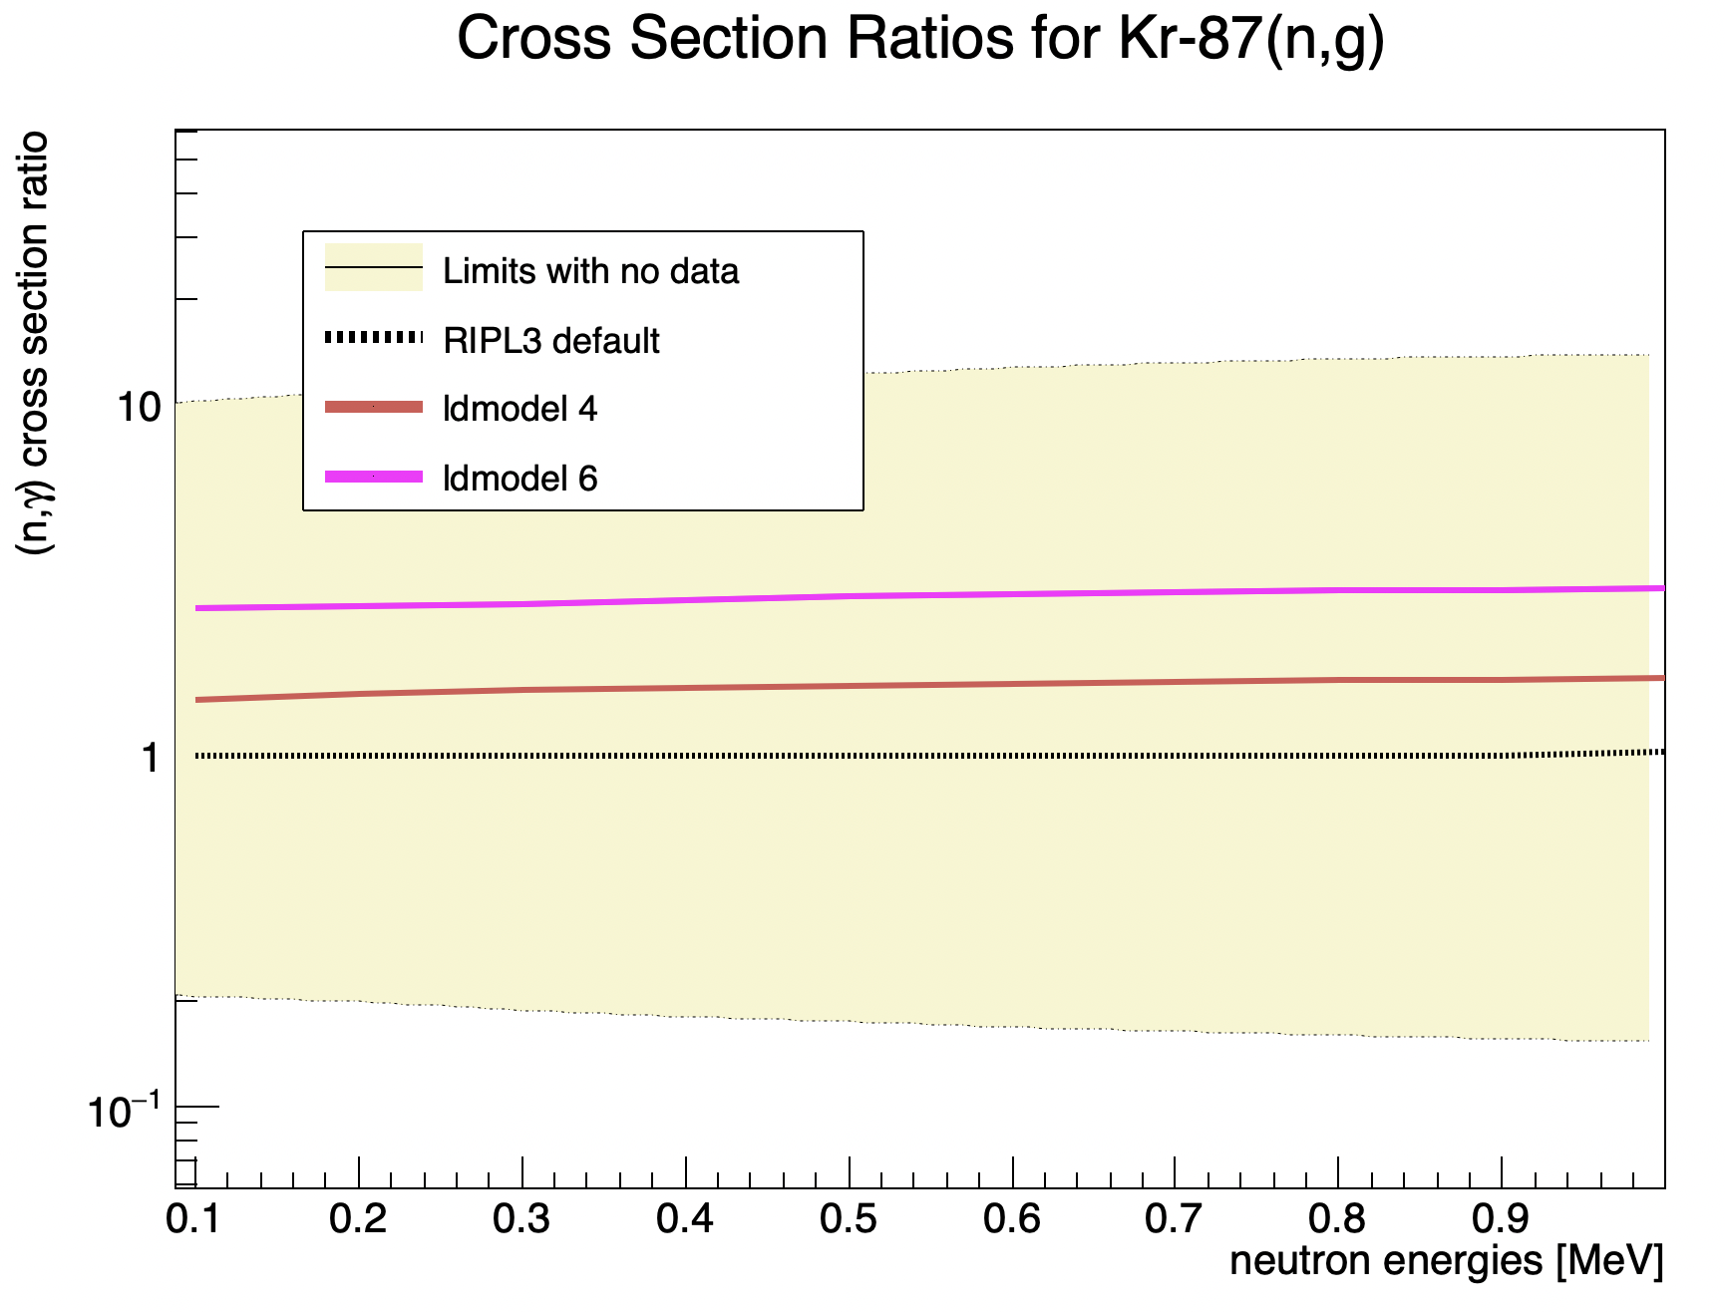
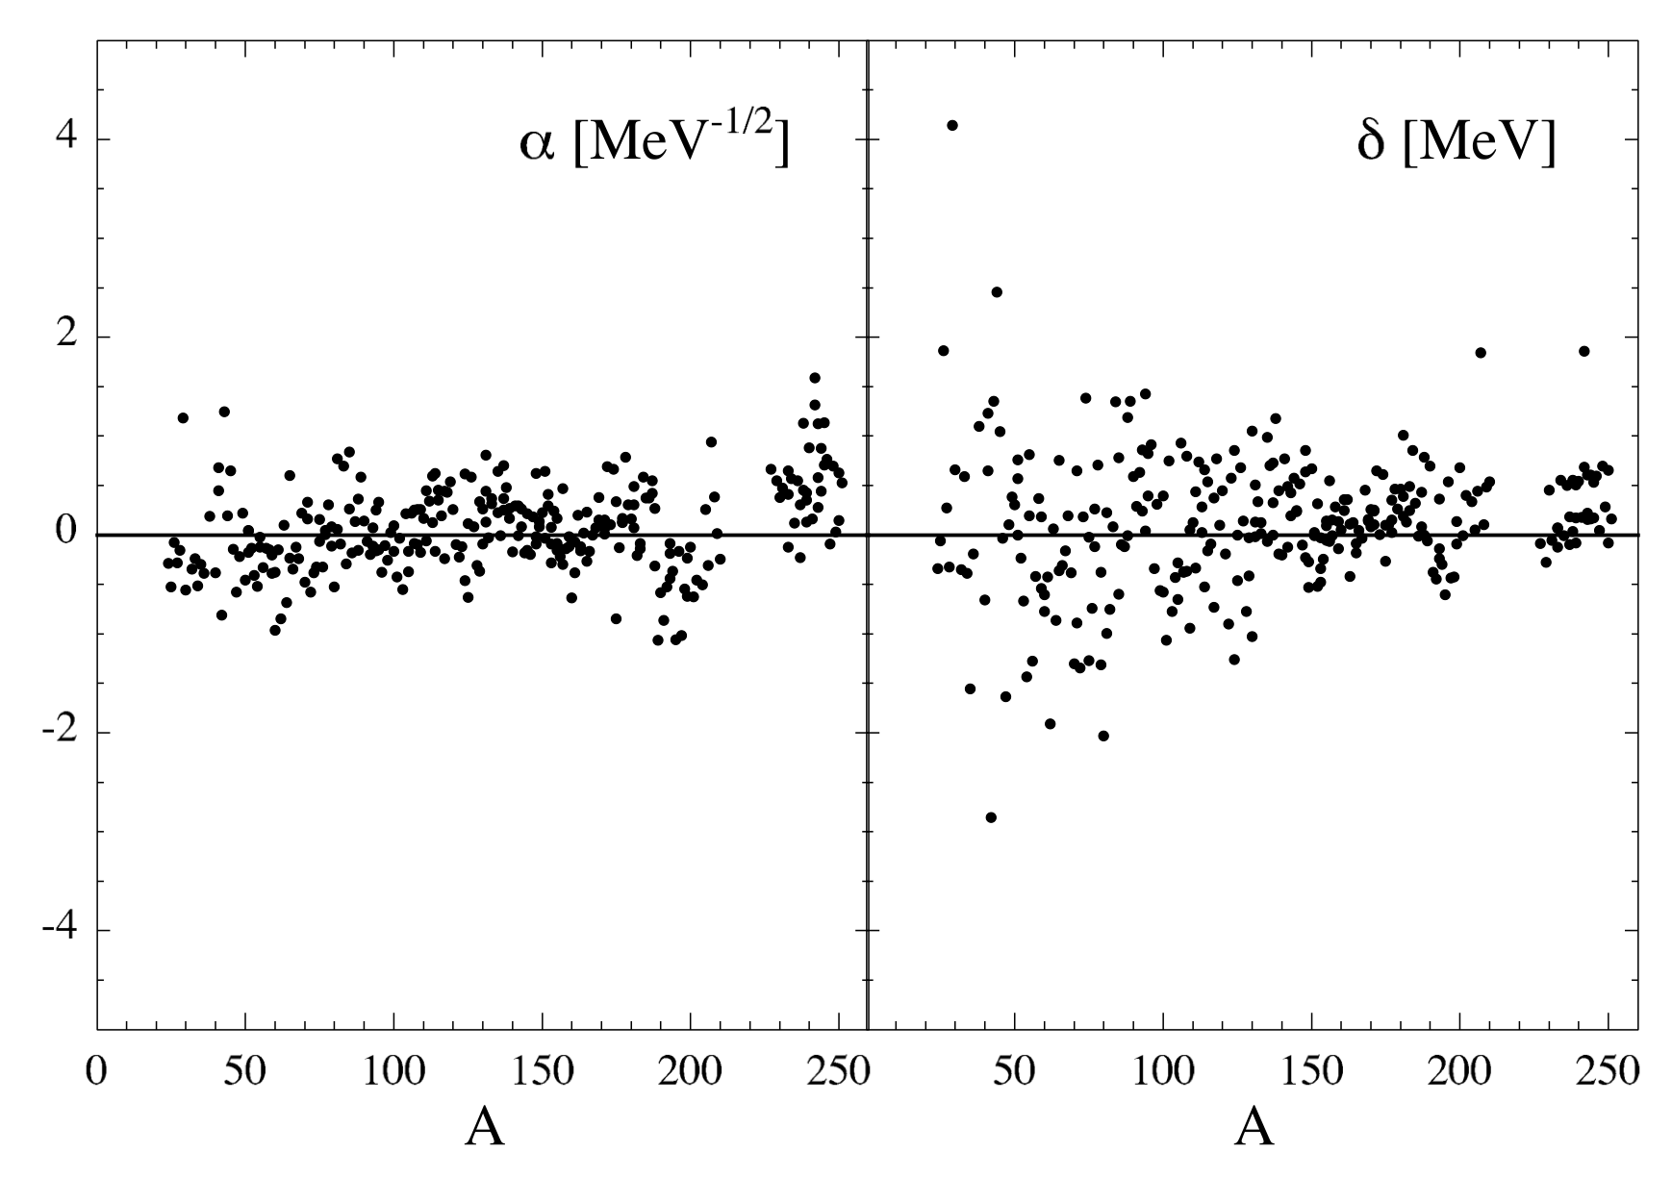

Uncertainty n-capture from level density models
S. Goriely, S. Hilaire and A. J. Koning
PRC 78, 064307 (2008)
Dennis Mücher, Univ. of Cologne muecher@ikp.uni-koeln.de NPA-X Sep 7th 2022

Slide 5
Conclusion I
Uncertainties of n-capture rates away from stability are up to two orders of magnitude, and larger than suggested when just comparing different (TALYS) models.
Dennis Mücher, Univ. of Cologne muecher@ikp.uni-koeln.de NPA-X Sep 7th 2022

Slide 6
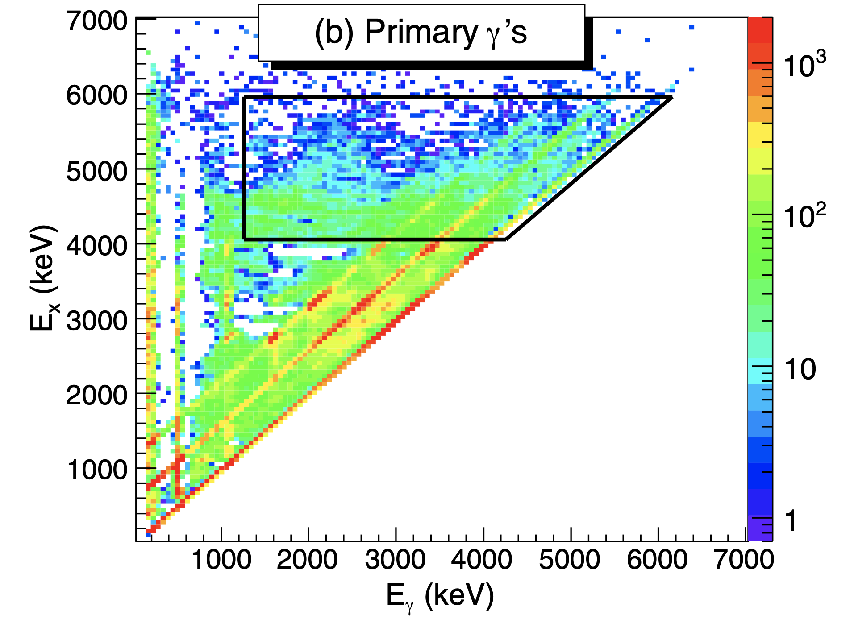

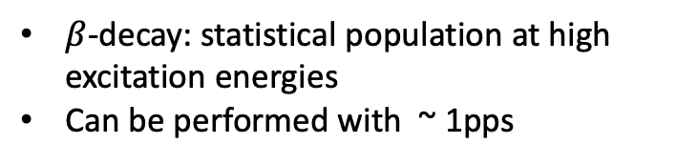
The $β$-Oslo technique
$β$-decay: statistical population at high excitation energies
Can be performed with ~ 1pps
β⁻
(n,γ)
(A, Z-1)
(A-1, Z)
γ
(A, Z)
A. Spyrou et al., PRL 113, 232502 (2014)
Dennis Mücher, Univ. of Cologne muecher@ikp.uni-koeln.de NPA-X Sep 7th 2022

Slide 7
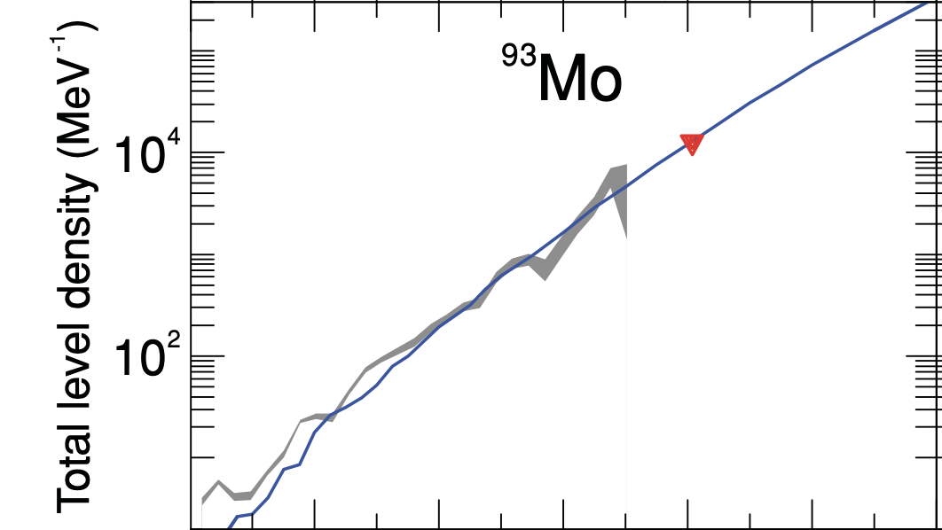
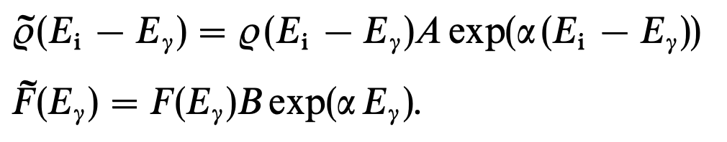
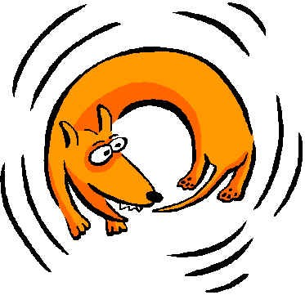
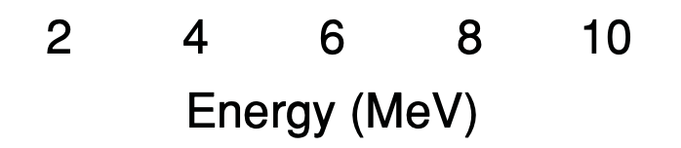
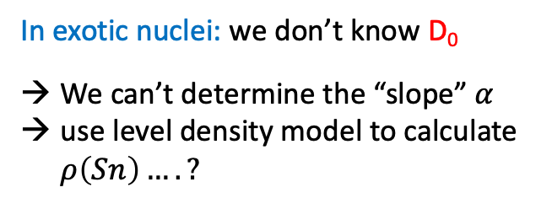
Level densities via the Oslo Method
Oslo-Data
In exotic nuclei: we don’t know D₀
We can’t determine the “slope” $α$
use level density model to calculate $ρ\left(Sn\right)….?$
from D₀
S. Goriely, S. Hilaire and A. J. Koning
PRC 78, 064307 (2008)
Dennis Mücher, Univ. of Cologne muecher@ikp.uni-koeln.de NPA-X Sep 7th 2022

Slide 8
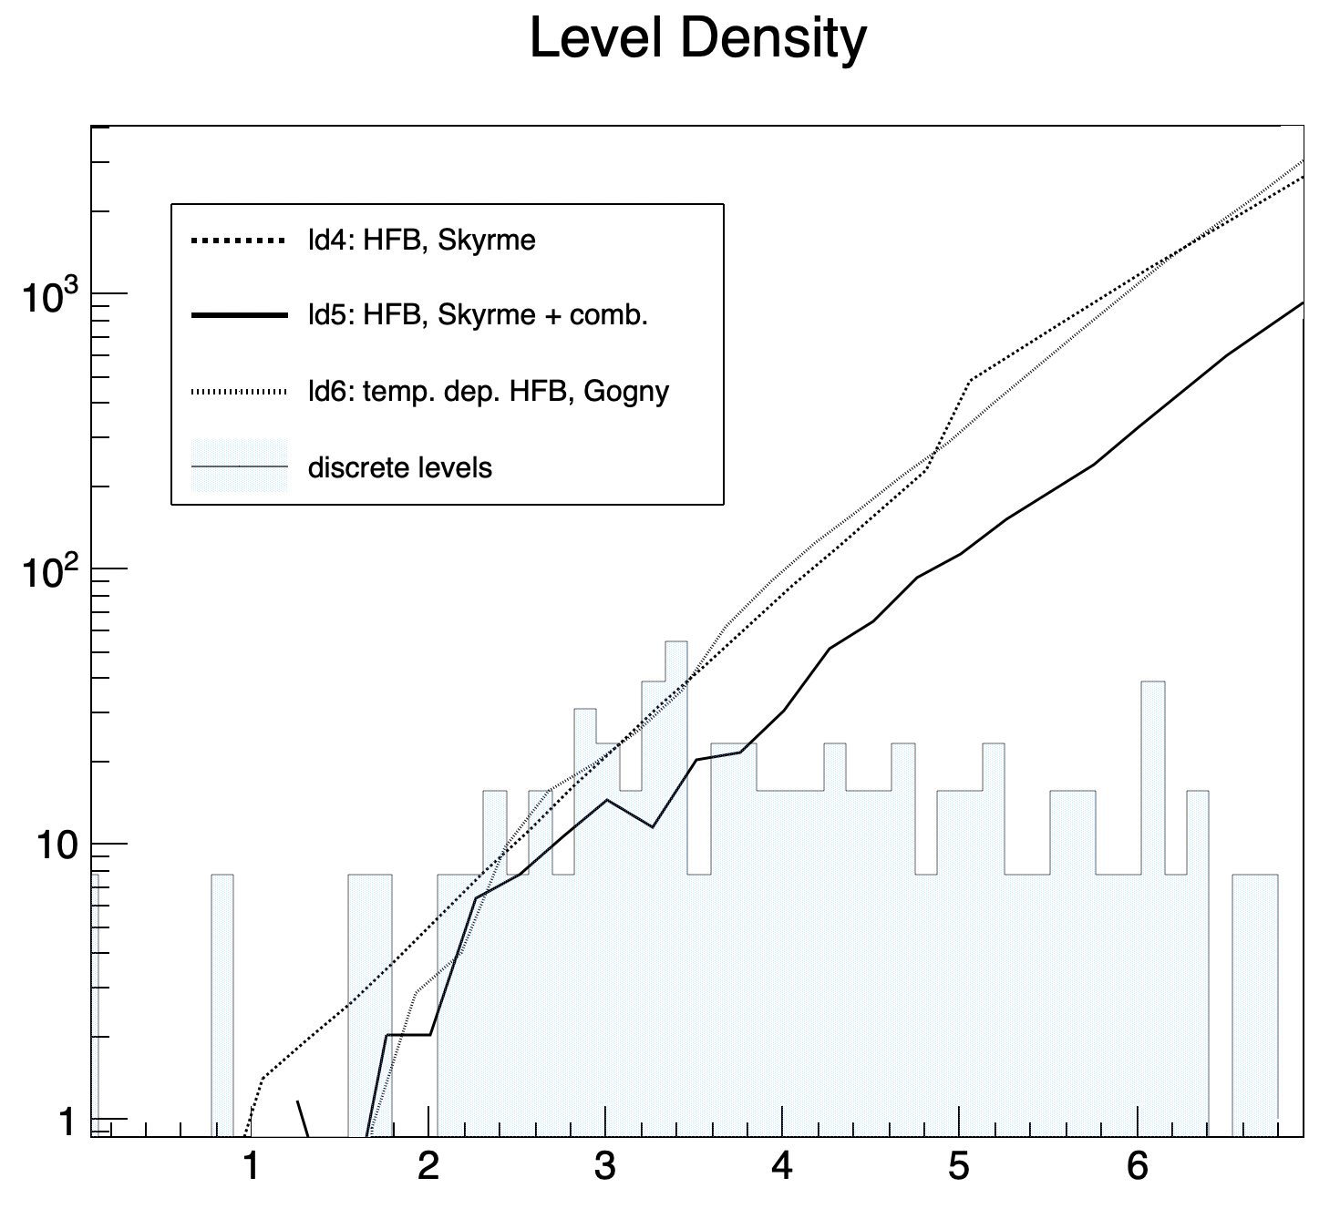
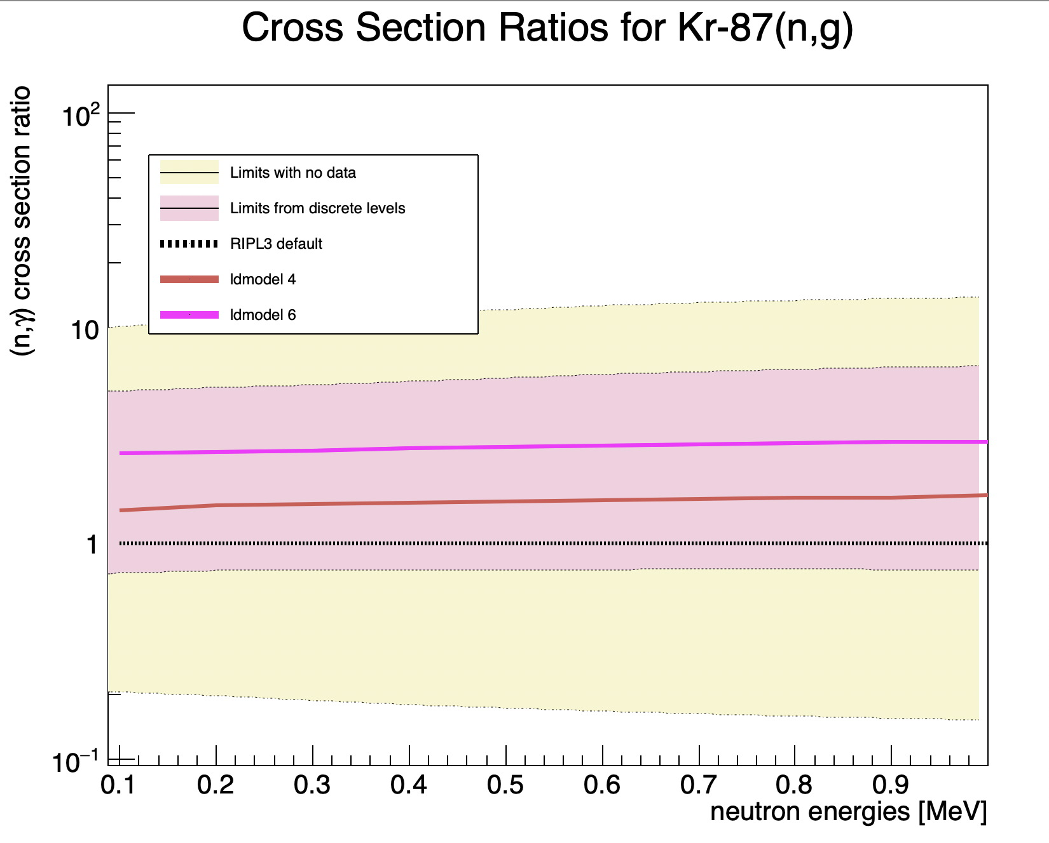
Guidance from discrete levels
⁸⁸Kr
Dennis Mücher, Univ. of Cologne muecher@ikp.uni-koeln.de NPA-X Sep 7th 2022

Slide 9
Conclusion II
Already the measurement of a few discrete states at low excitation energies allows for a significant reduction in neutron capture uncertainties in exotic nuclei.
Dennis Mücher, Univ. of Cologne muecher@ikp.uni-koeln.de NPA-X Sep 7th 2022

Slide 10
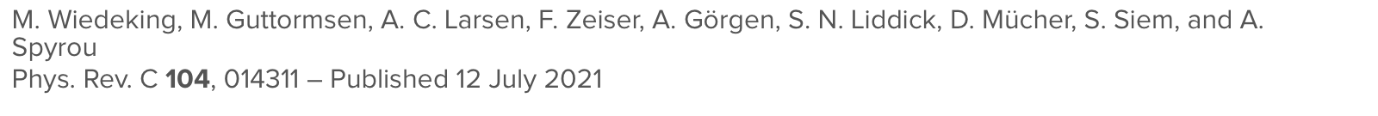
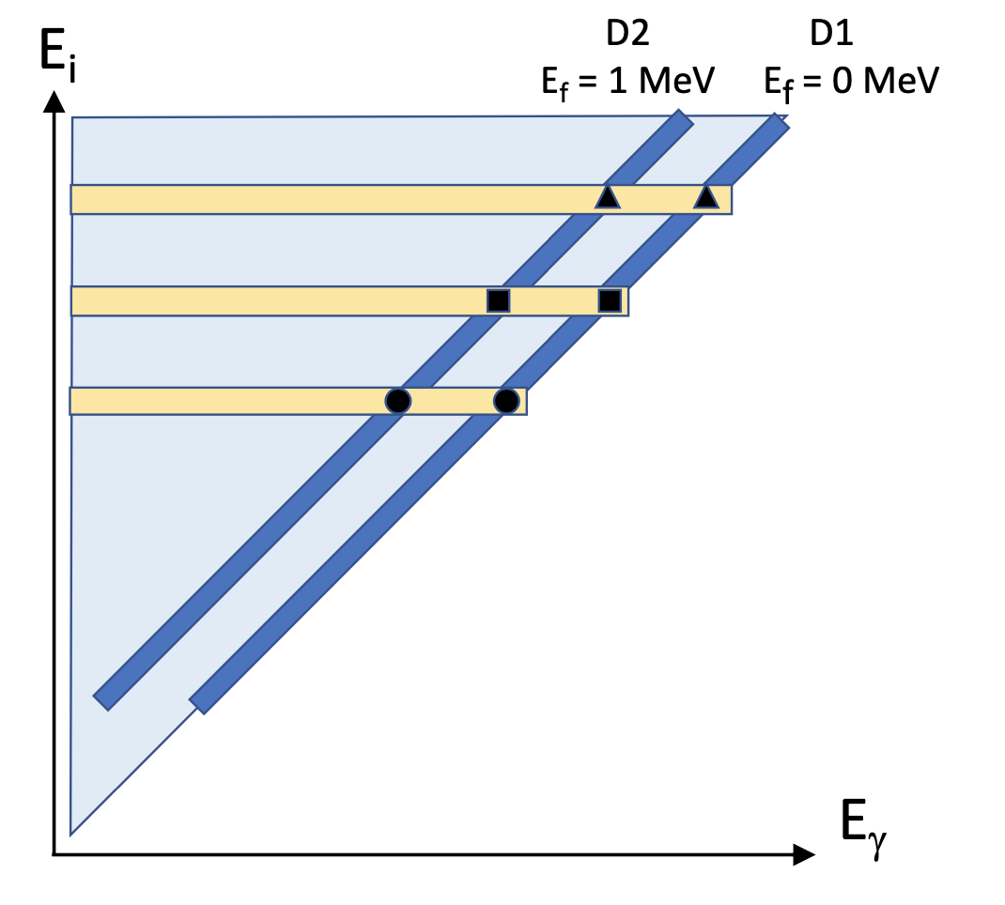
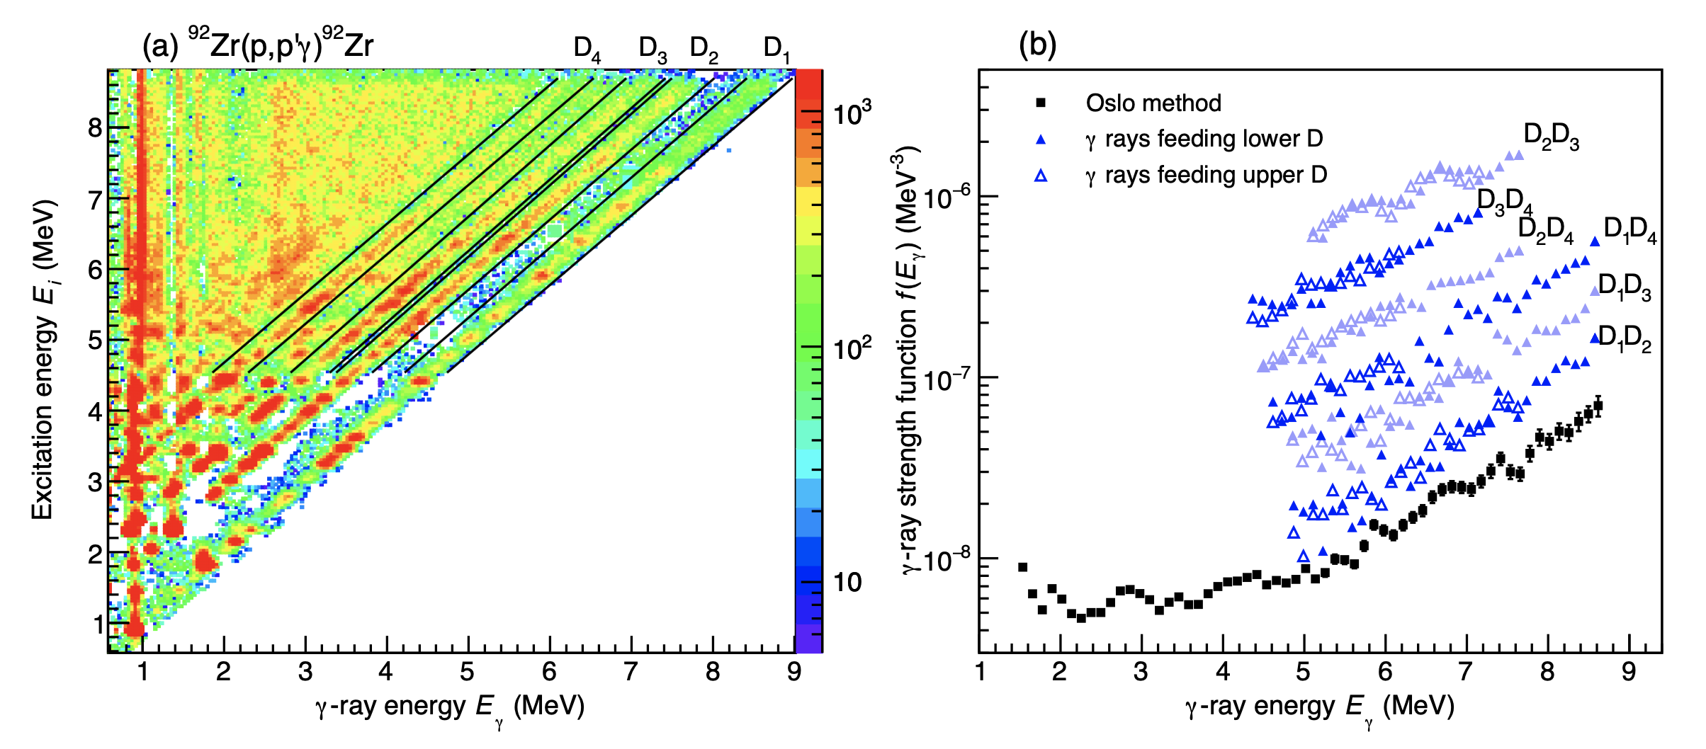
The Shape Method
idea: apply to unstable nuclei & combine with Oslo method!
Dennis Mücher, Univ. of Cologne muecher@ikp.uni-koeln.de NPA-X Sep 7th 2022

Slide 11
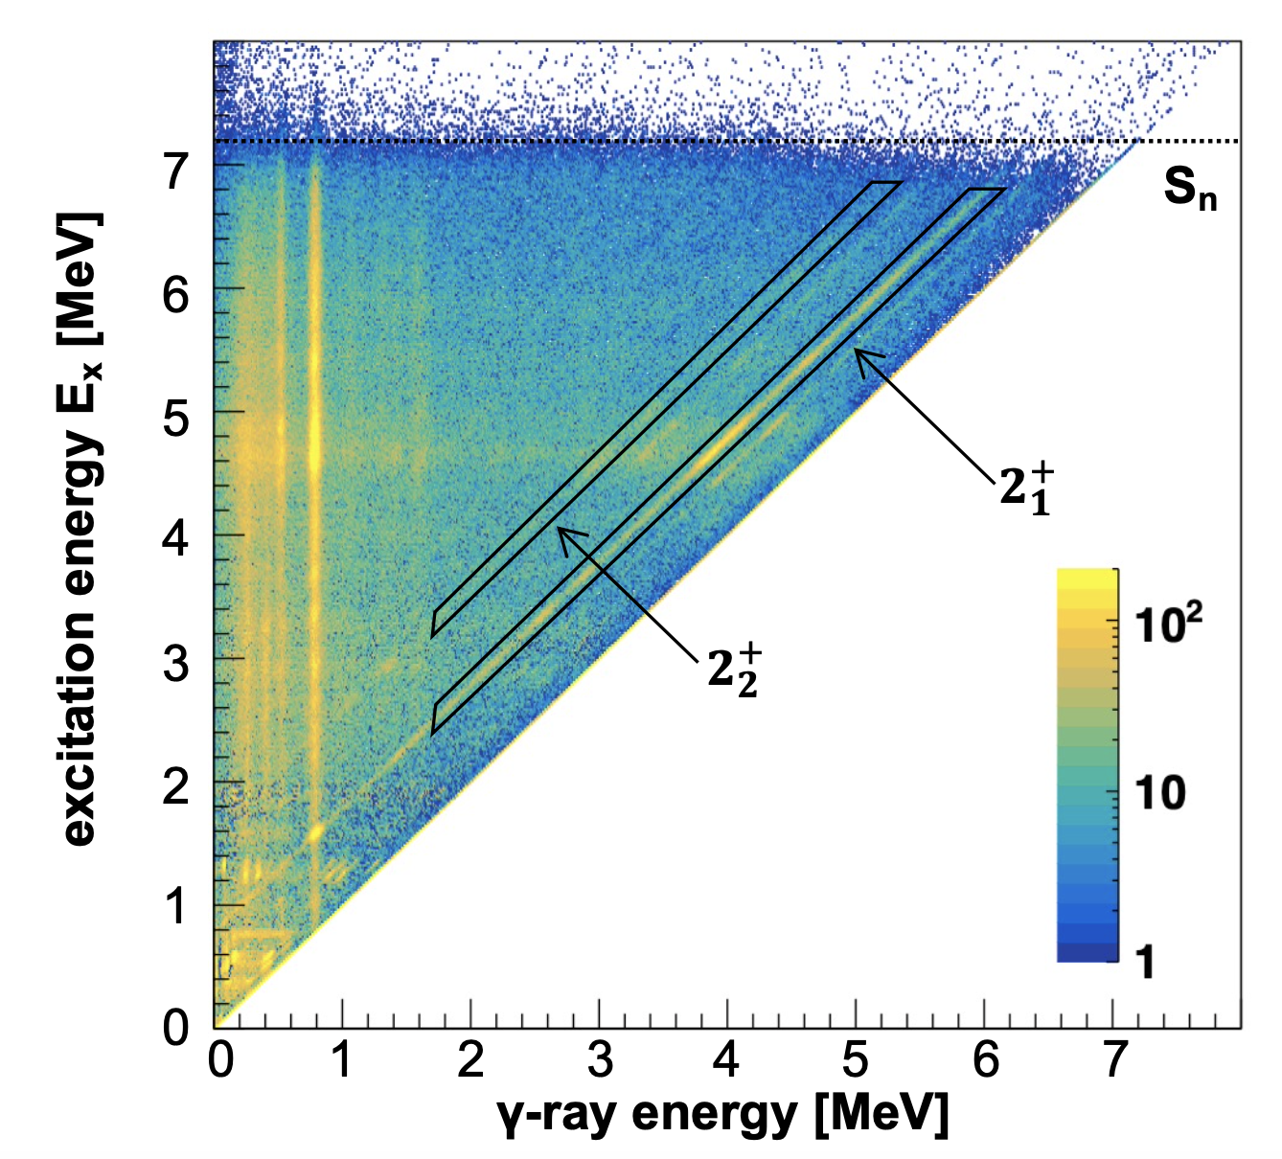
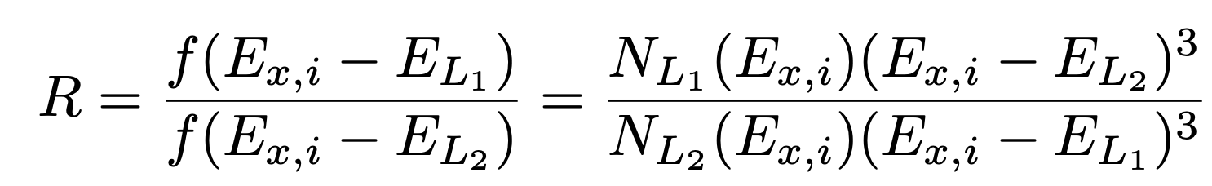
The Shape Method
Integration bin with sufficient number of states
2⁺
⁸⁸Br->⁸⁸Kr
Data from SuN @ CARIBU
2⁺
Dennis Mücher, Univ. of Cologne muecher@ikp.uni-koeln.de NPA-X Sep 7th 2022

Slide 12
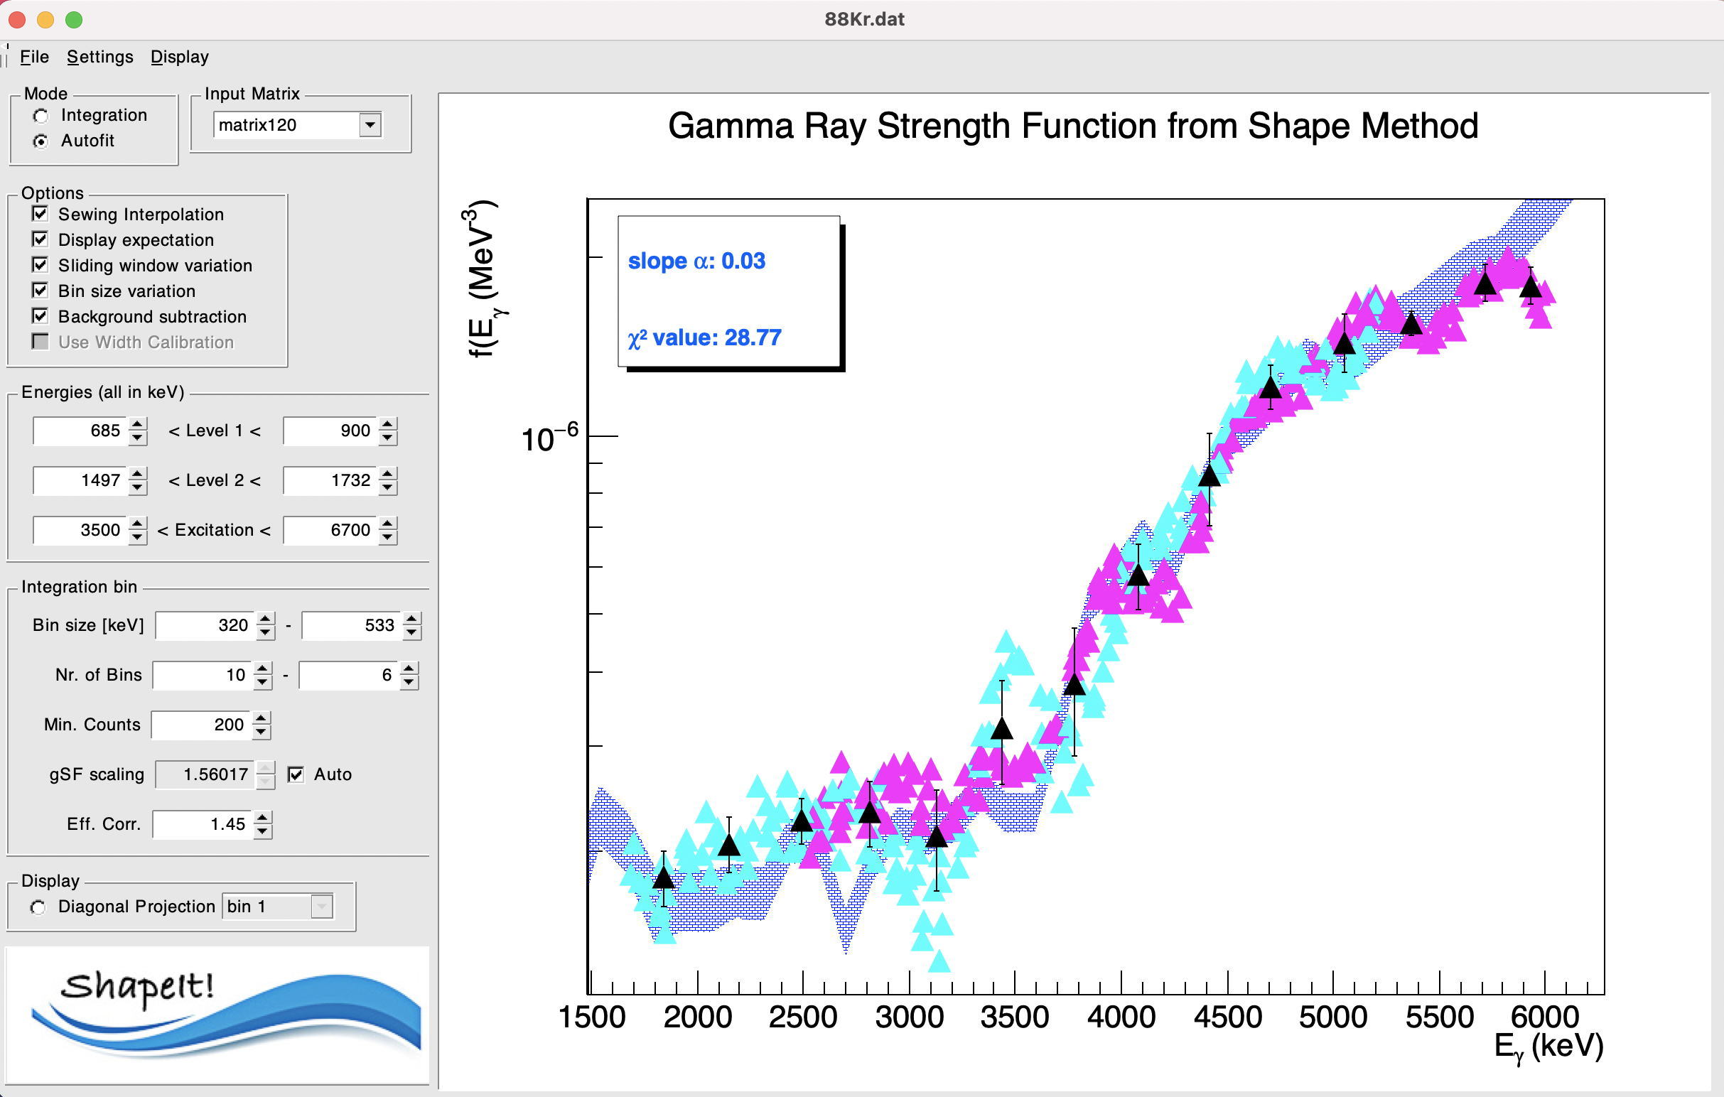
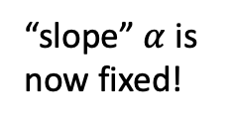
ShapeIt!
Open source: https://github.com/dennismuecher/ShapeIt
C++, based on ROOT framework
platform independent
Autofit & integration mode w/o background subtraction
Quantifies robustness of results due to fluctuations
Monte-Carlo-based uncertainty analysis of “slope” of gSF
Extraction of absolute partial level densities
TALYS intgeration
“slope” $α$ is now fixed!
Dennis Mücher, Univ. of Cologne muecher@ikp.uni-koeln.de NPA-X Sep 7th 2022

Slide 13
absolute (partial) NLD in unstable nucleus
⁸⁸Kr
⁸⁸Kr
D.M, A. Spyrou et al, under review at Phys Rev C Letters
Dennis Mücher, Univ. of Cologne muecher@ikp.uni-koeln.de NPA-X Sep 7th 2022

Slide 14
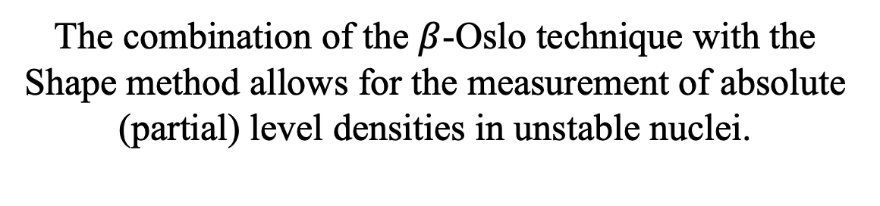
Conclusion III
The combination of the $β$-Oslo technique with the Shape method allows for the measurement of absolute (partial) level densities in unstable nuclei.
Dennis Mücher, Univ. of Cologne muecher@ikp.uni-koeln.de NPA-X Sep 7th 2022

Slide 15
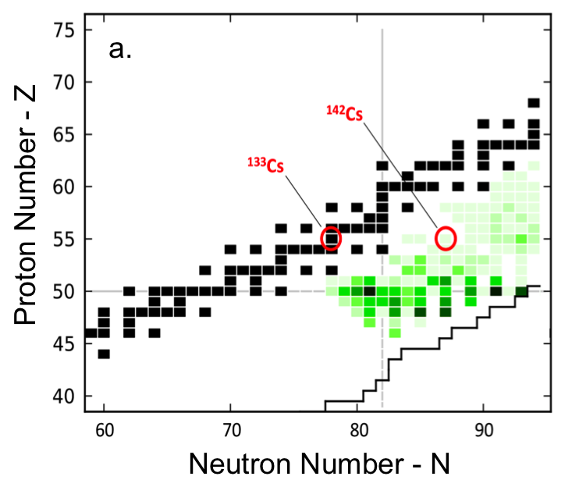
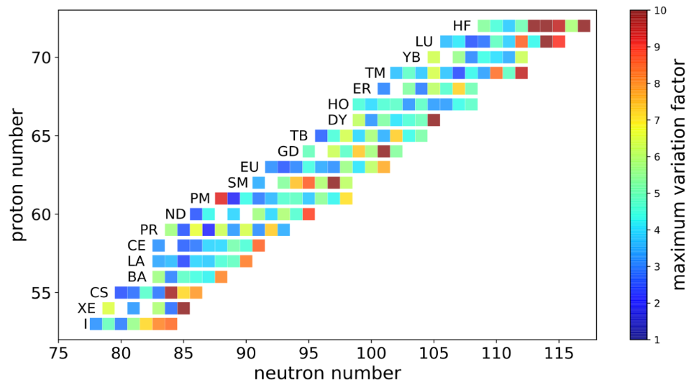
What’s next?
i-process studied using CARIBU (ANL)+SuN
19.-22. July 2022
¹³⁹Ba
¹⁴⁰Ba
See talk by A. Spyrou this afternoon
β⁻
(n,γ)
r-process constraints at TRIUMF using TIGRESS + EMMA
¹⁴⁰Cs
Dennis Mücher, Univ. of Cologne muecher@ikp.uni-koeln.de NPA-X Sep 7th 2022

Slide 16
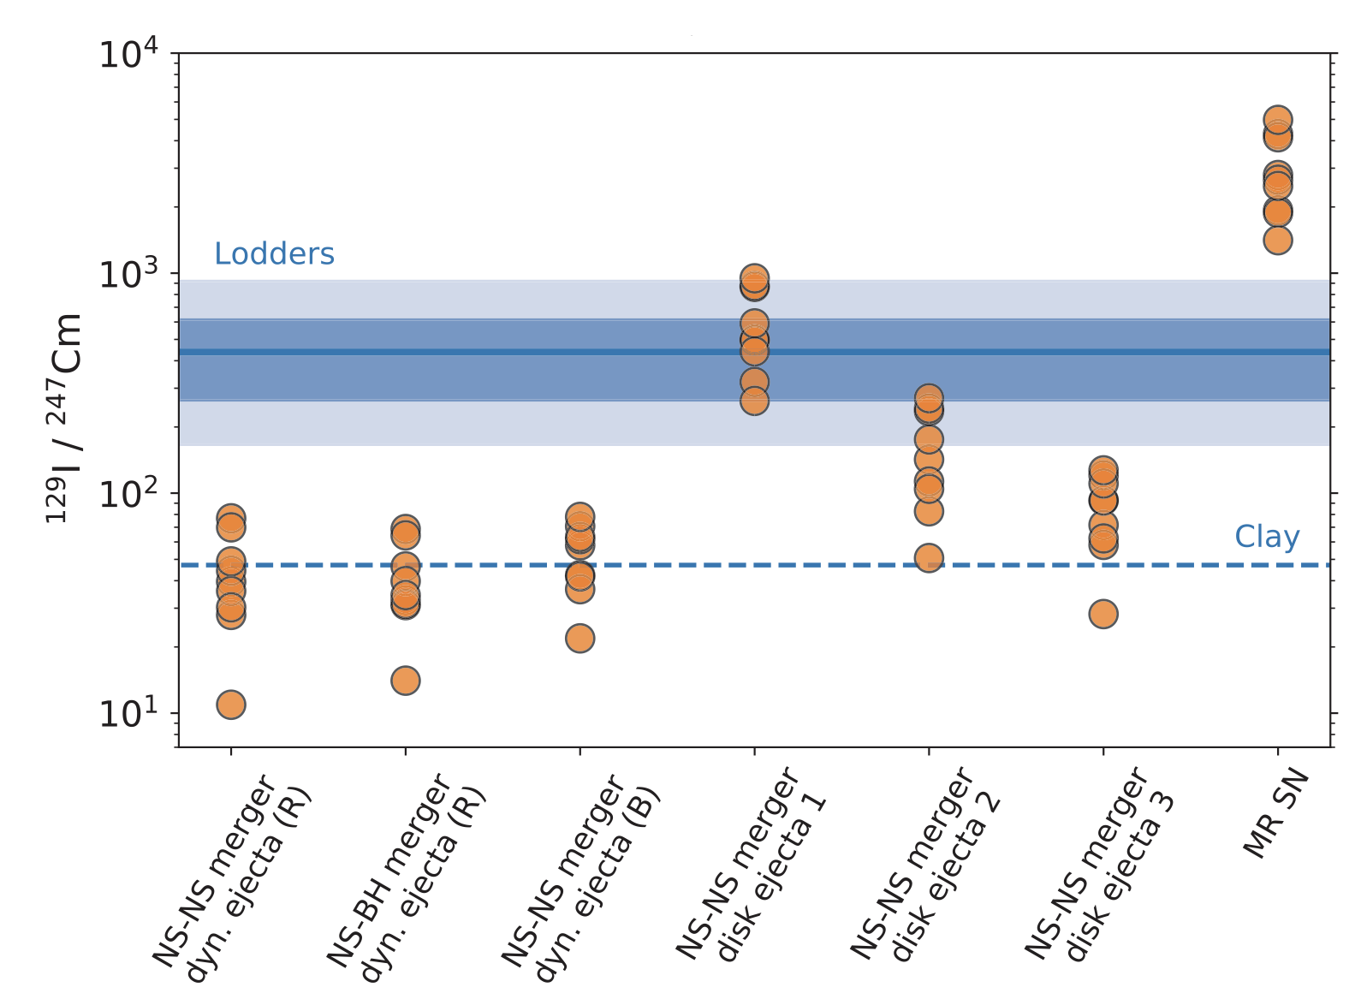
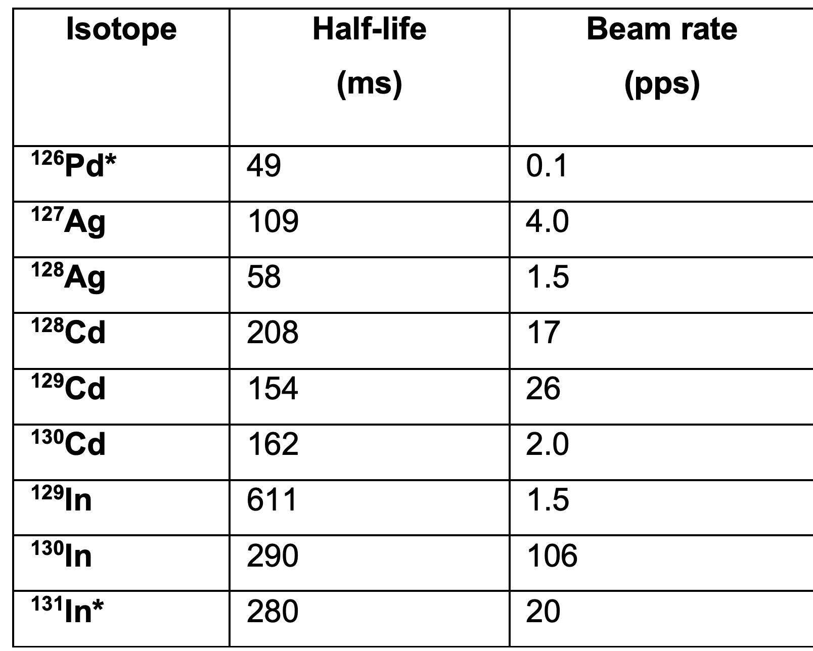
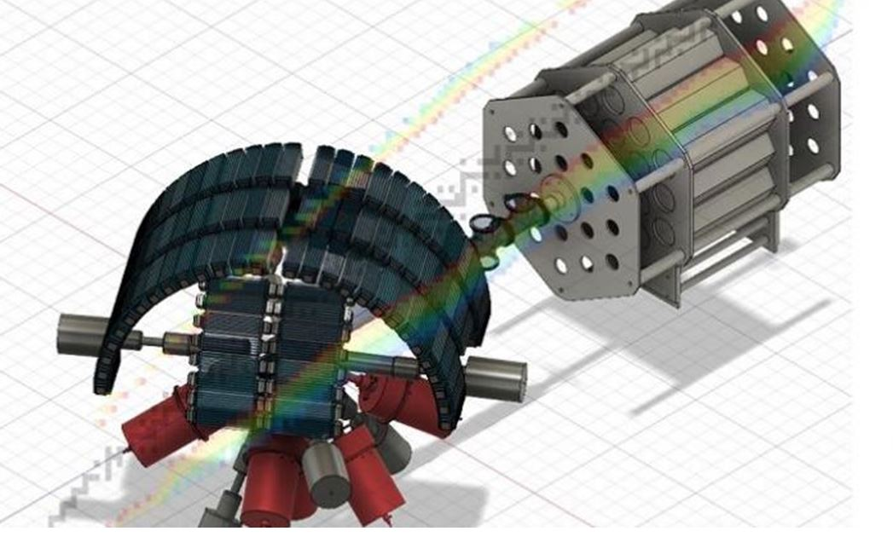
N=82 nuclei at FRIB
Reactions that impact the production of ¹²⁹I
B. Cote et al, Science 2021
¹²⁹I/²⁴⁷Cm
Proposal approved at FRIB by A. Spyrou, DM
Mumpower/Surman et al
FRIB Decay Station
→ Too low beam intensity for reaction-based techniques, inverse Oslo, surrogate, …
MTAS
Dennis Mücher, Univ. of Cologne muecher@ikp.uni-koeln.de NPA-X Sep 7th 2022

Slide 17



Thank you!
A. Spyrou, M. Wiedeking, A. C. Larsen, M. Guttormsen
+ SuN + ANL + TRIUMF + …
Dennis Mücher, Univ. of Cologne muecher@ikp.uni-koeln.de NPA-X Sep 7th 2022

Slide 18
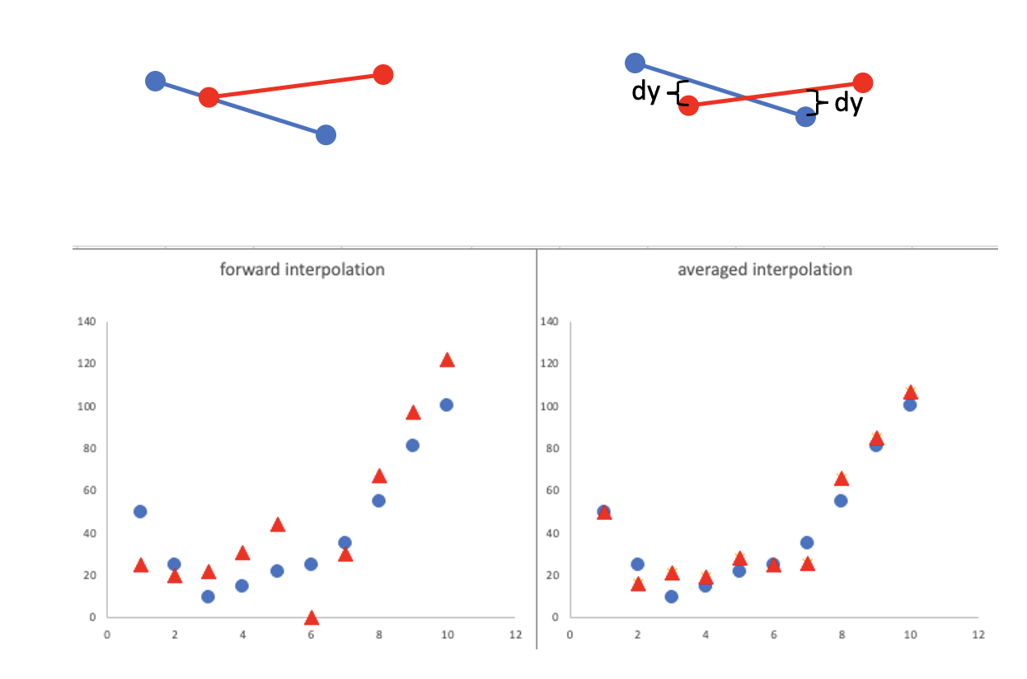
Sewing: a numerical problem
”forward” sewing
”symmetric” sewing
Sewing reproduction
arbitrary input
Dennis Mücher, Univ. of Cologne muecher@ikp.uni-koeln.de NPA-X Sep 7th 2022

