Slide 1

A global comparison of experimental and theoretical (p,γ)-reaction data relevant for the p process
Felix Heim, Martin Müller, Svenja Wilden, and Andreas Zilges
Institute for Nuclear Physics, University of Cologne, Germany
Nuclear Physics in Astrophysics - X
CERN, Geneva - Switzerland
September 7th, 2022
fheim@ikp.uni-koeln.de
Supported by DFG (ZI 510/8-2)

Slide 2
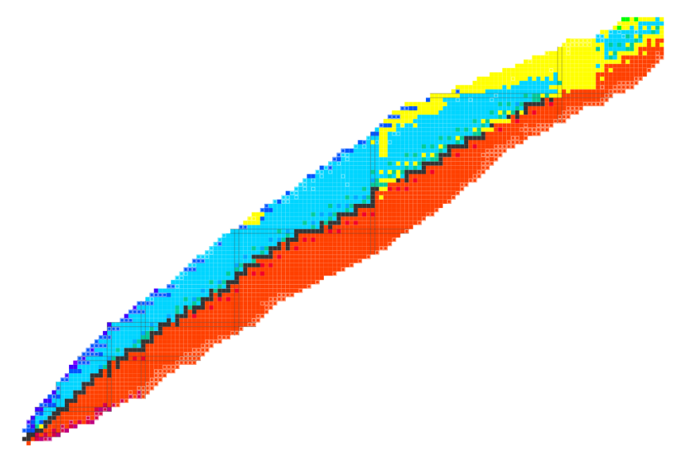
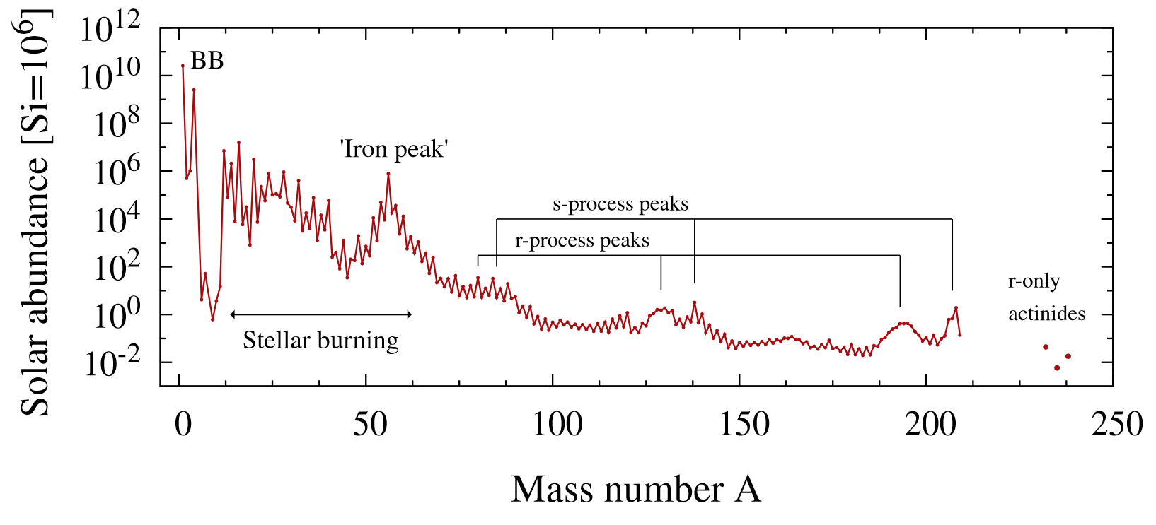
Nuclear Physics and Astrophysics
Data taken from K. Lodders et al. (2009)
82
p process
Fission
Number of Protons
s process
r process
50
rp process
28
20
8
Stellar fusion
Number of Neutrons
2
2
8
20
28
50
82
126
Astrophysics
Nuclear Physics
Temperatures
Neutron densities
Time scale of explosive scenarios
Cross sections and reaction rates
Masses
Half-lives

Slide 3
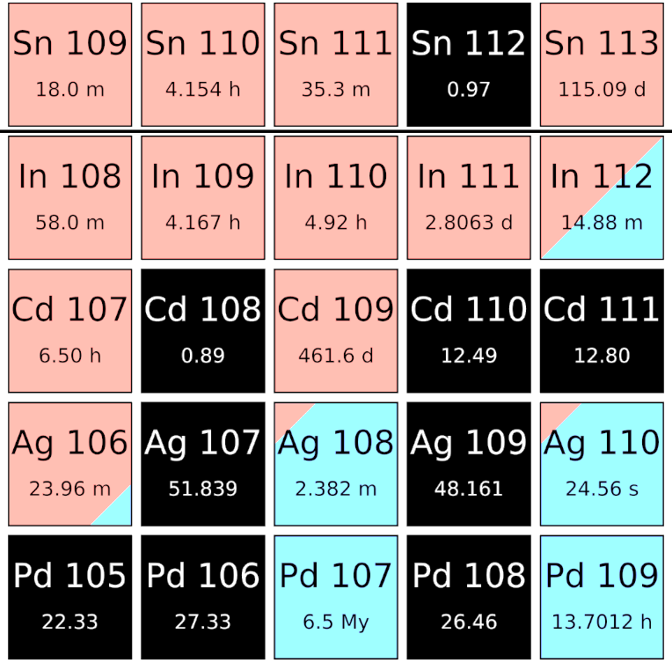
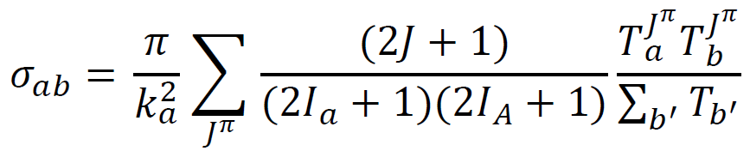
Nucleosynthesis of p isotopes
(γ,n)
(γ,α)
(γ,p)
p nuclei are created by the γ process
Over the whole nuclear chart: thousands of reactions
Abundances determined by (γ,n)-, (γ,p)- and (γ,α)-reaction rates
(p,γ)
(β⁺)
Experimentally constrained reaction-rate data at astrophysical relevant energies required!
Hauser-Feshbach statistical model for theoretical calculations
  Optical-model potentials (OMP)
  Nuclear level densities (NLD)
  γ-ray strength functions

Slide 4
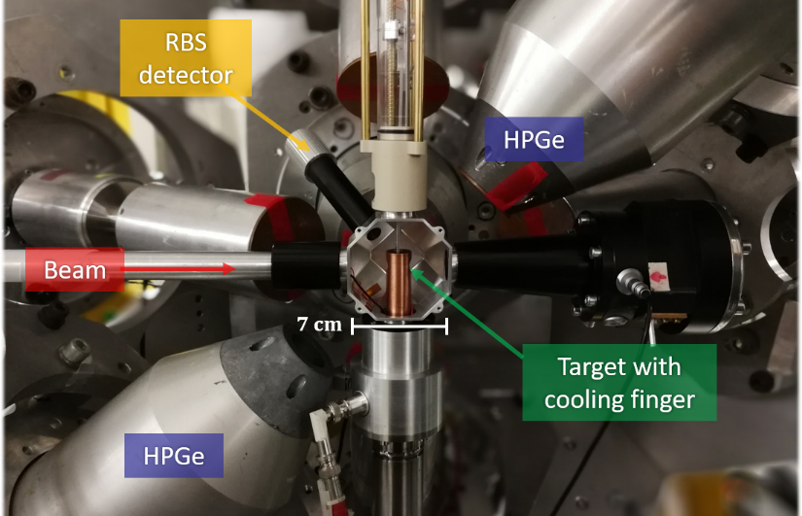
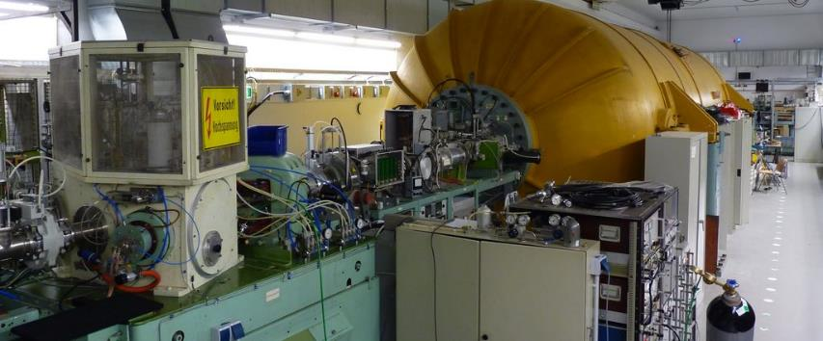
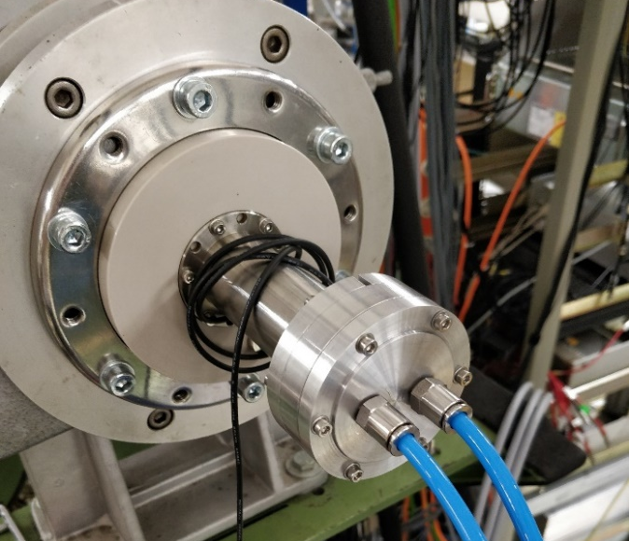
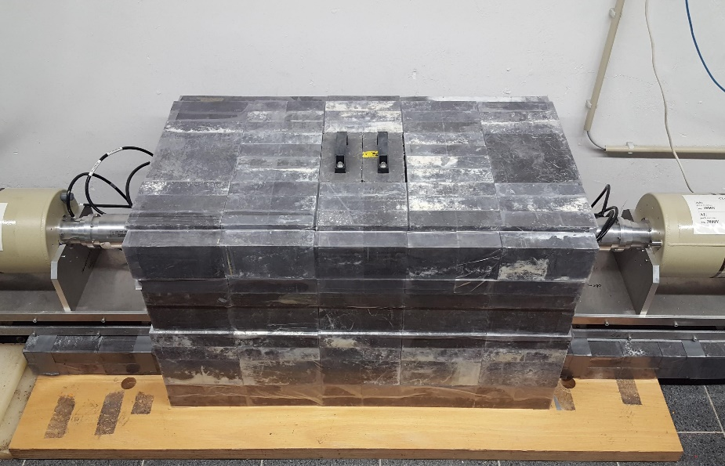
10 MV tandem accelerator and HORUS γ-ray spectrometer
In-beam @ HORUS
10 MV FN-Tandem @ University of Cologne
14 HPGe detectors with total efficiency of 3-4 % @ 1.3 MeV
γγ-coincidence measurements
In-beam ⁸⁷Rb(p,γ)⁸⁸Sr
→ Poster #72 by Svenja Wilden
Activation
10 MV tandem accelerator
  Duoplasmatron (^{3,4}He)
  Sputter source (up to A = 127)
  200 nA (^{3,4}He) to 800 nA (p)
Offline Counting
Activation ^{170,172}Yb(α,n)^{173,175}Hf
→ Poster #80 by Martin Müller

Slide 5
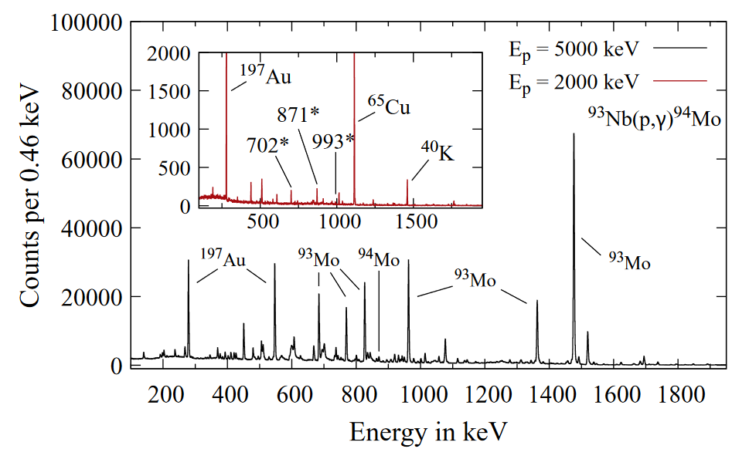
Measured in-beam γ-ray spectra
⁹³Nb(p,γ)⁹⁴Mo
Sum spectrum of 14 HPGe detectors
Main panel: 30 minutes @ 500 nA
F. Heim et al., Phys. Rev. C 101, 035807 (2020)

Slide 6
Measured in-beam γ-ray spectra
⁹³Nb(p,γ)⁹⁴Mo
Sum spectrum of 14 HPGe detectors
Main panel: 30 minutes @ 500 nA
Inner panel: 2 hours @ 800 nA
F. Heim et al., Phys. Rev. C 101, 035807 (2020)

Slide 7
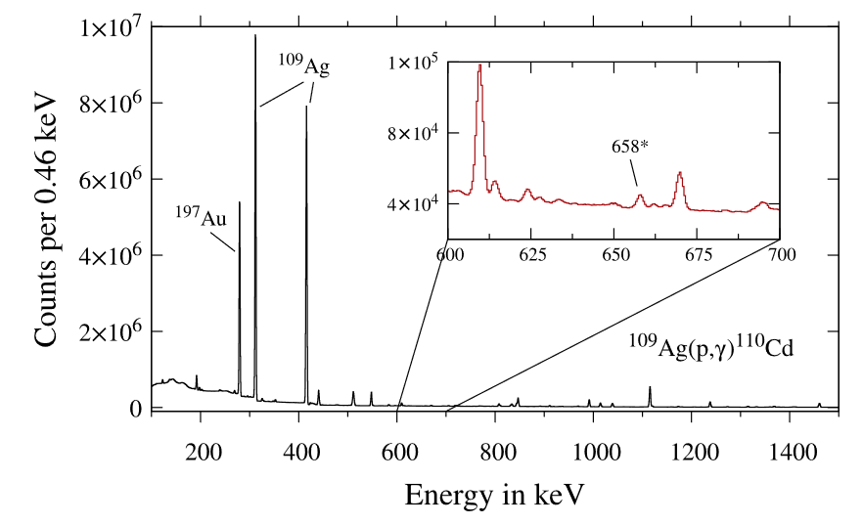
Measured in-beam γ-ray spectra
⁹³Nb(p,γ)⁹⁴Mo
¹⁰⁹Ag(p,γ)¹¹⁰Cd
Sum spectrum of 14 HPGe detectors
Main panel: 30 minutes @ 500 nA
Inner panel: 2 hours @ 800 nA
Sum spectrum of 14 HPGe detectors
24 hours
610 nA beam intensity
F. Heim et al., Phys. Rev. C 101, 035807 (2020)
F. Heim et al., Phys. Rev. C 103, 055803 (2021)

Slide 8
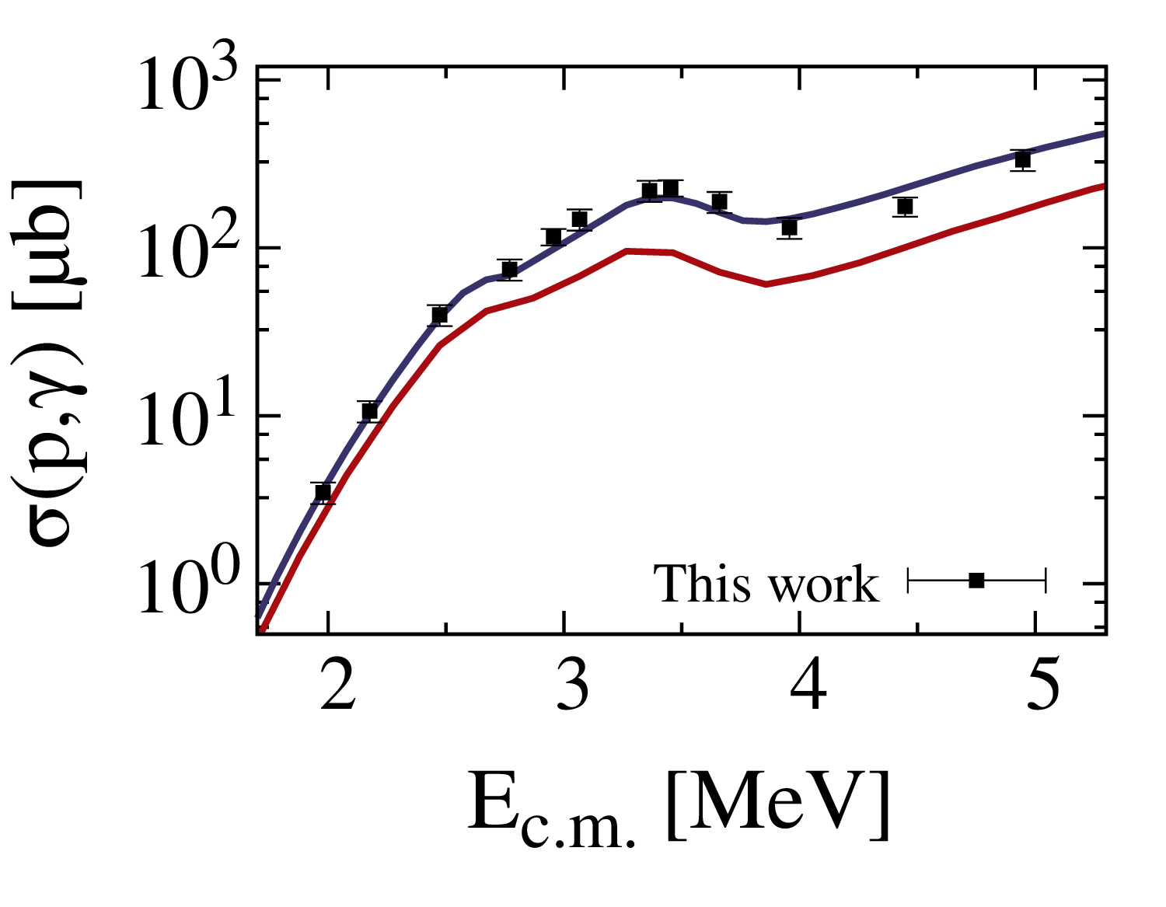
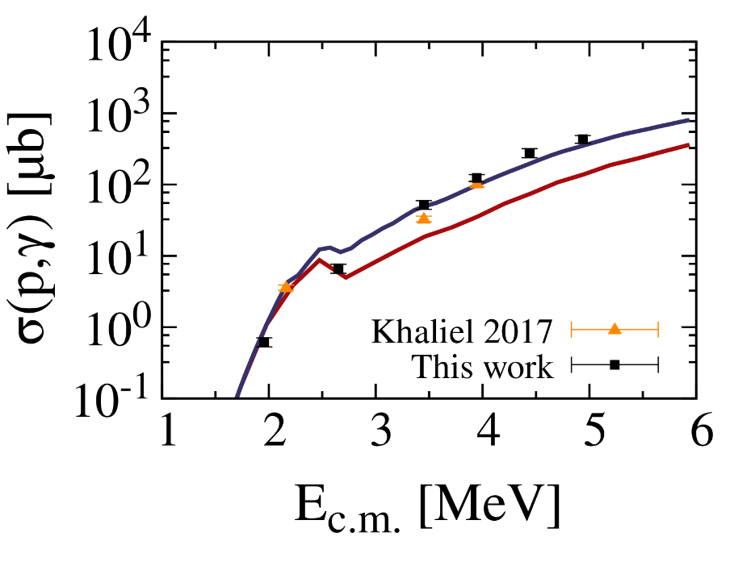
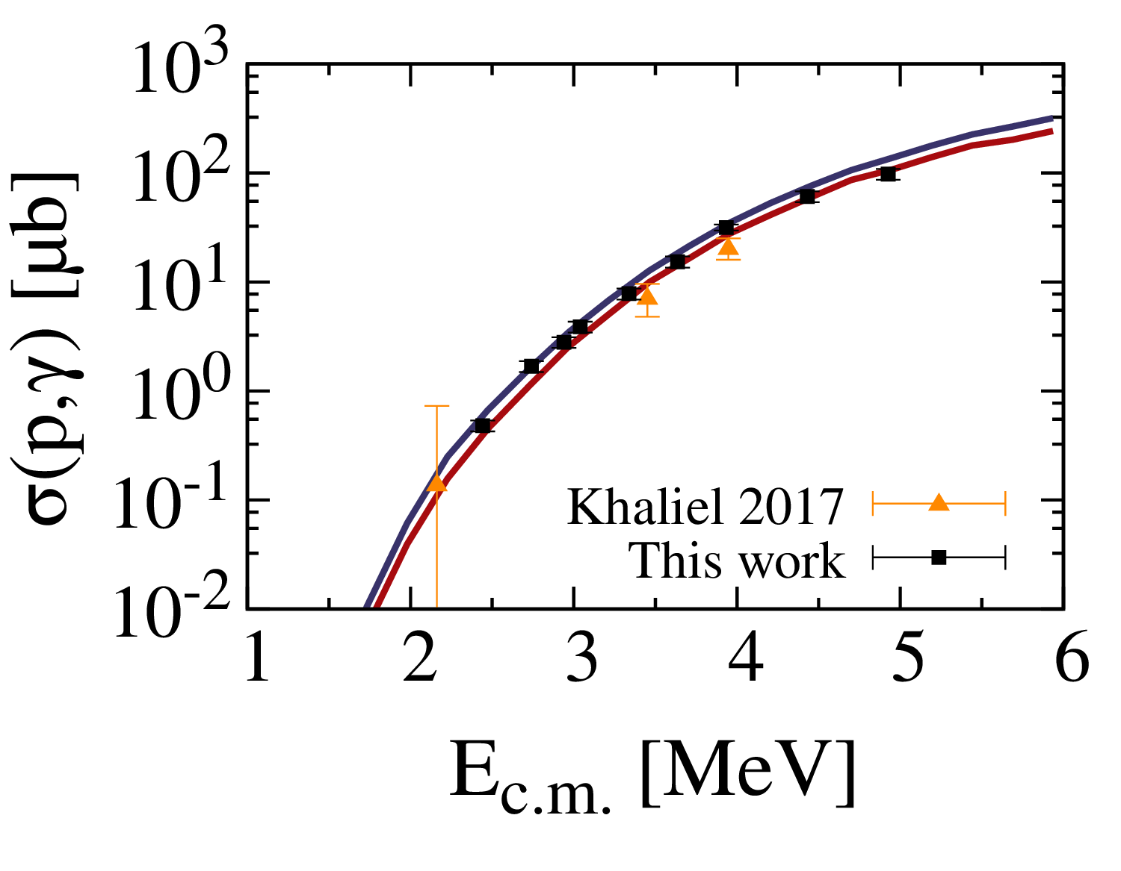
Experimental (p,γ) cross sections from the University of Cologne
⁹³Nb
¹⁰⁷Ag
¹⁰⁹Ag
F. Heim et al., Phys. Rev. C 101, 035807 (2020)
F. Heim et al., Phys. Rev. C 101, 035805 (2020)
F. Heim et al., Phys. Rev. C 103, 055803 (2021)
A. Khaliel et al., Phys. Rev. C 96, 035806 (2017)
→ Instead of testing all available models, a consistent set of models is systematically applied:
Blue:
E1 strength function: Microscopic Gogny-D1M QRPA model
NLD: HFB+Skyrme [14] + renormalization (in ⁹⁴Mo and ¹⁰⁸Cd)
Red:
TALYS default models (Gen. Lorentzian + constant-temperature NLD)

Slide 9
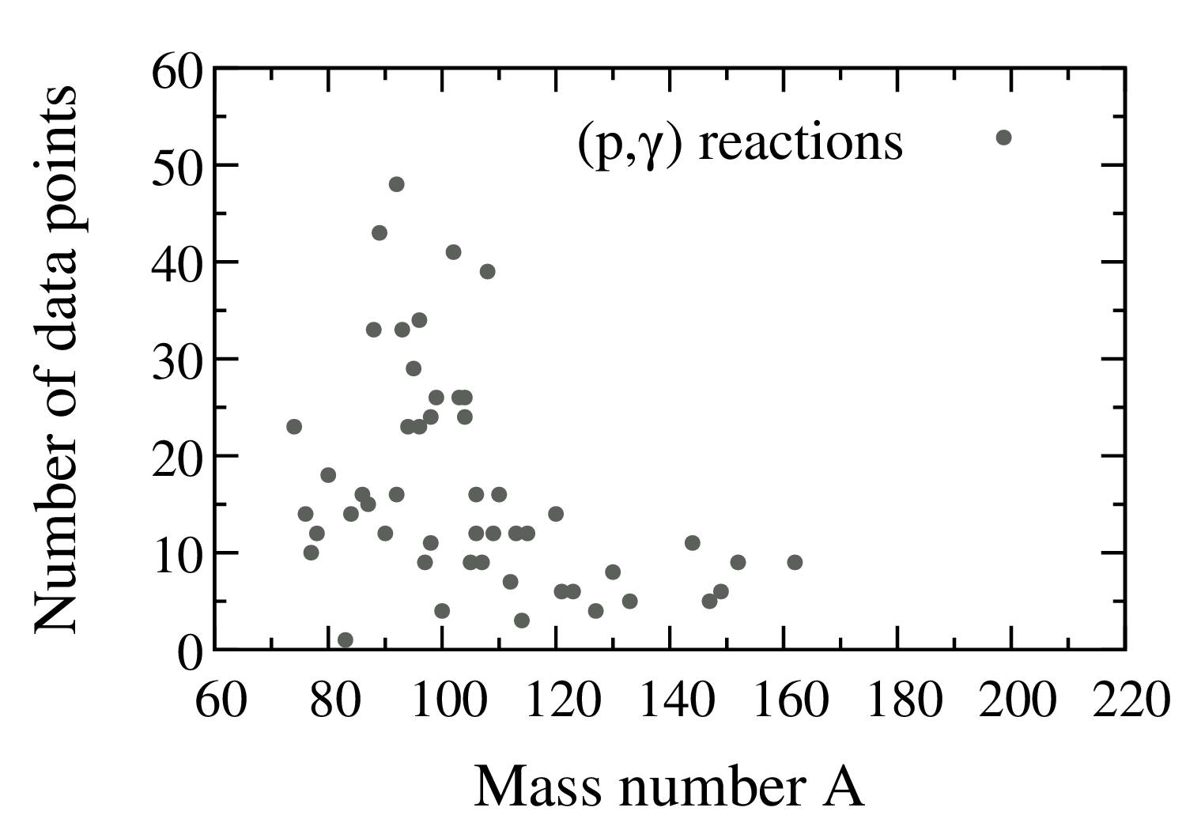
Global overview on (p,γ) reaction data
1 data point ≡ 1 measured beam energy for 1 reaction
90 < A < 110 well studied
For A > 120 very scarce database
See talks by R. Reifarth, I. Dillmann (Monday)
M. Williams (Wednesday)
C. Bruno (Wednesday, 14:00)
S. Dellmann (Friday, 12:15)
51 isotopes
Experiments with radioactive nuclei?
Experiments using inverse kinematics?
How global are available theoretical models?
(p,γ) experiments can give much more than only cross sections!

Slide 10
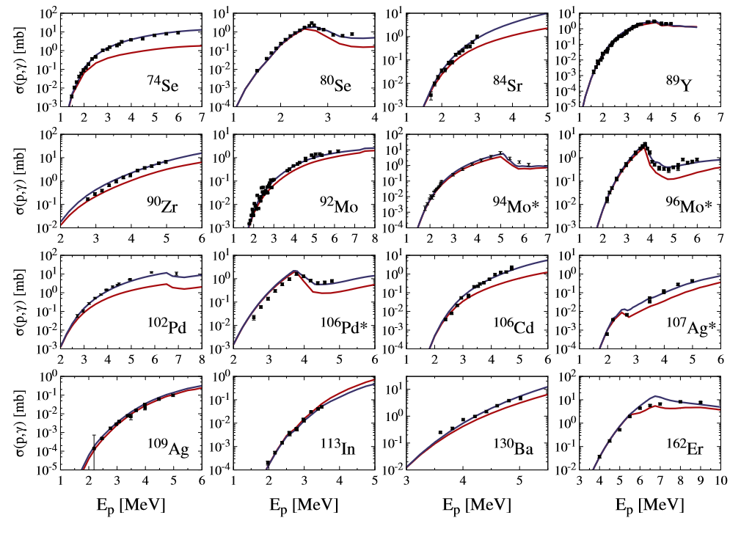
Systematic analysis of (p,γ) reaction data
Red:
TALYS default models
(Gen. Lorentzian + CTM)
J. Kopecky and M. Uhl, Phys. Rev. C 41, 1941 (1990)
A. Gilbert and A. G. W. Cameron, Can. J. Phys. 43, 1446 (1965)
σ(p,γ) [mb]
Blue:
E1: Microscopic Gogny-D1M QRPA model
NLD: HFB+Skyrme (+renormalization with asterisk)
M. Martini et al., Phys. Rev. C 94, 014304 (2016)
S. Goriely et al., Phys. Rev. C 98, 014327 (2018)
S. Hilaire and S. Goriely, Nucl. Phys. A 779, 63 (2006)
S. Goriely, S. Hilaire and A. J. Koning, Phys. Rev. C 78, 064307 (2008)
E_{p} [MeV]

Slide 11
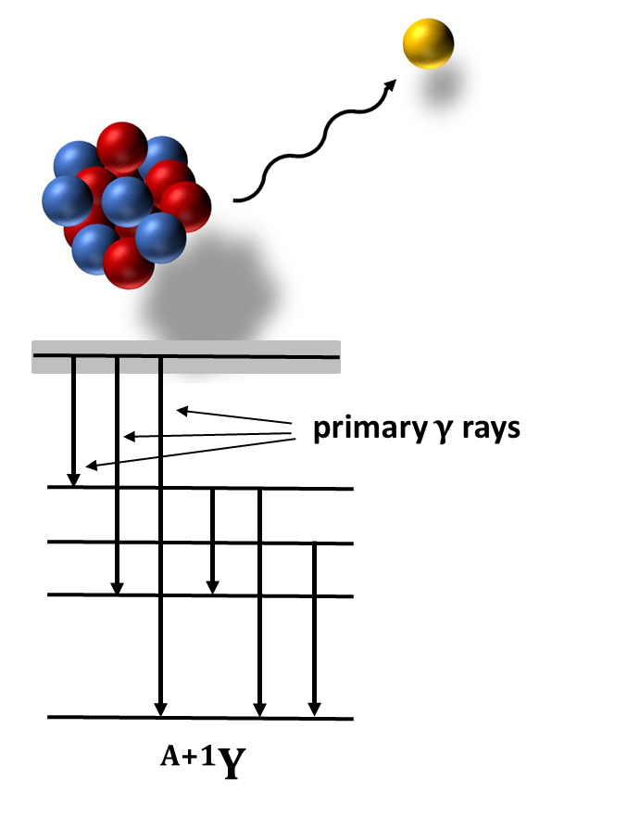
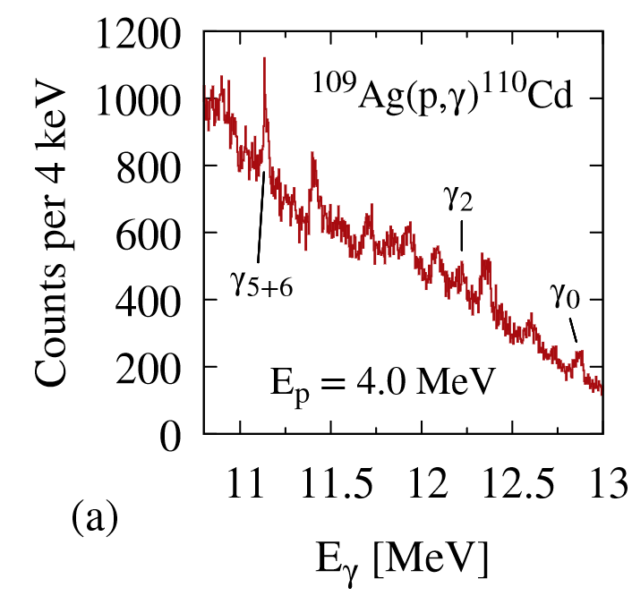


The γ-ray strength function accessed via (p,γ) reactions
γ-ray strength function:
$$\overset{⃖}{f_{XL}}\left(E_{γ}\right)=E_{γ}^{−(2L+1)}\left\langle Γ_{XL}(E_{γ})\right\rangle ⋅ρ(E_{x})$$
γ
γ
γ
Level density
Intensity of γ rays
^{A}X
$$\vec{f}(E_{γ})=\overset{⃖}{f}(E_{γ})$$
Brink-Axel hypothesis
D. Brink, PhD thesis (Oxford University 1955)
P. Axel, Phys. Rev. C 41, 1941 (1990)
F. Heim et al., Phys. Rev. C 103, 055803 (2021)

Slide 12
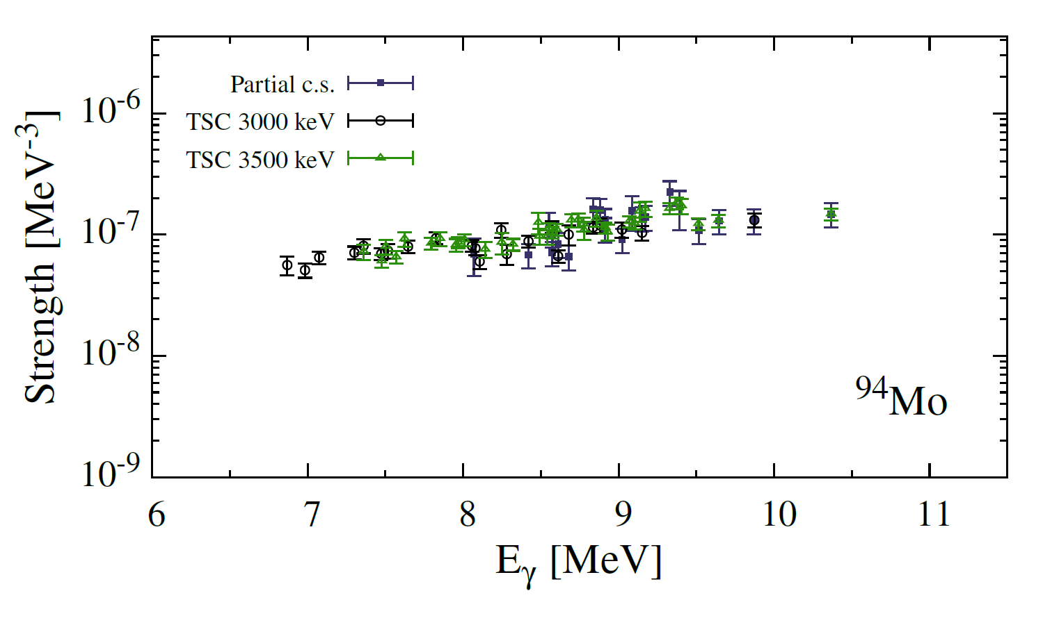
Primary γ-ray intensities from second generation γ rays
(p,γ) reaction allows to reliably measure the γ-ray strength function
Consistent data for different excitation energies → Brink-Axel hypothesis
F. Heim et al., Phys. Rev. C 103, 025805 (2021)

Slide 13
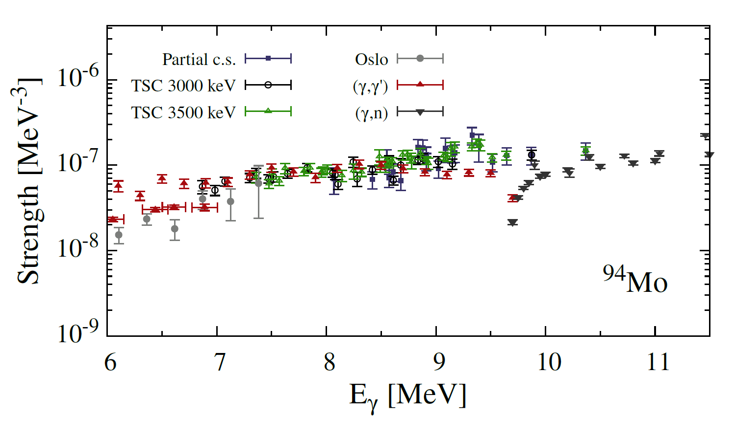
Primary γ-ray intensities from second generation γ rays
(p,γ) reaction allows to reliably measure the γ-ray strength function
Consistent data for different excitation energies → Brink-Axel hypothesis
Agreement with other methods!
C. Romig et al., Phys. Rev. C 88, 044331 (2013)
G. Rusev et al., Phys. Rev. C 79, 061302 (2009)
H. Utsunomiya et al., Phys. Rev. C 88, 015805 (2013)
A. Banu et al., Phys. Rev. C 99, 025802 (2019)
F. Heim et al., Phys. Rev. C 103, 025805 (2021)

Slide 14
Outlook
(p,γ):
90 < A < 110 well studied
For A > 120 very scarce database
51 isotopes

Slide 15
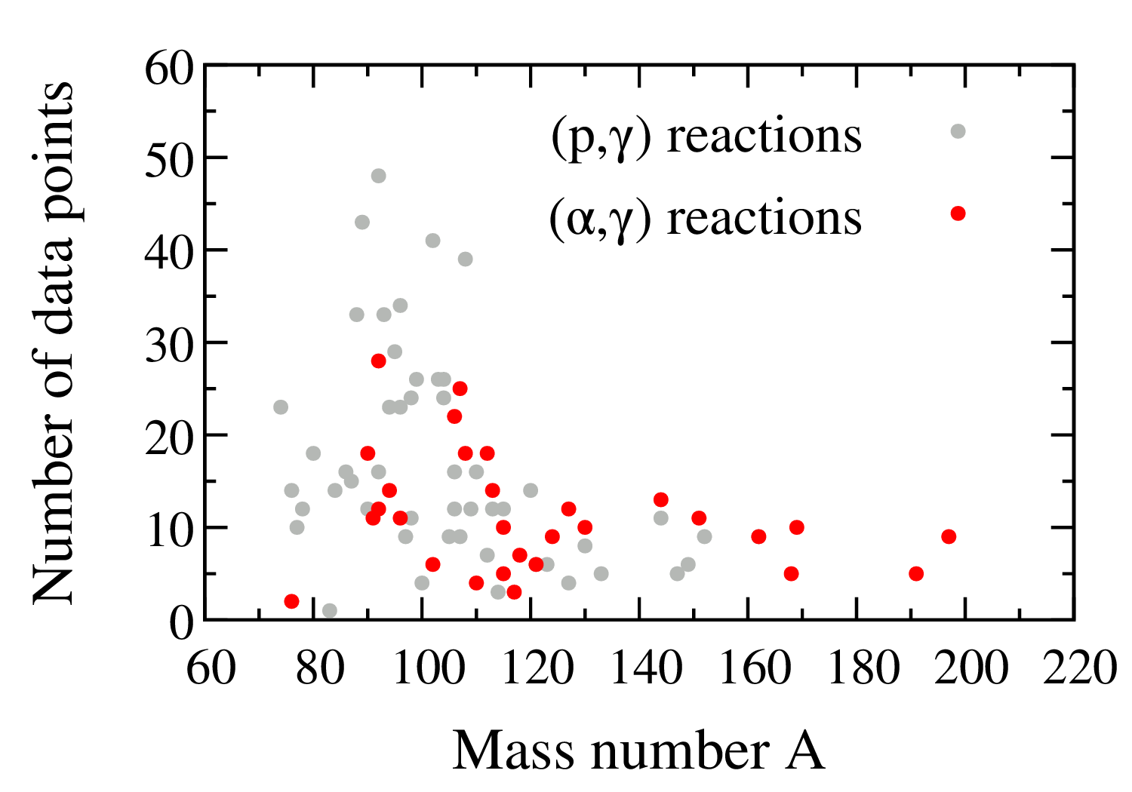
Outlook: (α,γ) & (α,n) reactions
(p,γ):
90 < A < 110 well studied
For A > 120 very scarce database
51 isotopes
(α,γ):
29 isotopes
Mass region A > 120 of high astrophysical importance
Scarce data within the Gamow window
Theory very sensitive to α-OMP
→ (α,n) reactions can provide missing data

Slide 17
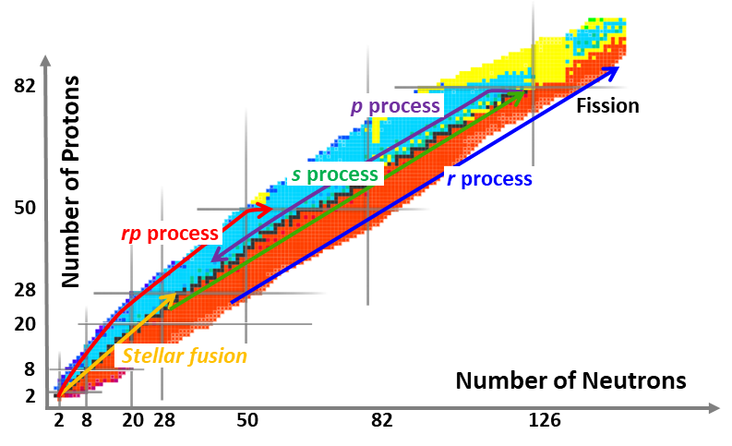

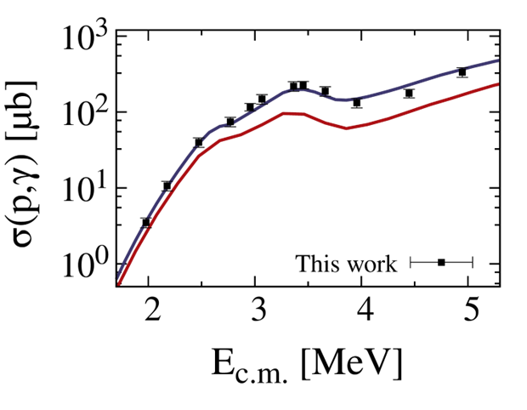
Summary
The predictions of reaction rates on heavy isotopes are still highly uncertain
Nucleosynthesis of p nuclei within the γ process acts on the whole nuclear chart and includes a large reaction network
Nuclear Astrophysics in Cologne
  Direct measurements of (p,γ), (α,γ) and (α,n) reactions using various techniques
  Investigating nuclear physics input parameters of the Hauser-Feshbach model
Extending the available experimental database to test and improve underlying nuclear models very valuable
State-of-the-art theoretical descriptions and models give promising prospects

Slide 18
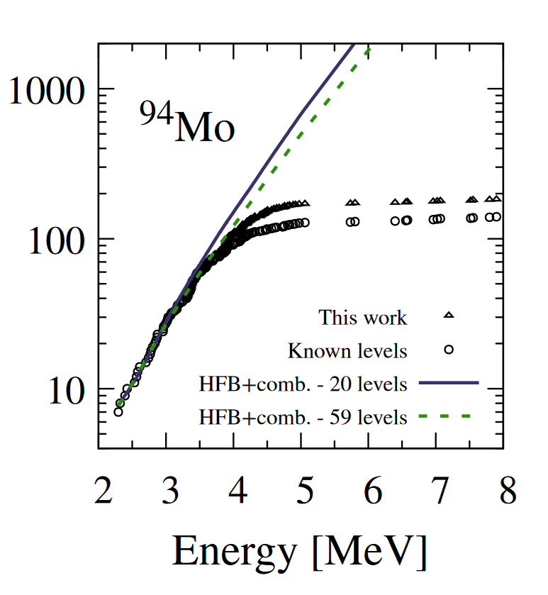
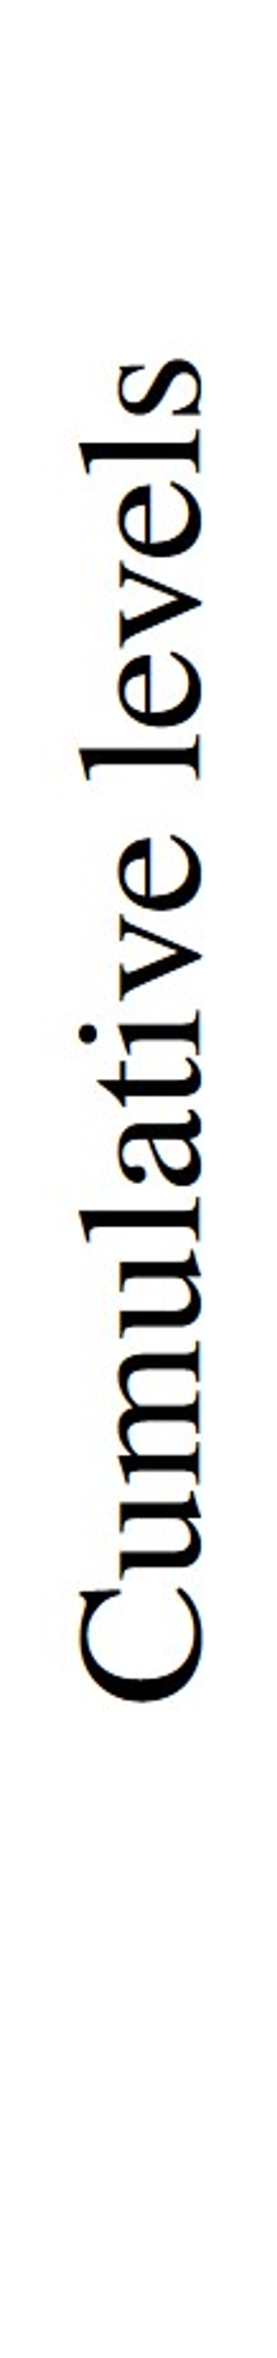
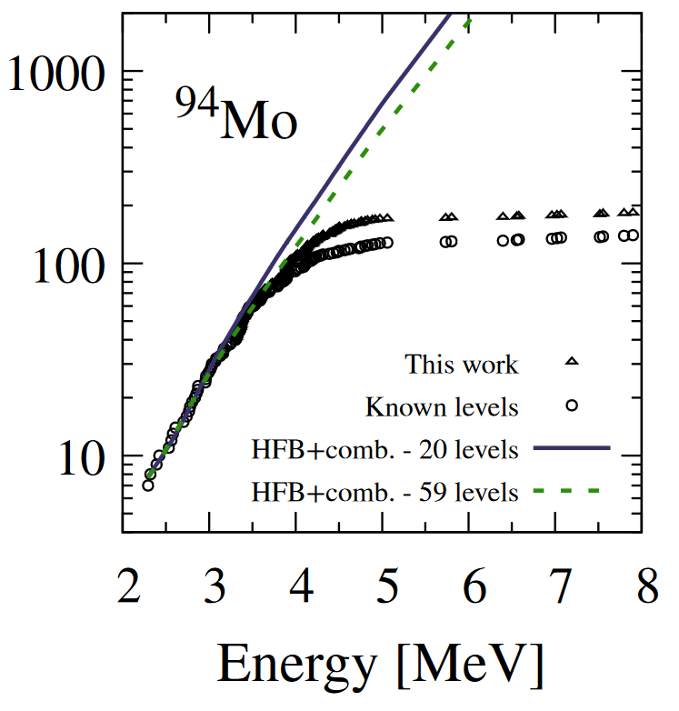

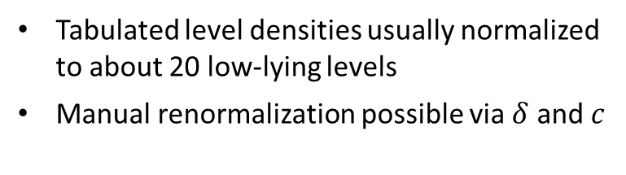
Nuclear level densities for statistical model calculations
More realistic: microscopic calculations with effective NN interactions
$$ρ\left(E_{X},J,π\right)=e^{c∙\sqrt{E_{X}−δ}}ρ_{HFB}(E_{X}−δ,J,π)$$
Tabulated level densities usually normalized to about 20 low-lying levels
Manual renormalization possible via $δ$ and $c$
S. Hilaire and S. Goriely, Nucl. Phys. A 779, 63 (2006)
S. Goriely, S. Hilaire and A. J. Koning, Phys. Rev. C 78, 064307 (2008)
F. Heim et al., Phys. Rev. C 103, 025805 (2021)
14/19

Slide 19
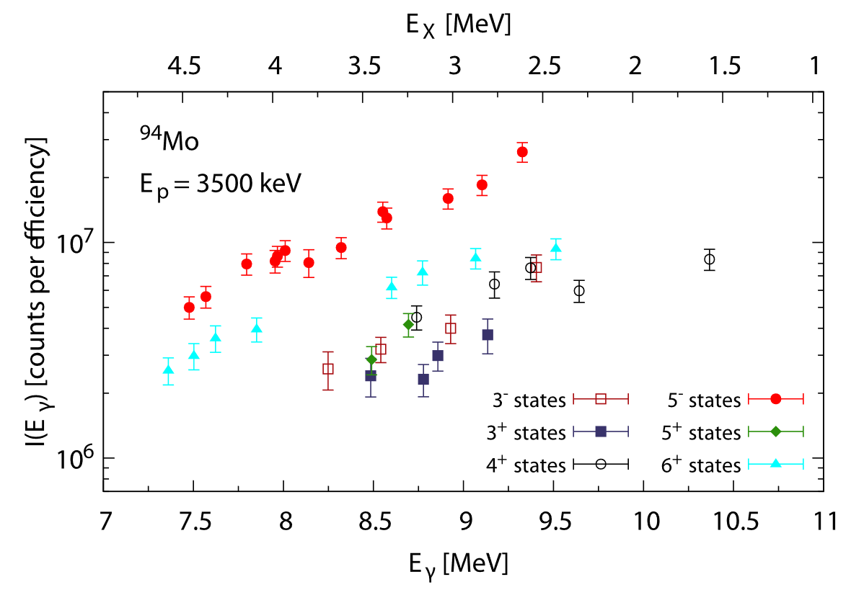
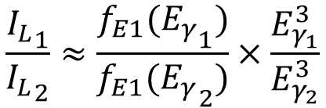
The intensity of primary γ rays in ⁹⁴Mo
Extracted γ-ray strength function data from ⁹³Nb(p,γ)⁹⁴Mo:
For low-lying states with same J^{π}, the dependence on the level density cancels out
Ratio method:
$$\frac{{I_{L}}_{1}}{{I_{L}}_{2}}≈\frac{f_{E1}({E_{γ}}_{1})}{f_{E1}({E_{γ}}_{2})}×\frac{E_{γ_{1}}^{3}}{E_{γ_{2}}^{3}}$$
M. Wiedeking et al., Phys. Rev. Lett. 108, 162503 (2012)
P. Scholz, F. Heim et al., Phys. Rev. C 101, 045806 (2020)
F. Heim et al., Phys. Rev. C 103, 025805 (2021)

Slide 20
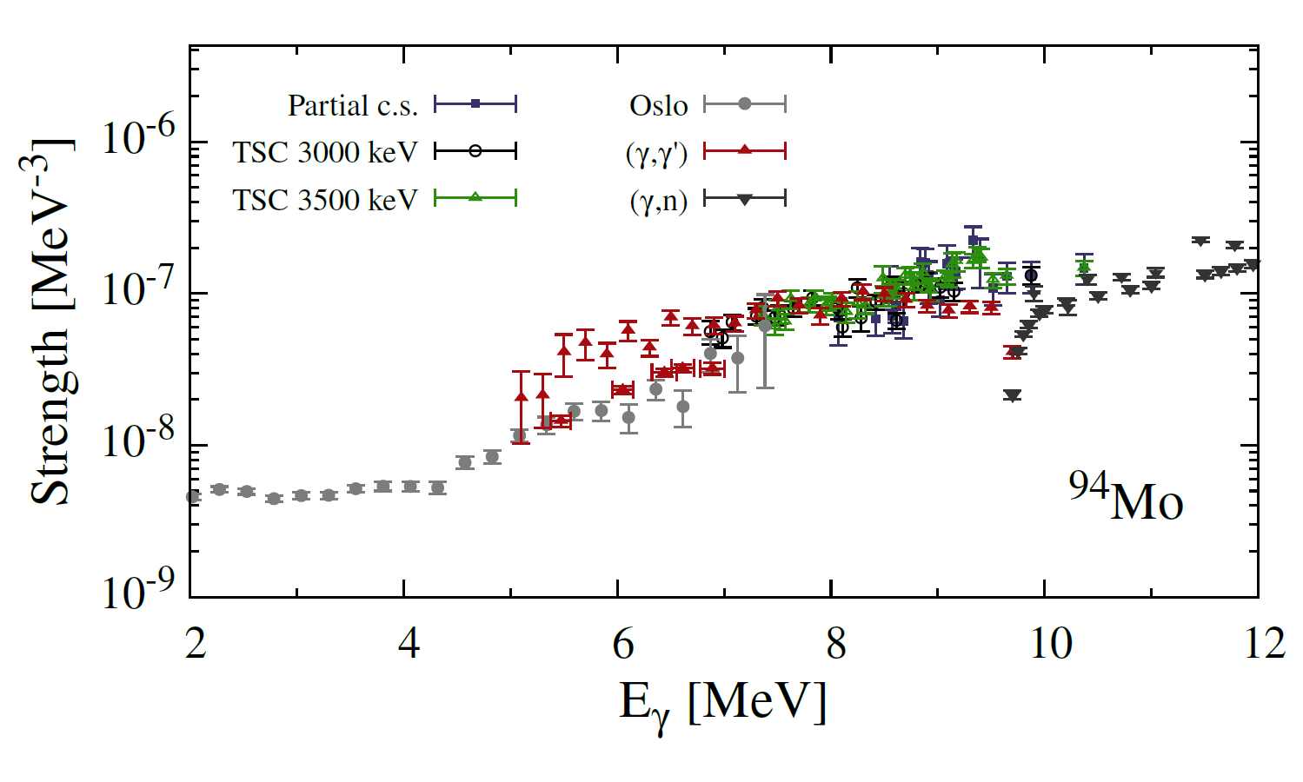
Primary γ-ray intensities from second generation γ rays
(p,γ) reaction allows to reliably measure the γ-ray strength function
Consistent data for different excitation energies → Brink-Axel hypothesis
Agreement with other methods!
C. Romig et al., Phys. Rev. C 88, 044331 (2013)
G. Rusev et al., Phys. Rev. C 79, 061302 (2009)
H. Utsunomiya et al., Phys. Rev. C 88, 015805 (2013)
A. Banu et al., Phys. Rev. C 99, 025802 (2019)
F. Heim et al., Phys. Rev. C 103, 025805 (2021)

Slide 21
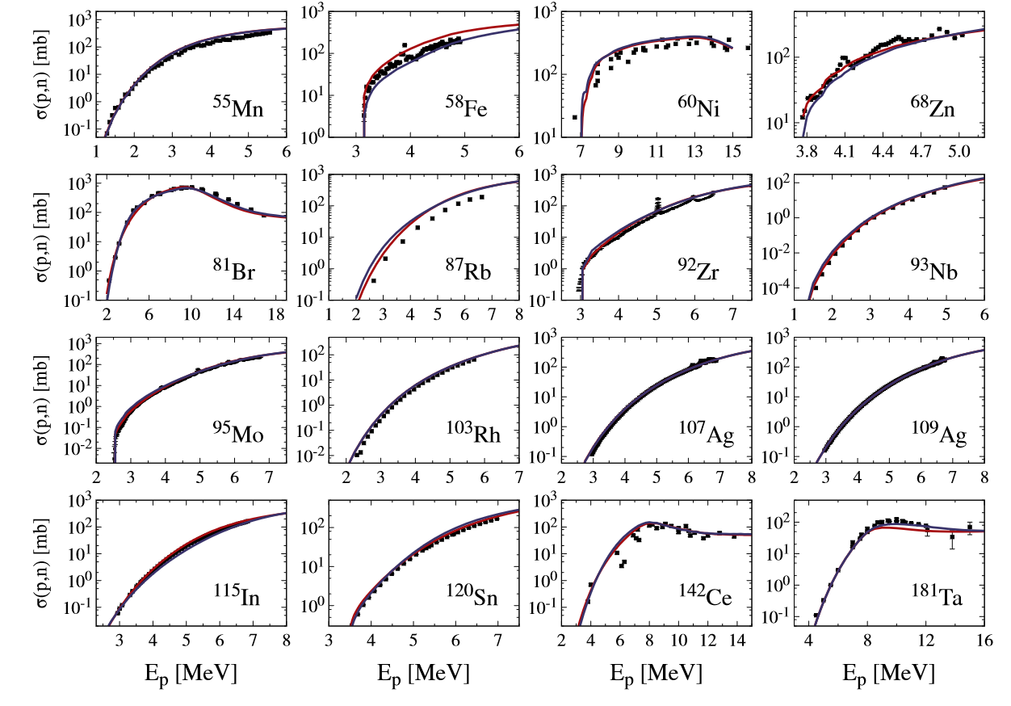
Constraining optical model potentials
(p,n) cross sections
Measured (p,n) reactions well-suited to study the nucleonic OMPs
Excellent agreement over the whole nuclear chart
red:
A. Koning and J. Delaroche,
Nucl. Phys. A 713, 231 (2003)
blue:
E. Bauge, J. P. Delaroche and M. Girod,
Phys. Rev. C 63, 024607 (2001)

Slide 22
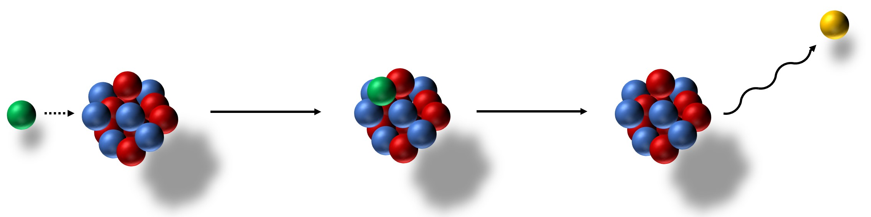
Reaction mechanism of (p,γ) reactions
a)
b)
c)
γ
p
E_{c.m.}+ Q
primary γ rays
proton capture
Sum of groundstate transitions gives the total cross section
^{A}X
^{A+1}Y

Slide 23
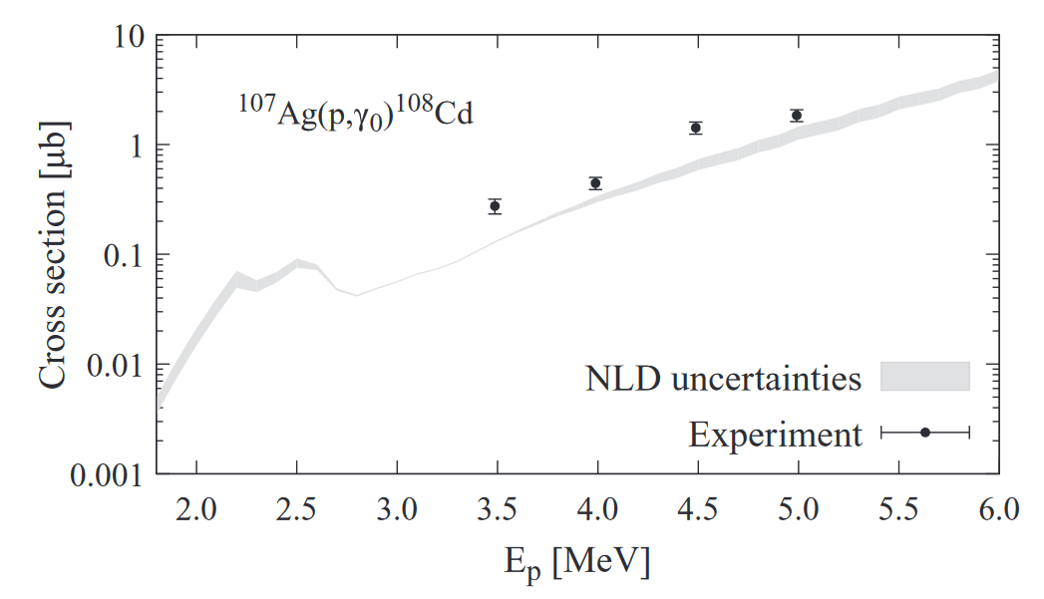
Sensitivity of primary γ rays

Slide 24
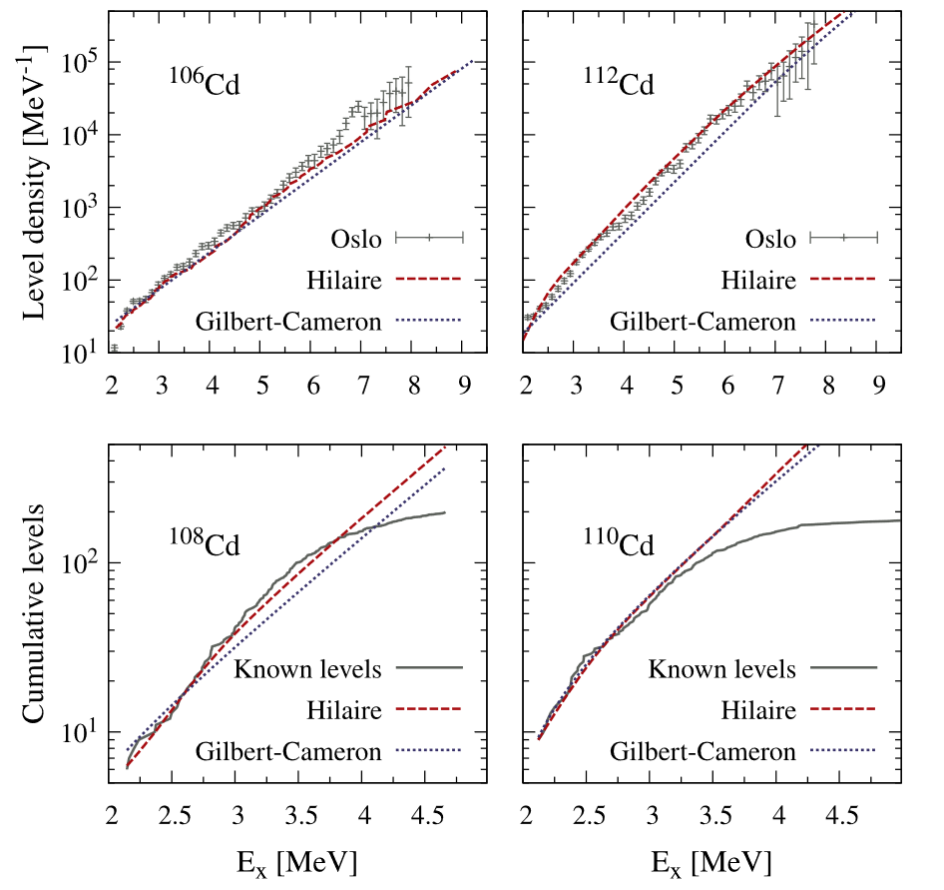


Nuclear level densities for statistical model calculations
At high energies: individual levels cannot be counted separately!
Simple ansatz: constant temperature model („Gilbert-Cameron“)
$$ρ\left(E_{X}\right)=\frac{1}{T}e^{\frac{E_{X}−E_{0}}{T}}$$
More realistic: microscopic calculations with effective NN interactions
$$ρ\left(E_{X},J,π\right)=e^{c∙\sqrt{E_{X}−δ}}ρ_{HFB}(E_{X}−δ,J,π)$$
S. Hilaire and S. Goriely, Nucl. Phys. A 779, 63 (2006)
S. Goriely, S. Hilaire and A. J. Koning, Phys. Rev. C 78, 064307 (2008)
F. Heim et al., Phys. Rev. C 103, 055803 (2021)

Slide 25
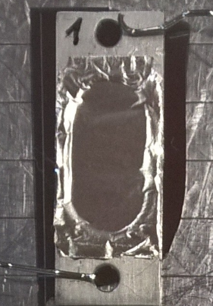
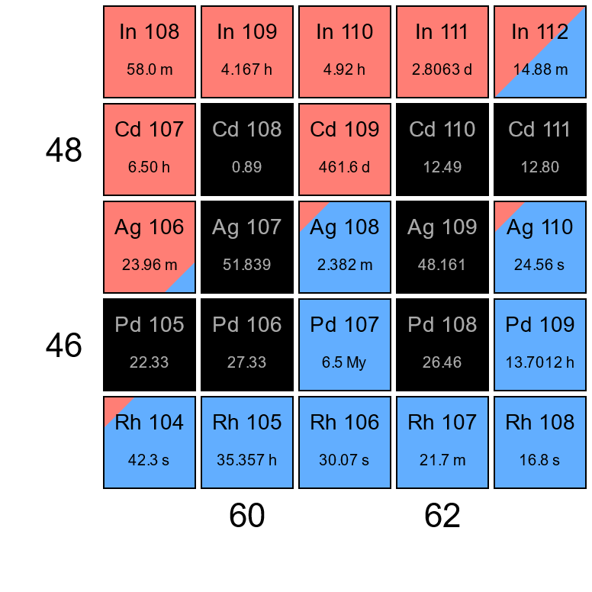
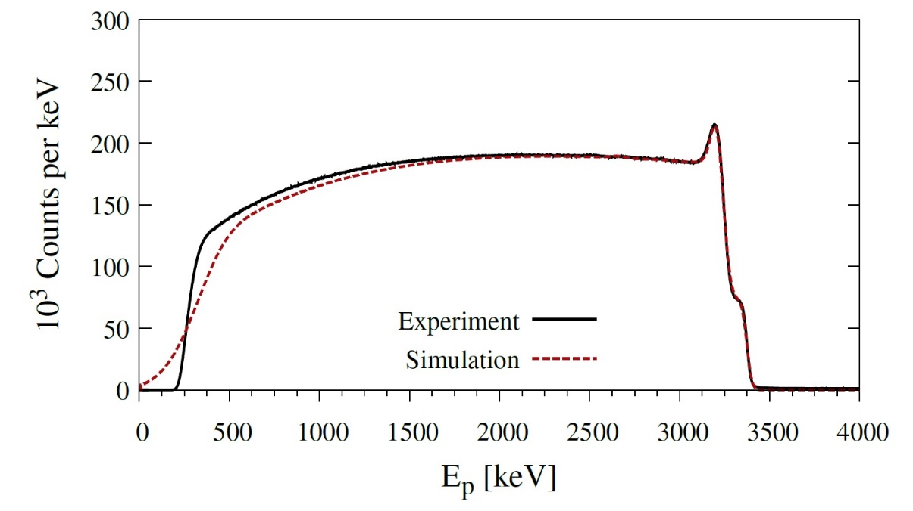
The ¹⁰⁷Ag(p,γ)¹⁰⁸Cd reaction
Motivation: Detailed studies of γ-ray strength function and NLD
  E_{p} = 2.0 MeV to 5.0 MeV
  Proton beams of up to 1 µA for one week
¹⁰⁷Ag target #1
N_{T}=1.07 mg/cm²
Target thickness determined via Rutherford Backscattering Spectrometry (RBS):
Notes:
Gsf, NLD: if you forgot what this was, no problem, these are just two nuclear physics input parameters we wanted to study. I will skip the details.
Targets are generally a few microns thick, careful handling.

Slide 26
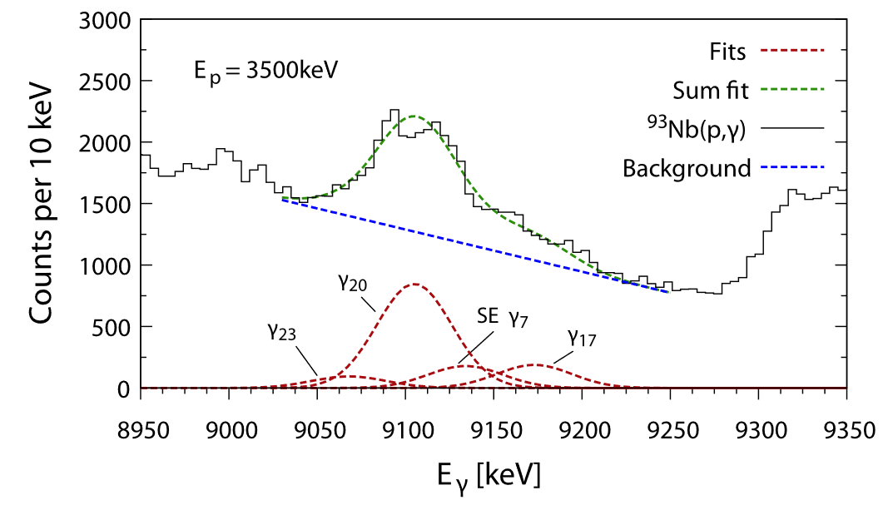
Primary γ-ray transitions in ⁹⁴Mo

Slide 27
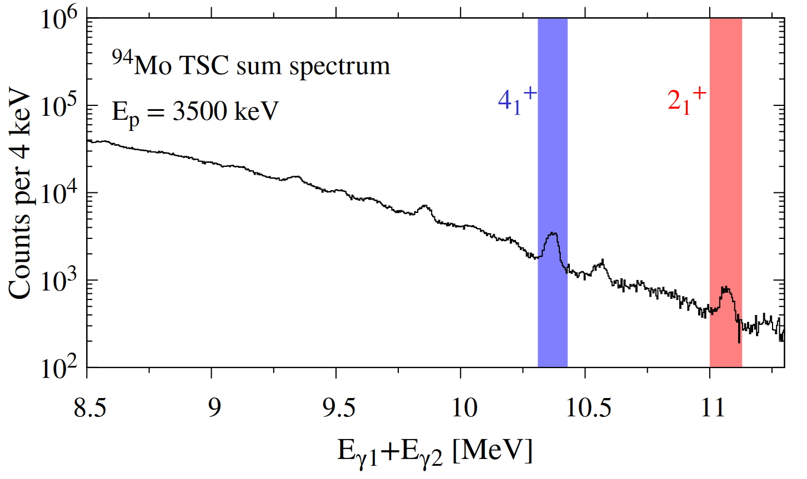
Two-Step Cascade sum spectrum
TSC sum spectrum contains all two-step γ-ray cascades that populate a specific level
4₁⁺
2₁⁺

Slide 28

Discrete two-step-cascade spectra
⁹⁴Mo
⁹⁴Mo
4₁⁺
2₁⁺
⁹⁴Mo
F. Heim et al., Phys. Rev. C 103 (2021) 025805

Slide 29
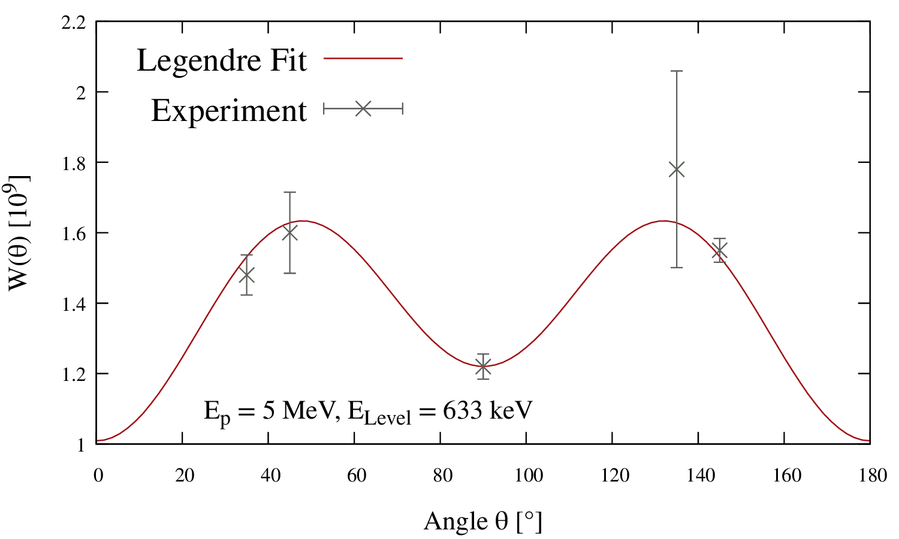
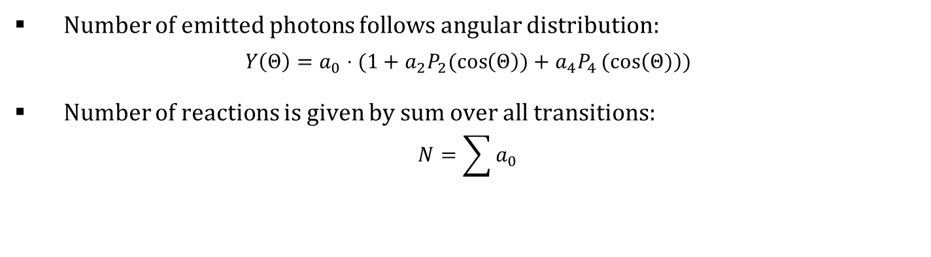
Angular distributions
Number of emitted photons follows angular distribution:
$$Y\left(Θ\right)=a_{0}⋅(1+a_{2}P_{2}(\cos\left(Θ\right))+a_{4}P_{4}(cos\left(Θ)\right))$$
Number of reactions is given by sum over all transitions:
$$N=\sum{a_{0}}$$

