Slide 1
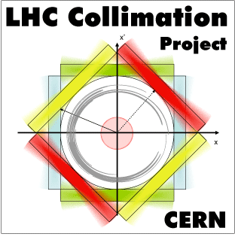

Preliminary results from crystal collimation studies in 2018
M. D’Andrea, D. Mirarchi, S. Redaelli, R. Rossi, W. Scandale
Acknowledgments:
UA9 Collaboration that provided the crystals installed in the LHC
R. Losito (EN), S. Gilardoni, M. Calviani, I. Lamas (EN-STI),
A. Masi, M. Di Castro, M. Butcher, P. Serrano, C. Dionisio (EN-SMM)
that provided hardware and controls of LHC goniometers
HL-LHC Technical Coordination Committee meeting,
14th March 2019, CERN

Slide 2
Outline
With materials previously shown by D. Mirarchi at
International Review of the HL-LHC Collimation System
Crystal channeling at the LHC
Methods for crystal characterization
Preliminary results with protons
Preliminary results with ions
Conclusions and outlook

Slide 3
Outline
Crystal channeling at the LHC
Methods for crystal characterization
Preliminary results with protons
Preliminary results with ions
Conclusions and outlook

Slide 4
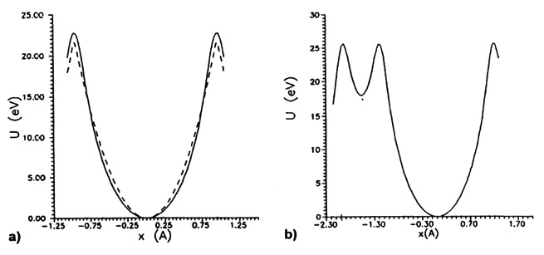


Planar channeling
Potential between a particle and an atom described
by the Thomas-Fermi model:
Potential seen by protons
from crystalline planes
Continuous approximation (small $θimp$):
If the protons have p_{T} < U_{max}
Typical values at energies
of our interest:
Critical channeling angle
Forced to oscillate in a relatively empty space

Slide 5
LHC Collimation
Cold magnets
Warm magnets
Cold magnets
Tertiary halo
Main limitations:
Secondary halo
Protons collimation:
+ hadronic shower
Single diffractive events
Circulating
beam
Primary halo
Insertion
Arc
Small deflection
Non-negligible δp/p
IP
Lead ions collimation:
Protection
Devices
(TCD)
Primary
Collimators
(TCP)
Secondary
Collimators
(TCSG)
Absorbers
(TCLA)
Fragmentation and dissociation
Tertiary
Collimators
(TCT)
Bottleneck
Cleaning efficiency reduced to 10⁻² (10⁻⁴ with protons)
Bent crystal
Deflected halo
Massive Absorber
Secondary halo
Main promises:
+ hadronic shower & Dechanneling
Reduction of inelastic interactions
Circulating
beam
Primary halo
Insertion
Arc
Reduced off-momentum losses in DS
IP
Similar performance with p and Pb
Significant improvement w.r.t. present

Slide 6
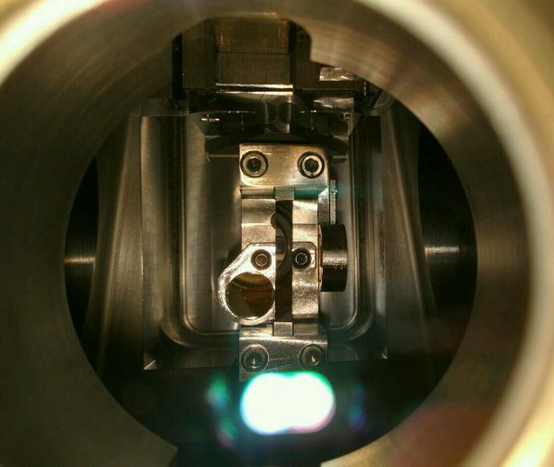
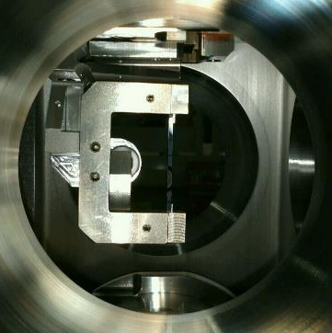
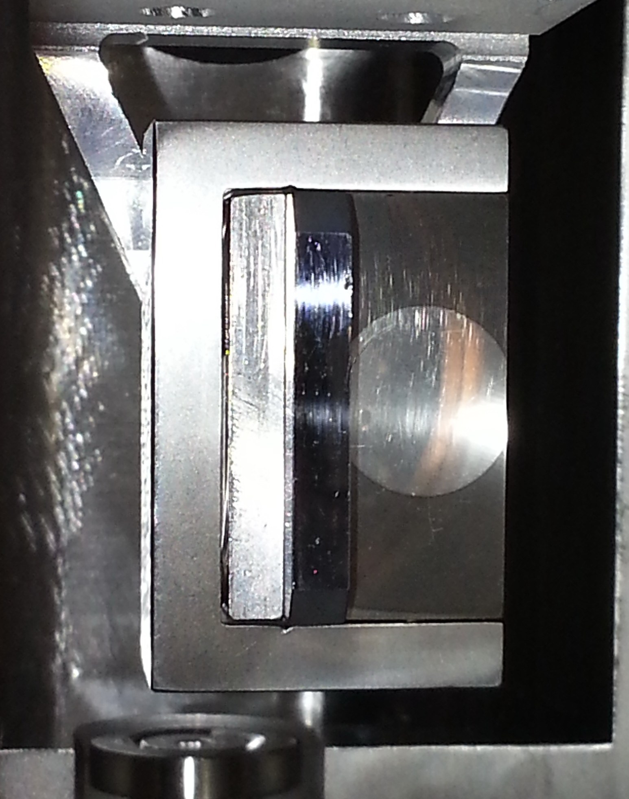
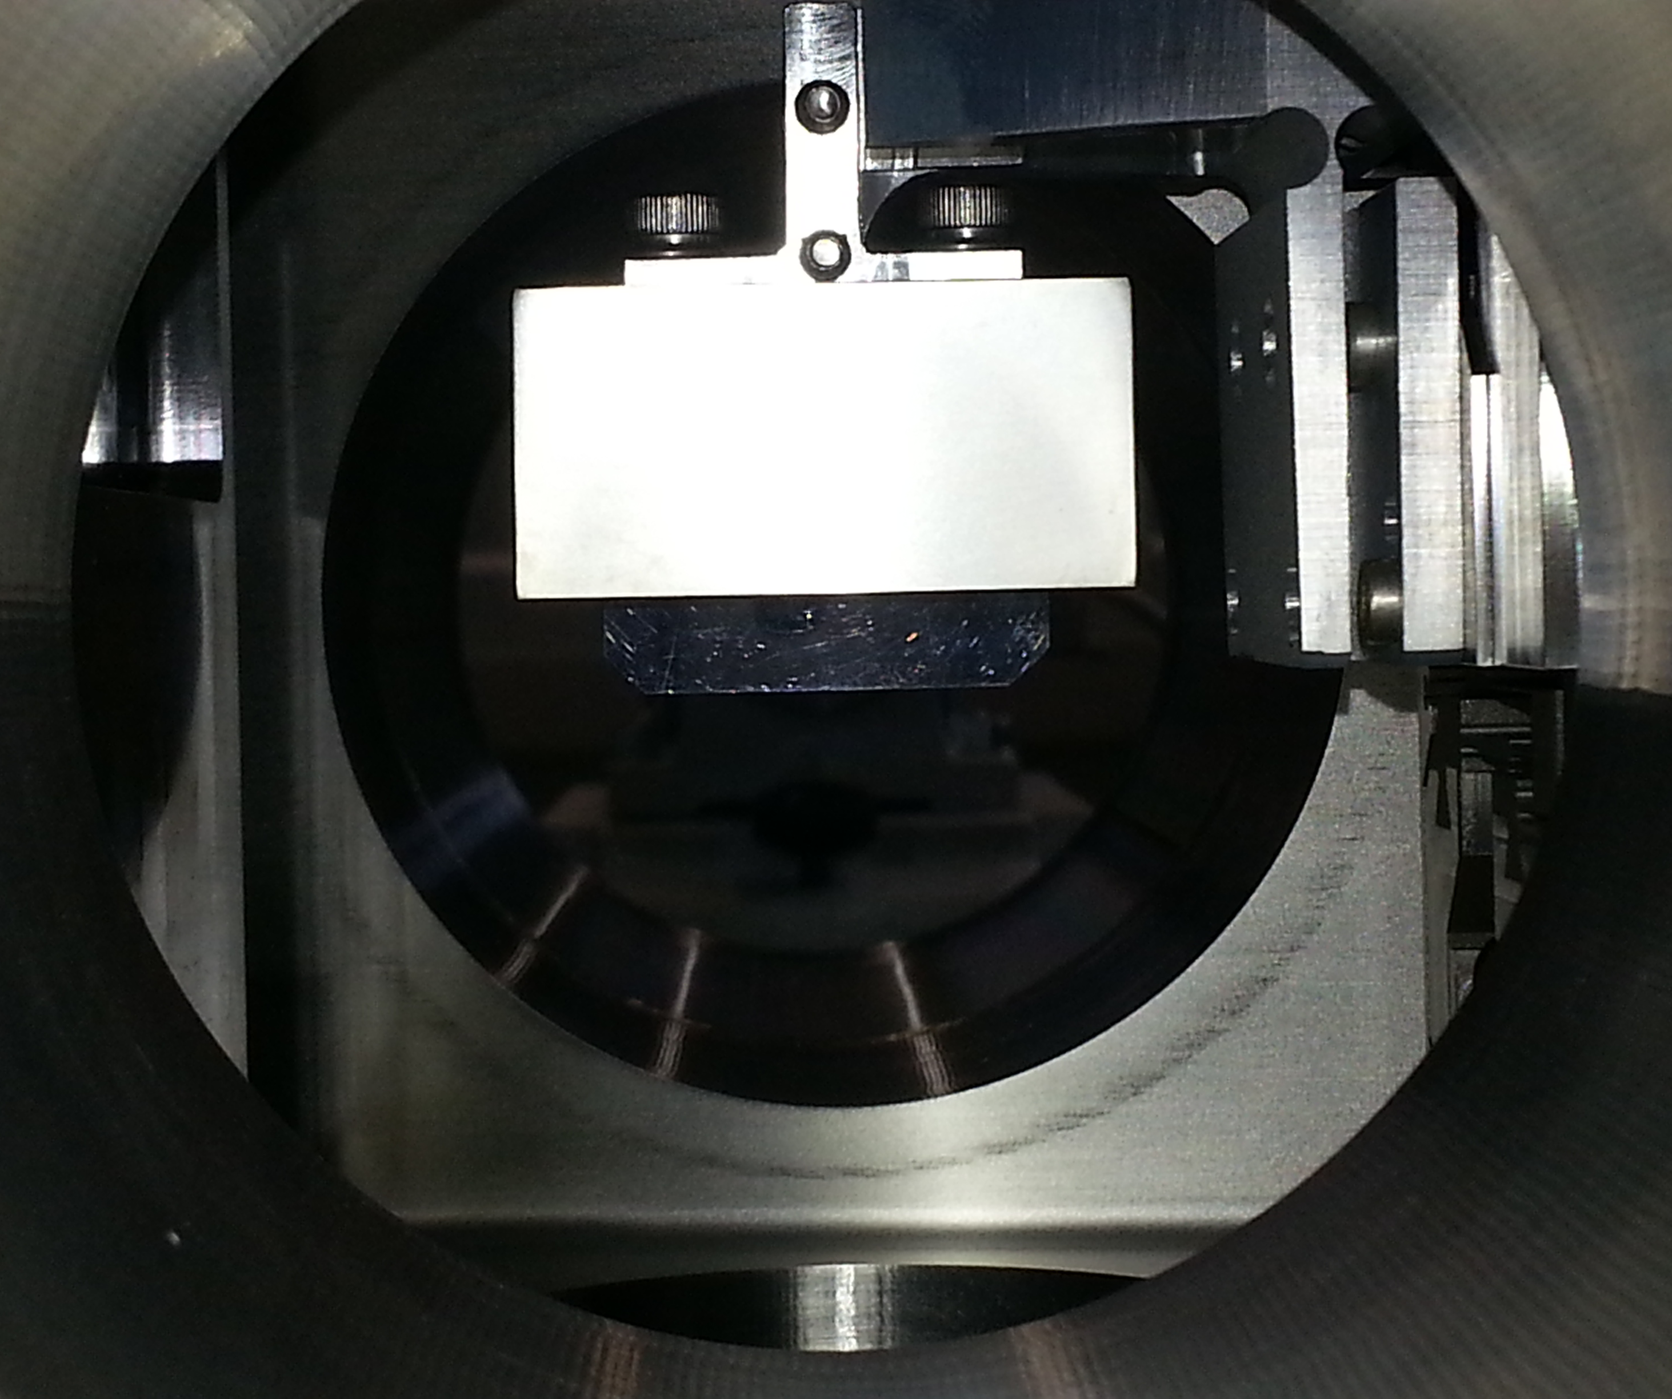
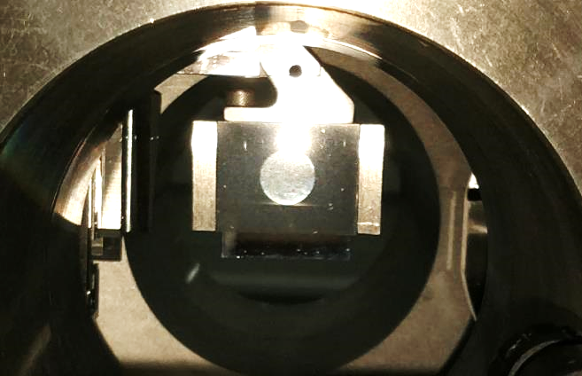
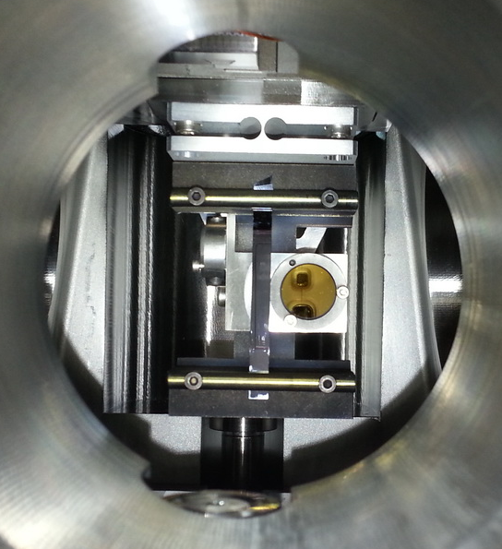
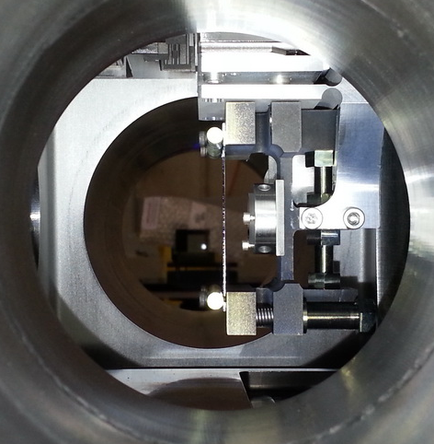
Present layout
Four crystals installed in the LHC: two per beam, one per plane
Same specifications for all crystals, two different producers and technologies
TCPCH.A5R7.B2
TCPCV.A6L7.B1
Strip
QM
Beam 2
Beam 1
PNPI
Beam 2
PNPI
Beam 1
Pics. Courtesy of Y. Gavrikov
TCPCV.A6R7.B2
TCPCH.A4L7.B1
QM
Strip
Beam 1
S. Redaelli
PNPI
Beam 1
INFN-Fe
Beam 1
Complete layout to allow thorough investigations and operational tests

Slide 7
Milestones achieved
2015
First p channeling at the LHC: 450 GeV and 6.5 TeV
First Pb channeling at the LHC: 450 Z GeV
2016
First channeling during energy ramp
First assessment of cleaning performance with p beams
First Pb channeling at the LHC: 6.5 Z TeV
Demonstration of improved cleaning for protons
2017
First channeling of Xe at 450 Z GeV 6.5 Z TeV, together with assessment of cleaning performance
2018
First channeling during squeeze and collision
First operational use in a physics run
Operational tests with ions: crystals part of intensity ramp up
Demonstration of improved cleaning for ions
Total MD time: 58h with p, 34h with ions

Slide 8
Outline
Crystal channeling at the LHC
Methods for crystal characterization
Preliminary results with protons
Preliminary results with ions
Conclusions and outlook

Slide 9
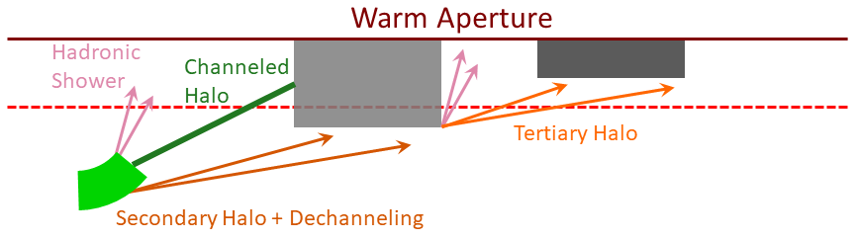
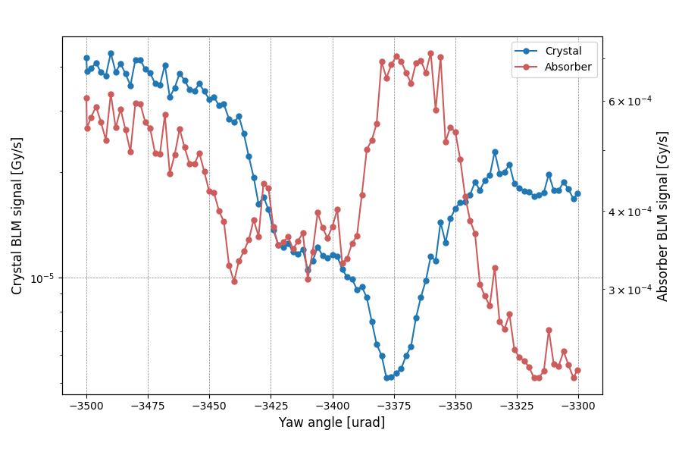
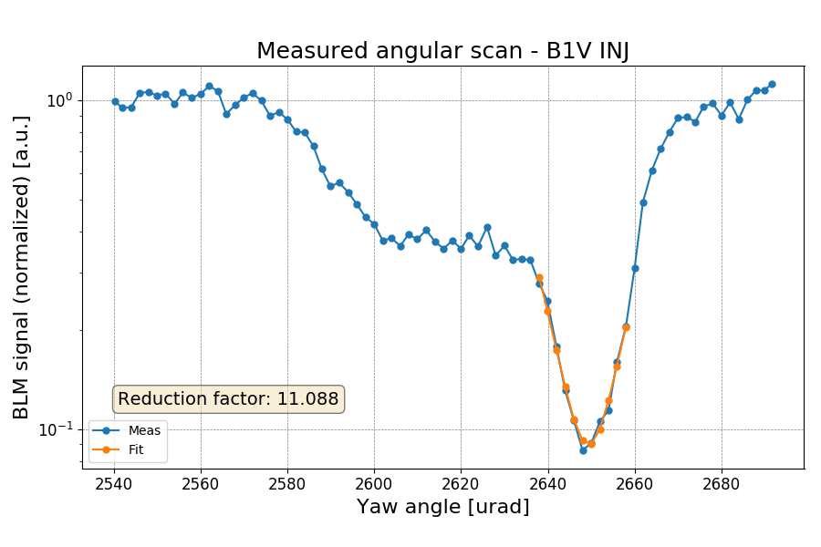
Angular scan
The crystal device is aligned to the beam halo and rotates around its axis
What we look at:
What we look for:
decreased losses at the crystal
optimal channeling orientation
increased losses at the absorber
reduction factor
AM
VR
CH
AM
Background subtracted, normalization to lost particles flux and amorphous level
Notes:
Method used to establish channeling: crystal orientation changed with respect to beam direction (after beam based alignment -> crystal is primary)
In channeling orientation nuclear interactions in the crystal are reduced: we look for a reduction in losses at the crystal
Consequently, losses increase at the collimator used as absorber, which catches the channeled beam
After normalizing the signal at the crystal for the beam flux, familiar angular scan shape is reconstructed: amorphous, volume reflection, channeling
This allows to find optimal channeling orientation and losses reduction factor

Slide 10
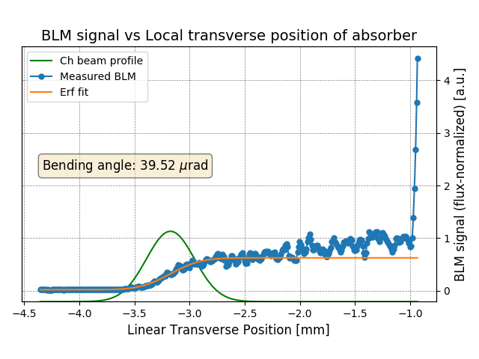
Linear scan
The absorber is retracted and inserted until it touches the primary beam, with the crystal in channeling orientation
What we look at:
losses at the absorber as a function of its transverse position
Primary Beam
After normalization to losses when the primary beam is touched, the height of the error function gives directly the efficiency
What we look for:
multiturn channeling efficiency
characterization of channeled beam and crystal bending angle
Distance between channeled and primary beam is converted into deflection angle using the transfer matrix
Notes:
Crystal is left in channeling orientation, while the absorber is retracted and then inserted until it touches the beam: it intercepts the whole channeled beam
Losses at the absorber as a function of its transverse position allow to reconstruct the profile of the channeled beam
The profile is fitted with an error function (the integral of a gaussian): after normalization with respect to losses when the primary beam is touched allows to find the channeling efficiency
The derivative of the fitted profile is the channeled beam gaussian: distance between the mean value of the gaussian and the point where the beam is touched can be converted into deflection with the transfer matrix -> method to check the bending angle of the crystal

Slide 11
Loss maps
Same procedure used to validate the standard system: the beam is blown up with ADT (transverse white noise) to generate controlled losses around the machine
Dump
β-coll
ATLAS
δp/p-coll
CMS
ALICE
LHCb
Q12-13
Q12-13
Cold region after collimation insertion is divided in areas corresponding to dispersive peaks
R. Rossi
Notes:
The beam is blown up with the ADT to generate controlled losses around the machine: standard method used to check collimation hierarchy
This is an example of a B1 loss map with the standard collimation system
The area of interest for our discussion is of course IP7, where we can see the usual collimator hierarchy: highest losses at the primary collimator and then showers downstream

Slide 12
Outline
Crystal channeling at the LHC
Methods for crystal characterization
Preliminary results with protons
Preliminary results with ions
Conclusions and outlook

Slide 13
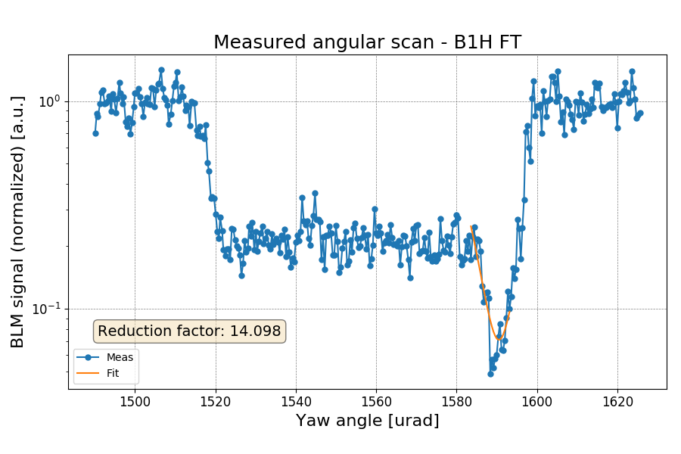
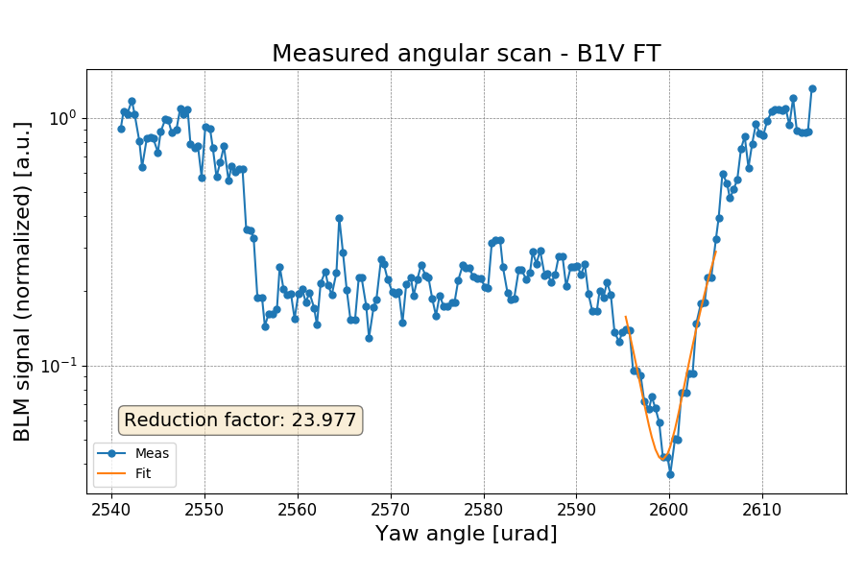
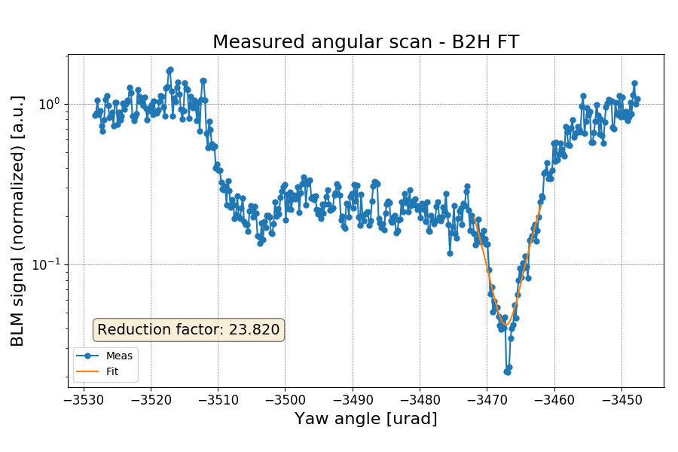
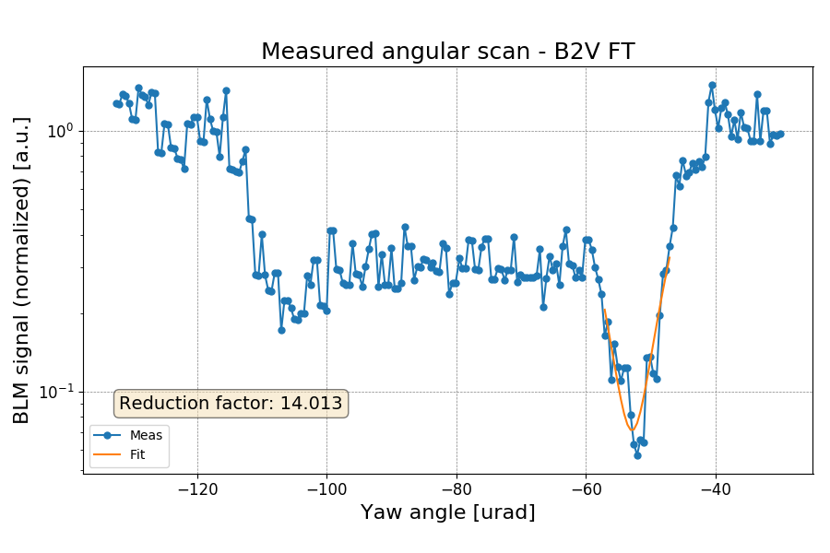
Angular scans at flat top with protons
All devices completely characterized in preparation for measurements with ions
B1H
B1V
B2H
B2V
Linear scans and loss maps with various settings also performed

Slide 14
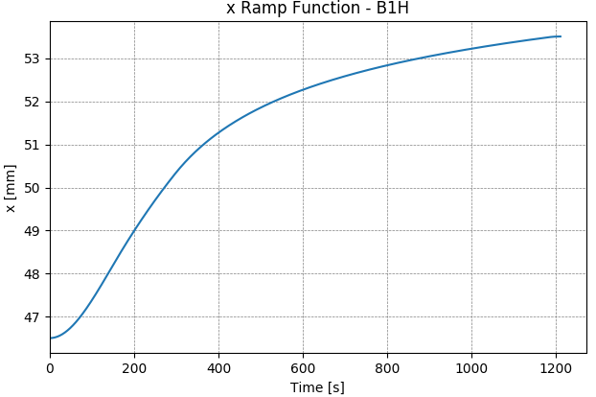
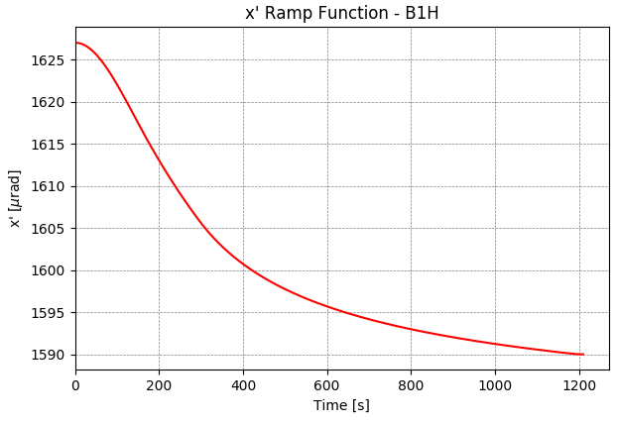
Channeling during energy ramp
Massive Absorber
Bent crystal
Deflected halo
➛ ➛ Beam ➛ ➛
Example of linear and angular functions used to follow adiabatic dumping
~7 mm
~35 μrad
θ_{c} ~ 10μrad
450 GeV
θ_{c} ~ 2.5 μrad
6.5 TeV

Slide 15
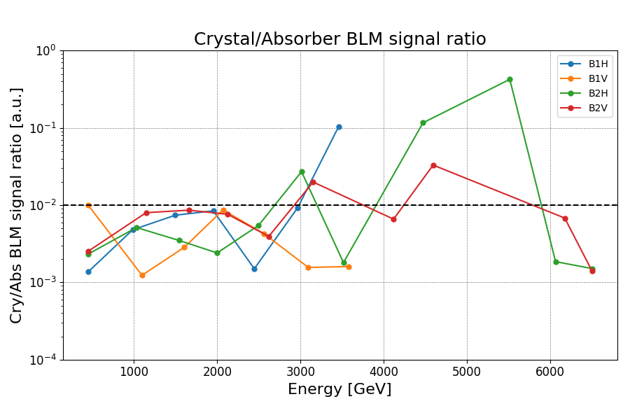
Channeling during dynamic phases
Channeling conditions assessed by means of continuous loss maps
Observable: ratio of losses at absorber w.r.t. at crystals
Abs
Abs
CH
AM
<10⁻²
Beam 1
Cry
Beam 1
Cry
Only B1H in 2016
All 4 crystals in 2018!
R. Rossi
MCBs trip
AM
Ideal system with 2 crystals per plane could accommodate orbit changes better
CH
Similar results during squeeze, collapsing separation, orbit corrections
Good control of channeling during dynamic phases achieved!

Slide 16
First physics run using crystals!
First ever data taking using crystal collimation during high-β* at 450 GeV!
Very challenging conditions for collimation required to suppress background
Both standard and crystal collimation schemes prepared for operations
Fully automated insertion of crystals directly in channeling deployed
Standard
Crystal
Feedback from experiments using crystals:
Significant background suppression
No need of scraping during the fill
Better data quality
and more integrated lumi!
Future plans:
Courtesy of TOTEM
High-β* run at intermediate energies may be requested in Run3/HL-LHC
Preference of using crystal collimation scheme during data taking

Slide 17
Outline
Crystal channeling at the LHC
Methods for crystal characterization
Preliminary results with protons
Preliminary results with ions
Conclusions and outlook

Slide 18
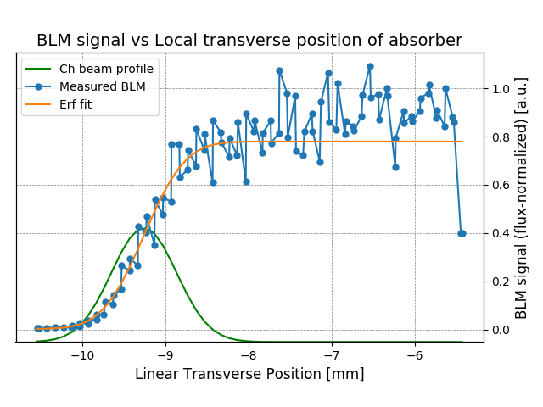
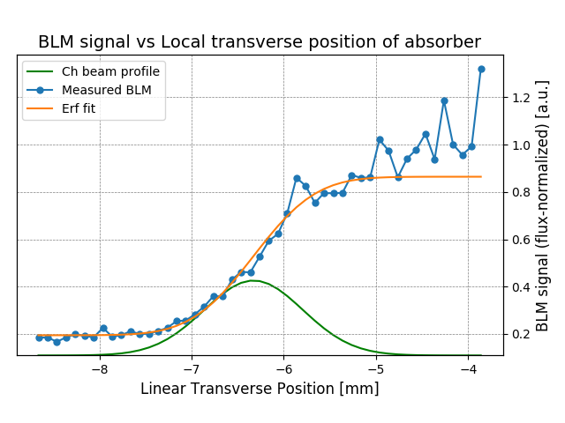
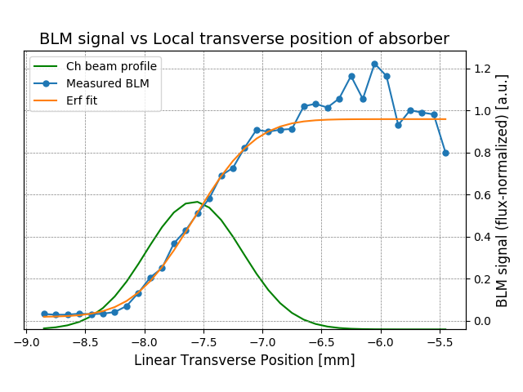
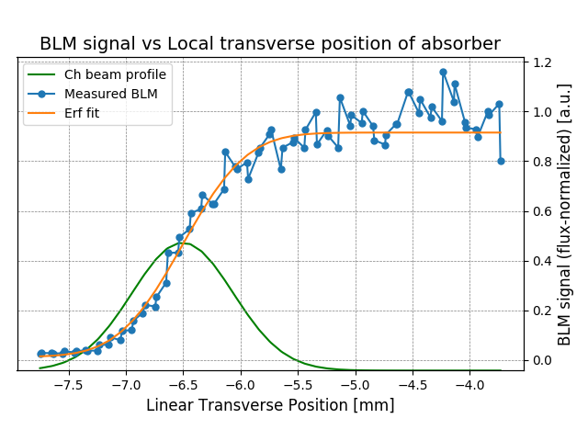
Multiturn CH efficiency at injection for ions
~78%
~86%
B1H
B1V
B2H
B2V
~95%
~91%

Slide 19
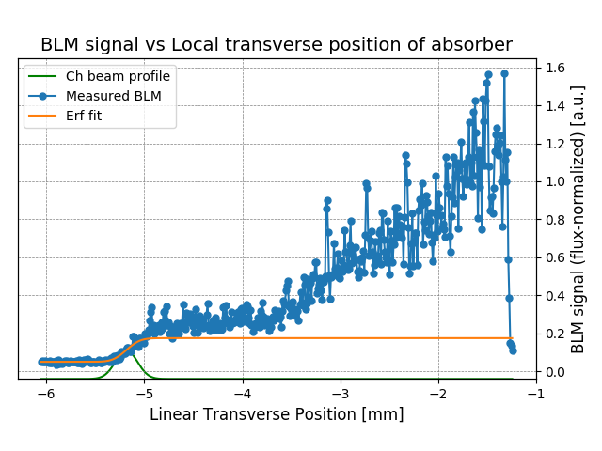
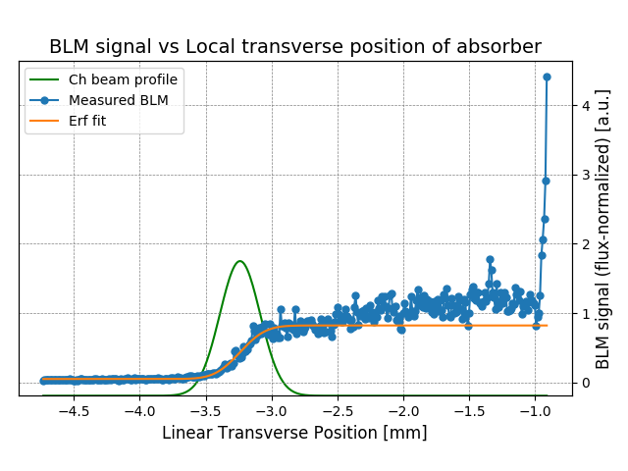
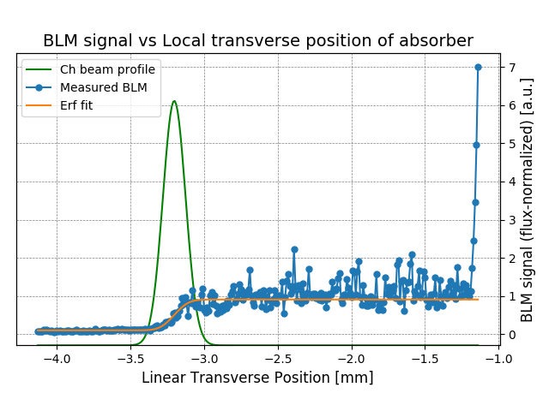
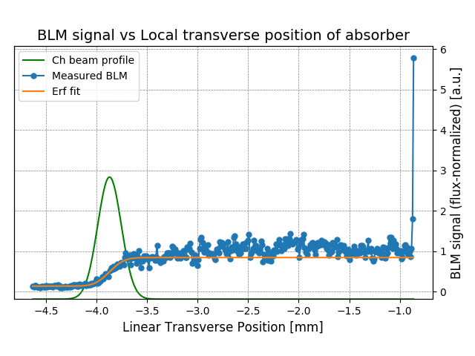
Multiturn CH efficiency at flat top for ions
Radius close to critical value: high dechanneling population and low efficiency
~20%
~82%
B1H
B1V
Smaller radius: much lower dechanneling population and higher efficiency
B2H
B2V
~91%
~84%

Slide 20
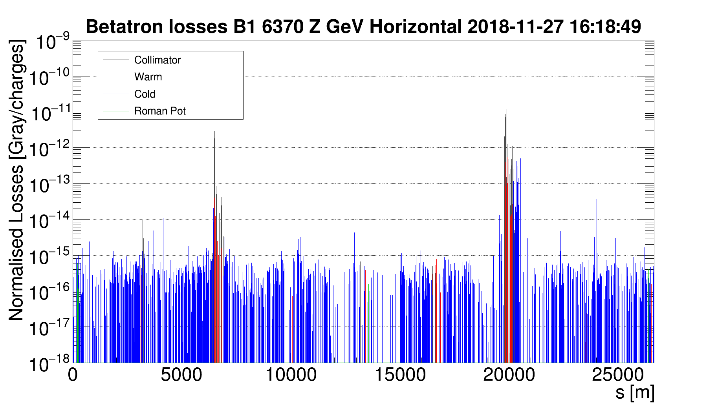
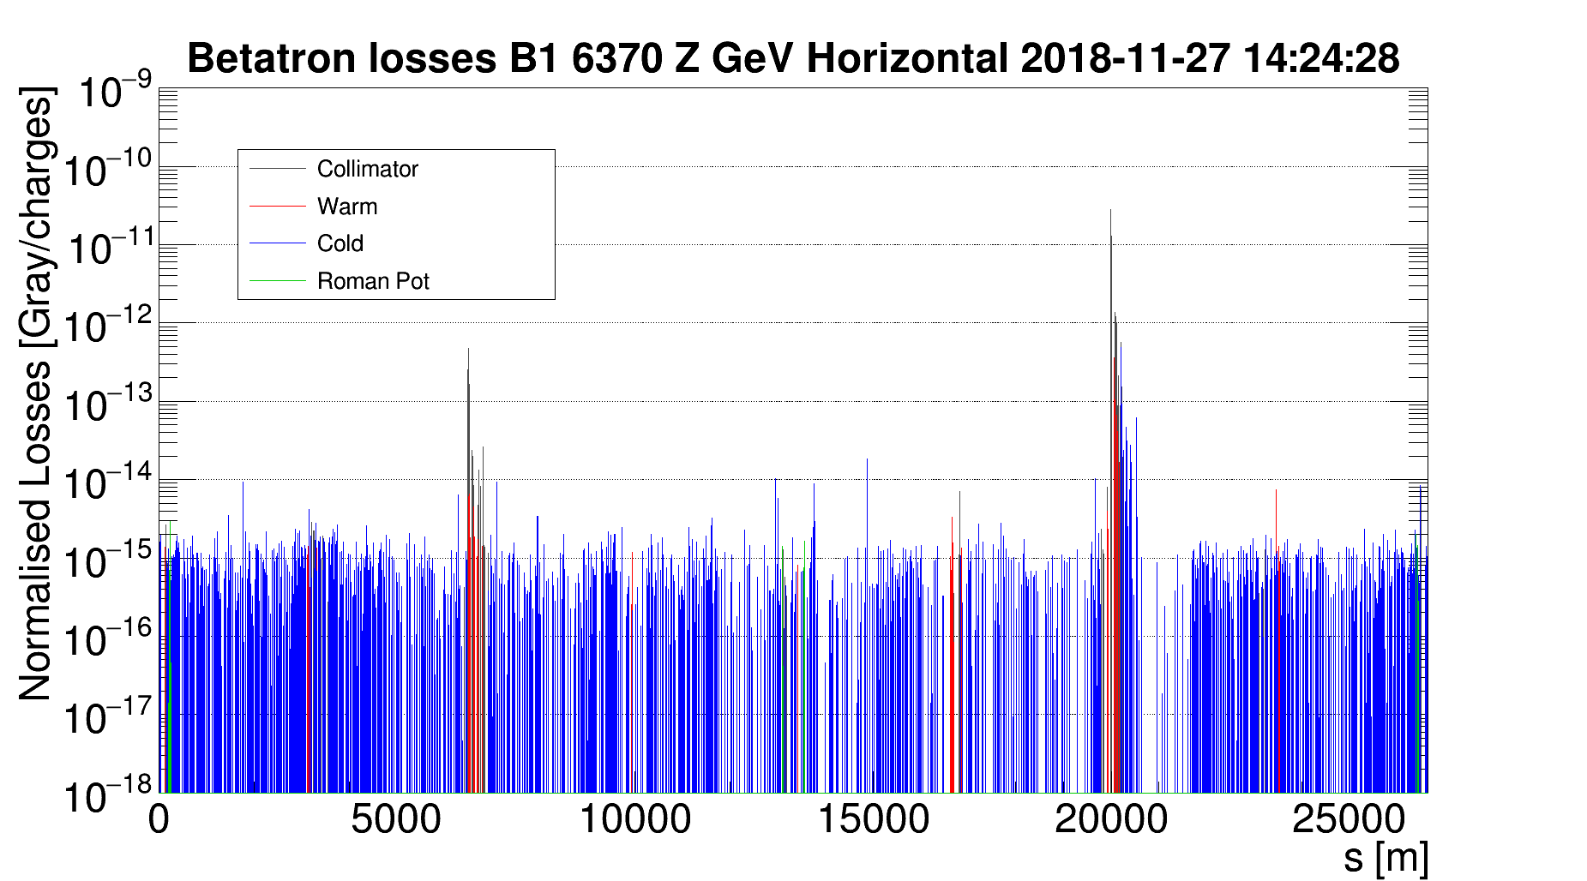
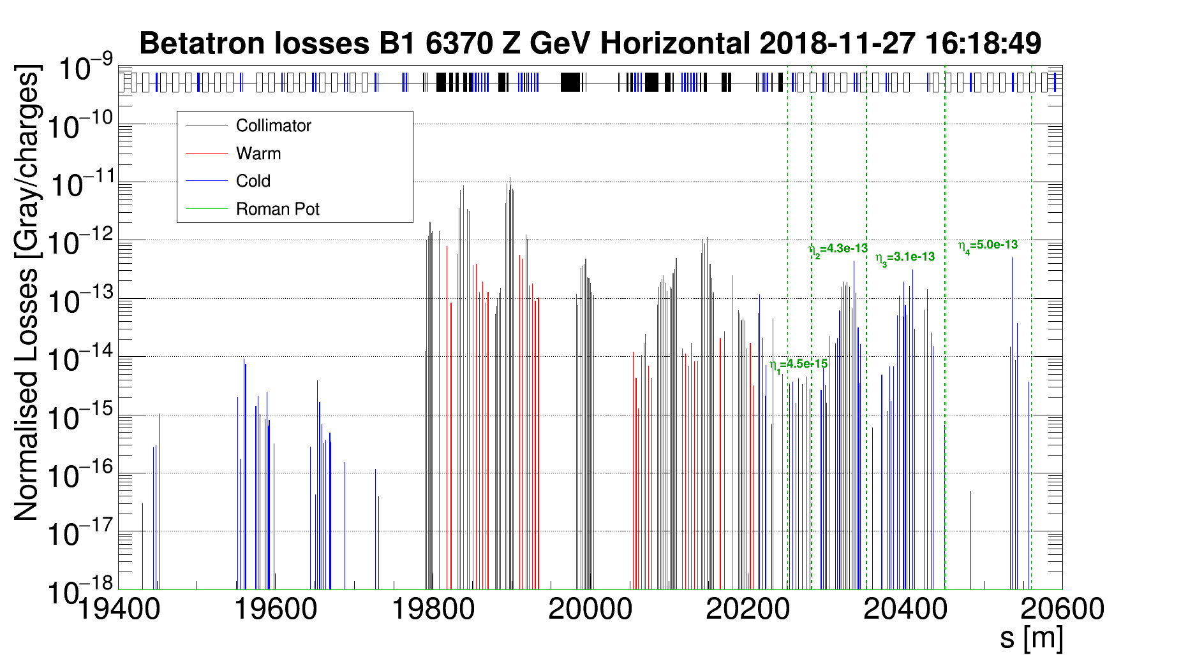
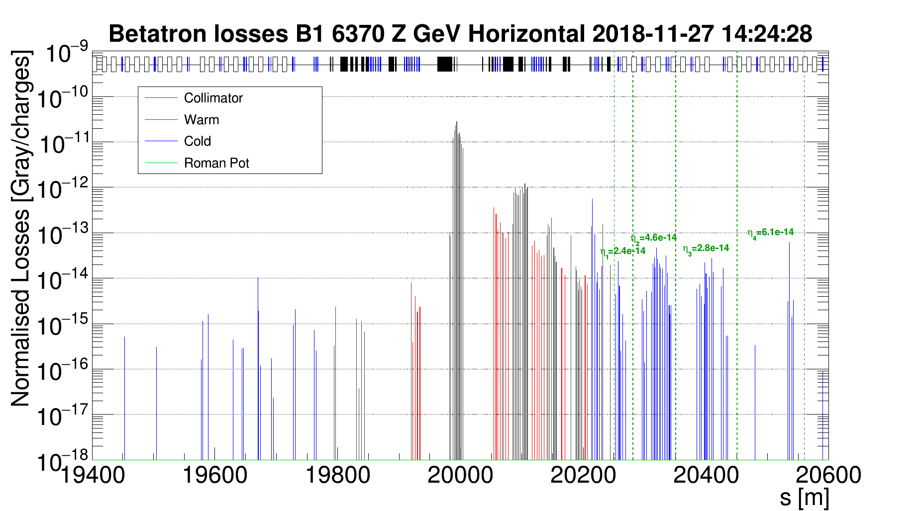
Std and Cry system comparison
STD
CRY
Normalization to particle flux
Generally cleaner pattern

Slide 21
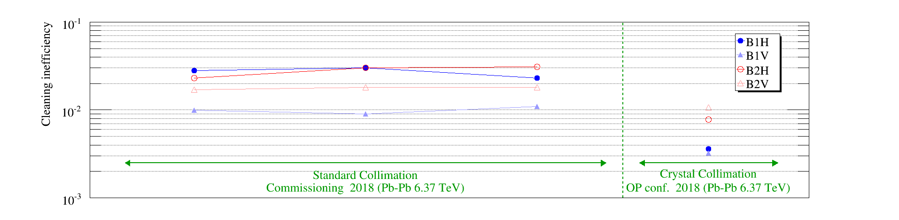
Operational tests with Pb beams
Adiabatic insertion of crystals in present collimation scheme
Standard system fully in place with crystals placed 0.25σ tighter than TCPs
All 4 crystals inserted at top energy during intensity ramp up tests
Maximum stored intensity 648 bunches
Stable channeling kept for 2-3 hours
Constant monitoring of temperature sensors on goniometers
No temperature increase observed
Final assessment on-going by impedance team
Beam loss reduction on highest cold losses, with adiabatic insertion of crystals
D. Mirarchi

Slide 22
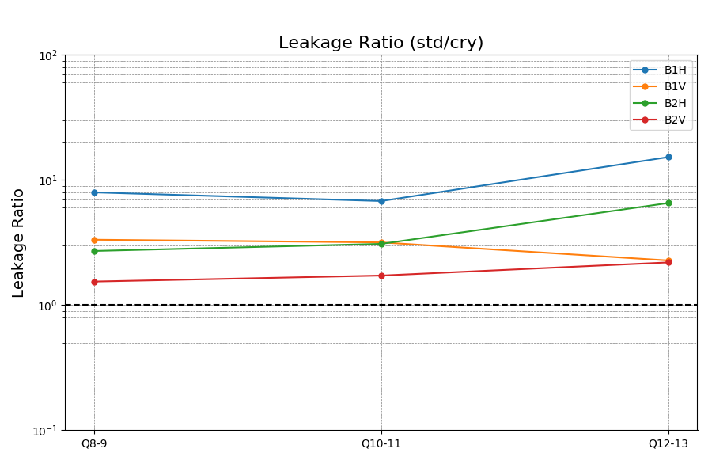


Cleaning gain in operational tests
Evaluation through ratio of leakage with standard collimation system and crystal collimation system for each region
Up to a factor 10 improvement with operational settings!

Slide 23
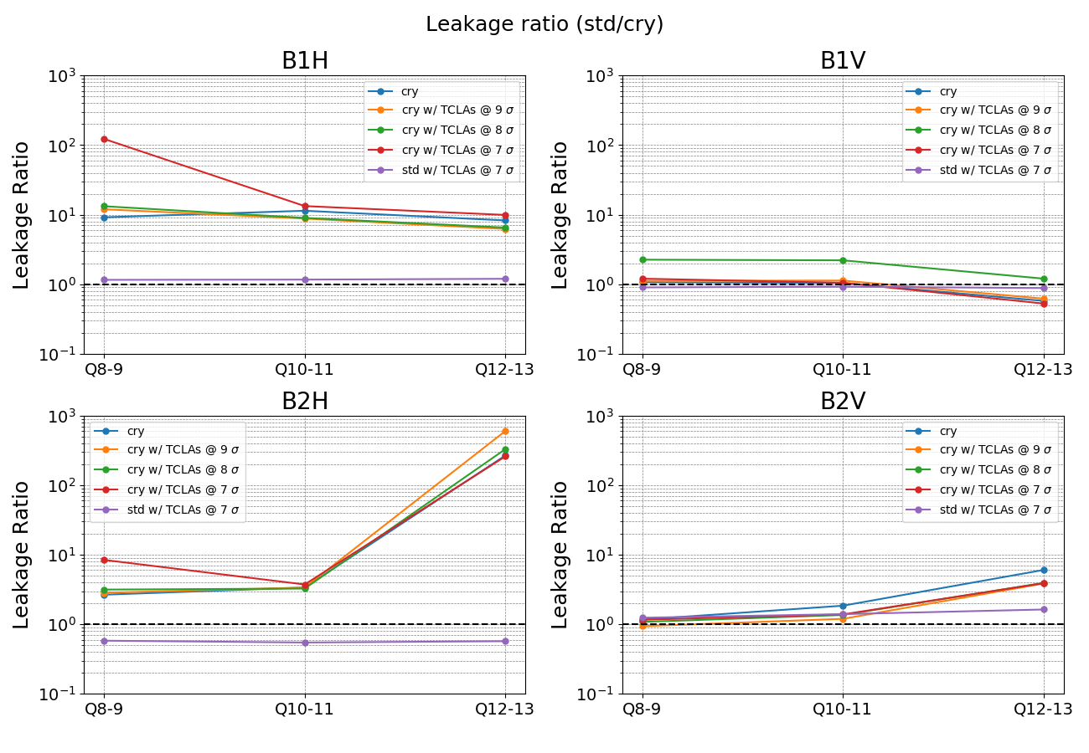
Detailed studies: only TCLAs moved
Fragments from TCSGs intercepted
Strip
QM
Strip
QM
Higher gain achievable with specific settings!

Slide 24
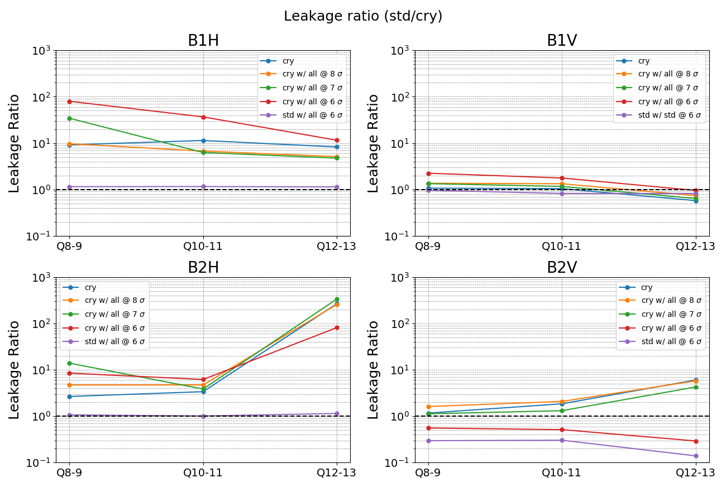
Detailed studies: TCSGs and TCLAs moved
Fragments from crystals and dechanneling intercepted
Strip
QM
Strip
QM
Higher gain achievable with specific settings!

Slide 25
Outline
Crystal channeling at the LHC
Methods for crystal characterization
Preliminary results with protons
Preliminary results with ions
Conclusions and outlook

Slide 26
Conclusions and outlook
Main outcomes
Good operational experience achieved in Run2 and first use during physics
Stable channeling during entire cycle demonstrated
Improved cleaning at flat top demonstrated
Goniometers hardware and controls provided required stability
Outlook
Comparison of measurements with simulations: miscut effects to be properly taken into account
New goniometers with updated angular redundancy currently being prototyped
Ideal system would need 8 crystals: 4 per beam, 2 per plane to fully accommodate orbit oscillations

Slide 27
Thank you for your attention!

