Slide 1





Welcome
APPEAL-3
The Discovery of the Higgs Boson – A Step Closer to the Big Bang
APPEAL-4
Discovery of the Higgs Boson –Step Closer to the Big Bang – what’s next?
APPEAL-5
The International Year of Light
APPEAL-6
Understanding the Universe – From Gravitational Waves to Sub-atomic Particles
APPEAL-7
Misadventures Along the Path to Big Physics Discoveries
APPEAL-8
Year of Engineering 2018 – Making Big Science Happen
APPEAL- 9
APPEAL-10 Future Accelerator Projects
Big Science at the High Energy Frontier
6th July 2019: Organized by CERN, JAI, STFC & University of Oxford
Professor Emmanuel Tsesmelis CERN & John Adams Institute for Accelerator Science

Slide 2
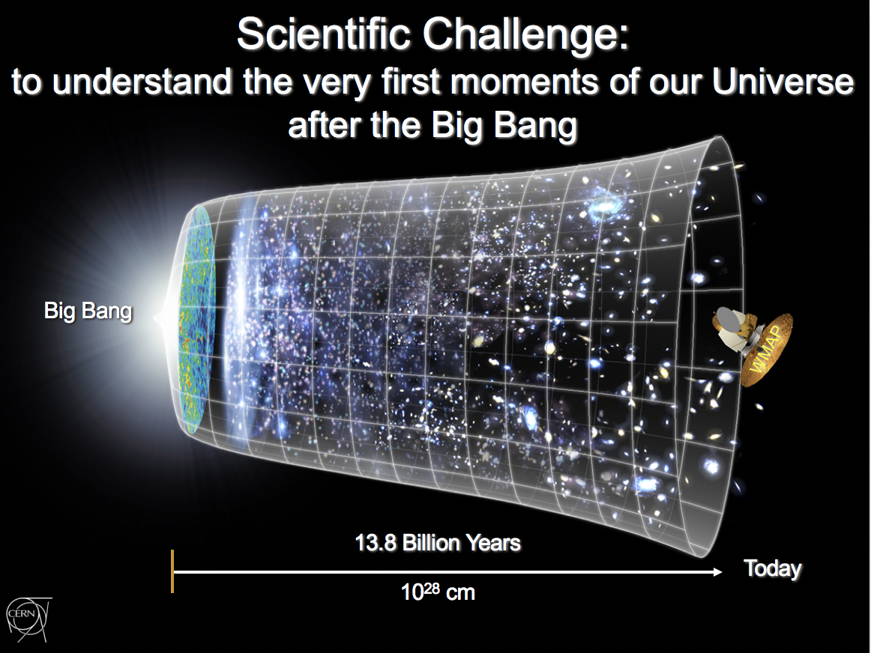
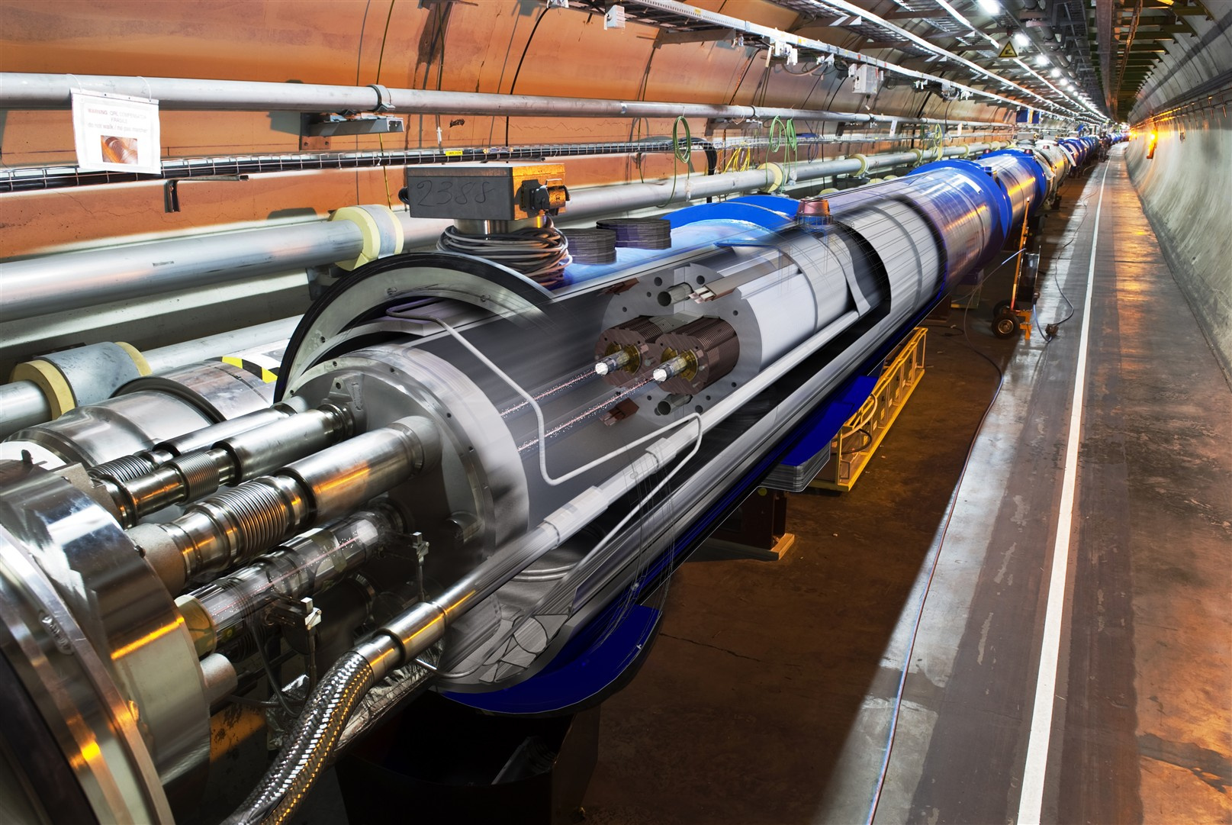
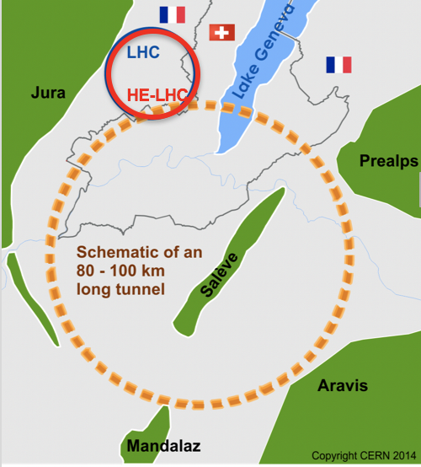
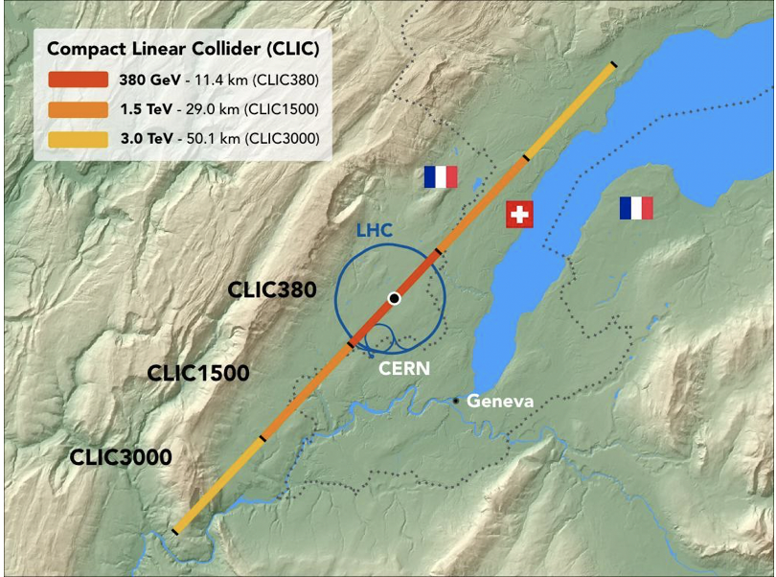
Future Accelerator Projects
Big Science at the High Energy Frontier

Slide 3
The European Strategy for Particle Physics
The European Strategy for Particle Physics is the cornerstone of Europe’s decision-making process for the long-term future of the field.
The European Strategy process was initiated by the CERN Council in 2005.

Slide 4
1st Update - European Strategy for Particle Physics 2013
Scale of facilities required by particle physics is resulting in globalisation of the field.
Europe’s top priority should be exploitation of full potential of the LHC, including the HL-LHC machine and detectors with view to collecting 10x more data than in initial design, by around 2030.
CERN should undertake design studies for accelerator projects in a global context, with emphasis on proton-proton and electron-positron HE frontier machines.
  These design studies should be coupled to vigorous accelerator R&D programme, including high-field magnets and high-gradient accelerating structures, in collaboration with national institutes, laboratories and universities worldwide..

Slide 5
1st Update - European Strategy for Particle Physics 2013
The initiative from the Japanese particle physics community to host the ILC in Japan is most welcome, and European groups are eager to participate.
  Europe looks forward to a proposal from Japan to discuss a possible participation.
CERN should develop a neutrino programme to pave way for substantial European role in future long-baseline experiments.
  Europe should explore possibility of major participation in leading long-baseline neutrino projects in US & Japan.

Slide 6
2nd Update - European Strategy for Particle Physics 2020
Europe, in collaboration with partners from around the world, is engaged in R&D projects for a range of ambitious post-LHC facilities under the CLIC and FCC umbrellas.
It is time to check progress on these, matching their expected performance to physics needs. The discussions will be based on scientific evidence gleaned from the impressive results coming in from the LHC, as well as from technological and resourcing considerations.

Slide 7
2nd Update - European Strategy for Particle Physics 2020
Other areas of particle physics
  CERN, is now contributing fully to a globally-coordinated neutrino programme with experiments to be carried out in the USA and Japan.
  The International Linear Collider, which would be complementary to the LHC, remains on the table with a site having been identified in Japan and a decision on whether to go forward expected soon.
  There are ambitious plans to build a large collider in China. And at CERN, a study to investigate the potential for physics beyond colliders.

Slide 8
The Programme
Welcome
  Emmanuel Tsesmelis
Introduction to Accelerators – Physics & Particle Colliders
  Emmanuel Tsesmelis
Future Circular Colliders
  Stephen Gibson
Future Linear Colliders
  Philip Burrows
Physics at Oxford
  Roman Walczak
Medical Applications of Accelerators
  Manjit Dosanjh
Lunch at Jesus College
Laboratory Demonstrations
  Stephen Gibson et al.

