Slide 2
Brainstorming: Education Kit
Julia.Woithe@cern.ch

Slide 3
Goal & Summary
Goal: foster an early interest and love for sciences
  Inquiry based learning / hands-on activities are students’ favourite learning activities
  (Lyons & Quinn, 2010; Swarat et al., 2012)
  Game-based learning motivates students and fosters their self-beliefs
  (Whitton & Moseley, 2012)
Target group: math and science teachers and their lower secondary school students, grades 6-8, (11-14 years)
  Critical age group, “science is not for me” (ASPIRES project, e.g. Archer et al. 2010)
Education kit:
  Provide material and instruction for fascinating experiments
  Content related to curriculum, identify most promising topics & grade
  Scientific method (predict – observe – explain, unexpected observations)
  CERN / modern physics context / content

Slide 4
Topics for exciting experiments
Structure of matter (grade 6): particle model, volume, mass, weight, density
Properties of matter (grade 6/7): changes of state, thermal conductivity, temperature, heat, specific heat, conductors and insulators, electrical conductivity
Motion and forces (grade 7): velocity, uniform, accelerated and pendular motion, force intensity, forces’ characteristics, gravitational force, friction, composition of forces, Newton's laws of motion, levers, pressure, specific weight

Slide 5
Topics for exciting experiments
Action at a distance (grade 7/8): magnetic and electrostatic forces, magnetic field and poles, electric current, electric circuit, current intensity and potential difference, gravitational force
Energy and its transformation (grade 8): work and energy, kinetic, potential, thermal and electrical energy, power, conservation, dissipation, chemical reactions
Interaction between energy and matter (grade 8): audio waves, frequency, amplitude, infrasound and ultrasound, reflection and absorption; light waves, infrared and ultraviolet radiations, reflection, refraction and diffusion of light

Slide 6
CERN topics & contexts
Scientific method: theory vs. experiment, predict, observe, explain
Indirect observations: “mystery boxes”, scattering experiments
Maths: Powers of ten, very small length scales, high energy scales
Forces and motion: particle accelerators, linear & circular
Magnets: mysterious forces, needed for accelerators and detectors
Electric charges: mysterious forces, needed for accelerators
Electric circuits: at the core of almost everything, electr. resistance
Pressure/vacuum: needed for accelerators, detectors, antimatter

Slide 7
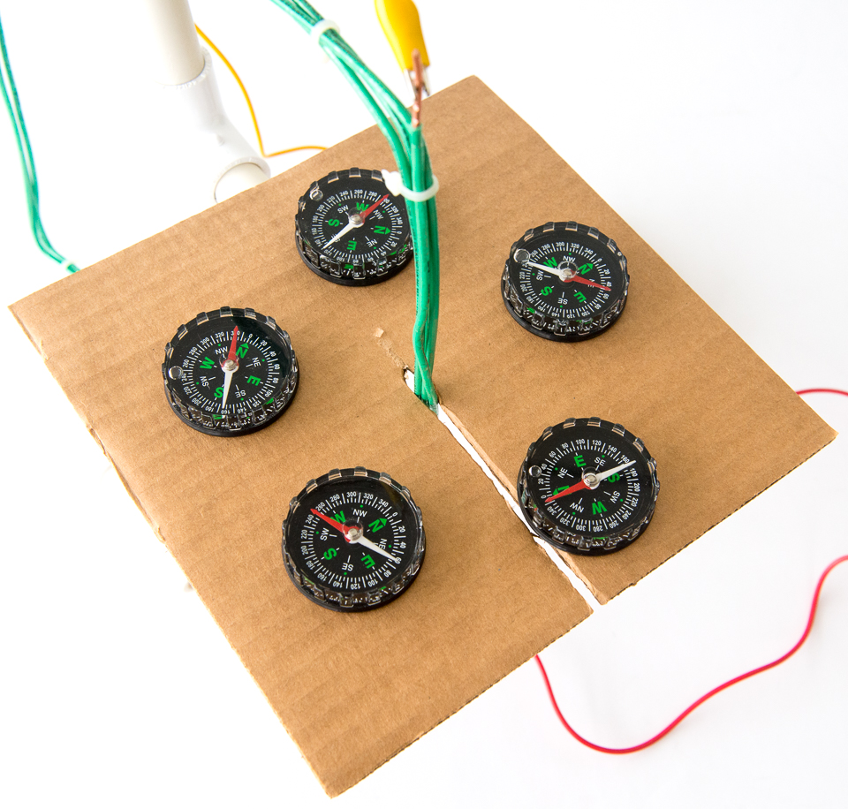
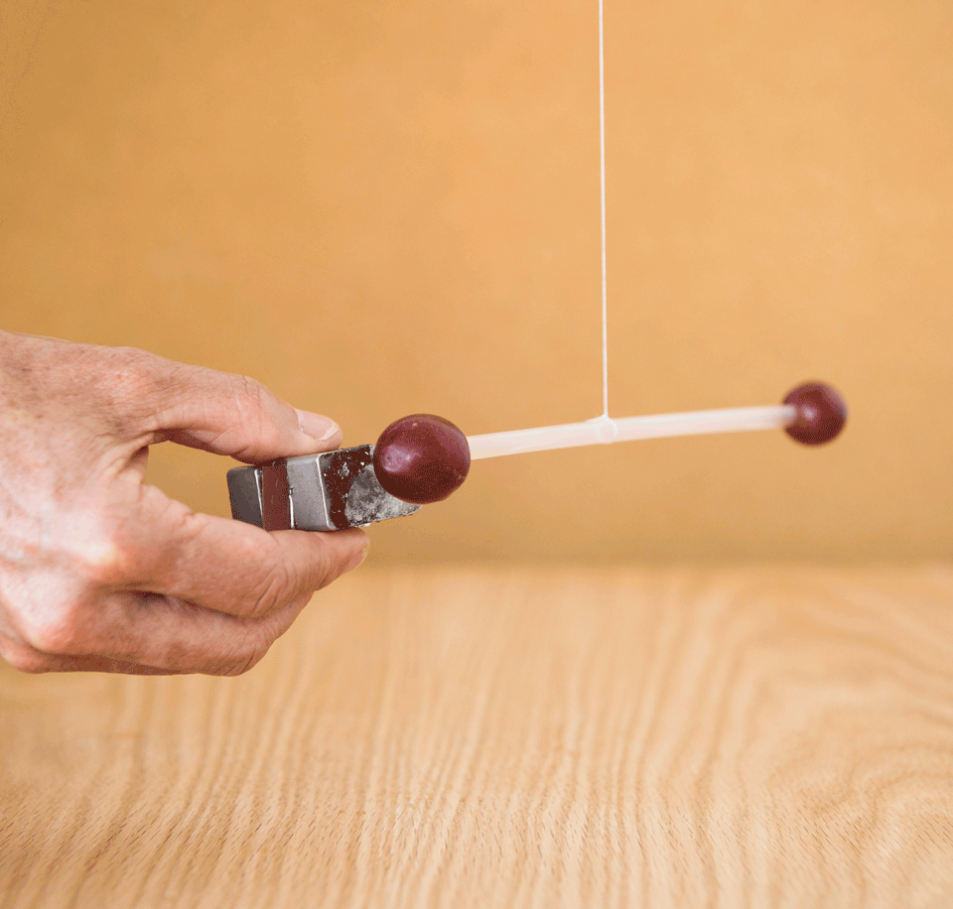
Existing resources
Exploratorium, science snacks (EN)
www.exploratorium.edu/snacks
Hands-on science activities, explorations of natural phenomena that teachers or students can make using common, inexpensive, readily available materials

Slide 8
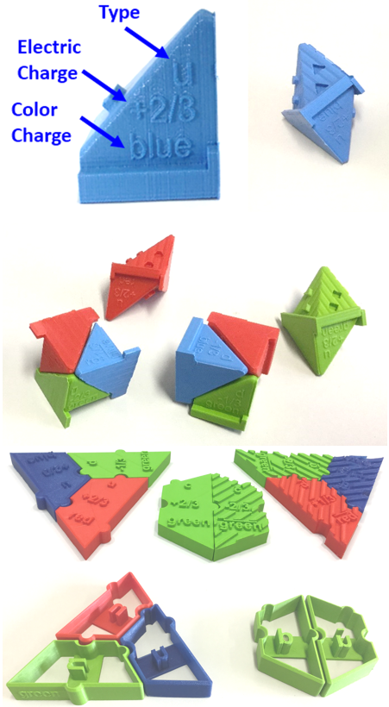
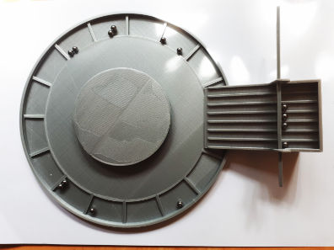
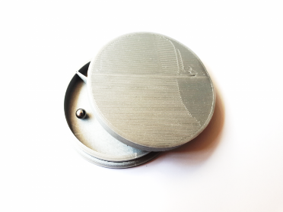
Existing resources
S‘Cool LAB classroom activities (EN)
cern.ch/scool-lab/classroom-activities
Collection of hands-on activities for the classroom related to particle physics

Slide 9
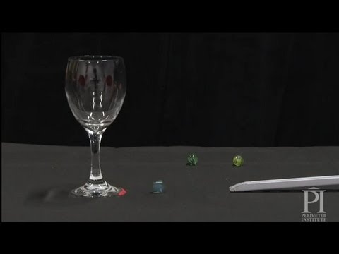
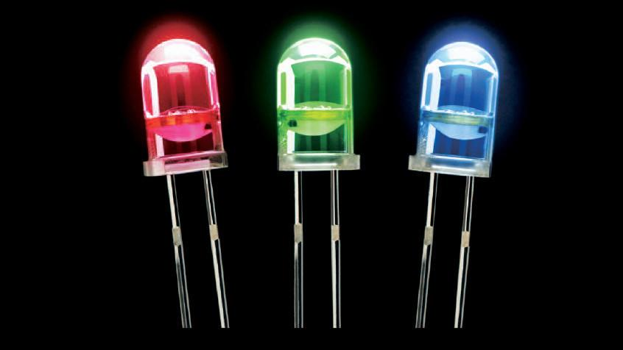
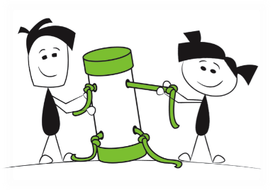
Existing resources
Perimeter Institute (EN)
resources.perimeterinstitute.ca
Education resources & classroom kits, hands-on activities and demos, modifiable worksheets, background information for teachers, and original PI videos

Slide 10
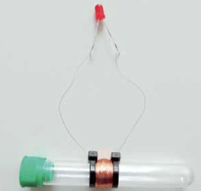
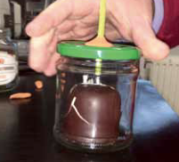
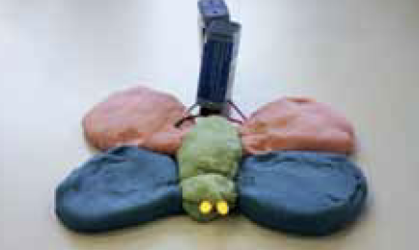
Existing resources
Helmholtz Association, network of school labs (DE)
www.helmholtz.de/experimente
Guide for easy experiments to do at home (or in the classroom)

Slide 11
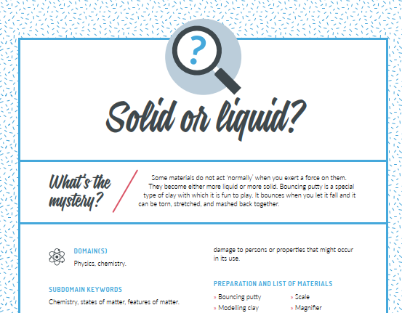
Existing resources
TEMI (IT, EN, …)
http://www.projecttemi.eu/
Teaching Enquiry with Mysteries Incorporated: Inspiring teaching materials to support enquiry-based learning in the sciences

Slide 12
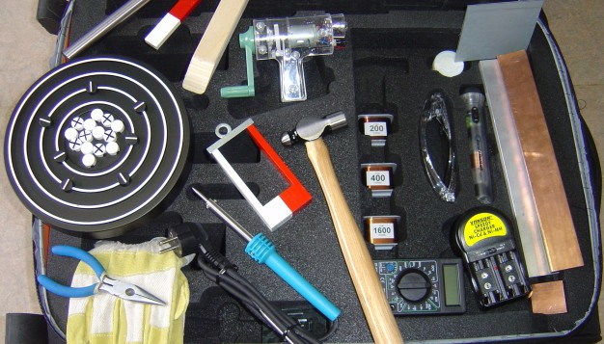
Existing resources
MOSEM education kit (EN)
https://eu.mosem.eu/downloads/mosem-teacher-guide-electronic/
Education kit of simple experiments with magnets, electricity & induction, blended with electronic and printed support (upper secondary)

Slide 13
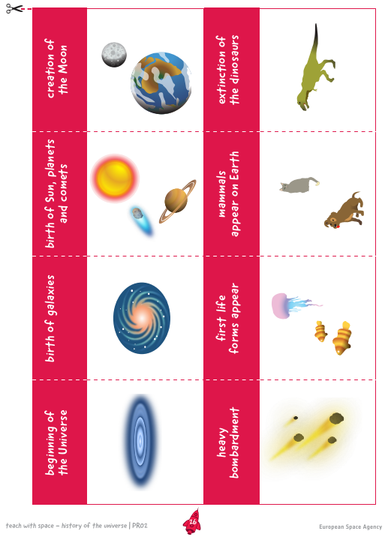
Existing resources
ESA Education (EN)
https://www.esa.int/Education/Teachers_Corner/Teach_with_space3
Teaching material in the space context e.g. powers of ten

Slide 14
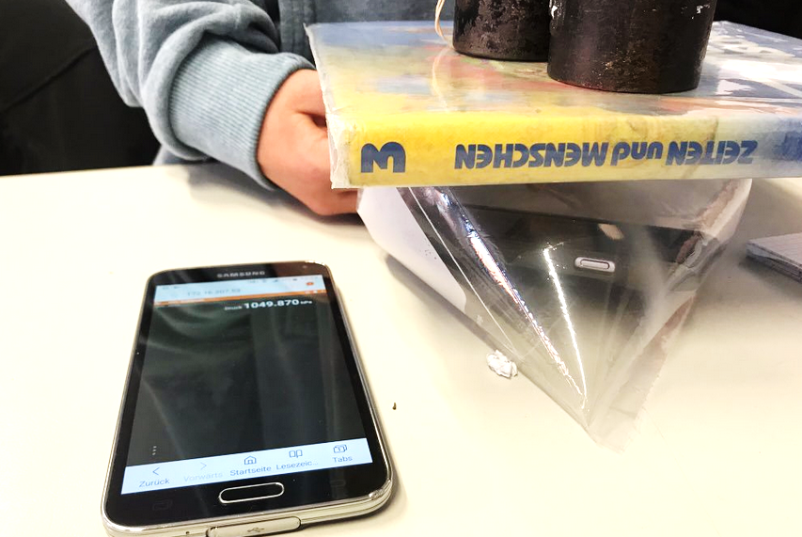
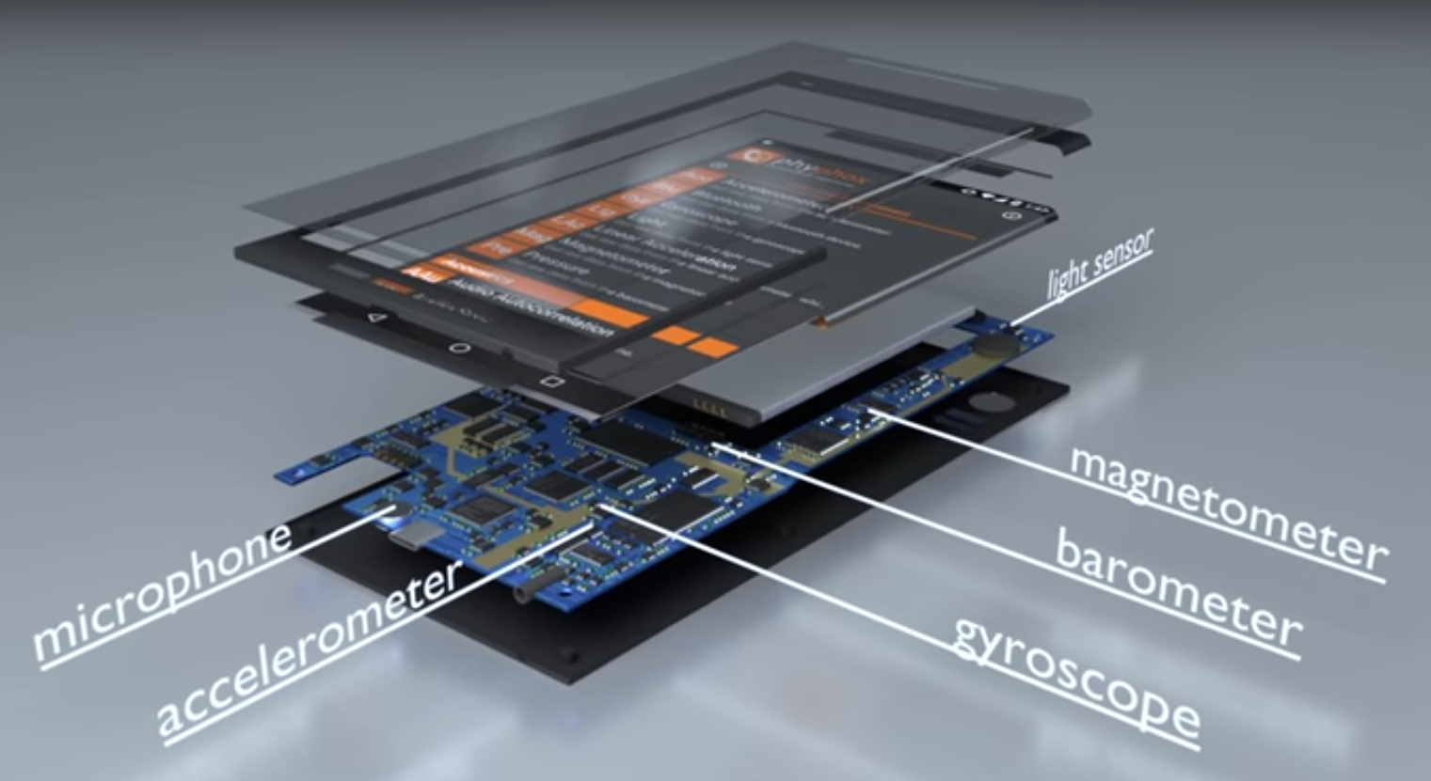
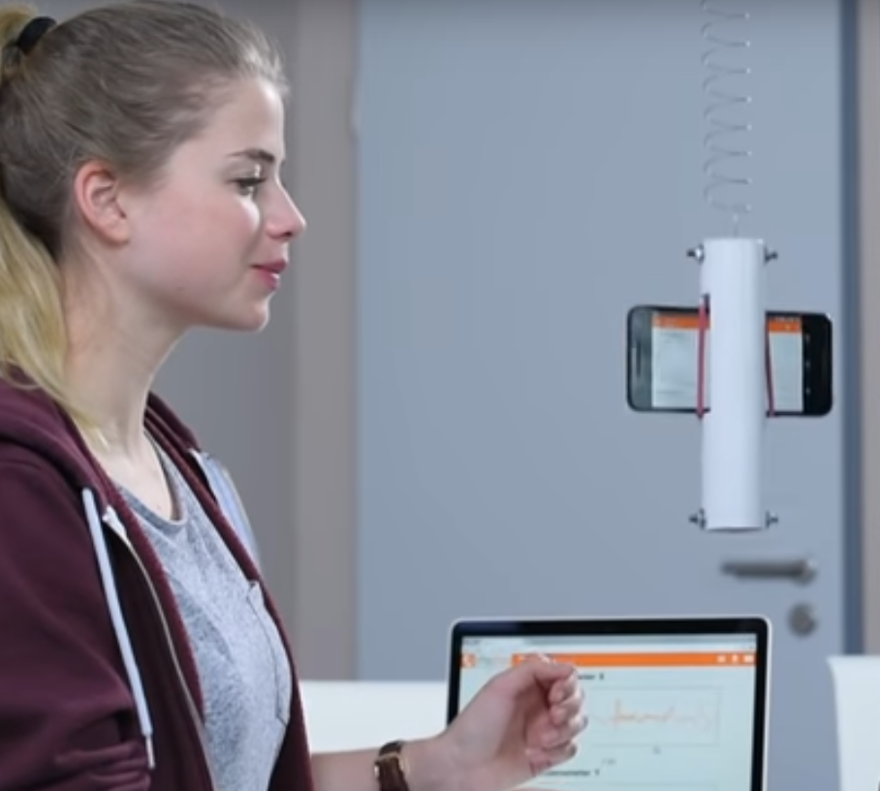
Existing resources - tools
PhyPhox App (IT, EN, …)
phyphox.org/experiments/
App allow to use the sensors in your phone for numerous experiments

Slide 15
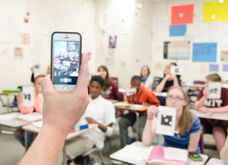

Existing resources - tools
Plickers App (EN)
https://www.plickers.com
Poll a class for free, instant checks-for-understanding, exit tickets, and impromptu polls

Slide 16
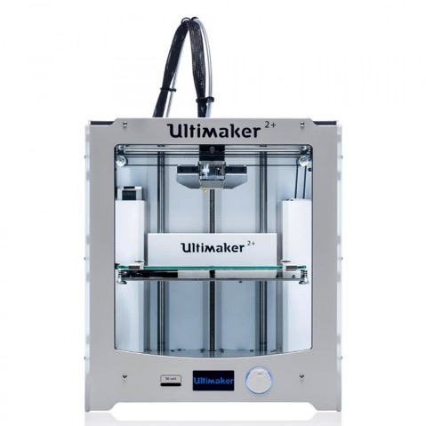
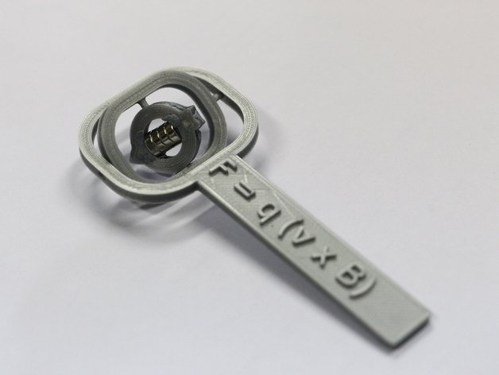
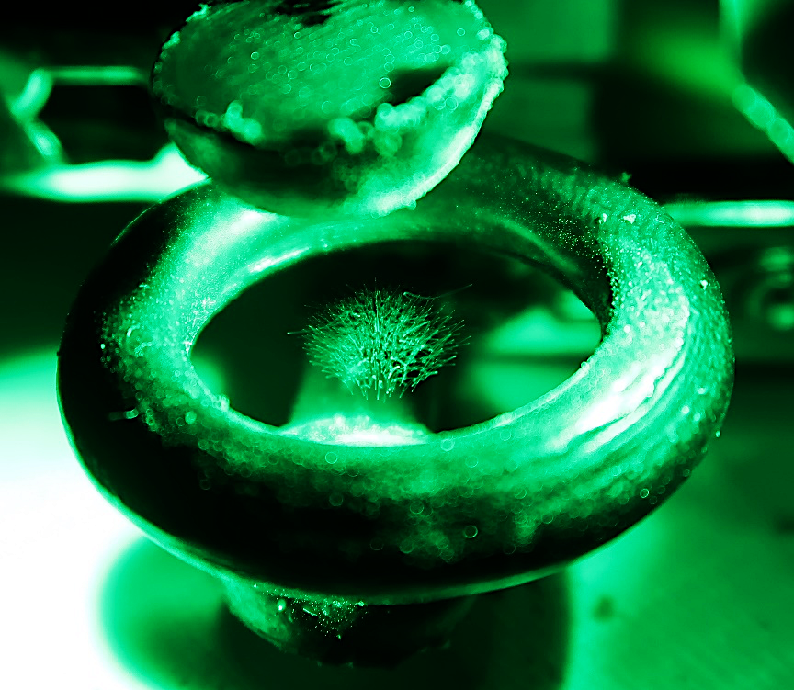
Existing resources - tools
3D printers and databases for educational 3D printable things e.g.
www.thingiverse.com/education

Slide 17
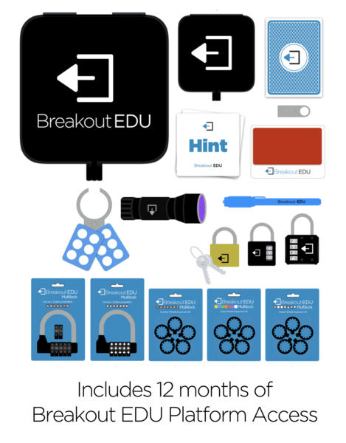
Existing resources - tools
Breakout EDU kit
https://www.breakoutedu.com
Kit with different tools and locks, to play educational escape games with a class

Slide 18
Summary: useful equipment / tools
Everyday equipment: rope, elastic strings, tape, aluminium foil, balloons, sand paper, straws, blu-tack
Many great experiments need: magnets, compasses (2D & 3D), LEDs, resistors, copper wire, cables, conductive paint, springs, batteries/battery packs
Promote available tools: Smartphone sensors (Phyphox), online polls (plickers), 3D printers
Gamify activities for additional motivation: captivating storyline, puzzles, hints, locks & keys

Slide 19
Experiences & risks
Teachers are more likely to use material regularly if strongly encouraged to do so at least once (e.g. force teachers to document at least 1 experiment via social media to keep the kit)
Curriculum links and well-designed ready-to-use worksheets are crucial
It is important to understand the needs of the target audience well

Slide 20
Literature
Archer, L., et al. (2010). "“Doing” science versus “being” a scientist: Examining 10/11‐year‐old schoolchildren's constructions of science through the lens of identity." Science Education 94(4): 617-639.
Lyons, T. and F. Quinn (2010). "Choosing Science: Understanding the declines in senior high school science enrolments.”
Swarat, S., et al. (2012). "Activity matters: Understanding student interest in school science." Journal of Research in Science Teaching 49(4): 515-537
Whitton, N., & Moseley, A. (Eds.). (2012). Using games to enhance learning and teaching: a beginner's guide. Routledge.

Slide 21
Brainstorming
Topics, equipment, tools, gamification, development, pilot, …

