Slide 1

Quarterly pledge implementation
MB 02.04.2019
Julia Andreeva , CERN

Slide 2
REBUS functionality in CRIC
WLCG topology (Federation, Regional Centers Sites, Experiment sites, yearly pledges) is implemented in CRIC. Data is bootstrapped from REBUS
Authorization and authentication for federation responsibles who are allowed to modify pledge information is enabled and authorized groups are bootstrapped from REBUS (to be tested)
UI for data navigation (table and per instance detailed view) and UI for data update have been implemented
Advanced logging information on the level of a single object instance (who, when and how touched object info) is enabled
WLCG CRIC instance https://wlcg-cric.cern.ch/

Slide 3
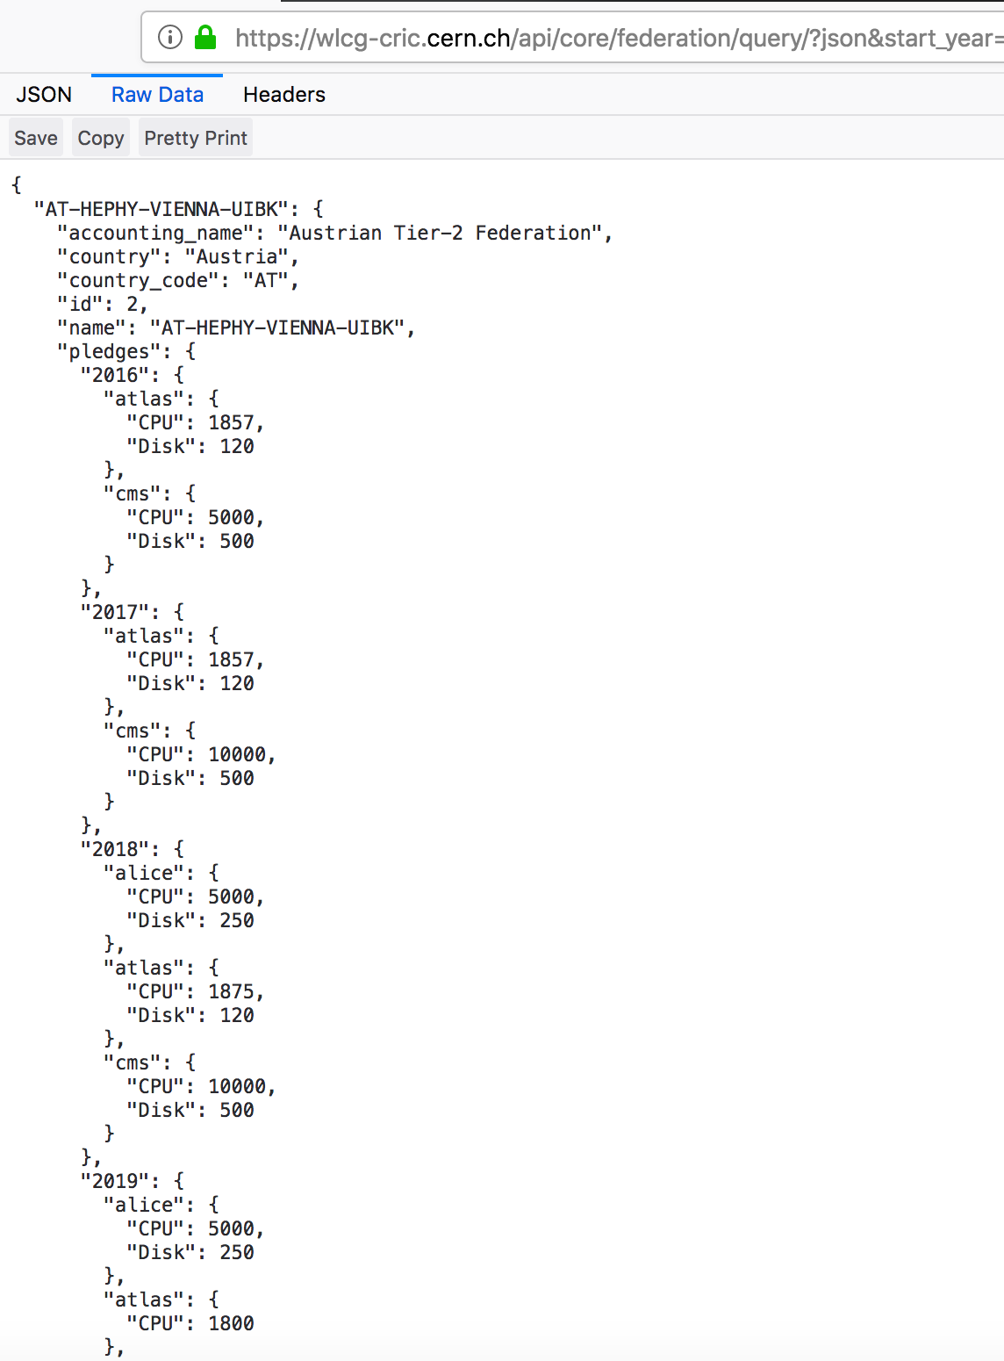
Quarterly pledges
Current functionality is the same as in REBUS. First clients started to use CRIC APIs and we should not break them
Implementing flexible pledge handling: pledge, start validity date, end validity date.
This implies that an API for pledge historical info retrieval will change. We will provide a backward compatible API taking pledge as been defined by the 1st of April of each calendar year

Slide 4
Main implications
The main implications are for the accounting applications and monthly accounting reports
The EGI portal should be changed to deal with the finer granularity pledge.
WLCG Storage Space Accounting application has to be adapted
Monthly accounting report generation should be changed as well

Slide 5
What we plan to do
In order to accelerate the implementation, we will take over generation of the monthly accounting reports from the EGI portal. We need to integrate storage accounting data into monthly accounting reports. So, both new features ( storage usage and quarterly pledges) will be implemented at the same time. This functionality will be accessible from the WLCG accounting validation application which has been presented at the last GDB. See backup slides. Time line - summer this year.
Follow up with the EGI developer on the required changes in the EGI portal
Follow up with other clients (experiment-specific accounting applications)

Slide 6
Backup slide. Improving the procedure (2)
Validate monthly data
Sites
EGI CPU accounting
Pulls monthly CPU accounting
Extended WSSA
Validation application: Agree/Provide corrected data
Validated monthly summaries
and logs of site validation
Auto-generated monthly summaries
CRIC (topology and authorization)

Slide 7
Backup slide. Improving the procedure (3)
Sites
Validate monthly data
EGI CPU accounting
Pulls monthly CPU accounting
Extended WSSA
Validation application: Agree/Provide corrected data
Validated monthly summaries
and logs of site validation
Auto-generated monthly summaries
CRIC (topology and authorization)
Comparing the two and following up on the inconsistencies

