Slide 1
ALARA level II – Group 1 - ISOLDE YETS 2017-2018 and operation 2018
Justification, optimisation and REX
EDMS 1570850
24/08/2018
EN-STI-LP/RBS/TCD sections
Notes:
Method:
individual interviews with group leaders based on the April schedule -> to gather bottom-up data,
EN retreat on 1st July -> the aim was to bring the MTP in line with the last schedule & saving requests from the Council in June
ENMB on 26th July -> validate with group leaders the top-down arbitration

Slide 2
Introduction – YETS 2017-2018
Introduction
Target transfer to ISR3
Reorganization of the targets in ISR 3
FE maintenance
SEMGRID beam alignment
Laser window exchange maintenance and tests
LIEBE target tests
Inspection of the HRS and GPS FE
Cleaning of the 179 and 838
Montrac maintenance and tests
List (LIST) Tests
Retrieval of the target #501 and test laser on HRS FE
Additional maintenance of the MONTRAC
HRS FE patch-panel replacement
Conclusion

Slide 3
1. Introduction
WDP | WDP N° | WDP state | Est Coll. Dose (μSv) | Real Coll. Dose (μSv) | Δ Real-est. Coll. Dose (%) | Est Max Ind. Dose (μS) | Real Max Ind. Dose (μS) | Δ Real-est. Ind. Dose (%) | Group1 | Group 2 | Impact N° | Impact state | Period
Target transfer to ISR3 | 1055/1 | Approved | 419 | 493 | +18 | 126 | 134 | +6 | 2 | 3 | 105026 | Approved | YETS
Reorganization of the targets | 1084/1 | Approved | 222 | 75 | -66 | 98 | 61 | -38 | 1 | 1 | 106618 | Approved | YETS
FE maintenance and micro switch system replacement | 1093/1 | Approved | 3248 | 2766 | -15 | 879 | 757 | -14 | 2 | 3 | 107149 | Approved | YETS
SEMGRID beam alignment | 1111/2 | Approved | 116 | 134 | +16 | 66 | 84 | +27 | 2 | 3 | 107007 | Approved | YETS
Laser window exchange | 1090/1 | Approved | 99 | 13 | -87 | 49 | 10 | -80 | 1 | 3 | 107256 | Approved | YETS
LIEBE target tests | 1114 / 1 | Approved | 1322 | 1058 | -20 | 699 | 429 | -39 | 2 | 1 | 108540 | Approved | YETS
Inspection of the FE on HRS and GPS | 1094/1 | Approved | 800 | 115 | -86 | 267 | 62 | -77 | 2 | 2 | 107103 | Approved | YETS
Cleaning of the 179 and 838 | 1095/1 | Approved | 379 | 30 | -92 | 181 | 28 | -85 | 2 | 2 | 107270 | Approved | YETS
MONTRAC maintenance and tests | 1081/1 | Approved | 706 | 196 | -72 | 433 | 66 | -85 | 2 | 2 | 106492 | Approved | YETS

Slide 4
1. Introduction
WDP | WDP N° | WDP state | Est Coll. Dose (μSv) | Real Coll. Dose (μSv) | Δ Real-est. Coll. Dose (%) | Est Max Ind. Dose (μS) | Real Max Ind. Dose (μS) | Δ Real-est. Ind. Dose (%) | Group1 | Group 2 | Impact N° | Impact state | Period
LIST TEST | 1123 /1 | Approved | 82 | 28 | -66 | 27 | 13 | -52 | 1 | 2 | 109149 | Approved | YETS
Retrieval of the target #501 and test laser on HRS FE | 1141 /1 | Approved | 35 | 14 | -60 | 35 | 11 | -69 | 1 | 2 | 110064 | Approved | YETS
Additional MONTRAC maintenance | 1125 /1 | Approved | 736 | 86 | -88 | 371 | 69 | -81 | 2 | 2 | 109180 | Approved | YETS
ISOLDE HRS FE patch panel replacement | 1157/1 | Approved | 1664 | 546 | -67 | 456 | 243 | -47 | 2 | 2 | 111111 | Approved | YETS

Slide 5
Introduction
Target transfer to ISR3

Slide 6
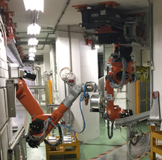
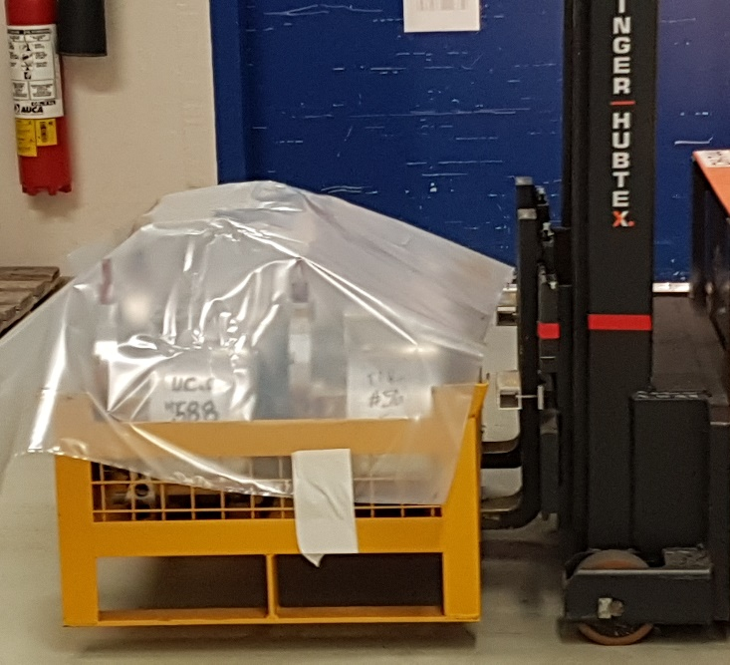
2. Target transfer to ISR3
JUSTIFICATION
Targets removed to reduce dose rate for maintenance interventions inside the target area.
Targets removed to free storage space for the following operation year.
OPTIMIZATION | PICTURE
Intervention performed every year → Expertise allows faster and more precise interventions.
Transport done outside working hours because dose rate at contact of the truck may be > 2mSv/h
Targets placed in the boxes using the KUKA robot and transported by remote forklift

Slide 7
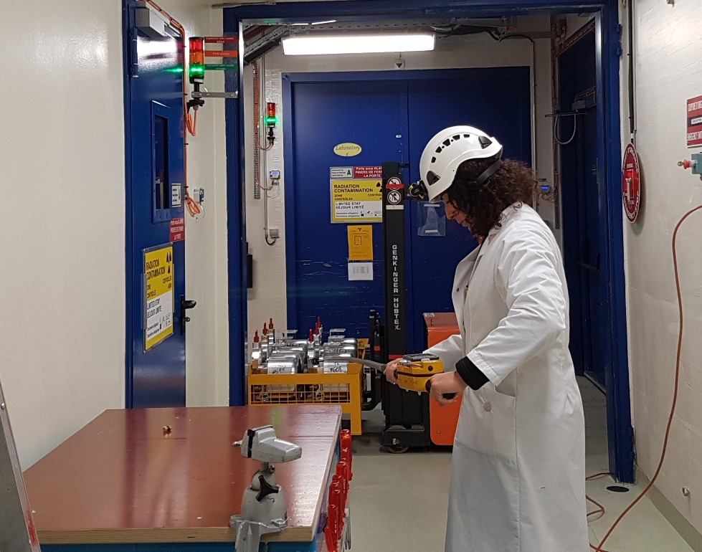
2. Target transfer to ISR3
OPTIMIZATION | PICTURE
Gabarit inside truck to ensure a sufficient distance between the box and the container walls to reduce dose rate at contact of the truck
Distance kept free from cabin driver (an empty box or a box with cold targets is placed at the first position inside the truck).
RP measurements on truck done with telescopic monitor
RP measurements on each target done using the KUKA robot
Optimisation of target distribution inside boxes ("hot" targets are shielded by less irradiated targets)

Slide 8
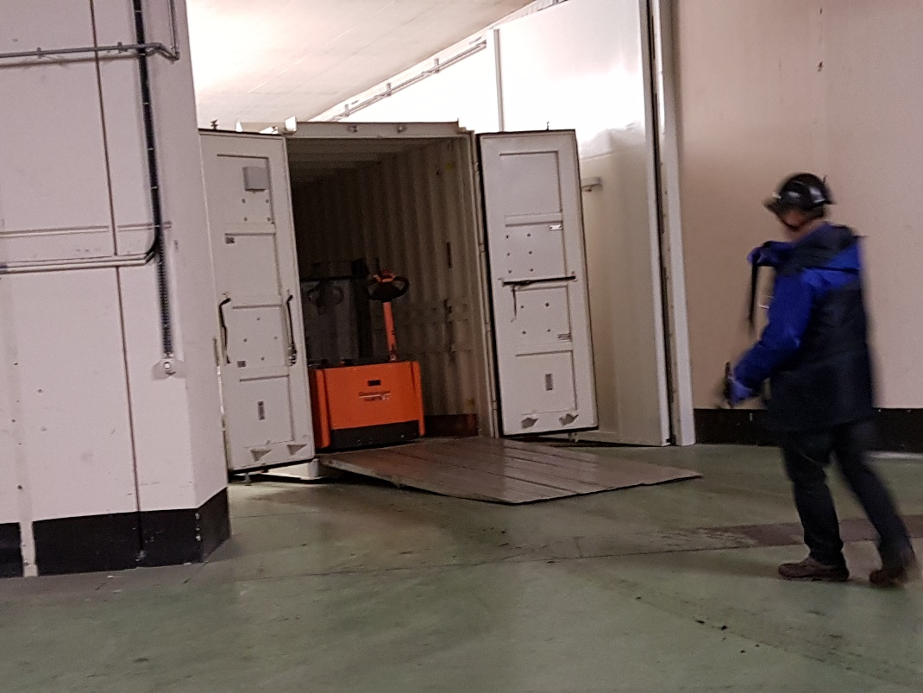
2. Target transfer to ISR3
OPTIMIZATION | PICTURE
Camera placed in the Target Area to help the robot operator
Communication with the robot operator established with walkie-talkies to avoid phone network problems
Forklift used to shield the last box (dose reduced during opening/closing of the truck doors)

Slide 9
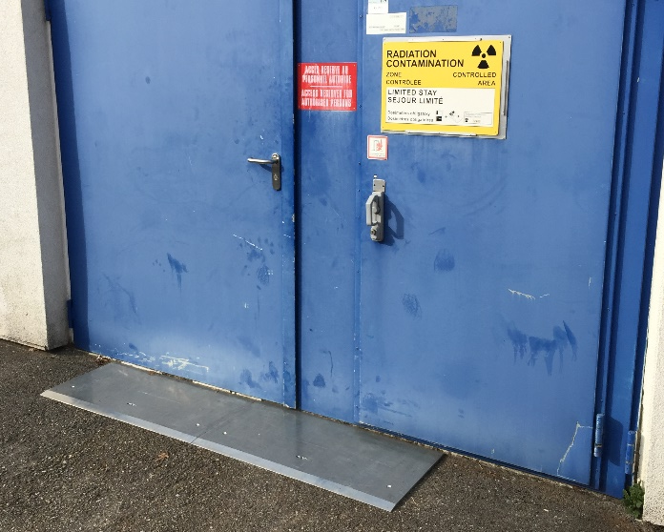
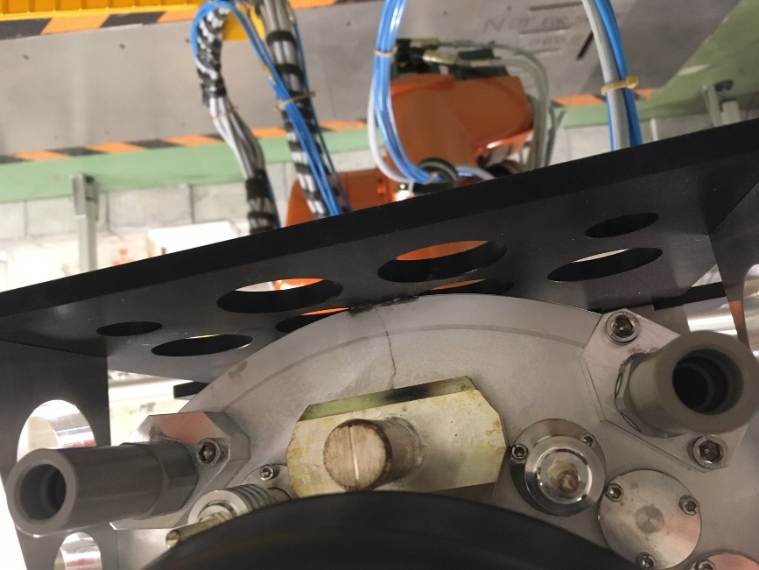
2. Target transfer to ISR3
REX | RESULTS / ACTION / PICTURE
New fixed ramp installed to cross the entrance of building 179 with the forklift more easily (see REX from EDMS 1570850) | R = Forklift with box did not get stack at the exit of the building
Integrity of the targets checked before putting them inside the boxes in order to detect any problems (see REX from EDMS 1570850) | R = It permits to detect traces of a leak on target #611 planned to be reused for 2018 operation. This target was moved manually to an ISR waste disposal box.
The number of plugs available was not enough for all the targets and some old plugs had to be decontaminated | A = - plugs should be checked and ordered if needed before starting the activity - Add to procedure 1449875

Slide 10
2. Target transfer to ISR3
REX | RESULTS / ACTION / PICTURE
Some back up targets brought from the ISR the previous year were forgotten | A = - check all the targets present in the shelves before arranging the boxes, - check also the cupboards in building 179 - add to procedure 1449875
The target distribution inside the ISR was not consistent with the excel sheet and targets were not placed in the planned spot | A = - Check and update this file before transport - update the Excel file EDMS 1278074 - add to procedure 1449875
The Walkie-Talkies run out of batteries during the target distribution | A = - always charge the batteries before the activity - add to procedure 1449875
Additional targets irradiated in 2016 were added to the list of the targets to bring back after the beginning of the intervention. As it was not planned, targets #530 and #587 were put manually into the boxes manually. | R= Increased of the dose received A = - Check the list of all the targets to repatriate with RP, the operation and physics before the beginning of the intervention - add to procedure 1449875

Slide 11
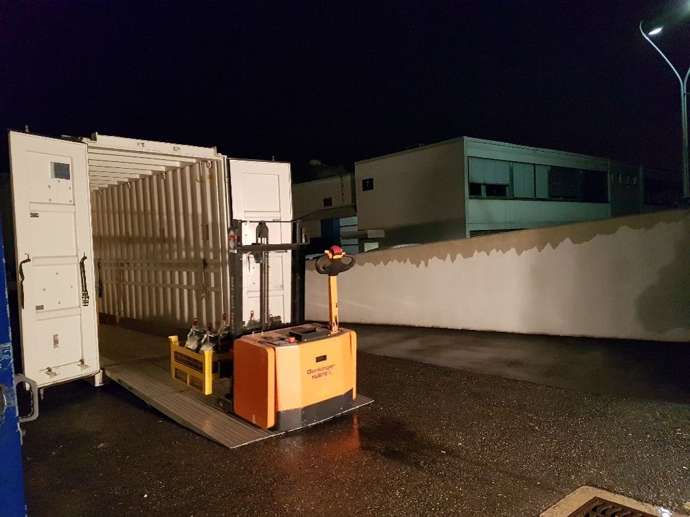
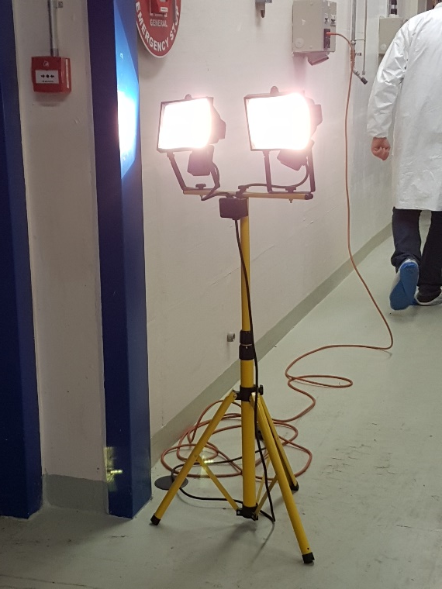
2. Target transfer to ISR3
REX | RESULTS / ACTION / PICTURE
Because of the weather forecast, the target transfer was shifted from Saturday 20-01-18 to Friday 19-01-18 at 18h (night) | A = additional light projectors added at the entrance of blg 179

Slide 12
Introduction
Target transfer to ISR3
Reorganization of the targets in ISR 3

Slide 13
3. Reorganization
of the targets in ISR 3
JUSTIFICATION
Optimize the distribution of the targets stored inside the ISR 3 by : Changing the boxes of 3 targets by boxes of 6 targets to save space Regrouping on the shelves the boxes with targets in order not to have free spaces between the boxes
Reduce the dose received while making the transport back by : Having free space to put the targets that are going back to ISOLDE far away from the rest of the targets
OPTIMIZATION
RP measurements done with telescopic monitor
Rearrangement of the targets done at the entrance of the ISR 3 to avoid being exposed to the dose rate of the other targets stored on the shelves
To reduce the dose received, rearrangement of the target planned in advance with the Excel File containing the location of all the boxes and targets

Slide 14
3. Reorganization
of the targets in ISR 3
REX | RESULTS / ACTION / PICTURE
The Excel file was not properly updated after rearranging the targets which lead to misunderstanding during the target transport | see REX slide 10
Some of the rearranged targets are needed for future operation and/or tests | A= Always check with the target responsible before moving targets

Slide 15
Introduction
Target transfer to ISR3
Reorganization of the targets in ISR 3
FE maintenance

Slide 16
4. FE maintenance
Phase I - Worksite preparation and shielding installation
JUSTIFICATION
Reduce the Dose rate reduced by a factor : 40% inside GPS Faraday Cage 30% inside HRS Faraday Cage By installing Shielding on dumps and beam windows,
Cost of installation lower than collective dose saved over YETS
OPTIMIZATION
Intervention performed every year → Expertise allows faster and more precise interventions
Shielding installed before performing any intervention inside the Faraday Cage
Shielding is part of the optimisation process

Slide 17
4. FE maintenance
Phase I - Worksite preparation and shielding installation
REX | RESULTS / ACTION / PICTURE
Dose received during the removal of the MONTRAC cover was higher than expected (x2) | R1= the seal melted and additional screwdrivers were used to remove the MONTRAC cover A= - The MONTRAC cover should setup without seal. - Add procedure 1564564 /Julien Riegert – EN/STI R2= No impact on the ventilation of the faraday cage has been observed since that remounting without seal
During the replacement of the electrode on GPS side, the electrode didn’t come back properly into its place. At the beginning, it was assumed that the problem came from the electrode which didn’t engage properly on the threading : the initial solution was to manually hold the electrode and to turn it to put it back on the thread. | R1= This operation done manually didn’t work and conduced to an important increased of the dose received of 400 uSv. (240uSv initially planned)

Slide 18
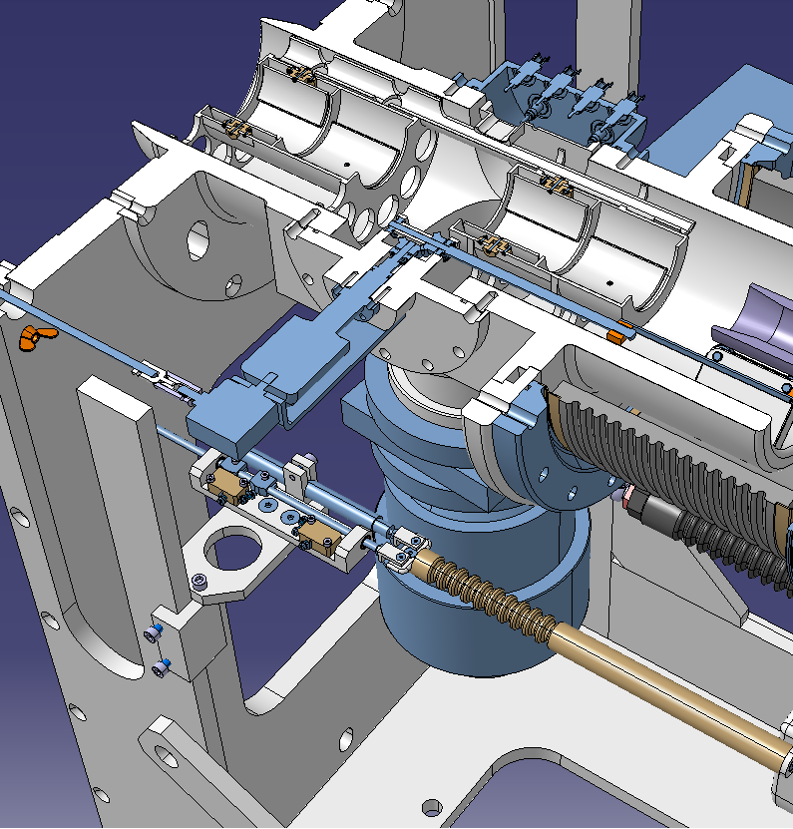
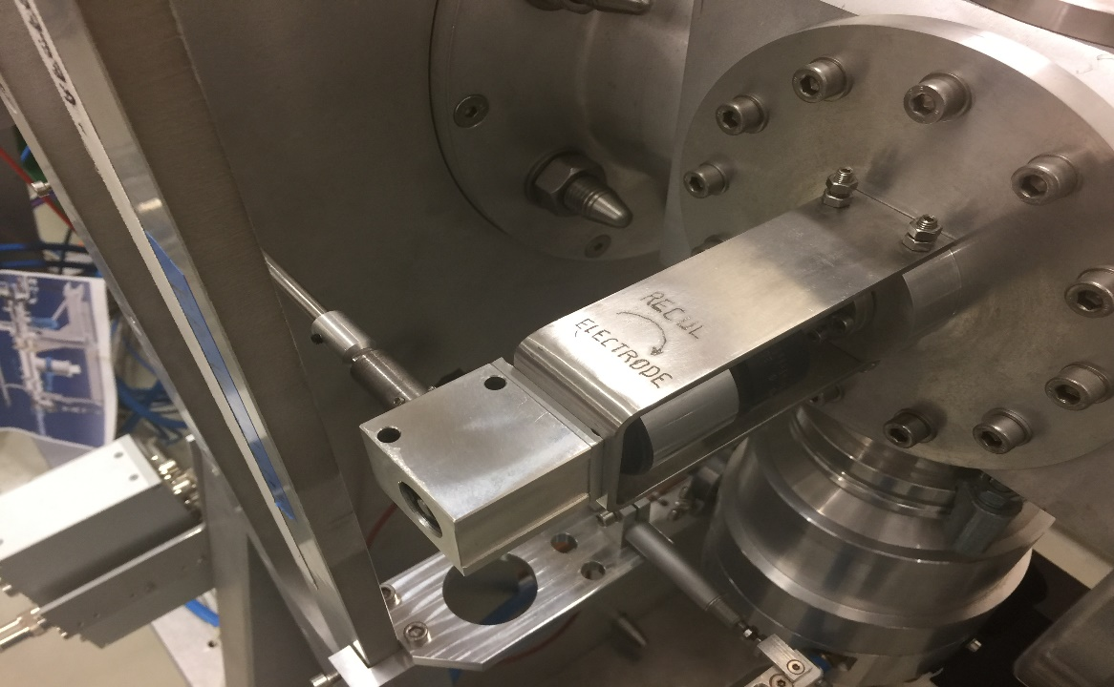
4. FE maintenance
Phase I - Worksite preparation and shielding installation
REX | RESULTS / ACTION / PICTURE
The next day, a second operator examined the FE, and found that the problem was linked to two screws untighten that had caused calibration problems (see following slide) | A= On next generation of FE installed during LS2, a system with cotters will replace theses screws and remove this type of problem / Stefano Marzari – EN/STI
Electrode
Position of screws to tight (Offline 2 picture)

Slide 19
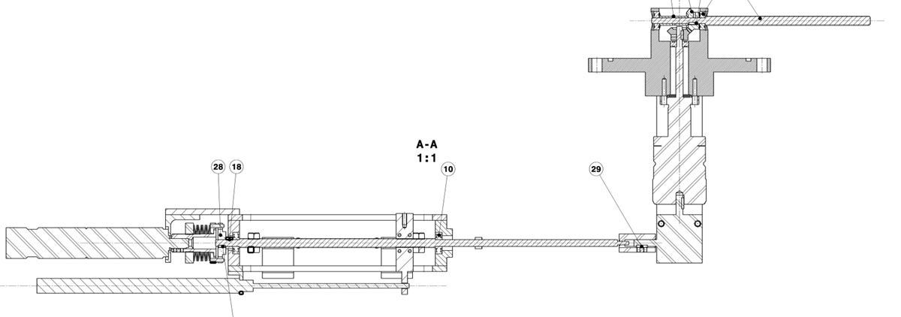
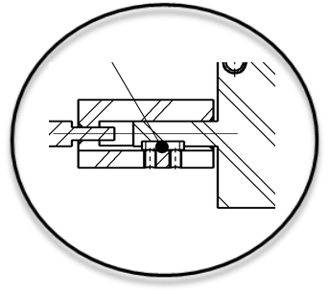
4. FE maintenance
Phase I - Worksite preparation and shielding installation
cotters

Slide 20
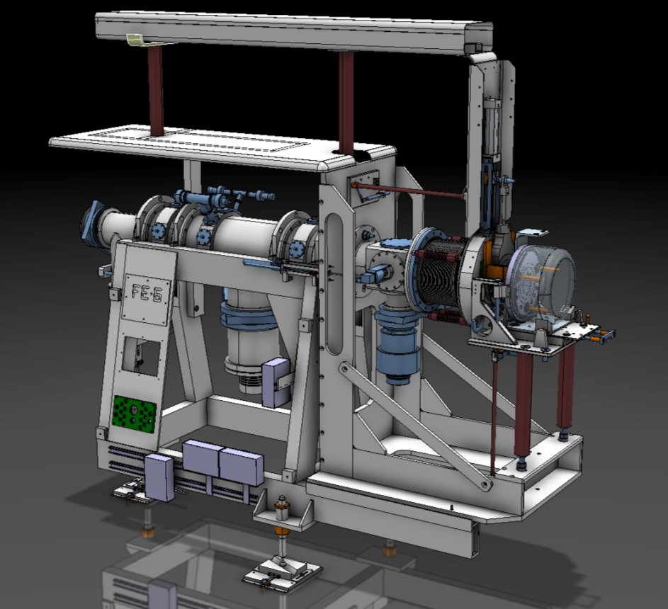
4. FE maintenance
Phase II - Annual FE Maintenance
JUSTIFICATION | PICTURE
Lubrication to avoid failure during the operation year.
Cleaning to avoid sparking between ground and HV.
Visual inspection to detect any anomalies.
OPTIMIZATION
Intervention performed every year → Expertise allows faster and more precise interventions.
Intervention done after 3 months of cooling time
Beam dumps and beam window shielded before intervention

Slide 21
4. FE maintenance
Phase II - Annual FE Maintenance
REX | RESULTS / ACTION / PICTURE
The switches on GPS and HRS were inspected. | R= No problems were found so there were not replaced
During the reinstallation of the MONTRAC cover, it was difficult to screw the support (which permit to attach the MONTRAC cover) | A = - To optimize the duration of removal and reinstallation of the MONTRAC cover, an electric screwdriver must be used - Add to procedure EDMS 1564564 / Julien Riegert – EN/STI
The attachments of the MONTRAC cover come on a bar that is fixed against the wall. That bar was removed by mistake during the removal of the MONTRAC cover | A = precise in the next WDP that only the MONTRAC cover has to be removed / Julien Riegert– EN/STI
During the reinstallation of the bar mentioned in the previous point, 2 threading on 4 were damaged, thus the bar stays in position only with 2 screws instead of 4 | A = Reinstall this bar with 4 specific screws during the LS2 / Stefano Marzari – Bernard Crepieux– EN/STI

Slide 22
Introduction
Target transfer to ISR3
Reorganization of the targets in ISR 3
FE maintenance
SEMGRID beam alignment

Slide 23
5.SEMGRID beam alignment
JUSTIFICATION
Proton beam optimization
OPTIMIZATION
Intervention performed every year → Expertise allows faster and more precise interventions
According to the 2016-2017 REX, HRS is more difficult to setup so it is done first
Target placed and removed partially with robot : During this shutdown, the target is also transferred from the exchange point to the HRS and GPS Front-End with the KUKA robot and not manually: this reduces the dose received
Connect the SEMGRID cable on the SEMGRID target in the middle of the trenches instead of connecting it on the FE

Slide 24
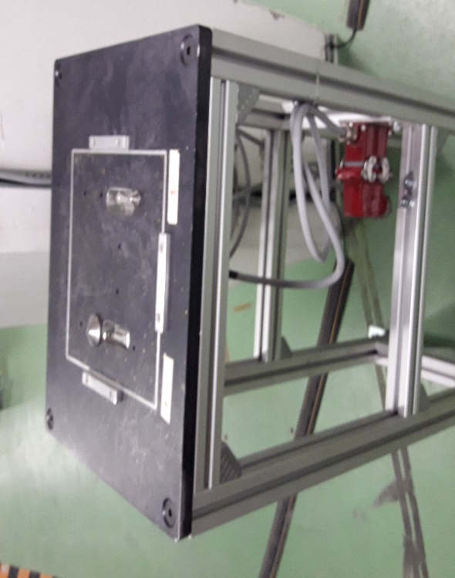
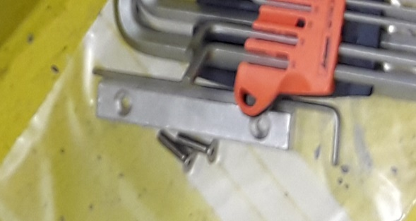
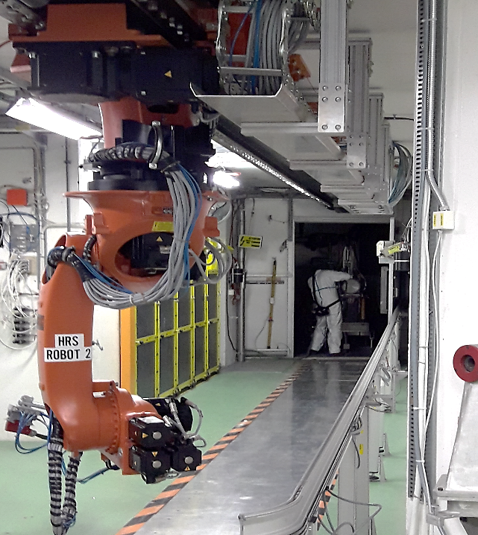
5.SEMGRID beam alignment
REX | RESULTS / ACTION / PICTURE
The base of the SEMGRID target is bigger than usual targets therefore a stop piece has been removed on the exchange point to install the SEMGRID target on it | A = precise in the next WDP that the stop piece should be removed / Julien Riegert – EN/STI
Due to the bad condition of the SEMGRID cable, to avoid moving the SEMGRID target with the cable with the robot, it was decided to plug it directly when the SEMGRID target is on the FE instead of doing it in the middle of the trenches | R= The dose received was higher than expected (+16% for collective dose and +27% for individual dose) A= Replace the SEMGRID cable during the LS2 / Richard Catherall – EN/STI

Slide 25
Introduction
Target transfer to ISR3
Reorganization of the targets in ISR 3
FE maintenance
SEMGRID beam alignment
Laser window exchange maintenance and tests

Slide 26
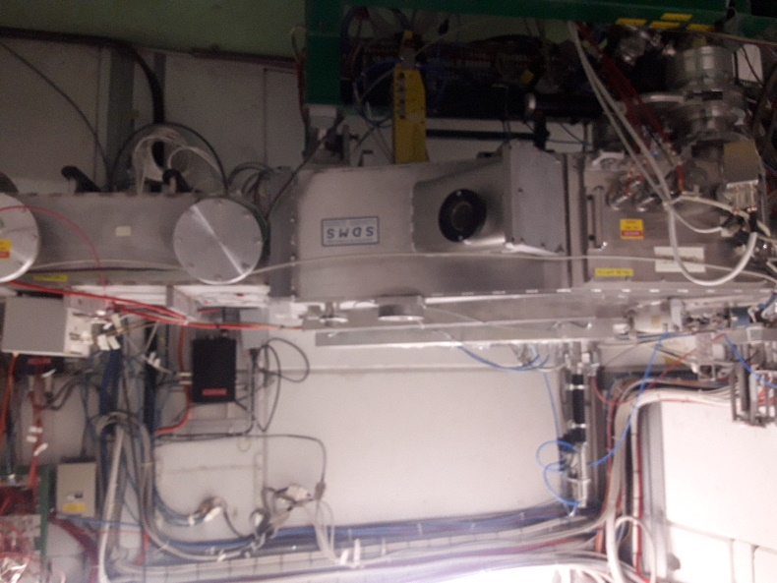
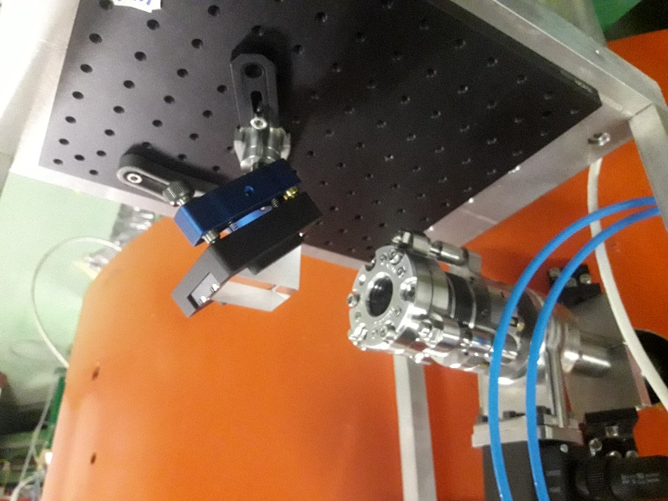
6. Laser window exchange
JUSTIFICATION
Several mechanisms can lead to a non-transparent coating on the GPS (MAG70) and HRS (MAG90) laser windows during the operation year (UV-induced carbon coating, ion beam deposits on internal window surface). This reduces the reliability of laser beam transport to the ion source. Window replacement during shut-down is required because we have seen that it is not possible to reliably judge the window cleanliness by visual inspection only
OPTIMIZATION
Intervention performed and coordinated by EN-STI-LP as decided during the YETS 2015/2016
REX | RESULTS / ACTION / PICTURE
Separators correctly pumped down to reduce radon releases during intervention
To pull the HRS window out from the flange once the outer window holder has been removed, the use a small suction pad (<30 mm diameter) is needed | A= add to laser windows exchange procedure (EDMS 1132987 for HRS side and 1108892 for GPS side) / Bruce Marsh – EN/STI

Slide 27
Introduction
Target transfer to ISR3
Reorganization of the targets in ISR 3
FE maintenance
SEMGRID beam alignment
Laser window exchange maintenance and tests
LIEBE target tests

Slide 28
7. LIEBE target tests
JUSTIFICATION
Complete the tests performed during YETS 2016-2017, Test the setting up of the target cooling SKID, the real target (instead of a mock-up target) and the pump
Test the alignment procedure
New Cabling installation and hypertac tested before intervention
Separate in the Boris tube, the power supply cables and the sensors cables otherwise the electrical interferences stops the use of the thermocouples
Task repetition will allow a faster intervention when the target will be installed.
Task training and tests needed in order to anticipate problems and be ready for target irradiation
Irradiation of the LIEBE target foreseen at the end of this year’s operation period

Slide 29
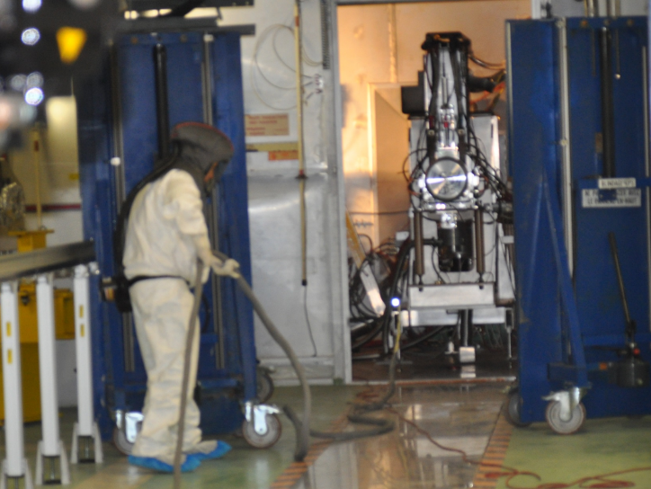
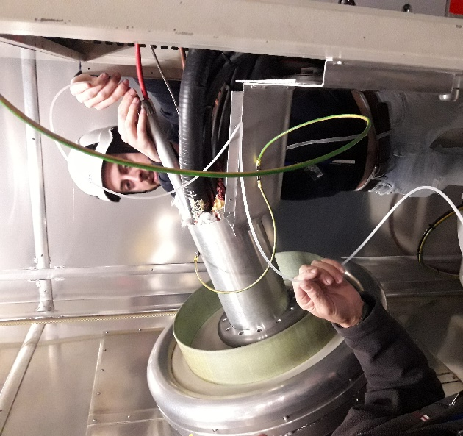
7. LIEBE target tests
OPTIMIZATION | PICTURE
Intervention performed during the shut-down period instead of at the end of next years run when dose rates will be much higher
Intervention performed after 3 months of cooling time
Beam dumps and beam window shielded before intervention
Shielding used to reduce dose rate during cabling installation on Boris Tube
Cables pulled from the HV room (outside the highly radioactive area)

Slide 30
7. LIEBE target tests
REX : PUMP SETUP TESTS | RESULTS / ACTION / PICTURE
Table successfully placed on the stand by the Telemax.
The hose for the compressed air connected to the trolley was an obstacle in the trajectory of the Telemax during the whole operation | A= A spiral tube must be used to have the cable stretched / Ferran Boix Pamies – EN/STI
The lowering speed of the trolley is too high to position the table safely | A= Adjust the pneumatic system to reduce the lowering speed / Ferran Boix Pamies – EN/STI
The Telemax had difficulty getting the trolley up on the ramp | A= the ramp will be modified to have a finer interface with the ground / Ferran Boix Pamies – EN/STI
During decoupling of the compressed gas cable from the trolley by the Telemax, involuntary pressing of the trolley's push-button is possible, which can cause the table to fall | A= Disconnection with Telemax of the cable must be made after positioning the table and outside the support / Ferran Boix Pamies – EN/STI
New tests are foreseen in September 2018 outside the controlled area for these aspects by EN/SMM/ESA (geometers) and EN/SMM/MRO (telemax operator)

Slide 31
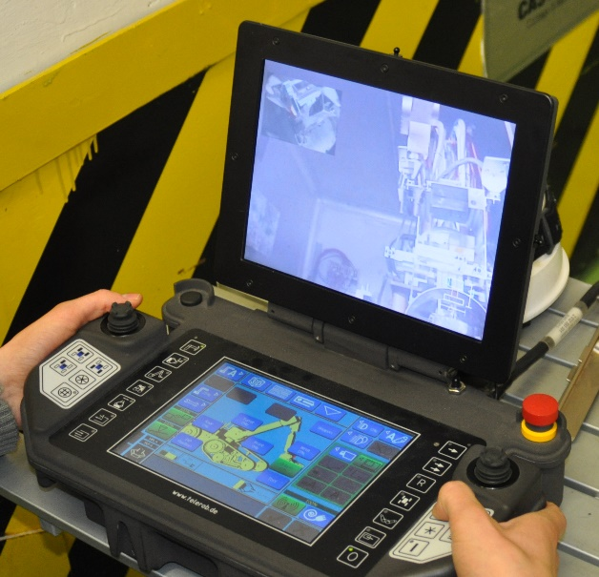
7. LIEBE target tests
REX : REPEATABILITY OF TABLE/SUPPORT POSITION TESTS | RESULTS / ACTION / PICTURE
After installation of the table by the Telemax twice, the distance between the position of the table after first and second installation was measured. Spacing Max=1mm (support)+0.8 (table)=1.8mm in the axis parallel to the front end, deviations in other directions about 0.5mm (pending final results of the surveyors' report). The maximum distance between the cylinder of the LIEBE target and the pump is 3.8mm in a perfect alignment case | A= - the consequence of the accumulation of errors in several directions should be tested outside the controlled area in September 2018 by EN/SMM/ESA (geometers) and EN/SMM/MRO (telemax operator) / Ferran Boix Pamies – EN/STI Alignment measurements can be made by installing a camera at the Telemax ➔ No human presence would then be required for the alignment of LIEBE in the target area.

Slide 32
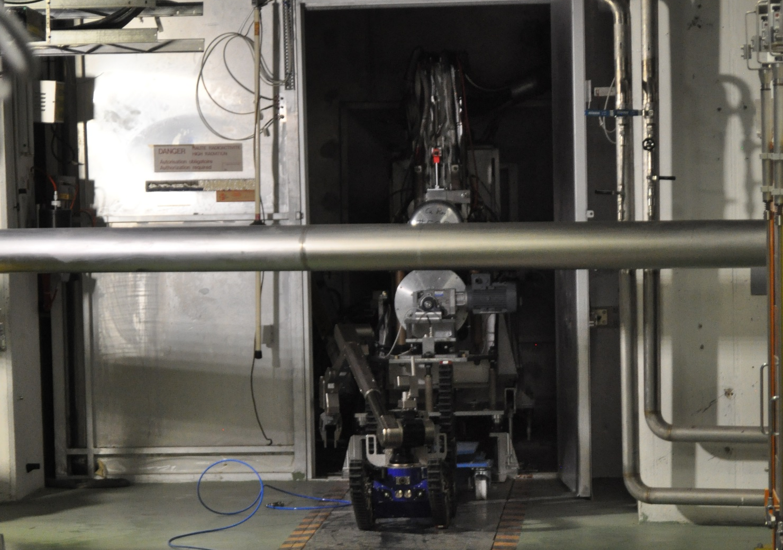
7. LIEBE target tests
REX : REPEATABILITY OF TABLE/SUPPORT POSITION TESTS | RESULTS / ACTION / PICTURE
Decoupling performed
The metal cylinders that help to connect the hypertacks make it difficult to decouple by means of the Telemax | A= -shortening of the cylinders ➔ New tests are foreseen in September 2018 outside the controlled area / Ferran Boix Pamies – EN/STI

Slide 33
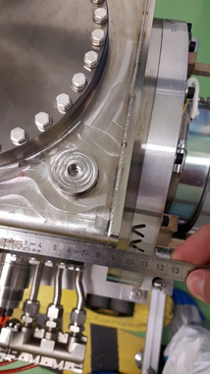
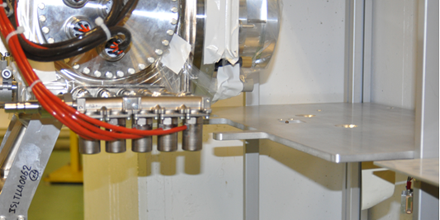
7. LIEBE target tests
REX : TARGET TESTS | RESULTS / ACTION / PICTURE
The handle was not correctly positioned for direct gripping to the robot: the handle was moved to allow the target to be correctly positioned on the Front End | A= the position of the handle must be marked on the target in order to be able to reposition it correctly in case of removal - 9 cm from the rear face
The target could not be positioned on the shelves: because of the solenoid valves | A= provide and fix wedges on the shelves to be able to position the LIEBE target / Fix also the position of the solenoid valves as there is a risk of collision with the front end ground braids if the solenoid valves change positions. This has been simulated with the 3D model software CATIA

Slide 34
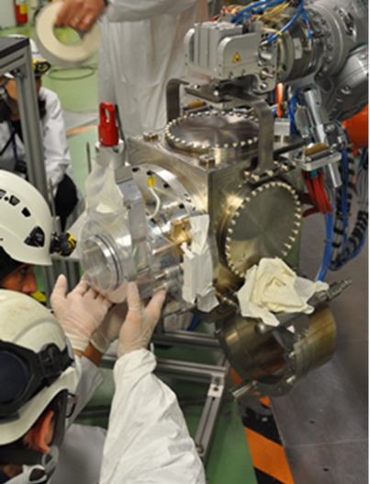
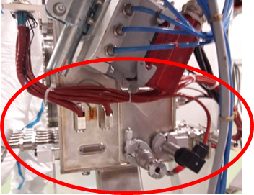
7. LIEBE target tests
REX : TARGET TESTS | RESULTS / ACTION / PICTURE
Coupling test of the target on the Front End: the cone, the underside of the target, the guides are protected with plastic and tarlatane to avoid contaminating the target | A=clean with alcohol the guides after removal of the tape to remove glue deposits
Position the hypertac behind the grounding braids of the Front-End as there is a risk of catching them when the target is removed | A= to add in the new version of the WDP / Julien Riegert – EN/STI
Push the LIEBE cables closer to the target | A= - to add in the new version of the WDP / Julien Riegert – EN/STI - Use of radiation resistant collars to hang cables (no plastic collar

Slide 35
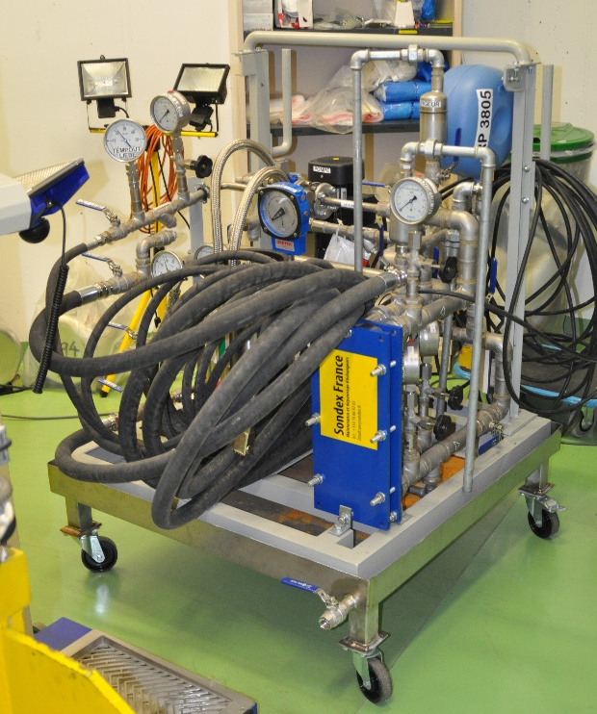
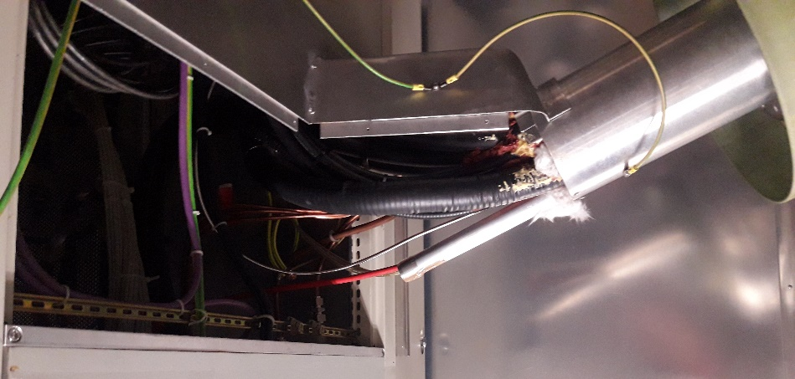
7. LIEBE target tests
REX : SETUP OF THE SKID | RESULTS / ACTION / PICTURE
Time to setup the skid ~ 3min45 ➔ Plan to unwind the cables in advance of the skid (loss of time to untangle the pipes) | A= to add in the new version of the WDP / Julien Riegert – EN/STI
REX : PULLING OF THE CABLE (through the Boris tube from HV room) | RESULTS / ACTION / PICTURE
A 15m needle was pushed from HV room to GPS front end. The needle was unrolled and inserted straight without twisting. | R= It ensured a good introduction of the needle and avoided blockages inside the Boris tube.

Slide 36
7. LIEBE target tests
REX : PULLING OF THE CABLE (through the Boris tube from HV room) | RESULTS / ACTION / PICTURE
At the entrance of the target area, cables were attached on the needle behind lead panels to reduce the dose received
From HV room, the needle was extracted with the cables attached
REX : PULLING OF THE CABLE (from Target area) | RESULTS / ACTION / PICTURE
There was a problem to put in place the coiffe where the cables are situated. The first team didn’t manage to do this because of the volume of cable which is too large. The intervention had been stopped and an experienced operator did the operation the day after. | A= - The experienced operator tightened the cables with a collar to reduce the volume and was then able to put the cap (coiffe) back in place. - The cap (coiffe) must be changed during the LS2 / Stefano Marzari – Bernard Crepieux – EN/STI

Slide 37
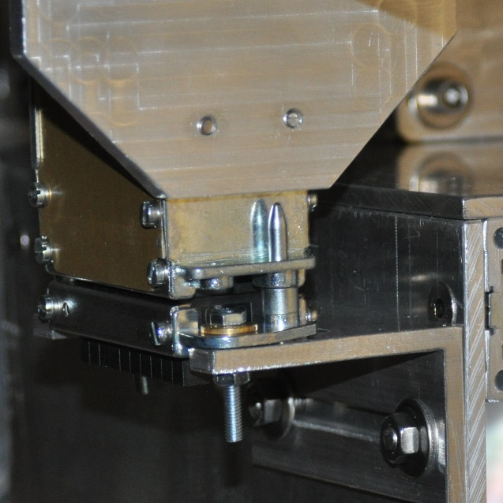
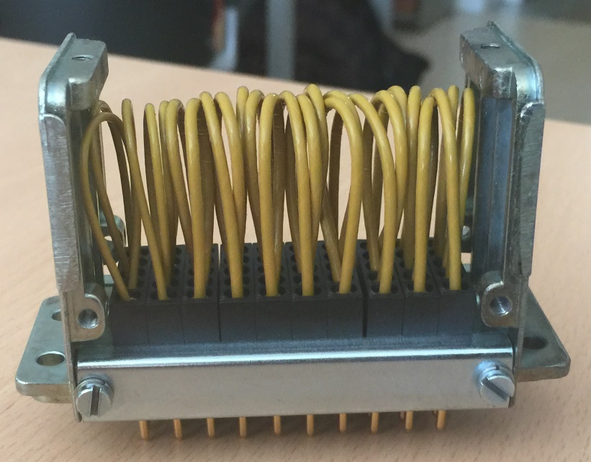
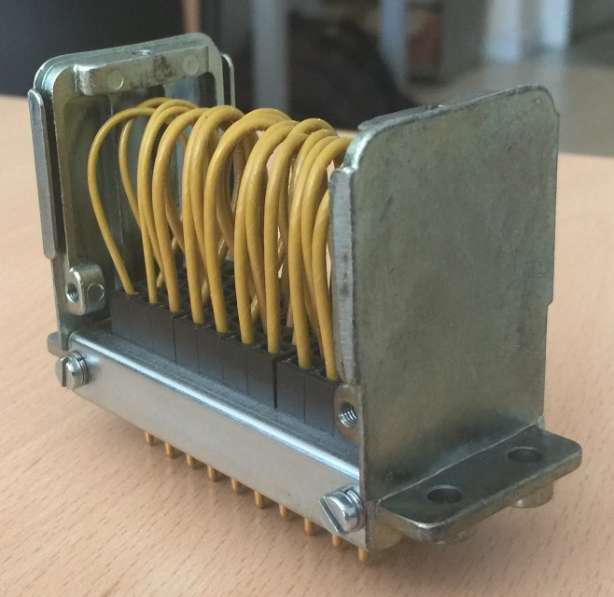
7. LIEBE target tests
REX : PULLING OF THE CABLE (from Target area) | RESULTS / ACTION / PICTURE
The cover on the hypertacs couldn’t be remounted | A= - There were remounted without their cover : theses hypertacs will be used once, by consequence it is not important if there will be damaged (without their cover) during their removal after LIEBE intervention at the end of the year.
Hypertac cover
Hypertac without cover

Slide 38
Introduction
Target transfer to ISR3
Reorganization of the targets in ISR 3
FE maintenance and micro switch system replacement
SEMGRID beam alignment
Laser window exchange maintenance and tests
LIEBE target tests
Inspection of the GPS and HRS FE

Slide 39
8.Inspection of the GPS and HRS FE
JUSTIFICATION
Inspect the state of the equipment of the FE in order to develop the modifications if necessary for the LS2
Update the designs of the FE 10 et 11 (LS2)
Inspect the cable tray for the replacement of the FE (LS2)
Collect information missing from the drawings
OPTIMIZATION
Intervention done after 3 months of cooling time
Beam dumps and beam window shielded before intervention
Targets are evacuated from the target area
Intervention is supervised and performed by an experienced person
Rehearsal of the intervention on the OFFLINE FE
Localization of the check points on the 3D model

Slide 40
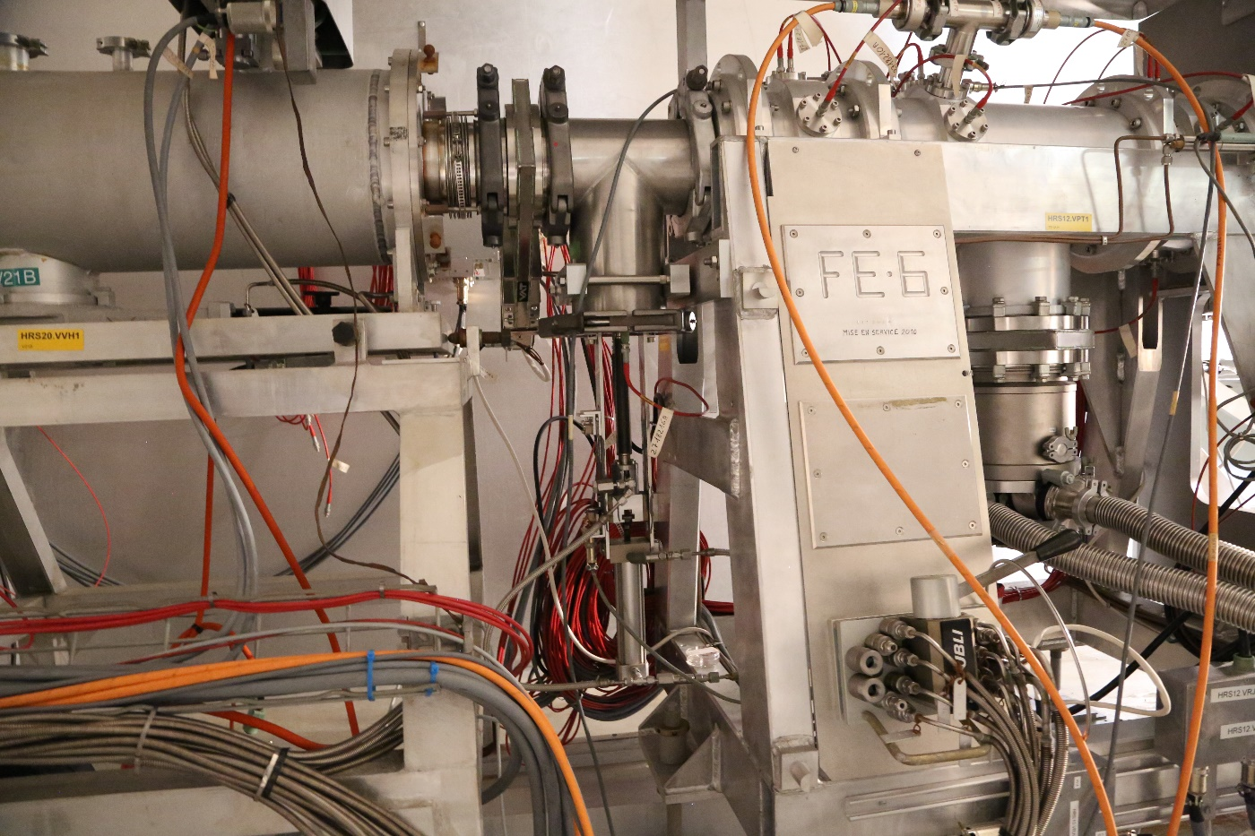
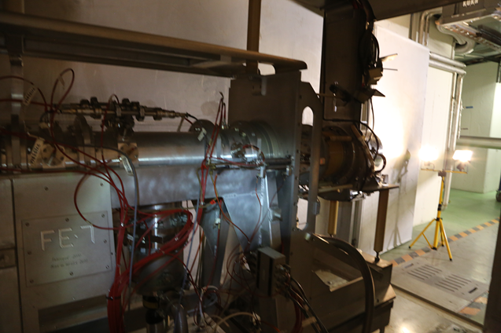
8.Inspection of the GPS and HRS FE
REX : PULLING OF THE CABLE (from Target area) | RESULTS / ACTION / PICTURE
The intervention was faster than estimated | R= The dose received was lower.
HRS Front-End
(picture taken during inspection)
GPS Front-End
(picture taken during inspection)

Slide 41
Introduction
Target transfer to ISR3
Reorganization of the targets in ISR 3
FE maintenance
SEMGRID beam alignment
Laser window exchange maintenance and tests
LIEBE target tests
Inspection of the GPS and HRS FE
Cleaning of the 179 and 838

Slide 42
9. Cleaning of the 179 and 838
JUSTIFICATION
Cleaning of the areas after the shutdown interventions
Cumulated dirt under the aluminium plates induces the lifting of these plates and causes friction with the door
OPTIMIZATION
Intervention done after 3 months of cooling time
Beam dumps and beam window shielded before intervention
Targets are evacuated from the target area
REX | RESULTS / ACTION / PICTURE
Cleaning was correctly done without any problems | A= - The ground beneath the aluminium plates should be cleaned every year during the shut-down - Add to the Front-Ends maintenance document EDMS 993790 / Julien Riegert – EN/STI

Slide 43
Introduction
Target transfer to ISR3
Reorganization of the targets in ISR 3
FE maintenance
SEMGRID beam alignment
Laser window exchange maintenance and tests
LIEBE target tests
Inspection of the GPS and HRS FE
Cleaning of the 179 and 838
Montrac maintenance and tests

Slide 44
10. Montrac maintenance and tests
JUSTIFICATION
Annual maintenance
New components installed based on the results of the previous tests
Further tests needed to: Validate the system before it starts to operate Prevent failures during operation
OPTIMIZATION
Beam dumps and beam window shielded before intervention
Targets are evacuated from the target area
Maintenance done on the MEDICIS side first (non classified area) to gain experience and speed ➔ Optimisation of the time spent inside the Target Area
Expertise allows faster and more precise interventions : Maintenance of the irradiation point already performed last year (EDMS 1564564)

Slide 45
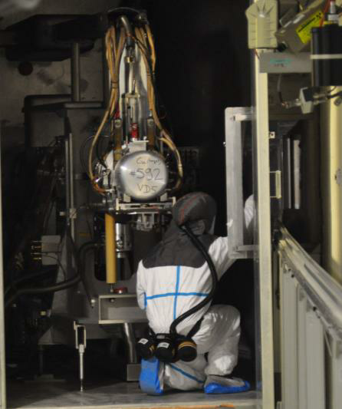
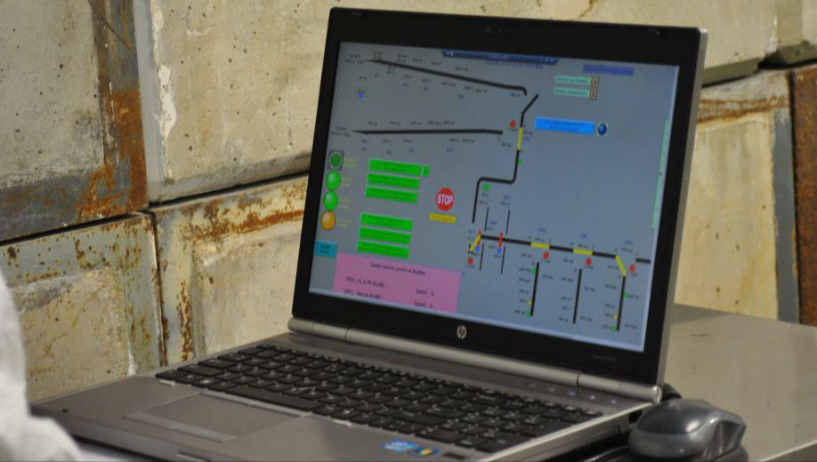
10. Montrac maintenance and tests
OPTIMIZATION
Interventions outside the Faraday Cage performed with Faraday Cage shielding and after 3 months of cooling time
Most of the tests performed outside the high radiation area

Slide 46
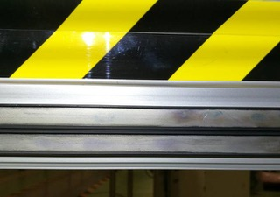
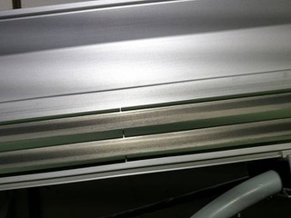
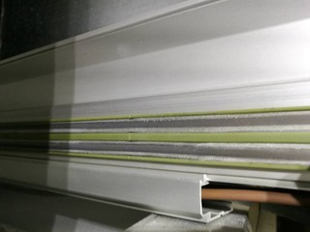
10. Montrac maintenance and tests
REX | RESULTS / ACTION / PICTURE
During MONTRAC test, some problems appeared to reach the Irradiation Point with all the available shuttles. After inspection, the deterioration of the power rail (dust presence), as long as the presence of dust this fault caused a poor electrical contact between the shuttle wheels and the power rail. | R / A = After analysis, it was decided to clean the power rails without changing any spare parts because of their unavailability : This intervention was performed in another impact (see details part 14.) The identification of this default during MONTRAC maintenance has avoided failure during MEDICIS operation.
exchange point
middle of HRS corridor
irradiation point

Slide 47
Introduction
Target transfer to ISR3
Reorganization of the targets in ISR 3
FE maintenance
SEMGRID beam alignment
Laser window exchange maintenance and tests
LIEBE target tests
Inspection of the GPS and HRS FE
Cleaning of the 179 and 838
Montrac maintenance and tests
LIST Tests

Slide 48
11. List Tests
JUSTIFICATION
Annual maintenance
Test with the robot the following requirements for the List Target : Trajectory Coupling / uncoupling on FE
Further tests needed to: Validate the system before it starts to operate Prevent failures during operation
OPTIMIZATION
Intervention done after 3 months of cooling time
Targets are evacuated from the target area
Beam dumps and beam window shielded before intervention
Shielding used with lead panels to reduce dose rate during the reading of the tension value on multimeter
Test done with a non irradiated modified target #593 (RF plug added to the target)

Slide 49
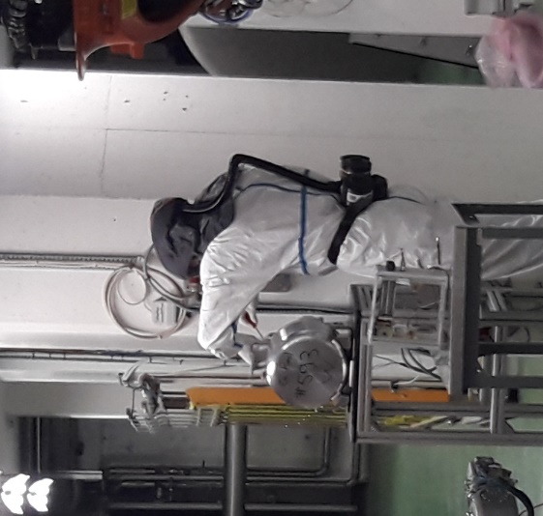
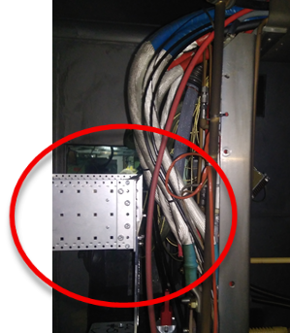
11. List Tests
REX | RESULTS / ACTION / PICTURE
The support of the RF connector had been setup on the GPS plug target #593
Verification of RF cable was performed from HT room after confirmation of the procedure at offline
Coupling was tested after this modification and was conclusive
For the robot test including the transducer box setup on the GPS plug target #593, the clamping of the target was not possible due to presence of cable on the Front-End which collided with the transducer box | A= the design was modified (reduction of the height between the support and the transducer box and 90°rotation of the transducer box)

Slide 50
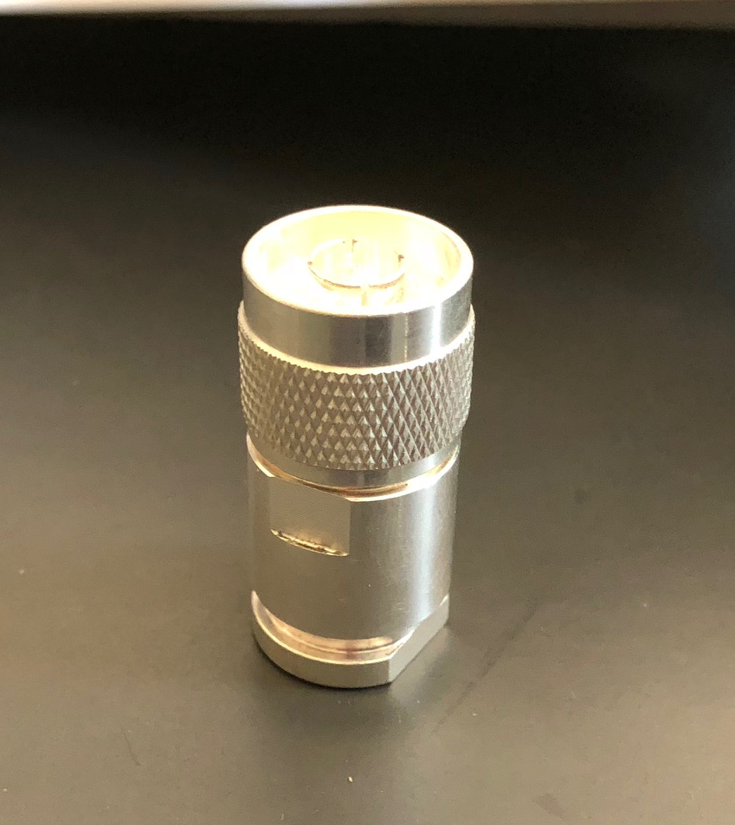
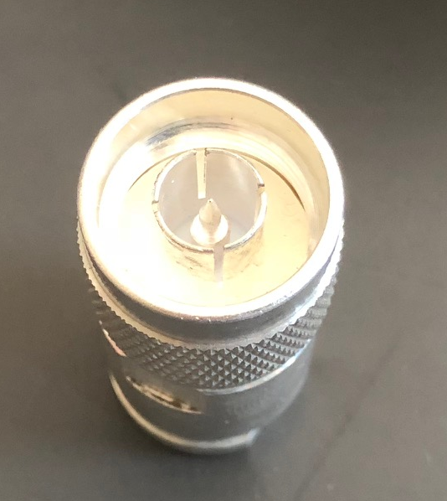
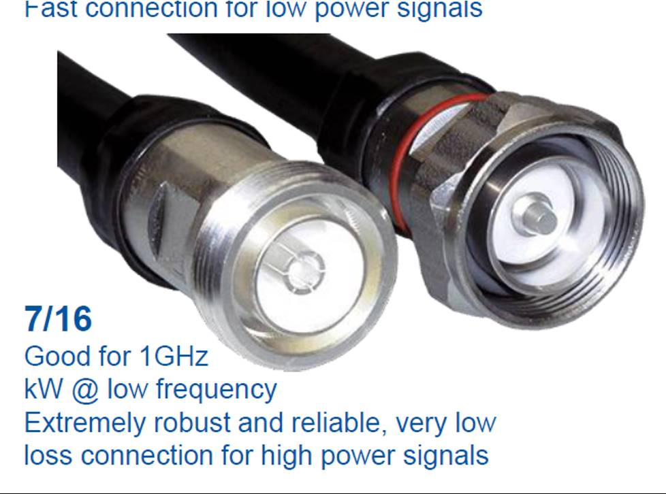
11. List Tests
REX | RESULTS / ACTION / PICTURE
When the LIST target was put on the front end, there was a problem related to the RF part of the ion source. To allow the physics program to continue, a diagnosis and tuning of the RF part was carried out on the LIST target, which had not been irradiated but only coupled. | R = No problems were found during this inspection. When the target was coupled again, it functioned very well. The problem was coming from a bad connection of the feedthroughs currently used. Feedthroughs currently used
 | A = Upgrade new frontends with new RF feedthroughs suggested by RF group during LS2 / Sebastian Rothe – EN/STI Reinhard Heinke – EP/UIS Have 2 RF couplers will allow to suppress the transducer box. So that the target handling will be simplified New feedthroughs to install

Slide 51
Introduction
Target transfer to ISR3
Reorganization of the targets in ISR 3
FE maintenance
SEMGRID beam alignment
Laser window exchange maintenance and tests
LIEBE target tests
Inspection of the GPS and HRS FE
Cleaning of the 179 and 838
Montrac maintenance and tests
Lists Tests
Retrieval of the target #501 and test laser on HRS FE

Slide 52
12. Retrieval of the target #501 and test laser on HRS FE
JUSTIFICATION
The target #501 (power meter target) was reported to be leaking in the technical meeting and was required to be verified, before discarding the target.
Pieces of the target – such as the installed power meter can be re-used
The leak could occur through bad coupling rather than a defective target : the vacuum information on the frontend when the target was coupled could not be retrieved via TIMBER therefore it was not clear if it was pumped or not.
OPTIMIZATION
Target box transported by remote forklift
Container type A used for transport
RP measurements on truck done with telescopic monitor
Inspection of the target #501 inside the fume hood of the laboratory 179/R-002
Intervention done after 12 months of cooling time inside the ISR 3
The target #501 was inside a box of 6 non-irradiated targets. This box was situated in the middle of the ISR3 surrounded by irradiated targets. After the removal of the target #501 at the beginning of the ISR3, this box was placed at the beginning of the ISR3 to reduce the dose received

Slide 53
12. Retrieval of the target #501 and test laser on HRS FE
REX | RESULTS / ACTION / PICTURE
Target #501 transfer from ISR3 to bldg. 179 without problems
The Argon bottle needed to do the leak test on the pump stand was empty | A= Check before pumpstand intervention if the quantity of gas available is sufficient / Bernard Crepieux – Michael Owen – EN/STI
After the leak test on the pump stand, the target #501 didn’t have any leaks. | R= This target was probably not well clamped before.
A function test was made and we noticed an opened circuit. And we reattached the wire inside the target. | R= This target worked well without any problem after this intervention

Slide 54
Introduction
Target transfer to ISR3
Reorganization of the targets in ISR 3
FE maintenance
SEMGRID beam alignment
Laser window exchange maintenance and tests
LIEBE target tests
Inspection of the GPS and HRS FE
Cleaning of the 179 and 838
Montrac maintenance and tests
Lists Tests
Retrieval of the target #501 and test laser on HRS FE
Additional maintenance of the MONTRAC

Slide 55
13. Additional maintenance of the MONTRAC
JUSTIFICATION
During MONTRAC test (see part.11), some problems appeared to reach the Irradiation Point. All the available shuttles were used with similar results ➔ After inspection, this fault was due to the poor electrical contact between the shuttle wheels and the power rail. The main problem is the deterioration of the power rail, with the presence of dust, which visibly increase while approaching the HRS Front End
The additional actions of maintenance of the MONTRAC are : Inspection, cleaning of the rails and functioning tests Option 1 : change the conductor bands without the isolators on the rail activated Option 2 : change the conductor bands with the isolators on the rail activated Option 3 : Clean the shuttles wheels
exchange point
middle of HRS corridor
irradiation point

Slide 56
13. Additional maintenance of the MONTRAC
OPTIMIZATION
Intervention done after 3 months of cooling time
Targets are evacuated from the target area
Beam dumps and beam window shielded before intervention
Shielding used with lead panels to reduce dose rate during the additional maintenance
The cleaning of the rails is carried out with the arm extended, the body being as far as possible from the active elements
REX | RESULTS / ACTION / PICTURE
The spare part were not available for the intervention, consequently only a cleaning was performed | A= The replacement of spare parts is foreseen during the LS2 / Regis Seidenbinder – EN/STI
This first action (cleaning of the rails) allowed the removal of a lot of dusts on the rails | R= the first tests with the shuttles were conclusive and the shuttles moved correctly on the rails without stopping.

Slide 57
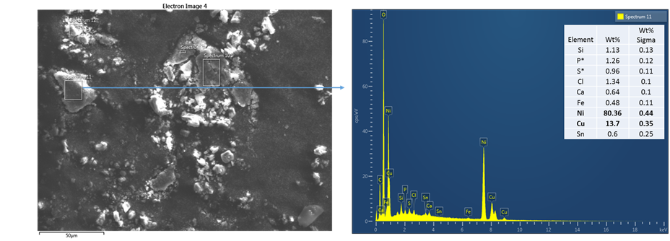
13. Additional maintenance of the MONTRAC
REX | RESULTS / ACTION / PICTURE
Samples were made on the MONTRAC rails to analyse the dusts. Analysis were made by EN-MME. | R= The results shows an important amount of Oxides (O). A= During the LS2, 3 options are possible to fix this problem / Regis Seidenbinder – EN/STI: - OPTION 1: Change the rails for new rails with an oxidation resistant material (permanent solution) - OPTION 2: Cover the rails with a coating resistant to oxidation (permanent solution) - OPTION 3: Clean the rails (temporary solution to repeat)
C sticker #5 (Bandeau conducteur)

Slide 58
Introduction
Target transfer to ISR3
Reorganization of the targets in ISR 3
FE maintenance
SEMGRID beam alignment
Laser window exchange maintenance and tests
LIEBE target tests
Inspection of the GPS and HRS FE
Cleaning of the 179 and 838
Additional maintenance of the MONTRAC
Lists Tests
Retrieval of the target #501 and test laser on HRS FE
Montrac Maintenance and Tests
HRS FE patch-panel replacement

Slide 59
14. HRS FE patch-panel replacement
JUSTIFICATION
Insulation tests show a severe insulation breakdown problem during ISOLDE commissioning phase between the separator-area patch panel and the quadrupole electrodes T and R. Without proper insulation of the cables the HRS FE cannot be used
Replace all the patch panel connectors (which are not rad-hard) in order to avoid a future intervention during operation when dose rates will be higher

Slide 60
14. HRS FE patch-panel replacement
Risk Analysis for the irradiation hazard related
to steps whose dose rate is higher than 2mSv/h
Task | Step where the dose rate is >2000uSv/h | Task Related Hazards | Hazard Risk Reduction | Action In Case Hazard Materialises
Disconnect the DE cables from the HRS FE (8 cables) | 7000 | Irradiation (= exceeding the authorized dose) | The persons who train on the OFFLINE 2 and who perform the intervention according to the WDP are the same There is no very high dose gradient because we do not have irradiated targets on site. The intervention takes place mainly on the side of the Front-End which is closed and therefore the risk of contamination is low. As usual, RP makes stopping points to check compliance with doses and avoid any drift. The duration of each step are checked during the intervention | RP Stops the activity Alarm on DMC
Disconnect the QP cables from the HRS FE (12 cables) | 2000
Disconnect the cables from the old patch panel and connect them in the new patch panel one by one (30 cables 30 seconds per cable) | 2500
Connect the new DE cables to the HRS FE (8 cables) | 7000
Connect the new QP cables to the HRS FE (12 cables) | 2000

Slide 61
14. HRS FE patch-panel replacement
OPTIMIZATION
HRS beam dump and beam window shielded were left in place during commissioning phase as implementation of REX (EDMS 1570850)
Intervention rehearsed at ISOLDE off-line 2. Distances and positions measured to simulate the conditions at the HRS FC
Cables bunched by equipment and labelled outside the high radiation area
Pictures of the different cables and connections studied before the intervention
Cables and connectors pre-assembled outside the high radiation area
Working positions as far as possible from the beam dump
Additional light projectors added in front of the faraday cage to improve visibility during intervention
Preparation of the appropriate tools before intervention

Slide 62
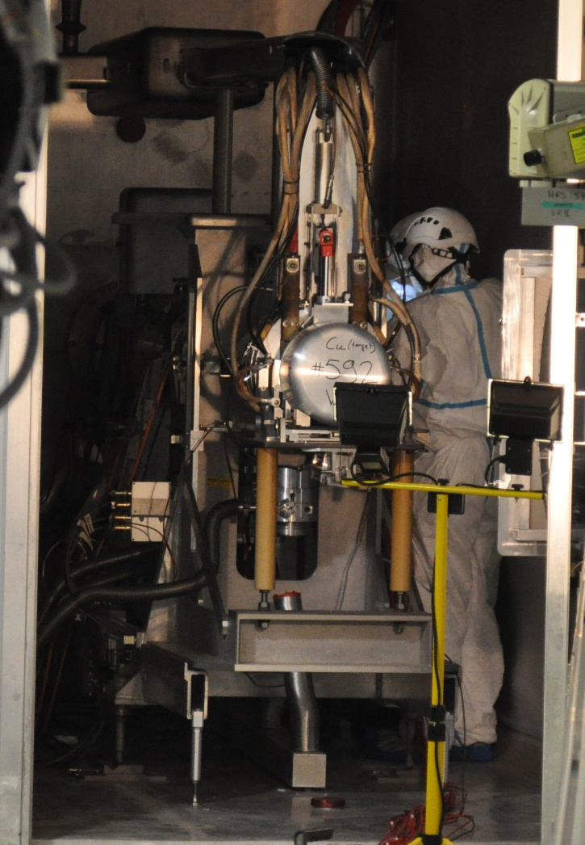
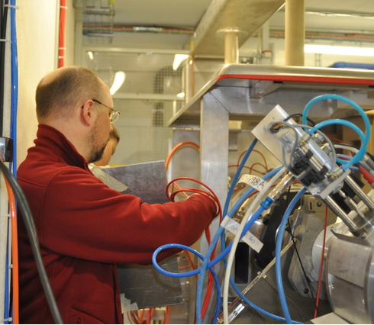
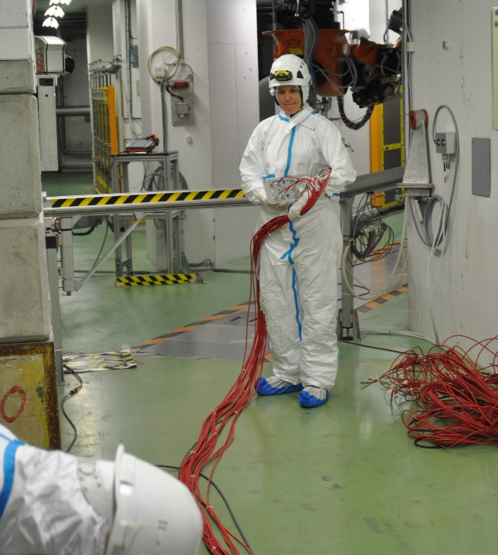
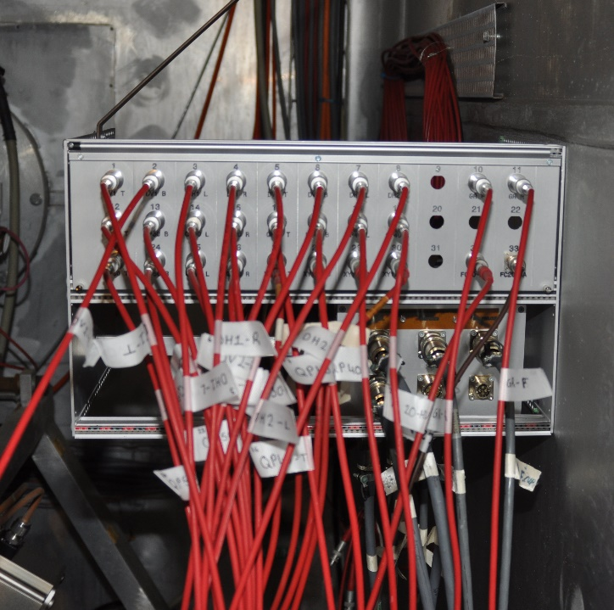
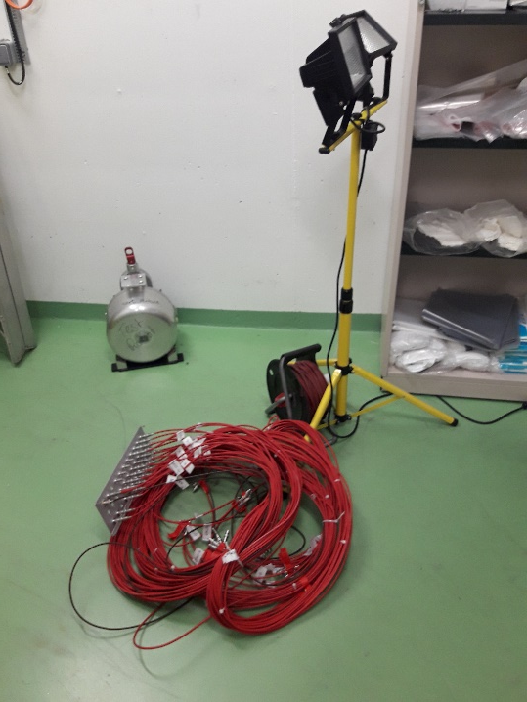
14. HRS FE patch-panel replacement
REX
Total Collective dose received was three time less than expected (525 μSv), the working positions were further from the beam dump than foreseen and calculated on the WDP
During the removal of the old cables connected to the FE and linked to the old patch panel, there were another cables entangled with them. It was necessary to disconnect them, untangle them with the old patch panel cable and reconnect them on the FE
The threshold of the DMC (dose received) was configured too low and the alarm activated prematurely. To communicate more easily in the Faraday cage (patch panel replacement step) it was necessary to go out to deactivate and reactivate the DMC
Patch panel replacement
Cables and connectors pre-assembled
Patch panel
Intervention rehearsals

Slide 63
Introduction
Target transfer to ISR3
Reorganization of the targets in ISR 3
FE maintenance
SEMGRID beam alignment
Laser window exchange maintenance and tests
LIEBE target tests
Inspection of the GPS and HRS FE
Cleaning of the 179 and 838
Additional maintenance of the MONTRAC
Lists Tests
Retrieval of the target #501 and test laser on HRS FE
Montrac Maintenance and Tests
HRS FE patch-panel replacement
Conclusion

Slide 64
15.Conclusion
CONCLUSION : MAIN POINTS
For the FE maintenance: The dose received during the replacement of the electrode on GPS side was higher than expected (~+66%), but on next generation of FE, the use of cotters will avoid this type of problem
For the LIEBE target tests: An extensive preparatory work and numerous tests have been carried out and will improve operations with the LIEBE target. New tests are foreseen in September 2018 outside the controlled area
For the additional maintenance of the MONTRAC: the cleaning of the rails was conclusive and the shuttles moved correctly on the rails without stopping. Action must be taken during the LS2 to avoid the recurrence of this problem.
For the target transfer: The WDPs and the procedures (target transfer) were updated according to the previous intervention folder. A new ramp has been installed to cross more easily the entrance of building 179 with the forklift during the target transfer to and from ISR3.
For the patch panel replacement: The beam dump shielding was left until the end of the YETS to reduce the dose rates inside the Target Area. It was particularly beneficial for the patch panel replacement which occurred close to the FE in the end of the YETS and which was not foreseen.
For the next intervention folder, the risk analysis, for the irradiation hazard related to steps whose dose rate is higher than 2mSv/h, has to be included for each intervention (was included as comment in impact)

Slide 65
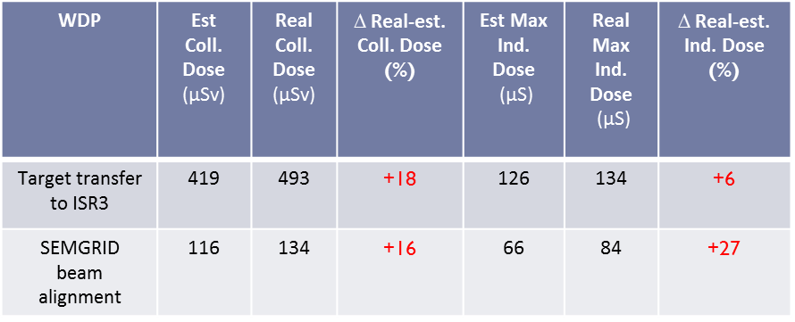
15.Conclusion
CONCLUSION : MAIN POINTS
Two interventions exceeded the individual and the collective dose foreseen:
Target transfer to ISR3 : To optimize the transfer of the targets and avoid extra dose due to additional manual transfer, the list of all the targets to be moved should be checked with RP, the operation and physics before the beginning of the intervention. Estimation of the collective dose is based on past intervention with less margin.
The SEMGRID beam alignment : problems in connecting the SEMGRID cable are a recurring problem that lead to additional doses. To optimize this, a new SEMGRID target will be built and all the cables and connectors will be replaced during LS2.

