Slide 1
Verification (digital):
ASICs and FPGAs
Getting ASIC right first time.
Get large complex FPGA based systems working

Slide 2
Background & History
ASIC designers invests significant efforts (as much as on design itself or more) on verification because of mask costs ( 100k – 1M), lost time ( ~1 year) and difficulties to find cause of bugs (limited observability)
  Complexity of digital circuits have increased exponentially
  Verilog – VHDL test benches OK until 5-10 years ago (for HEP)
  Multi chip systems with critical chip interfaces (multi chip verification)
  SEU/SET verification: (Small devil trying to make our chip fail all the time).
  At Functional / RTL / Gate level
  Recent complex HEP chips: Tools used
    System Verilog – UVM verification frameworks: Cadence, Synopsys, Mentor
    Cocotb: Python based, interfacing with Verilog/VHDL simulators
    Seminar: https://indico.cern.ch/event/776422/
    C++ , System C, ?
  Organized first System Verilog - UVM courses at CERN ~5 years ago
  (Not covering analog, Layout, mixed signal, production testing, etc. verification)
FPGAs getting very complex and part of extremely complex processing/triggering systems
  Use of many very high speed serial links
  Use of complex IP blocks
  Experimental verification/debugging at FPGA and system level becomes in-efficient/impossible
    Large complex system can not be made to work using experimental trial and error approach
  Traditionally VHDL based. Not sufficient for verification
  Now also using System Verilog - UVM, Cocotb, system C, etc.

Slide 3
HEP Verification frameworks
ASICs
  Velo-pix / Time-pix / Medi-pix: Pixel chips: LHCb, Medical, R&D, etc.
  (Twepp presentations, etc.)
  RD53: Pixel chips for ATLAS/CMS upgrades
  (Twepp presentations, etc.)
  MPA – SSI: CMS strip tracker
  ABCstar: ATLAS strip tracker
  LpGBT, (ADPLL)
  ALICE ALPIDE monolithic pixel chip
  Seminar: https://indico.cern.ch/event/598463/
  Clic-pix:
  More ?,
  More coming ? ( Calorimeters, timing detectors, Muon)
FPGA verification frameworks ?
ASIC – FPGA – software co-simulation and verification ?.

Slide 4
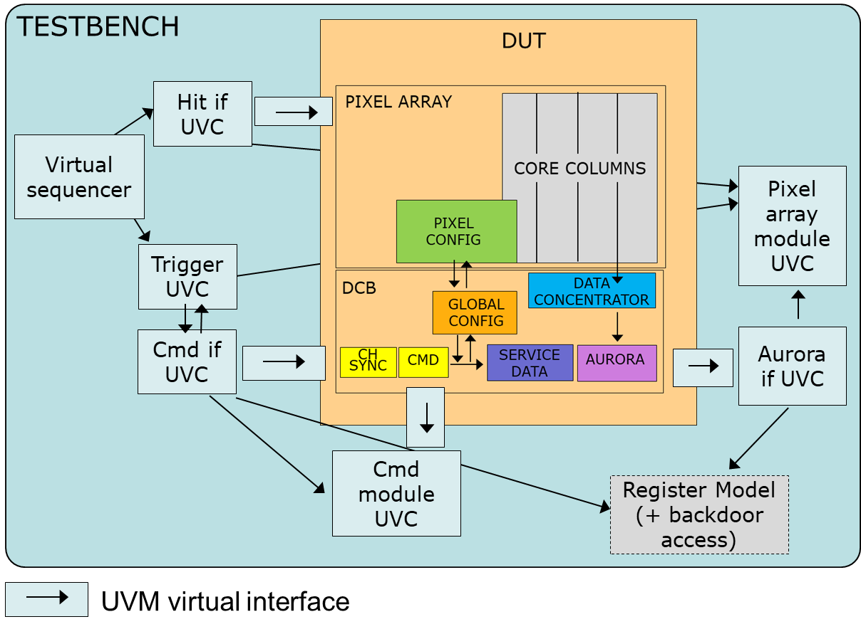
  VEPIX53, Verification Environment for RD53 PIXel chips
RD53 verification framework
  Project and goals: ASIC; Experiment: CMS, ATLAS; Detector: Inner Tracker, Submissions: Q3 2019 (ATLAS), Q1 2020 (CMS).
  Groups involved: CERN ESE-EP-ME + contributions from other groups in RD53 collaboration (recently)
  Status: Used for RD53A demonstrator chip (2018). Extensive use for final chip verification.
  Tools used: System Verilog (SV), UVM . From: Cadence (incisive/xcelium, vmanager), initial support for Mentor (questa)
    Block diagram and functionality
    Interface components: specific to the interface (generation/monitoring, protocol verification)
      hit (pixels): DPI-C interface to read ROOT files; trigger; input command; aurora output
    Module UVM components
        reference model and scoreboards for automated verification of pixel array (incl. classification of losses) and command decoder
          modelling with SV assertions for simple blocks (Channel Sync, FSMs, counters, etc.)
          SV register model (w/o UVM register layer) being developed
        SEU injection optionally running during standard tests (gate-level simulation, pre-generation of list of registers in netlist)
        Code coverage adopted, functional coverage only started (limited time and first the focus is on basic verification of new features)
        Continuous integration in gitlab for standard tests
        Has been developed/used over the last 4 years
        Verification of DAQ firmware and software with chip RTL model: “Cocotb like” with socket interface for chip –firmware-software co-verification (Bonn)
Sara Marconi, CERN/EP/ESE

Slide 5
MPA – SSI: CMS tracker chips
PS-Module verification environment
vManager: Test handling + GUI interface
Stub data path: Continuous transmission of high-pT information (BX rate)
L1 data path: Triggered transmission of raw information (L1 rate)
Test cases library
Monte Carlo gen.
Reference
model
Scoreboards
MPA Stub
Combinatorial and noise
Configuration
MPA L1
Stub and low-pT particle gen
T1 commands and
L1 trigger gen.
SSA Stub
CIC Stub
SSA L1
CIC L1
Simulation Environment
monitor
Sequence
Config
Sequence
Sequence
Sequence
Config
Sequencer
Sequencer
Parameters evaluation
Sequencer
Sequencer
driver
monitor
driver
monitor
monitor
monitor
Assertion based verification
SEU injection
parser
parser
interface
interface
interface
interface
interface
interface
interface
interface
interface
Analog FE
Model
Analog FE
Model
Analog FE
Model
MPA
MPA
SSA ASIC x16
(strip readout ASIC)
CIC ASIC x2
(data concentrator)
DUV
Analog FE
Model
Analog FE
Model
Analog FE
Model
MPA
MPA
MPA ASIC x16
(pixel readout and correlation)
Alessandro Caratelli, CERN/EP/ESE

Slide 6
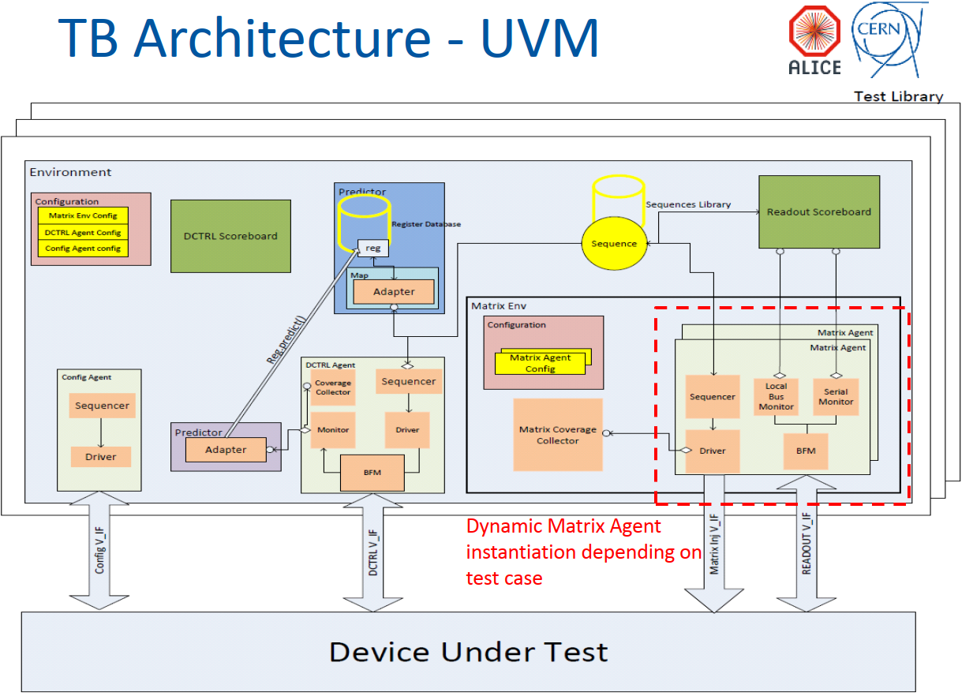
Svetlomir Hristozkoz, Gianluca Aglieri CERN/EP/ESE

Slide 7
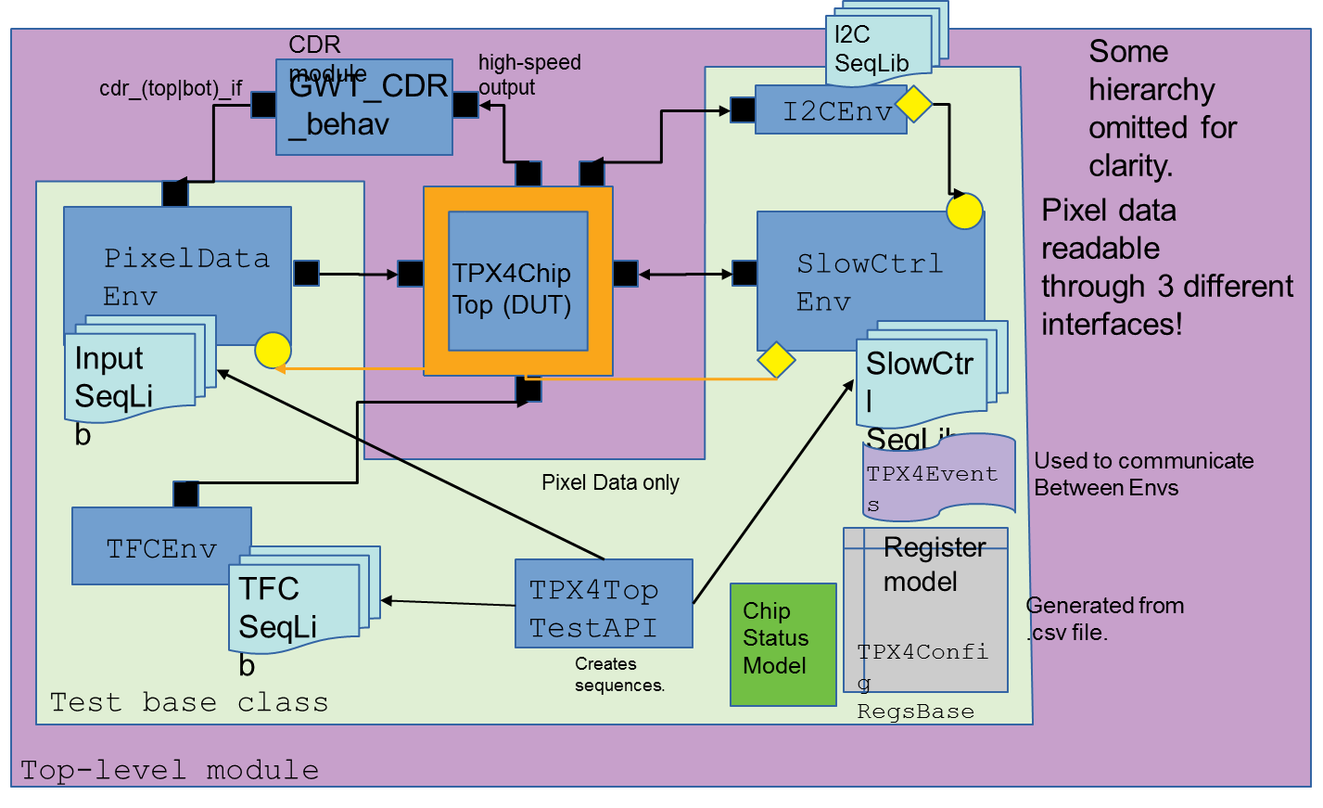
Timepix4 verification environment
Tools: IUS 15.2 + vManager, SystemVerilog + UVM 1.1d, Groups: CERN, NIKHEF
Project: Timepix4, Medipix4 collaboration, signoff spring/summer 2019
Phase: Final verification phase
Tuomas Poikela, CERN/EP/ESE

Slide 8
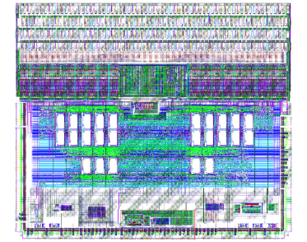
ABCStar Verification Framework
ABCStar is an ATLAS silicon tracker (256 channels, strips are 90 um x 2.5cm to 5cm; die is 7.8x6.7 mm)
Prototype submission on May 2018
GF130nm, digital-on-top signoff, top half is custom layout and bottom half is digital
Silicon proven; TID tested; SEE tests in April 2019
Only one minor bug reported (so far): state machine halts <- could have been easily detected!
Tools:
  RTL: Verilog and VHDL
  Verification: systemVerilog
  Random constrained tests
  Assertions with golden model (systemVerilog)
  and cover groups
  Output decoder
  vPlanner for cover analysis
  JIRA for bugtracking
  Implementation: Cadence tools
  DFT: scan chains
Pedro Vicente Leitao, CERN/EP/ESE

Slide 9
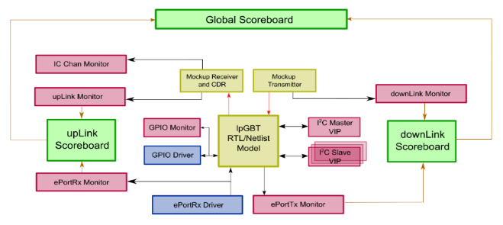
LpGBT ASIC (10Gbps)
Groups involved in digital verification: CERN/EP-ESE
Status: prototype submitted on 07/2018
Design verification tools:
  Languages used: Verilog / SystemVerilog / VerilogA / Spice
  UVM + Verification IP (Mentor)
  Cadence Incisive simulator
  Mixed mode simulations (Verilog/SystemVerilog/UVM/VerilogA/Spice)
  Continuous Integration (gitlab + virtual machines on CERN open stack + set of custom scripts)
    Regression testing
    Documentation generation and publishing
Design validation tools (FPGA based test system):
  Languages used: VHDL / Python
  Mentor Questa Simulator
  Cocotb + GHDL simulator
  Continuous Integration (gitlab + virtual machines on CERN open stack + set of custom scripts)
    Regression testing (including hardware)
Szymon Kulis, Stefan Biereigel, CERN/EP/ESE

Slide 10
Observations
Major/huge task to make appropriate verification framework
  Framework (for specific type of chip: pixel or system: trigger processor) that allows test routines/verification to be made at high level and automated
  Verification has to be automated to verify complex design
    Formal verification (not based on simulations)
    Systematic tests.
    Randomized tests
    Dedicated of very specific/special functions ( e.g. handling errors and error recovery)
    “In-side design/block” assertions (localized intelligent checking: interfaces, busses, etc. )
  Verification has to be run many times as design evolves
    Simulation time becomes an issue. Critical for gate level verification with timing back annotation
  Functional coverage
  Exceptional cases/conditions
  SEU injection – verification (TMR, triple clocking/resets)
  Continuous integration/verification with design repository (Gitlab) ( e.g. when distributed design team)
In industry: Dedicated verification teams specialized in Verification
  Re-usable blocks as products evolve (do not start from scratch). Standardized verification blocks/interfaces.
HEP: Verification often by designers themselves and with limited experience
  Made from scratch
  Requires people with right background and long term engagement for the project.
  Design issues found when running ASIC in final large experiment can be “fatal”: SEU/SET
  Large complex ASIC/FPGA based systems can be difficult/impossible to get to work:
    Insufficient sub-system verification
    Interface problems between different sub-systems
    Insufficient local error monitoring/handling and necessary test and debug features
    Technical background of people that must get final system to work
    Designers not any more available
    Lack of documentation

Slide 11
ADPLL ASIC (all digital CDR/PLL demonstrator)
Groups involved in digital verification: CERN/EP-ESE
Status: submission planned for summer 2019
Design verification tools:
  Languages used: Verilog / Python
  Python based system simulator (full custom)
  Cocotb + Icarus Verilog (integrated with system simulator)
  Cadence Incisive simulator
Continuous Integration (gitlab + virtual machines on CERN open stack + set of custom scripts)
  Regression testing
  Documentation generation and publishing

