Slide 1
Schedule and Coordination of the technical stop
January 12th 2010
K. Foraz

Slide 2
Aim of this technical stop
Repairs the nQPS connectors
Perform all activities needed for 6kA
Commission machine for 6kA

Slide 3
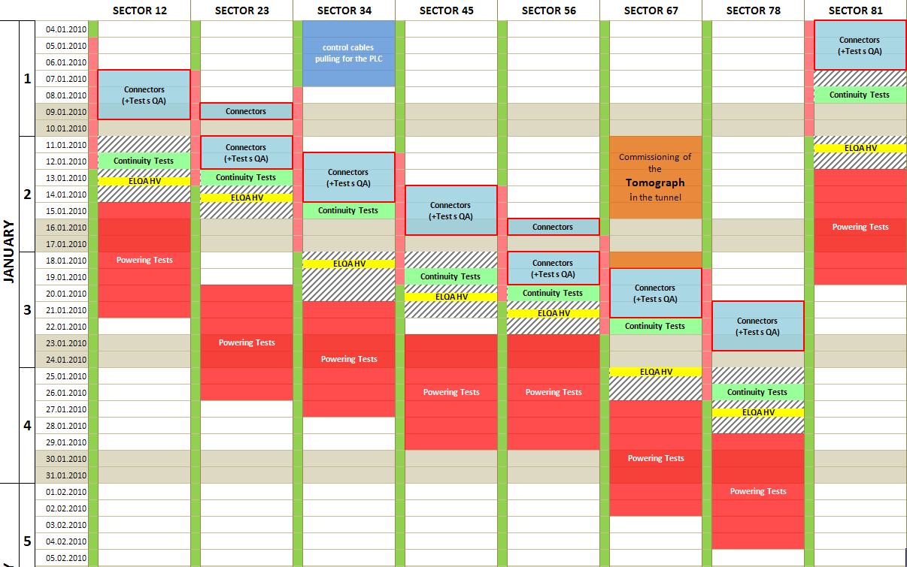
Baseline schedule

Slide 4
Organization
From electrical lock out ph1 to unlock out
1. Request
User
MEF
4. Inform
& coordinate
2. Check
HCC
3. Check
& Implement
Edit ADI’s

Slide 5
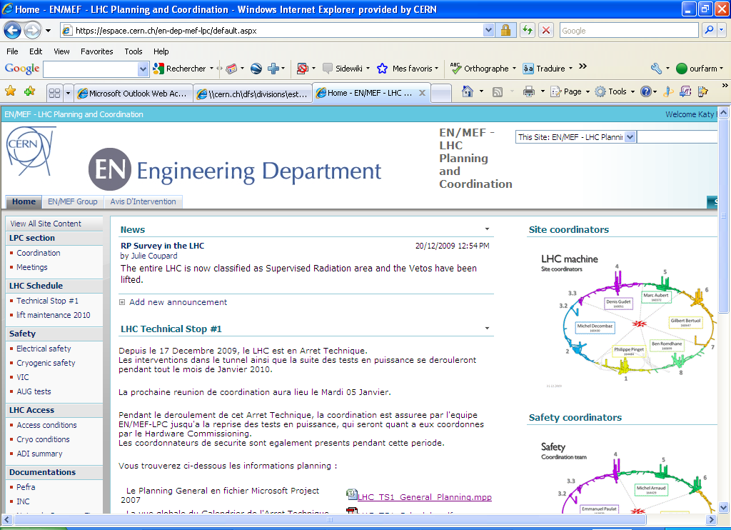
MEF-LPC Website

Slide 6
List of activities
Is presented at each meeting
nQPS Connectors, incl. work preparation, repairs, quality, ELQA
Non conformities solving
  Electrical activities – Non conformities solving
      Still TBC Cable change in PM45
  Collimation: TDI – waiting from test results
  Cooling and Ventilation
  Kickers: AGK , IPOC hardware, OASIS, LVDT, PFN…
  BLM & BPM repairs
  Power converters
  Cryogenics: DFB’s filters, NC on CV891, valves, tunnel instr., cold compressors….
  ODH (minors:panels…)

Slide 7
List of activities
Maintenance & Inspection
  Lift maintenances
  Cooling and Ventilation
  Power converters
  ODH
  Access system
Others
  Safety signalization for the cryo valves
  TZ76 dampers
  Radmon collimation
  TIM tests
  TOTEM – request a 3rd week
  Survey Low-Beta
  Commissioning of the tomograph
  Protection of 600A current leads

Slide 8
nQPS status
  Tableau JCG

Slide 9
Other activities progress
Electrical activities – Non conformities solving On schedule
Lift maintenances done
Safety signalization for the cryo valves finished tomorrow
TZ76 dampers will be finished this week
Collimation Pt 3 & pt7 in progress
    Tests have been done on TDI, waiting for action/no action
TIM tests in progress
Ventilation: control &/ repairs in progress
TOTEM in progress (requesting a 3rd week)
Survey Low-Beta in progress (60%)
Kickers activities in progress
BLM consolidation in progress
TE-EPC intervention in progress
Cryogenic consolidation in progress (65% done)
Commissioning of the tomograph this week
Protection of 600A current leads done
ODH
Access system maintenance in progress
All activities on schedule
No show stopper

Slide 10
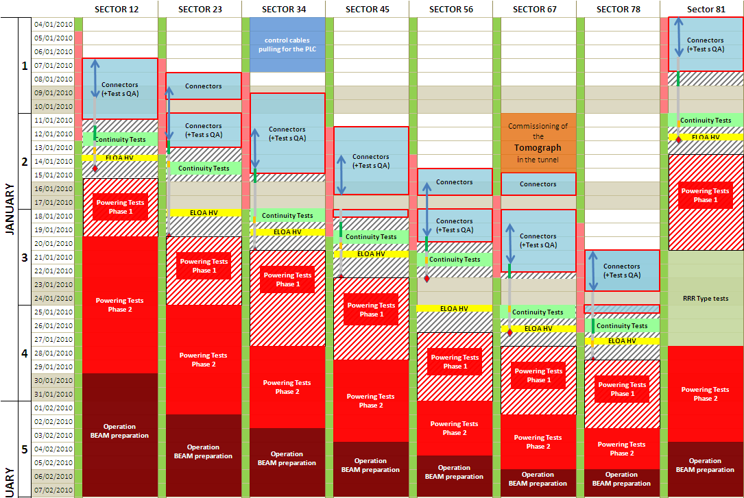
Updated schedule

Slide 11
Patrols (forecast @ Jan. 12)
Jan. 12th : Arc 81
Jan. 13een: Arc 12
Jan. 15een: Arc 23
Jan. 19een: Arc 34 + Point 1 + Point 2
Jan. 20th: Arc 45
Jan. 22nd: Arc 56 + Point 3 + Point 4 + Point 5
Jan. 26th: Arc 67
Jan. 27th: Arc 78 + Point 8
Jan. 28th: Point 6
Feb. 1st: Point 7

