Slide 1

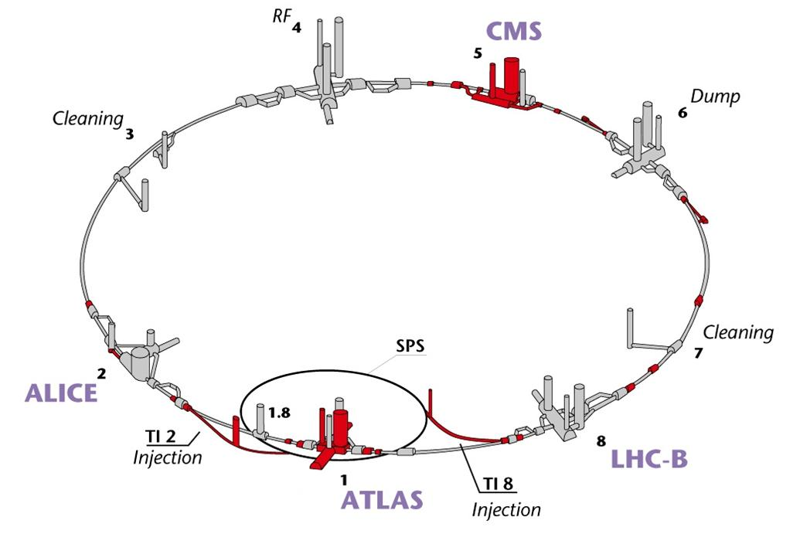
Safety Rules Recall
Safety
For more info: http://indico.cern.ch/conferenceDisplay.py?confId=64274
M.Solfaroli

Slide 2


Cryogenic Safety
The cryogenic risks
The dangers for personnel are:
  ODH
  Cold burns
  Oxygen enriched air
They can be caused by:
  Workers
  Transport / handling
  Cryogenic system (helium jam / multi-helium jam)
The hazards are defined according to:
  The type of intervention
  The cryogenic conditions
  The location in the tunnel (emergency exit)
…thanks Julie!

Slide 3



Cryogenic Safety
Reminder on existing cryogenic safety rules
Compulsory individual safety equipment
LHC Machine - Level 4: Underground risks + test
Biocell training:
  Theoretical part :
    Risk « Lack of oxygen »
    Regulatory rules
    The Biocell masks
    Conduct in case of alarm
    Implementation of the mask
  Practical part
    Simulation of real conditions in the tunnel : wearing the mandatory personal protective equipment, darkness, leakage noise and fumes harmless, ODH alarm
…thanks Julie!

Slide 4
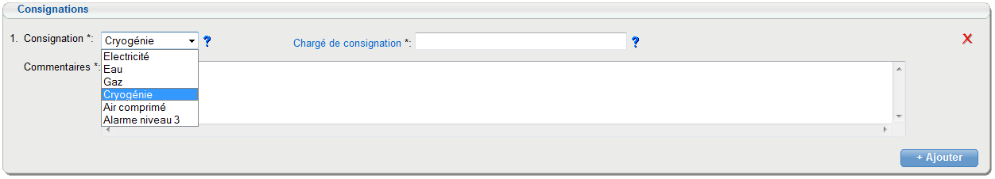
Cryogenic Safety
Cryogenic “consignation”
  A reminder is included in the ADI: you MUST obtain a written “consignation” for any intervention on a cryogenic element.
…thanks Julie!

Slide 5
Electrical Safety
At CERN, the Electrical Safety is based on the UTE-C-18-510 publication which defines general safety rules and states that the electrical workers MUST be “Habilité”:
    B0/H0 for non electrical workers
    B1/H1 for electrical workers
    B2/H2 for persons in charge of the Electrical Safety
  Before working on electrical installation, ALL electrical risks MUST be eliminated by the “consignation” of the installation through:
    Separate the installation from its electrical sources “chargé de consignation” (BC)
    Lock in open position the separation devices “chargé de consignation” (BC)
    Identify the installation “chargé de travaux” (B2)
    Check that the voltage is zero, earth and short circuit the installation (“MALT-CC”) “chargé de travaux” (B2)
…thanks Hugues!

Slide 6
Electrical Safety
High energy stored in the sc magnets
  The “consignation” as defined in the UTE publication is not enough to assure the elimination of the electrical risks. Before working on an electrical sc circuit (see EDMS 762293):
    It is mandatory to verify the absence of current (realized before the “MALT-CC” by the power converters group)
    The EE switch (if present) must be locked in open position
High energy stored in the QHPS
  The QHPS (capacitor banks charged at 900V) can generate an electrical risk if the insulation between the QH and the magnet is broken.
    For the IPD, IPQ and IT magnets, the QHPS must be switched off and discharged.
    For the MB and MQ magnets:
      It is mandatory to ground the current leads if the intervention is done at the level of the DFBA
      It is mandatory to switch off and to discharge the concerned QPHS if the intervention is done at the level of the IFS boxes
…thanks Hugues!

Slide 7
Electrical Safety
Intervention on an ESSS (except the ARC)
All the superconducting circuits must be “consignés”:
      PCs must be separated from the electrical network and their feeders must be locked in open position
      Absence of current must be verified
      Absence of voltage must be verified
      Current Leads must be grounded
      DC cables must be grounded (if necessary)
  All the EE systems must be locked in open position.
  QHPSs must be separated from the electrical network and discharged; their feeders must be locked in open position.
…thanks Hugues!

Slide 8
Electrical Safety
Intervention on an ARC
  At the DFB module level (Low Current Module or High Current Module)
    All the superconducting circuits of the DFB module must be “consignés”
    All the EE systems of the DFB module must be locked in open position
    All the QHPS of the DFB module and located in the UA and the RR must be separated from the electrical network and discharged. Their feeders must be locked in open position
  At the level of the IFS boxes
    Only concerned superconducting circuits must be “consignés”
    Only concerned EE systems must be locked in open position
    Only concerned QHPS must be separated from the electrical network and discharged. Their feeders must be locked in open position
    All PCs of the arc MUST be blocked at the PIC level
    No powering tests on the ARC during the intervention
…thanks Hugues!

Slide 9
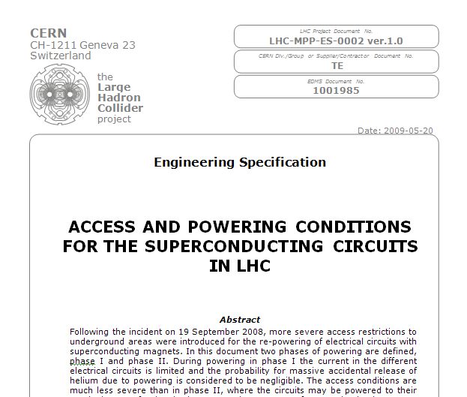
Underground access during powering tests
EDMS number: 1001985

Slide 10
Underground access during powering tests
PHASE I
LOW CURRENT phase
Underground areas and tunnel
accessible for people involved in
powering tests
PHASE II
HIGH CURRENT phase
No access for anybody
in a wide area

Slide 11
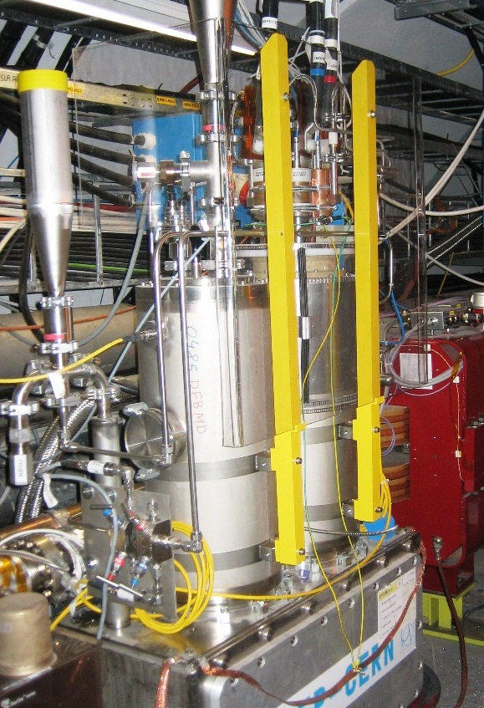
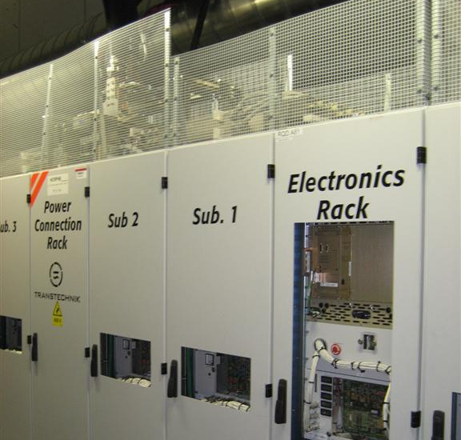
Underground access during powering tests
RISKS
Phase I
CRYOGENIC:
Risk of an accidental massive helium release
HAS BEEN CONSIDERED NEGLIGIBLE
ELECTRICAL:
In the UAs
In the tunnel

Slide 12
Underground access during powering tests
Access condition
Assumed that the current is limited:
Only people with “test related” activities are allowed to access the tunnel
Power tests may continue in the powering subsectors where NOBODY works
Means to enforce the rule
Current limitation:
Hardware current limitation for RB and RQD/F power converters
Software current limitation on the other converters
Software interlock
Access control:
All doors closed and emergency handles rearmed
Tunnel area in restricted mode
UAs in general mode

Slide 13
Underground access during powering tests
RISKS
Phase II
CRYOGENIC:
Accidental massive helium release CANNOT BE EXCLUDED!
ELECTRICAL:
In the UAs
In the tunnel

Slide 14
Underground access during powering tests
Access condition (the rule)
As the current is NOT limited:
Nobody is allowed in the tunnel nor in the related underground areas
Means to enforce the rule
Access control:
All doors closed and emergency handles rearmed
All related zones patrolled
All related areas in closed mode
Software interlock

Slide 15
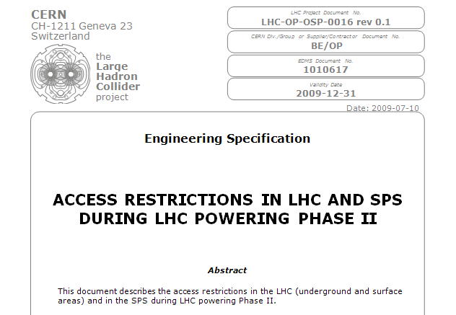
Underground access during powering tests
EDMS number: 1010617

Slide 16
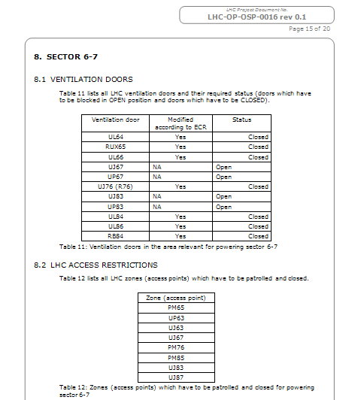
Underground access during powering tests

Slide 17
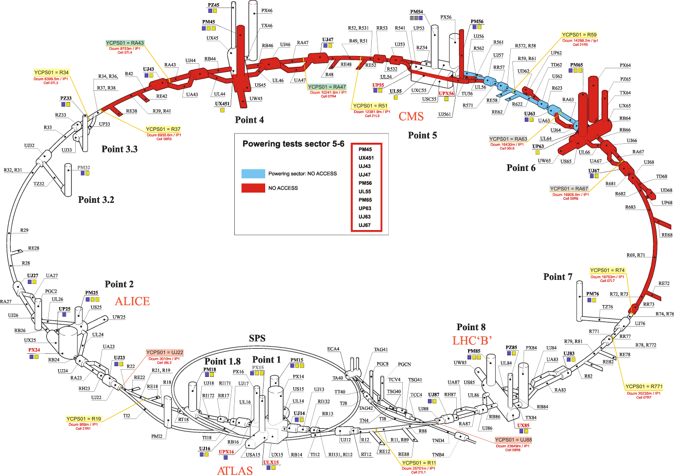
Underground access during powering tests

Slide 18
Underground access during powering tests
How to deal with access requests:
For punctual interventions:
Finish all tests ongoing
Block the whole sector via “global PIC”
Switch the area in restricted mode
Authorize people with an approved ADI in
For longer interventions we can step back to Phase I through the special procedure, described in the document: “Transition from Powering phase 1 to Powering Phase 2 and vice versa” EDMS: 1012328.
This procedure has been applied several times during the last campaign

Slide 19
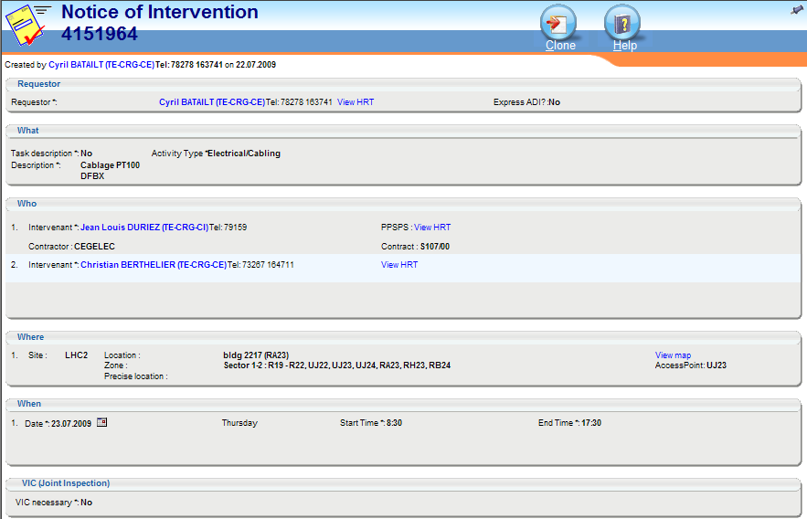
Underground access during powering tests
ADIs

Slide 20
Underground access during powering tests
Powering Interlock
BIC – Access Status = true
Key UP
Beam ON
Access OK for PO PHASE 2 = true
OR
POWERING permit = true
I_meas < I_max = true
OR
PC in simulation mode = true
This is just an help on safety (SW)!
…thanks Laurette!

Slide 21
Acknowledgment
A special thanks to:
The speakers of “Powering tests and Safety” (half) day - 23-07-2009
  Rudiger, Mirko, Hugues, Julie (Katy), Laurette and Gianluigi
The safety team
For more info: http://indico.cern.ch/conferenceDisplay.py?confId=64274

