Slide 1
LIU-PS Planning report

Slide 2
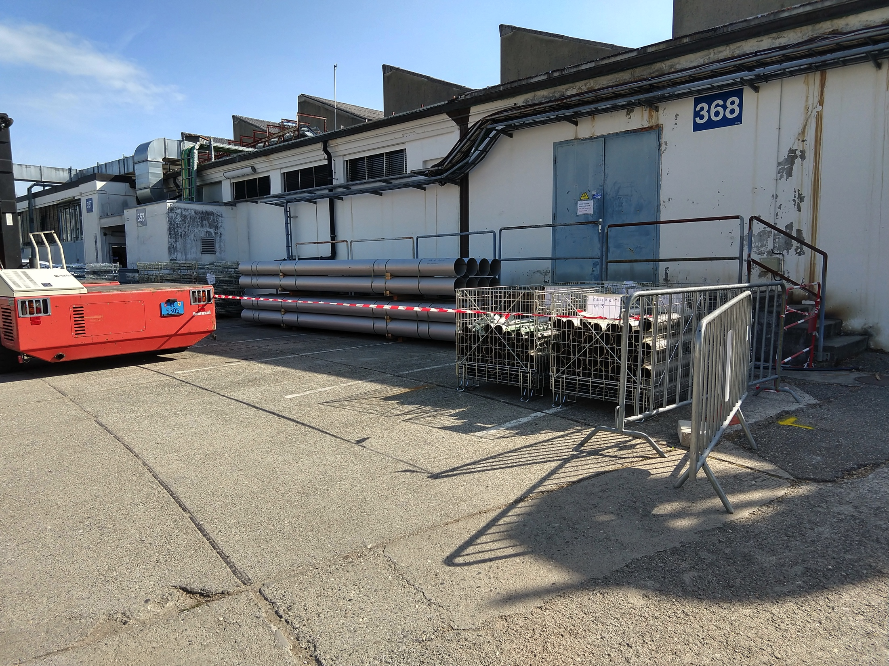
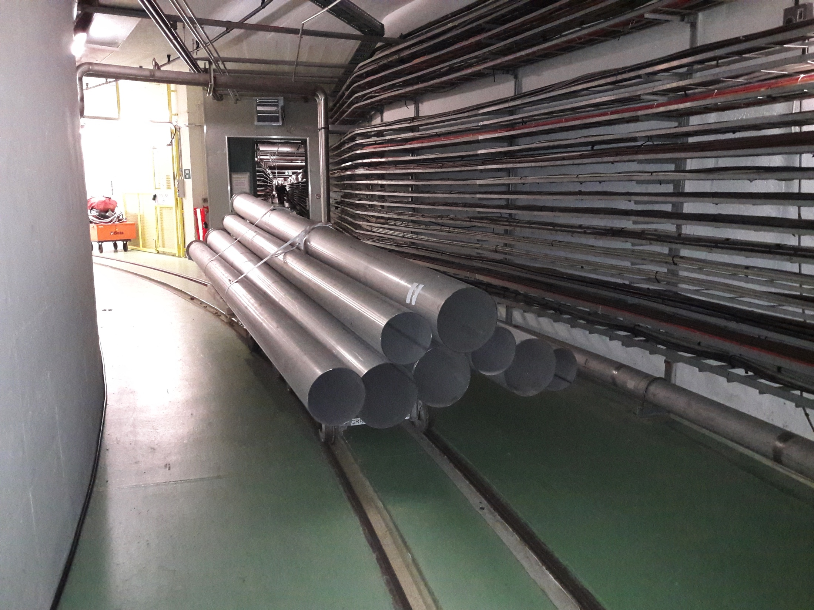
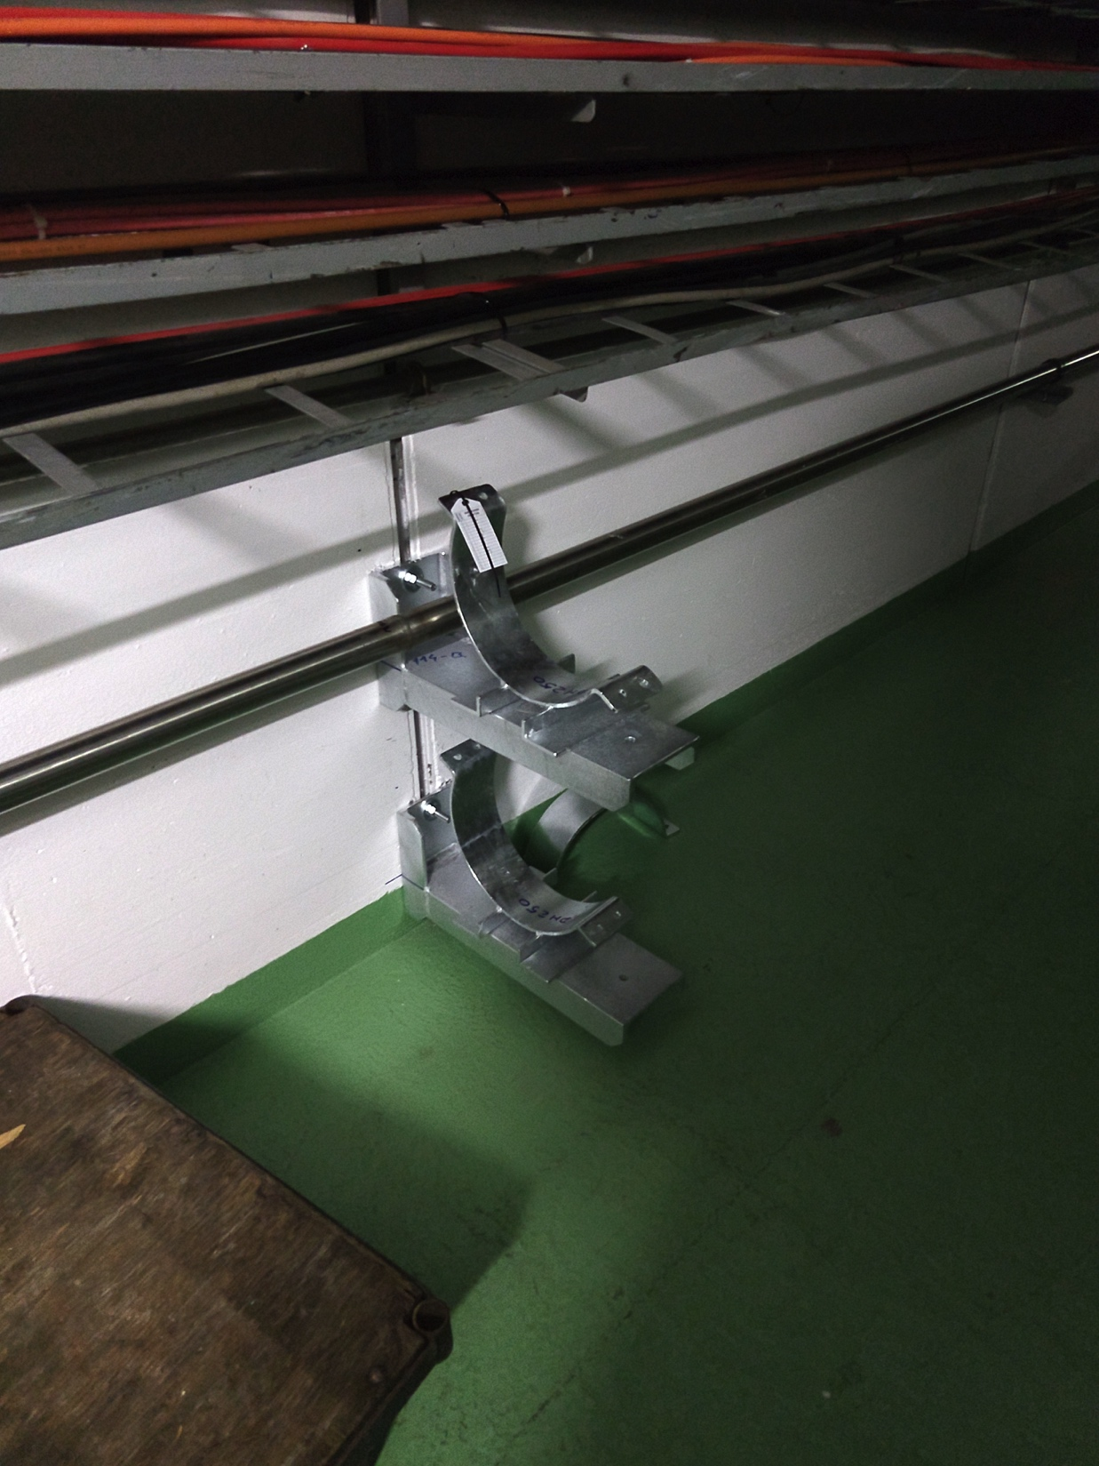
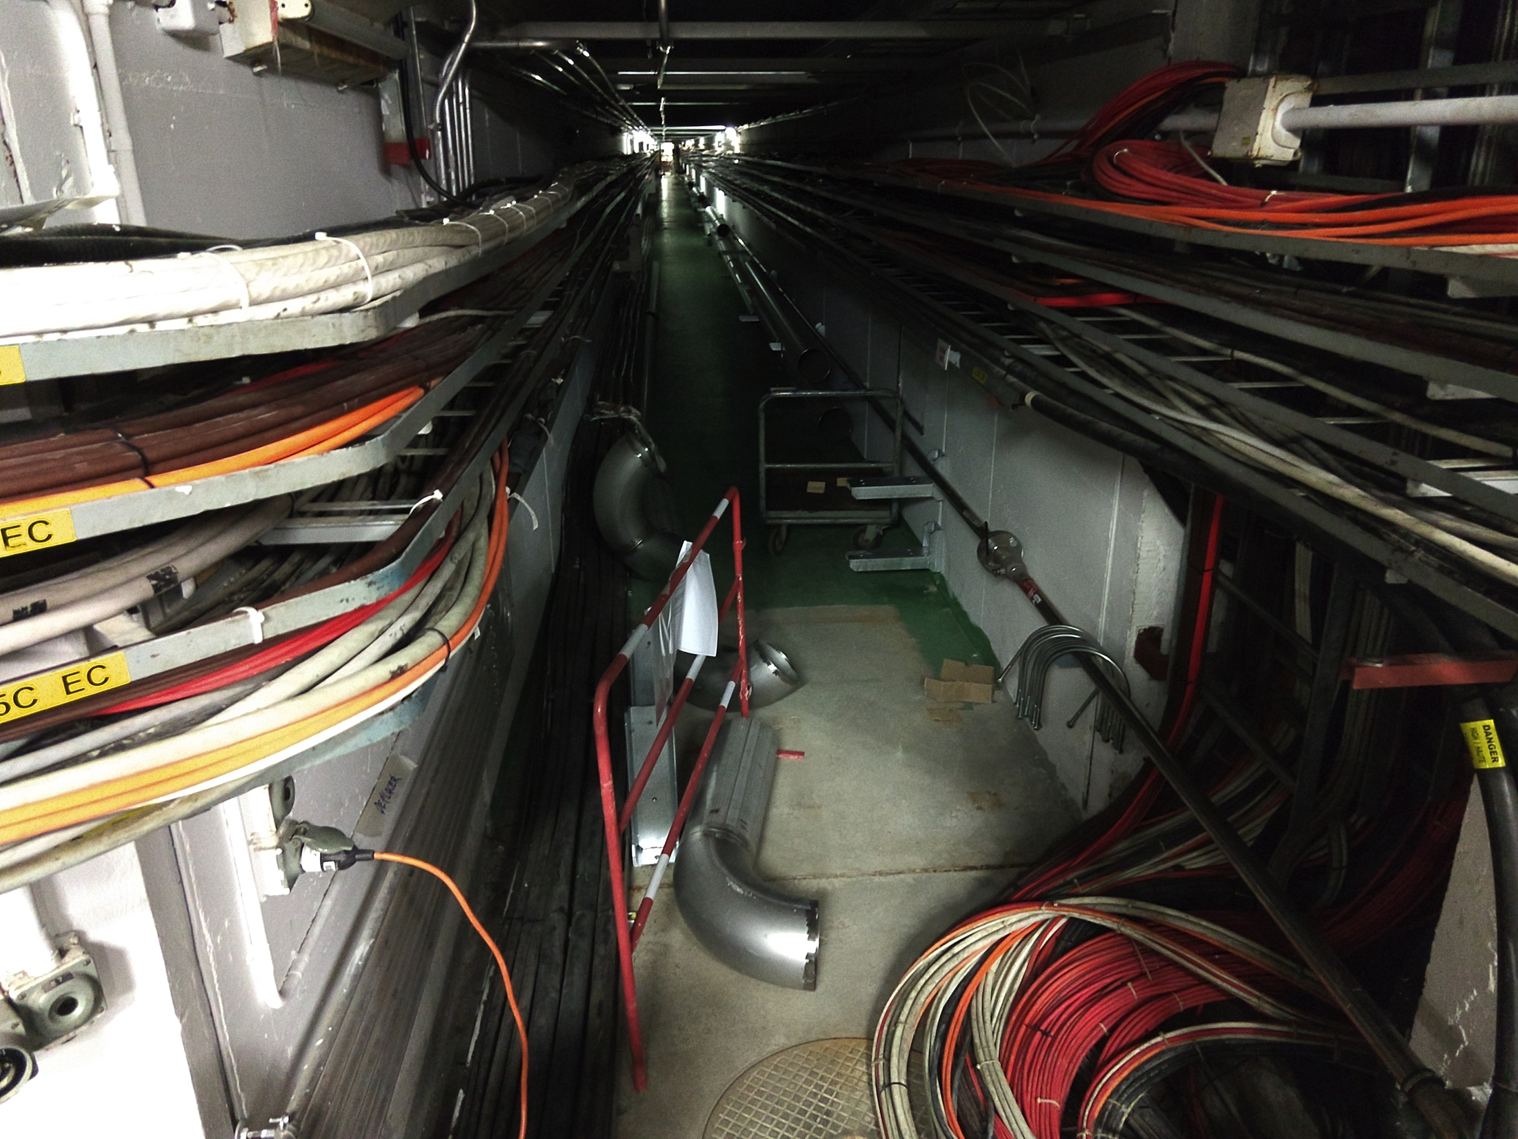
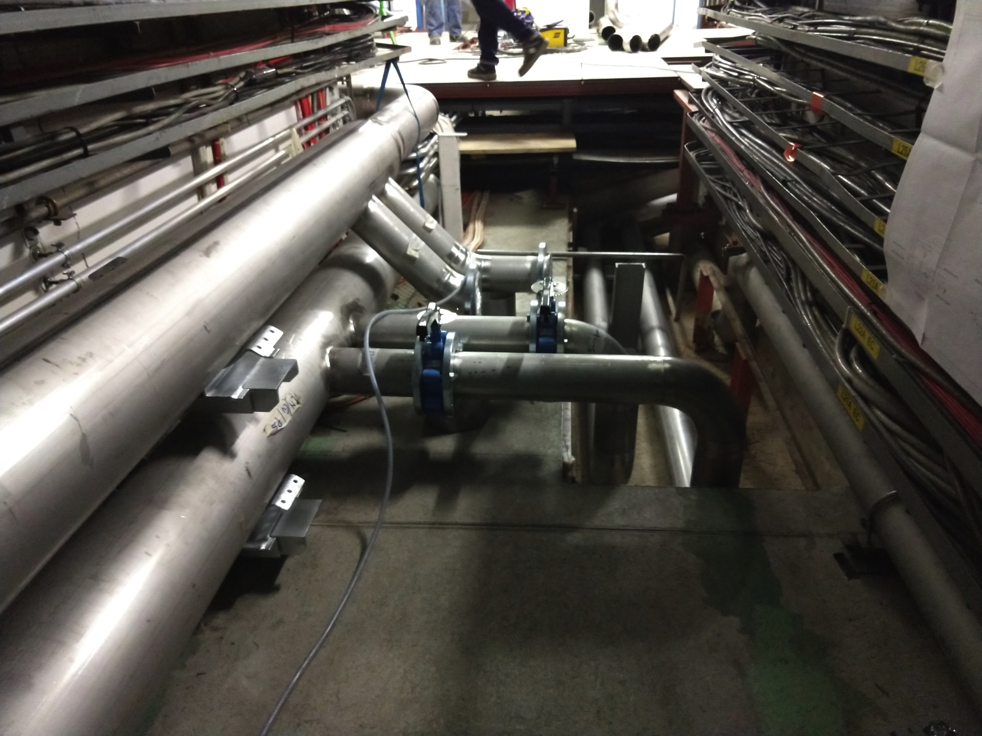
New demineralized water circuit
Progressing quite well

Slide 3
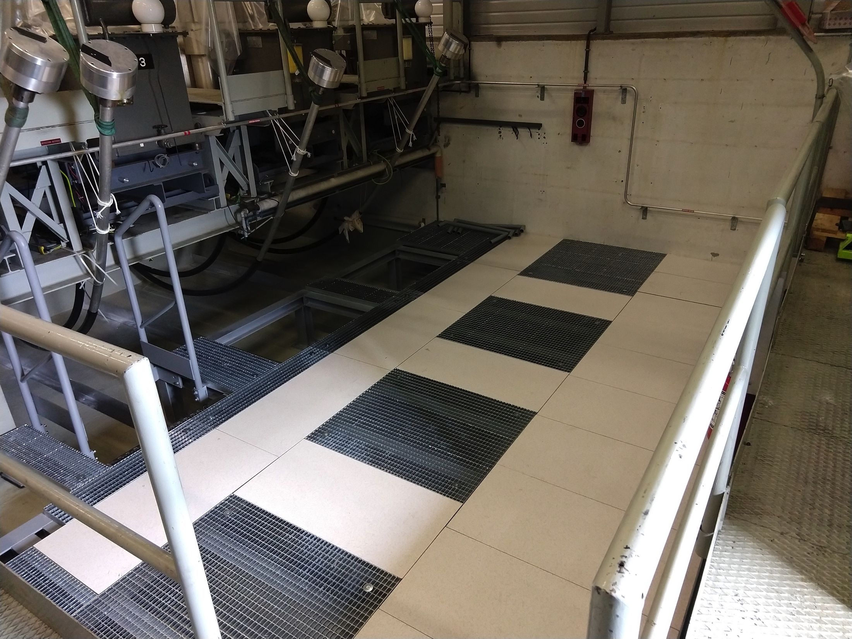
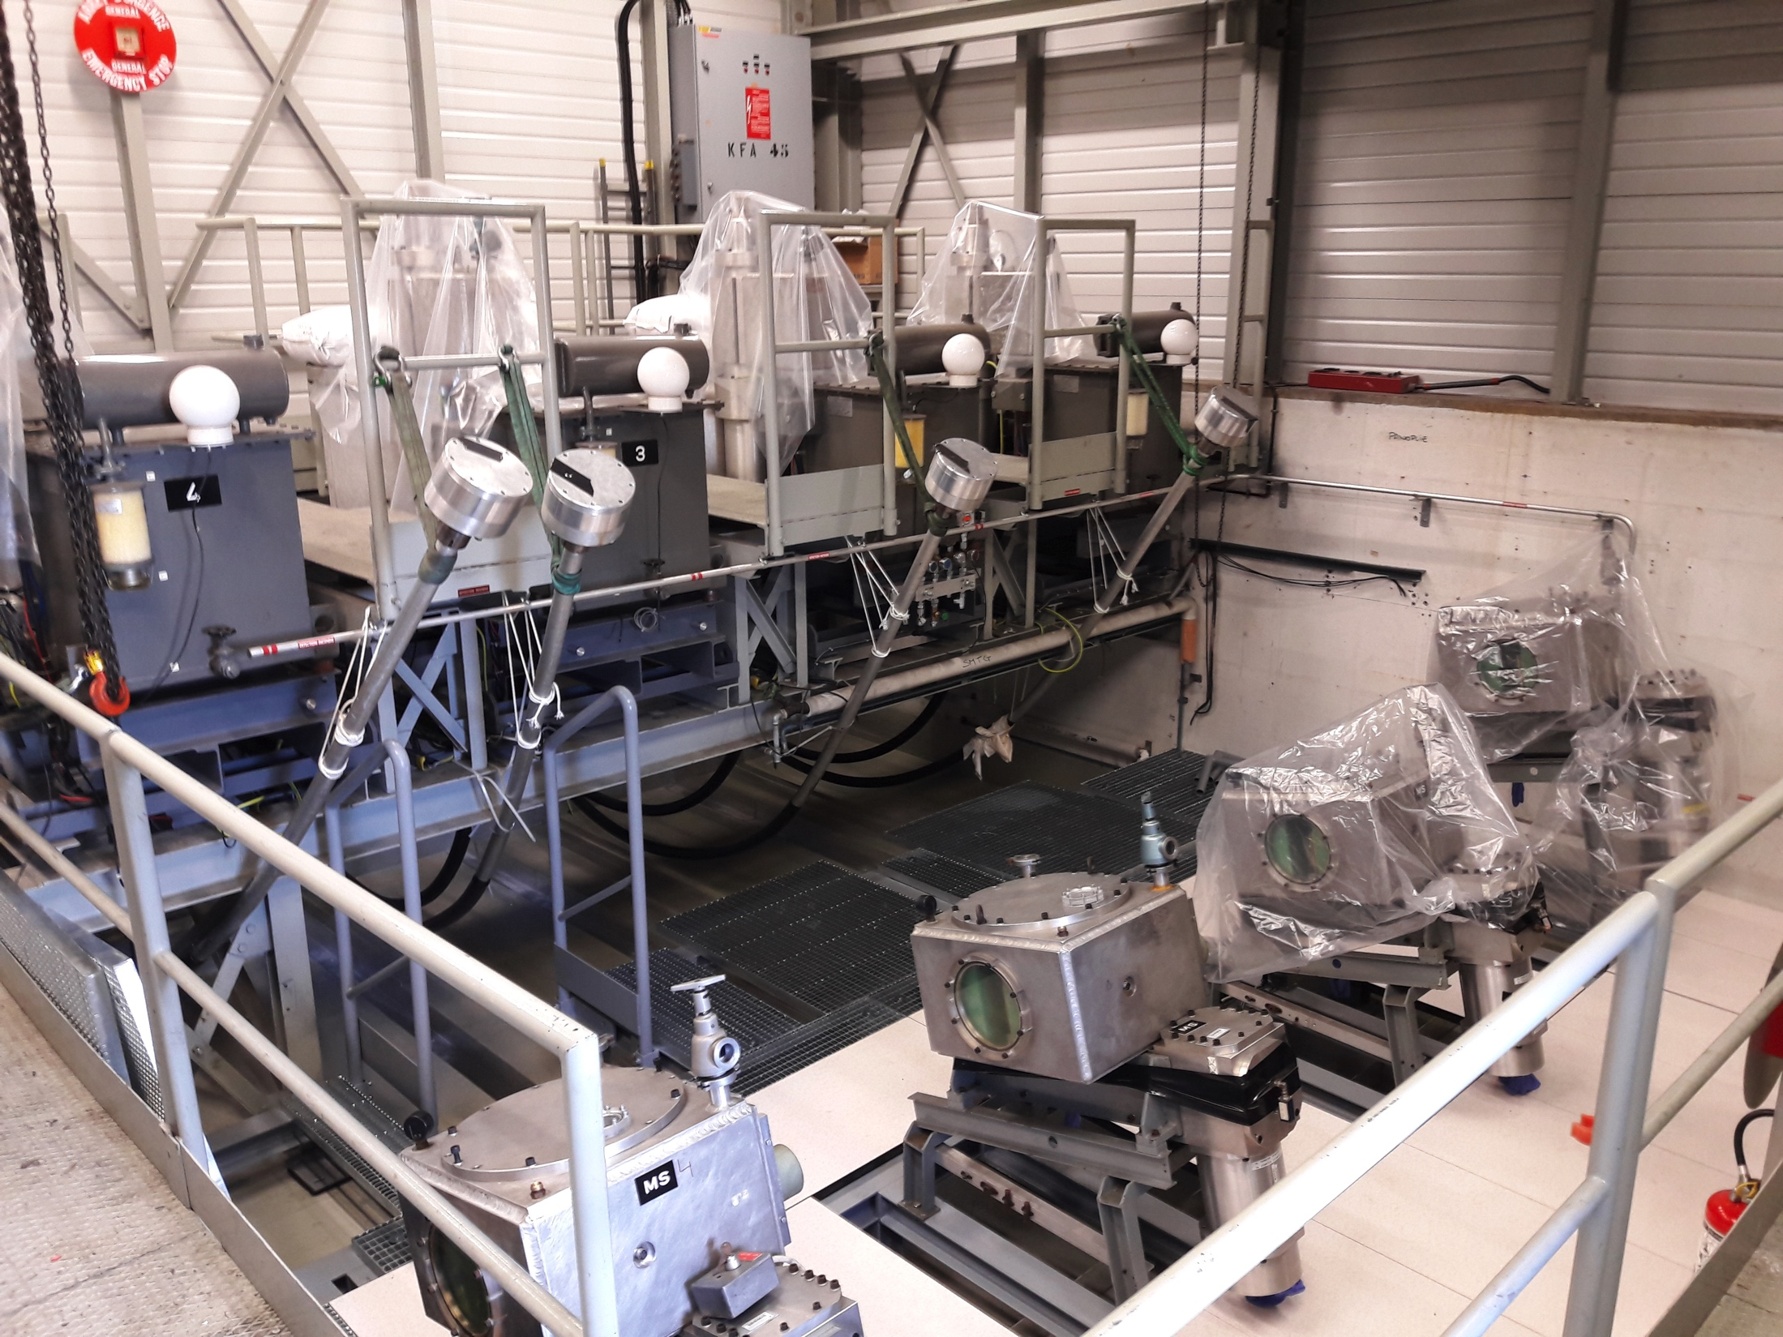
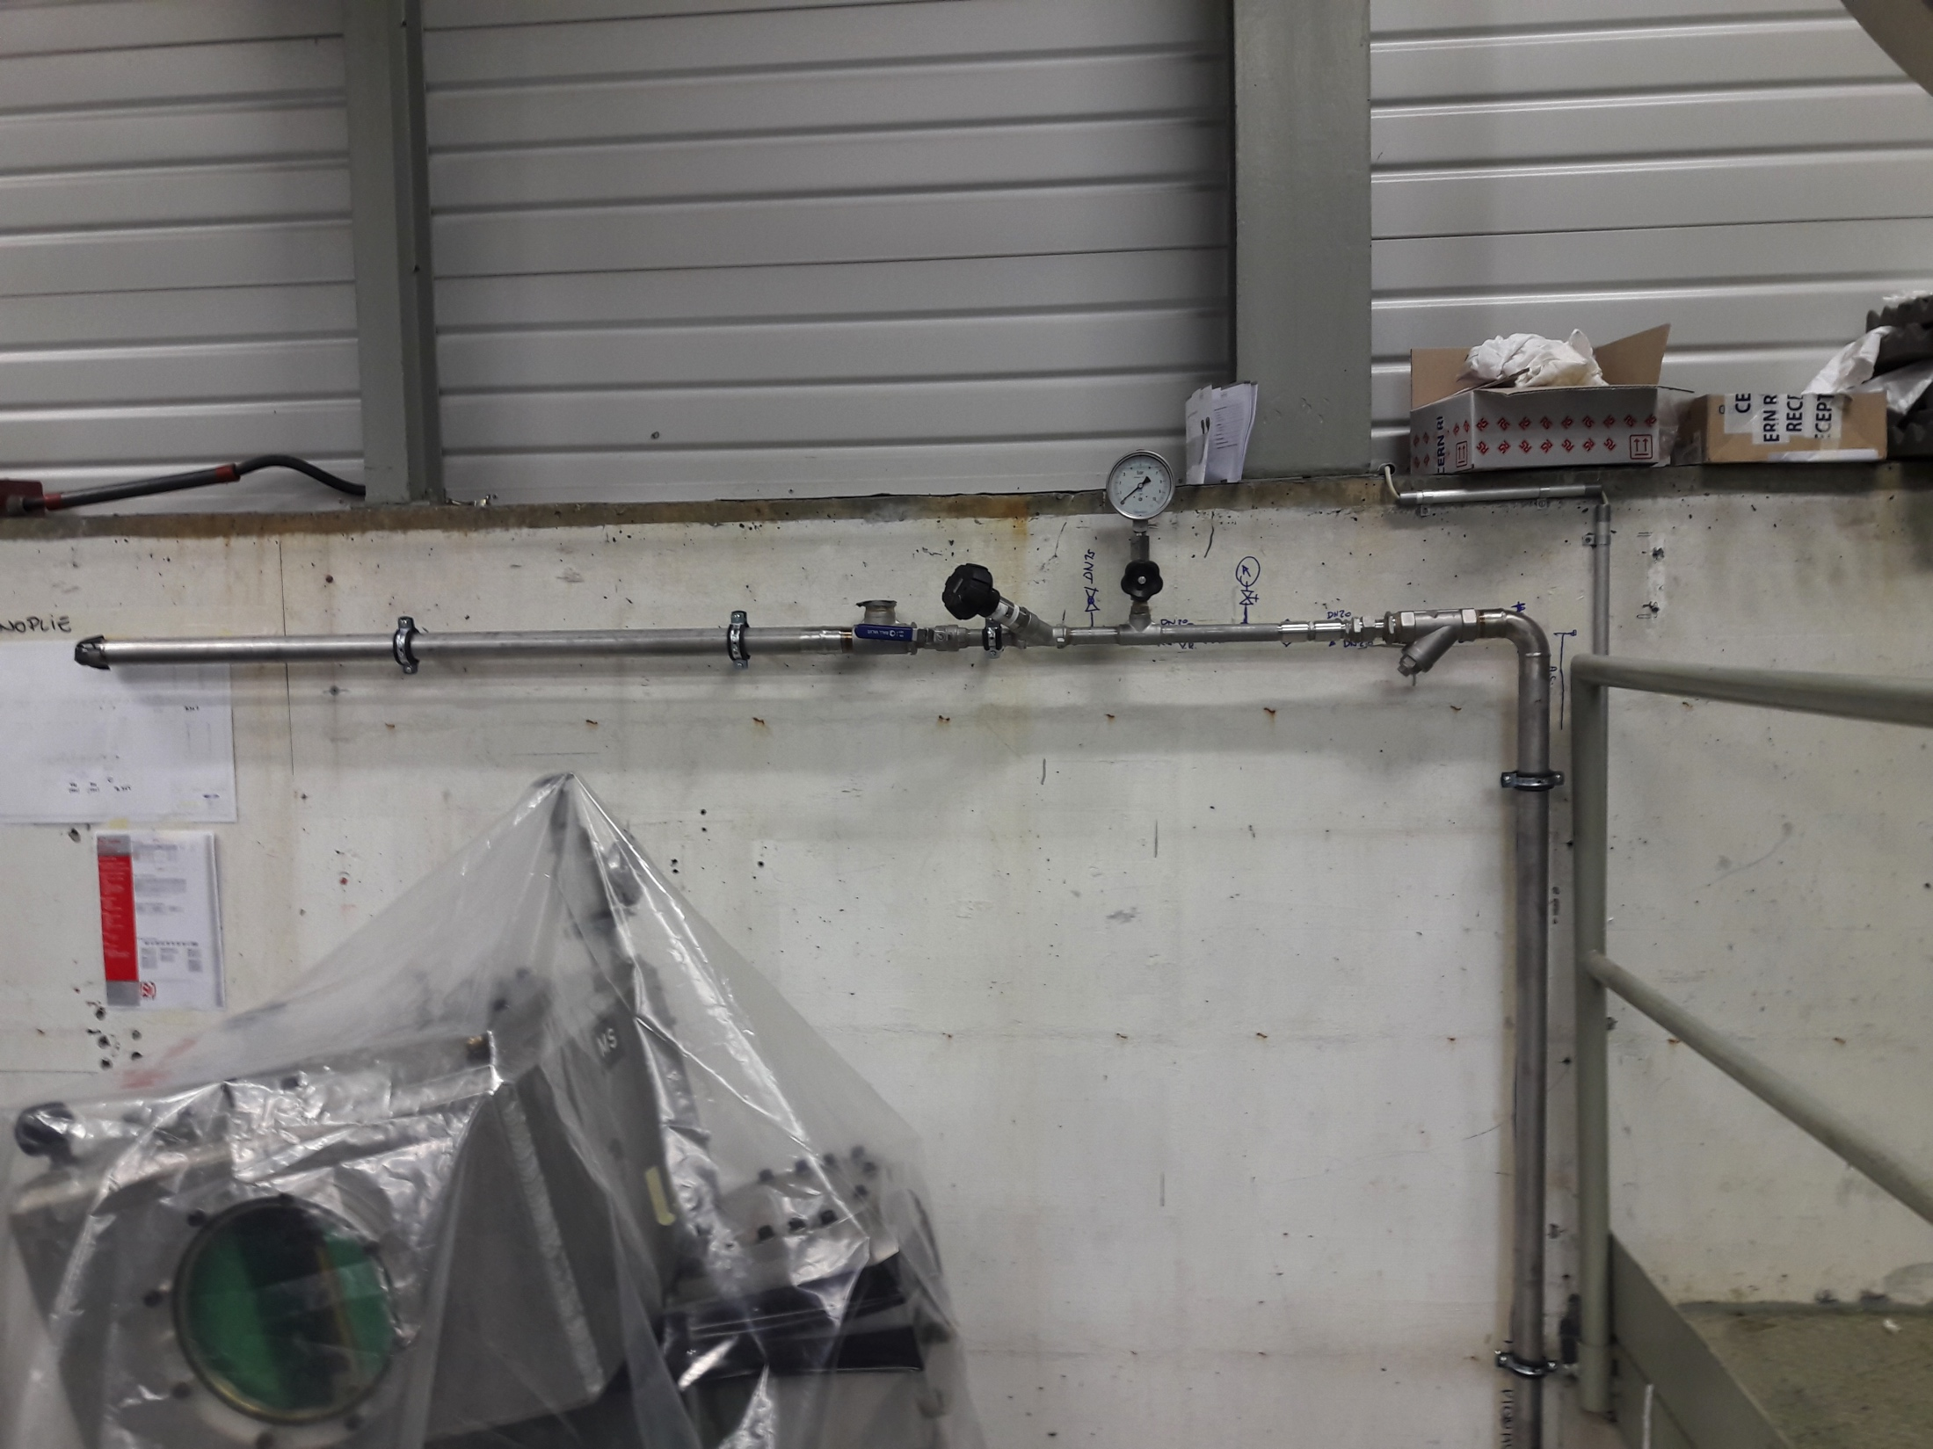
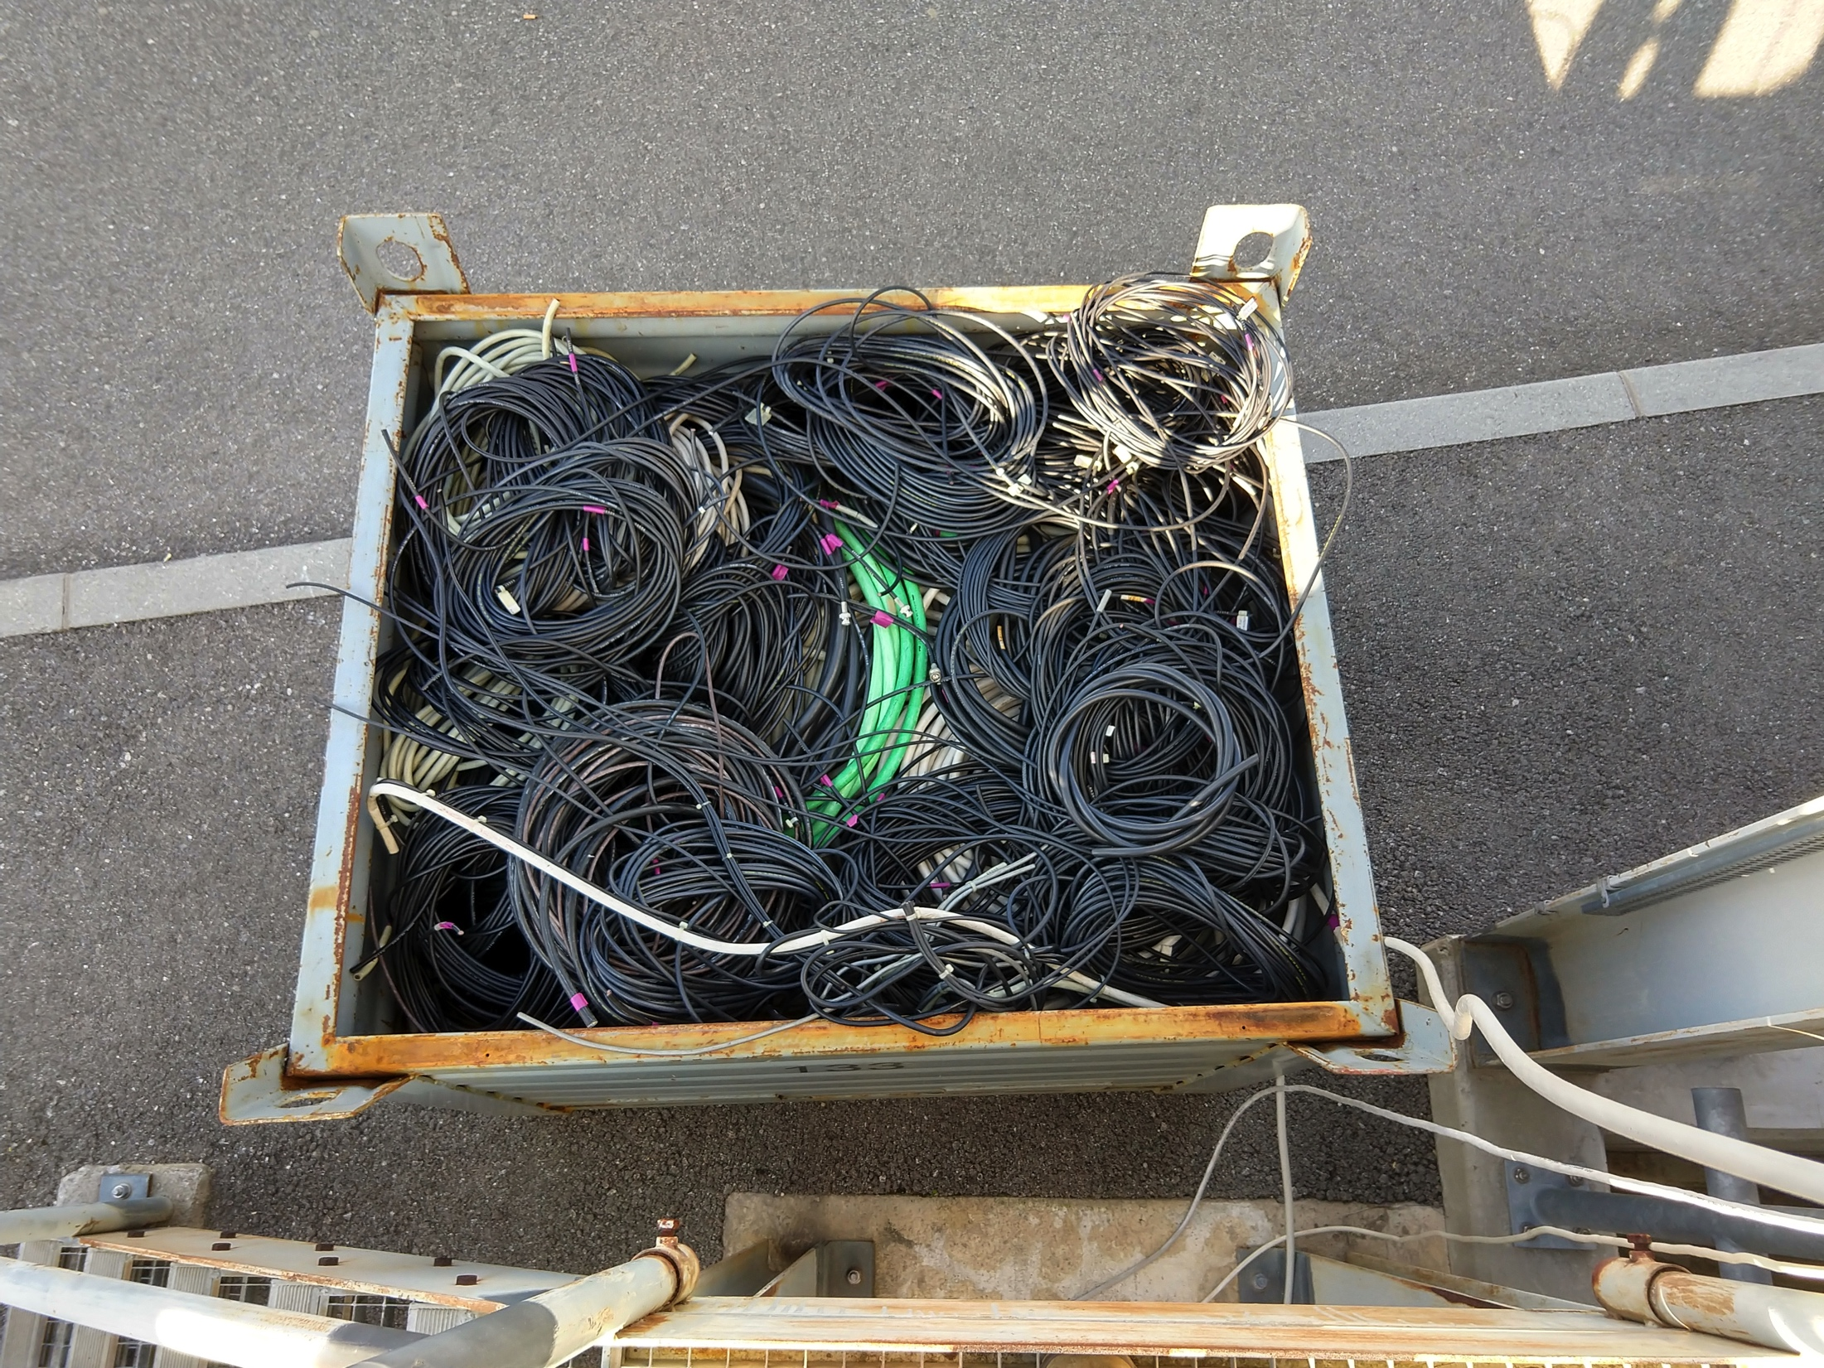
B.365 – KFA45 area
  Oil retention renovation works performed as planned
  New structure installed as planned and minor modifications have been agreed with ABT to be performed after the CV pipes installation
  CV pipes partially installed
  De-cabling is finished
Issue:
  Few activities were not detailed enough in the planning

Slide 4
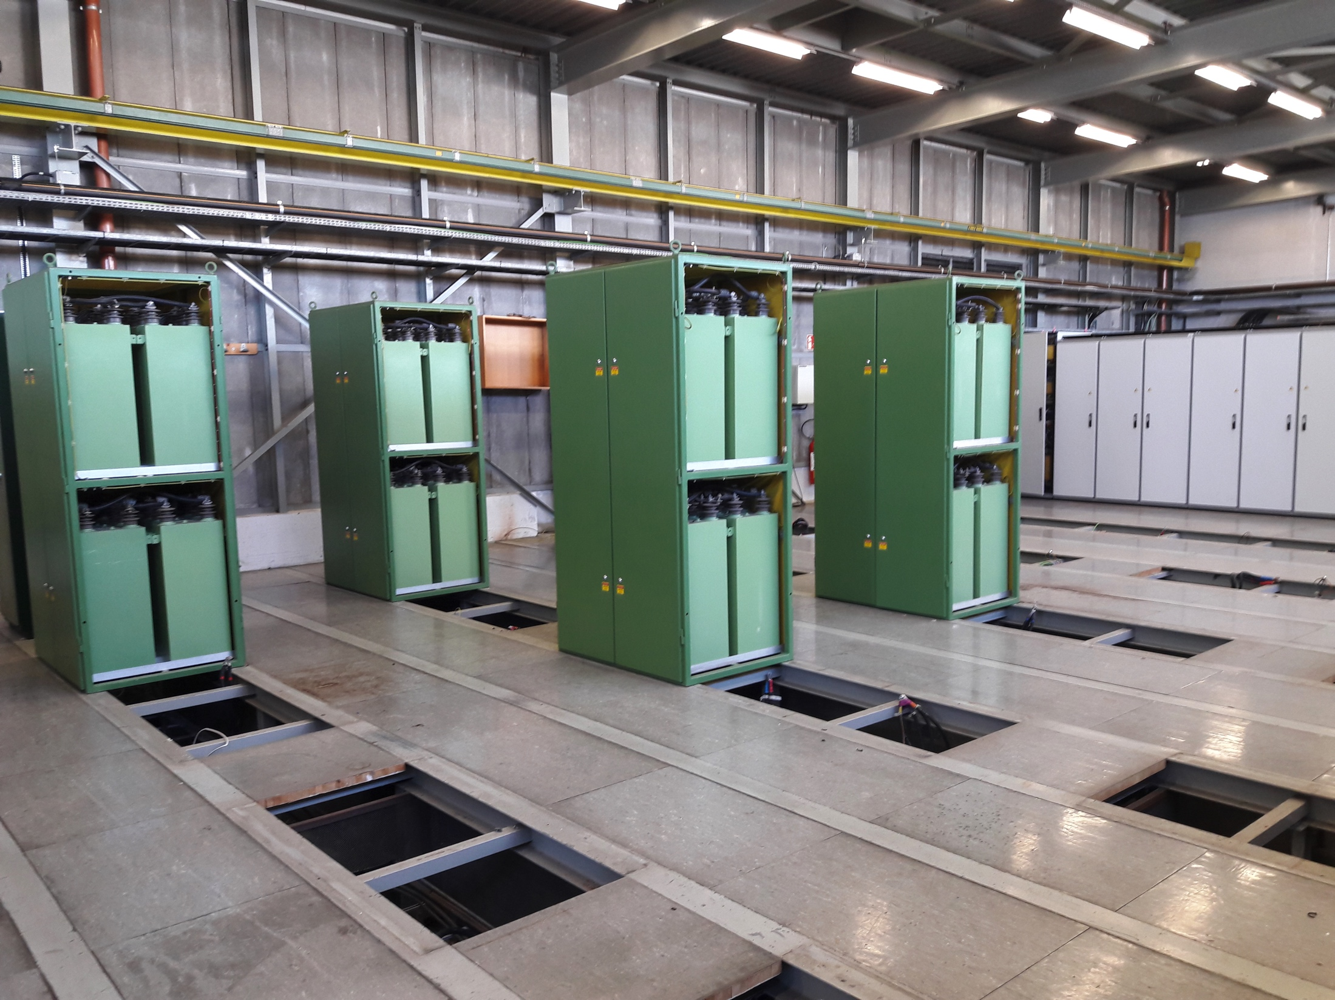
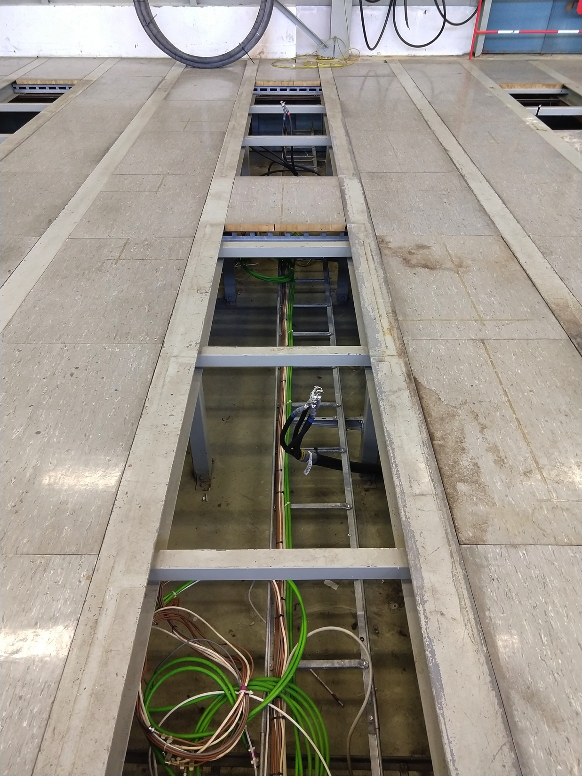
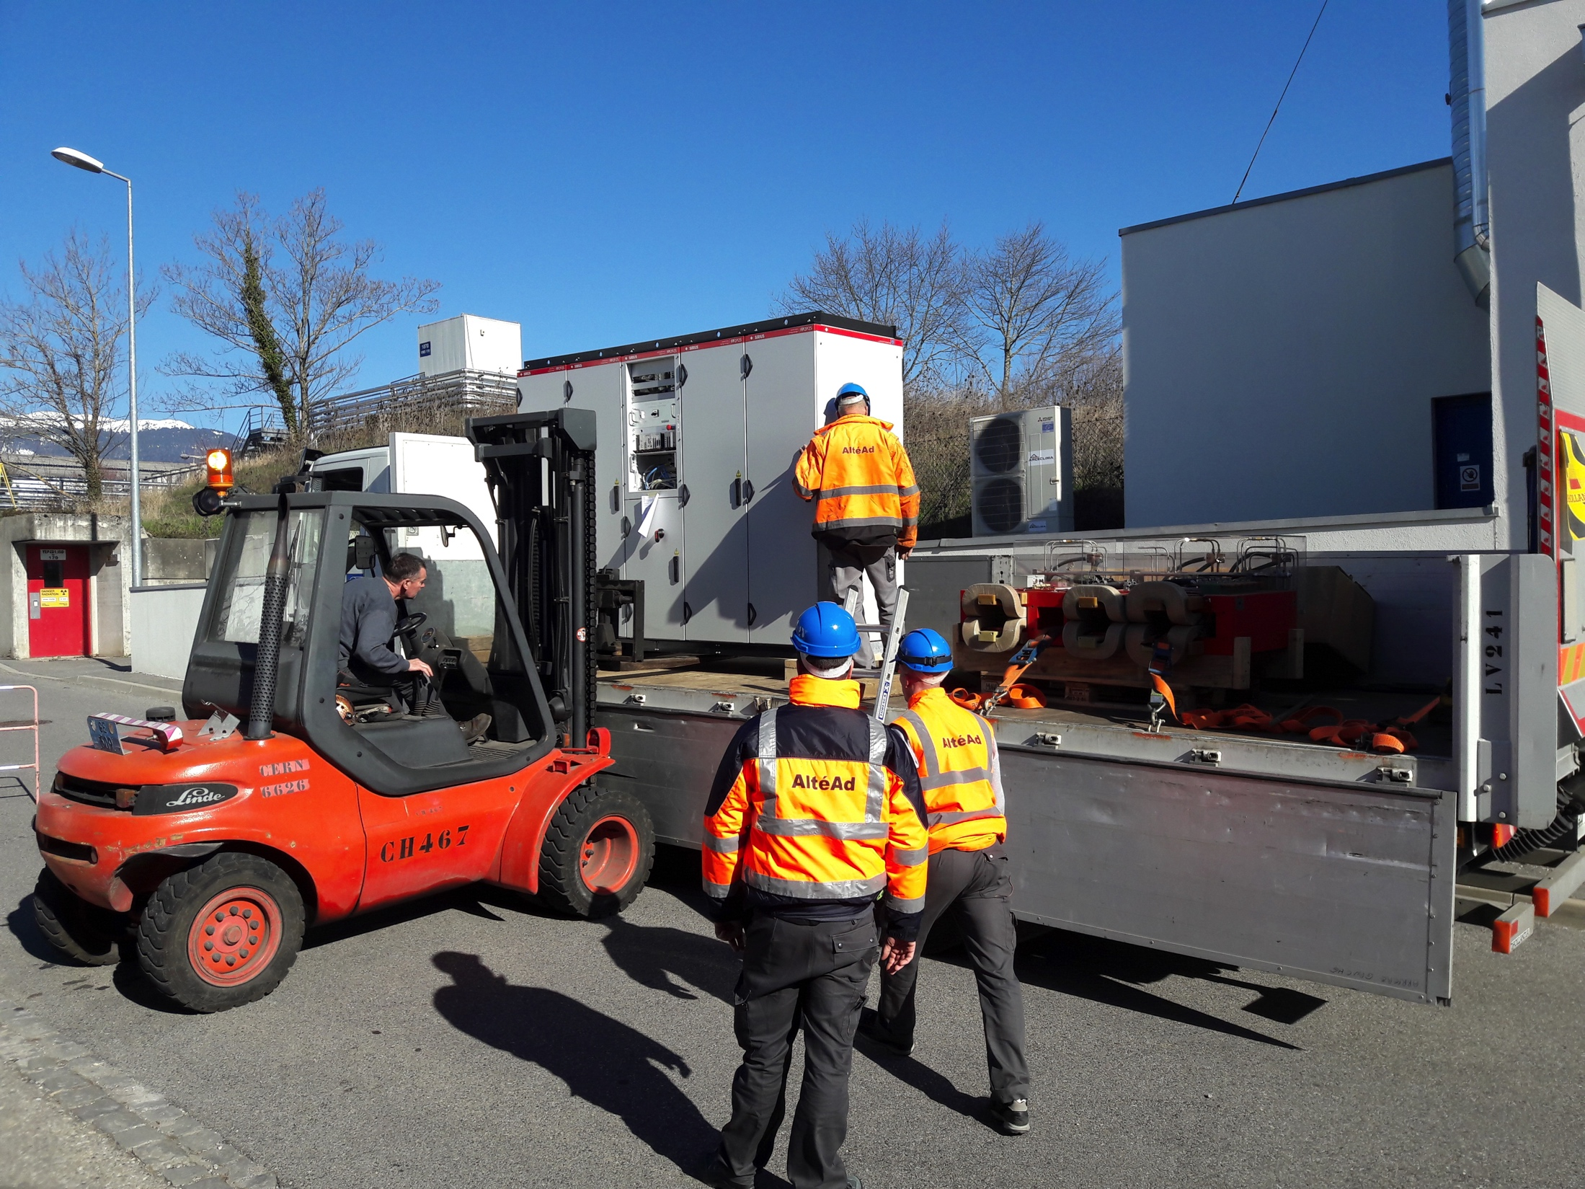
B.365 – PCs area
Power Converters have been disconnected and removed
De-cabling is finished
Issue:
  Some control cables left even if identified in purple

Slide 5
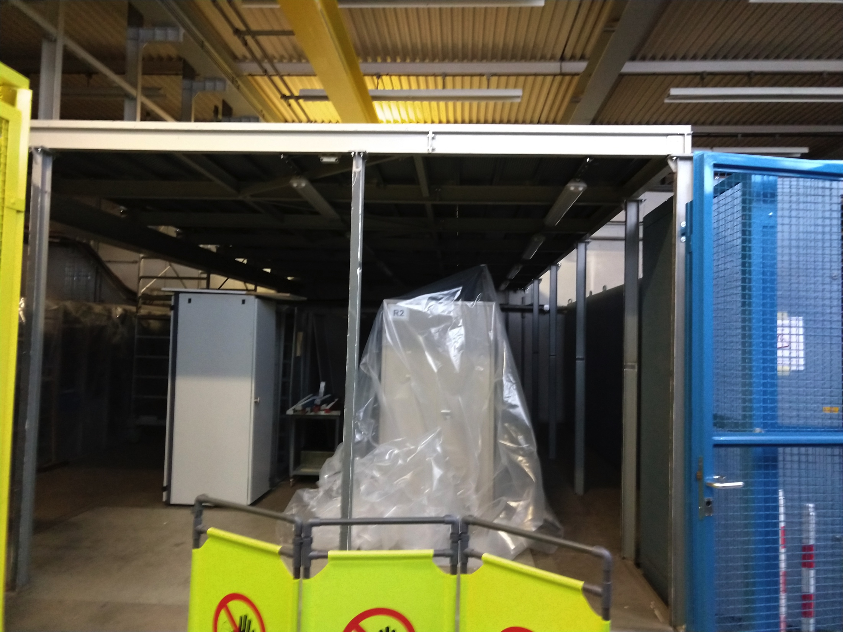
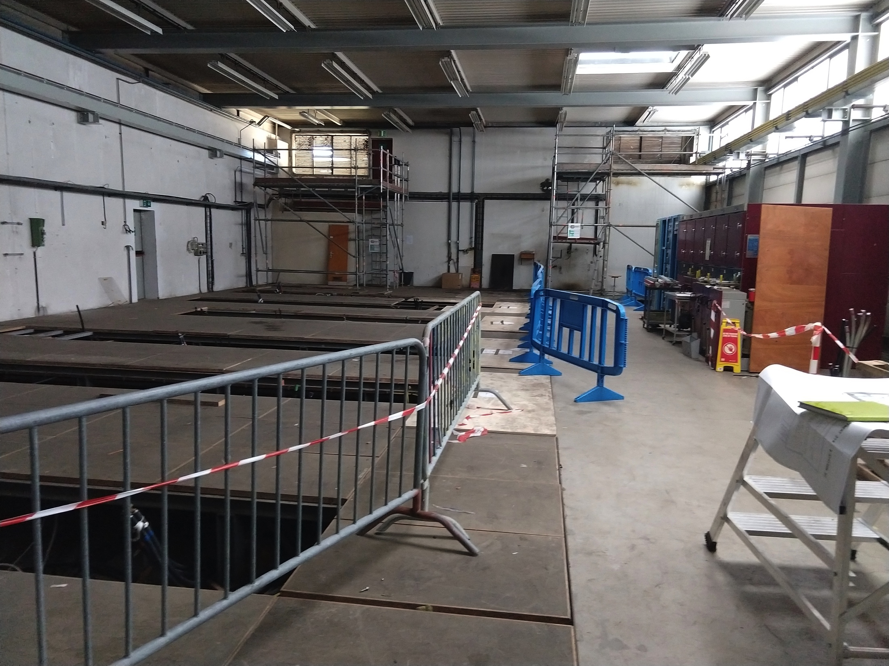
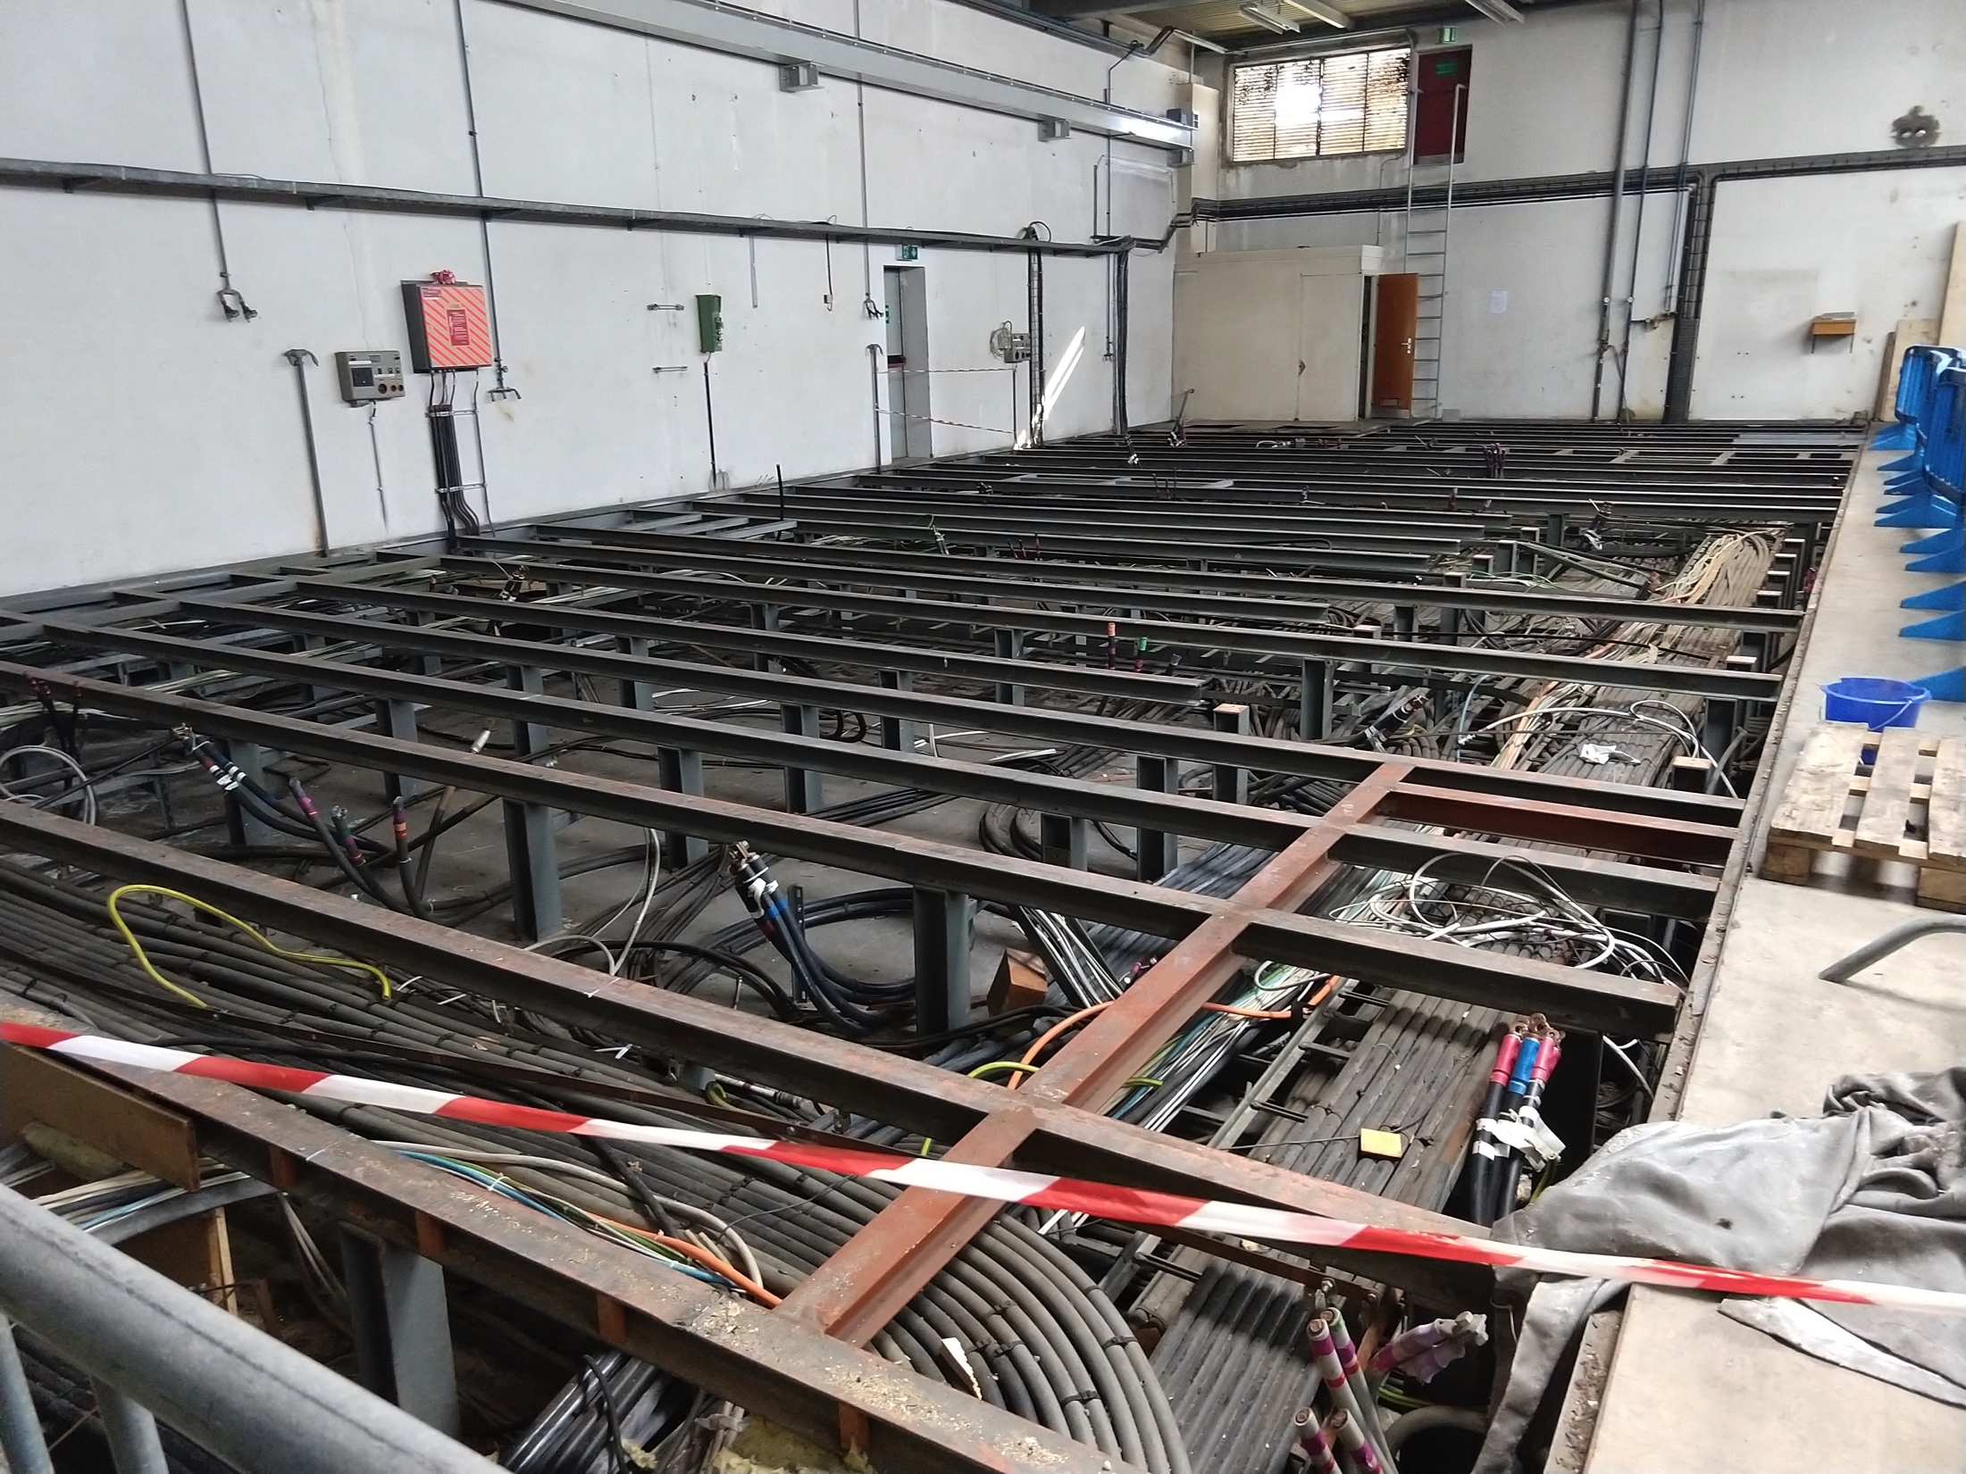
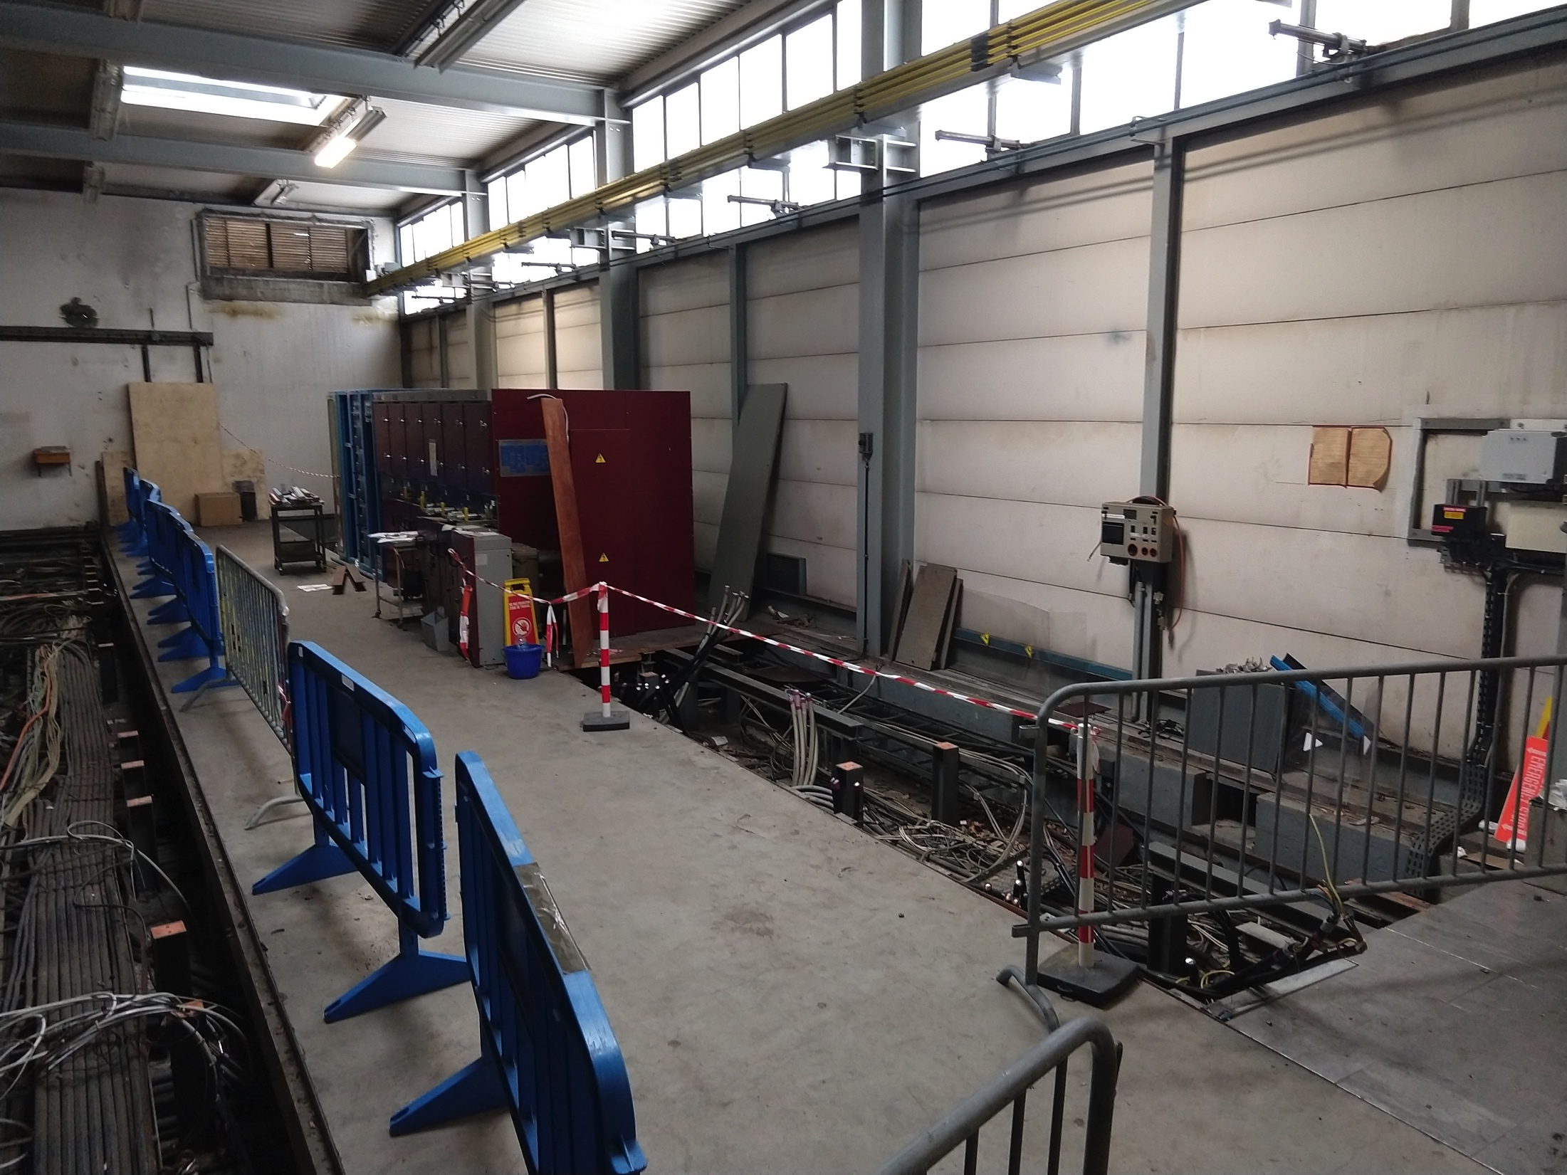
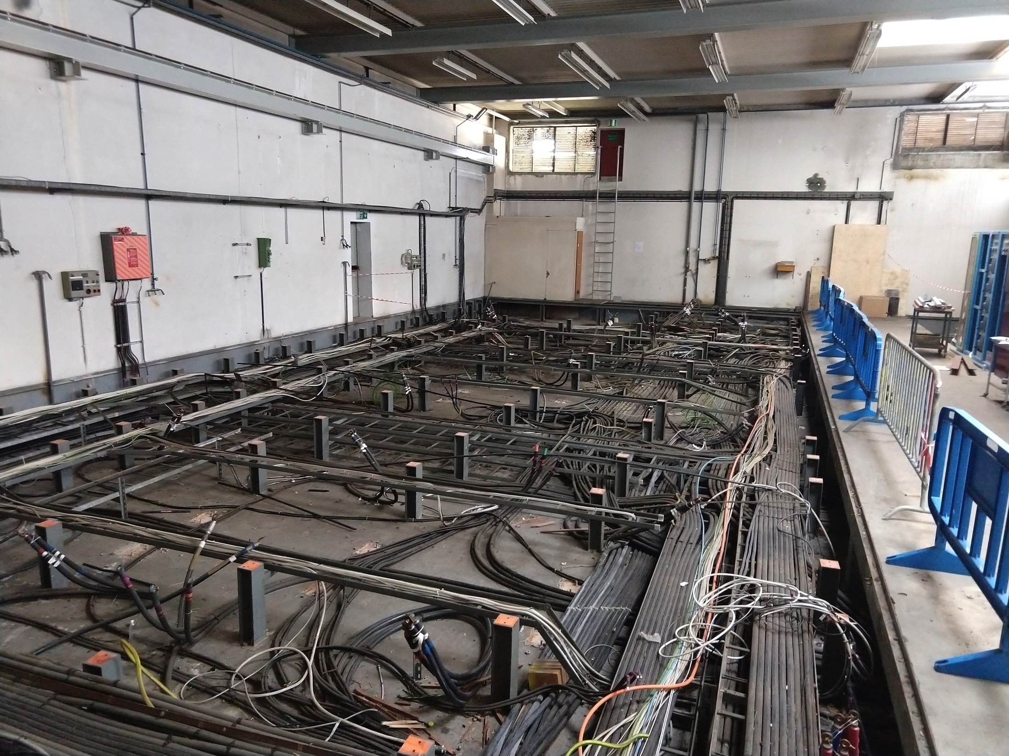
B.269
Power converters have been removed
Ventilation Units have been dismantled
False floor structure has been removed
CV doesn’t need the second time slot that was foreseen in the planning, so we have margin until the 8th of April
De-cabling will start tomorrow – in advance with respect to the planning

Slide 6
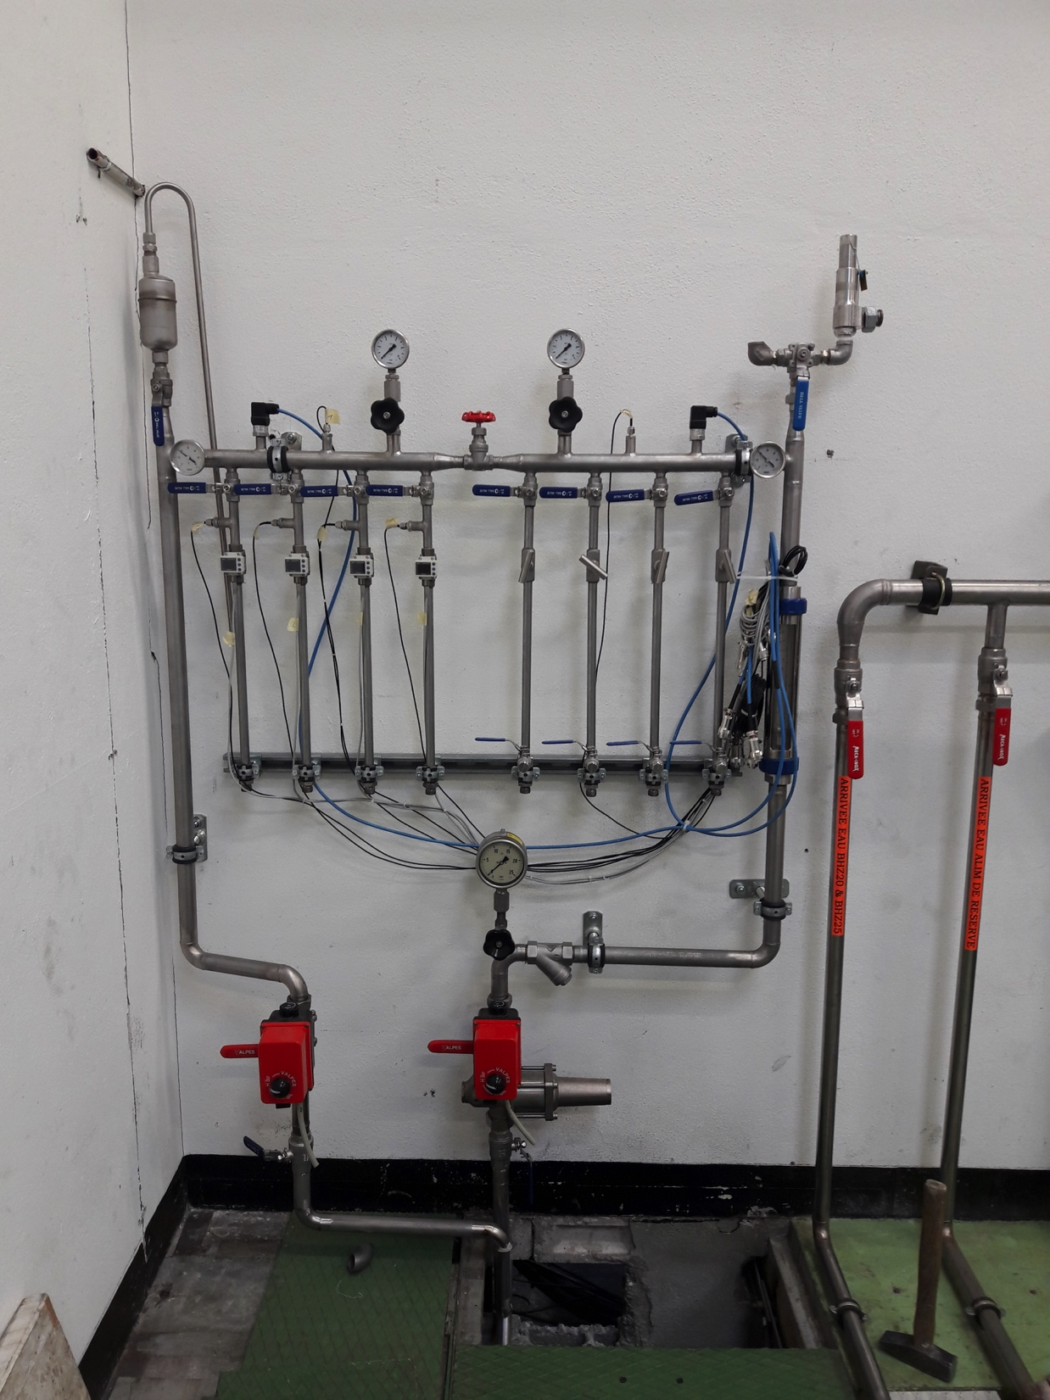
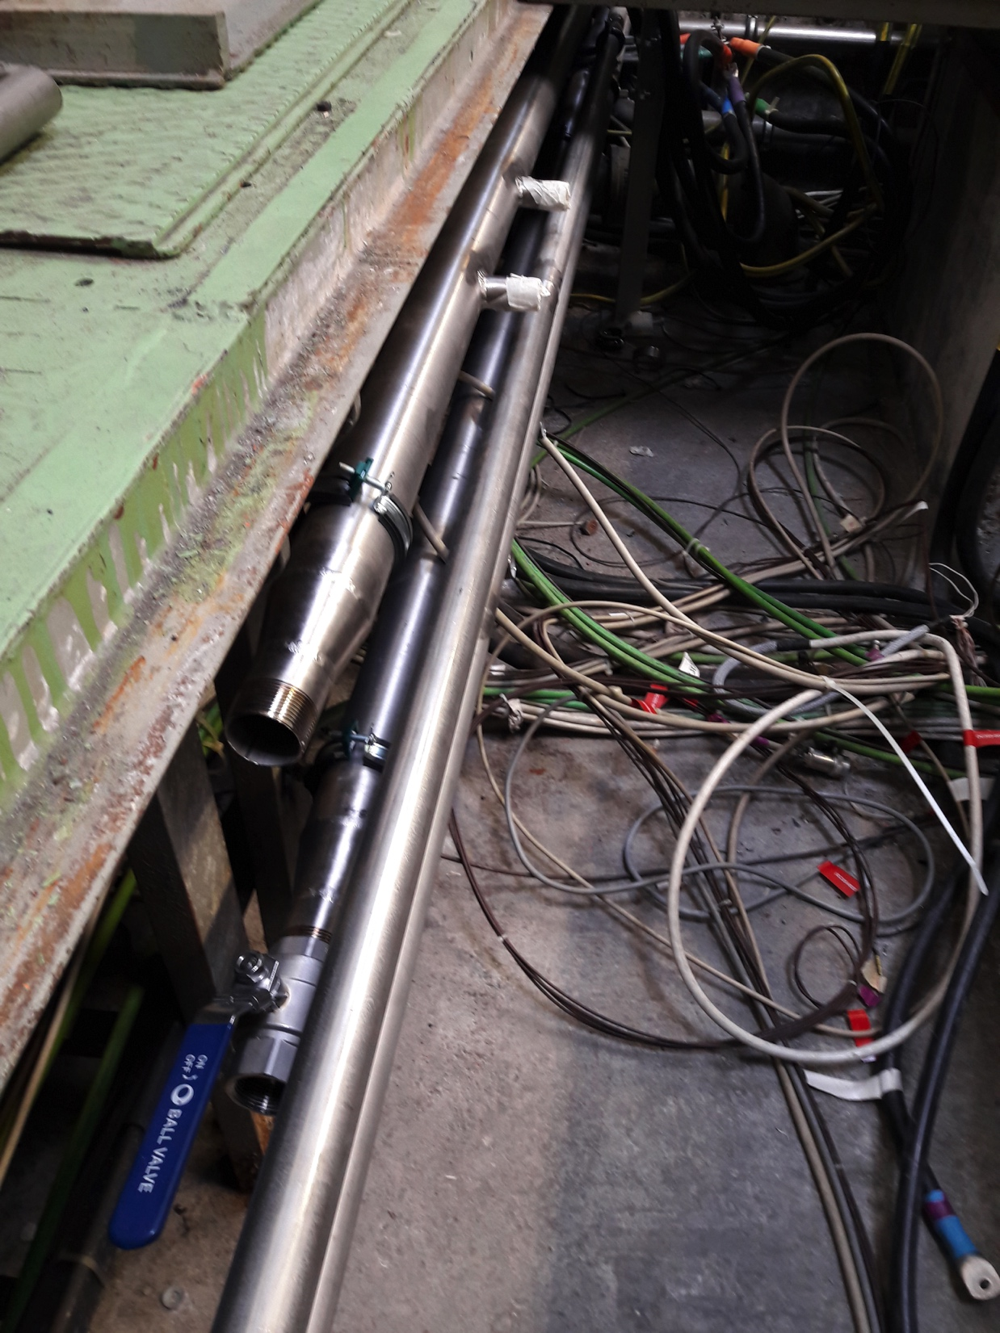
B.355
CV pipes installed for new vertical BGI power converters
New pipes and cooling manifold installed for the new transverse feedback system

Slide 7
Main Units renovation (cons.)
10/43
  already renovated
2/10
  kept in B.150 (MU27 and MU39) for the LINAC4 and BTP works
8/10
  already re-installed and re-aligned in the machine (MU73, MU24, MU22, MU29, MU32, MU13, MU11 and MU4)

Slide 8
Question?

