Slide 1
LIU-PS EVM Status
Data extraction: 2 April 2019

Slide 2
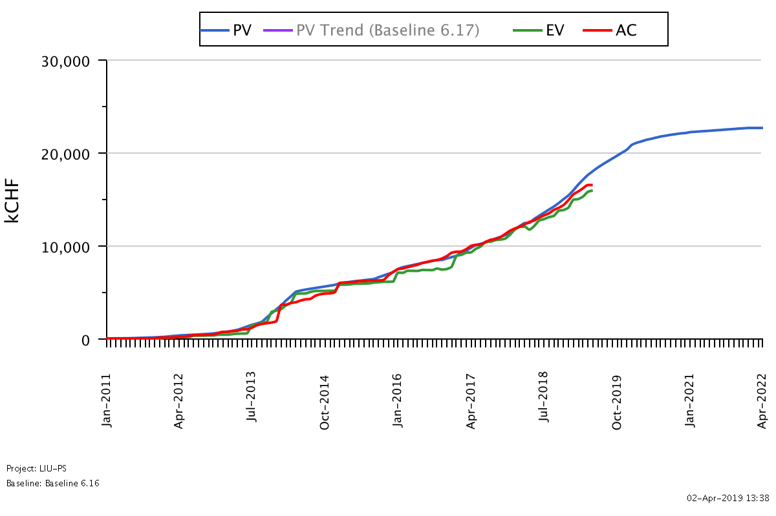
LIU-PS Dashboard
Was 4.0 on the 02.03.19
Reporting up-to-date for 62% of the workunits

Slide 3

LIU-PS Crosstab by Group

Slide 4
Spare Slides

Slide 5
LIU-PS Crosstab – BE Department

Slide 6
LIU-PS Crosstab – EN Department

Slide 7
LIU-PS Crosstab – HSE Department

Slide 8
LIU-PS Crosstab – TE Department

