Slide 1
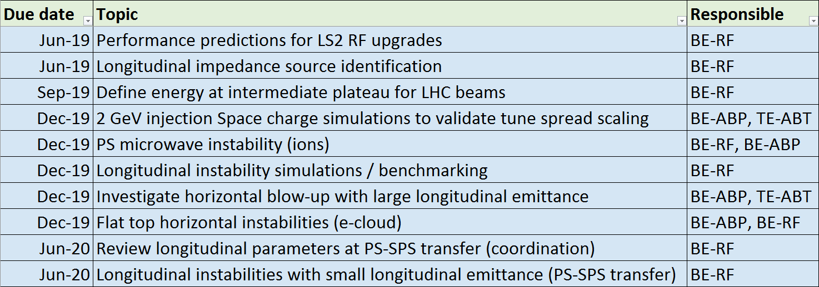
Topics and major milestones for 2019
Aggregation of
Priority list from first meeting of beam dynamics working group (link)
Follow-up from LHC Injectors Upgrade Workshop (link)
Extraction of committments for LIU-PS beam dynamics working group:

