Slide 1
Analysis and results of PI.KFA45 Magnetic measurements
N. Ayala, A. Ferrero, T. Kramer
With the support of: F. Pedrosa, J. Bauche, J. Ferreira, L.M. Coralejo, L. Sermeus, N. Thaus, P. Demarest, R. Noulibos, Y. Sillanoli.

Slide 2
Table of contents
Introduction
Measurement set-up
Measurement results
Conclusions

Slide 3
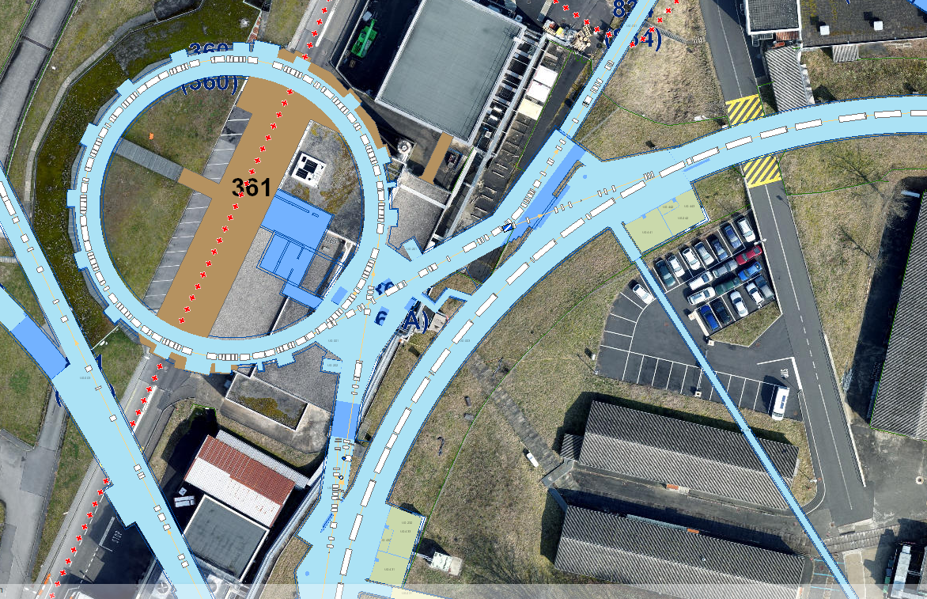
Introduction
Transfer Line
PSB
KFA45
PS

Slide 4
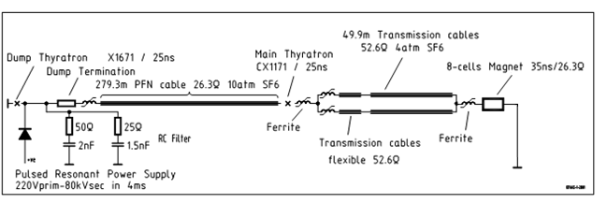
Introduction
Magnet termination and all associated elements replaced by a direct short circuit (SC)
This modification allows to double the kick strength

Slide 5
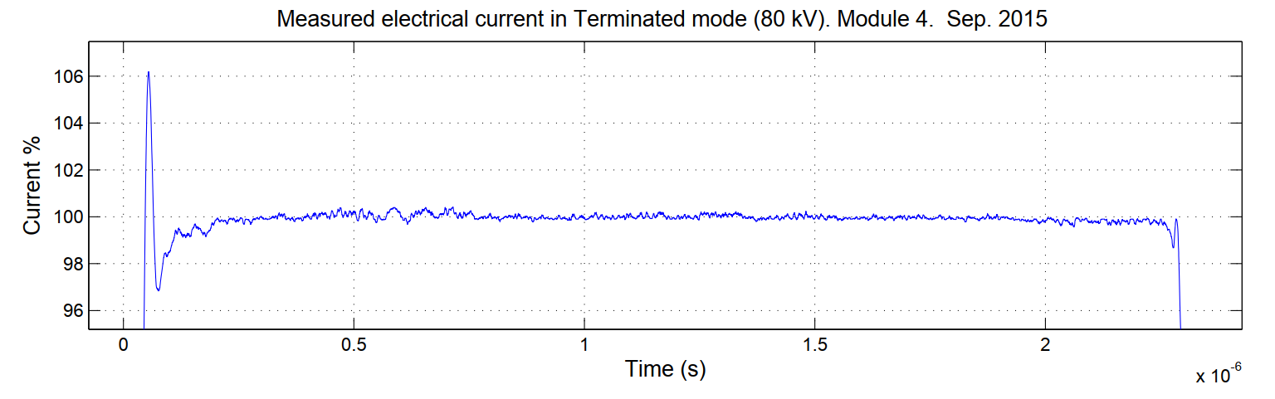
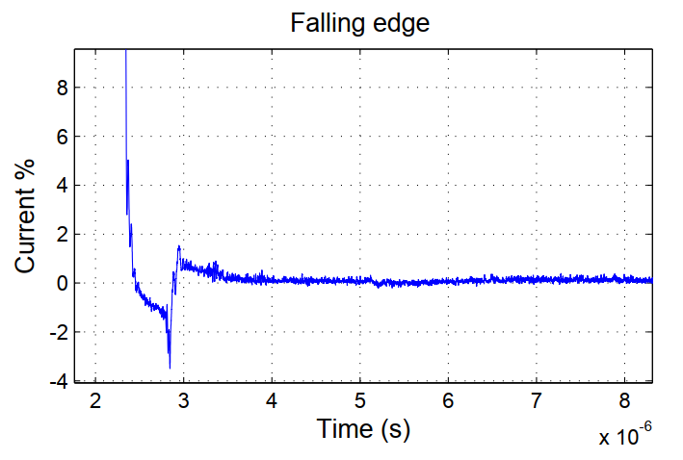
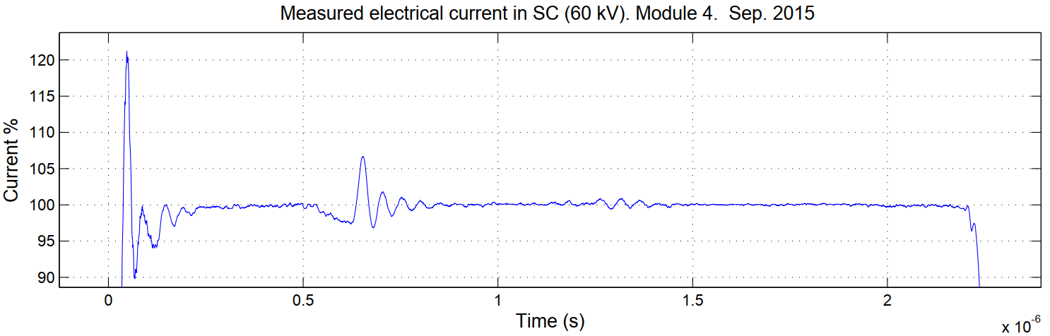
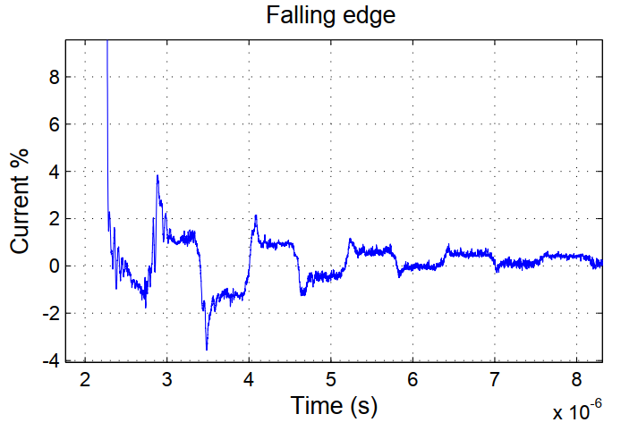
Introduction
2 x Tx
2 x Tx
Under SC configuration undesired ripples appear in the pulse

Slide 6
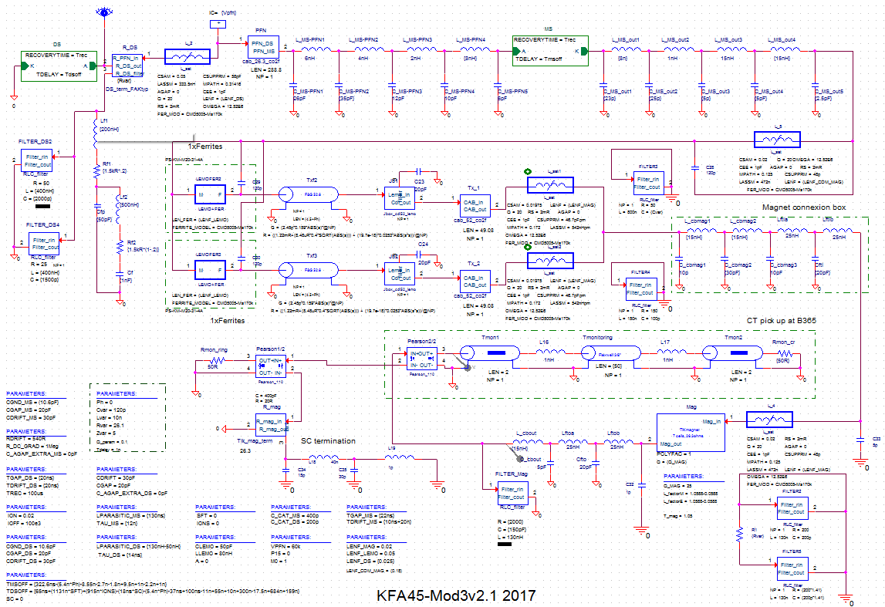
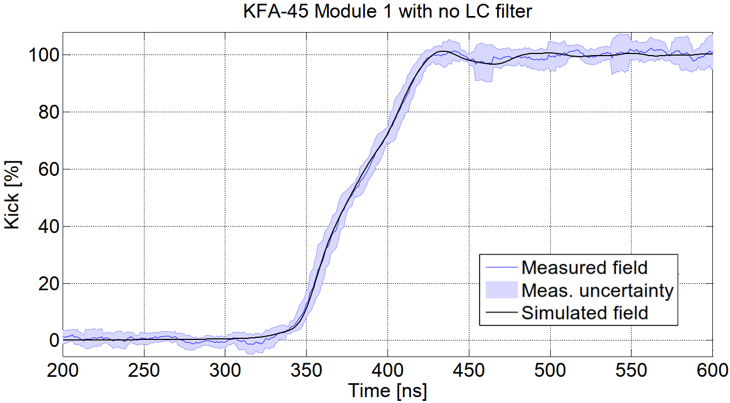
Introduction
Simulations
Current measurements
Beam based field measurements
Direct magnetic field measurements needed to validate all previous work

Slide 7
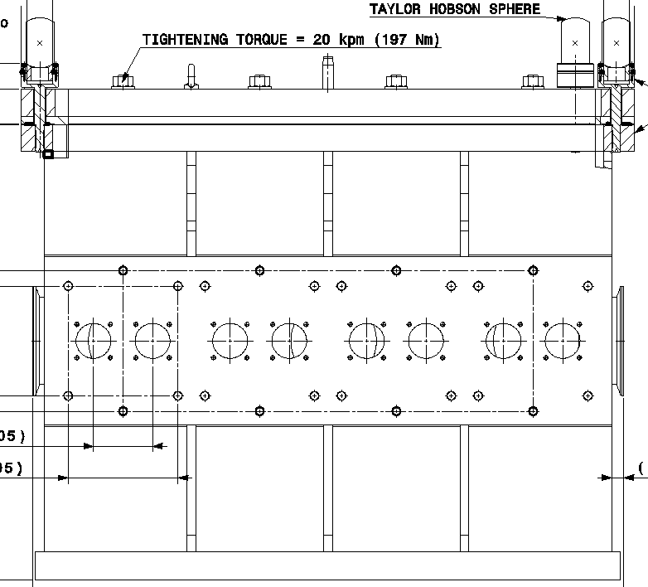
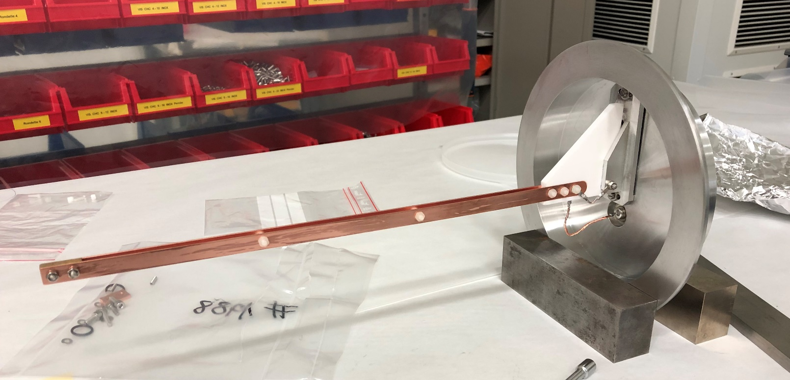
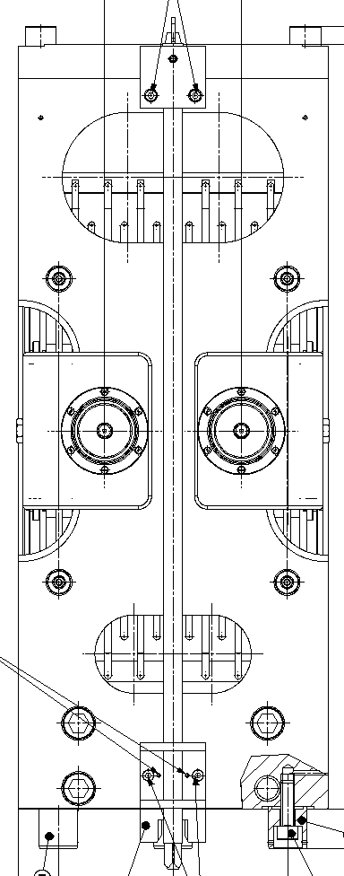
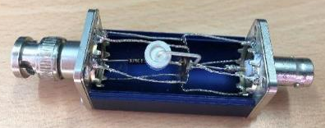
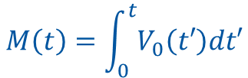

Measurement set-up
A stripline loop was used for measuring the time variation magnetic field in the magnet aperture
Only one module was measured
$$∇×E=−\frac{∂B}{∂t}$$
$$M\left(t\right)=\int_{0}^{t}{V_{0}\left(t′\right)dt′}$$

Slide 8
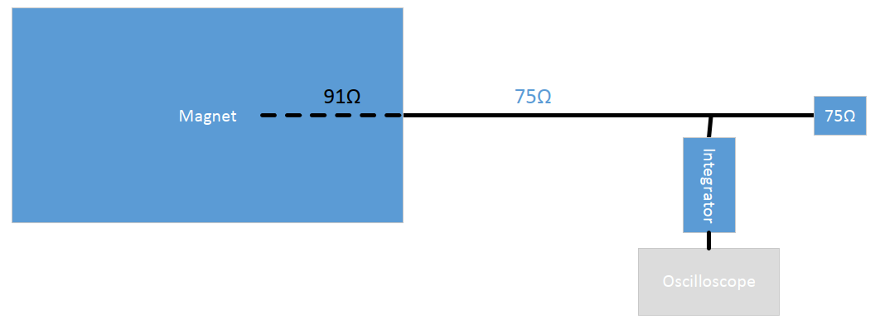
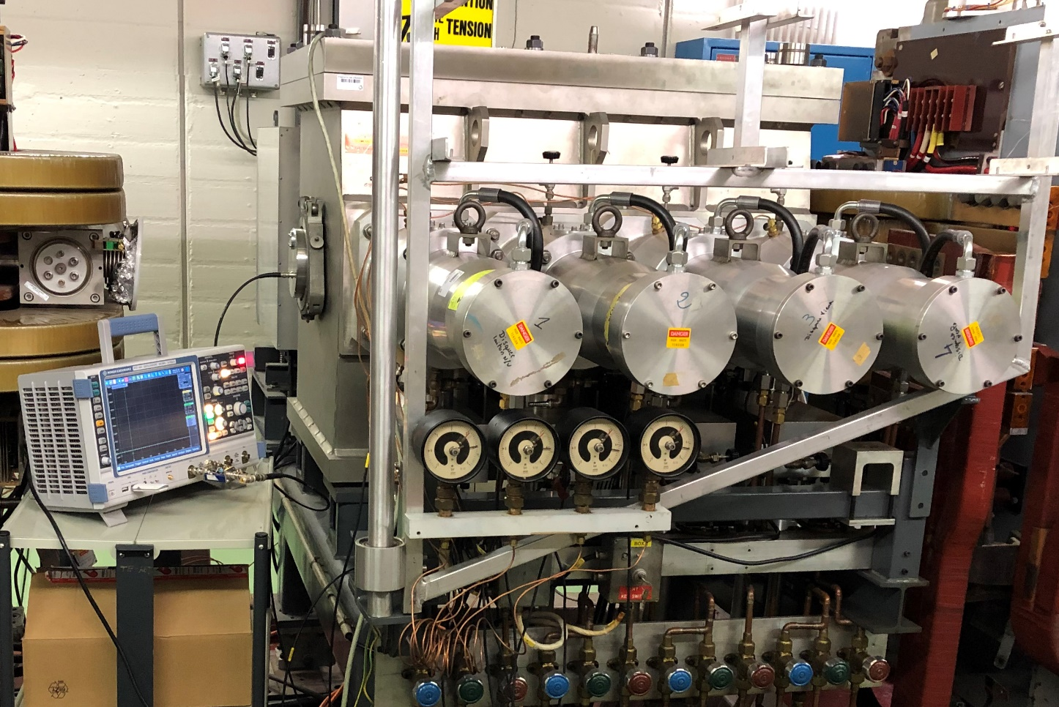
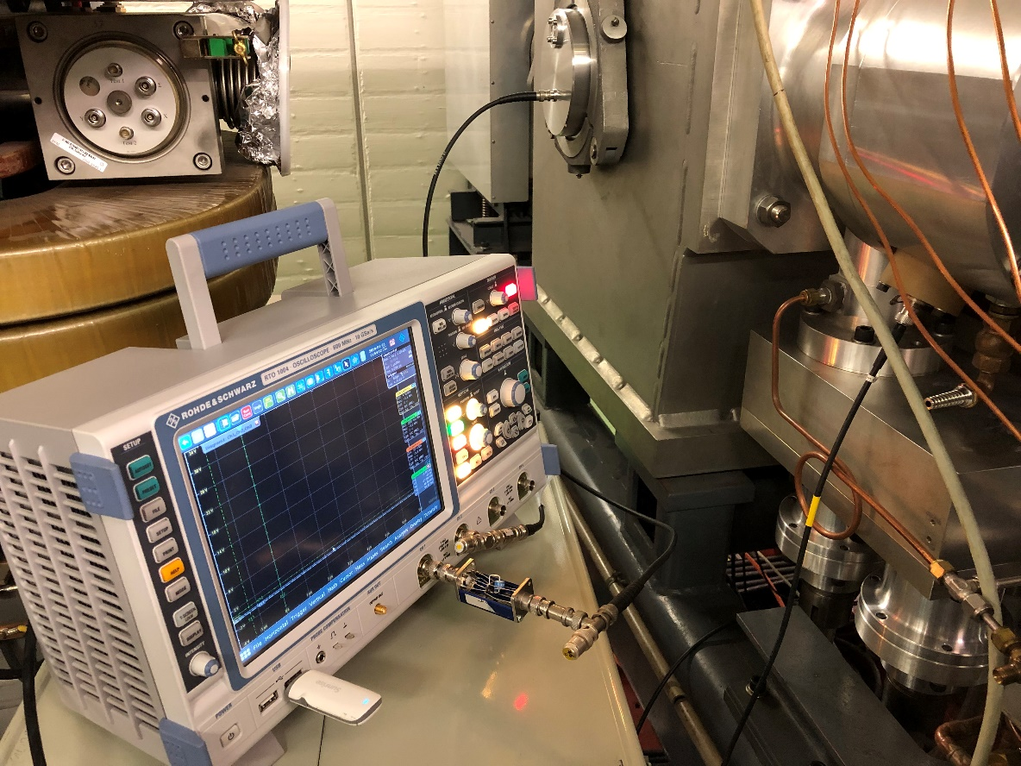
Measurement set-up
Probe 91Ω
75Ω
Magnet
Integrator
75Ω

Slide 9
Current vs Magnetic field pulses
*Field measured on Module 1, January 25th, 2019

Slide 10
Magnetic field dependences w.r.t. PFL voltage
Flat top ripple measured for different PFL voltages
The normalized ripple amplitude on the flat top increases with the PFL voltage

Slide 11
Magnetic field dependences w.r.t. PFL voltage
Post pulse ripple measured for different PFL voltage
The normalized post pulse ripple decreases with the PFL voltage

Slide 12
Saturation effects
*Courtesy L. Sermeus
Operational voltage
for 3 modules @2GeV
Operational voltage
for 4 modules @2GeV

Slide 13
Beam based meas. vs magnetic field meas.
Time (µs)
*Courtesy of V. Forte
Good agreement between both methods to measure the rise and fall times

Slide 14
Beam based meas. vs magnetic field meas.
Both methods are able to measure the post pulse ripple
10ns filtering window size
*Courtesy of V. Forte

Slide 15
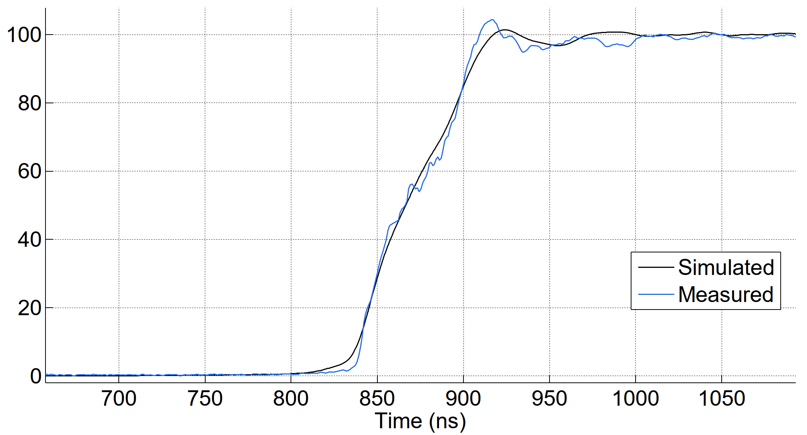
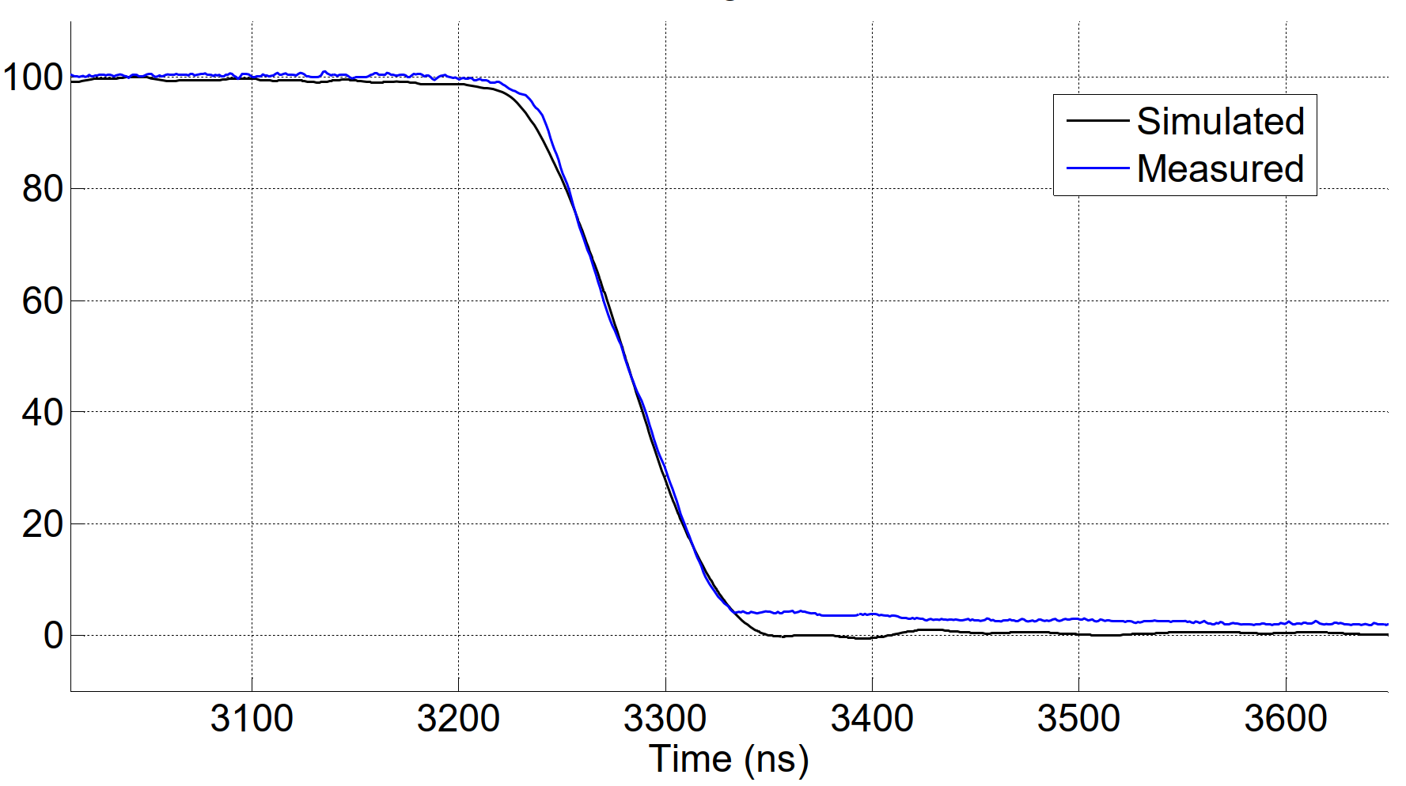
Magnetic field simulations vs measurements
Rise time
Fall time
Kick (%)
*Simulation model: version 2018 (adjusted on BBM, no LC filter)
Good agreement of rise and fall times, even the simulation is more pessimistic in the rising edge

Slide 16
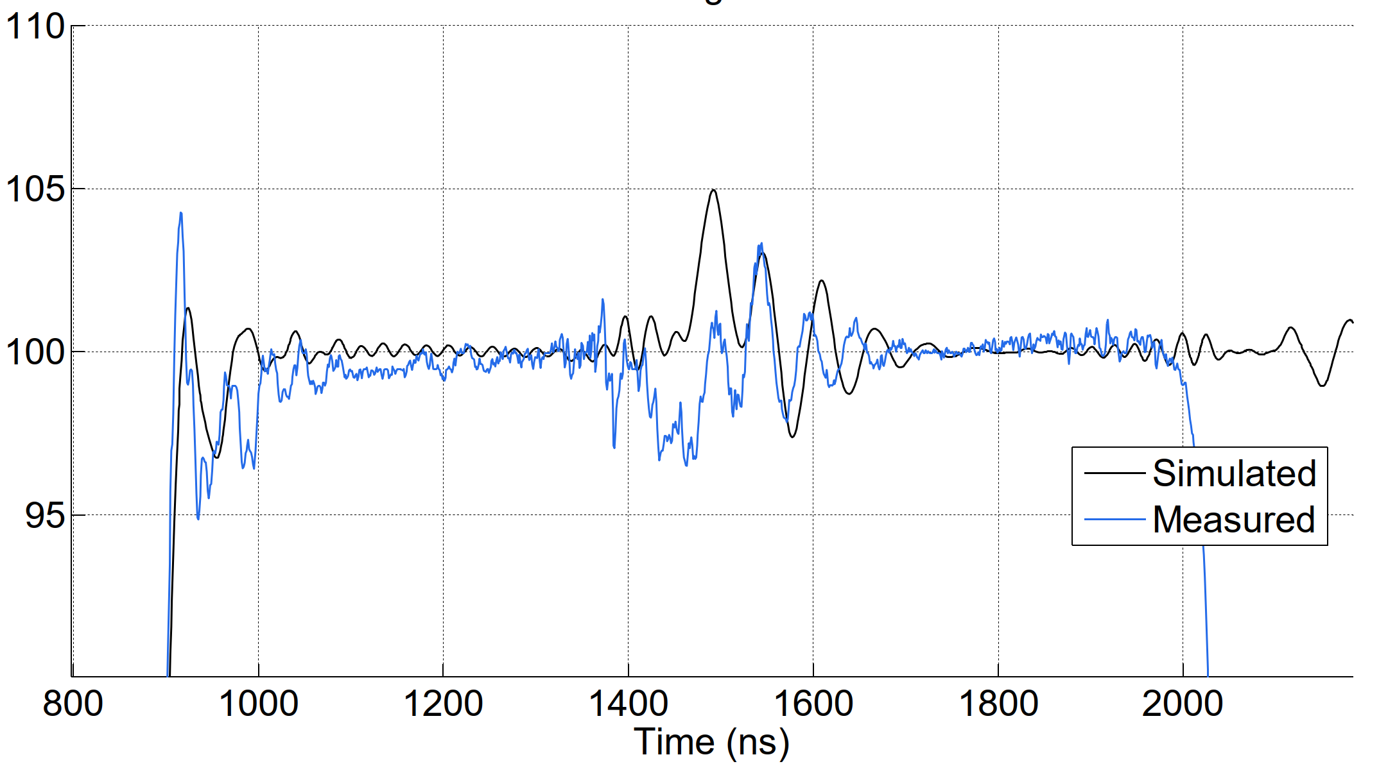
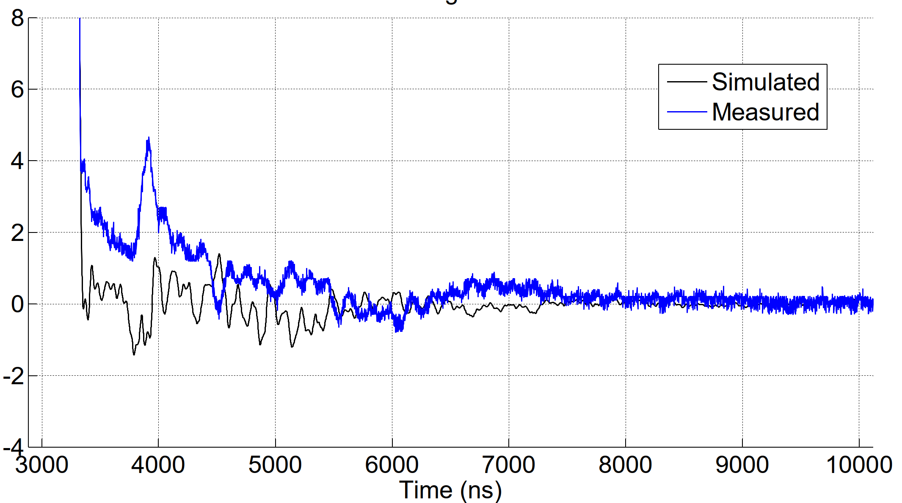
Magnetic field simulations vs measurements
Kick (%)
Disagreement in post pulse prediction
Disagreement of flat top ripple
Kick (%)

Slide 17
Conclusions
Ripple increases on the flat-top and decreases on the post pulse w.r.t PFL voltage.
Saturation effects observed @70kV and agree with previous measurements done when the magnet was constructed.
Beam based method agrees with direct magnetic field measurements.
pSpice model works pretty well, ev. some refinement on the model possible?
Next steps:
  New (long) probe
  Measurement of new LIU magnet
  Tuning of new connection box filter circuit
  IPAC’19 paper

Slide 18
References
T. Kramer et al., “Feasibility study of the PS injection for 2 GeV LIU beams with an upgraded KFA-45 injection kicker system, operating in short circuit mode”, Proc. of IPAC’16
V. Forte et al., “Beam-based waveform measurements of the CERN PS injection Kicker”, Proc. of IPAC’17
V. Forte et al., “CERN PS Kicker for proton injection: From Beam-based waveform measurements to hardware improvements”, Proc. of IPAC’18
A. Michet et al., “A probe for kicker KFA45 Proton Synchrotron Booster”, CERN EDMS: 2065251
N. Ayala et al., “Magnetic Field Waveform Measurements for the PS Injection Kicker Magnet PI.KFA45”, CERN EDMS: 2066720

