Slide 2
Know The New User Communities
IT-CDA project
Summary of the Results
IT-CDA White Area Meeting 27-May-2019
Project Status Report
Peter Jones IT-CDA

Slide 3
Background
Survey 2016-2017 - Know the User Communities
Understand the user community
  Evaluating user working habits and choices of hardware and software
  Help IT-CDA to propose solutions for the future
A Survey of 94 questions (Drupal site) asked:
  Which devices people use and their working environments
  Users’ Communication, Collaboration and Conferencing preferences.
1200+ users participated - a 5 month snapshot of work practices and preferences
Results in CDS and presented at the ITUM Meeting 29-May-2017
We saw a correlation with survey results and the age groups.
What are the differences between of those arriving at CERN users and the established CERN user?
Are there any new trends?

Slide 4
Survey for Newcomers
Survey 2018-2019
Find out the choices and preferences of CERN’s younger generation
  For Malt – does everyone use OS solutions?
A new shorter survey (Drupal site) targeting new users
  Min 20 questions – Max 30
Made available to new comers who follow the HR ‘onboarding project’
Survey launched March 2018.
  Not mandatory
  Confidential
Results of 1 year up to April 2019.

Slide 5
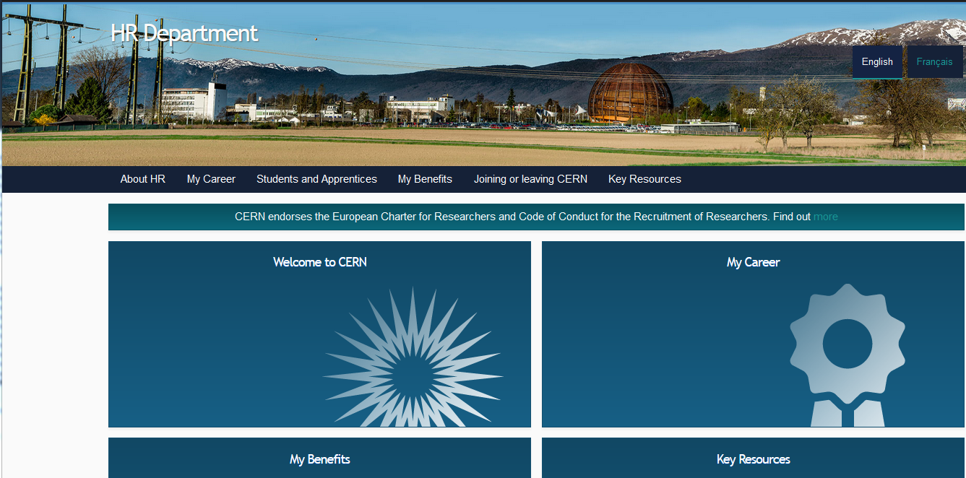
onboarding project
Setup by Anna Cook HR

Slide 6
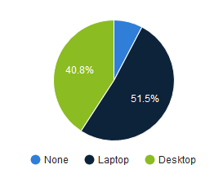
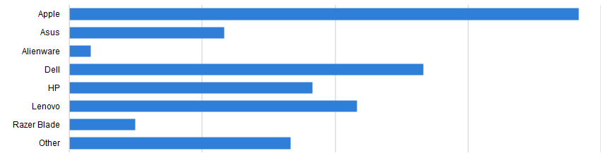
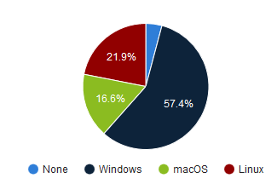
Computer Hardware
Do you prefer using a laptop or desktop?
Make of laptop
Which operating system do you prefer?
Hardware preference is still for some sort of Laptop.
Windows is the preferred OS of the new users

Slide 7
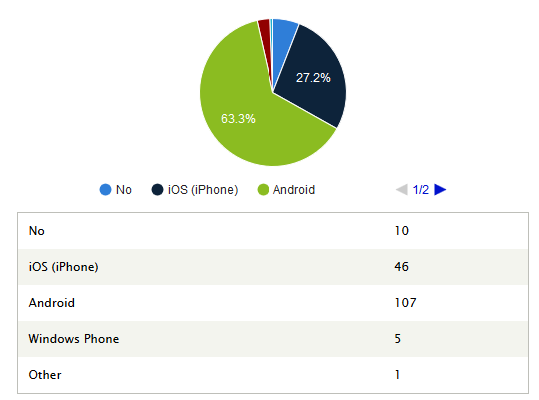
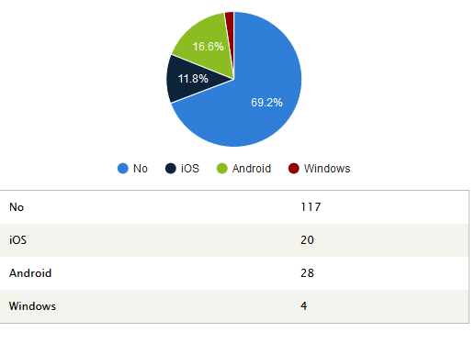
Computer Hardware
Do you use a Smartphone?
Make of Do you use a Tablet?
In 2016-17, 23% of people said that they did not have a Smartphone.
Here only 6% are without a smartphone and the preference is for Android
The percentage of people using tablets (30%) and this is the same as in 2016.

Slide 8
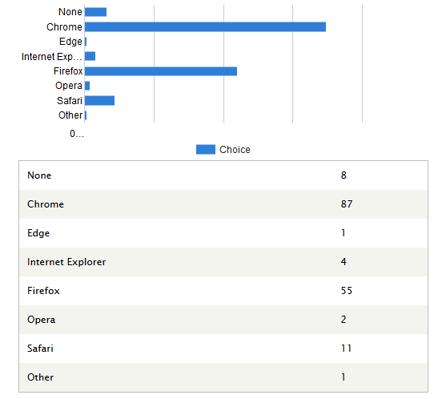
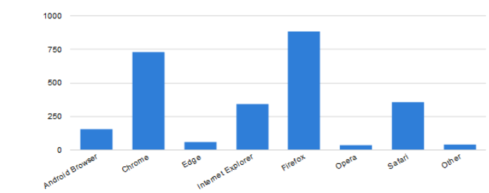
Browsers
What is your preferred browser?
2016-17
Compare with the same question
OS browser preferred.
Chrome has overtaken Firefox as the preferred web browser
  From 2016: Firefox 41%, Chrome 33%, Safari 12%
The Microsoft web browsers are not very popular with the new CERN users.

Slide 9
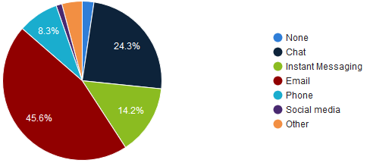
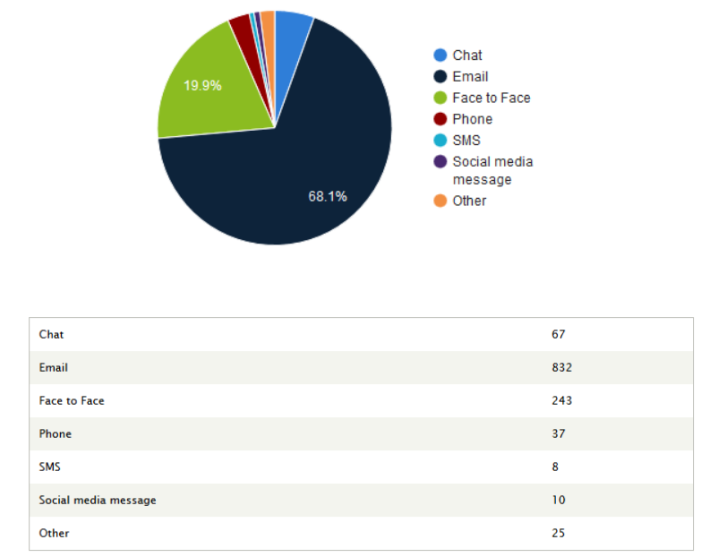
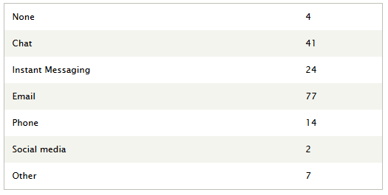
Communication
What is your preferred method of communicating with work colleagues?
2016-17
Compare with the same question
Email is the preferred method of communication, which was the case in 2016.
Chat was favoured by 5% in 2016 - now 14%
Social media not for work?

Slide 10
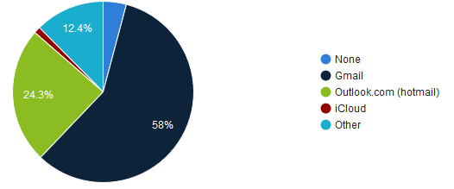
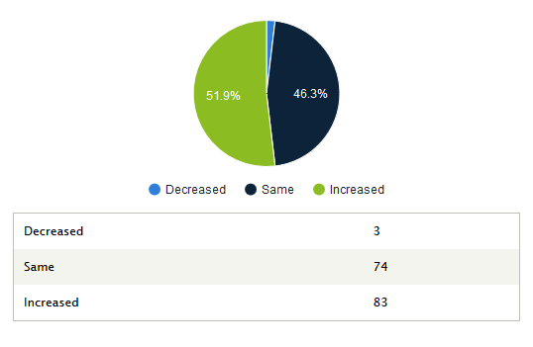
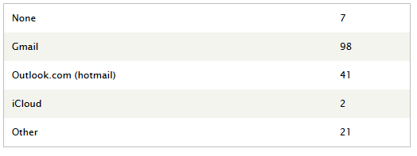
Email
What is your main email service?
Has your use of email increased over the last year?
In 2016 we asked if CERN users have another email service and of those users 70% used their home institute’s email service and 25% used Gmail.
For this survey, Gmail is preferred
Outlook (Hotmail) is used by 25% of newcomers. In 2016 0.5% of participants said that they used Hotmail for work.*

Slide 11
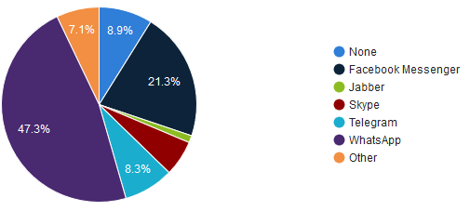
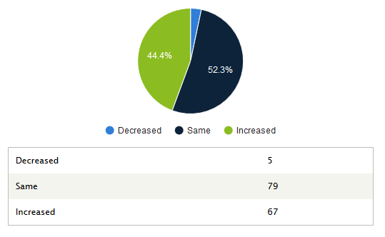
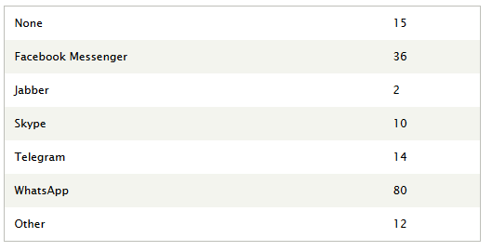
Instant Messaging
What is your preferred Instant Messaging service?
Has your use of Instant Messaging software increased over the last year?
Skype was by far the preferred tool for instant messaging in 2016, but today only 5% choose this.
Only 3% of people used WhatsApp in 2016, which is now the preferred method.
Overall, the use in instant messaging is on the rise.

Slide 12
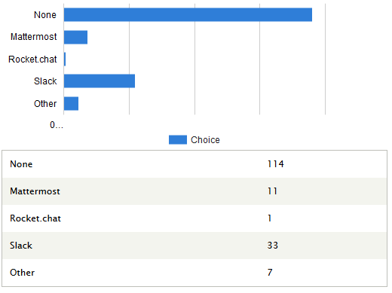
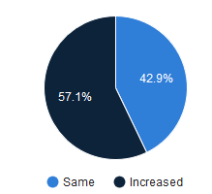
Work place chat
What is your preferred work place chat service?
Has your use of work place chat software increased over the last year?
Although on the increase not many of the new users are familiar with the chat services on option

Slide 13
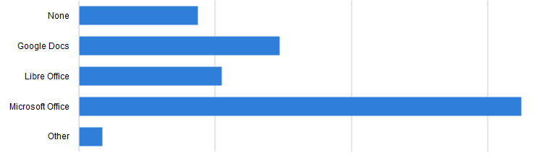
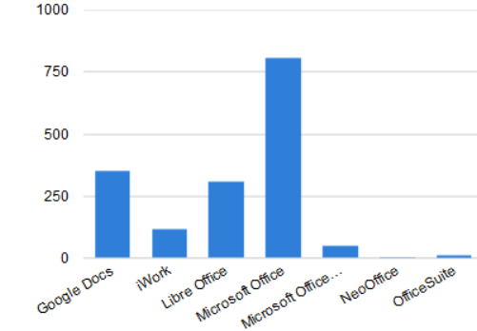
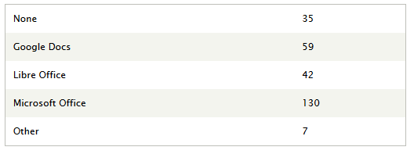
Office Suites
Which Office Suites do you use?
2016-17
Compare with the same question
Not much change. Microsoft Office is the most used.

Slide 14
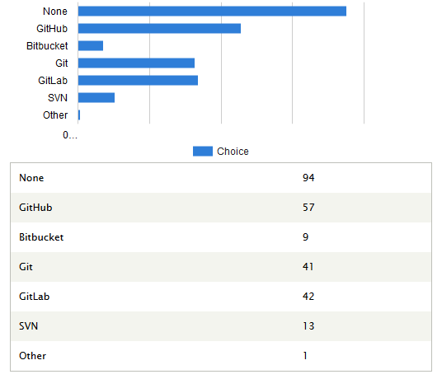
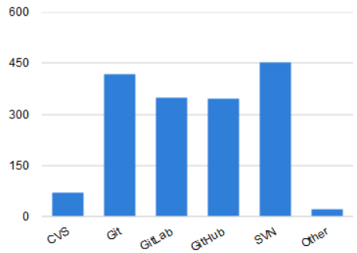
Version Control
Which version control system do you use?
2016-17
Compare with the same question
Few new-comers use SVN, which was a popular in the previous survey
Most are familiar to a Git based option

Slide 15
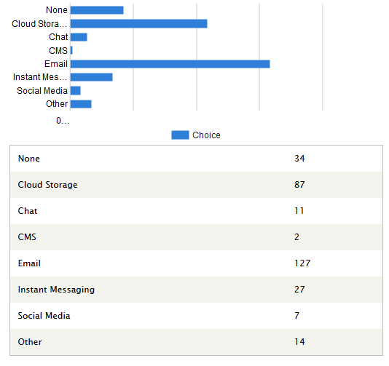
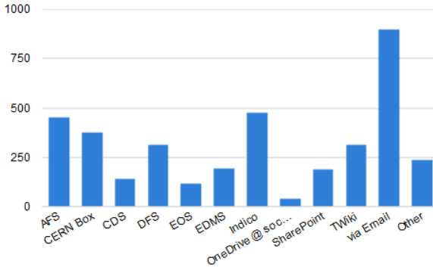
Sharing Documents
How do you share documents with colleagues?
2016-17
Compare with the same question
As with the result of the same question in 2016, people still prefer to use email to share documents.

Slide 16
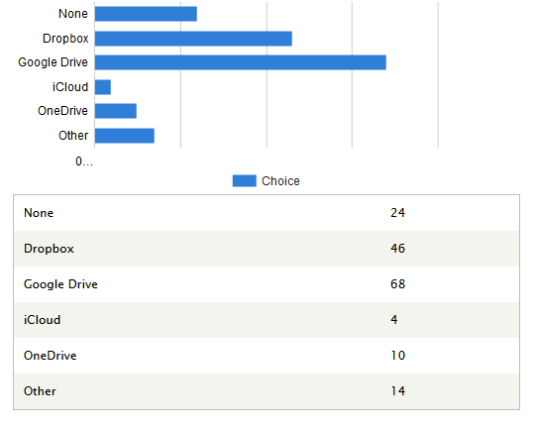
Cloud Storage
What is your preferred Cloud Storage and File-Sharing service?
Only 4 Mac users replying to this survey use iCloud.
Google Drive is the most popular cloud storage.

Slide 17
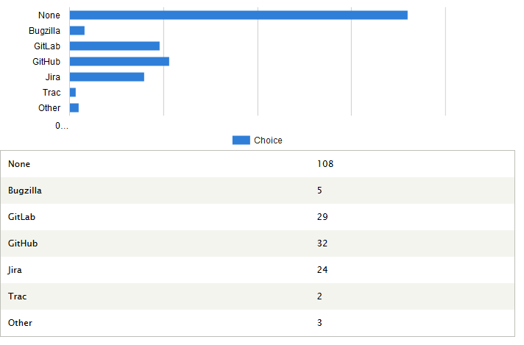
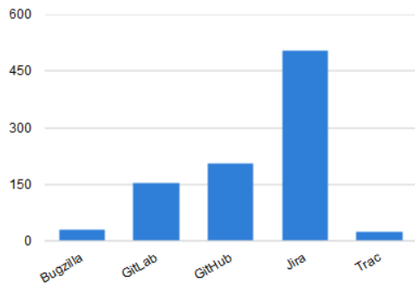
Issue Tracking
Which Bug and Issue Tracking Software do you use?
2016-17
Compare with the same question
Of those using Issue tracking many have experience with Gitlab and Jira - both supported in IT-CDA.

Slide 18
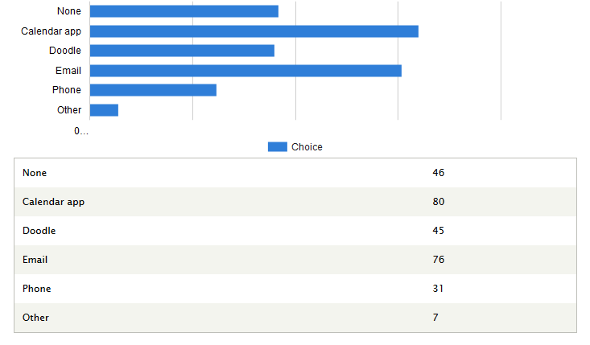
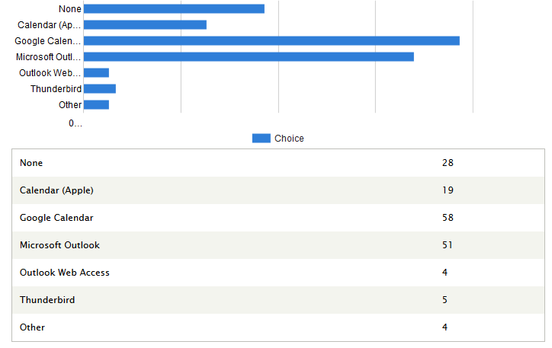
Scheduling
How do you schedule meetings?
What is your preferred calendar ?
Email again is used as a scheduler for meetings.
As in 2016 the Google calendar and Doodle are popular online scheduling tools.

Slide 19
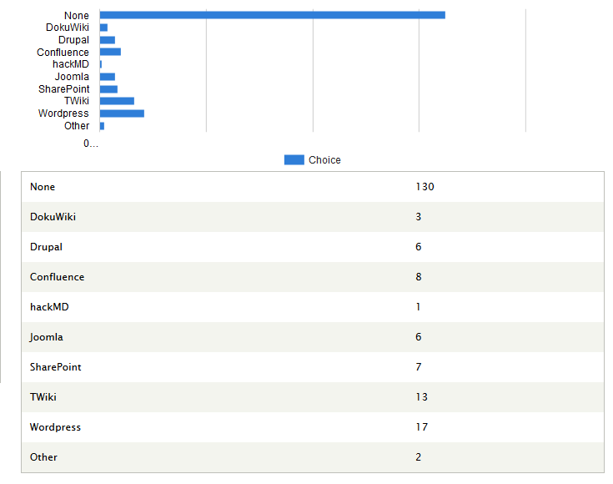
CMS
Do you use any Content Management Systems - CMS?
Most new users do not have experience with a CMS.
Some have used an IT-CDA supported CMS.
Wordpress is the most popular CMS

Slide 20
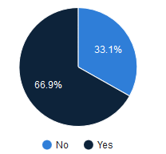
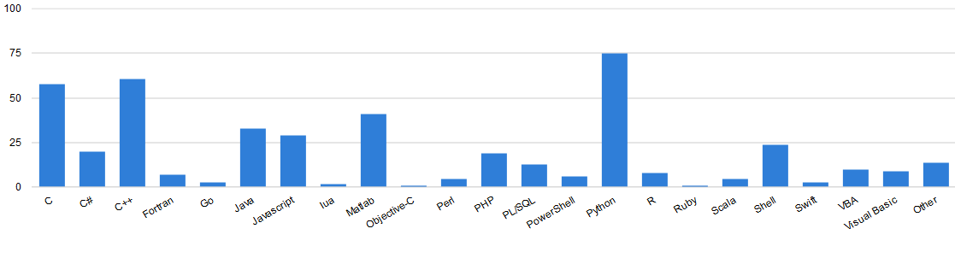
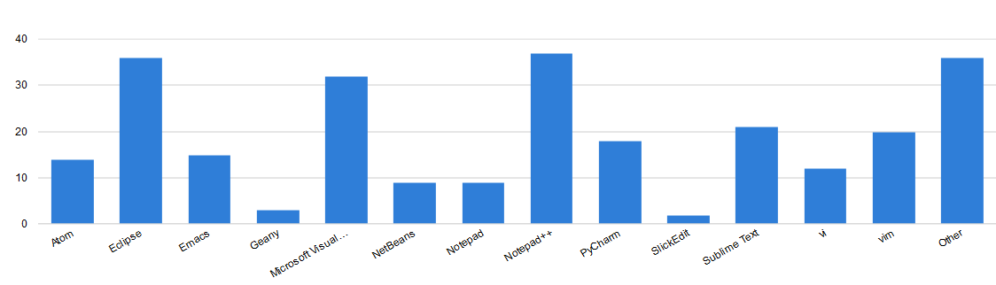
Computer Programming
Do you do any computer programming?
Which computer languages do you use?
What programming editors or IDEs do you use?
As in 2016 C++ and Python are the most popular programming languages
25% of people use Matlab compared to only 6% in 2016.
More users for MS Visual and Notepad++ . Not many newcomers use emacs.

Slide 21
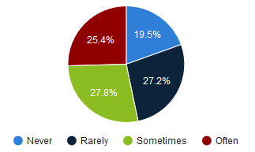
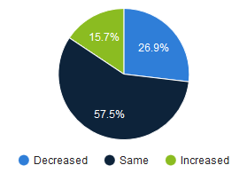
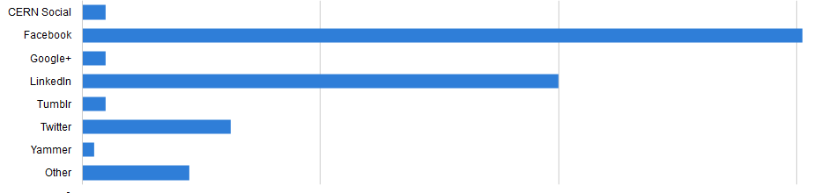
Social Media
Do you use social media?
Has your use of social media increased over the last year?
Which social media services do you use?
80% said that they use Social Media
There is a rise in Social Media use as compared with the 2016 results
Facebook remains the most used Social Media

Slide 22
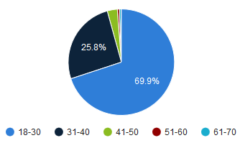
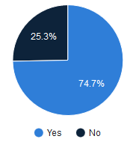
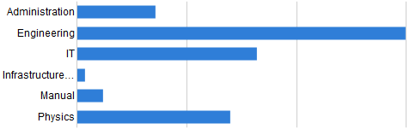
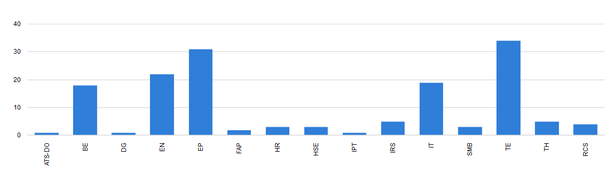
User Profiles
What is your age range?
Is this your 1st experience working at CERN?
Nature of work at CERN
CERN Department

Slide 23
  Conclusion
  The Survey gives an idea of the work practices and preferences of the new-comers to CERN over the last 12 months
  Survey sample size:
    170 participants / 800 = 95% confidence level and 7% margin of error
  The survey shows some diverse results
    Newcomers use Windows, Mac and Linux
  Most popular options
    Microsoft Windows operating system
    Microsoft Office Suite
    Email used heavily for communicating and sharing documents
    Google for email, scheduling, cloud storage and browser
    Facebook and WhatsApp for messaging, chat and social media
  For continuous improvement
    We should decide on the future of the current survey

