Slide 1

HSF-OSG-WLCG workshop summary
ALICE Software & Computing week
Apr 4, 2019
Maarten Litmaath
CERN v2.1

Slide 2
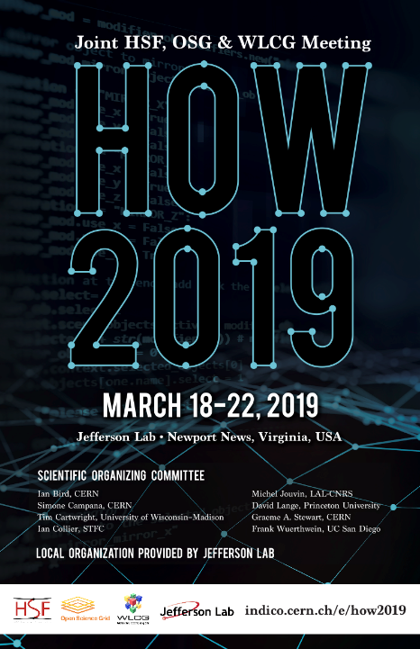
HSF (HEP Software Foundation) and WLCG had a first combined workshop in March 2018
  Standard now
This time it was combined ad-hoc with the OSG
(Open Science Grid) all-hands meeting at JLab
246 participants
Good hospitality & nice social events

Slide 3
Scientific program
https://indico.cern.ch/event/759388/timetable/#all.detailed
Plenary sessions on Monday and Friday
Up to 3 (6) parallel (sub)tracks on the other days
  WLCG
  HSF
  OSG – does not concern us here
Some overlap between the tracks
  Some people had to make choices

Slide 4
Monday plenary sessions
Introductions to JLab
Input from communities/experiments on current and future computing challenges
  LHC experiments: ALICE, ATLAS, CMS, LHCb
  DUNE, Belle II
  Dark matter
  EIC
  Photon/neutron sources
  LSST
  LIGO/VIRGO
  IceCube
Evolution of the WLCG collaboration

Slide 5
Tuesday parallel tracks
WLCG (+ HSF)
  Technology watch on computing, storage and networking
  HPC centers, clouds
  Experiment software frameworks on heterogenous resources
  Authentication and Authorization Infrastructure evolution
  Security operations
HSF
  GPU and other accelerator technologies
    Including ALICE GPU Algorithms by David Rohr

Slide 6
Wednesday parallel tracks
WLCG
  Resource and cost estimates
  Benchmarking
  Performance evaluation
  Storage modeling and data popularity
  DOMA (Data Organization, Management and Access)
    WG topics: 3rd party copies; quality of service; access
    Rucio, DIRAC
    Data provisioning for HPCs and clouds
HSF
  Simulation, analysis, reconstruction, machine learning
    Including Real-time analysis model in ALICE by David Rohr

Slide 7
Thursday parallel tracks
HSF
  Present and future technologies for data analysis
  Notebooks, Python, ROOT, vectorization, …
  Training
  Performance monitors/profilers, static analyzers
  Packaging
WLCG
  Information system evolution
  Operational intelligence
  Long term future of the storage services at T2s
  Lightweight sites

Slide 8
Friday plenary session
Forward look and close out
  DE Funding Initiative
  UK IRIS Project
  US IRIS-HEP Project
  The Future of Scientific Computing

Slide 9
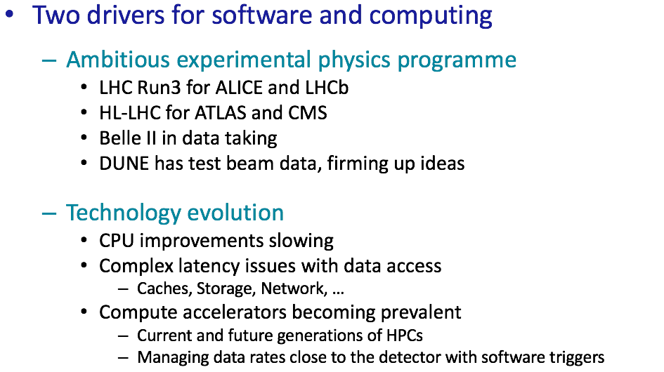
HSF digest (1)
Thanks to Graeme Stewart and Ian Collier

Slide 10
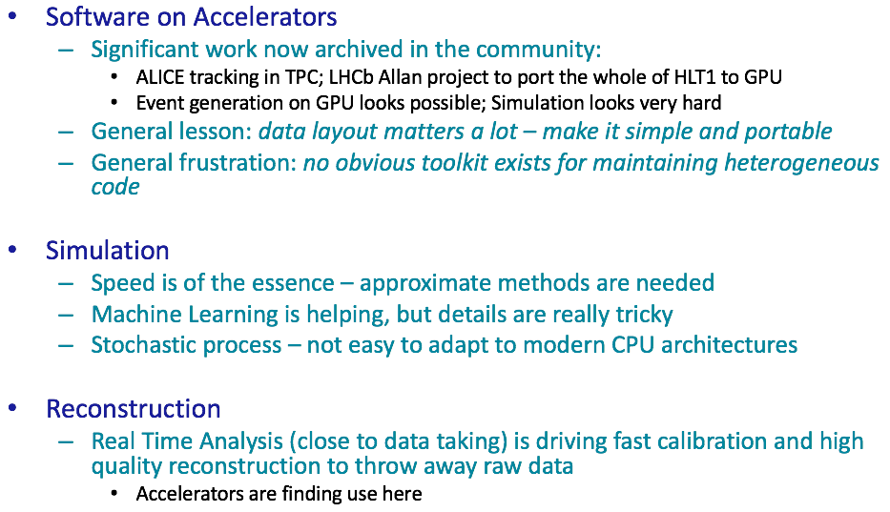
HSF digest (2)
Thanks to Graeme Stewart and Ian Collier

Slide 11
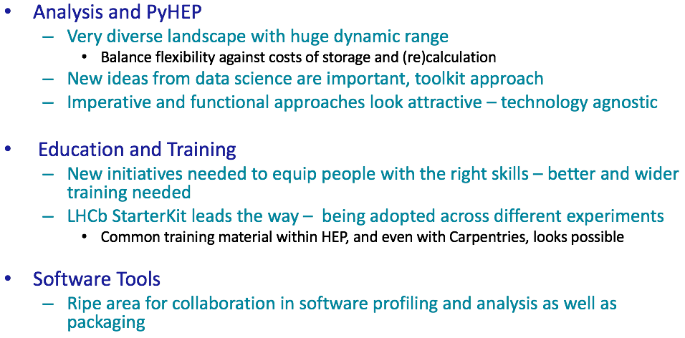
HSF digest (3)
Thanks to Graeme Stewart and Ian Collier

Slide 12
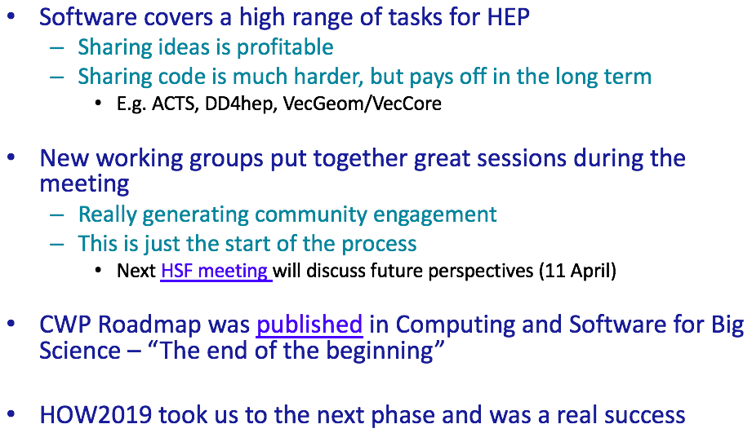
HSF digest (4)
Thanks to Graeme Stewart and Ian Collier

Slide 13
Concluding observations (1)
We need to be more cautious about the technology evolutions that can be expected
  20% yearly increase “for free” was no longer true lately
ATLAS and CMS Run 4 requirements are driving a lot of the activities
  With benefits already planned for Run 3 and for other experiments and communities, e.g. through Rucio
Other experiments and communities will at least have somewhat similar requirements
  WLCG will evolve toward more explicit forms of collaboration with related communities
    Profit better from necessary efforts and investments
    Speak to funding agencies with a common voice
Funding agencies have finally started recognizing the importance of sustainable SW development for big science

Slide 14
Concluding observations (2)
Use of HPC centers and clouds will keep increasing
  They are expected to become easier to use
Use of GPUs, other accelerators and machine learning will become steadily more important
Authentication and authorization will become easier
  Federated identities instead of certificates
The organization, management and access of big data will shift toward data lakes
  WLCG will probably be a hybrid infrastructure for many years to come
Sites will be able to choose between several ways to make their service deployment and operations more lightweight
We have an interesting decade ahead of us! ☺

