Slide 1
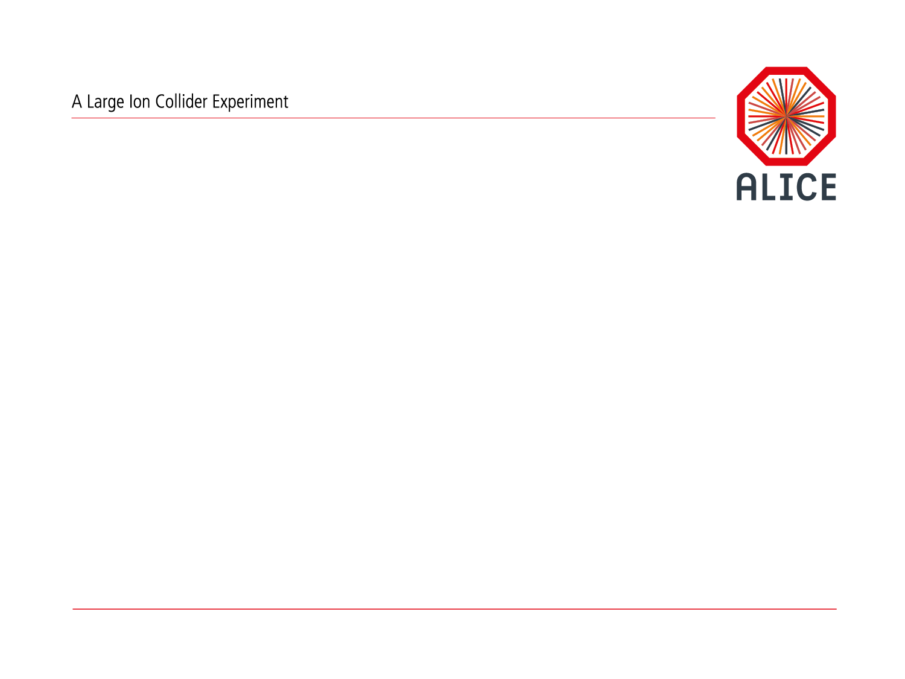
Opportunities for simulation optimizations (in Run3)
Sandro Wenzel (CERN)

Slide 2
Introduction
“Simulate what we need for our physics goals, not more (and not less)”
“Achieve this need within the resource budget (no-gap scenario)”
This session is meant to
Get an updated picture of MC requirements needed for Run3 (feedback from PWGs)
Give latest numbers on G3/G4 (pp) performance as baseline
Give some pointers about simulation hotspots and areas where
  Optimization / parameter tuning will be most effective
  Fast-simulation modules could make impact
Trigger general discussions about approaches for simulation/workflow optimizations
This talk … with overlap + extra info in yesterday’s session

Slide 3
Starting point: MC resources for pp (Run2 vs Run3)
Run2:
Transport and digitization major time consumers
Overall G4/G3 ratio: 2.0x (INCLXX); 1.2x (BERT);
Run2
Run3: (current status)
Transport time same as Run2 for the moment
Much improved time for digitization and reco
Leads to increased effect of G4 globally
  Potentially ~3.4x (INCLXX), ~1.4x (BERT)
  Target to use INCLXX only in ITS
Makes transport the real hotspot
  Calls for optimization effort focusing on transport (cuts, parameters)
  Better applicability of traditional fast-sim methods (shower libraries)
preliminary
Run3
Time in [s] for 100 pp events using production scripts on a benchmark machine; see ALIROOT-7121

Slide 4
Starting point: MC resources for pp (Run2 vs Run3)
Understand where we spend time in transport
  Per detector categories (modules)
  Per particle categories (etc)
Work out few suggestion to follow-up
Use MCStepLogger to collect step info
  Works for both AliRoot and O2
  Produces ROOT files which can be analyzed using any sort of query and cuts
Run2
Run3
preliminary
See also previous CWG8 report (2013) with similar focus and conclusions

Slide 5
General overview
 | transp. time | steps (1E6) | Tracks (1E6) | steps/track | functional hotspots (Intel VTUNE) | dominating PDG | remarks
G3 | 1240s | 291 | 25 | 11.64 | geometry calculations (TGeo safety) | gamma: 36% e-: 42% e+: 7.2% neutron: 5.6% proton: 1.8% | VecGeom would be beneficial
G4-BERT | 1800s | 256 | 42 | 6.09 | geometry calculations (TGeo + TGeo/G4 conversions lookups) | gamma: 34.6% e-: 51% e+: 4.4% neutron: 1.8% proton: 1.6% | VecGeom would be beneficial
G4-INCLXX | 4404s | 256 | 42 | 6.09 | G4 physics processes | gamma: 33.6% e-: 50.4% e+: 4.2% neutron: 3.2% proton: 2.8%

Slide 6
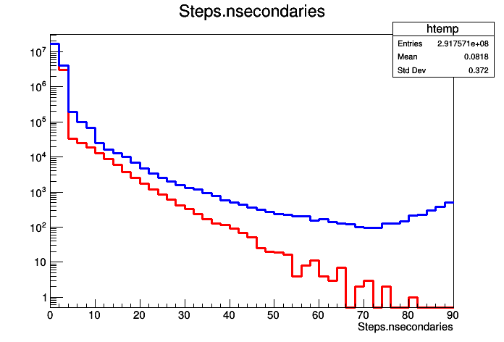
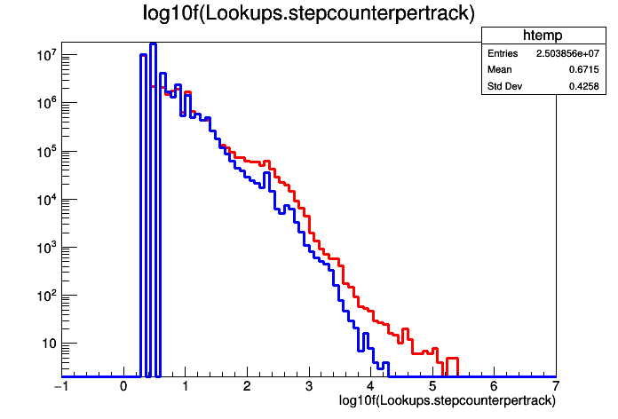
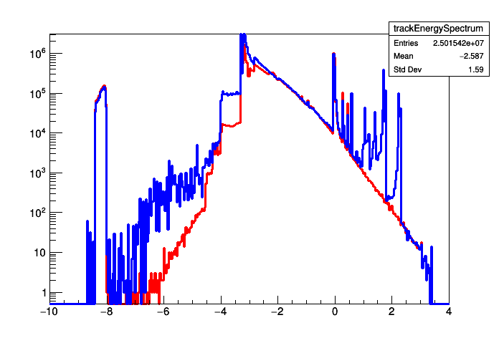
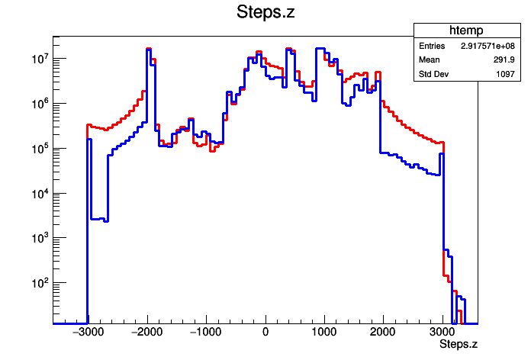
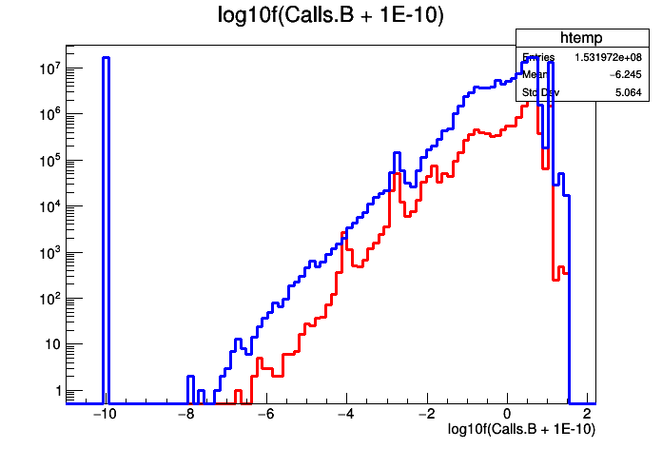
MC transport analysis dashboard
Blue G4 (INCLXX)
Red G3
log10(E/ GeV)
#Secondaries per step
Steps per track
Energy spectrum of transported tracks
Advertisement that we can get access to insightful (big) data and we should use it!
Field values used
Z-Position profile
Selections/cuts/joins can be applied to study very specific questions

Slide 7
Where are MC steps done (Run2 pp setup)?
(Suprisingly) most MC steps are done in non-sensitive detector areas
  DIPO, PIPE, BODY/ALIC standing out
AD most important sensitive part (ZDC not included)
G3/G4 differ somewhat (DIPO, BODY)
Details for DIPO on next slide
G4
G3
Green = G4
Blue = G3

Slide 8
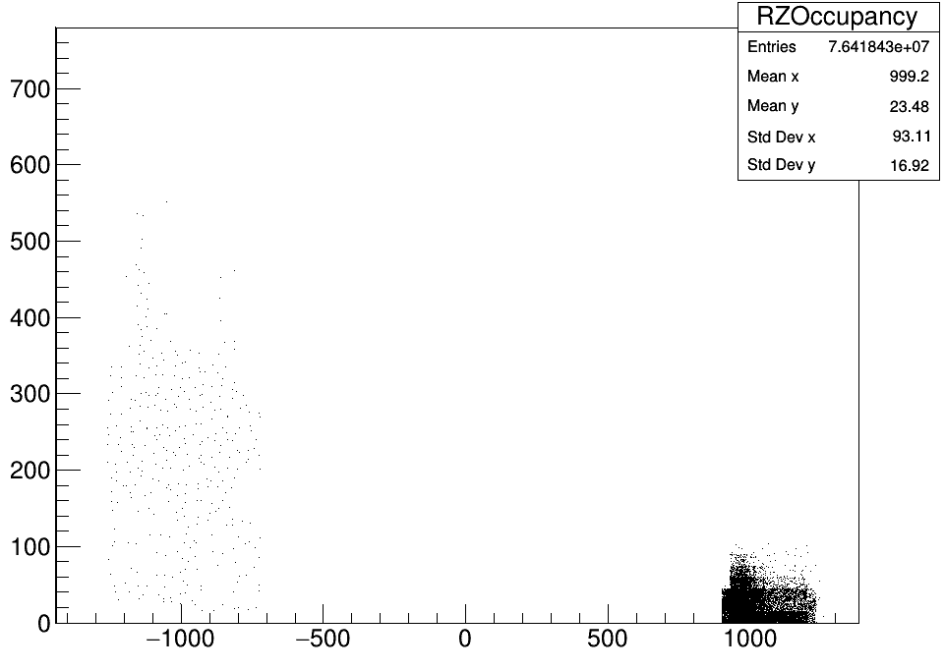
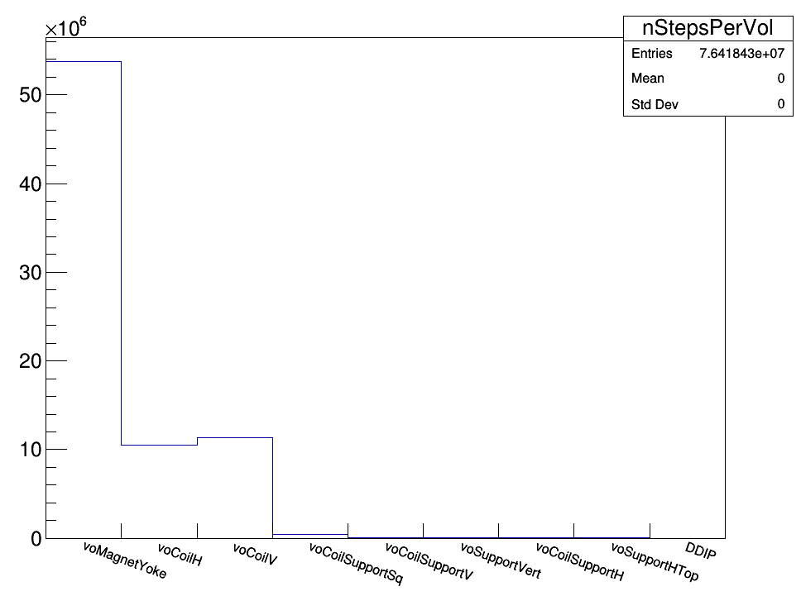
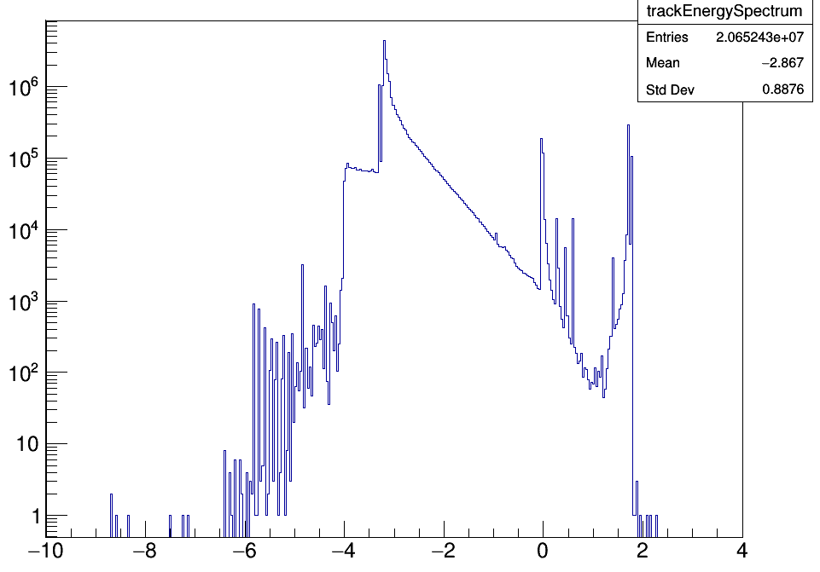
DIPO: Most evident optimization target for G4
R / cm
Dominated by a single iron material on A-side !
Gain up to ~25% by optimizing this
Z / cm
log10(E/ GeV)

Slide 9
Summary : Finding about sim performance
Few very dominating materials (voMagnetYoke, PIPE)
  Should be priority target of optimization
    Cut optimizations
    Parametrized/fast simulation
Too large geometry cuts in general; Too many steps (G3) far away from any detector in mother volume
  Example: taking out ACORDE reduces mother volume and instantly gives 10% gain for G3
  In general should try to apply geometry tracking cuts as tight as possible
    Set Rmax, ZmaxA, ZmaxC, implement “black body” absorber with custom voxels
    Might need systematic studies
  Crude / fast transport in ALIC
AD (apart from ZDC) most resource taking sensitive module
Tailored productions (taking out certain modules or secondaries) if possible will save resources

Slide 10
How to continue
Believe we have some evident items to work on!
  Geometry cuts !
  Physics parameter tuning
  Parametrized fast sim for few candidates
How to organize the work ?
  Some dedicated task force / discussion forum would be appropriate / essential
  Where to attach such task force ?
  Participation and input from PWG and detector experts
Continuous performance monitoring
  Wishful to have MC reports (such as included here) generated automatically and visible to collaboration

