Slide 1
HL-LHC remote alignment system: what it is and what it will bring us
R. De Maria, P. Fessia, D. Gamba, M. Giovannozzi, J. Hansen, A. Herty, I. Lamas Garcia, H. Mainaud Durand, S. Redaelli, M. Sosin, CERN, Geneva, Switzerland
9th HL-LHC Collaboration Meeting, Fermilab, USA - 14-16 October 2019

Slide 2
Outline
What has been done in the LHC
What is the HL-LHC remote alignment system
What it will bring us
Summary

Slide 3
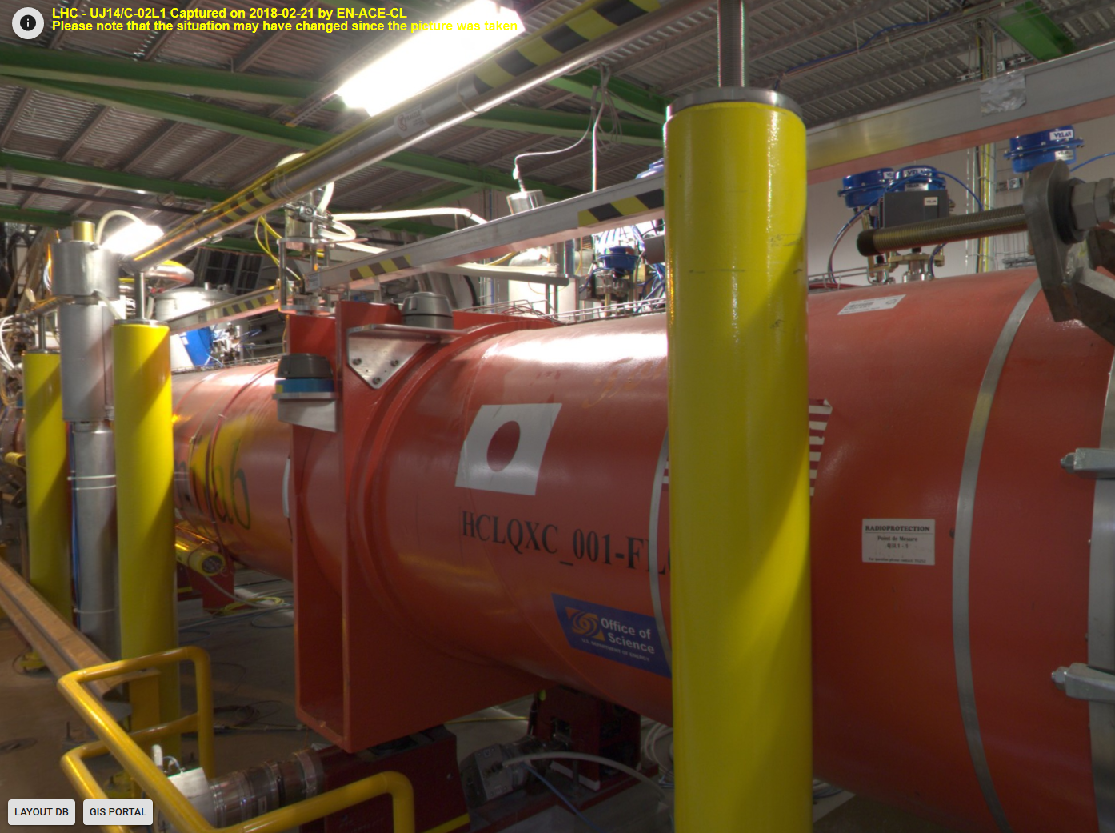

What has been done in the LHC
hydrostatic levelling network
stretched wire (protection)
HLS sensor
WPS sensor
sensor support
HLS remote validation
HLS network pillars
motors
jacks

Slide 4
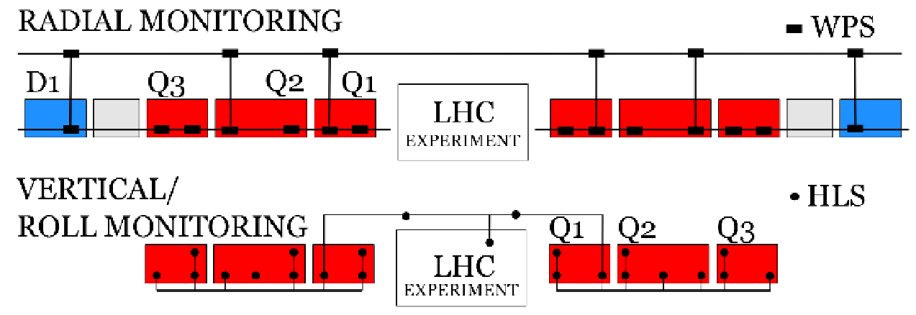
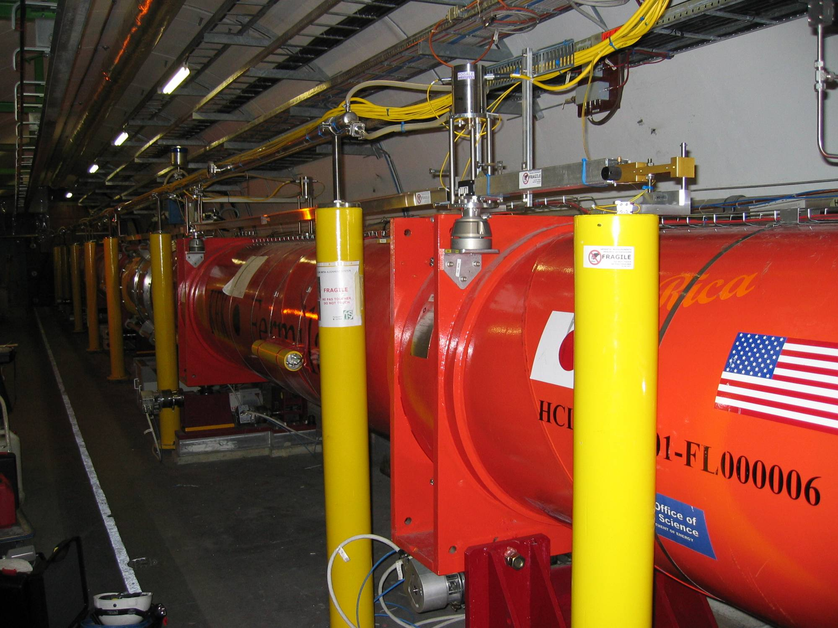
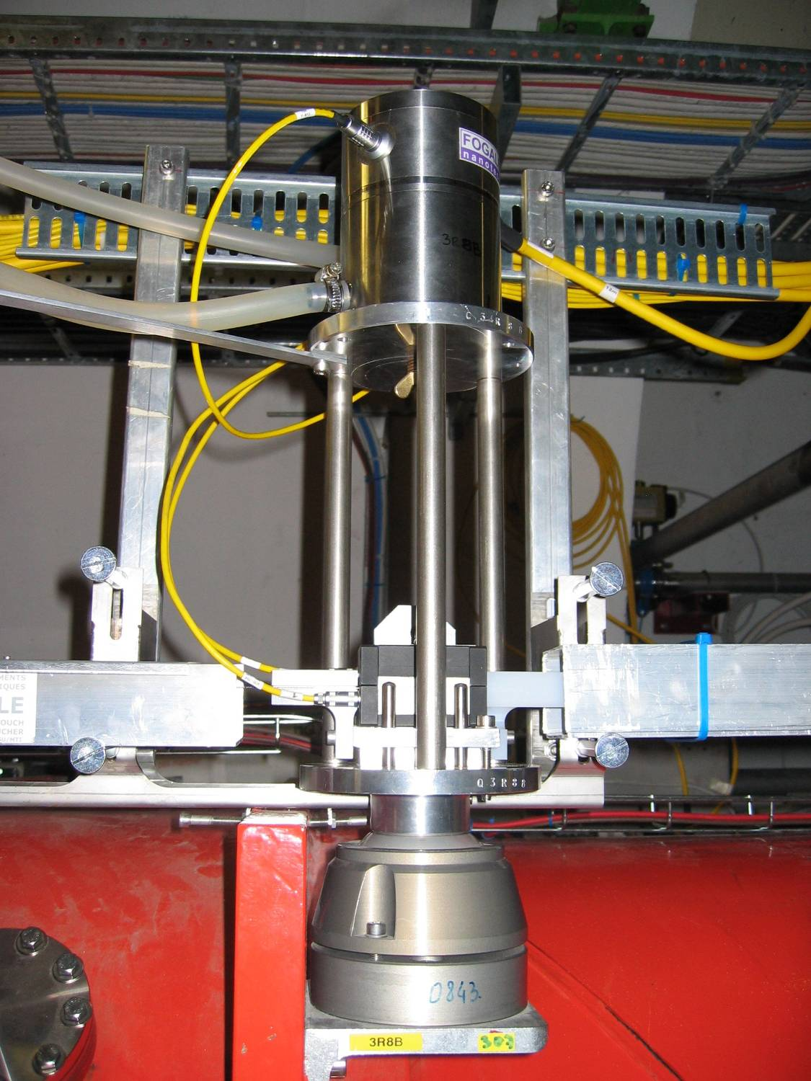
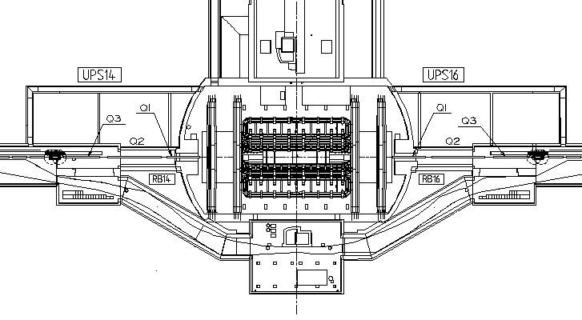
What has been done in the LHC
Relative determination of the position of quadrupoles inside the triplet: a few µm
Positioning of the fiducials of the triplet quadrupoles:
  Radial error: ± 0.2mm (1σ) from left side to right side
  Levelling error: ± 0.1 mm (1σ) from left side to right side

Slide 5
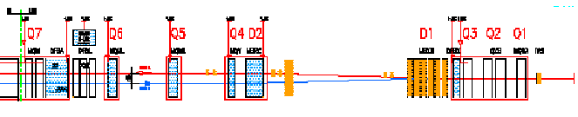
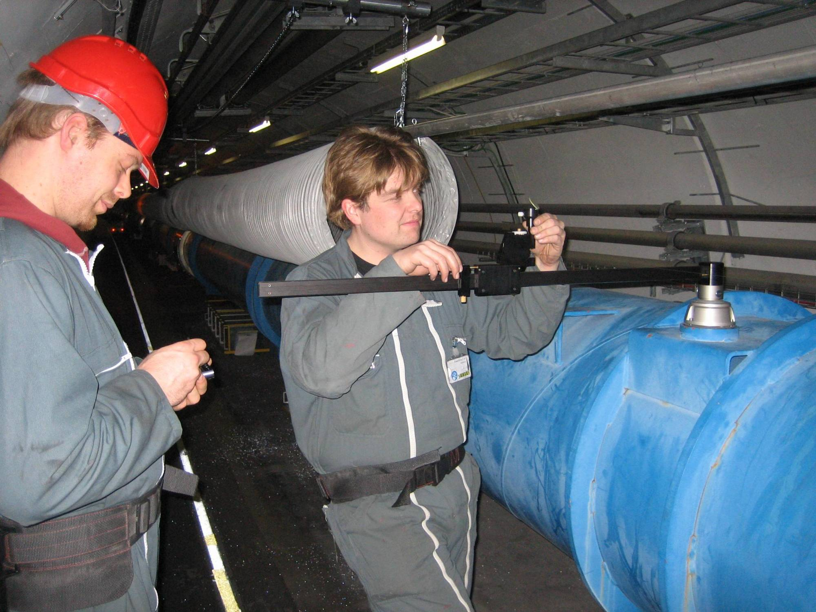
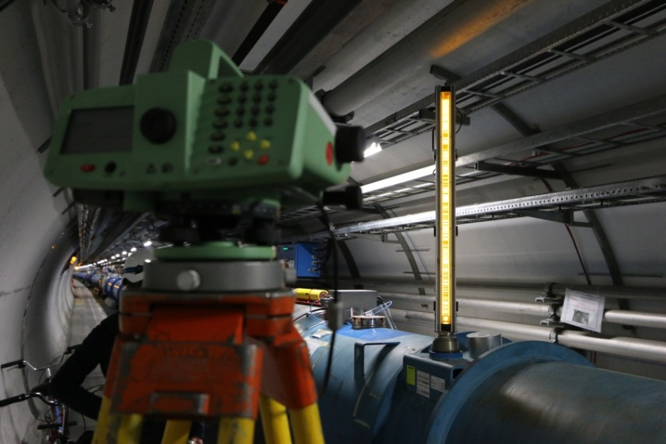
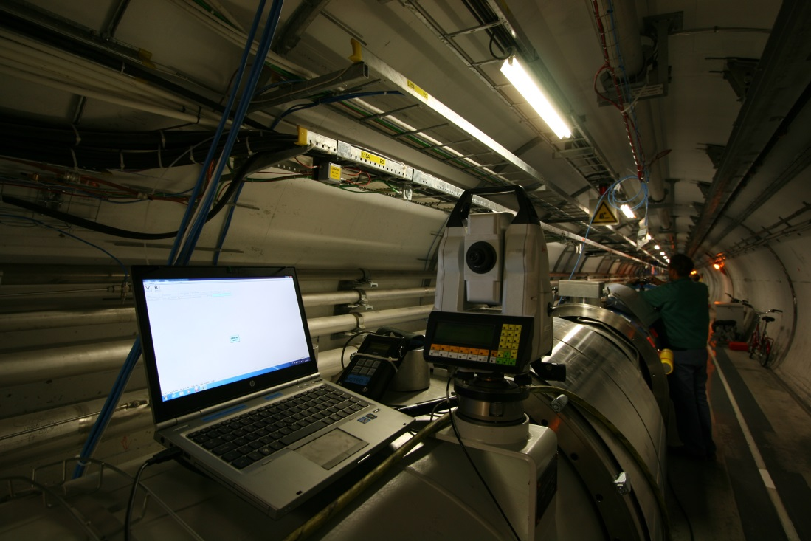
What has been done in the LHC
Final errors of alignment of one triplet fiducials w.r.t the main elements of the Matching Section (MS) : requested: ± 0.1 mm (1σ) but not achieved
For all other components of the MS: smoothing: ± 0.15 mm (1σ) over 110 m. Achieved.
Intermediary components: smoothing w.r.t. adjacent quadrupoles.

Slide 6
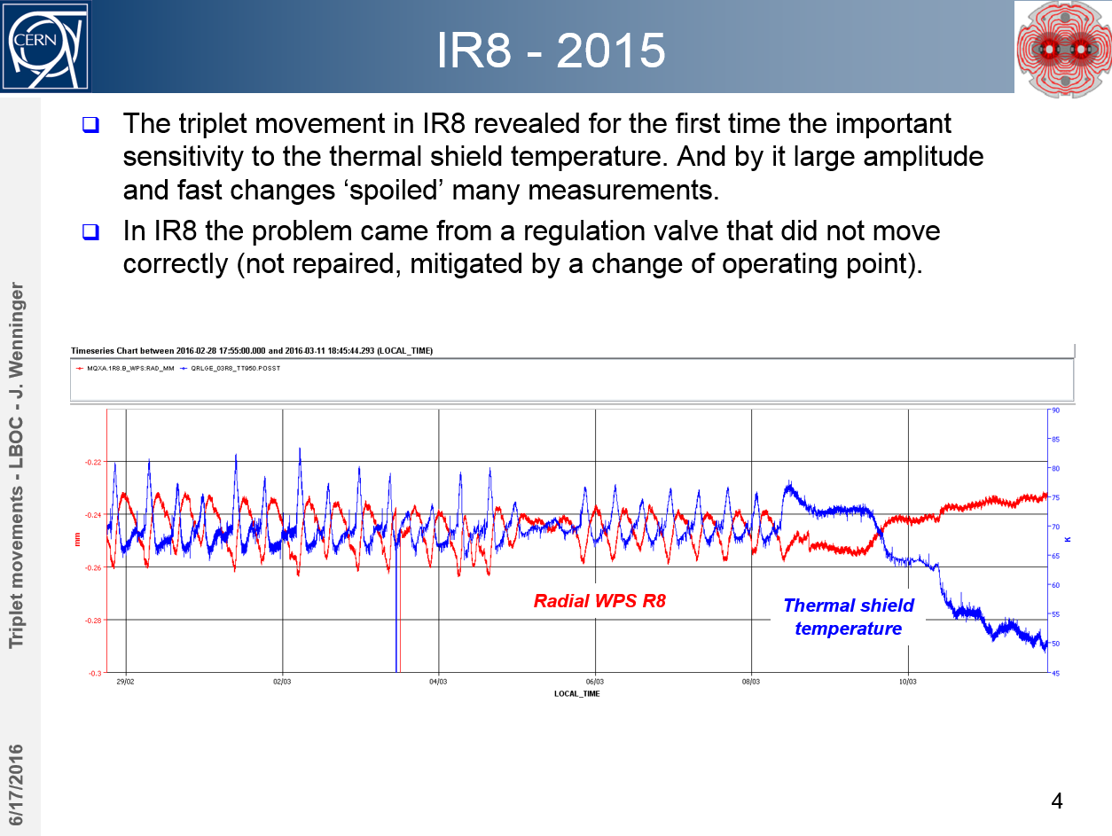
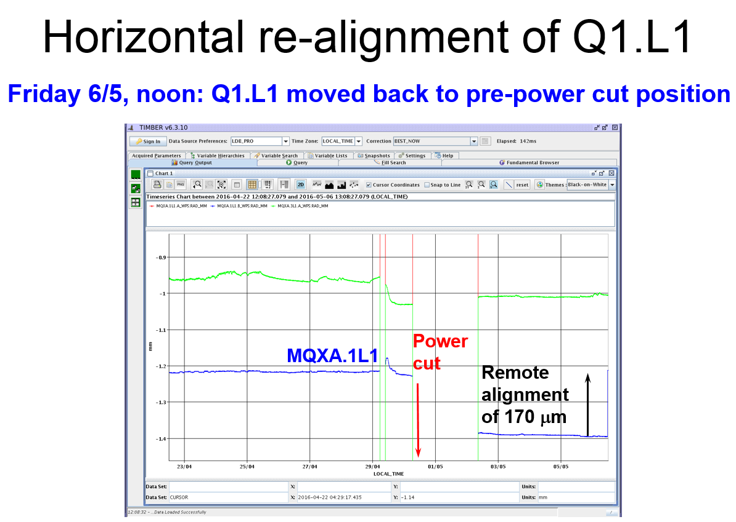
What has been done in the LHC
WPS data analyzed by the shift crews in the CERN Control Center to estimate the effective deflection of the triplet. Two ways to solve «large» movements:
  Magnetic corrections
  Remote re-alignment using WPS readings + motorized jacks

Slide 7
New features for HL-LHC
Longitudinal monitoring
  Concept as already installed for cryostats in LHC since YETS 2017/18 and LS2
Internal cold mass monitoring
  Request to determine the cold mass position and not only cryostat position
  Testing and validation of concept for crab cavities and dipole measurements
Permanently monitored reference points
  Deep references (GITL) for vertical network to be installed
Inclination sensors
  Additional concept either for HLS redundancy or where no HLS can be diploid
Different measurement technologies
  Capacitive sensors and Multi Target Frequency Scanning Interferometry

Slide 8
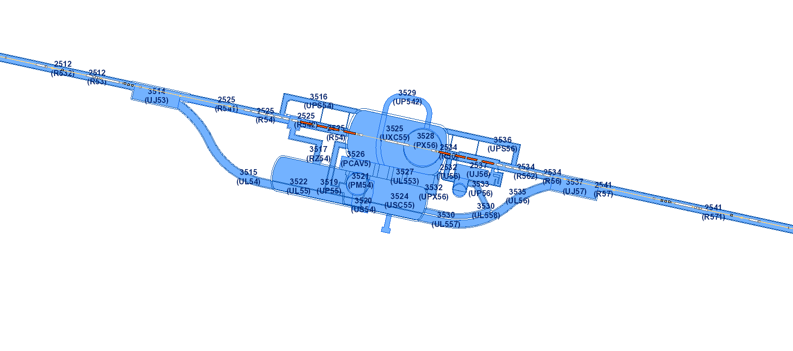
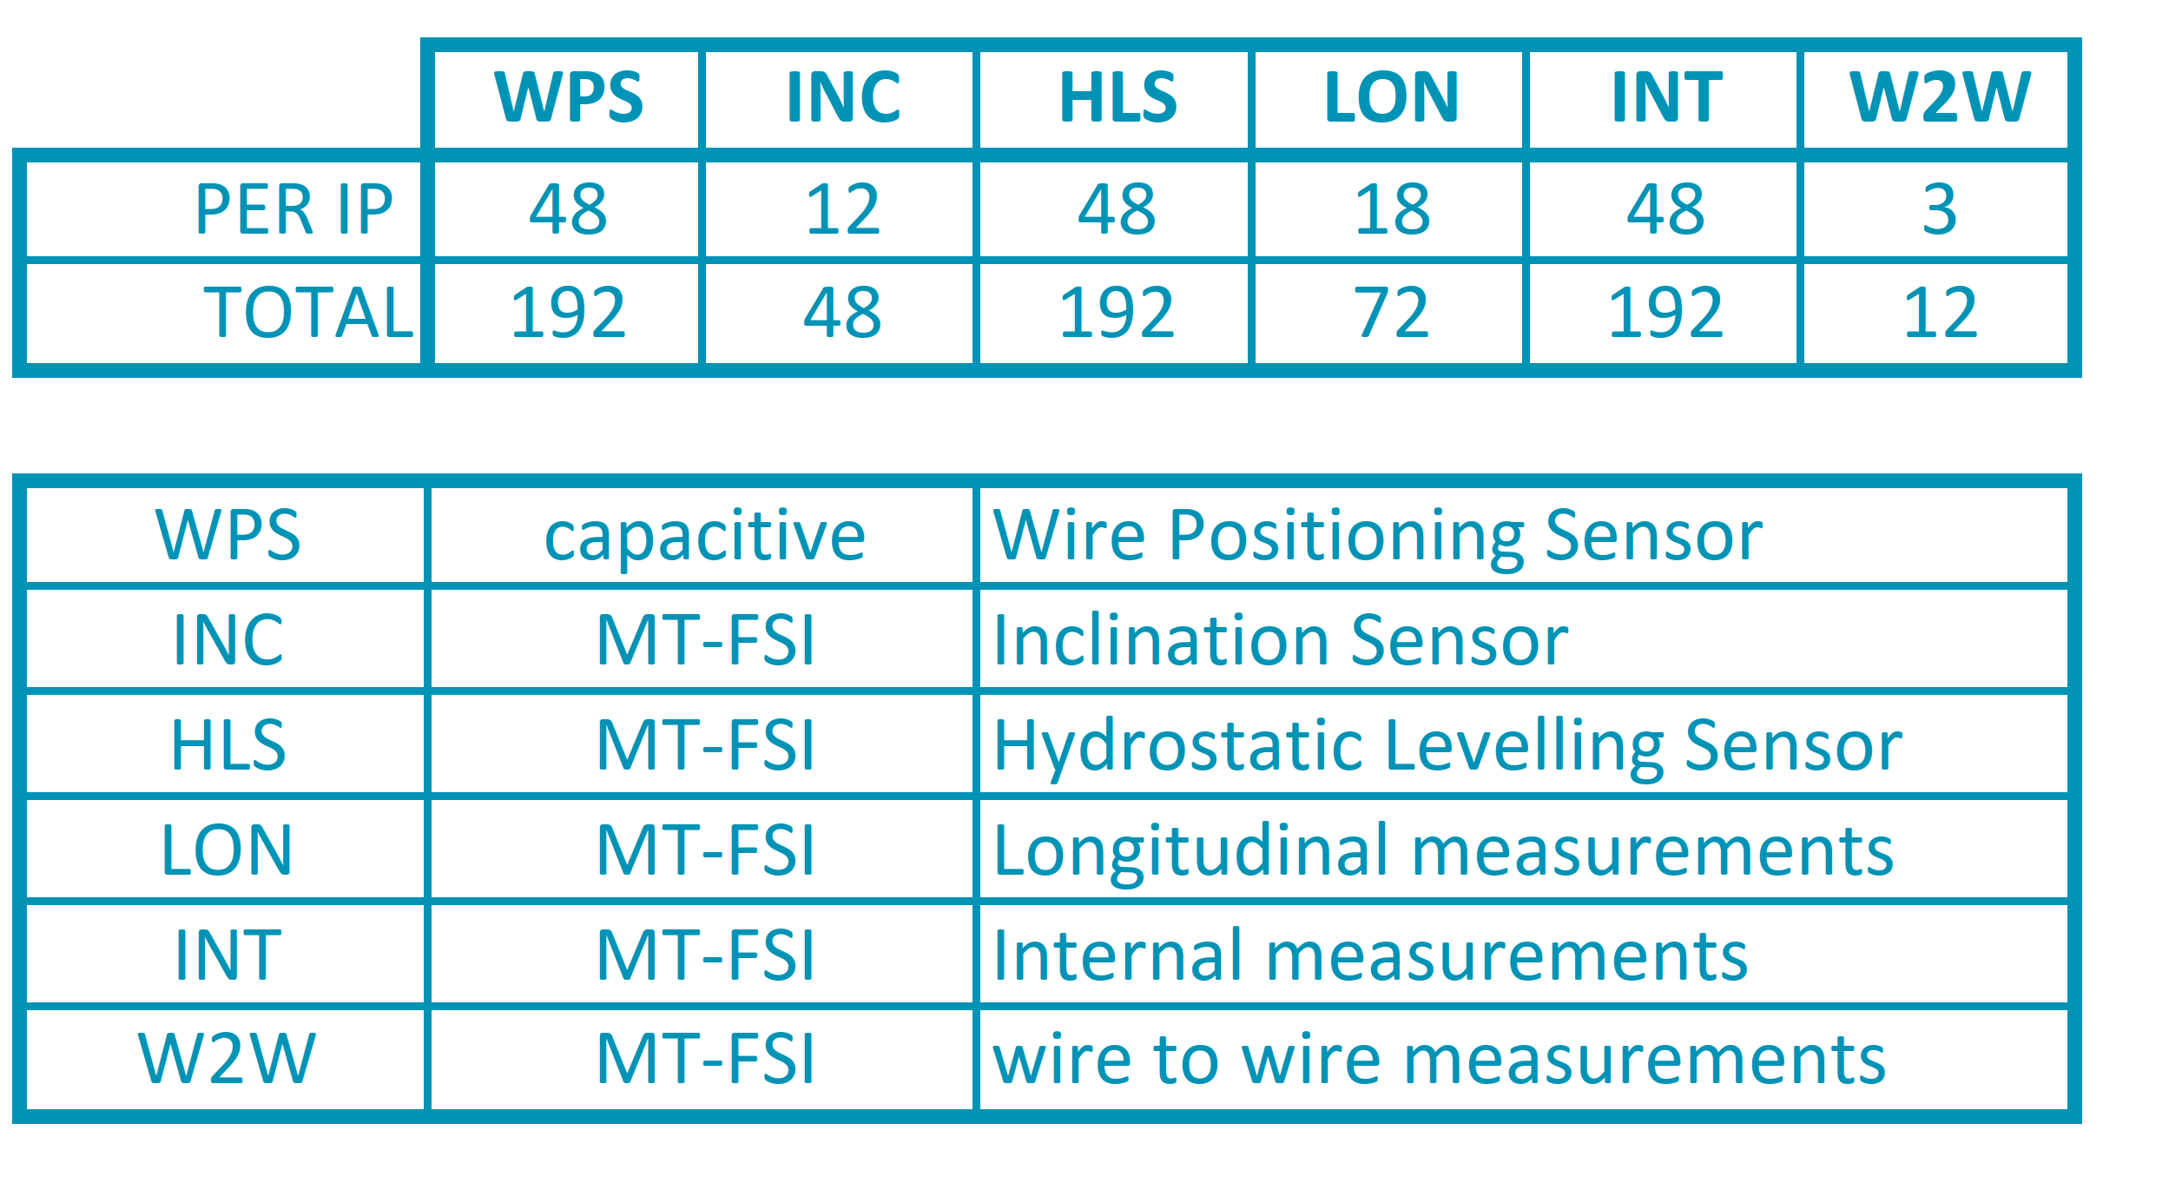
FRAS in a nutshell
470 m HL-LHC
130 m LHC (Q1 to Q3 each side + cavern link)
(Q1 to Q5 each side + cavern link)
Not taking into account, environmental sensors and actuator equipment.
In addition to the sensors:
  4 wire stretching devices
  Approx. 1 km of wire and wire protection
  Approx. 1 km of hydraulic network
  Remote diagnostic tools for sensors and systems

Slide 9
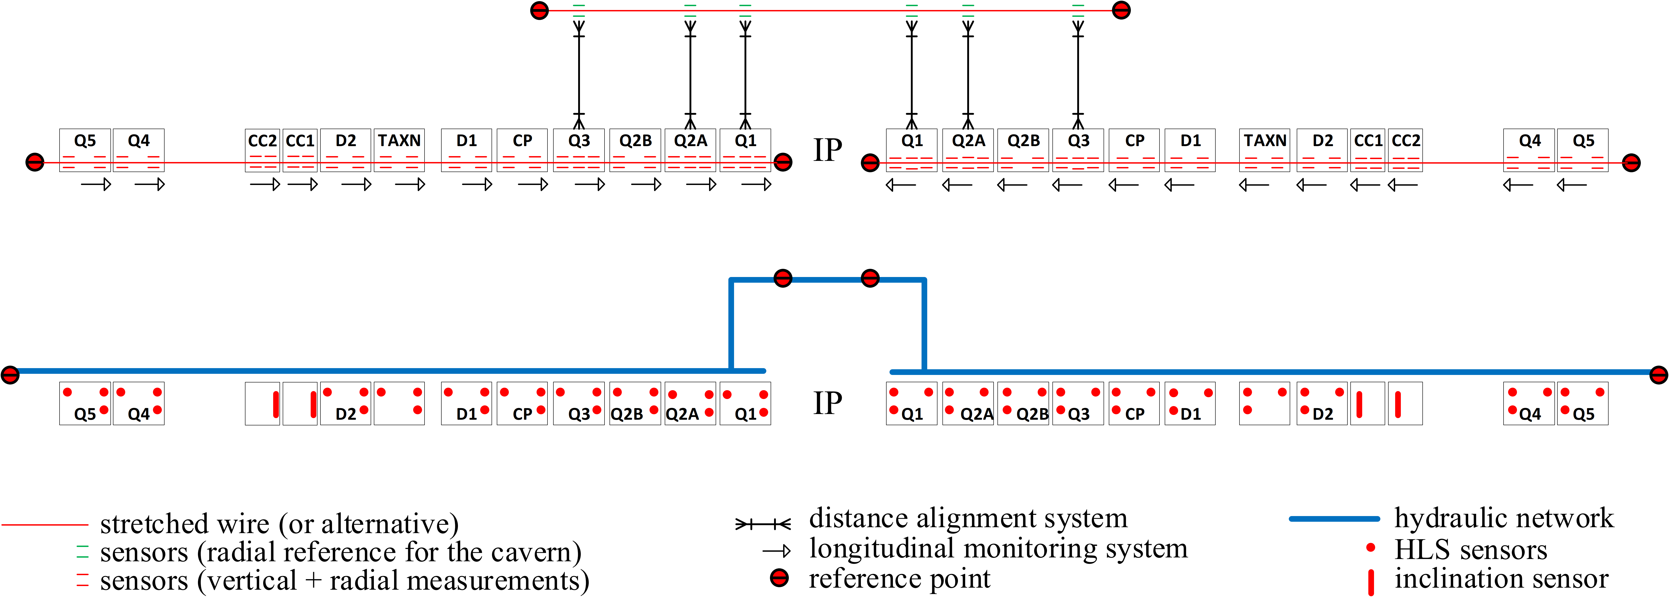
FRAS in a nutshell
130 WPS sensors
150 HLS sensors
Combined with an internal monitoring of the position of cold masses in the Inner Triplet cryostats using FSI system
Motorized jacks supporting all main components.

Slide 10
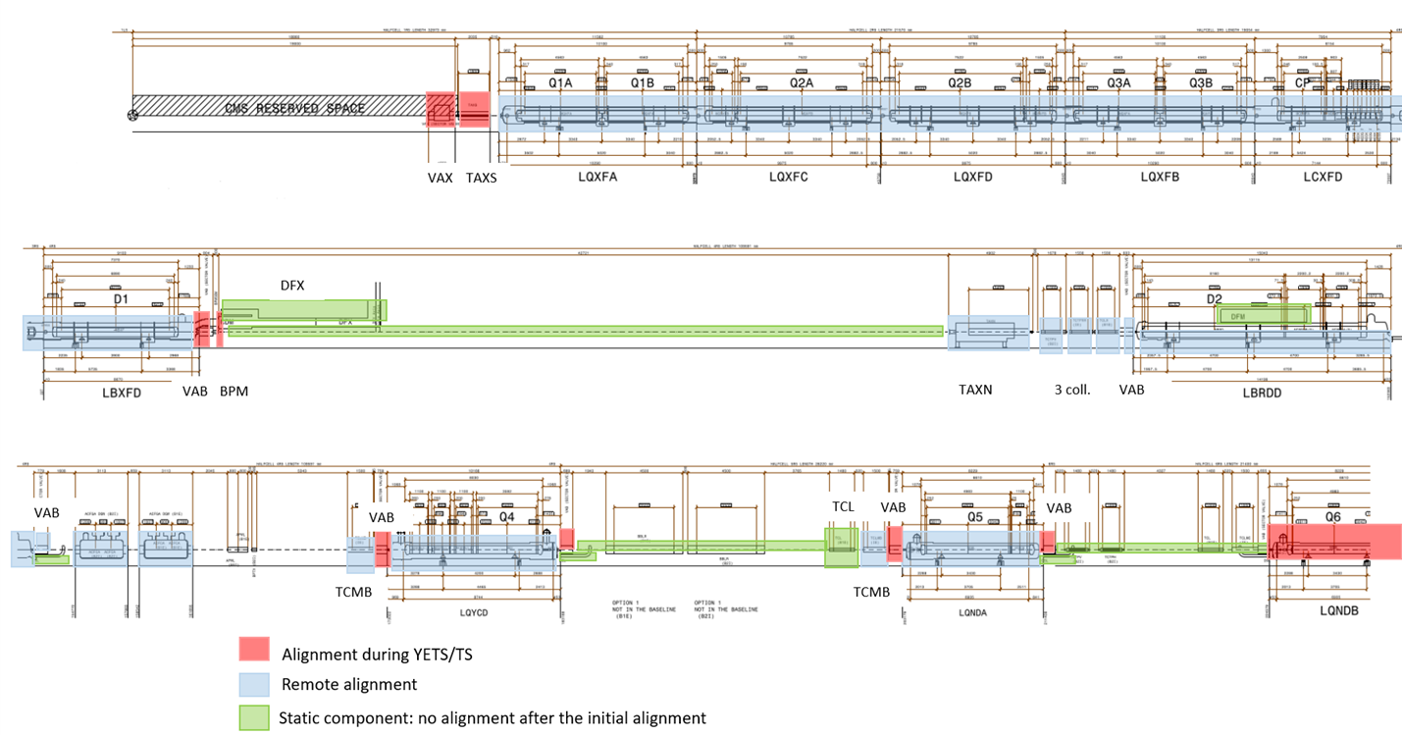
FRAS in a nutshell
The Full Remote Alignment System (FRAS) allows
  Aligning rigidly and remotely all the components from Q1 to Q5 on both sides of the Interaction Point within ± 2.5 mm
  Moving independently the components within the stroke of the corresponding bellows.

Slide 11
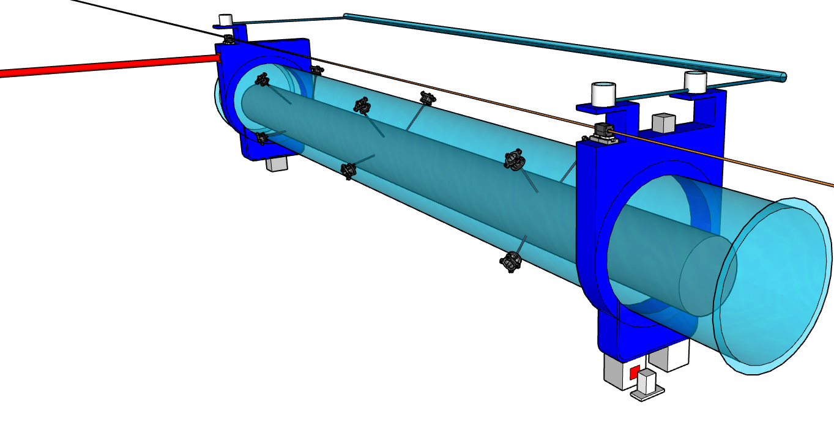
Strategy to measure the alignment
Hydrostatic Levelling System
was: capacitive HLS sensor
interferometric sensor MT-FSI
wire to wire measurement
was: invar rods, 2 DOMS, 2 WPS
long range MT-FSI, 2 WPS
inclinometer
internal
measurement
wire
For the determination of the position:
Manual or semi-manual
  Using Laser tracker
  Using permanent targets
beam
Wire Positioning System
was: capacitive WPS sensor
capacitive in-house sensor & new electronics
Alignment sensors
  Using permanent sensors
longitudinal measurement
was: capacitive DOMS sensor
short range MT-FSI

Slide 12
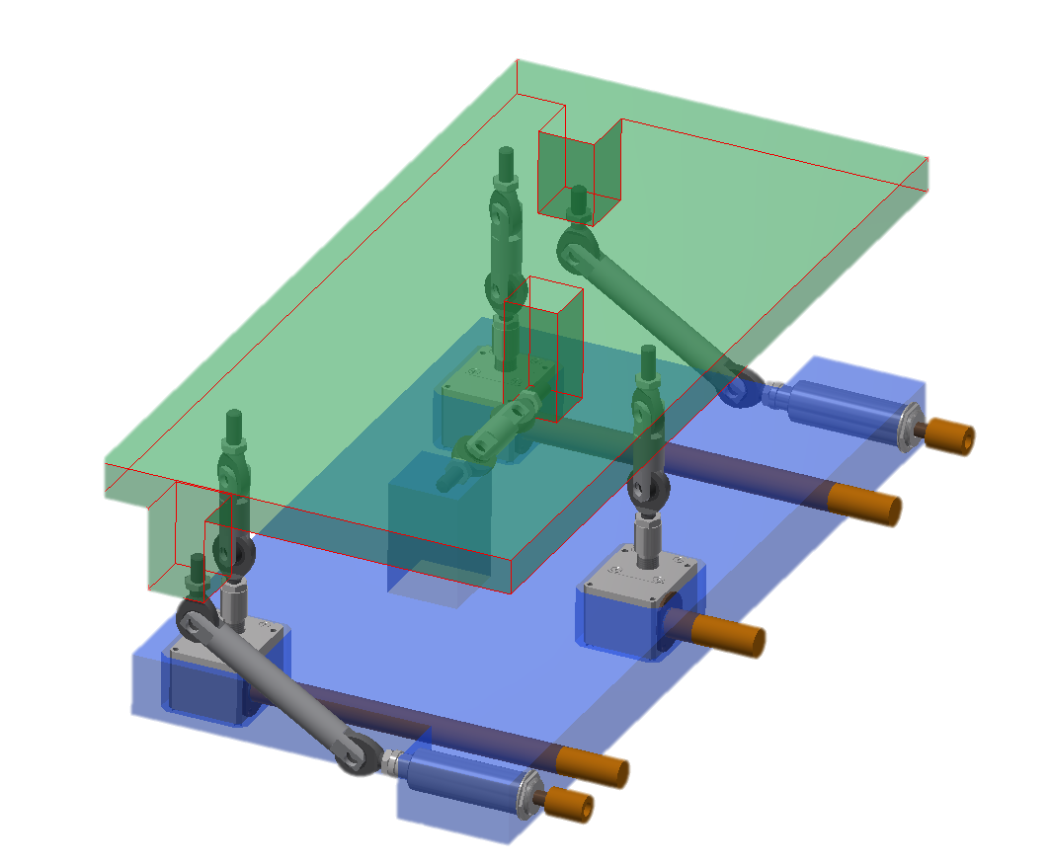
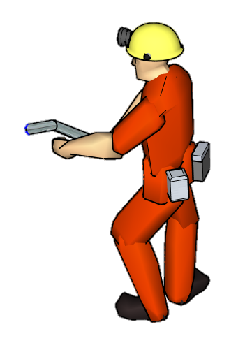
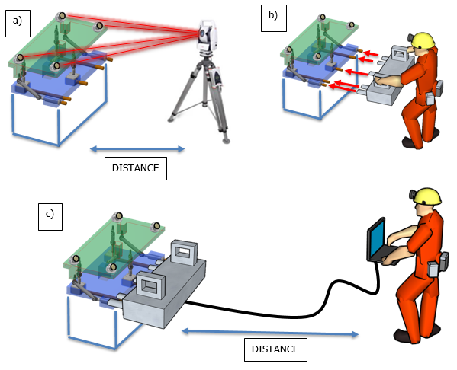
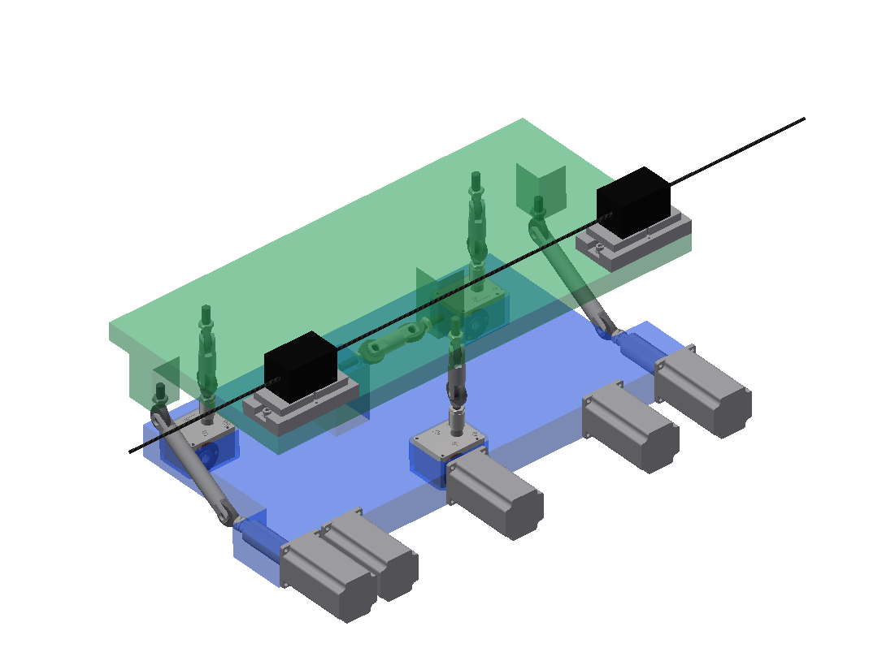
Universal Adjustment Platform
Allows for various operation use cases
Universal adjustment platform – manual operation concept
Universal adjustment solution - permanent motors version concept. Platform equipped with WPS sensors
Universal adjustment solution – concept of use plug-in motors:
a) Platform measurement from distance using a laser tracker;
b) Installation of plug-in motors in less than one minute;
c) Remote adjustment from distance.

Slide 13
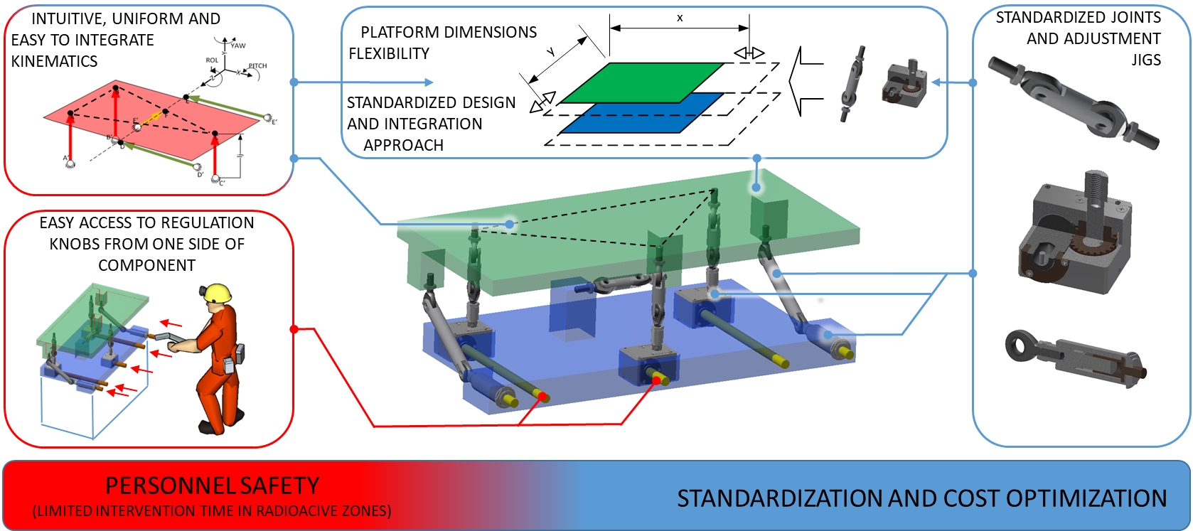
Universal Adjustment Platform
Definition of set of design rules and development of standardized and modular components to:
increase safety of surveyors
unify small (<2T) accelerator components adjustment systems

Slide 14
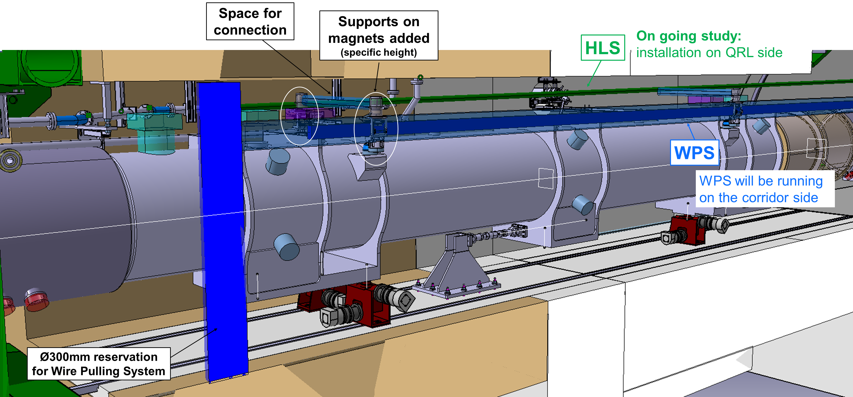
Conceptual Integration of HL-LHC FRAS
A first “conceptual integration” has been started in close collaboration between WP15.1 and WP15.4 with the aim of facilitating a real mechanical design
FSI
Q1
Motorised jacks

Slide 15
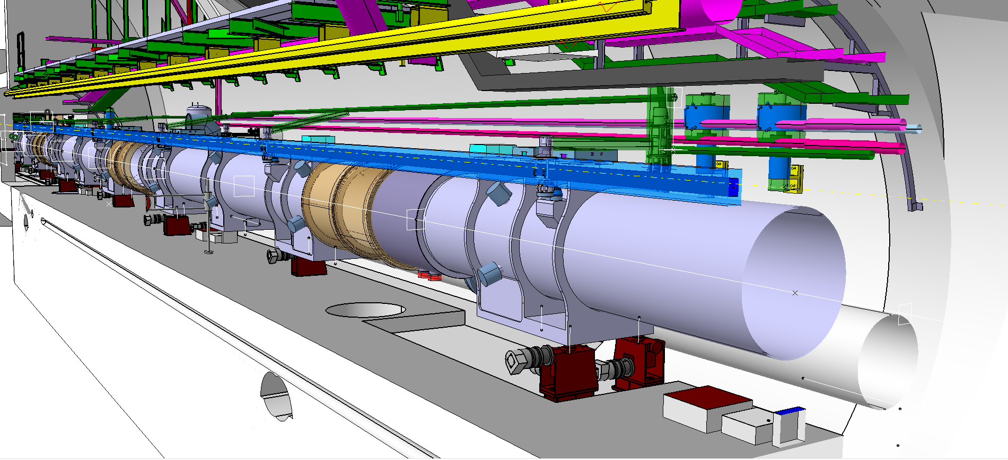
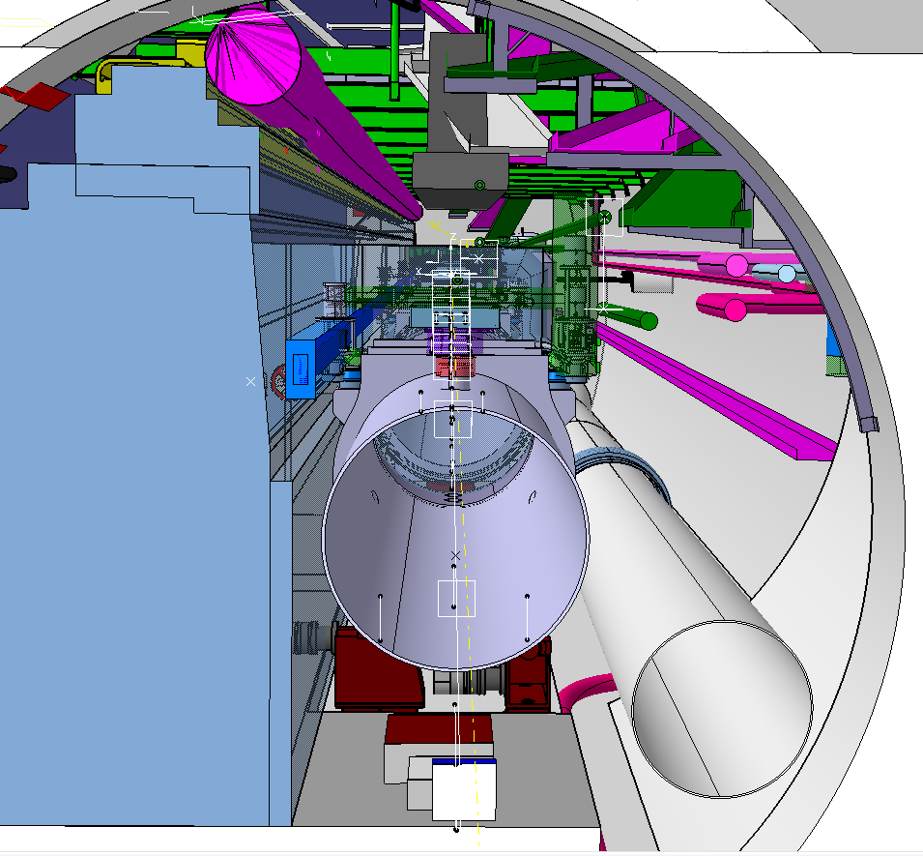

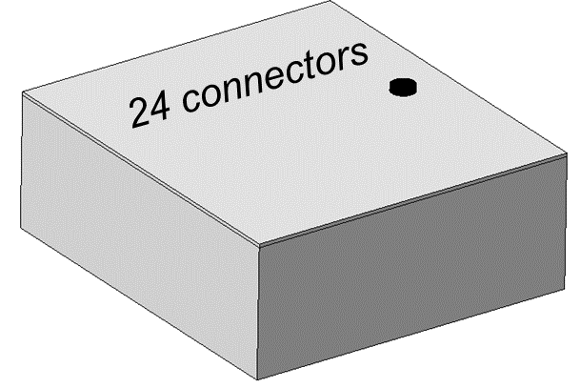
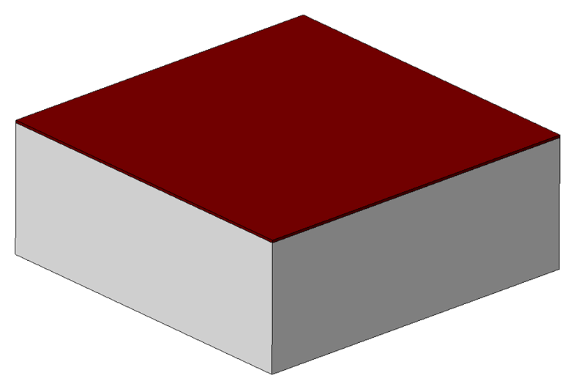
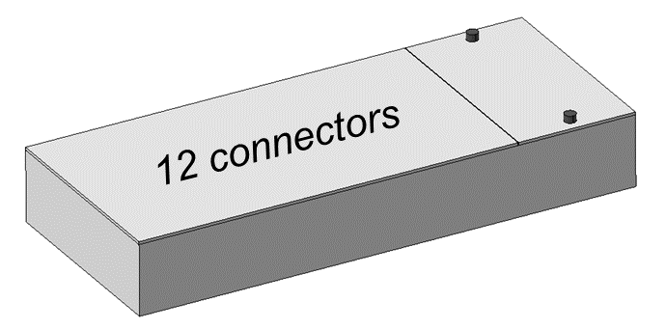
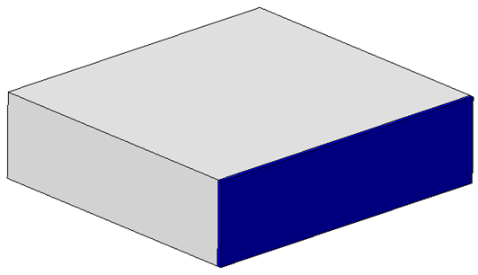
Conceptual Integration of HL-LHC FRAS
Components:
Motorised jacks
Patch panels and crates
Support for the HLS and WPS sensors
Filling Purging Stations (FPS)
Possible location for SU deep reference
HLS
WPS
Tunnel services
Space reserved for transport
Patch panels for FSI system
Patch panels for motors
Volume for inclinometers
QXL

Slide 16
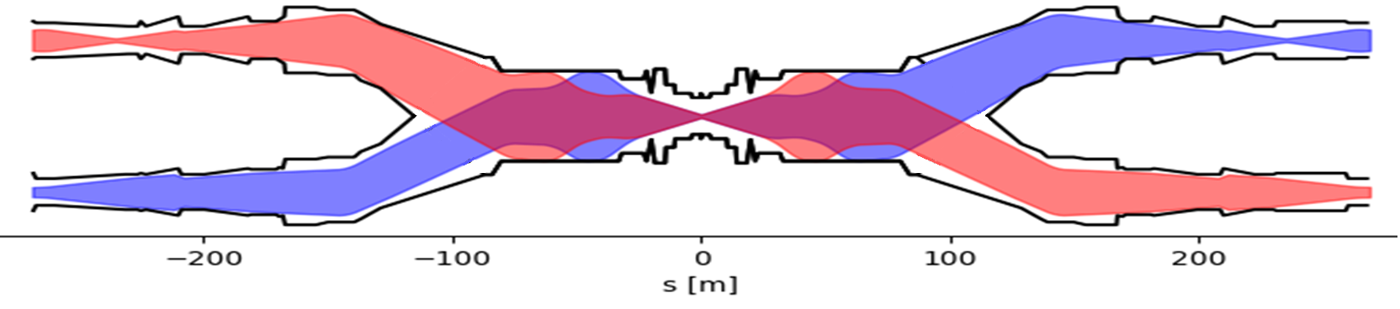
Alignment needs around ATLAS and CMS
HL-LHC simplified lattice and beam envelopes around the experiments
Q7-Q4
C
D2-D1
Q3-Q1
EXP
Q1-Q3
D1-D2
C
Q4-Q7
Good alignment is needed for
  Inner tracker to be transversely centred to the interaction point (IP) for reducing radiation damage and improve tracks reconstruction (<1 mm)
  Quadrupoles to be centred around the reference orbit to remain within orbit corrector strength budget and reduce orbit distortions (<0.5 mm)
  Crab cavities to be transversely centred around the beam orbit to keep RF power within operational limits (<1 mm)
Good alignment of non active elements is also needed to
  Preserve stay clear regions for the beam at low β*
  Maintain effective shielding of protecting masks for superconducting magnets

Slide 17
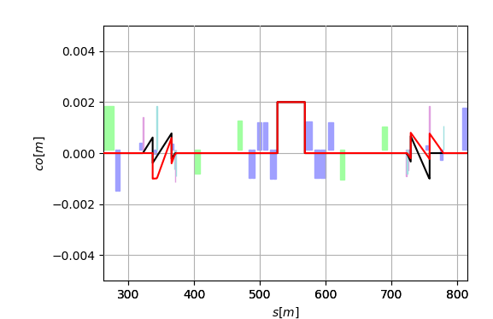
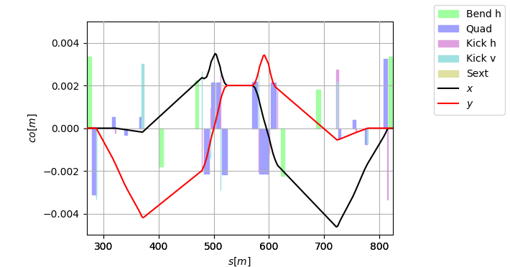
Alignment needs for ATLAS and CMS
ATLAS and CMS request that the machine is able to adjust the IP within ±2 mm in H/V
  Inner tracker cannot be easily mechanically aligned
  The experiments do not expect to control the positioning of the inner tracker better than few mm
  Observed ground motion can be in the order of several mm after several years
The beam orbit can be adjusted
  With orbit correctors
    Expensive in terms of integrated dipole correctors strength
    Expensive in terms of aperture (residual orbit distortions in the triplets and crab cavities)
  By re-aligning the machine from Q5 left to Q5 right
    FRAS
Q1
CC
Q4
Q5
Inner Tracker
Q7
Q4
CC
Q1
Q5
Q6
TAXS
Q7
TAXS
Q6

Slide 18
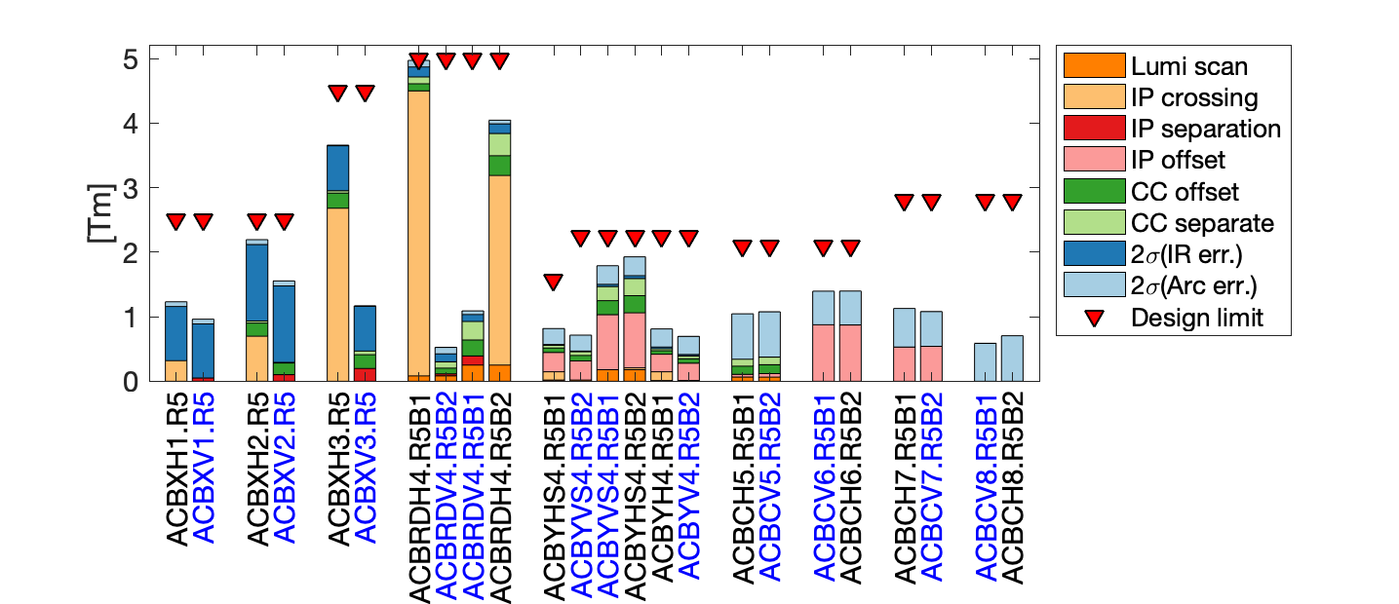
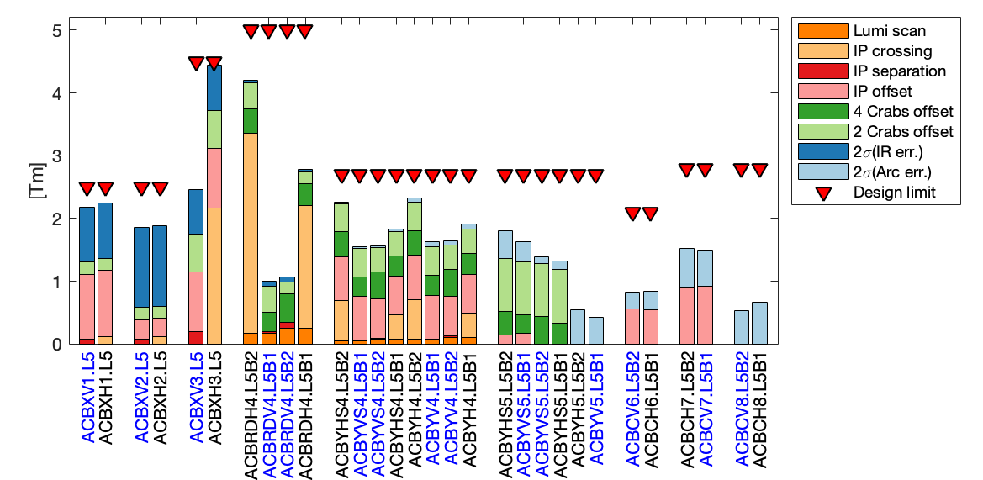
Orbit correctors strength budget
HL-LHCV1.4 after MS optimization
HL-LHCV1.3 before MS optimization
FRAS allows re-using LHC orbit correctors and magnet assemblies
Q4: 16 x MCBY 1.9 K -> 12 x MCBY at 4.5 K with FRAS
Q5: 12 x MCBY 1.9 K -> 4 x MCBC at 4.5 K with FRAS
Additional potential benefits
Perform orbit corrector strength minimization during beam-commissioning (better orbit residual, hence more aperture)
Mitigate impact of non-conform orbit correctors by performing ad-hoc fine tuning with circulating (safe) beam as reference
FRAS allows optimising the Matching Section layout
FRAS allows preserving HL-LHC performance

Slide 19
Aperture situation
 | Old | FRAS | Old | FRAS
 | Round β*=15 cm |  | Flat β*=7.5 cm
TAXS | 15.4 | 15.4 | 13.3 | 13.3
Triplets | 12.0 | 13.1 | 11.8 | 12.7
TAXN | 15.4 | 17.3 | 12.4 | 13.9
D2 | 15.5 | 19.3 | 12.9 | 14.5
Q4 | 14.5 | 19.3 | 10.4 | 13.6
Q5 | 24.8 | 21.1¹ | 17.6 | 14.9¹
Q6 | 25.5 | 26.7 | 18.0 | 18.9
Aperture requirements (beam σ)
> 12 σ in triplets
> 14.6 σ in Q6
> 19.2 σ elsewhere
¹due to reduced Q5 aperture from 70 mm to 56 mm after MS optimization
Aperture estimates based on LHC design assumptions on ground motion and fiducialization which are under review for HL-LHC.
FRAS allows pushing HL-LHC performance

Slide 20
FRAS goals and benefits
Goals
By products
Reduce dose to survey team
Gain aperture margin in various equipment
Cope with
experiment vs. machine misalignment in Run 4
after completion of installation
Matching
Section Optimization
FRA
Correct yearly ground motion drift without manned intervention in the tunnel
Reduce the requirement on the Matching Section orbit Corrector System
Provide tools to eliminate or at least minimize residual alignment errors using beam as reference
Mitigate spurious orbit deviations in the triplet (simplifying non linear corrections)
Cope with unexpected sources of misalignment avoiding performance losses and loss of time for physics

Slide 21
Summary
The FRAS is a highly-sophisticated based on
  Position monitoring systems
  Remotely-controllable adjustment devices
It brings already now
  The possibility to re-optimize the Matching Section, i.e.
    Re-using LHC components, e.g. Q4 and Q5
    Reducing the amount of work to be performed and the extent of the LHC machine modifications
  The simplification of the design of few elements, e.g. collimators
It will bring in the future
  Reduction of radiation to personnel
  Increased window for machine optimization (larger aperture margin and lower β∗ reach)
  Increased machine flexibility and reduced reaction time
  Decreased demands on orbit corrector system

Slide 22
Thank you for your attention!

Slide 23
Spare slides

Slide 24
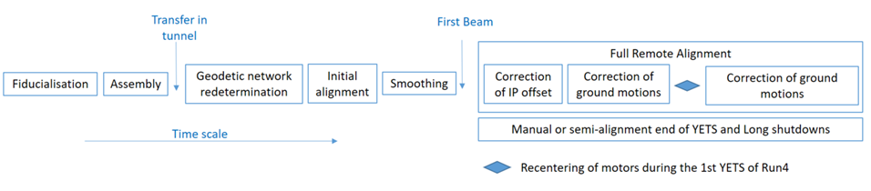
FRAS life cycle
The initial alignment will be performed w.r.t underground geodetic network
The smoothing will be performed along an “ideal” line from Q7 left – Inner tracker detector – Q7 right to make the first pilot beam pass through
After a few weeks of operation, a rigid remote re-alignment will be performed from Q5 left to Q5 right according to the offsets seen in the inner tracker
During the first year, all motors will be re-centered to benefit from the maximum stroke
The compensation of ground motion will take place preferably during TS, as a machine requalification is required after. Small machine movements could be allowed without requalification during the operation of a pilot beam.

Slide 25
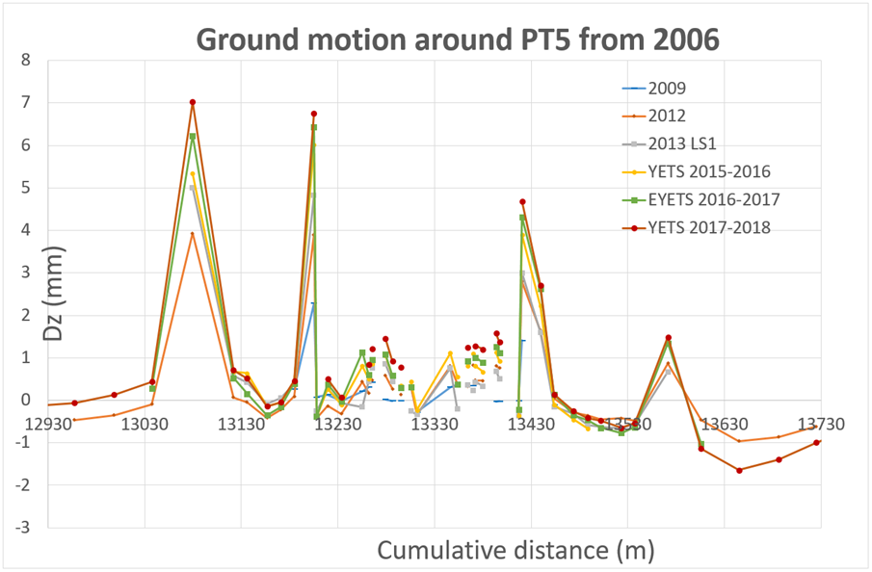
Ground motion in IR1/5
 | Radial (mm/year) | Vertical (mm/year)
Around IP5 (CMS) | ± 0.3 | + 0.7 in 5L (two specific area) + 0.5 in 5R (two specific area + 0.2 in any other area
Around IP1 (ATLAS) | ± 0.2 | ± 0.3
Maximum displacement in millimetre per year measured between the detector and the machine.
Ground motion around point 5 on the tunnel floor since 2006.

