Slide 1

SPS Tests of Crab Cavities & Lessons Learned
HL-LHC WP4, CERN
14 October 2019, HL-LHC Annual Meeting, FNAL

Slide 2
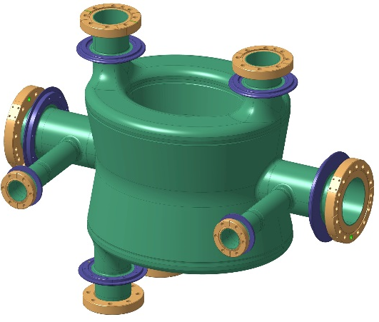
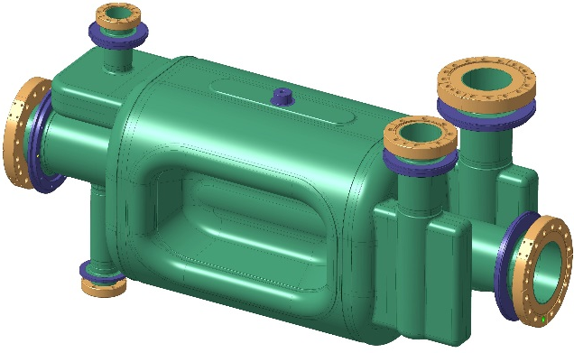
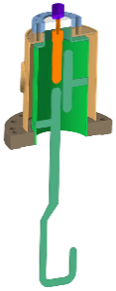
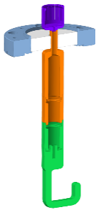
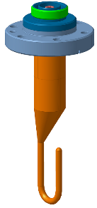
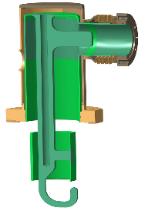
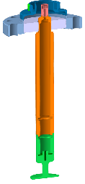
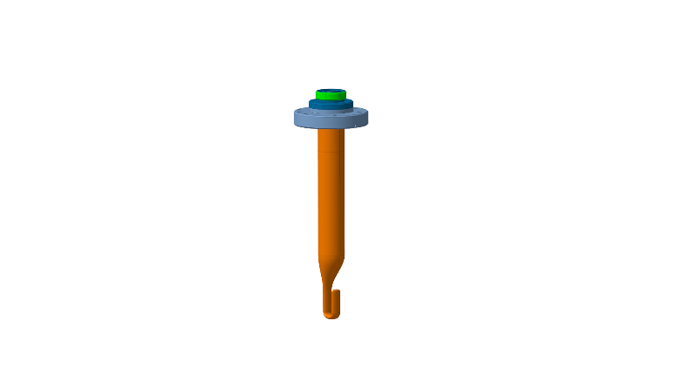
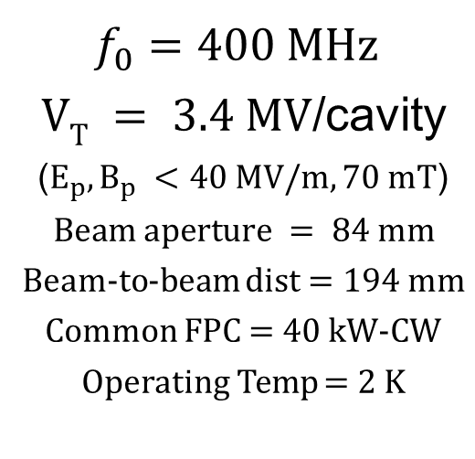
Dressed Cavity Geometries
Double Quarter Wave
RF Dipole
$f_{0}=400 MHz$
$VT = 3.4 MV$/cavity
($E_{p}, B_{p} <40 MV/m, 70 mT$)
$$Beam aperture = 84 mm$$
Beam-to-beam dist$=194 mm$
Common FPC = 40 kW-CW
Operating Temp = 2 K

Slide 3
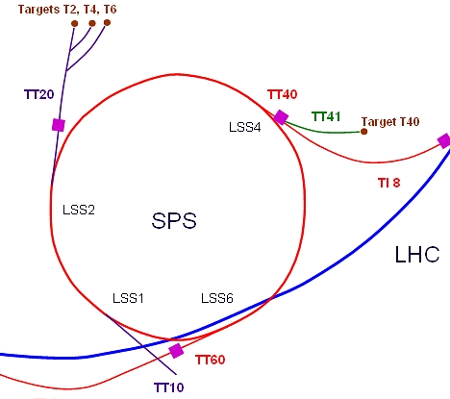
Super Proton Synchrotron, SPS
LSS6-BA6 is the highest energy superconducting test facility in the world!
DQW cavities successfully installed & tested in 2018
Circumference | 7 km
Injection-Extraction energy | 26-450 GeV
Main RF Frequency | 200 MHz, TW
CC Operating Freq Range | 400.528 – 400.788 MHz
Notes:
In SPS, work is organized in 2 phases, where most infrastructure will be installed in EYETS

Slide 4
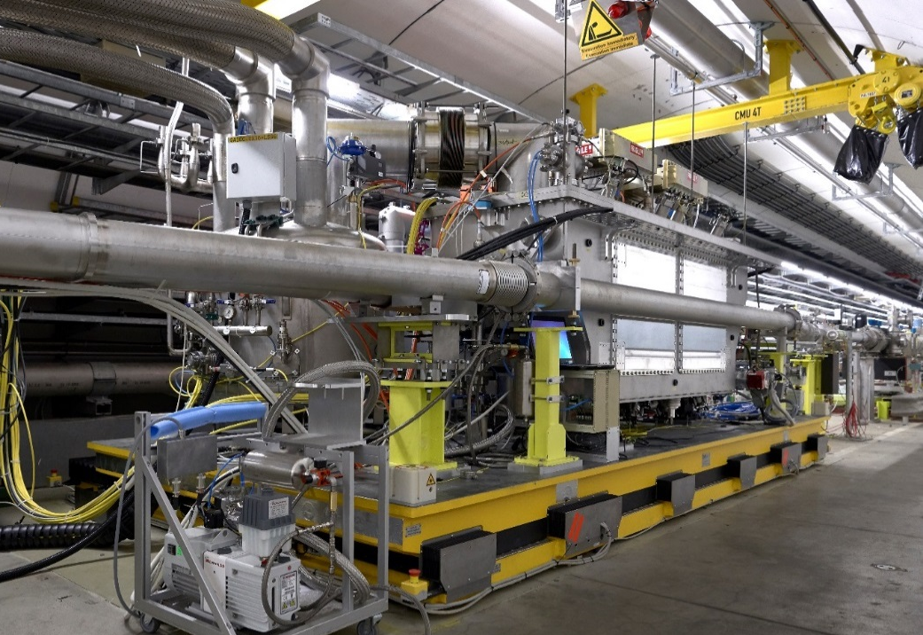
SPS-LSS6 – Crab Cavity Module

Slide 5
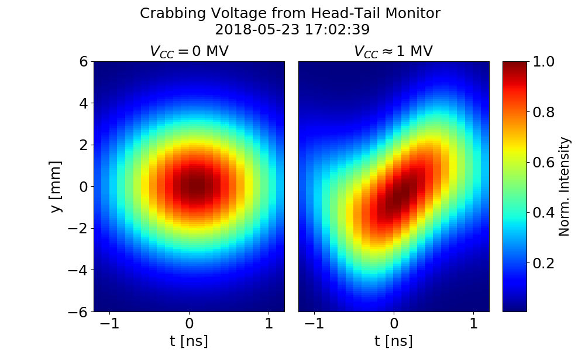
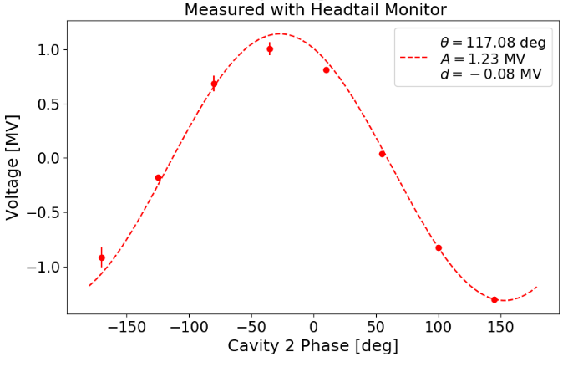
1: We can Crab Protons!
We can crab the proton beams of 3 ns, with predicted crabbing agrees with measured angles within 10%
No noticeable effect on beam in variety of conditions including strong RF curvature

Slide 6
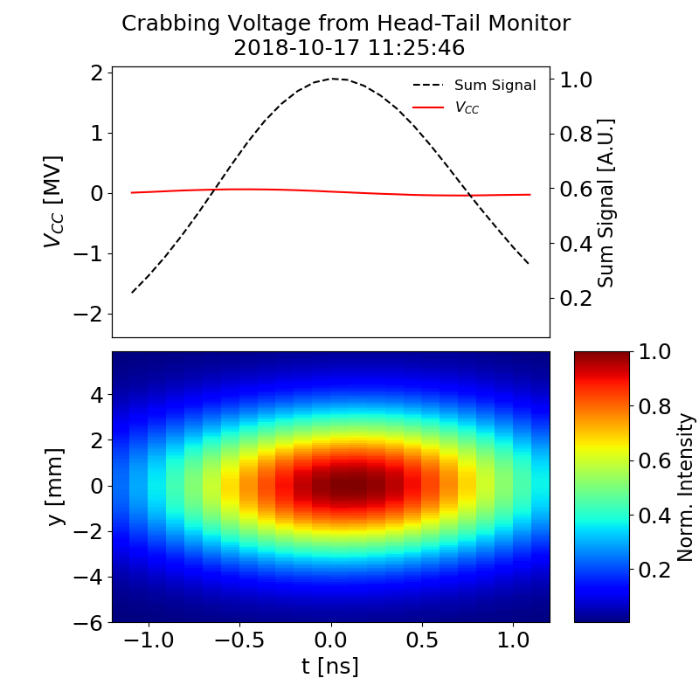
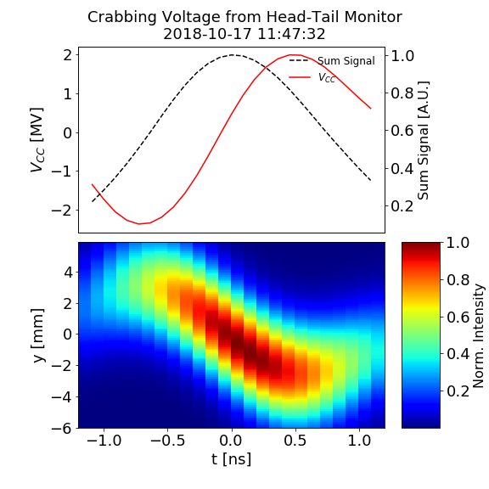
2: Transparency
We can regulate the intra-cavity phase in a precise and stable manner. In next run, we need to understand timescale of phase drifts
Cavity 1 - Cavity 2
Cavity 1 + Cavity 2

Slide 7
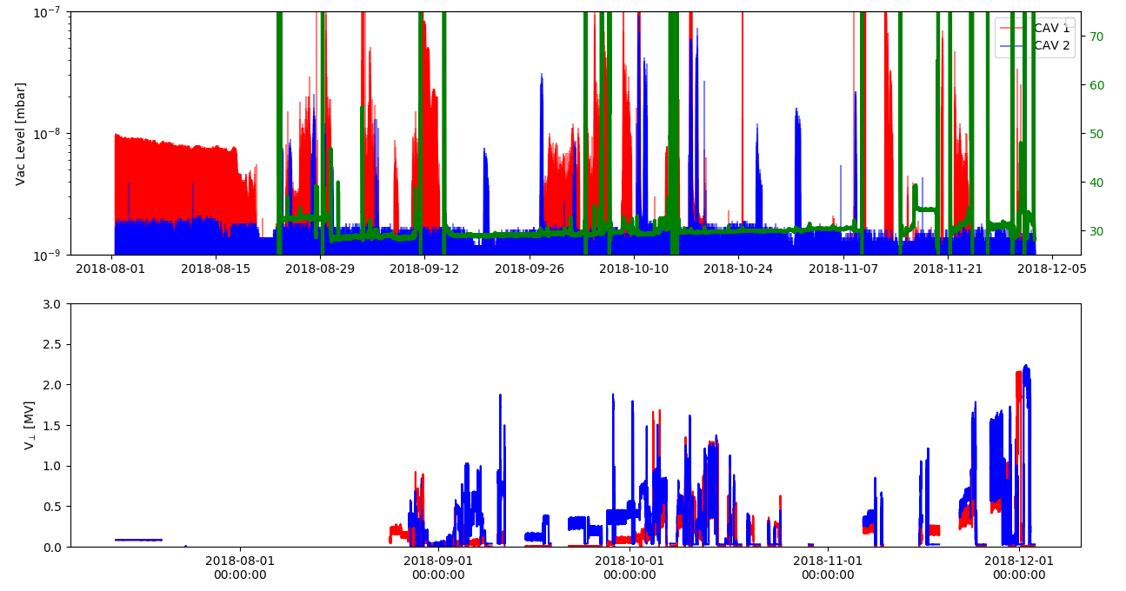
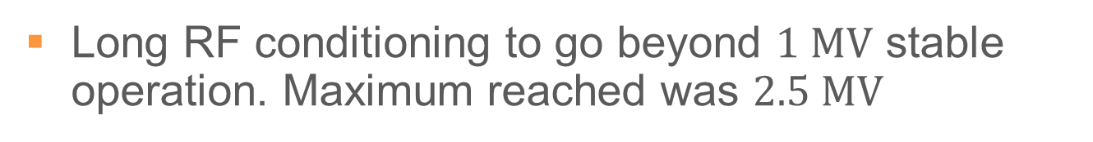
3: Voltage Ramp-Up
Long RF conditioning to go beyond $1 MV$ stable operation. Maximum reached was $2.5 MV$
Vaccum
Cryo
Aug
Sep
Oct
Nov
Dec
MD 4&5
MD 6&7
Voltage

Slide 8
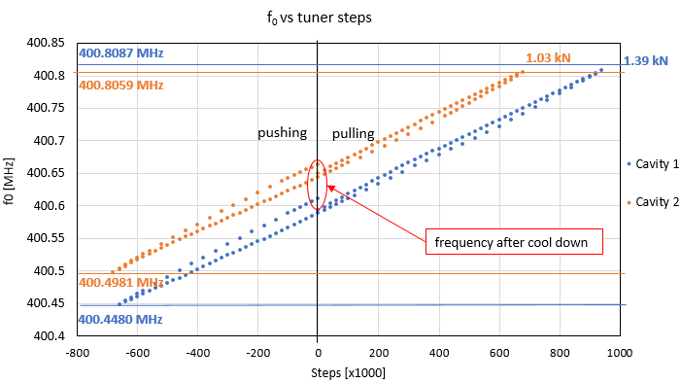
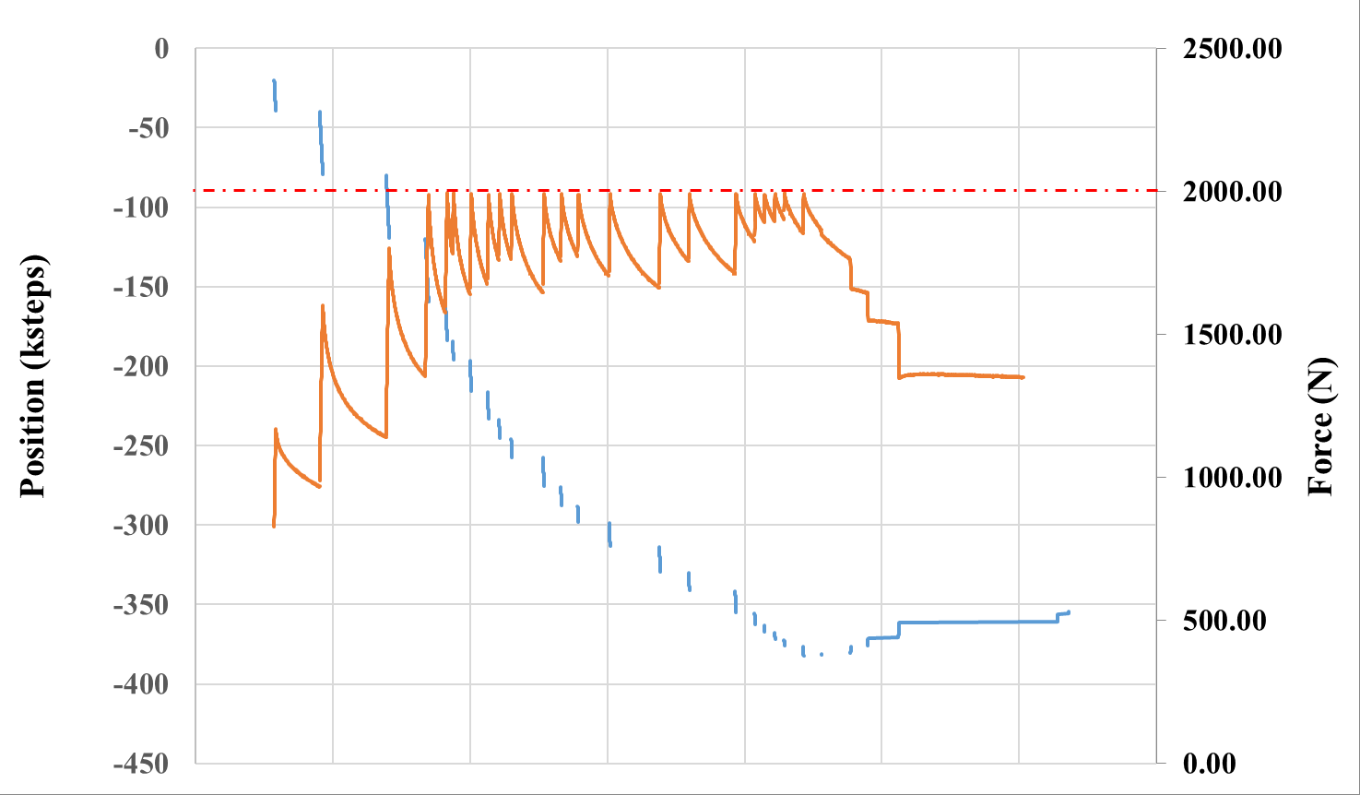
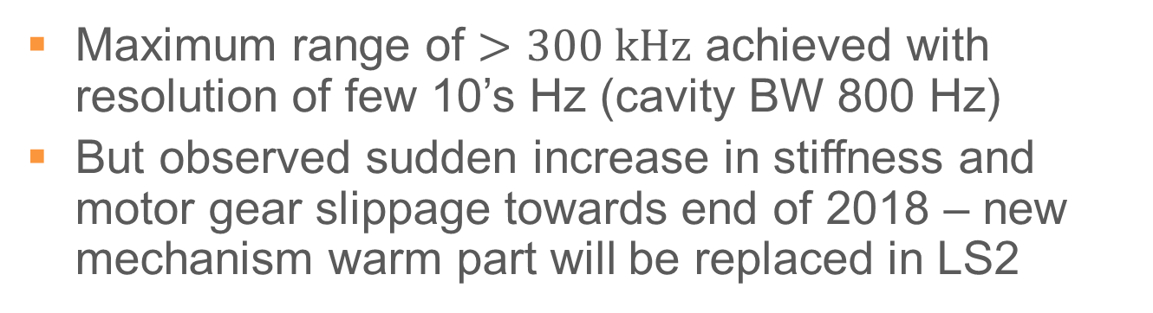
4: Freq Tuning
Maximum range of $>300 kHz$ achieved with resolution of few 10’s Hz (cavity BW 800 Hz)
But observed sudden increase in stiffness and motor gear slippage towards end of 2018 – new mechanism warm part will be replaced in LS2

Slide 9
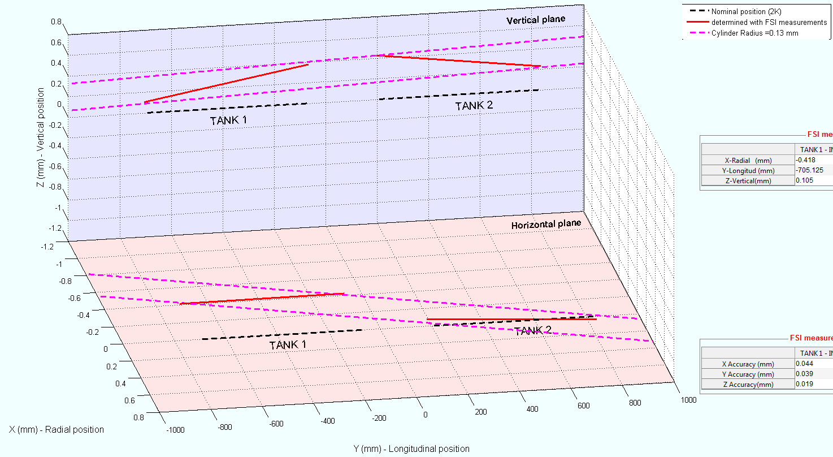
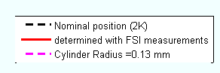

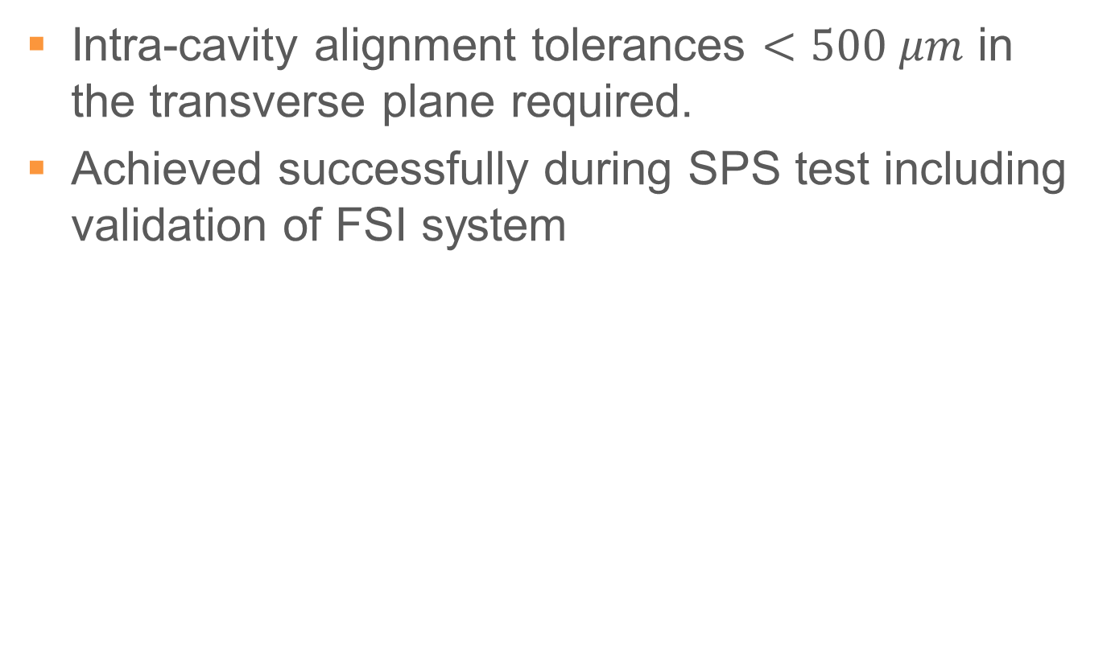
5: Alignment
Intra-cavity alignment tolerances $<500 μm$ in the transverse plane required.
Achieved successfully during SPS test including validation of FSI system
radius $\sim 130 μm$

Slide 10
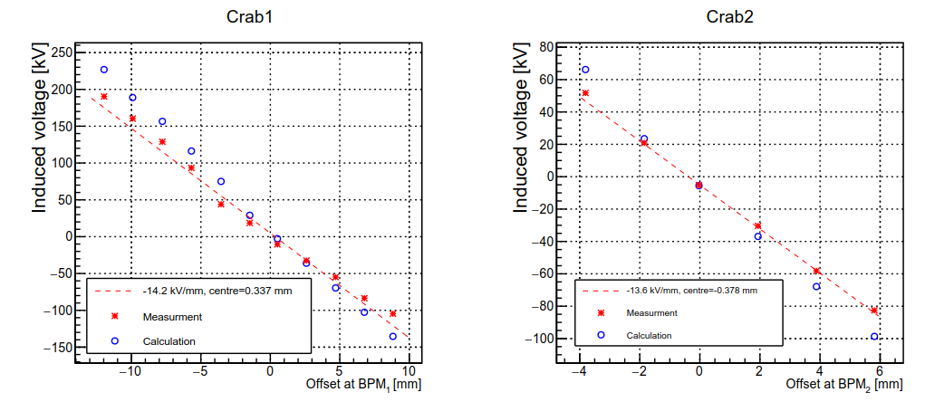
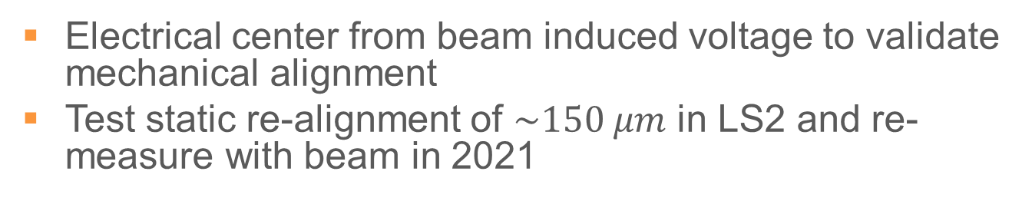
Beam Loading & Electrical Center
Electrical center from beam induced voltage to validate mechanical alignment
Test static re-alignment of $\sim 150 μm$ in LS2 and re-measure with beam in 2021

Slide 11
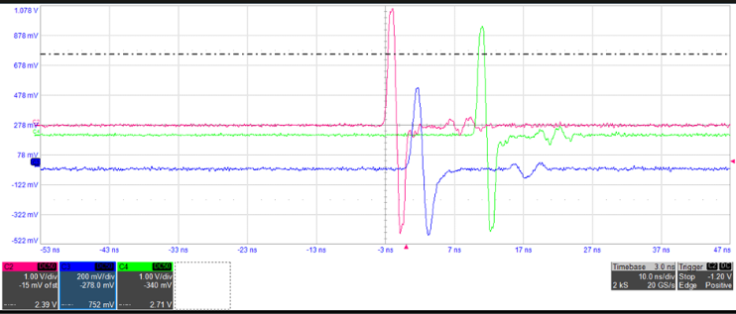
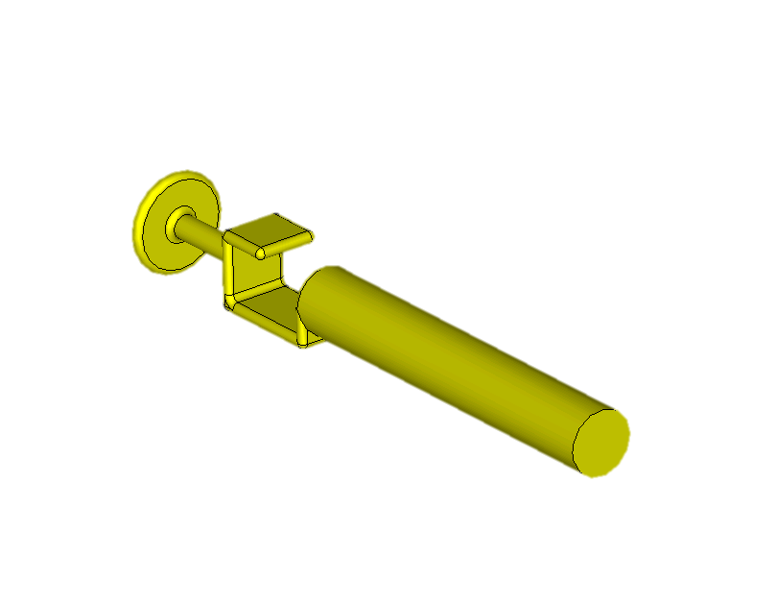
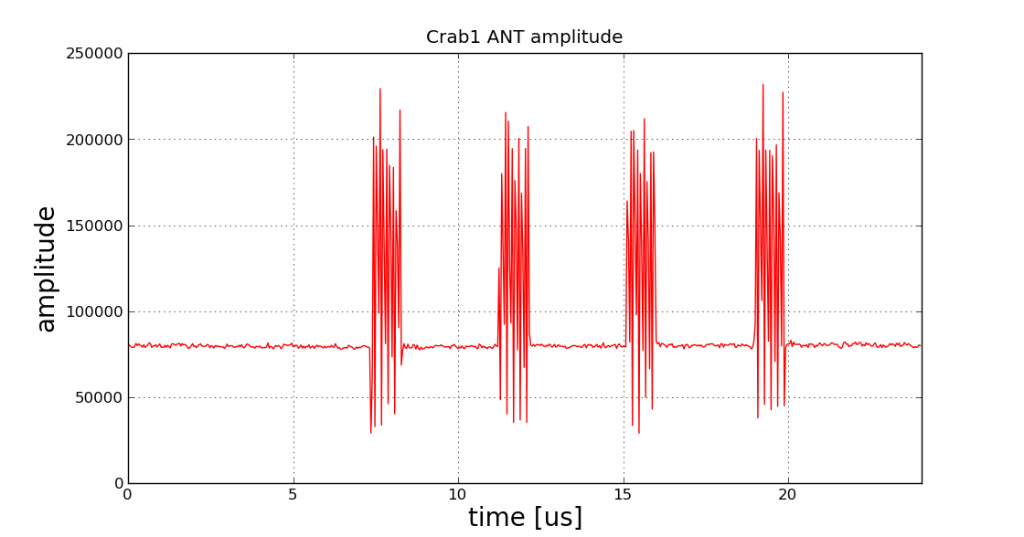
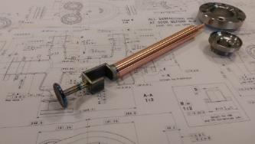
6: Field Antenna
Strong coupling of the field antenna (like a BPM) to the beam passage instead of just measuring cavity field variation
ANT1
ANT2
BPM
10 ns/div
36 bunches x 4 batches

Slide 12
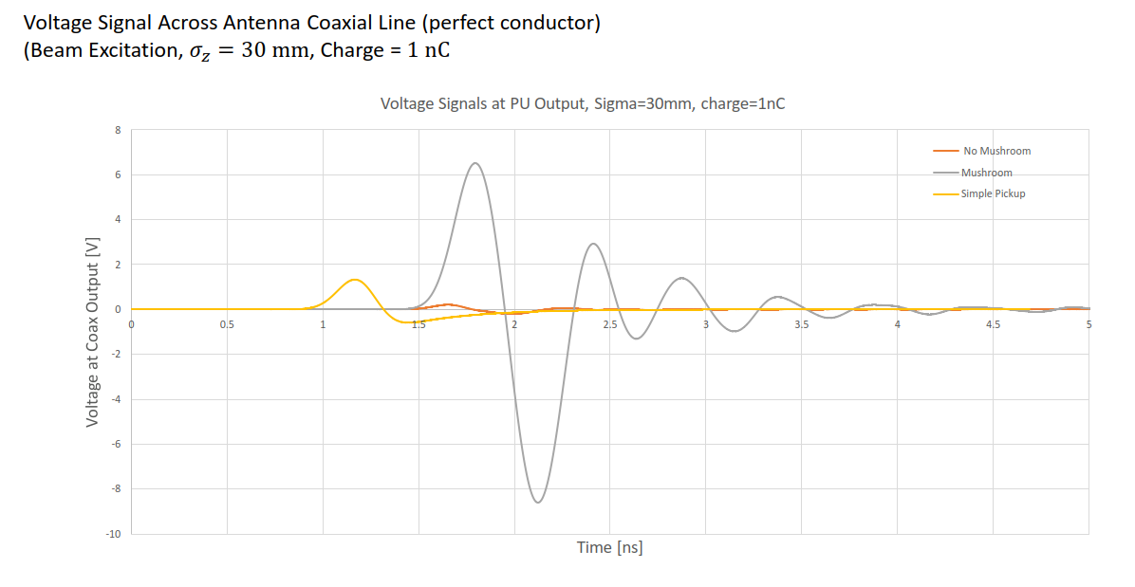
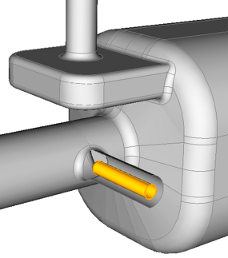
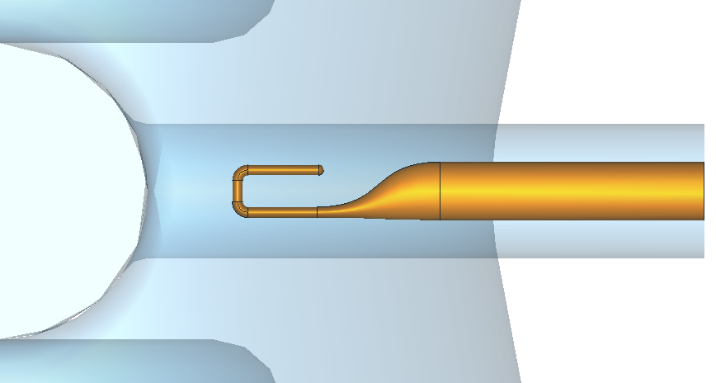
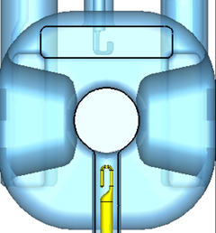
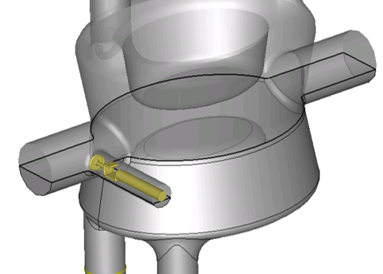
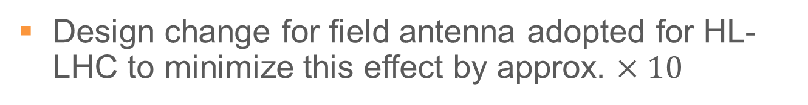
Direct Beam Coupling Mitigation
Design change for field antenna adopted for HL-LHC to minimize this effect by approx. $×10$
SPS
BPM
HL-LHC
Approx x5-10 reduction
SPS Field ANT
HL-LHC Field ANT

Slide 13
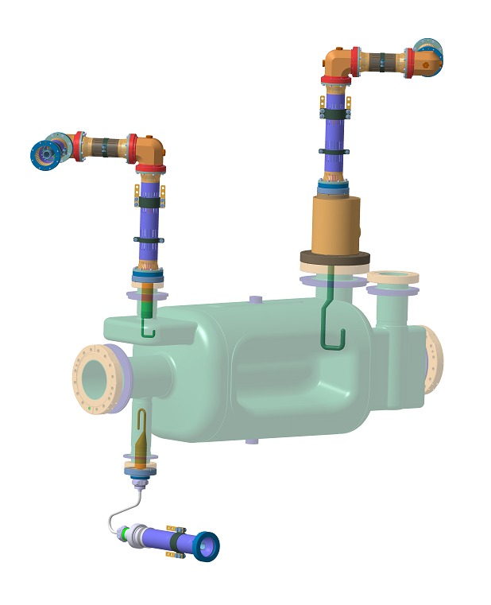
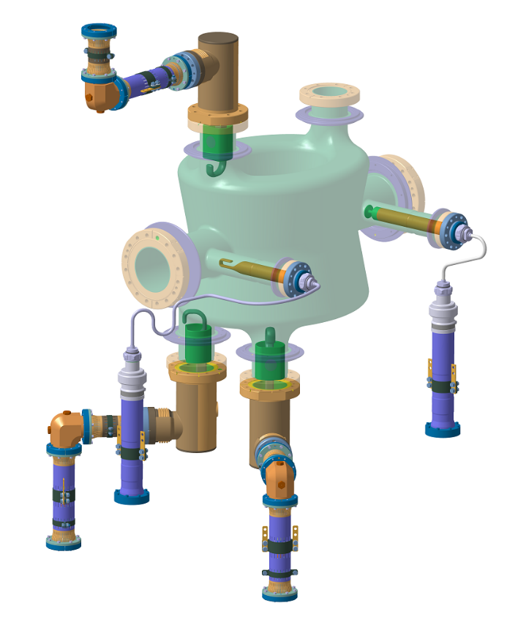
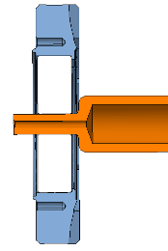
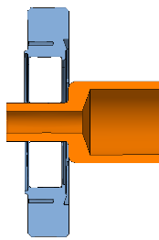


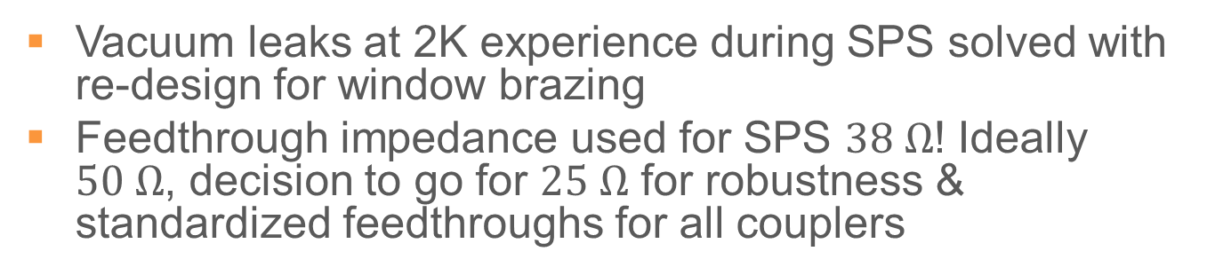
7: RF Feedthroughs
Vacuum leaks at 2K experience during SPS solved with re-design for window brazing
Feedthrough impedance used for SPS $38 Ω$! Ideally $50 Ω$, decision to go for $25 Ω$ for robustness & standardized feedthroughs for all couplers
$$50 Ω$$
$$25 Ω$$

Slide 14
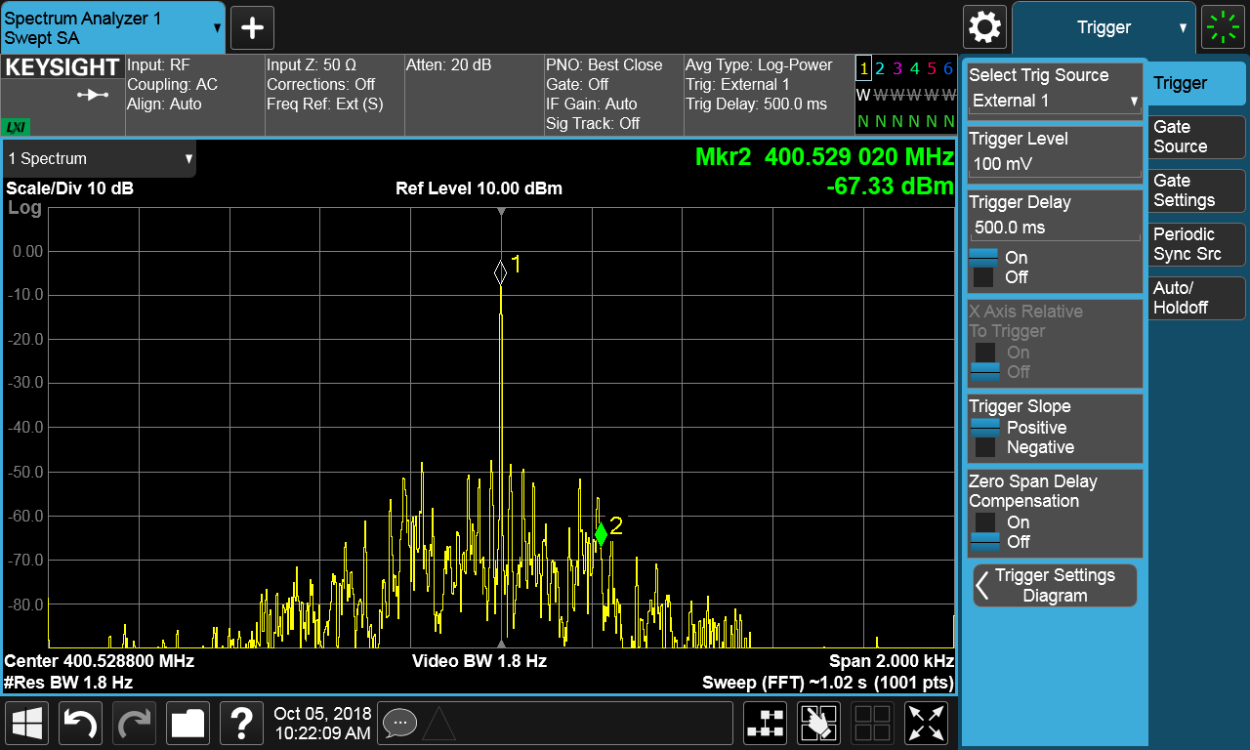
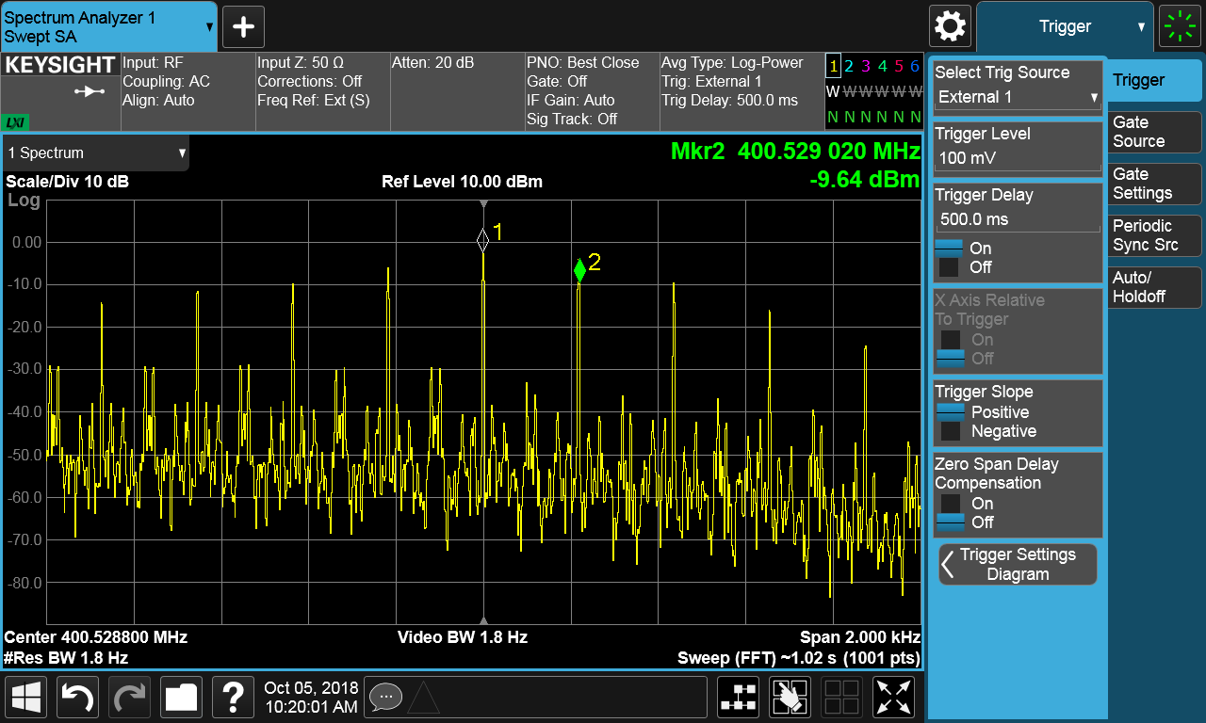

Electro-acoustic Instabilities > 1MV
Electro-acoustic instabilities above 1 MV (LFD is $\sim 400 Hz which is 1/2$ the cavity BW)
Self excited loop essential for setup. Now in place but not the case in 2018 MDs
800kV
1.9 MV

Slide 15
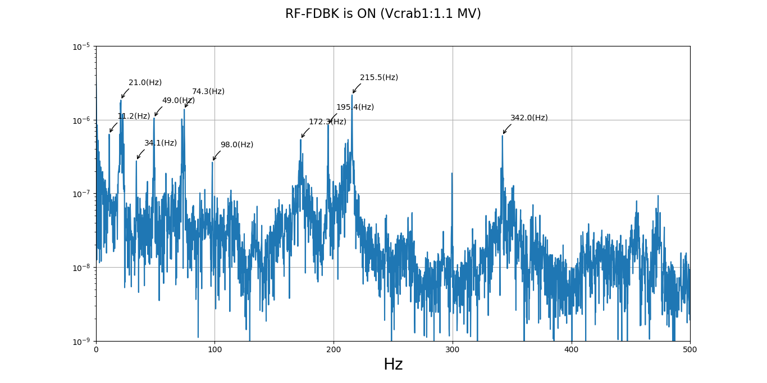
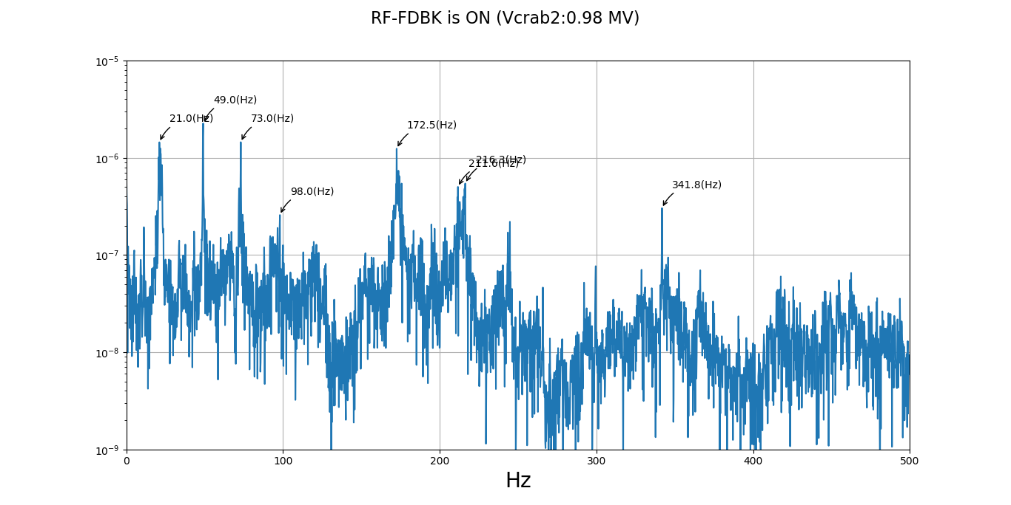
9: Microphonics
Microphonics, non-issue due small detuning & sufficient RF bandwidth
Choice of bandwidth appropriate
 | Cav 1 [Hz] | Cav 2 [Hz]
Pumps ? | 20-30 | 20-30
TX HV ripple + Tuner mode | 49 | 49
Mech. mode | 74 | 73
Harmonics of TX ripple | 98 | 98
Not Identified | 171 | 172
Harmonics of TX ripple ? | 195
Mechanical Mode | 210 | 212
Not identified | 342 | 342
Cavity 1
Cavity 2

Slide 16
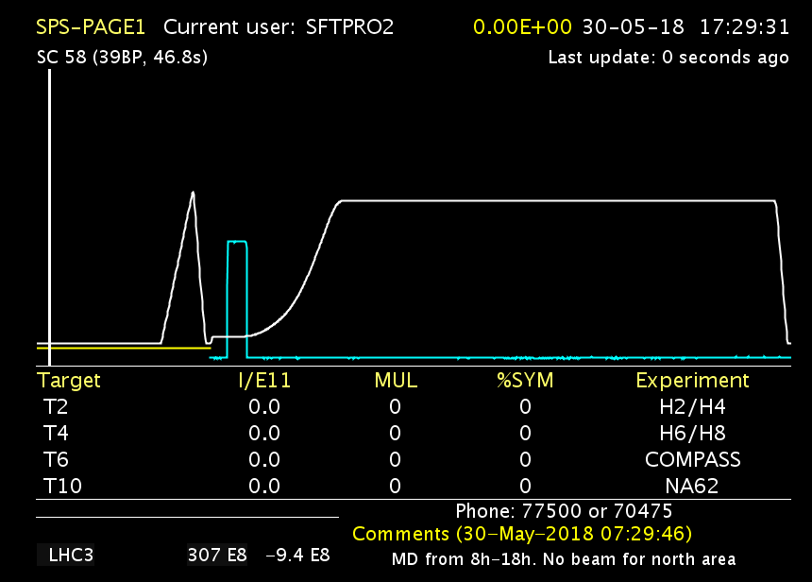
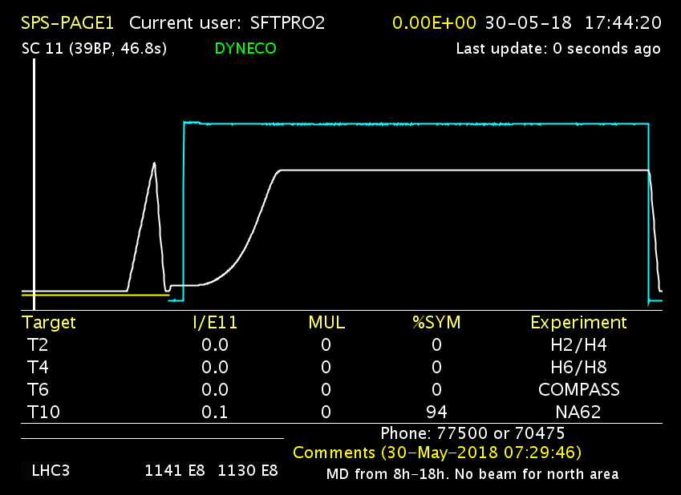
10: Voltage Program, Ramp
The easiest way (almost “brute force”) was to run cavities off to circulate beam in the SPS
Could be new operational scenario for HL-LHC where we turn on cavities at flattop. Easier than counter-phasing with low voltage, although the latter is baseline for HL-LHC
Cav1 ~1MV (400.787 MHZ), Cav2 off (400.528 MHz)
Beam Dumped due to voltage ramp set at start injection
After setting voltage to end of ramp

Slide 17
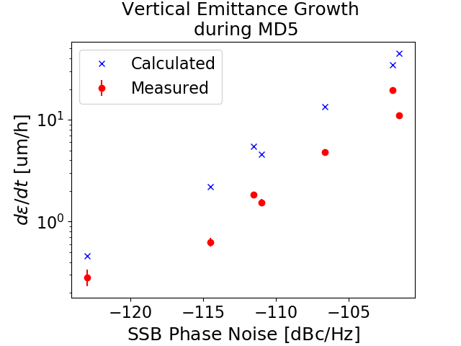
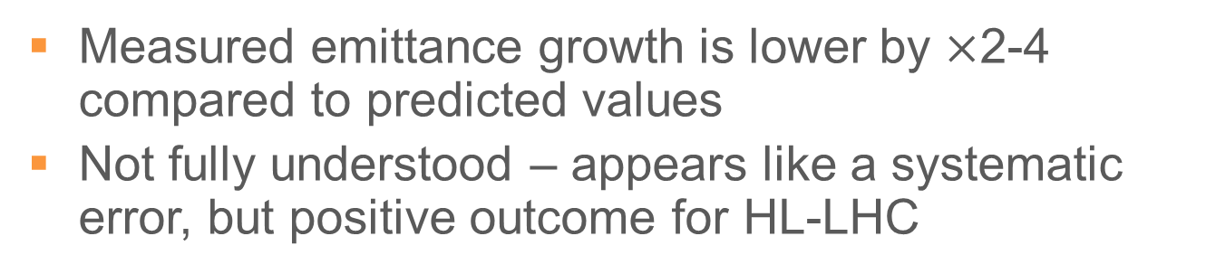
11: Emittance Growth
Measured emittance growth is lower by $×$2-4 compared to predicted values
Not fully understood – appears like a systematic error, but positive outcome for HL-LHC
Up to x4 lower
In measurements
Single cavity at 1 MV

Slide 18
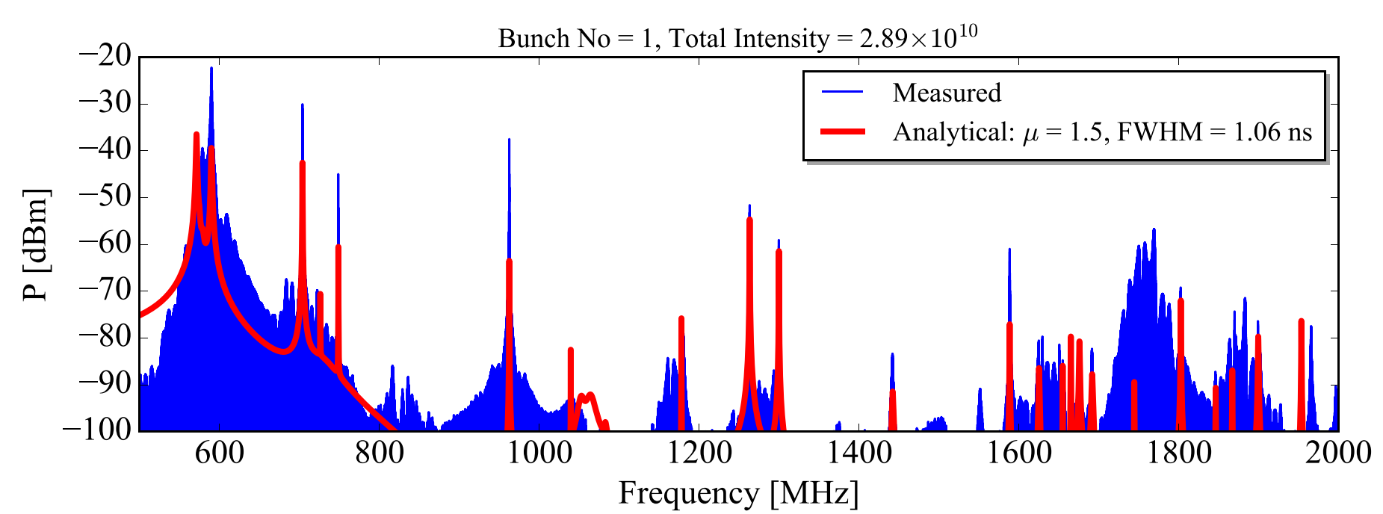


12: Impedance
Integrated max HOM power measured $<3 W$. More than 75% from $\sim 960 MHz$ as expected
Overall HOM power & scaling to the HL-LHC looks reasonable, some deviations related to lack of accurate beam profile
(including bunch length/distribution range)
Notes:
960 mhz mode needs to be titleedd

Slide 19

12: Vacuum Dynamics
High intensity limited by pressure rise in bypass ($2×60$ nominal bunches). No obvious problems with cavities or intensity related failure scenarios ($V=1MV)$
Scrubbing needed post LS2 to fill max current

Slide 20


13: Cryogenics
Cav1 $\sim 15 W$ & Cav2 $\sim 8 W$ (at $\sim 2.1 MV)$
Much higher than vertical tests ($5 W$). Better estimates needed post-LS2 after improved conditioning

Slide 21



14: RF Power
Only notable issue with RF power was linearity at low power ($<5 kW$). Added to specification for HL-LHC amplifiers (now SSPA)
Rest of the RF chain validated
Surface-BA6

Slide 22
Final Comments
SPS tests with Crab Cavities
  SPS-DQW experience was invaluable for beam & hardware validation in an “almost” LHC like environment
  Several operational aspects will be fine-tuned during 2021-24. Scrubbing needed before MDs
  The next prototype module (RFD) fabrication on track for installation in 2021-22. Series for HL-LHC is now launched
The SCRF infrastructure in SPS-LSS6 is unique can could serve for future SRF studies
Special thanks to our collaborations (UK & US) who played a critical part in the SPS success

Slide 23












Thank You !
https://videos.cern.ch/record/ (2631455, 2631454, 2630818)

