Slide 1
HL-LHC Options
Reasons for Embarking on 3 Additional Options in the Baseline
Oliver Brüning
Annual HL-LHC meeting – 14-16 October 2019

Slide 2

OPTIONS
THE
NEVERLAND!
Hollow e-lens
MQYY
LLRB
800 MHz
Undulator
Crystals
200 MHz
In the C&SR 2016, we presented a list of «desirable» options in the project.
Some others have been added in the last 18 months:
Where are we?
WFBS
LESS
Note: LHC is approaching its real limits only now. The situation is different than a few years ago for knowledge of aperture, control of collision, head-on beam-beam limit, injector performance, pile up/PUD acceptability. The upgrade is shooting at a moving target!

Slide 3
Options that we kept open
1.2MCHF
0.4 MCHF
CERN
Content of this talk!
8.2MCHF after
review in 2019

Slide 4
Hardware Options that have been Integrated
Options replaced by alternative / new design modifications:
1) MKI ➔ new ferrite rings and active cooling
2) Full Implementation of the Beam Gas Vertex Monitor
3) Inclinometer network vibration measurements: revised network config
Financed by project and consolidation and integrated into the CtC!
New Options I:
1) Fully remote alignment for matching section optimization:
beneficial for ALARA, technical solution is being developed by CERN;
should be cost neutral / beneficial with savings in MS upgrades
2) Higher precision current control for PC in S12, S45, S56 and S81
mitigation against increased tune fluctuations due to ATS optics
Implemented into baseline in 2019 and ‘financed by’ MS optimization
Study looks very promising; but left as option for consolidation

Slide 5
Other approved Options since C&SR3
IT Quad Cold diodes: desirable to increase robustness of protection system (not presented in C&SR 2016, stemmed out from Circuit Review 2017)
  Replace warm diodes and is today in the baseline
  Required R&D and validation (radiation hardness at cold)
  Extra cost for R&D financed as baseline: 0.55 MCHF
  Extra cost for implementation: 0.3 MCHF
  only, because of savings from warm diodes - bus bars included in WP3)

Slide 6
Hardware Options still considered for Baseline Integration
Options that are motivated / endorsed by reviews and MDs:
1) Hollow e-lens as means for beam halo depletion / control
2) Second Undulator for Synchrotron Light generation
➔ would allow halo measurement at injection and during ramp
3) Crystal Collimators for enhanced Pb beam collimation
1), 3), and 4)
Content of this presentation:
Decided to pursue all three of them through in-kind contributions
Options motivated by recent LHC operation experience:
4) MKB and / or TDE upgrade: new failure mode observation in the LHC
Decided to prepare integration into the HL-LHC baseline!!! [59th TCC – 4th October 2018]
Organized a dedicated review on the BDS: 5.2.2019
Integration into the baseline with the help of in-kind contributions

Slide 7
Main Points & Outcome of the BDS Review Feb’19
MKD Type 2 erratic involving beam sweeping on TCDS and TCDQ Mitigation by upgrading the generators [operation at lower voltage] and implementing a new re-triggering system
MKBV flashover with antiphase, effectively eliminating 3 dilution kicker ➔ Particularly problematic in horizontal plane where the LHC has only 4 dilution kicker!!!
TDE Nitrogen leaks: movement of the beam dump core during beam dumps with high beam intensity [16L2] ➔ new Nitrogen line constantly supplying N2 to the dump; mechanical integrity of the LHC dump core?
Energy density and hotspot temperature too high for nominal HL-LHC parameters and failure scenarios [even with the additional 2 hor. Dilution kicker] ➔ new windows and new dump core!

Slide 8
HL-LHC Hardware Options
H1) Considered for machine protection and risk mitigation:
WP14
-MKB or TDE upgrade
(Dump protection in case temperature of TDE can reach 3000º).
a) Additional diluter kickers
b) New / additional absorber materials
c) Modifications to the dump
d) Modification of the dump windows
➔ Technical solution needs to be ready for LS3
➔ Decision required during RunIII
➔ Studies and development included in WP14
➔ Ca. 3.6 MCHF for dump upgrade implementation
➔ Integration should not be an issue
O. Bruning, TCC – 8th March 2018
Implementation into HL-LHC project baseline
[59th TCC – 4th October]
Together with Consolidation and
in-kind contributions!!!
Still Valid!!!
➔ 8.2 MCHF for full upgrade after review Feb. 2019

Slide 9
Summary of Russia Collaboration agreement
The exact list of items is under discussion
  First approach:
    all hardware that is off the shelf is procured by CERN (HV components, PLCs, racks)
    All mechanical parts, magnetic cores, coils by Russia
    Participation of Russia in-kind to design studies and drawings production in addition to assembly and installation
    After signature we expect more precise technical discussions and precise planning

Slide 10
Hollow Electron Lens
Several reviews organized that underlined the necessity and benefit during 2012 to 2017: internal review 2012; Intern. Review on the needs in 2016; Intern. technical readiness 2017
No clear demonstration of definite need for operation:
Loss spikes of Run1 not evident during Run2; but beam dynamics and losses with
HL-LHC beams [2x beam intensity and beam-beam] not easily predictable
But clear outline of risk when operating with a beam with over 30MJ stored beam energy in beam halo [> 3σ]
➔ Prudent mitigation of risk for efficient operation!

Slide 11
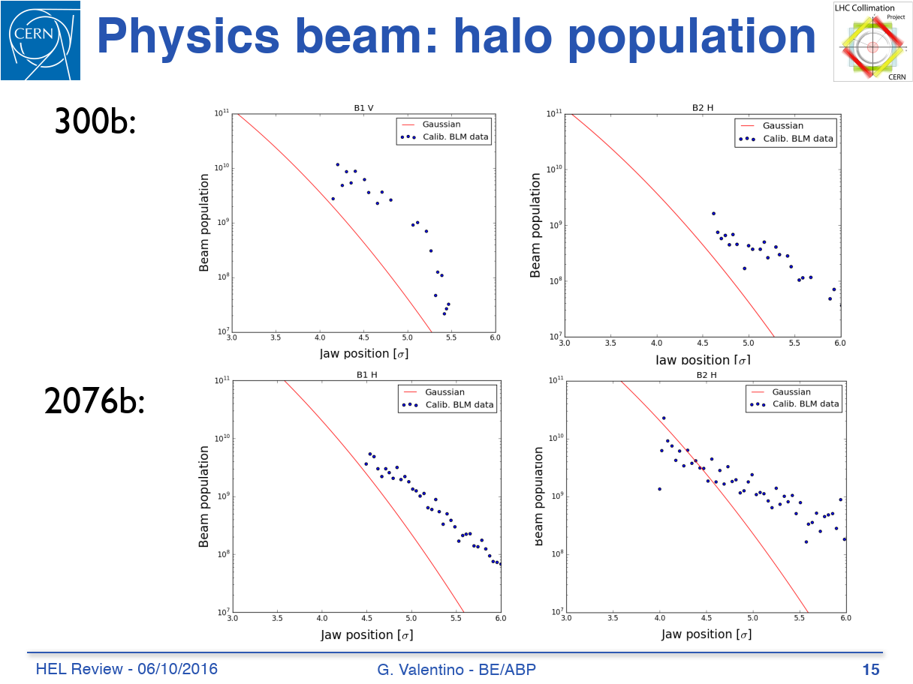
Motivations
Around 5% of the beams is in the tails (> 3.5 sigma), compared to 0.22% for Gaussian
Factor 22 difference: scaling to HL-LHC parameters = 33.6 MJ vs 1.48 MJ
No apparent correlation with energy

Slide 12
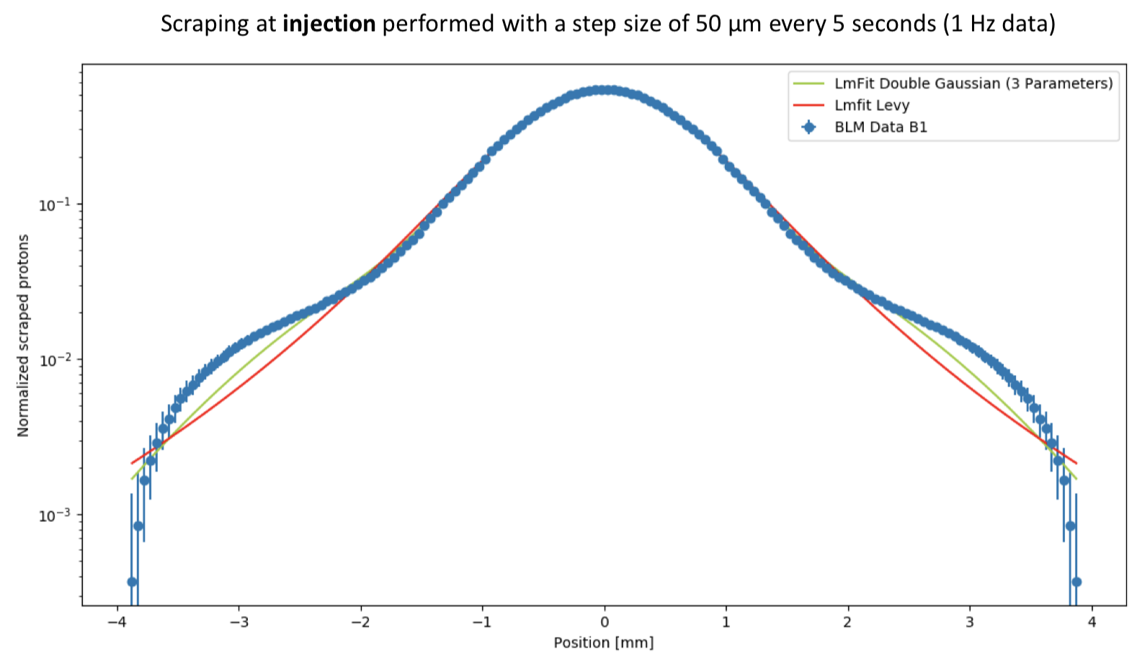
MD results
Studies at injection, step size 50um/5s, with 1 bunch
Measurements confirm overpopulation of beam tails.The fraction of particles in the tails over 4σ has also been evaluated, from which it has obtained that in the horizontal plane it is in a range between 2% and 3%, while in the vertical plane between 3% and 6%.
H.Morales, P.Racano
2019-02-11 International Review HL-LHC Collimation System Belen Salvachua

Slide 13
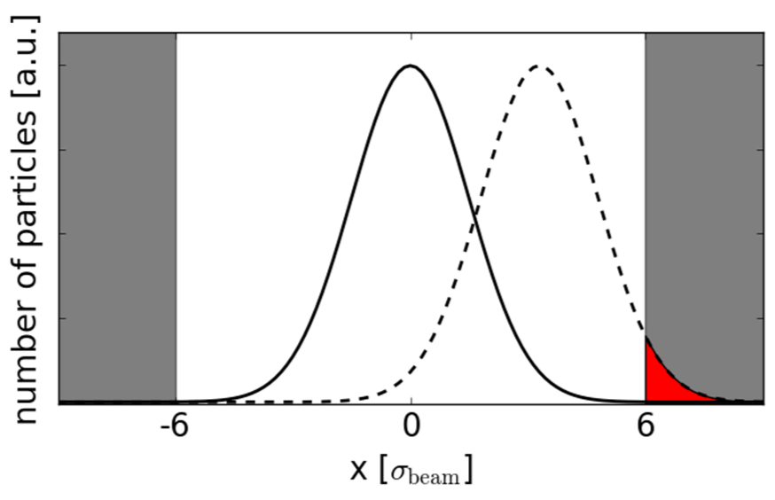
Motivations
Crab Cavity failure can induce fast (few turns) orbit shift or bunch rotation
Small earthquakes (Geothermie2020)
In 2012 and 2016 LHC operation sometimes sudden beam losses occurred => beam dumps in HL-LHC?
Increase of operational margin (e.g. less sensitive to transients)
Orbit shift (>1.5σ)

Slide 14
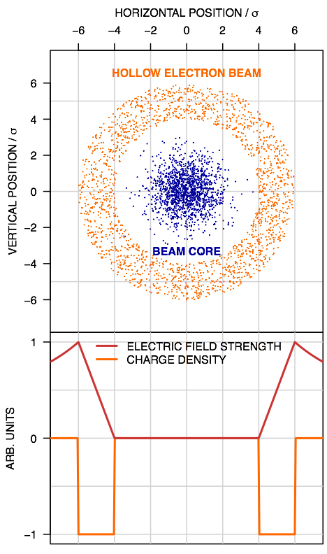
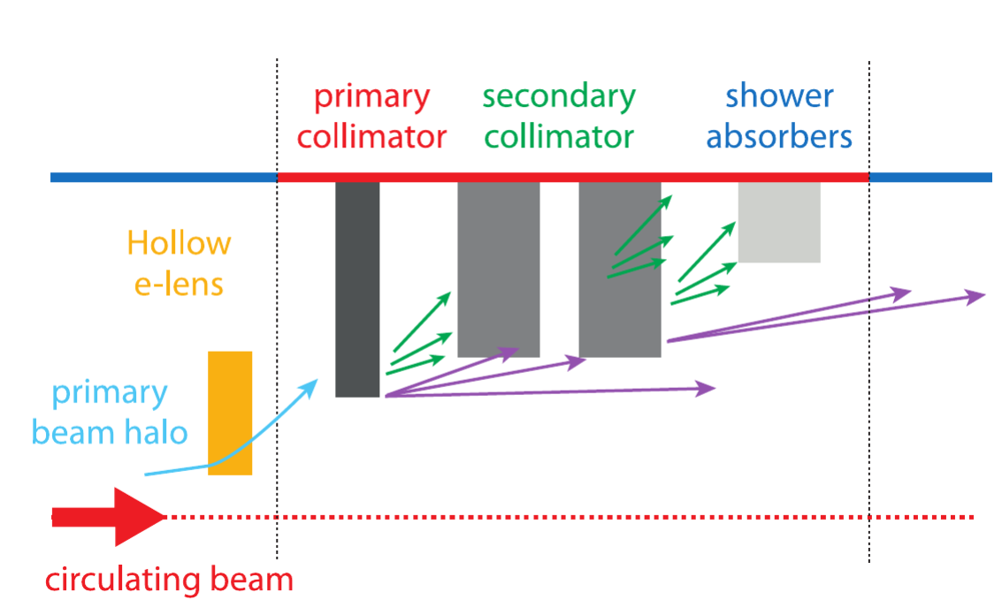
Principle of Hollow Electron Lens
Circulating beam travelling inside a hollow electron beam (cylindrical shell) over a short distance
Halo particles kicked to higher amplitudes
by electromagnetic field of electron beam
(slow process)
Eventually hit collimators
Circulating beam core not affected (in field-free region)
Courtesy of
G. Stancari

Slide 15
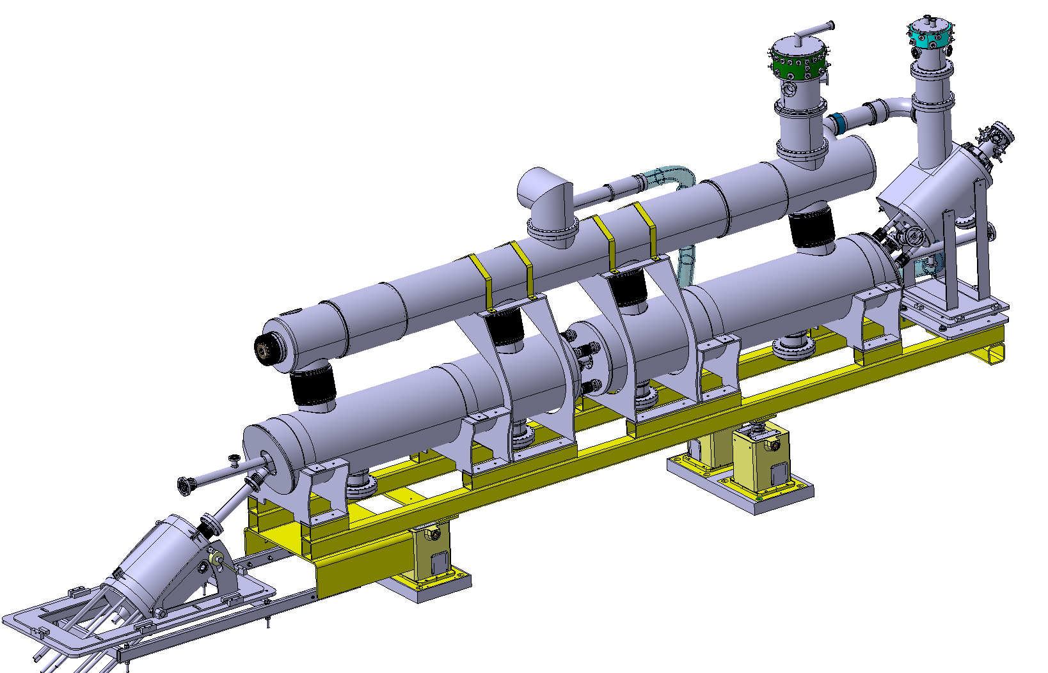
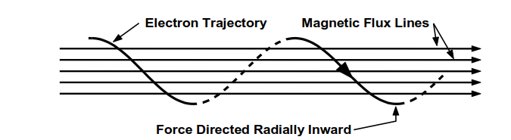
The system configuration
Force directed radially inward
e trajectory
e - ring
Magnetic flux lines
E-gun solenoid
~ 4000 mm
HL-LHC protons
BPMs integrated in vacuum chamber
Checking for diagnostics at collector
Main solenoids
Collector
room for BGC monitor
Electrons are produced by the cathode of an e-gun.
A system of superconducting solenoids cooled at 4.5K generates the magnetic field to tune de size and steer the trajectory of the electron ring.

Slide 16
Power Converter optimization and Modulator strategy for HEL
Power converters recovered and updated at CERN where possible
Modulator: participation to the design by Russian personnel under BE/RF supervision (under discussion)

Slide 17
Hollow Electron Lens
Organized review for technical readiness and design maturity for production in October 2018
International Collimation Review at CERN 11-12 Feb 2019: https://indico.cern.ch/event/780182/
Prepared resource document for CERN groups and HL-LHC Work Packages: EDMS 2186609
➔ lowered CERN core cost to ca. 35% of total budget
Discussed required manpower at CERN with implied groups

Slide 18
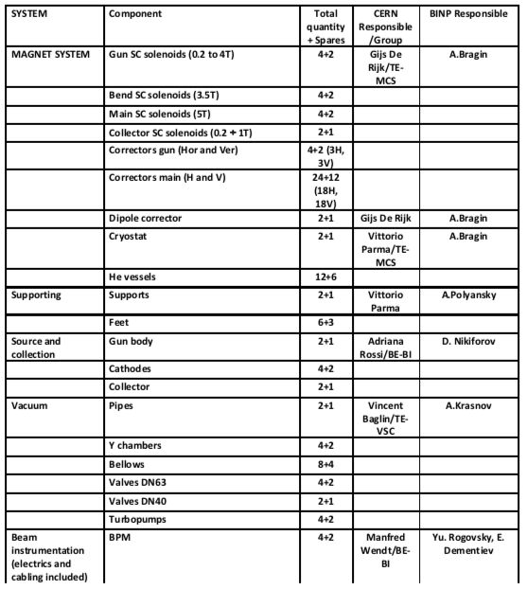
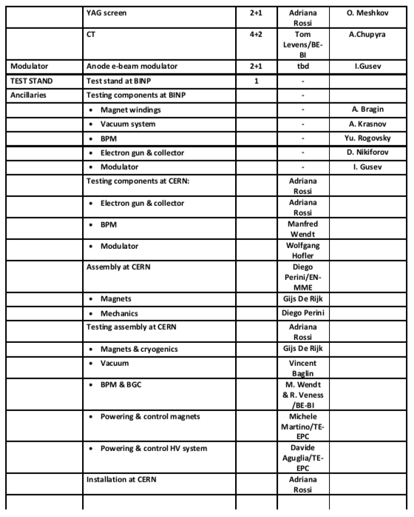
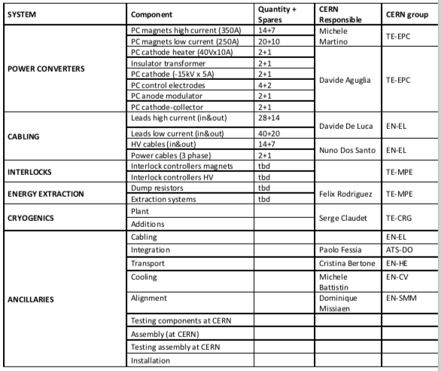
Summary of Russia Collaboration agreement
A precise list has been agreed during Summer
BINP
CERN

Slide 19
Crystal Collimation
Organized HL-LHC Crystal Collimation day at CERN in October 2018: https://indico.cern.ch/event/752062/timetable/#20181019
International Collimation Review at CERN 11-12 Feb 2019: https://indico.cern.ch/event/780182/
Prepared resource document for CERN groups and HL-LHC Work Packages: EDMS Number 2186610
➔ lowered CERN core cost to less than 0.5MCHF
➔ can be financed by remaining R&D funds

Slide 20
Simulated peak power load on DS magnets
C. Bahamonde - Tuesday’s talk
& 8th annual meeting Oct 2018
TCLD position |  | PROTONS (mW/cm³) |  |  |  |  | IONS (mW/cm3)
 |  | Cell 8/9 |  |  | Cell 11 |  | Cell 8/9 |  |  | Cell 11
 |  | MB* | MQ | 11T | MB* | MQ | MB* | MQ | 11T | MB* | MQ
No TCLD | 0.2h | 21 | 9.9 | - | 12 | 13 | 57 | 27 | - | 57 | 36
 | 1h | 4.2 | 2 | - | 2.4 | 2.6 | 11 | 5.4 | - | 11 | 7.2
MBB.8 | 0.2h | 6.6 | 8.1 | 11 | 8.7 | 13 | 5.4 | 15 | 21 | 36 | 33
 | 1h | 1.3 | 1.6 | 2.2 | 1.7 | 2.6 | 1.1 | 3 | 4.2 | 7.2 | 6.6
MBA.9 | 0.2h | 6.0 | 8.1 | 48 | <0.3 | <0.3 | 6.0 | 3.6 | 33 | <0.003 | <0.003
 | 1h | 1.2 | 1.6 | 9.6 | <0.06 | <0.06 | 1.2 | 0.7 | 6.6 | <0.0006 | <0.0006
*Quench limit for MB estimated to be ~20 mW/cm³ for steady state losses at 6.37Z TeV)

Slide 21
Outcome of the analysis by LS2 team
 | Delay in S 6-7 | Delay in S 7-8
Scenario 1: First in S 6-7 | -8 Weeks | +14 Weeks
Scenario 2: First in S 7-8 | +8 Weeks | -2.5 Weeks
Scenario 2 is preferred
The installation of a 11T dipole full assembly after LS2 would require about 41 weeks, broken down as follows:
  6 weeks for sector warm-up + ELQA @ warm
  25 weeks for 11T installation (MB removal + preparation works + 11T installation + TCLD installation)
  About 10 weeks for sector cool down + ELQA + powering tests (and this does not take into account the part commissioning)
Impact on delayed TCLD installation in IR7 on ion runs during Run3?!
➔
Crystal Collimators as a backup plan for late TCLD installation after LS2!!!
Courtesy M. Bernardini, S.E. Bustamante
Annual HL-LHC meeting – 14-16 October 2019, FNAL USA

Slide 22
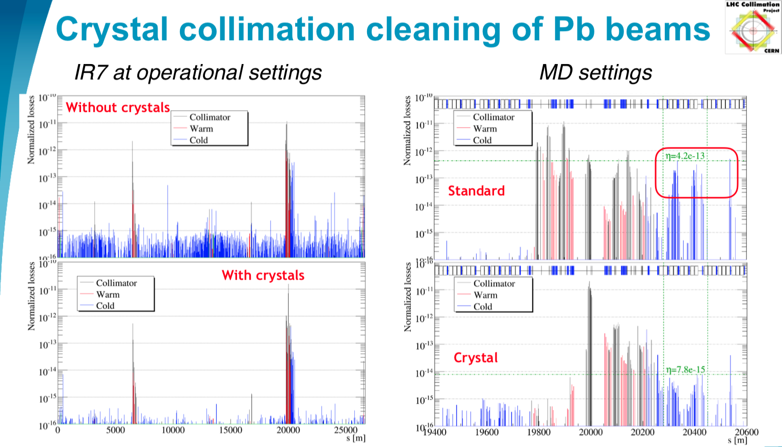
S. Redaelli @ Feb’19 Review
Factor 7 better cleaning efficiency with Crystals!!!
Up to 50 with MD settings for non-limiting
loss spikes!

Slide 23
Crystal Collimation System
Discussions on the location of the 11T Collimator unit in IR7 underlined that the Pb operation during HL-LHC will create losses that will induce magnet quenches without DS collimators
Very good MD results on the improved cleaning efficiency with crystals: ➔ factor 7 better efficiency
Cost effective backup plan for Risk mitigation in case the 11T dipole / collimator units are late for installation in LS3!
➔ Strictly speaking not required if 11T collimators are on schedule
Prepared resource document for CERN groups and HL-LHC Work Packages: EDMS Number 2186610
➔ lowered CERN core cost to ca. 0.4MCHF
Definition of a reduced system with 4 crystal collimators as
backup plan ➔ overall cost 1.2MCHF with 2/3rd of in-kind!

Slide 24
Summary of Russia Collaboration agreement
Two Institutes in Russia shall produce 4 + 2 crystal collimation systems
Motors and controls by CERN with reuse of material for standard collimation within a limited budget
CERN hardware will define also how many systems can be installed
Schedule and funding in Russia agreed with some flexibility to try to get first unit already before end LS2

Slide 25
Options that have been rejected

Slide 26
Reserve slides

Slide 27
Baseline recap
Baseline 0 (Design Study): C&SR1 March 2015 with initial Civil Engineering and T.I. not fully finalized. No EVM, assessment of the integral sum, profile not too detailed.
Baseline 1 (after big rebaselining of Aug. 2016; TDR_V0.1) : endorsed C&SR2 October 2016, first EVM and new schedule; Project complete of final C.E. + T.I.
Baseline 2 (better granularity and more accurate time profile): after C&SR2
Baseline 2.1: Following this C&SR3 of March 2018. It integrates all small re-scoping after C&SR2 of 2016 and schedule actualization; all extra/under-costs are noted down but NOT INTEGRATED.
Baseline 3.0: End of 2018 for new final TDR: 2.1 + other possible rescoping (MS final optimization, cold diode, HEL?; Crystal?)

Slide 28
Options approved and will be integrated in the budget as baseline 2.1 with other re-scoping

Slide 29
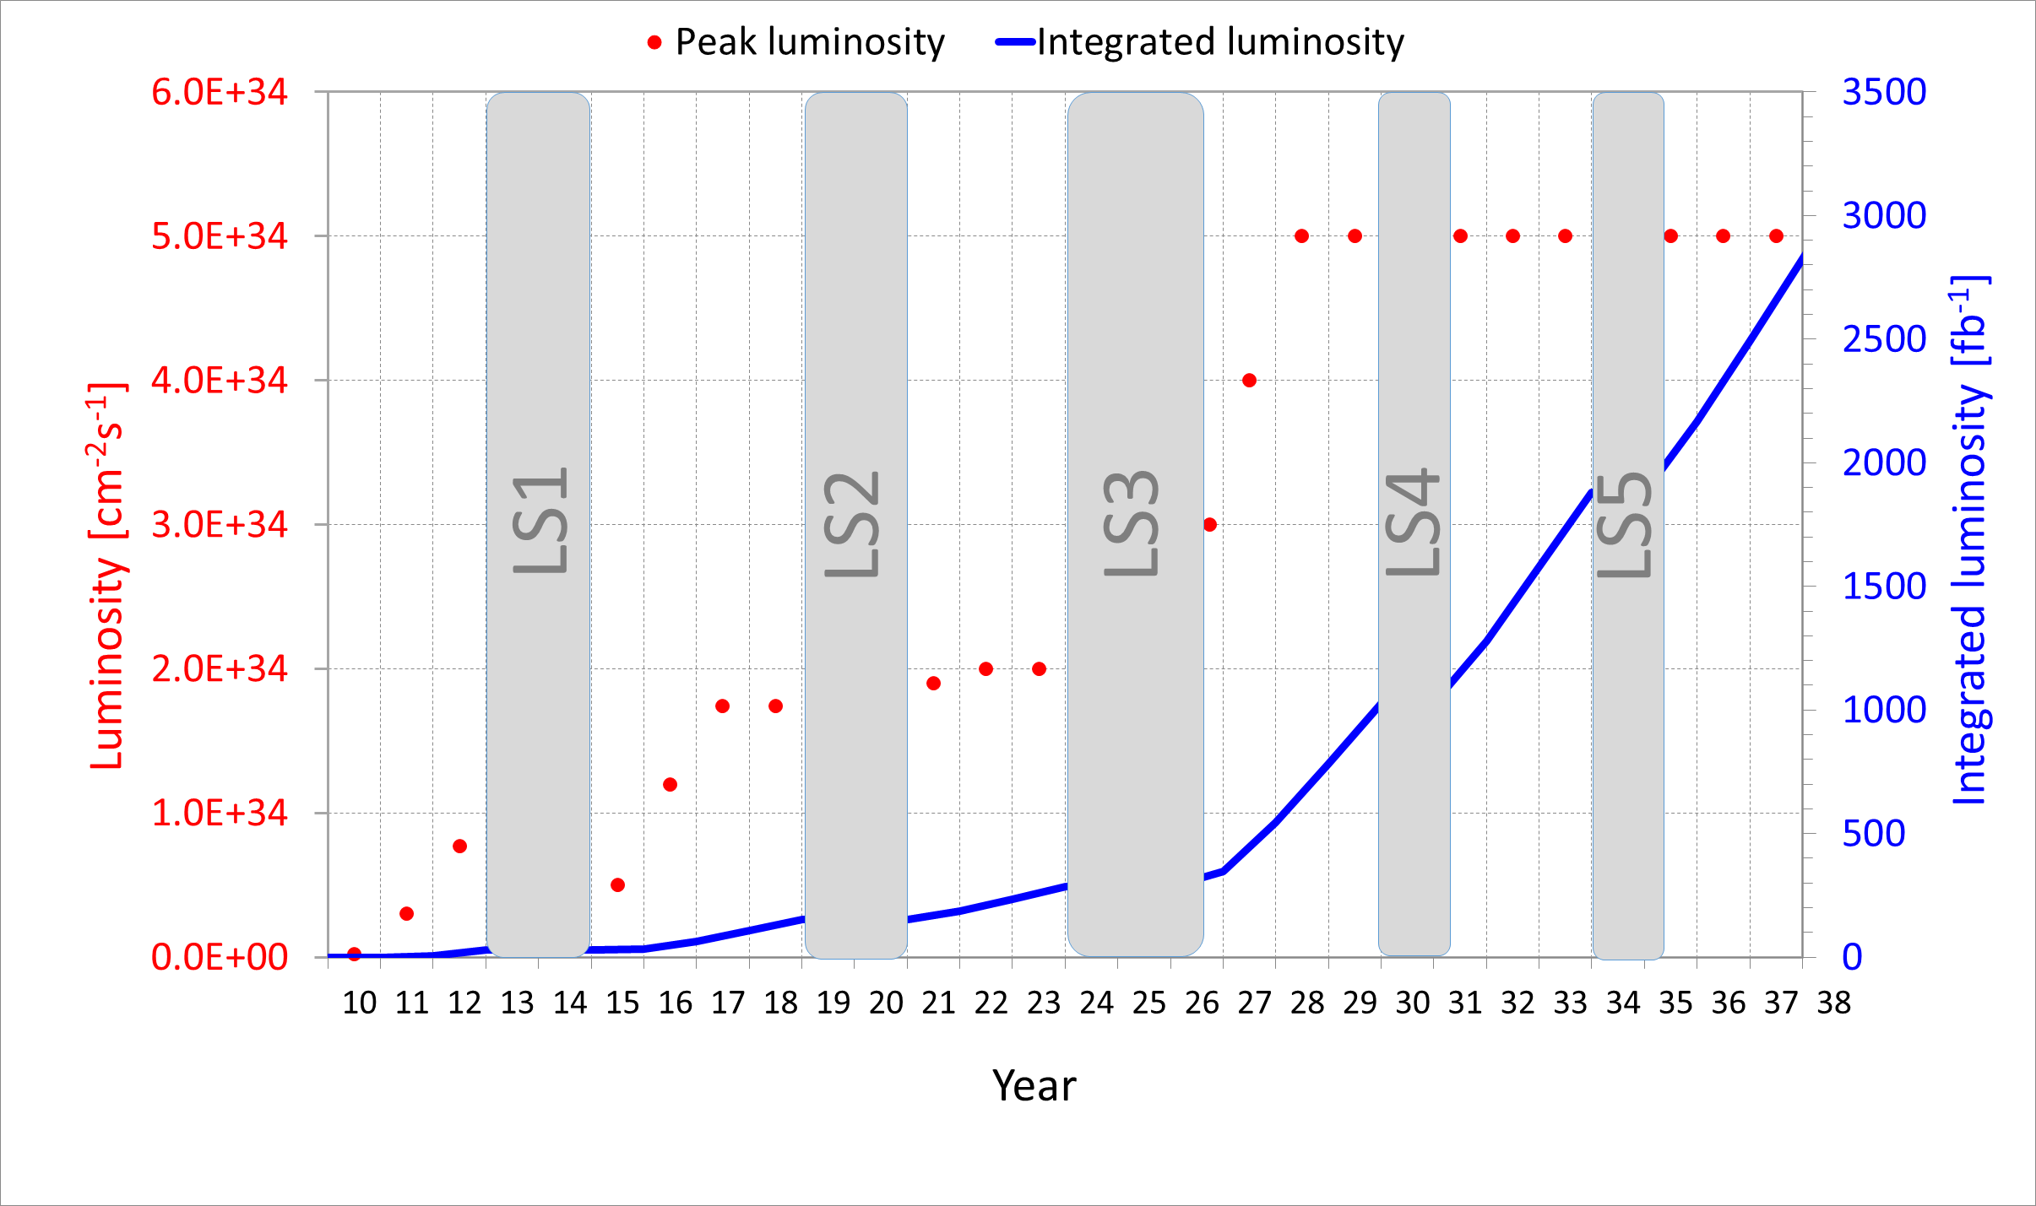
NOMINAL HL-LHC performance

Slide 30
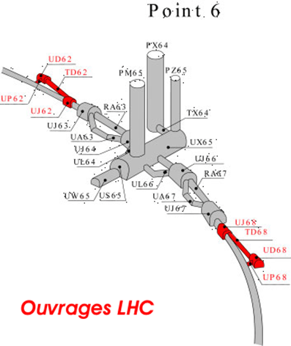
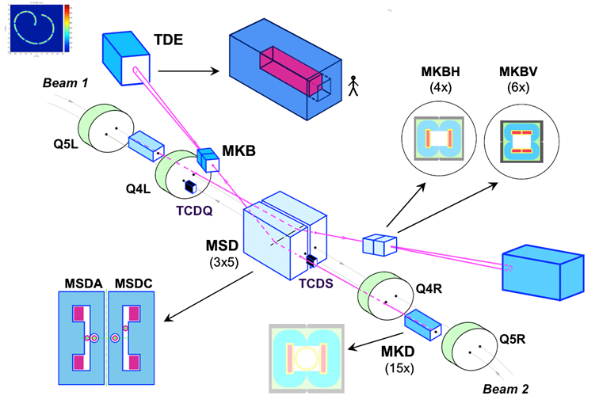
Main open option
MKB and/or TDE upgrade (prevent dump damage in case of MKB failure which could bring the temperature of TDE up to 3000º). Decision by 2020
  Additional diluter kickers
  Modifications of dump windows
  Modification of the dump (new / additional absorber materials)

